Slide 1
Ready to Vote
in 2026
Notes:
Tip for the Presenter: if you are giving this power point in one specific geographical county, it could be helpful to familiarize yourself with the county's voting practices. You should find out if there are drop boxes available and/or if satellite offices are available.
Thank you for joining us.
-Voting is a fundamental right of our democracy.
Your Vote is your Voice! Please exercise it.
In Pennsylvania, you are eligible to vote if you are:
A citizen of the United States (for at least one month before the next election)
A resident of Pennsylvania (for at least 30 days before the next election)
At least 18 years of age on or before the day of the next election

Slide 2
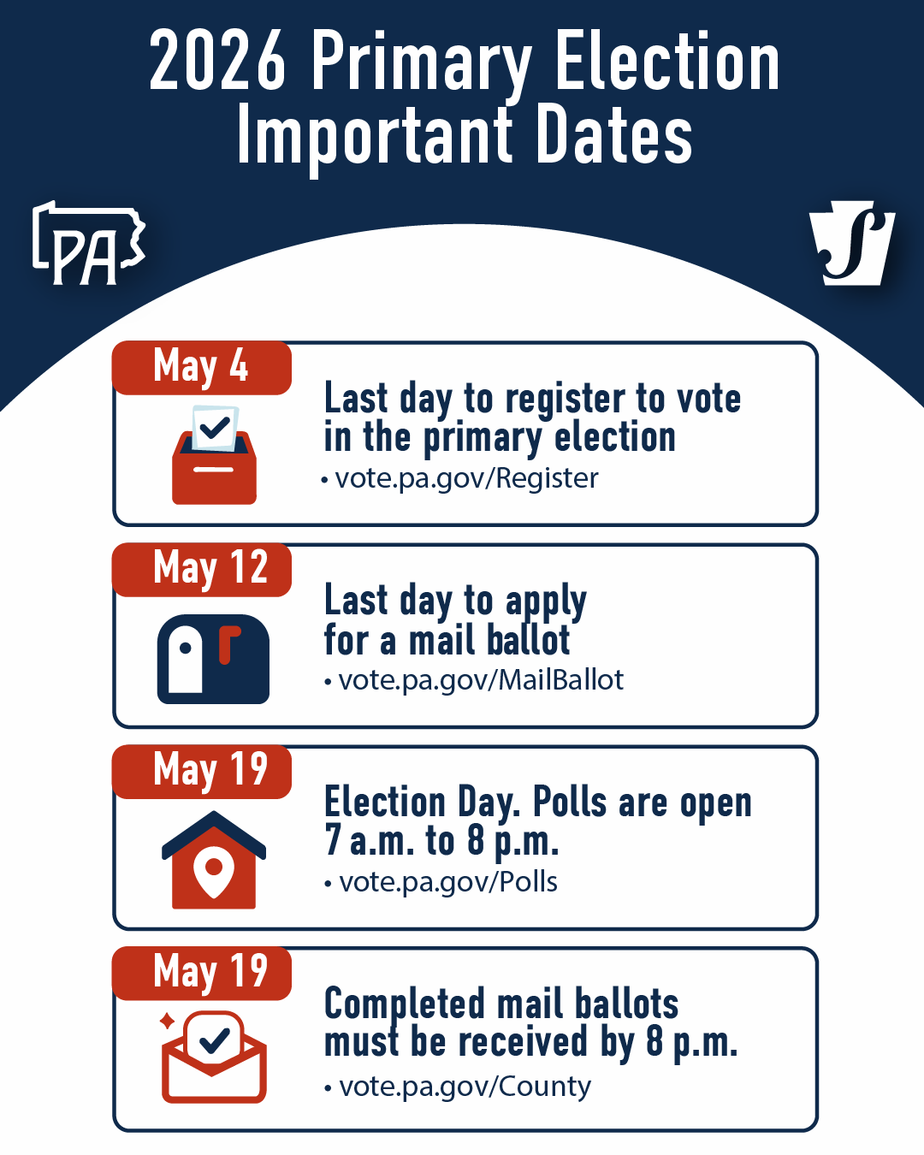
Election Day
Tuesday, May 19
Notes:
We are coming up on a very important election for a whole host of offices including:
-President of the United States
-United States Senator
-Pennsylvania Attorney General
-Pennsylvania Auditor General
And several other offices.
Here are the important dates!

Slide 3


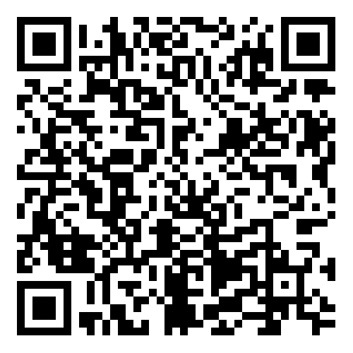
College Students can register at their home address, which can be either their:
Pre-College Address
College Address
Learn more
or
You can register in PA if you go to school in PA, even if your precollege address is out of state.

Slide 4



Ways to Vote
At your polling place
In person by mail ballot
Vote by mail
Notes:
Let's talk about WAYS to vote:
Since, 2020, you can vote by no-excuse mail ballot (deadline is October 29th to request your mail ballot!)
Can vote at your polling place
Or you can vote a mail ballot at a county election office or satellite office

Slide 5
Voting by Mail Ballot
The deadline to apply for a mail in ballot is May 12.​
Ballots must be returned to your county elections office by 8:00 pm on election day, May 19.
Apply online at vote.pa.gov/MailBallot
Include your email address if you want to receive updates about your ballot status!
Live abroad or serving overseas? Go to vote.pa.gov to find more information about special procedures and deadlines!
Notes:
Each county handles return of the mail ballot differently.
Some counties may utilize drop boxes
Others may have satellite offices.
Check your county's website for more details [PRESENTOR MAY PROVIDE THIS COUNTY SPECIFIC INFORMATION AS WELL).
-Simply having a postmarked ballot by 8 pm on 11/5 is NOT SUFFICIENT TO have it counted. It must be returned to the county election officials by that time and date.

Slide 6
Voting at Your Polling Place
Election Day is Tuesday, May 19.
Polls are open 7 a.m. – 8 p.m.
Find your polling place: vote.pa.gov/Polls
If it’s your first time voting in your election district, you will be asked for ID.
Notes:
Notes of warning:
If you requested a mail ballot, but decided to vote in person, please take your ENTIRE envelope including your ballot to your polling location and follow the instructions of the poll workers there on how to vote in person after spoiling your mail ballot.
If it is your first time voting at a NEW polling place, you need to bring an accepted form of identification: student IDs work, drivers licenses, etc. There are MANY acceptable forms of IDs listed on the Department of State Website.

Slide 7
Provisional Ballots
If a poll worker tells you that you cannot vote, but you believe you are registered and eligible, you have the right to demand a provisional ballot.
If a poll worker will not provide you one, contact the Department of State at
1-877-868-3772
Notes:
If a poll worker tells you that you cannot vote, and you believe you are registered and eligible, you have the right to DEMAND a provisional ballot. If a local official will not provide you one, contact the Department of State Voter Hotline.

Slide 8
In Person
by Mail Ballot
Before Election Day through May 12, you can request, receive, mark and cast a mail ballot all in one visit to your county election board office or other designated location.
Find your local county office and list of other designated locations by going to vote.pa.gov/county and finding your county's website!
Notes:
Please be aware that no matter what county you are in, if you go to a county election office or satellite office, you can request a mail ballot, fill it out on the spot, and then cast it all at one time.

Slide 9

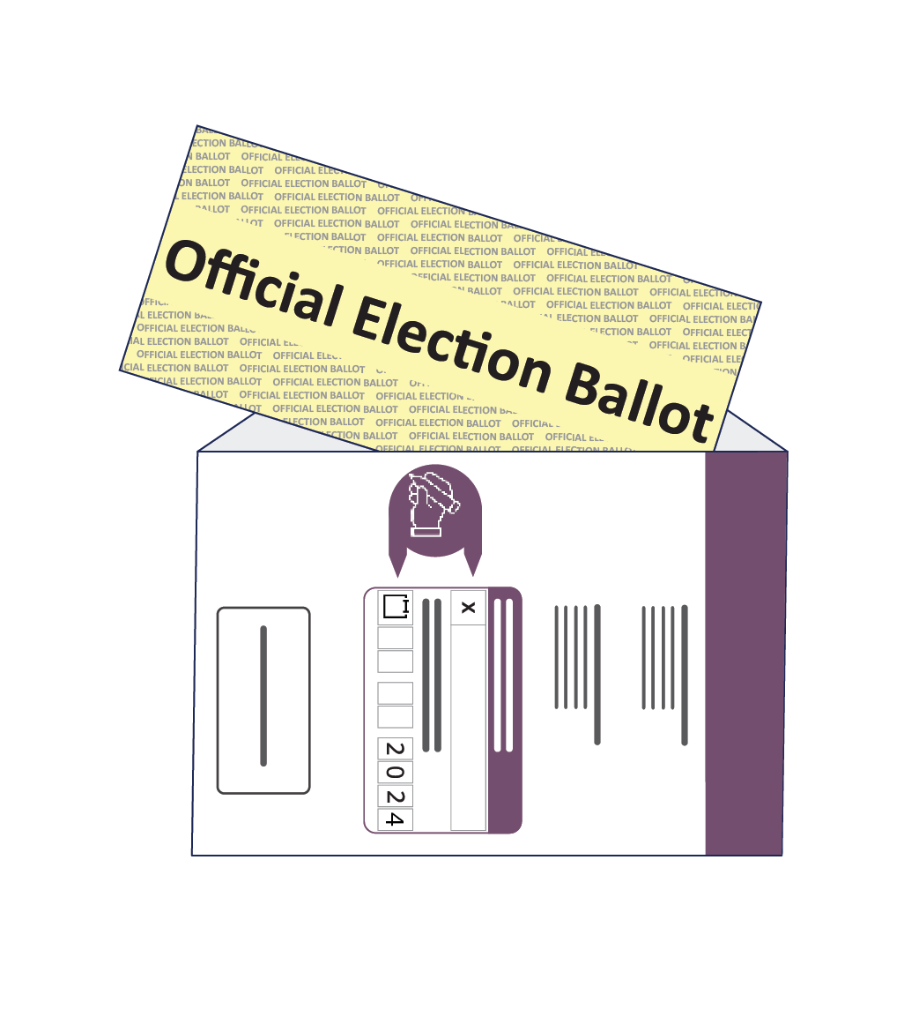
How to Complete Your Mail Ballot
Notes:
Want to walk through this with you as people have had problems!

Slide 10
Step One
Read the instructions and mark your ballot.
Be sure to complete the front and back of the ballot
Notes:
Please read the instructions carefully on the ballot to find out what kind of pen/pencil/ink color you should use to fill out the ballot. It can vary by county.

Slide 11

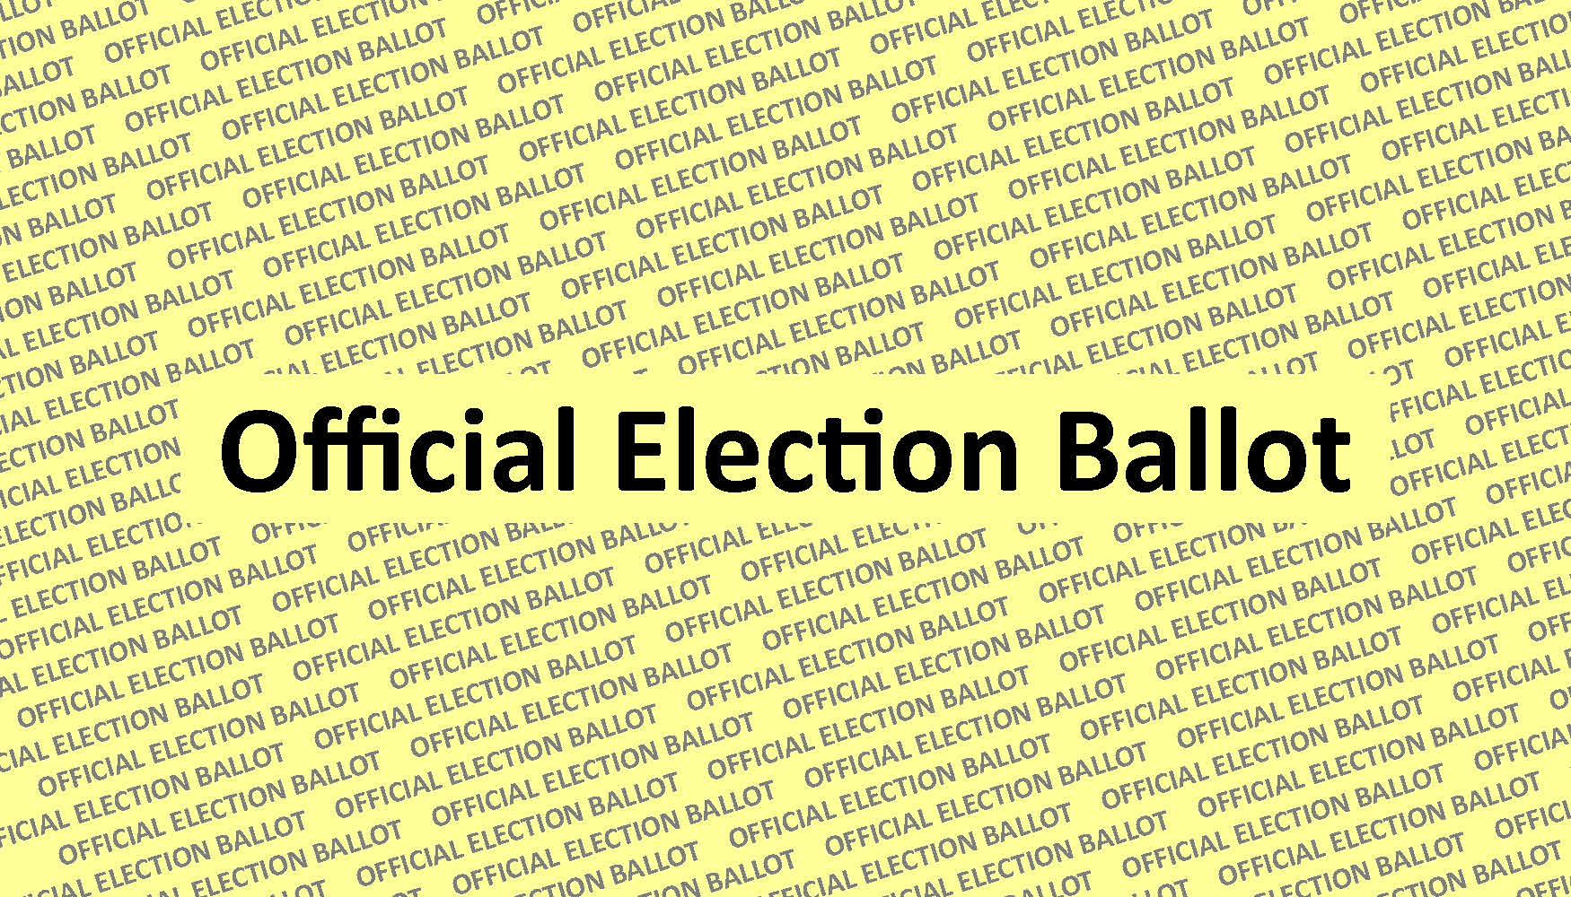
Step Two
Seal your ballot in the yellow envelope
marked "official election ballot."
Do not make any stray marks on
the yellow envelope.
Your ballot must be enclosed and
sealed in the yellow envelope marked
"official election ballot" or it will not be counted.

Slide 12
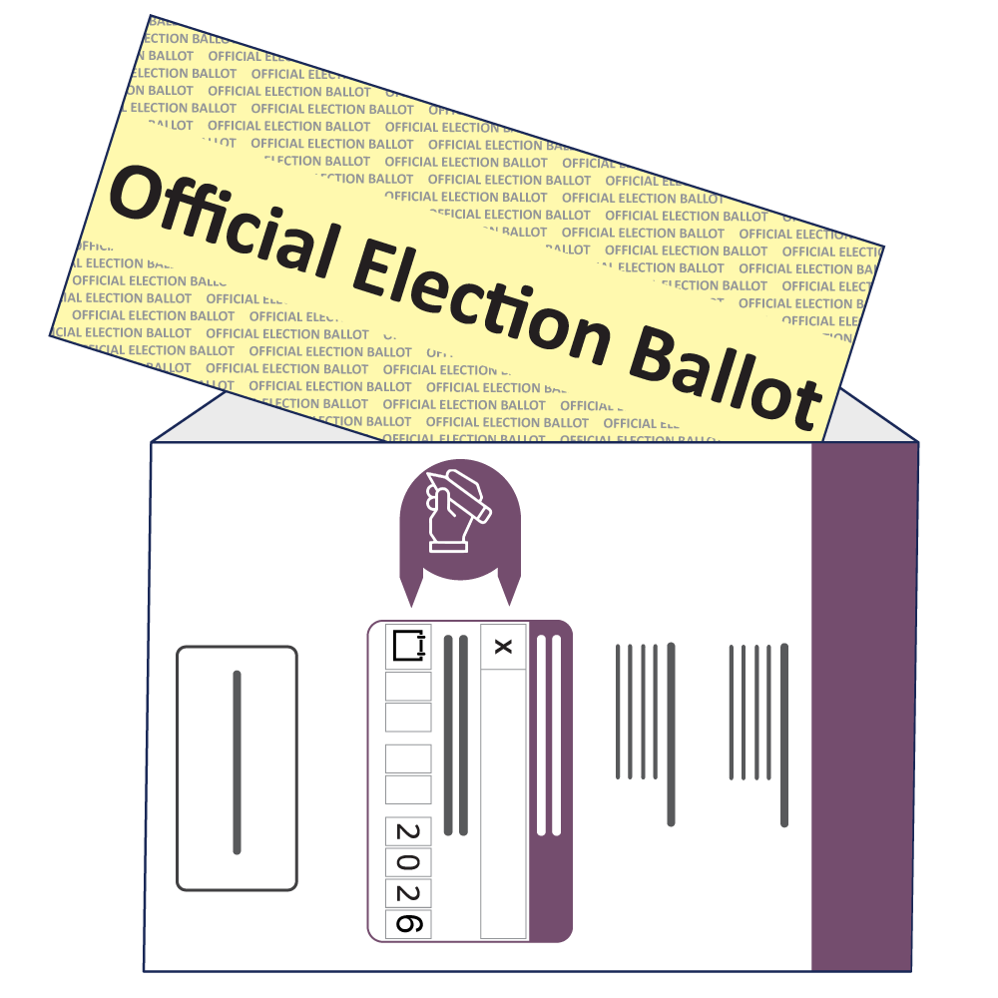
Step Three
Seal the yellow envelope in the pre-addressed outer return envelope.
Sign and write the current date on the voter's declaration on the outside of the outer return envelope.
If you do not complete the declaration on the return envelope, your ballot will not be counted.
Notes:
You MUST Fill out the voter's declaration which requires you to sign and date your envelope.
-USE THE DATE OF THE DAY YOU ARE SIGNING THE ENVELOPE.
-DO NOT use your birthday, the day of the election ,etc.
JUST THE DATE YOU ARE SIGNING AND SEALING THE ENVELOPE.
Want to flag that some counties may not use purple and white envelopes. They might green and white or blue and white. Doesn't matter the color. Make sure the yellow envelope goes into the LARGER return envelope
-which will be white and another color.

Slide 13
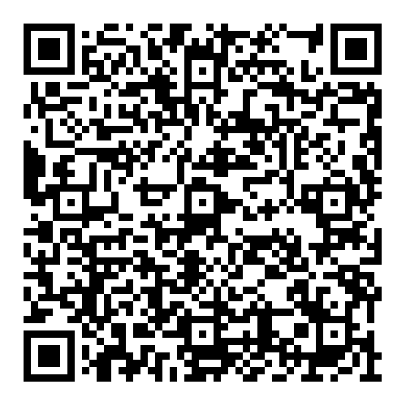
Step Four
Find where to return your completed mail ballot.
Return your complete ballot to the county election board.
Absentee and Mail-in Ballots must be received by 8pm on Election Day.
To ensure your ballot is counted, return the ballot as soon as possible.
Notes:
Again each county is different here!
-check to see if your county has drop boxes,. Satellite offices. Can also mail it back if there is enough time!

Slide 14
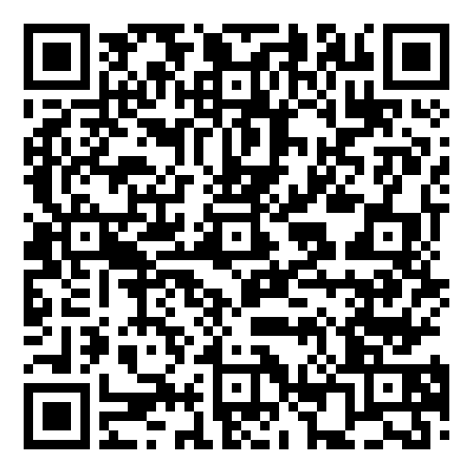
Find these steps online at vote.pa.gov

Slide 15
Track Your Ballot
You can check the status of your ballot at vote.pa.gov/MailBallotStatus
Provide an email address when you apply to get notifications.
Notes:
If you provide Department of State with your email, we will communicate with you about the status of your ballots and other notifications.

Slide 16

Poll Workers Needed
Pennsylvania relies on thousands of regular citizens like you to help elections run smoothly.
Learn about elections in PA
Gain valuable experience
Get paid for trainings and for working Election Day
Help your local community
Sign up at vote.pa.gov/GetInvolved.
Notes:
We would also like to put in a plug for those who would like to be poll workers. We need help!
Please sign up online for more information.

Slide 17
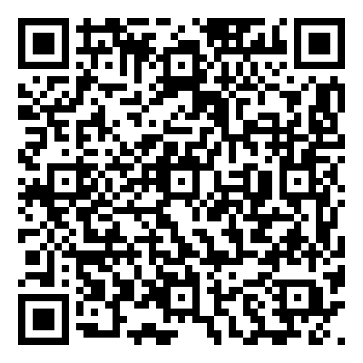
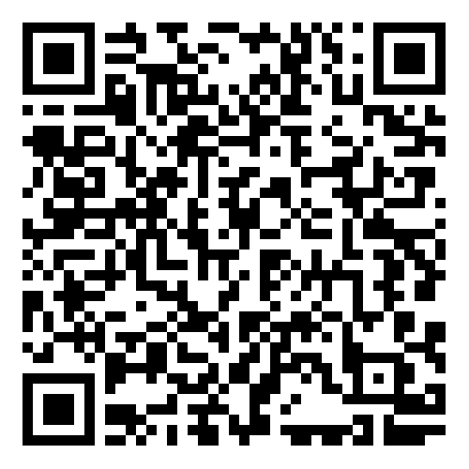
Get Involved
Share our #ReadytoVotePA Toolkit.
Share this presentation
Notes:
Other ways to get involved including sharing this information and other elements of our toolkits with your communities and families.
Your Vote is your Voice.
THANK YOU!

Slide 18



Stay connected
Follow us on social media
@PADepartmentofState
@PAStateDept
@PAStateDept

