Slide 1
New Employer ESS Access Registration
ESC – created 9/22/2021

Slide 2
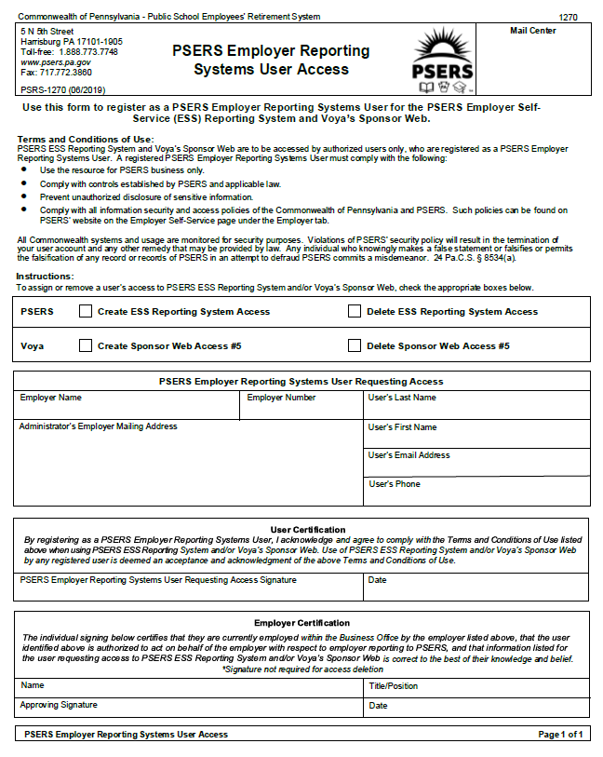
Step One is the completion of
a
1270 form

Slide 3
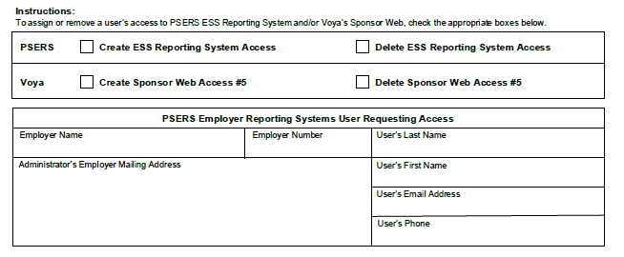
Please complete all boxes on the form
Remember to check box for EACH system being requested
or deleted

Slide 4
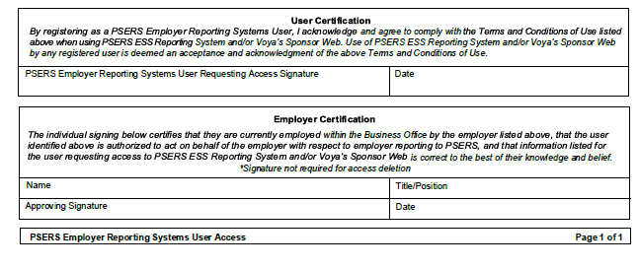
Signatures must be handwritten
First signature line is for staff requesting access
Second signature line is for staff requesting access’s supervisor

Slide 5
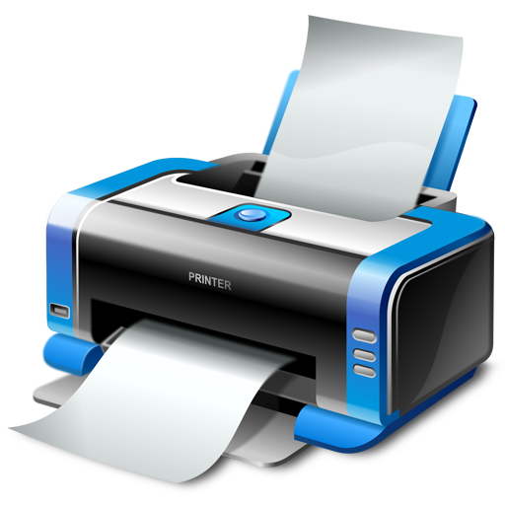
Fax all completed
1270 forms
to
717-772-3820

Slide 6
Staff requesting access will receive email notification from PSERS data services once ESS log in has been created.
Note: Administrator Number or PSERS ID will be mailed to district address/ Staff requesting access may also contact their ESC Rep

Slide 7
Click on the link
to create Password and set up log in
NOTE: Staff requesting access has 30 days to activate log in
must be using Chrome or Microsoft Edge as default Browser if not must copy and paste address into Chrome

Slide 8
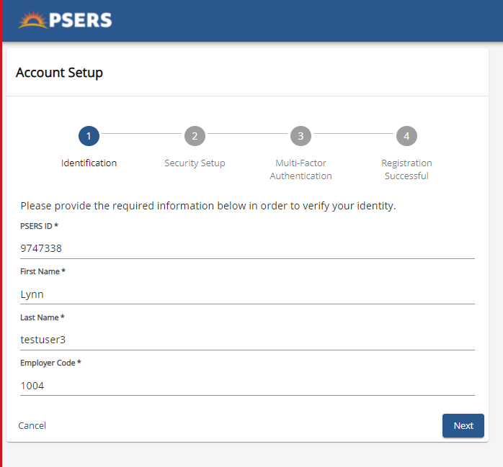
Complete each field
Click “NEXT”

Slide 9
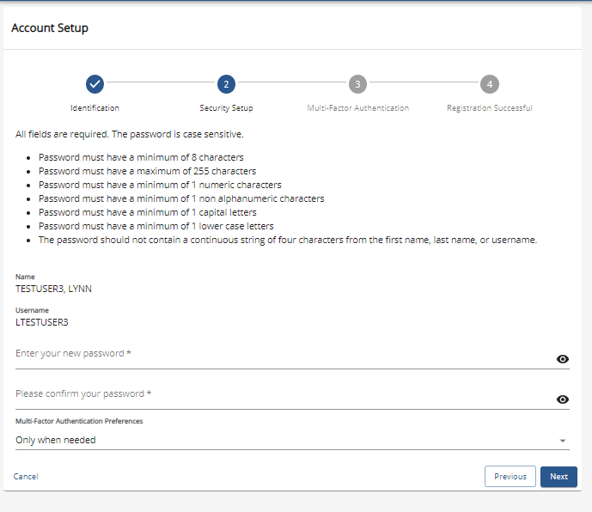
Create Password using directions
Using drop down arrow, select MFA preference
(suggested option – “only when needed”)
Click “NEXT”

Slide 10
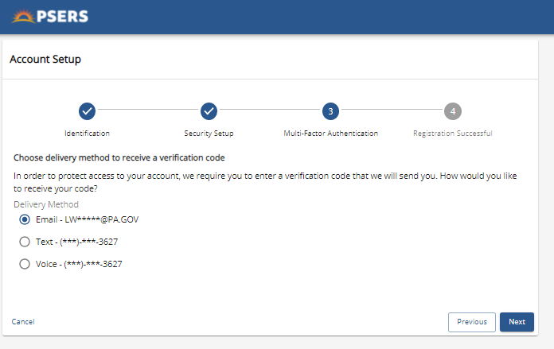
Select method to receive verification code
Click “Next”

Slide 11
Staff requesting MFA code will receive email
Code will be embedded in email text
Note: if you copy and paste Outlook may add a blank space in the beginning

Slide 12
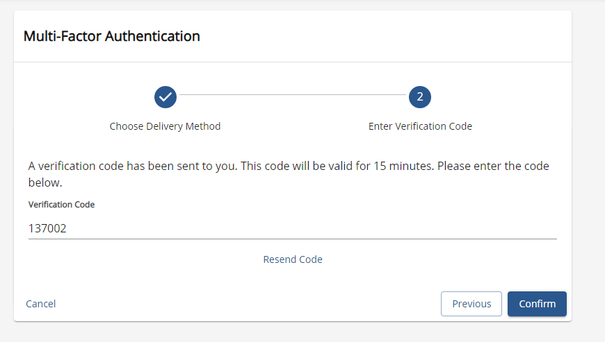
Enter 6 - digit code
Must enter within 15 minutes or request to resend code
click “CONFIRM”

Slide 13
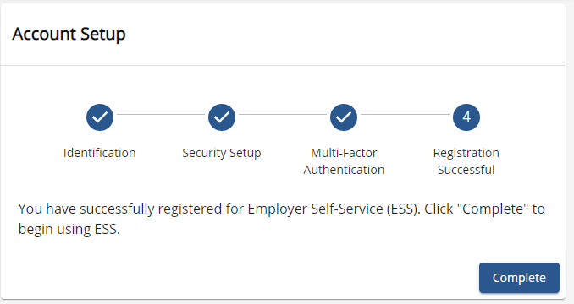
You’re Access is
Set Up!
Click “COMPLETE”

Slide 14
Enter the USERS name provided in email and the New Password you just created
Click “Sign In”

