Slide 1
LEARN TO HUNT:
PHEASANTS
PENNSYLVANIA GAME COMMISSION

Slide 2
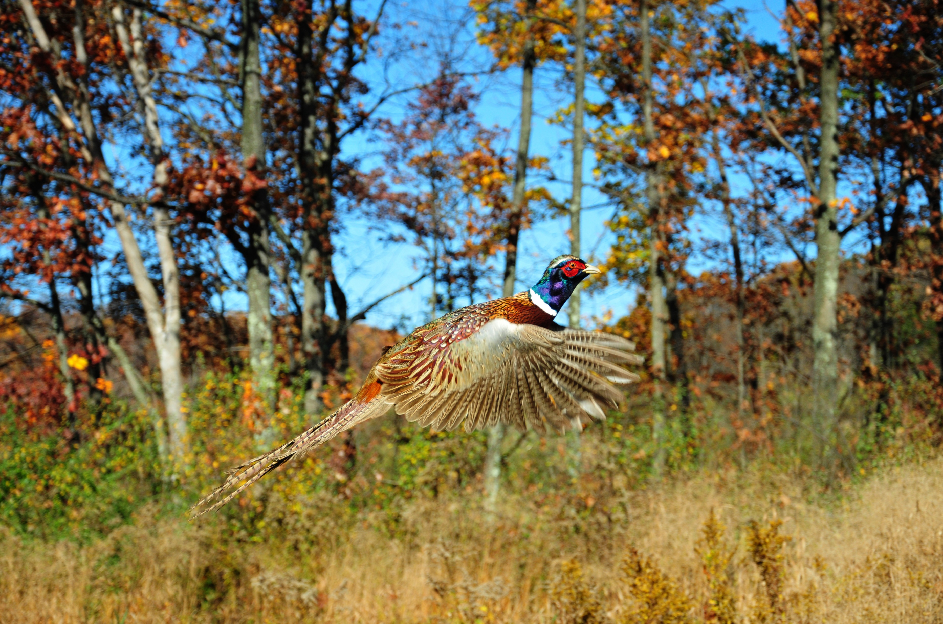
Ring-necked Pheasant
Introduced to the United States from Asia back in the early 1900’s
Adapt well to agricultural land, fields, meadows and thick habitat
Feed on a variety of seeds, grains, and insects
Notes:
Just a little background on ring-necked pheasants. They are members of the chicken family. They are native to Asia and they were introduced to the United States back in the early 1900’s. During this time, the Pennsylvania Game Commission set aside funds to purchase and propagate game. Pheasant eggs were purchased and given to commission refuge keepers, sportsmen organizations and private individuals interested in raising pheasants. By 1915, the PGC had stocked pheasants for the first time. During the late 1960’s and early 1970’s the population flourished. But, by the mid 1970’s the pheasant population harvest trends started to decline. As farming practices and use of pesticides, herbicides, and chemical fertilizers increased, this took a negative toll on the pheasant populations.
Wild pheasants are no longer found naturally on the landscape for the most part due to a combination of habitat loss, and the farm practices I mentioned.

Slide 3
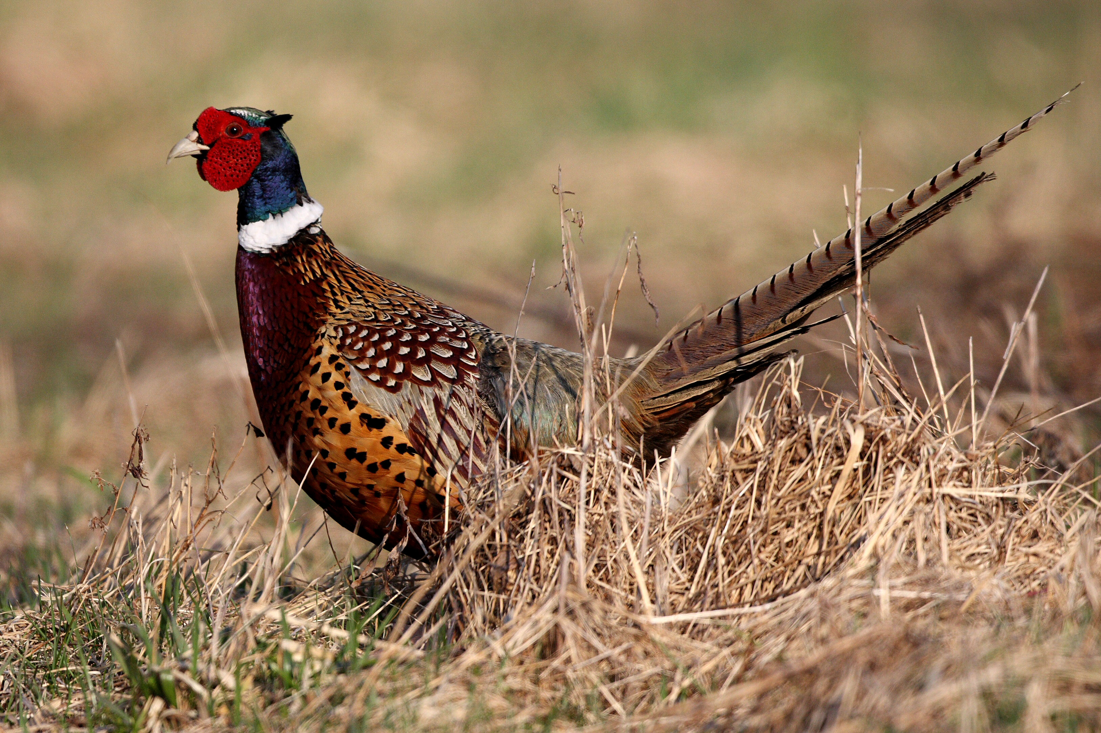
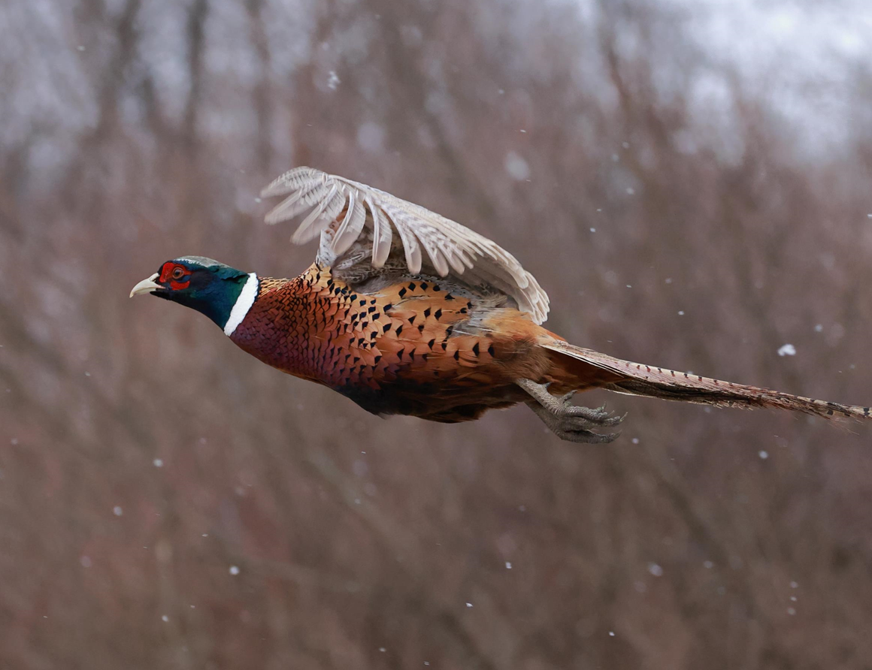
HOW TO IDENTIFY PHEASANTS
ROOSTER
Notes:
Roosters, or male ring-necked pheasants are colorful birds. They have bright red waddles or fleshy parts on their face and an iridescent green neck with a bold white ring around it, hence the name, ring-necked pheasant. Their bodies are a beautiful combination of reds, browns, golds and black. They have very long tail feathers that are coppery in color with thin black bars.
Roosters have a really distinct crowing sound. It is a loud double squawk followed by rapid muffled wingbeats that may or may not audible. They will typically crow the most at sunrise and sunset. They will often make a loud cackling sound when they are flushed into flight.

Slide 4
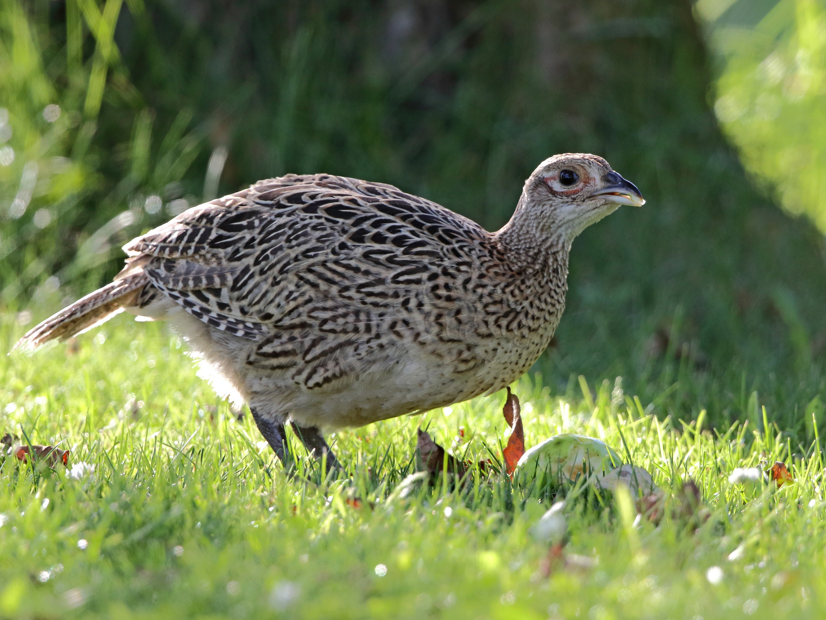
HOW TO IDENTIFY PHEASANTS
Hen
Notes:
Hens, or female ring-necked pheasant aren’t near as colorful as the roosters. Their plumage is a subtle camouflaging mixture of brown, black, and gray. They have a much shorter tail with thin black bars. They have this incredible camouflage so that they are able to blend in and hide from predators when nesting.
Hens are typically silent and don’t make any loud calls.
**Both roosters and hens are legal to be harvested statewide during the pheasant season.

Slide 5
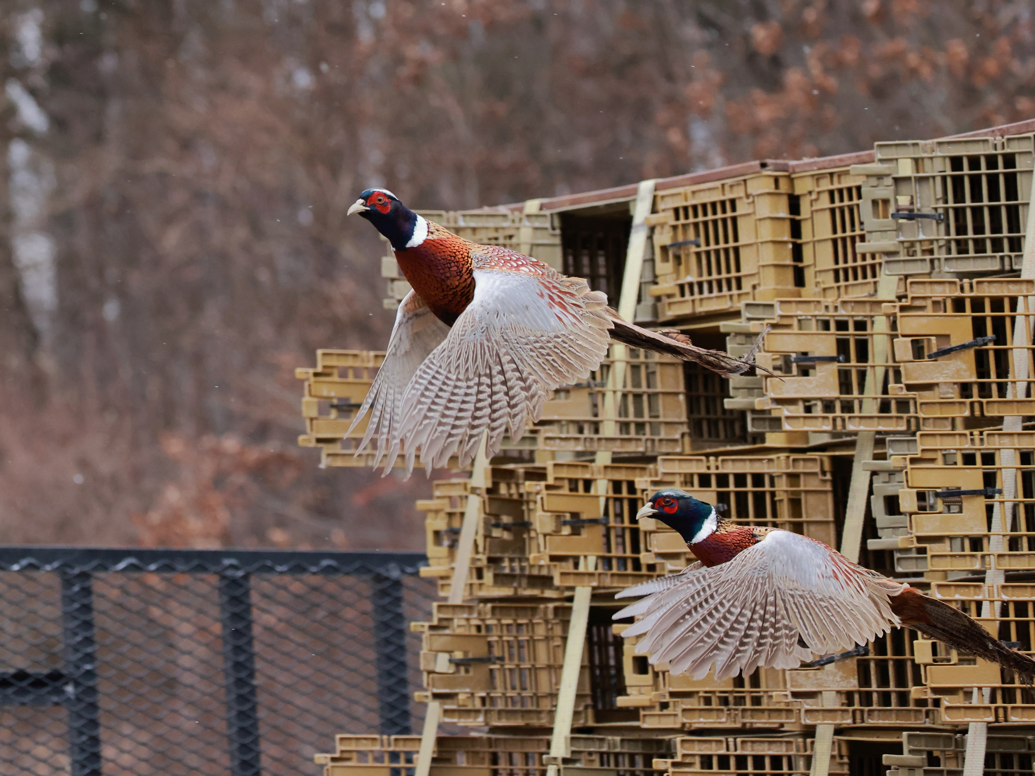
PHEASANT PROPAGATION PROGRAM
Notes:
The PGC currently distributes over 200,000 ring-necked pheasants annually. These birds are raised on two different game farms in the state. All of these birds are released on lands open to public hunting. This includes state gamelands, other state, federal, and county properties, and properties that are enrolled in the commission’s hunter access programs.
They are stocked throughout the season. The pre-season stocking typically takes place a week before season starts.
This picture here just shows how the pheasants are stocked. They are transported in crates that have slats for the birds to breathe. Once the stock truck gets where they are going, the crates are opened up and the birds will fly out. The birds are raised in a way that allows them to adapt well to the wild and be strong flyers.

Slide 6
PHEASANT STOCKING ALLOCATIONS
Seasonal Breakdown | Junior Hunt Releases |  | Pre-Season & In-Season Releases |  | Winter Season Releases |  | Regional Total
 | Males | Females | Males | Females | Male | Females |  | Males | Females
Northwest | 2,150 | 880 | 23,280 | 8,540 | 6,620 | 2,490 | 43,960 | 32,050 | 11,910
Southwest | 1,840 | 660 | 26,370 | 9,700 | 9,250 | 3,530 | 51,350 | 37,460 | 13,890
Northcentral | 2,010 | 690 | 13,030 | 4,760 | 4,500 | 1,540 | 26,530 | 19,540 | 6,990
Southcentral | 1,890 | 700 | 18,110 | 6,590 | 6,560 | 2,280 | 36,130 | 26,560 | 9,570
Northeast | 1,280 | 440 | 19,120 | 6,980 | 8,020 | 3,060 | 38,900 | 28,420 | 10,480
Southeast | 2,580 | 970 | 20,260 | 7,440 | 6,680 | 2,500 | 40,430 | 29,520 | 10,910
TOTAL | 11,750 | 4,340 | 120,170 | 44,010 | 41,630 | 15,400 | 237,300 | 173,550 | 63,750
Notes:
This is the pheasant stocking allocation chart for 2022. This chart is available on the PGC website and updated every year. Birds are stocked throughout the season. The pre-season stocking typically takes place a week before season starts. This gives you an average of how many are stocked in each region. Here is the link to the page Pheasant Allocation (pa.gov)

Slide 7
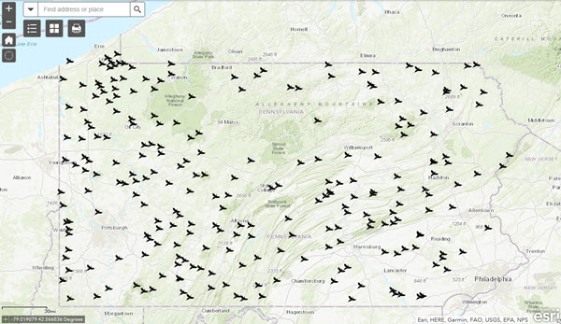
PHEASANT STOCKING MAP
Notes:
We also have a pheasant stocking map available on the Pennsylvania Game Commission website -- this is where you can go to see all the stocking locations across Pennsylvania. There are over 200 of them on state game lands, but also state parks and some county lands. Pheasants are stocked starting in October and periodically throughout December. A late season stocking usually happens in January as well.

Slide 8
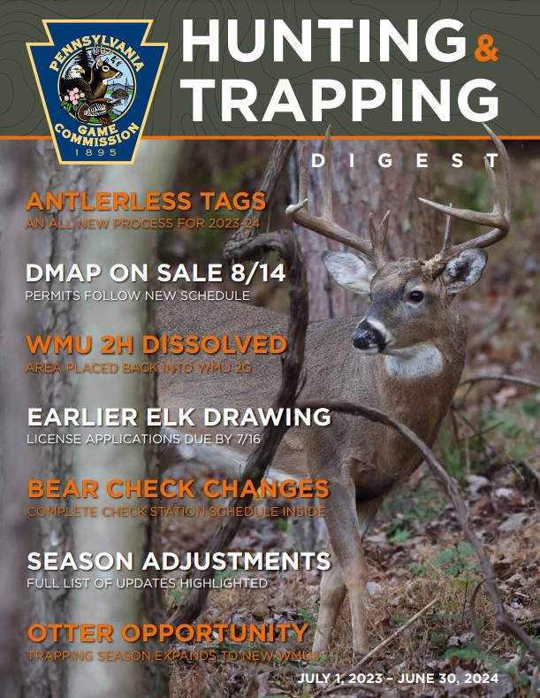
SEASONS AND BAG LIMITS
STATEWIDE PHEASANT SEASON
DATES:
JUNIOR PHEASANT HUNT
DATES:
2 Daily, 6 Possession
WHAT LICENSES/PERMITS DO I NEED?
ADULTS: General Hunting License, Pheasant Permit
JUNIORS: Junior Hunting License, Pheasant Permit (Free)
Notes:
This year, the Junior season for youth 16 and under runs from October 8th to the 15th . And then the statewide season will begin on October 22nd and run through November 25th. It will go out during the statewide deer rifle season and then come back in on December 12th and run through December 23rd. It will come in again of December 26th and run through February 27th. The bag limit is 2 daily and 6 in possession.
So to pheasant hunt, you will need your general hunting license or a mentored permit. It is $6.97 for hunters under the age of 16 and $20.97 for adults.
You will also need to purchase a pheasant permit if you are over the age of 16. This pheasant permit helps to cover the expenses of raising the pheasants and stocking them. This is a great deal. A lot of pheasant hunting preserves in Pennsylvania will charge 25-30 per pheasant that they stock for you to hunt. So with this permit, you can hunt the entire season for about 27 dollars. And just to note, for hunters under 17 the junior pheasant permit is free, but you still need to get it from an issuing agent. It is also free for mentored permit holders.
Senior lifetime resident hunting or senior lifetime resident combination license holders who acquired their license prior to May 13, 2017 are exempt from needing a pheasant permit.

Slide 9
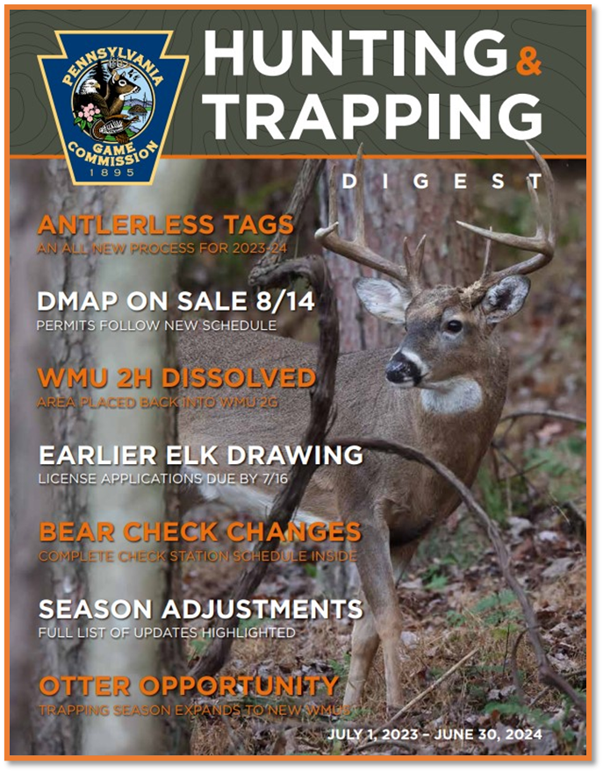
REGULATIONS
-Legal hunting hours are from one-half hour before sunrise to one-half hour after sunset
-Pheasants may be hunted in groups of six or fewer hunters. This applies for many forms of small game hunting.
-It is unlawful to discharge a firearm within 150 yards of a Game Commission vehicle that is stocking pheasants.
-It is unlawful to shoot into a Safety Zone, which is
a 150-yard buffer around occupied buildings.
Notes:
These are the regulations for pheasant hunting. As always it is very important to read the Hunting and Trapping digest thoroughly prior to going hunting.
Legal hunting hours are from one half hour before sunrise to one half hour after sunset.
Sundays are excluded except for two days: Sunday November 13th and Sunday November 20th. You are able to hunt these two Sundays, and all other regulations apply on these days as well.
If you are hunting in a group, you must have 6 or fewer hunters.
If you are hunting near a game commission vehicle that is stocking pheasants, please keep in mind that it is unlawful to discharge a firearm within 150 yards of a game commission vehicle that is stocking pheasants. It is strongly recommended to avoid hunting any where near a stocking vehicle, remember that shot can travel several hundred yards, especially when shooting up at flushed birds.
It is also unlawful to shoot into a safety zone, which is a 150 yard buffer around occupied buildings.

Slide 10
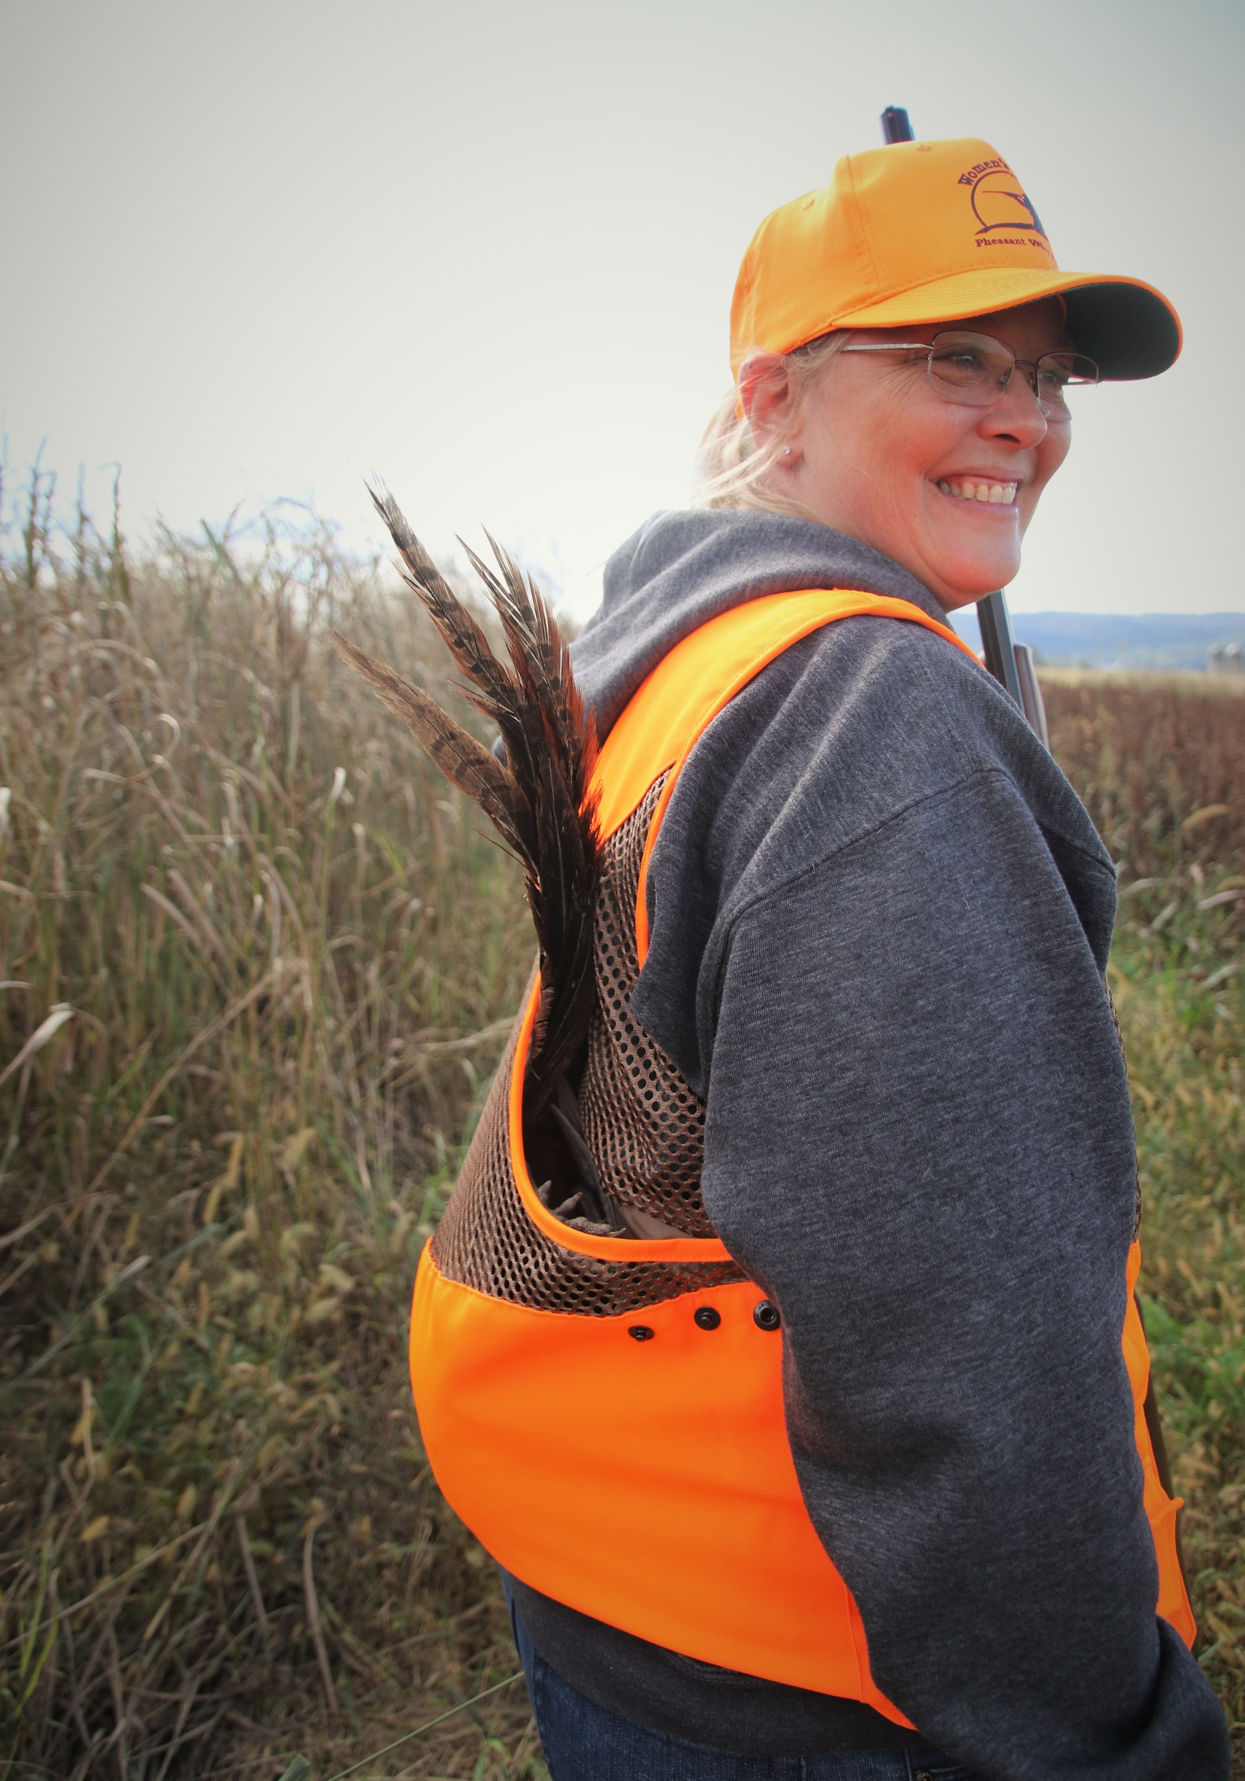
WHAT EQUIPMENT DO I NEED?
Fluorescent Orange Hat and Vest
Sturdy Pants and Boots
Shotgun & Ammunition
Notes:
Blaze orange clothing- 250 square inches on the head, back and chest combined. Visible from 360 degrees. An orange hat and vest fit this requirement. It is recommended to wear more than the minimum 250 square inches of blaze orange to ensure that you are seen
A vest with a gamebag on the back is great for carrying the game birds out of the field. You can buy these at most hunting stores. We also recommend brush pants, which are just a thicker material and an extra layer on the thigh and calf to help protect you from briars and brush. Sturdy boots that are comfortable to walk in are also important.
You will also need a shotgun. There are a few different types of shotguns to consider. You want to make sure that you know your shotgun well. You want to know how to use it safely before heading to the field.

Slide 11
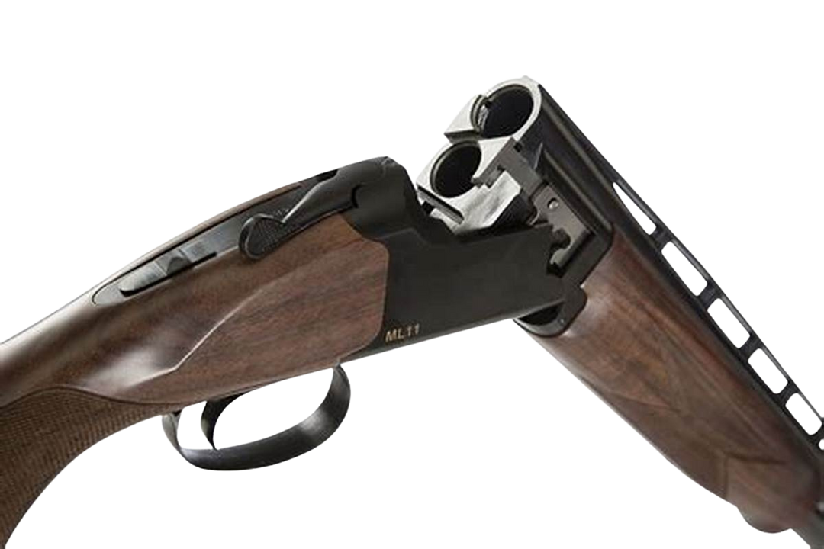
TYPES OF SHOTGUNS
Break Action
Notes:
There are several different actions you can choose from. This the break action. It works basically the same way a door hinge does. To open the action you point the barrel at the ground and then press a release and the stock drops downward. This allows the shotshells to eject from the gun.
This action is often selected for a hunters first shotgun.
If you have this type of shotgun available – demonstrate how the action works.

Slide 12
TYPES OF SHOTGUNS
Pump Action
Notes:
This is a pump action shotgun. These are typically pretty popular for pheasant hunters. The sliding forestock allows for the hunter to chamber another shell without taking their eye off the target.
If you have this type of shotgun available – demonstrate how the action works.

Slide 13
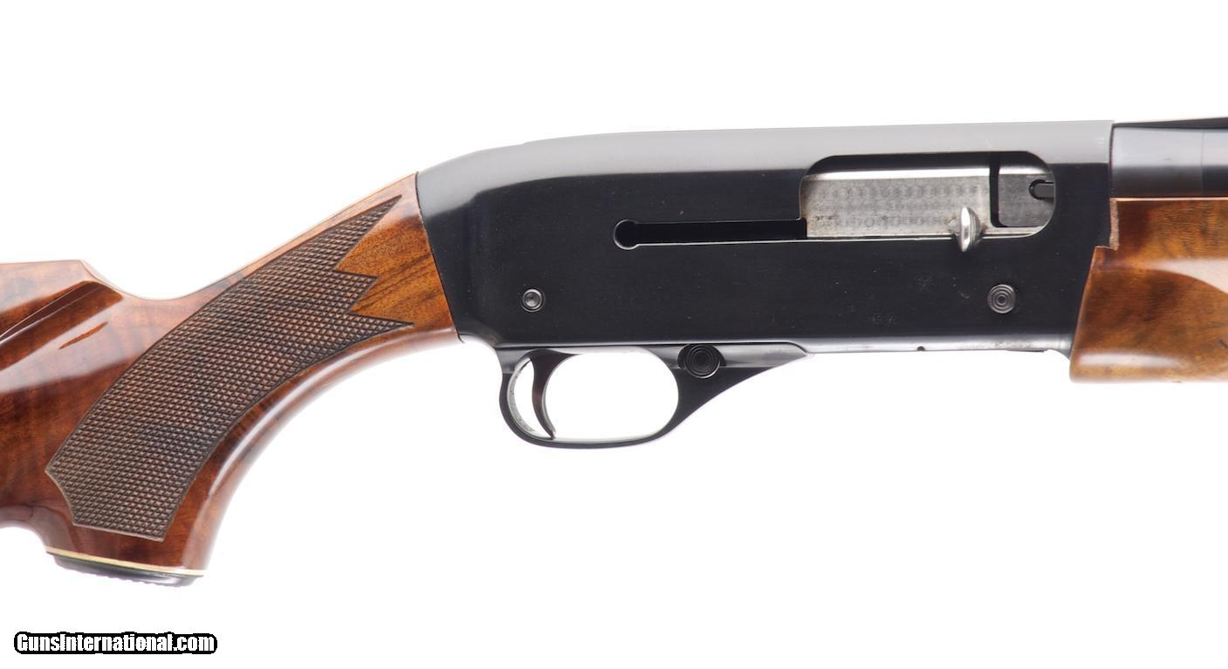
TYPES OF SHOTGUNS
Semiautomatic
Notes:
This is a semiautomatic shotgun. As each shot is fired manually, the shotshell is ejected automatically and the chamber is reloaded automatically.
If you have this type of shotgun available – demonstrate how the action works.

Slide 14
CHOKE TUBES
Notes:
A choke is a tube at the end of the shotgun. It is either removable with threads where you can take them in and out and change them, or some shotguns have the choke built in and it cannot be changed.
This illustration here shows the different types of choke tubes and what the diameter of a lead shot string with be at different distances.
The chart goes from the most open or wide spread choke down to the full choke. If you were to use a full choke, on average you would have a 40 inch spread at approximately 40 yards.
Most pheasant hunters prefer either the modified or improved cylinder choke because they provide the best opportunity for shots that are really close as well as shots that are a little further out.

Slide 15
SHOTGUN SHELLS
GAUGE:
10 gauge or less
12 or 20 gauge are commonly used
no more than 3 shells in chamber/magazine
SHOT SIZE:
No larger than No. 4 (No. 2 for steel).
No. 5-6 is commonly used
Notes:
Once you have a shotgun and choke selected, you are going to need to select the shells.
For shotguns, it is recommended to use at least a 20 gauge, so you are going to want a larger gauge to make sure that you are not wounding them rather than 28 gauge or .410 bore. There is also the potential for some further shots when pheasant hunting. Be sure to properly match your shotshell gauge and shell length to your shotgun.
You need to choose the right shot size. Size 5 and 6 is most commonly used because Pheasants have a lot of thick feathers to penetrate, size 4 is the largest legal size shot you are allowed to use for pheasant hunting.
You may only have 3 shells in the gun at a time when hunting. You need to have a plug in the gun so that is all it can hold.

Slide 16
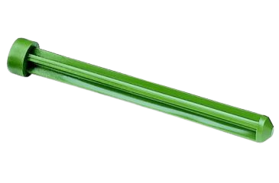
Plugs
Notes:
Per the regulations, you may only have 3 shells in the gun at a time when hunting. You need to have a plug in the gun so that is all it can hold.

Slide 17
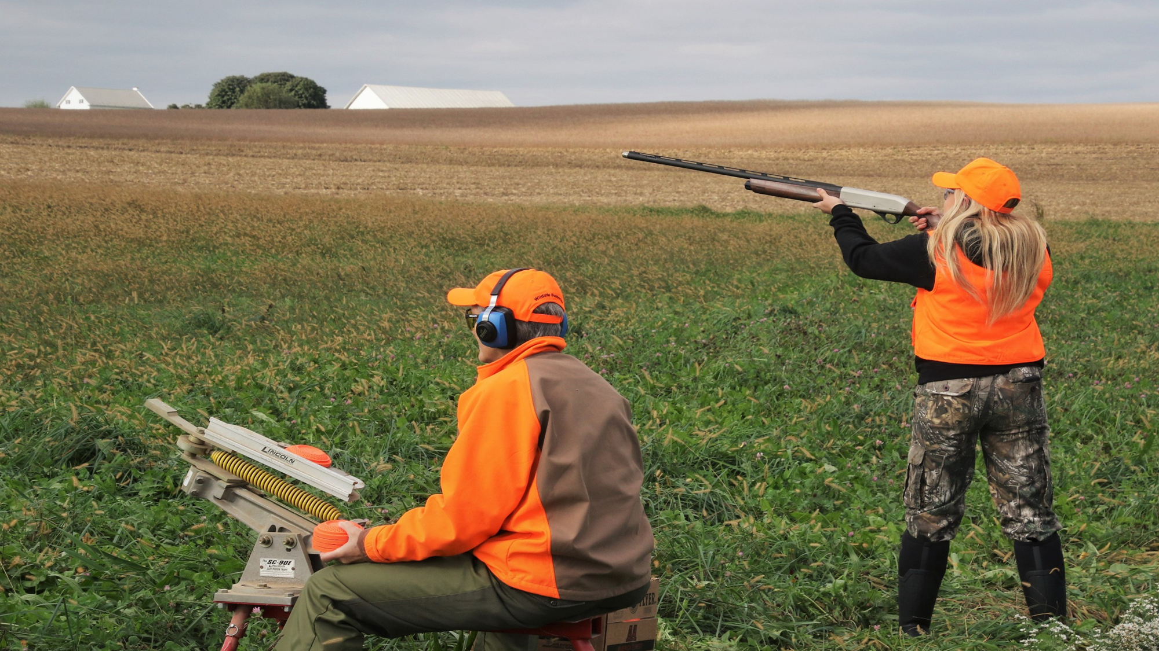
Notes:
In addition to making sure you have all the right equipment before going out pheasant hunting, you want to make sure you practice. You want to pattern the shells you are using and know their effective range.
Shooting clay targets is a great way to practice. The clays simulate a bird flying.
If you will be providing a trap shoot opportunity – note that this will be explained more during the shooting activity later in the day.

Slide 18
WEAR ORANGE
AND BE HEARD
Blaze Orange allows you to be seen by other hunters from a distance, and by members of your own hunting group should your view be obstructed by tall cover or hedgerows.
Auditory communication is very important. Keep talking to your hunting companions to ensure you always know where they are. If other hunters may be nearby and hidden by vegetation, use your voice to announce your presence with a simple “hunters over here” declaration.
Derek Stoner
Notes:
Safety is always of utmost importance when hunting with a group and shooting at moving game. Wearing blaze orange is required and important to ensure safety for all participants. When moving through tall cover, be sure to keep in auditory contact as well by talking to your hunting group members. If other hunters may be nearby, simply announce your presence. You can say something like “Hunters over here” just so others know where you are and not to shoot in the direction.
As I said before, it is recommended to wear more than that 250 square inches of orange.

Slide 19
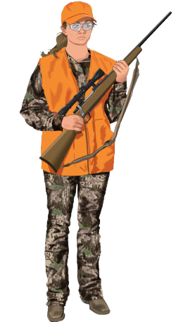
SAFE FIREARM CARRIES
Two-handed or “Ready” Carry
- Provides best control
- Can be used as a right- or left-hand carry
- Great carry if you need to shoot quickly
Notes:
The two handed or ready carry provides the best control, particularly in thick weeds or when you need to fire quickly. If you were to trip and fall, this carry gives you better control of the gun and helps you keep the muzzle pointed in a safe direction. It can be used as either a right- or left-handed carry. But you only want to use this carry if your gun would not be pointed at others while walking.

Slide 20
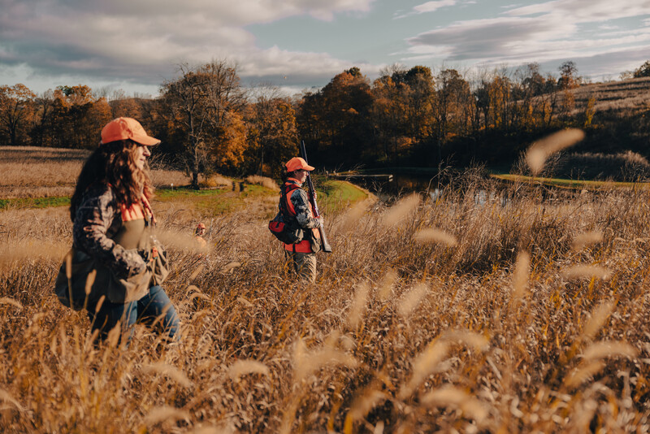
Notes:
This is just an example of a hunter using the ready carry. You can see she has two hands on the gun and the muzzle is pointed to the sky, away from the other hunters.

Slide 21
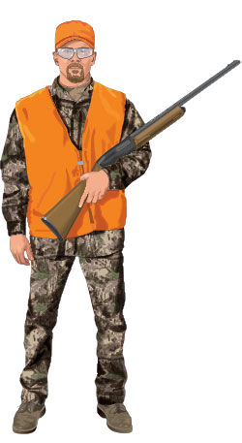
SAFE FIREARM CARRIES
Cradle Carry
-Comfortable & Secure
-Reduces arm fatigue
-Can be used as a right- or left-handed carry
Notes:
The cradle carry is comfortable and secure, and it helps to reduce arm fatigue. Like the two handed or ready carry, the cradle carry can be used as either a right or left handed carry. Do not use this carry if your gun would be pointed at others when walking side by side.

Slide 22
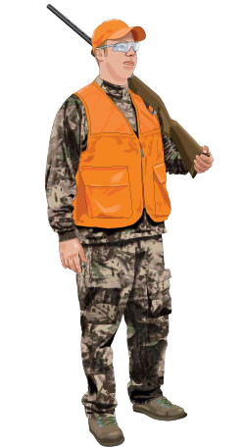
SAFE FIREARM CARRIES
Shoulder Carry
-Comfortable & Secure
-Reduces arm fatigue
Notes:
The shoulder carry is a good choice when walking beside or behind others. Don’t use it if someone is behind you. Be cautious when using this carry that you don’t spin around quickly and end up pointing the barrel at someone.

Slide 23
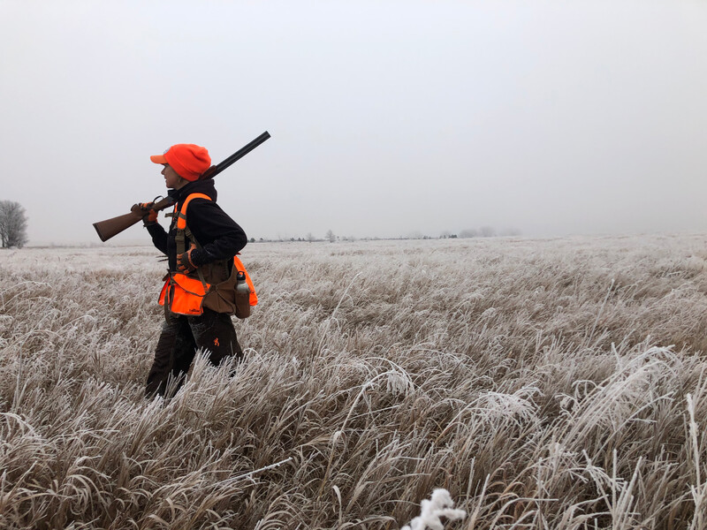
Notes:
This hunter is using the shoulder carry. Notice she is by herself and the muzzle is pointed to the sky behind her.

Slide 24
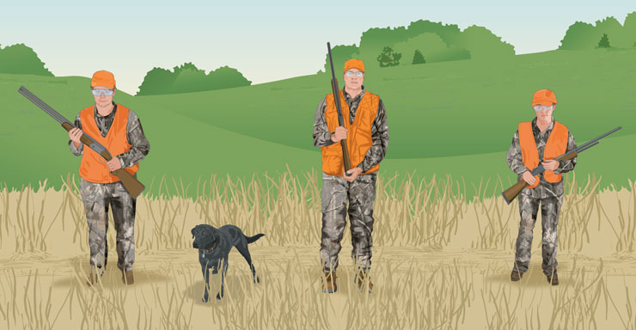
PROPER FIELD CARRIES
Notes:
Carry selection is based primarily on muzzle control and terrain. If three hunters are walking side by side:
The ones at the sides may carry their guns pointing either to the side away from their party or to the front.
The one in the center should keep the gun pointing to the front or up.
Ask the participants if they can identify the types of carry in this picture.

Slide 25
Notes:
The way you line up when you are hunting with a group is super important. You want to make sure that you are lined up parallel and everyone in the hunting party has a designated zone of fire that allows for safe shots away from the group. Swinging the shotgun through the line and turning around to take a shot is not safe. It is best to take shots at birds that flush within close proximity to the hunters.
This photo is a good example of how to safely line up. So the two hunters up front that are carrying the shot guns are parallel. The other guy in line with them who is not carrying a gun is probably the guide or dog handler. The two people trailing behind are observers. They are there watching the hunt take place. If a bird were to fly away behind the observers, the shooters would not be able to take the shot.

Slide 26
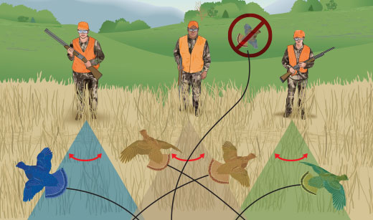
SAFE ZONES OF FIRE
Notes:
When hunting in a group with one or two other hunters, the hunters must walk abreast of one another, should be spaced 25 to 40 yards apart, and should always be in sight of one another.
Each hunter has a zone-of-fire, which spans about 45 degrees directly in front of each hunter. (Some states require an adult to be immediately beside a youth hunter. In this case, the adult should be a supervisor only—not a hunter.)
A way to visualize 45 degrees is to:
Focus on a distant, fixed object that is straight out in front of you.
Stretch your arms straight out from your sides.
Make a fist with your thumbs held up.
Gradually draw your arms in toward the front until both thumbs are in focus without moving your eyes. This will give you your outer boundaries.

Slide 27
WHERE TO HUNT PHEASANTS
-Agricultural areas
-Weedy edges or hedgerows
-Ditches and stream corridors
-Thick grassy vegetation
Notes:
Although we may not have the wild pheasant population like we used to, we are still fortunate that Pennsylvania has a lot of great habitat for pheasant populations.
Stocking takes place in areas that are well suited for pheasant survival. This might be areas with cropland and different types of grasses or even those edge habitats along fields. Pheasants are even known to frequent wetland habitats.
The linear nature of farm fields makes for efficient hunting. You have these rectangular blocks of cover that can be efficiently and thoroughly covered by hunters who are organized and prepared. A good tactic when working these larger fields is to divide it into blocks and work through it that way. Working the fields like this will allow you to detect and hopefully flush as many pheasants as possible.

Slide 28
Pheasant Habitat
Notes:
During the early part of season, October and November, pheasants prefer to spend time in agricultural fields, weedy meadows, and along hedgerows. They will spend a lot of time in fields that have not yet been harvested.

Slide 29
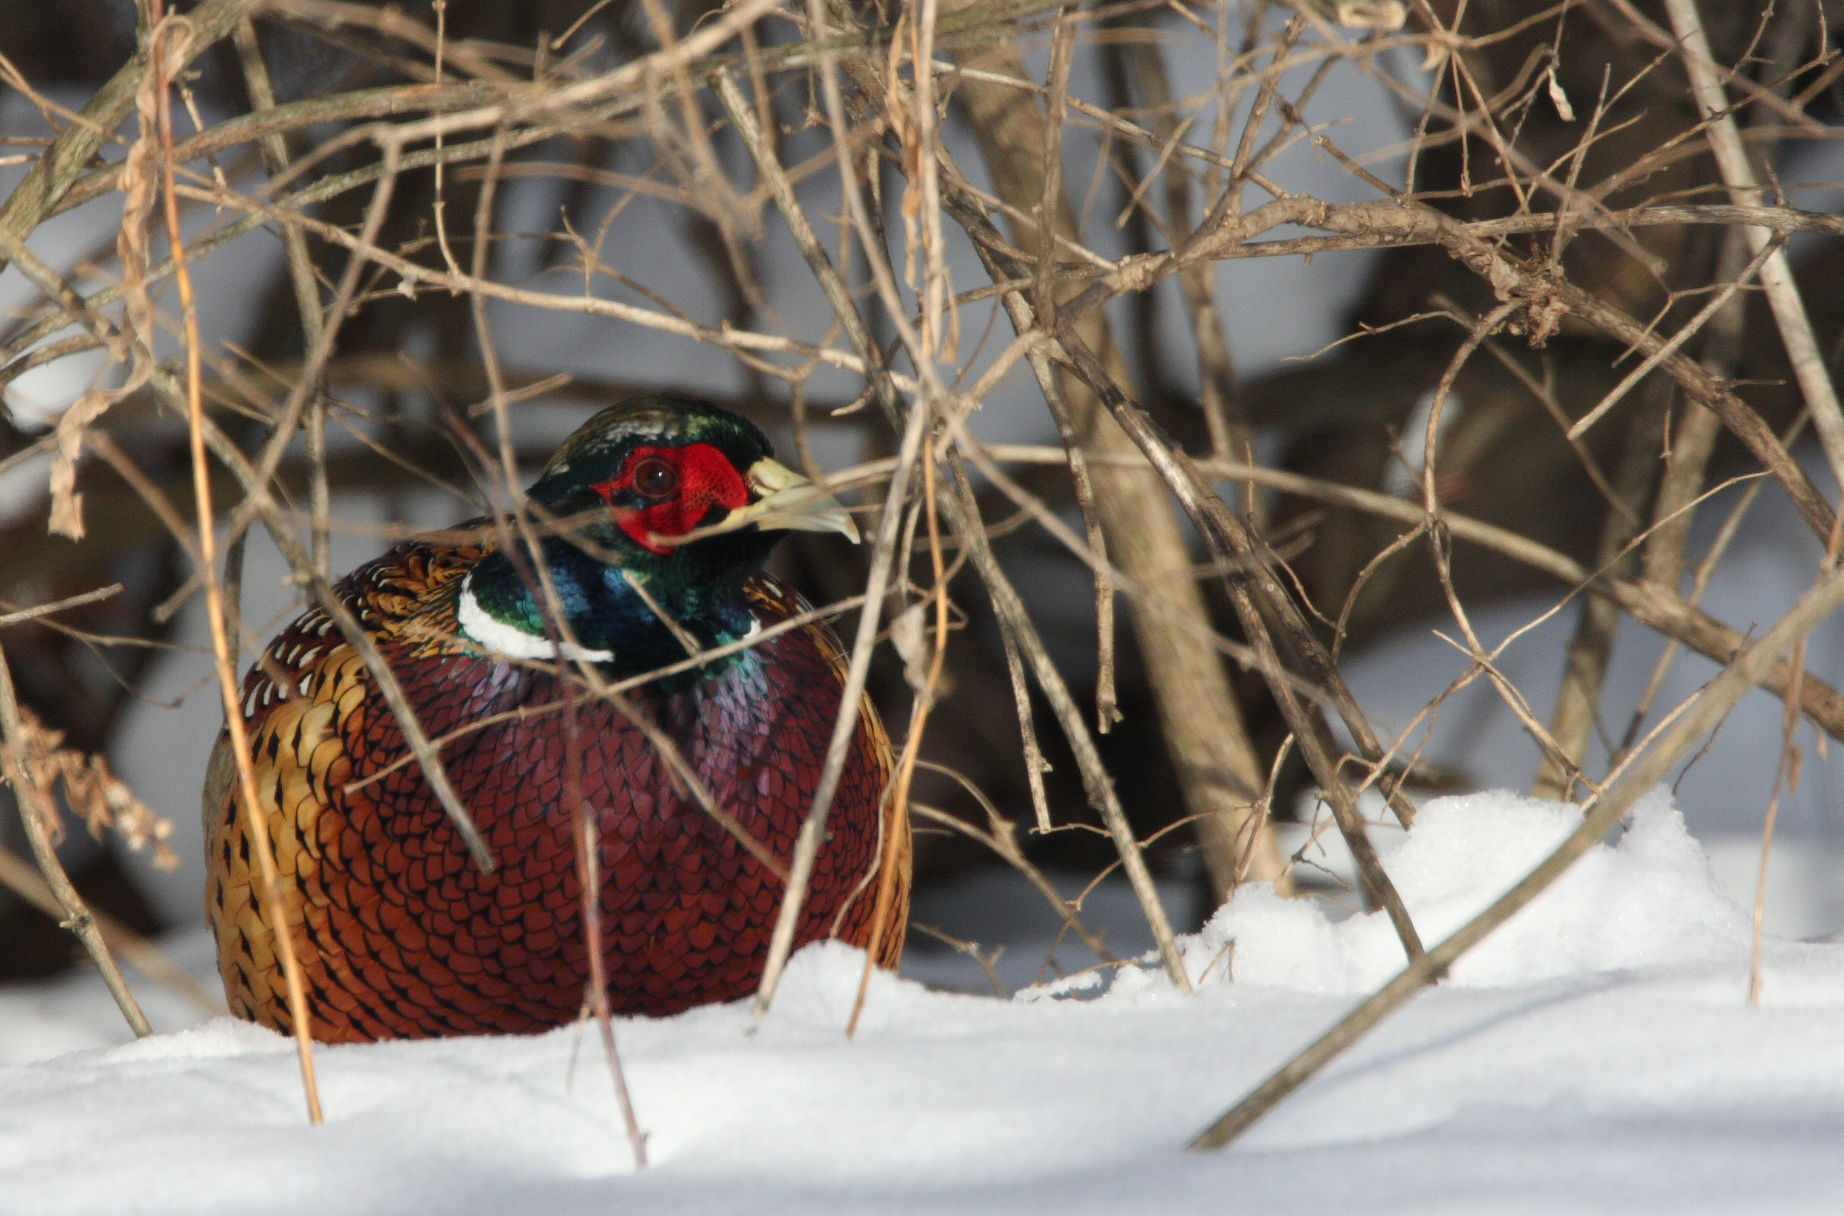
Notes:
During the late season, December through February, there's not going to be a lot of cover left in the fields. The fields have typically been harvested at this point and a lot of the remaining cover is beat down from weather. The pheasants will begin to seek shelter in hedgerows, marshes or places that have thick vegetation. When it gets really cold, they are going to seek out places to break the wind and cold. So during this time you will want to look in conifer stands too.

Slide 30
Notes:
Pheasants are primarily a ground bird. They spend most of their time walking around on the ground. However, occasionally they will take cover in trees if they sense a predator is near.

Slide 31
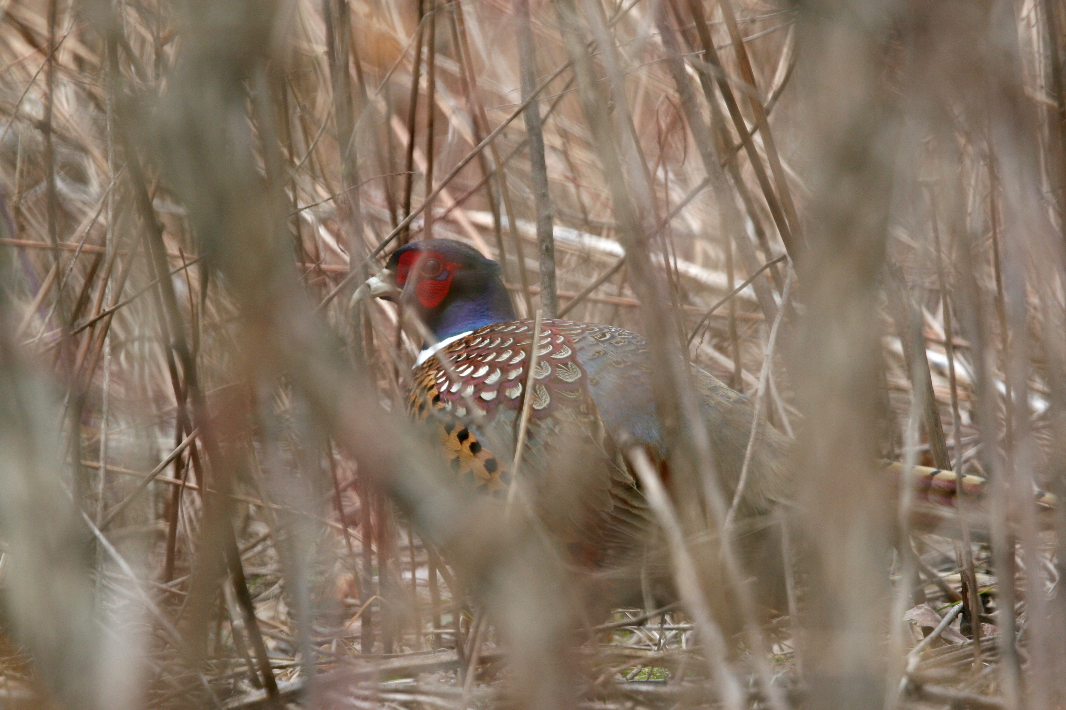
UNDERSTANDING PHEASANT BEHAVIOR
-Naturally seek cover in thick vegetation
-May travel in small groups to help spot predators and discover new food sources
-When pursued by hunters, pheasants prefer to run and hide
-Flushing and flying is a pheasant’s last resort. This is what you are hoping to encourage as a pheasant hunter
Notes:
Pheasants are naturally going to seek the thickest vegetation they can find to hide out in. They may be found traveling in small groups. This helps them to spot predators and to find new food sources. When they are pursued by hunters, their first response is going to be run and hide. Flushing and flying away is a pheasant’s last resort. Your goal as a hunter is to encourage them to fly so they give you the opportunity to shoot as they fly away. Always restrict shots to birds that are at least head high. To help with this, be sure to see space between the bottom of the bird and the horizon line.

Slide 32
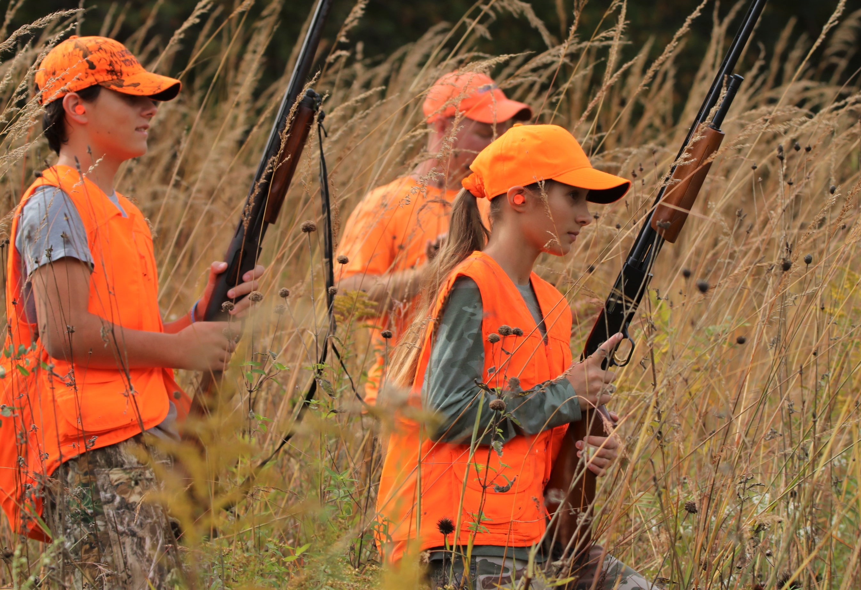
PHEASANT HUNTING TACTICS
WITHOUT A DOG
Walk slowly through the field, zig- zagging and pausing to make the pheasants uneasy and encourage them to flush.
With a group of hunters, spread out at least 20 to 30 yards apart and walk carefully through cover, paying close attention to thicker areas where pheasants may be hiding.
Check brushpiles, hedgerows and other places with thick cover where a pheasant could escape to while being pursued.
Notes:
So lets get into some pheasant hunting tactics. You can hunt them with or without a dog. Without a dog, you are essentially the one who is in the field trying to make that pheasant nervous enough to flush. So, you want to walk slowly zig zagging that field and pausing often, just like predator would. Pausing often is going to make the birds nervous and they are more likely to flush.
With a group of hunters, you can all spread out at least 20-30 yards apart. And you want to pay attention to all those really thick areas where a pheasant may hide. Sometimes in these thicker areas you can use your foot to rustle the cover and see if you can flush a bird out.

Slide 33
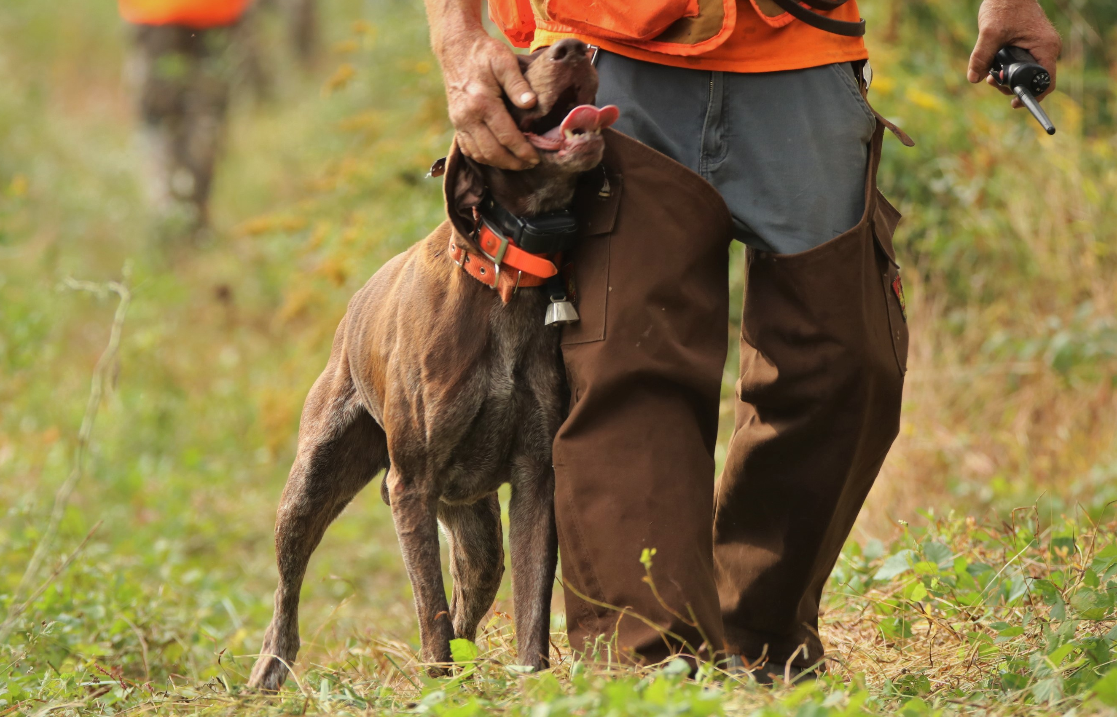
PHEASANT HUNTING TACTICS
WITH A DOG
Use the dog’s ability to smell game to help you find pheasants
Hunt into the wind or quartering into the wind to allow the pheasant scent to drift towards the approaching dog
Work with a group of two or three hunters for each dog
Give the dog space, trust them and let them lead you
Take frequent breaks to allow the dog to rest
Be aware of other hunting groups and keep your dog close enough that it does not interfere with other hunting activity.
Notes:
Hunting with a dog adds a whole new element to upland bird hunting. The dog is going to be able to use it’s nose to smell the pheasants and either point or flush them for you.
It’s best to try and hunt into the wind so that the scent drifts towards the approaching dog.
2-3 hunters per dog is typically a good amount to not overwhelm and distract the dog. You want to give the dog space and trust their senses. Allow them to use their natural instinct and training to work for you.
Make you sure you take frequent breaks to allow the dog to rest and be aware of other hunting groups. Make sure your dog is close enough that it does not interfere with other hunting activity.
Keeping your dog safe is also very important. It is not required that your dog wear any orange, but some hunters will put protective blaze orange vests on their dogs. These vests will protect them from the brush as well as make them visible to other hunters. They also make blaze orange collars.
A lot of hunters will also put a bell on their dog to be able to track them by sound.

Slide 34
TYPES OF BIRD DOGS
Pointers
Pointers will pause and indicate where a pheasant may be hiding and often range very far and wide at a quick pace sniffing for the scent of birds
Notes:
When it comes to upland bird dogs, there are a couple different types. There are pointers and flushers.
When pointers find a pheasant, they will stop and point their nose and head where the pheasant may be hiding. They often will range very far and wide. Once they find the area where the pheasant smell is the strongest, they point and then the hunter is able to approach and see if they can flush the bird.
Popular breeds of pointers are English Pointer, German Short-haired pointer, Weimaraner, German Wirehaired Pointers, and Brittany

Slide 35
TYPES OF BIRD DOGS
Flushers
Flushers will pursue a pheasant until it flies and often work very close and fast
Notes:
And then there are flushers…
Flushing dogs will chase the pheasant until it flushes, or flies away. They are trained to work a little closer, and they are very fast. If you are looking for a very fast moving exciting hunt, hunting with a flushing dog is the way to go.
Popular breeds of flushers are springer spaniels, Labrador retrievers, cocker spaniels, and golden retrievers
Whether you have a pointer or a flusher, bird dogs are amazing dogs. It is a huge time investment to train a dog to be an excellent bird dog. I would definitely encourage you, if you get the chance starting out as a pheasant hunter, to hunt with a dog, do it. It really is an awesome experience.

Slide 36
HUNTING TACTICS
Hunters zig-zagging and moving back and forth are going to attempt to create uncertainty in the pheasant’s mind and force them to stop running and flush, providing a good safe, shot.
As this photo illustrates, with a dog and hunters on the ground, it is never safe to shoot at a pheasant on the ground or one flying very low across the field.
Notes:
Regardless of what method you choose to hunt, you want to make sure to zig-zag the fields.
You want to work your way all the way to the edges of the field. Often the pheasants will move to these areas as you push them there. You want to pause often. This is going to create uncertainty in the pheasants mind, and will a lot of time cause them to flush.
Don’t move too quickly. The faster you go, the more likely you are to pass pheasants and not cause them to flush.
You also want to be prepared for runners. So a lot of times, these birds are going to run away. That is their first instinct.
When they do flush, keep in mind a reasonable range is typically 30 yards or less. You need to be quick, because they will fly away quickly.
When you take your shot, you want to focus on pointing at the head of the bird.
You need to make sure the bird is well up into the air before taking shots. It is never safe to take a low shot because you never know if there is another hunter or dog ahead of you, you may accidentally shoot in the direction of someone else.

Slide 37
ETIQUETTE
-Don’t shoot at birds someone else flushed
-When entering a field that other hunters are working, give them space and find another spot, or wait until they are finished
-Be patient and cooperate with other hunters
-Be mindful of where your shot will travel
Notes:
If another group is hunting nearby and they flush a bird. You should not shoot at it. They worked for that bird and should be the ones to get the shot.
When entering a field that someone else is working, make sure you give them space or wait until they are done hunting. Not only is it unsafe to have too many hunters in one field, it may also upset others.
You want to always be patient and cooperate with other hunters.
And, it is super important to be mindful of where your shot is going to travel. Never take a shot that is not safe.

Slide 38
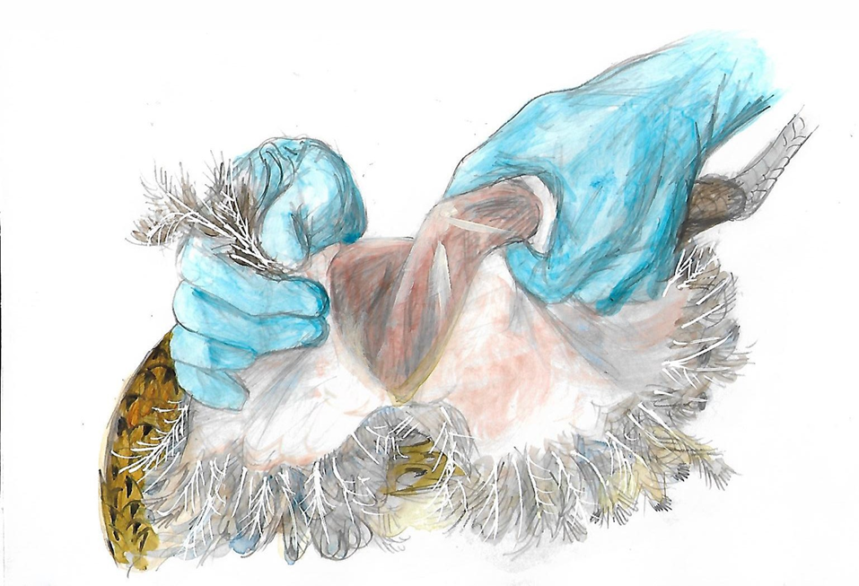
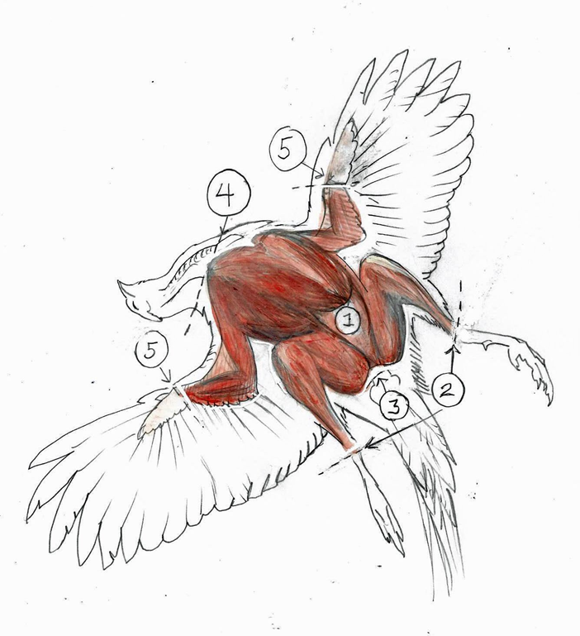
PROCESSING PHEASANTS
Using sharp kitchen shears, cut through the wings and neck close to the body and the legs below where the feathers end and remove them.
Using a sharp knife, cut through the thin skin on the chest and pull it back to expose the breast meat.
Continue removing the skin, pulling it around the remainder of the bird.
Make a hole in the skin at the base of the breastbone and use your fingers to remove the entrails.
Notes:
If you are successful, you will find yourself needing to field dress your pheasants. So the first thing we recommend is wearing protective gloves.
Sharp kitchen shears work great for cutting through the wings, neck and legs to remove them. You will want to cut these as close to the body for neck and wings and right where the leg feathers end if you can.
Once you have these parts off you can use a sharp knife to cut through the thin skin on the breast and pull it back to expose the breast meat. You can pull this skin around the remainder of the body to remove it.
Then you can make a hole in the skin at the base of the breastbone and use your fingers to remove the entrails;
If offering a pheasant cleaning station – let folks know you will demonstrate this process in one of the stations later.

Slide 39
RESOURCES
Pheasants Forever: www.pheasantsforever.org
Project Upland: www.projectupland.com
Ultimate Pheasant Hunting: www.ultimatepheasanthunting.com
Pennsylvania Pheasant Stocking Map:
https://www.pgc.pa.gov/Wildlife/WildlifeSpecies/Ring-
NeckedPheasant/PheasantAllocation/Pages/default.aspx
Notes:
These are some other pheasant hunting resources for you. Pheasants Forever is a great organization. They have a lot of local chapters all across Pennsylvania. A lot of these chapters put on great mentored hunts.
There is also project upland. They have a lot of great upland bird hunting information. Everything from articles to videos and recipes.
Ultimate pheasant hunting.com also has a great forum where you can ask questions as well as a lot of other useful information.

Slide 40
QUESTIONS?
mentoredhunting@pa.gov
Learn to Hunt
Notes:
Thank you all for joining us tonight and good luck if you get out into the field this year! We are going to take a break, feel free to ask any questions you might have and then we will meet back here to divide up and start stations.

