Slide 1
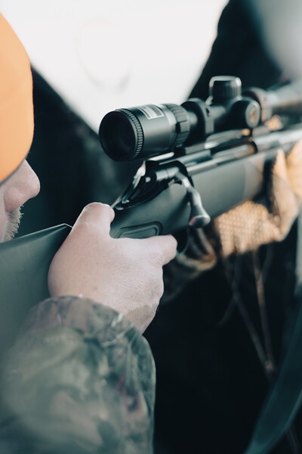
LEARN TO HUNT:
Deer with Firearms
PENNSYLVANIA GAME COMMISSION

Slide 2
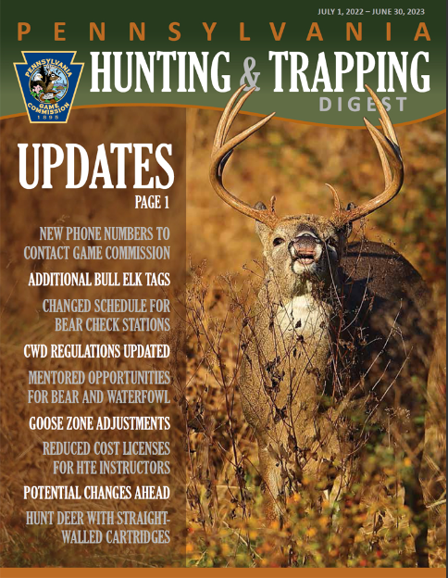
Seasons
Regular Firearms:
Statewide Antlered & Antlerless Nov. 26th- Dec. 10th
Special Firearms:
Statewide Antlerless Only
Oct 20th-22nd
Extended Firearms:
Antlerless Only
WMUs 2B, 5C, & 5D
Dec. 26th –Jan. 28th
Notes:
The statewide regular firearms season for antlered and antlerless deer begins this year on November 26th and runs through December 10th.
There is also a special firearms season statewide that runs from October 20th-October 22nd. During this special season, Junior and senior license holders, mentored youth, active-duty military and certain disabled permit holders may harvest an antlerless deer with a firearm.
There is also an extended Firearms season for antlerless deer in Wildlife Management Units 2B, 5C, and 5D. 2B is in the Pittsburgh area and 5C and 5D are both in the Philadelphia area. Be sure to check the digest for exact boundaries of these WMU’s. This season runs from December 26th through January 28th.

Slide 3
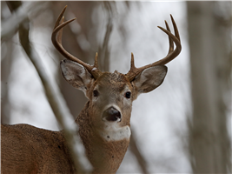
Licensing
- General hunting license required to hunt in any season
- Allows for the harvest of one antlered deer per license year
Notes:
A general hunting license is required to hunt in any of the seasons. Only one antlered deer (or buck as they are typically referred to) per license year can be taken with a general hunting license.

Slide 4
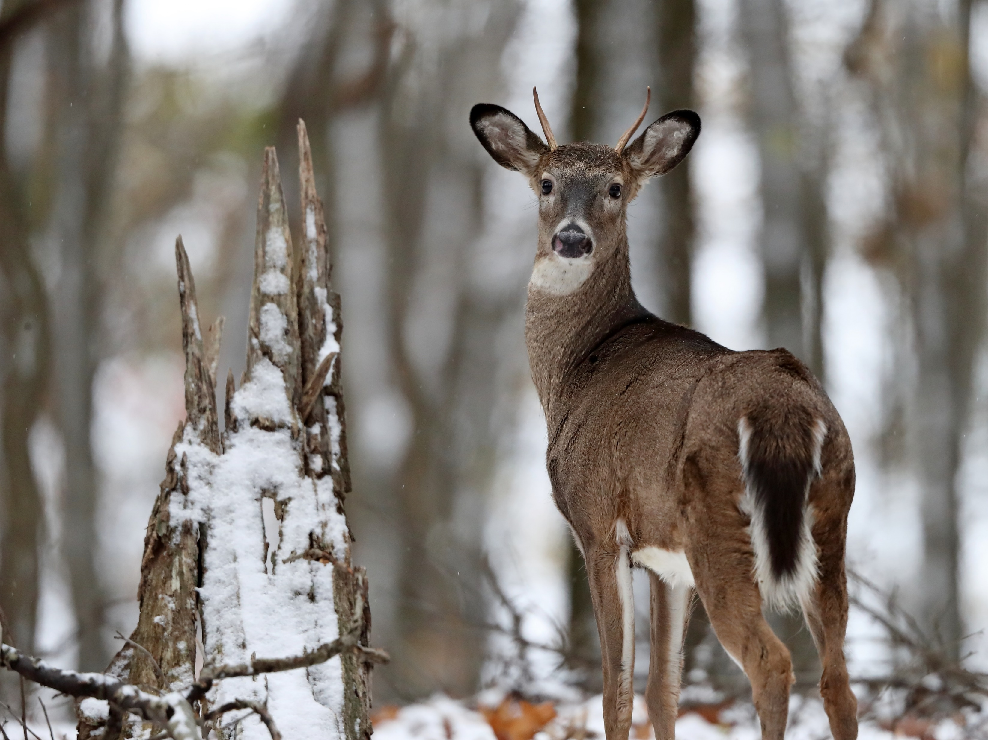
Antler Restrictions
STATEWIDE: Junior license holders, mentored youth, disabled hunters with a permit to use a vehicle, and resident active-duty U.S. Armed Services personnel, can harvest antlered deer with two or more points on one antler, or a spike three or more inches in length.
Notes:
STATEWIDE: Junior license holders, mentored youth, disabled hunters with a permit to use a vehicle, and resident active-duty U.S. Armed Services personnel, can harvest antlered deer with two or more points on one antler, or a spike three or more inches in length.

Slide 5
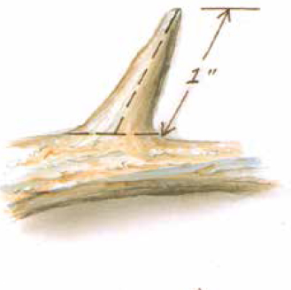
Antler Restrictions
All other hunters must abide by additional antler restrictions
Senior license holders must abide by antler restrictions, as well.
A point is defined as any antler projection (including the brow tine) at least one inch in length from base to tip. The brow tine is the point immediately above the antler burr.
The main beam tip shall be counted as a point regardless of length.
An antlerless deer will remain defined as a deer without antlers or a deer with antlers, both of which are less than three inches in length.
Notes:
All other hunters must abide by additional antler restrictions
Senior license holders must abide by antler restrictions, as well.
A point is defined as any antler projection (including the brow tine) at least one inch in length from base to tip. The brow tine is the point immediately above the antler burr.
The main beam tip shall be counted as a point regardless of length.
An antlerless deer will remain defined as a deer without antlers or a deer with antlers, both of which are less than three inches in length.

Slide 6
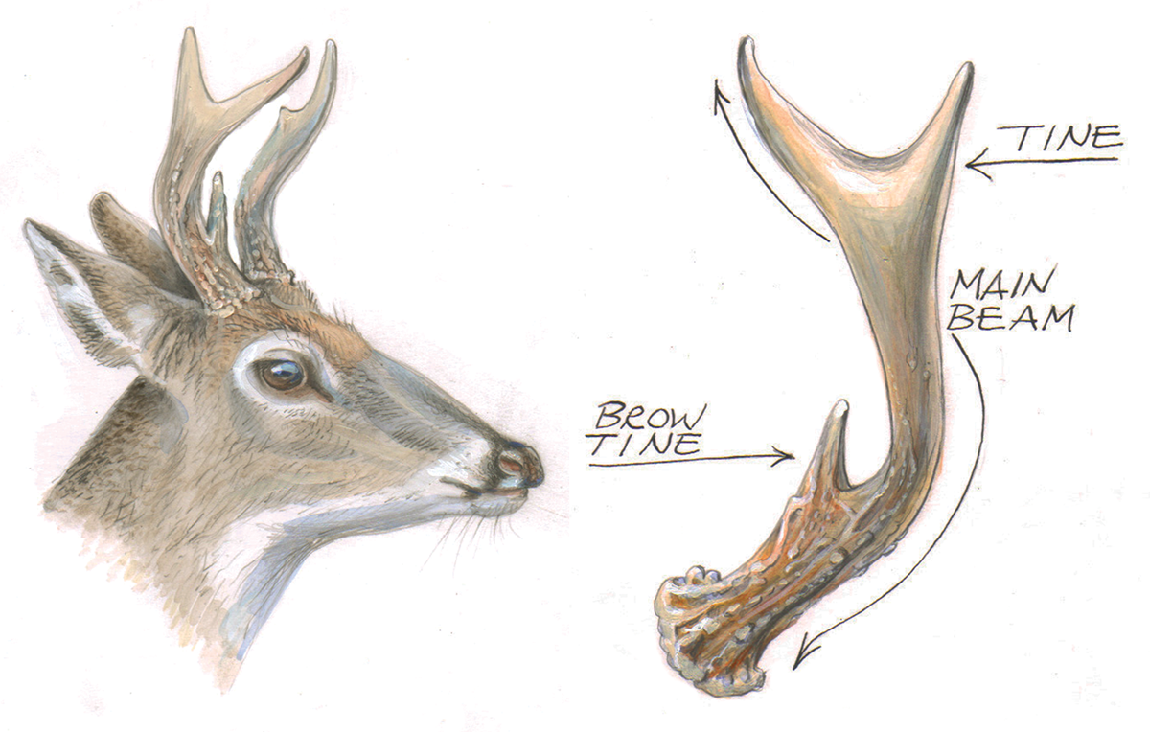
Antler Restrictions
In most parts of the state, hunters are required to abide by three points on one side.
Notes:
In most parts of the state, hunters are required to abide by three points on one side.

Slide 7
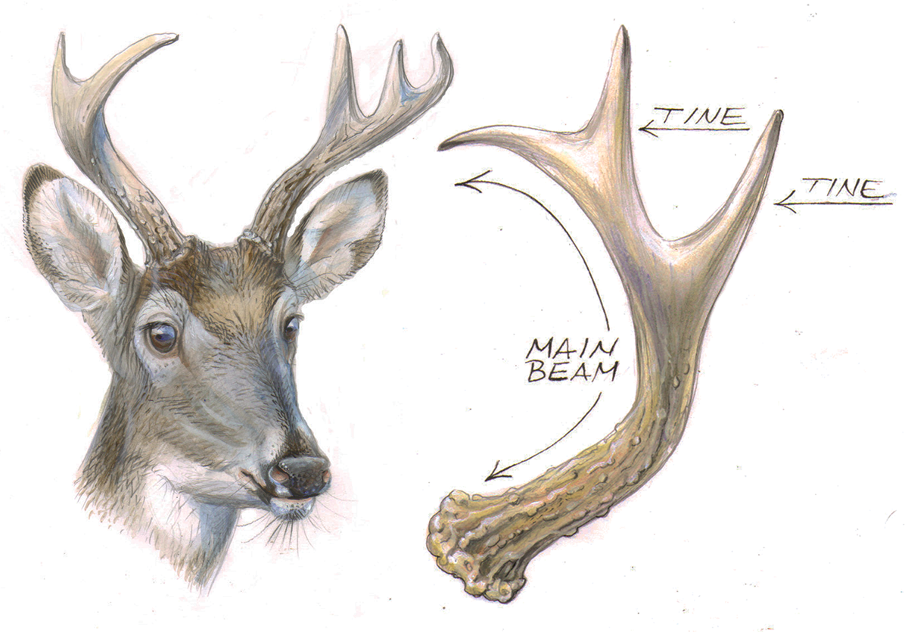
Antler Restrictions
In WMUs 1A, 1B, 2A, 2B, & 2D hunters are required to abide by “three up”; three points, including the main beam counted as one of the points, on one side, excluding the brow tine (the point immediately above the antler burr).
Notes:
In WMUs 1A, 1B, 2A, 2B, & 2D hunters are required to abide by “three up”; three points, including the main beam counted as one of the points, on one side, excluding the brow tine (the point immediately above the antler burr).
I know that is a lot to take in and remember. You can find more information on antler restrictions on page 26 of the 2022-23 Hunting and Trapping Digest.

Slide 8
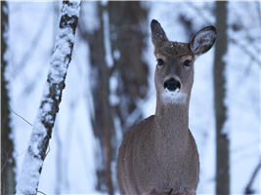
Antlerless Licenses
Notes:
If you plan to harvest antlerless deer, you will also need an antlerless tag in addition to a general hunting license. If you are looking to purchase an antlerless tag for this license year, there may still be some available in your Wildlife Management Unit. You can check their availability at Huntfish.pa.gov. You want to make sure that you harvest antlerless deer only in the unit where your antlerless tag is valid. Your antlered tag is valid in all units.
A bill was recently passed in Pennsylvania that will likely change the way antlerless tags can be purchased in upcoming years. Watch for press releases, social media posts, and other information from the PGC in upcoming months for more information.
There are also DMAP tags that can be purchased each year. DMAP stands for Deer Management Assistance Program. These permits allow for hunters to harvest an antlerless deer on the specific property for which the permit is issued. You can find more information on these permits on page 30 of the Hunting and Trapping Digest.

Slide 9
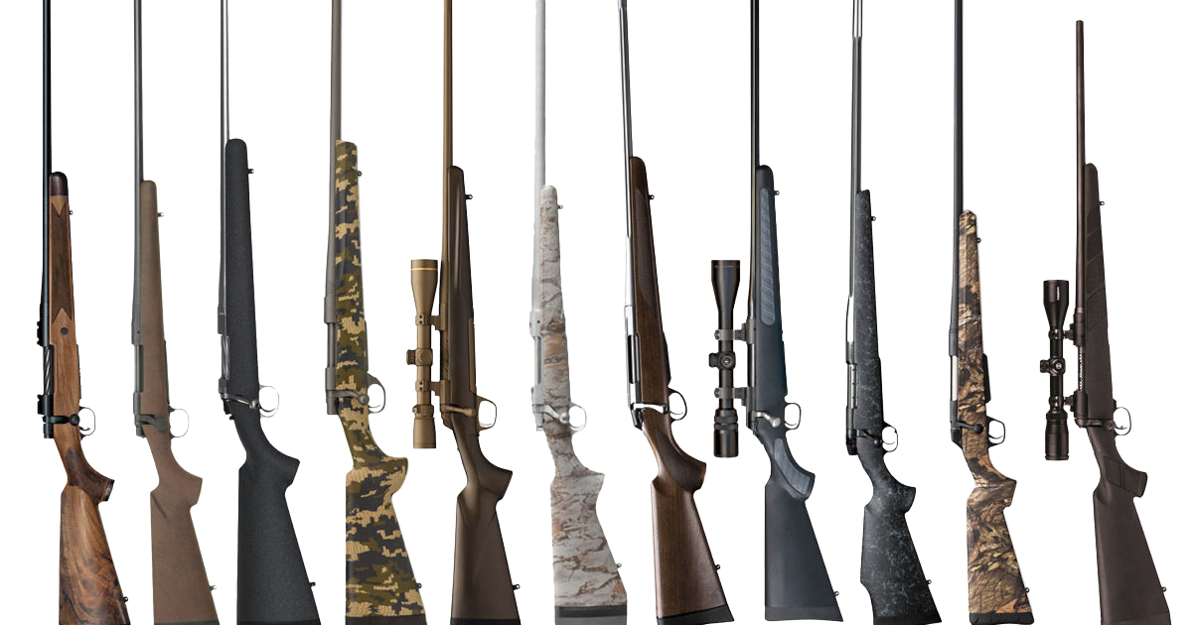
Arms & Ammunition
Manually operated centerfire rifles, handguns, and shotguns with all-lead bullet or ball, or a bullet designed to expand on impact.
Semiautomatic centerfire shotguns that propel single projectile ammunition
Muzzleloading long guns of any type, 44 caliber or larger
Long, recurve, or compound bows and crossbows with broadheads of cutting-edge design.
Notes:
If you plan to hunt deer with a rifle, you are going to find a wide variety to choose from.
When using a rifle remember that typically the higher the caliber the bigger the bullet. Some of the most popular rifle calibers for whitetail deer hunting include: .243, .25-06, .270, .30-30, .300, .308, .30-06, or .7mm. All of these calibers are suitable for hunting whitetail deer.
Personally, I prefer to use a .243 or a 30-06. You definitely want to take ammunition availability into consideration when choosing your caliber.
Once you choose your caliber, you will want to consider is the type of action you prefer. You have a couple different kinds to choose from.

Slide 10
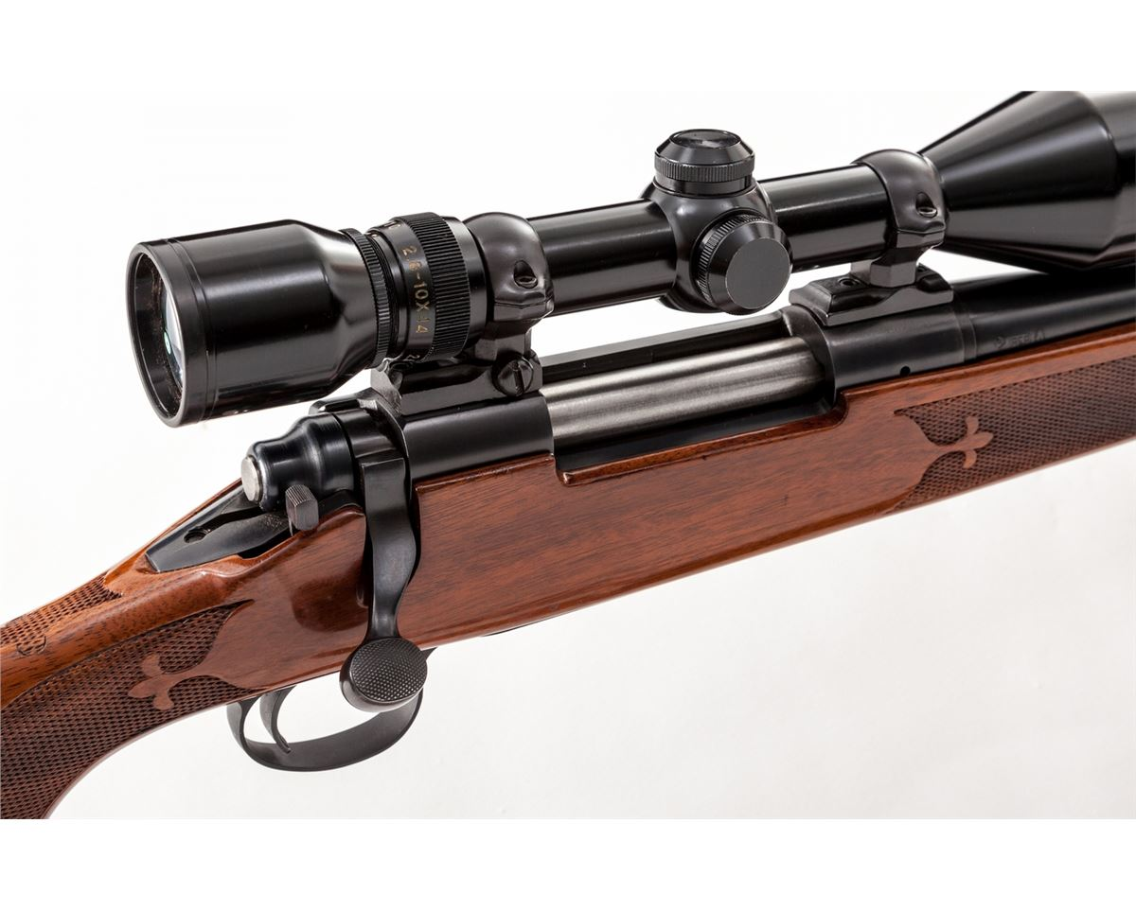
Bolt Action
Notes:
The bolt action rifle is probably the most popular choice among deer hunters. It operates like opening and closing a door bolt. They hold multiple cartridges in the magazine.

Slide 11
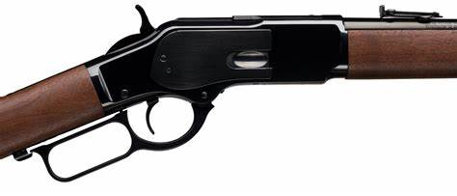
Lever Action
Notes:
The lever action is another popular choice. You can find these in more modern variations that are chambered for more powerful cartridges like the 30-06 and you can also find traditional rifles that are chambered for lower pressure cartridges like the .30-30. In the more traditional calibers, the effective range is generally less than that of the more powerful cartridges chambered in bolt action rifles. This makes the lever action a favorite for hunters hunting in thick cover where they won’t need to take long shots.

Slide 12
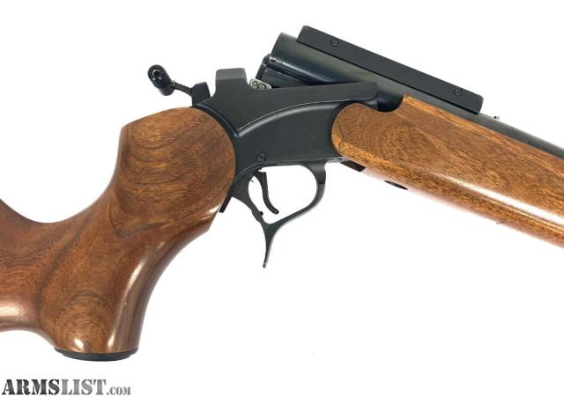
Hinge Action
Notes:
The last action you have to consider is the single shot or hinge action. Like the name implies, these rifles only hold one shot. These rifles tend to be lighter than bolt action or lever action rifles. They are also a great choice for adults mentoring new hunters, because they break open to easily show an unloaded gun.

Slide 13
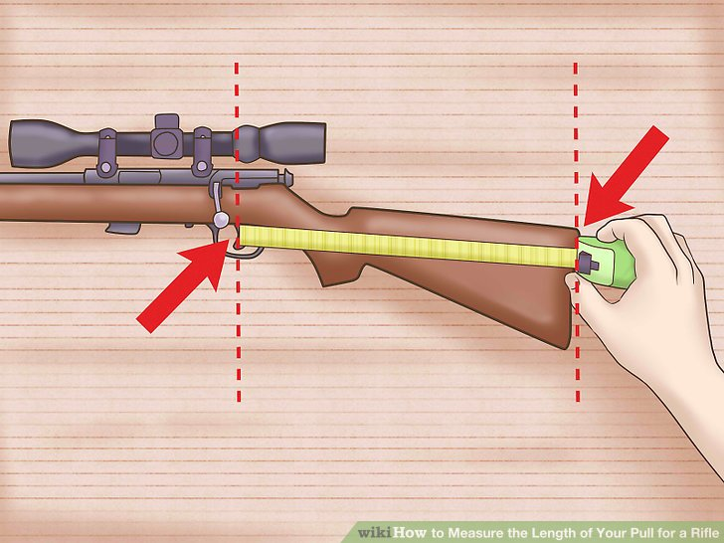
Rifle Fit
Stock Length
Notes:
When choosing a rifle to hunt with, you need to make sure it is a good fit. A rifle that does not fit correctly will be uncomfortable to shoot and it can also make shooting unsafe. If the stock is too long or too short, it will be hard to shoulder the gun properly.
When evaluating the fit of a rifle, make sure to keep in mind that during rifle season, you will likely be wearing layers and a jacket. Thick layers an change the way a gun shoulders.

Slide 14
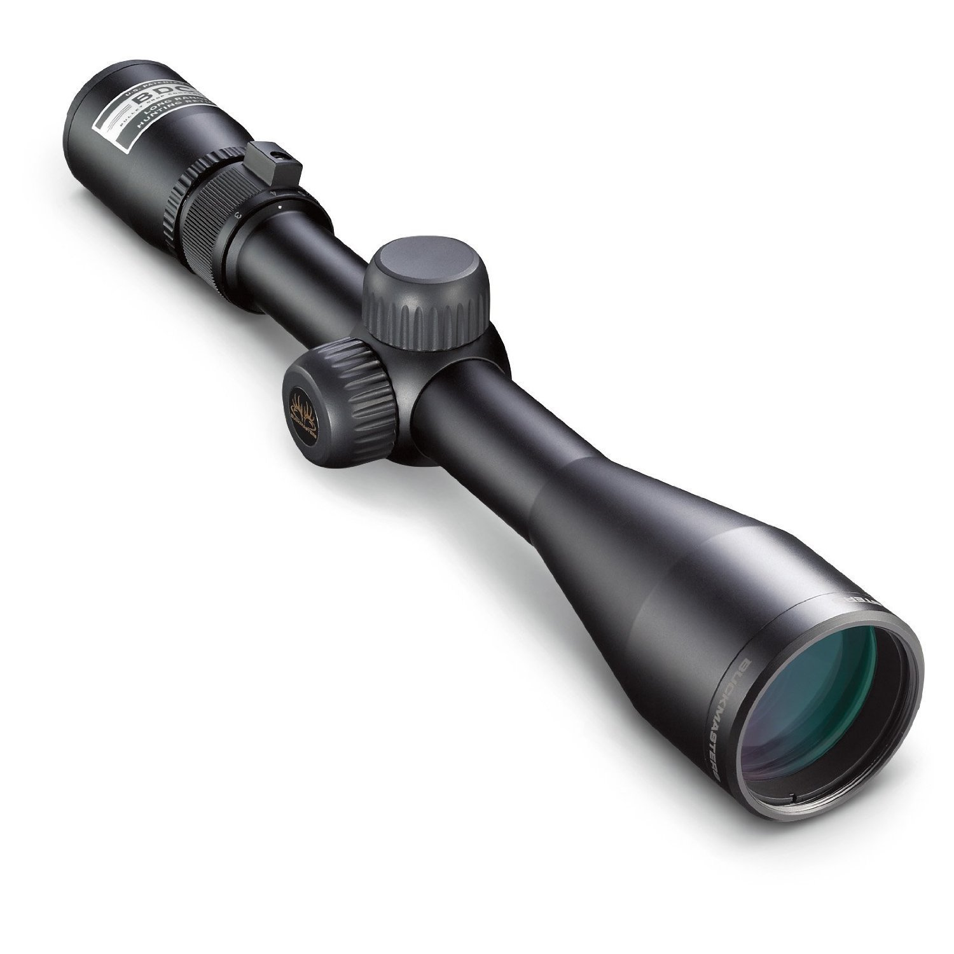
Optics
Notes:
When you are rifle hunting, odds are, a lot of your shots are going to be further away. You are going to want to have a scope mounted on your rifle. There are MANY options to choose from, and we could probably do an entire presentation just on optic selection, but if you talk to someone at your local sporting good store, they will be able to point you in the right direction based on your needs and budget.

Slide 15
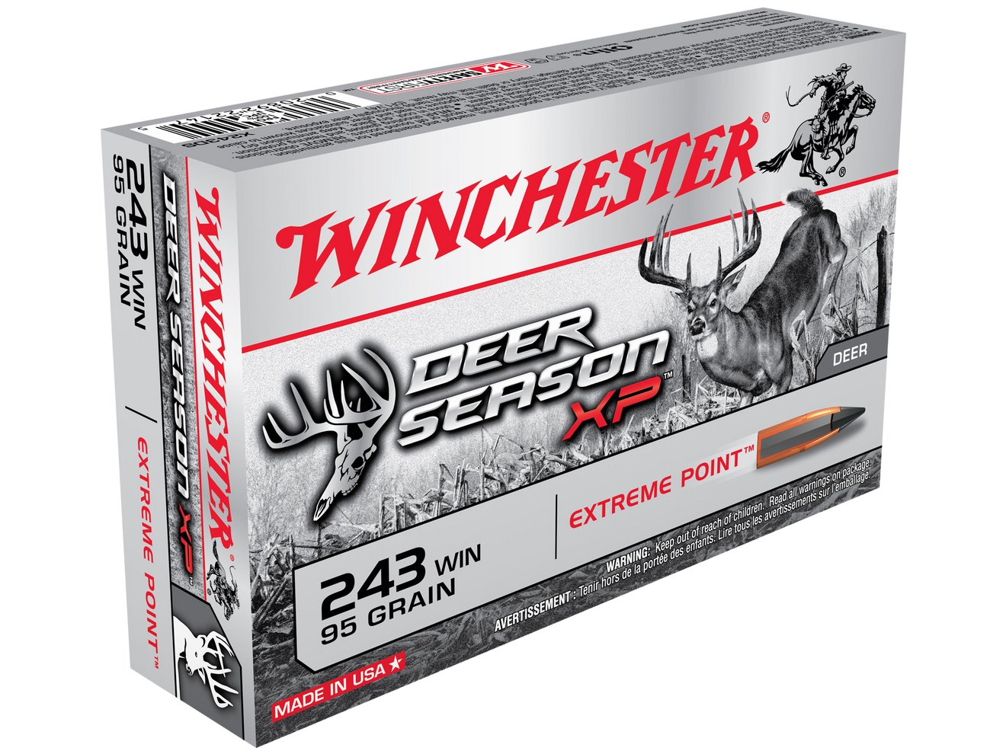
Arms & Ammunition
Notes:
When it is time to find the right ammo, first ensure that you have the right caliber ammo for your gun, and then consider the weight of the bullet. Remember that:
Heavier bullets increase accuracy downrange while maintaining velocity
Lighter bullets will travel faster and therefore flatter
A denser hide (deer) will require a bullet that can create a great deal of penetration in which a heavier bullet should be used
This means:
A lighter bullet generally creates more expansion because of the fast speed it travels at, but offers less penetration
A heavier bullet travels slower creating less violent expansion then a light bullet, this maximizes penetration
Again, this is a topic that we could spend a lot of time discussing, but I would recommend consulting with the salesperson at your local ammunition store or an experienced hunter when selecting ammo for your rifle.

Slide 16
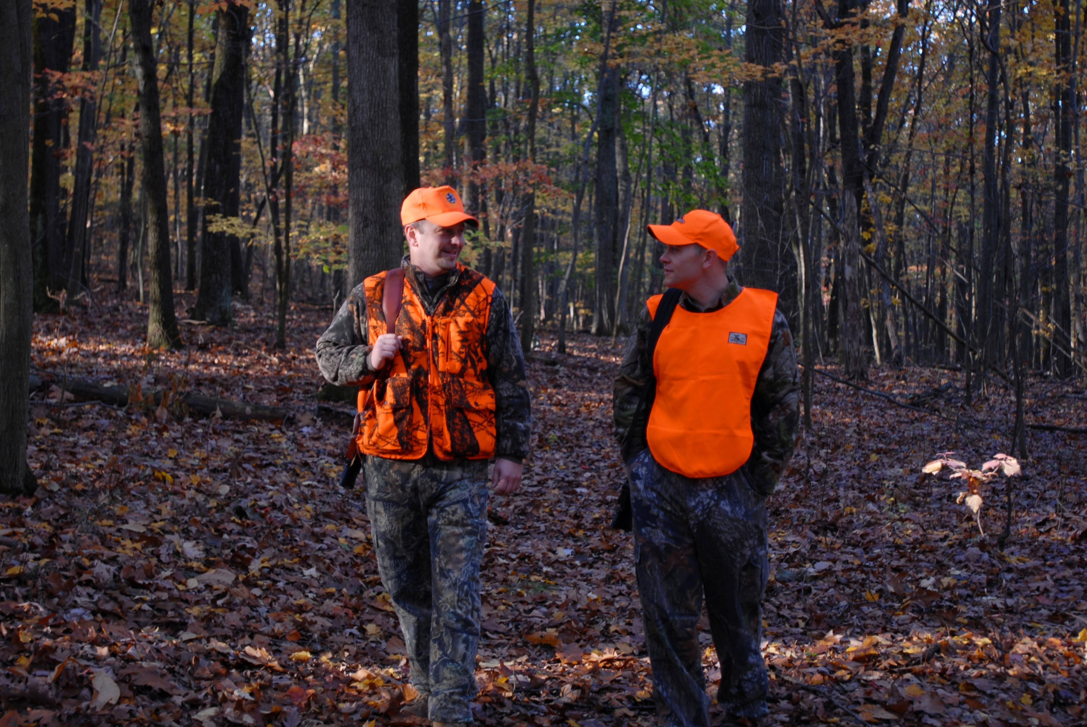
Fluorescent Orange Requirements
A minimum of 250 square inches on head, chest, and back combined, visible 360 degrees
Notes:
When fluorescent orange is required, the full amount of orange required for that season must be worn while moving from one hour prior to the start of legal hunting hours and for one hour past the closing of legal hunting hours.
Camouflage florescent orange may satisfy orange regulations when 250 square inches of safety material is required if the orange content is at least 250 square inches.

Slide 17
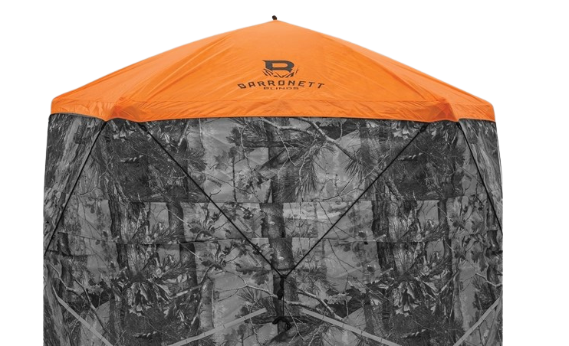
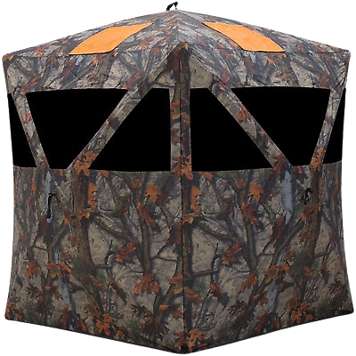
Fluorescent Orange Requirements
Blinds and Enclosed Tree Stands
A minimum of 100 square inches of fluorescent orange material (orange alert band) must be displayed within 15 feet of a blind or enclosed tree stand and visible 360 degrees during the firearms deer season. This is in addition to wearing orange while in the blind.
Notes:
If you are hunting from a blind or an enclosed tree stand, a minimum of 100 square inches of fluorescent orange material (orange alert band) must be displayed within 15 feet of a blind or enclosed tree stand and visible 360 degrees during the firearms deer season. You must also keep your blaze orange one while you are in the blind or tree stand.

Slide 18
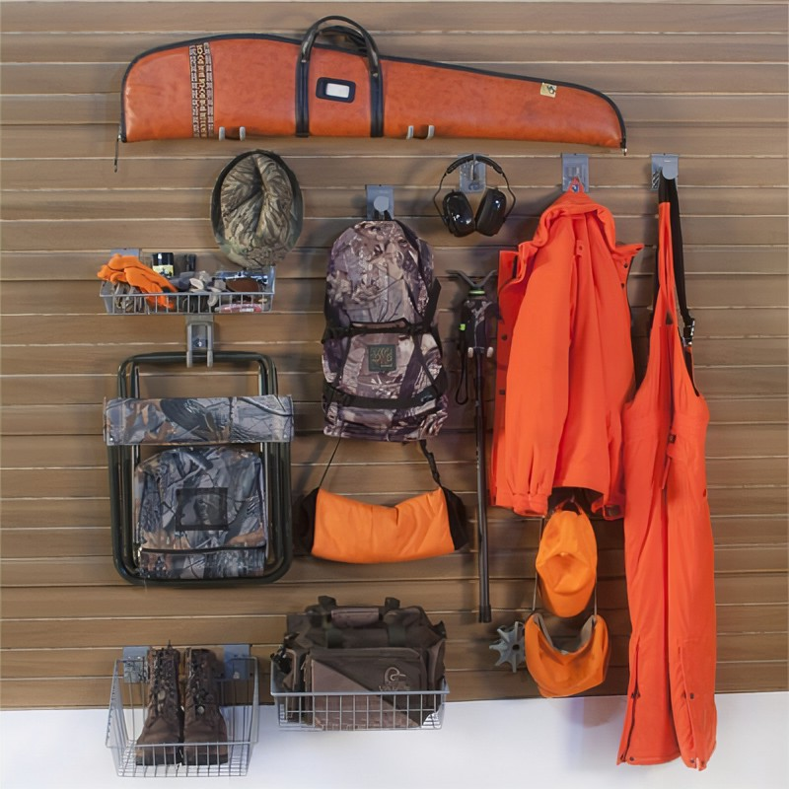
Hunting Gear
Warm Clothing
Waterproof Footwear
Hat
HotHands
Gloves
Knife
Drag rope
Flashlight or headlamp
Backpack or pack for gear
Binoculars
Lens wipe for scope
Scent Killer
Notes:
There are hundreds of items out there that you can use to make your hunt more comfortable and convenient. I just want to go over some of the basics that I would recommend for rifle season. Since it is late November into early December, you are going to want to make sure you have warm clothes and warm waterproof hunting boots.
I recommend dressing in layers so that you are able to adjust accordingly throughout the day.
You will also want warm gloves. HotHands are a great way to keep your hands warm throughout the hunt. They also make large warming packs and foot warmers as well.
You will want a knife just in case you need to field dress a deer, a drag rope or deer cart to get the deer out of the woods, a flashlight, a pack for all your gear, binoculars since sometimes shots in rifle season can be longer, and a lens wipe to keep your scope clean and dry.
You will also want Scent Killer spray.

Slide 19
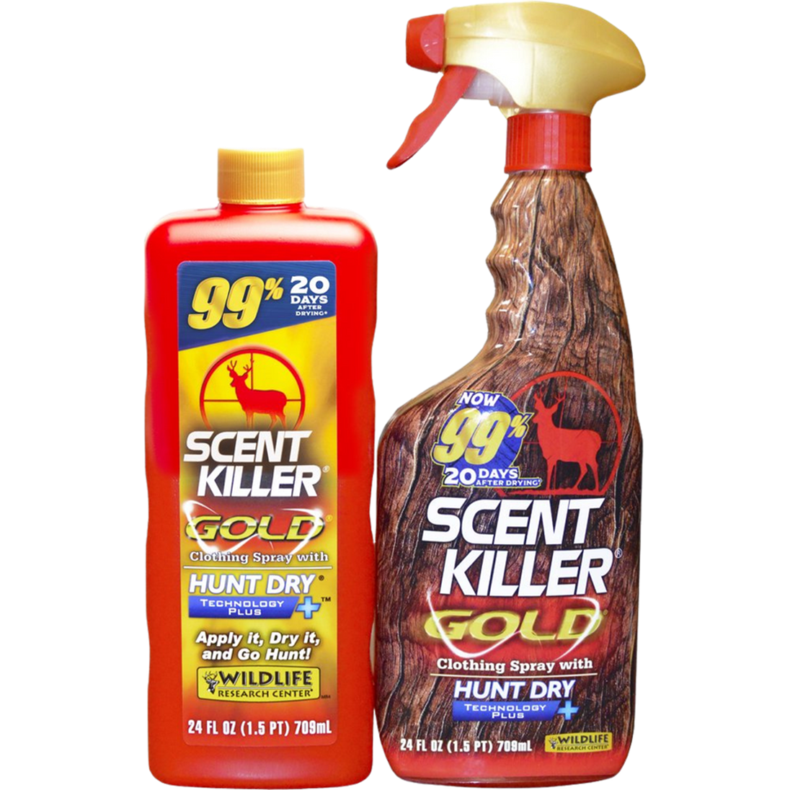
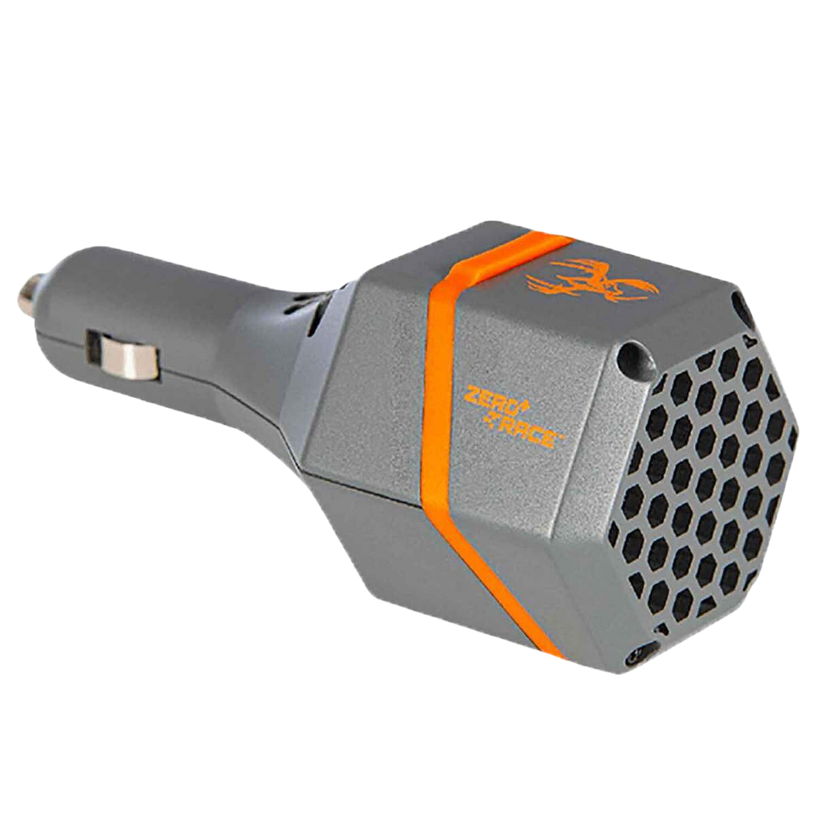
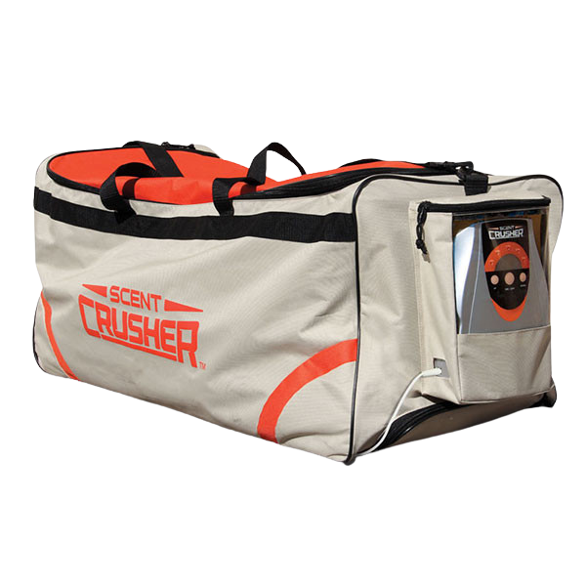
Scent Control
Notes:
When it comes to scent control you also have a lot of different options. The most cost-effective method is using scent eliminating clothing spray. They also make laundry detergent, dryer sheets, shampoo, conditioner, and body wash. They also make ozone scent control bags and lockers like you see on the left here, and ozone vehicle plugs to eliminate any scents from your vehicle.

Slide 20
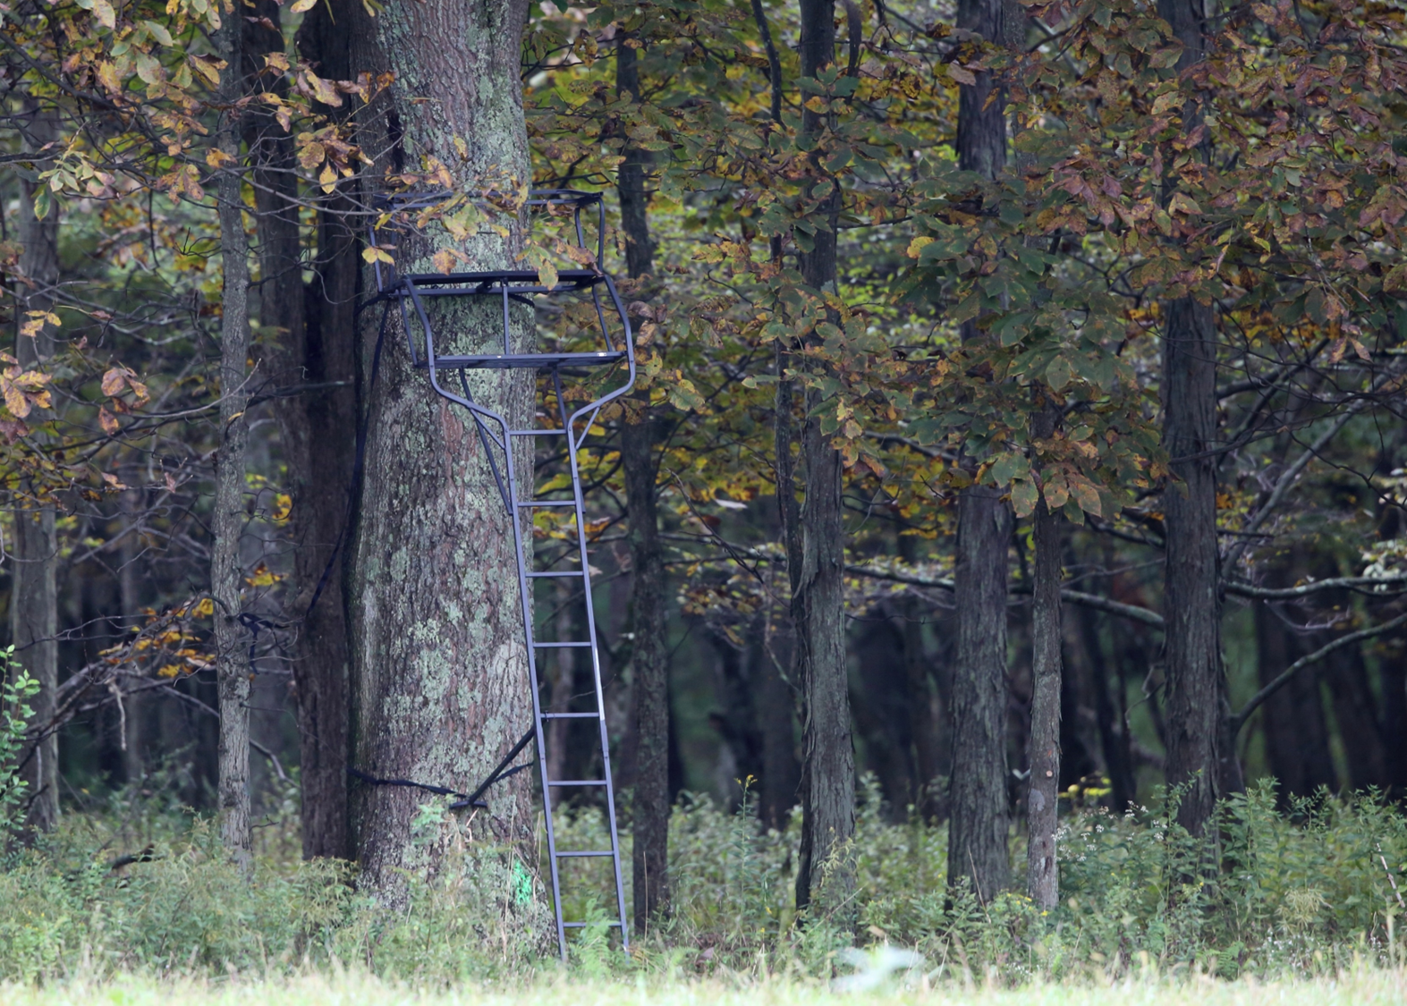
Tree Stands
Ladder Stand
Notes:
When it comes to hunting deer with a firearm, there are a few different tactics you can use. The first tactic we will talk about is hunting from a tree stand.
There are several different types of tree stands you can choose from. This is a ladder stand. These are a popular choice; however, they are heavy and can require 2-3 people to set-up.
Since ladder stands are so heavy, they are good for spots where you know you will be hunting there for the entire season.

Slide 21
Tree Stands
Hang on
Notes:
A hang on stand is another option. The ladder for this stand comes in segments and must be secured to the tree with straps. They are lighter and easier to move. The platform is typically smaller than that of a ladder stand.

Slide 22
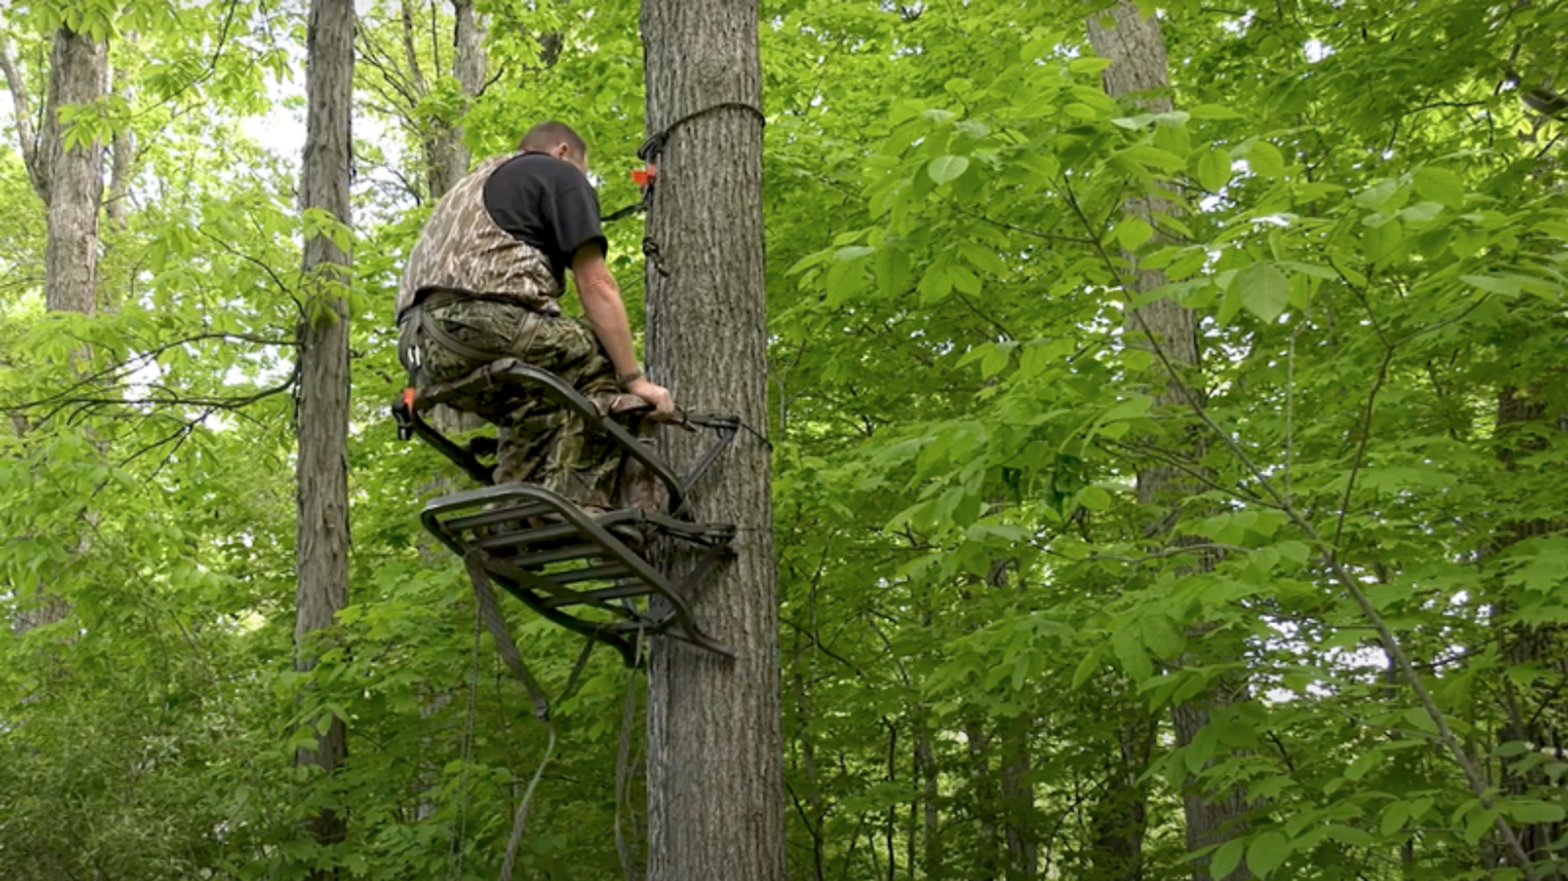
Tree Stands
Climber
Notes:
Climbers are a great option for hunters who prefer to move spots often. A climber consists of two parts that wrap around the tree and are used to move the individual up the base of the tree. It takes a little longer to get in and out of your tree with these because you must climb up and down each time.

Slide 23
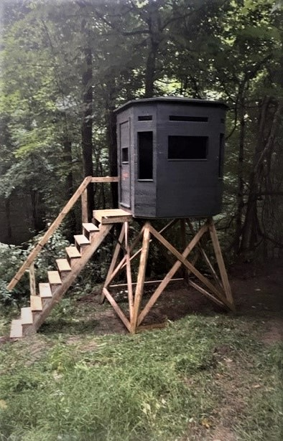
Tree Stands
Enclosed Stands
Notes:
Enclosed stands are also an option. These come in portable options, but they can also be permanently built on private land. These provide a warm, dry hunting experience. We will talk more about the regulations for tree stands and blinds on game lands in a couple slides.
If you are constructing your own stand, we recommend using a platform as opposed as nailing directly into trees. Not only do the nails cause damage to the tree, but they can also come loose as the tree shifts, causing the stand to be unsafe to use.

Slide 24
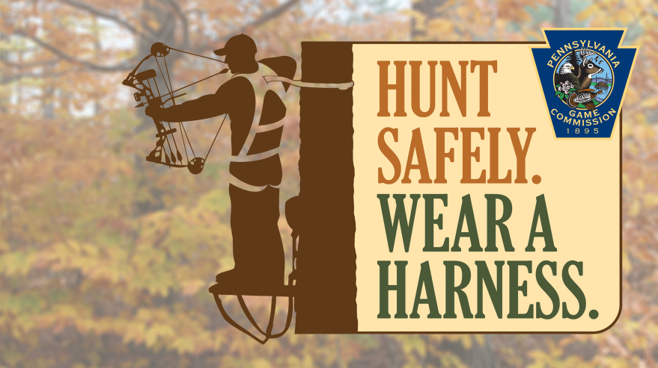
Notes:
When you are hunting from an elevated platform of any type you need to wear a harness. Any time that both feet aren’t on the ground, you should be strapped to the tree. This way, if you were to accidentally slip and fall, you can easily recover yourself.

Slide 25
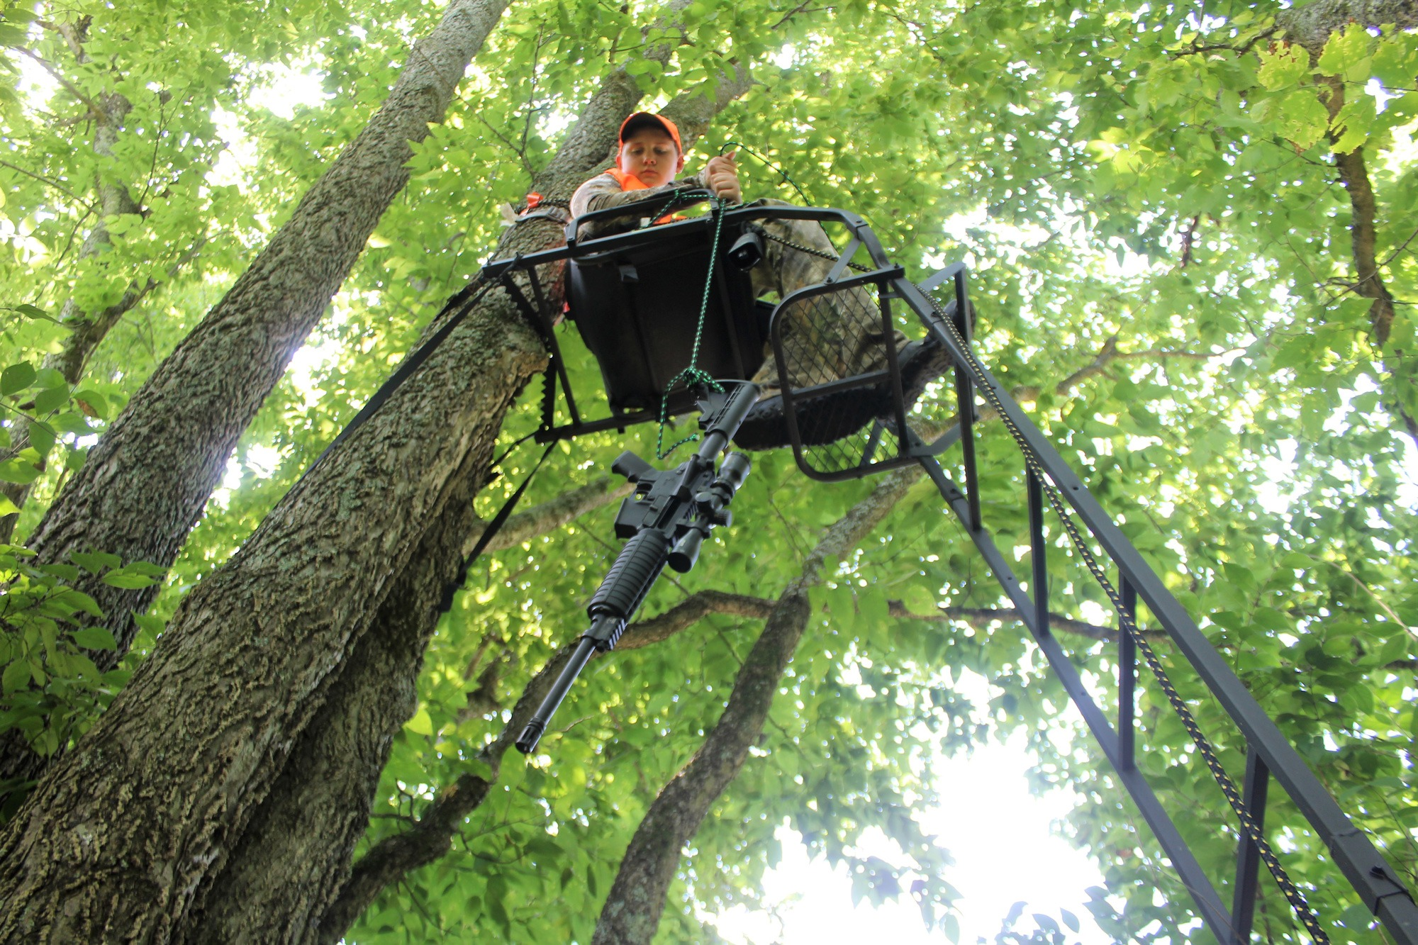
Haul Ropes
Never climb with anything in your hands or on your back
Use a heavy cord to bring up and lower your rifle and gear
Notes:
Regardless of the type tree stand you choose, you will need to make sure you have haul rope to raise and lower your gear. It is never safe to climb wit anything in your hands or on your back. When hoisting your rifle, you want to make sure it is unloaded and the muzzle is pointed towards the ground, away from you.

Slide 26
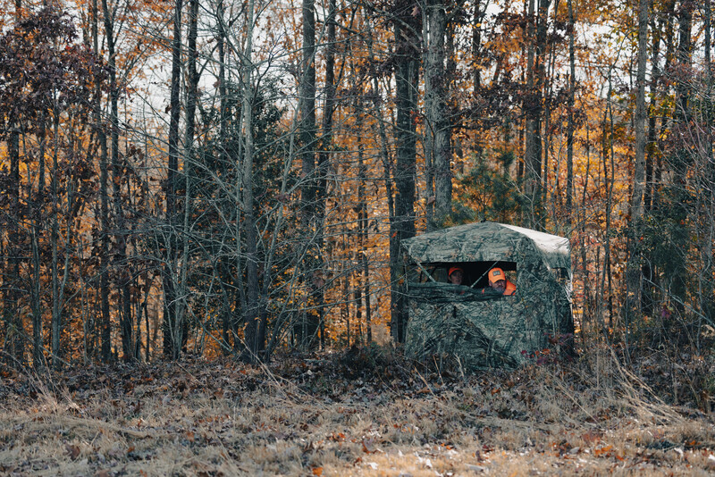
Ground Blinds
Notes:
If you would prefer to hunt on the ground instead, ground blinds are a great option for cover. These are great for areas where you cannot easily get a tree stand in. You will want to blend your blind into the surrounding area to make it appear as natural as possible.

Slide 27
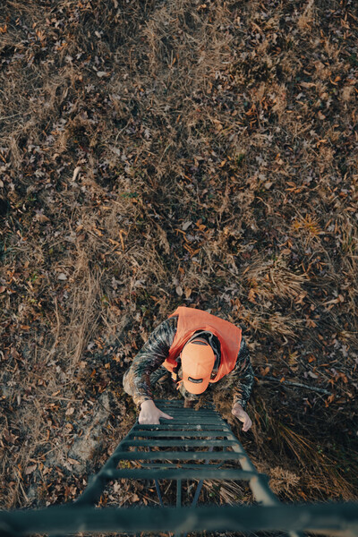
Tree Stand & Blind Regulations
On public lands it is unlawful to:
-Damage any tree by constructing a tree stand or using a portable tree stand or device to climb a tree
- Use or occupy a tree stand, that when constructed, damages a tree.
Notes:
There are some regulations that need to be followed when using a tree stand or blind.
It is unlawful to damage any trees or occupy a tree stand that is causing damage to a tree on public land. This does not apply to landowners constructing stands on their own property, or persons who have received written permission from a landowner to build or use a tree stand.

Slide 28
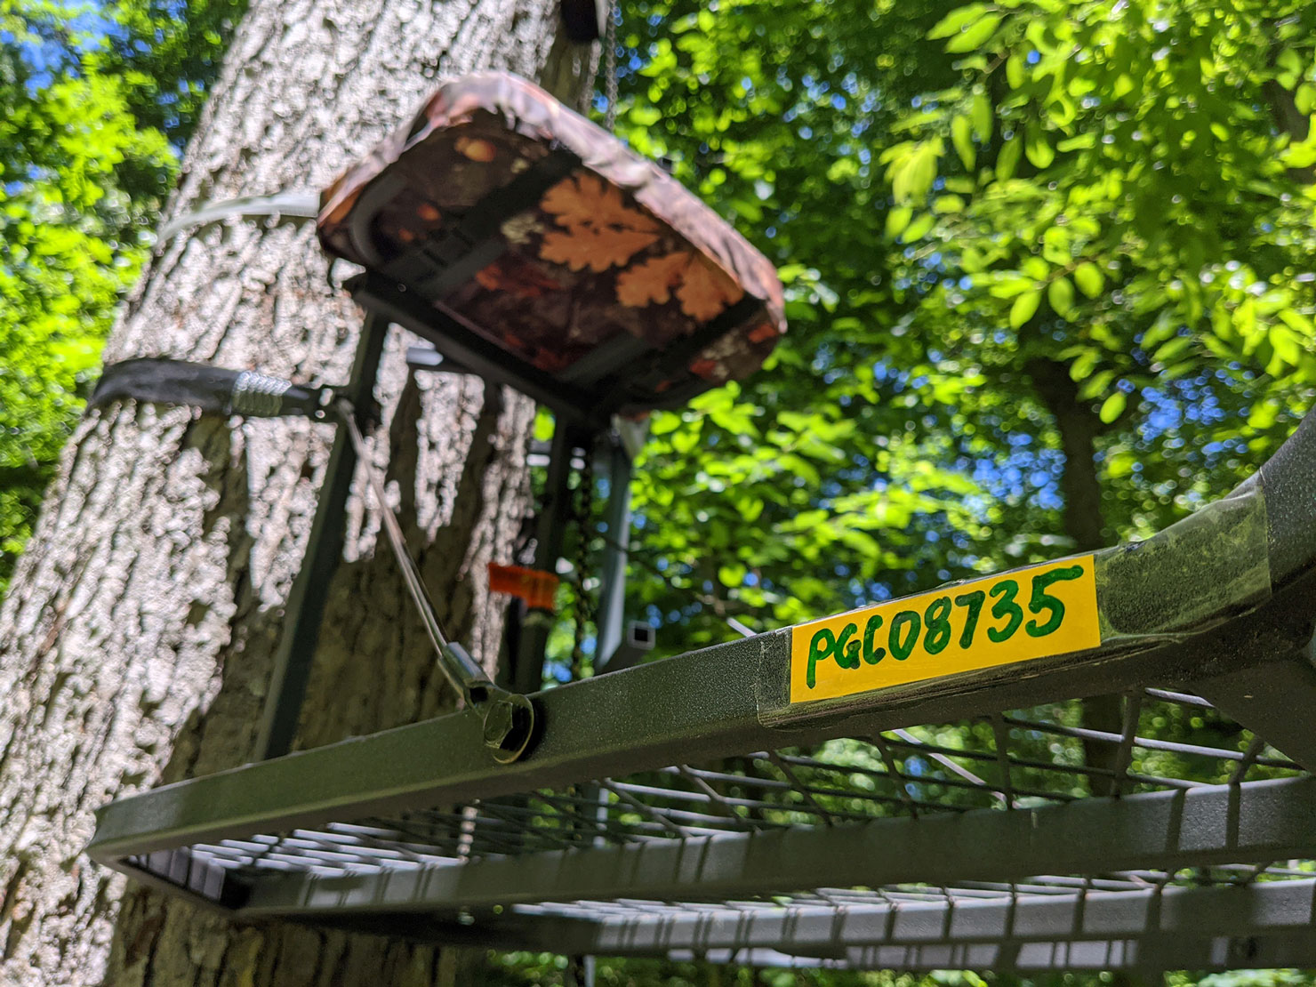
Tree Stand & Blind Regulations
Tree stands and portable hunting blinds on state game lands can be placed out not more than two weeks before the first season and must be removed no later than two weeks after the final deer season in that area.
Placing a tree stand or blind on public land does not reserve that area for that hunter, others may still hunt there.
Tree stands and portable hunting blinds left on state game lands and other Hunter Access properties under PGC management need to be marked with a durable and legible identification tag that includes the owner’s first and last name, home address, or the CID number of the owner.
Notes:
Tree stands and portable hunting blinds on state game lands can be placed out not more than two weeks before the first season and must be removed no later than two weeks after the final deer season in that area.
Placing a tree stand or blind on public land does not reserve that area for that hunter, others may still hunt there.
Tree stands and portable hunting blinds left on state game lands and other Hunter Access properties under PGC management need to be marked with a durable and legible identification tag that includes the owner’s first and last name, home address, or the CID number of the owner.

Slide 29
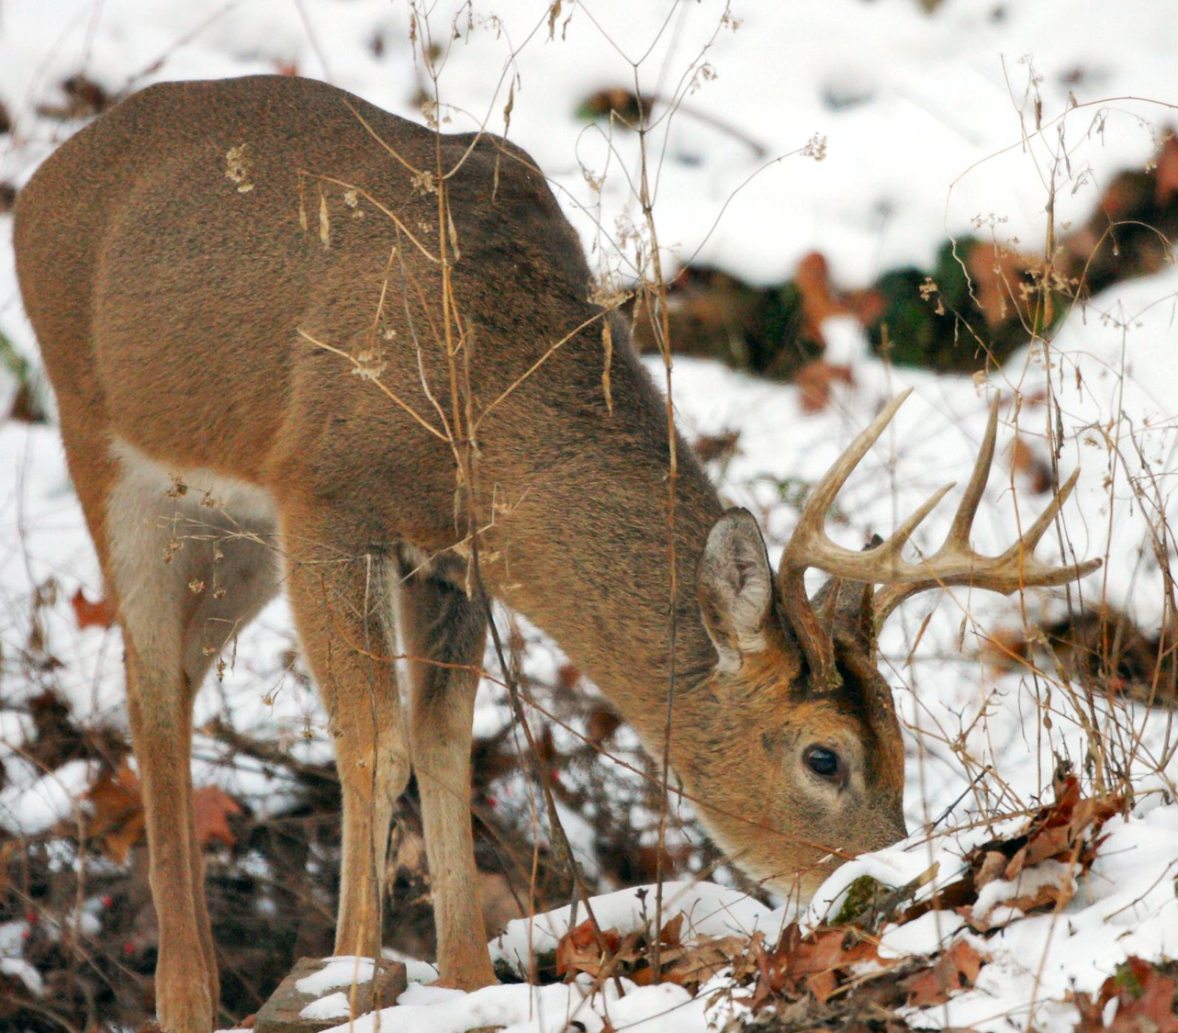
Stand & Blind Placement
Food Sources
Natural Funnels
Notes:
During rifle season, you are going to want to focus on food sources when determining where to place your stand or blind. You want to look for acorns remaining or even crops such as winter wheat or clover.
In areas with little pressure, deer will typically move the most during the early morning hours and late afternoon into the evening. But in areas where there are a lot of hunters in the woods, deer will move all day. Placing your stand in natural funnels, or those areas where deer move through naturally can be good.
Personally, I recommend staying in your stand daylight to dark the first couple days of rifle season. There are usually a lot of hunters moving around, and it gets the deer up and moving more than usual. I have found that lunch time, when other hunters are going in for a break, can be the best time to harvest a buck if you are still in your stand.

Slide 30
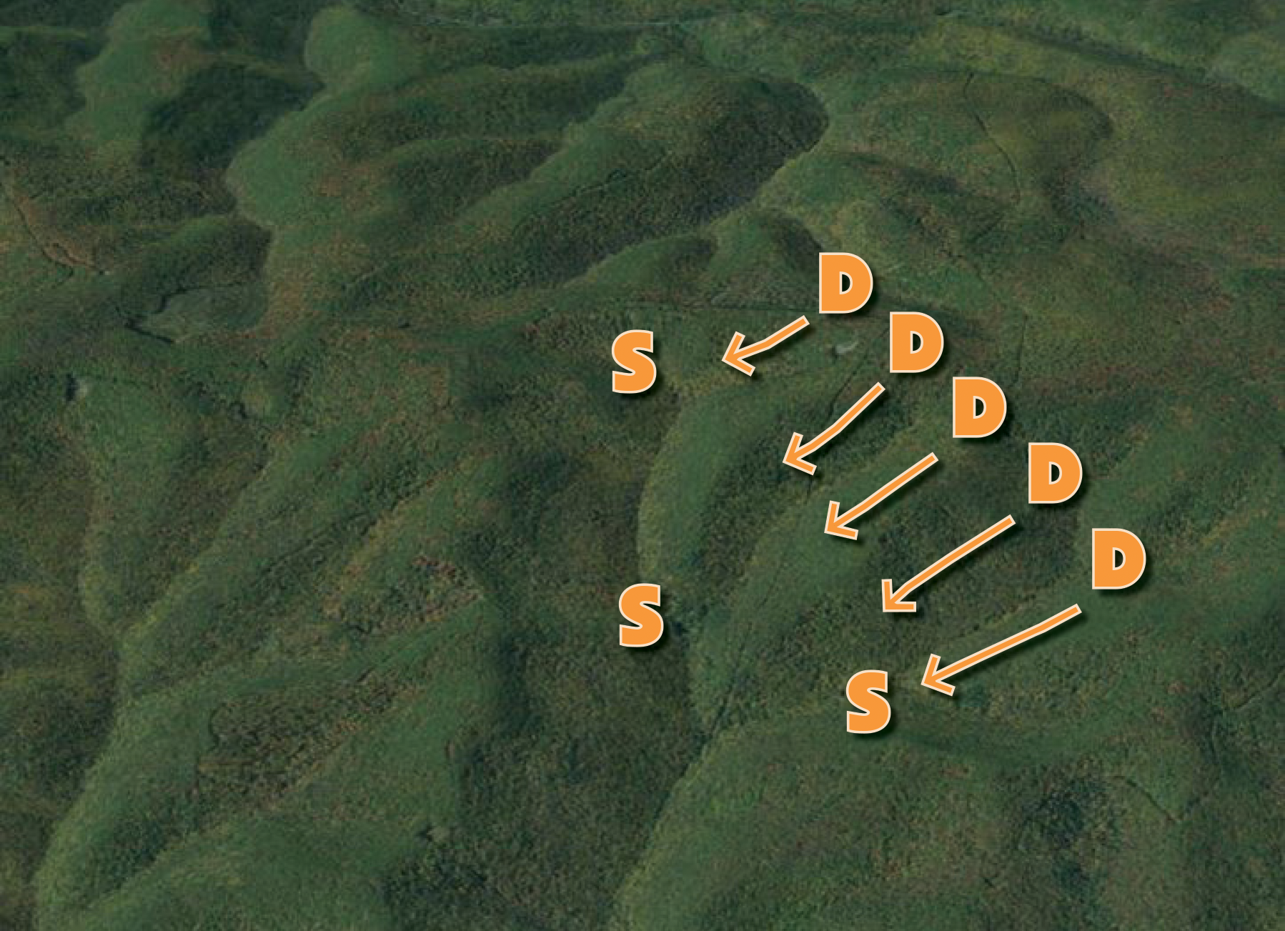
Drives
Drivers walk through the woods and push game to watchers
No more than 25 hunters
Must be well coordinated with safety in mind
Notes:
Another option you have is driving the deer. For those who might not know, driving means using “drivers” or hunters walking through the woods to push game to hunters waiting at natural pinch points on the other side.
Drives are a tradition here in Pennsylvania, but they can also be very dangerous if they are not performed safely.
If you are driving you want to plan it out well. Be sure drive members know where to be and that they are aware of where the watchers are. Also make sure watchers stay in their assigned place. All members of the drive should communicate with one another. Radios are a great way to do this.
Make sure you think before you shoot. Know your safe zone of fire. Never swing your firearm on game that comes back through the line of drivers.
Take turns and consider conducting drives that limit the taking of game to those designated as watchers.
Make sure you wear at least 250 square inches of blaze orange. More is recommended.
Regulations state that no more than 25 hunters can participate in a drive. It is also illegal to drive game in a Safety Zone without permission.

Slide 31
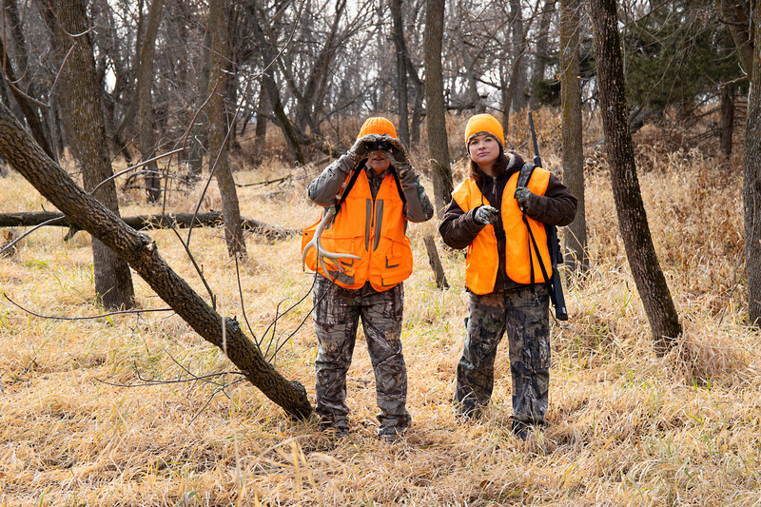
Spot and Stalk
Stay quiet
Be aware of the wind
Dress Lightly
Pay attention to wind
Notes:
If you are looking for a little more advanced tactic when deer hunting, spot and stalk is also an option. It requires you to spot the animal you are hunting from a distance and quietly sneak up on that animal for a clean shot.
When you are trying to spot a deer, you will want to be at a higher elevation than the animal. You can also look for fresh tracks, especially if you have snow cover.
When you are stalking an animal, you want to walk quietly, stopping often to observe your surroundings. You always want to be ready for a shot that may present itself, but you also want to make sure that you clearly identify your target before taking that shot.
You also want to pay close attention to wind direction. Try to stay down wind of the animal to avoid being detected.
Dress lightly. The heavier you dress, the more noise you will make as your approach the animal. You will also get warm quickly moving around.

Slide 32
Safety
Wear more than the required 250 square inches of blaze orange
Read all regulations in the Hunting and Trapping Digest, prior to going afield
Choose safe hunting partners
Pals and Plans
Safety Harness & Haul Rope
Identify your target
Be familiar with your firearm, and keep the safety on at all times
Notes:
I just want to take a minute and recap on some important safety tips to keep in mind, no matter what hunting method you may choose.
You want to consider wearing more than the required 250 square inches of blaze orange. This will not effect how many deer you see. Read all of the regulations in the hunting and trapping digest, prior to going hunting. You want to choose safe hunting partners. Make sure that they know the rules and regulations, and if you see them doing something unsafe, politely correct them.
Make sure that someone knows where you are and what your plan is. That way, if you don’t come out of the woods when you said you would, they know where to look for you. Also, it is a good idea to keep some type of communication evice with you at all times. If you are in an area that does not have cell service, I recommend carrying a radio.
Always wear your safety harness anytime you don’t have both feet on the ground, and always use a haul rope to get your rifle and equipment into the tree stand.
Make sure that you clearly identify your target before taking your shot.
And, make sure that you are comfortable and familiar with your firearm. Always keep the muzzle pointed in a safe direction, and the safety is on at all times until you are ready to take your shot.

Slide 33
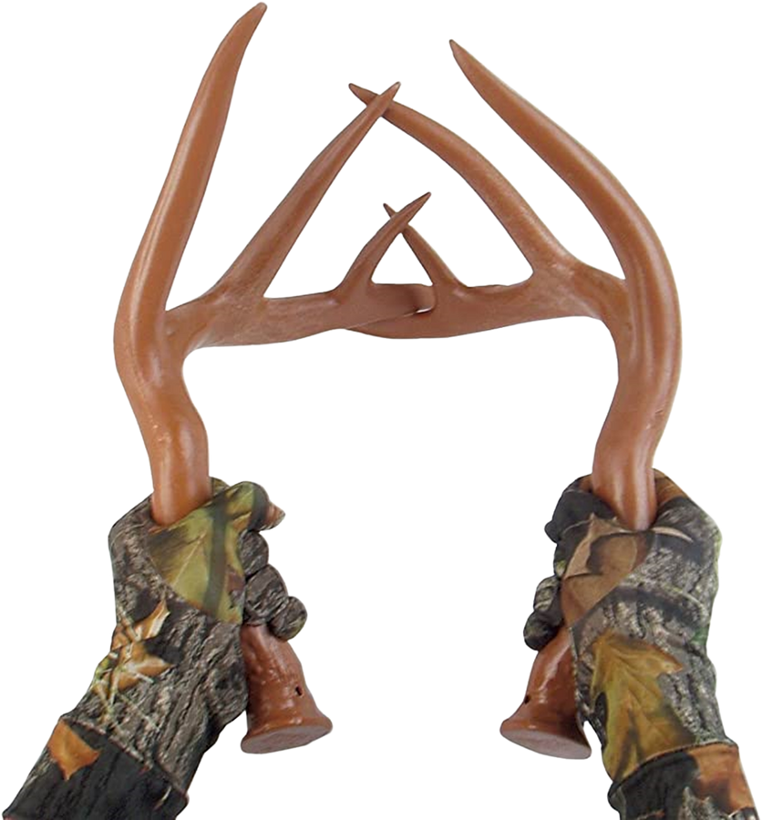
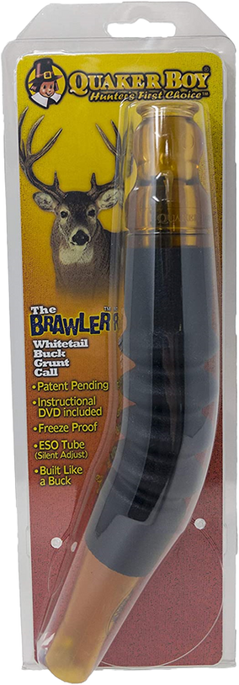
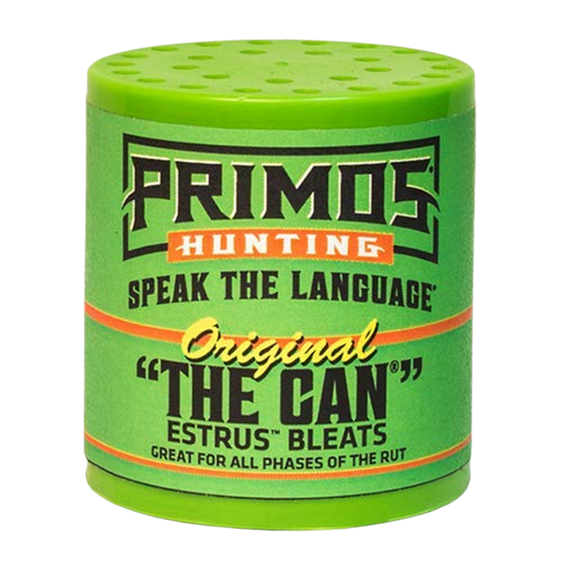
Calls
Grunt Call
Rattling
Bleat Can
Notes:
The rut is usually in the end stages when rifle season comes in in Pennsylvania. Calls typically still work, especially during the early parts of season.
Rattling simulates two bucks fighting. This will often trigger other bucks in the area to come in. A grunt tube simulates the grunt sound that bucks make when they are communicating with each other as a challenge.
The bleat call mimics the sound of a doe that is ready to be bred.

Slide 34
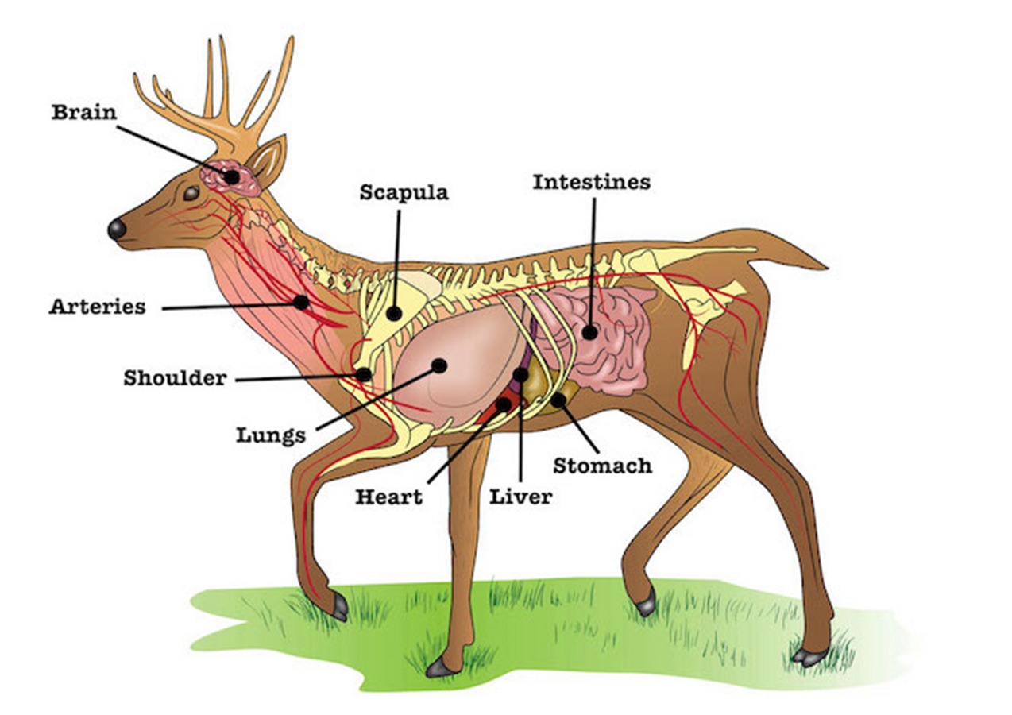
Shot Placement
Notes:
It is very important to know deer anatomy when you are placing your shot. Something to pay attention to is the placement of the front shoulder blade. It is ideal to have the front leg in a forward position when taking your shot to ensure that the vital area is completely exposed. This vital area is comprised of three organs.
The heart, lungs, and liver are the most ideal places to hit the deer.
Brain- Just a side note, most people think that the brain is a vital organ, and while it may be vital, it is never good to try a head shot. A deer's brain is about the size of your fist. If you miss this area, you stand the chance of injuring the deer with a non-fatal hit.

Slide 35
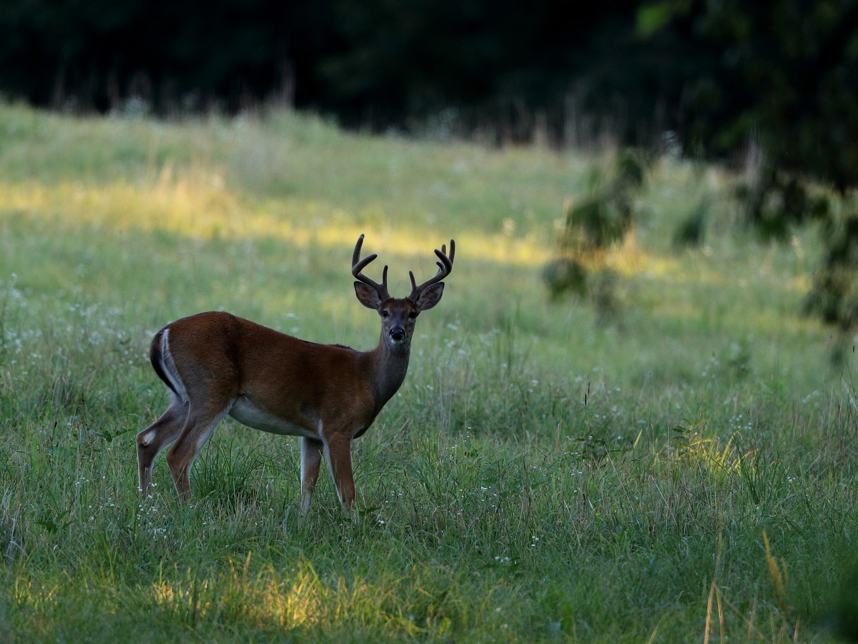
Broadside
Notes:
The broadside angle is one of the best possible positions to shoot a deer in. Your point of aim is right behind the front leg. It is best to take this shot with the front leg in a forward position, as mentioned before. If you hit the front shoulder with a rifle, the deer will still likely die, however the bone will fragment into the meat.

Slide 36
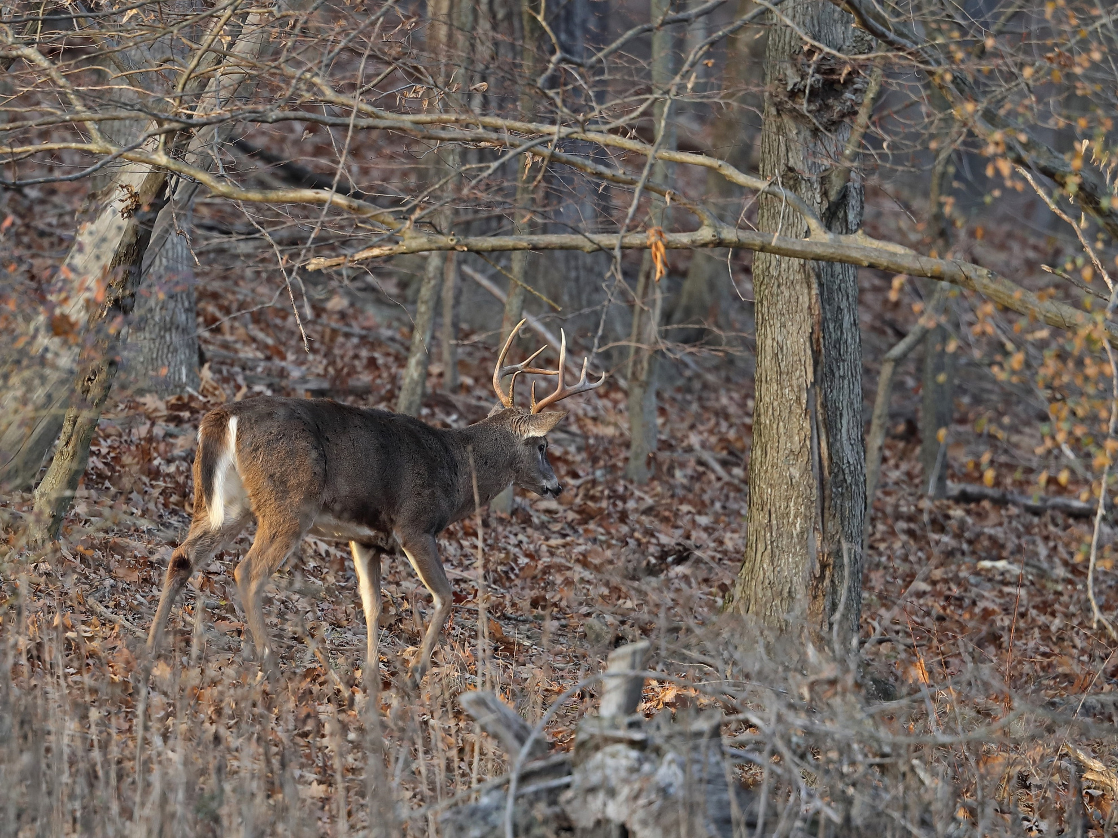
Quartering Away
Notes:
Quartering away is the second best shot angle. This is a great angle to hit the lungs and heart, as long as the deer is not quartering away at too much of an angle. This position opens up the vitals.

Slide 37
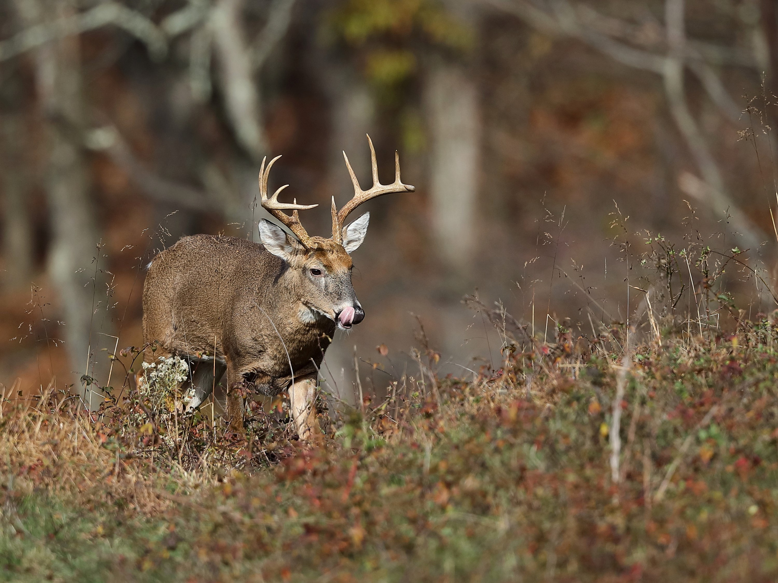
Quartering Toward
Notes:
When a deer is quartering towards you, their front shoulder is exposed and the vital area is partially covered by bone and muscle. Chances of penetrating the vital area are very small. You should never attempt to take a shot at a deer that is quartering towards you.

Slide 38
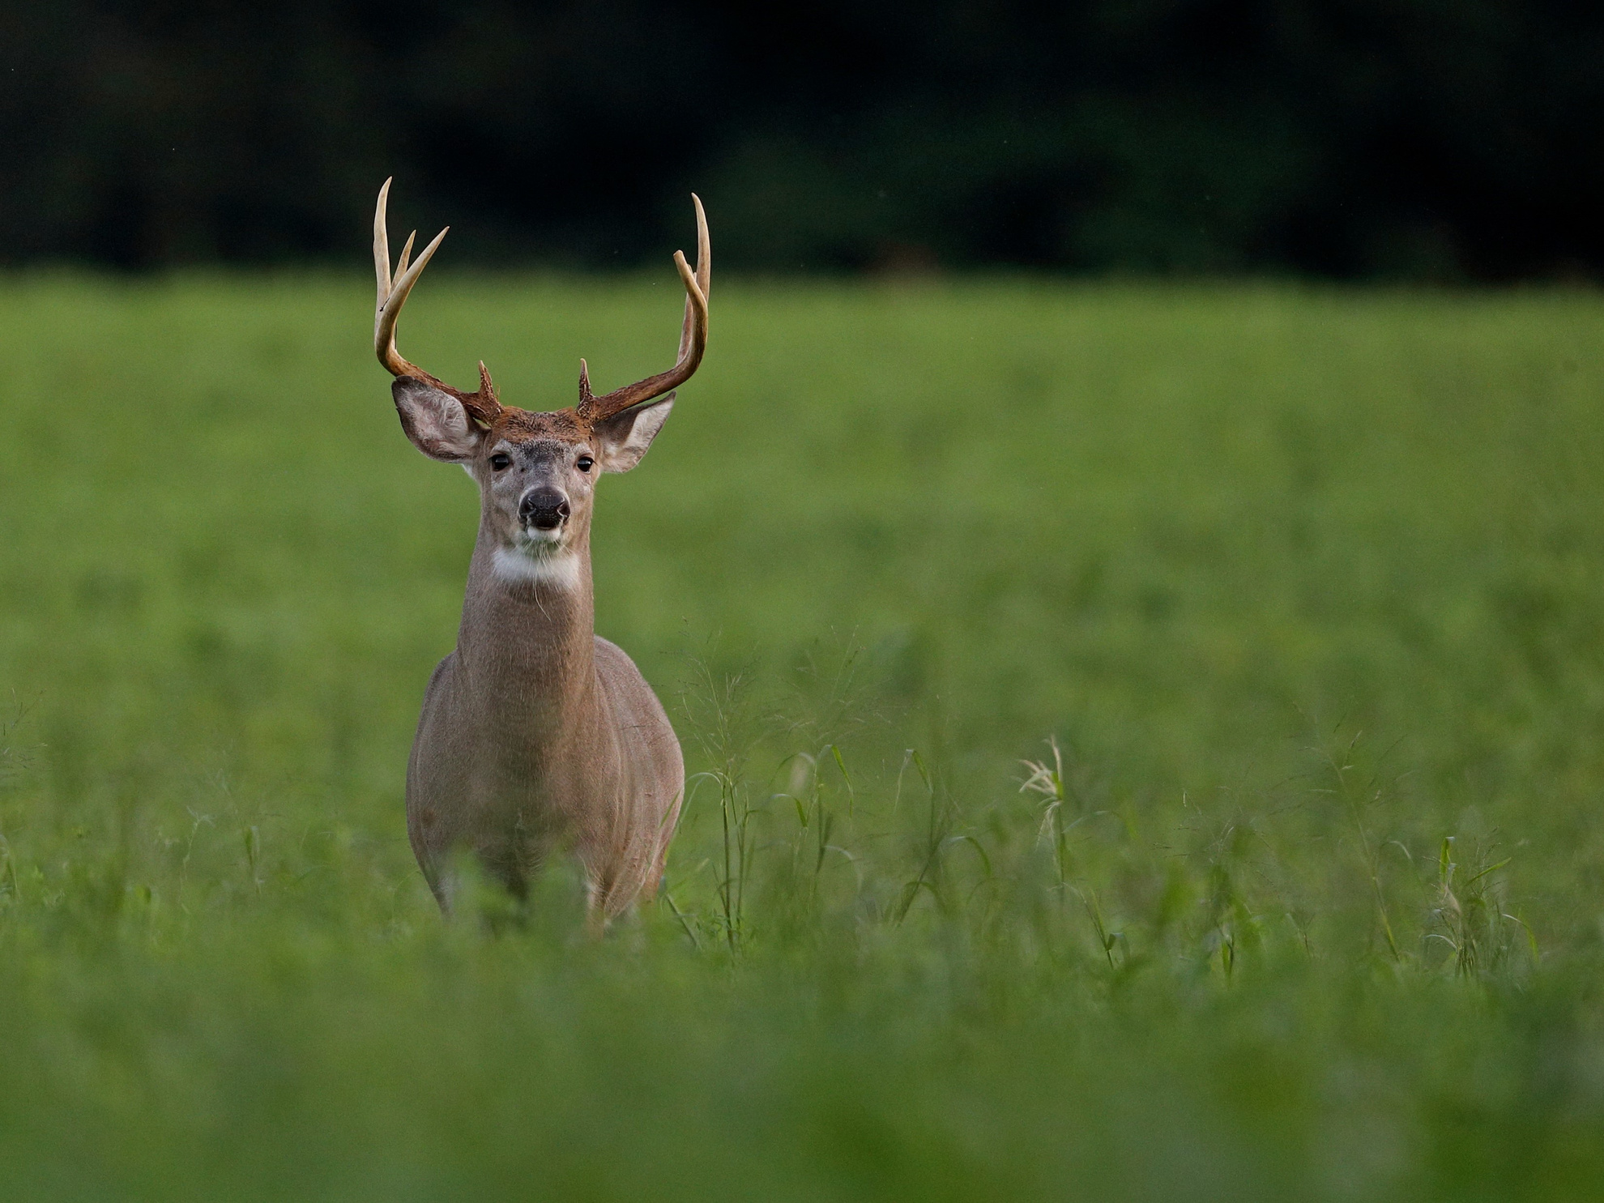
Straight On
Notes:
You should avoid taking a shot at a deer that is walking straight towards you. There is a lot of room for error with this shot and it often leads to a wounded deer that is not recovered.

Slide 39
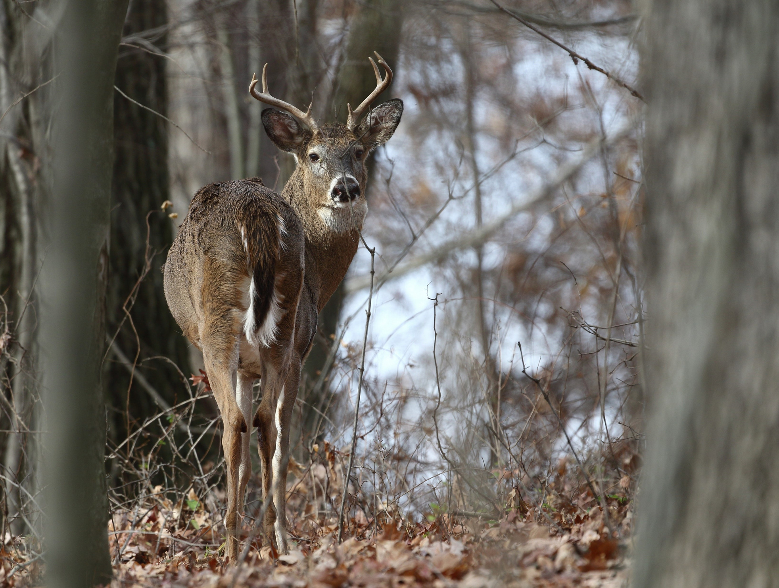
Straight Away
Notes:
Never take a shot at a deer that is walking away from you. This will likely result in a bad hit

Slide 40
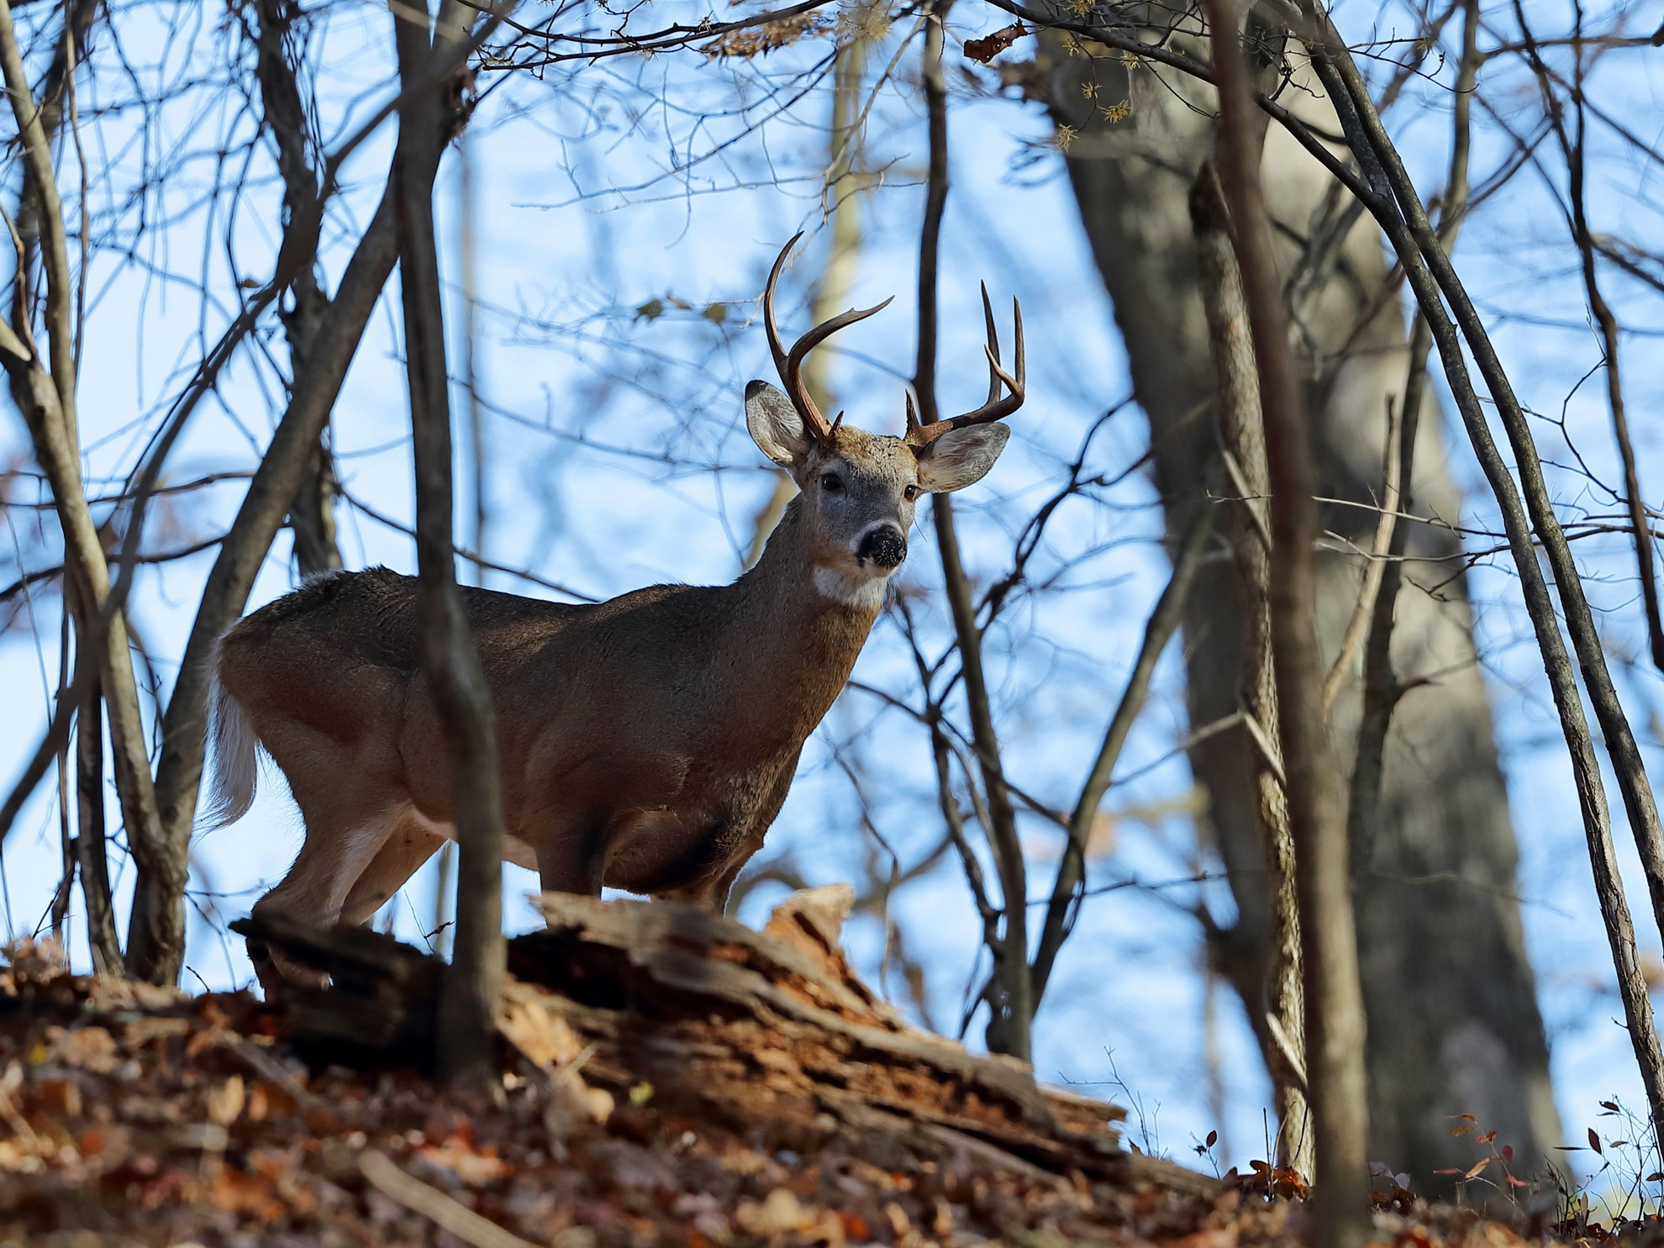
No Backstop
Notes:
It is never safe to take a shot when you are unsure what is beyond your target. Bullets can travel a long ways. If the deer is on the horizon and you can’t directly see what is behind it, do not take the shot.

Slide 41
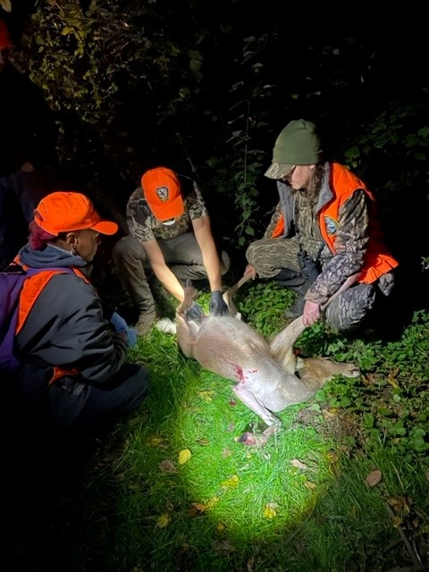
Field Dressing
Tag your harvest before moving
Remember to notch the tag
Field dress
Notes:
The first thing you need to do when you recover your harvest is tag the animal. You must detach the harvest tag from your license, fill it out using a ballpoint pen and securely attach it to the deer’s ear. The new green harvest tags have boxes with months and date numbers on the back of them. You must cut them with the correct month and day of harvest.
This tag must be attached before the carcass is moved.
Once tagged, you want to get the animal field dressed as soon as possible. I have attached the link to Huntered.com. They have great step-by-step directions for field dressing an animal. These Field Dressing Deer Techniques are courtesy of Penn State University-College of Agriculture Science-Agriculture Research and Cooperative Extension.
They use a 12-step process. This isn't the end all be all way to do it, there are several variations but this is a good starting point.

Slide 42
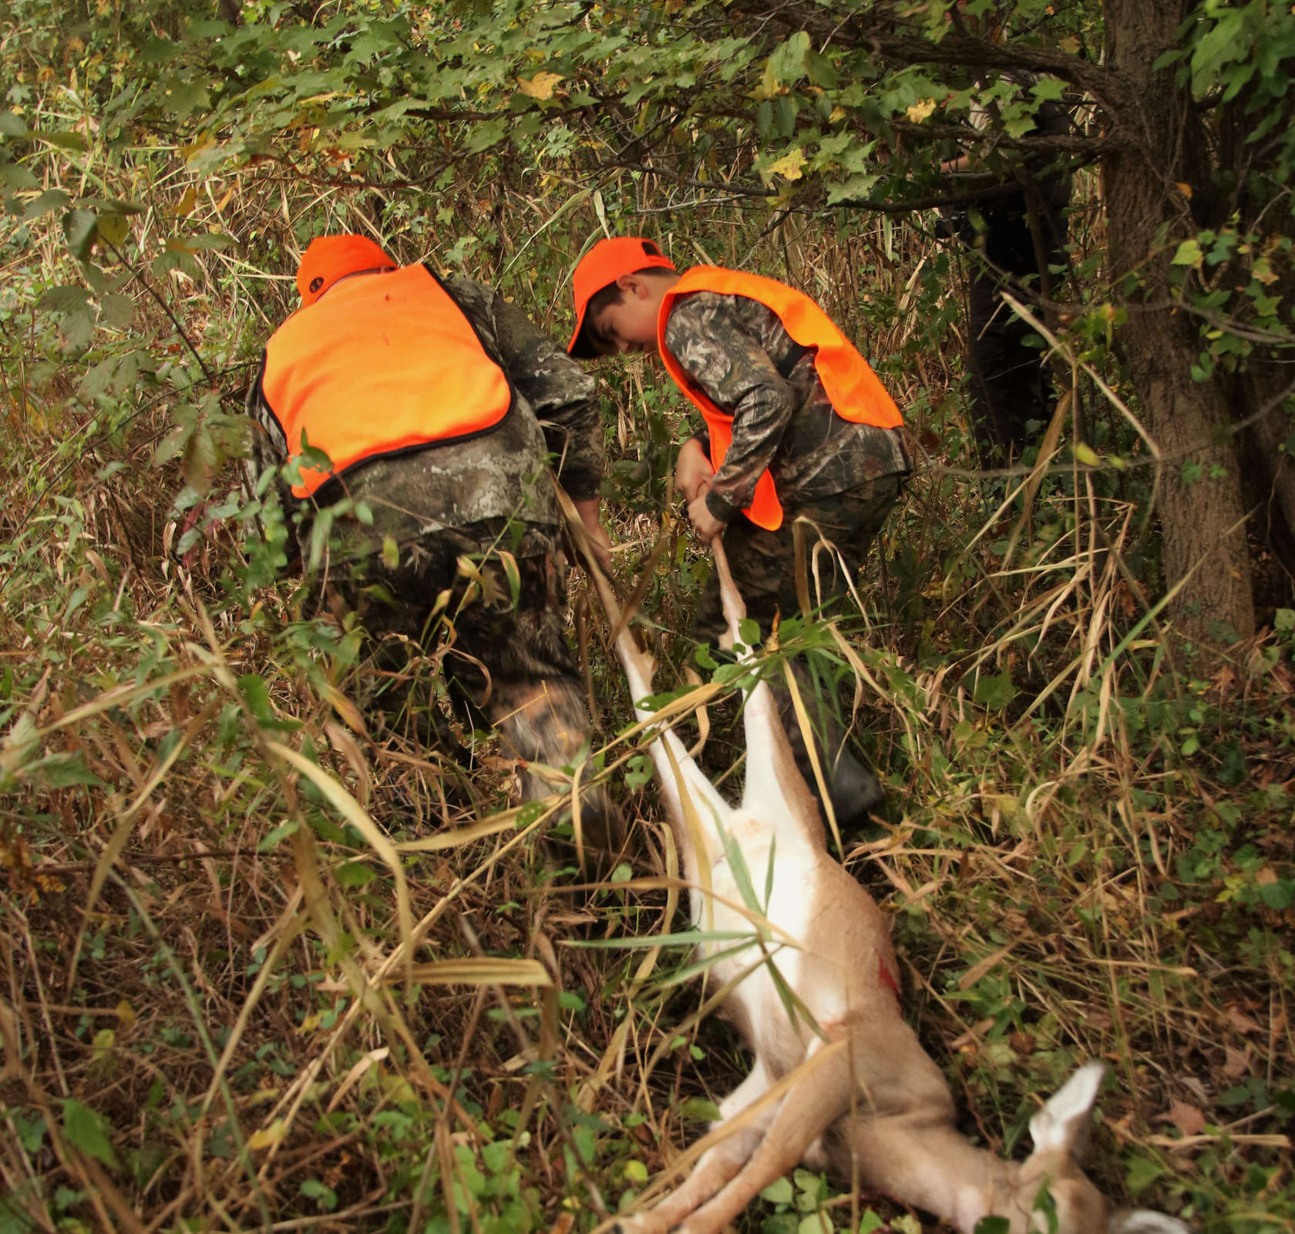
Recovery
Buddy System
Drag Ropes
Carts/Sleds
Notes:
And once you have that animal recovered, keep in mind that it needs to be reported to the Game Commission within 10 days. You can do this by sending in a postage page report that is found in the Hunting and Trapping Digest, or you can make the report online or over the phone. For more information on how to do this, see page 22 of the Digest.

Slide 43
Notes:
If you harvest a deer and don’t want or need the meat, you are able to donate it to Hunters Sharing the Harvest for no cost. To find an approved deer processor, Visit the Hunters Sharing the Harvest website, www.sharedeer.org, or call 866-474-2141 for more information.

Slide 44
Field Dressing & Processing Videos
Field Dressing Your Deer
Processing Your Deer

