Slide 1


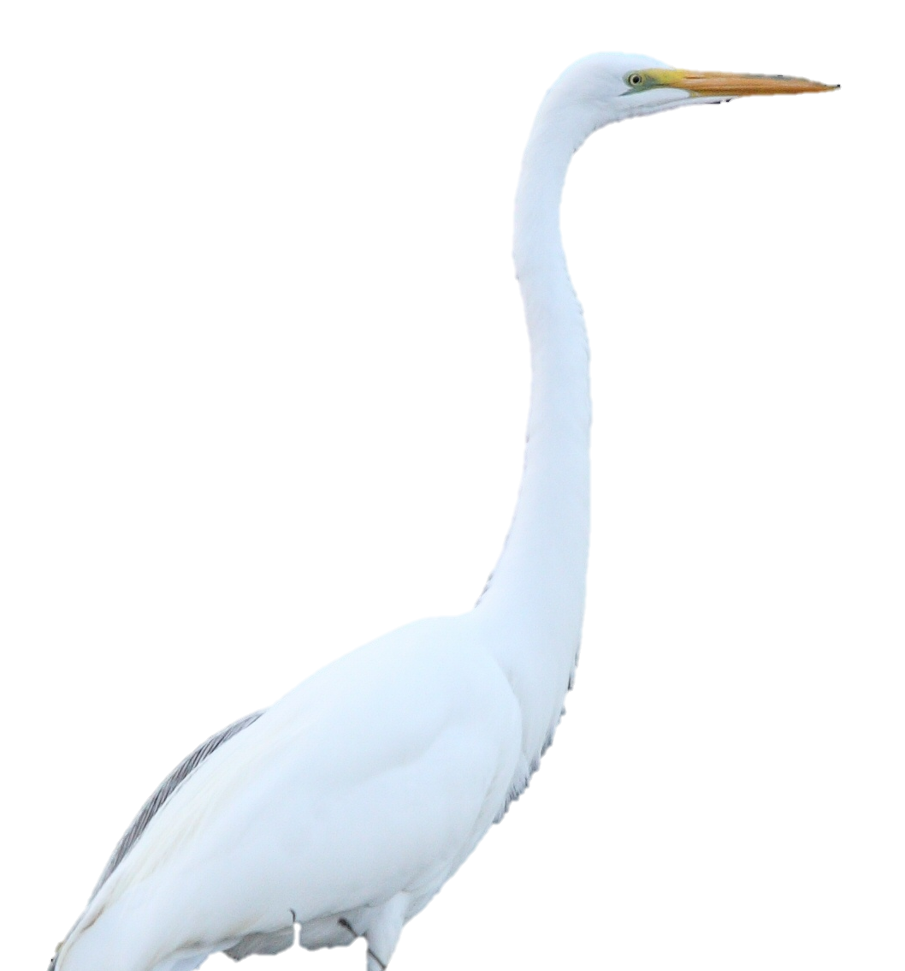
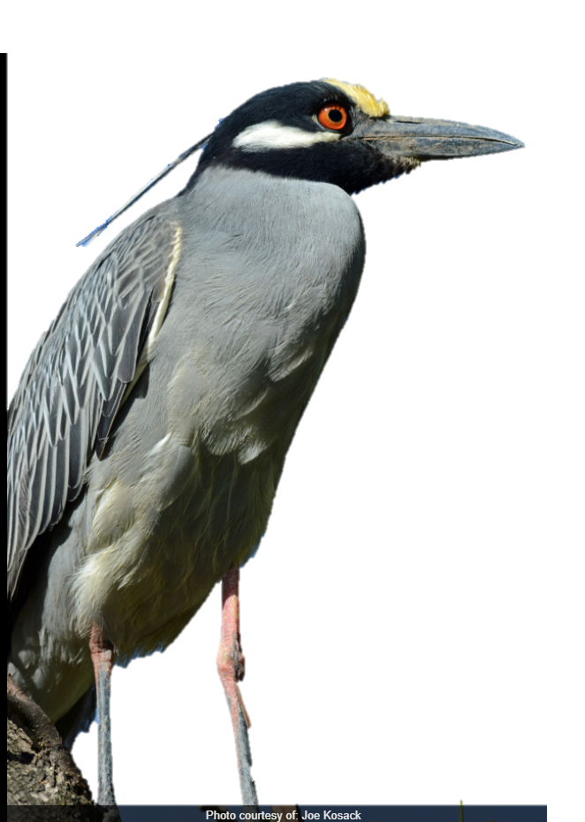
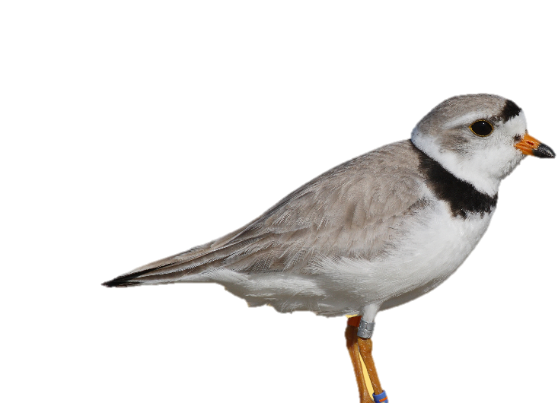
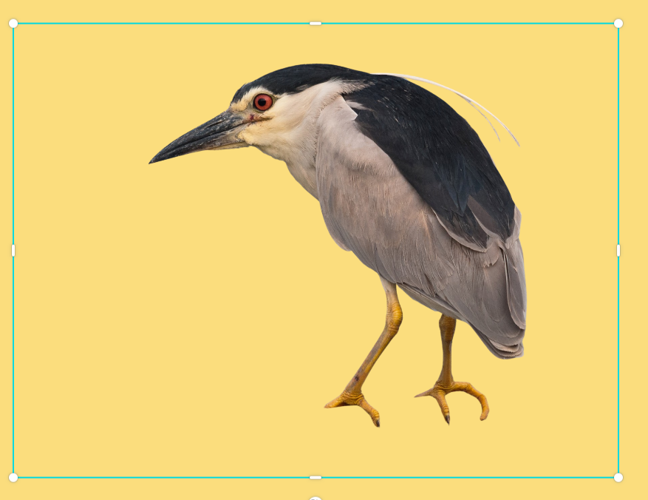
Wading & Shorebirds of Pennsylvania:
Threatened & Endangered Species
Great egret
Yellow-crowned night-heron
Piping plover
Black-crowned
night-heron
Notes:
Hi, my name is ________ and I am a __________ for the Pennsylvania Game Commission. Today, I’m going to talk to you about some of the threatened and endangered wading and shorebirds we have here in PA.

Slide 2
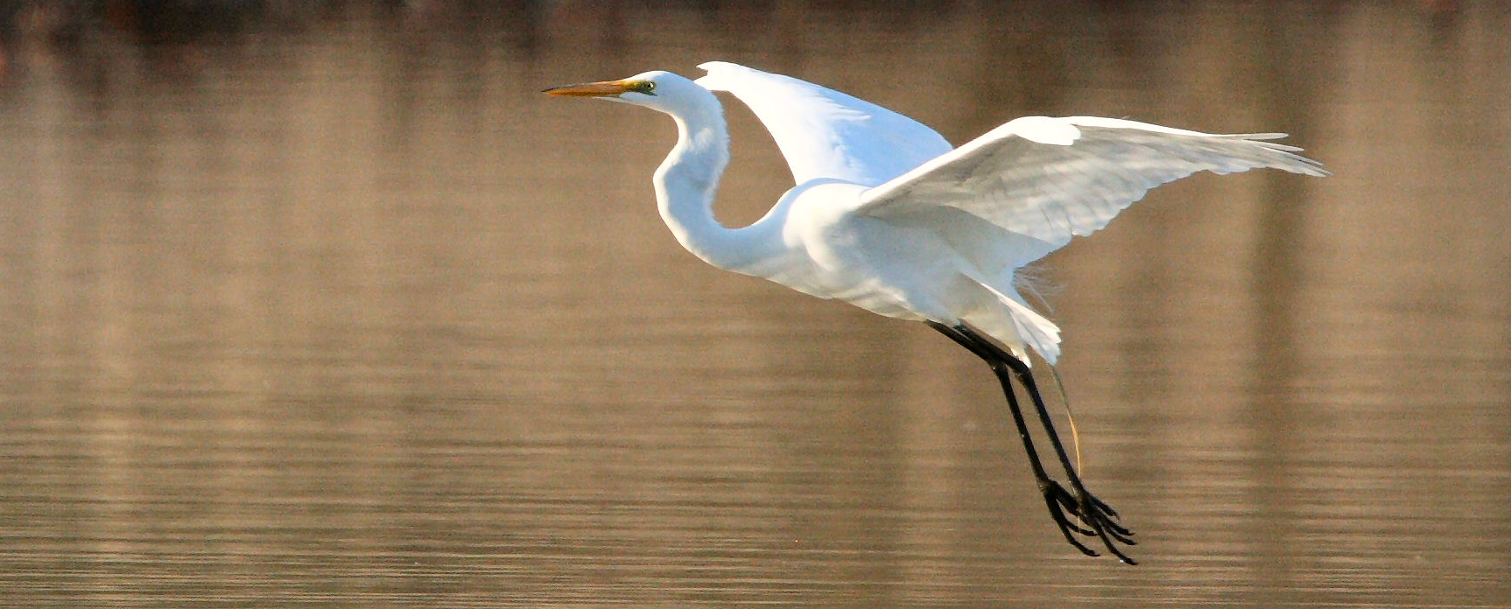
Threatened vs. Endangered
The great egret is just one of many state endangered birds in Pennsylvania
Notes:
First, let’s talk about what it means to be threatened or endangered. Under the Endangered Species Act, species may be listed as either threatened or endangered. Endangered means a species is in danger of extinction throughout all or a significant portion of its range (where it lives). Threatened species are those likely to become endangered within the foreseeable future. Once a species is no longer present on the planet, the species is said to be extinct.

Slide 3
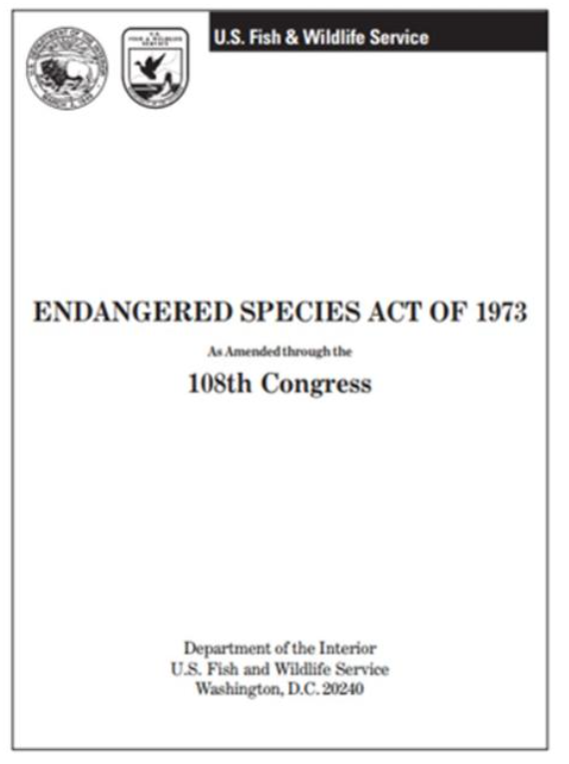


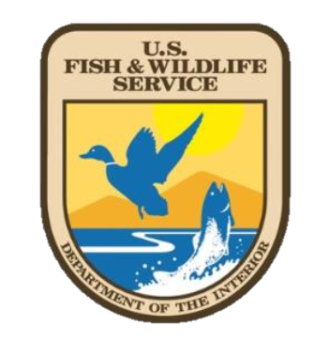
Federal Protections
Notes:
Congress passed the Endangered Species Act in 1973. This legislation allows for the identification, protection, and recovery of species of greatest conservation need, such as threatened and endangered birds, mammals, fish, among others. It is based on three key elements: 1) listing species as threatened or endangered; 2) designating habitat essential for their survival and recovery; and 3) ultimately restoring healthy populations of the species so they can be removed from the list. The Endangered Species Act is administered by two federal agencies, the United States Fish and Wildlife Service (USFWS) and the National Oceanic and Atmospheric Administration (NOAA). Migratory, rare, and breeding birds can also be protected under the Lacey Act of 1900 and the Migratory Bird Treaty of 1918.

Slide 4
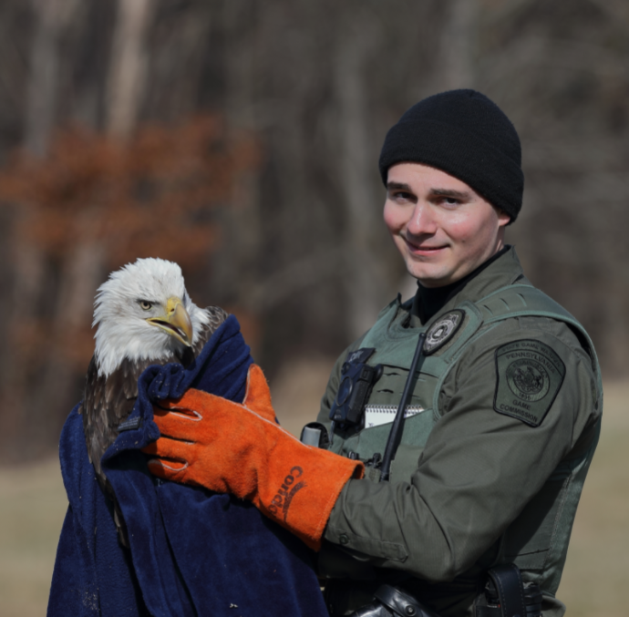

State Protections
Notes:
Species can also be protected under state laws, in addition to federal. In Pennsylvania, wildlife is protected under 2 main laws, Title 34 Game and Wildlife Code and Title 58 Pennsylvania Code.

Slide 5
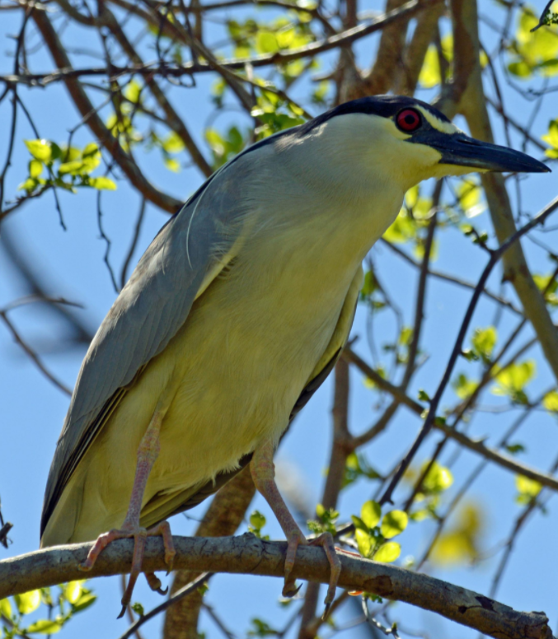

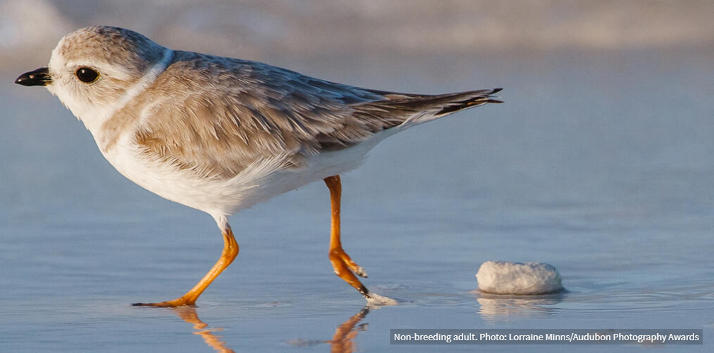
Wading vs. Shorebird
Long, strong legs & toes = wading bird
Brown backs, lighter bellies = shorebirds
Notes:
Now what is a wading bird? A Shorebird? A wading bird is a bird that wades - or walks – in water. They are characterized by long, strong legs & toes to help them navigate through the wetlands, marshes, and swamps they inhabit. Shorebirds are adapted to survive in open habitats along coasts and shorelines. Their brown, rust, black, and white plumage helps them camouflage from predators.

Slide 6
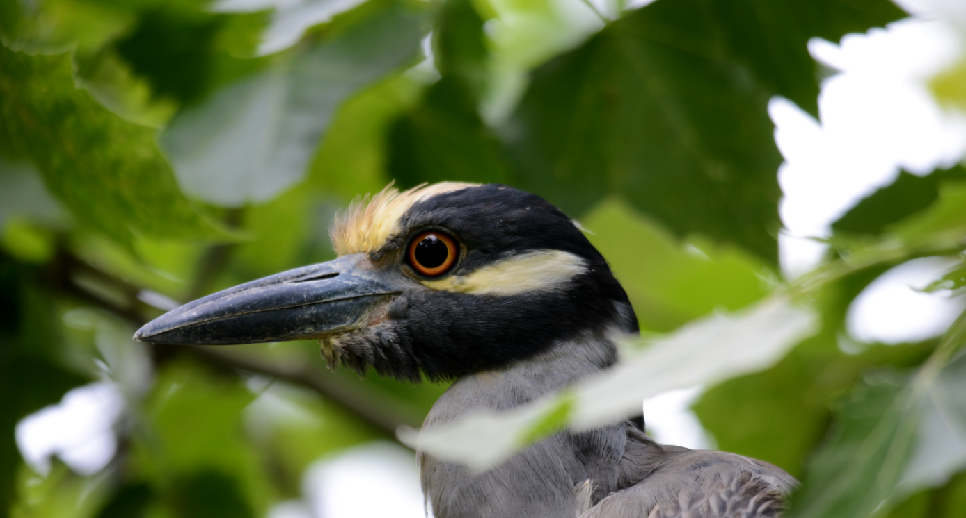
Yellow-crowned Night-heron
Notes:
Scientific name: Nyctanassa violacea
Status: Endangered wading bird in Pennsylvania
Diet: crustaceans, frogs, fish, slamanders, lizards, worms, insects, crayfish
Breeding: its range edge is northern PA
Nesting: one of the rarest nesting birds in PA, nest singly and in small loose colonies
Mainly nest only with other yellow crowned night herons but on occasion will nest with other herons
They have stick nests that they create in shrubs or trees. They also may line the nest with leaves, fine twigs, or rootlets
Nest building is a bonding experience for two yellow crowned night herons with both the male and female participating. Many times they re-use the nests for a few years
Lay three to four eggs, both sexes incubate, pale bluish green without marks

Slide 7
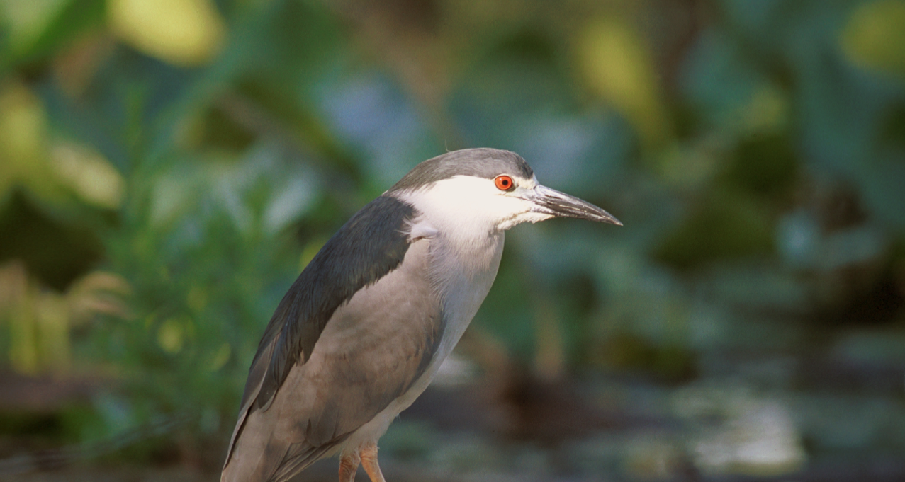
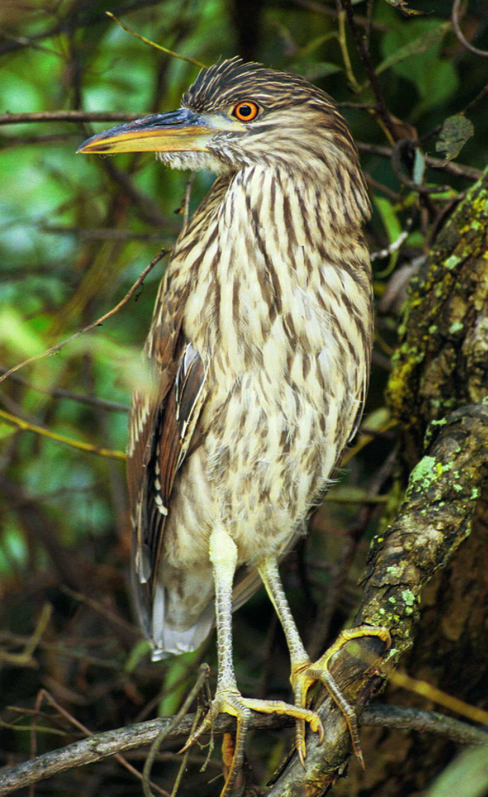
Black-crowned Night-heron
Adult
Juvenile
Notes:
Scientific name: Nycticorax nycticorax
Status: Endangered wading bird in PA
Diet: mainly fish, worms, carrion, small rodents, insects, crayfish
Like to search for food at dusk, dawn, or at night
roost communally
Nesting: communal nesting. Nest in shrubs, trees or in cattail stands
Habitat: wetlands and riparian
Nests: line with fine material and build with twigs or reeds and sticks
Males and females build nests
Eggs are pale blue or green, unmarked, and about 3 will hatch at a time

Slide 8
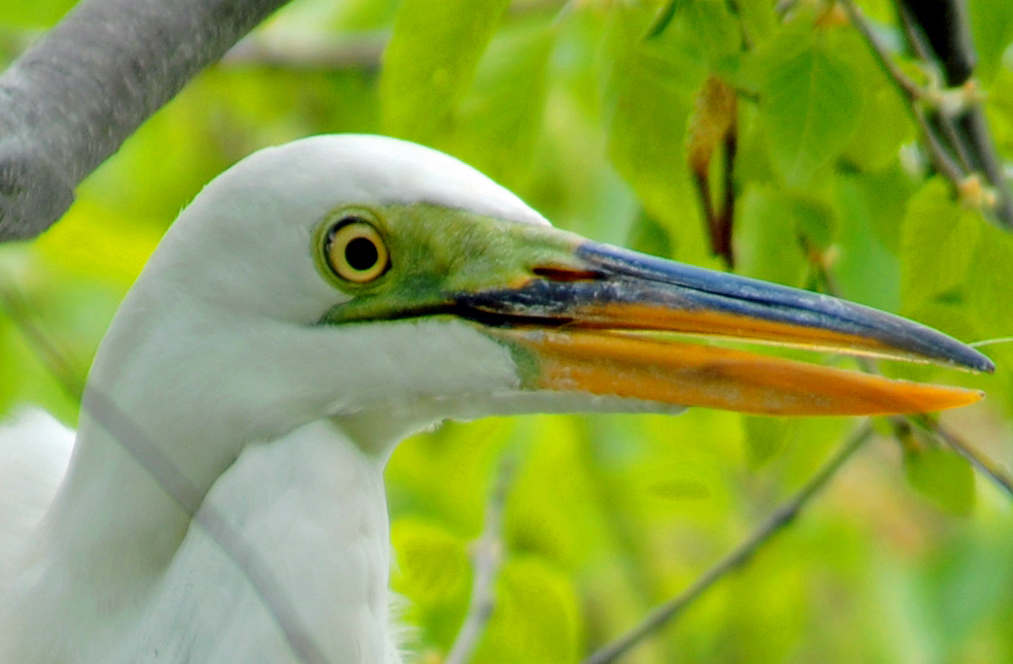
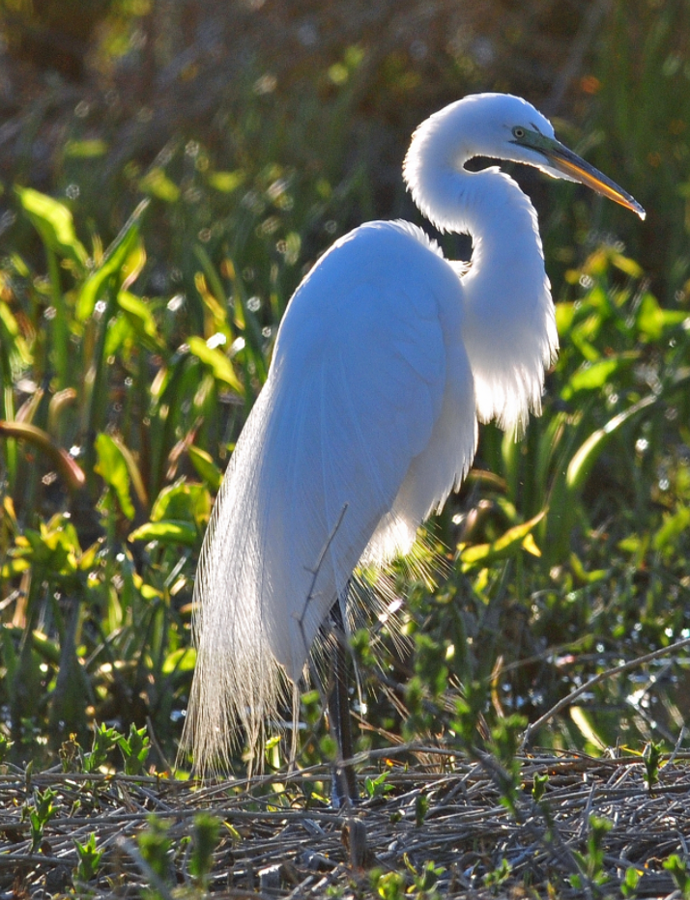
Great Egret
Notes:
Scientific name: Ardea alba; Great (Common or American) Egret
Status: State Endangered wading bird
Their white plumage was used to feather hats for women
This international trade drove an unsustainable level of hunting
Threats:
Habitat loss: flooding of shallow feeding areas caused by precipitation changes (climate change) and dams
Competition over nesting sites with double-crested cormorants whose populations are on the rise
Decline in nesting trees which occurs due to erosion and nesting cormorants’ acidic droppings
Water quality
Diet: crayfish, small fish, amphibians, insects, small mammals, reptiles, crustaceans
Largest white heron in PA
Breeding: Resident egrets arrive in March
Nesting: Both males and females incubate, lay three to four, color: blue/ greenish blue

Slide 9
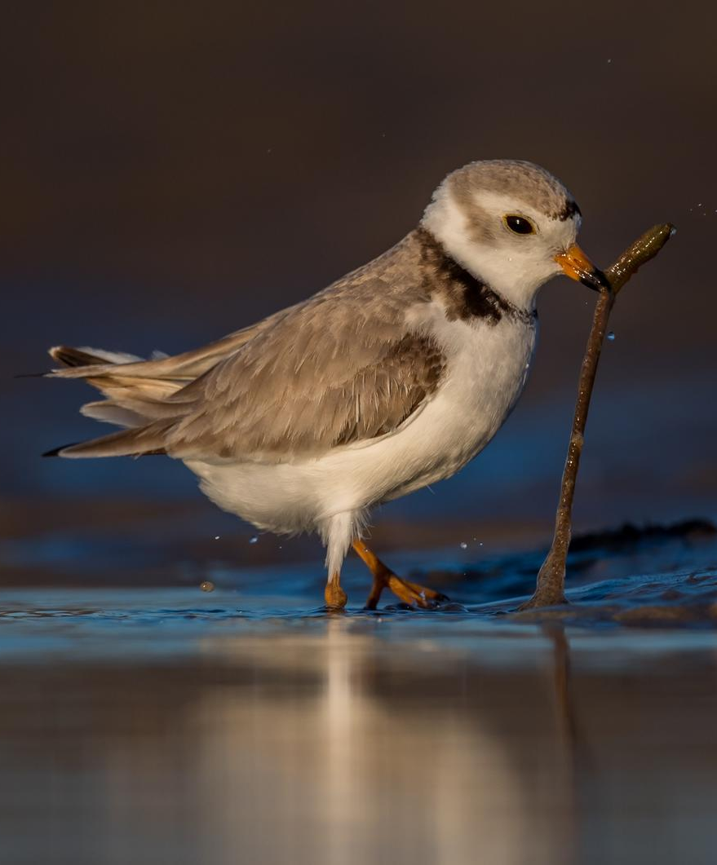
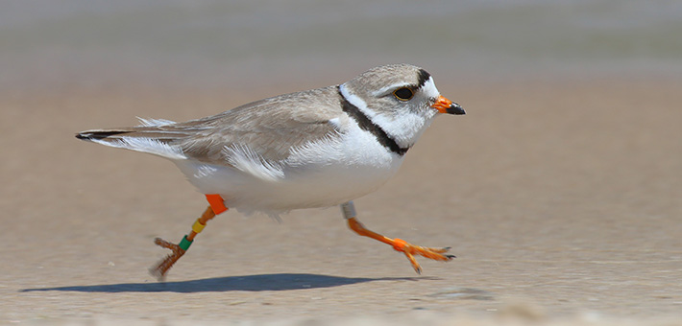
Piping Plover
Notes:
Scientific name: Charadrius melodus
Status: Federally & State Endangered shorebird
Diet: aquatic insects and worms
Breeding: Arrive to breeding locations in mid-April, likely that a male and female who bred and successfully raised their young the previous year will breed together again
Nesting: lay their eggs in a bowl-shaped scrape in the sand that is lined with shells or pebbles. There are typically four eggs laid one at a time and 1.5 days apart. The male and female trade off incubating the eggs until they hatch after about 28 days
Threats:
Human disturbance: their coastal nests get trampled by human visitors, also can cause nest abandonment
Predators: owls, feral cats, coyotes crows, foxes, gulls, and merlins
Habitat degradation: vegetation encroachment
Management:
Predator exclosures around nests
Banding to understand movements, breeding ranges, survivorship, dispersal, and mate retention

Slide 10
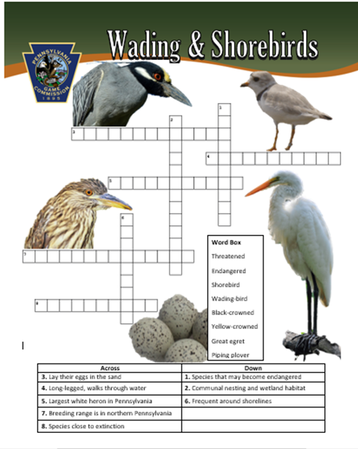

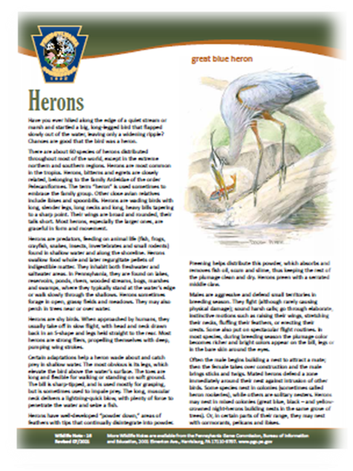
Activities
Notes:
Using what they have learned in the lesson, students will be able to complete the wading and shorebirds crossword puzzle, as well as build their own nest! To learn more, students can read the Herons wildlife note on our website at: www.pgc.pa.gov
Link to activity: http://whitegunpowder.com/paper-birds-nest-diy/#lightbox/3/

