Slide 1


PENNVEST
Settlement
Process

Slide 2
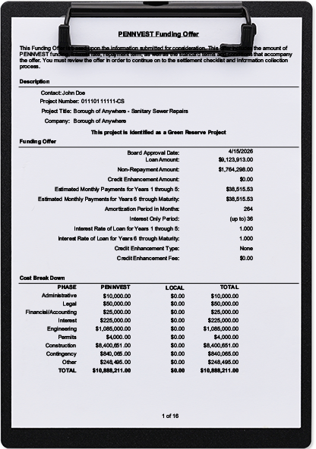

From Offer to Disbursement
PENNVEST Funding Offer

Slide 3
Complete Settlement Within
180 Days

Slide 4
PENNVEST Legal Staff
Shawn Weis
Chief Counsel
Shelley Rohrer
Assistant Counsel
Missy Smith
Settlement Officer
Hannah George
Settlement Officer
Heather Myers
Legal Office Supervisor

Slide 5
The PENNVEST
Settlement Overview

Slide 6
Prepare for a Successful Settlement
Be shovel-ready
Read the funding offer
Understand the terms & conditions
Meet settlement deadlines
You are expected to complete Settlement within 180 days of Board approval
*See 35 P.S. § 751.10

Slide 7
Funding Offer Components
Applicant details
Funding offer details
Contact (Borrower)
Loan and/or non-repayment amounts
Cost breakdown
Administrative
Collateral
Collateral details
Terms & conditions
General financial
Project ID number
Project title
Company (Legal Entity)
Estimated monthly payments
Interest rates
Legal
Financial
Interest
Engineering
Permits
Construction
Contingency
Other
Special conditions
Construction-related
Additional for federally-funded projects
Management

Slide 8
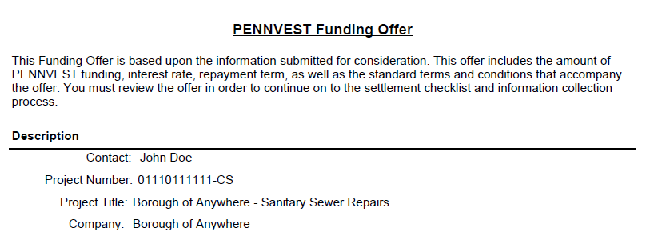
Applicant details

Slide 9
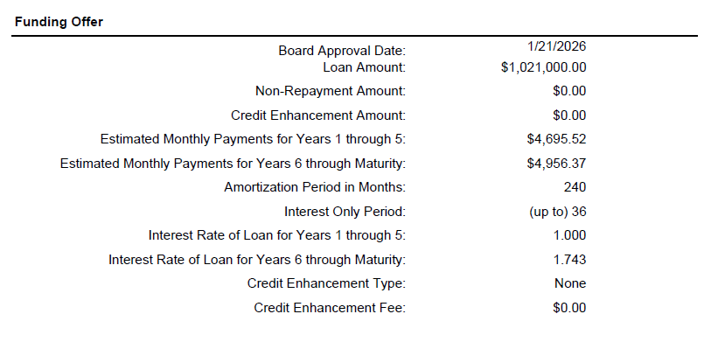
Funding offer details

Slide 10
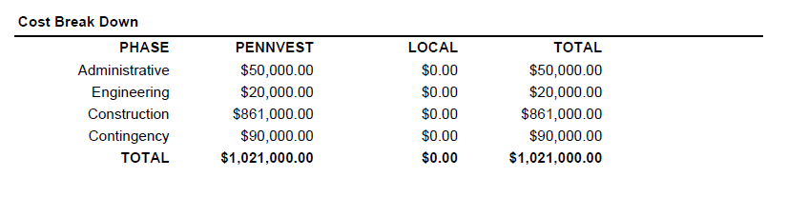
Cost breakdown

Slide 11
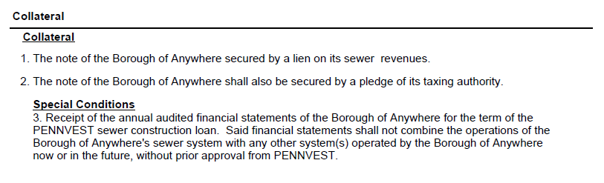
Collateral

Slide 12
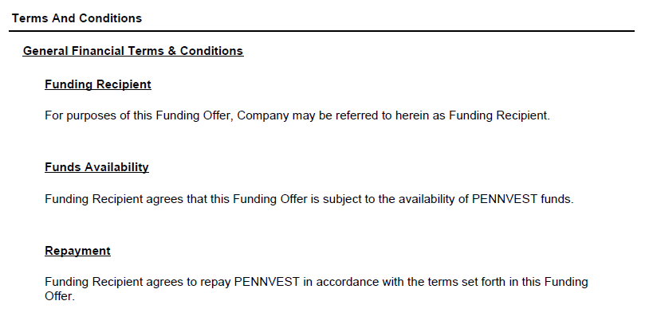
Terms & conditions

Slide 13
Our Regulatory Requirements
ALL PROJECTS
FEDERAL EQUIVALENCY & NON-EQUIVALENCY -FUNDED PROJECTS
“Or-equal” provisions in bid documents
Pennsylvania Steel Products Procurement Act (Act 3 of 1978)
Pennsylvania Prevailing Wage Act
Davis-Bacon Wage Rate Compliance¹
FEDERAL EQUIVALENCY-FUNDED PROJECTS
Disadvantaged Business Enterprise Solicitations (DBE)
Build America, Buy America (BABA) Act
American Iron and Steel Regulations¹
Single Audit
Architectural/Engineering Service Procurement³
Competitive procurement
Fiscal Sustainability Plan Preparation ²
1 –Does not apply to CWSRF-319 projects
2 –Only applies to CWSRF-212 projects
3 –Does not apply to drinking water projects

Slide 14
PENNVEST Settlement
Step By Step

Slide 15
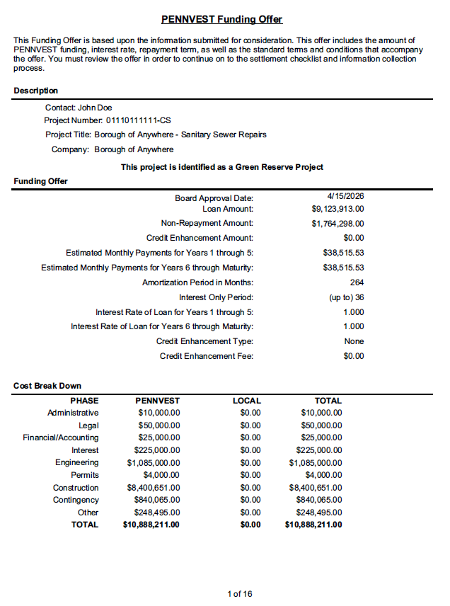
Conference Call #1
1
Review funding offer, terms and conditions, bid schedule, and interim financing requirements.
Discuss the completed Settlement Worksheet and items necessary to complete settlement.
Schedule a Settlement date.
Got questions? We have answers.

Slide 16
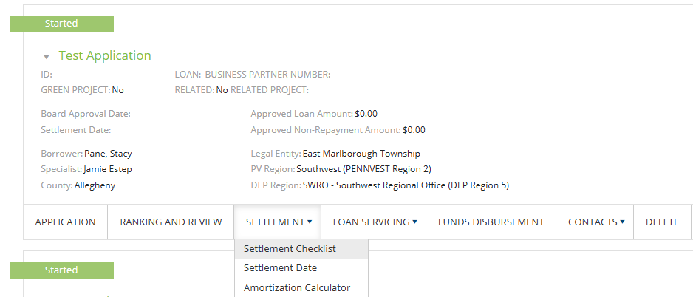
Conference Call #2
2
Discuss the completed Bid Result Form.
Ensure we are still on target with our settlement timeline.
Review and complete required items on the settlement checklist.

Slide 17
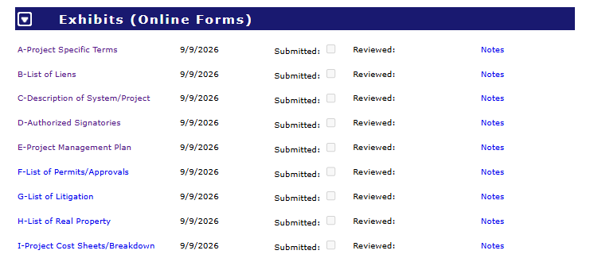
Settlement Checklist - Exhibits

Slide 18
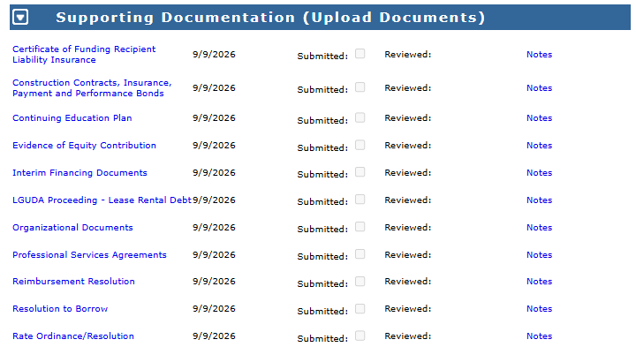
Settlement Checklist –
Supporting Documentation

Slide 19
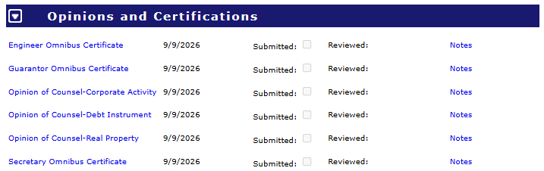
Settlement Checklist –
Opinions and Certifications

Slide 20
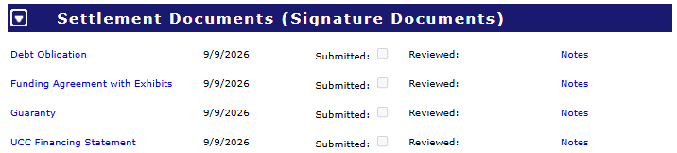
Settlement Checklist –
Settlement Documents

Slide 21

Conference Call #3
3
Review outstanding documents from the Settlement Checklist.
Discuss what the settlement call will look like.

Slide 22

Conference Call #4
4
Sign the Settlement documents

Slide 23

Settlement Workflow
Bid Project
Complete & return bid result form/Conference call #2
PENNVEST
Board Meeting & Funding Offer Issued
Complete and return settlement worksheet. Schedule settlement/
Conference call #1
Upload all supporting documentation & complete settlement checklist (3 weeks prior to settlement)
Conference call #3
Settlement/
Conference call #4

Slide 24
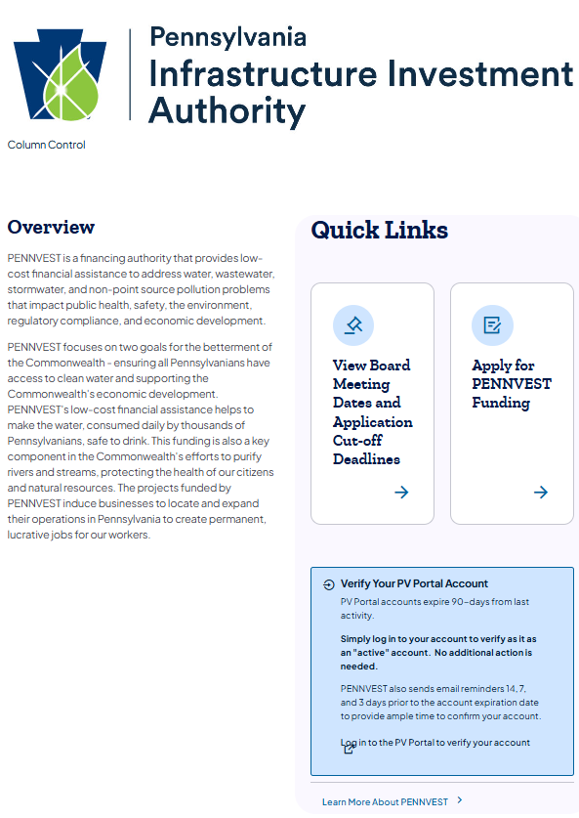
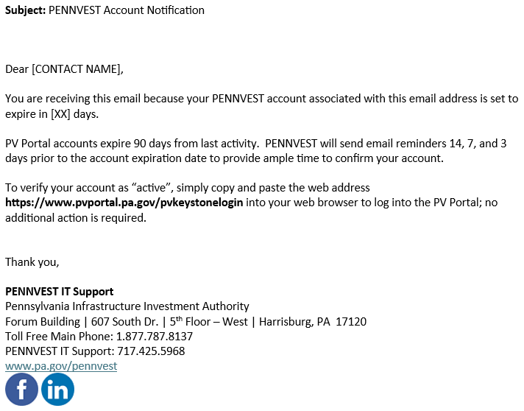
PV Portal Notice
Sample Email
Quick Link
If no activity on account within a 90-day span, the account will automatically expire
PENNVEST sends email reminders to log in prior to expiration date
  14 days prior
  7 days prior
  3 days prior
These emails are not spam

Slide 25
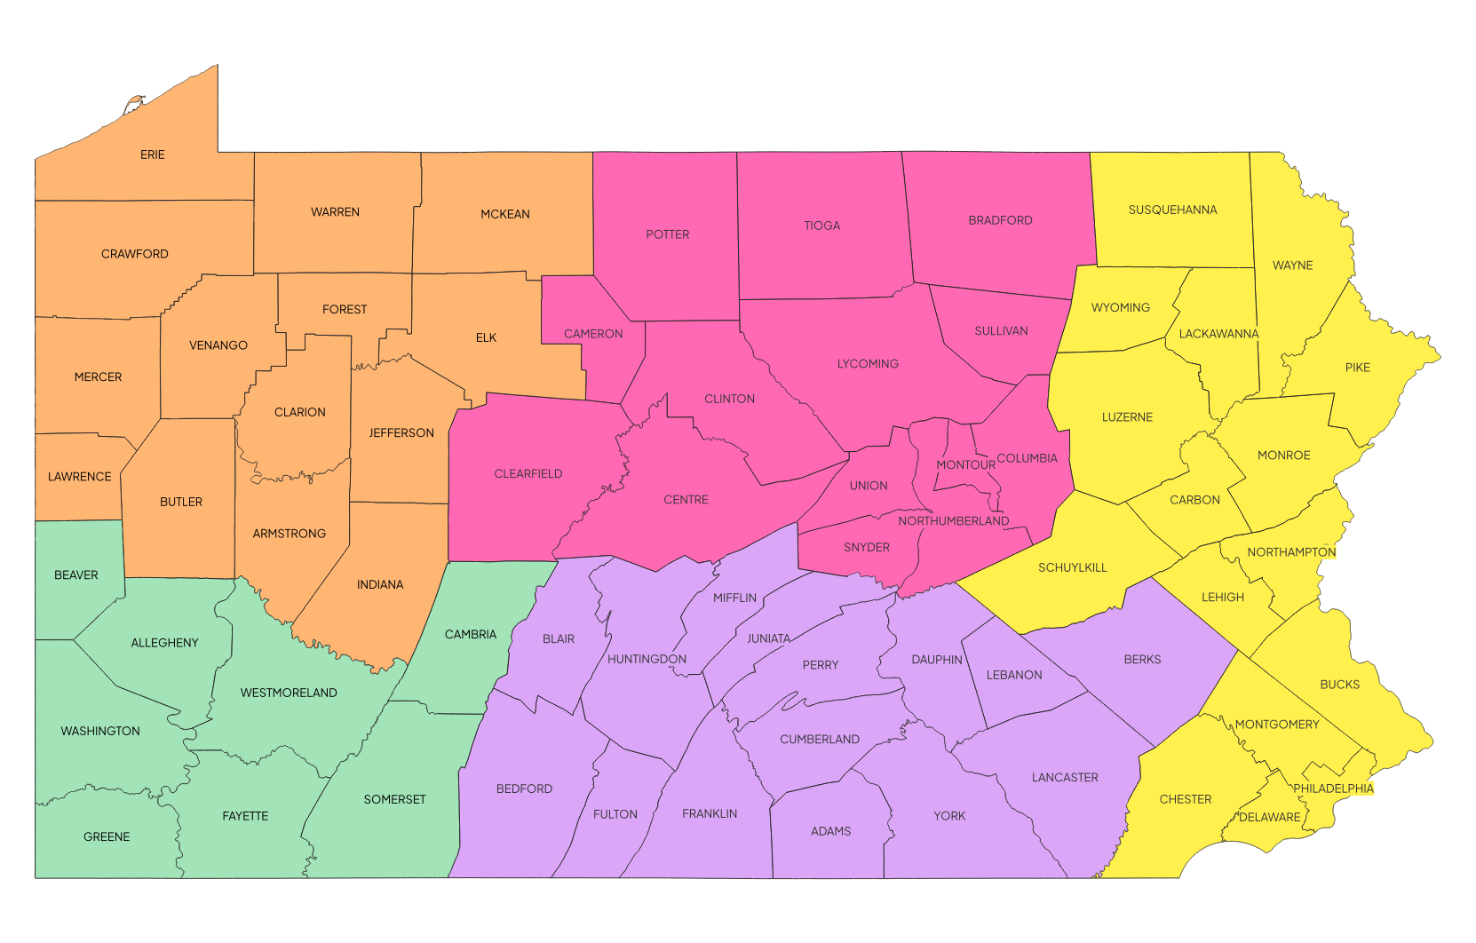
PENNVEST Regional Contacts
Region | Project Specialist | Phone | Email
Northcentral | Leslie Cote | 717-783-4489 | lecote@pa.gov
Northeast/ Southeast | Rebecca Hayden | 717-783-4488 | rhayden@pa.gov
Northwest | Brendan Linton | 717-783-6799 | blinton@pa.gov
Southcentral | Tesra Schlupp | 717-783-8618 | tschlupp@pa.gov
Southwest | Jamie Estep | 717-317-5034 | jestep@pa.gov

Slide 26
Want to learn more?
Virtual Session
November 4 –
Disbursement Process
PENNVEST Processes:
A Deep Dive

Slide 27
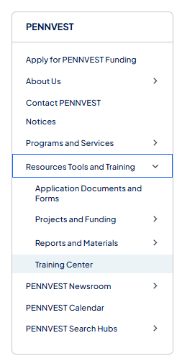
How to Register
Visit www.pa.gov/pennvest
Expand the “Resources Tools and Training” section
Select “Training Center”

Slide 28
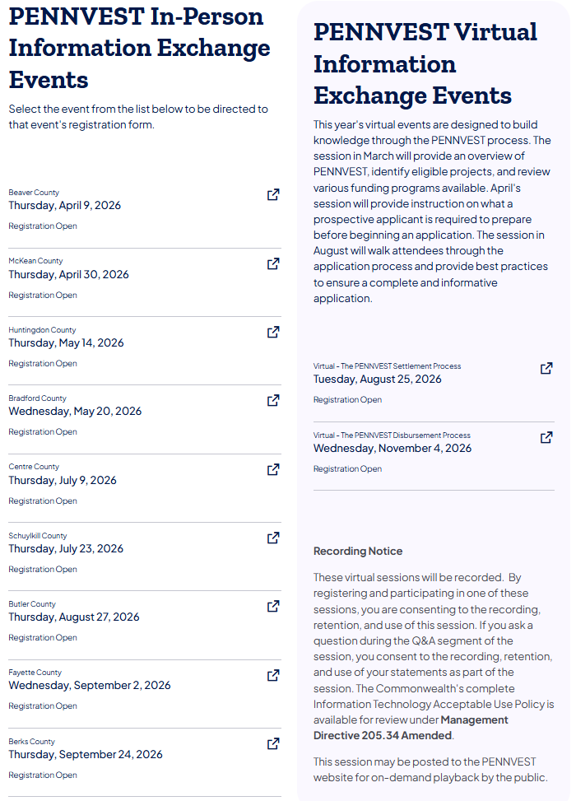
Training Center
In-person and Virtual event lists.
Select the event date to view event details and the registration form.

Slide 29
PENNVEST
Settlement
Process
Thank You for Joining Us

