Slide 1


Board of Directors Meeting
July 16, 2025
10:30 a.m.

Slide 2

Recording Notice
This meeting is being recorded.
By participating in this webinar, you consent to the
recording, retention, and use of this session.
If you ask a question, you consent to the
recording, retention, and use of your statements
as part of the meeting.

Slide 3
Technical Information
Can’t Hear Us?
Join the audio portion of the presentation via your telephone:
Call 1-267-332-8737
Meeting ID 316 308 519#
Technical Difficulties?
Call 1-717-705-4473 or
Send a Chat message via the Microsoft Teams meeting
Want the App?
Search “Microsoft Teams” in the Google Play Store or the App Store.

Slide 4
Public Comment
During the presentation, all attendees will be muted.
There are two methods you can use within this
Microsoft Teams meeting to pose a public comment or question.
“Raise Hand” function
“Chat” function

Slide 5
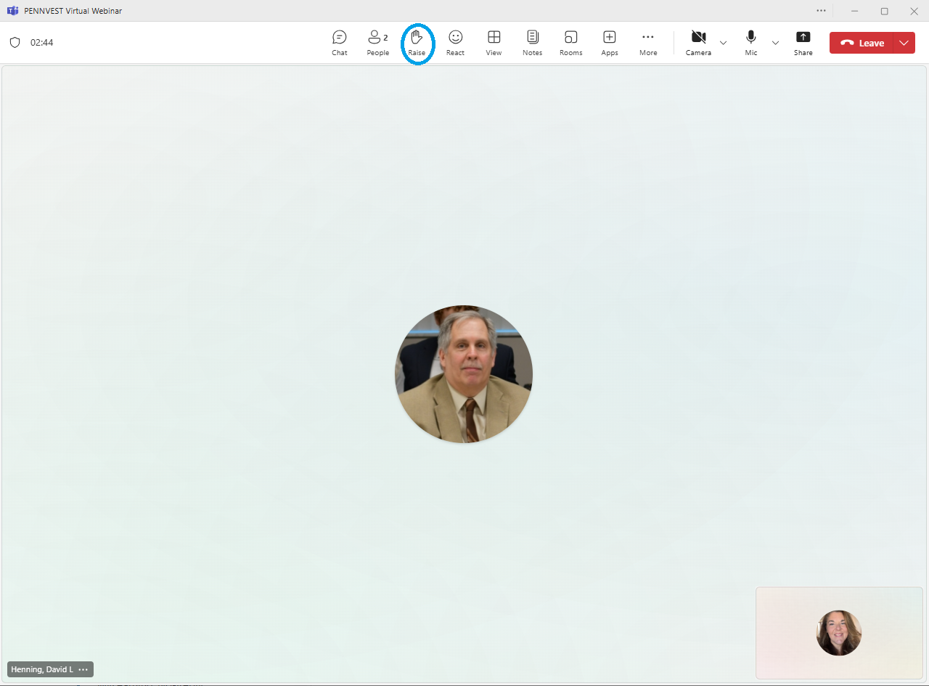



Raise Hand
In the top toolbar, raise your hand by clicking on the hand icon to indicate your request to speak.
Attendees with raised hands will be unmuted individually, allowing participants to speak one at a time.
Your microphone will show a diagonal line through the icon when muted. When the diagonal line disappears, you may pose your question or comment.

Slide 6

Chat
In the top toolbar, click on the chat bubble icon to open the chat dialogue box. Type your question or comment in the Meeting Chat.
PENNVEST staff will monitor the Chat area throughout the meeting.
Replies may be delivered verbally, or returned through the same chat box, from appropriate meeting participant(s). Responses will typically be given during an applicable Public Comment portion of the meeting.

Slide 7

Public Comment
Participant Best Practices
1. Log in to the Board Meeting through a computer or smart phone (using the Teams app).
2. When your microphone has been unmuted, begin by stating:
Your name.
Your affiliation (i.e., company, organization, etc.).
Indicate the specific project, agency activity, or agenda item about which you are commenting.
If your comment or question is on behalf of another individual or organization, please acknowledge this, immediately after your name and affiliation, and reference the name(s) of the associated person(s) or group(s).

Slide 8
Public Comment
Notices
All verbal comments, questions and responses will be recorded and can be shared publicly.
PENNVEST cannot guarantee all persons requesting to speak will be able to do so, specifically in the case of technical difficulties beyond our control, such as:
Audio feedback.
Poor sound quality.
Interruptions in bandwidth services.

Slide 9
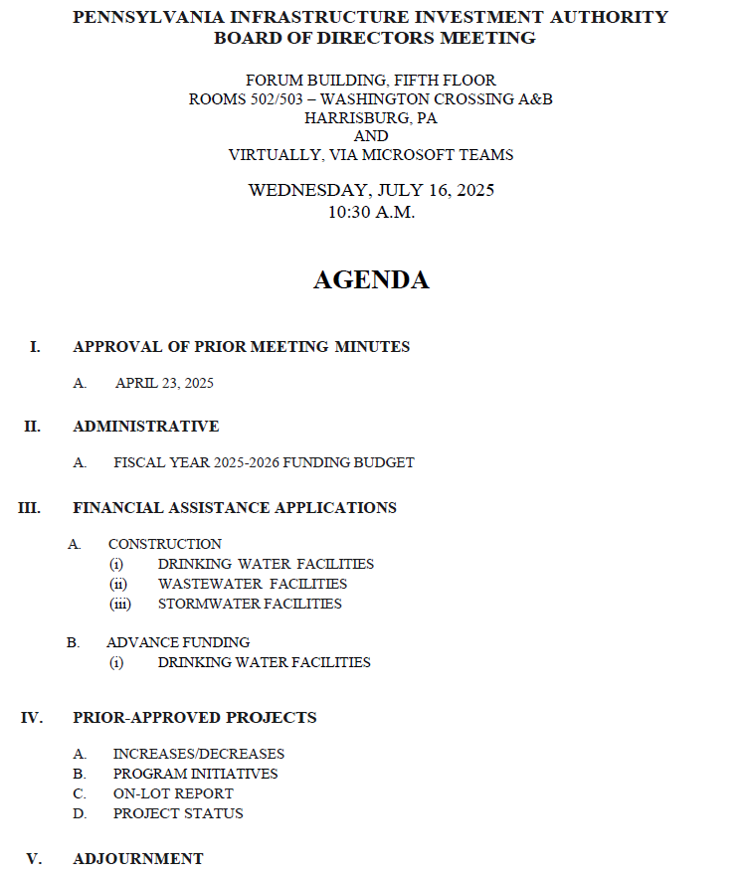

Today’s
Agenda

Slide 10
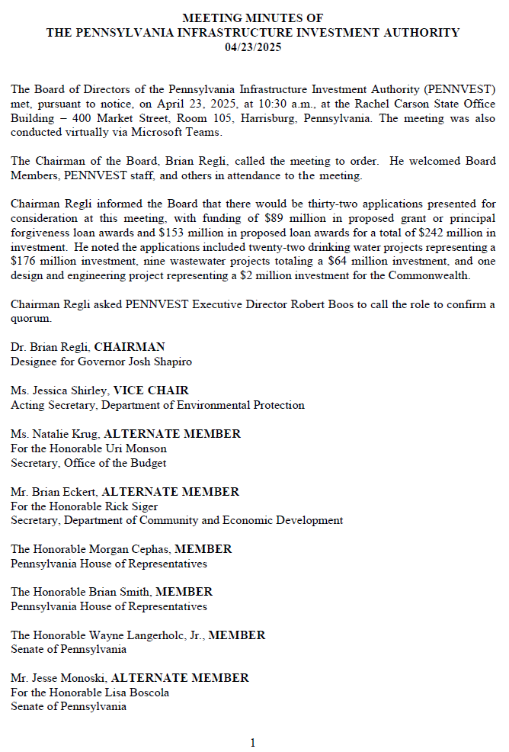
APPROVAL OF PRIOR MEETING MINUTES
A. APRIL 23, 2025

Slide 11

Board Discussion
I. APPROVAL OF PRIOR MEETING MINUTES A. APRIL 23, 2025

Slide 12
Public Comment
I. APPROVAL OF PRIOR MEETING MINUTES A. APRIL 23, 2025

Slide 13

Vote
I. APPROVAL OF PRIOR MEETING MINUTES A. APRIL 23, 2025

Slide 14
ADMINISTRATIVE
II. ADMINISTRATIVE

Slide 15
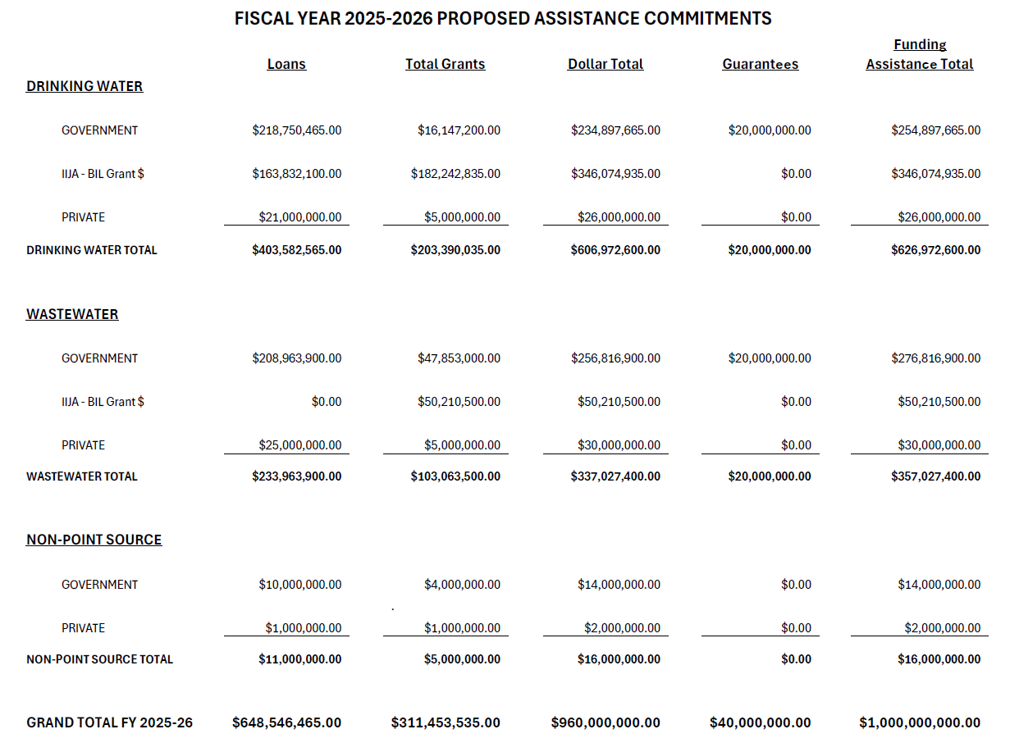
II. ADMINISTRATIVE
A. FISCAL YEAR
2025-2026
FUNDING BUDGET
II. ADMINISTRATIVE A. FISCAL YEAR 2025-2026 FUNDING BUDGET

Slide 16
Board Discussion
II. ADMINISTRATIVE A. FISCAL YEAR 2025-2026 FUNDING BUDGET

Slide 17
Public Comment
II. ADMINISTRATIVE A. FISCAL YEAR 2025-2026 FUNDING BUDGET

Slide 18
Vote
II. ADMINISTRATIVE A. FISCAL YEAR 2025-2026 FUNDING BUDGET

Slide 19
FINANCIAL ASSISTANCE APPLICATIONS
III. FINANCIAL ASSISTANCE APPLICATIONS

Slide 20
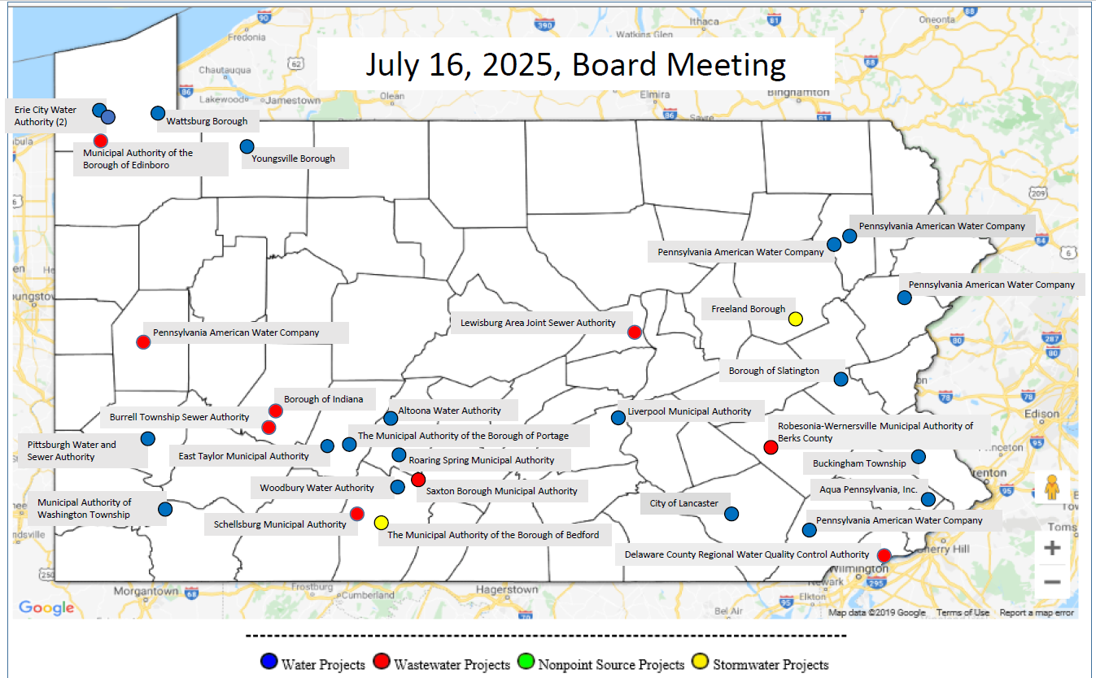
MAP OF PROJECT APPLICATIONS RECOMMENDED FOR APPROVAL
III. FINANCIAL ASSISTANCE APPLICATIONS

Slide 21
DRINKING WATER
CONSTRUCTION PROJECTS
III. FINANCIAL ASSISTANCE APPLICATIONS A. CONSTRUCTION (i) DRINKING WATER

Slide 22
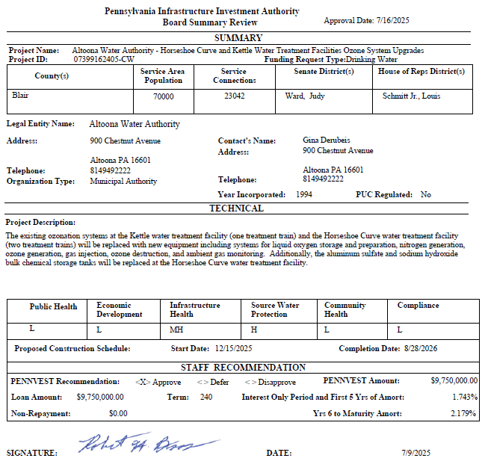
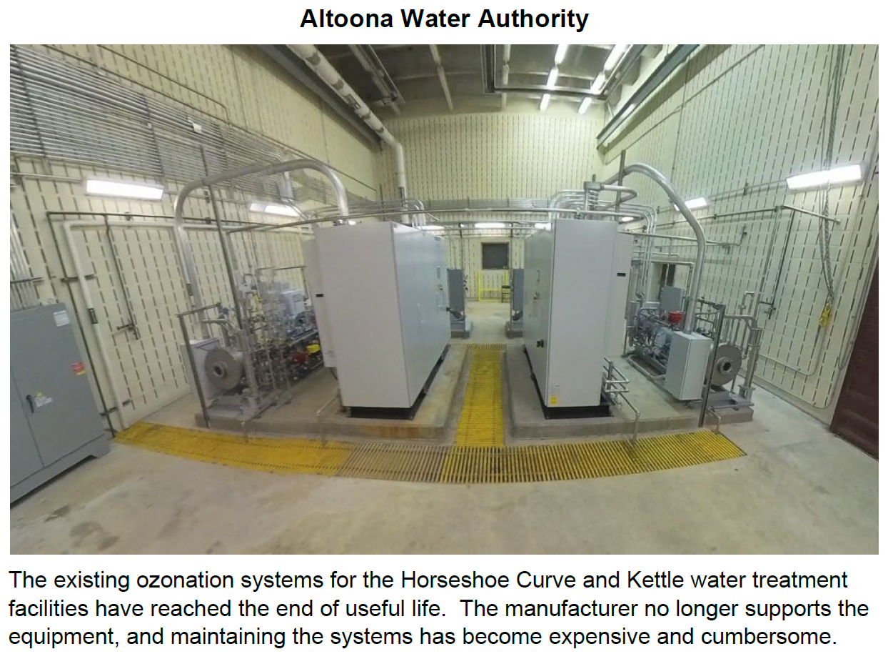
Altoona Water Authority

Slide 23
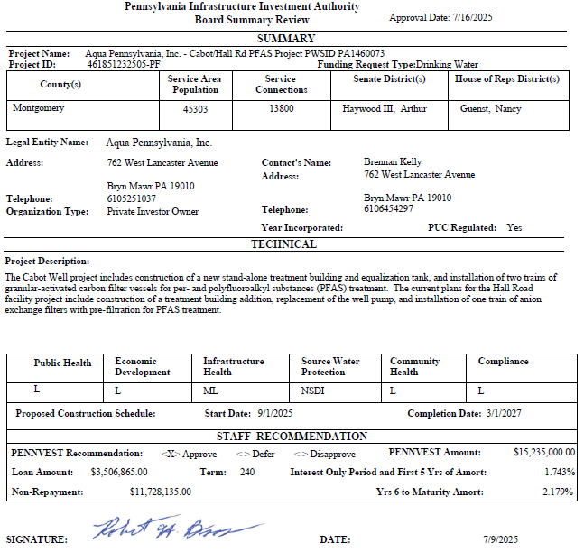
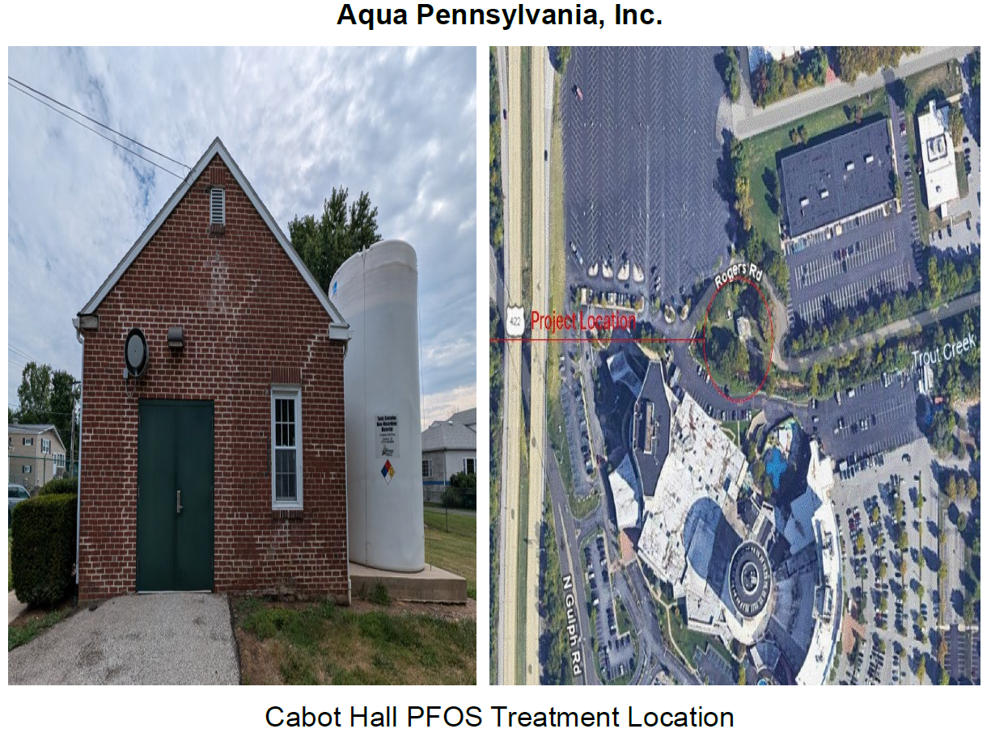
Aqua Pennsylvania, Inc.

Slide 24
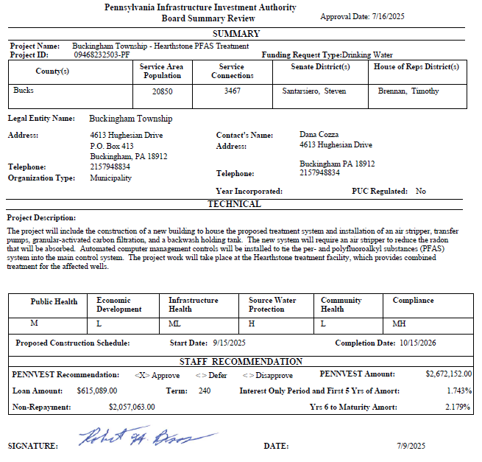
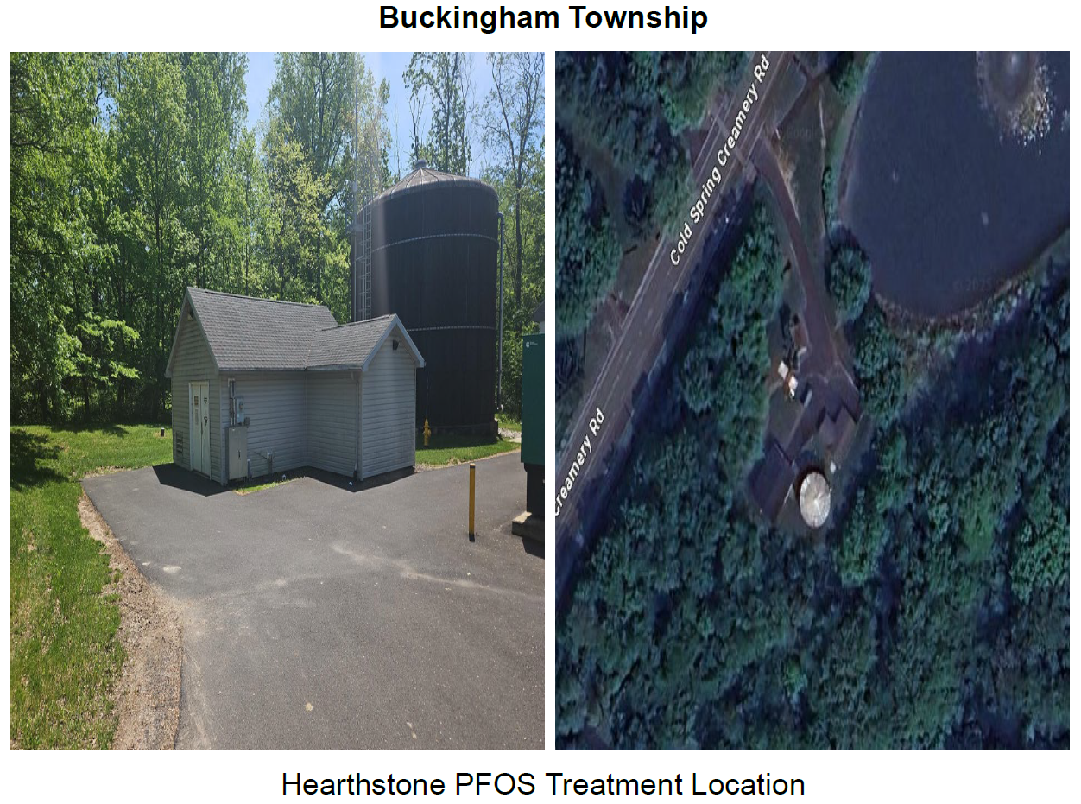
Buckingham Township

Slide 25
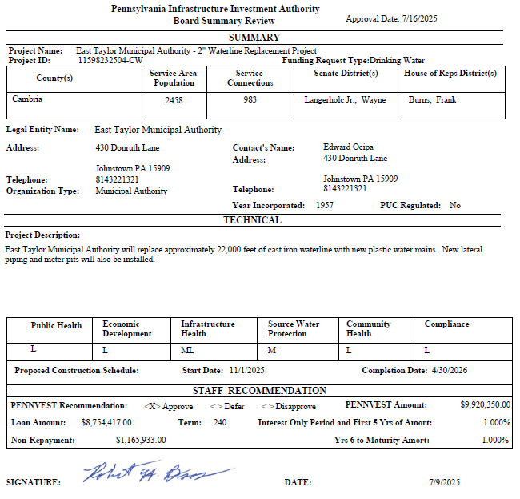
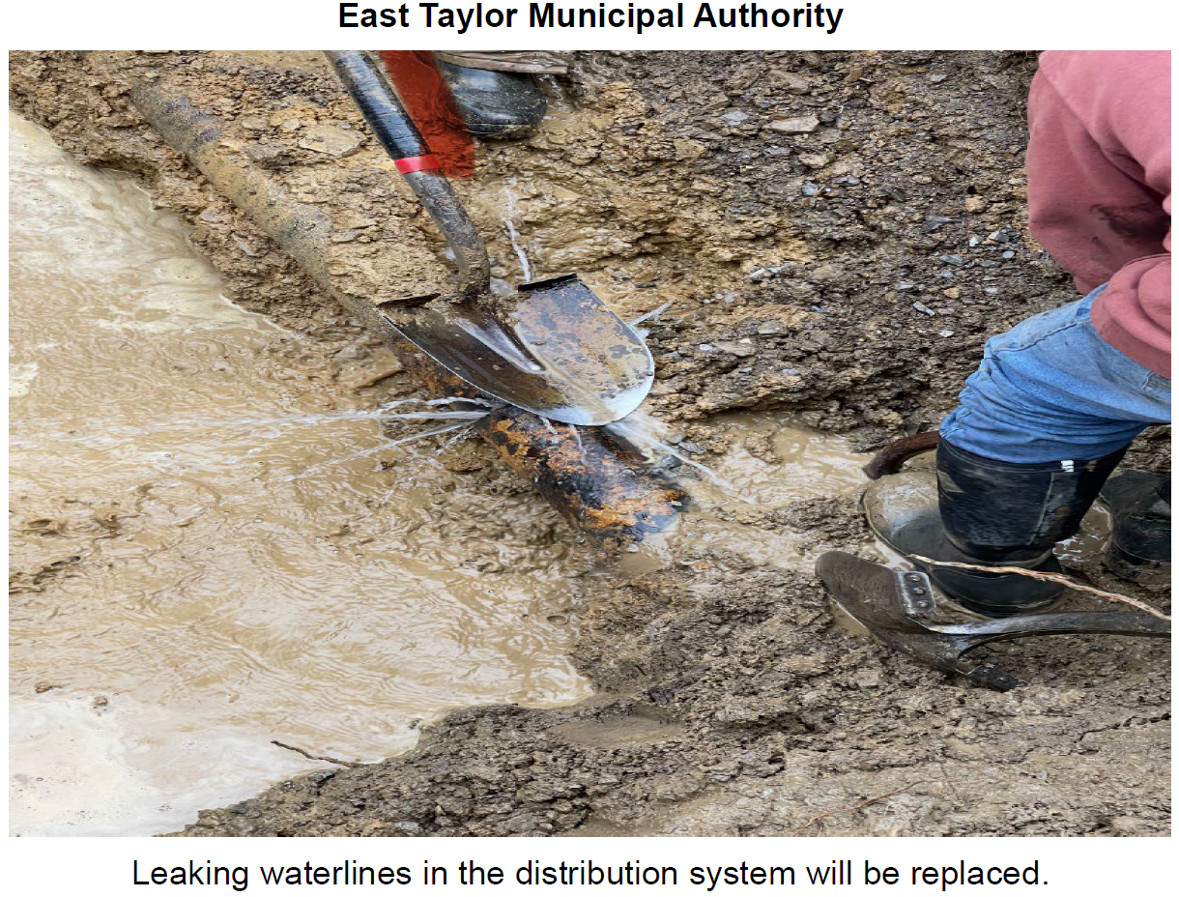
East Taylor Municipal Authority

Slide 26
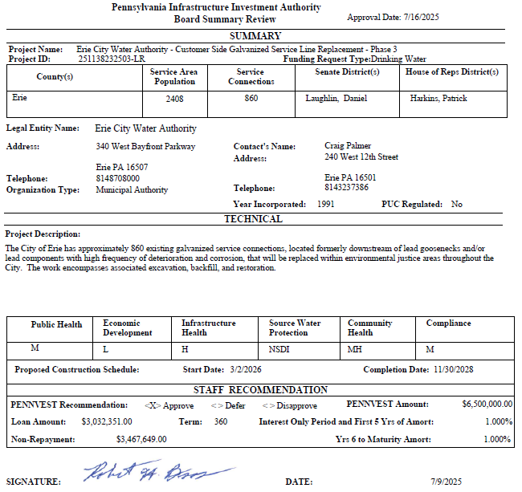
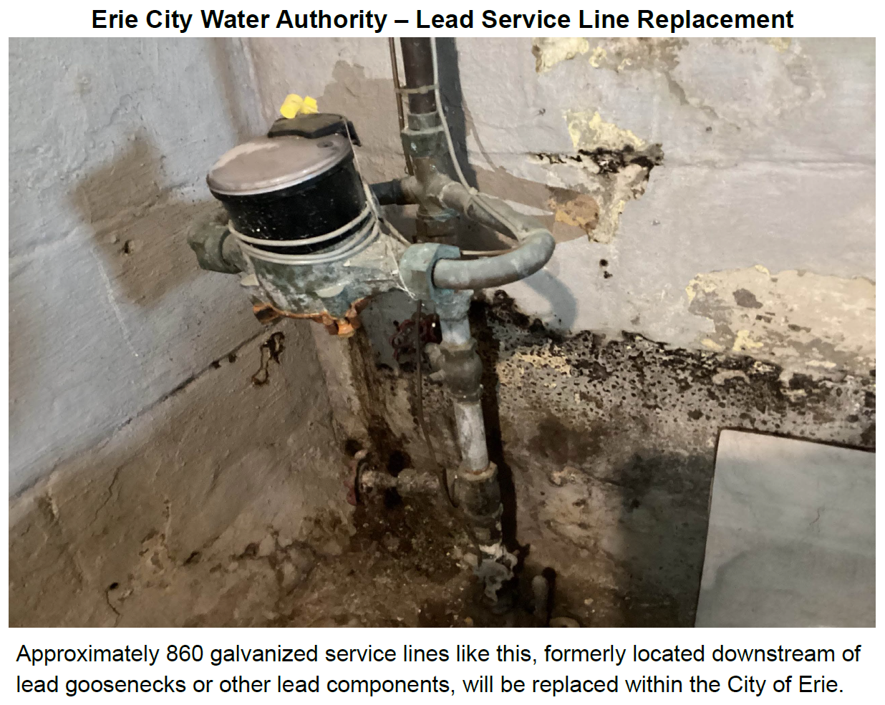
Erie City Water Authority – Lead Service Line

Slide 27
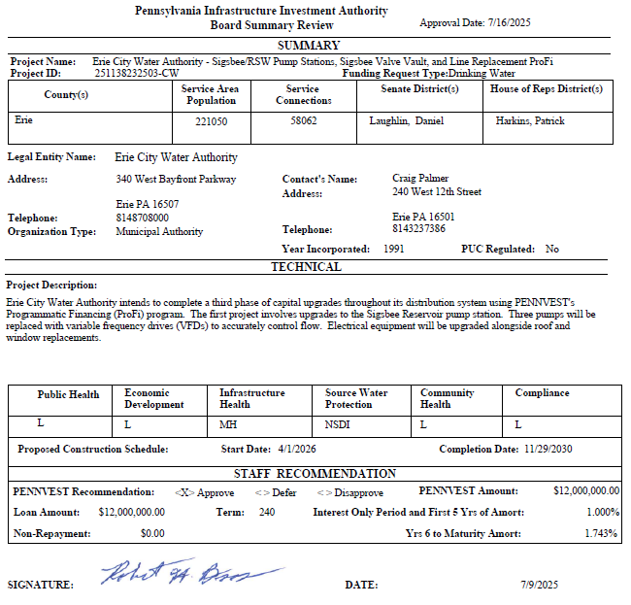
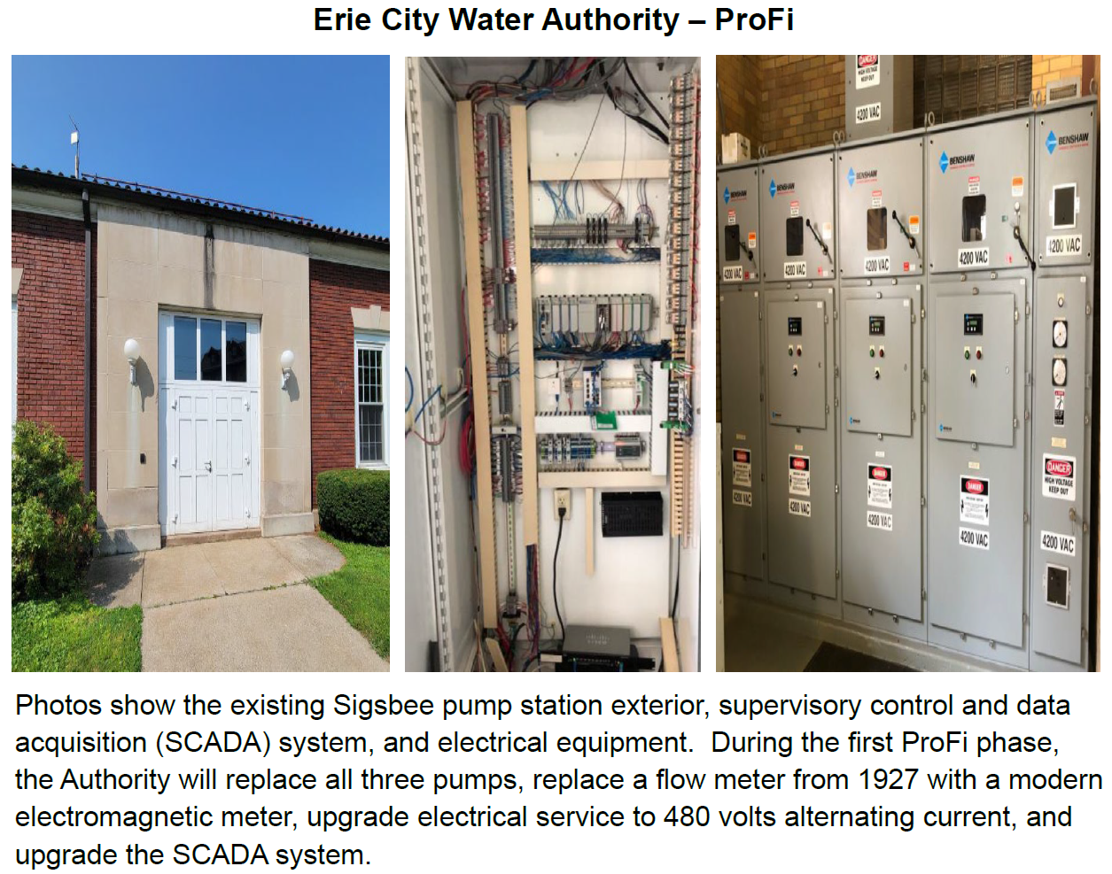
Erie City Water Authority – Pro-Fi

Slide 28

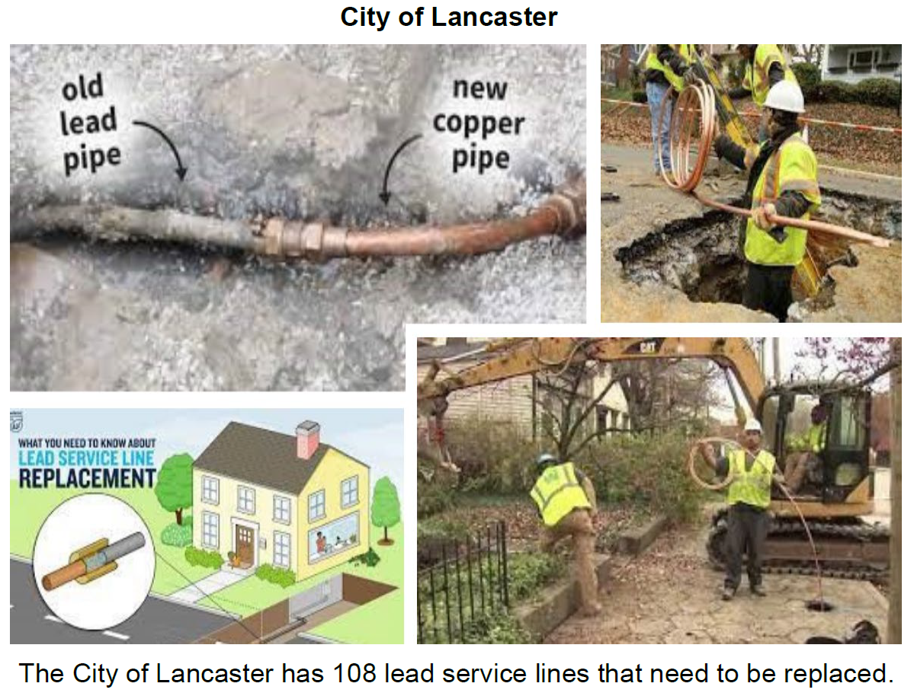
City of Lancaster

Slide 29
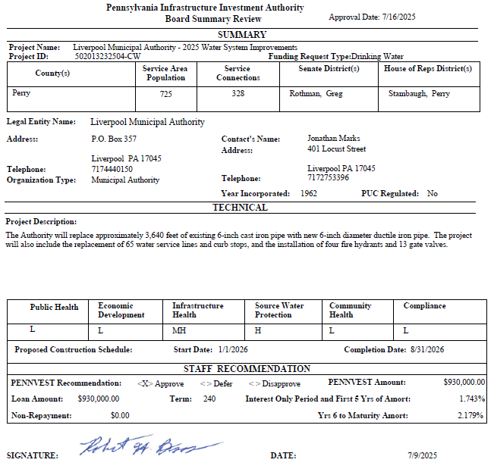
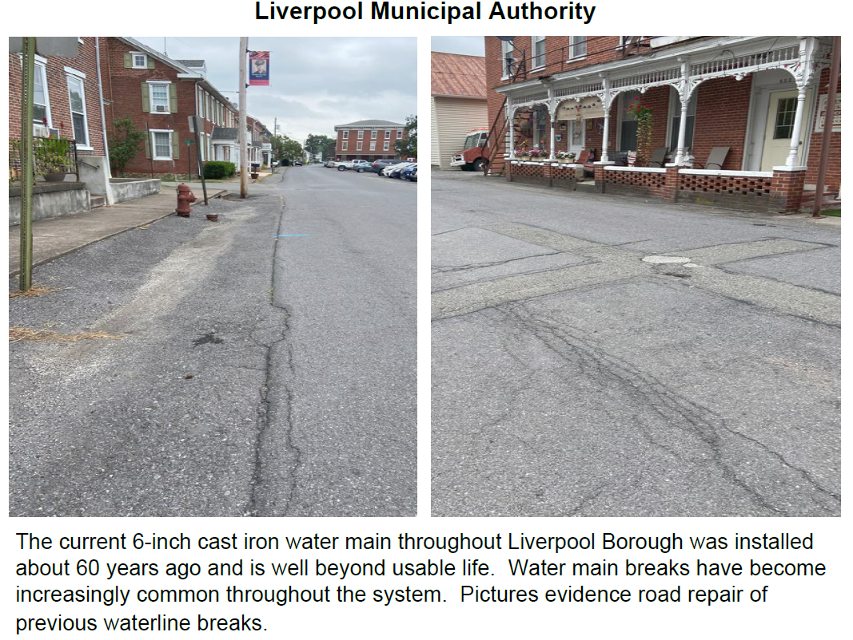
Liverpool Municipal Authority

Slide 30
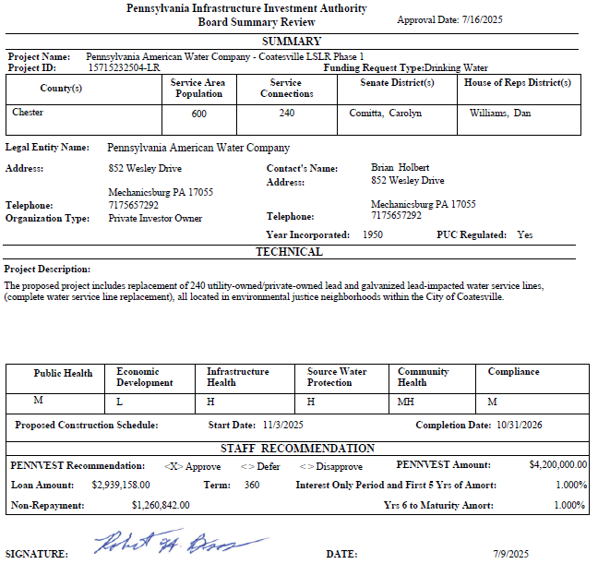
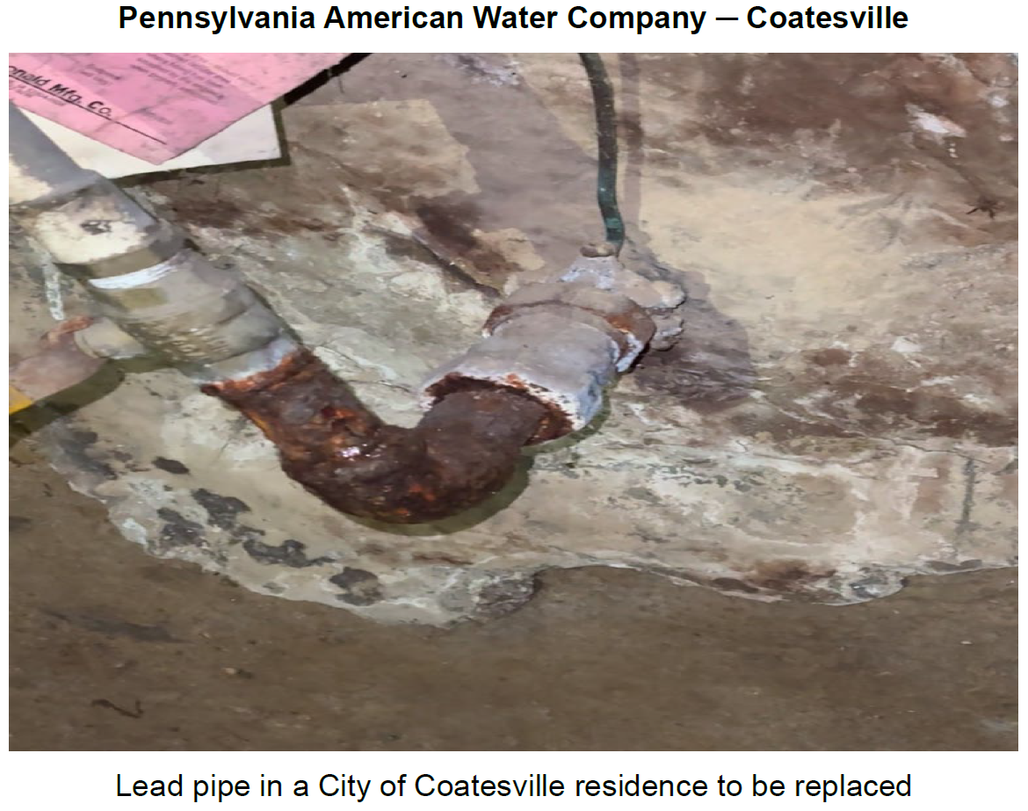
Pennsylvania American Water Company – Coatesville

Slide 31
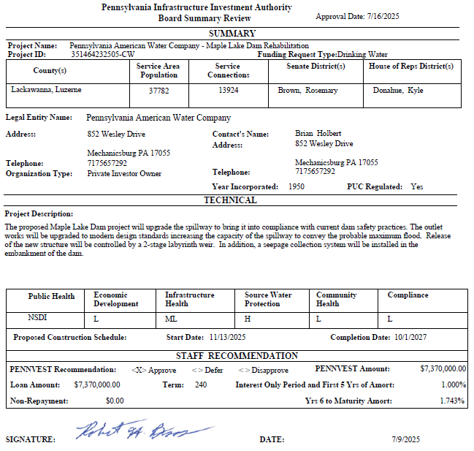
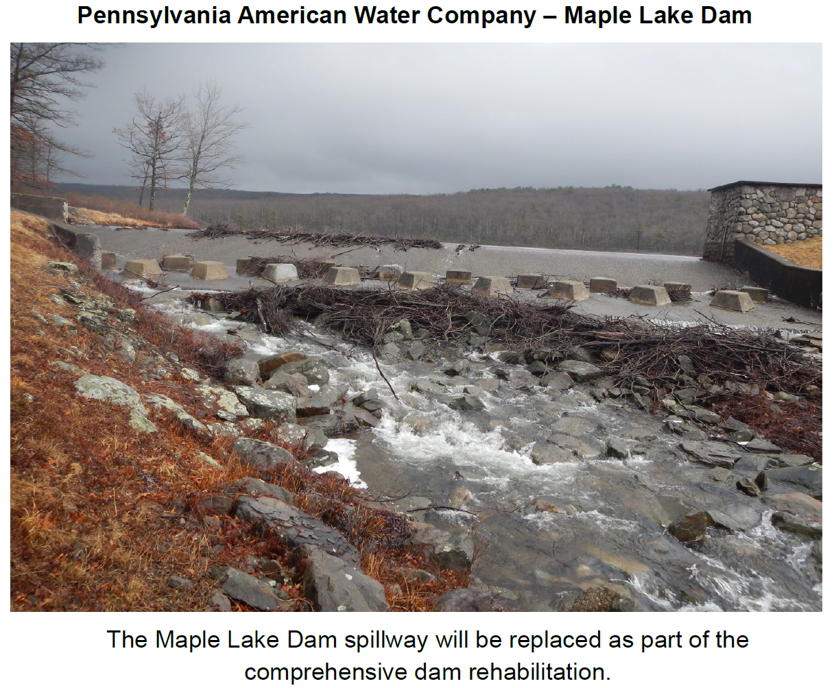
Pennsylvania American Water Company – Maple Lake

Slide 32
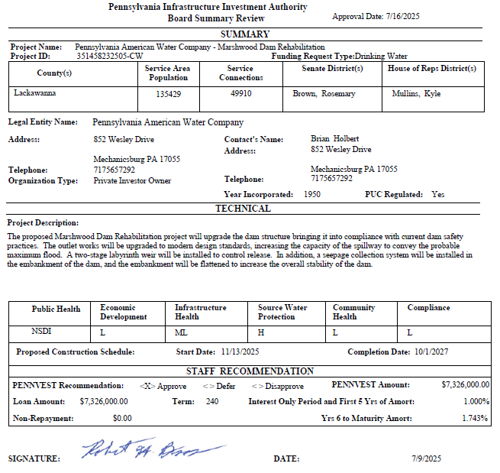
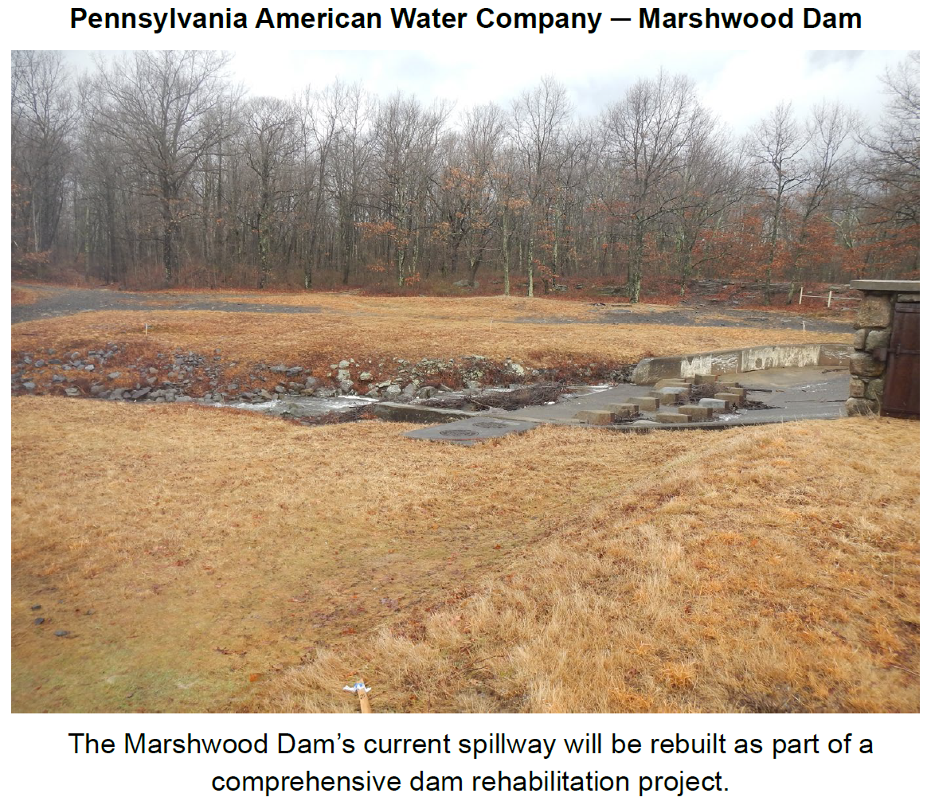
Pennsylvania American Water Company – Marshwood

Slide 33

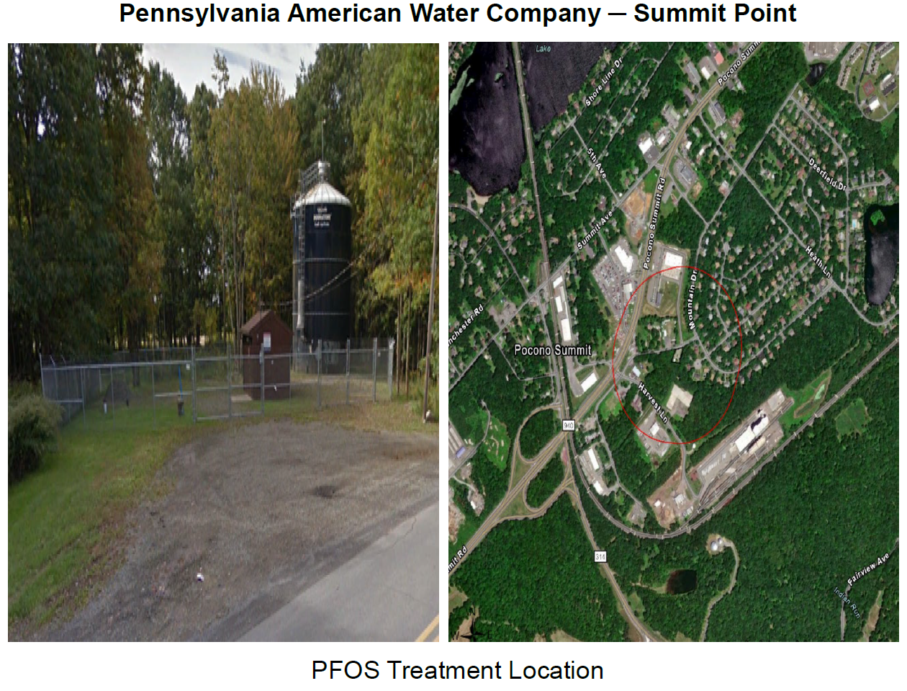
Pennsylvania American Water Company – Summit Point

Slide 34

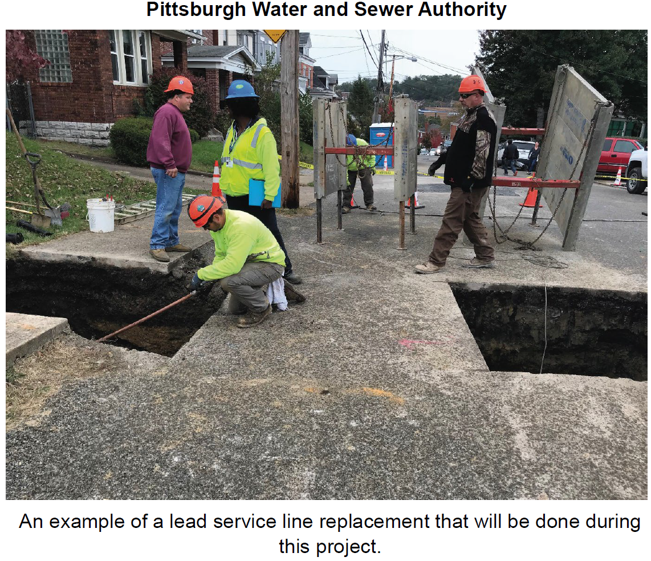
Pittsburgh Water & Sewer Authority

Slide 35
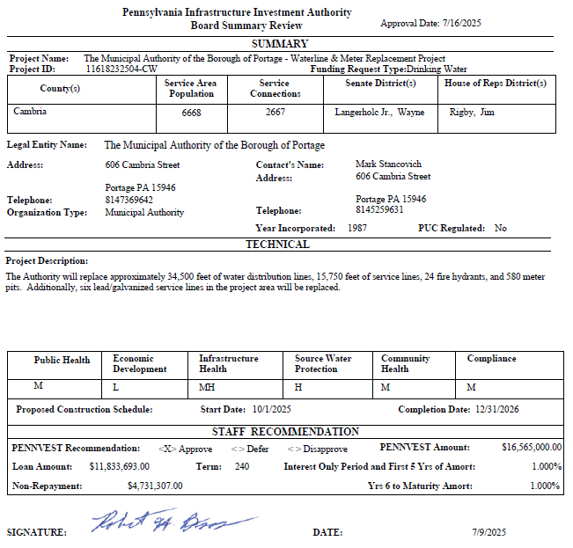
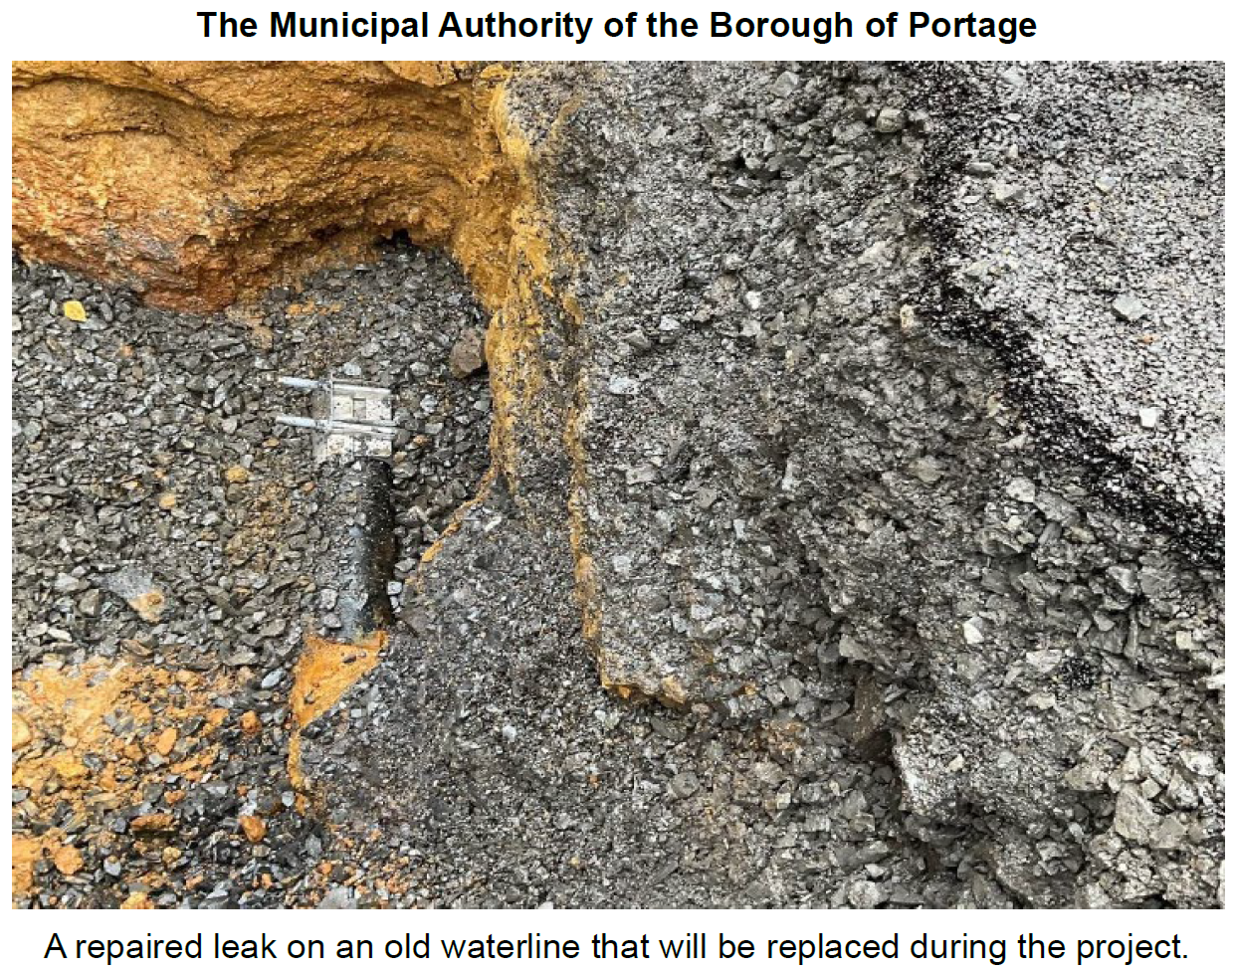
The Municipal Authority of the Borough of Portage

Slide 36
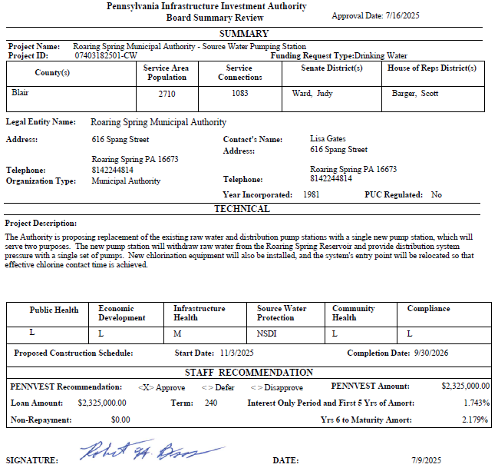
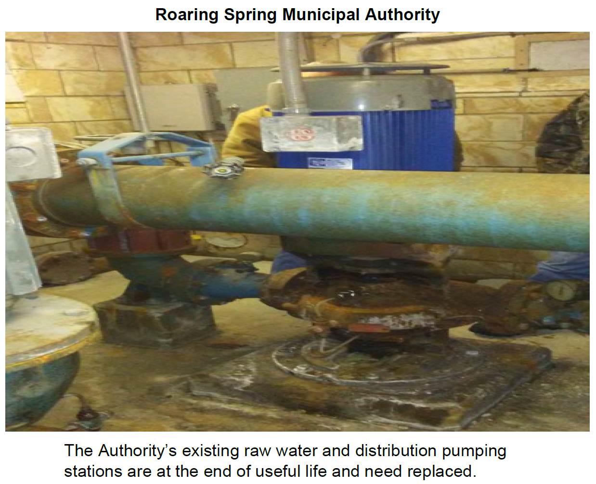
Roaring Spring Municipal Authority

Slide 37
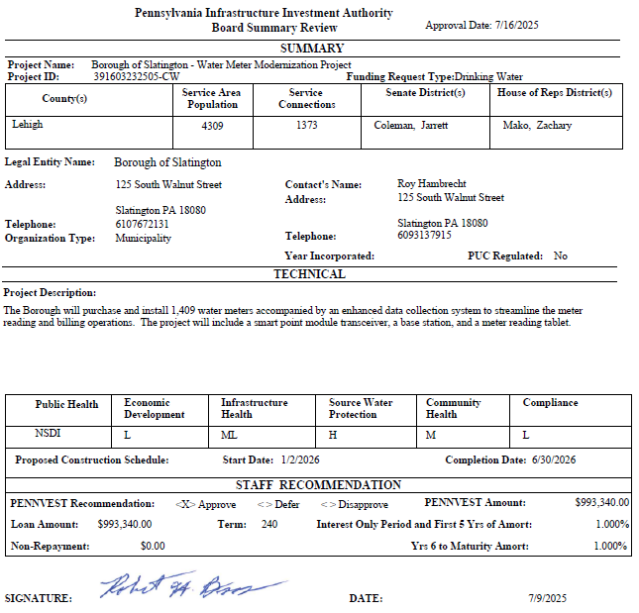
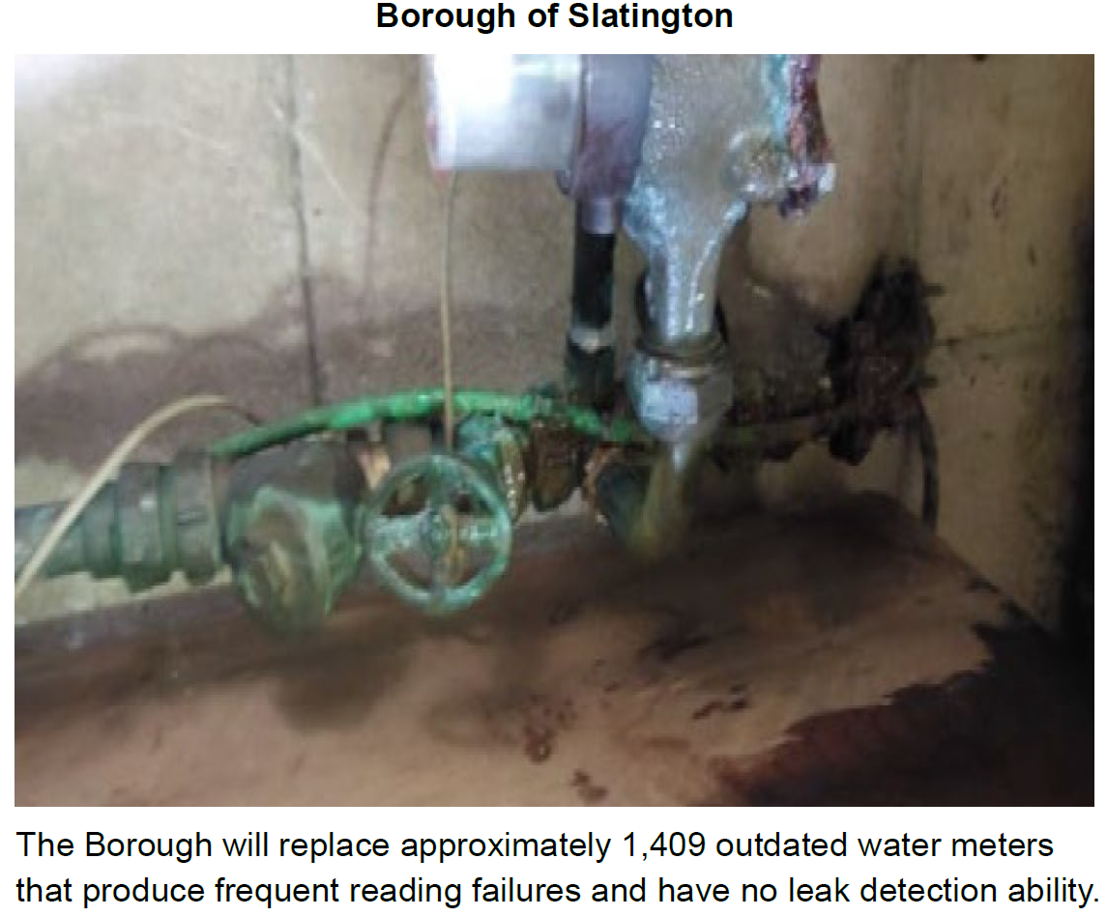
Borough of Slatington

Slide 38
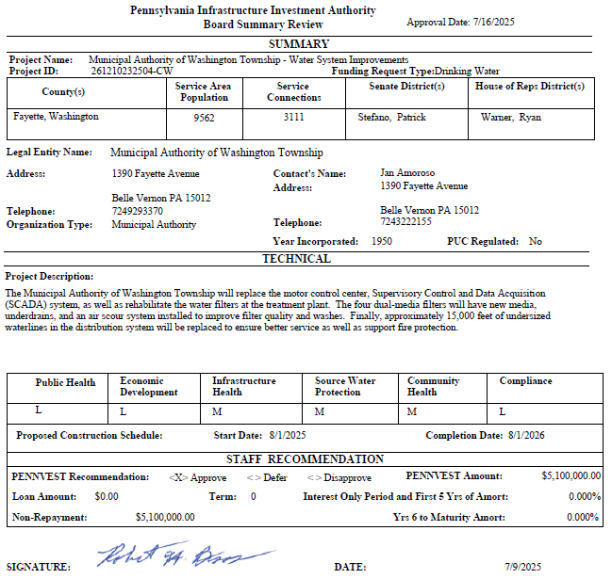
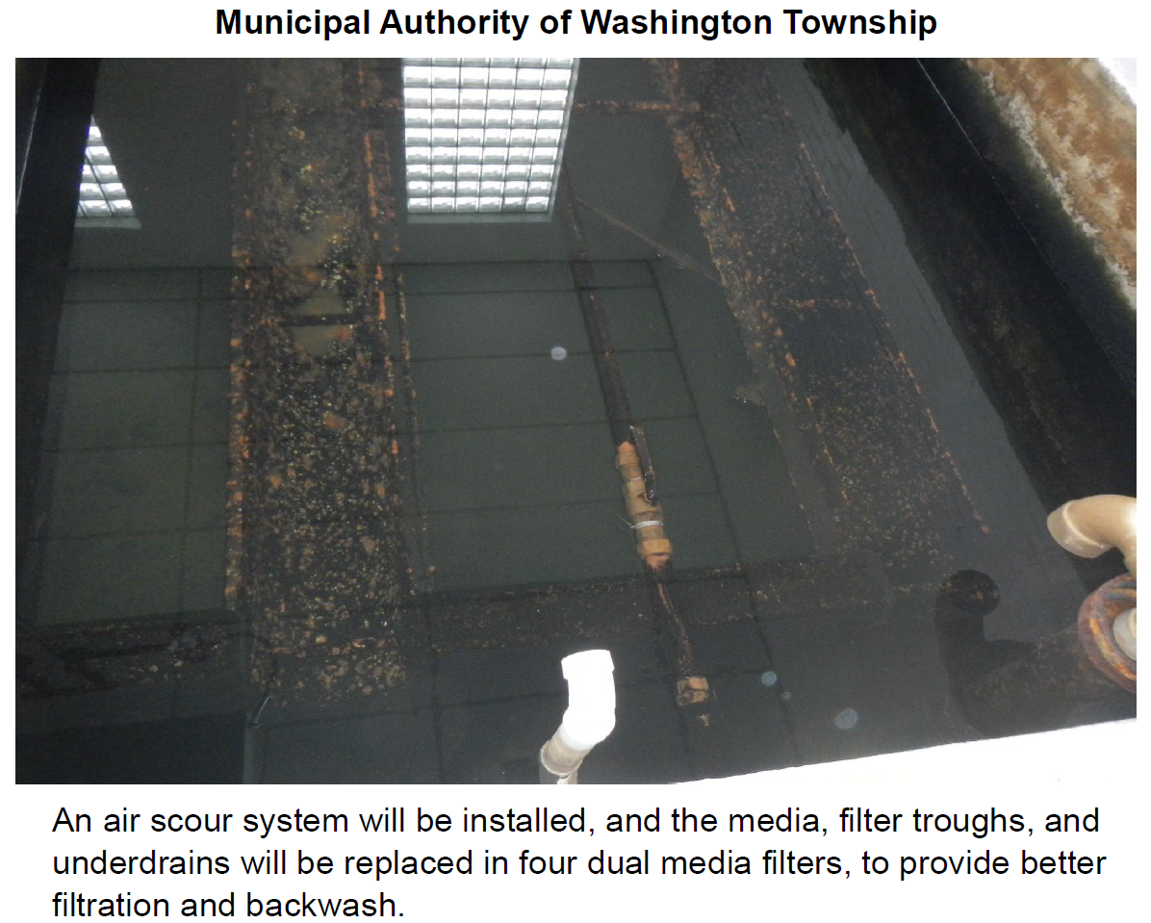
Municipal Authority of Washington Township

Slide 39
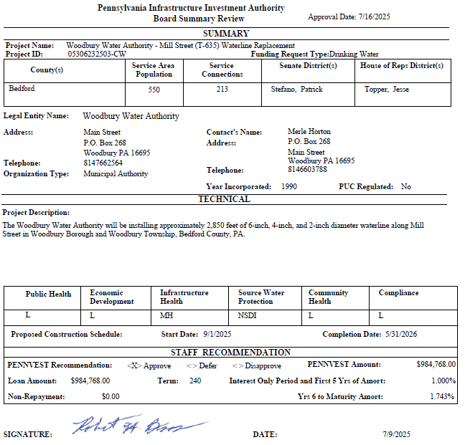
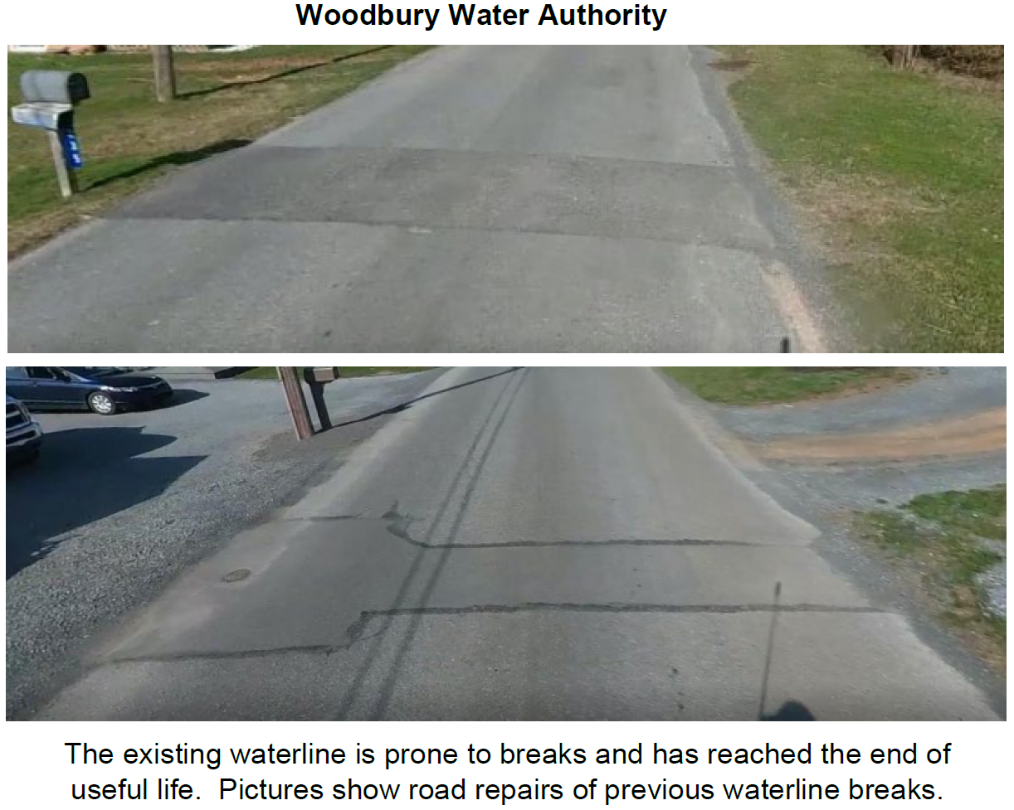
Woodbury Water Authority

Slide 40
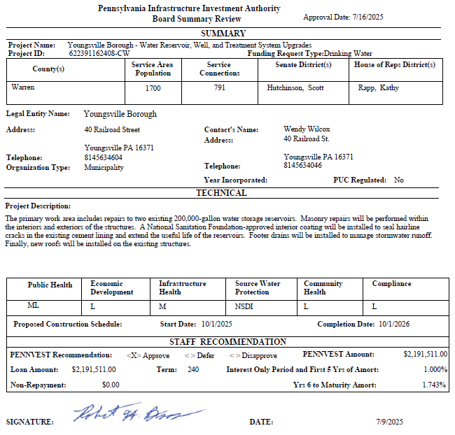
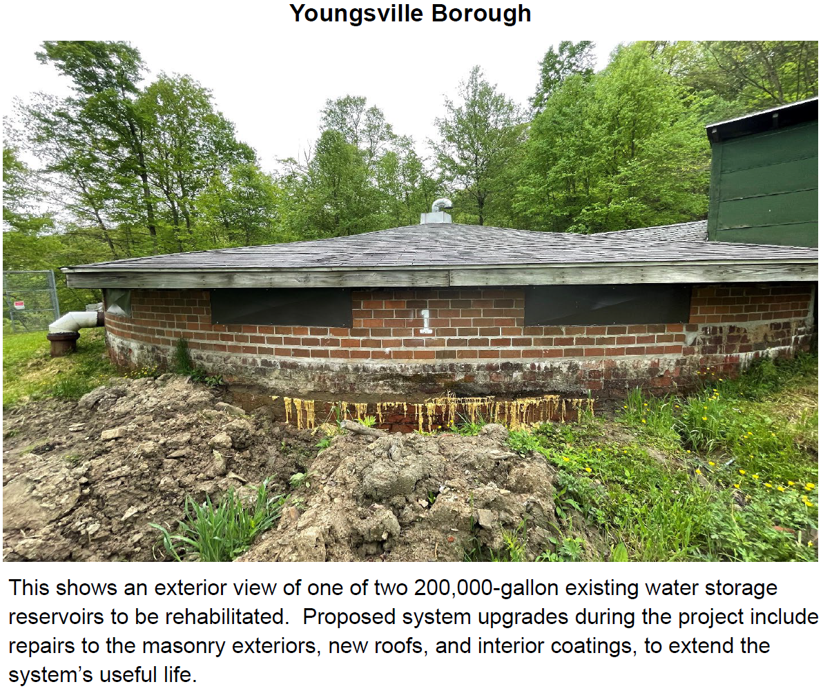
Youngsville Borough

Slide 41
PROJECT SPECIALIST
PRESENTATIONS
III. FINANCIAL ASSISTANCE APPLICATIONS A. CONSTRUCTION (i) DRINKING WATER

Slide 42
Pittsburgh Water & Sewer Authority

Slide 43
The Municipal Authority of the Borough of Portage

Slide 44
Board Discussion
III. FINANCIAL ASSISTANCE APPLICATIONS A. CONSTRUCTION (i) DRINKING WATER

Slide 45
Public Comment
III. FINANCIAL ASSISTANCE APPLICATIONS A. CONSTRUCTION (i) DRINKING WATER

Slide 46
Vote
III. FINANCIAL ASSISTANCE APPLICATIONS A. CONSTRUCTION (i) DRINKING WATER

Slide 47
WASTEWATER
CONSTRUCTION PROJECTS
III. FINANCIAL ASSISTANCE APPLICATIONS A. CONSTRUCTION (ii) WASTEWATER

Slide 48
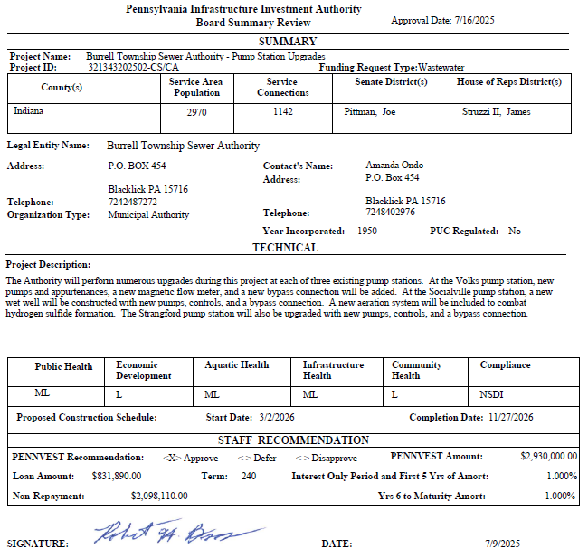
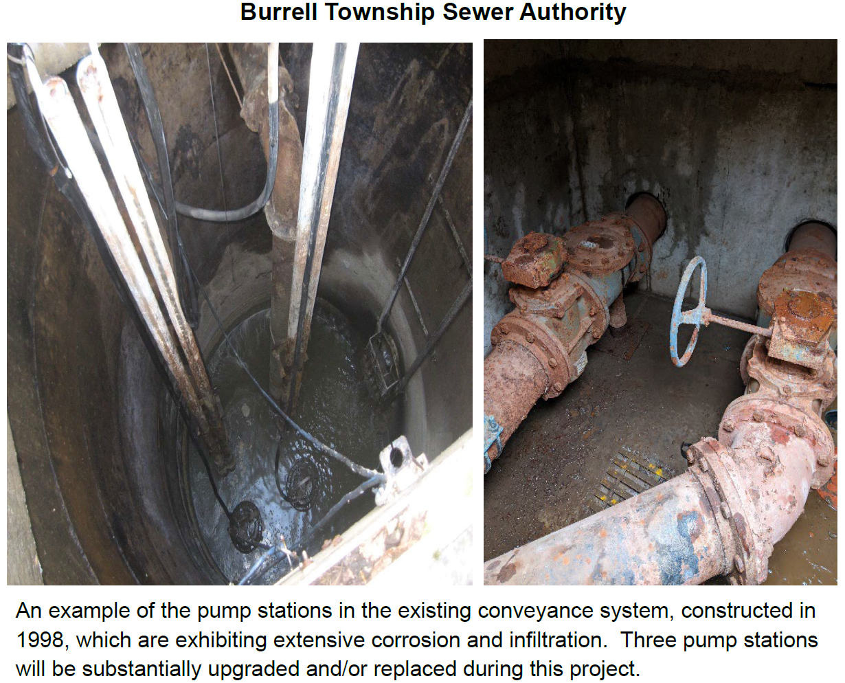
Burrell Township Sewer Authority

Slide 49
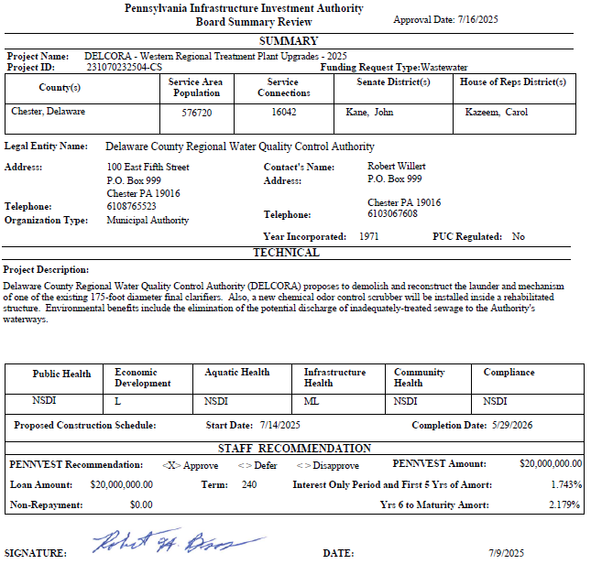
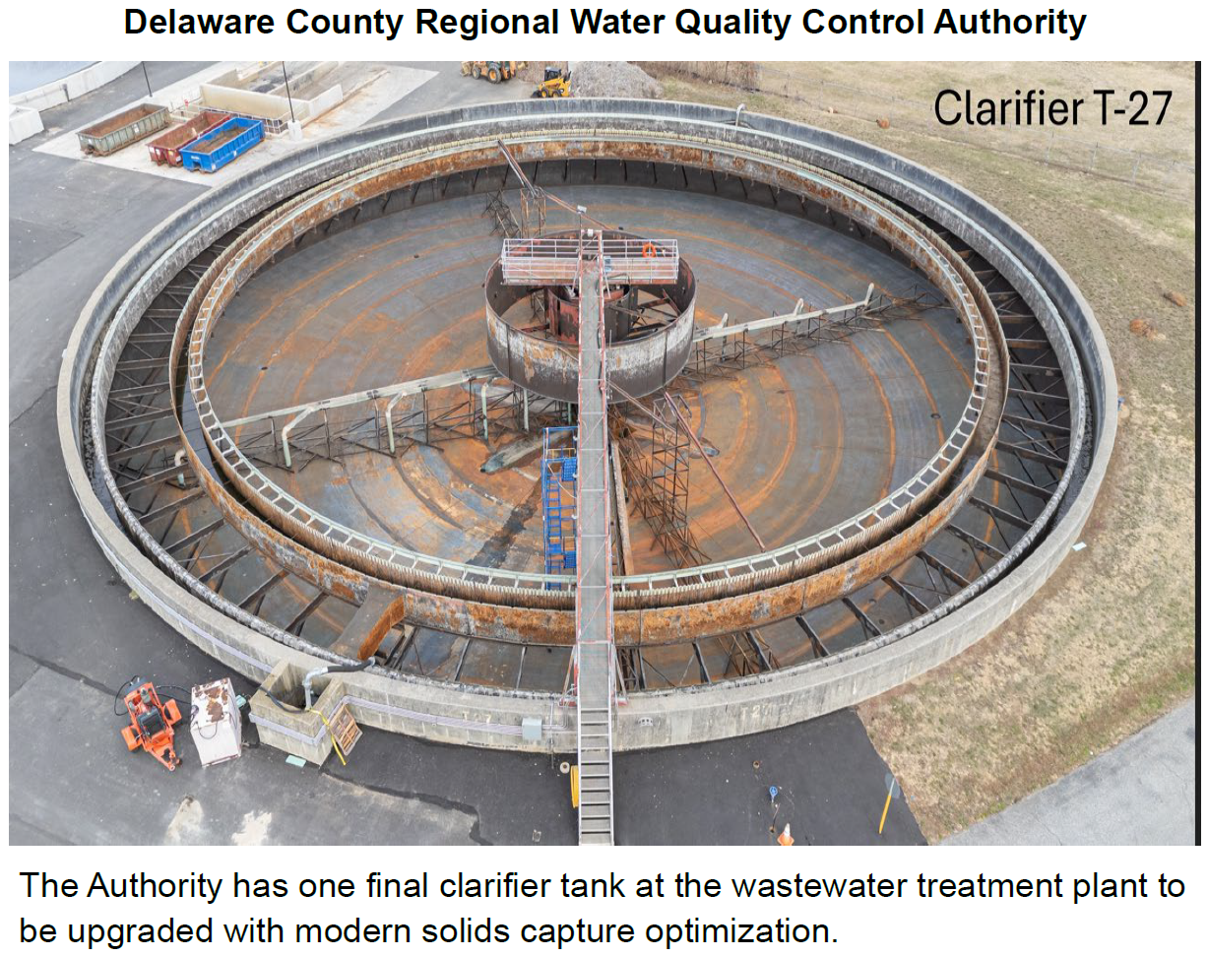
Delaware County Regional Water Quality Control Authority

Slide 50
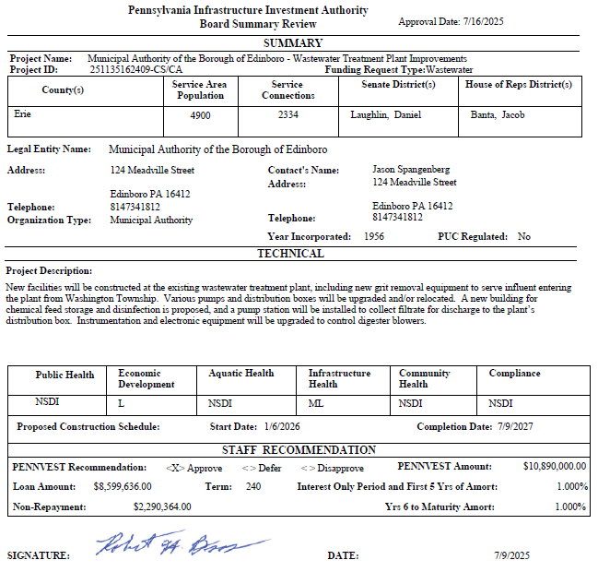
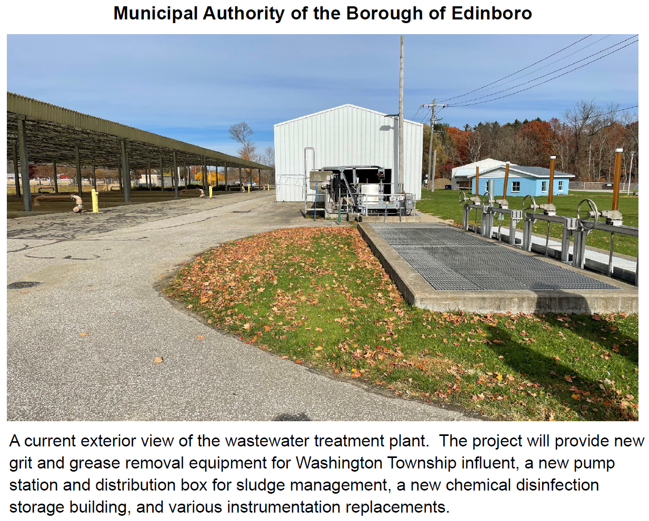
Municipal Authority of the Borough of Edinboro

Slide 51
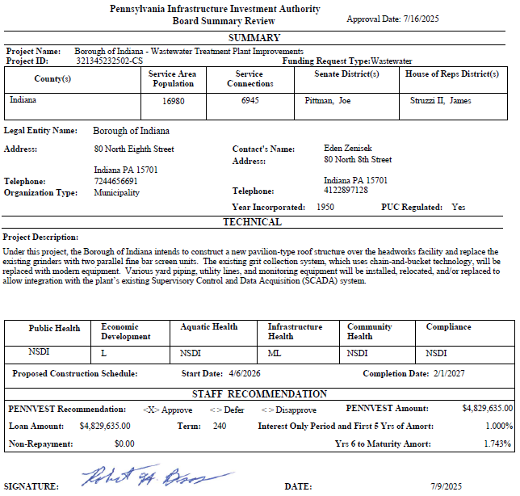
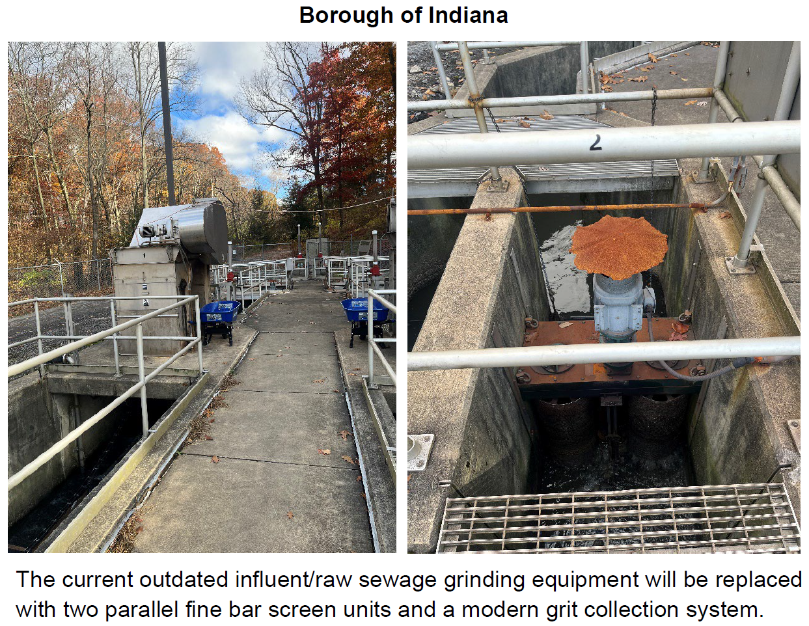
Borough of Indiana

Slide 52
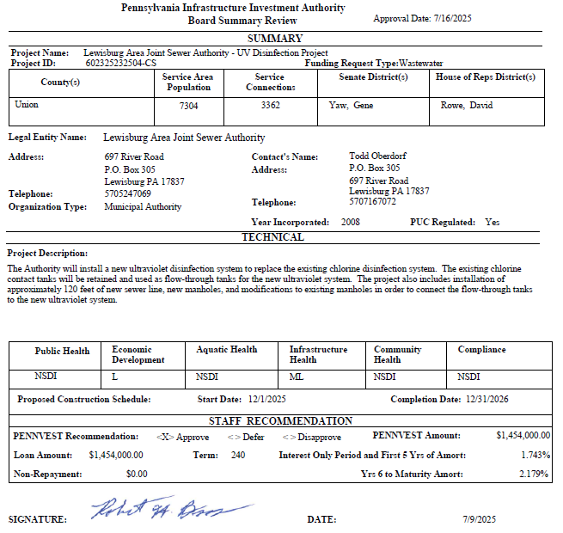
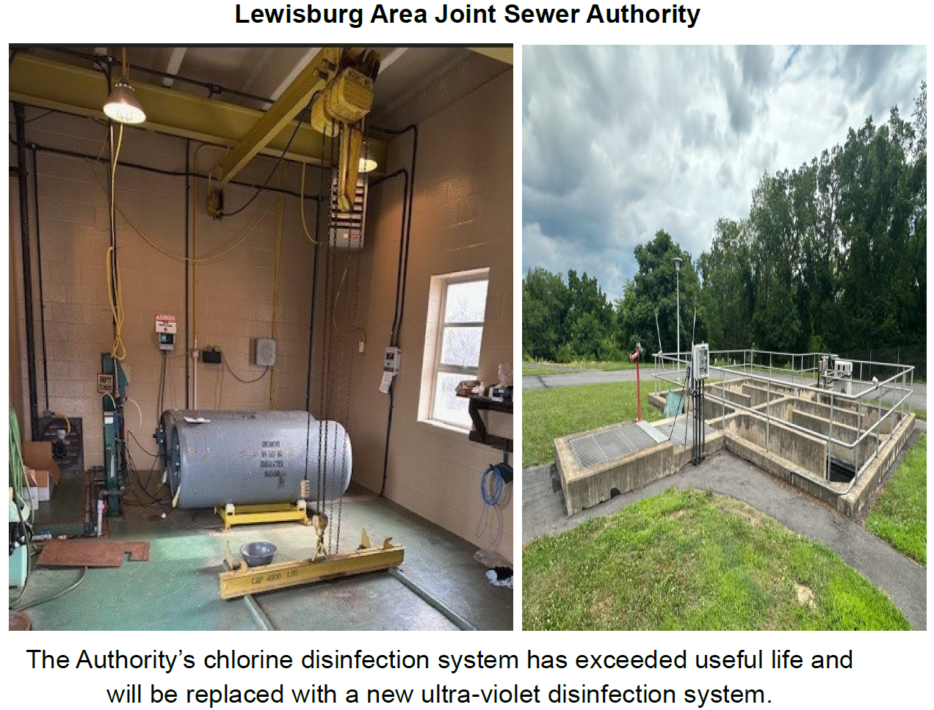
Lewisburg Area Joint Sewer Authority

Slide 53


Pennsylvania American Water Company

Slide 54


Robesonia-Wernersville Municipal Authority

Slide 55


Saxton Borough Municipal Authority

Slide 56


Schellsburg Municipal Authority

Slide 57
PROJECT SPECIALIST
PRESENTATIONS
III. FINANCIAL ASSISTANCE APPLICATIONS A. CONSTRUCTION (ii) WASTEWATER

Slide 58
Delaware County Regional Water Quality Control Authority

Slide 59
Lewisburg Area Joint Sewer Authority

Slide 60
Board Discussion
III. FINANCIAL ASSISTANCE APPLICATIONS A. CONSTRUCTION (ii) WASTEWATER

Slide 61
Public Comment
III. FINANCIAL ASSISTANCE APPLICATIONS A. CONSTRUCTION (ii) WASTEWATER

Slide 62
Vote
III. FINANCIAL ASSISTANCE APPLICATIONS A. CONSTRUCTION (ii) WASTEWATER

Slide 63
STORMWATER
CONSTRUCTION PROJECTS
III. FINANCIAL ASSISTANCE APPLICATIONS A. CONSTRUCTION (iii) STORMWATER

Slide 64


The Municipal Authority of the Borough of Bedford

Slide 65


Freeland Borough

Slide 66
PROJECT SPECIALIST
PRESENTATIONS
III. FINANCIAL ASSISTANCE APPLICATIONS A. CONSTRUCTION (iii) STORMWATER

Slide 67
The Municipal Authority of the Borough of Bedford

Slide 68
Board Discussion
III. FINANCIAL ASSISTANCE APPLICATIONS A. CONSTRUCTION (iii) STORMWATER

Slide 69
Public Comment
III. FINANCIAL ASSISTANCE APPLICATIONS A. CONSTRUCTION (iii) STORMWATER

Slide 70
Vote
III. FINANCIAL ASSISTANCE APPLICATIONS A. CONSTRUCTION (iii) STORMWATER

Slide 71
DRINKING WATER FACILITIES ADVANCE FUNDING
III. FINANCIAL ASSISTANCE APPLICATIONS B. ADVANCE FUNDING (i) DRINKING WATER

Slide 72


Wattsburg Borough

Slide 73
PROJECT SPECIALIST
PRESENTATIONS
III. FINANCIAL ASSISTANCE APPLICATIONS B. ADVANCE FUNDING (i) DRINKING WATER

Slide 74
Wattsburg Borough

Slide 75
Board Discussion
III. FINANCIAL ASSISTANCE APPLICATIONS B. ADVANCE FUNDING (i) DRINKING WATER

Slide 76
Public Comment
III. FINANCIAL ASSISTANCE APPLICATIONS B. ADVANCE FUNDING (i) DRINKING WATER

Slide 77
Vote
III. FINANCIAL ASSISTANCE APPLICATIONS B. ADVANCE FUNDING (i) DRINKING WATER

Slide 78
PRIOR-APPROVED
PROJECTS
INCREASES/DECREASES
IV. PRIOR-APPROVED PROJECTS A. INCREASES/DECREASES

Slide 79

Totals of Increases/Decreases Report

Slide 80

Dollars Disencumbered Report

Slide 81

Current Individual Increase Requests Summary

Slide 82
Board Discussion
IV. PRIOR-APPROVED PROJECTS A. INCREASES/DECREASES

Slide 83
Public Comment
IV. PRIOR-APPROVED PROJECTS A. INCREASES/DECREASES

Slide 84
Vote
IV. PRIOR-APPROVED PROJECTS A. INCREASES/DECREASES

Slide 85
PRIOR-APPROVED
PROJECTS
PROGRAM INITIATIVES
IV. PRIOR-APPROVED PROJECTS B. PROGRAM INITIATIVES

Slide 86

Small Projects Report

Slide 87

Bipartisan Infrastructure Law (BIL) Project Summary

Slide 88

Bipartisan Infrastructure Law (BIL) Project Summary

Slide 89

Bipartisan Infrastructure Law (BIL) Project Summary

Slide 90
PRIOR-APPROVED
PROJECTS
ON-LOT REPORT
IV. PRIOR-APPROVED PROJECTS C. ON-LOT REPORT

Slide 91

On-Lot Report

Slide 92
PRIOR-APPROVED
PROJECTS
PROJECT STATUS
IV. PRIOR-APPROVED PROJECTS D. PROJECT STATUS

Slide 93

Application to Approval Projects for July 16, 2025

Slide 94

Approval to Settlement Projects for July 16, 2025

Slide 95

Approval to Settlement Projects for July 16, 2025

Slide 96

Approval to Settlement Projects for July 16, 2025

Slide 97

Approval to Settlement Projects for July 16, 2025

Slide 98

Approval to Settlement Projects for July 16, 2025

Slide 99
Final Public Comment

Slide 100
Save the date
The next scheduled board meeting:
October 15, 2025
Application cut-off date:
July 30, 2025

Slide 101
Vote to Adjourn
V. ADJOURNMENT

