Slide 1


Board of Directors Meeting
July 15, 2026
10:30 a.m.

Slide 2

Recording Notice
This meeting is being recorded.
By participating in this webinar, you consent to the
recording, retention, and use of this session.
If you ask a question, you consent to the
recording, retention, and use of your statements
as part of the meeting.

Slide 3
Transcription Notice
Commonwealth of Pennsylvania policy prohibits the use of Artificial Intelligence transcription software during this meeting.
Please note, PENNVEST staff is required to disable or remove transcription tools from the meeting.

Slide 4
Technical Information
Can’t Hear Us?
Join the audio portion of the presentation via your telephone:
Call 1-267-332-8737
Meeting ID 977 049 971#
Technical Difficulties?
Call 717-574-8449 or
Send a Chat message via the Microsoft Teams meeting
Want the App?
Search “Microsoft Teams” in the Google Play Store or the App Store.

Slide 5
Public Comment
During the presentation, all attendees will be muted.
There are two methods you can use within this
Microsoft Teams meeting to pose a public comment or question.
“Raise Hand” function
“Chat” function

Slide 6
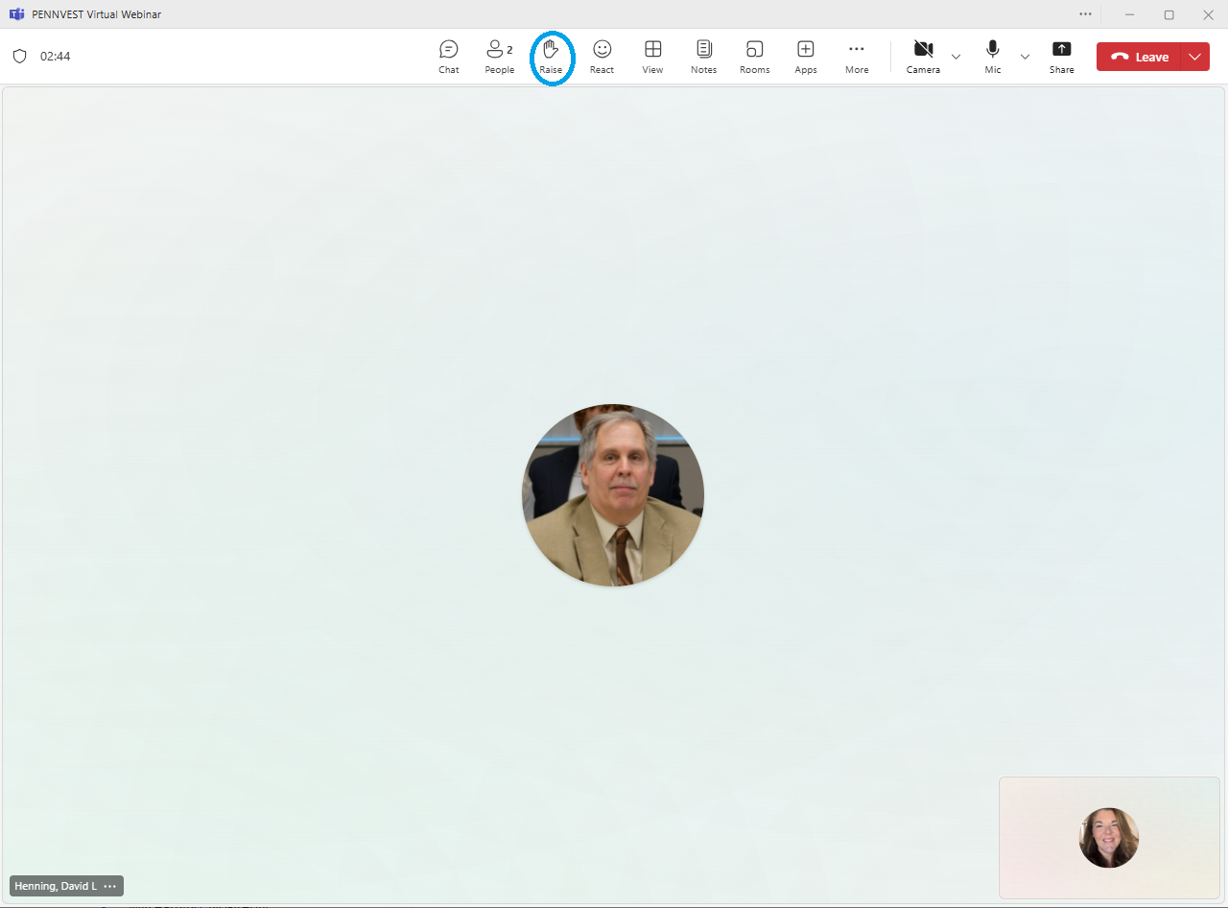



Raise Hand
In the top toolbar, raise your hand by clicking on the hand icon to indicate your request to speak.
Attendees with raised hands will be unmuted individually, allowing participants to speak one at a time.
Your microphone will show a diagonal line through the icon when muted. When the diagonal line disappears, you may pose your question or comment.

Slide 7

Chat
In the top toolbar, click on the chat bubble icon to open the chat dialogue box. Type your question or comment in the Meeting Chat.
PENNVEST staff will monitor the Chat area throughout the meeting.
Replies may be delivered verbally, or returned through the same chat box, from appropriate meeting participant(s). Responses will typically be given during an applicable Public Comment portion of the meeting.

Slide 8

Public Comment
Participant Best Practices
1. Log in to the Board Meeting through a computer or smart phone (using the Teams app).
2. When your microphone has been unmuted, begin by stating:
Your name.
Your affiliation (i.e., company, organization, etc.).
Indicate the specific project, agency activity, or agenda item about which you are commenting.
If your comment or question is on behalf of another individual or organization, please acknowledge this, immediately after your name and affiliation, and reference the name(s) of the associated person(s) or group(s).

Slide 9
Public Comment
Notices
All verbal comments, questions and responses will be recorded and can be shared publicly.
PENNVEST cannot guarantee all persons requesting to speak will be able to do so, specifically in the case of technical difficulties beyond our control, such as:
Audio feedback.
Poor sound quality.
Interruptions in bandwidth services.

Slide 10
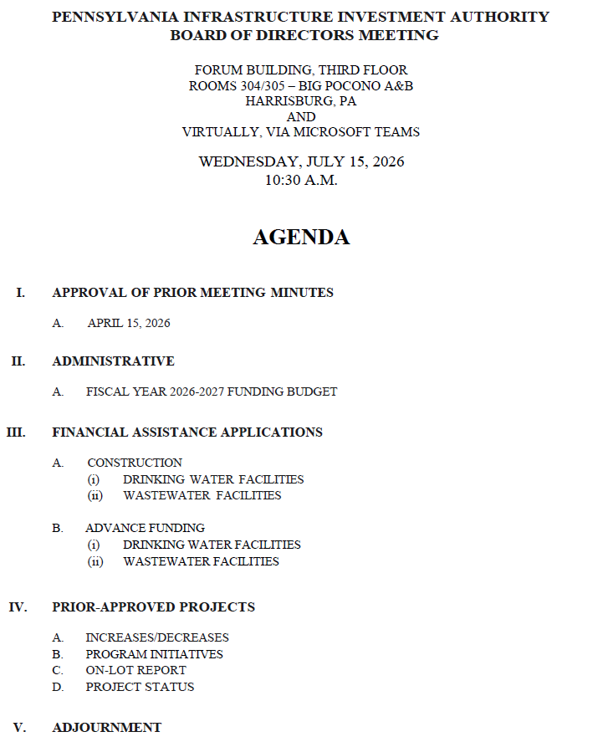

Today’s
Agenda

Slide 11
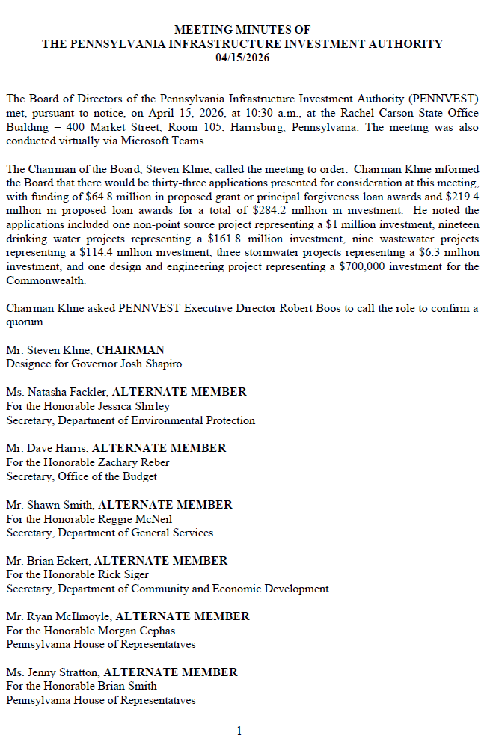
APPROVAL OF PRIOR MEETING MINUTES
A. APRIL 15, 2026

Slide 12

Motion
I. APPROVAL OF PRIOR MEETING MINUTES A. APRIL 15, 2026

Slide 13
Board Discussion
I. APPROVAL OF PRIOR MEETING MINUTES A. APRIL 15, 2026

Slide 14
Public Comment
I. APPROVAL OF PRIOR MEETING MINUTES A. APRIL 15, 2026

Slide 15

Vote
I. APPROVAL OF PRIOR MEETING MINUTES A. APRIL 15, 2026

Slide 16
ADMINISTRATIVE
II. ADMINISTRATIVE

Slide 17
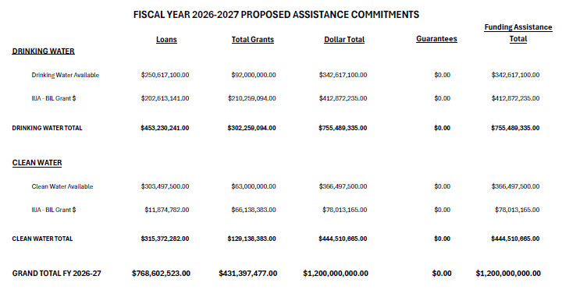
II. ADMINISTRATIVE A. FISCAL YEAR 2026-2027 FUNDING BUDGET
II. ADMINISTRATIVE
A. FISCAL YEAR
2026-2027
FUNDING BUDGET

Slide 18
II. ADMINISTRATIVE A. FISCAL YEAR 2026-2027 FUNDING BUDGET

Slide 19
Motion
II. ADMINISTRATIVE A. FISCAL YEAR 2026-2027 FUNDING BUDGET

Slide 20
Board Discussion
II. ADMINISTRATIVE A. FISCAL YEAR 2026-2027 FUNDING BUDGET

Slide 21
Public Comment
II. ADMINISTRATIVE A. FISCAL YEAR 2026-2027 FUNDING BUDGET

Slide 22
Vote
II. ADMINISTRATIVE A. FISCAL YEAR 2026-2027 FUNDING BUDGET

Slide 23
FINANCIAL ASSISTANCE APPLICATIONS
III. FINANCIAL ASSISTANCE APPLICATIONS

Slide 24
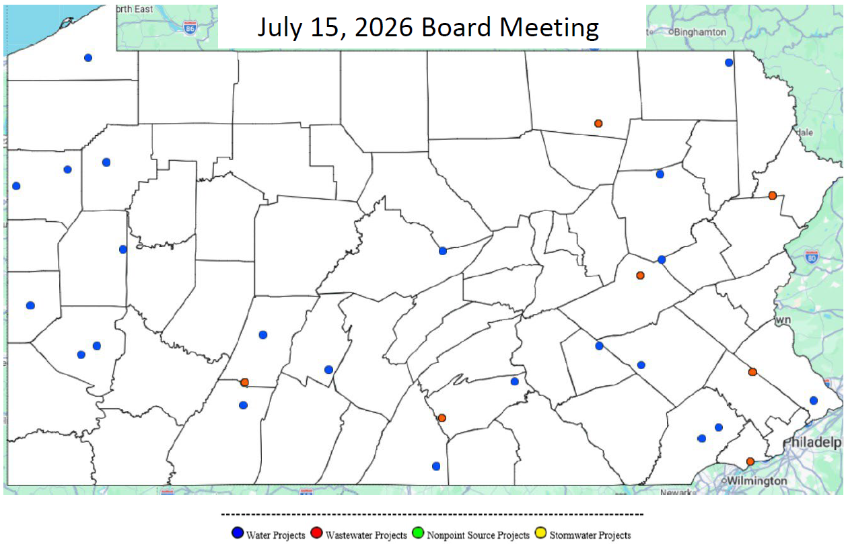
MAP OF PROJECT APPLICATIONS RECOMMENDED FOR APPROVAL
III. FINANCIAL ASSISTANCE APPLICATIONS

Slide 25
DRINKING WATER
CONSTRUCTION PROJECTS
III. FINANCIAL ASSISTANCE APPLICATIONS A. CONSTRUCTION (i) DRINKING WATER

Slide 26
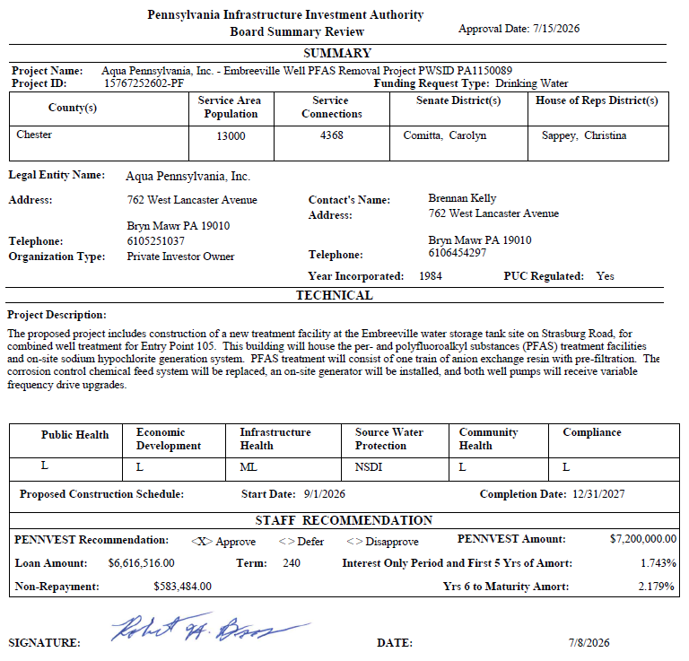
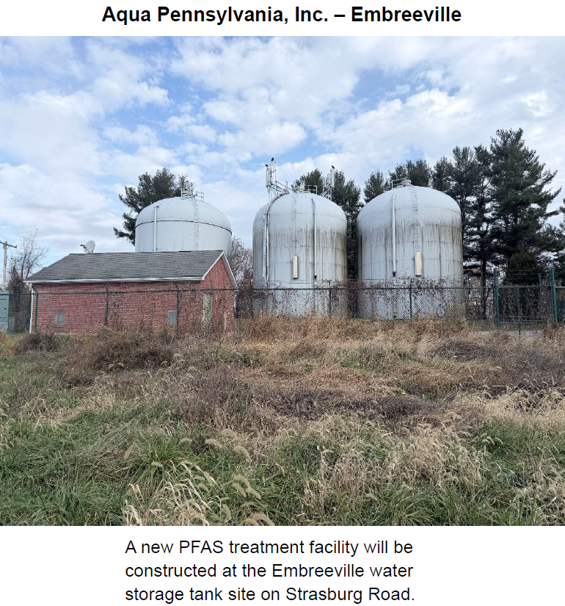
Aqua Pennsylvania, Inc. – Embreeville

Slide 27
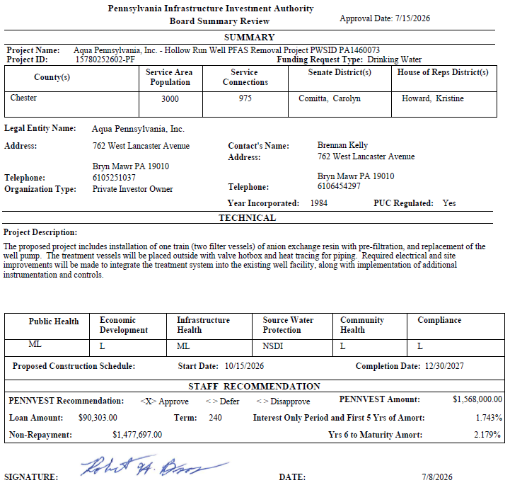
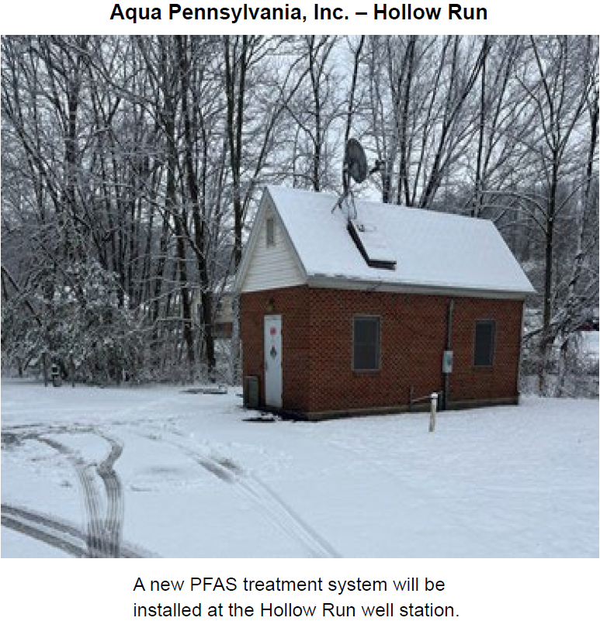
Aqua Pennsylvania, Inc. – Hollow Run

Slide 28
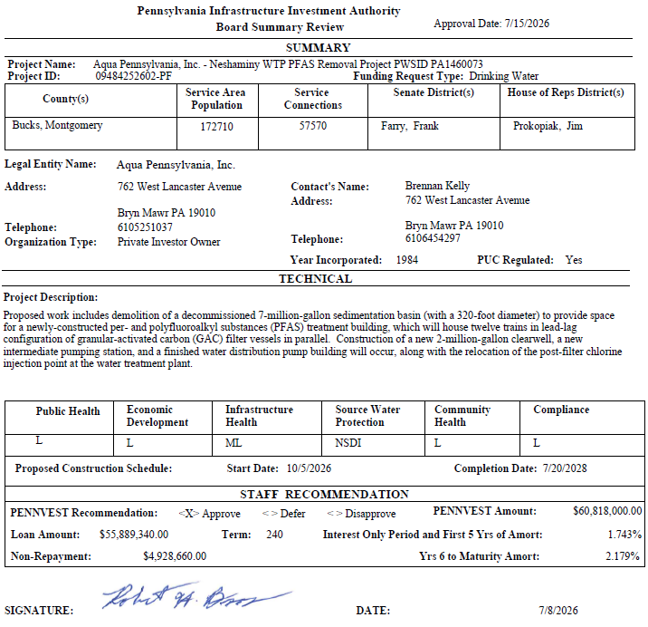
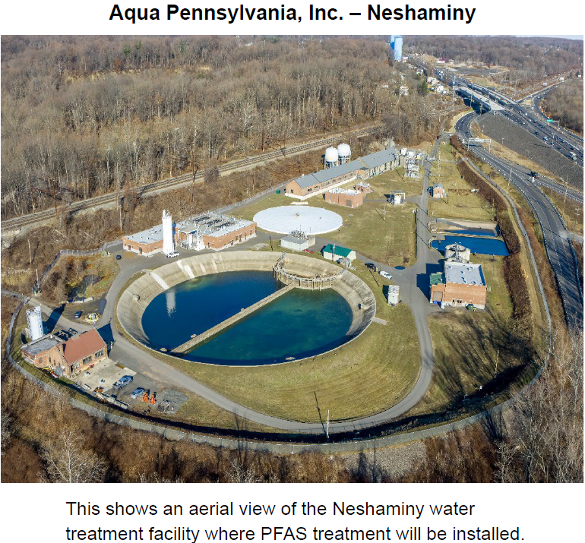
Aqua Pennsylvania, Inc. – Neshaminy

Slide 29
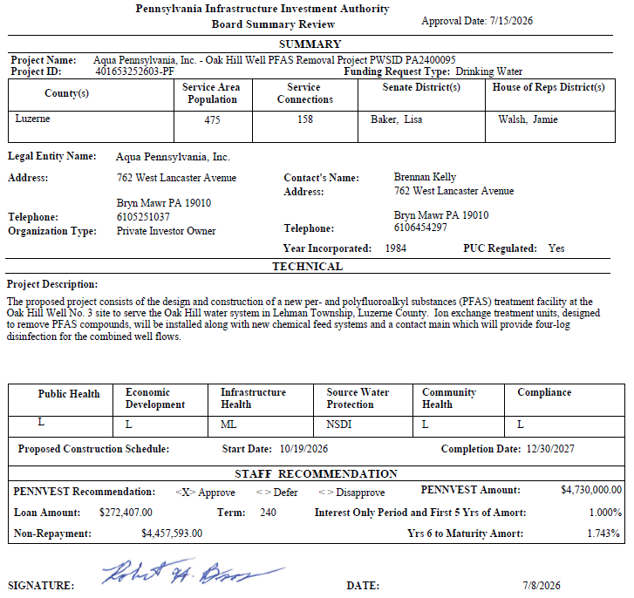
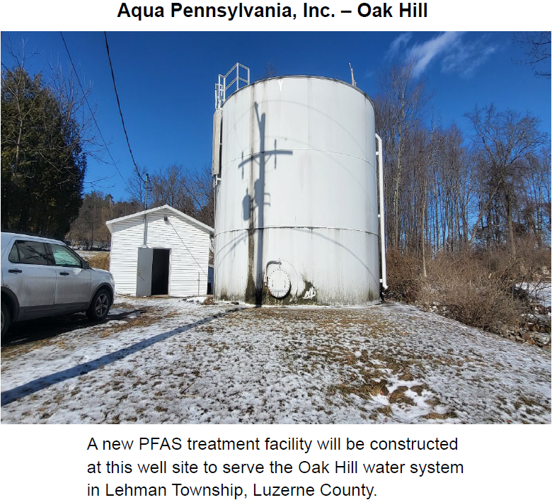
Aqua Pennsylvania, Inc. – Oak Hill

Slide 30
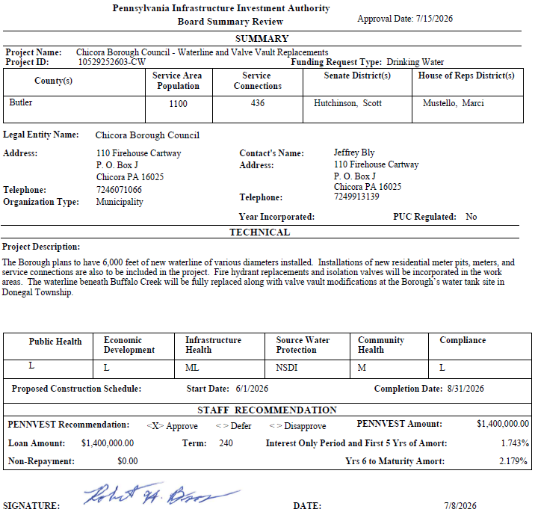
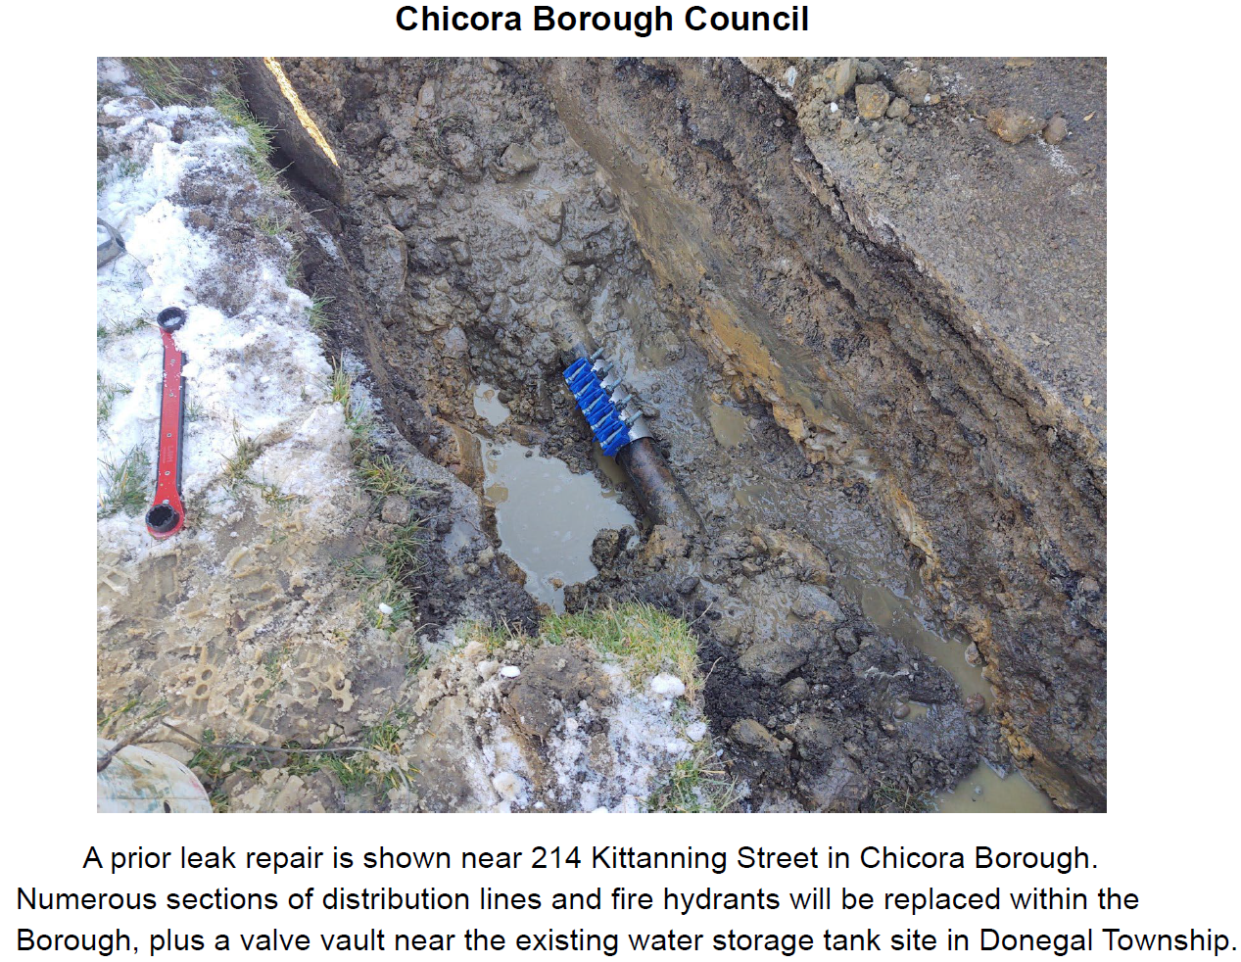
Chicora Borough Council

Slide 31
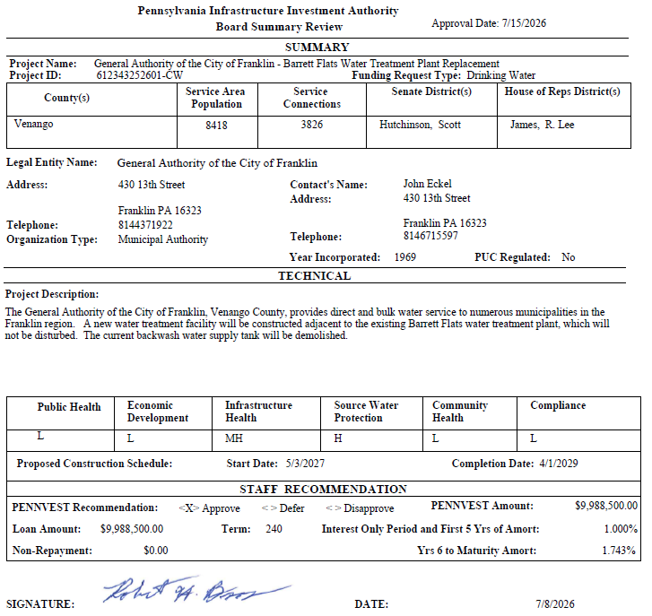
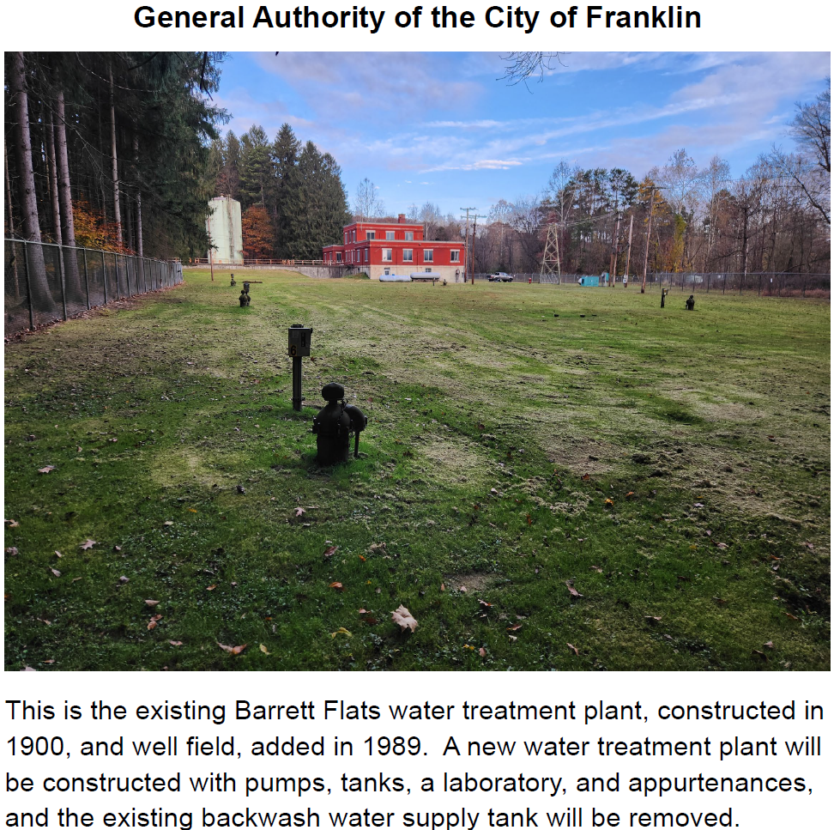
General Authority of the City of Franklin

Slide 32
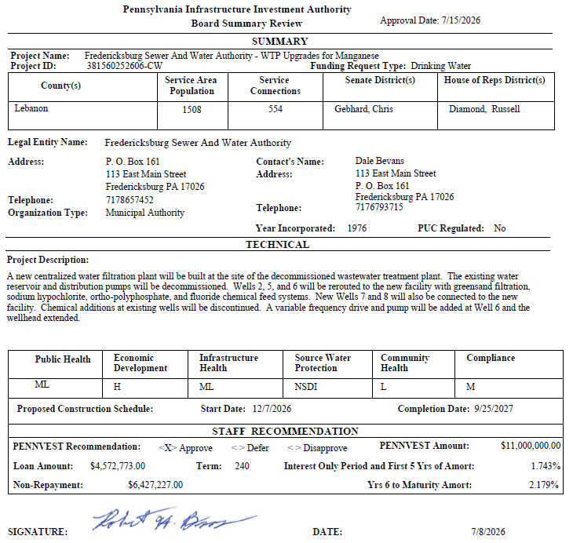
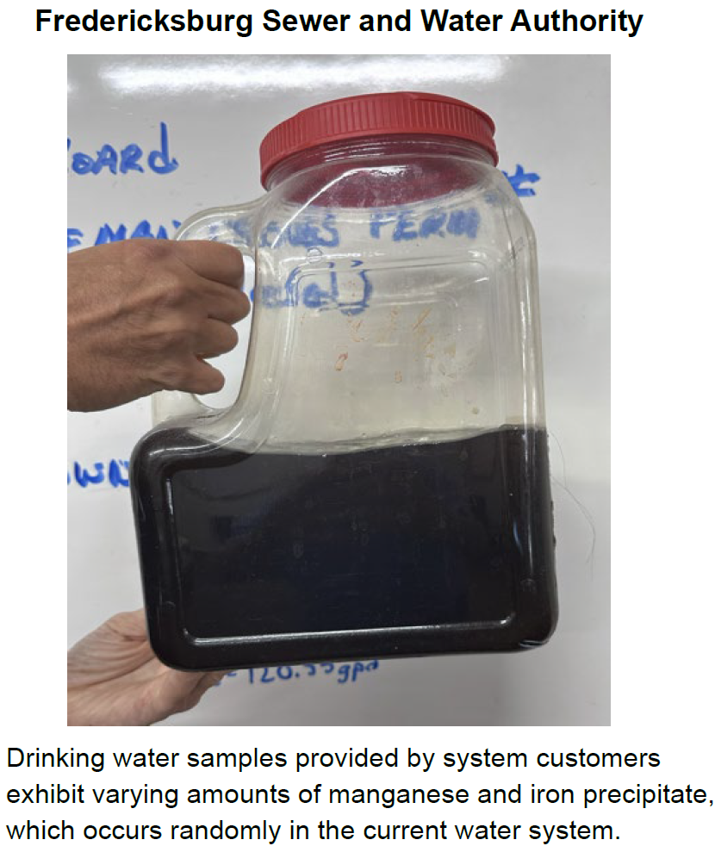
Fredericksburg Sewer and Water Authority

Slide 33
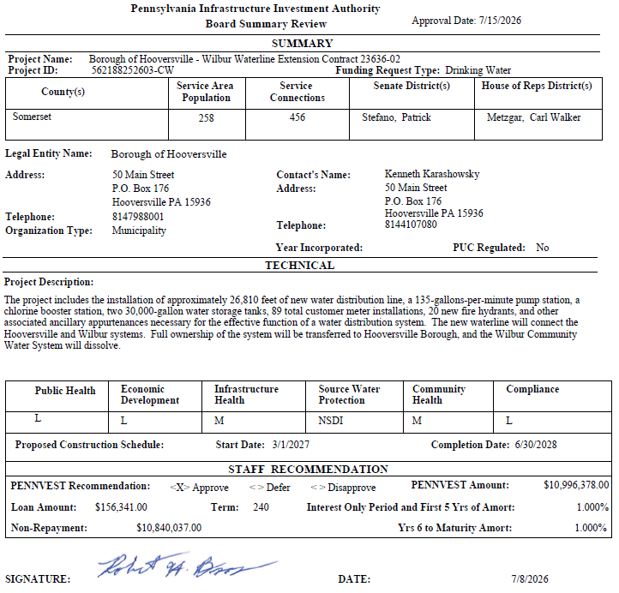
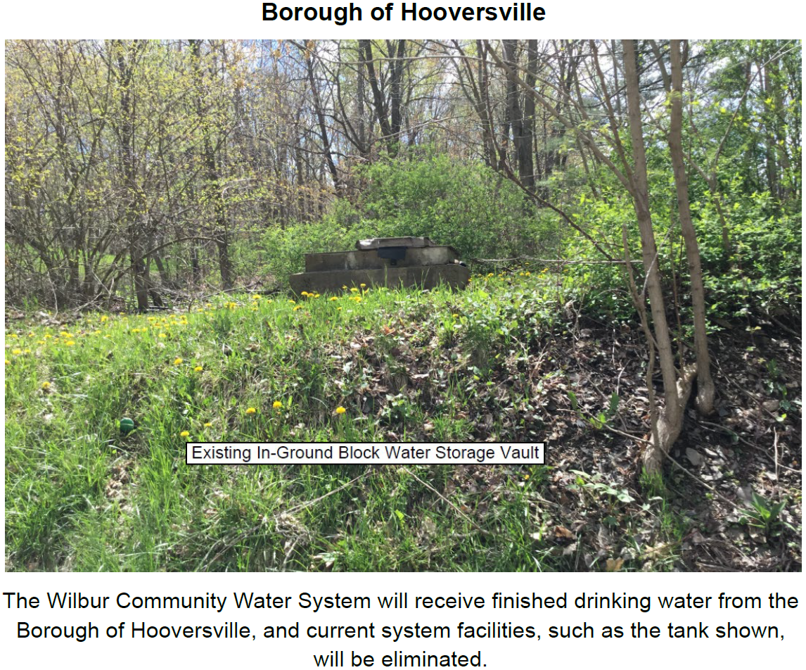
Borough of Hooversville

Slide 34
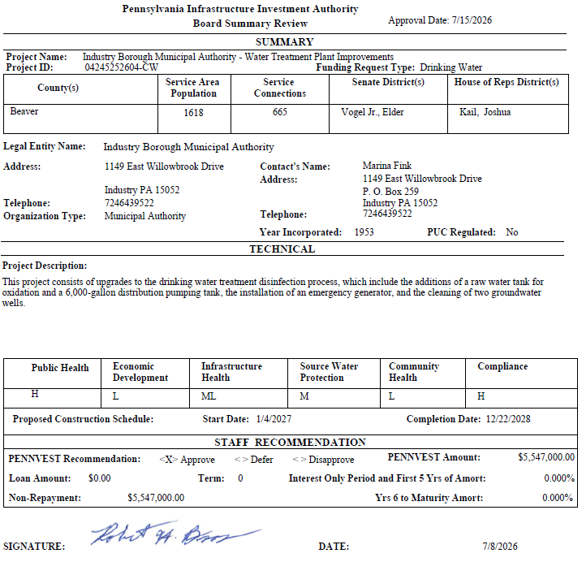
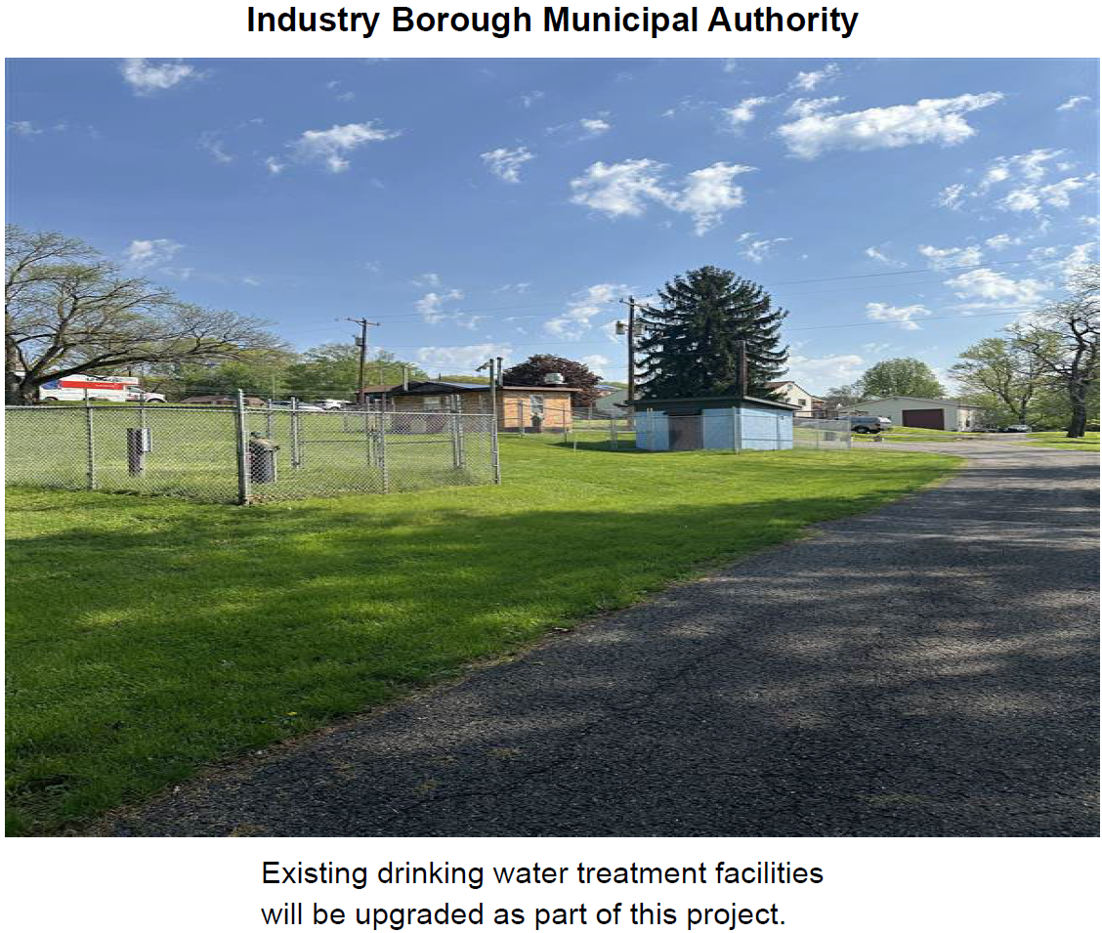
Industry Borough Municipal Authority

Slide 35
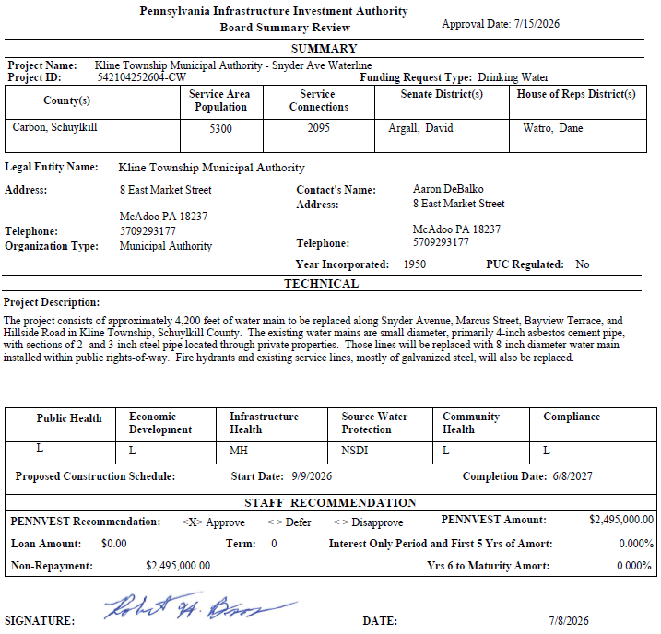
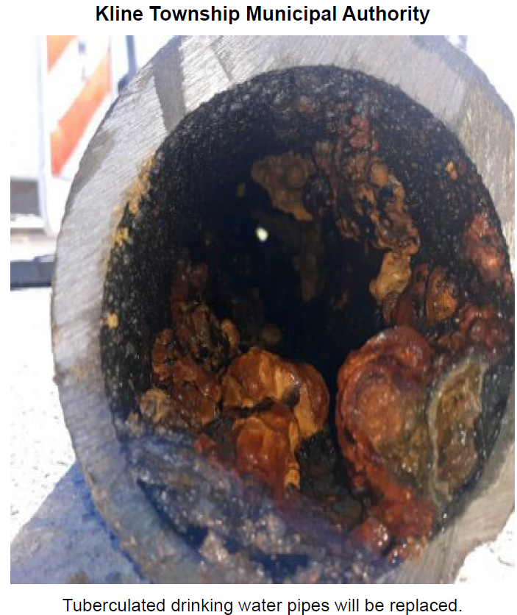
Kline Township Municipal Authority

Slide 36
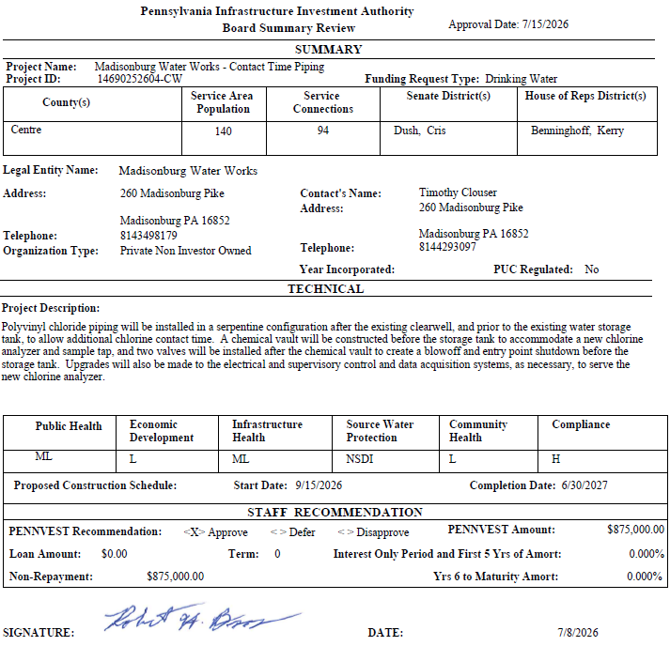
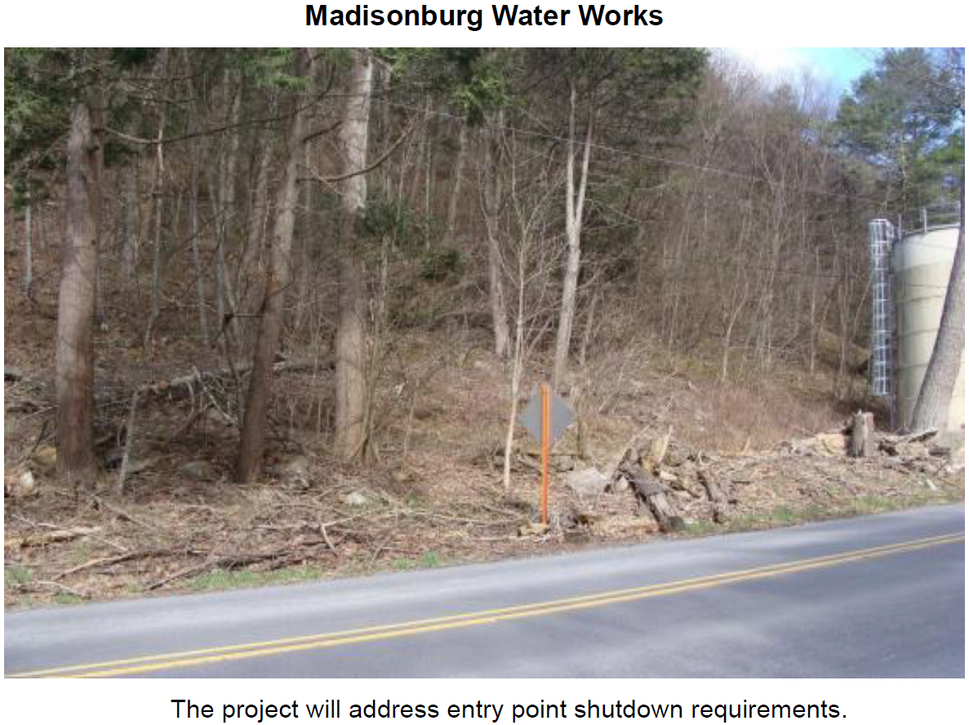
Madisonburg Water Works

Slide 37
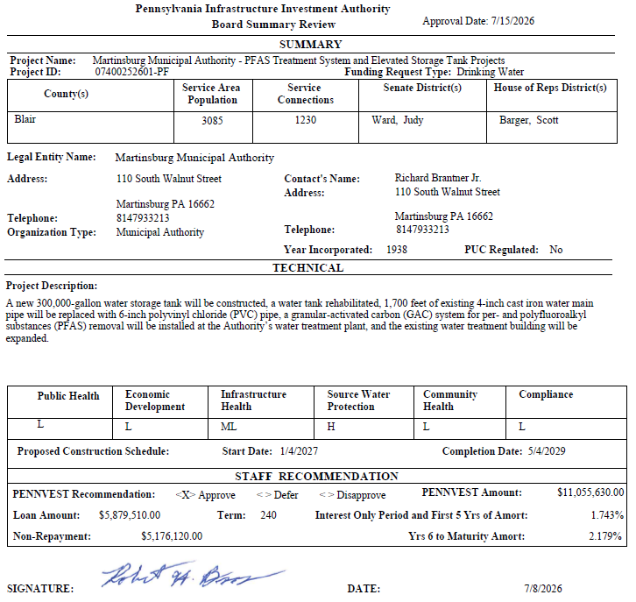
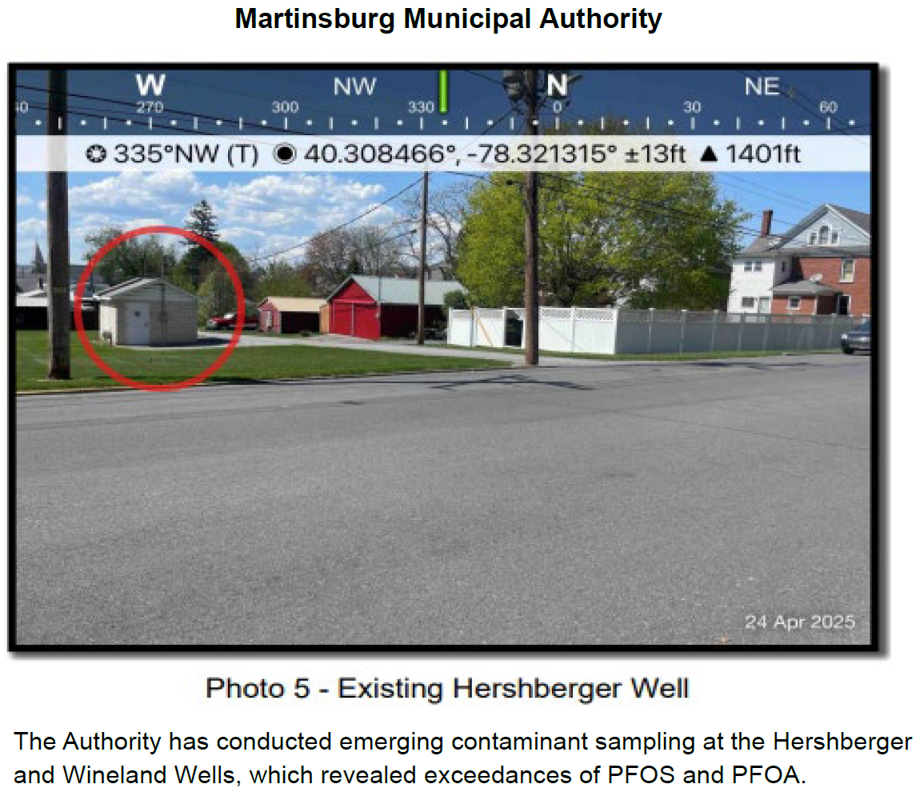
Martinsburg Municipal Authority

Slide 38
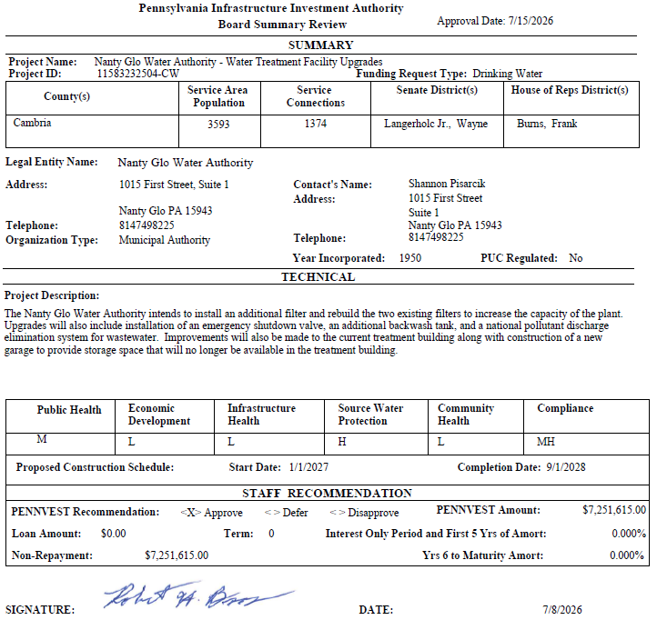
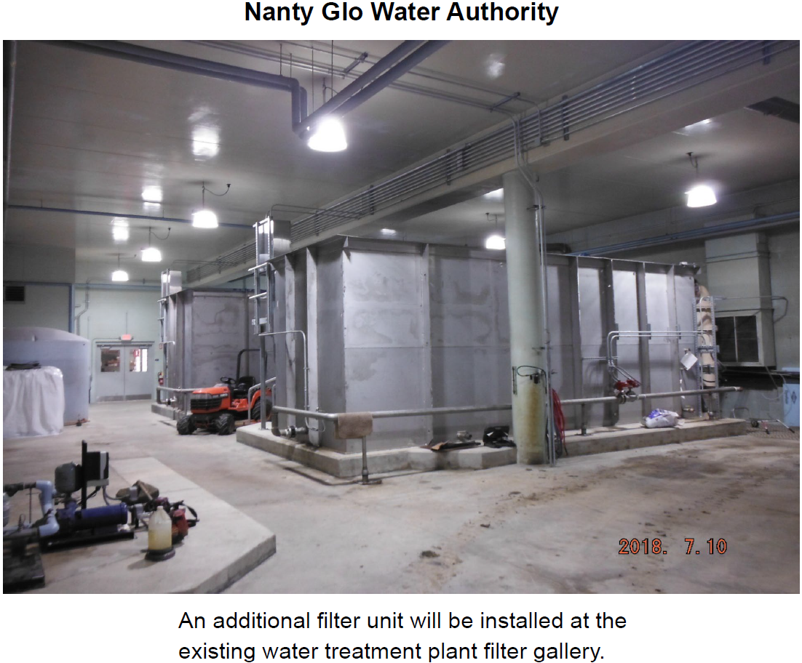
Nanty Glo Water Authority

Slide 39
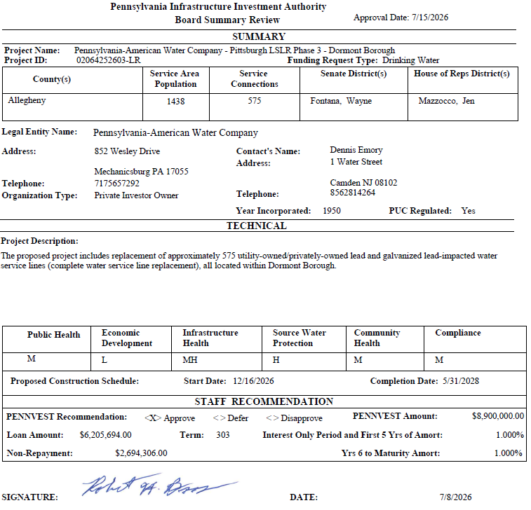
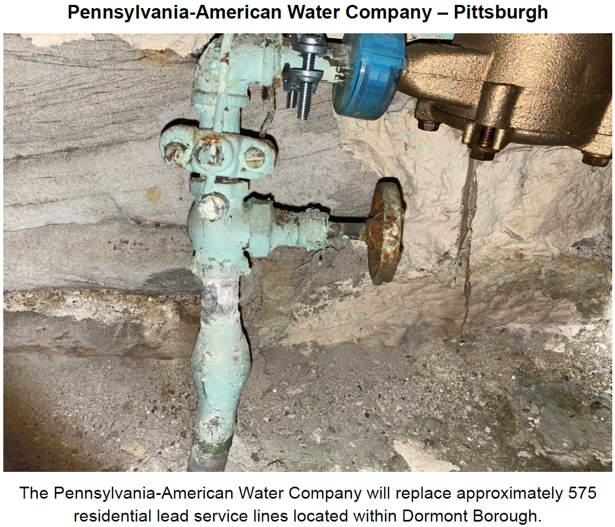
Pennsylvania American Water Company – Pittsburgh

Slide 40
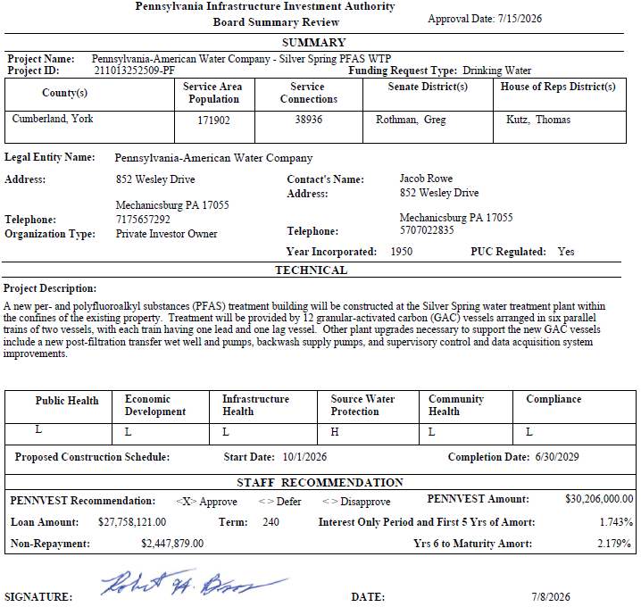
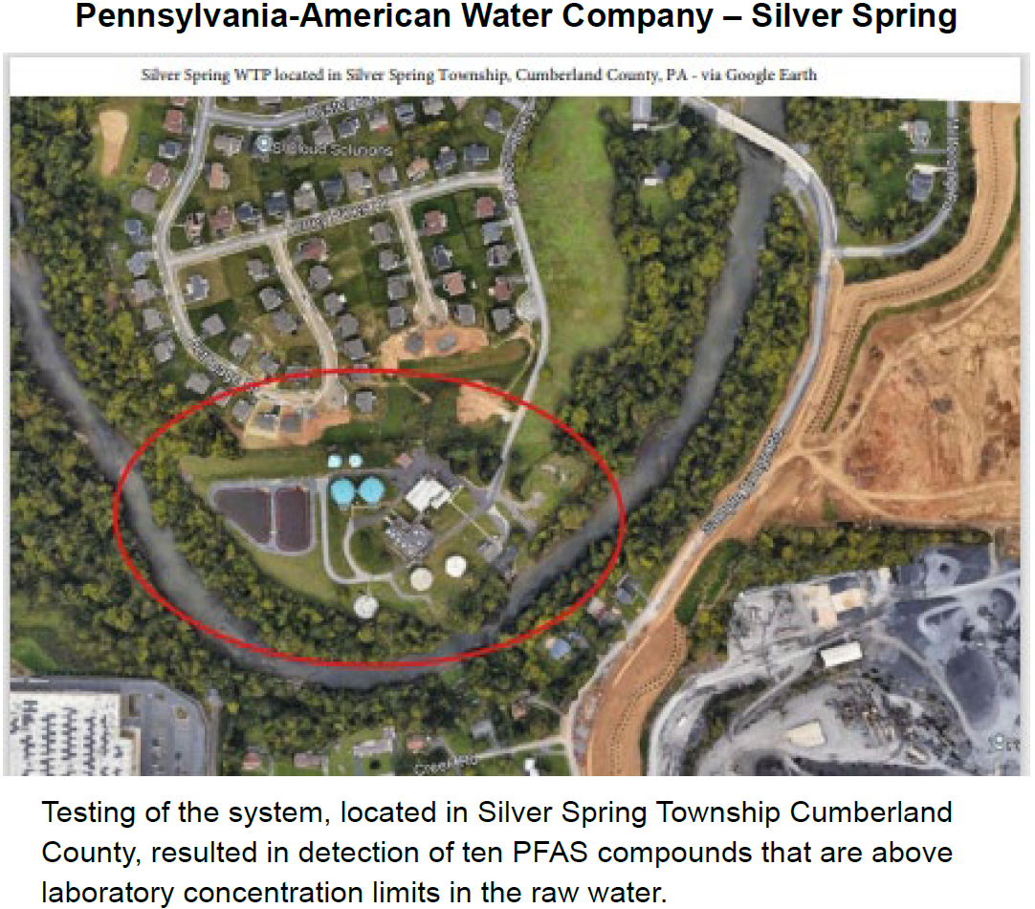
Pennsylvania American Water Company – Silver Spring

Slide 41
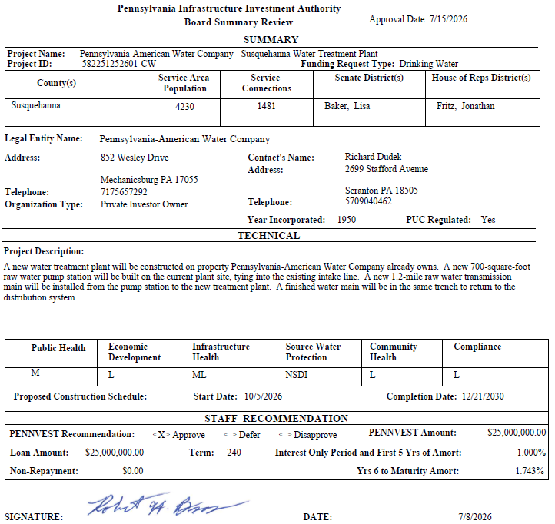
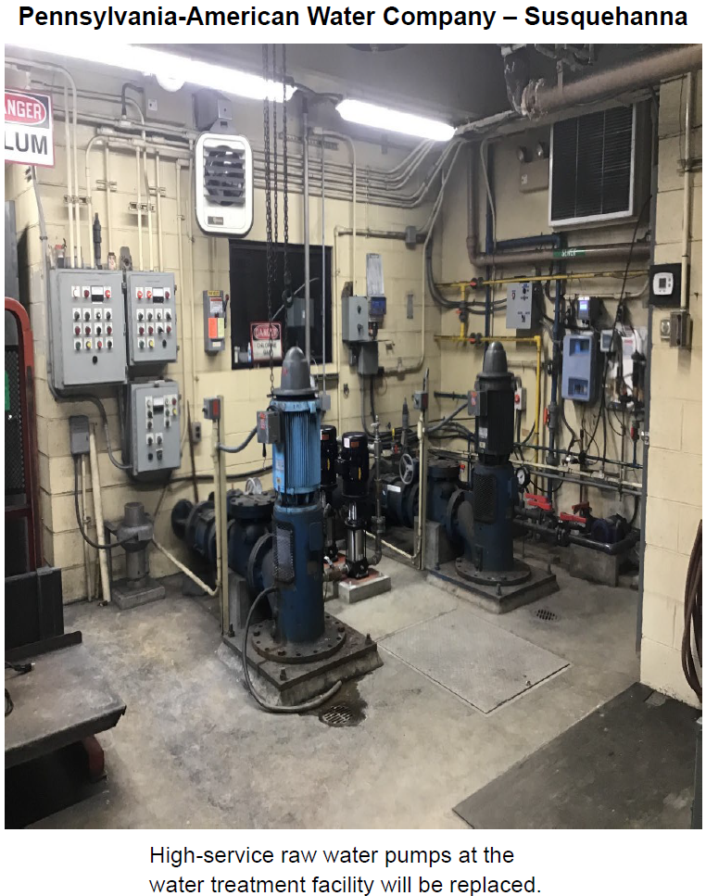
Pennsylvania American Water Company – Susquehanna

Slide 42
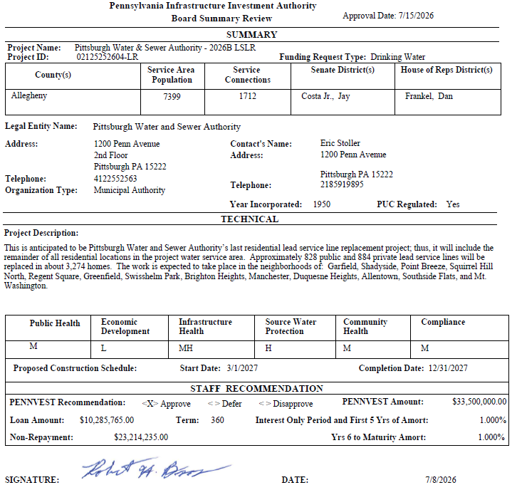
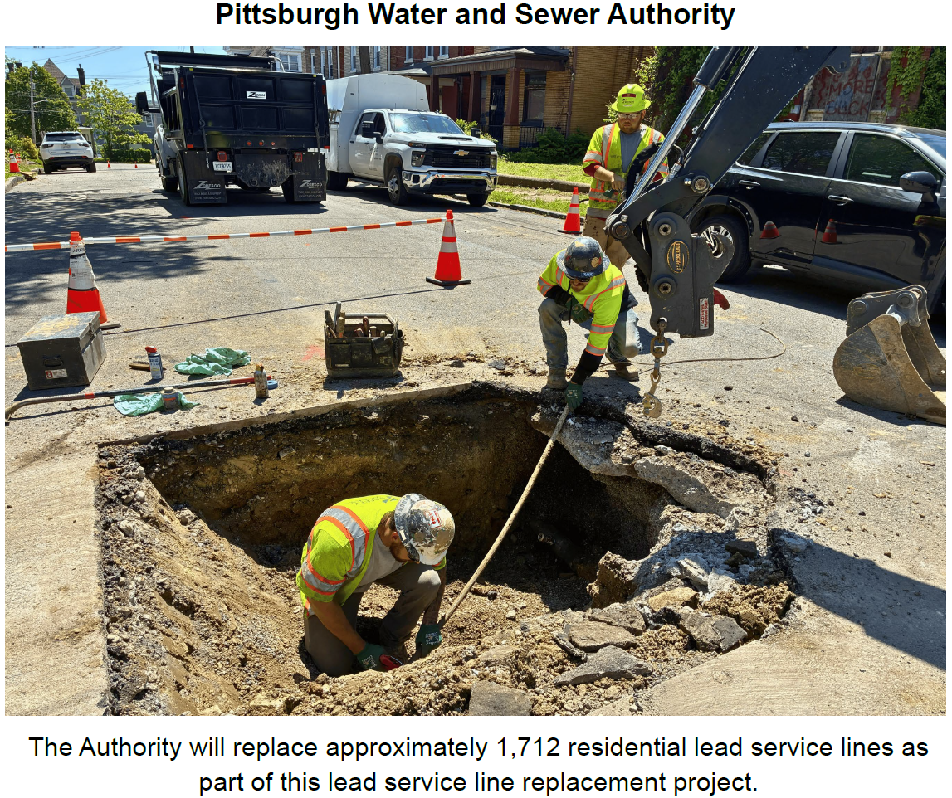
Pittsburgh Water and Sewer Authority

Slide 43
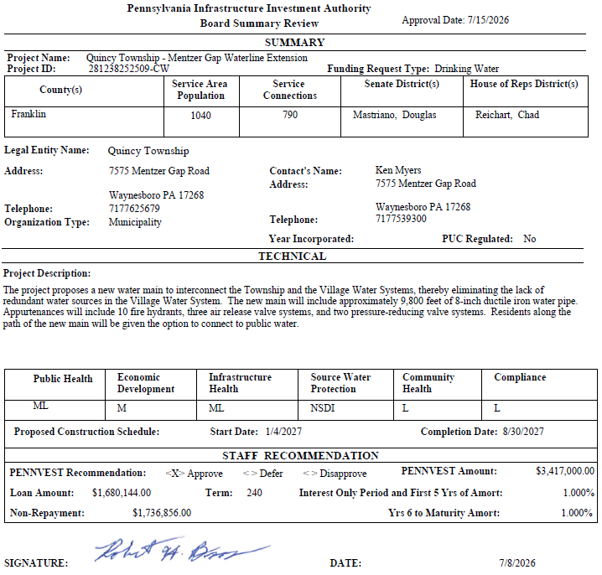
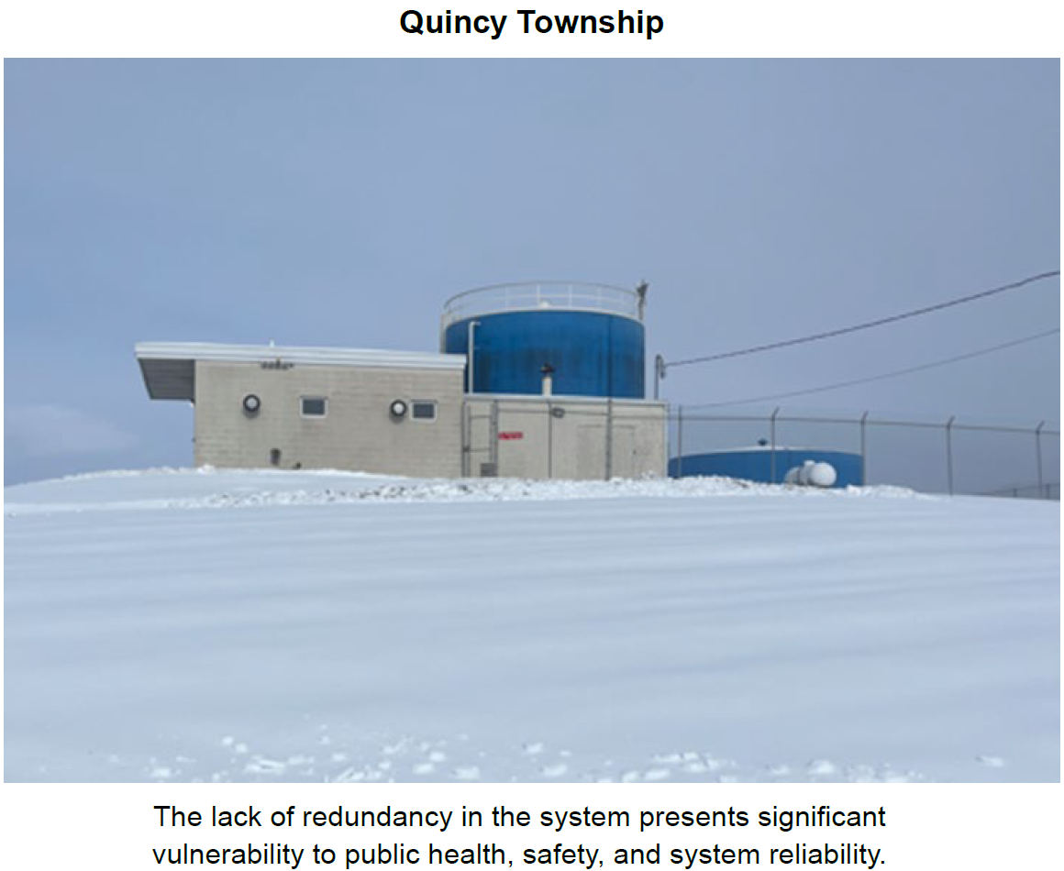
Quincy Township

Slide 44
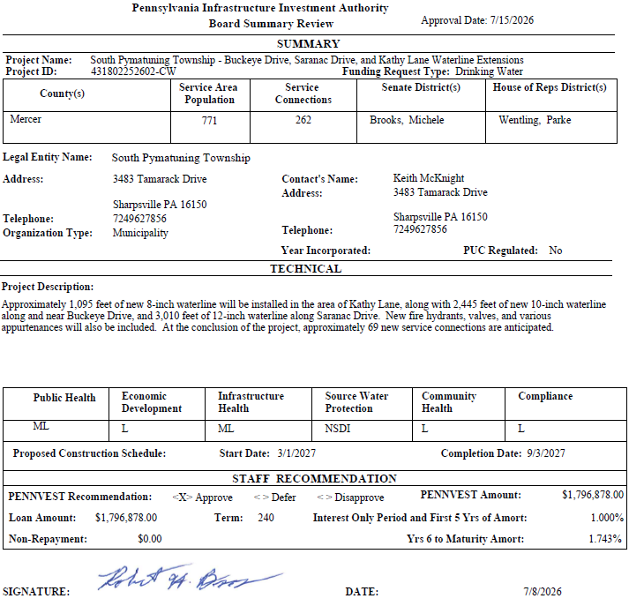
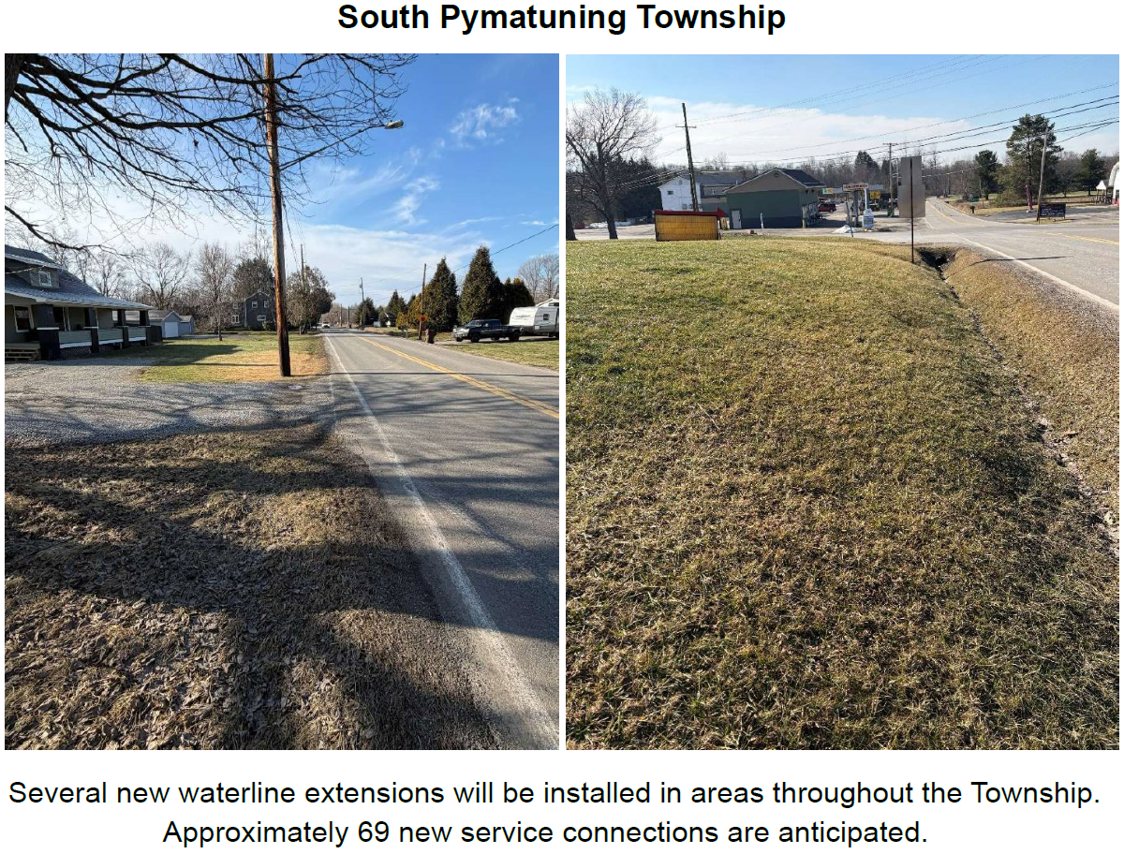
South Pymatuning Township

Slide 45
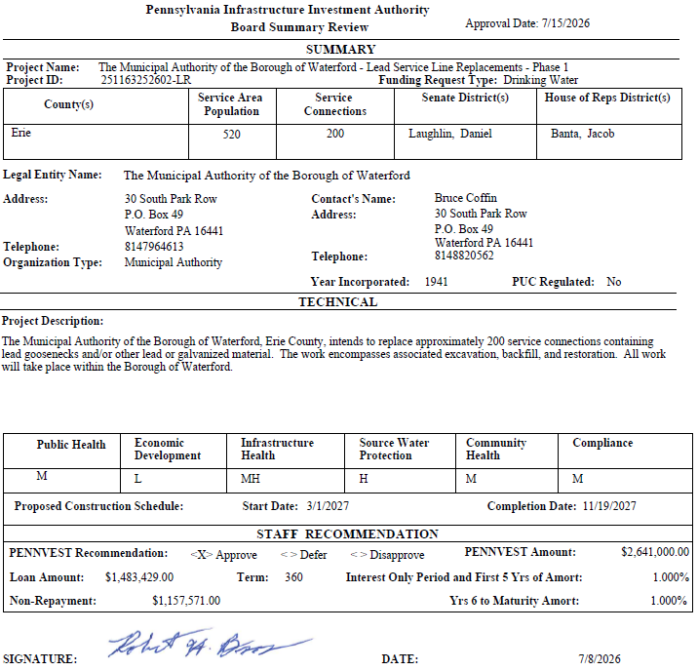
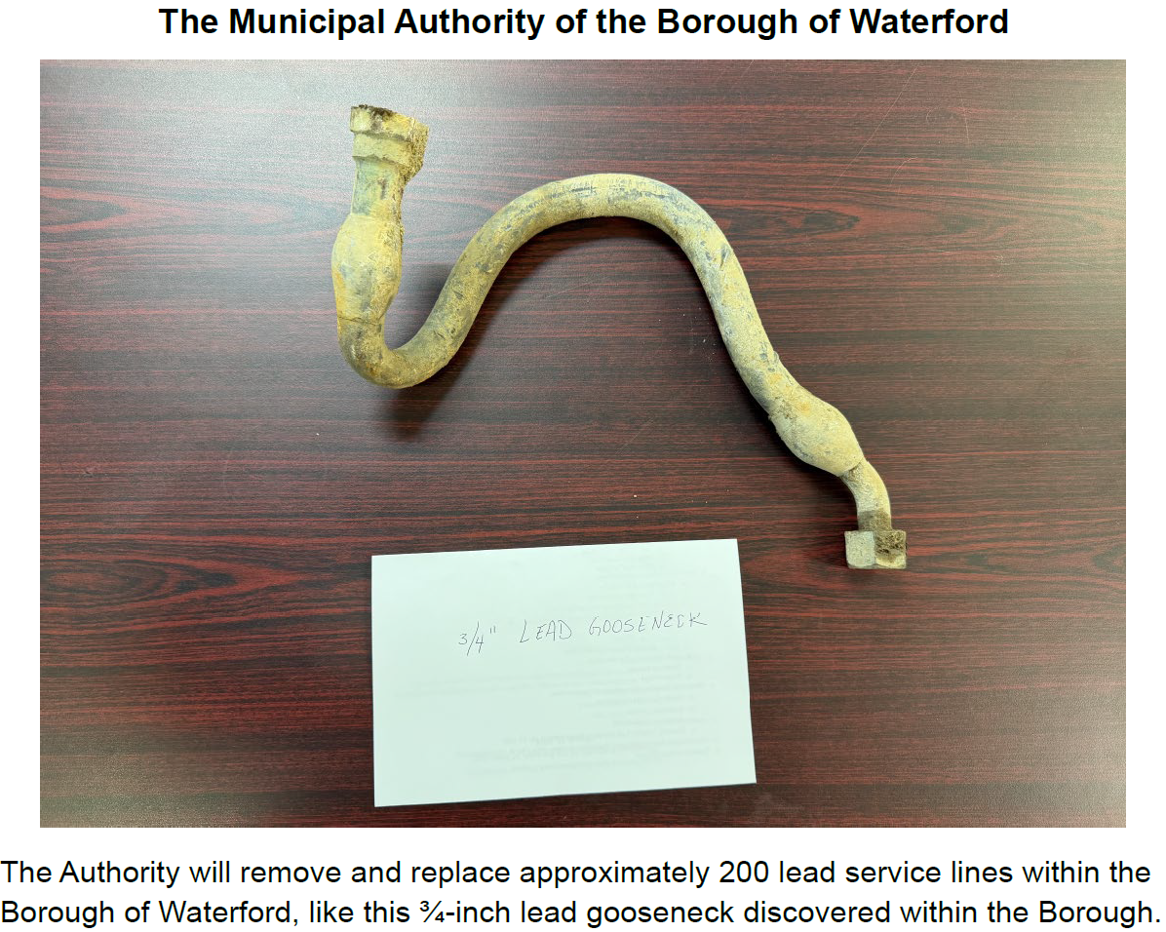
The Municipal Authority of the Borough of Waterford

Slide 46
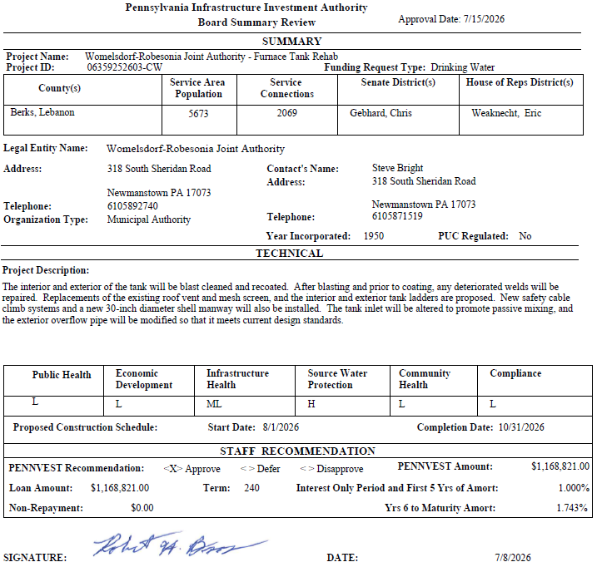
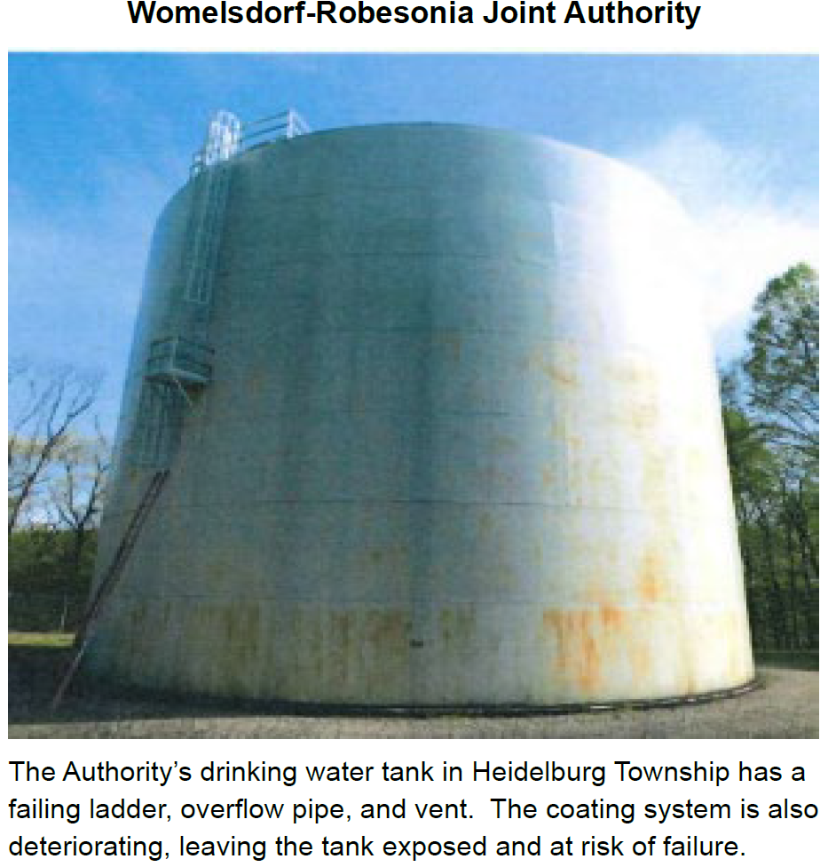
Womelsdorf-Robesonia Joint Authority

Slide 47
PROJECT SPECIALIST
PRESENTATIONS
III. FINANCIAL ASSISTANCE APPLICATIONS A. CONSTRUCTION (i) DRINKING WATER

Slide 48
Fredericksburg Sewer and Water Authority

Slide 49
Borough of Hooversville

Slide 50
Motion
III. FINANCIAL ASSISTANCE APPLICATIONS A. CONSTRUCTION (i) DRINKING WATER

Slide 51
Board Discussion
III. FINANCIAL ASSISTANCE APPLICATIONS A. CONSTRUCTION (i) DRINKING WATER

Slide 52
Public Comment
III. FINANCIAL ASSISTANCE APPLICATIONS A. CONSTRUCTION (i) DRINKING WATER

Slide 53
Vote
III. FINANCIAL ASSISTANCE APPLICATIONS A. CONSTRUCTION (i) DRINKING WATER

Slide 54
WASTEWATER
CONSTRUCTION PROJECTS
III. FINANCIAL ASSISTANCE APPLICATIONS A. CONSTRUCTION (ii) WASTEWATER

Slide 55
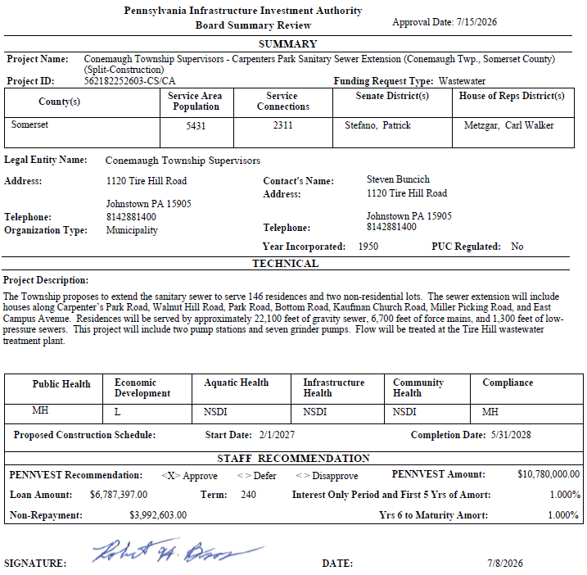
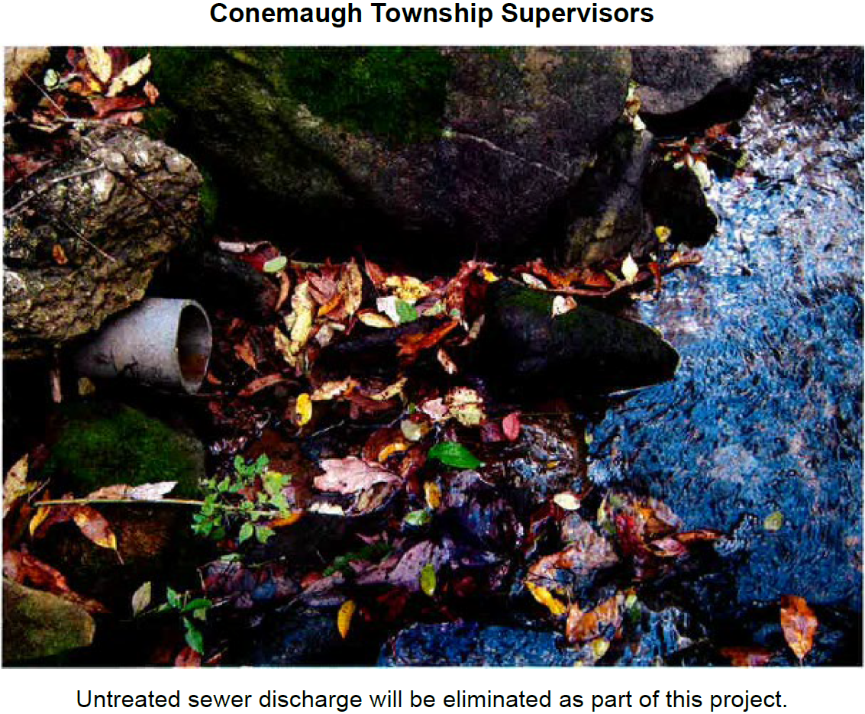
Conemaugh Township Supervisors

Slide 56
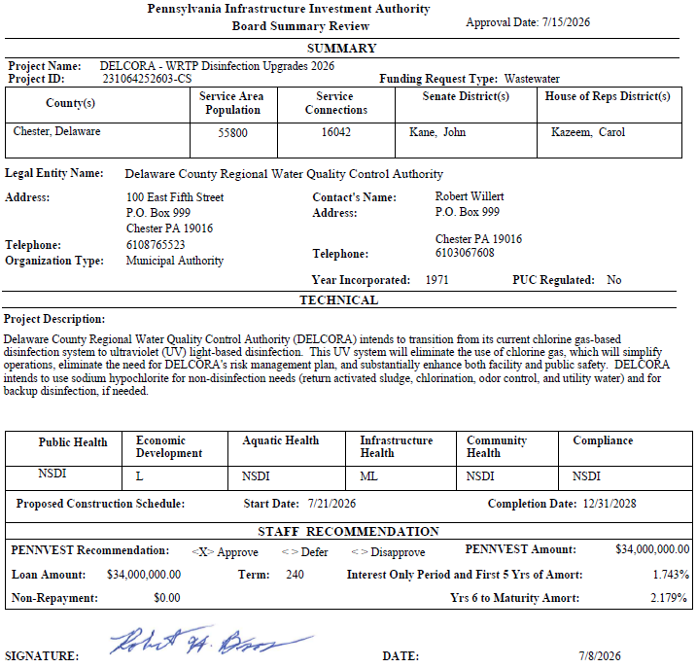

Delaware County Regional Water Quality Control Authority

Slide 57


Franconia Sewer Authority

Slide 58


New Albany Borough

Slide 59


Shippensburg Borough Authority

Slide 60


Skytop Lodge Corporation

Slide 61
PROJECT SPECIALIST
PRESENTATIONS
III. FINANCIAL ASSISTANCE APPLICATIONS A. CONSTRUCTION (ii) WASTEWATER

Slide 62
New Albany Borough

Slide 63
Motion
III. FINANCIAL ASSISTANCE APPLICATIONS A. CONSTRUCTION (ii) WASTEWATER

Slide 64
Board Discussion
III. FINANCIAL ASSISTANCE APPLICATIONS A. CONSTRUCTION (ii) WASTEWATER

Slide 65
Public Comment
III. FINANCIAL ASSISTANCE APPLICATIONS A. CONSTRUCTION (ii) WASTEWATER

Slide 66
Vote
III. FINANCIAL ASSISTANCE APPLICATIONS A. CONSTRUCTION (ii) WASTEWATER

Slide 67
DRINKING WATER FACILITIES ADVANCE FUNDING
III. FINANCIAL ASSISTANCE APPLICATIONS B. ADVANCE FUNDING (i) DRINKING WATER

Slide 68


Borough of Stoneboro

Slide 69
PROJECT SPECIALIST
PRESENTATION
III. FINANCIAL ASSISTANCE APPLICATIONS B. ADVANCE FUNDING (i) DRINKING WATER

Slide 70
Borough of Stoneboro

Slide 71
Motion
III. FINANCIAL ASSISTANCE APPLICATIONS B. ADVANCE FUNDING (i) DRINKING WATER

Slide 72
Board Discussion
III. FINANCIAL ASSISTANCE APPLICATIONS B. ADVANCE FUNDING (i) DRINKING WATER

Slide 73
Public Comment
III. FINANCIAL ASSISTANCE APPLICATIONS B. ADVANCE FUNDING (i) DRINKING WATER

Slide 74
Vote
III. FINANCIAL ASSISTANCE APPLICATIONS B. ADVANCE FUNDING (i) DRINKING WATER

Slide 75
WASTEWATER FACILITIES ADVANCE FUNDING
III. FINANCIAL ASSISTANCE APPLICATIONS B. ADVANCE FUNDING (ii) WASTEWATER

Slide 76


Mahanoy City Sewer Authority

Slide 77
PROJECT SPECIALIST
PRESENTATION
III. FINANCIAL ASSISTANCE APPLICATIONS B. ADVANCE FUNDING (ii) WASTEWATER

Slide 78
Mahanoy City Sewer Authority

Slide 79
Motion
III. FINANCIAL ASSISTANCE APPLICATIONS B. ADVANCE FUNDING (ii) WASTEWATER

Slide 80
Board Discussion
III. FINANCIAL ASSISTANCE APPLICATIONS B. ADVANCE FUNDING (ii) WASTEWATER

Slide 81
Public Comment
III. FINANCIAL ASSISTANCE APPLICATIONS B. ADVANCE FUNDING (ii) WASTEWATER

Slide 82
Vote
III. FINANCIAL ASSISTANCE APPLICATIONS B. ADVANCE FUNDING (ii) WASTEWATER

Slide 83
PRIOR-APPROVED
PROJECTS
INCREASES/DECREASES
IV. PRIOR-APPROVED PROJECTS A. INCREASES/DECREASES

Slide 84

Totals of Increases/Decreases Report

Slide 85

Dollars Disencumbered Report

Slide 86

Current Individual Increase Requests Summary

Slide 87
Motion
IV. PRIOR-APPROVED PROJECTS A. INCREASES/DECREASES

Slide 88
Board Discussion
IV. PRIOR-APPROVED PROJECTS A. INCREASES/DECREASES

Slide 89
Public Comment
IV. PRIOR-APPROVED PROJECTS A. INCREASES/DECREASES

Slide 90
Vote
IV. PRIOR-APPROVED PROJECTS A. INCREASES/DECREASES

Slide 91
PRIOR-APPROVED
PROJECTS
PROGRAM INITIATIVES
IV. PRIOR-APPROVED PROJECTS B. PROGRAM INITIATIVES

Slide 92

Small Projects Report

Slide 93

Small Projects Report

Slide 94

Bipartisan Infrastructure Law (BIL) Project Summary

Slide 95
PRIOR-APPROVED
PROJECTS
ON-LOT REPORT
IV. PRIOR-APPROVED PROJECTS C. ON-LOT REPORT

Slide 96

On-Lot Report

Slide 97
PRIOR-APPROVED
PROJECTS
PROJECT STATUS
IV. PRIOR-APPROVED PROJECTS D. PROJECT STATUS

Slide 98

Application to Approval Projects for July 15, 2026

Slide 99

Approval to Settlement Projects for July 15, 2026

Slide 100

Approval to Settlement Projects for July 15, 2026

Slide 101

Approval to Settlement Projects for July 15, 2026

Slide 102
Final Public Comment

Slide 103
Save the date
The next scheduled board meeting:
October 21, 2026
Application cut-off date:
July 29, 2026

Slide 104
Vote to Adjourn
V. ADJOURNMENT

