Slide 1


Board of Directors Meeting
April 15, 2026
10:30 a.m.

Slide 2

Recording Notice
This meeting is being recorded.
By participating in this webinar, you consent to the
recording, retention, and use of this session.
If you ask a question, you consent to the
recording, retention, and use of your statements
as part of the meeting.

Slide 3
Transcription Notice
Commonwealth of Pennsylvania policy prohibits the use of Artificial Intelligence transcription software during this meeting.
Please note, PENNVEST staff is required to disable or remove transcription tools from the meeting.

Slide 4
Technical Information
Can’t Hear Us?
Join the audio portion of the presentation via your telephone:
Call 1-267-332-8737
Meeting ID 301 744 254#
Technical Difficulties?
Call 1-717-705-4477 or
Send a Chat message via the Microsoft Teams meeting
Want the App?
Search “Microsoft Teams” in the Google Play Store or the App Store.

Slide 5
Public Comment
During the presentation, all attendees will be muted.
There are two methods you can use within this
Microsoft Teams meeting to pose a public comment or question.
“Raise Hand” function
“Chat” function

Slide 6
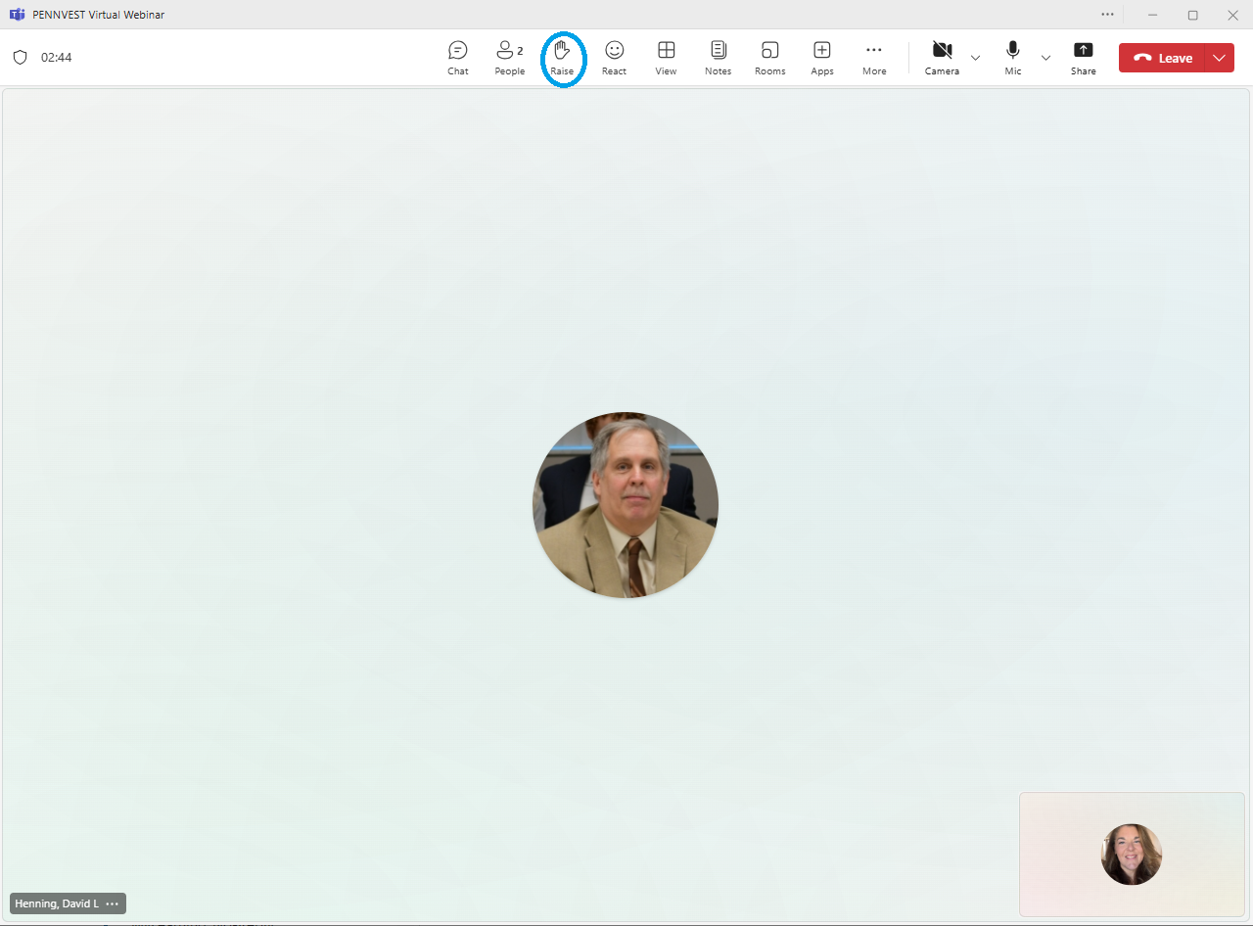



Raise Hand
In the top toolbar, raise your hand by clicking on the hand icon to indicate your request to speak.
Attendees with raised hands will be unmuted individually, allowing participants to speak one at a time.
Your microphone will show a diagonal line through the icon when muted. When the diagonal line disappears, you may pose your question or comment.

Slide 7

Chat
In the top toolbar, click on the chat bubble icon to open the chat dialogue box. Type your question or comment in the Meeting Chat.
PENNVEST staff will monitor the Chat area throughout the meeting.
Replies may be delivered verbally, or returned through the same chat box, from appropriate meeting participant(s). Responses will typically be given during an applicable Public Comment portion of the meeting.

Slide 8

Public Comment
Participant Best Practices
1. Log in to the Board Meeting through a computer or smart phone (using the Teams app).
2. When your microphone has been unmuted, begin by stating:
Your name.
Your affiliation (i.e., company, organization, etc.).
Indicate the specific project, agency activity, or agenda item about which you are commenting.
If your comment or question is on behalf of another individual or organization, please acknowledge this, immediately after your name and affiliation, and reference the name(s) of the associated person(s) or group(s).

Slide 9
Public Comment
Notices
All verbal comments, questions and responses will be recorded and can be shared publicly.
PENNVEST cannot guarantee all persons requesting to speak will be able to do so, specifically in the case of technical difficulties beyond our control, such as:
Audio feedback.
Poor sound quality.
Interruptions in bandwidth services.

Slide 10
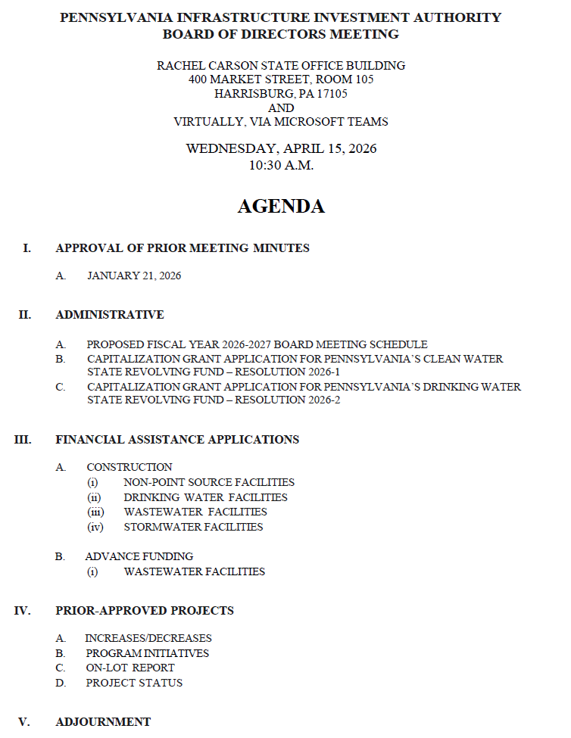

Today’s
Agenda

Slide 11
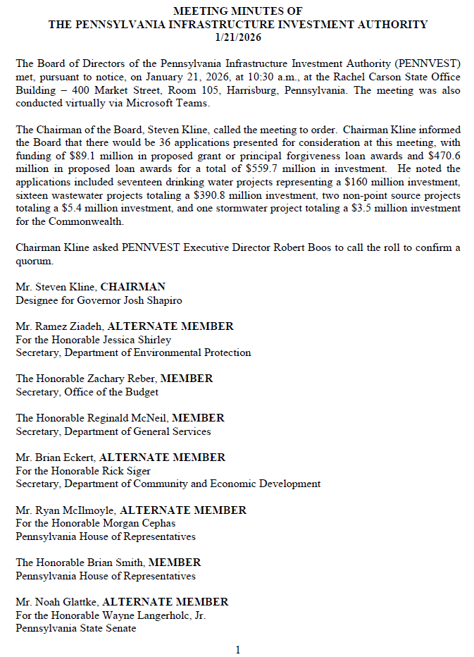
APPROVAL OF PRIOR MEETING MINUTES
A. JANUARY 21, 2026

Slide 12

Motion
I. APPROVAL OF PRIOR MEETING MINUTES A. JANUARY 21, 2026

Slide 13
Board Discussion
I. APPROVAL OF PRIOR MEETING MINUTES A. JANUARY 21, 2026

Slide 14
Public Comment
I. APPROVAL OF PRIOR MEETING MINUTES A. JANUARY 21, 2026

Slide 15

Vote
I. APPROVAL OF PRIOR MEETING MINUTES A. JANUARY 21, 2026

Slide 16
ADMINISTRATIVE
II. ADMINISTRATIVE

Slide 17
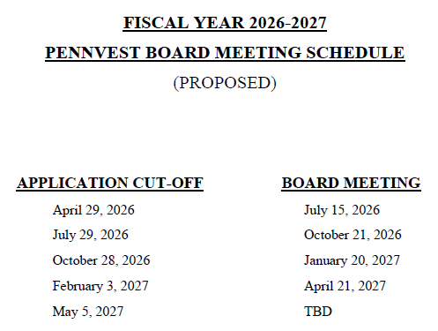
II. ADMINISTRATIVE
A. PROPOSED FISCAL YEAR
2026-2027 BOARD
MEETING SCHEDULE
II. ADMINISTRATIVE A. PROPOSED FISCAL YEAR 2026-2027 BOARD MEETING SCHEDULE

Slide 18
Motion
II. ADMINISTRATIVE A. PROPOSED FISCAL YEAR 2026-2027 BOARD MEETING SCHEDULE

Slide 19
Board Discussion
II. ADMINISTRATIVE A. PROPOSED FISCAL YEAR 2026-2027 BOARD MEETING SCHEDULE

Slide 20
Public Comment
II. ADMINISTRATIVE A. PROPOSED FISCAL YEAR 2026-2027 BOARD MEETING SCHEDULE

Slide 21
Vote
II. ADMINISTRATIVE A. PROPOSED FISCAL YEAR 2026-2027 BOARD MEETING SCHEDULE

Slide 22
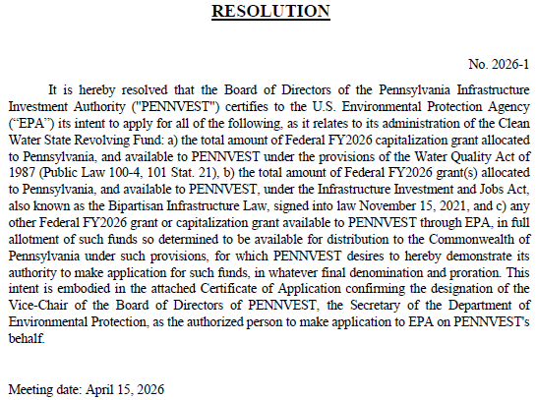
II. ADMINISTRATIVE
B. CAPITALIZATION GRANT
APPLICATION FOR
PENNSYLVANIA’S CLEAN
WATER STATE REVOLVING
FUND – RESOLUTION
2026-1
II. ADMINISTRATIVE B. CAPITALIZATION GRANT – CLEAN WATER

Slide 23
Motion
II. ADMINISTRATIVE B. CAPITALIZATION GRANT – CLEAN WATER

Slide 24
Board Discussion
II. ADMINISTRATIVE B. CAPITALIZATION GRANT – CLEAN WATER

Slide 25
Public Comment
II. ADMINISTRATIVE B. CAPITALIZATION GRANT – CLEAN WATER

Slide 26
Vote
II. ADMINISTRATIVE B. CAPITALIZATION GRANT – CLEAN WATER

Slide 27
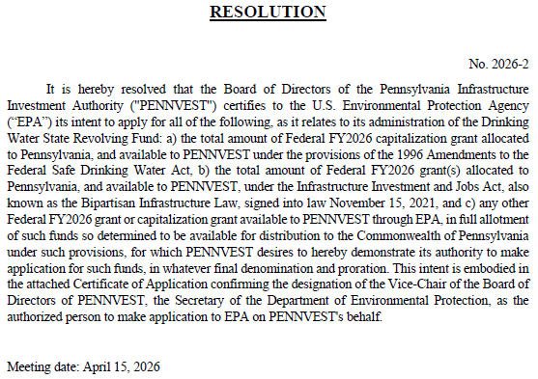
II. ADMINISTRATIVE
C. CAPITALIZATION GRANT
APPLICATION FOR
PENNSYLVANIA’S DRINKING
WATER STATE REVOLVING
FUND – RESOLUTION
2026-2
II. ADMINISTRATIVE C. CAPITALIZATION GRANT – DRINKING WATER

Slide 28
Motion
II. ADMINISTRATIVE C. CAPITALIZATION GRANT – DRINKING WATER

Slide 29
Board Discussion
II. ADMINISTRATIVE C. CAPITALIZATION GRANT – DRINKING WATER

Slide 30
Public Comment
II. ADMINISTRATIVE C. CAPITALIZATION GRANT – DRINKING WATER

Slide 31
Vote
II. ADMINISTRATIVE C. CAPITALIZATION GRANT – DRINKING WATER

Slide 32
FINANCIAL ASSISTANCE APPLICATIONS
III. FINANCIAL ASSISTANCE APPLICATIONS

Slide 33
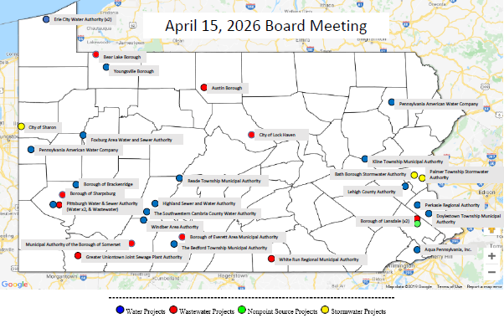
MAP OF PROJECT APPLICATIONS RECOMMENDED FOR APPROVAL
III. FINANCIAL ASSISTANCE APPLICATIONS

Slide 34
NON-POINT SOURCE
CONSTRUCTION PROJECTS
III. FINANCIAL ASSISTANCE APPLICATIONS A. CONSTRUCTION (i) NON-POINT SOURCE

Slide 35
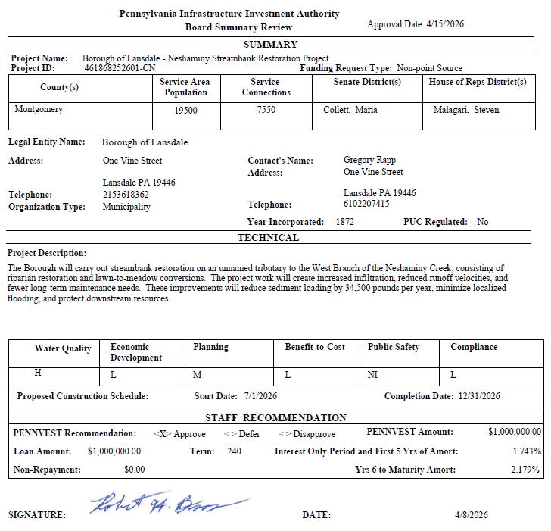
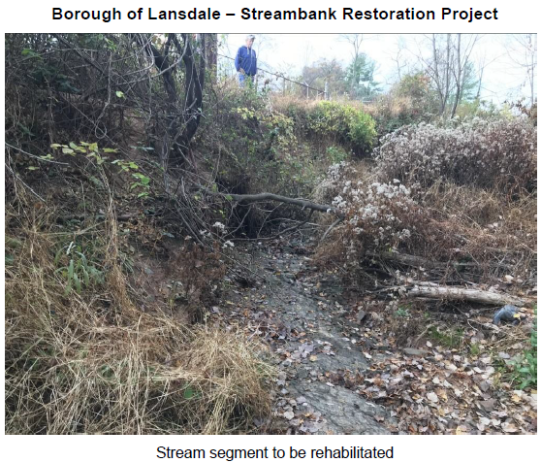
Borough of Lansdale

Slide 36
PROJECT SPECIALIST
PRESENTATION
III. FINANCIAL ASSISTANCE APPLICATIONS A. CONSTRUCTION (i) NON-POINT SOURCE

Slide 37
Borough of Lansdale

Slide 38
Motion
III. FINANCIAL ASSISTANCE APPLICATIONS A. CONSTRUCTION (i) NON-POINT SOURCE

Slide 39
Board Discussion
III. FINANCIAL ASSISTANCE APPLICATIONS A. CONSTRUCTION (i) NON-POINT SOURCE

Slide 40
Public Comment
III. FINANCIAL ASSISTANCE APPLICATIONS A. CONSTRUCTION (i) NON-POINT SOURCE

Slide 41
Vote
III. FINANCIAL ASSISTANCE APPLICATIONS A. CONSTRUCTION (i) NON-POINT SOURCE

Slide 42
DRINKING WATER
CONSTRUCTION PROJECTS
III. FINANCIAL ASSISTANCE APPLICATIONS A. CONSTRUCTION (ii) DRINKING WATER

Slide 43
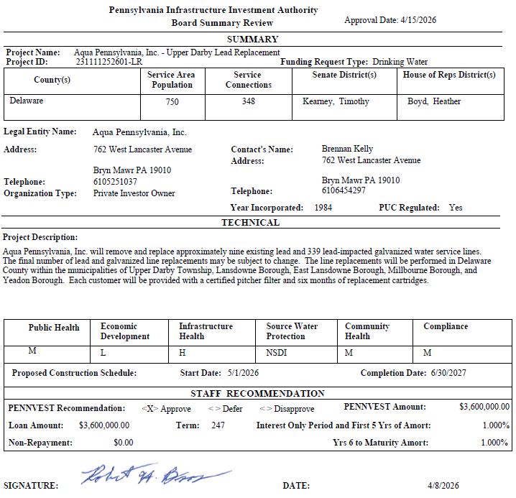
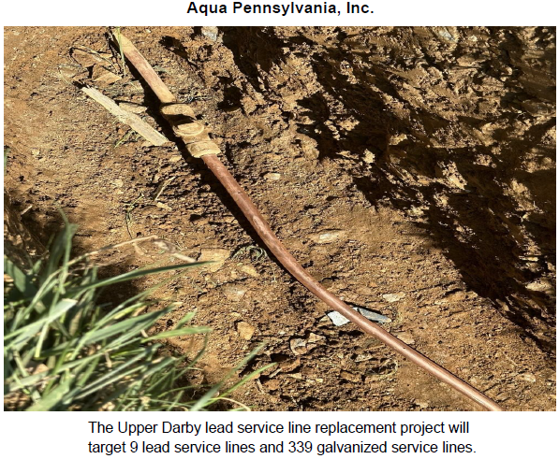
Aqua Pennsylvania, Inc. – Upper Darby

Slide 44
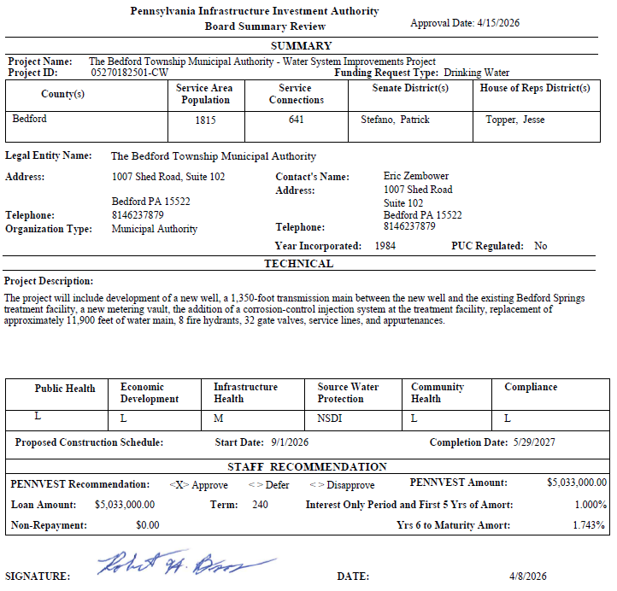
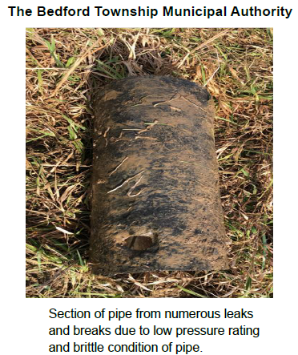
The Bedford Township Municipal Authority

Slide 45
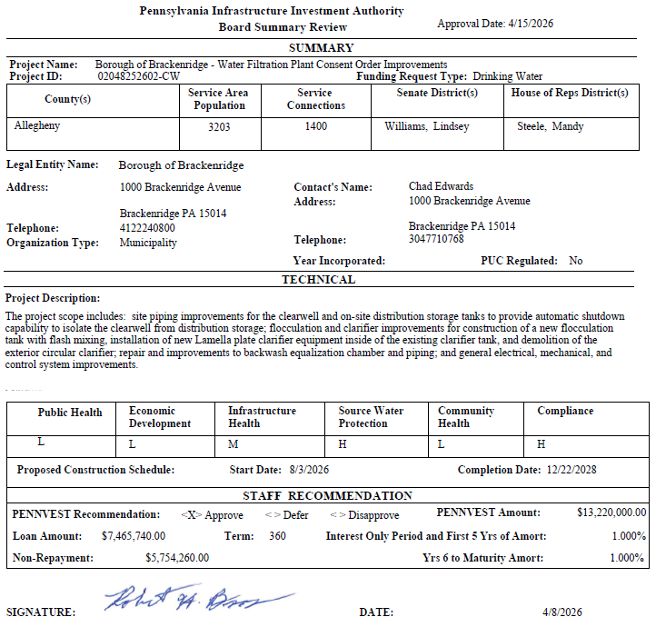
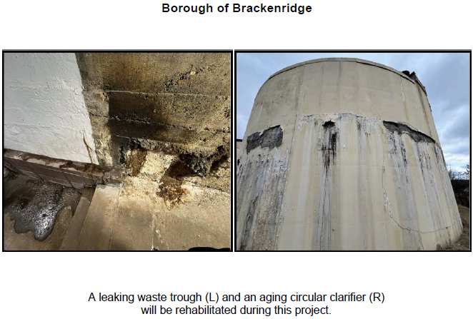
Borough of Brackenridge

Slide 46
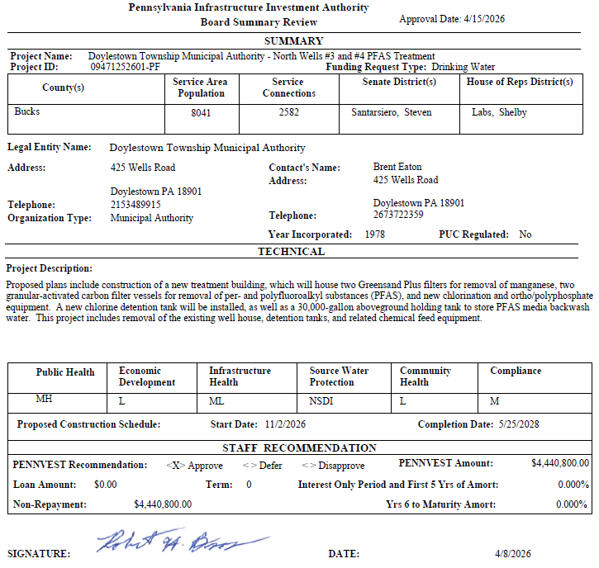
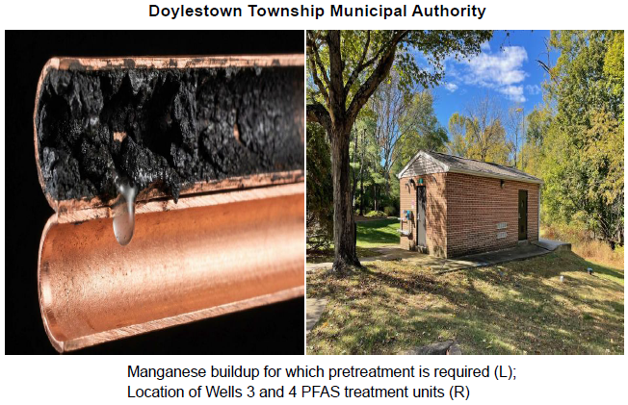
Doylestown Township Municipal Authority

Slide 47
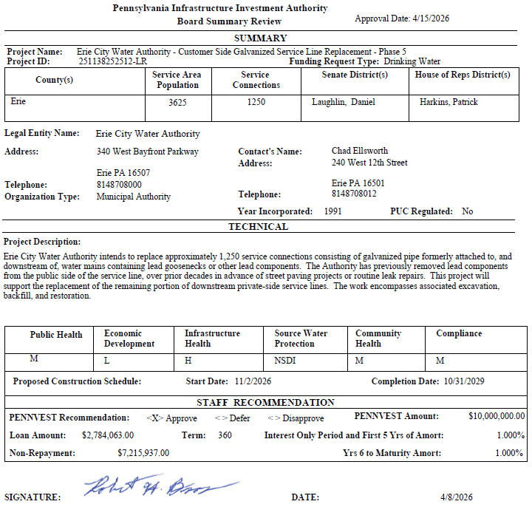
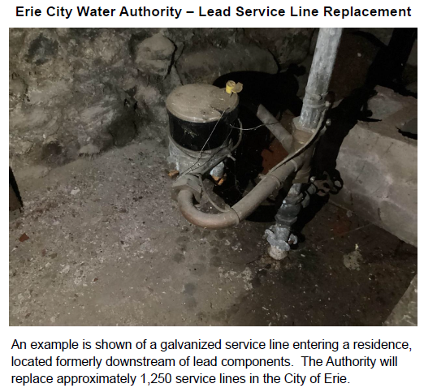
Erie City Water Authority – Lead Service Line Replacement

Slide 48
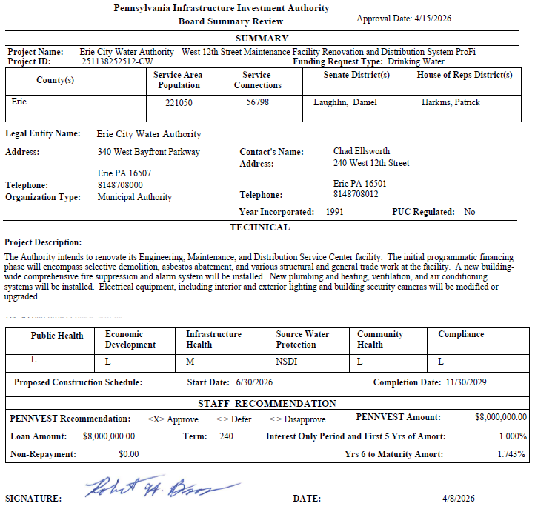
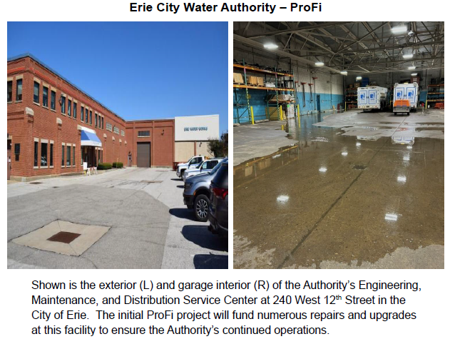
Erie City Water Authority – ProFi

Slide 49
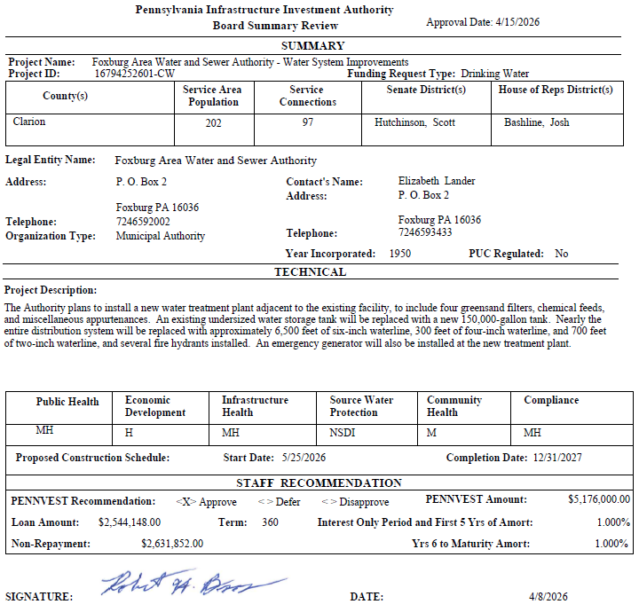
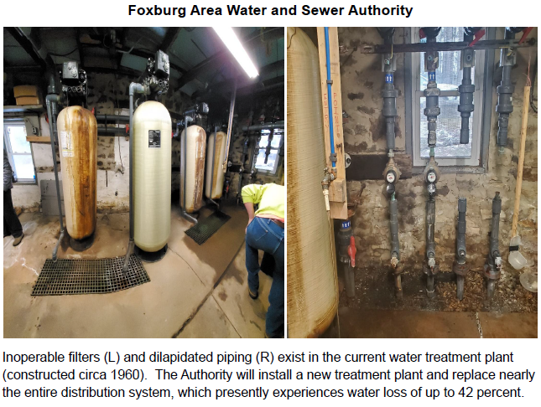
Foxburg Area Water and Sewer Authority

Slide 50
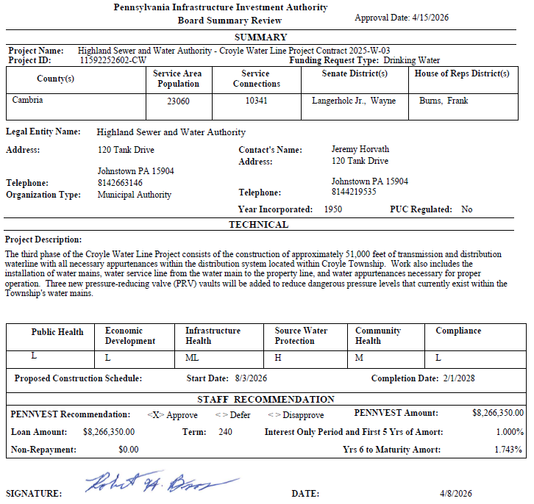
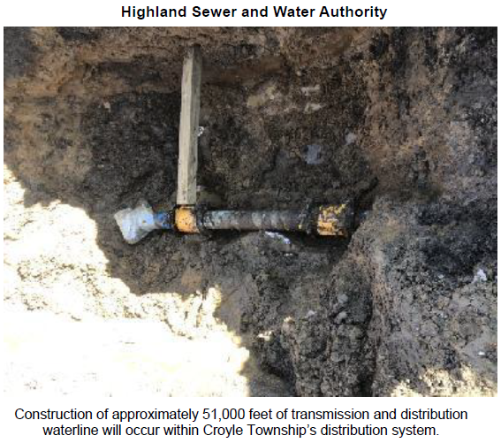
Highland Sewer & Water Authority

Slide 51
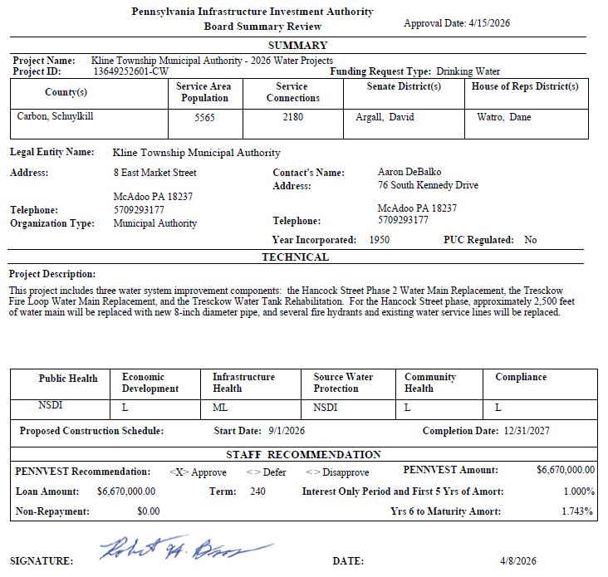
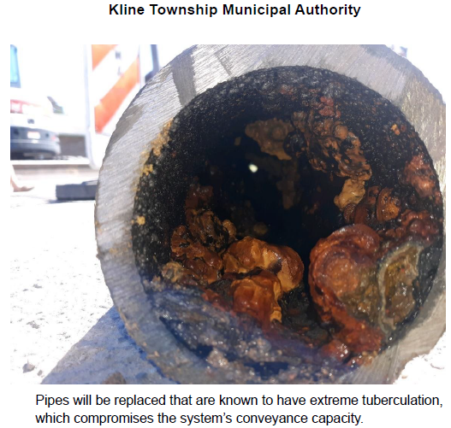
Kline Township Municipal Authority

Slide 52
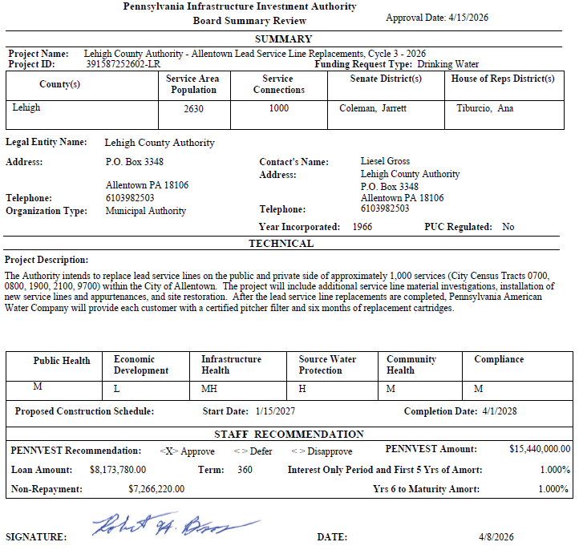
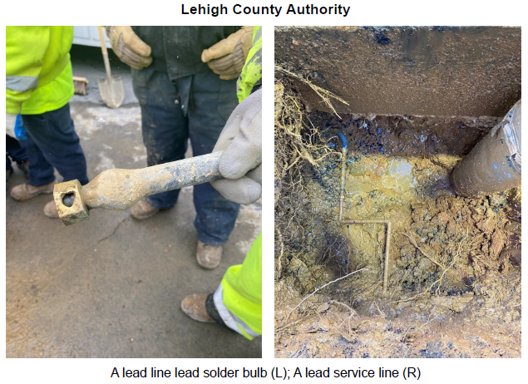
Lehigh County Authority

Slide 53
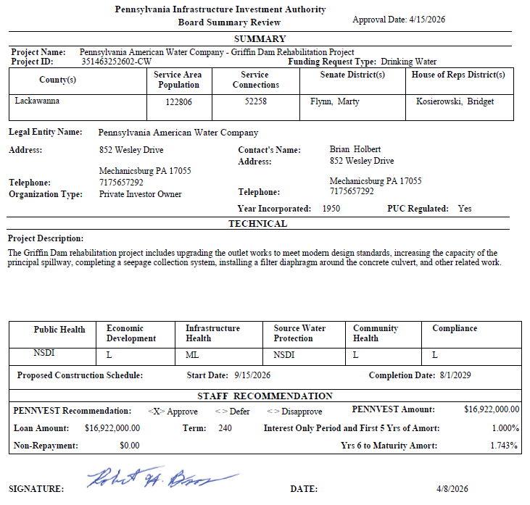
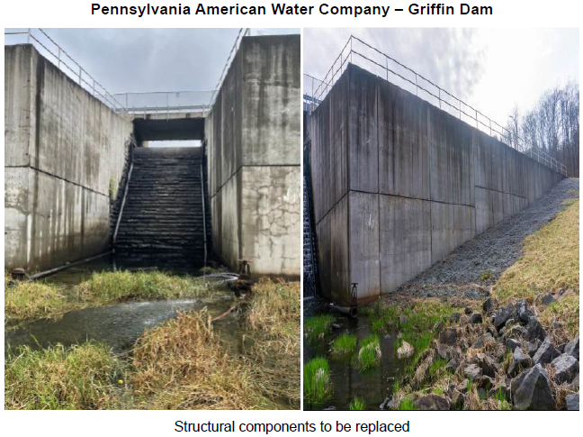
Pennsylvania American Water Company – Griffin Dam

Slide 54
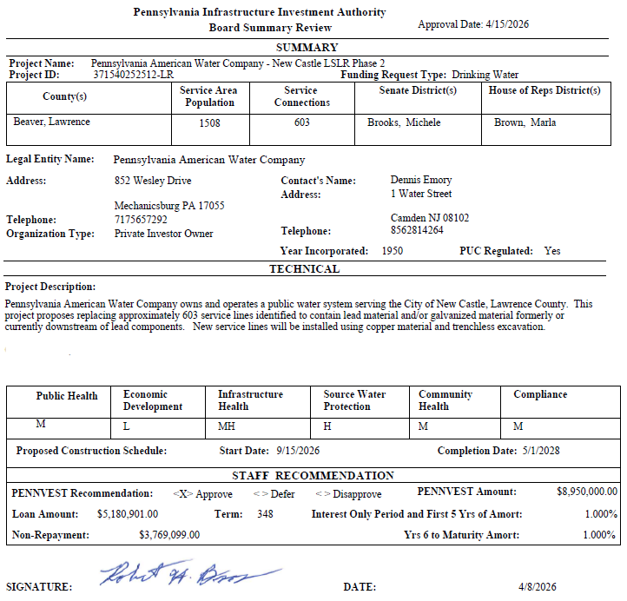
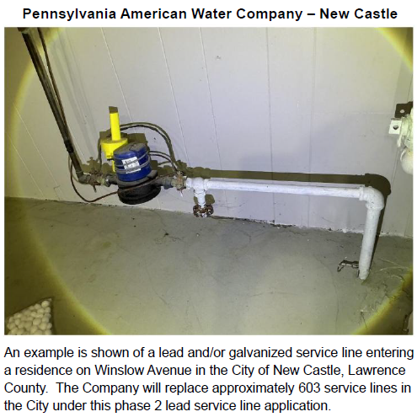
Pennsylvania American Water Company – New Castle

Slide 55
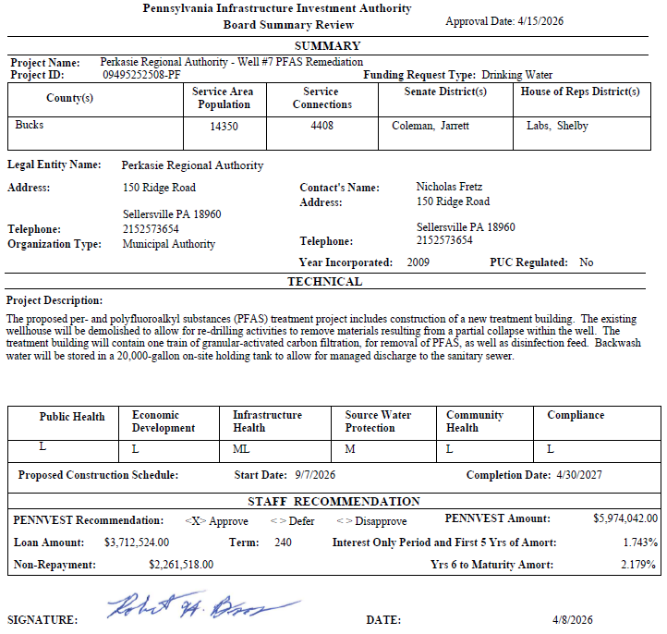
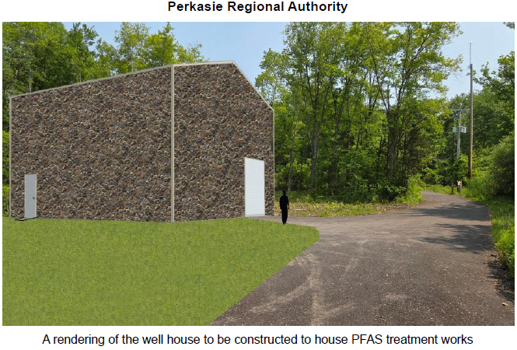
Perkasie Regional Authority

Slide 56
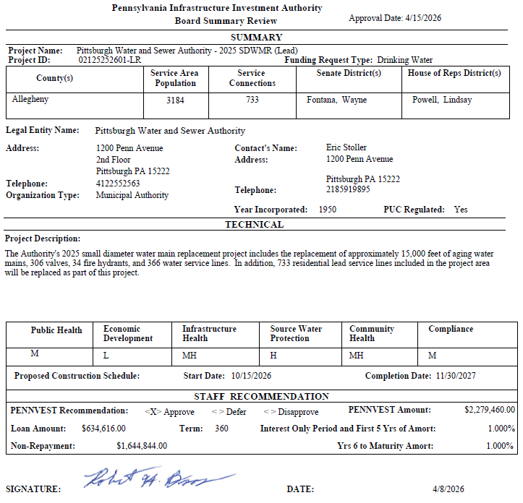
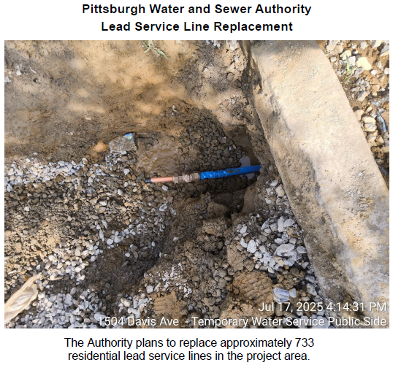
Pittsburgh Water and Sewer Authority – Lead Service Line

Slide 57
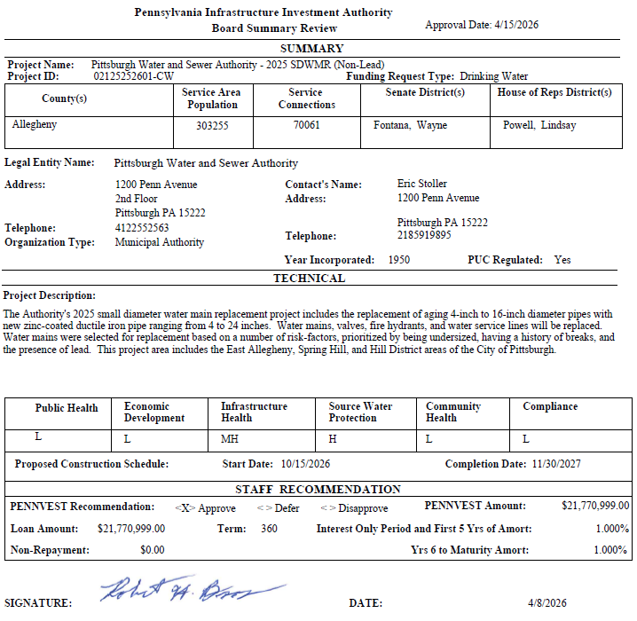
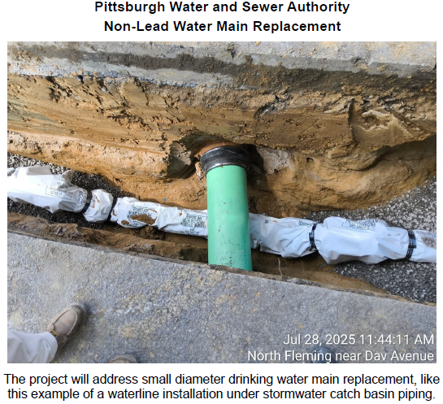
Pittsburgh Water and Sewer Authority – Non-Lead Water Main

Slide 58
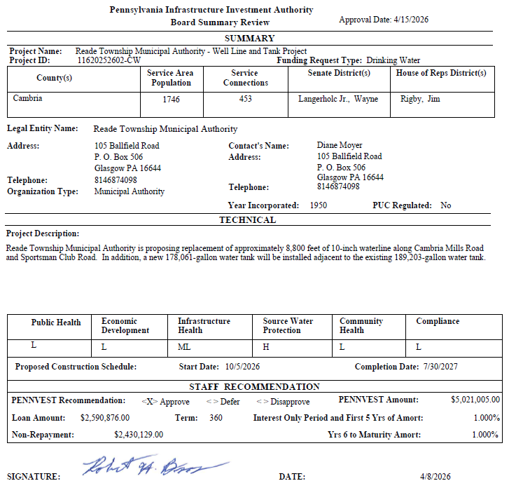
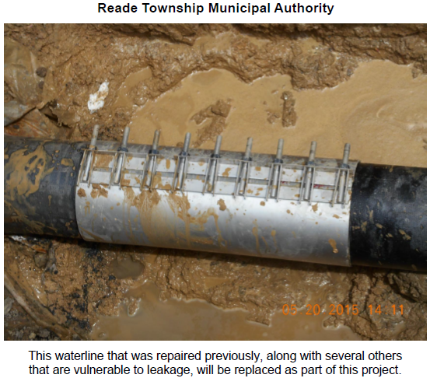
Reade Township Municipal Authority

Slide 59
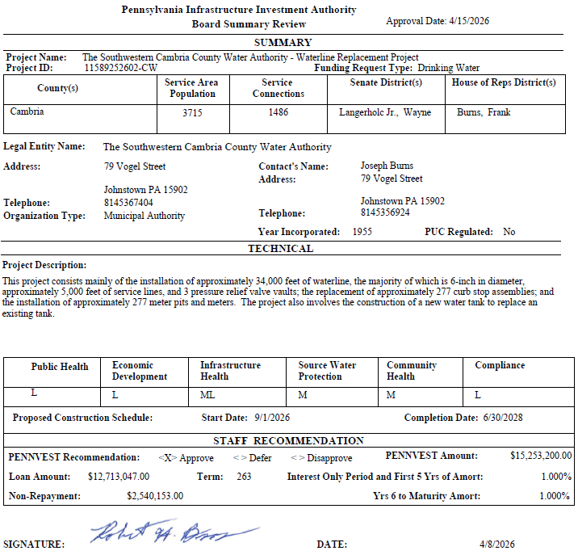
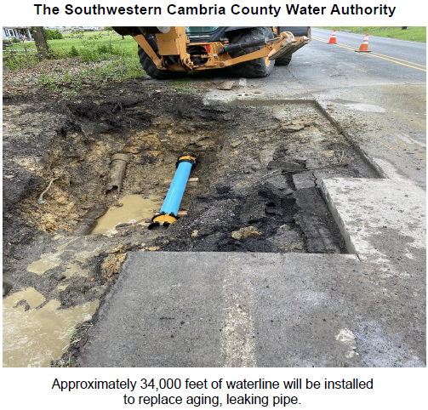
The Southwestern Cambria County Water Authority

Slide 60
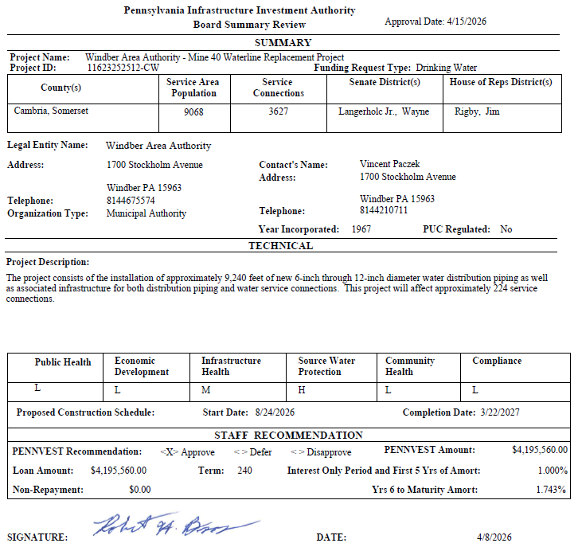
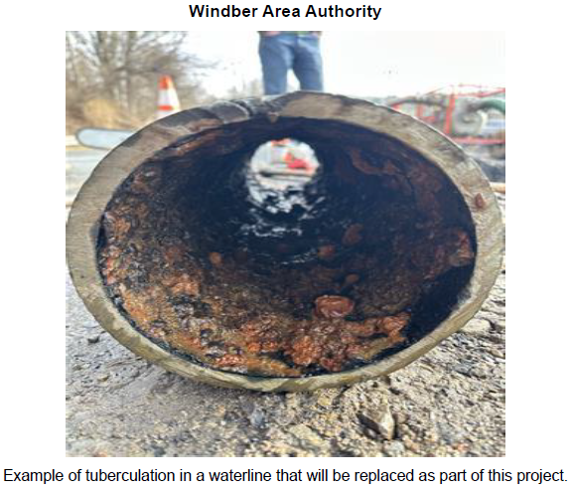
Windber Area Authority

Slide 61
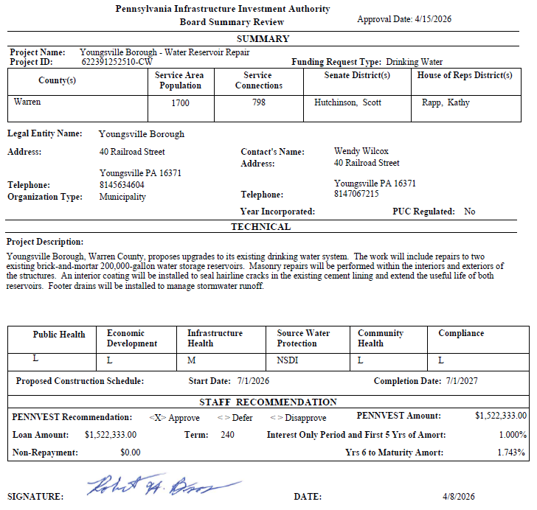
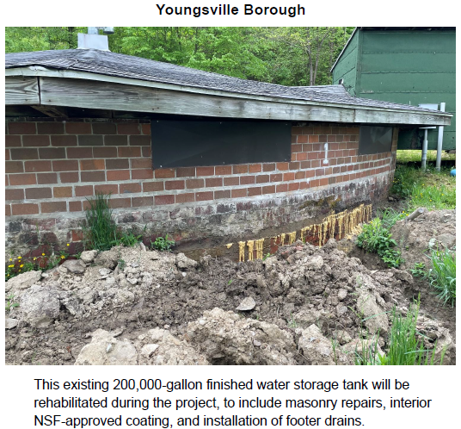
Youngsville Borough

Slide 62
PROJECT SPECIALIST
PRESENTATIONS
III. FINANCIAL ASSISTANCE APPLICATIONS A. CONSTRUCTION (ii) DRINKING WATER

Slide 63
Foxburg Area Water and Sewer Authority

Slide 64
The Bedford Township Municipal Authority

Slide 65
Motion
III. FINANCIAL ASSISTANCE APPLICATIONS A. CONSTRUCTION (ii) DRINKING WATER

Slide 66
Board Discussion
III. FINANCIAL ASSISTANCE APPLICATIONS A. CONSTRUCTION (ii) DRINKING WATER

Slide 67
Public Comment
III. FINANCIAL ASSISTANCE APPLICATIONS A. CONSTRUCTION (ii) DRINKING WATER

Slide 68
Vote
III. FINANCIAL ASSISTANCE APPLICATIONS A. CONSTRUCTION (ii) DRINKING WATER

Slide 69
WASTEWATER
CONSTRUCTION PROJECTS
III. FINANCIAL ASSISTANCE APPLICATIONS A. CONSTRUCTION (iii) WASTEWATER

Slide 70

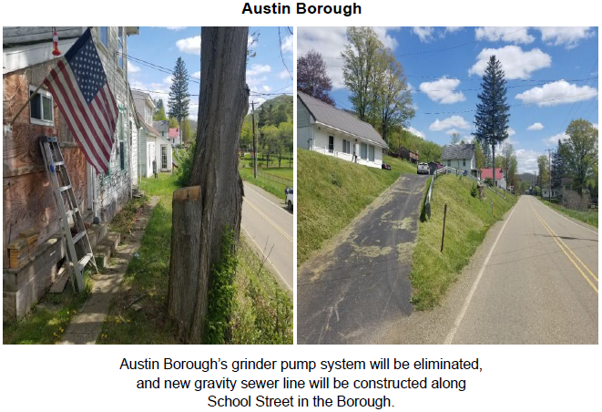
Austin Borough

Slide 71
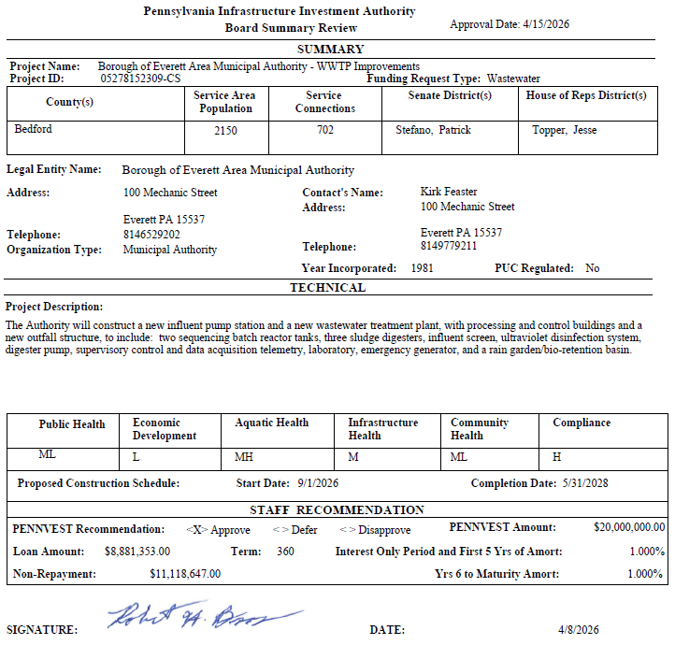
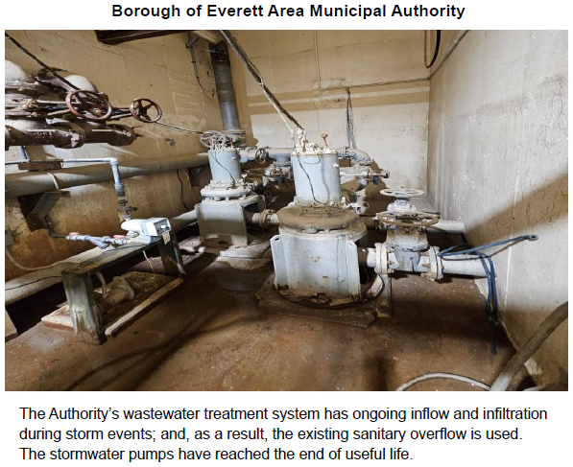
Borough of Everett Area Municipal Authority

Slide 72


Greater Uniontown Joint Sewage Plant Authority

Slide 73


Borough of Lansdale

Slide 74


City of Lock Haven

Slide 75


Pittsburgh Water and Sewer Authority

Slide 76


Borough of Sharpsburg

Slide 77


Municipal Authority of the Borough of Somerset

Slide 78


White Run Regional Municipal Authority

Slide 79
PROJECT SPECIALIST
PRESENTATIONS
III. FINANCIAL ASSISTANCE APPLICATIONS A. CONSTRUCTION (iii) WASTEWATER

Slide 80
Austin Borough

Slide 81
Borough of Sharpsburg

Slide 82
Motion
III. FINANCIAL ASSISTANCE APPLICATIONS A. CONSTRUCTION (iii) WASTEWATER

Slide 83
Board Discussion
III. FINANCIAL ASSISTANCE APPLICATIONS A. CONSTRUCTION (iii) WASTEWATER

Slide 84
Public Comment
III. FINANCIAL ASSISTANCE APPLICATIONS A. CONSTRUCTION (iii) WASTEWATER

Slide 85
Vote
III. FINANCIAL ASSISTANCE APPLICATIONS A. CONSTRUCTION (iii) WASTEWATER

Slide 86
STORMWATER
CONSTRUCTION PROJECTS
III. FINANCIAL ASSISTANCE APPLICATIONS A. CONSTRUCTION (iv) STORMWATER

Slide 87


Bath Borough Stormwater Authority

Slide 88


Palmer Township Stormwater Authority

Slide 89


City of Sharon

Slide 90
PROJECT SPECIALIST
PRESENTATION
III. FINANCIAL ASSISTANCE APPLICATIONS A. CONSTRUCTION (iv) STORMWATER

Slide 91
Palmer Township Stormwater Authority

Slide 92
Motion
III. FINANCIAL ASSISTANCE APPLICATIONS A. CONSTRUCTION (iv) STORMWATER

Slide 93
Board Discussion
III. FINANCIAL ASSISTANCE APPLICATIONS A. CONSTRUCTION (iv) STORMWATER

Slide 94
Public Comment
III. FINANCIAL ASSISTANCE APPLICATIONS A. CONSTRUCTION (iv) STORMWATER

Slide 95
Vote
III. FINANCIAL ASSISTANCE APPLICATIONS A. CONSTRUCTION (iv) STORMWATER

Slide 96
WASTEWATER FACILITIES ADVANCE FUNDING
III. FINANCIAL ASSISTANCE APPLICATIONS B. ADVANCE FUNDING (i) WASTEWATER

Slide 97


Bear Lake Borough

Slide 98
PROJECT SPECIALIST
PRESENTATION
III. FINANCIAL ASSISTANCE APPLICATIONS B. ADVANCE FUNDING (i) WASTEWATER

Slide 99
Bear Lake Borough

Slide 100
Motion
III. FINANCIAL ASSISTANCE APPLICATIONS B. ADVANCE FUNDING (i) WASTEWATER

Slide 101
Board Discussion
III. FINANCIAL ASSISTANCE APPLICATIONS B. ADVANCE FUNDING (i) WASTEWATER

Slide 102
Public Comment
III. FINANCIAL ASSISTANCE APPLICATIONS B. ADVANCE FUNDING (i) WASTEWATER

Slide 103
Vote
III. FINANCIAL ASSISTANCE APPLICATIONS B. ADVANCE FUNDING (i) WASTEWATER

Slide 104
PRIOR-APPROVED
PROJECTS
INCREASES/DECREASES
IV. PRIOR-APPROVED PROJECTS A. INCREASES/DECREASES

Slide 105

Totals of Increases/Decreases Report

Slide 106

Dollars Disencumbered Report

Slide 107

Current Individual Increase Requests Summary

Slide 108
Motion
IV. PRIOR-APPROVED PROJECTS A. INCREASES/DECREASES

Slide 109
Board Discussion
IV. PRIOR-APPROVED PROJECTS A. INCREASES/DECREASES

Slide 110
Public Comment
IV. PRIOR-APPROVED PROJECTS A. INCREASES/DECREASES

Slide 111
Vote
IV. PRIOR-APPROVED PROJECTS A. INCREASES/DECREASES

Slide 112
PRIOR-APPROVED
PROJECTS
PROGRAM INITIATIVES
IV. PRIOR-APPROVED PROJECTS B. PROGRAM INITIATIVES

Slide 113

Small Projects Report

Slide 114

Bipartisan Infrastructure Law (BIL) Project Summary

Slide 115

Bipartisan Infrastructure Law (BIL) Project Summary

Slide 116

Bipartisan Infrastructure Law (BIL) Project Summary

Slide 117

Bipartisan Infrastructure Law (BIL) Project Summary

Slide 118

Bipartisan Infrastructure Law (BIL) Project Summary

Slide 119
PRIOR-APPROVED
PROJECTS
ON-LOT REPORT
IV. PRIOR-APPROVED PROJECTS C. ON-LOT REPORT

Slide 120

On-Lot Report

Slide 121
PRIOR-APPROVED
PROJECTS
PROJECT STATUS
IV. PRIOR-APPROVED PROJECTS D. PROJECT STATUS

Slide 122

Application to Approval Projects for April 15, 2026

Slide 123

Approval to Settlement Projects for April 15, 2026

Slide 124

Approval to Settlement Projects for April 15, 2026

Slide 125

Approval to Settlement Projects for April 15, 2026

Slide 126
Final Public Comment

Slide 127
Save the date
The next scheduled board meeting:
July 15, 2026
Application cut-off date:
April 29, 2026

Slide 128
Vote to Adjourn
V. ADJOURNMENT

