Slide 1


Board of Directors Meeting
October 21, 2026
10:30 a.m.

Slide 2

Recording Notice
This meeting is being recorded.
By participating in this webinar, you consent to the
recording, retention, and use of this session.
If you ask a question, you consent to the
recording, retention, and use of your statements
as part of the meeting.

Slide 3
Transcription Notice
Commonwealth of Pennsylvania policy prohibits the use of Artificial Intelligence transcription software during this meeting.
Please note, PENNVEST staff is required to disable or remove transcription tools from the meeting.

Slide 4
Technical Information
Can’t Hear Us?
Join the audio portion of the presentation via your telephone:
Call 1-267-332-8737
Meeting ID 122 188 152#
Technical Difficulties?
Call 717-705-4473 or
Send a Chat message via the Microsoft Teams meeting
Want the App?
Search “Microsoft Teams” in the Google Play Store or the App Store.

Slide 5
Public Comment
During the presentation, all attendees will be muted.
There are two methods you can use within this
Microsoft Teams meeting to pose a public comment or question.
“Raise Hand” function
“Chat” function

Slide 6
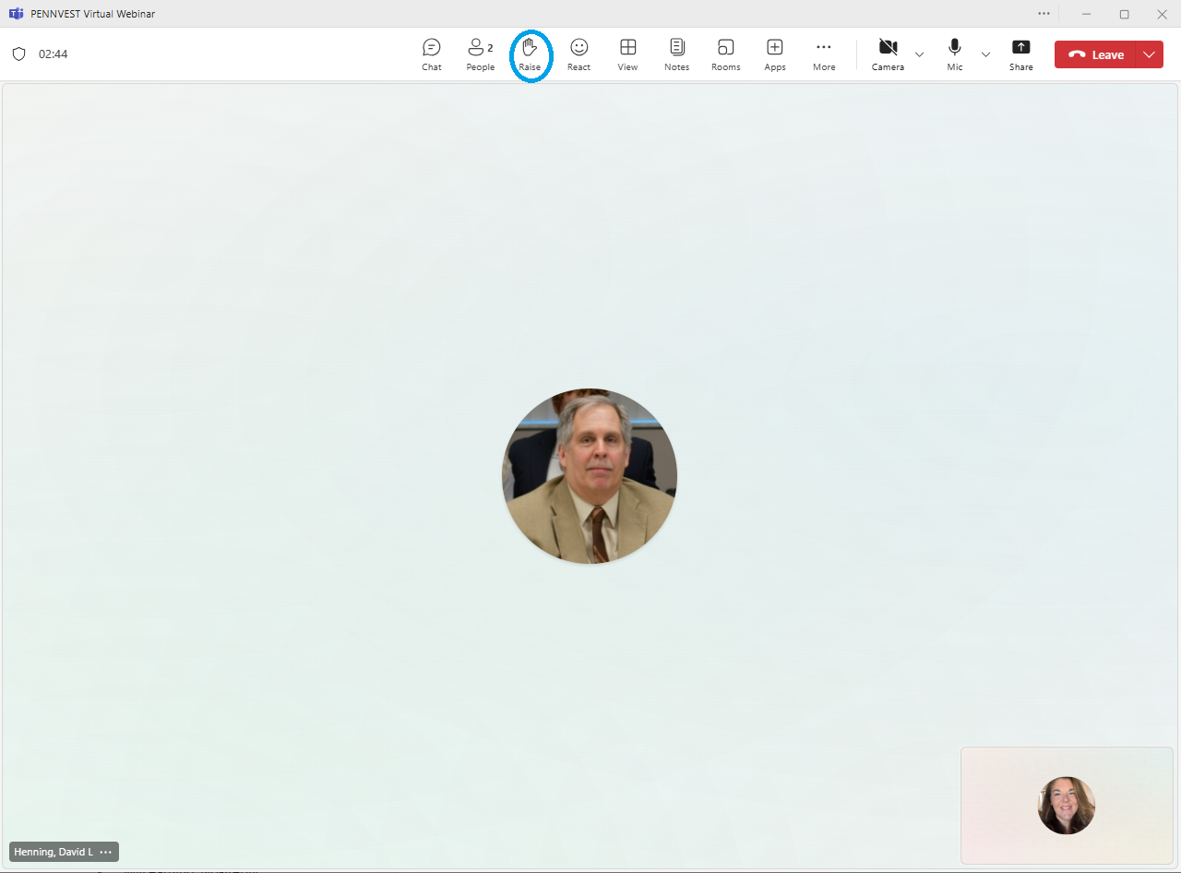



Raise Hand
In the top toolbar, raise your hand by clicking on the hand icon to indicate your request to speak.
Attendees with raised hands will be unmuted individually, allowing participants to speak one at a time.
Your microphone will show a diagonal line through the icon when muted. When the diagonal line disappears, you may pose your question or comment.

Slide 7

Chat
In the top toolbar, click on the chat bubble icon to open the chat dialogue box. Type your question or comment in the Meeting Chat.
PENNVEST staff will monitor the Chat area throughout the meeting.
Replies may be delivered verbally, or returned through the same chat box, from appropriate meeting participant(s). Responses will typically be given during an applicable Public Comment portion of the meeting.

Slide 8

Public Comment
Participant Best Practices
1. Log in to the Board Meeting through a computer or smart phone (using the Teams app).
2. When your microphone has been unmuted, begin by stating:
Your name.
Your affiliation (i.e., company, organization, etc.).
Indicate the specific project, agency activity, or agenda item about which you are commenting.
If your comment or question is on behalf of another individual or organization, please acknowledge this, immediately after your name and affiliation, and reference the name(s) of the associated person(s) or group(s).

Slide 9
Public Comment
Notices
All verbal comments, questions and responses will be recorded and can be shared publicly.
PENNVEST cannot guarantee all persons requesting to speak will be able to do so, specifically in the case of technical difficulties beyond our control, such as:
Audio feedback.
Poor sound quality.
Interruptions in bandwidth services.

Slide 10
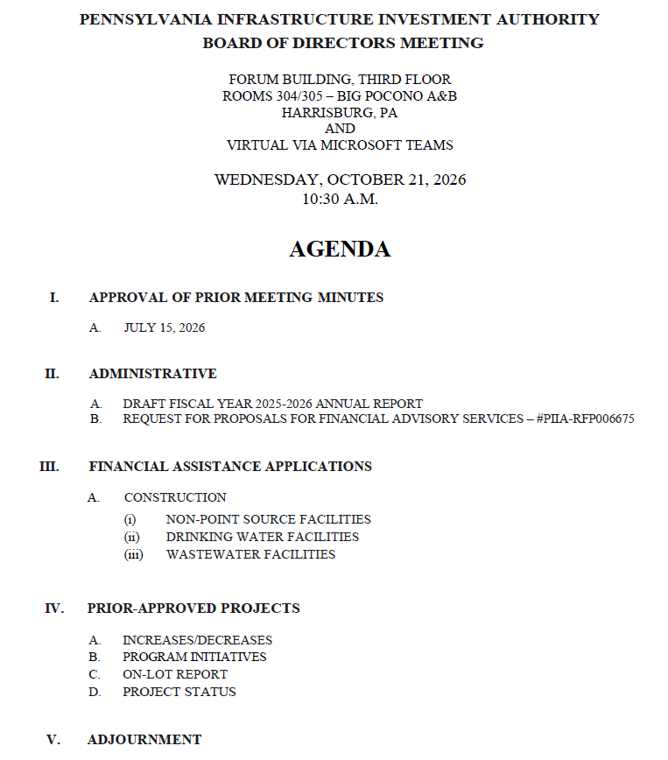

Today’s
Agenda

Slide 11
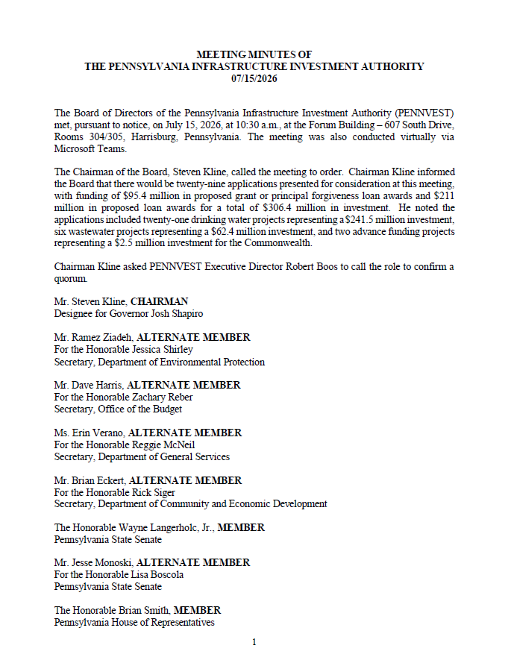
APPROVAL OF PRIOR MEETING MINUTES
A. JULY 15, 2026
I. APPROVAL OF PRIOR MEETING MINUTES A. JULY 15, 2026

Slide 12

Motion
I. APPROVAL OF PRIOR MEETING MINUTES A. JULY 15, 2026

Slide 13
Board Discussion
I. APPROVAL OF PRIOR MEETING MINUTES A. JULY 15, 2026

Slide 14
Public Comment
I. APPROVAL OF PRIOR MEETING MINUTES A. JULY 15, 2026

Slide 15

Vote
I. APPROVAL OF PRIOR MEETING MINUTES A. JULY 15, 2026

Slide 16
ADMINISTRATIVE
II. ADMINISTRATIVE

Slide 17

II. ADMINISTRATIVE A. DRAFT FISCAL YEAR 2025-2026 ANNUAL REPORT
II. ADMINISTRATIVE
A. DRAFT FISCAL
YEAR 2025-2026
ANNUAL REPORT

Slide 18
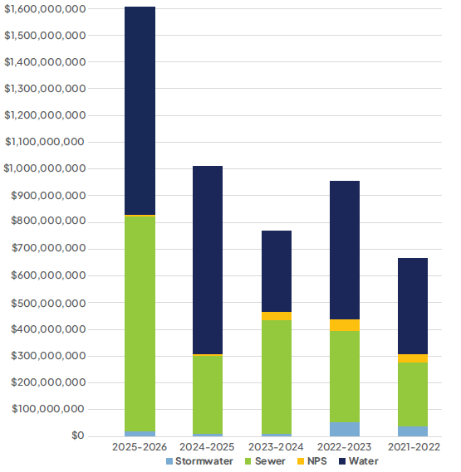
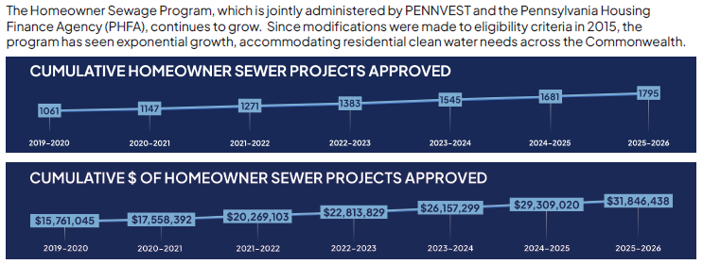
Program Highlights

Slide 19
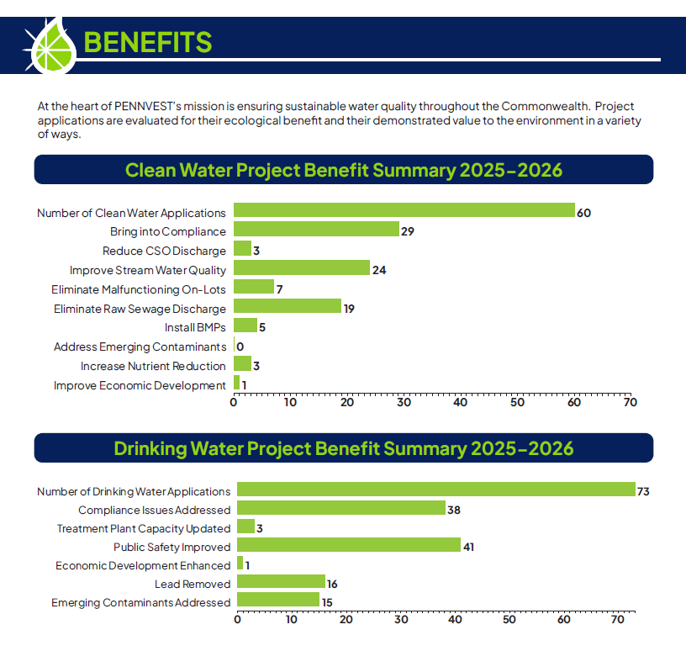
Benefits

Slide 20
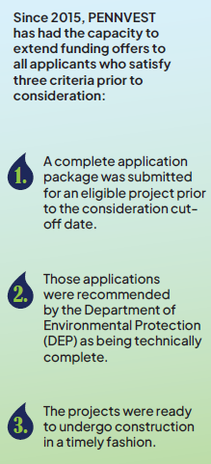
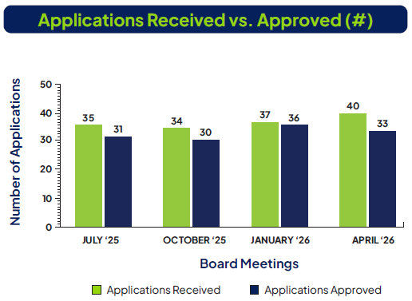
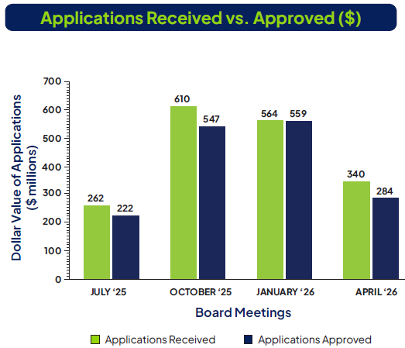
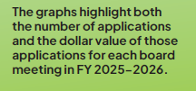
Applications

Slide 21
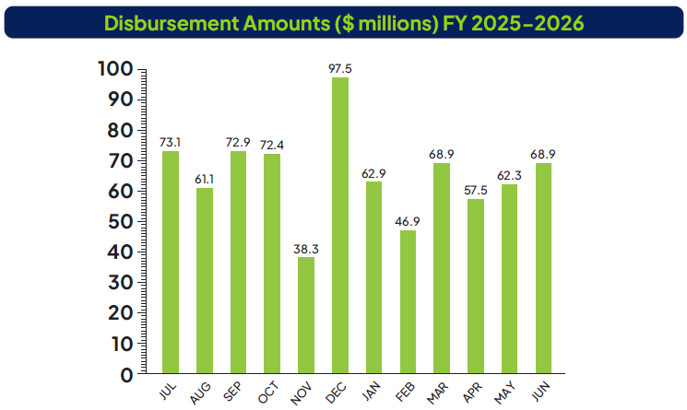
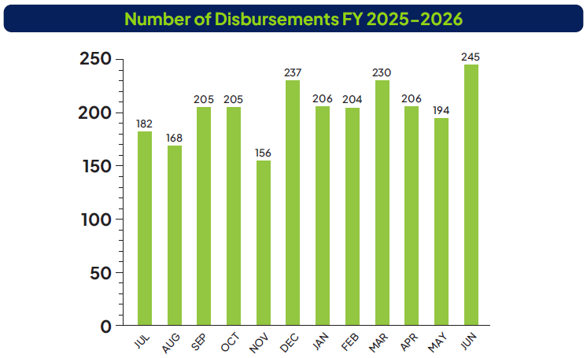
Disbursements

Slide 22
Motion
II. ADMINISTRATIVE A. DRAFT FISCAL YEAR 2025-2026 ANNUAL REPORT

Slide 23
Board Discussion
II. ADMINISTRATIVE A. DRAFT FISCAL YEAR 2025-2026 ANNUAL REPORT

Slide 24
Public Comment
II. ADMINISTRATIVE A. DRAFT FISCAL YEAR 2025-2026 ANNUAL REPORT

Slide 25
Vote
II. ADMINISTRATIVE A. DRAFT FISCAL YEAR 2025-2026 ANNUAL REPORT

Slide 26
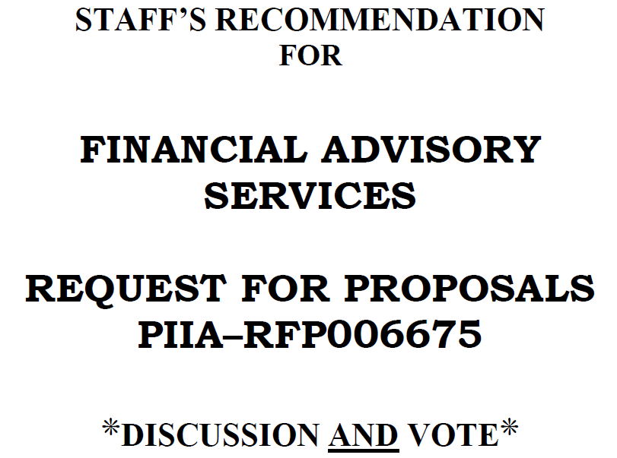
II. ADMINISTRATIVE B. RFP FOR FINANCIAL ADVISORY SERVICES – #PIIA-RFP006675
II. ADMINISTRATIVE
B. REQUEST FOR PROPOSALS FOR FINANCIAL ADVISORY SERVICES –
#PIIA-RFP006675

Slide 27
Motion
II. ADMINISTRATIVE B. RFP FOR FINANCIAL ADVISORY SERVICES – #PIIA-RFP006675

Slide 28
Board Discussion
II. ADMINISTRATIVE B. RFP FOR FINANCIAL ADVISORY SERVICES – #PIIA-RFP006675

Slide 29
Public Comment
II. ADMINISTRATIVE B. RFP FOR FINANCIAL ADVISORY SERVICES – #PIIA-RFP006675

Slide 30
Vote
II. ADMINISTRATIVE B. RFP FOR FINANCIAL ADVISORY SERVICES – #PIIA-RFP006675

Slide 31
FINANCIAL ASSISTANCE APPLICATIONS
III. FINANCIAL ASSISTANCE APPLICATIONS

Slide 32
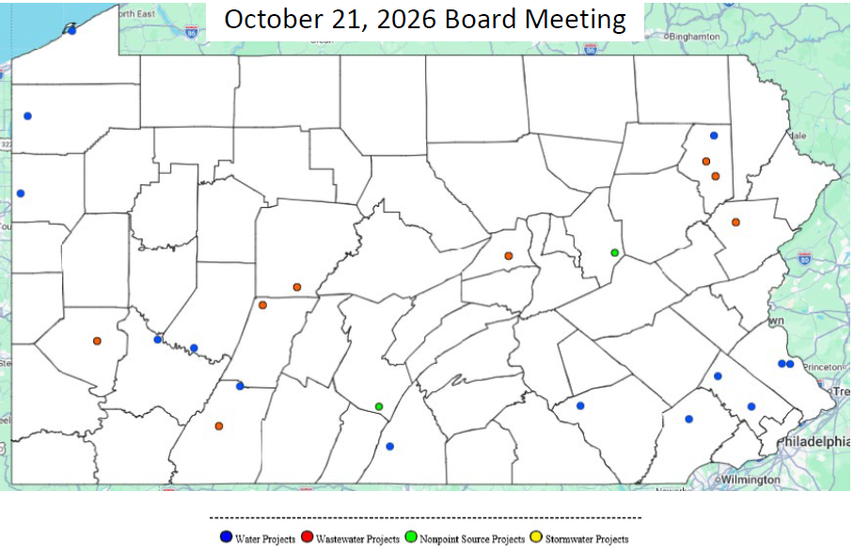
MAP OF PROJECT APPLICATIONS RECOMMENDED FOR APPROVAL
III. FINANCIAL ASSISTANCE APPLICATIONS

Slide 33
NON-POINT SOURCE
PROJECTS
III. FINANCIAL ASSISTANCE APPLICATIONS A. CONSTRUCTION (i) NON-POINT SOURCE

Slide 34
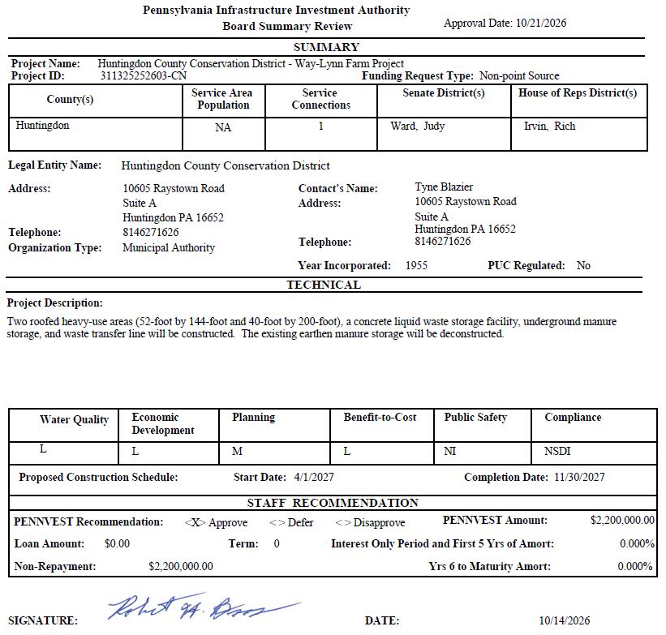
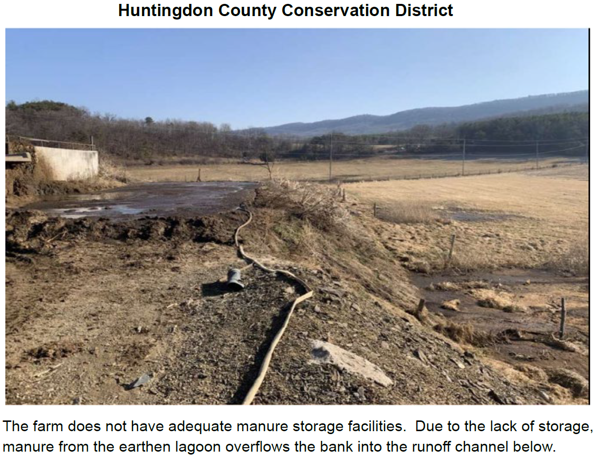
Huntingdon County Conservation District

Slide 35
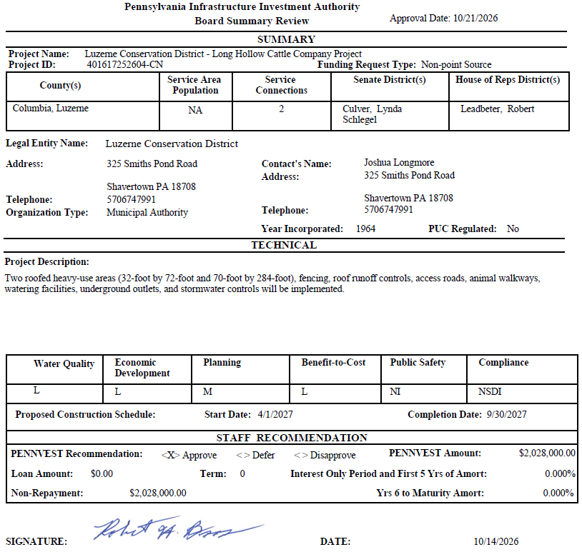
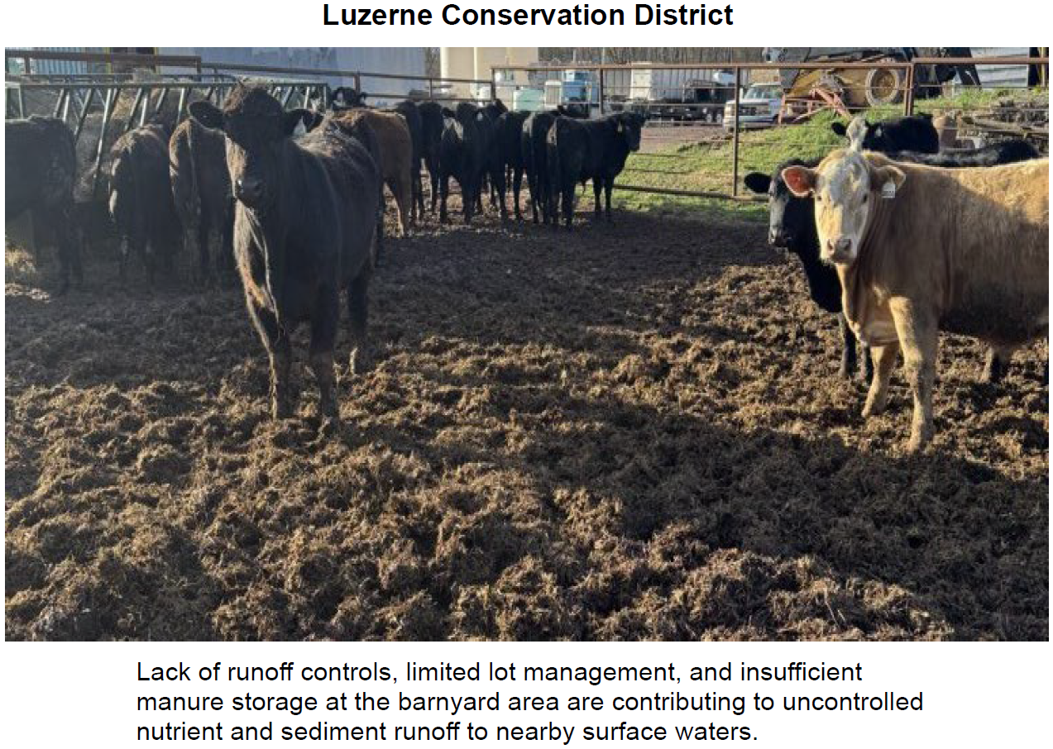
Luzerne Conservation District

Slide 36
PROJECT SPECIALIST
PRESENTATION
III. FINANCIAL ASSISTANCE APPLICATIONS A. CONSTRUCTION (i) NON-POINT SOURCE

Slide 37
Huntingdon County Conservation District

Slide 38
Motion
III. FINANCIAL ASSISTANCE APPLICATIONS A. CONSTRUCTION (i) NON-POINT SOURCE

Slide 39
Board Discussion
III. FINANCIAL ASSISTANCE APPLICATIONS A. CONSTRUCTION (i) NON-POINT SOURCE

Slide 40
Public Comment
III. FINANCIAL ASSISTANCE APPLICATIONS A. CONSTRUCTION (i) NON-POINT SOURCE

Slide 41
Vote
III. FINANCIAL ASSISTANCE APPLICATIONS A. CONSTRUCTION (i) NON-POINT SOURCE

Slide 42
DRINKING WATER
CONSTRUCTION PROJECTS
III. FINANCIAL ASSISTANCE APPLICATIONS A. CONSTRUCTION (ii) DRINKING WATER

Slide 43
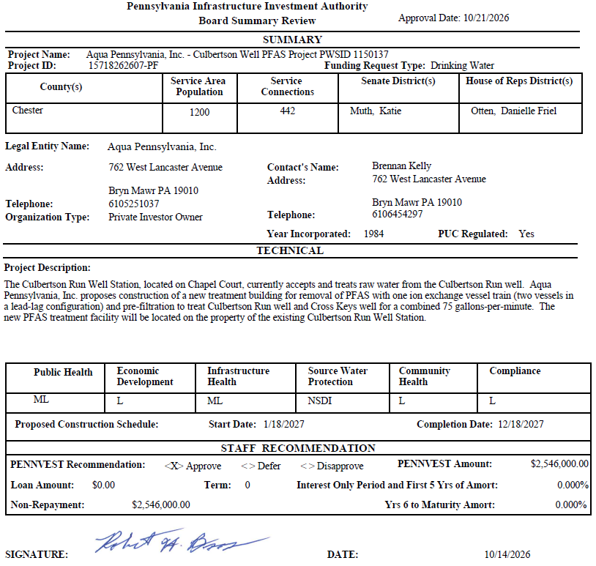
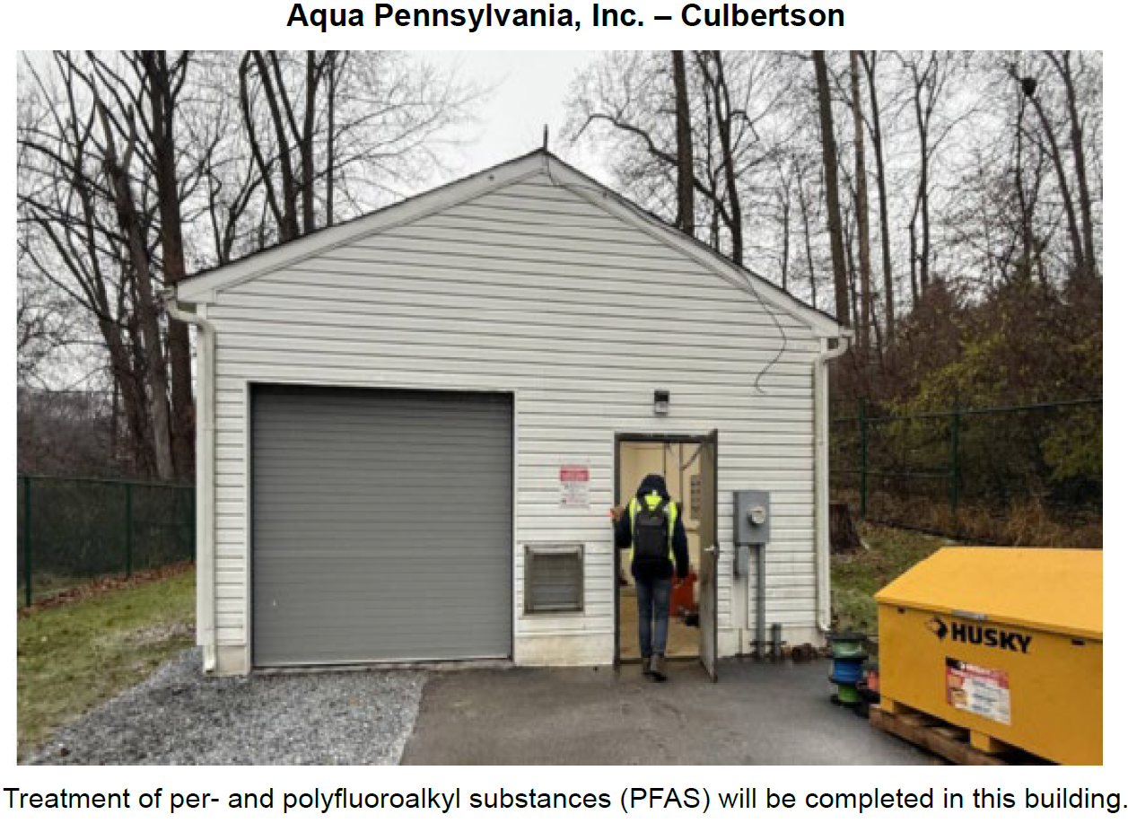
Aqua Pennsylvania, Inc. – Culbertson

Slide 44
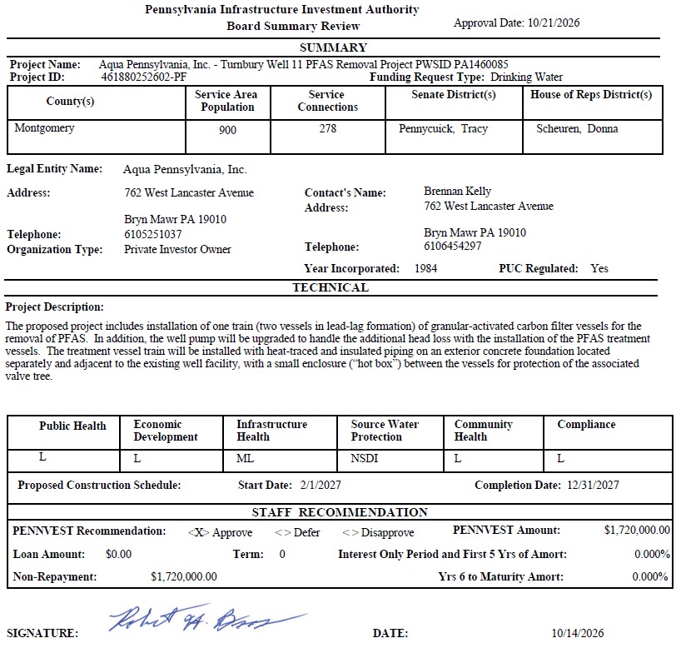
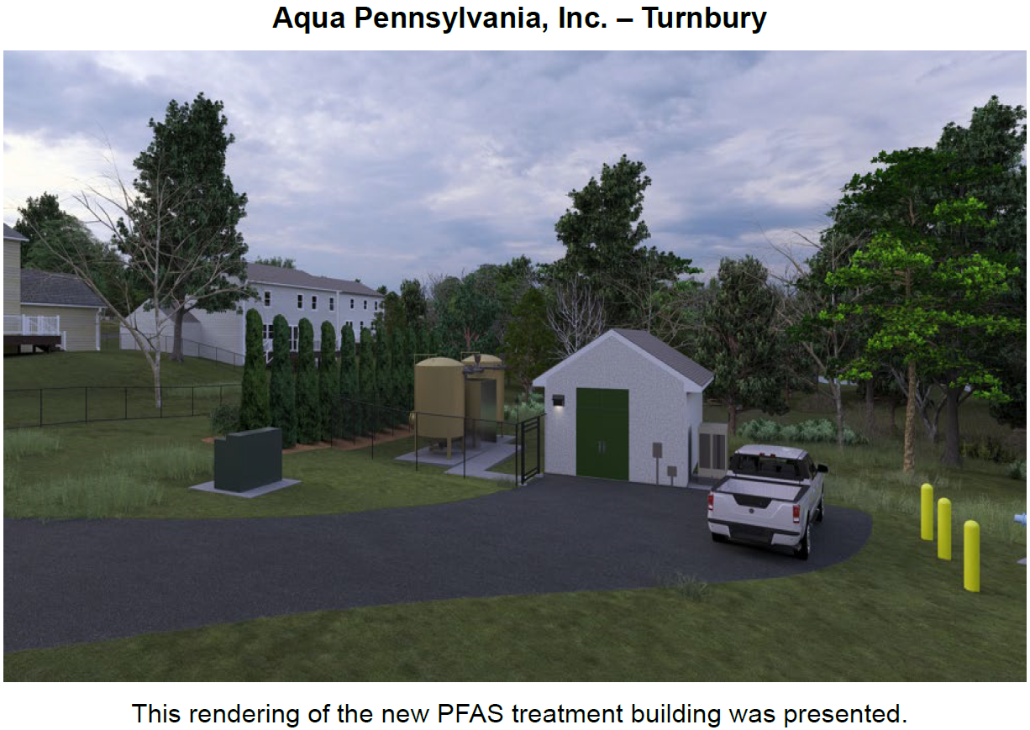
Aqua Pennsylvania, Inc. – Turnbury

Slide 45
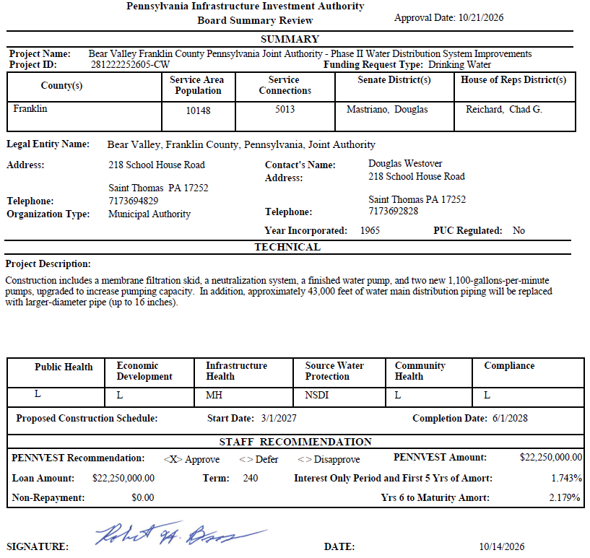
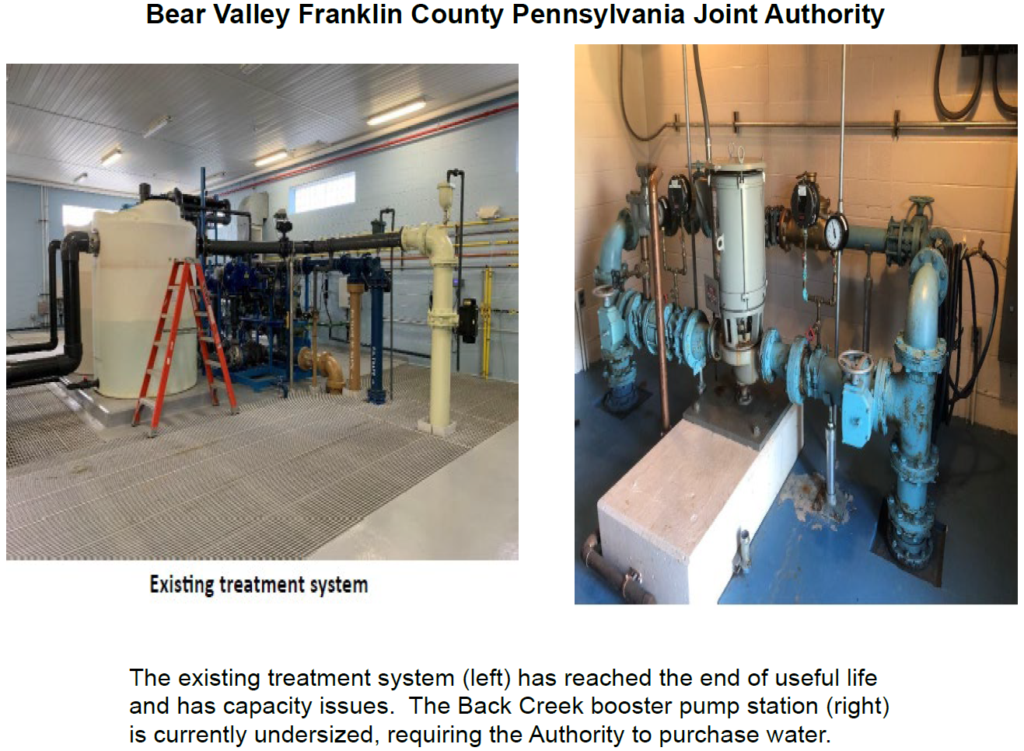
Bear Valley Franklin County Pennsylvania Joint Authority

Slide 46
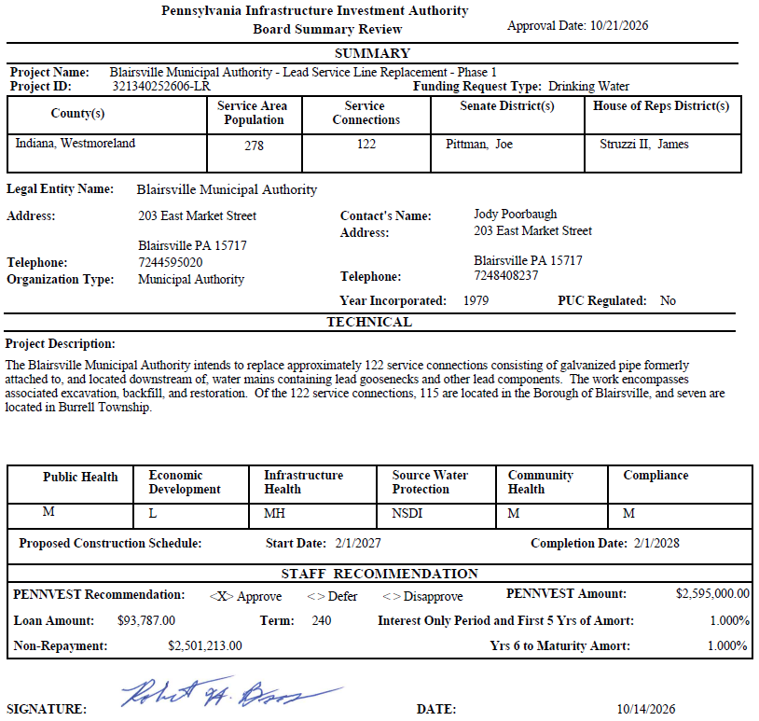
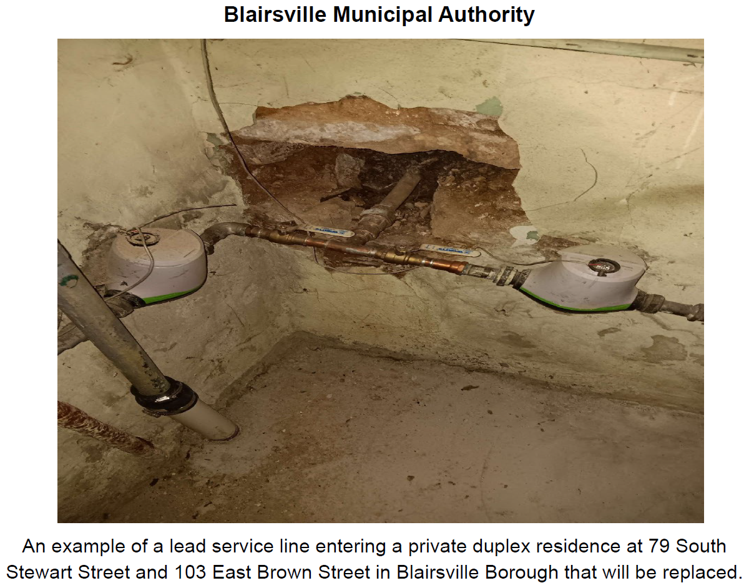
Blairsville Municipal Authority

Slide 47
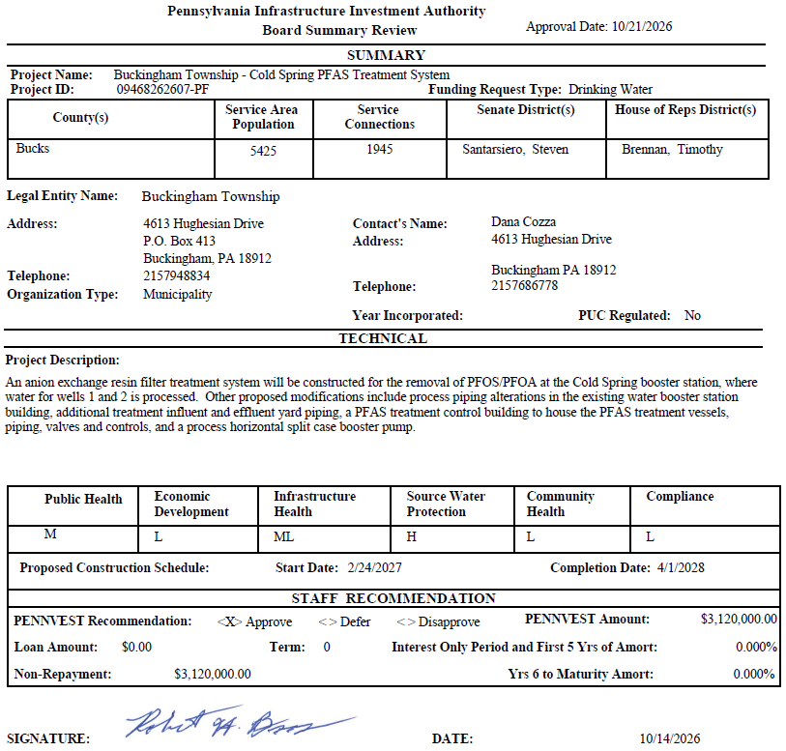
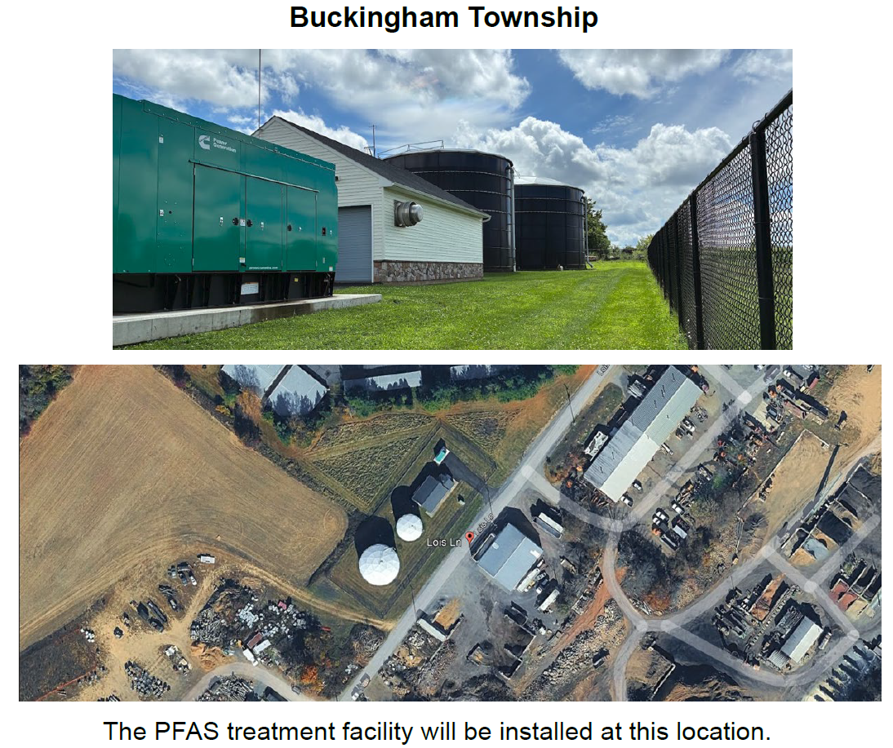
Buckingham Township

Slide 48
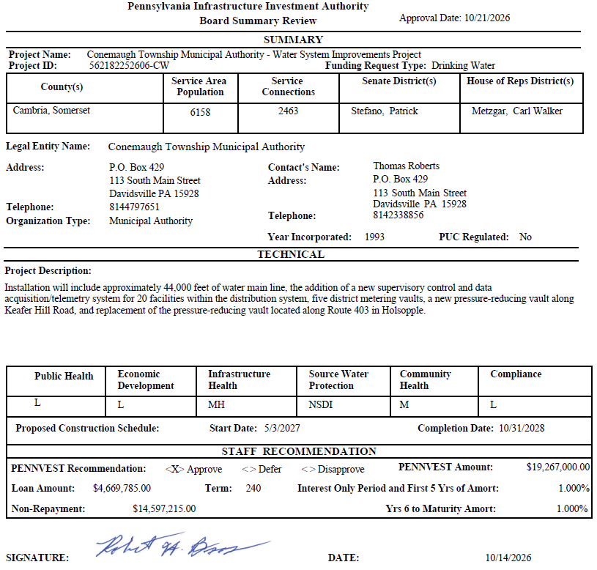
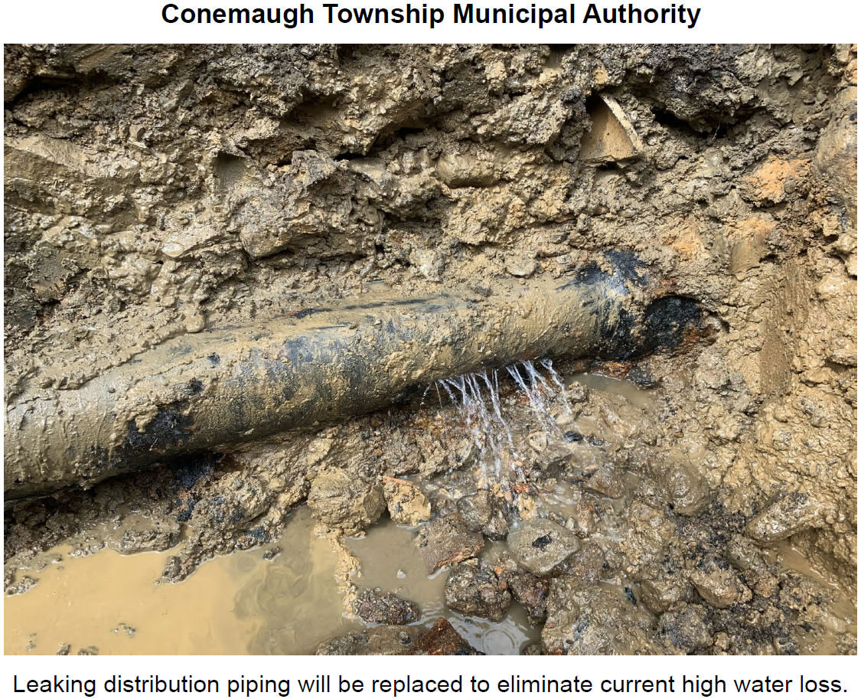
Conemaugh Township Municipal Authority

Slide 49
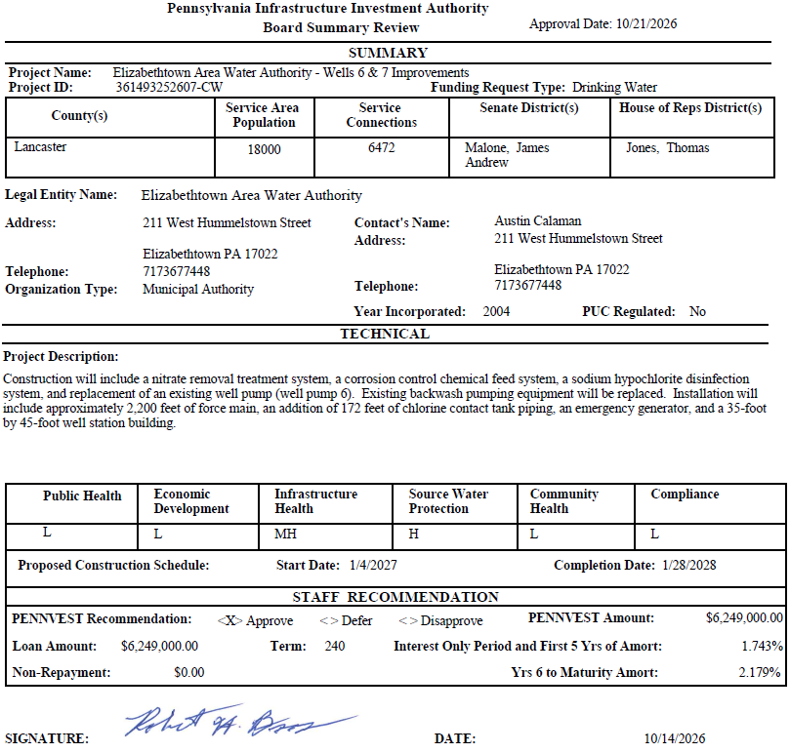
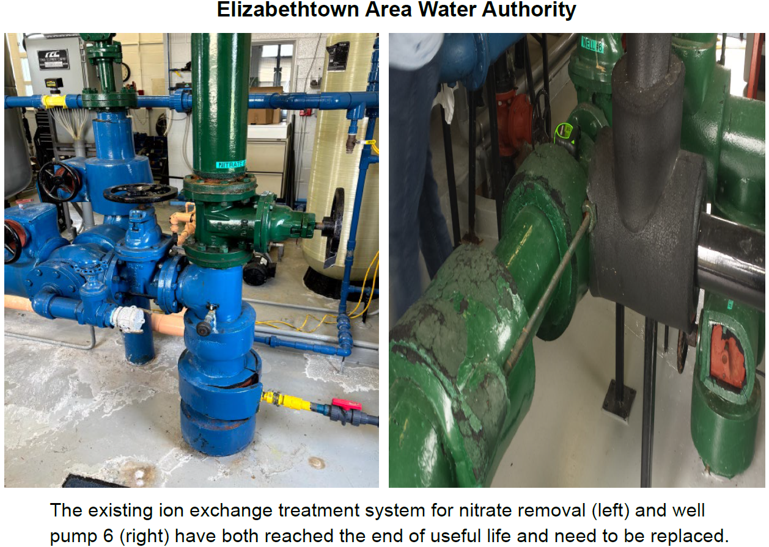
Elizabethtown Area Water Authority

Slide 50
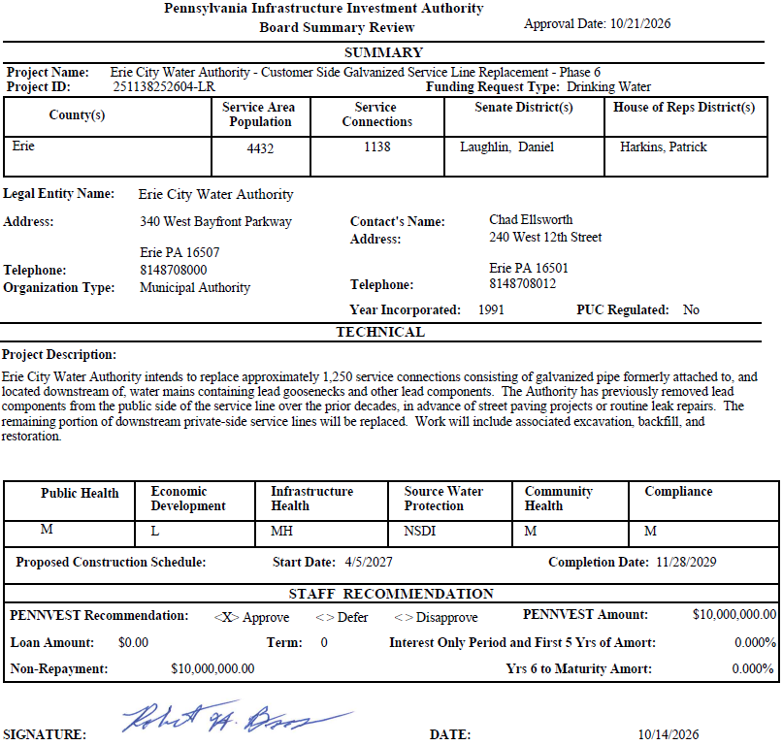
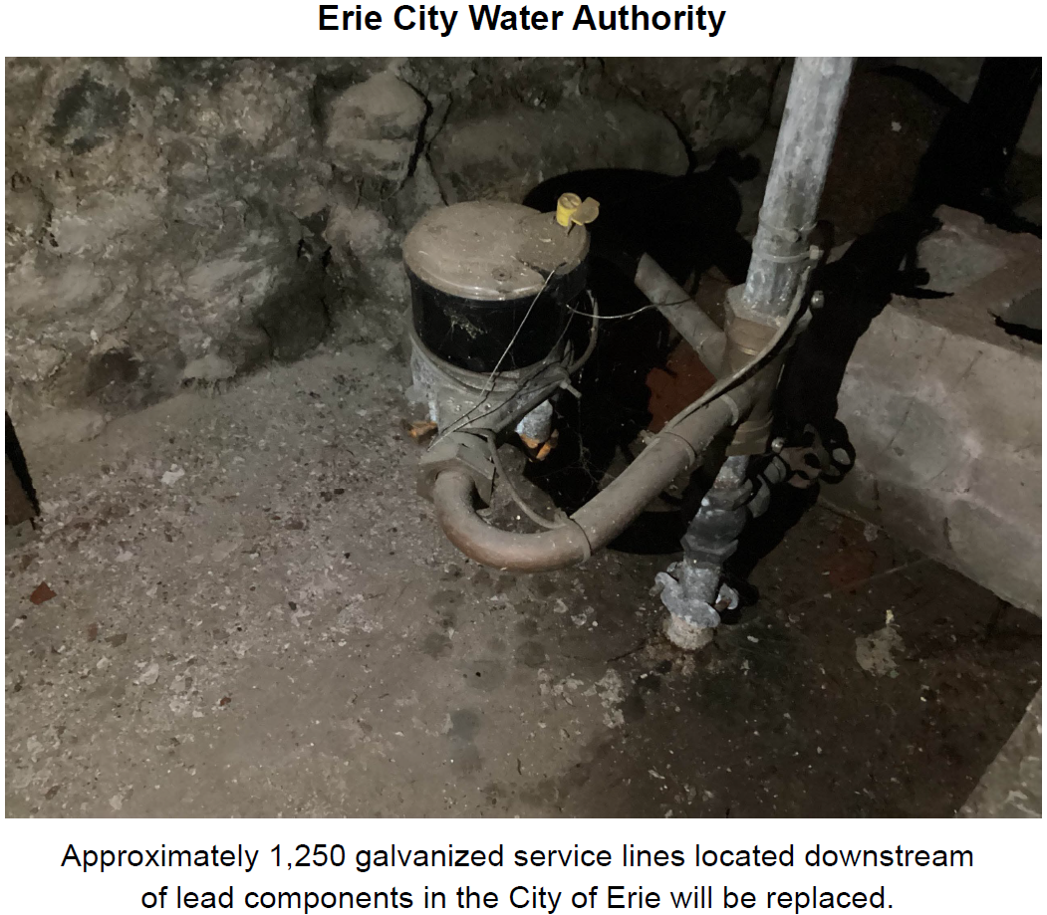
Erie City Water Authority

Slide 51
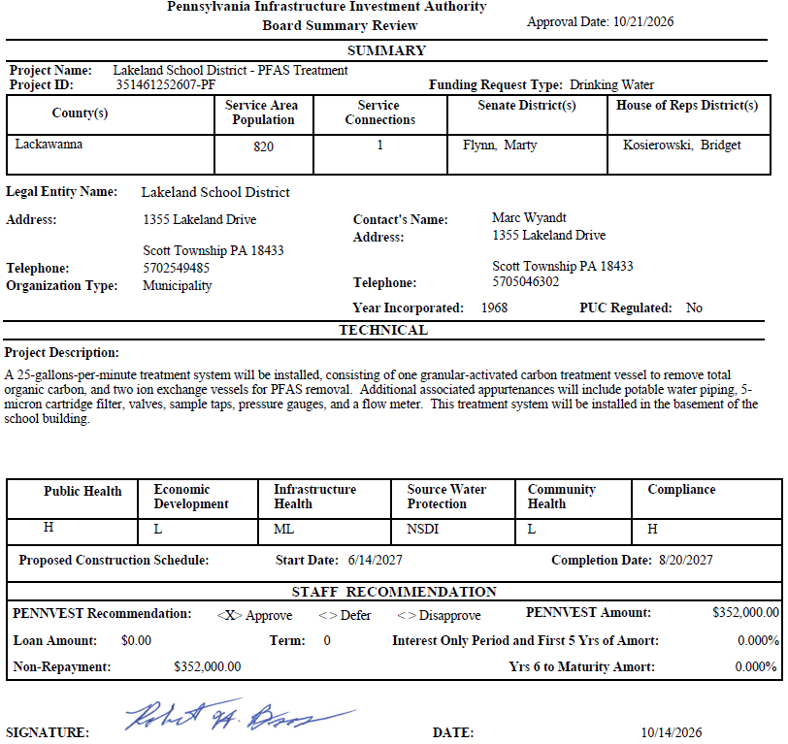
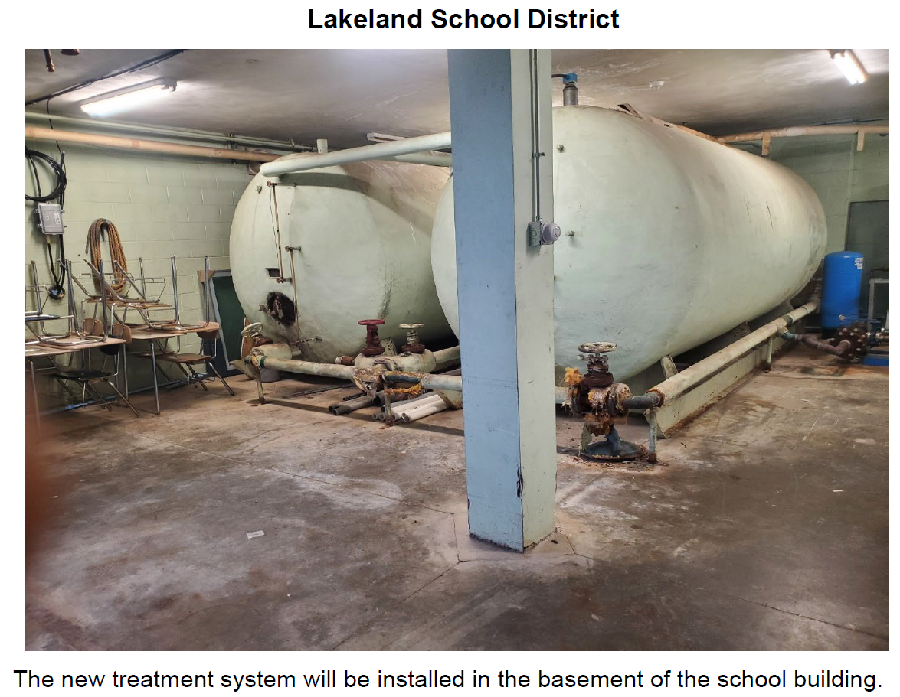
Lakeland School District

Slide 52
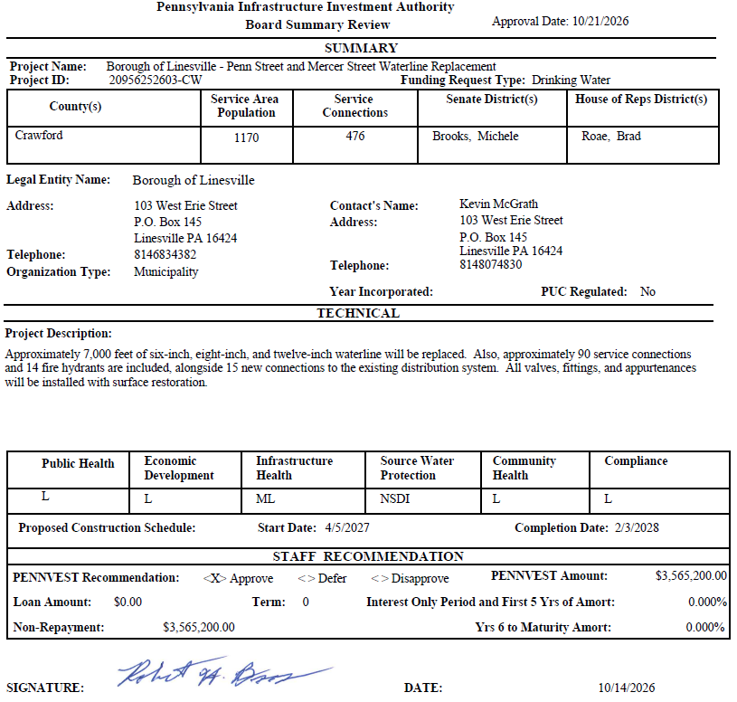
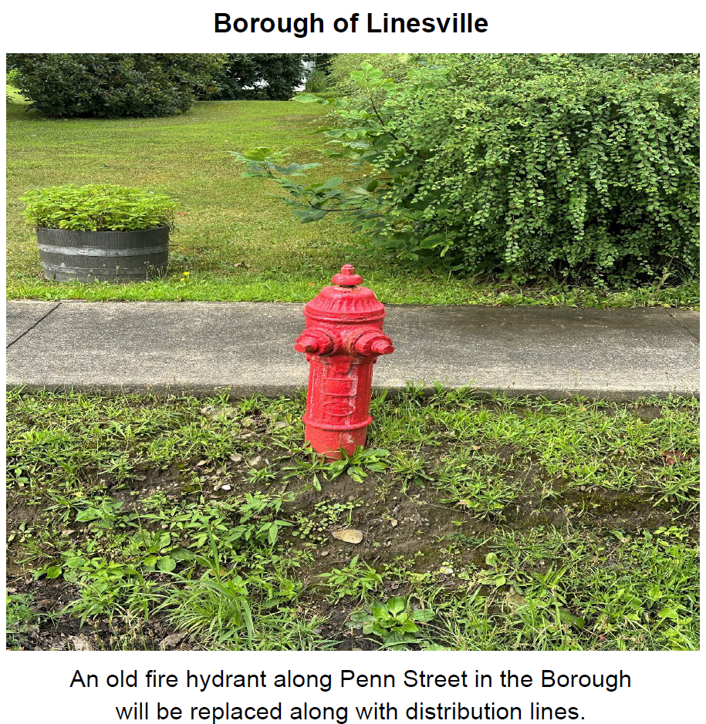
Borough of Linesville

Slide 53
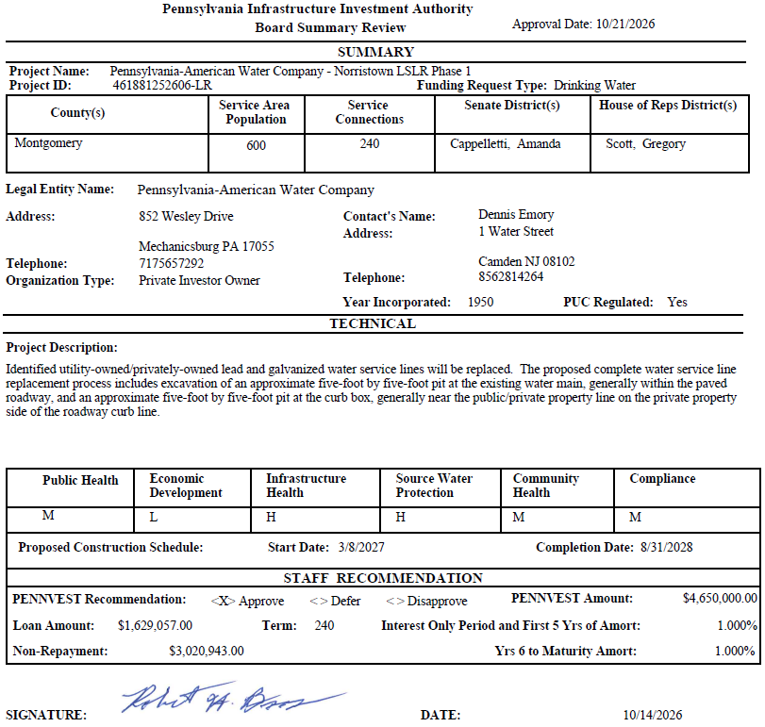
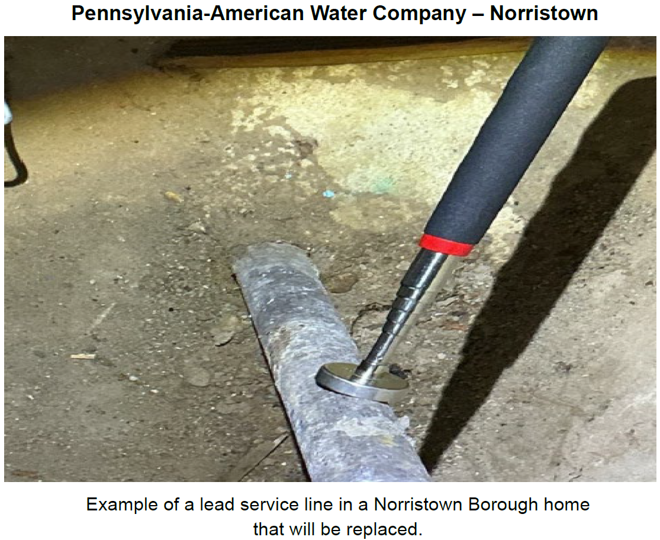
Pennsylvania-American Water Company - Norristown

Slide 54
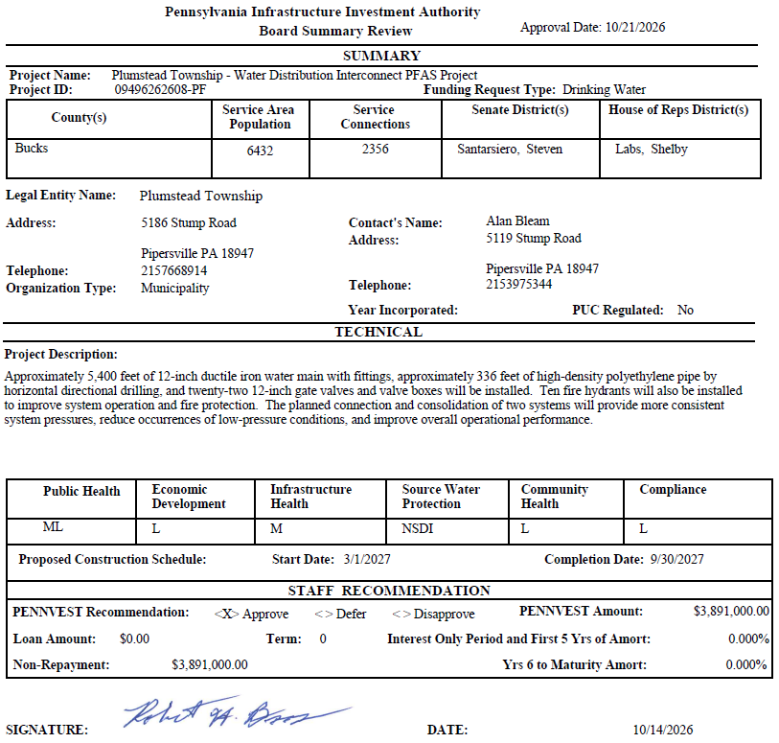
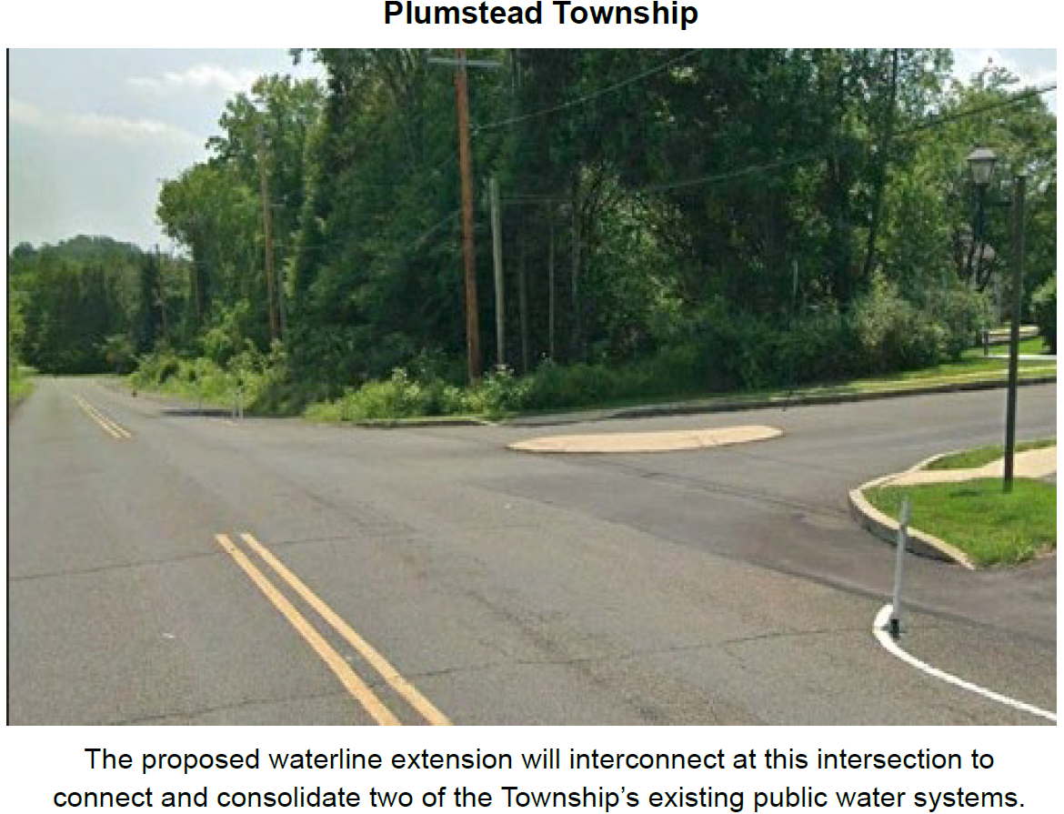
Plumstead Township

Slide 55
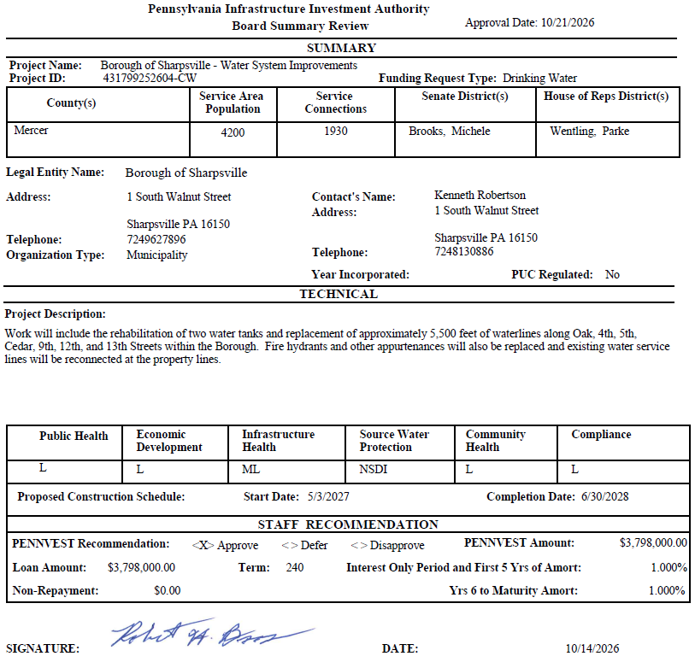
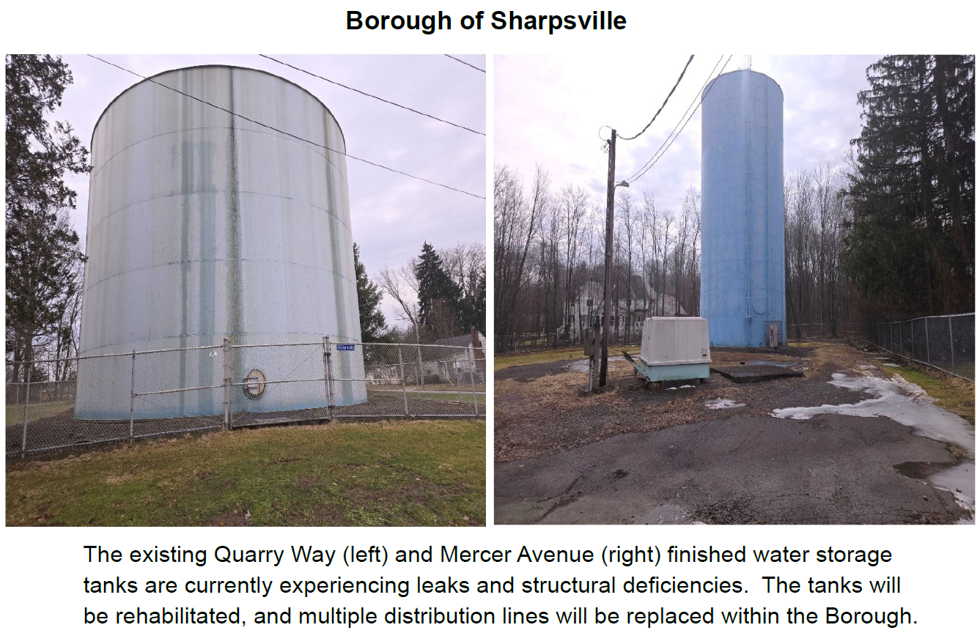
Borough of Sharpsville

Slide 56
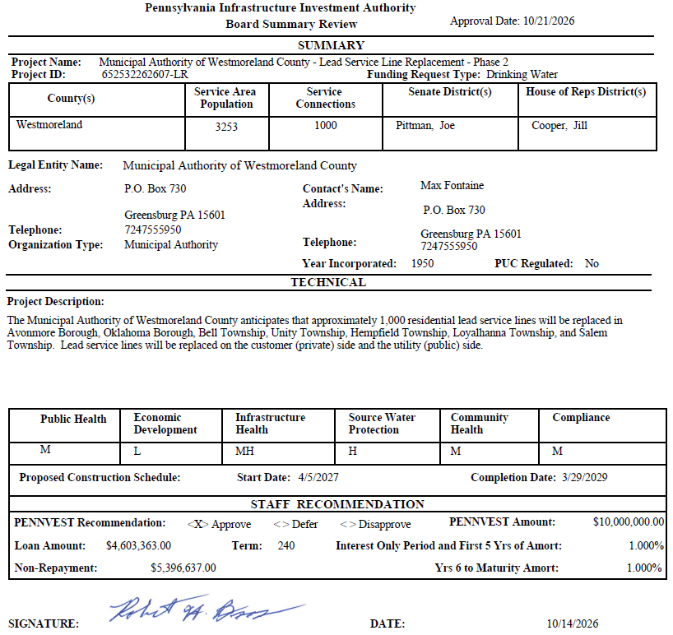
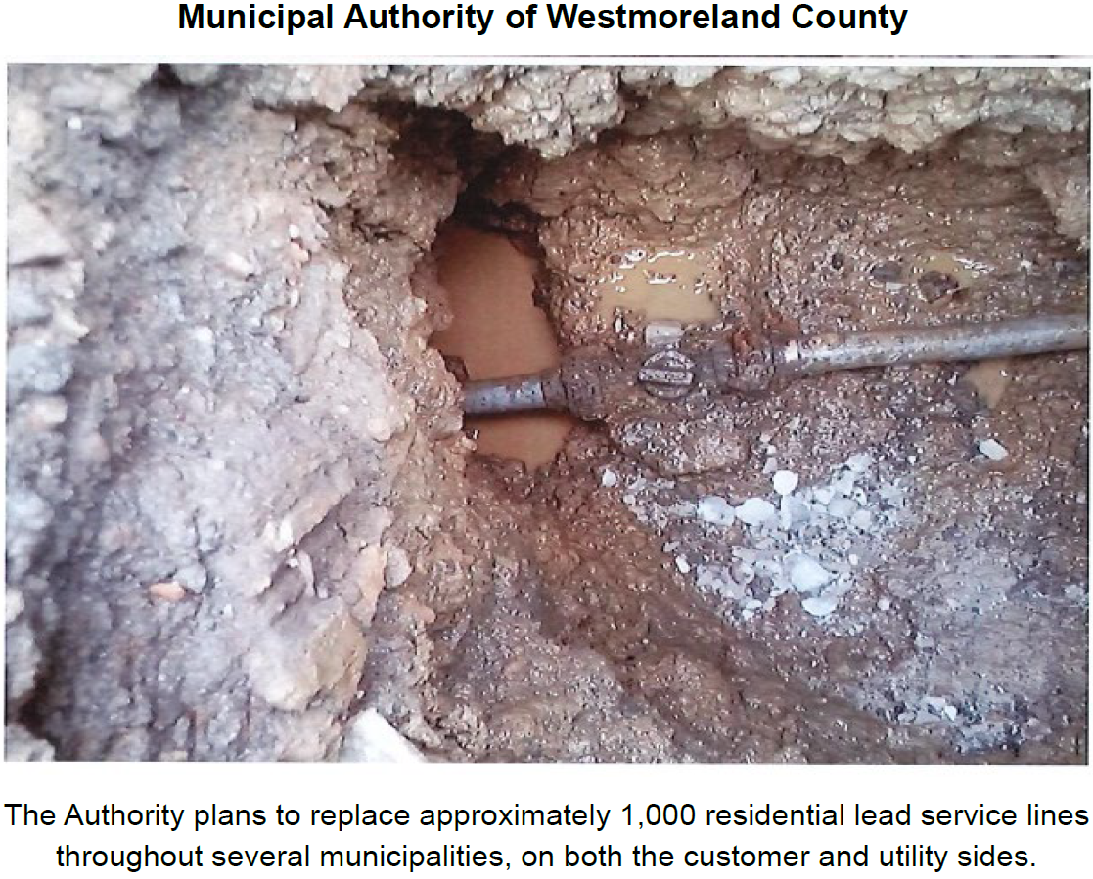
Municipal Authority of Westmoreland County

Slide 57
PROJECT SPECIALIST
PRESENTATIONS
III. FINANCIAL ASSISTANCE APPLICATIONS A. CONSTRUCTION (ii) DRINKING WATER

Slide 58
Blairsville Municipal Authority

Slide 59
Lakeland School District

Slide 60
Motion
III. FINANCIAL ASSISTANCE APPLICATIONS A. CONSTRUCTION (ii) DRINKING WATER

Slide 61
Board Discussion
III. FINANCIAL ASSISTANCE APPLICATIONS A. CONSTRUCTION (ii) DRINKING WATER

Slide 62
Public Comment
III. FINANCIAL ASSISTANCE APPLICATIONS A. CONSTRUCTION (ii) DRINKING WATER

Slide 63
Vote
III. FINANCIAL ASSISTANCE APPLICATIONS A. CONSTRUCTION (ii) DRINKING WATER

Slide 64
WASTEWATER
CONSTRUCTION PROJECTS
III. FINANCIAL ASSISTANCE APPLICATIONS A. CONSTRUCTION (iii) WASTEWATER

Slide 65
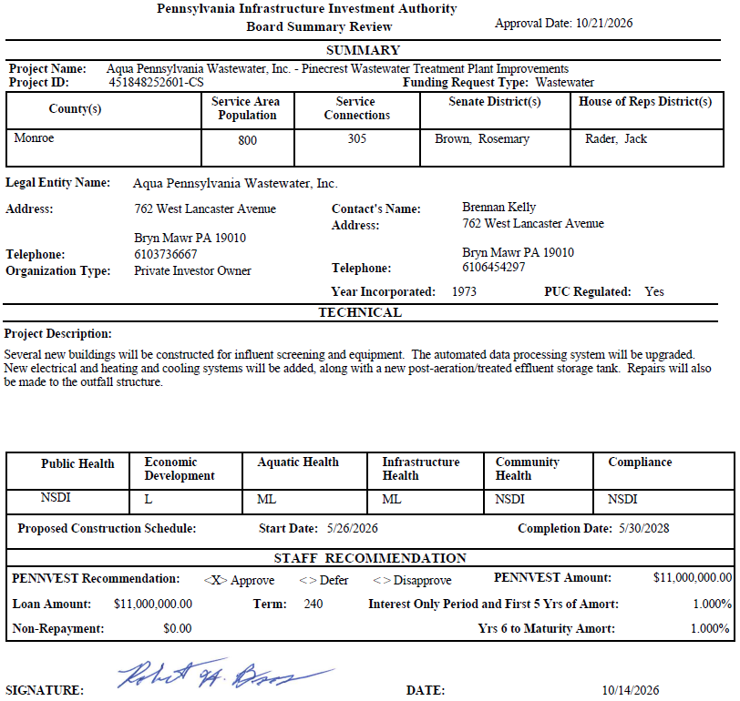
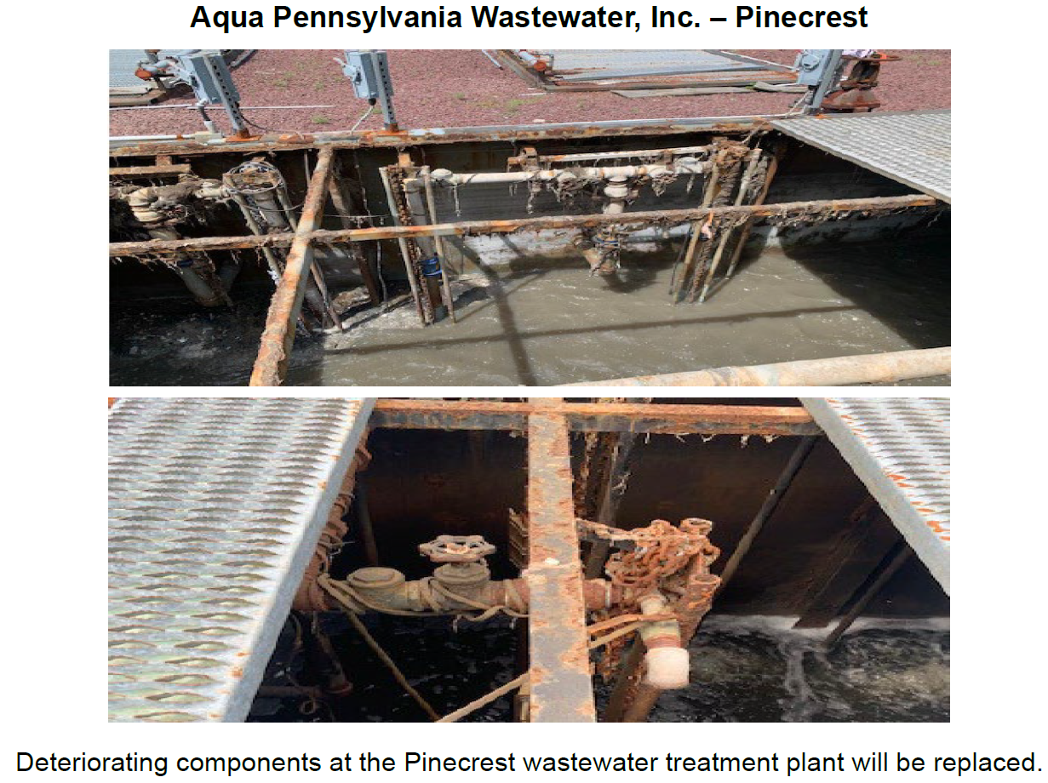
Aqua Pennsylvania Wastewater, Inc. – Pinecrest

Slide 66
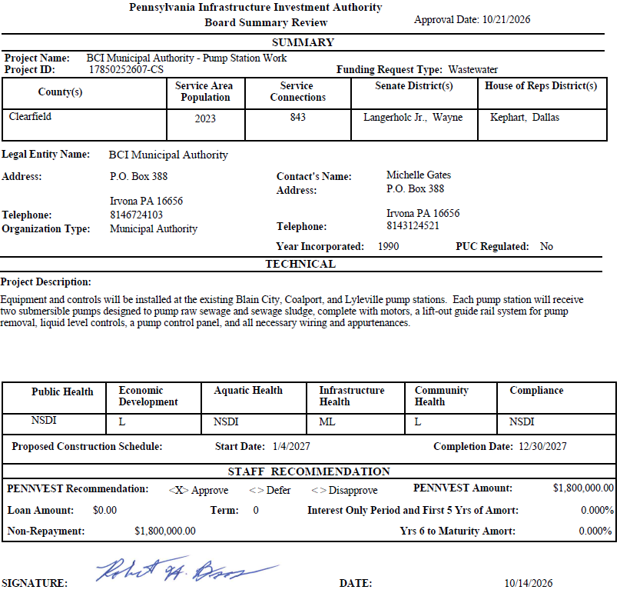
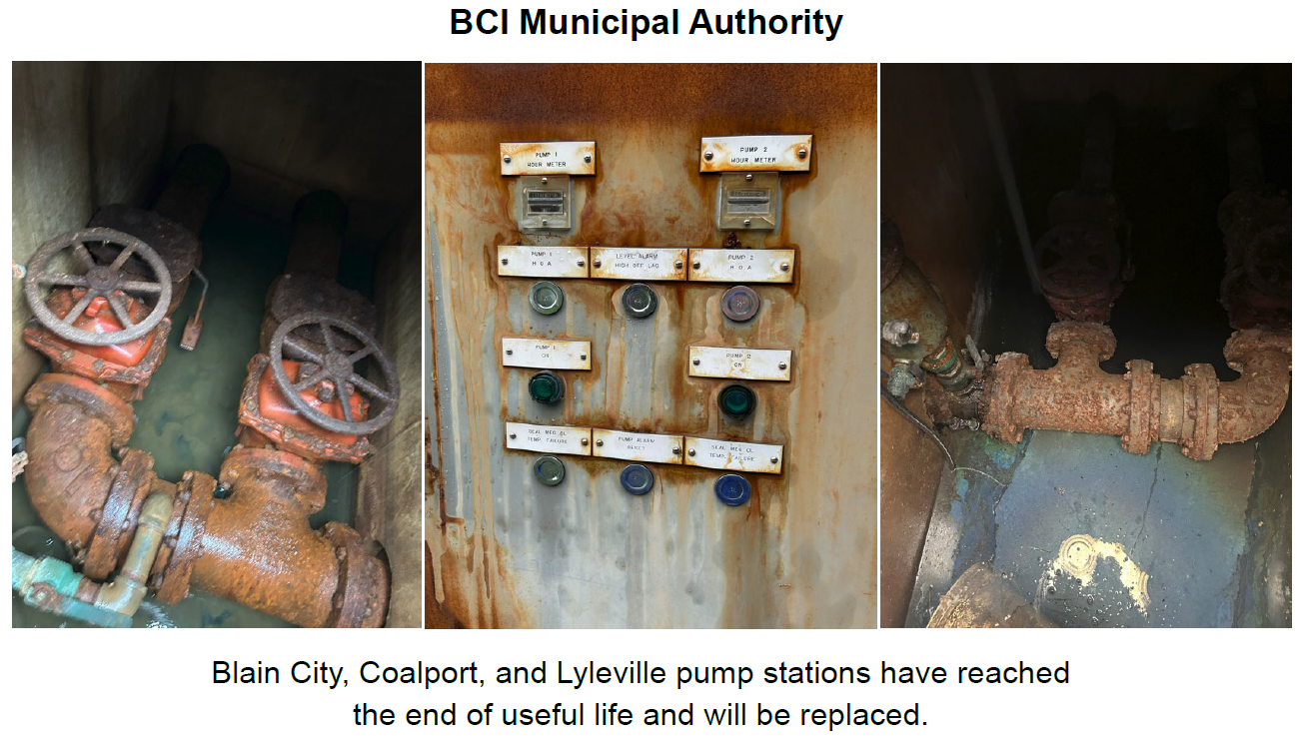
BCI Municipal Authority

Slide 67


Borough of Mifflinburg

Slide 68


Pennsylvania-American Water Company - Scranton

Slide 69


Pittsburgh Water and Sewer Authority

Slide 70


Municipal Authority of the Borough of Somerset

Slide 71


Spring Brook Township Sewer Authority

Slide 72


West Branch Sewer Authority

Slide 73
PROJECT SPECIALIST
PRESENTATIONS
III. FINANCIAL ASSISTANCE APPLICATIONS A. CONSTRUCTION (iii) WASTEWATER

Slide 74
BCI Municipal Authority

Slide 75
Pennsylvania-American Water Company - Scranton

Slide 76
Municipal Authority of the Borough of Somerset

Slide 77
Motion
III. FINANCIAL ASSISTANCE APPLICATIONS A. CONSTRUCTION (iii) WASTEWATER

Slide 78
Board Discussion
III. FINANCIAL ASSISTANCE APPLICATIONS A. CONSTRUCTION (iii) WASTEWATER

Slide 79
Public Comment
III. FINANCIAL ASSISTANCE APPLICATIONS A. CONSTRUCTION (iii) WASTEWATER

Slide 80
Vote
III. FINANCIAL ASSISTANCE APPLICATIONS A. CONSTRUCTION (iii) WASTEWATER

Slide 81
PRIOR-APPROVED
PROJECTS
INCREASES/DECREASES
IV. PRIOR-APPROVED PROJECTS A. INCREASES/DECREASES

Slide 82

Totals of Increases/Decreases Report

Slide 83

Dollars Disencumbered Report

Slide 84

Current Individual Increase Requests Summary

Slide 85
Motion
IV. PRIOR-APPROVED PROJECTS A. INCREASES/DECREASES

Slide 86
Board Discussion
IV. PRIOR-APPROVED PROJECTS A. INCREASES/DECREASES

Slide 87
Public Comment
IV. PRIOR-APPROVED PROJECTS A. INCREASES/DECREASES

Slide 88
Vote
IV. PRIOR-APPROVED PROJECTS A. INCREASES/DECREASES

Slide 89
PRIOR-APPROVED
PROJECTS
PROGRAM INITIATIVES
IV. PRIOR-APPROVED PROJECTS B. PROGRAM INITIATIVES

Slide 90

Small Projects Report

Slide 91

Small Projects Report

Slide 92

Bipartisan Infrastructure Law (BIL) Project Summary

Slide 93
PRIOR-APPROVED
PROJECTS
ON-LOT REPORT
IV. PRIOR-APPROVED PROJECTS C. ON-LOT REPORT

Slide 94

On-Lot Report

Slide 95
PRIOR-APPROVED
PROJECTS
PROJECT STATUS
IV. PRIOR-APPROVED PROJECTS D. PROJECT STATUS

Slide 96

Application to Approval Projects for October 21, 2026

Slide 97

Approval to Settlement Projects for October 21, 2026

Slide 98

Approval to Settlement Projects for October 21, 2026

Slide 99
Final Public Comment

Slide 100
Save the date
The next scheduled board meeting:
January 20, 2027
Application cut-off date:
October 28, 2026

Slide 101
Vote to Adjourn
V. ADJOURNMENT

