Slide 1


Board of Directors Meeting
October 15, 2025
10:30 a.m.

Slide 2

Recording Notice
This meeting is being recorded.
By participating in this webinar, you consent to the
recording, retention, and use of this session.
If you ask a question, you consent to the
recording, retention, and use of your statements
as part of the meeting.

Slide 3
Technical Information
Can’t Hear Us?
Join the audio portion of the presentation via your telephone:
Call 1-267-332-8737
Meeting ID 705 622 820#
Technical Difficulties?
Call 1-717-705-4473 or
Send a Chat message via the Microsoft Teams meeting
Want the App?
Search “Microsoft Teams” in the Google Play Store or the App Store.

Slide 4
Public Comment
During the presentation, all attendees will be muted.
There are two methods you can use within this
Microsoft Teams meeting to pose a public comment or question.
“Raise Hand” function
“Chat” function

Slide 5
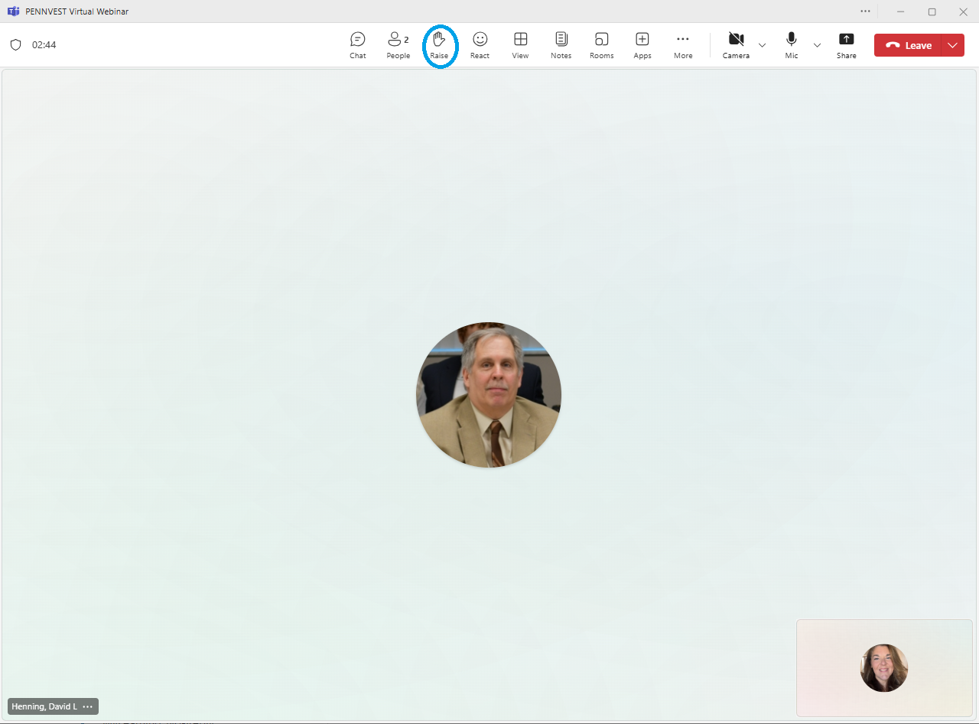



Raise Hand
In the top toolbar, raise your hand by clicking on the hand icon to indicate your request to speak.
Attendees with raised hands will be unmuted individually, allowing participants to speak one at a time.
Your microphone will show a diagonal line through the icon when muted. When the diagonal line disappears, you may pose your question or comment.

Slide 6

Chat
In the top toolbar, click on the chat bubble icon to open the chat dialogue box. Type your question or comment in the Meeting Chat.
PENNVEST staff will monitor the Chat area throughout the meeting.
Replies may be delivered verbally, or returned through the same chat box, from appropriate meeting participant(s). Responses will typically be given during an applicable Public Comment portion of the meeting.

Slide 7

Public Comment
Participant Best Practices
1. Log in to the Board Meeting through a computer or smart phone (using the Teams app).
2. When your microphone has been unmuted, begin by stating:
Your name.
Your affiliation (i.e., company, organization, etc.).
Indicate the specific project, agency activity, or agenda item about which you are commenting.
If your comment or question is on behalf of another individual or organization, please acknowledge this, immediately after your name and affiliation, and reference the name(s) of the associated person(s) or group(s).

Slide 8
Public Comment
Notices
All verbal comments, questions and responses will be recorded and can be shared publicly.
PENNVEST cannot guarantee all persons requesting to speak will be able to do so, specifically in the case of technical difficulties beyond our control, such as:
Audio feedback.
Poor sound quality.
Interruptions in bandwidth services.

Slide 9
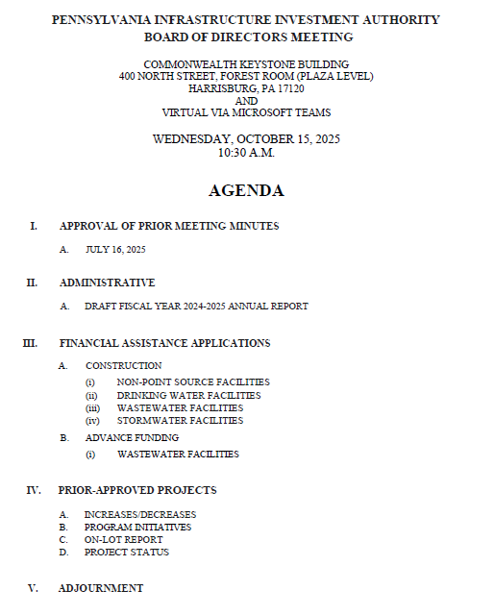

Today’s
Agenda

Slide 10
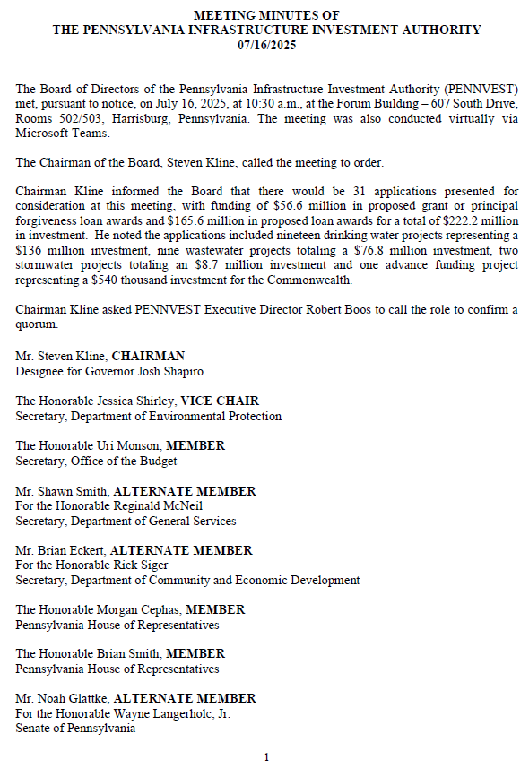
APPROVAL OF PRIOR MEETING MINUTES
A. JULY 16, 2025

Slide 11

Board Discussion
I. APPROVAL OF PRIOR MEETING MINUTES A. JULY 16, 2025

Slide 12
Public Comment
I. APPROVAL OF PRIOR MEETING MINUTES A. JULY 16, 2025

Slide 13

Vote
I. APPROVAL OF PRIOR MEETING MINUTES A. JULY 16, 2025

Slide 14
ADMINISTRATIVE
II. ADMINISTRATIVE

Slide 15

II. ADMINISTRATIVE
A. DRAFT FISCAL YEAR
2024-2025
ANNUAL REPORT
II. ADMINISTRATIVE A. DRAFT FISCAL YEAR 2024-2025 ANNUAL REPORT

Slide 16
Board Discussion
II. ADMINISTRATIVE A. DRAFT FISCAL YEAR 2024-2025 ANNUAL REPORT

Slide 17
Public Comment
II. ADMINISTRATIVE A. DRAFT FISCAL YEAR 2024-2025 ANNUAL REPORT

Slide 18
Vote
II. ADMINISTRATIVE A. DRAFT FISCAL YEAR 2024-2025 ANNUAL REPORT

Slide 19
FINANCIAL ASSISTANCE APPLICATIONS
III. FINANCIAL ASSISTANCE APPLICATIONS

Slide 20
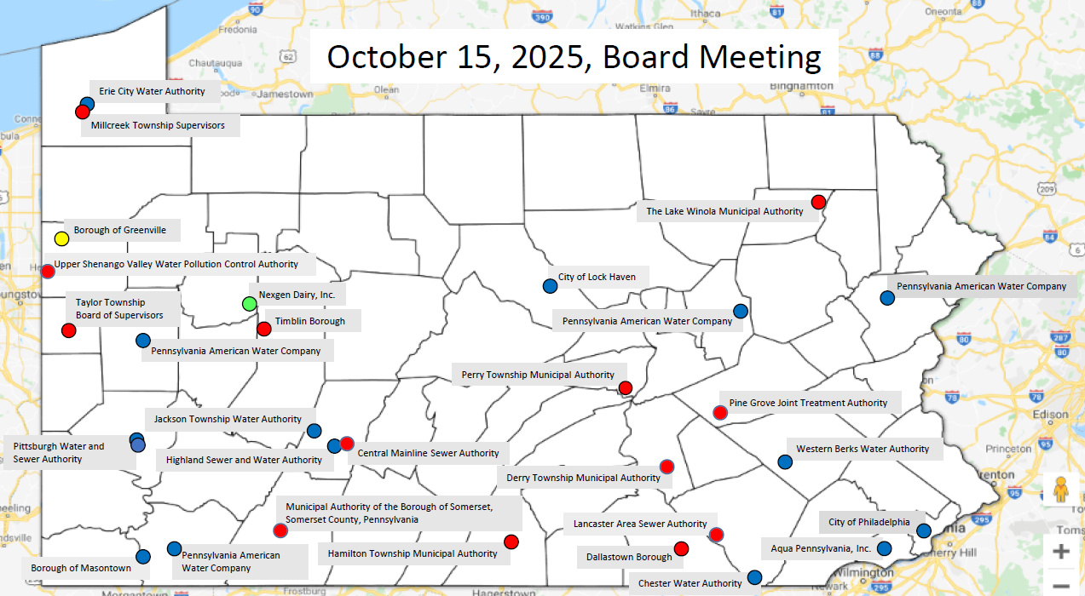
MAP OF PROJECT APPLICATIONS RECOMMENDED FOR APPROVAL
III. FINANCIAL ASSISTANCE APPLICATIONS

Slide 21
NON-POINT SOURCE
CONSTRUCTION PROJECTS
III. FINANCIAL ASSISTANCE APPLICATIONS A. CONSTRUCTION (i) NON-POINT SOURCE

Slide 22
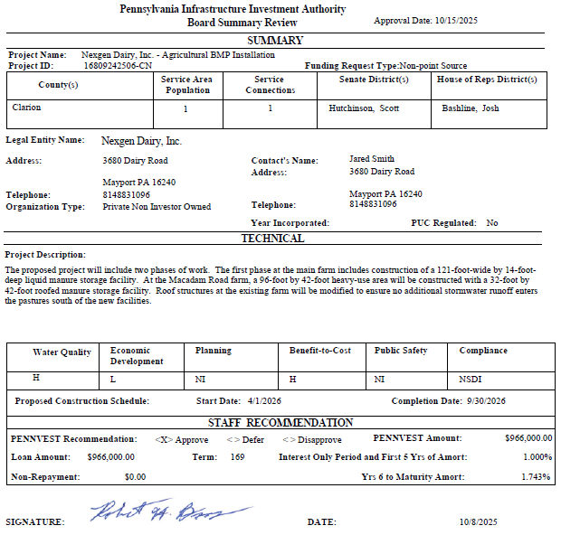
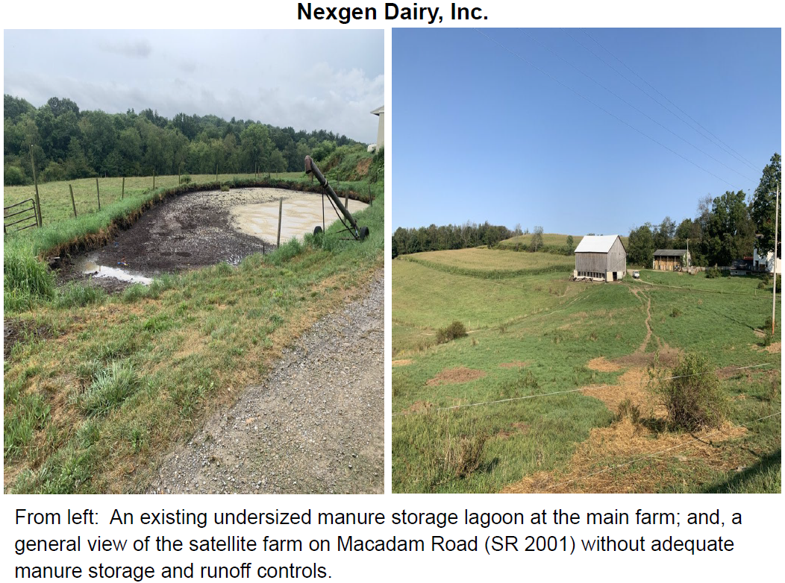
Nexgen Dairy, Inc.

Slide 23
PROJECT SPECIALIST
PRESENTATIONS
III. FINANCIAL ASSISTANCE APPLICATIONS A. CONSTRUCTION (i) NON-POINT SOURCE

Slide 24
Nexgen Dairy, Inc.

Slide 25
Board Discussion
III. FINANCIAL ASSISTANCE APPLICATIONS A. CONSTRUCTION (i) NON-POINT SOURCE

Slide 26
Public Comment
III. FINANCIAL ASSISTANCE APPLICATIONS A. CONSTRUCTION (i) NON-POINT SOURCE

Slide 27
Vote
III. FINANCIAL ASSISTANCE APPLICATIONS A. CONSTRUCTION (i) NON-POINT SOURCE

Slide 28
DRINKING WATER
CONSTRUCTION PROJECTS
III. FINANCIAL ASSISTANCE APPLICATIONS A. CONSTRUCTION (ii) DRINKING WATER

Slide 29
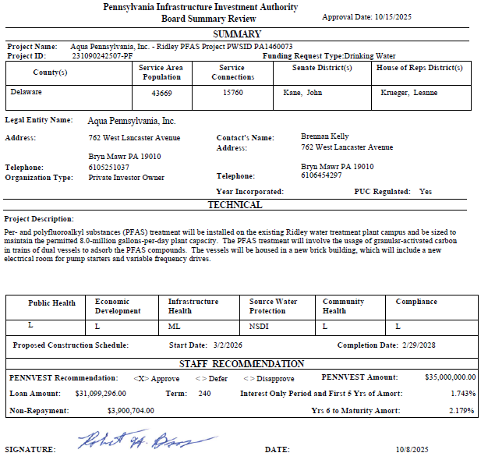
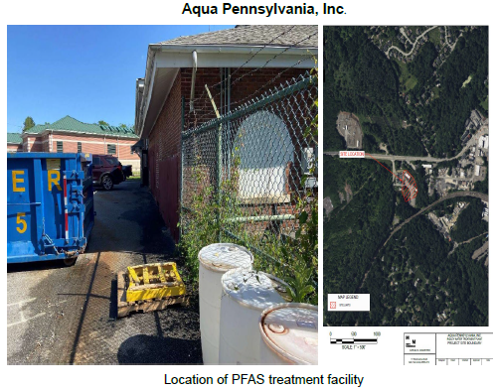
Aqua Pennsylvania, Inc.

Slide 30
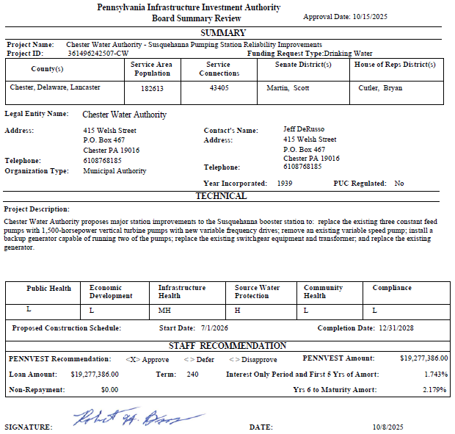
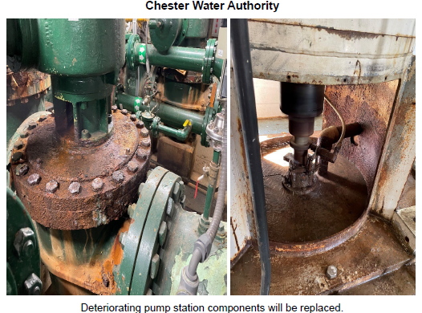
Chester Water Authority

Slide 31
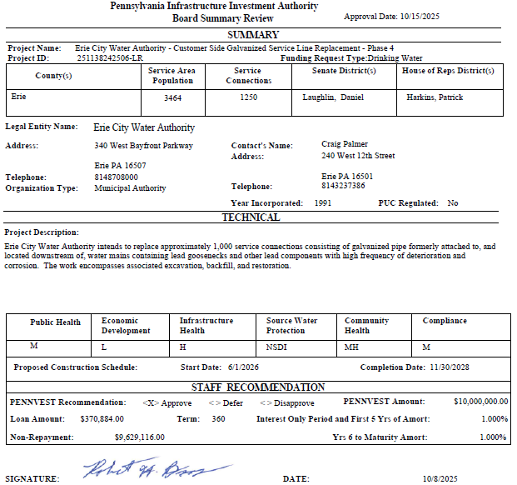
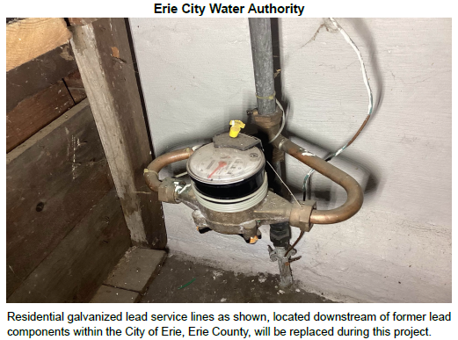
Erie City Water Authority

Slide 32
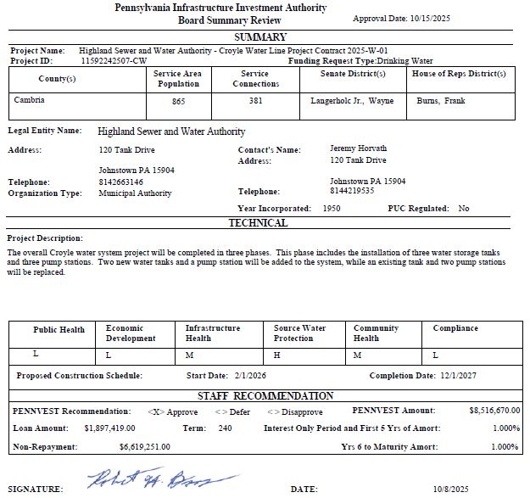
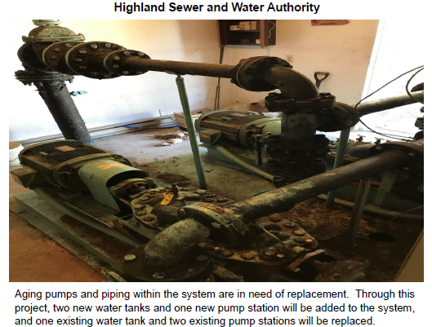
Highland Sewer and Water Authority

Slide 33
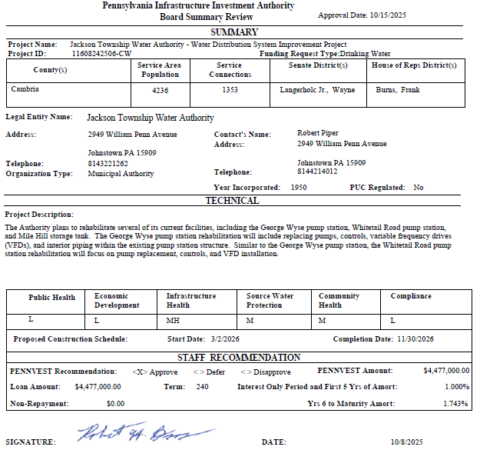
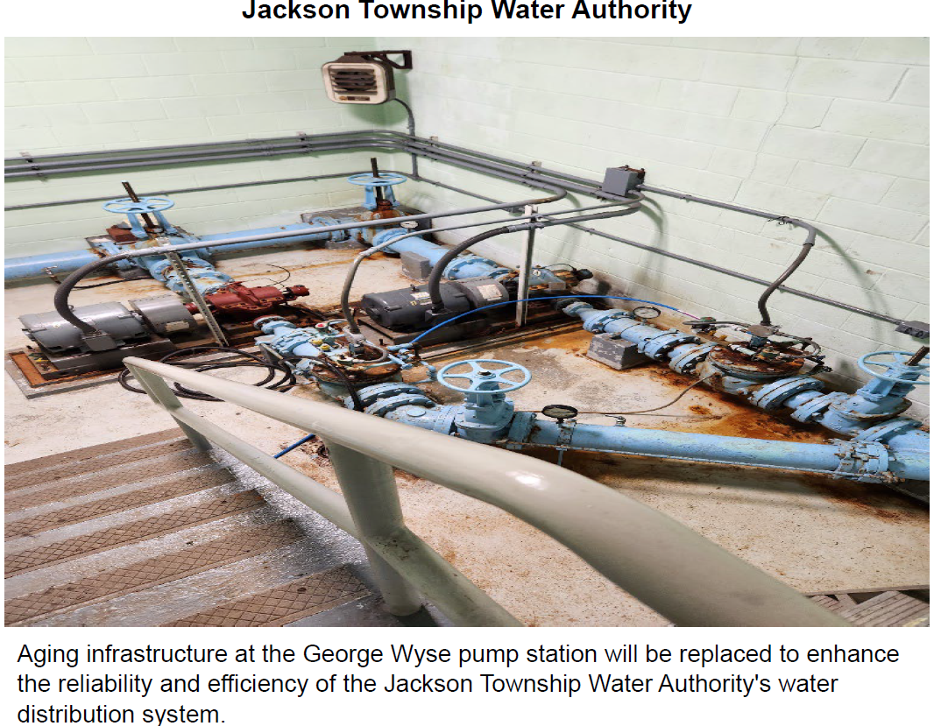
Jackson Township Water Authority

Slide 34
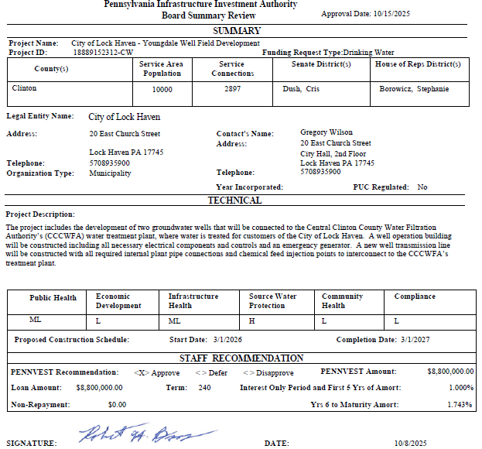
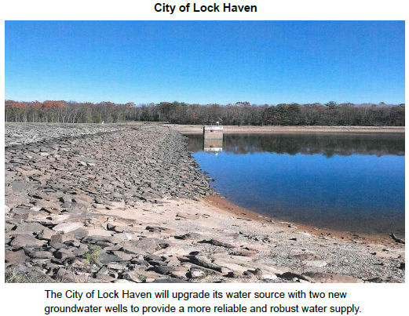
City of Lock Haven

Slide 35
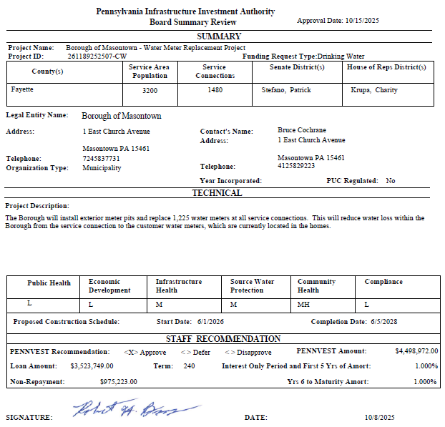
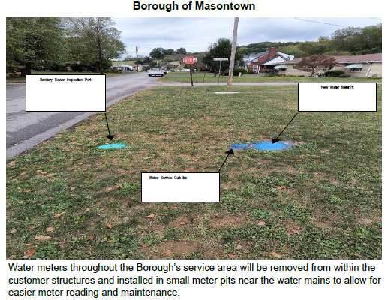
Borough of Masontown

Slide 36
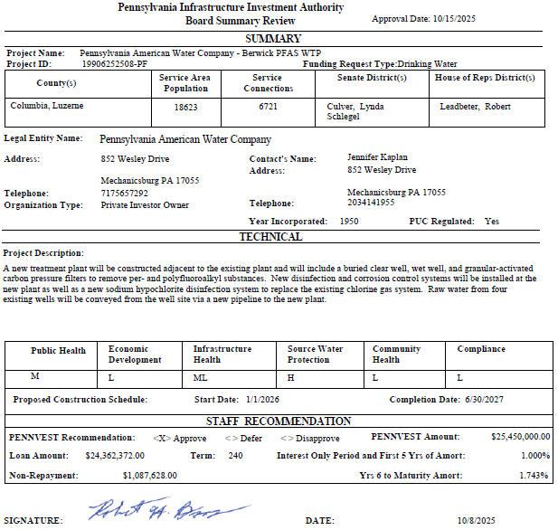
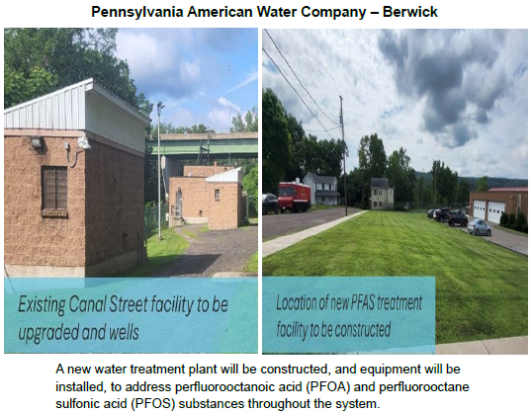
Pennsylvania American Water Company – Berwick

Slide 37
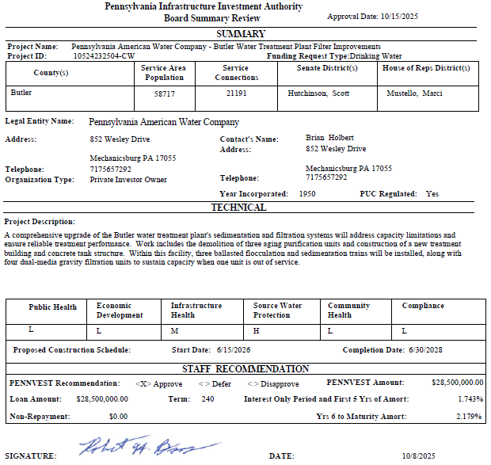
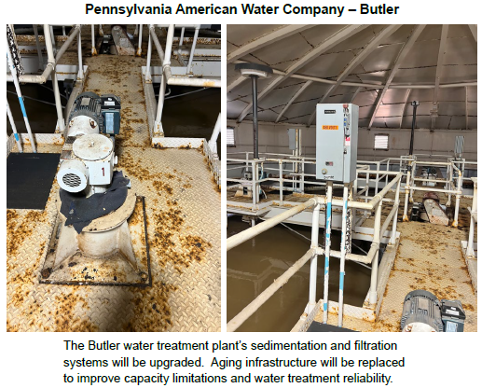
Pennsylvania American Water Company – Butler

Slide 38
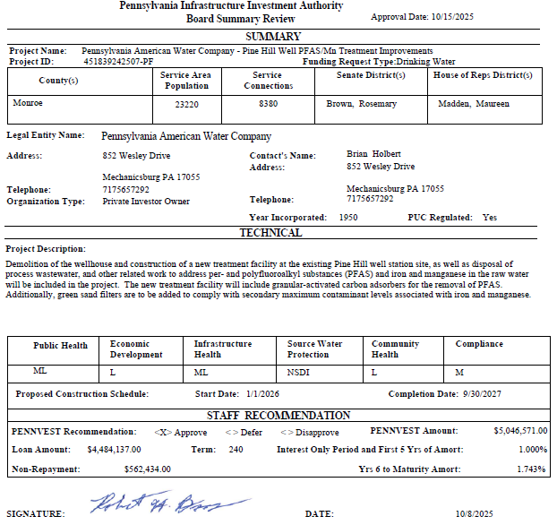
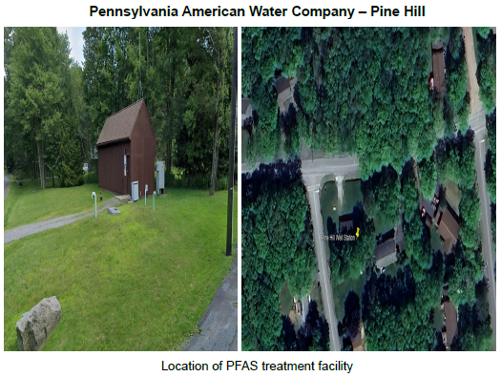
Pennsylvania American Water Company – Pine Hill

Slide 39
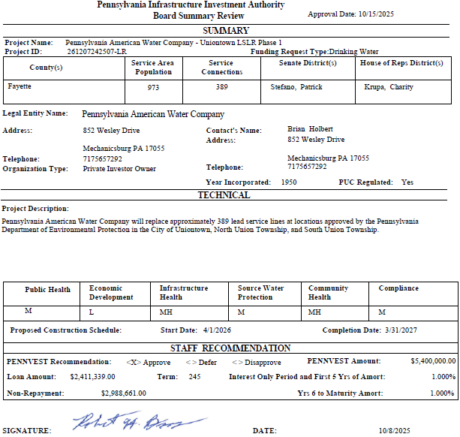
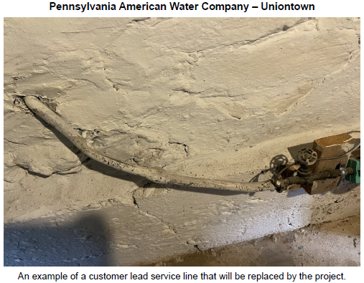
Pennsylvania American Water Company – Uniontown

Slide 40
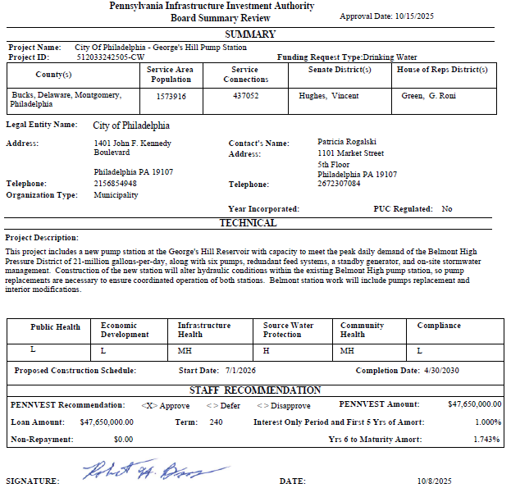
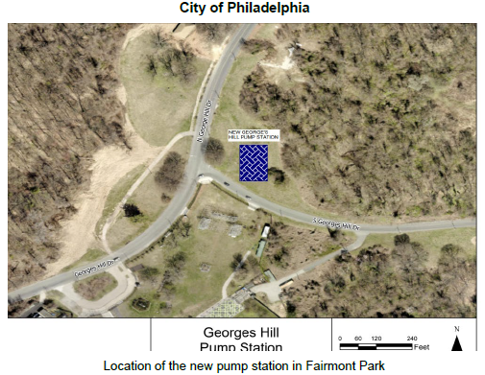
City of Philadelphia

Slide 41
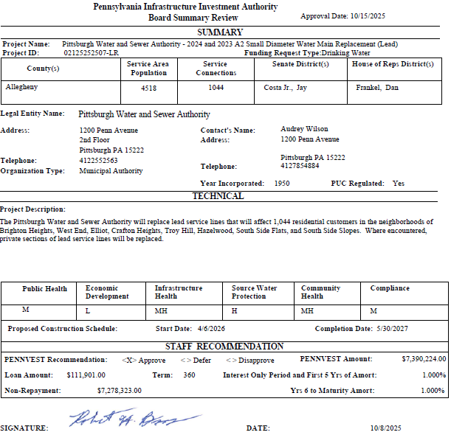
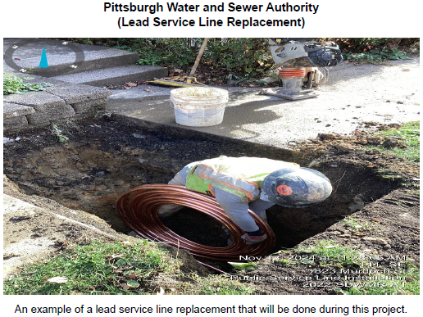
Pittsburgh Water and Sewer Authority - Lead

Slide 42
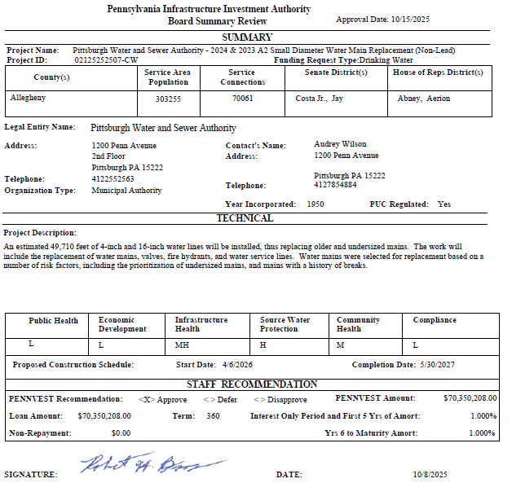
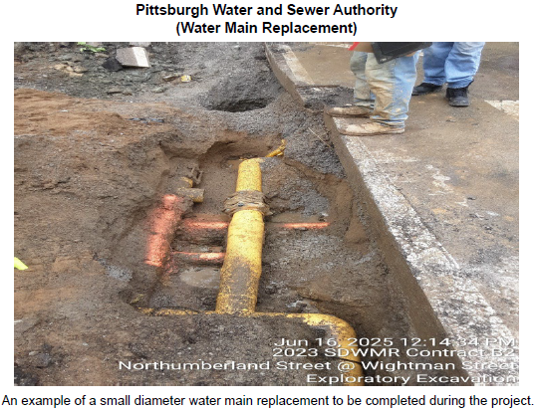
Pittsburgh Water and Sewer Authority – Non-Lead

Slide 43
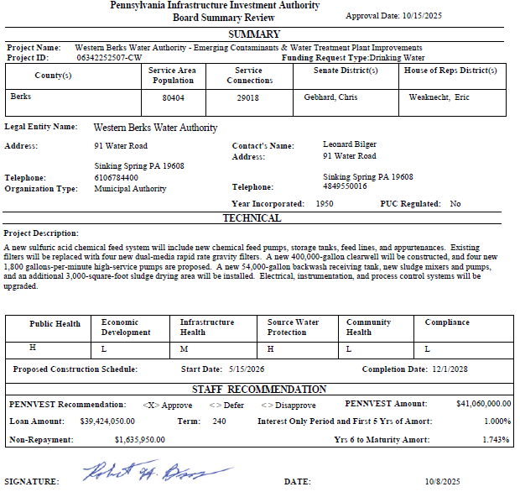
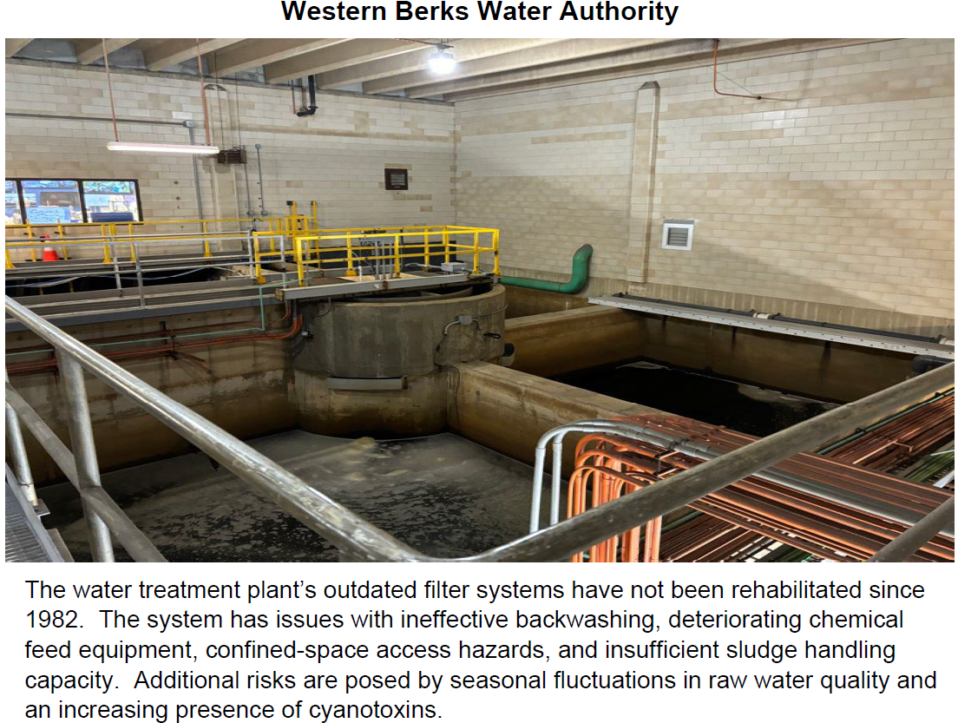
Western Berks Water Authority

Slide 44
PROJECT SPECIALIST
PRESENTATIONS
III. FINANCIAL ASSISTANCE APPLICATIONS A. CONSTRUCTION (ii) DRINKING WATER

Slide 45
Chester Water Authority

Slide 46
Pennsylvania American Water Company – Uniontown

Slide 47
Board Discussion
III. FINANCIAL ASSISTANCE APPLICATIONS A. CONSTRUCTION (ii) DRINKING WATER

Slide 48
Public Comment
III. FINANCIAL ASSISTANCE APPLICATIONS A. CONSTRUCTION (ii) DRINKING WATER

Slide 49
Vote
III. FINANCIAL ASSISTANCE APPLICATIONS A. CONSTRUCTION (ii) DRINKING WATER

Slide 50
WASTEWATER
CONSTRUCTION PROJECTS
III. FINANCIAL ASSISTANCE APPLICATIONS A. CONSTRUCTION (iii) WASTEWATER

Slide 51

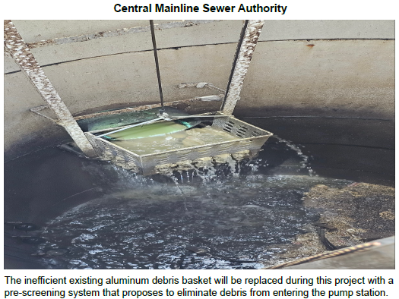
Central Mainline Sewer Authority

Slide 52
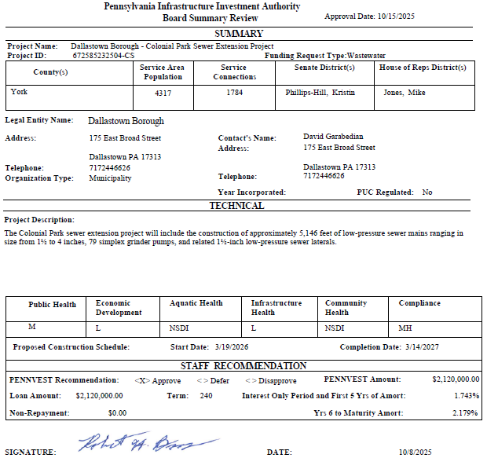
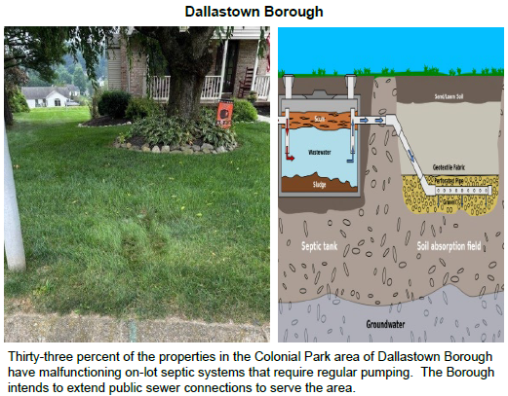
Dallastown Borough

Slide 53
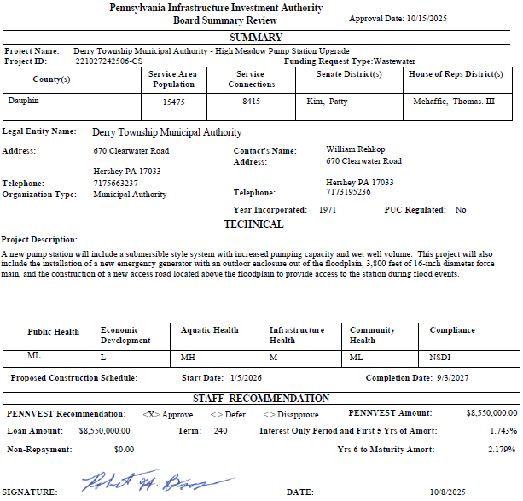
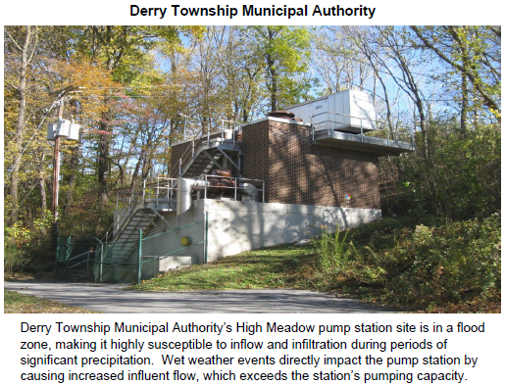
Derry Township Municipal Authority

Slide 54
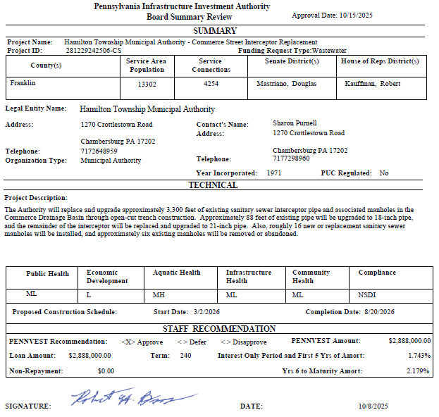
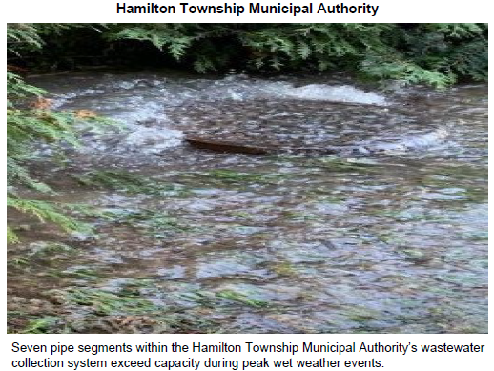
Hamilton Township Municipal Authority

Slide 55
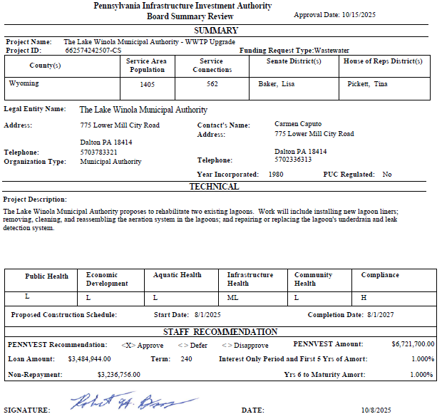
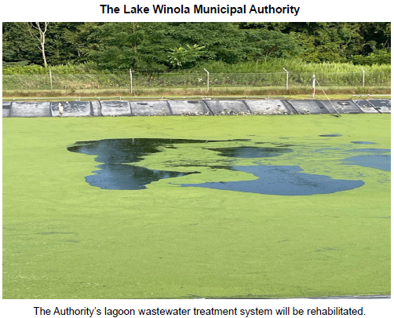
The Lake Winola Municipal Authority

Slide 56
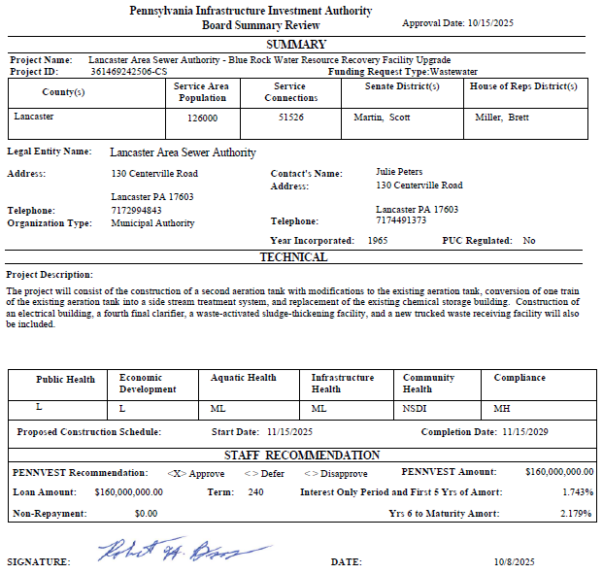
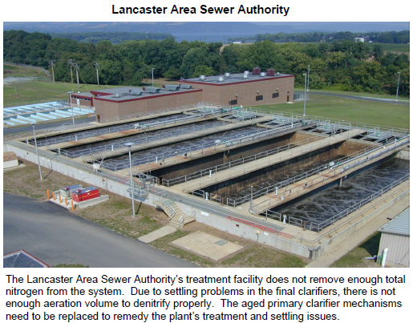
Lancaster Area Sewer Authority

Slide 57
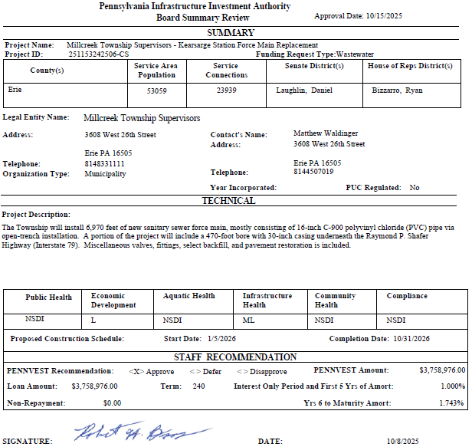
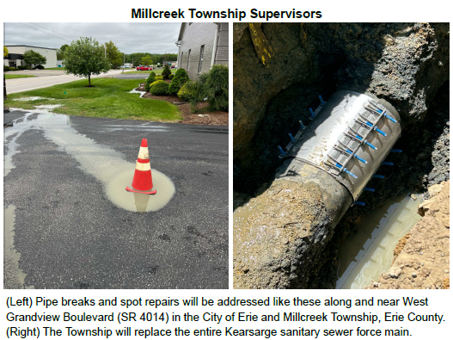
Millcreek Township Supervisors

Slide 58
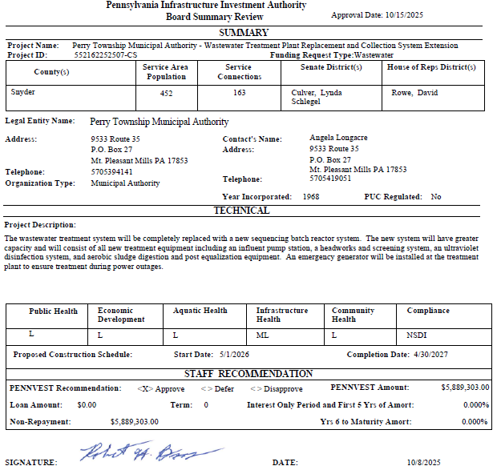

Perry Township Municipal Authority

Slide 59


Pine Grove Joint Treatment Authority

Slide 60


Municipal Authority of the Borough of Somerset

Slide 61


Taylor Township Board of Supervisors

Slide 62


Upper Shenango Valley Water Pollution Control Authority

Slide 63
PROJECT SPECIALIST
PRESENTATIONS
III. FINANCIAL ASSISTANCE APPLICATIONS A. CONSTRUCTION (iii) WASTEWATER

Slide 64
Lancaster Area Sewer Authority

Slide 65
Perry Township Municipal Authority

Slide 66
Board Discussion
III. FINANCIAL ASSISTANCE APPLICATIONS A. CONSTRUCTION (iii) WASTEWATER

Slide 67
Public Comment
III. FINANCIAL ASSISTANCE APPLICATIONS A. CONSTRUCTION (iii) WASTEWATER

Slide 68
Vote
III. FINANCIAL ASSISTANCE APPLICATIONS A. CONSTRUCTION (iii) WASTEWATER

Slide 69
STORMWATER
CONSTRUCTION PROJECTS
III. FINANCIAL ASSISTANCE APPLICATIONS A. CONSTRUCTION (iv) STORMWATER

Slide 70


Borough of Greenville

Slide 71
PROJECT SPECIALIST
PRESENTATIONS
III. FINANCIAL ASSISTANCE APPLICATIONS A. CONSTRUCTION (iv) STORMWATER

Slide 72
Borough of Greenville

Slide 73
Board Discussion
III. FINANCIAL ASSISTANCE APPLICATIONS A. CONSTRUCTION (iv) STORMWATER

Slide 74
Public Comment
III. FINANCIAL ASSISTANCE APPLICATIONS A. CONSTRUCTION (iv) STORMWATER

Slide 75
Vote
III. FINANCIAL ASSISTANCE APPLICATIONS A. CONSTRUCTION (iv) STORMWATER

Slide 76
WASTEWATER FACILITIES ADVANCE FUNDING
III. FINANCIAL ASSISTANCE APPLICATIONS B. ADVANCE FUNDING (i) WASTEWATER

Slide 77


Timblin Borough

Slide 78
PROJECT SPECIALIST
PRESENTATIONS
III. FINANCIAL ASSISTANCE APPLICATIONS B. ADVANCE FUNDING (i) WASTEWATER

Slide 79
Timblin Borough

Slide 80
Board Discussion
III. FINANCIAL ASSISTANCE APPLICATIONS B. ADVANCE FUNDING (i) WASTEWATER

Slide 81
Public Comment
III. FINANCIAL ASSISTANCE APPLICATIONS B. ADVANCE FUNDING (i) WASTEWATER

Slide 82
Vote
III. FINANCIAL ASSISTANCE APPLICATIONS B. ADVANCE FUNDING (i) WASTEWATER

Slide 83
PRIOR-APPROVED
PROJECTS
INCREASES/DECREASES
IV. PRIOR-APPROVED PROJECTS A. INCREASES/DECREASES

Slide 84

Totals of Increases/Decreases Report

Slide 85

Dollars Disencumbered Report

Slide 86

Current Individual Increase Requests Summary

Slide 87
Board Discussion
IV. PRIOR-APPROVED PROJECTS A. INCREASES/DECREASES

Slide 88
Public Comment
IV. PRIOR-APPROVED PROJECTS A. INCREASES/DECREASES

Slide 89
Vote
IV. PRIOR-APPROVED PROJECTS A. INCREASES/DECREASES

Slide 90
PRIOR-APPROVED
PROJECTS
PROGRAM INITIATIVES
IV. PRIOR-APPROVED PROJECTS B. PROGRAM INITIATIVES

Slide 91

Small Projects Report

Slide 92

Bipartisan Infrastructure Law (BIL) Project Summary

Slide 93

Bipartisan Infrastructure Law (BIL) Project Summary

Slide 94

Bipartisan Infrastructure Law (BIL) Project Summary

Slide 95
PRIOR-APPROVED
PROJECTS
ON-LOT REPORT
IV. PRIOR-APPROVED PROJECTS C. ON-LOT REPORT

Slide 96

On-Lot Report

Slide 97
PRIOR-APPROVED
PROJECTS
PROJECT STATUS
IV. PRIOR-APPROVED PROJECTS D. PROJECT STATUS

Slide 98

Application to Approval Projects for October 15, 2025

Slide 99

Approval to Settlement Projects for October 15, 2025

Slide 100

Approval to Settlement Projects for October 15, 2025

Slide 101

Approval to Settlement Projects for October 15, 2025

Slide 102

Approval to Settlement Projects for October 15, 2025

Slide 103
Final Public Comment

Slide 104
Save the date
The next scheduled board meeting:
January 21, 2026
Application cut-off date:
October 29, 2025

Slide 105
Vote to Adjourn
V. ADJOURNMENT

