Slide 1


Board of Directors Meeting January 21, 2026 10:30 a.m.

Slide 2

Recording Notice
This meeting is being recorded.
By participating in this webinar, you consent to the
recording, retention, and use of this session.
If you ask a question, you consent to the
recording, retention, and use of your statements
as part of the meeting.

Slide 3
Transcription Notice
Commonwealth of Pennsylvania policy prohibits the use of Artificial Intelligence transcription software during this meeting.
Please note, PENNVEST staff is required to disable or remove transcription tools from the meeting.

Slide 4
Technical Information
Can’t Hear Us?
Join the audio portion of the presentation via your telephone:
Call 1-267-332-8737
Meeting ID 280 947 765 986 08#
Technical Difficulties?
Call 1-717-705-4473 or
Send a Chat message via the Microsoft Teams meeting
Want the App?
Search “Microsoft Teams” in the Google Play Store or the App Store.

Slide 5
Public Comment
During the presentation, all attendees will be muted.
There are two methods you can use within this
Microsoft Teams meeting to pose a public comment or question.
“Raise Hand” function
“Chat” function

Slide 6
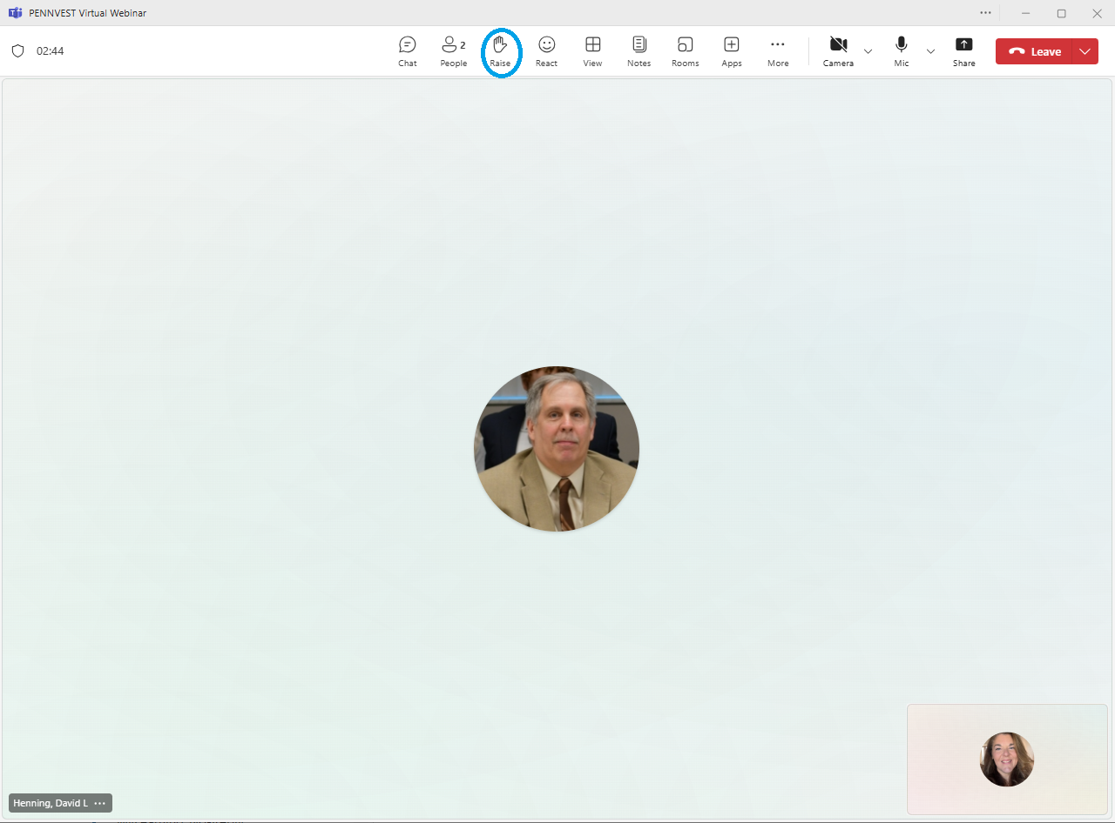



Raise Hand
In the top toolbar, raise your hand by clicking on the hand icon to indicate your request to speak.
Attendees with raised hands will be unmuted individually, allowing participants to speak one at a time.
Your microphone will show a diagonal line through the icon when muted. When the diagonal line disappears, you may pose your question or comment.

Slide 7

Chat
In the top toolbar, click on the chat bubble icon to open the chat dialogue box. Type your question or comment in the Meeting Chat.
PENNVEST staff will monitor the Chat area throughout the meeting. Replies may be delivered verbally, or returned through the same chat box, from appropriate meeting participant(s). Responses will typically be given during an applicable Public Comment portion of the meeting.

Slide 8

Public Comment
Participant Best Practices
1. Log in to the Board Meeting through a computer or smart phone (using the Teams app).
2. When your microphone has been unmuted, begin by stating:
Your name.
Your affiliation (i.e., company, organization, etc.).
Indicate the specific project, agency activity, or agenda item about which you are commenting.
If your comment or question is on behalf of another individual or organization, please acknowledge this, immediately after your name and affiliation, and reference the name(s) of the associated person(s) or group(s).

Slide 9
Public Comment
Notices
All verbal comments, questions and responses will be recorded and can be shared publicly.
PENNVEST cannot guarantee all persons requesting to speak will be able to do so, specifically in the case of technical difficulties beyond our control, such as:
Audio feedback.
Poor sound quality.
Interruptions in bandwidth services.

Slide 10
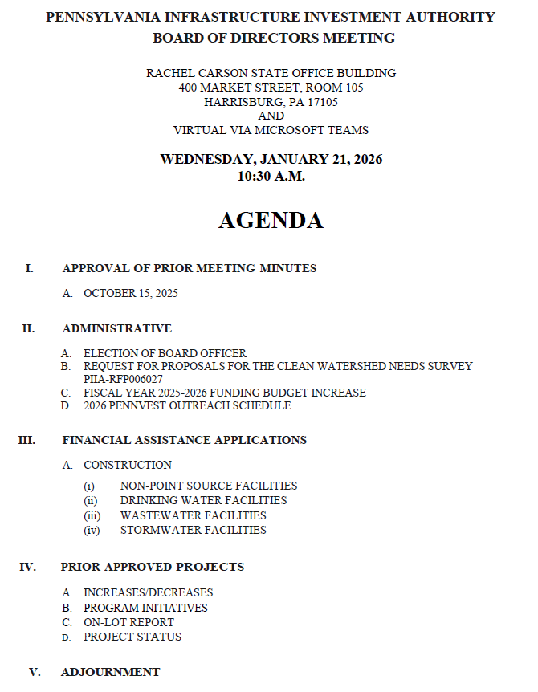

Today’s
Agenda

Slide 11
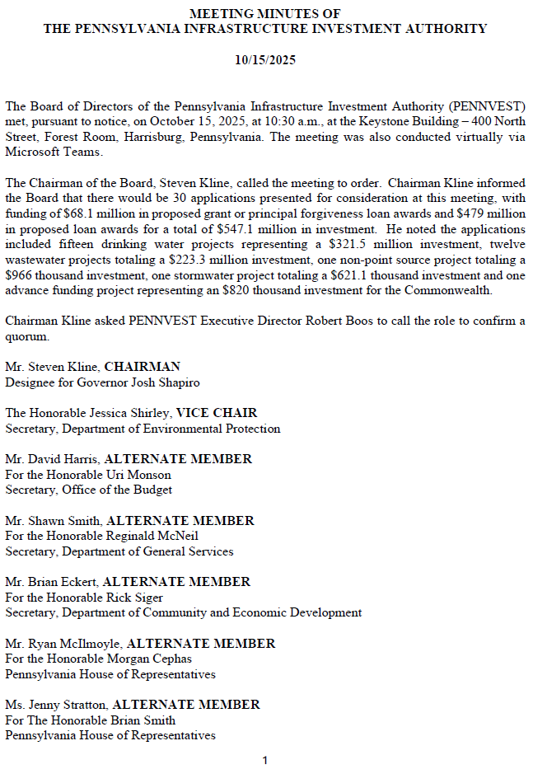
APPROVAL OF PRIOR MEETING MINUTES
A. OCTOBER 15, 2025

Slide 12

Motion
I. APPROVAL OF PRIOR MEETING MINUTES A. OCTOBER 15, 2025

Slide 13
Board Discussion
I. APPROVAL OF PRIOR MEETING MINUTES A. OCTOBER 15, 2025

Slide 14
Public Comment
I. APPROVAL OF PRIOR MEETING MINUTES A. OCTOBER 15, 2025

Slide 15

Vote
I. APPROVAL OF PRIOR MEETING MINUTES A. OCTOBER 15, 2025

Slide 16
ADMINISTRATIVE
II. ADMINISTRATIVE

Slide 17
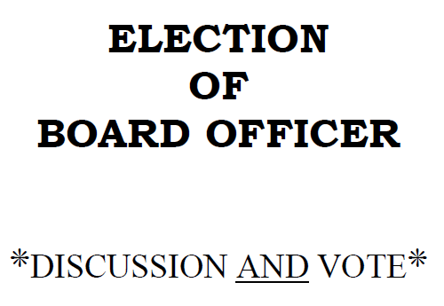
II. ADMINISTRATIVE
A. ELECTION OF
BOARD OFFICER
II. ADMINISTRATIVE A. ELECTION OF BOARD OFFICER

Slide 18
Motion
II. ADMINISTRATIVE A. ELECTION OF BOARD OFFICER

Slide 19
Board Discussion
II. ADMINISTRATIVE A. ELECTION OF BOARD OFFICER

Slide 20
Public Comment
II. ADMINISTRATIVE A. ELECTION OF BOARD OFFICER

Slide 21
Vote
II. ADMINISTRATIVE A. ELECTION OF BOARD OFFICER

Slide 22
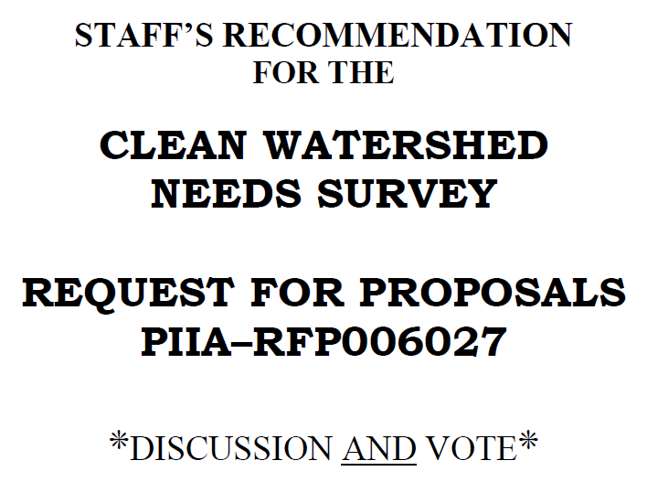
II. ADMINISTRATIVE
B. REQUEST FOR PROPOSALS
FOR THE CLEAN
WATERSHED NEEDS
SURVEY PIIA-RFP006027
II. ADMINISTRATIVE B. REQUEST FOR PROPOSALS – PIIA-RFP006027

Slide 23
Motion
II. ADMINISTRATIVE B. REQUEST FOR PROPOSALS – PIIA-RFP006027

Slide 24
Board Discussion
II. ADMINISTRATIVE B. REQUEST FOR PROPOSALS – PIIA-RFP006027

Slide 25
Public Comment
II. ADMINISTRATIVE B. REQUEST FOR PROPOSALS – PIIA-RFP006027

Slide 26
Vote
II. ADMINISTRATIVE B. REQUEST FOR PROPOSALS – PIIA-RFP006027

Slide 27
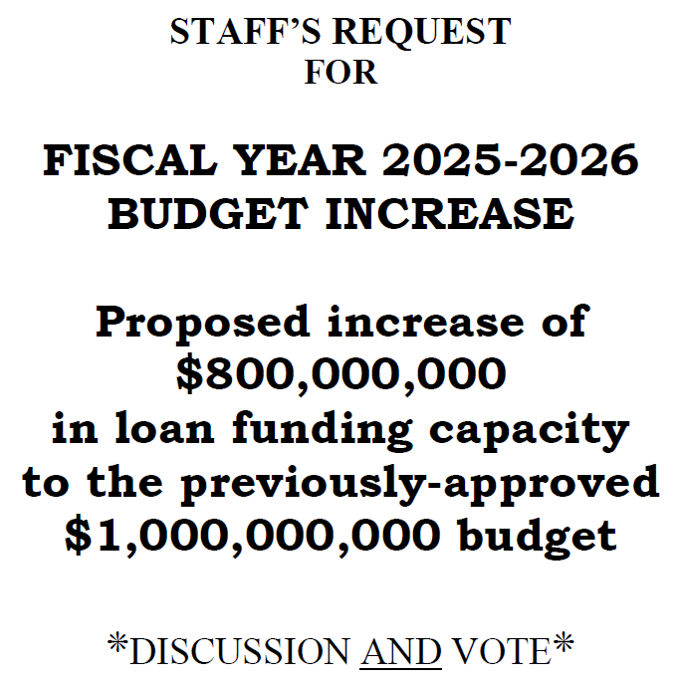
II. ADMINISTRATIVE
C. FISCAL YEAR 2025-2026
FUNDING BUDGET
INCREASE
II. ADMINISTRATIVE C. FISCAL YEAR 2025-2026 FUNDING BUDGET INCREASE

Slide 28
Motion
II. ADMINISTRATIVE C. FISCAL YEAR 2025-2026 FUNDING BUDGET INCREASE

Slide 29
Board Discussion
II. ADMINISTRATIVE C. FISCAL YEAR 2025-2026 FUNDING BUDGET INCREASE

Slide 30
Public Comment
II. ADMINISTRATIVE C. FISCAL YEAR 2025-2026 FUNDING BUDGET INCREASE

Slide 31
Vote
II. ADMINISTRATIVE C. FISCAL YEAR 2025-2026 FUNDING BUDGET INCREASE

Slide 32
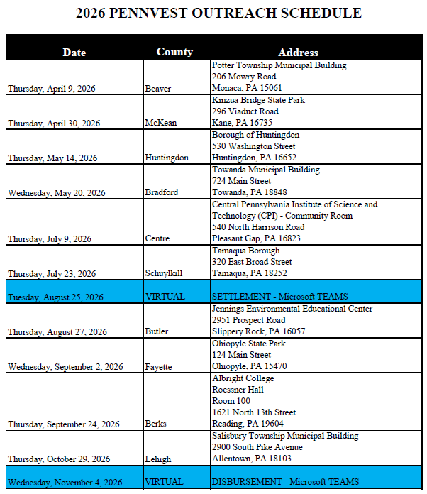
II. ADMINISTRATIVE
D. 2026 PENNVEST OUTREACH
SCHEDULE
II. ADMINISTRATIVE D. 2026 PENNVEST OUTREACH SCHEDULE

Slide 33
FINANCIAL ASSISTANCE APPLICATIONS
III. FINANCIAL ASSISTANCE APPLICATIONS

Slide 34
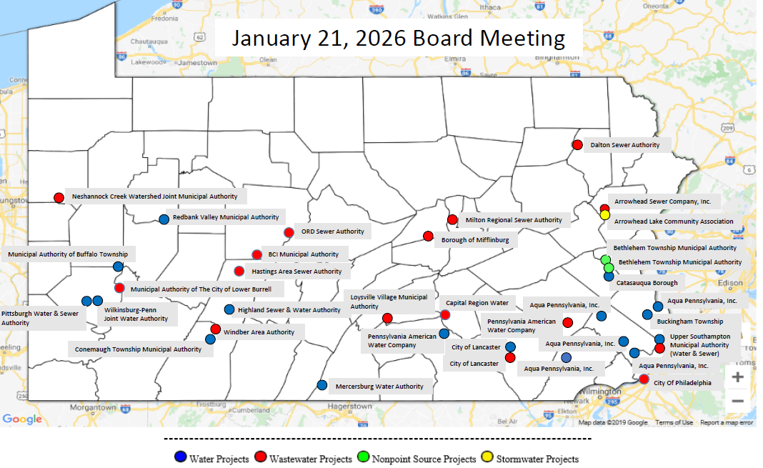
MAP OF PROJECT APPLICATIONS RECOMMENDED FOR APPROVAL
III. FINANCIAL ASSISTANCE APPLICATIONS

Slide 35
NON-POINT SOURCE CONSTRUCTION PROJECTS
III. FINANCIAL ASSISTANCE APPLICATIONS A. CONSTRUCTION (i) NON-POINT SOURCE

Slide 36
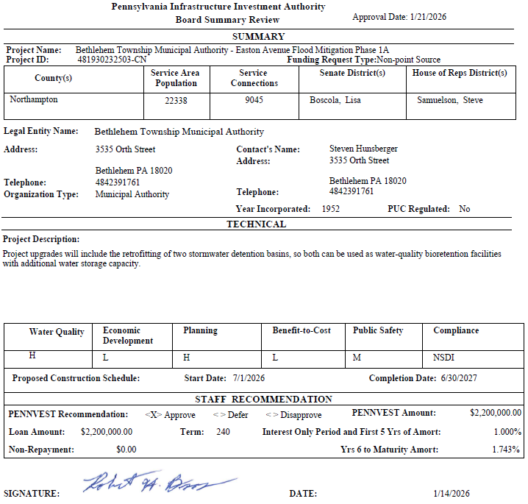
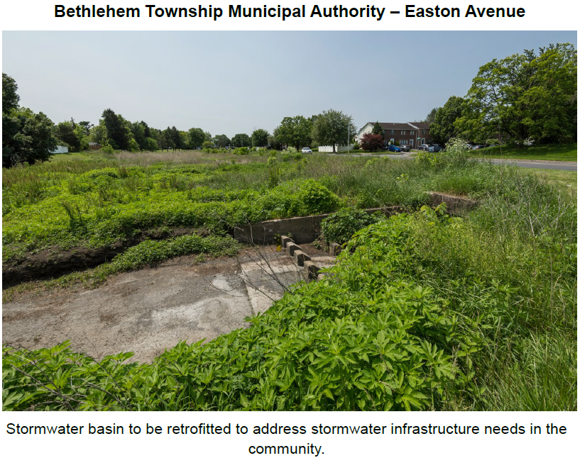
Bethlehem Township Municipal Authority - Easton

Slide 37
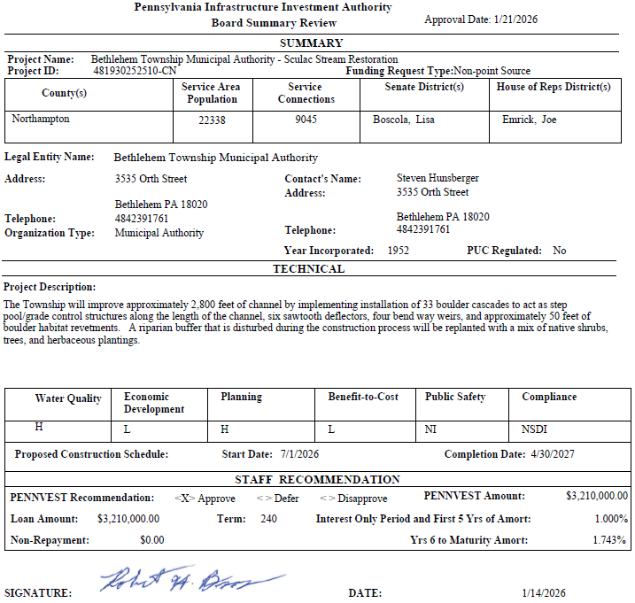
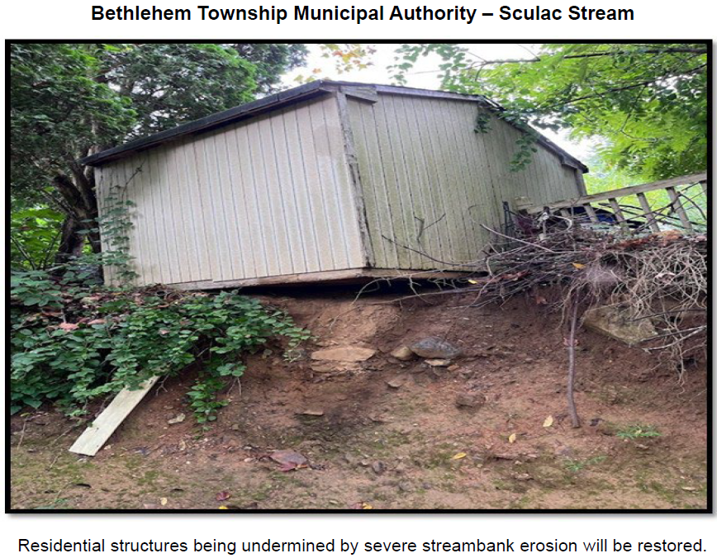
Bethlehem Township Municipal Authority - Sculac

Slide 38
PROJECT SPECIALIST PRESENTATION
III. FINANCIAL ASSISTANCE APPLICATIONS A. CONSTRUCTION (i) NON-POINT SOURCE

Slide 39
Bethlehem Township Municipal Authority - Easton

Slide 40
Motion
III. FINANCIAL ASSISTANCE APPLICATIONS A. CONSTRUCTION (i) NON-POINT SOURCE

Slide 41
Board Discussion
III. FINANCIAL ASSISTANCE APPLICATIONS A. CONSTRUCTION (i) NON-POINT SOURCE

Slide 42
Public Comment
III. FINANCIAL ASSISTANCE APPLICATIONS A. CONSTRUCTION (i) NON-POINT SOURCE

Slide 43
Vote
III. FINANCIAL ASSISTANCE APPLICATIONS A. CONSTRUCTION (i) NON-POINT SOURCE

Slide 44
DRINKING WATER CONSTRUCTION PROJECTS
III. FINANCIAL ASSISTANCE APPLICATIONS A. CONSTRUCTION (ii) DRINKING WATER

Slide 45
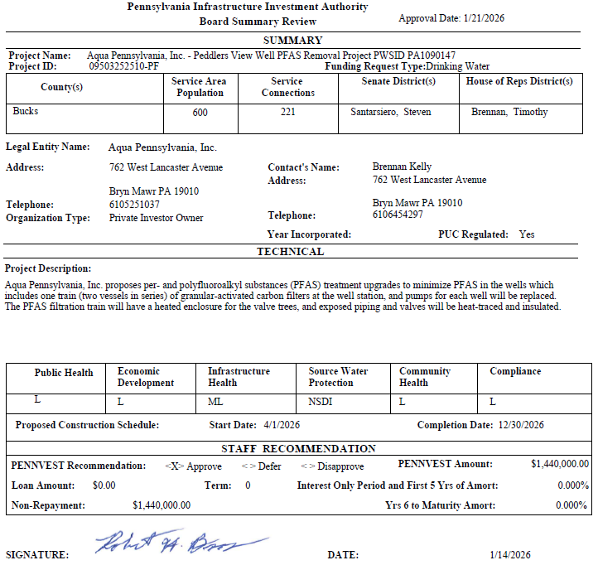
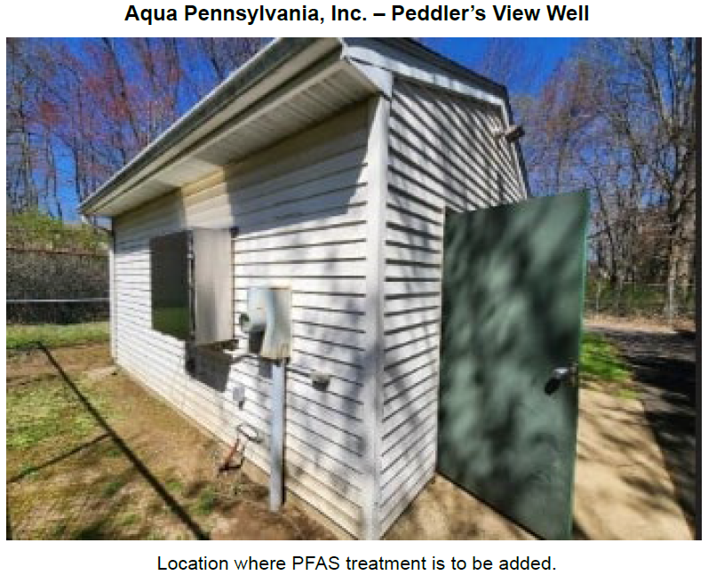
Aqua Pennsylvania, Inc. – Peddler’s View Well

Slide 46
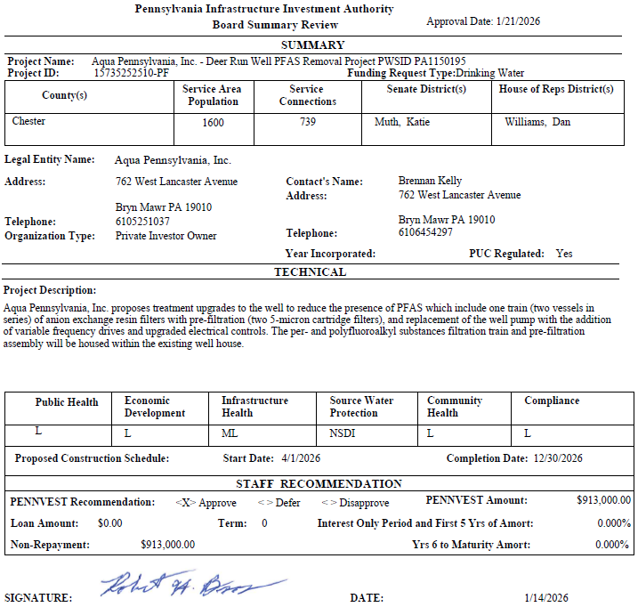
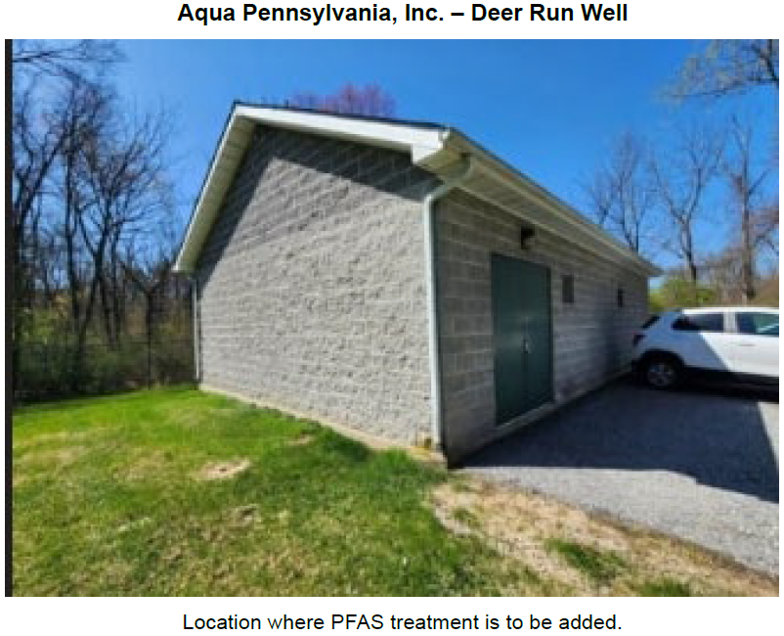
Aqua Pennsylvania, Inc. – Deer Run Well

Slide 47
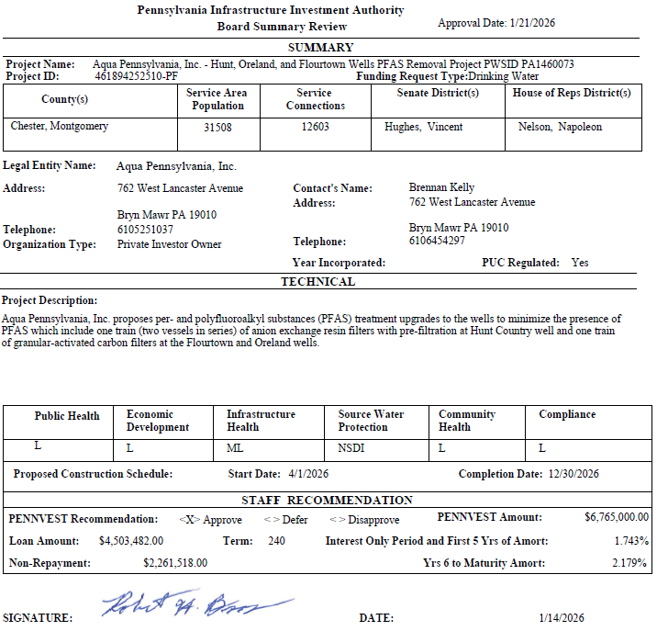
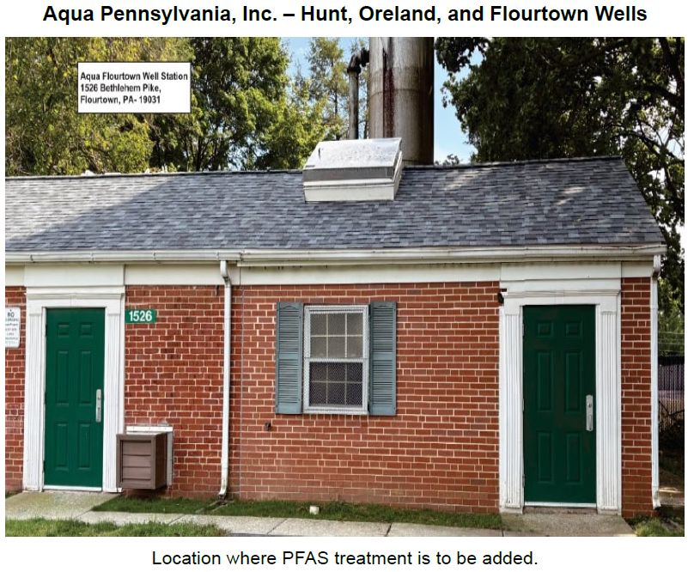
Aqua Pennsylvania, Inc. – Hunt, Oreland, and Flourtown Wells

Slide 48
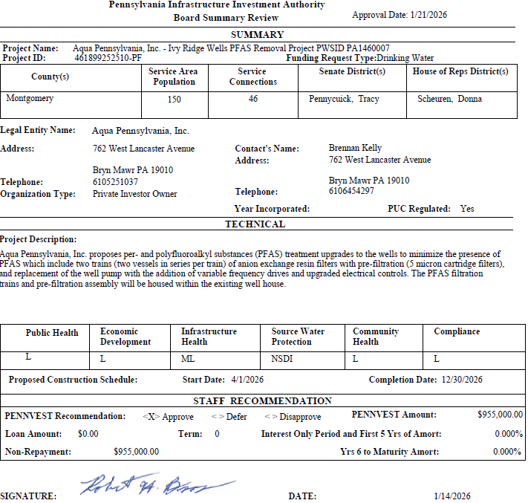
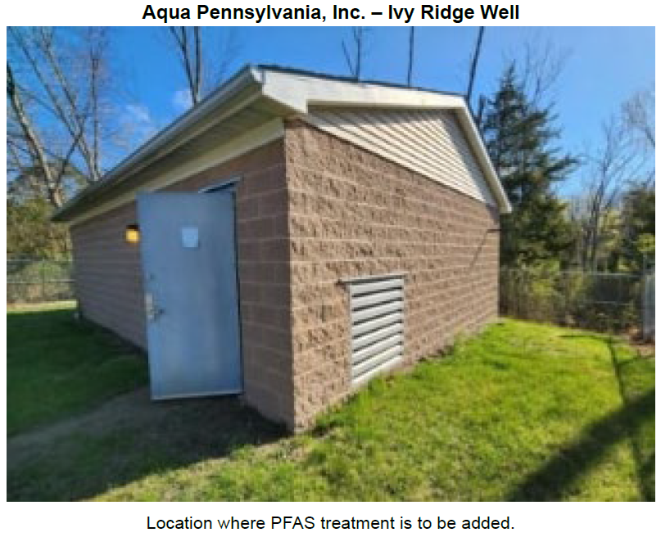
Aqua Pennsylvania, Inc. – Ivy Ridge Wells

Slide 49
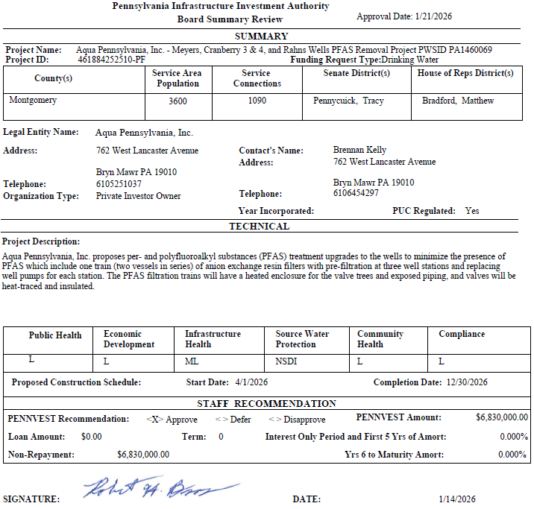
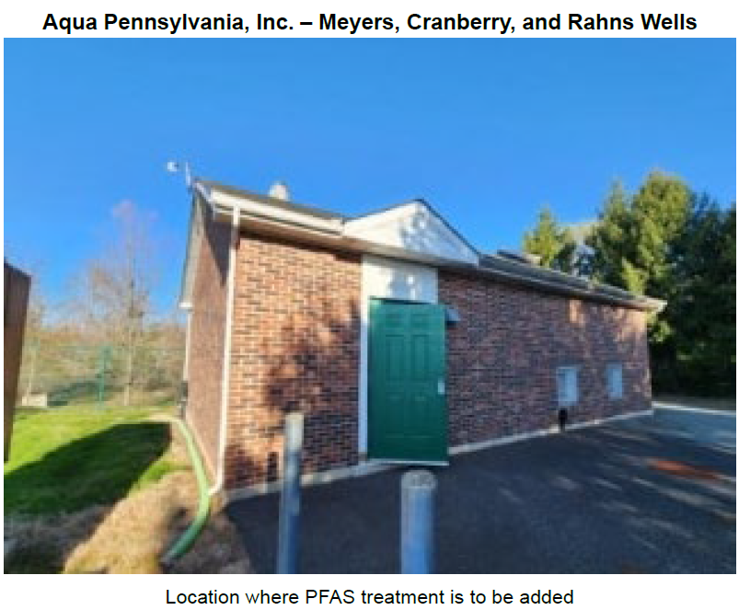
Aqua Pennsylvania, Inc. – Meyers, Cranberry 3 & 4, and Rahns Wells

Slide 50
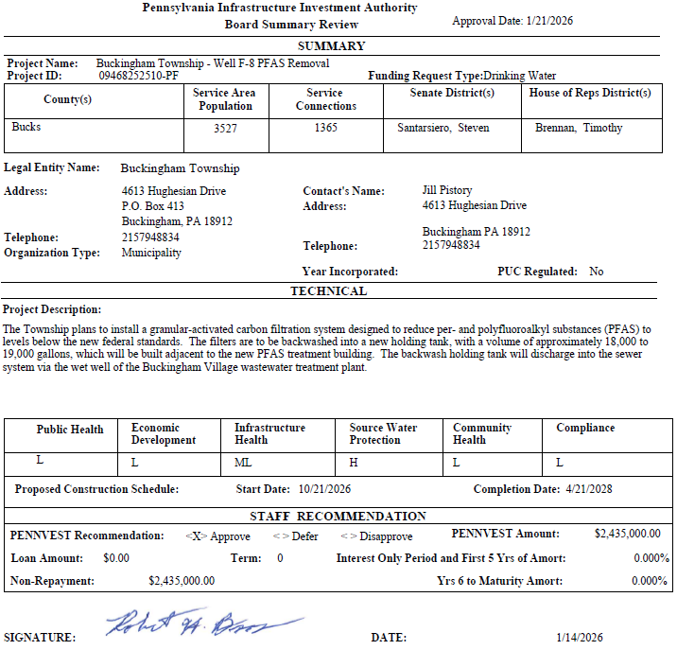
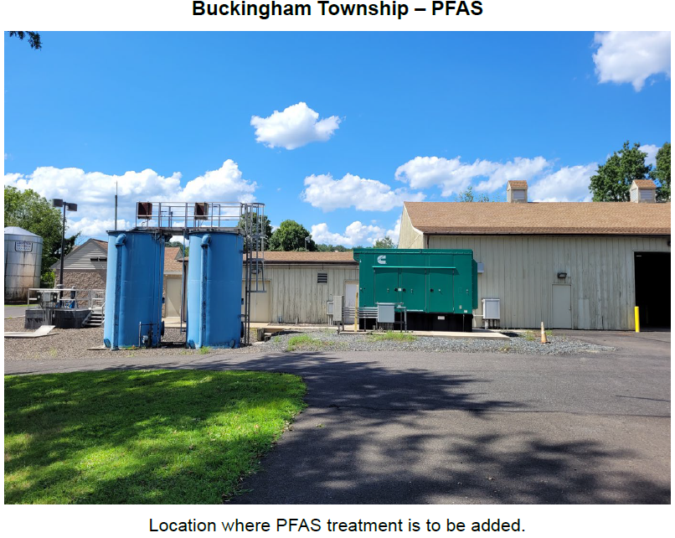
Buckingham Township

Slide 51
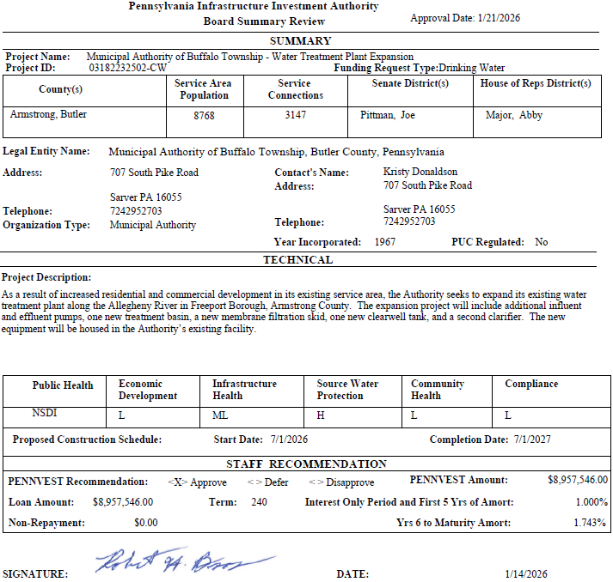
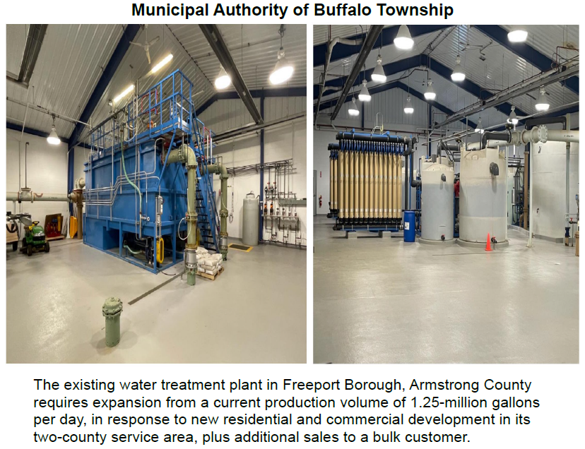
Municipal Authority of Buffalo Township

Slide 52
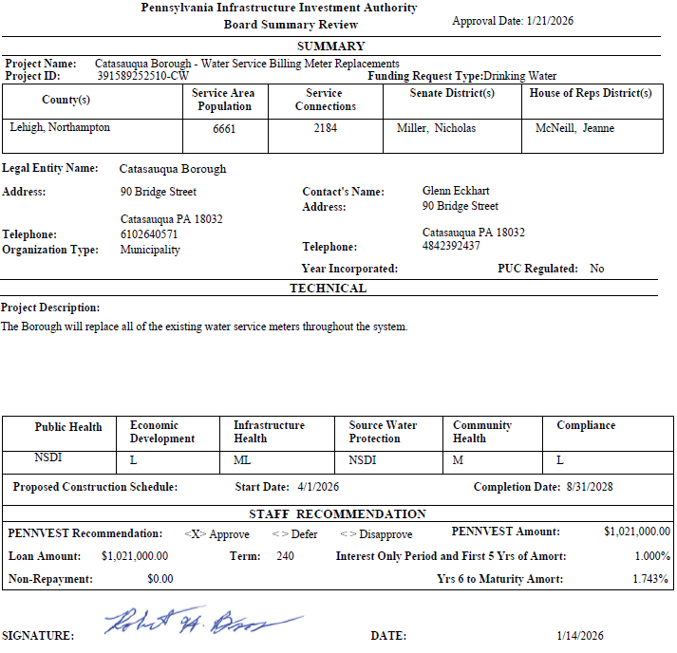
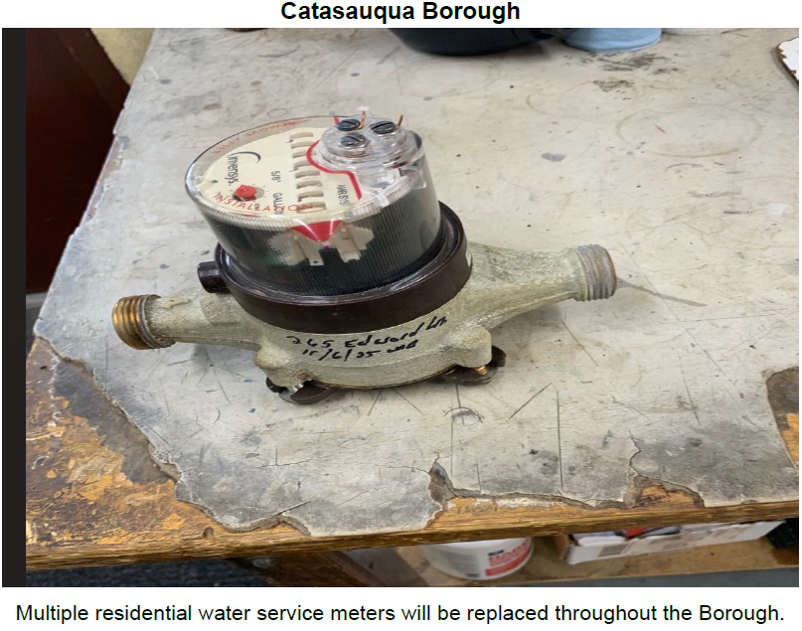
Catasauqua Borough

Slide 53
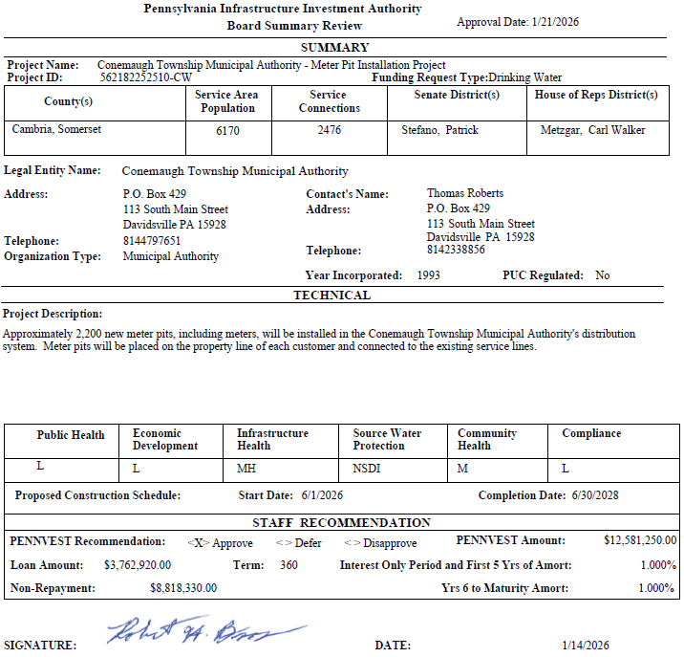
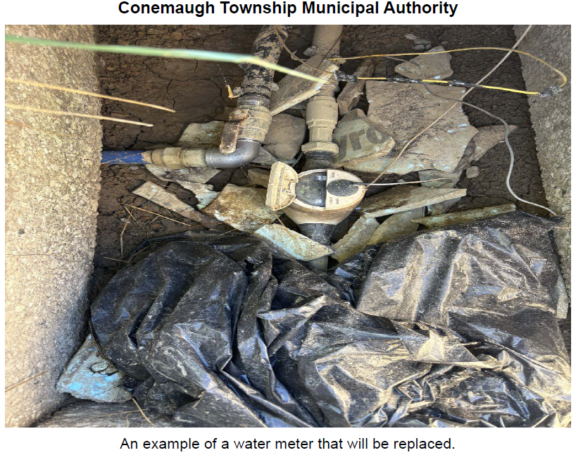
Conemaugh Township Municipal Authority

Slide 54
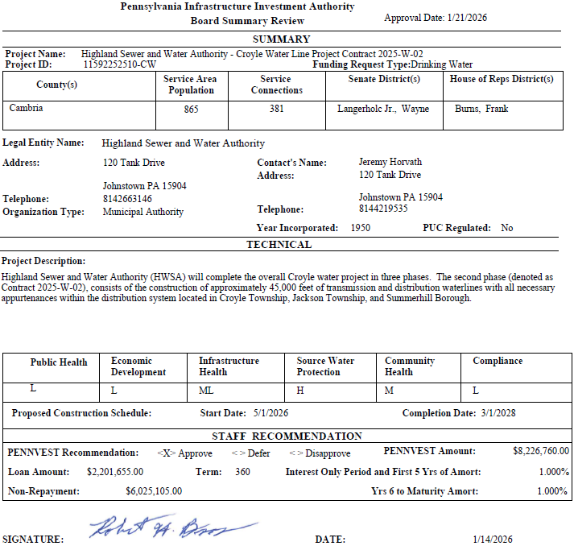
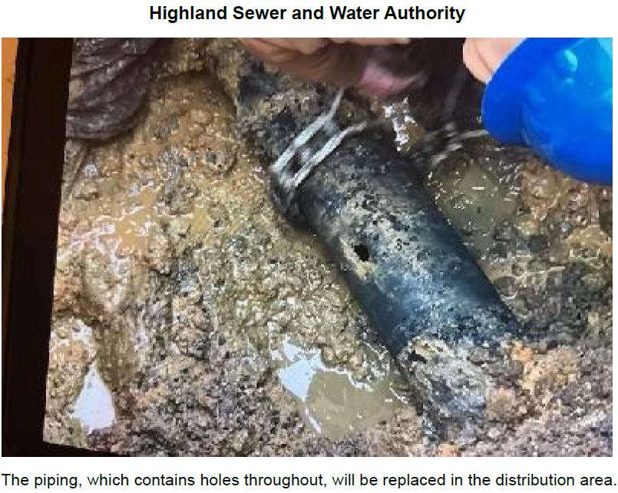
Highland Sewer and Water Authority

Slide 55
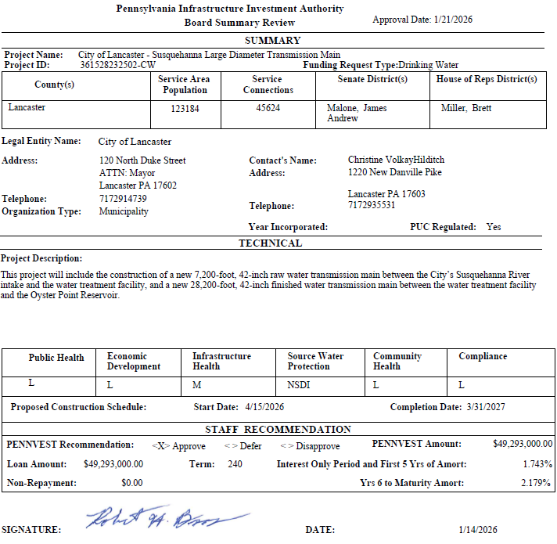
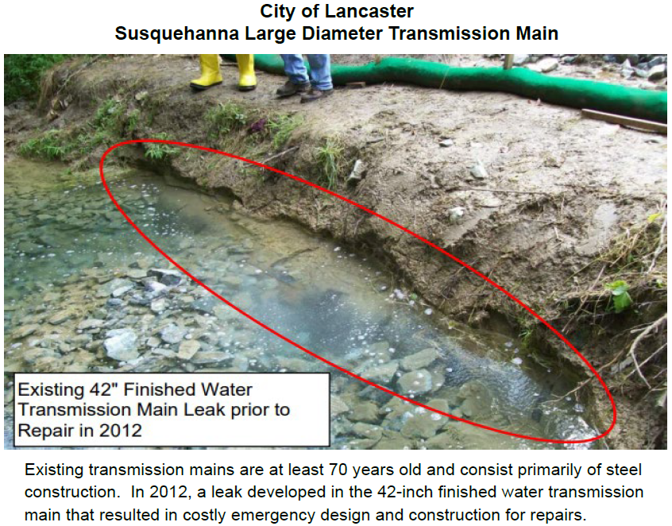
City of Lancaster

Slide 56
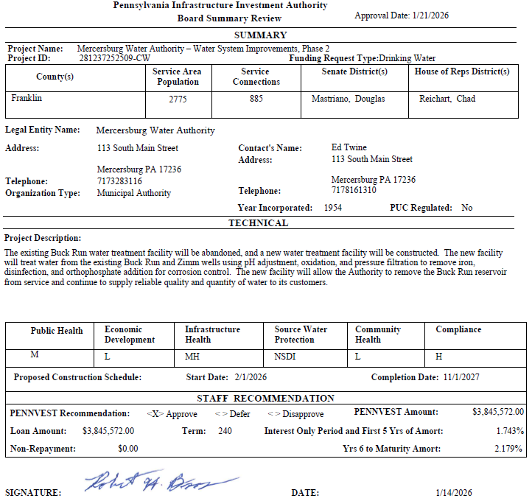
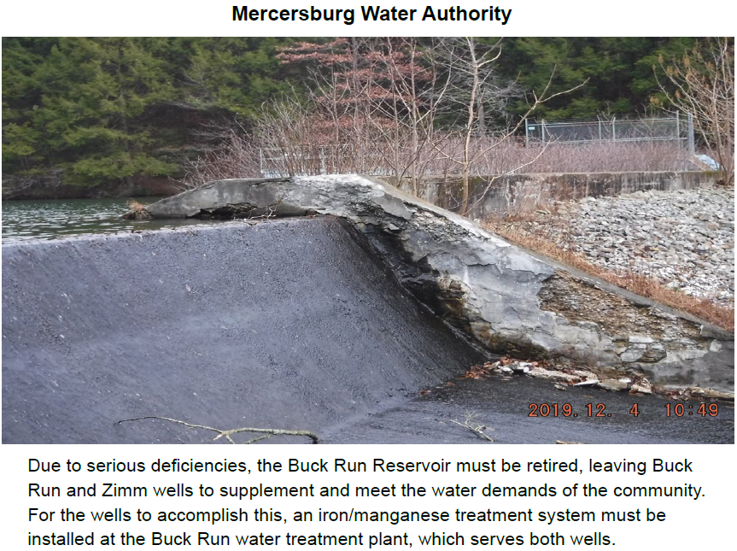
Mercersburg Water Authority

Slide 57
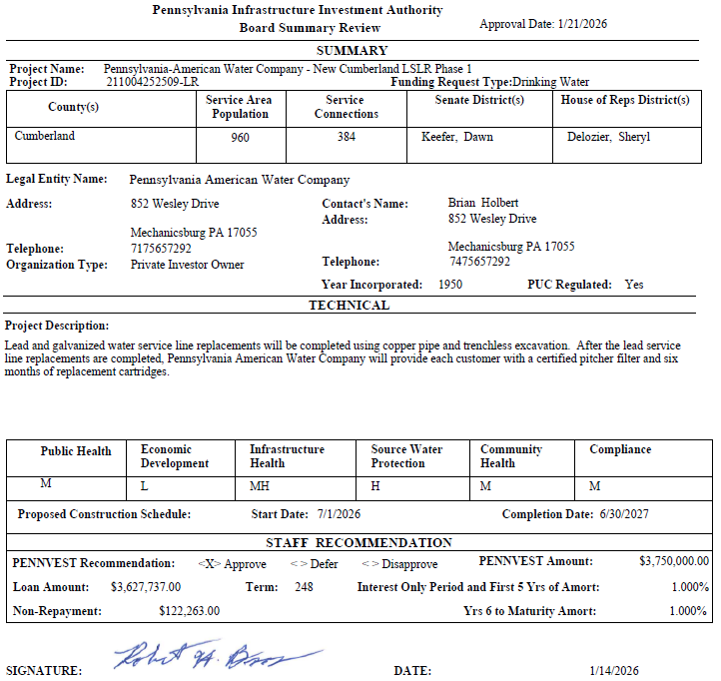
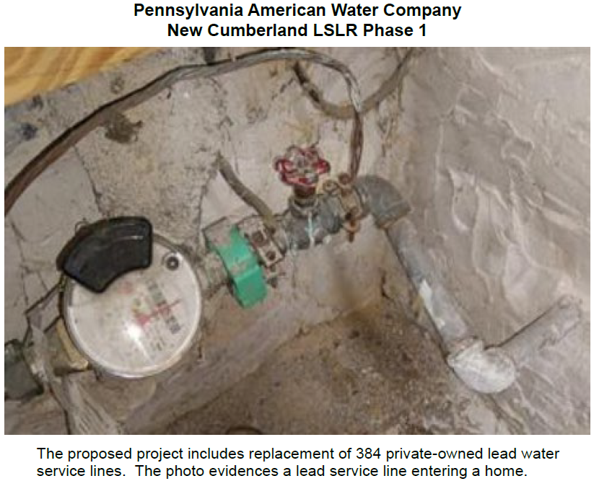
Pennsylvania American Water Company

Slide 58

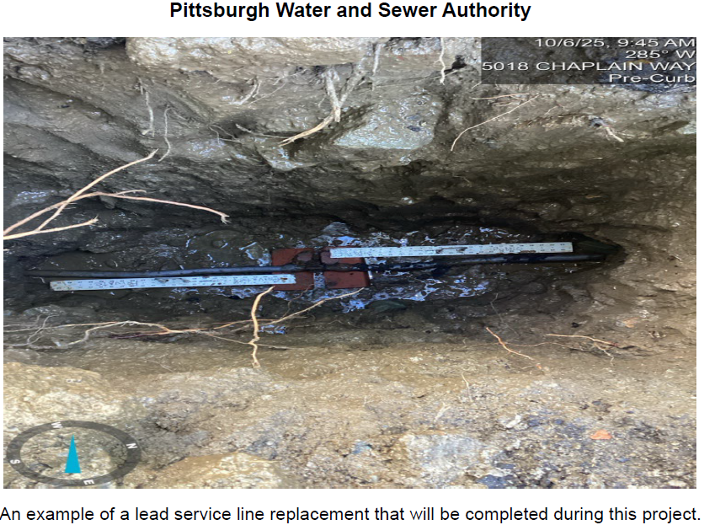
Pittsburgh Water and Sewer Authority

Slide 59
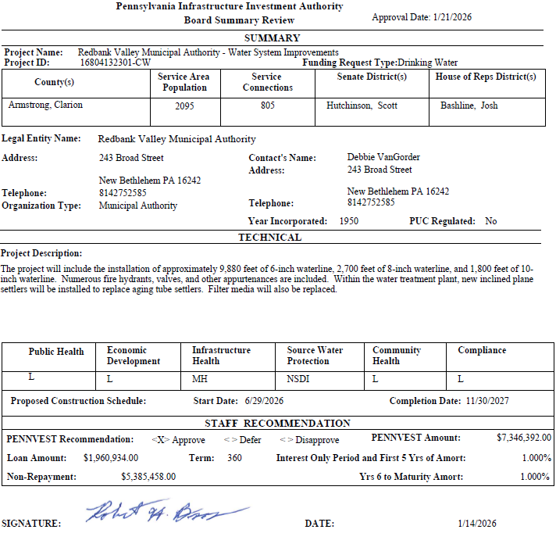
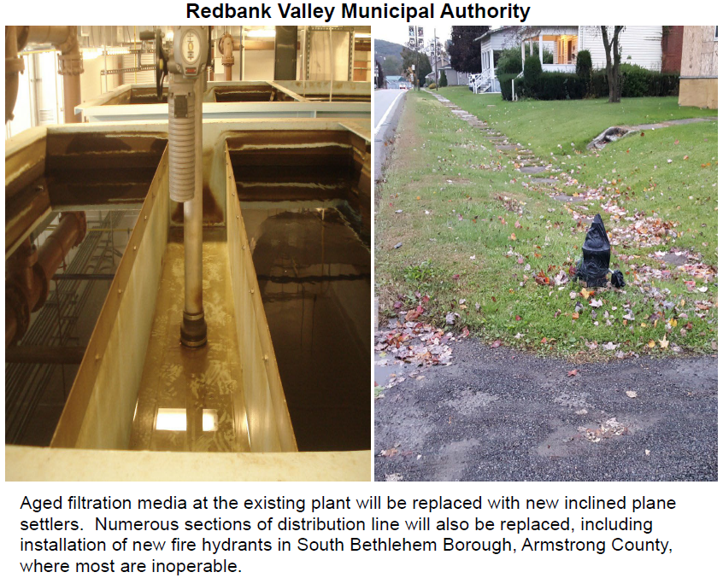
Redbank Valley Municipal Authority

Slide 60
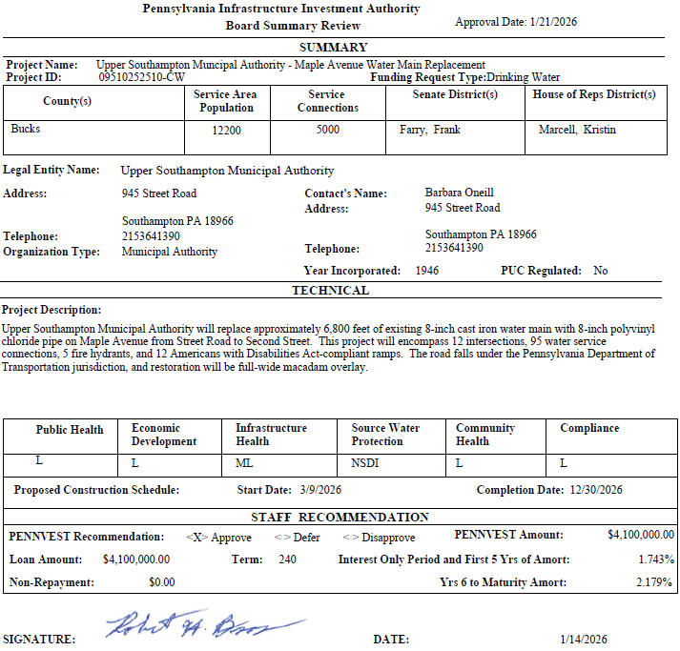
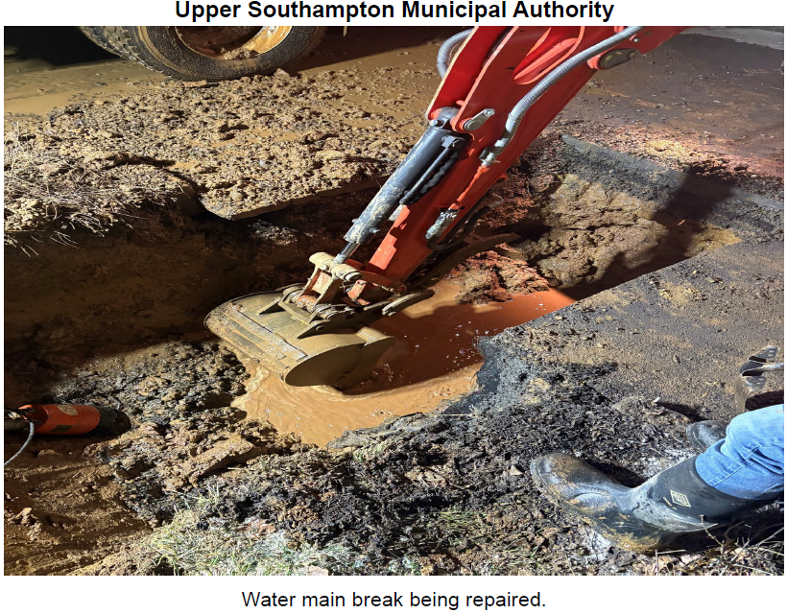
Upper Southampton Municipal Authority

Slide 61
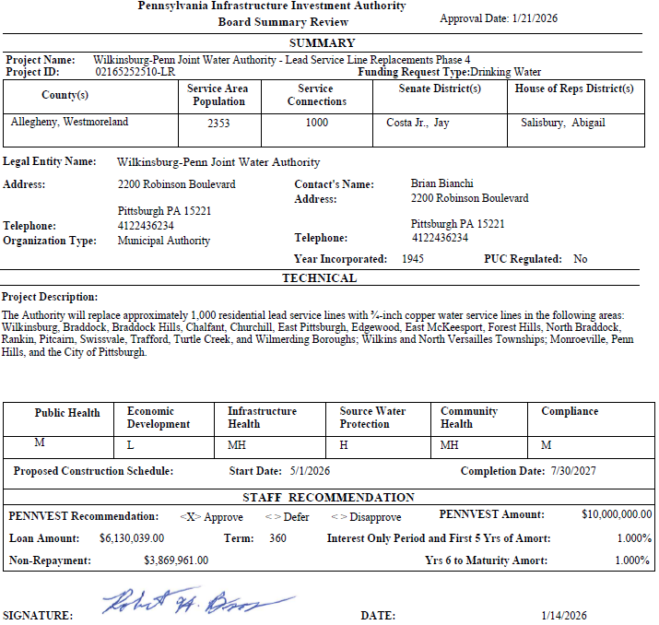
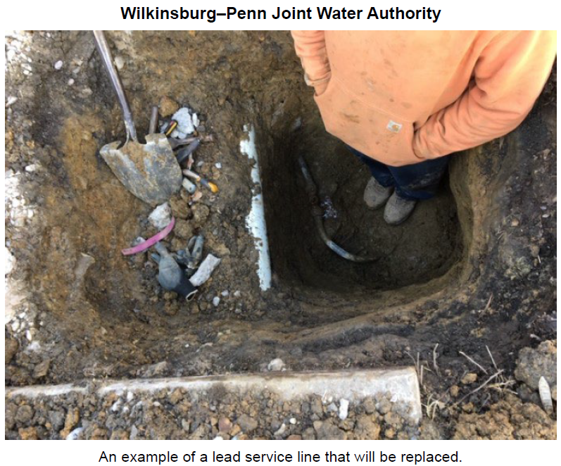
Wilkinsburg-Penn Joint Water Authority

Slide 62
PROJECT SPECIALIST PRESENTATIONS
III. FINANCIAL ASSISTANCE APPLICATIONS A. CONSTRUCTION (ii) DRINKING WATER

Slide 63
City of Lancaster

Slide 64
Wilkinsburg-Penn Joint Water Authority

Slide 65
Motion
III. FINANCIAL ASSISTANCE APPLICATIONS A. CONSTRUCTION (ii) DRINKING WATER

Slide 66
Board Discussion
III. FINANCIAL ASSISTANCE APPLICATIONS A. CONSTRUCTION (ii) DRINKING WATER

Slide 67
Public Comment
III. FINANCIAL ASSISTANCE APPLICATIONS A. CONSTRUCTION (ii) DRINKING WATER

Slide 68
Vote
III. FINANCIAL ASSISTANCE APPLICATIONS A. CONSTRUCTION (ii) DRINKING WATER

Slide 69
WASTEWATER CONSTRUCTION PROJECTS
III. FINANCIAL ASSISTANCE APPLICATIONS A. CONSTRUCTION (iii) WASTEWATER

Slide 70
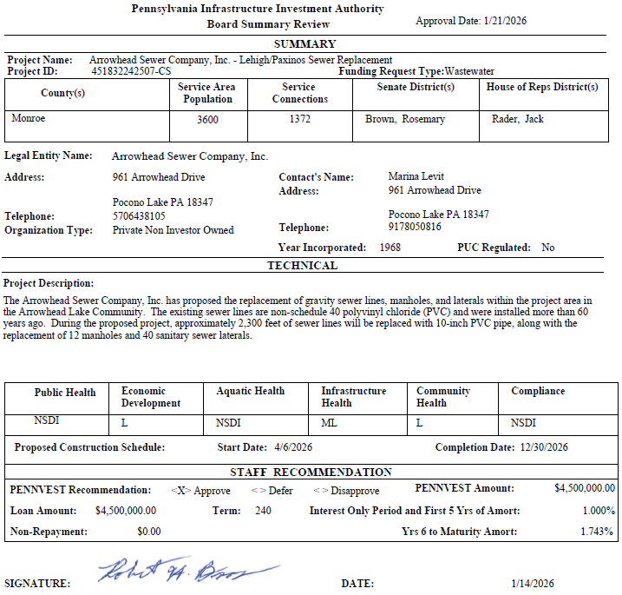
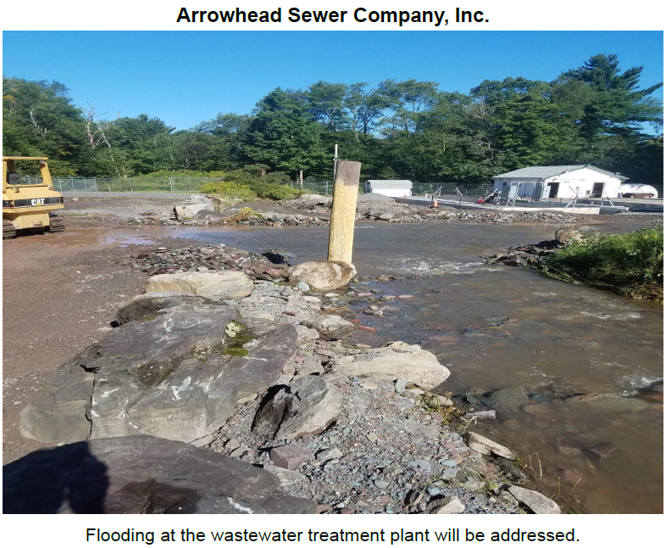
Arrowhead Sewer Company, Inc.

Slide 71
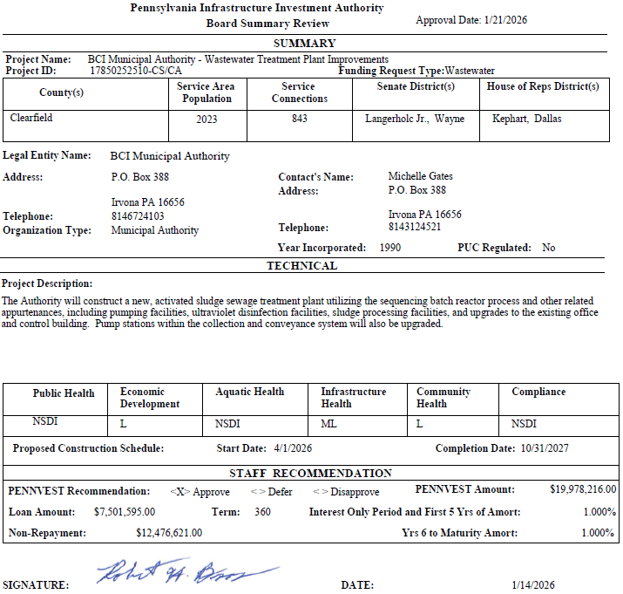
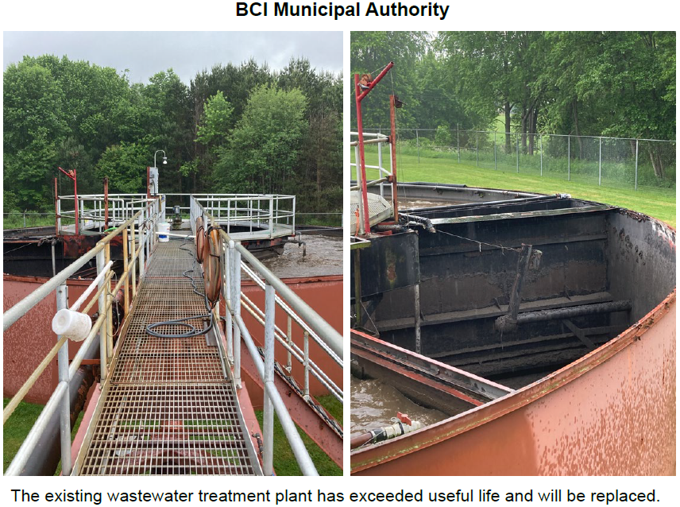
BCI Municipal Authority

Slide 72
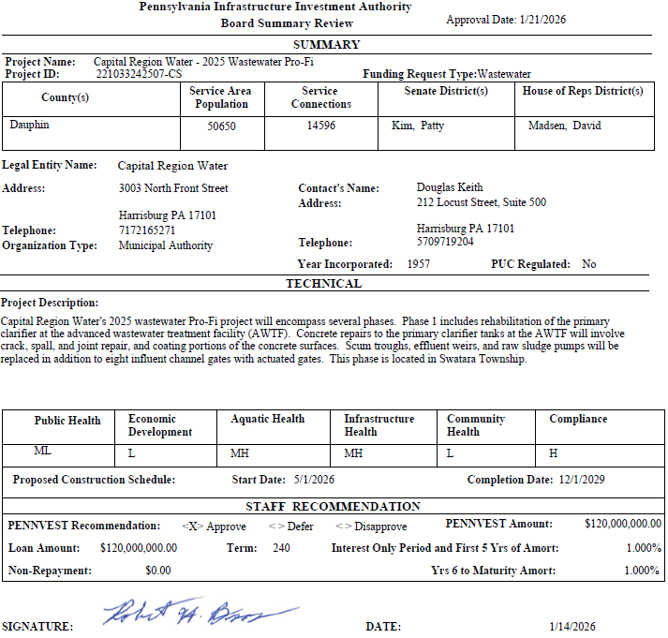

Capital Region Water

Slide 73


Dalton Sewer Authority

Slide 74


Hastings Area Sewer Authority

Slide 75


City of Lancaster

Slide 76


Municipal Authority of the City of Lower Burrell

Slide 77


Loysville Village Municipal Authority

Slide 78


Borough of Mifflinburg

Slide 79


Milton Regional Sewer Authority

Slide 80


Neshannock Creek Watershed Joint Municipal Authority

Slide 81


ORD Sewer Authority

Slide 82


Pennsylvania American Water Company

Slide 83


City of Philadelphia

Slide 84


Upper Southampton Municipal Authority

Slide 85


Windber Area Authority

Slide 86
PROJECT SPECIALIST PRESENTATIONS
III. FINANCIAL ASSISTANCE APPLICATIONS A. CONSTRUCTION (iii) WASTEWATER

Slide 87
Neshannock Creek Watershed Joint Municipal Authority

Slide 88
ORD Sewer Authority

Slide 89
Motion
III. FINANCIAL ASSISTANCE APPLICATIONS A. CONSTRUCTION (iii) WASTEWATER

Slide 90
Board Discussion
III. FINANCIAL ASSISTANCE APPLICATIONS A. CONSTRUCTION (iii) WASTEWATER

Slide 91
Public Comment
III. FINANCIAL ASSISTANCE APPLICATIONS A. CONSTRUCTION (iii) WASTEWATER

Slide 92
Vote
III. FINANCIAL ASSISTANCE APPLICATIONS A. CONSTRUCTION (iii) WASTEWATER

Slide 93
STORMWATER CONSTRUCTION PROJECT
III. FINANCIAL ASSISTANCE APPLICATIONS A. CONSTRUCTION (iv) STORMWATER

Slide 94


Arrowhead Lake Community Association

Slide 95
PROJECT SPECIALIST PRESENTATION
III. FINANCIAL ASSISTANCE APPLICATIONS A. CONSTRUCTION (iv) STORMWATER

Slide 96
Arrowhead Lake Community Association

Slide 97
Motion
III. FINANCIAL ASSISTANCE APPLICATIONS A. CONSTRUCTION (iv) STORMWATER

Slide 98
Board Discussion
III. FINANCIAL ASSISTANCE APPLICATIONS A. CONSTRUCTION (iv) STORMWATER

Slide 99
Public Comment
III. FINANCIAL ASSISTANCE APPLICATIONS A. CONSTRUCTION (iv) STORMWATER

Slide 100
Vote
III. FINANCIAL ASSISTANCE APPLICATIONS A. CONSTRUCTION (iv) STORMWATER

Slide 101
PRIOR-APPROVED PROJECTS INCREASES/DECREASES
IV. PRIOR-APPROVED PROJECTS A. INCREASES/DECREASES

Slide 102

Totals of Increases/Decreases Report

Slide 103

Dollars Disencumbered Report

Slide 104

Current Individual Increase Requests Summary

Slide 105
Motion
IV. PRIOR-APPROVED PROJECTS A. INCREASES/DECREASES

Slide 106
Board Discussion
IV. PRIOR-APPROVED PROJECTS A. INCREASES/DECREASES

Slide 107
Public Comment
IV. PRIOR-APPROVED PROJECTS A. INCREASES/DECREASES

Slide 108
Vote
IV. PRIOR-APPROVED PROJECTS A. INCREASES/DECREASES

Slide 109
PRIOR-APPROVED PROJECTS PROGRAM INITIATIVES
IV. PRIOR-APPROVED PROJECTS B. PROGRAM INITIATIVES

Slide 110

Small Projects Report

Slide 111

Bipartisan Infrastructure Law (BIL) Project Summary

Slide 112

Bipartisan Infrastructure Law (BIL) Project Summary

Slide 113

Bipartisan Infrastructure Law (BIL) Project Summary

Slide 114

Bipartisan Infrastructure Law (BIL) Project Summary

Slide 115

Bipartisan Infrastructure Law (BIL) Project Summary

Slide 116
PRIOR-APPROVED PROJECTS ON-LOT REPORT
IV. PRIOR-APPROVED PROJECTS C. ON-LOT REPORT

Slide 117

On-Lot Report

Slide 118
PRIOR-APPROVED PROJECTS PROJECT STATUS
IV. PRIOR-APPROVED PROJECTS D. PROJECT STATUS

Slide 119

Application to Approval Projects for January 21, 2026

Slide 120

Approval to Settlement Projects for January 21, 2026

Slide 121

Approval to Settlement Projects for January 21, 2026

Slide 122

Approval to Settlement Projects for January 21, 2026

Slide 123
Final Public Comment

Slide 124
Save the date
The next scheduled board meeting:
April 15, 2026
Application cut-off date:
February 4, 2026

Slide 125
Vote to Adjourn
V. ADJOURNMENT

