Slide 1
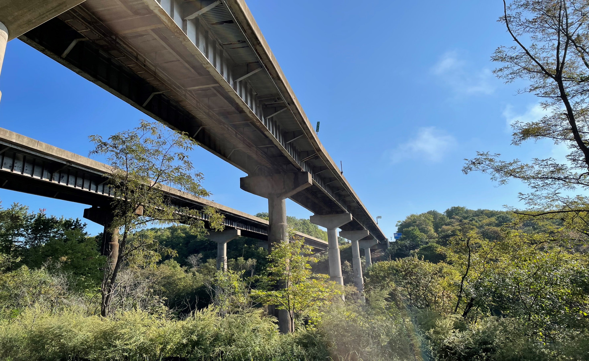

Public-Private Transportation
Partnership Board Meeting
June 12, 2024

Slide 2
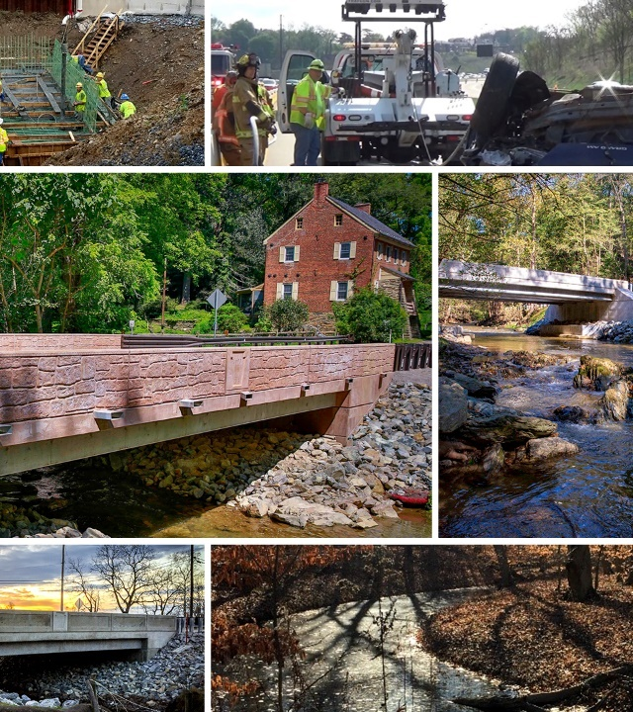
Agenda
Call to Order
Roll Call
Adoption of 11.29.2023 Meeting Minutes
Chair’s Remarks
New Business
Project Updates
Other Business
Public Comments
Adjournment

Slide 3
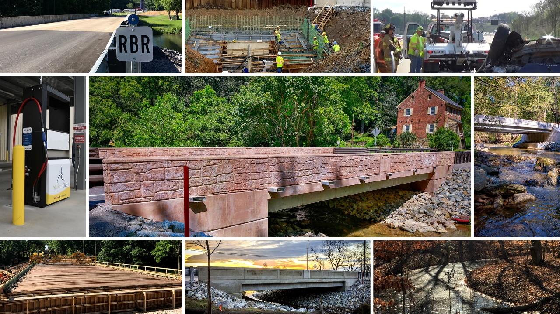
Project Updates

Slide 4

Unsolicited Proposals Update

Slide 5
Unsolicited Proposals Received (April 2024)
Project Name | Proposed By | Proposal Summary
Aviation Education and Workforce Collaborative | Aerium | The goal of the proposed project is to enhance aviation education and workforce development by collaborating with secondary institutions in Pennsylvania. The project objectives include: funding acquisition to develop comprehensive aviation programs in schools; curriculum development to assist schools in implementing relevant curricula to meet industry demands; resource provision offering training and supporting the establishment of dual enrollment and articulation agreements; and pathway development to transition students from education to industry. The project is proposing to leverage the state's resources, expertise, and support, while strategically addressing workforce needs, promoting economic growth, and fostering innovation within Pennsylvania's aviation industry.

Slide 6
Unsolicited Proposals – Under Consideration
Project Name | Proposed By | P3 Action
PennDOT Solar Initiative | Solar Renewable Energy, LLC | Preparing Detailed Level Screening Report
District 4 Northern Tier Counties Bridge Replacements | CDR Maguire | Preparing Detailed Level Screening Report
I-76 Schuylkill Expressway Managed Lanes | CINTRA | Pre-screening / Candidacy
Aviation Education and Workforce Collaborative | Aerium | Pre-screening / Candidacy

Slide 7
Unsolicited Proposals – On Hold
Project Name | Proposed By | Reason On Hold
PennDOT Truck Parking Expansion Program | Truck Specialized Parking Services, Inc. | Coordinating with Freight Working Group to identify Truck Parking strategies
I-83 South Bridge and Associated Improvements | S&B Construction / Trumbull Construction | Awaiting grant submission opportunities while proposal is under evaluation

Slide 8
Unsolicited Proposals – Dismissed
Project Name | Proposed By | P3 Action
P3 Planning for V2X Digital Infrastructure | Sonamore Inc, DBA – P3 Mobility | Dismissed
Pop Up Metro: A Rapidly Deployable Zero-Emission Rail Transit Initiative | Pop Up Metro, LLC | Dismissed

Slide 9
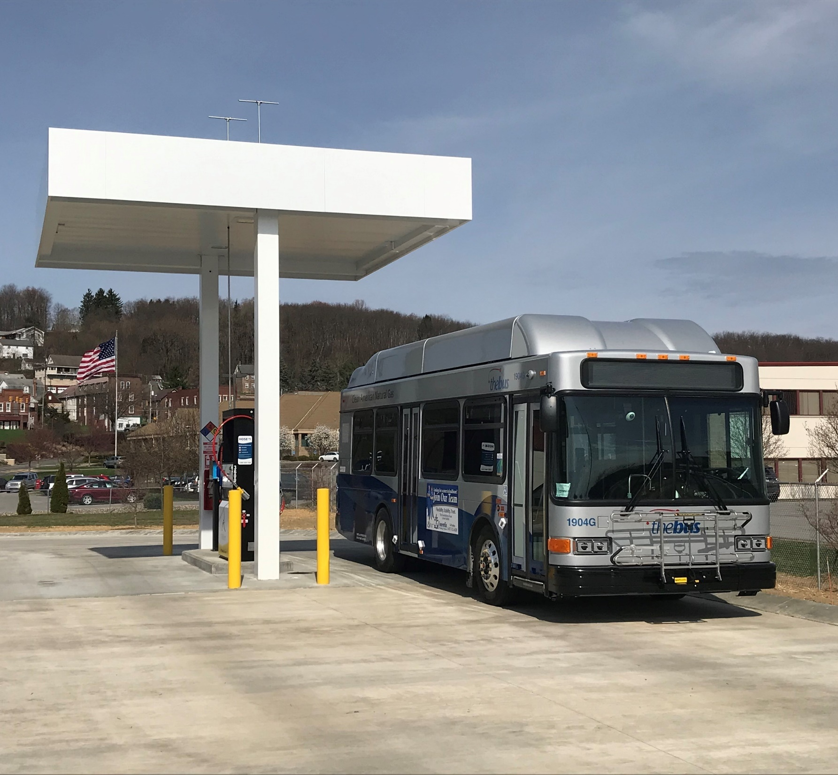
Compressed Natural
Gas (CNG) Fueling Stations

Slide 10
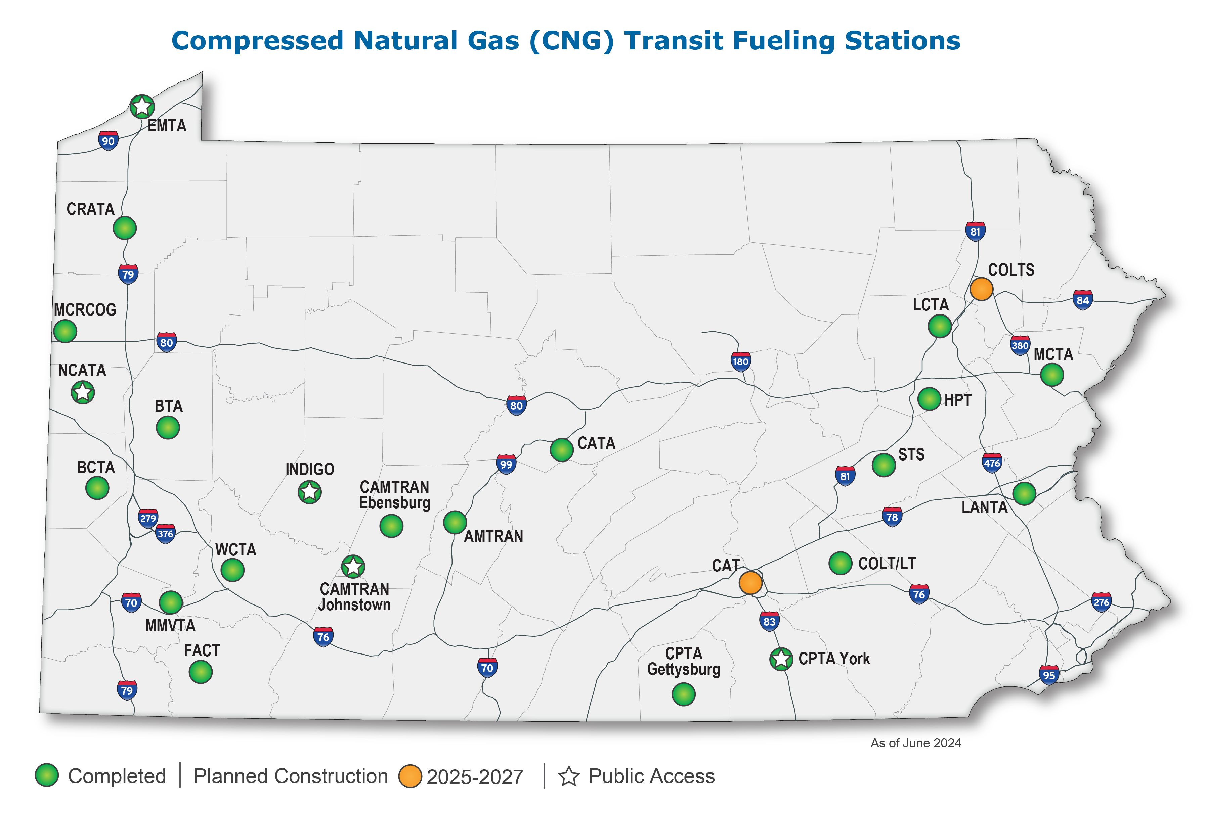
CNG Fueling Stations for Public Transit Agencies

Slide 11
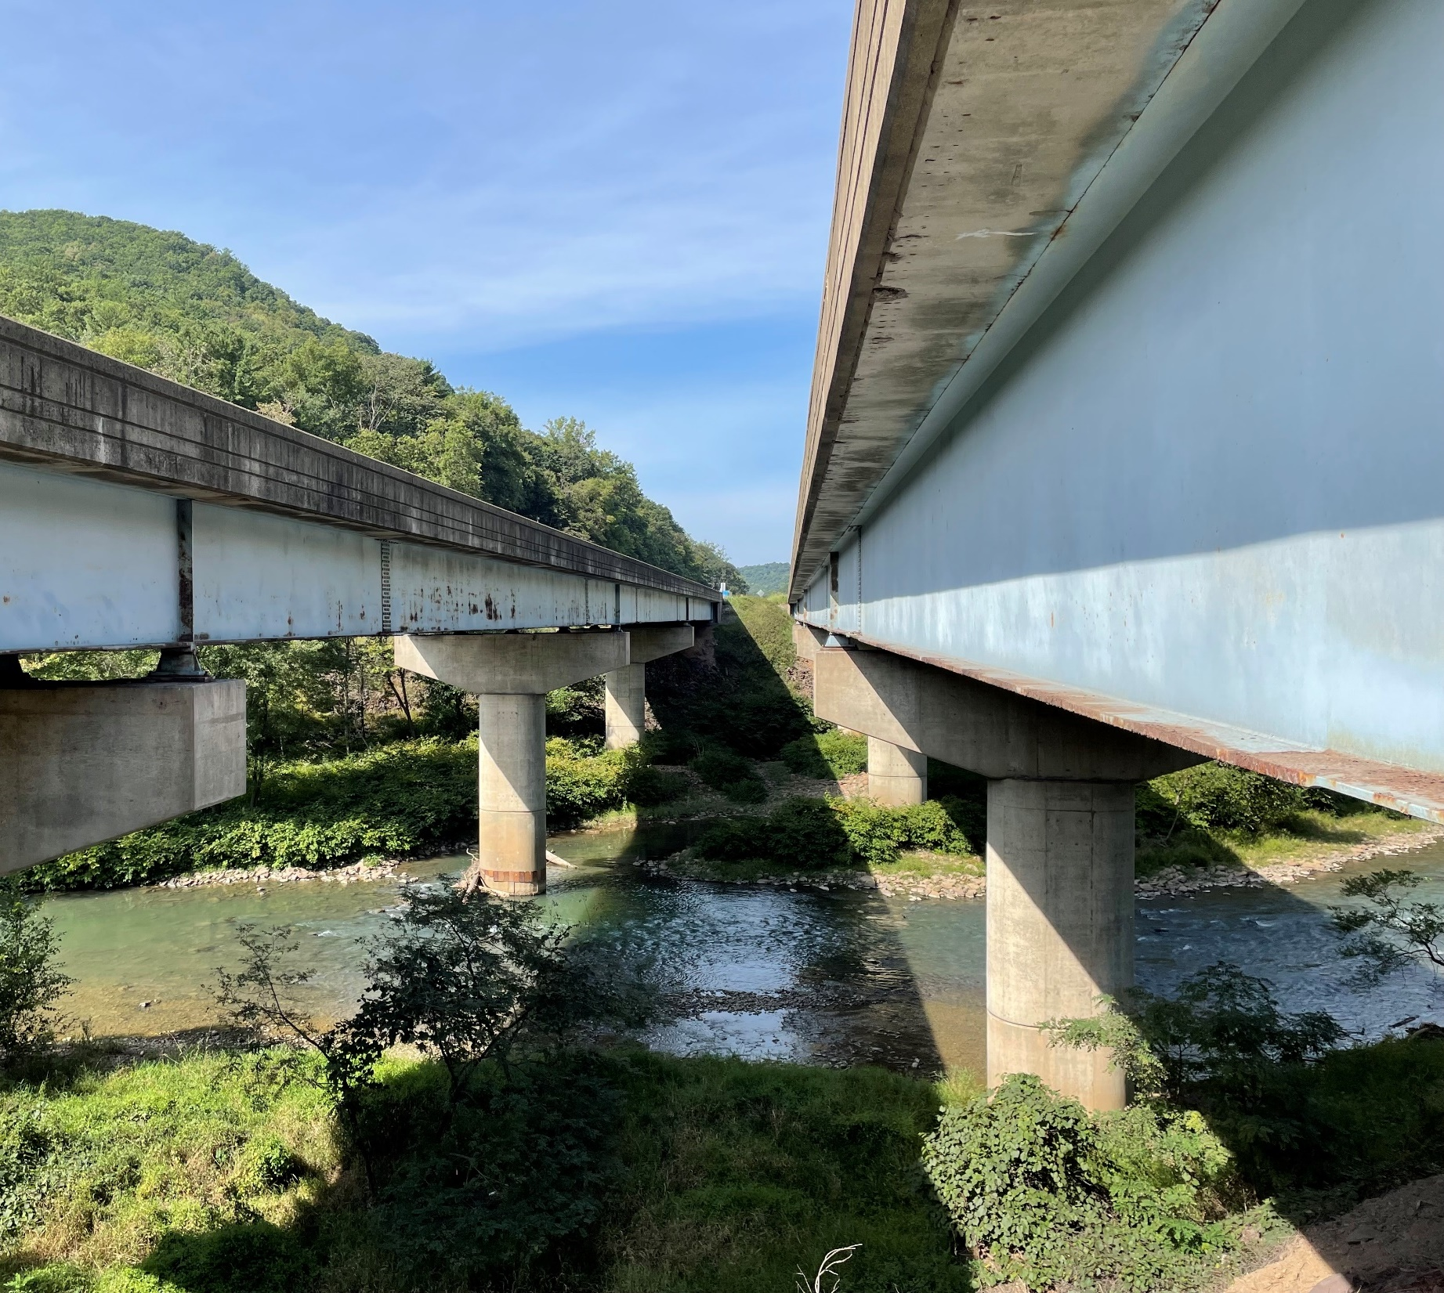
Major Bridge P3

Slide 12
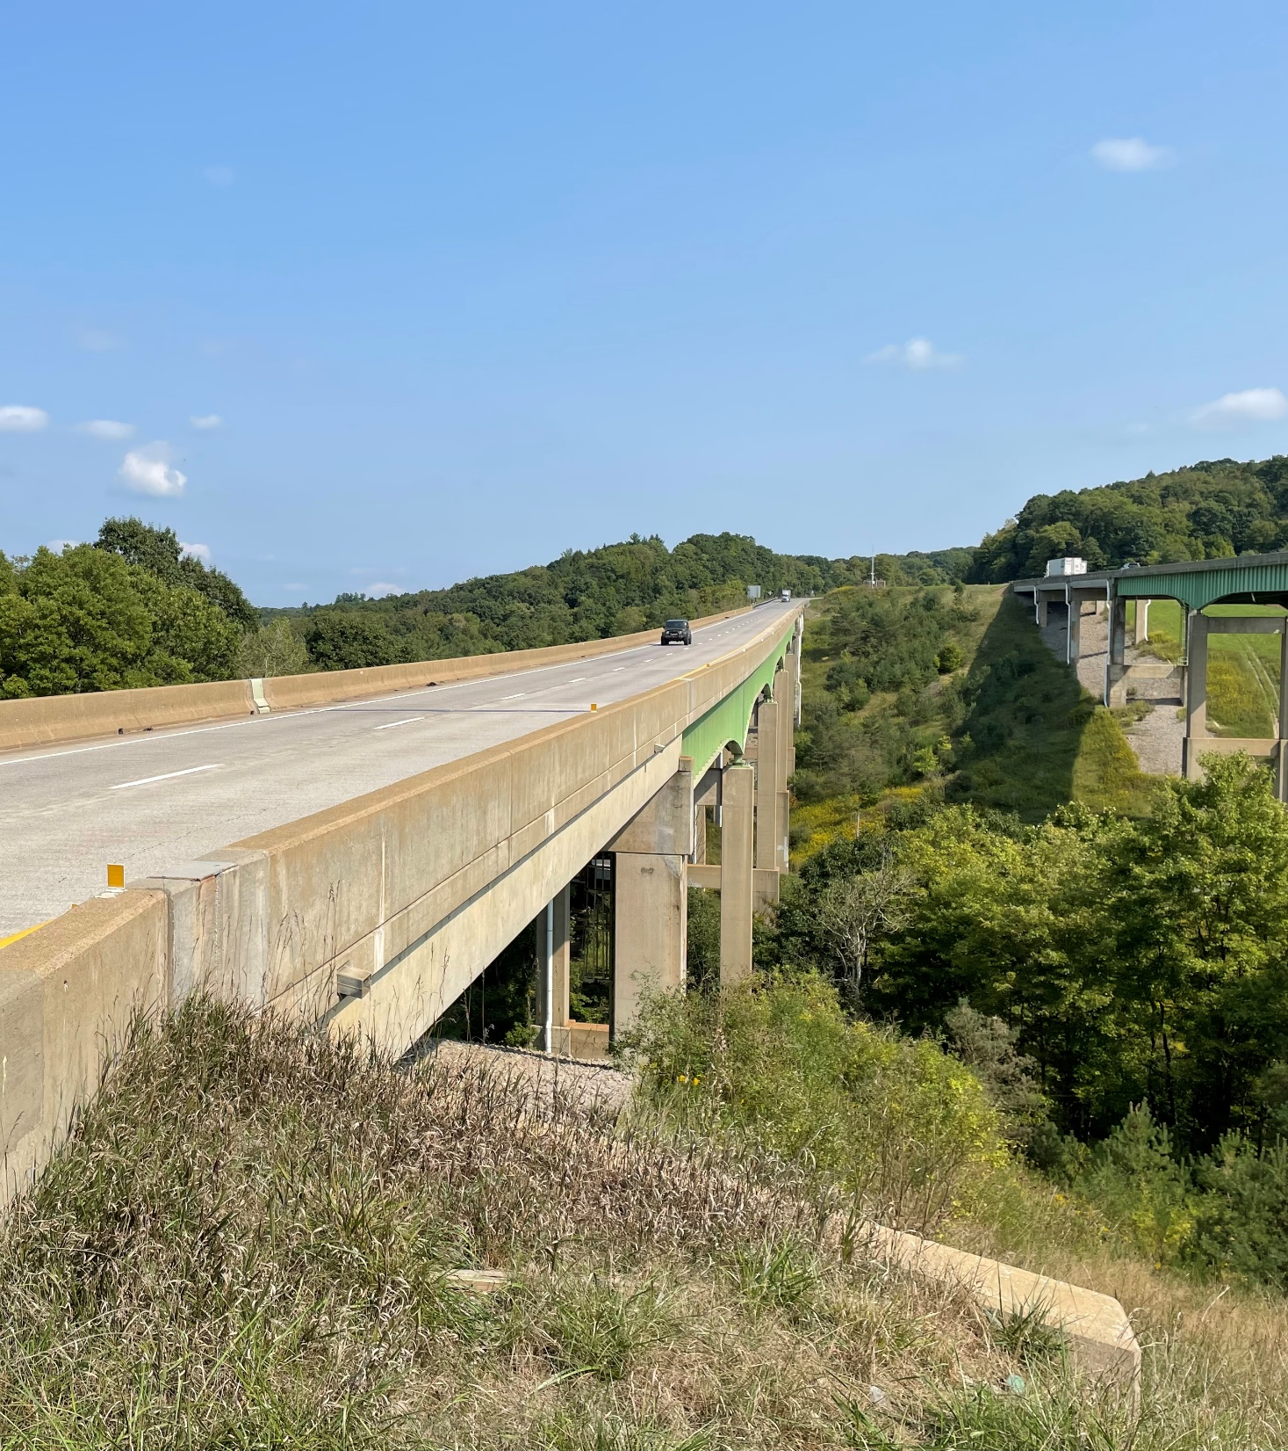

Project Overview
Approved by the P3 Board in November 2020 to replacement or rehabilitate major interstate bridges
In August 2022, PennDOT chose to move the bridge projects in the MBP3 forward without tolling and pay for the project(s) using existing funds to make annual payments to the development entity over 35 years

Slide 13
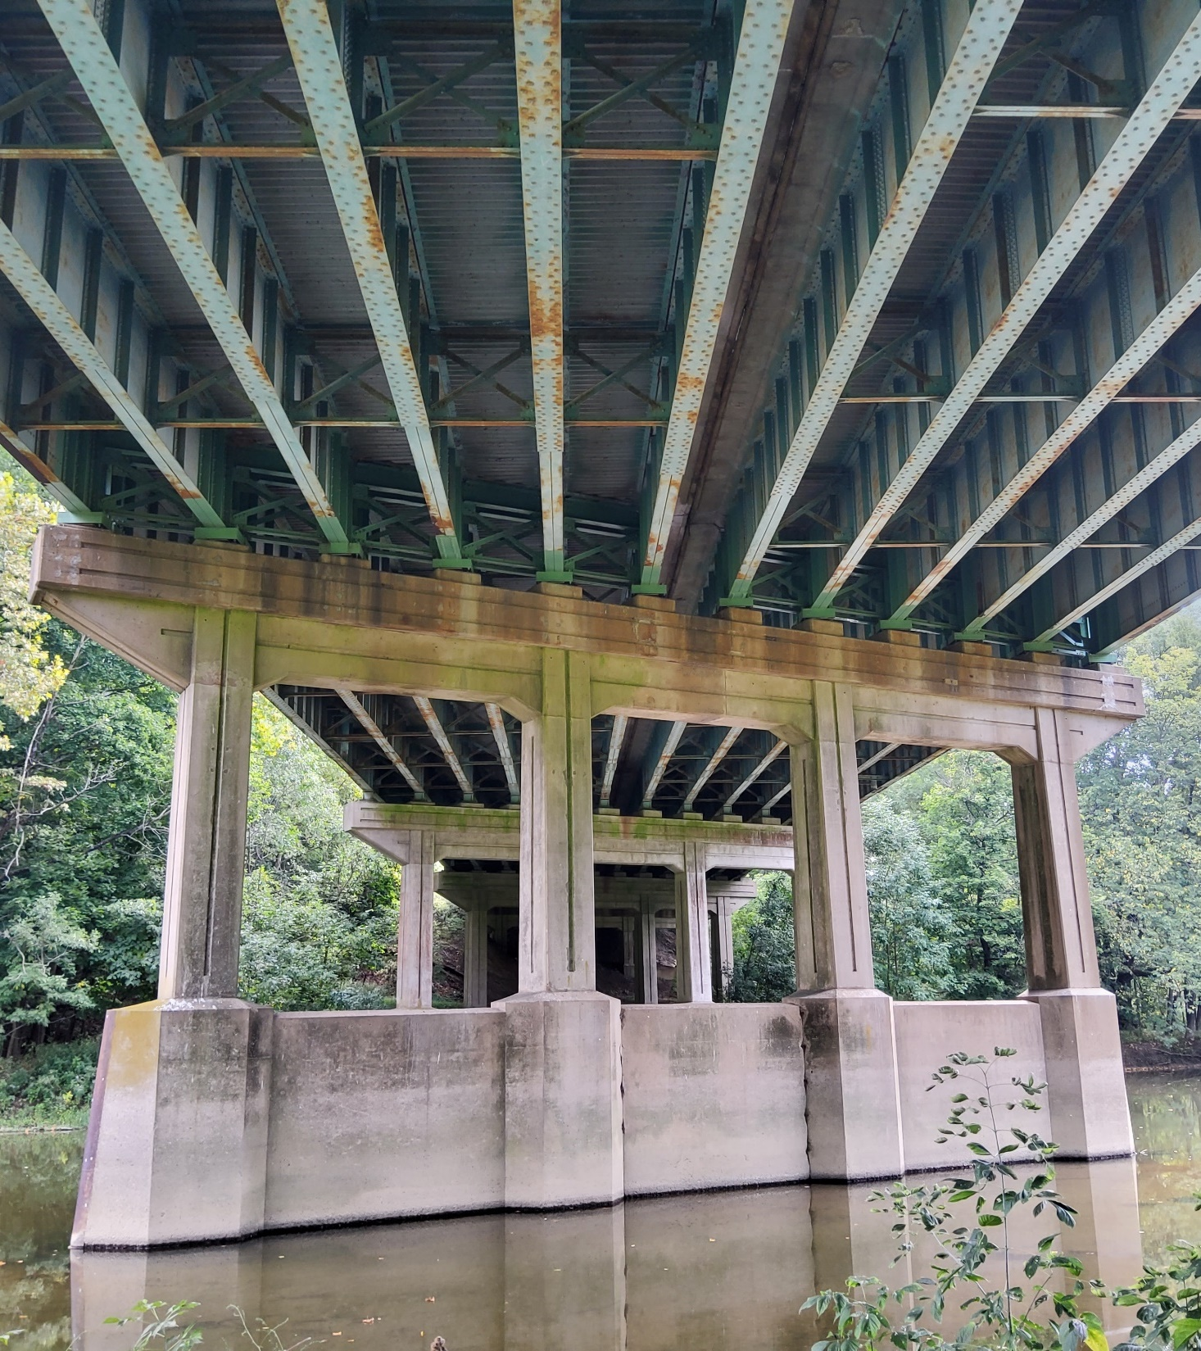
Pre-Development Agreement (PDA) Work
Partnership Agreement on Bridges to be Included in Package One
Finalization of Preliminary Engineering
Negotiation of Technical Provisions
Finalization of P3 Project Agreement
Development of Independent D & C Cost Model Report

Slide 14
Bridging Pennsylvania Developers I (BPD-I)
Equity Members
Macquarie | Leading international investor, developer, and advisor for infrastructure assets
Shikun & Binui Concessions | S&B’s international investing and concessionaire arm
Lead Construction Contractor
Shikun & Binui USA Construction | S&B’s US subsidiary, a developer and builder of complex infrastructure projects specializing in PPP/P3 and DB
FCC Construccion | International engineering and construction company with 120 years of experience
Lead Engineering Firm
Michael Baker International | Leading national engineering consulting firm with over 80 years of experience
Exclusive Local Subcontractors
Fay (North Fork) | Leading PA-based contractor specializing in bridges demolition and reconstruction
Wagman (Lehigh River, Nescopeck) | Leading PA-based contractor with major heavy civil, general contract and geotechnical operations
H&K (Susquehanna, Lenhartsville) | Leading PA-based contractor for construction materials and full-service heavy civil works
Kokosing (Canoe Creek) | Leading PA-based contractor specialized in road and bridge construction
Independent Quality Firm
Volkert, Inc | Quality assurance firm specializing in large-scale project management

Slide 15
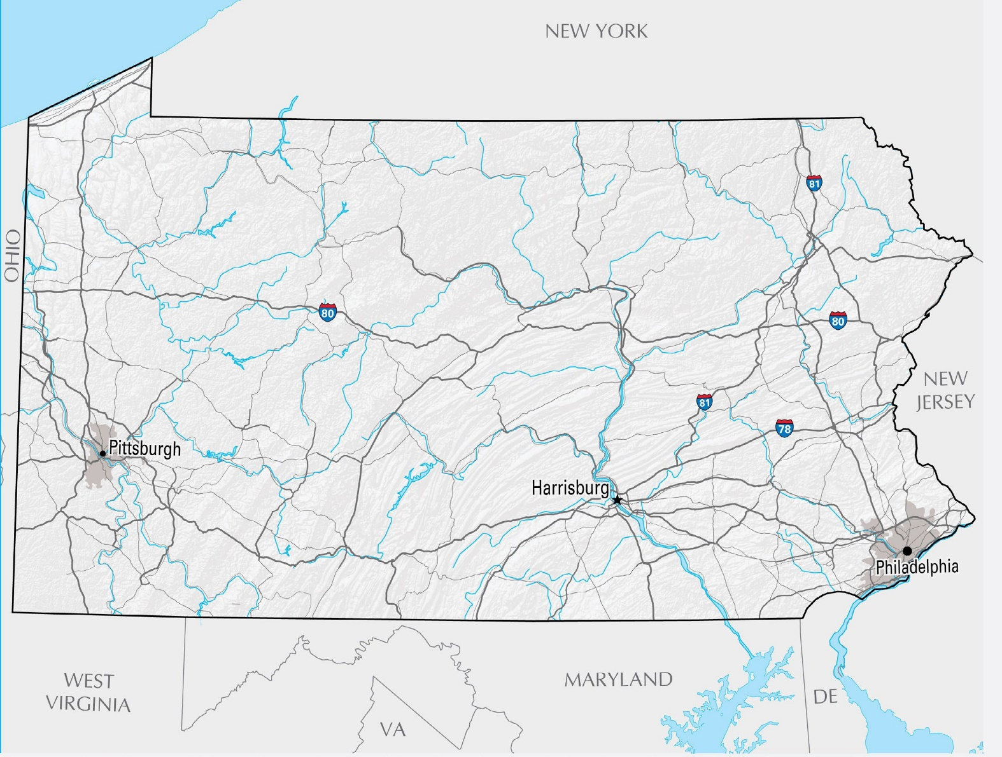
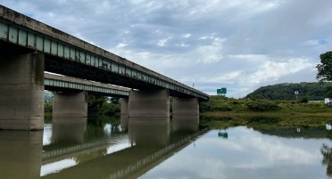
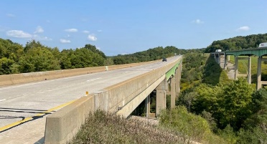
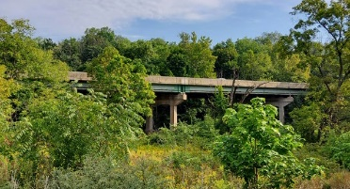
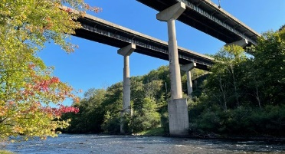
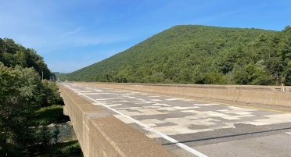
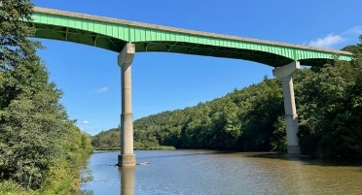




Package One Bridges
1
Response to the RFP – DE proposal recommended 6 bridges; Department concurred
More rural and geographically Located
Environmental activities were further progressed
Package provided strong bond investor interest
2 6
5 4
3
1
2
3
4
5
6
81 Susquehanna
80 Canoe Creek
78 Lenhartsville
80 Lehigh River
80 Nescopeck
80 North Fork

Slide 16
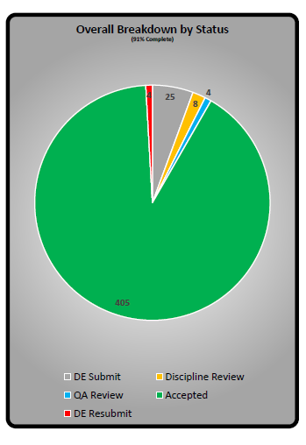
Overall Final Design Status
Notes:
FOR YOUR INFO:
Contract Costs
Design & Construction - $899M
Maintenance - $85M
Financing - $835M
Amendment Settlement $43.5M

Slide 17
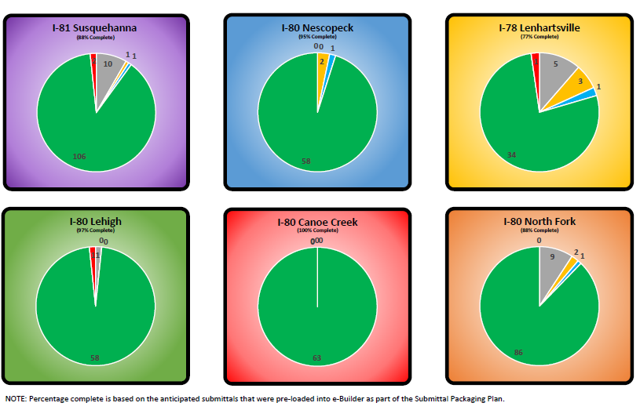
Final Design Status by Bridge
Notes:
FOR YOUR INFO:
Contract Costs
Design & Construction - $899M
Maintenance - $85M
Financing - $835M
Amendment Settlement $43.5M

Slide 18
Construction Schedule
Bridge | Construction Start | Bridge Completion
I-81 Susuquehanna | July 2023 | Summer 2028
I-80 Canoe Creek | October 2023 | Summer 2028
I-80 Nescopeck | April 2024 | Fall 2027
I-80 Lehigh | Anticipated Summer 2024 | Summer 2028
I-80 North Fork | Anticipated Summer 2024 | Summer 2028
I-78 Lenhartsville | Anticipated Summer 2024 | Summer 2028

Slide 19
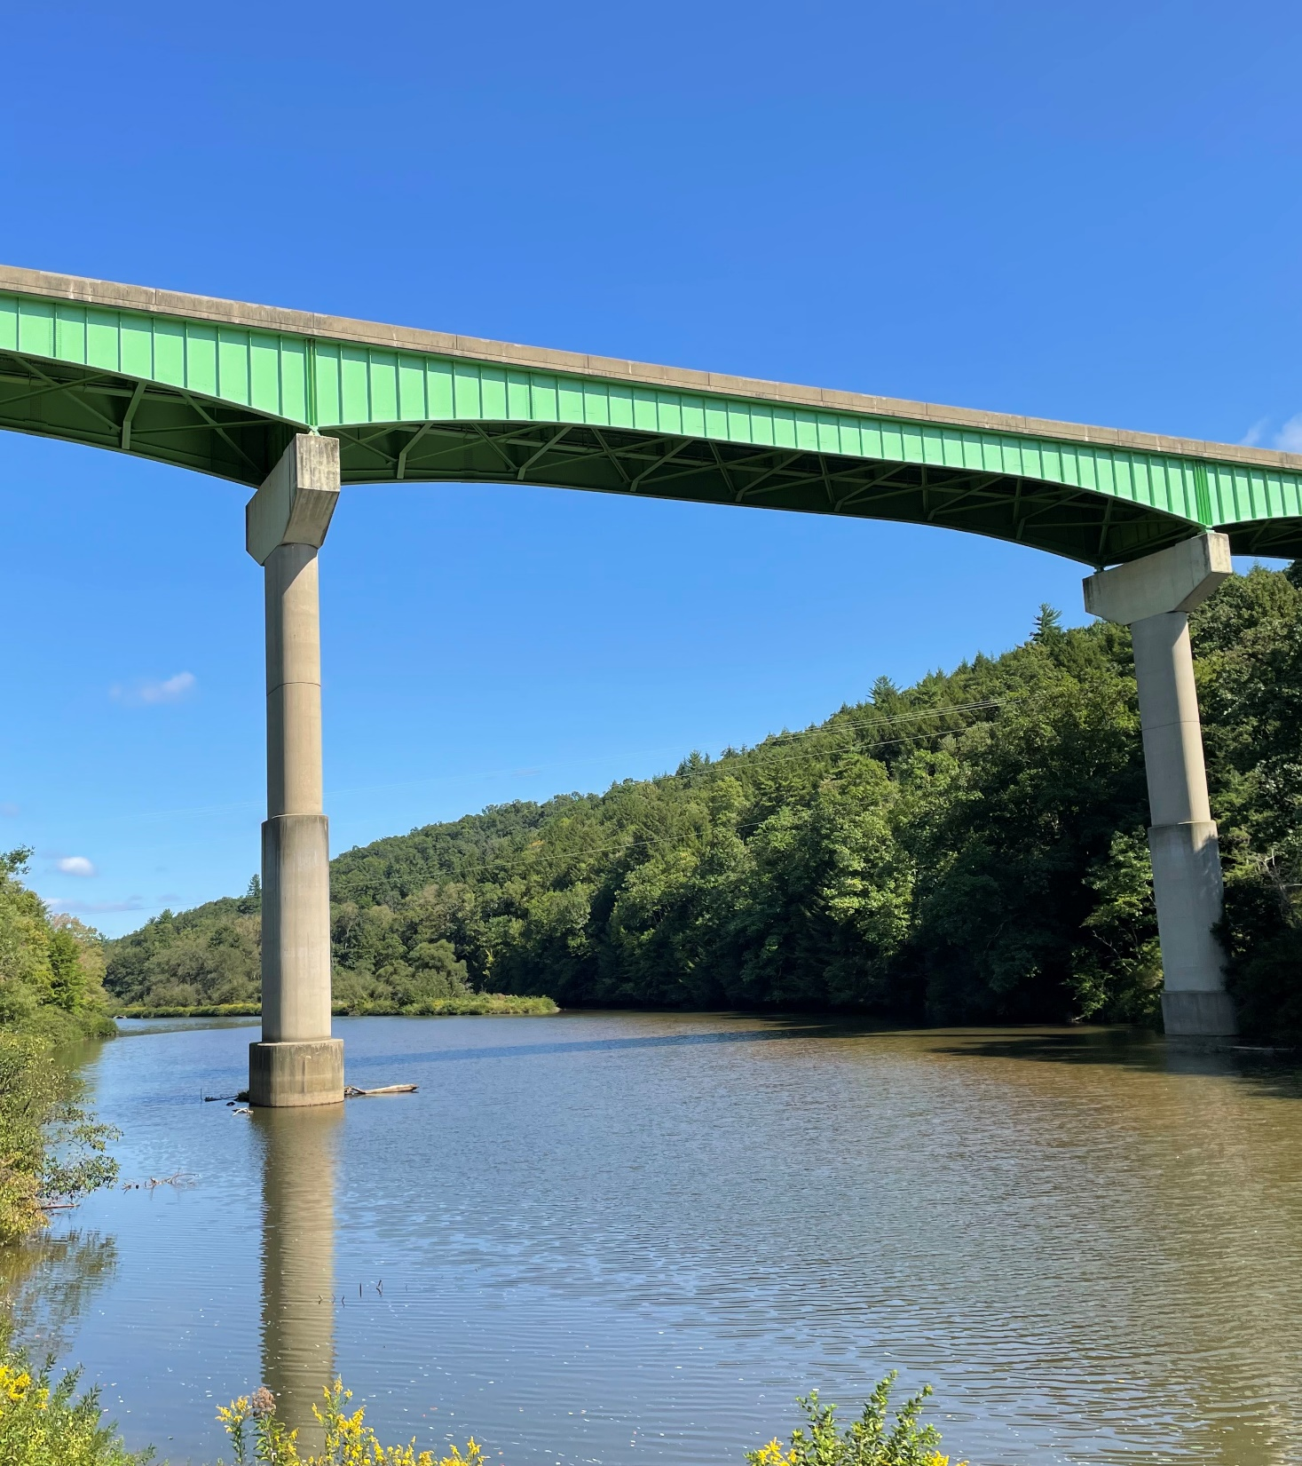
Package One Next Steps
DE working to achieve Notice To Proceed 3 (NTP3) authorizing full construction to begin
Limited NTP3s have been issued for the Susquehanna, Canoe Creek and Nescopeck Projects, initiating DE maintenance responsibilities during the Construction Period
Additional Limited NTP3s are anticipated as design progresses
Full NTP3 is scheduled for September 2024, at which point design will be complete and all 6 Bridges will be under full construction

Slide 20
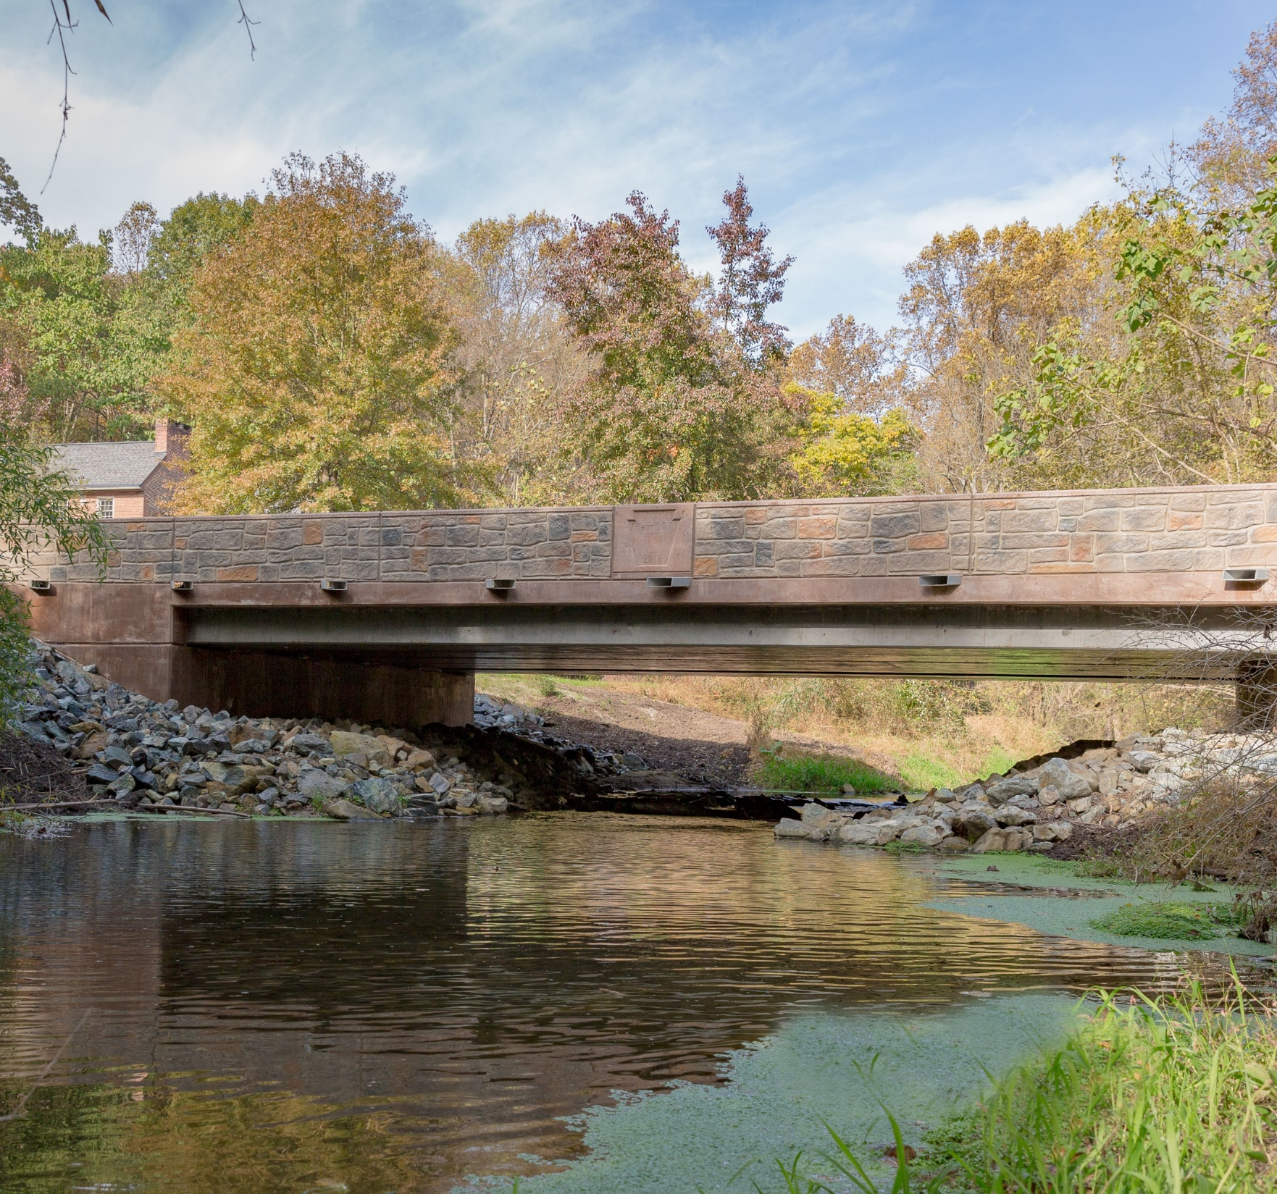
Rapid Bridge Replacement (RBR) Project

Slide 21
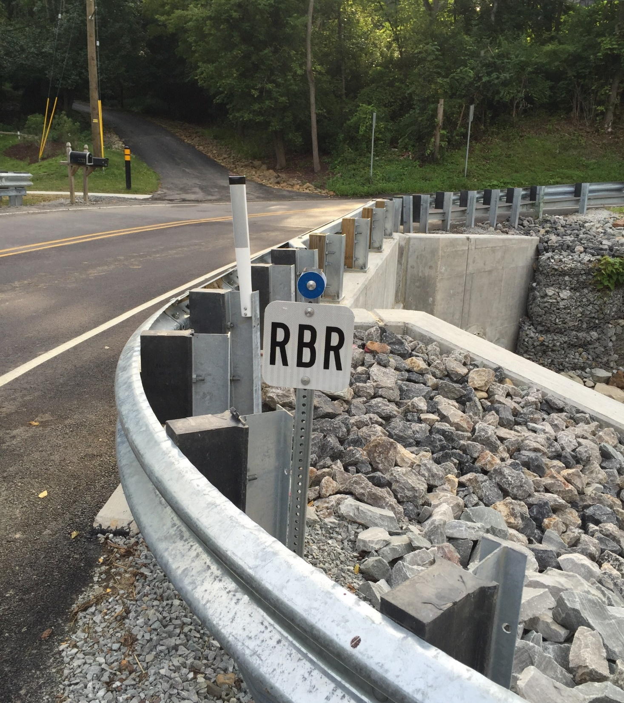
Project Summary
Replaced 558 poor condition bridges more quickly
    Standardization of design techniques and construction methods
Transferred maintenance activities to private sector for a 25-year term
Use of PA-based contractors and designers

Slide 22
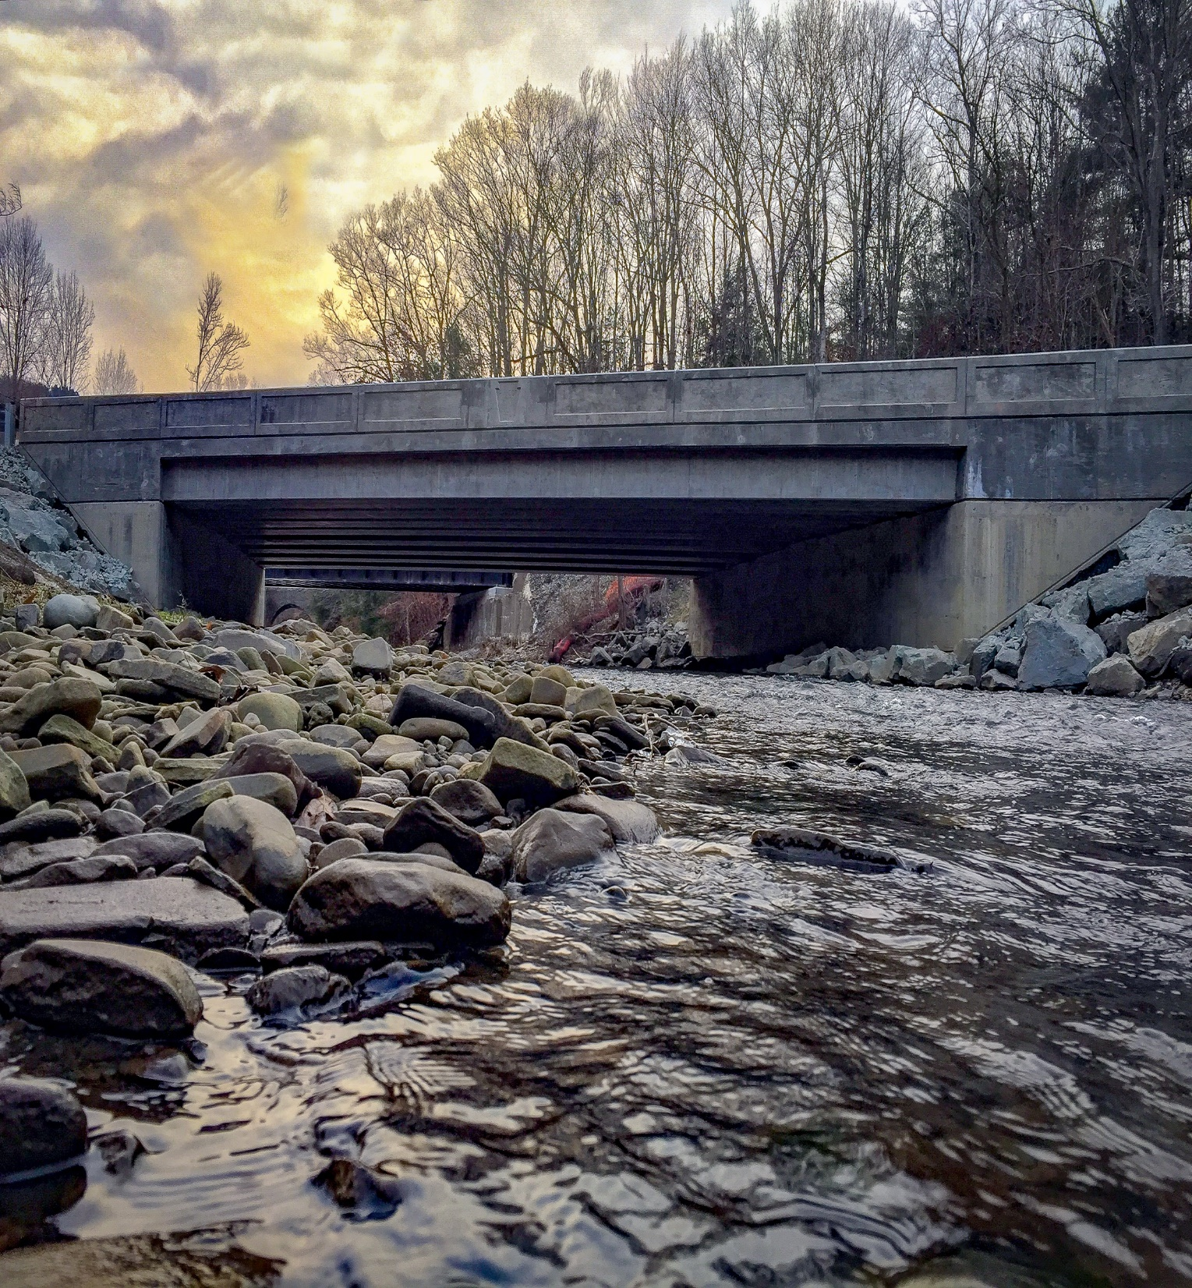
Project Status
All bridges constructed and are currently in the 25-year Maintenance Period
First bridge went into the Maintenance Period - September 2015
Bridges will complete Maintenance Period in order of construction completion
Last bridge to complete Maintenance Period will be in September 2044

Slide 23
Agenda
Call to Order
Roll Call
Adoption of 11.29.2023 Meeting Minutes
Chair’s Remarks
New Business
Project Updates
Other Business
Public Comments
Adjournment

Slide 24

Thank You
Next Board Meeting:
December 17, 2024
1:00 P.M.
For more information on
Public-Private Partnerships:
www.penndot.pa.gov

