Slide 1

Grant Application Walkthrough
An overview of the grant application process

Slide 2

This presentation will go over the grant application process:
Create an Application in Egrants
Completing the Main Summary
Budget Setup
Creating Your Budget
Authorized Signatories & Application Submission
Viewing Your Application
Signing Your Application
Additional Resources
Questions
Welcome!

Slide 3
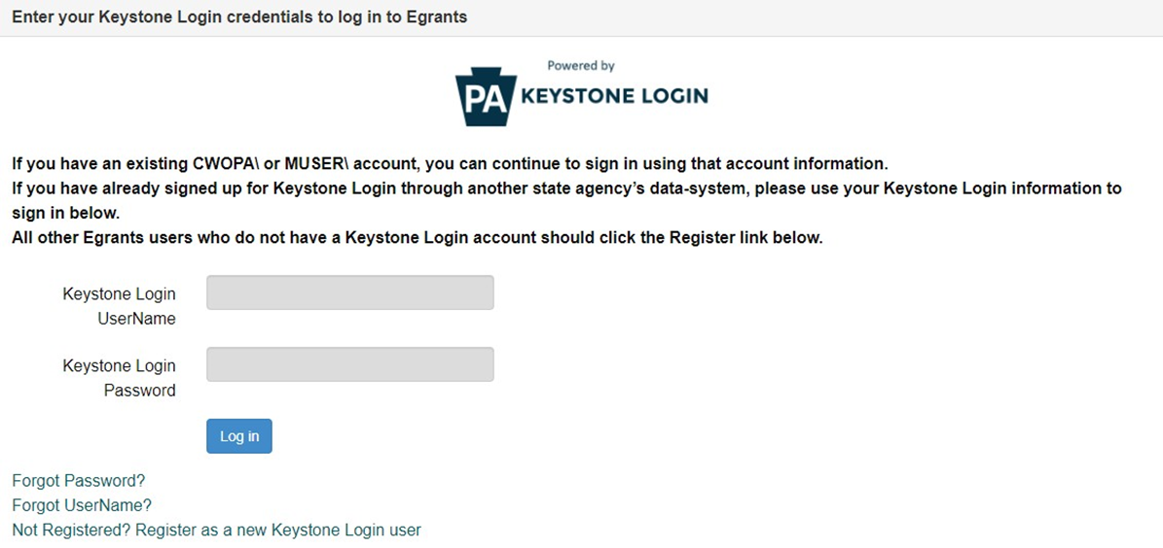

Creating an Application in Egrants
Log into the Egrants system by following the link in the slide. Enter your Keystone Login Username and password. If you do not have a Keystone User ID Click on Not Registered? Register as a new Keystone Login user.
EGrants
Notes:
To create your grant application, you must first log into the Egrants system by following the link in the slide above. To do this enter your Keystone Login Username and password. If you do not have a Keystone User ID Click on Not Registered? Register as a new Keystone Login user.

Slide 4
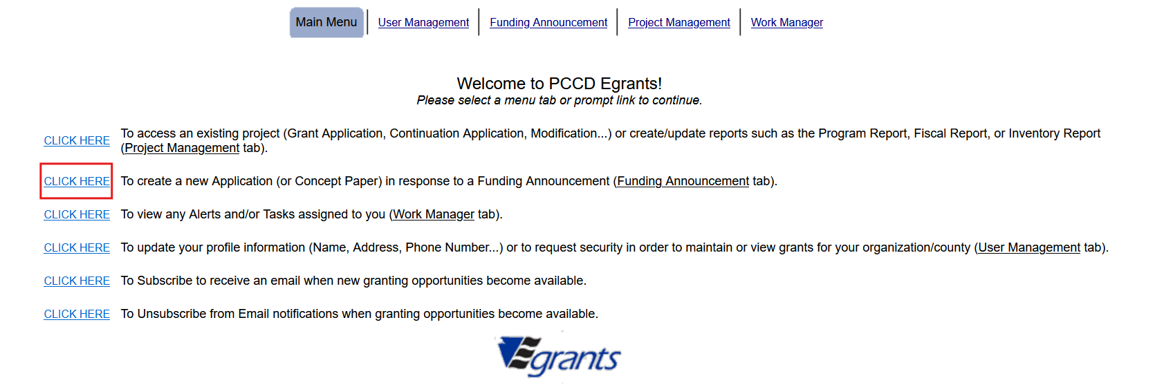
Creating an Application in Egrants
Choose the menu item link - To create a new Application. To Access an existing project.
Notes:
On the Main Menu, click the top menu item link which reads “To create a new Application (or Concept Paper) in response to a Funding Announcement (Funding Announcement tab).” At any point in the process, you can save your grant application and return to it later. To do this, you will navigate to the main menu and click on the option outlined in green – To Access an existing project.

Slide 5
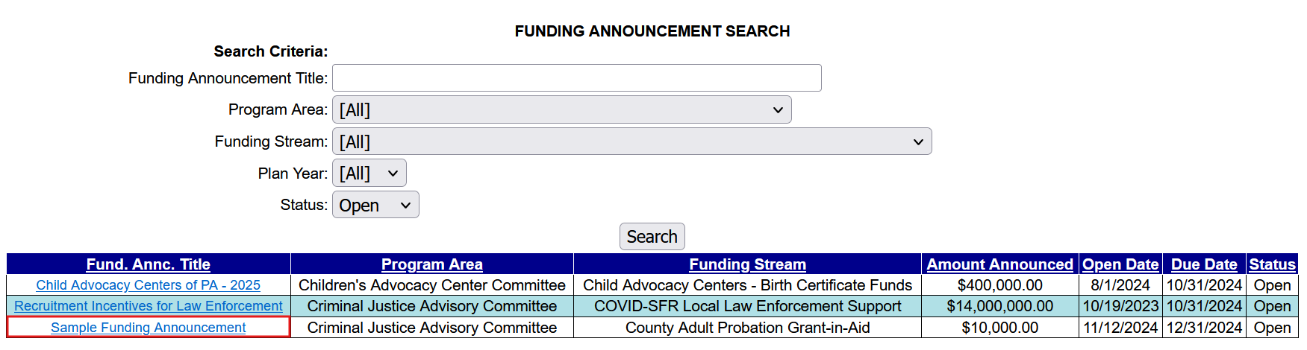
Creating an Application in Egrants
Click on the funding announcement title that corresponds with the grant application being created.
Notes:
Click on the funding announcement title that corresponds with the grant application being created. For this example, we will be using our Sample Funding Announcement.

Slide 6
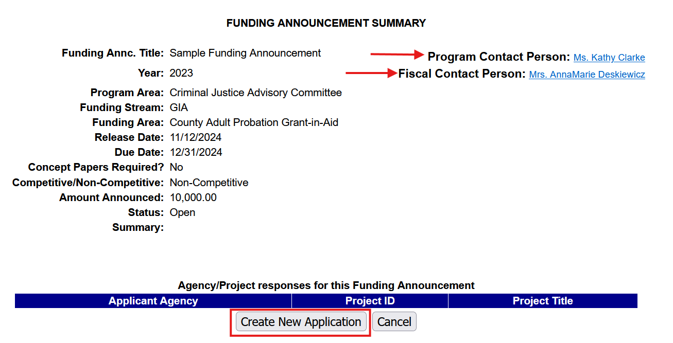
Creating an Application in Egrants
The Fiscal and Program contacts are listed at the top. Please refer to these contacts for application questions, for competitive funding announcements, questions to clarify the funding announcement requirements will have to be emailed to the email resource account identified in the funding announcement document.
To create the new application, click on Create New Application.
Click to create new application
Notes:
In the top right corner of the Funding Announcement Summary page, you will find the name of the Fiscal and Program contacts for this funding announcement. If you have any questions during the application process, you may contact either individual. Please note for competitive funding announcements, questions to clarify the funding announcement requirements will have to be emailed to the email resource account identified in the funding announcement document. To create the new application, click on Create New Application.

Slide 7
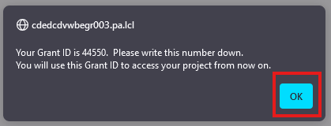
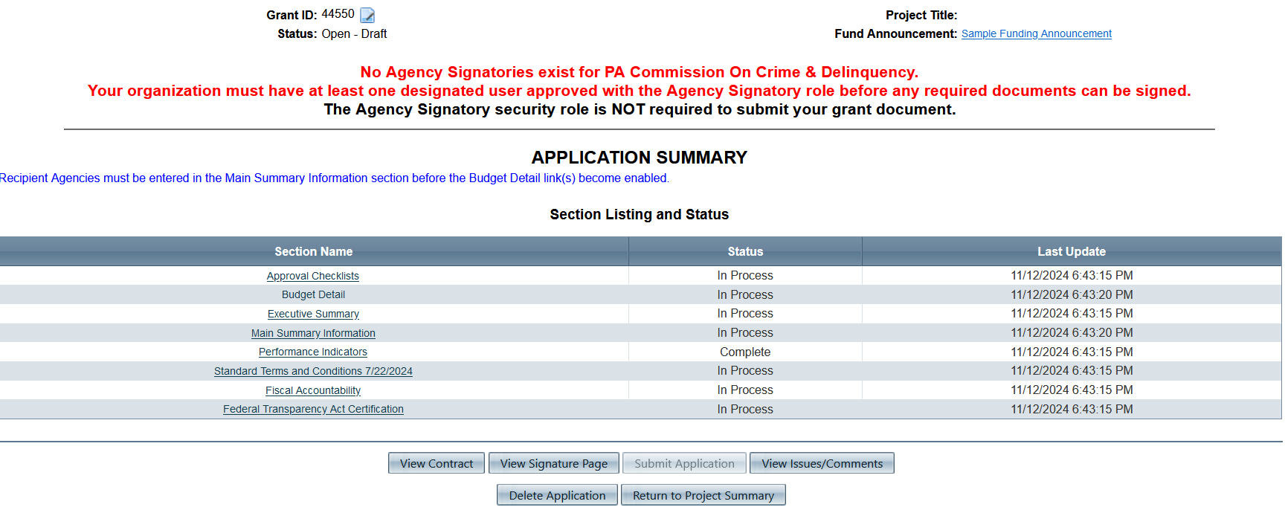
Creating an Application in Egrants
Each funding announcement has a specific summary that includes sections applicable to that funding. The sections that you see listed here may differ from those on your screen.
Note your grant ID number
Notes:
Prior to the application summary page appearing, a prompt will appear that shows your grant ID number. This is the number you will reference when contacting PCCD for any questions related to your application. Once you have copied the grant id number down, click okay. You will now see the Application Summary screen. Each funding announcement has a specific summary that includes sections applicable to that funding. The sections that you see listed here may differ from those on your screen.

Slide 8
Creating an Application in Egrants
On the application summary screen, you must complete the Main Summary information section prior to entering your budget. To do this Click on the Main Summary Information hyperlink.
Notes:
On the application summary screen, you must complete the Main Summary information section prior to entering your budget. To do this Click on the Main Summary Information hyperlink.

Slide 9
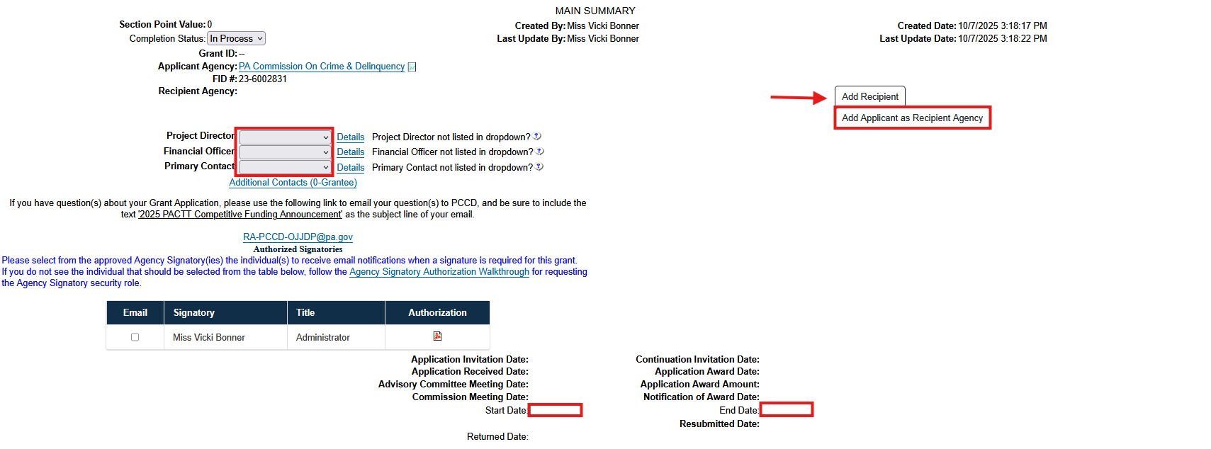
Completing the Main Summary
Add all recipient agencies receiving funding and managing any portion of the project. Click the Add Applicant as Recipient Agency button if appropriate. Click the Add Recipient button to search for and add recipient agencies other than the applicant agency. Click the link for that agency in the search results that you want to add and then click save on the next screen. You can add as many recipient agencies as needed and a separate budget will be created for each entity.
Select the project director, financial officer, and primary contact from the drop-down menus.
Enter the grant start and end date per the funding announcement.
Notes:
Select the project director, financial officer, and primary contact from the drop-down menus. The financial officer must be someone different than the project director. If the person you want to select is not listed, they are not registered or do not have egrants access to the applicant agency.
Add all recipient agencies that will be receiving funding and managing any portion of the project. Click the Add Applicant as Recipient Agency button if appropriate. Click the Add Recipient button to search for and add recipient agencies other than the applicant agency. Click the link for that agency in the search results that you want to add and then click save on the next screen. You can add as many recipient agencies as needed and a separate budget will be created for each entity.

Slide 10
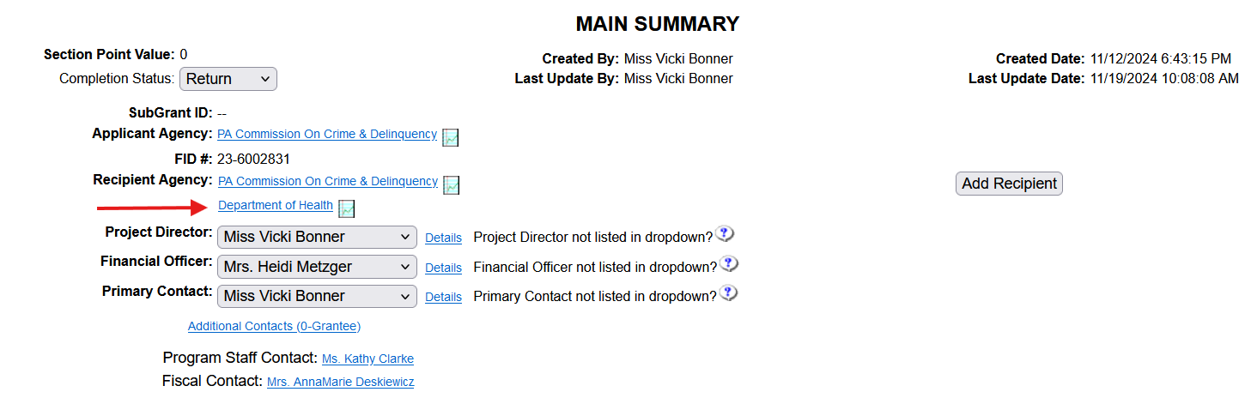
Completing the Main Summary
If you added multiple recipient agencies you will now see them listed. To complete the main summary section, change the completion status from “In Process” to “Complete” then click save at the bottom of the page, you will return to the Application Summary Page.
Notes:
If you added multiple recipient agencies you will now see them listed. To complete the main summary section, change the completion status from “In Process” to “Complete” then click save at the bottom of the page, you will return to the Application Summary Page.

Slide 11
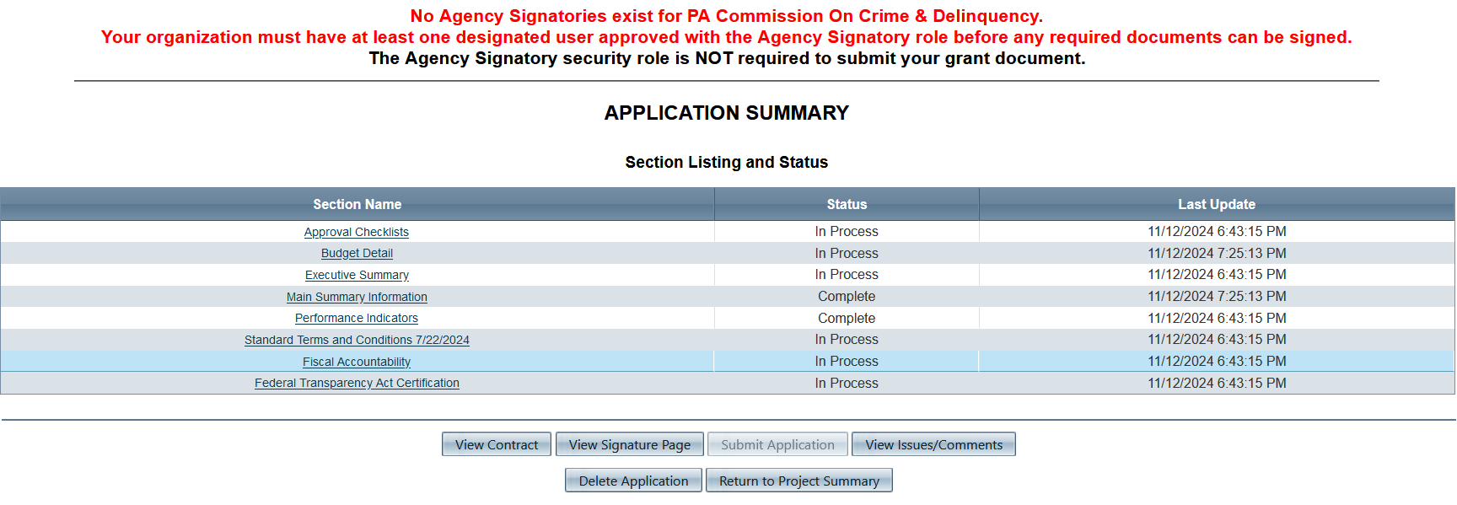
Budget Setup
On the application summary page, you will now see that the Main Summary Information section has been marked complete and you can now move on to the other sections of the grant application.
Notes:
On the application summary page, you will now see that the Main Summary Information section has been marked complete and you can now move on to the other sections of the grant application. We will take a look at the Budget Detail section to get started.

Slide 12
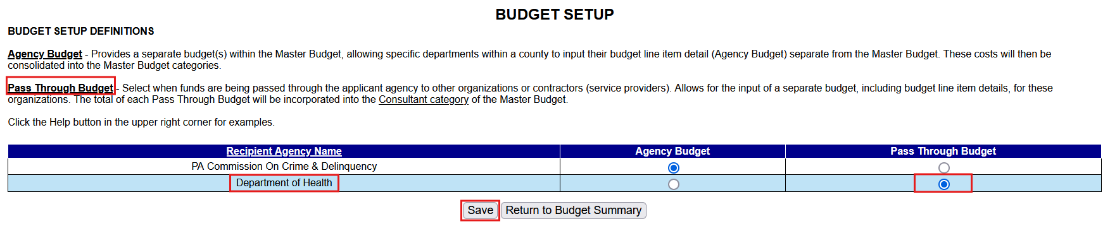
Budget Setup
If you have more than one recipient, you will select your agency as the agency budget and the entity you are passing funds to as the pass though budget. When finished click save.
Notes:
If you have more than one recipient, you will select your agency as the agency budget and the entity you are passing funds to as the pass though budget. When finished click save.

Slide 13
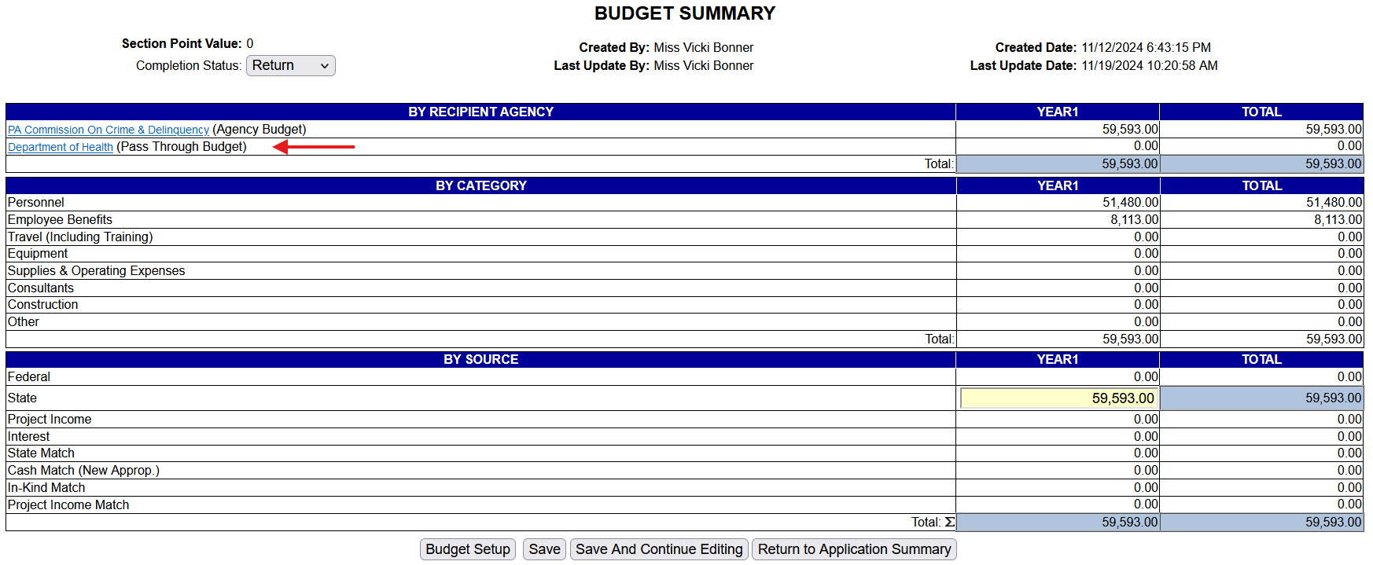
Budget Setup
You will now see on the Budget summary screen the added recipient budget.
Notes:
You will now see on the Budget summary screen the added recipient budget.

Slide 14

Creating Your Budget
For more details on creating your application budget, click on the link below.
Budget Detail Walkthrough
Notes:
For more details on creating your application budget, click on the link below.

Slide 15
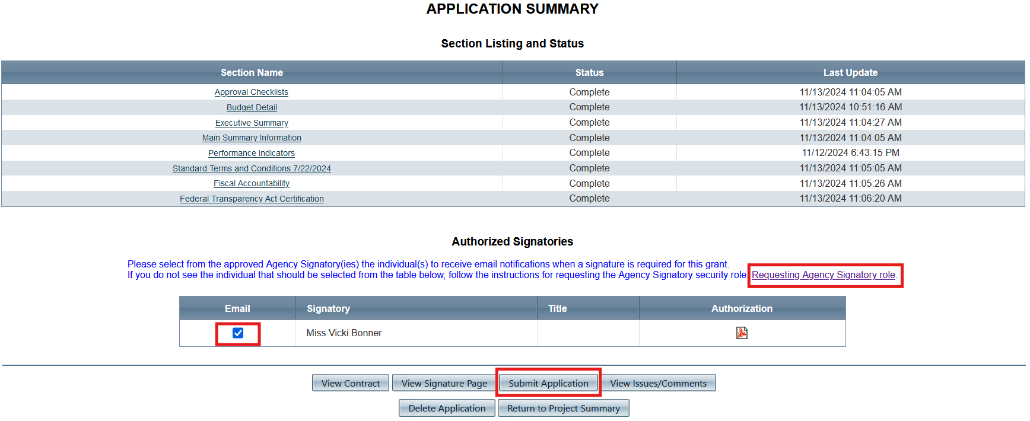
Authorized Signatories & Application Submission
You DO NOT need to have a signatory to submit the application
Click here to request Agency Signatory Role
Notes:
Prior to your grant being awarded a signatory must be assigned to your grant application. This person will need to be registered in e-grants and have a Keystone User ID and password. To request this role, you will need to click on Requesting Agency Signatory Role and follow the directions.
Once a signatory has been approved and assigned to your agency place a check mark in the box located under email, this will notify the agency signatory of all signature requests for the grant application. Once this step is complete you can click Submit Application.
Please note that you DO NOT need to have a signatory to submit the application. You will need a signatory to be awarded the grant funding.

Slide 16
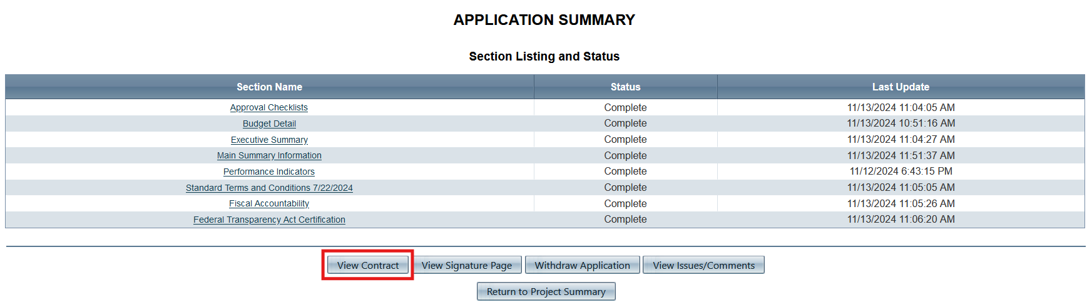
Viewing Your Application
Click here to view your application and print
Notes:
Once the application has been submitted you can view it any time by clicking on view contract from the application summary screen.

Slide 17
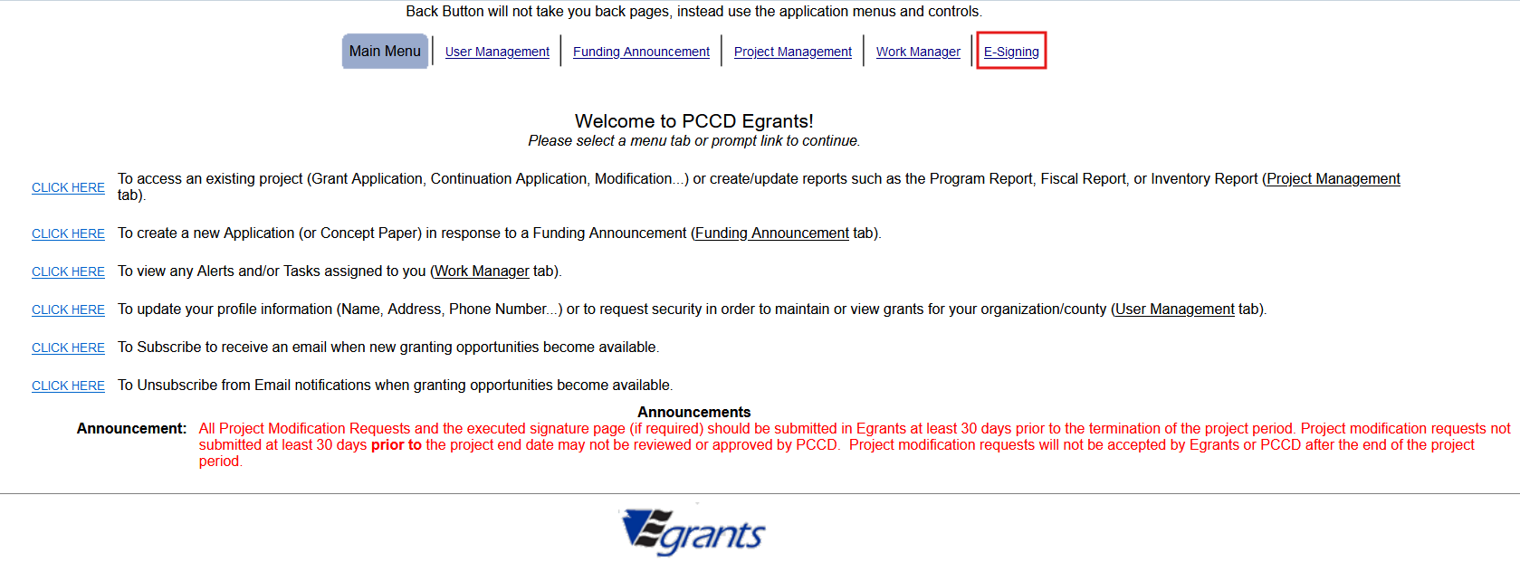
Signing your Grant Application
Click here to sign your application
How does the signatory sign the grant
Notes:
These are goals for today’s presentation.
To sign your application, click on the E-signing hyperlink at the top of the Main Menu in E-grants.

Slide 18
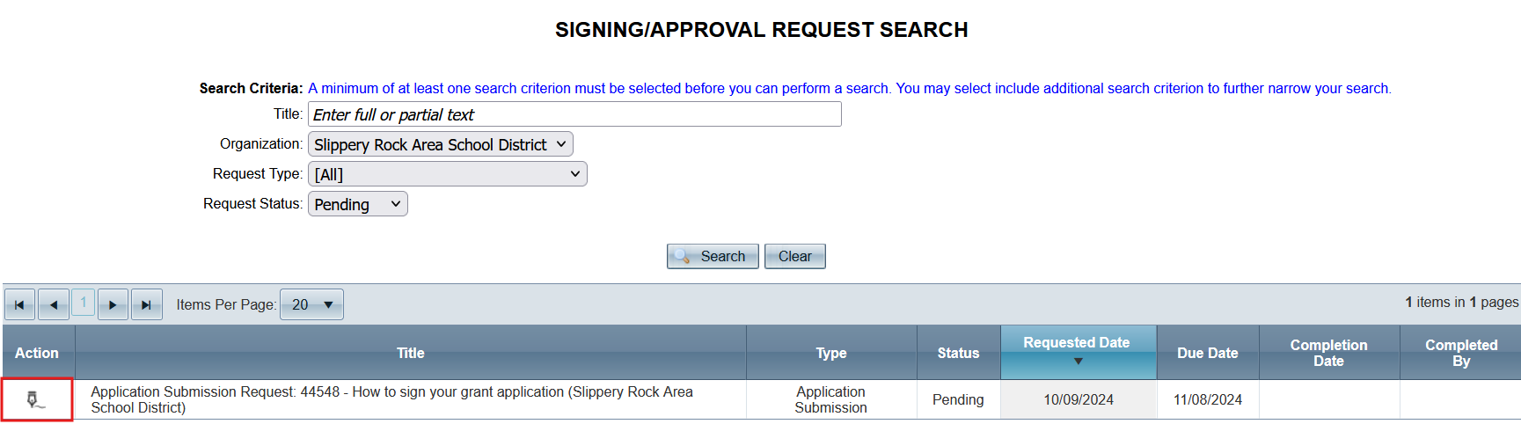
Signing Your Grant Application
Click on the pen mark. You will be directed to the Signing Request Detail Page
Notes:
These are goals for today’s presentation.
This will take you to the Signing/Approval Request Search page. From here click on the pen mark. You will be directed to the Signing Request Detail Page.

Slide 19
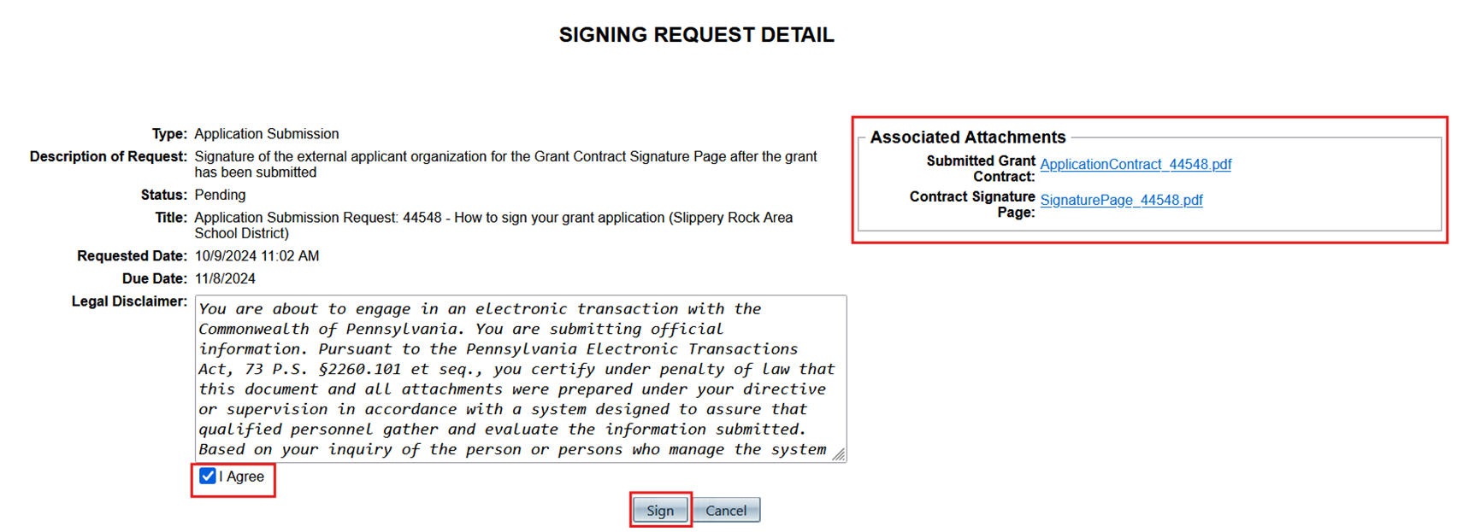
Signing Your Grant Application
Click to view application and signature page
Click “I Agree” then sign
Notes:
These are goals for today’s presentation.
From here, click on the box next to “I agree”, then click sign. You will be able to download and print/save the application signature page and grant contract by clicking on the attachments in the Associated Attachments box.

Slide 20
Additional Resources
For additional application guidance see the resources below
Executive Summary Walkthrough
Procurement Details Walkthrough
Fiscal Accountability Walkthrough
Approval Checklist Walkthrough
Federal Transparency Act section Walkthrough
Nonprofit Agency Checklist
Notes:
These are goals for today’s presentation.

Slide 21



Questions?
How does the signatory sign the grant
EGRANTS Support
Egrants Electronic Signature Access Request Instructions (PDF)​
Egrants Electronic Signature Acc​ess Request Form (PDF)​
Notes:
These are goals for today’s presentation.
If you have any questions about the signature process, please contact the PCCD Egrants Helpdesk. Or Follow the links on this slide for help with the e-signature process.

Slide 22
Thank you!

