Slide 1
MPOETC
TRAINING AND EDUCATION DIVISION
Use of Force Legal Standards Review 2026

Slide 2
Use of Force Legal Standards Review Outline
Review of the Three Levels of Police/Citizen Interactions
Sanctity of Human Life
Legally Justifiable Force
Graham vs. Conner
Tennessee vs. Garner
Commonwealth vs. Ellis
Notes:
Introduction

Slide 3
Use of Force Legal Standards Review Outline
Barnes vs. Felix
Emotional Intelligence Civil and Vicarious Liability
Duty to Intervene
Qualified Immunity
Critical Decision-Making Model/Implicit Bias
De-escalation/Do’s and Don’ts
Notes:
Introduction

Slide 4
Resource Documents
The following reference materials can be viewed within the resource instructor notes of this presentation:
Commonwealth vs. Ellis, 662 A.2d 1043, 1047 (Pa. 1995)
Title 18, P.a.C.S., §501, Definitions and §508, Use of Force in Law Enforcement
Graham vs. Connor, 490 U.S. 386 (1989)
Tennessee vs. Garner, 471 U.S. 1 (1985)
Barnes vs. Felix, 605 U.S. __ (2025)
Notes:
Com. v. Ellis :: 1995 :: Supreme Court of Pennsylvania Decisions :: Pennsylvania Case Law :: Pennsylvania Law :: U.S. Law :: Justia
Title 18 Chapter 5 Section 8 - The Official Website of the Pennsylvania General Assembly
Graham v. Connor | 490 U.S. 386 (1989) | Justia U.S. Supreme Court Center
Tennessee v. Garner | 471 U.S. 1 (1985) | Justia U.S. Supreme Court Center
23-1239 Barnes v. Felix (05/15/2025)
Other Cases:
Figueroa v. Mazza et al., No. 14-4116 (2d Cir. 2016) :: Justia
Pearson v. Callahan | 555 U.S. 223 (2009) | Justia U.S. Supreme Court Center

Slide 5



Interactions
To establish the lawful objective, the legality of the police/citizen interaction will need to be assessed by the police officer at the onset of an encounter with a citizen.
Notes:
1. Opening Frame
Today we’re locking in the legal foundation every PA officer must know cold.
Two big topics: (1) the three levels of police-citizen contact recognized in Pennsylvania, and (2) the current PA use-of-force legal standards.
If you understand these, you stay legal, you stay safe, and you stay employed.

Slide 6
Interactions
Is your contact with the citizen a…?
Mere Encounter
Investigatory Detention
Custodial Arrest
REF: Commonwealth v. Ellis, 662 A.2d 1043, 1047 (Pa. 1995)
Notes:
2. Three Levels of Interaction – Commonwealth v. Ellis (1995)
Level 1 – Mere Encounter
Level 2 – Investigatory Detention (Terry Stop)
Level 3 – Custodial Arrest
Requires probable cause
Full custodial seizure
Force justified under 18 Pa.C.S. § 508 (any force officer believes necessary to effect lawful arrest or defend self/others)

Slide 7

Mere Encounter
A mere encounter is defined as a request for information
A mere encounter does not require any level of requisite suspicion by the police officer

Slide 8

Mere Encounter
Constitutional provisions do not prohibit a law enforcement officer from approaching a citizen and:
Asking an individual to answer questions
Requesting cooperation in an investigation
Notes:
Example 1: Street Contact
An officer approaches a man standing on a sidewalk and says,
“Hey, how’s it going? Mind if I talk to you for a minute?”
The man is not blocked, no commands are given, and the officer does not activate emergency lights or retain identification. The man is free to ignore the officer and walk away.
This is a mere encounter because the contact is voluntary and non-coercive.
Example 2: Park Conversation
While on foot patrol in a public park, an officer walks up to a woman sitting on a bench and asks,
“Good evening. Have you seen anyone acting suspicious around here tonight?”
The officer’s tone is conversational, no weapons are displayed, and the officer does not instruct the woman to stay or answer questions.
This is a mere encounter because there is no show of authority or detention.
Example 3: Vehicle Contact (No Lights)
An officer parks behind a legally parked vehicle without activating emergency lights and approaches on foot, saying,
“Hi, everything okay here?”
The driver is not ordered to remain, the officer does not block the vehicle’s exit, and the driver could lawfully drive away.
This is a mere encounter because a reasonable person would feel free to leave.

Slide 9
Mere Encounter
There is no official compulsion on the part of the citizen to stop or respond.
A Law Enforcement Officer SHOULD NOT detain a citizen if the citizen refuses to produce identification during a mere encounter.
Notes:
What Officers MAY NOT Do:
If any of the following occur, it is no longer a mere encounter:
Ordering the person to stop
Blocking movement
Retaining ID
Using emergency lights/sirens
Displaying weapons in a coercive way
Using authoritative language or tone (“You must…”
Key Training Rule:
A mere encounter becomes an investigatory detention when a reasonable person would believe they are not free to leave due to police conduct or authority.
Once that threshold is crossed, reasonable suspicion is required.

Slide 10
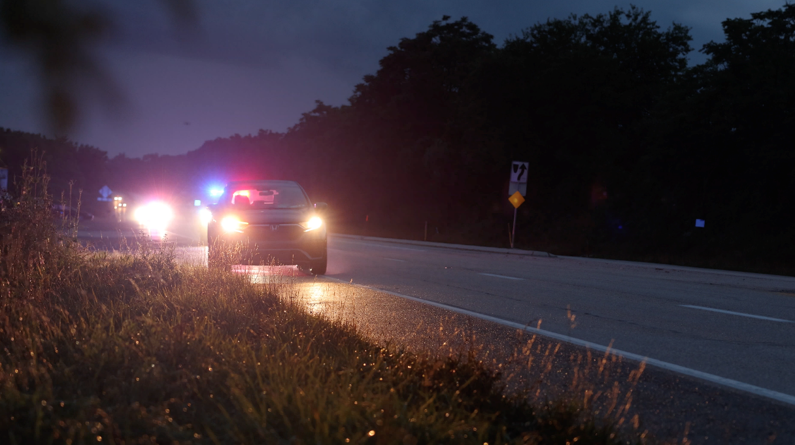
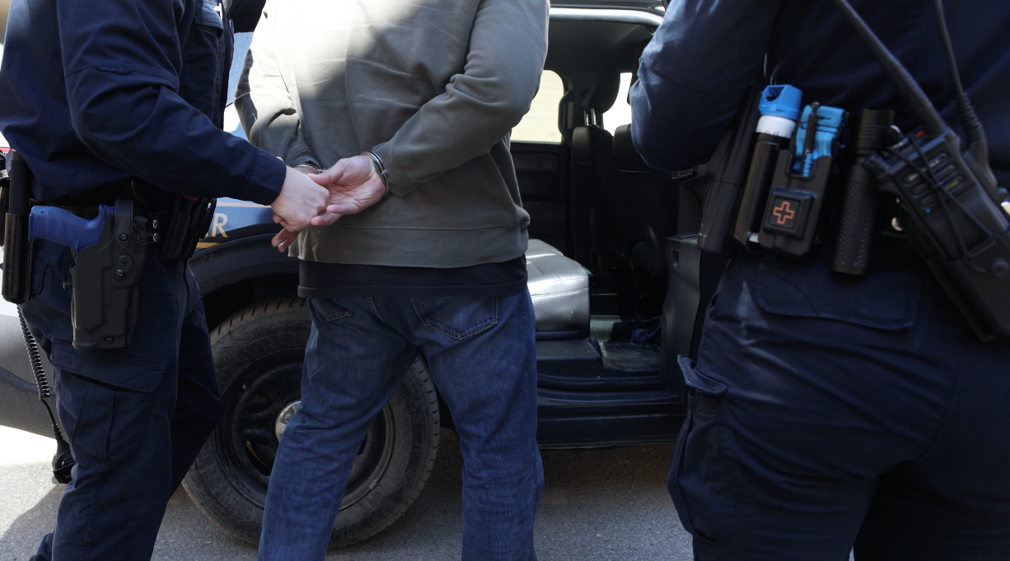
Legal Police/Citizen Interactions
A governmental deprivation of a citizen’s freedom of movement; to include custodial arrest and investigatory detention
Notes:
A reasonable person would believe they are not free to leave or terminate the encounter, based on totality of circumstances (tone, commands, number of officers, display of weapon, physical blocking, etc.).
Why This Matters on the Street
No seizure = No Fourth Amendment claim.
Seizure without legal justification = illegal seizure → evidence suppressed + civil liability.
Bottom line you teach every officer: The second you cross from “mere encounter” into restricting freedom of movement; you have seized that person. Have your justification ready.

Slide 11
Investigatory Detention
Investigatory Detention is defined as the middle ground between a mere encounter and custodial arrest
Investigatory Detention subjects an individual to a stop and period of detention; it does not however, subject an individual to such coercive conditions as to constitute the functional equivalent of an arrest
Investigatory Detention must be supported by reasonable suspicion
Notes:
Level 2 – Investigative Detention (Terry Stop)
Requires reasonable suspicion of criminal activity
Temporary, limited detention for investigation
Can frisk if specific facts suggest weapons (Terry frisk)
Must be able to articulate RS on BWC and in report
Terry v. Ohio | 392 U.S. 1 (1968) | Justia U.S. Supreme Court Center

Slide 12
Custodial Arrest
Custodial Arrest is defined as any act that indicates an intention to take the person into custody and subjects him to the actual control and will of the person making the arrest
Custodial Arrest must be supported by probable cause
Probable Cause
Probable cause exists where the facts and circumstances within the knowledge of the officer are reasonably trustworthy and sufficient to warrant a person of reasonable caution in believing that the person has committed (or is now committing) a criminal offense
Notes:
Level 3 – Arrest Requires probable cause
Full custodial seizure
Force justified under 18 Pa.C.S. § 508 (any force officer believes necessary to effect lawful arrest or defend self/others)
Probable Cause exists when the facts and circumstances within the officer’s knowledge, and of which the officer has reasonably trustworthy information, are sufficient to warrant a prudent person in believing that the suspect has committed, is committing, or is about to commit an offense.
Sources:
U.S. Supreme Court (Beck v. Ohio, 1964; Illinois v. Gates, 1983 – totality of the circumstances)
Pennsylvania (Commonwealth v. Thompson, 985 A.2d 928 (Pa. 2009))

Slide 13
Legally Justified
U.S. CONSTITUTION.
4TH Amendment.
Article 1 Section 8 of the PA Constitution
…to be free from the use of excessive force….
Notes:
The Fourth Amendment to the U.S. Constitution, as interpreted by the U.S. Supreme Court, forms the basis for constitutional standards concerning detention and arrest.
The Fourth Amendment states that people have a right “to be secure in their persons, houses, papers and effects, against unreasonable searches and seizures.” This right limits the power of the police to seize people.
Courts have held that the lawful powers of police “necessarily” include “the right to use some degree of physical coercion or threat…”; however, the Fourth Amendment also protects the “right to be free from the use of excessive force in the course of an arrest.” Officers should only use the amount of force necessary to mitigate an incident, make an arrest, or protect themselves or others from harm.
State statutes also define the authority of officers to arrest with or without warrants and further define what force can be used in the course of an arrest or a police encounter; but these statutes cannot grant authority that conflicts with the rights guaranteed by the Constitution.
Why It Matters More Than the 4th Amendment in PA (2025)
Pennsylvania courts interpret Article I, § 8 more protectively than the U.S. Constitution’s 4th Amendment (Commonwealth v. Edmunds, 1991 – still the law).
PA rejected the federal “good-faith exception” to the exclusionary rule — if you violate Article I, § 8, evidence gets suppressed even if you made an honest mistake on a warrant.
PA requires greater justification for warrantless searches in many contexts (e.g., vehicle searches, plain smell of marijuana no longer = automatic PC after Commonwealth v. Barr, 2021).

Slide 14
Proportionality:
Legally Justified & Ethically Justified
Legally Justified:,
Justification of force used through application of Federal & State laws for the given circumstances.
Ethically Justified:,
Reasonable application of force used with conscious thought & concern given to the circumstances.
Notes:
In the Police Academy we are first taught the law. Statutes (laws) found in Title 18, the Crimes Code and Title 75, the Vehicle Code are taught adnauseam. Young officers are well versed in the elements of a given crime. They learn how to show proof that a crime was committed and that a person knowingly intended to commit that crime. These are the basics of a justified arrest.
However, people are involved; therefore, no arrest is as simplified as the elements of a crime and intent to commit that crime. If we truly care about the people we serve, we also seek to ensure that we use appropriate actions in carrying out the arrest of that person. We must put our own egos aside and determine if we can carry out the arrest process in such a way as to honor the law and honor the person we are arresting.
Academy cadets just begin to learn discretion and appropriate use of force toward the end of their Academy experience. Their real education in use of discretion and taking appropriate actions when making an arrest will be learned during their Field Training on the streets.
Let’s review some fundamental legal use of force concepts and then discuss the impact of combining that information with the proportionality of taking an ethically justified approach to that same circumstance and what that means.

Slide 15

Sanctity of Human Life
The need for law enforcement to protect themselves, members of the public, and, whenever possible, criminal suspects and subjects in crisis from danger and harm.
Notes:
The very core of our duty is to preserve life and protect those who cannot protect themselves.
We must preserve the sanctity of human life for all we serve, INCLUDING criminal suspects. If nothing else, this should guide our final actions.
The bottom-line, we want to make sure that EVERYONE goes home at the end of the day.
Next, we will discuss use of force in terms of what would be legally justified proportional to what is ethically justified in a given situation.

Slide 16
Legal Authority
Peace officers are authorized to use force when they reasonably believe it necessary to:
Protect themselves and others from injury or death
Overcome resistance while making a lawful arrest
Prevent the escape of a subject from custody
Prevent a Subject from committing suicide
Prevent a Subject from committing a crime
Notes:
Core Rule (memorize this): A Pennsylvania peace officer is justified in using any force the officer reasonably believes is necessary in these five situations:
Protect Themselves or Others from Bodily Harm or Death
Covers both non-deadly and deadly force
Primary self-defense / defense-of-others justification
Graham factor #2 (immediate threat) lives here
Overcome Resistance While Making a Lawful Arrest
The arrest itself must be lawful (PC required)
Officer need not retreat (§ 508(a)(1))
Any force the officer believes necessary — no “continuum” in PA statute
Prevent Escape from Lawful Custody
Includes escape from lawful Terry stop or full arrest
Deadly force only under Garner/§ 508 (c) deadly-force rules (forcible felony + weapon/imminent danger)
Prevent Suicide or Serious Self-Harm
Recognized under PA case law § 508 (d)
Treated as defense-of-others (the “other” is the subject)
Example: wrestling a gun away from a suicidal person
Prevent Commission of a Crime
Narrower than the first four
Usually limited to forcible felonies or crimes creating imminent danger
Example: tackling a subject swinging a bat at a crowd
Critical 2025 Caveats You Must Teach
All five require the officer’s belief to be objectively reasonable (Graham v. Connor + Barnes v. Felix)
Deadly force is never justified solely to prevent escape unless Garner/§ 508 deadly-force box is checked
BWC articulation is mandatory: “Using force under § 508 to overcome resistance to lawful arrest” or “to protect from imminent serious injury”

Slide 17
Criminal Justification
Points of Emphasis
Law Enforcement Officers have no duty to retreat when confronted by resistance or threatened resistance while effectuating a lawful arrest
Law Enforcement Officers are authorized to use necessary force to effectuate a lawful arrest
Law Enforcement Officers will generally be authorized to use necessary less-lethal force options to overcome resistance likely to result in bodily injury
Notes:
No Duty to Retreat – The Pennsylvania Rule
When you are making a lawful arrest, you need not retreat or desist because of resistance or threatened resistance.
Full stop. No backing up, no “give them space,” no disengaging just because the subject fights or threatens to fight.
This is one of the strongest statutory protections in the country — use it, know it, quote it on BWC
.
2. Authorized to Use “Necessary” Force
You are justified in using any force you reasonably believe to be necessary to: – Effect the lawful arrest – Defend yourself or another from bodily harm while making the arrest
“Any force” means exactly that — hands-on, taser, baton, OC, strikes — whatever you believe is required.
3. Less-Lethal Force Against Injury-Causing Resistance
When resistance is likely to result in bodily injury to you, another officer, or a third party, you are generally authorized to use less-lethal options (taser, strikes, takedowns, etc.) to overcome it.
Example phrases for BWC: – “Subject actively resisting lawful arrest by pulling away and swinging — deploying taser under § 508 to overcome resistance likely to cause injury.” – “No retreat required under Pennsylvania law — using necessary force to complete lawful arrest.”
Bottom-line mantra every PA officer repeats: “Lawful arrest + resistance = I don’t retreat, and I use whatever force I reasonably believe is necessary. Period.”

Slide 18
Graham v. Connor, 490 U.S. 386 (1989)
Reasonableness must be judged from the perspective of a reasonable officer on the scene:
Seriousness of the offense
Immediate threat to the officer or others
Resisting a lawful arrest
Fleeing a lawful arrest
Notes:
Key points in Graham vs. Connor
Established the “objective reasonableness” standard.
Is the officer’s use of force OBJECTIVELY appropriate?
“Objective” refers to what a reasonably prudent and well-trained officer believes would be acceptable under a similar set of facts and circumstance.
What an officer “knows” is critical in determining the appropriateness of an officer’s force.
Was there a need for the amount of force used in relationship to the injury incurred by the suspect?
Was the force applied in good faith or maliciously and sadistically?
“Reasonably prudent and well-trained officer” means that officer MUST know the law—whether in fact, he/she does or not. The officer must know the acceptable, and unacceptable limits of the law.
Determined that the “reasonableness” of a seizure requires a balancing of the nature of an individual’s Fourth Amendment interests against the countervailing governmental interests at stake.
The “reasonableness” of a particular use of force must be judged from the perspective of a reasonable officer on the scene, rather than with the 20/20 vision of hindsight. Officers must often make split-second judgments in tense, uncertain, and rapidly evolving situations. It is not fair to the officer to be judged in the sanctity of a judge’s chambers, months after the incident, with more information than the officer had at the time of the incident.
Established a non-exhaustive list of factors, now known as the “Graham Factors” which help to determine the severity of the crime at issue.
Seriousness of the crime
Suspect posed an immediate threat of safety to the officer or others
Active resistance
Actively trying to evade arrest by “flight”
S.I.R.F
The reasonable officer uses his/her brain to not only determine if their use of force is justified; but necessary for the circumstances. Was it ok to beat up a diabetic man seeking help – NO!

Slide 19
Seriousness of the Offense
Criminal offense/non-criminal call for service
Consider governmental interest and the need to use force to apprehend
Courts will often distinguish severity based upon the actual or likely degree of violence, danger, and injury associated with the incident
Example: Aggravated Assault vs. Mental Health Commitment or Medical Emergency
Notes:
The first Graham factor — seriousness or severity of the crime or nature of the call — is where every federal and Pennsylvania court begins when judging whether force was objectively reasonable.
Officers must immediately “bucket the incident” as either a criminal offense (with real or likely violence, danger, or injury) or a non-criminal/welfare call (mental health crisis, medical emergency, 302, overdose, welfare check).
Governmental interest in apprehension and control scales directly with severity: an armed aggravated assault or robbery in progress carries a strong interest justifying significant force, while a suicidal subject with no victims or a diabetic episode carries little to no interest in arrest and almost never justifies hands-on or less-lethal force.
Courts routinely distinguish high-severity calls (felony crimes involving weapons or injury) from low/no-severity calls (mental health commitments, medical emergencies, or simple welfare checks) and hammer officers who treat the latter like the former.
Real-world example: using a takedown or taser on an unarmed, non-violent 302 subject frequently results in excessive-force findings and large settlements, whereas the same force against an active aggravated-assault suspect is routinely upheld.
Bottom line: the call type writes the first sentence of the judge’s opinion — articulate the bucket and the corresponding governmental interest on body-worn camera before you ever touch, tase, or strike.

Slide 20
Immediate Threat to the Officer or Others
Whether the Subject poses an Immediate Threat to the Safety of Law Enforcement Officers or Others
Officer/offender size and ability
Pre-Assault indicators
Weapons available
Number of officers vs. number of offenders
Environmental conditions
Officer/subject disabilities
Notes:
Graham Factor #2 — whether the subject poses an immediate threat to the safety of officers or others — is the single most heavily weighted factor in virtually every excessive-force case and is often decisive for both deadly and less-lethal force decisions. Courts in 2025 demand that officers articulate specific, observable facts showing an immediate threat at the exact moment force is used; vague statements like “I feared for my safety” are no longer enough.
Officers must instantly evaluate and verbalize on BWC the following sub-factors: size/ability disparity between officer and subject, pre-assault indicators (blading, target glance, clenched fists, removing clothing), visible or reachable weapons, number of officers vs. number of subjects, environmental conditions (confined space, icy ground, inside vehicle, edged-weapon distance), and any known or apparent disabilities that raise or lower the threat level.
A threat is only “immediate” when a reasonable officer on scene would believe death or serious bodily injury is about to happen right now — not “maybe later” or “he looked scary.”
Bottom line: if you cannot list at least two of these sub-factors on body-worn camera in real time, the court will almost certainly rule there was no immediate threat, and any significant force (taser, strikes, takedown, or firearm) will be deemed objectively unreasonable.

Slide 21
Resisting a Lawful Arrest
Whether the Subject is Actively Resisting Arrest or Attempting to Evade Arrest by Flight
Law Enforcement Officers should consider the nature of any resistance and/or flight
Resistance Considerations
Legal authority to overcome resistance
Passive vs. Active Resistance
Likely injury or danger to result from resistance
Notes:
Graham Factor #3 — whether the subject is actively resisting a lawful arrest or attempting to evade by flight — is the factor that most often determines whether hands-on or less-lethal force survives judicial scrutiny in Pennsylvania courts in 2025. Courts demand that officers distinguish the nature and intensity of resistance in real time; treating passive resistance (going limp, refusing verbal commands, dead-weight noncompliance) the same as active resistance (pulling away, pushing, striking, kicking) is one of the fastest ways to lose qualified immunity and generate a six- or seven-figure settlement.
Passive resistance generally justifies only minimal control techniques (escort holds, pain compliance, soft empty-hand); deploying a taser, strikes, or hard takedown on purely passive behavior is routinely ruled excessive.
Active resistance that creates a realistic risk of injury to officers or others justifies proportionate less-lethal force under 18 Pa.C.S. § 508; assaultive/deadly resistance justifies any force the officer reasonably believes necessary, including deadly force.
Flight alone can constitute active evasion, authorizing reasonable force to stop it, but deadly force for flight is almost never justified unless the Garner/§ 508 deadly-force requirements (forcible felony + weapon or imminent danger) are fully met.
Bottom line: officers must accurately label the resistance as passive, active, or assaultive on body-worn camera and match force precisely to that label — mischaracterizing passive resistance as active (or failing to articulate the difference) is the single most common reason Pennsylvania agencies lose excessive-force cases today.

Slide 22
Fleeing a Lawful Arrest
Whether the Subject is Actively Resisting Arrest or Attempting to Evade Arrest by Flight
Law Enforcement Officers should consider the nature of any resistance and/or flight
Flight Considerations
Seriousness of the offense
Danger posed if not captured
Ability to ID offender at a later date
Notes:
Graham Factor (additional considerations) — whether the subject is actively resisting a lawful arrest or attempting to evade arrest by flight — operates as two distinct prongs in 2025 Pennsylvania courts; officers must identify and articulate which prong (or both) applies at the exact moment force is used.
The resistance prong hinges on the nature and intensity of the resistance: passive resistance (going limp, verbal refusal, dead-weight noncompliance) justifies only minimal control techniques, while active resistance (pulling away, pushing, striking, kicking) authorizes proportionate less-lethal force under § 508, and assaultive/deadly resistance justifies any force the officer reasonably believes necessary.
The flight prong requires officers to instantly weigh three specific considerations on body-worn camera: (1) seriousness of the offense (felony violent crime vs. summary citation), (2) danger posed to the public if the subject is not captured immediately, and (3) ability to identify and apprehend the subject later (known identity, fixed address, license plate captured).
Mislabeling passive resistance as active or pursuing low-level, non-dangerous runners when identification is already secured is one of the fastest ways to lose qualified immunity.
Bottom line: every Pennsylvania officer must accurately label the resistance or flight prong and explicitly articulate the supporting facts on BWC — failure to do so hands the plaintiff’s attorney the winning argument in federal court.

Slide 23
Tennessee v. Garner, 471 U.S. 1 (1985)
Deadly force is considered a seizure under the 4th Amendment
A police officer may not seize an unarmed, non-dangerous person by shooting him dead
An officer can justifiably use deadly force if the officer believes that a suspect poses a significant threat of death or serious bodily injury to the officer or others
Notes:
Key points in Tennessee vs. Garner:
Deadly force is considered a seizure under the 4th Amendment.
A police officer may not seize an unarmed, non-dangerous person by shooting him dead.
An officer can justifiably use deadly force if the officer believes that a suspect poses a significant threat of death or serious bodily injury to the officer or others.
Deadly force may still be used when the suspect threatens the officer with a weapon, or there is probable cause to believe the suspect has committed a crime involving the infliction or threatened infliction of serious physical harm. Deadly force may be used to prevent escape in this instance and, where feasible, a warning should be given.
At the time of this incident in 1974 – the law in Tennessee and the policies of the Memphis Police Department stated that Officer Elton Hymon could use deadly force to stop a fleeing felon (armed or not). The officer’s actions were deemed to be justified; however, the court decided that this was not the “appropriate” use of force given the fact that the 15-year-old suspect was unarmed.

Slide 24
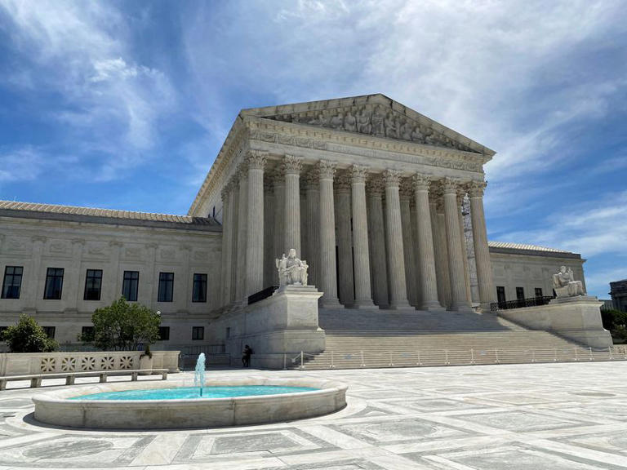
Recent SCOTUS Decision
The following section addresses the opinion rendered by the U.S. Supreme Court in May 2025 on Barnes v. Felix.
Notes:
Barnes v. Felix, decided unanimously by the U.S. Supreme Court on May 15, 2025, reaffirmed the "totality of the circumstances" standard for evaluating Fourth Amendment excessive force claims, rejecting the Fifth Circuit's "moment-of-threat" doctrine that limited analysis to the instant of force deployment.
The case arose from a 2016 traffic stop in Houston, Texas, where Harris County Constable Roberto Felix Jr. fatally shot 24-year-old Ashtian Barnes after Barnes, pulled over for an unpaid toll, began driving away with Felix partially on the vehicle's doorsill. Barnes' mother sued Felix and Harris County under 42 U.S.C. § 1983, alleging excessive force. Lower courts granted summary judgment to Felix, applying the "moment-of-threat" rule—focusing solely on the two seconds before the shots—ignoring Felix's actions leading up to the shooting.
Justice Kagan, writing for the Court, vacated the ruling, holding that excessive force must be assessed under the full context of events, including prior officer conduct that may create the danger necessitating force, consistent with Graham v. Connor (1989) and County of Los Angeles v. Mendez (2017).
The decision remanded for reconsideration, emphasizing that "no rule that precludes consideration of prior events... is reconcilable with the fact-dependent and context-sensitive approach" to reasonableness. This ruling standardizes analysis nationwide, ensuring courts cannot "put on chronological blinders" and bolsters accountability by factoring in officer-created risks.
An incident involving an active shooter demonstrates a high level of exigency as the continued action of the subject represents the threat of serious bodily injury and/or death to others. The exigency is predicated on the threat to others.
An incident involving a suicidal subject alone in a residence presenting no threat to others, while exigent, presents a unique challenge for a police response. In this case the exigency is contingent on a threat to self and no one else.
In a case like this, an officer could find themselves in a claim of “officer-created jeopardy” if the situation ends in the police using deadly force to control the subject and their conduct appears driven by a reckless rushed approach, rather than a strategy meant to stabilize the encounter through use of time, distance, cover, etc.
While nothing should prevent an officer from using force to protect themselves and others in the performance of their duties, officers should constantly assess the exigency of a situation and their legal authority when taking police actions.

Slide 25
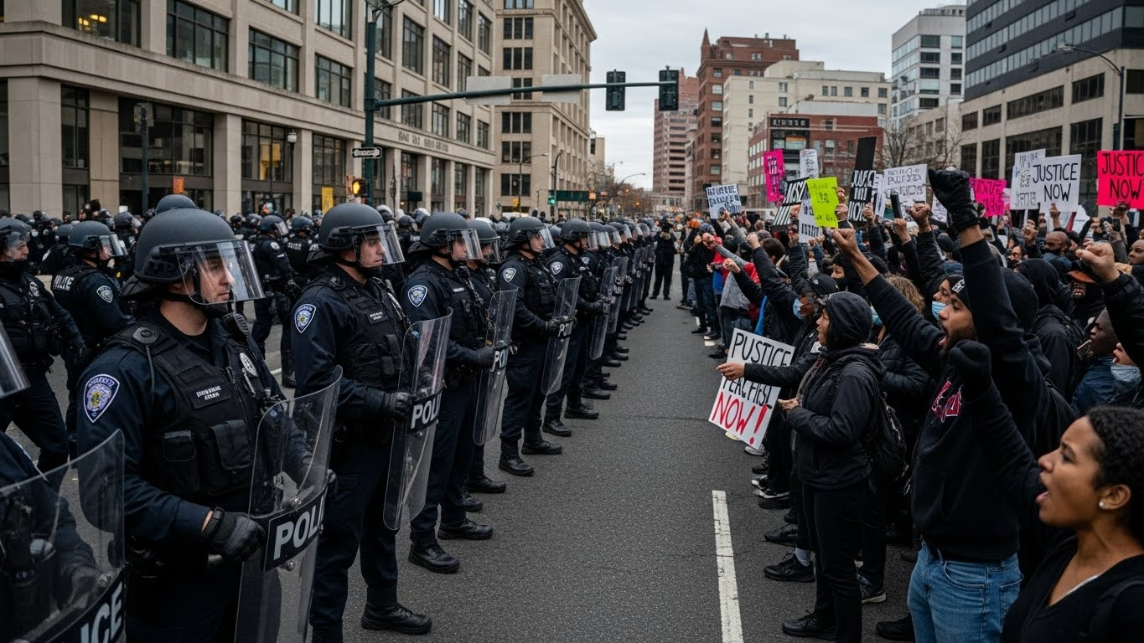

Ethically Justified
The conscious consideration of circumstances surrounding
the situation at hand.
Notes:
What criteria should officers take into consideration as they are making the decision as to what actions they are going to take when making the arrest?
Tactical legitimacy tells us that all tactical police actions are guided by the severity of the crime as well as the subject’s own actions. Officers should strive to not escalate a situation unnecessarily.
Once those criteria are met, how do officers determine if the force that they plan to use is ethically “appropriate” for the situation at hand?
What information should officers take into consideration to determine if their force is appropriate or not?

Slide 26
Emotional Intelligence
Self Awareness
Self Management
Social Awareness
Relationship Management
Notes:
Key to achieving an appropriate use of force response is to remember we are dealing with people and so, we need to humanize the situation.
One way to realize that goal is to utilize “Emotional Intelligence”. Emotional Intelligence is the ability, capacity, or skill to perceive, assess, and manage the emotions of oneself, of others, and of groups.
There are four components of emotional intelligence we can apply when interacting with people. They are:
Self-Awareness: It is the ability to understand your own emotions and their effects on your performance. You know what you are feeling and why – and how it helps or hurts what you are trying to do. It can help guide your decision-making process and prevent you from getting swept-up by emotions which seem to arise out of thin air. It’s an essential element to keep your feet on the ground and stay confident.
Self-Management: Managing your emotional reactions to situations and people. Being able to control impulsive feelings and behaviors, manage your emotions in healthy ways, take initiative, follow through on commitments, and adapt to changing circumstances.
Social Awareness: It is the ability to recognize and understand the moods of other individuals and entire groups of people. It’s the ability to observe body language, facial expressions, and even posture in an effort to respond appropriately. Listening and observing are the most important elements.
Relationship Management: Ability to use your awareness of your own emotions and those of others to manage interactions successfully. This ensures clear communication and effective handling of conflict.

Slide 27
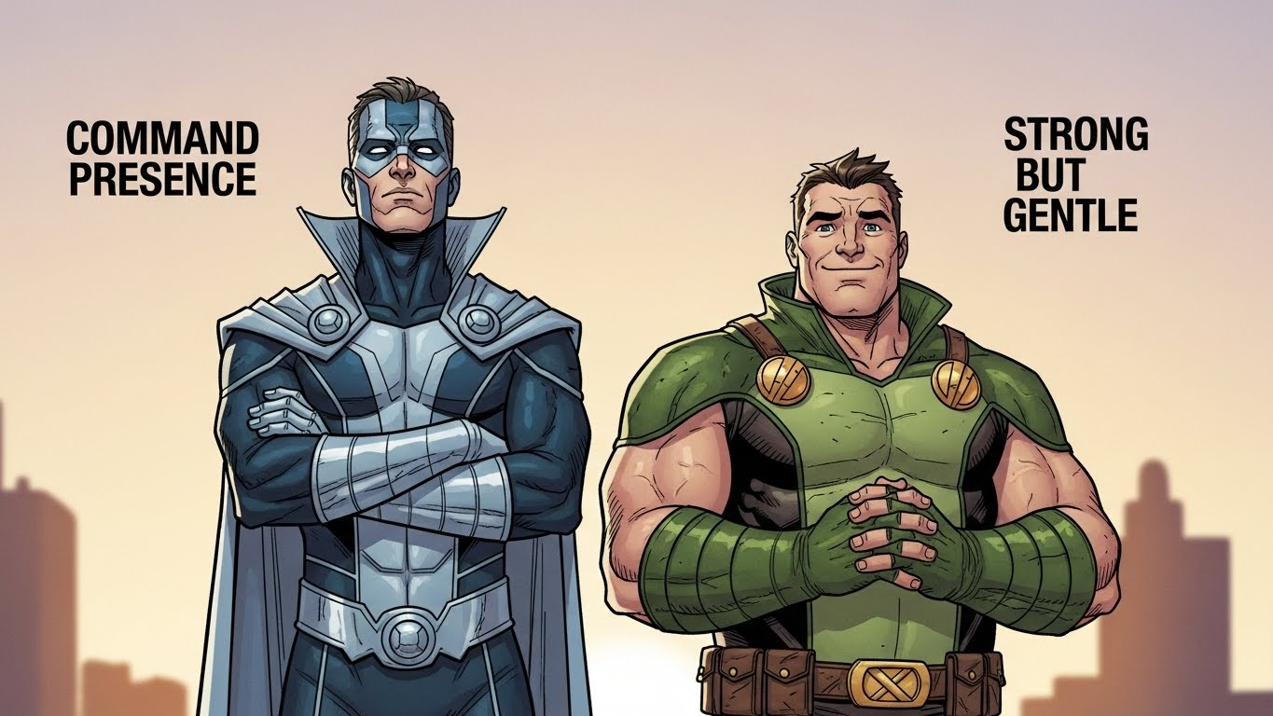
Contact Maturity
What’s really going on here?
What’s going on internally with the person?
Avoid authoritarian action.
Notes:
Another idea that helps us determine if we are taking appropriate action, in a given situation, is a concept refer to as “contact maturity.” This concept is the tactical version of emotional intelligence, which we just discussed in the previous slide.
Contact maturity means that an officer needs to take the current situation into context. What’s really going on here?
Officers need to have the insight to recognize the big picture.
Acknowledge that certain behaviors may not actually be resistance.
Try to determine what’s going on internally with this person.
Given the person’s frame of mind, as long as the person isn’t harming themselves or others, can you let the person vent or just leave?
Look to avoid authoritarian action.
Work towards stabilizing the situation.
Command presence – one of the most important tools an officer has, because if you can’t project strength and authority, you’ll put yourself at risk. Yet, there are times when cops must convey gentleness and kindness. “It all comes down to – what kind of person do you want to be? Small people seek revenge. When they’re hurt, they want to get even. Big people take the moral high ground. They forgive. They treat others the way they’d like to be treated.” Chief John P. Weiss, 2020

Slide 28
Civil Liability
Title 42 US Code § 1983
Facts to be proven in a civil action:
The defendant had a duty;
The defendant breached that duty;
There was a causal connection between the breach of the duty and the injury; and
The injury to the plaintiff resulted from that breach.
Notes:
For law enforcement, the impact of being legally and ethically justified to act in a given situation is most visible in civil law. In the next few slides, we will discuss some concepts that have developed in civil law over time and punctuate those changes with two of the most important decisions rendered by the courts relating to an officer’s justified use of force and what the courts determined as the appropriate force that should have been used (Tennessee vs Garner and Graham vs Connor).
The civil rights statute that provides civil remedies for official misconduct was enacted by Congress in 1871 and now is codified as Title 42 US Code subsection 1983 (commonly referred to as Section 1983 actions or a 1983 suit).
In a civil action initiated against the defendant, the plaintiff bringing the action against the defendant must prove that:
The defendant had a duty;
The defendant breached that duty;
There was a causal connection between the breach of the duty and the injury; and
The injury to the plaintiff resulted from that breach.
Example: Imagine a police officer responds to a domestic disturbance call in a high-crime neighborhood. The subject, a 28-year-old man with no weapons visible, is arguing loudly with his partner but complies with initial commands to step outside. However, the officer—citing prior radio reports of the man being "aggressive"—immediately tackles him to the ground without further assessment or de-escalation attempts, resulting in the man suffering a fractured arm and concussion. The man's family sues the officer and the city under 42 U.S.C. § 1983, alleging a Fourth Amendment violation for excessive force.
In court, the plaintiff argues the force was disproportionate under Graham v. Connor (1989), as the situation involved a misdemeanor dispute with no immediate threat, active resistance, or flight. The officer claims qualified immunity, but the judge denies it, citing Barnes v. Felix (2025), which requires considering the full "totality of circumstances"—including the officer's failure to create time/distance or verbalize options. The city settles for $750,000, with the officer facing internal discipline.

Slide 29
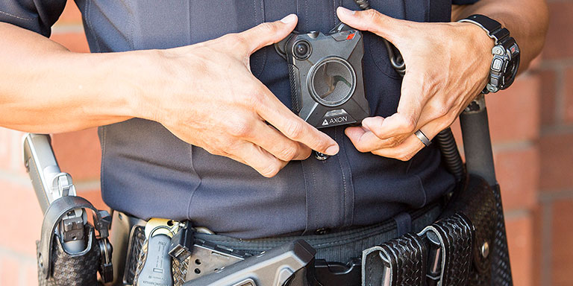
Vicarious Liability
Vicarious liability is a situation in which one party is held partly responsible for the unlawful actions of a third party.
Notes:
A form of secondary liability that arises out of the concept that there is a relationship/ responsibility between a supervisor, administrator, or agency and an officer, in which the supervisor, administrator, or agency has a ‘right, ability or duty to control’ the activities of the officer. Generally, when the conduct of the officer is so closely connected in time, place, and causation that it is regarded as a risk of harm fairly attributable to the supervisor, administration, or agency, those entities can also be held liable.
Basically, vicarious liability is a situation in which one party is held partly responsible for the unlawful actions of a third party.
The law has developed the view that some relationships by their very nature require the person who engages others to accept responsibility for the wrongdoings of those others.
Example:
Two police officers are on duty and assigned to patrol together. During a lawful traffic stop, Officer Johnson uses excessive force against the driver that is not justified under department policy or law. Officer Taylor does not participate in the force but is present, observes the conduct, and fails to intervene despite having the opportunity to do so. As a result of Officer Johnson’s actions, the driver is injured and files a civil lawsuit.
Outcome:
The municipality may be held vicariously liable for Officer Johnson's actions because the conduct occurred within the scope of employment.
Officer Taylor may face individual liability for failure to intervene.
The department may also face policy, training, or supervision claims.
Key Points:
Vicarious liability attaches when:
The officer was on duty
Acting within the scope of employment
The act occurred during an official police function
The employer (municipality) may be responsible even if it did not authorize the misconduct.
Separate from direct liability (e.g., negligent training or supervision).

Slide 30
Duty to Intervene
“
A police officer is under a duty to intercede and prevent fellow officers from subjecting a citizen to excessive force, and may be held liable for his failure to do so if he observes the use of force and has sufficient time to act to prevent it.
”
Figueroa v. Mazza 825 F.3d 89, 106 (2d Cir. 2016)
Notes:
Based on United States Court of Appeals, Second Circuit. Jun 3, 2016 - “A police officer is under a duty to intercede and prevent fellow officers from subjecting a citizen to excessive force, and may be held liable for his failure to do so if he observes the use of force and has sufficient time to act to prevent it” Figueroa v. Mazza, 825 F.3d 89, 106 (2d Cir. 2016)
A police officer cannot be held liable, if he/she does not have a realistic opportunity to prevent the attack.
Law enforcement as a whole is judged (whether fair or not) by the inappropriate actions of the few.
Sometimes it is necessary to step in and take action when an officer or officers are not showing “contact maturity” or using “emotional intelligence” in a given situation.
Example:
Two uniformed police officers respond to a disturbance call. During the encounter, Officer Miller places a handcuffed subject against a wall. The subject is compliant and no longer resisting. Despite this, Officer Adams strikes the subject several times in the torso.
Officer Miller is present, observes the strikes, recognizes that the force is no longer justified, and has a reasonable opportunity to intervene. Officer Miller fails to take any action to stop the force, such as issuing a verbal command, physically separating Officer Adams from the subject, or calling for a supervisor.
Outcome:
Officer Adams may be liable for use of excessive force.
Officer Miller may be liable for failure to intervene, even though Officer Miller did not personally use force.
The department may face civil liability and policy violations.
Key Training Points
Duty to intervene applies when an officer:
Observes or knows another officer is using unlawful or excessive force
Has a realistic opportunity to prevent or stop it
Intervention can be:
Verbal (“That’s enough—he’s compliant.”)
Physical (separating officers, controlling hands)
Procedural (calling a supervisor, activating body-worn camera, documenting)

Slide 31
Qualified Immunity
Protects a government official from lawsuits alleging that the official violated a plaintiff's rights, only allowing suits where officials violated a “clearly established” statutory or constitutional right.
Notes:
31
Qualified immunity is considered a defense.
Qualified immunity protects a government official from lawsuits alleging that the official violated a plaintiff’s rights, only allowing suits where officials violated a “clearly established” statutory or constitutional right.
Qualified immunity is a type of legal immunity. “Qualified immunity balances two important interests—the need to hold public officials accountable when they exercise power irresponsibly and the need to shield officials from harassment, distraction, and liability when they perform their duties reasonably.”
Person v. Callahan (555 U.S. 223, 2009).
Qualified immunity only applies to suits against government officials as individuals, not suits against the government for damages caused by the officials’ actions. Although qualified immunity frequently appears in cases involving police officers, it also applies to most other executive branch officials. While judges, prosecutors, legislators, and some other government officials do not receive qualified immunity, most are protected by other immunity doctrines.
Qualified immunity has been the topic of much public debate since the summer of 2020. If this legal protection is removed, the landscape of law enforcement will be forever changed.
How does Qualified Immunity work in the real world?
Courts generally ask:
Was a constitutional right violated?
Was that right “clearly established” at the time of the conduct?
If the answer to either question is no, the officer is entitled to qualified immunity.
What “Clearly Established” Means
Existing case law must put the unlawfulness of the conduct beyond debate
Officers must have fair notice their actions were unconstitutional
The facts do not need to be identical, but they must be sufficiently similar
What Qualified Immunity Does Not Do
It does not protect criminal conduct
It does not prevent internal discipline
It does not apply if the law was clearly established
It does not stop a lawsuit from being filed—it can end it early

Slide 32
Review Department Policy
Does your department have a current use of force policy?
Does your department have current arrest policies?
What actions are acceptable?
What actions are unacceptable?
Are ALL officers aware of and familiar with these policies?
Notes:
Take the time now to review your department’s policies. This includes, use of force and arrest. You should be able to answer the following questions regarding your department policies:
What actions are acceptable?
What actions are unacceptable?
Are ALL officers aware of and familiar with these policies?

Slide 33
Critical Decision-Making Model (CDM)
Collect information
Collect information
Assess situation, threats & risks
Consider police powers & agency policy
Identify options & determine best course of action
Act, review & re-assess
Act, review, & re-assess
Assess the situation, threats, & risks
ETHICS
VALUES
PROPORTIONALITY
SANCTITY OF HUMAN LIFE
Identify options & determine the best course of action
Consider police powers & agency policy
Notes:
We have seen this model in previous MIST courses. It continues to be a valuable tool that we can use every day.
At the center of the CDM is an ethical core that provides grounding and guidance for the entire process of using the CDM. In PERF’s CDM, there are four elements that guide decision-making:
• Police ethics
• The values of the police agency
• Proportionality
• The sanctity of human life
The CDM has 5 steps. It is a circular process, not a linear one. It is important to note that Step 5 is “Act, review, and re-assess.” In other words, if the officer takes action but finds that the action does not resolve the situation, the officer restarts the process. Furthermore, officers may move to any step as needed, as the situation changes. This is sometimes called “spinning the wheel.”
We should be utilizing this tool on every call. By providing a structure for critical thinking, the CDM helps officers to organize their decision-making process and reach better decisions. Officers sometimes say, “I didn’t have time to think” in a critical situation, but in many situations, that is not the case. Rather, the problem was that the officers had not received guidance on the key questions to ask themselves in a critical situation.
The CDM not only helps officers to make better decisions; it also helps officers to explain their actions after the fact.
An officer who is accustomed to using the CDM will be able to recall and explain his thought processes:
“First, I collected the following information about the situation…..Next, I assessed the following threats and risks and developed a working strategy…. Then, I considered the applicable laws and my agency’s policies, and then, I decided that the best option was the following….”
This type of structured, rational explanation increases the officer’s credibility with supervisors, investigators, and attorneys, judges, and juries in court.

Slide 34
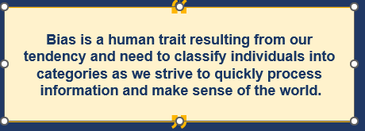
Implicit Bias
US Dept. of Justice,
Community Relations Services
Notes:
Definition (straight from the science) Implicit (unconscious) bias = attitudes or stereotypes that affect our understanding, actions, and decisions without us realizing it. They are automatic, fast, and operate outside conscious control.
Why it matters on the street
Split-second decisions (who to stop, who to watch, who “looks suspicious,” how quickly to go hands-on) are heavily influenced by the brain’s System 1 (fast, instinctive) thinking.
Implicit bias lives in System 1 → it can shape perception of threat, speed of force escalation, and who gets the benefit of the doubt.
Real-world law enforcement examples (2025 data)
Higher rates of stops/searches of minority drivers when no contraband is found (“hit rate” studies).
Faster shoot/don’t-shoot errors in simulator studies when Black subjects hold harmless objects (classic “weapon bias” research).
More rapid escalation to hands-on or less-lethal force with minority subjects exhibiting identical behavior (PERF/Stanford 2020–2024 studies).
Legal impact in Pennsylvania & federal courts
Implicit bias alone does not violate the Constitution (equal protection requires intentional discrimination), but it can make force look objectively unreasonable under Graham v. Connor when the same behavior from different demographic groups receives different force responses.
Post-2020 § 1983 cases now routinely include implicit-bias expert testimony; juries are allowed to consider it when deciding reasonableness.
What actually reduces it (evidence-based, not feel-good)
Exposure & counter-stereotyping – repeated positive contacts with diverse community members
Slow-down protocols – verbal “pause” phrases, deliberate CDM verbalization, peer challenge (“Hey, why are we stopping this car?”)
Stress inoculation – high heart rate amplifies bias; tactical breathing keeps you in deliberate-thinking mode
Fair & Impartial Policing – Train up and stay up to date on trends related to I.B.
There are many definitions circulating out there, from the US Department of Justice, Community Relations Services, Understanding Bias: A Resource Guide provides their general definition – “Bias is a human trait resulting from our tendency and need to classify individuals into categories as we strive to quickly process information and make sense of the world.”
Our brains take chunks of information associated with familiar items, begins to sort and categorize them, and then responds according to how we have been trained to react to that categorized item.

Slide 35
De-escalation
Containment & Control
Containment:
Priority
Limit movement
Slow down and focus on de-escalation
Control:
Establish scene control
Recognize officer’s decision to de-escalate tied to agency and community support
Requires cooperation
Is not something you do to a person
Recognize, create, and maintain conditions that allow de-escalation of one’s own emotions
Notes:
An honest assessment of de-escalation will acknowledge that not everybody police encounter is able or willing to de-escalate, therefore de-escalation requires cooperation. De-escalation is not something you do to a person, but rather it’s about how to recognize, create, and maintain conditions that allows the person to de-escalate his/her own emotions. It is a GOAL not a TACTIC!
Therefore, with the sanctity of human life at the forefront, when officers are not confronted with imminent threat or risk, and once cooperation has been established, officers can set the scene for implementing effective de-escalation tactics.
Source: PoliceOne online article by Lewis “Von” Kliem, 5/26/2020. Four Conditions for Effective De-escalation
The first two conditions for de-escalation, containment and control are concerned with whether an officer should attempt de-escalation.
Containment:
Containment should be a priority as it is the creation and enforcement of boundaries that limit a subject’s movements to a specific area, while still offering a subject reasonable area of movement. By “reasonable” we are referring to the ability to prevent sudden attacks, avoid split-second decision-making, and maintain response options, including appropriate backstops if force is used.
Containment areas are defined by where a subject is allowed to remain without placing officers or the public at unreasonable risk. Based on the behavior of the subject and as situations may change, containment areas will need to either expand or contract.
But containment alone may not be enough. For officers to safely slow down and focus on non-coercive de-escalation, the suspect must also be reasonably controlled.
Control:
Establish sufficient scene control to ensure that serious crimes, such as active assaults, property damage, or evidence destruction are prevented or stopped before engaging in verbal de-escalation.
Recognize that an officer’s decision to talk or force compliance is directly tied to his/her agency and community’s willingness to support that decision.
As a result, when a person is only threatening him/herself, or where criminal conduct is minor, the decision to delay force in favor of de-escalation may remain the most reasonable response.
The final two conditions for de-escalation are contact and communication.

Slide 36
Communication Dos & Don’ts
Stop saying “Relax” or ”Calm Down" it does NOT work!
Say instead “Try breathing with me” or “Take a deep breath with me”
Don’t “draw a line in the sand”
Avoid being condescending
Use first names when addressing the person
Notes:
Stop saying “Relax”, ”Calm Down", or "Chill Out" to someone in an emotional state, it DOES NOT work! Refer to MIST 2026-Trauma Informed Policing regarding de-escalation, brain function and dealing with subjects with trauma.
Using these terms will often escalate the person even further.
Use phrases such as “Try breathing with me” or “Take a deep breath with me, in through your nose, out through your mouth.”
Don’t “draw a line in the sand” and say things such as, “I am not going to tell you again…” or “This is the last time I’m going to tell you!”
Avoid being condescending or appearing annoyed, irritated and frustrated.
Try using first names when addressing the person, such as, “Frank, your feelings are justified, I understand right now you are frustrated. Let’s try and work through this together.”

Slide 37

To get credit for completing this course, please print the certificate on the last next page and give to your Control Tactics Instructor

Slide 38
