Slide 1
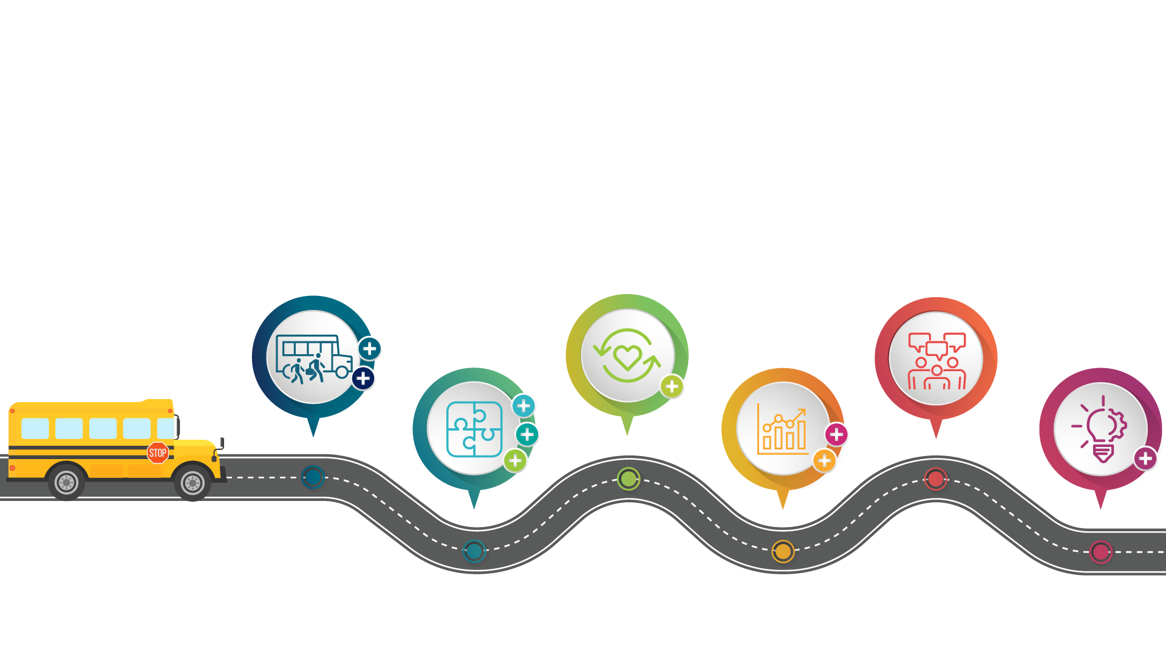
Creating Equitable School Systems

Slide 2
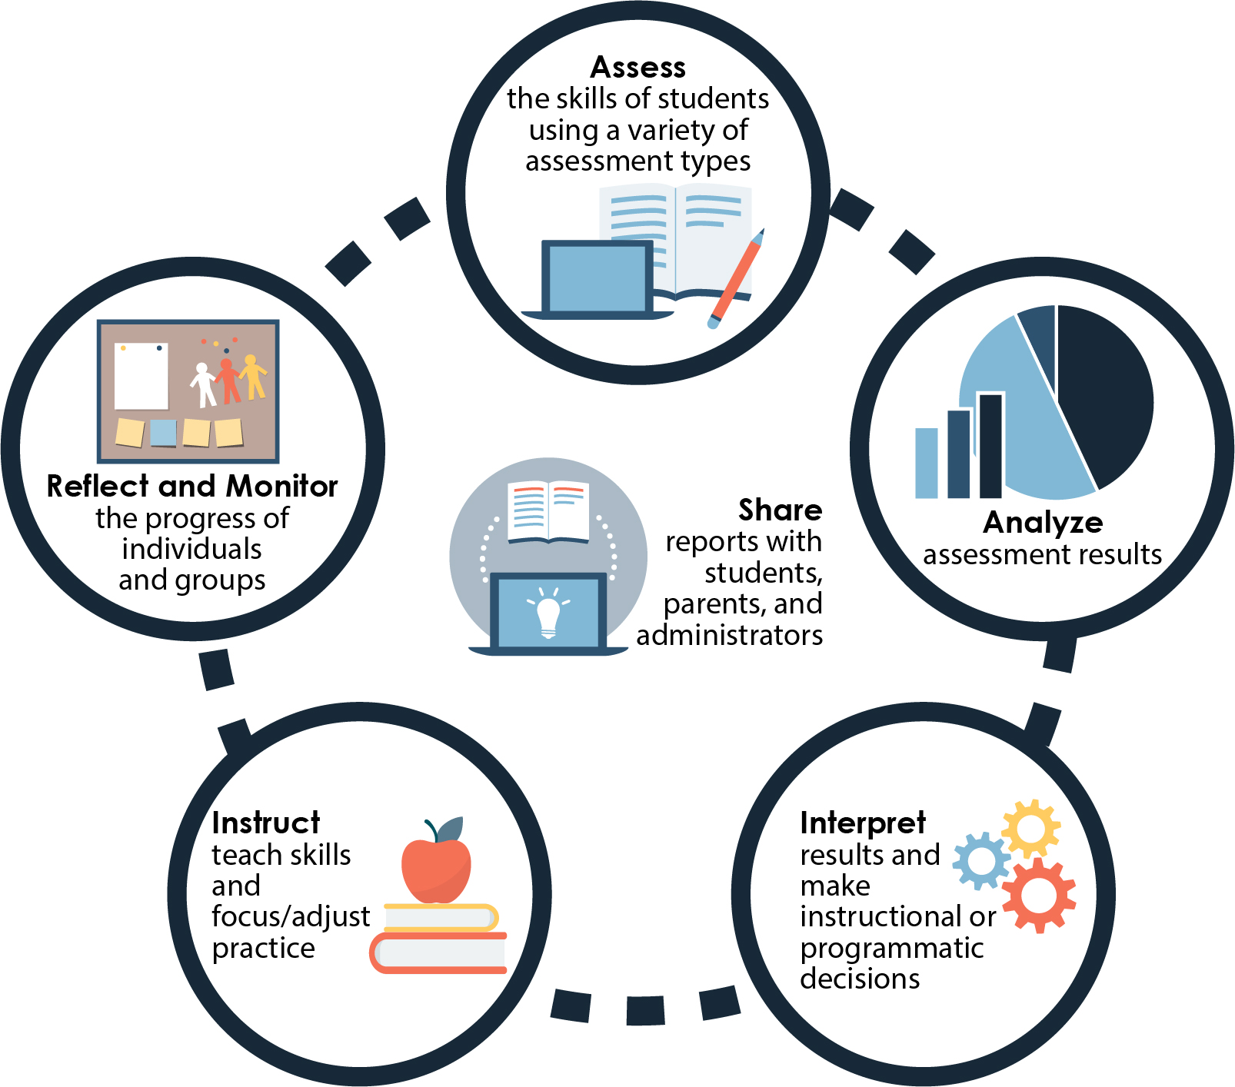
Focus of Instruction

Slide 3
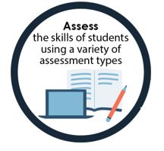
Assess
What diagnostic assessment tools were used to evaluate student learning prior to school closure?
What assessment data collection shifts occurred with the move to remote learning?
What assessment data collection supports will be needed?
What additional assessment tools are needed to identify learning gaps?
Focus on Effective Assessment

Slide 4
Focus on Effective Assessment

Slide 5
Assess (CDTs)
CDTs
Classroom Diagnostic Tools (CDTs)
Administer online assessments, divided by content area
Receive diagnostic information
Inform instruction, remediation, and/or acceleration

Slide 6
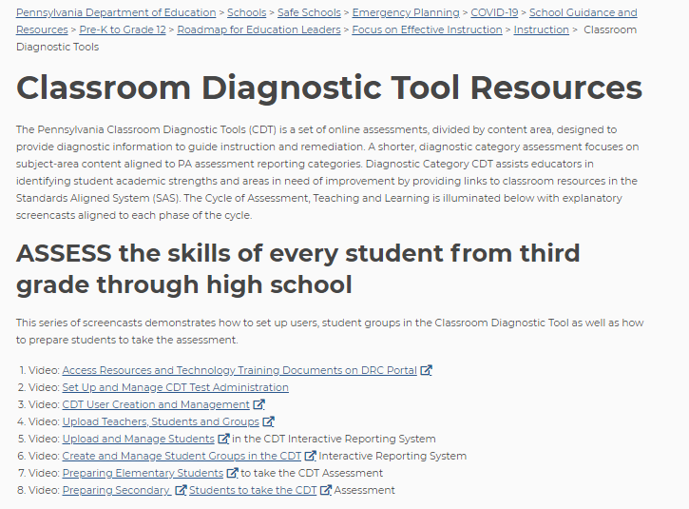
Classroom Diagnostic Tool Resources

Slide 7
Assess (SAS)
SAS Assessment Center
SAS Assessment Center
Build assessments by searching standards-aligned items
Create customized assessment items
Send Check for Understanding assessments to students

Slide 8
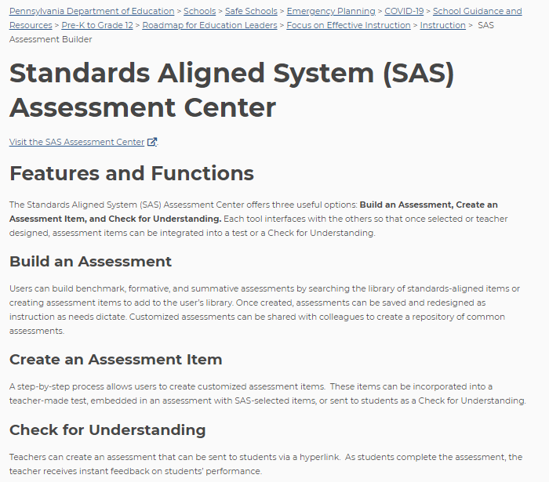
Standards Aligned System (SAS) Assessment Center

Slide 9
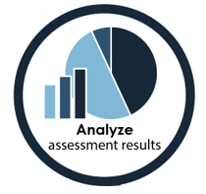
Analyze
Is data organized for ease in understanding and interpretation?
Do we examine data to identify patterns and trends?
How do we address students with learning gaps (e.g. students with disabilities, ELs)?
Do we follow the data protocol process?
Data Protocol Process

Slide 10
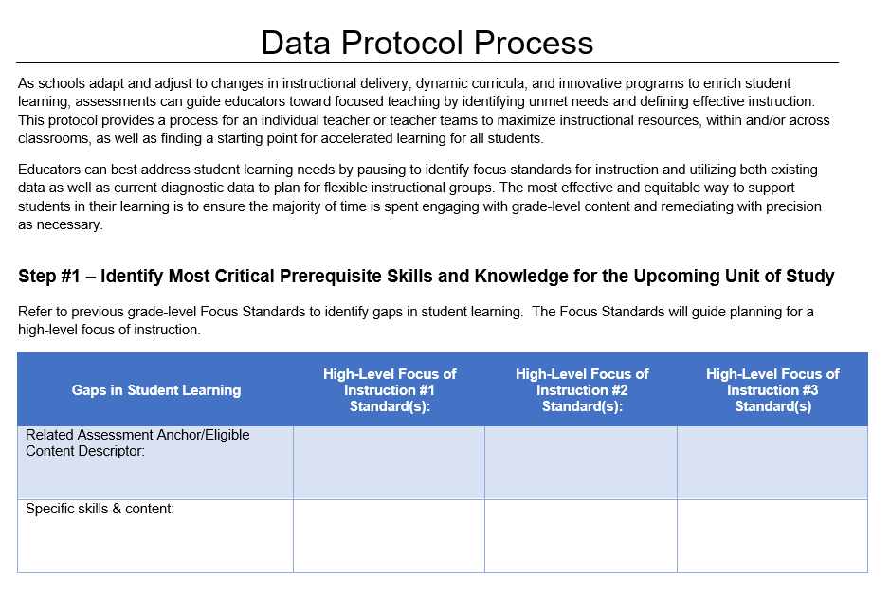
Data Protocol Process

Slide 11
Interpret
Have we identified areas of academic strength and need?
What other data are relevant?
How do we use data to plan instruction?
What additional assessments should we consider?

Slide 12
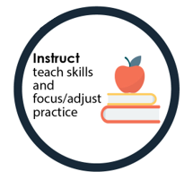
Instruct
As we prioritize grade-level content, are we remediating with precision and accelerating as needed?
Are we setting high expectations?
Are we making strategic instructional choices?
Focus on Effective Instruction

Slide 13
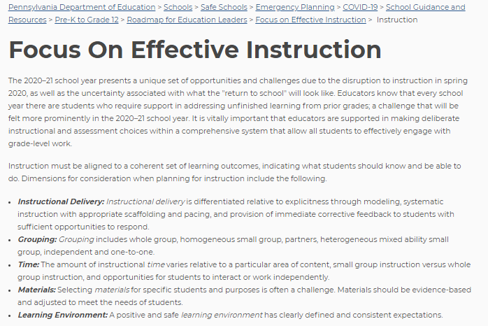
Focus on Effective Instruction

Slide 14
Instruct (Focus Documents)
ELA
High-Level Focus Documents
Math
Science

Slide 15
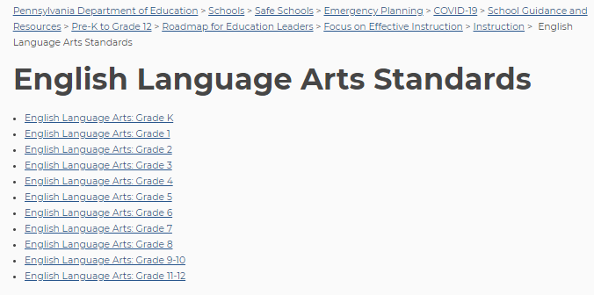
High-Level Focus Documents

Slide 16
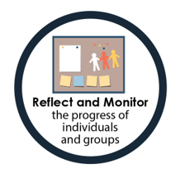
Reflect and Monitor
How have the changes in instructional or grouping practices affected students?
Have the changes had a positive effect? No effect? Negative effect?
Do we monitor instructional practices and observe students’ reactions and responses to them?
What additional assessments may be necessary to help plan and teach more effectively?

Slide 17
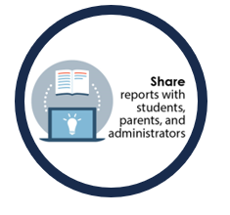
Share
Do we have students self-evaluate their work to develop their knowledge and understanding of what they know?
Do we inform families and caregivers of their children's progress?
Do our school leaders use classroom data to support teaching and learning schoolwide?
Notes:
Sharing the progress of individuals and groups engages key stakeholders in a cycle of teaching and learning.
We must ask these important questions as we engage learners, families/caregivers, and school leadership in the teaching and learning process.
Strong communication among all stakeholders highlights the importance of student accountability, family/caregiver responsibility, and leadership commitment to high academic expectations.

Slide 18
Resources
SAS
High-Level Focus Documents (PDF)
Curriculum Maps and Instructional Frameworks
CDT Toolkit
Online Resources for Instruction Toolkit
Pennsylvania State Literacy (PaSLP) Toolkit
PAIU Open Education Resources (OER) Commons
STEM Toolkit

Slide 19
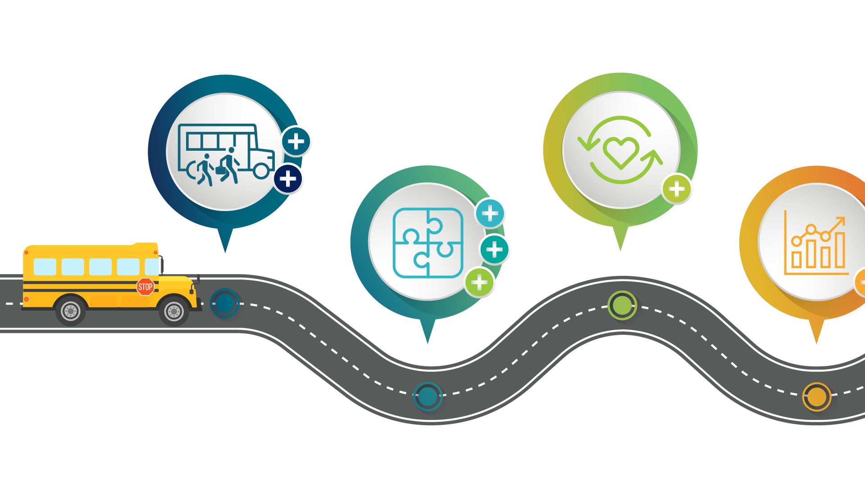
PDE Information
For more information on the Roadmap for Education Leaders, please visit PDE’s website at www.education.pa.gov
For more information on the Roadmap for Education Leaders, please visit PDE’s website at www.education.pa.gov
The mission of the Department of Education is to ensure that every learner has access to a world-class education system that academically prepares children and adults to succeed as productive citizens. Further, the Department seeks to establish a culture that is committed to improving opportunities throughout the commonwealth by ensuring that technical support, resources, and optimal learning environments are available for all students, whether children or adults.
The mission of the Department of Education is to ensure that every learner has access to a world-class education system that academically prepares children and adults to succeed as productive citizens. Further, the Department seeks to establish a culture that is committed to improving opportunities throughout the commonwealth by ensuring that technical support, resources, and optimal learning environments are available for all students, whether children or adults.

