Slide 1


Commonwealth of Pennsylvania Department of Education
YESSER! Ace ESSER Monitoring
2023 PAFPC Conference

Slide 2




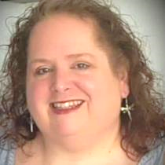
Meet Your Facilitators
PDE ESSER Monitoring Team
Session Facilitators
  Bobbie Harper
  ESSER Monitoring Manager
  Deloitte & Touche LLP
  Joe Simon
  ESSER Monitoring Manager
  Deloitte & Touche LLP
Here With Us Today
  Susan McCrone
  Federal Programs Division Chief
  PDE
  Julie Patton
  Director of Compliance
  PDE

Slide 3

Agenda
Overview of ESSER
What is ESSER and why is it unique?
ESSER Monitoring: What to Expect?
Overview of Monitoring
Monitoring Procedures
Current State of ESSER Monitoring
Risky Business
Understanding the Risk Assessment
How to be Proactive
Acing ESSER Monitoring
Plan Ahead: Sharing leading practices to prepare for a monitoring visit
Use Your Resources
Technical Assistance

Slide 4
Overview of ESSER

Slide 5









What is the Elementary and Secondary School Emergency Relief grant?
COVID-19 created a waterfall of grant funding for local education agencies in the Commonwealth
2020
2021
2022
2023
2024
2025
Allowable Uses o LEAs | f ESSER Funds for | Coordinate preparedness and response efforts to COVID-19 | Provide resources to address individual school needs
Address the unique needs of low-income, minority, and at- risk children | Plan and coordinate long-term closures | Improve LEA preparedness and response efforts | Sanitize and clean LEA facilities
Plan and implement summer learning and supplemental afterschool programs | Initiate activities to maintain LEA operations, including any activity authorized by ESEA | Purchase educational technology | Provide staff and student mental health services and support
Address learning loss among disadvantaged populations (ESSER II) | Facility repairs and improvements to reduce virus transmission (ESSER II) | Improve air quality in school facilities, including heating, ventilation, & AC (ESSER II) | Develop strategies to reopen and operate facilities safely and effectively(ESSER III)
ESSER I
$13.2 billion set aside from the CARES Act – March 2020
$523.8 million awarded to PDE – May 2020
Note: Funds must be liquidated by January 2023
ESSER II
$54.3 billion set aside from CRRSA Act – December 2020
$2.22 billion awarded to PDE – January 2021
Note: Funds must be liquidated by January 2024
ESSER III (ARP ESSER)
$122 billion set aside from ARP Act – March 2021
$5.1 billion awarded to PDE – March 2021
Note: Funds must be liquidated by January 2025
These Grants Are Governed By A Matrix Of Federal, Agency, and State Requirements
State Laws, Regulations and Policies:
Federal Statutes:
Federal Regulations:
2 CFR 200
ESF Compliance Supplement
Agency Specific Guidance:
U.S. Dept. of Education
PDE ARP ESSER Act 24 of 2021
PA ARP ESSER State Plan
PA LEA Chart of Accounts
PA Master Standard Terms and Conditions
PA School Code/Procurement Code
CARES Act
CRRSA Act
ARP Act of 2021
Notes:
Joe

Slide 6


























Elementary and Secondary School Emergency Relief (ESSER) Grant Funding is NOT “Business as Usual”
Allowable uses for ESSER funds varied greatly from annual recurring grant programs
IN THE NEWS
~$8
BILLION
"We're so thankful to be able to receive this funding," said
Superintendent Brian Troop, of the Ephrata
Area School District in Lancaster County.
~$800
MILLION
“The funds really have to be used to assist the school in
preparing for, preventing,
responding to COVID”
“We have to spend 20% of ESSER III for instructional
programming to help support
students who maybe fell behind”
A global pandemic shut down the | With students stuck at home with parents, | To make classrooms safter, ESSER funded | Significant investments were made for | Strategic planning for safe reopening of
economy and took | educators had to | construction and | historically | school operations was
students out of their | invest in remote | capital projects to | underserved groups of | eligible for
classrooms requiring | learning technology, | reduce viral | students and required | reimbursement to get
novel approaches to | training, and | transmission in | maintenance of ideal | students back into
fund the impacts on | curriculum to avoid | classrooms and other | teacher to student | the classroom
education | learning loss | facilities | ratios
“The district is also using the funding to
help the staffing crisis.
It's been able to attract substitutes by offering free lunches and bonus pay”
“The district
added a half-day summer program and created two new positions
called student engagement facilitators”
“The district
added a half-day summer program and created two new positions called student engagement facilitators.”
Read The Article!
ESSER funded a SIGNIFICANT portion of these unique activities
Notes:
Joe

Slide 7
ESSER Monitoring: What to Expect?

Slide 8
The Purpose of Monitoring
Working together to retain ESSER investments in the Commonwealth
Monitoring is an important part of grant management
As the pass-through for ESSER, PDE is required to demonstrate oversight of subawards per 2 CFR Part 200
We are in this together
Our goal is to provide actionable feedback and
leading practices to address programmatic shortfalls.
Trusted and meaningful relationships
The ultimate goal Is financial security
Investing in YOU!
Through monitoring PDE aims to cultivate reliable and meaningful relationships
with Local Education Agencies (LEAs).
Monitoring is a huge investment for the Commonwealth. Resources are being spent so we can aid the LEAs!
Our goal is to keep the money that has been invested in our schools, IN OUR SCHOOLS.
Our monitoring team is here to answer questions, provide guidance, and prepare you for possible future audits.
We will provide references, explanations, and sufficient detail so your team knows what to do next time!
Our focus is on accountability, transparency, and maintaining a focus on equity.
We want to protect schools against potential
claw backs.
PERIOD.
Notes:
Joe. Monitoring is a huge investment for the Commonwealth, we are spending tons of resources because we want to make sure the money we received stays

Slide 9

What to Expect When You’re Expecting…..an ESSER Monitoring Review
Our monitoring teams want to hear your story, see your files, and ask hard questions before the OIG does
Scope of Monitoring Procedure
Goals
Claimed Expenditures
 | Claimed Expenditures | The Monitoring Team will review your General Ledger to select a sample for testing. During the monitoring process, the Team will test your ability to verify your expenditures and comply with audit requirements
 | Supporting Documentation | For the selected sample, the Monitoring Team will request supporting documentation required by federal guidance to make sure expenditures are eligible and supported.
 | Procurement/ Allowable Uses | The Monitoring Team will discuss the procurement requirements and allowable uses of ESSER funding and recommend best practices to maintain compliance.
 | Purchasing Procedures | The Monitoring Team will ask about your purchasing policies and procedures to assess whether they align to federal and state requirements.
 | Cost Tracking Practices | The Monitoring Team will inquire how you’re tracking ESSER expenditures, from budgeting reconciliation, managing equipment and property, to adherence to the PA Chart of Accounts.
 | Federally Compliant Policies | The Monitoring Team will review your policies and make recommendations as needed to make sure you are in alignment with federal and state requirements.
Supporting Documentation
Financial Testing
Procurement and Allowable Uses
Identification of Best Practices
Purchasing Procedures
Grants Administration Discussions
Cost Tracking Practices
Federally Compliant Policies
Notes:
Joe

Slide 10

Timeline of ESSER Monitoring Procedures
Overview of the monitoring process from start to finish
Final results discussions
The monitoring team will provide a Final Results Letter based on monitoring observations with recommendations on programmatic compliance and recommended practices.
Monitoring week
You’ll start off monitoring week with a Kick Off call where we will discuss your experience with ESSER funds, then take a deep dive into your policies and procedures. Check in calls will be held every day to discuss expenditures selected for testing. The week will wrap up with an Exit Meeting to include a high-level discussion of observations found.
Preparation for monitoring
The monitoring team will request your general ledger report of ESSER expenses to select a testing sample prior to the monitoring week.
introductions
An Announcement Letter will be sent to you approximately a month before your visit and afterwards a member of our monitoring team will reach out to confirm your monitoring visit and schedule a pre-monitoring introduction call.
Notes:
Joe Monitoring is a huge investment for the Commonwealth, we are spending tons of resources because we want to make sure the money we received stays

Slide 11

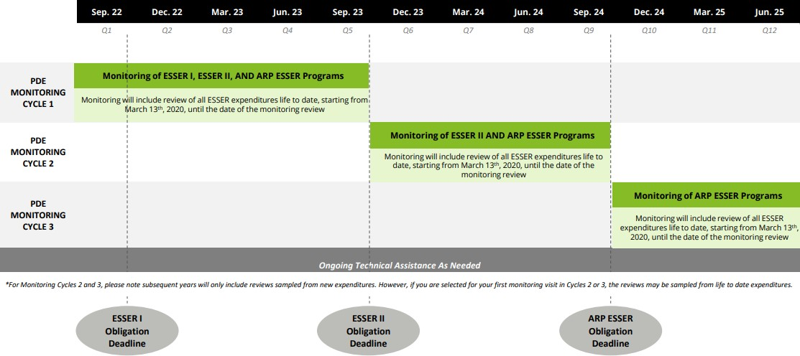

Current State of ESSER Monitoring
LEAs should anticipate reviews of expenditures incurred since the inception of the program
YOU ARE HERE
Indicates times for grant closeout. Please start taking measures to prepare for closeout. More to come on this topic in the Conquering Monitoring session!
Notes:
Joe

Slide 12
Risky Business

Slide 13






Understanding the Risk Assessment
Example indicators considered in evaluating risk
Risk Indicators that Carry the Most Weight
Construction projects increase risk level given the complexity of projects, tendency to have delays/cancellations, and additional requirements that often apply
Greater amount of ESSER funding received increases risk level given there is more money on the line should funds be spent inappropriately
Low Risk
High Risk
Indicators that an LEA may have a low risk profile as it relates to ESSER funding include (but is not limited to) the following:
Indicators that an LEA may have a high risk profile as it relates to ESSER funding include (but is not limited to) the following:
Moderate Risk
Little to no turnover of key personnel
Indicators that an LEA may have a moderate risk profile as it
relates to ESSER funding include (but is not limited to) the following:
Construction projects were funded with ESSER grants
Failure to comply with ESSER-reporting deadlines increases risk level as it demonstrates lack of compliance with grant requirements
No major changes to accounting or ERP systems
Amount of ESSER funding allocated is greater than the
average
No direct or indirect single audit findings in prior fiscal year
Amount of ESSER funding allocated is average
Having failed to adhered to reporting deadlines and/or requirements for ESSER of other programs managed by PDE
Lack of participation in ESSER-related trainings increases risk level due to the unique nature of ESSER grants, as discussed previously
Amount of ESSER funding allocated is lower than the average
Normal turnover of key personnel
Active participant in PDE ESSER training events
Note: Risk Assessment updated annually

Slide 14








How Can You Be Proactive?
Steps you can start taking now to get ahead of next year’s risk assessment
Participate in Trainings | Meet Reporting Deadlines | Address Year 1 Observations | Spend Funds on Time
Actively participate in PDE ESSER Training Events (office hours, fall meetings, annual conference, SAS, PDE Data Summit) | Make sure ESSER-required reporting deadlines to PDE are met | Adequately respond to and address observations from Year 1 of ESSER Monitoring | Make sure ESSER grant funding is fully spent prior to the program liquidation date
Follow Leading Internal Controls Practices | Receive Prior Approval for Capital Expenditures and Construction | Educate Team on PII | Comply with ESSER Specific Requirements
Take measures to follow leading practices for internal controls to mitigate the likelihood of observations. Some internal control areas include: segregation of duties, review and approvals, and safeguarding assets | Receive prior-approval from PDE for large capital expenditures and for construction projects prior to spending grant funding on those costs | Educate your team on what constitutes personally identifiable information (PII) and how to appropriately safeguard PII | Comply with ESSER program specific requirements to maintain maintenance of equity

Slide 15
Acing ESSER Monitoring

Slide 16





Plan Ahead
Leading practices to reduce stress all around
Make sure THE RIGHT PEOPLE are available the week of the visit
Be prepared to TALK THROUGH the procedures behind your policies
Document procurement rationale & archive in procurement files
Adhere to appropriate cost tracking requirements
Redact PII from ALL files
Be transparent about gaps and ask for recommendations to address those gaps
Maintain digital based, organized files

Slide 17


Technical Assistance
Providing one-on-one support to help you understand and address monitoring observations
Get hands-on training by the PDE ESSER Monitoring Team to help you understand and appropriately address compliance gaps
One-On-One Guidance
The PDE ESSER Monitoring Team will schedule time with your team so that you are able to ask questions and get the hands-on support you need.
Free For LEAs
Technical assistance support is an investment by the Commonwealth. If you need help and are approved for assistance, it will be provided at no additional cost to you.
Timing
Technical assistance will be provided after your ESSER monitoring visit should you choose to opt in. Our team will work around your availability.
Helping Remediate Observations
Our technical assistance training material can be tailored to meet your organization’s unique needs based on monitoring visit outcomes. We can focus on the areas you need the most and work collaboratively with your team to remediate observations.
How To Request
Technical assistance requests can be sent to ra-edessermonitor@pa.gov.
Additionally, you may request it directly with your PDE ESSER monitors during or after the visit.

Slide 18



Resources Available
Helping you ace ESSER monitoring
ASK QUESTIONS BEFOREHAND
Questions may be directed to RA Account- RA-EDESSERMONITOR@PA.GOV
Asking questions will better prepare you for your visit – we are here to help!
REVIEW THE PDE ESSER WEBSITE
PDE Website - Monitoring of LEAs’ Coronavirus Associated Federal Programs (pa.gov)
Review the checklist and document request list, so you are aware of what is required for the visit
ATTEND ESSER PDE OFFICE HOURS
Weekly ESSER GEER Extra Communications
PDE Office Hours: every Monday from 1-2pm and every Thursday from 9-10AM. Join the office hours.

