Slide 1


Commonwealth of Pennsylvania Department of Education
Conquering Monitoring: Leading Practices for Improving your LEA’s Processes
2023 PAFPC Conference

Slide 2





Meet Your Facilitator
PDE ESSER Monitoring Team
Session Facilitator
  Chrystina Cappello
  ESSER Monitoring Lead
  Deloitte & Touche LLP
  Bobbie Harper
  ESSER Monitoring Manager
  Deloitte & Touche LLP
Here With Us Today
  Susan McCrone
  Federal Programs Division Chief
  PDE
  Julie Patton
  Director of Compliance
  PDE

Slide 3

Agenda
ESSER Monitoring: Your Friendly Neighborhood Monitor
Why ESSER is Unique
Leading Practices
Preparing for Closeout
Complete Files
ESSER Monitoring Goals
Leading Practices: What Successful LEAs Are Doing
Feedback Received From LEAs
Recordkeeping: Keep It Where You Can Retrieve It….Quickly
Policies and Procedures: Practice What You Preach
Learnings from Monitoring
Single Audit Completion
Final Reporting
We’re Your Monitors, Not Your Auditors
Progress of Monitoring

Slide 4
ESSER Monitoring: Your Friendly Neighborhood Monitor

Slide 5


























ESSER grant funding is NOT “business as usual”
Allowable uses for ESSER funds varied greatly from annual recurring grant programs
IN THE NEWS
~$8
BILLION
"We're so thankful to be able to receive this funding," said
Superintendent Brian Troop, of the Ephrata
Area School District in Lancaster County.
~$800
MILLION
“The funds really have to be used to assist the school in
preparing for, preventing,
responding to COVID.”
“We have to spend 20% of ESSER III for instructional
programming to help support
students who maybe fell behind.”
A global pandemic shut down the | With students stuck at home with parents, | To make classrooms safter, ESSER funded | Significant investments were made for | Strategic planning for safe reopening of
economy and took | educators had to | construction and | historically | school operations was
students out of their | invest in remote | capital projects to | underserved groups of | eligible for
classrooms requiring | learning technology, | reduce viral | students and required | reimbursement to get
novel approaches to | training, and | transmission in | maintenance of ideal | students back into
fund the impacts on | curriculum to avoid | classrooms and other | teacher to student | the classroom.
education. | learning loss. | facilities. | ratios.
“The district is also using the funding to
help the staffing crisis.
It's been able to attract substitutes by offering free lunches and bonus pay.”
“The district
added a half-day summer program and created two new positions called student engagement facilitators.”
Read The Article!
ESSER funded a SIGNIFICANT portion of these unique activities.

Slide 6

ESSER Monitoring Goals
Your friendly monitor is there to help you keep the money and educate you on what auditors are looking for
Audit Readiness
How ready are you to pass an audit?
Keep the money in schools
Confidence in Procedures
Building confidence that your procedures align with grant requirements
Understanding Federal Guidance
Applying compliance with the federal guidelines through testing ESSER expenditures

Slide 7
We’re Your Monitors, Not Your Auditors
Leverage your monitors to improve your processes
Consistent Policies & Procedures
Bullet
Dash
Sub-bullet
Given ESSER funding is not “business as usual” (more dollars and allowable uses), the monitoring procedures may be extensive.
ESSER monitoring presents with a unique opportunity to improve and implement leading grant management practices for the long term.
Allowable Costs
Separation of Duties
Compliance with
2 CFR Part 200
Informed Oversight
Adequate Support Documents
Good Faith Compliance

Slide 8

Feedback Received From LEAs
Local Education Agencies (LEAs) found the ESSER monitoring process supportive and impactful*
OFFERING SUPPORT
WHAT WE HEARD
98%
“It was good to hear we are doing things right, here's some things to improve on and not be faced with an audit down the road that says we misspent funds, you owe this much money back.”
48 of 49 LEAs reported that the monitoring visit was helpful to their organization.
"The monitors gave practical guidance on certain procedures and protocols not commonly known. This will be helpful as we spent the remainder of our ESSER funds.”
DRIVING CHANGE
90%
44 of 49 LEAs are adjusting their processes as a result of what they learned during the monitoring visits.
"The monitoring team did a great job of connecting with my team, helping us through the process in a non-threatening manner, and helping us to understand how the monitoring process worked."
*Feedback data is as of March 31, 2023.

Slide 9
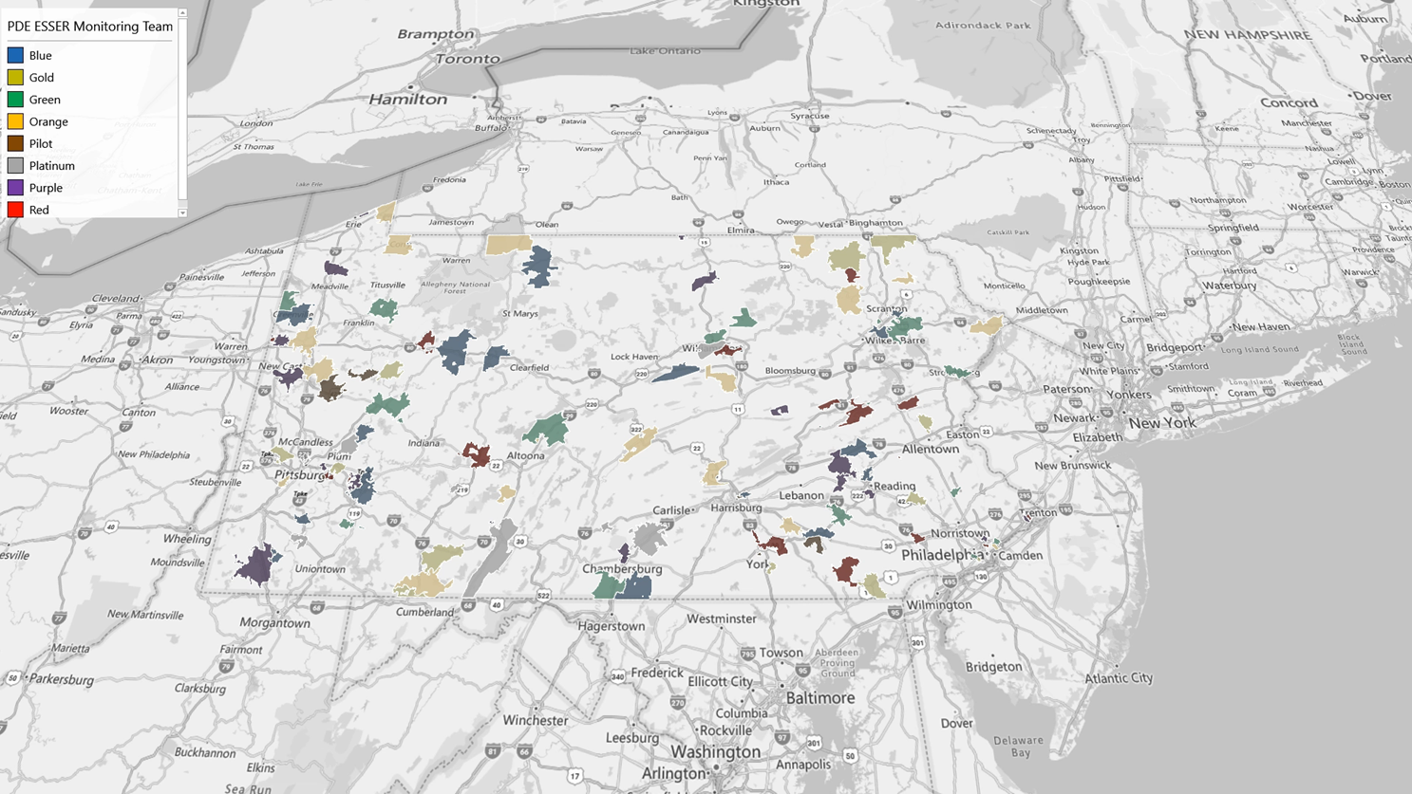
ESSER Monitoring Progress
LEAs with completed ESSER monitoring visits for FY23 as of April 7, 2023
121 total completed visits

Slide 10
Leading Practices

Slide 11

Leading Practices: What Successful LEAs Are Doing
Practices you can implement up front to save you time (and grant funding) in the long run
Recordkeeping
Maintaining organized records of required documentation, from procurement to cost tracking to equipment management
Policies and Procedures
Reviewing and training employees regularly while also aligning procedures
to policies

Slide 12
Recordkeeping: Keep It Where You Can Retrieve It….Quickly
Organizing support documentation for grant expenditures
How
What
Procurement
Plan large procurements in advance.
Execute competitive procurement, when needed.
Retain complete procurement documentation, including sole source justification.
Documentation and Recordkeeping Leading Practices
Complete
Organized
Accurate
Readily Available
Purchasing
Bundle the PO, Invoice, and proof of payment for each purchase.
Retain approvals and confirmation of delivery in files.
Equipment Management
Tag all federally-funded assets and include funding source.
Maintain 2 CFR 200 compliant inventory records.
Conduct physical inventory reconciliation at least every 2 years.
Cost Tracking Requirements
Maintain records that adhere to cost tracking requirements according to the chart of accounts.

Slide 13






Policies and Procedures: Practice What You Preach
Adopt your policy within the federal guidelines
If processes don’t align with policies, update them.
Follow the most
stringent of federal, state, and local guidelines.
Regularly train employees on policies and procedures.
Rules of the Road
Purchase Orders
Obtain and document required approvals for expenditures in accordance with purchasing policy.
Procurement
Some LEA policies have stricter procurement thresholds than federal and/or state requirements. LEAs must adhere to the most stringent requirements.
Capitalized Equipment
Capitalize equipment based on their capitalization threshold, which may be stricter than federal requirements.
Personally Identifiable Information (PII)
PII is an asset that must be protected. LEAs should maintain, train employees on, and adhere to policies that govern its collection, storage, and use.

Slide 14
Preparing for Closeout

Slide 15
Preparing for Closeout
During the closeout procedure, prepare to conduct final checks of financial and administrative activities to maintain compliance
Complete Files
Maintain all supporting documentation for your grants and organize it in a manner
that allows for easy and
quick retrieval.
Learnings From Monitoring
Understand formal and informal observations shared during monitoring and implement adequate measures to address the issue(s).
Single Audit Completion
Complete single audits if required and address all findings identified.
Final Reporting
Verify that all expenditures claimed under ESSER are fully allowable and supported by necessary documentation.
Reconcile all claims and return overpayments on time.

