Slide 1
Charter School Trustee Training Operations: Act Strategically
2018-2019 Training

Slide 2
Introduction
Thank you for participating in this presentation on Operations: Acting Strategically, the fourth of six Pennsylvania charter school trustee trainings provided by the Pennsylvania Department of Education.
This presentation is for informational purposes only. It is not legal advice and should not be relied upon as such. Schools should defer to their solicitor for legal advice.
Presentations of this PowerPoint without the Commonwealth’s recording do not represent the views of the Commonwealth or any Commonwealth agency.

Slide 3
Standards for Effective Charter School Governance
About Charter Board Partners

Slide 4
This Session
Standard Four: Act Strategically
Determine the strategic direction of the school
Respect the balance between governance and management

Slide 5
Determine the Strategic Direction
Oversee the development of a strategic plan that reflects the board’s vision and priorities for the school’s future
Set annual goals for the school, board, and board committees
Organize the board, its committees, and all meetings to advance the annual goals and strategic plan

Slide 6
Oversee the Development of a Strategic Plan
Created in partnership between board and leader
Define vision for organization for next 3-5 years
Provide goals, an accountability framework, and a mechanism for monitoring progress
Should not be overcomplicated
Consider creating a strategic planning committee

Slide 7
Roles in Strategic Planning Process
School Leader
Board
Consultant

Slide 8
Components of a Strong Strategic Plan
1. Vision
2. Mission
3. Organizational priorities and goals
4. Strategies to reach each goal
5. Mechanisms for measuring progress

Slide 9
Strategic Planning Process
Outline the process for creating the strategic plan
Assess your school’s current reality and future threats
Define the charter school’s direction (mission, vision)
Hold a strategic planning retreat

Slide 10
Strategic Planning Process
5. Draft the strategic plan
6. Approve the plan and develop a process of review
7. Develop the operational/annual plan
8. Use the strategic plan

Slide 11
Set Annual Goals
Aligned with strategic vision
Create a shared sense of direction
Change each year

Slide 12
Goal-Setting Timeline
June: Approve goals and committee tasks
July: Set benchmarks and metrics
September-April: Track progress towards goals
May-June: Evaluate outcomes and improve processes for coming year

Slide 13
SMART GOALS
Specific
Measurable
Attainable
Relevant
Time-Bound

Slide 14
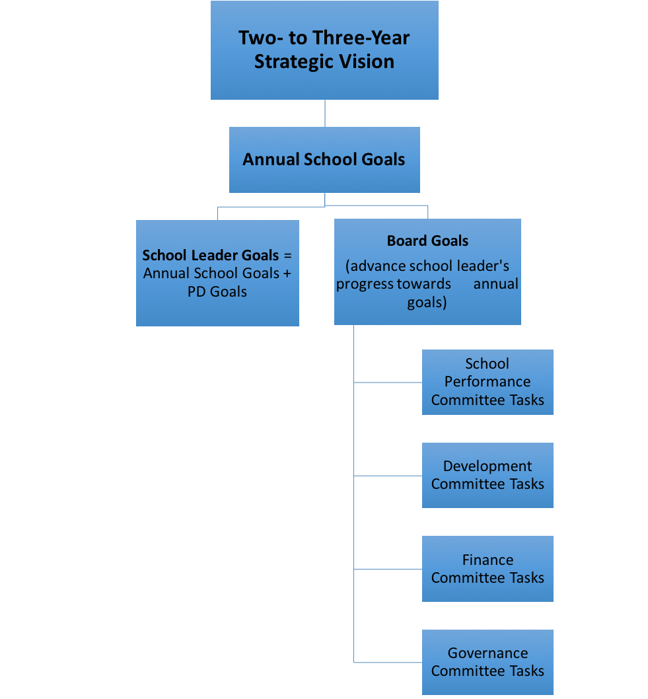
Sample Framework

Slide 15
Frequently Asked Questions
What if we don’t have a strategic plan?
Who drafts annual goals?
How many should we have?
What’s the best time of year to draft goals?
What is the difference between a goal and a task?
How does the leader evaluation fit in?

Slide 16
Organize Board & Committees around Goals
Committees drive the implementation
Assign goals to committees
Committees create tasks for goal achievement

Slide 17
Respect Balance of Oversight and Management
Define and build board-wide understanding of the oversight role of the board and the management role of the school leader
Give the school leader the autonomy and authority to manage the school while maintaining strong and close oversight

Slide 18
Define and Build Board-Wide Understanding
The board owns the WHAT
The leader owns the HOW

Slide 19
The Gray Areas
During times of change, roles can become unclear
Communication is key

Slide 20
The Line Can Change
Boards in early-stage have a different function than mature governing boards
Boards may have to step in during leader transition moments
Use turn signal and communicate well

Slide 21
CMOs and MCSOs
Charter Management Organizations (CMOs)
Multiple Charter School Organizations (MCSOs)
Communication is key!

Slide 22
Grant Autonomy but Provide Oversight
Trust, but verify
Base conversations on data
Ask hard questions

Slide 23
Some Things to Consider
Is your board work aligned around a 2-3 year strategic plan?
Does your board work collaboratively with your leader to establish annual goals?
Does the board share a common understanding of the role of the board versus the role of management?
What new ideas have you learned that you could take back to your board?

Slide 24
Thank You
For more information on charter school governance best practices, please visit www.education.pa.gov and www.charterboards.org
The mission of the Department of Education is to ensure that every learner has access to a world-class education system that academically prepares children and adults to succeed as productive citizens. Further, the Department seeks to establish a culture that is committed to improving opportunities throughout the commonwealth by ensuring that technical support, resources, and optimal learning environments are available for all students, whether children or adults.

