Slide 1
Charter School Trustee Training Instruction and Academic Programs: Focus Relentlessly on Student Achievement
2018-19 Training

Slide 2
Introduction
Thank you for participating in this presentation on Instruction and Academic Programs, the first of six Pennsylvania charter school trustee trainings provided by the Pennsylvania Department of Education.
This presentation is for informational purposes only. It is not legal advice and should not be relied upon as such. Schools should defer to their solicitor for legal advice.
Presentations of this PowerPoint without the Commonwealth’s recording do not represent the views of the Commonwealth or any Commonwealth agency.

Slide 3
Standards for Effective Charter School Governance
About Charter Board Partnership

Slide 4
This Session
Standard One: Focus Relentlessly on Student Achievement
Govern to fulfill the mission of the school and the promises of the charter
Know whether students are on track to achieve at high levels

Slide 5
Govern to Fulfill the Mission and Charter
Commit to the mission of the school
Assume ultimate responsibility for school and student success
Use student data to inform board decisions

Slide 6
Govern to Fulfill the Mission and Charter
Commit to the mission of the school

Slide 7
Govern to Fulfill the Mission and Charter
Assume ultimate responsibility for school and student success

Slide 8
Govern to Fulfill the Mission and Charter
Use student data to inform board decisions

Slide 9
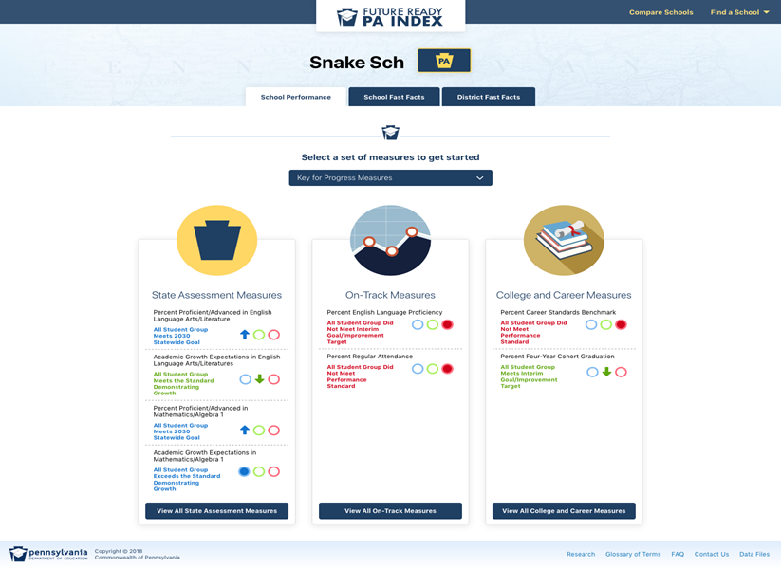

Slide 10
Know Whether Students are on Track
Agree on the definition of academic excellence
Understand how student achievement is measured at the school
Review indicators of student success regularly to monitor progress toward school goals

Slide 11
Know Whether Students are on Track
Agree on the definition of academic excellence

Slide 12
Standards Aligned System
PDE developed the Standards Aligned System (SAS) to improve student achievement, accessible through PDE’s website
SAS identifies six elements that impact student achievement:
Standards
Assessments
Curriculum Framework
Instruction
Materials and Resources
Safe and Supportive Schools

Slide 13
Know Whether Students are on Track
Understand how student achievement is measured at the school

Slide 14
Every Student Succeeds Act
In 2015, the federal government passed the Every Student Succeeds Act (ESSA), which reauthorized the previous Elementary and Secondary Education Act (ESEA) and replaced the No Child Left Behind Act
Each state was required to submit academic standards, goals, and plans for achieving those goals (ESSA Plan) to the U.S. Department of Education
Pennsylvania’s ESSA Plan was approved on January 16, 2018
Provisions include increased investment in evidence-based strategies, additional data reporting requirements, and improving the Pre-K-to-Postsecondary pipeline

Slide 15
Know Whether Students are on Track
Review indicators of student success regularly to monitor progress toward school goals

Slide 16
Board Composition
Ensure that you have at least one board member who understands K-12 education (ideally a former teacher or principal)
Also useful to have someone fluent in academic data
Consider whether you need someone to represent a mission-specific focus (i.e. IB model, French immersion)

Slide 17
School Performance Committee
Includes at least one voting board member
Staffed by the CEO and other academic leaders
Responsible for:
Partnering with the school leader to set and reach rigorous academic goals
Building board-wide understanding of academic progress
Maintaining a strong committee

Slide 18
Importance of a Strong Dashboard
Board’s way of tracking metrics at a board-appropriate level
Answers the question: “Are we on track to meet our achievement goals?”
Updated by school staff, reviewed by School Performance Committee, and shared with board
Used to drive board discussions and decisions

Slide 19
Steps to Creating a Dashboard
Set goals and metrics for measuring progress
Design a clear, simple dashboard
Use the dashboard effectively

Slide 20
Set Goals and Metrics
Board and school leader work in partnership to create annual goals
Identify formative metrics that dovetail with information that the school is already tracking

Slide 21
S.M.A.R.T Goals
Specific
Measurable
Achievable
Relevant
Time Bound

Slide 22
Monitoring Progress
Formative assessments

Slide 23
Design a Clear, Simple Dashboard
Concise, simple, and visual
Technology that is easy for both staff and board to use
Clearly shows when areas are “lit up,” indicating an area of concern

Slide 24
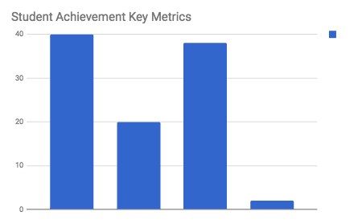
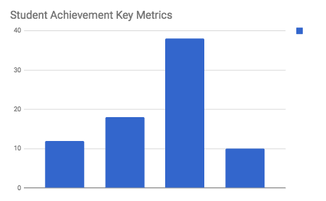
Example
Instructional Intervention
Needs
Support
On Track
Accelerated
Instructional
Intervention
Needs Support
On Track
Accelerated
Math
Language and Literacy

Slide 25
Use the Dashboard Effectively
Determine who will review it (and at what intervals)
Use it to inform board decisions
Adapt to needs

Slide 26
Avoid Pitfalls
Timing of data release
Avoid quick decision making
Not a formal school leader evaluation
Dashboard ownership

Slide 27
Some Things to Consider
Is your board aligned around how you measure academic excellence?
Do you have at least one board member with an education background?
How well do you feel your board is doing on supporting the school leader in achieving the school’s academic goals?

Slide 28
Thank You
For more information on charter school governance best practices visit www.education.pa.gov
and www.charterboards.org
The mission of the Department of Education is to ensure that every learner has access to a world-class education system that academically prepares children and adults to succeed as productive citizens. Further, the Department seeks to establish a culture that is committed to improving opportunities throughout the commonwealth by ensuring that technical support, resources, and optimal learning environments are available for all students, whether children or adults.

