Slide 1

Charter School Trustee Training
Ethics, Open Meetings and Regulations:
Maintain Legal and Regulatory Compliance
2018-19 Training

Slide 2
Introduction
Thank you for participating in this presentation on Ethics, Open Meetings, and Regulations, the sixth of six Pennsylvania charter school trustee trainings provided by the Pennsylvania Department of Education.
This presentation is for informational purposes only. It is not legal advice and should not be relied upon as such. Schools should defer to their solicitor for legal advice.
Presentations of this PowerPoint without the Commonwealth’s recording do not represent the views of the Commonwealth or any Commonwealth agency.

Slide 3
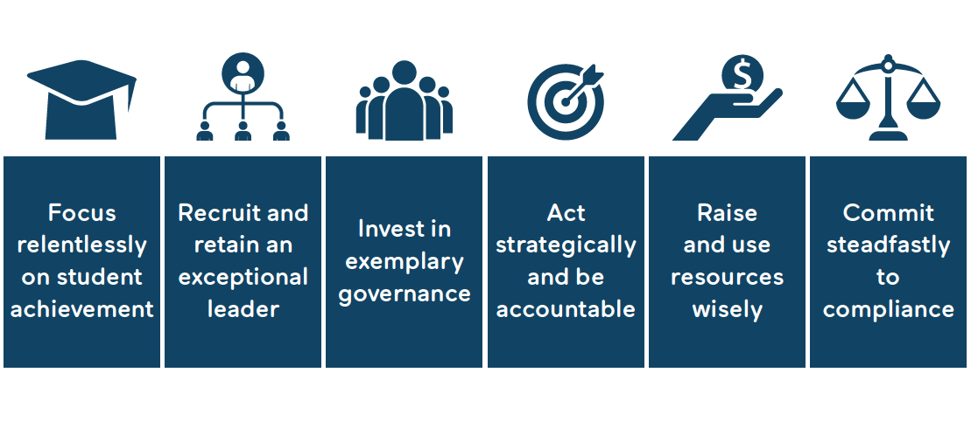
Standards for Effective Charter School Governance
About Charter Board Partners
About CBP

Slide 4
This Session
This Session
Standard Six:
Maintain Legal and Regulatory Compliance
Minimize risks
Meet expectations

Slide 5
Loyalty, Obedience, and Care
Loyalty: Act in the interest of the school alone
Obedience: Comply with laws and bylaws
Care: Be informed and use best judgement

Slide 6
Loyalty, Obedience, and Care
Loyalty: Act in the interest of the school alone

Slide 7
Loyalty, Obedience, and Care
Obedience: Comply with laws and bylaws

Slide 8
Loyalty, Obedience, and Care
Care: Be informed and use best judgement

Slide 9
Board Policies
Board Member Agreement
Code of Conduct
Conflicts of Interest
Document Retention
FERPA
Gift Acceptance
Non-Discrimination
Whistleblower

Slide 10
Board Policies
Board Member Agreement

Slide 11
Board Policies
Code of Conduct

Slide 12
Board Policies
Conflicts of Interest

Slide 13
Board Policies
Document Retention

Slide 14
Board Policies
FERPA

Slide 15
Board Policies
Gift Acceptance

Slide 16
Board Policies
Non-Discrimination

Slide 17
Board Policies
Whistleblower Policy

Slide 18
Meet Expectations
PDE
Authorizer
Federal Government
IRS
Local Government
Staff, parents, students, general public

Slide 19
Sunshine Act
The Pennsylvania Sunshine Act, requires agencies to deliberate and take official action on agency business in an open and public meeting.
It requires that meetings have prior notice, and that the public can attend, participate, and comment before an agency takes that official action.
Notes:
Pennsylvania’s Sunshine Act (Open Meetings Law): https://www.openrecords.pa.gov/SunshineAct.cfm

Slide 20
Public Officials and Employee Ethics Act
Statement of Financial Interest
Privilege and Responsibility

Slide 21
Compliance Audit
Conducted independently by a legal expert
Informs board on its overall compliance
Advises on areas of risk

Slide 22
Pennsylvania Charter School Law
Improve pupil learning
Increase learning opportunities for all pupils
Encourage the use of different and innovative teaching methods
Create new professional opportunities for teachers
Provide parents and pupils with expanded choices in the types of education opportunities available within the public school system
Accountability for meeting measurable academic standards

Slide 23
Types of Charter Schools
“Brick and Mortar”
Regional
Cyber Charter

Slide 24
Some Things to Consider
Does every member of your board complete a conflict of interest statement annually?
When is the last time your board reviewed and updated its bylaws?
Do you have updated board and school policies saved in a place were all board members, school staff, and parents can easily access?

Slide 25
Contact/Mission
For more information on charter school
governance best practices visit
www.education.pa.gov
and www.charterboards.org
The mission of the Department of Education is to ensure that every learner has access to a world-class education system that academically prepares children and adults to succeed as productive citizens. Further, the Department seeks to establish a culture that is committed to improving opportunities throughout the commonwealth by ensuring that technical support, resources, and optimal learning environments are available for all students, whether children or adults.

