Slide 1
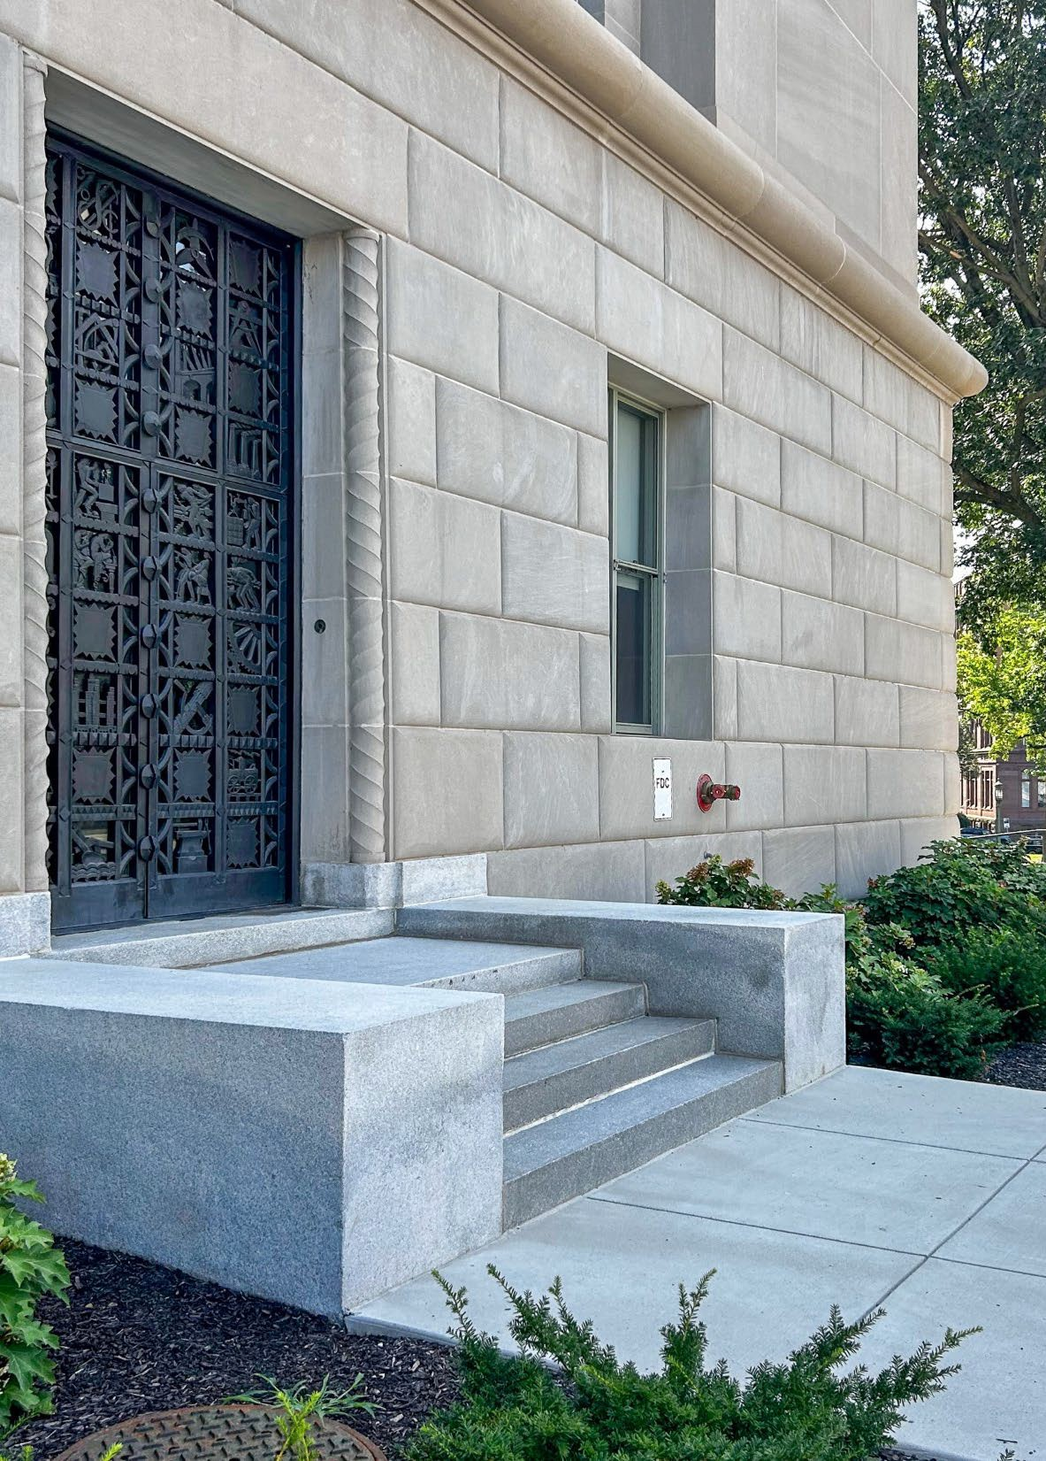

2026
PA EmpowerU - Increasing Food Security on College Campuses: Collaborating with Food Policy Councils

Slide 2

PA EmpowerU Representatives
Ali Caccavella, Special Advisor to the Deputy Secretary & Liaison to the State Board of Higher Education
Jamie Ayrton, Director, Bureau of Postsecondary & Adult Education
Jenny Piper, Chief, Division of Higher Education, Access & Equity
David Stewart, Higher Education Associate II, Division of Higher Education, Access & Equity
Lisa Balsamo, Higher Education Associate II, Division of Higher Education, Access & Equity
Cindy Gebhard, Management Technician, Division of Higher Education, Access & Equity
Michelle Simmons, Administrative Officer, Office of Postsecondary & Higher Education
2

Slide 3

Please introduce yourself in the chat:
Name
School/organization
One word to describe how you’re feeling about food insecurity

Slide 4
Overview
AGENDA
I. Introductions & Warm-Up
II. PA EmpowerU – Increasing Food Security On College Campuses: Collaborating with Food Policy Councils
III.
Presenters:
        Vonda Ramp, M.S., R.D. State Director, Child Nutrition, PA Dept of Education
  Camille Traczek, Deputy Director, Office of Policy, Department of Education
  Katie Kerr, Central PA Food Bank
Mim Seidel, MS, RDN, Mim Seidel Consulting LLC
Q/A/Discussion
Next Steps & Resources

Slide 5
Questions/Answers

Slide 6
Upcoming EmpowerU Related Events:
Oct. 6, 2026, 11 am – 12 noon. Webinar: The Rise of AI: Title IX Considerations for Practitioners .This presentation will help to frame and plan for the ever-increasing presence of AI in the Title IX and compliance fields.
Nov. 10, 2026, 11 am – 12 noon. Webinar: Surviving the Pilot of Peer Education. The goal of this session is to provide support to potential Peer Educator advisors who are interested in developing their own Peer Educator program but are unsure where to begin. Each state of the program’s journey will be framed through the lens of a TV production timeline.
Jan. 26, 2027, 11 am – 12 noon. Webinar: PA Dress for Success. This webinar will introduce our IHE partners to Dress for Success, a leading organization dedicated to advancing women--and, in some cases, men--in the workplace. Attendees will meet their local representatives, learn about the services available, explore how to connect students and colleagues with those services, and discover opportunities to volunteer and support the mission.

Slide 7
Contacts & Post-Webinar Resources 9/22/26
Vonda Ramp, M.S., R.D.
State Director, Child Nutrition Program
PA Department of Education, vramp@pa.gov
Camille Traczek, Deputy Director, Office of Policy
PA Department of Education, ctraczek@pa.gov
Katie Kerr
Central PA Food Bank, kkerr@centralpafoodbank.org
Mim Seidel, MS, RDN
Mim Seidel Consulting LLC, seidelmim@gmail.com

Slide 8
Post-Webinar Resources PA Food Policy Council
Affiliation | Contact | Email
Pennsylvania Food Policy Council | Dawn Plummer | dawplummer@pa.gov
Healthy Franklin County | Noel Purdy | npurdy@wellspan.org
Healthy Franklin County Food Security Task Force | Jay Eury | jeury@sccap.org
York County Food Alliance | JoeAnne Ward-Cottrell | mwardcottrell@wellspan.org
Adams County Food Policy Council | Carly Auchey | cauchey@gettysburg.edu
Adams County Food Policy Council | Matt Moser | mmoser@centralpafoodbank.org
Adams County Food Policy Council | Kathy Gaskin | kgaskin@wellspan.org
Cumberland County Food System Alliance | Xin Li | xli@ship.edu
Dauphin County Food Access Coalition | Katie Kerr | kkerr@centralpafoodbank.org
Erie Food Policy Advisory Council | Stephanie Thauer | consciousfoodproject@gmail.com
Lackawanna County Food Policy Council | Gretchen Hunt-Greaves | ghunt@ceopeoplehelpingpeople.org
Lehigh Valley Food Policy Council | Todd Nemura | todd@bluezones.com
North Central PA Coalition Against Hunger | Katie Kerr | kkerr@centralpafoodbank.org
Philadelphia Food Policy Advisory Council | Dimka Braswell | dimbras@outlook.com
Philadelphia Food Policy Advisory Council | Ash Richards | ash.richards@phila.gov
Perry Council Food Access Coalition | Mallory McClure | info@pcfac.org
Pittsburgh Food Policy Council | Kellie Wild | kelliew@pittsburghfoodpolicy.org
Bucks County Foodshed Alliance | Renee Cauller | renee.cauller.bcfa@gmail.com
Wayne Communities Food Alliance | Jane Bollinger | janebollinger05@gmail.com
Montgomery Food Policy Council | Sam Applefield | Samuel.Applefield@montgomerycountypa.gov
Aliquippa Food Council | Alexandra Jones | info@quipgreen.org
Pottstown Area Food Collaborative | David Kraybill | davek@pottstownfoundation.org
Chester County Food Alliance | Nick Imbesi | nimbesi@chestercountyfoodbank.org
Susquehanna County Food Council | Gretchen Hunt | ghunt@ceopeoplehelpingpeople.org
Crawford County Food Alliance | Stephanie Thauer | consciousfoodproject@gmail.com
Washington County Food Policy Council (in formation) | Sarah Bashore | meiss@pennwest.edu

Slide 9

Contact/Mission
For more information on PA Empower U please visit PDE’s website at pa.gov/education.
The mission of the Department of Education is to ensure that every learner has access to a world-class education system that academically prepares children and adults to succeed as productive citizens. Further, the Department seeks to establish a culture that is committed to improving opportunities throughout the commonwealth by ensuring that technical support, resources, and optimal learning environments are available for all students, whether children or adults.

