Slide 1
Submitting Administrator Changes in FRCPP
May 3, 2024

Slide 2
Access to FRCPP
Log into MyPDESuite
Launch the FRCPP application
Not registered for FRCPP? This guide can help.

Slide 3
Accessing the School Reconfiguration Plan (1 of 2)
Click on the Reports Tab in the upper blue banner
Select the School Services Folder

Slide 4
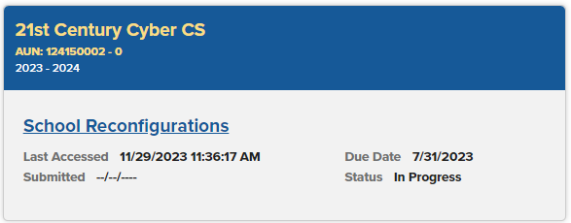
Accessing the School Reconfiguration Plan (2 of 2)
Click on the current School Reconfiguration Plan
If you don’t have access to the School Reconfiguration Plan, this guide can help. You will need to have Viewer and Writer Permission for the Plan.

Slide 5
Administrator Changes
Go to the Administrator Changes page in the School Reconfiguration Plan.
Select the Administrator you are updating (Chief LEA Administrator or Assistant LEA Administrator).
Select the Category Type (New, Renewal, Acting, Substitute, or Extension).
Click Create Administrative Update.

Slide 6
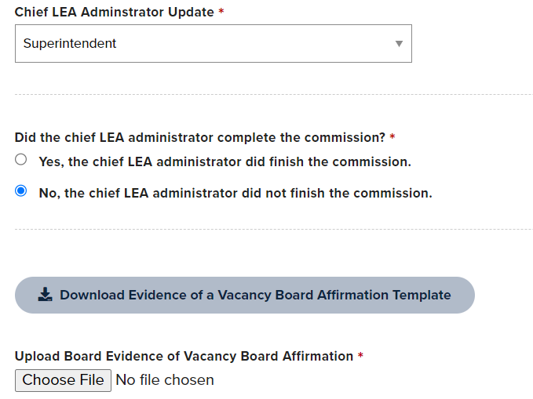
New Commission (1 of 2)
Select the Chief LEA (Superintendent or Executive Director) or Assistant LEA Administrator (Assistant Superintendent or Assistant Executive Director) role you are updating.
If the current commissioned officer listed in EdNA did not finish their commission, select No. This will open the Vacancy Affirmation Template and upload button.

Slide 7
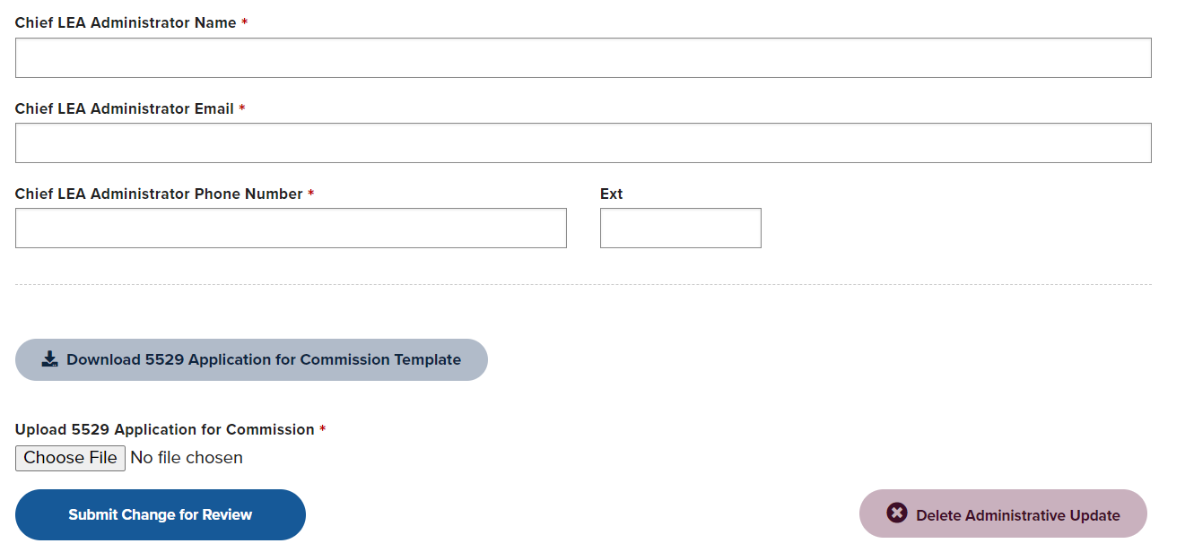
New Commission (2 of 2)
Fill in the new Administrator's Name, Email, and Phone Number then upload the completed PDE-5529 form and submit the change for review.

Slide 8
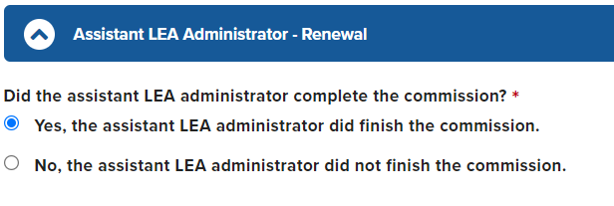
Renewal Commission (1 of 2)
Select the Chief LEA (Superintendent or Executive Director) or Assistant LEA Administrator (Assistant Superintendent or Assistant Executive Director) role you are updating.
As this is a commission renewal, select Yes for the commission completion question.

Slide 9
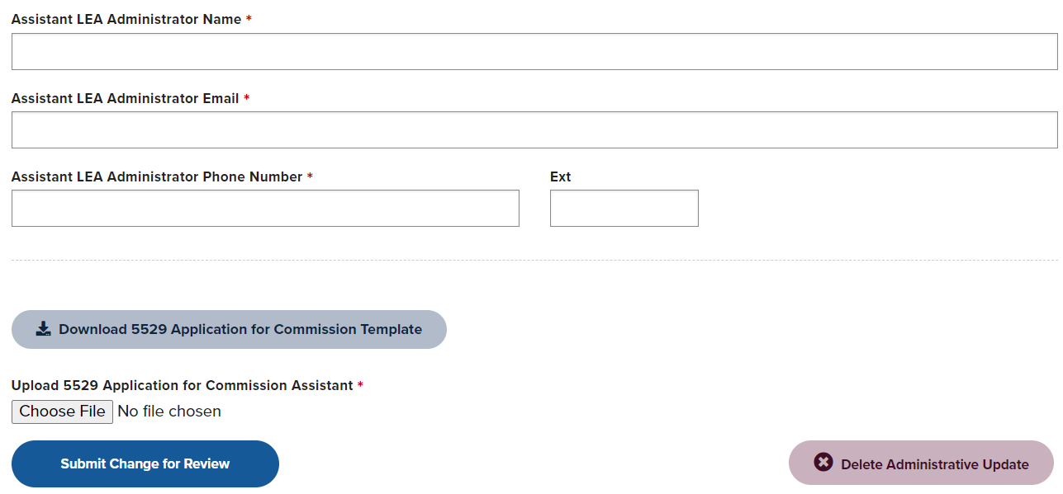
Renewal Commission (2 of 2)
Fill in the Administrator's Name, Email, and Phone Number then upload the completed PDE-5529 form and submit the change for review.

Slide 10
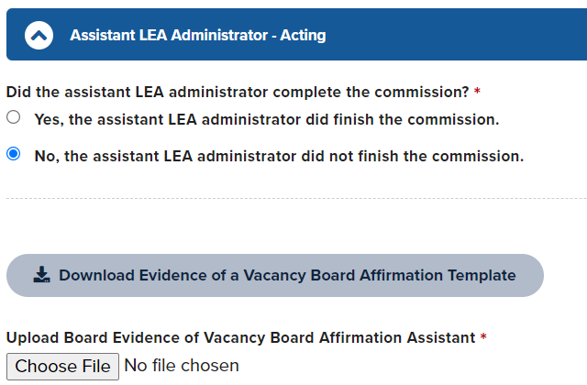
Acting and Substitute (1 of 2)
Select the Chief LEA (Superintendent or Executive Director) or Assistant LEA Administrator (Assistant Superintendent or Assistant Executive Director) role you are updating.
If the current commissioned officer listed in EdNA did not finish their commission, select No. This will open the Vacancy Affirmation Template and upload button.

Slide 11
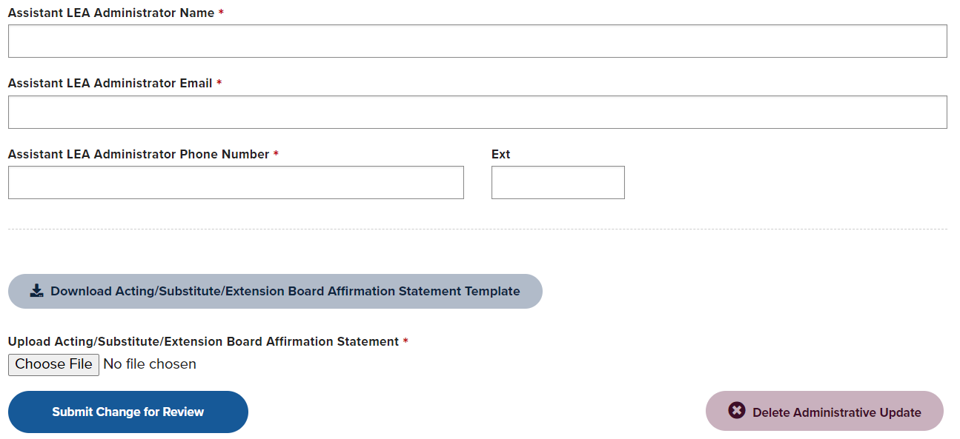
Acting and Substitute (2 of 2)
Fill in the new Administrator's Name, Email, and Phone Number then upload the completed affirmation form and submit the change for review.

Slide 12
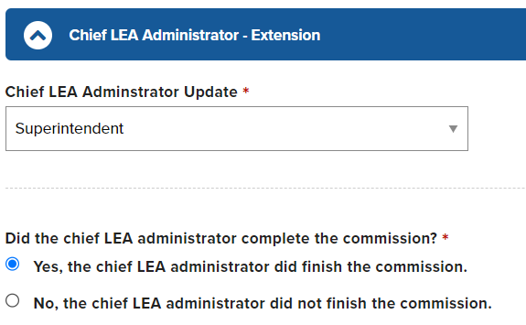
Extension (1 of 2)
Select the Chief LEA (Superintendent or Executive Director) or Assistant LEA Administrator (Assistant Superintendent or Assistant Executive Director) role you are updating.
As this is a commission extension, select Yes for the commission completion question.

Slide 13
Extension (2 of 2)
Fill in the Administrator's Name, Email, and Phone Number then upload the completed affirmation form and submit the change for review.

Slide 14
Contact
For more information on submitting administrator changes in FRCPP please visit PDE’s Commissioned School Officers website.
Need support or have questions? Reach out to the support team at RA-EDFRCPP@pa.gov.

