Slide 1

2019 Pennsylvania State Literacy Plan (PaSLP)

Slide 2
Contact/ PDE Mission
For more information on the PaSLP please visit PDE’s website at www.education.pa.gov
The mission of the Department of Education is to ensure that every learner has access to a world-class education system that academically prepares children and adults to succeed as productive citizens. Further, the Department seeks to establish a culture that is committed to improving opportunities throughout the commonwealth by ensuring that technical support, resources, and optimal learning environments are available for all students, whether children or adults.

Slide 3
History of Pennsylvania Literacy
1977 - A Comprehensive Reading Communication Arts Plan (written by Dr. Morton Botel)
1998 - The Pennsylvania Framework for Reading, Writing, and Talking Across the Curriculum (written by Dr. Susan Lytle & Dr. Morton Botel)
2000 - The PA Literacy Framework (Dr. Jean Winsand, chairman)
2012 - The Comprehensive Literacy Plan (Dr. Rita Bean, chairman)
2019 - Pennsylvania State Literacy Plan (Dr. Rita Bean, chairman)

Slide 4
Purpose of PaSLP
The Pennsylvania State Literacy Plan
(PaSLP) provides:
Districts and charter schools with the guidance and tools needed to develop and implement a local literacy plan;
Leadership with information to facilitate the analysis of local literacy needs and to develop curriculum addressing the needs; and
Leadership with information to develop professional learning experiences for teachers.

Slide 5
Goals
Improve literacy learning outcomes
Create a culture of data-informed decision making
Create 21st century classrooms and schools

Slide 6
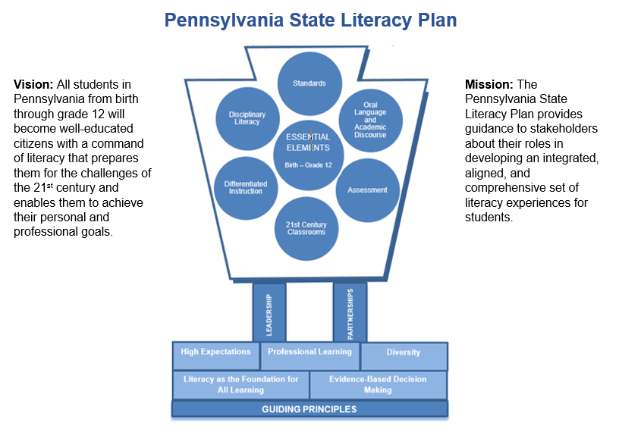
Visual Representation

Slide 7
Guiding Principles
Literacy as a Critical Foundation for all Learning
Diversity
High Expectations
Evidence-Based Decision Making
Professional Learning

Slide 8
Guiding Principle 1
Literacy as a Critical Foundation for All Learning
Being fully literate in the 21st century requires that students:
Read, write, and communicate at high levels;
Construct meaning from and across multiple sources; and
Communicate ideas orally and in writing.

Slide 9
Guiding Principle 2
Diversity
Acknowledge, value, and respect diversity in our schools and classrooms.
Provide educational experiences that enable students to learn about their own culture as well as the culture of others.
Value and acknowledge diversity in our curriculum and instructional practices.

Slide 10
Guiding Principle 3
High Expectations
Belief that all students can gain literacy skills that prepare them to be future ready;
Instruction that addresses the full range of learners and differentiated to meet each student’s needs; and
Well-integrated system connecting general, compensatory, gifted, and special education.

Slide 11
Guiding Principle 4
Evidence-based Decision Making
Literacy programs, practices, and policies must be:
Evidence-based,
Grounded in reliable and valid research results, and
Informed by experiential and contextual evidence (resources for educators).

Slide 12
Guiding Principle 5
Professional Learning
Teach effectively in the schools of the 21st century.
  Understand the mechanisms of reading acquisitions, and
  Address the diverse needs of students in the 21st century
Ongoing, job-embedded learning opportunities promoting lifelong learning and reflective teaching.
  Understand reading psychology and development,
  Understand the structure of the English language,
  Apply best practices in all aspects of reading instruction, and
  Use validated, reliable, efficient assessments to inform classroom teaching

Slide 13
Essential Elements
Standards
Oral Language and Academic Discourse
Assessment
21st Century Classrooms
Differentiated Instruction
Disciplinary Literacy

Slide 14
Essential Element 1
Standards
Literacy programs (birth-grade 12):
  Well-articulated, coherent set of goals based on PDE standards;
  Articulation between all levels, especially at important transition points;
  Reciprocal relationship among the language arts (reading, writing, speaking, and listening); and
  Meaningful integration of literacy experiences.

Slide 15
Essential Element 2
Oral Language and Academic Discourse
Oral language is the foundation for learning and for literacy development.
Speaking and listening are tools of communication that become the basis for the written word.

Slide 16
Essential Element 3
Assessment
Assessment systems should address the dual purposes of assessment (i.e., accountability and informed decision-making).
An effective assessment plan requires:
  inclusion of technically adequate information,
  multiple measures, and
  opportunities for educators to learn how to administer, analyze, interpret, and apply data results to inform instructional practices and improve student learning.

Slide 17
Essential Element 4
21st Century Classrooms
Classrooms must offer students opportunities to develop real-world problem-solving skills that enable them to:
  think critically and creatively,
  work collaboratively with others, and
  analyze, interpret, and synthesize information.

Slide 18
Essential Element 5
Differentiated Instruction
Proponents of differentiation purport that its principles and guidelines are grounded in years of educational research and have roots in theories of learning.
Differentiated instruction is an awareness of and active response to students’ various needs.
Differentiation often requires systemic curriculum adaptations which transcend individual classrooms and require alignment of these practices across classrooms.

Slide 19
Essential Element 6
Disciplinary Literacy
Provides students with supported experiences and opportunities to read, write, talk, and think deeply in service of content learning.
Allows students to experience deep disciplinary literacy as a means of learning content.

Slide 20
Implementing the Plan – Section A
Section A
  Specific action areas and recommendations
    Action Area #1: Standards and Goals
      PDE provides:
        PA Learning Standards from birth to grade 12; and
        Standards Aligned System (SAS) that integrates standards with instruction and assessment available on website.
      Recommendations to districts and charter schools:
        Align curriculum to PA Early Learning and PA Core Standards;
        Increase rigor in meeting PA Core Standards with commitment to high expectations for all students; and
        Utilize SAS to provide professional learning and technical assistance to increase knowledge and use of available resources, including curriculum mapping tool, curriculum frameworks, assessment tools, instructional resources, and transition documents.

Slide 21
Implementing the Plan – Section B
Section B
  Summary of each guiding principle
  Guidance for the various entities that support literacy education
    Guiding Principle 1 – Literacy as a Critical Foundation for All Learning
      Regional Support Agencies:
        Promote professional learning activities that deepen educators’ understanding of the Pennsylvania State Literacy Plan, PA Core Standards, and available resources at the state level.
Districts and Charter Schools:
        Develop literacy programs based on a needs assessment process; programs are coherent, aligned vertically and horizontally, and shared by all.
      Early Learning Providers:
        Seek opportunities to work with schools and families or caregivers to promote early language and literacy learning.

Slide 22
Implementing the Plan – Section C
Section C
  Resources for developing, implementing, or evaluating a literacy plan
    Pennsylvania State Literacy Plan Needs Assessment
      www.education.pa.gov
      www.pdesas.org.
      Complete PA Literacy Needs Assessment
      Partial PA Literacy Needs Assessment
        Step 1
        Step 2
        Step 3
        Step 4
        Step 5

Slide 23
Appendixes
Appendix A
  Building Upon Keystones to Opportunity (2011-2019)
Appendix B
  Professional Learning Opportunities
Appendix C
  Using Student Outcomes Data for Decision Making

Slide 24
Resources - SAS
Standards Aligned System (SAS)
Standards
Assessment
Curriculum Framework
Instruction
Materials and Resources
Safe and Supportive Schools

Slide 25
Resources - PaSLP
  PaSLP
    2019 Pennsylvania State Literacy Plan
    Pennsylvania State Literacy Needs Assessment
    PA Literacy Plan Template
    PA Learning Paths
  PaSLP Toolkit
    PaSLP Visual Representation
    PaSLP Guiding Principles
    PaSLP Essential Elements
    PaSLP Guiding Questions
    PaSLP Reading Focus of Instruction
    PaSLP Writing Focus of Instruction
    PaSLP Language Focus of Instruction
    PaSLP Speaking & Listening Focus of Instruction
    PaSLP Bookmarks
    PaSLP Poster

Slide 26
Contact Information
For more information on ELA updates please visit PDE’s website at www.education.pa.gov.
Should you have any questions regarding this information, please contact:
Rebekah Baum-Leaman, Ed.D. rbaumleama@pa.gov or RA-EDPASLP@pa.gov.
Rebekah Baum-Leaman, Ed.D. | ELA Content and Assessment Advisor
Division of Instructional Quality
Bureau of Curriculum, Assessment and Instruction
Phone: 717.783.6538
rbaumleama@pa.gov | www.education.pa.gov
2019

