Slide 1
Sample Curriculum Materials
Supporting In-car Instruction

Slide 2
Vision and Targeting
Student Targeting Practice
Hand position on steering wheel
Grip of steering wheel
Turning of wheel techniques
Target Identification
Use of Central Vision
Use of Fringe Vision
Turning Head Before Steering
Seeing targeting path
Transition pegs for steering recovery

Slide 3
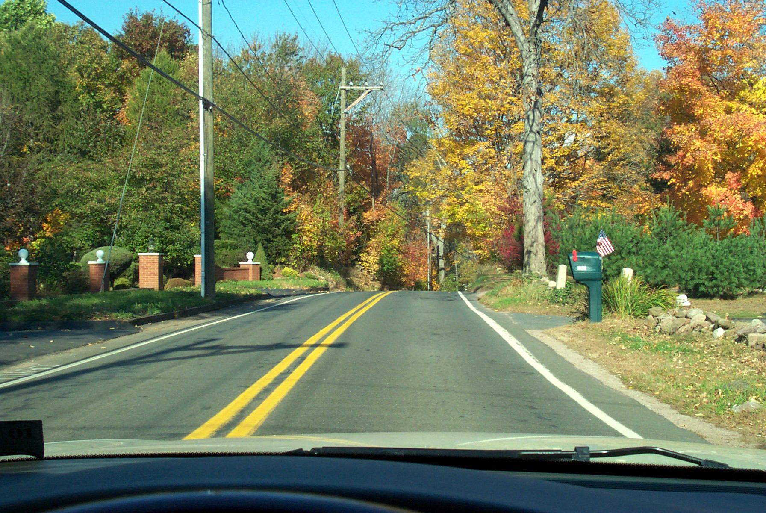
Notes:
Use this slide to teach students how to look to the target area and to practice what they see in the target area.

Slide 4
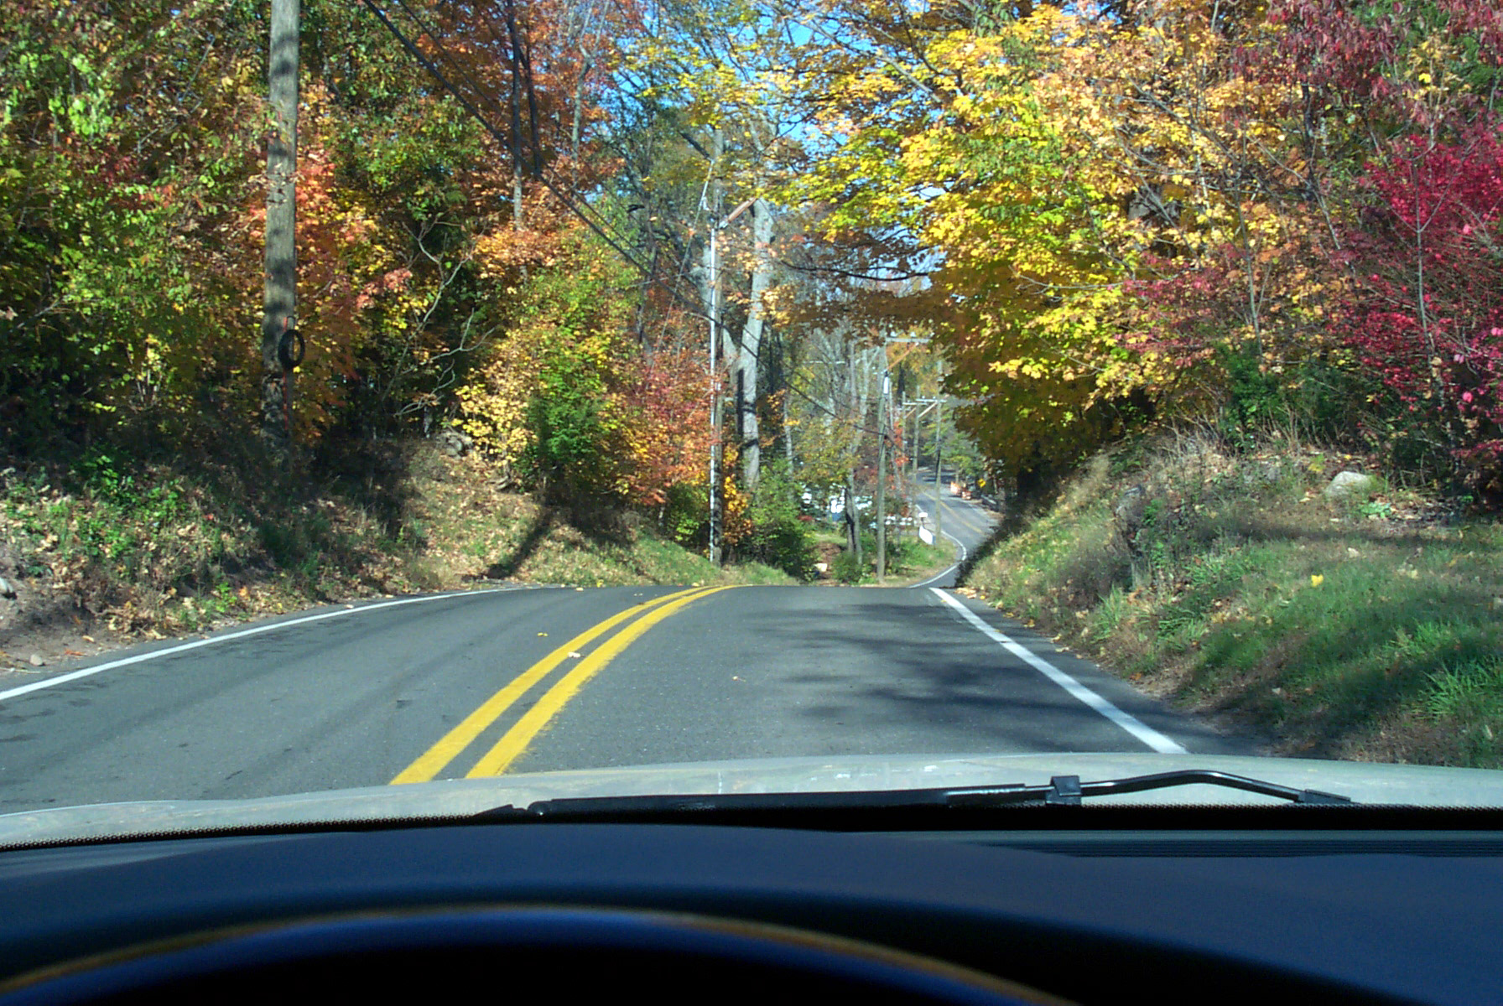
Notes:
Use this slide to teach students how to look to the target area and to practice what they see in the target area. The curves in the road should turn the alert switch on and reduce speed.

Slide 5
Notes:
Use this slide to teach students how to look to the target area and to practice what they see in the target area.

Slide 6
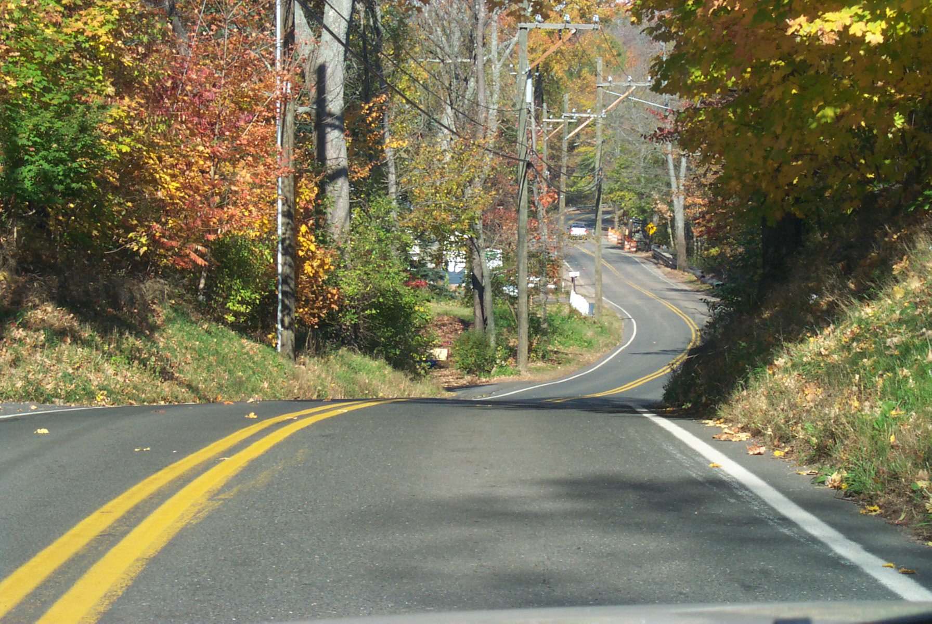
Notes:
Use this slide to teach students how to look to the target area and to practice what they see in the target area. Ask student what risk-generating factors factors they can think of when approaching a curve.

Slide 7
Risk-Generating Factors
While Approaching A Curve
Direction of the curve, left or right
Camber of the road surface
Grade elevation, up, down or level
Loose sand, gravel, water, ice, snow, dew on road surface
Composition of the pavement
Suspension system of the vehicle
Searching location and technique
Steering technique
Speed selection
Direction of the curve, left or right
Camber of the road surface
Grade elevation, up, down or level
Loose sand, gravel, water, ice, snow, dew on road surface
Composition of the pavement
Suspension system of the vehicle
Searching location and technique
Steering technique
Speed selection
Notes:
Review risk factors with class. Excessive speed into a curve kills thousands every year.

Slide 8
SEE Driving System
Search for a sightline or travel-path restriction or change
Evaluate for Open Space
Execute Appropriate Speed Control, Lane Position, and Communication
Notes:
Reminder of the steps of the Zone Control System.

Slide 9
Risk-Generating Factors
Tire pressure
Application of acceleration forces
Application of braking forces
Number of occupants in the vehicle
Seating location of occupants
Drive line entry into the curve
Apex position
Exiting point of the drive line
Driver condition
Driver awareness

Slide 10
4 Seconds to Survive Applied to:
Curve Entry
Approaching Intersection Entry
Approaching Sightline/Travel path Blockage
Following Intervals for Time and Space
Notes:
Vision should relate correct speed control

Slide 11
Driver Control Skills for Curves/Hills
Entry to Curve/Hill
  Vision to Exit
  Deceleration area
  Steer to exit of curve
Apex of Curve/Hill
  Vision to exit
  Transition Point for Speed Adjustment
  Steer to exit of curve
Exit of Curve/Hill
  Vision to new travel path 12-115 seconds
  Acceleration area
  Steer to new travel path

Slide 12
Which Behaviors Do You Need?
Searching To Target Area
Evaluation of 15 second range
Evaluation of 4 second range
Use of Focal and UFOV
How to measure space in Seconds
How to see the intended target area
  End of travel path
Knowing the effects speed has upon control

Slide 13
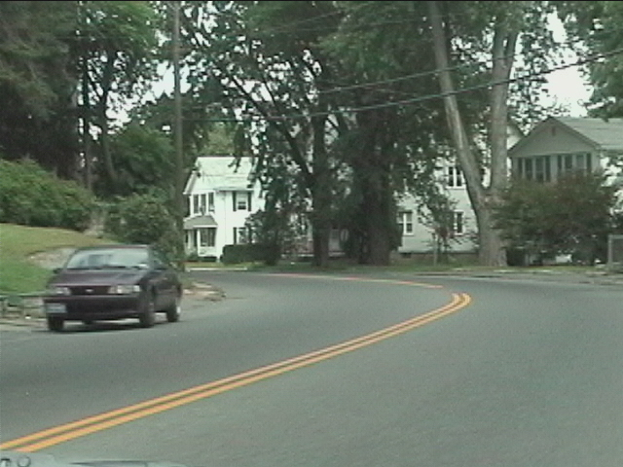
EXIT
APEX
Using sightline to curve/hill exit for determining speed selection into curve/hill
ENTRY
Notes:
Curve creates LOS Blockage

Slide 14
Approach at 30 m.p.h. (5 seconds to exit of curve)
Notes:
Proper speed selection

Slide 15
Approach of 60 m.p.h. (2.5 seconds exit of curve)

Slide 16
Notes:
Two and one-half seconds of road space = speed too fast

Slide 17
Reduce speed when you cannot see the exit with at least 4-seconds of road surface.
EXIT
APEX
ENTRY
Notes:
Four Seconds to Survive will be explained more thoroughly in subsequent NIDB Curriculum Updates.

Slide 18
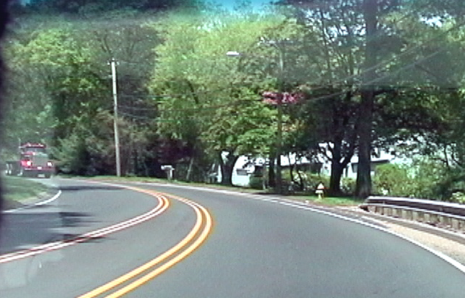
Notes:
Practice looking into curves and visualizing road space.

Slide 19
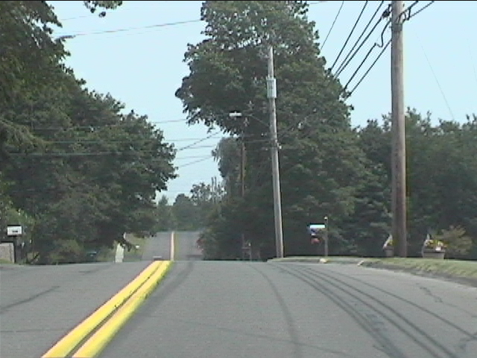
Notes:
LOS blockage due to hillcrest.

Slide 20
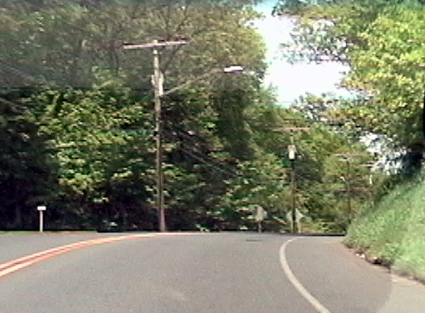
Notes:
LOS blockage due to curve and Hillcrest.

Slide 21
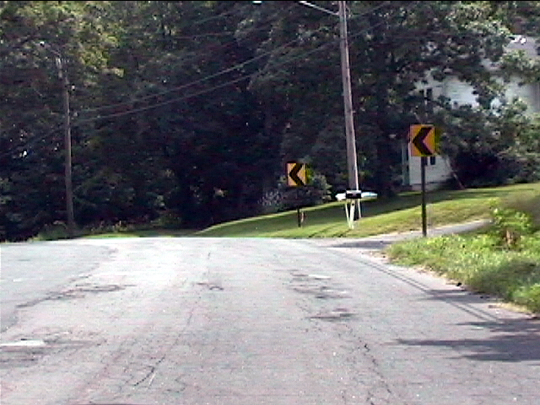
Notes:
LOS blockage due to curve.

Slide 22
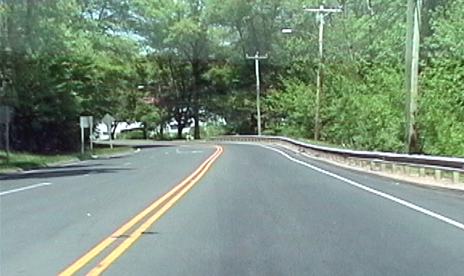
Notes:
See curve in Target Area.

Slide 23
Target Area Searching
Evaluate Targeting Path for Sightline/Path of Travel
Evaluate for Open Space to Exit
Execute Appropriate Speed, Positioning, Control, Communication
Search Target Area for Sightline/ Path of Travel Restrictions
Notes:
Target Area Searching - Review with students

Slide 24
Choosing a Path of Travel
Open Space Restricted Space
Sightline or Path of Travel
Blockage
Notes:
LOS-POT Blockage = Closed Zone = Look for Open Zones = Look for LOS-POT Blockage = Closed Zone = Look for Open Zones…etc…

Slide 25
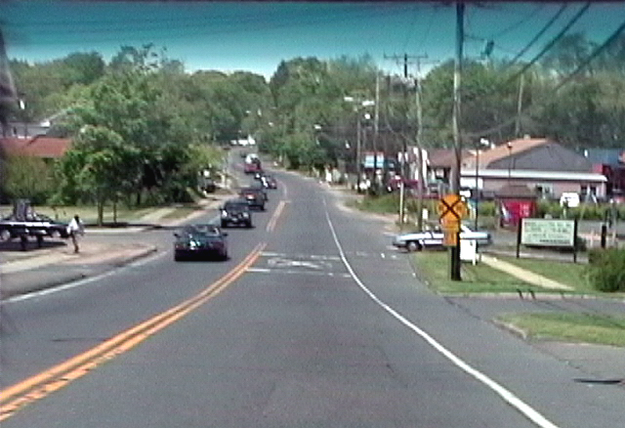

Slide 26
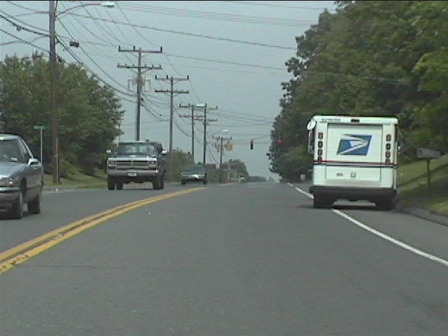
Notes:
Zone Control practice. Have students use the ABC’s for this situation!

Slide 27
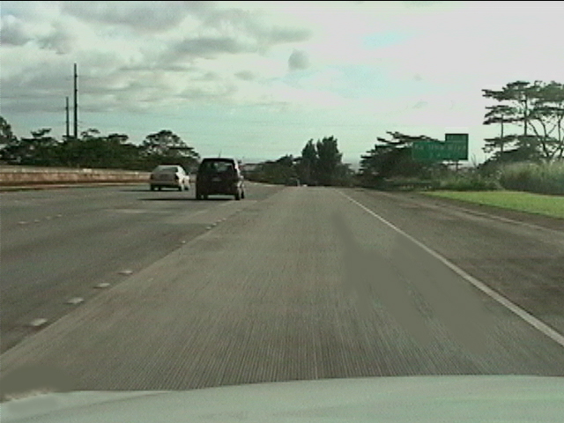
Notes:
Targeting practice.

Slide 28
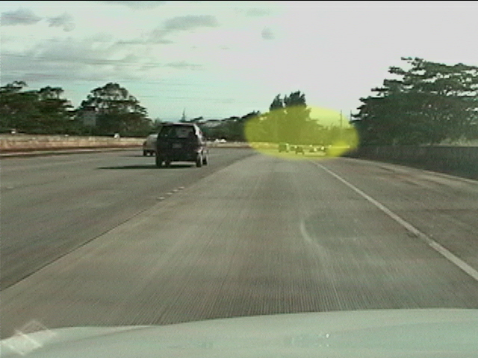
Notes:
Target Area Search.

Slide 29
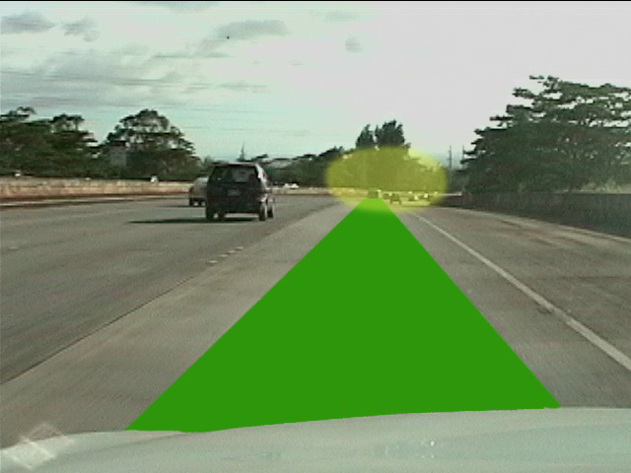
Notes:
Targeting Path and Target Area

Slide 30
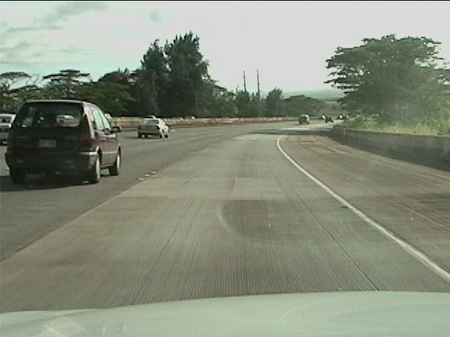
Six Seconds later
Notes:
Looking through a curve for new Target Area

Slide 31
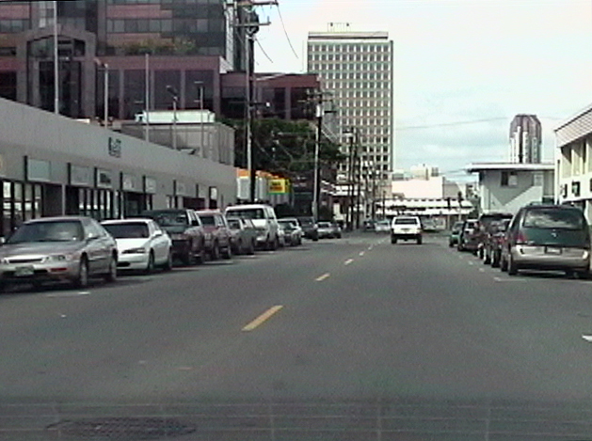
Notes:
What do you see in the target area?
Yes, the building is in the target area which tells us we have a tee intersection there.

Slide 32
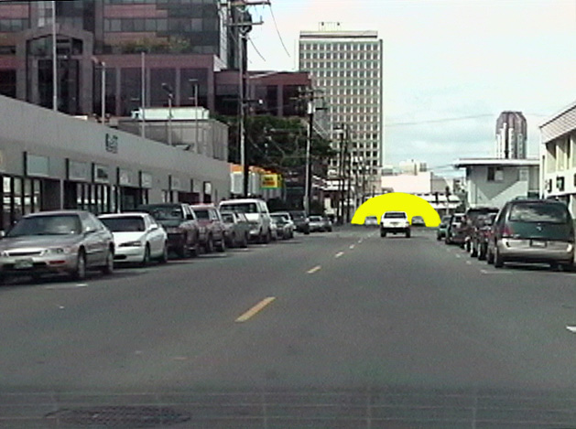
Notes:
Say: What is your best lane position at this moment?
A. Lane position one (center of lane)
*B. Lane position two (to left side of lane)
C. Lane position three (to right side of lane)
D. Lane position four (straddle the center line)
*correct response

Slide 33
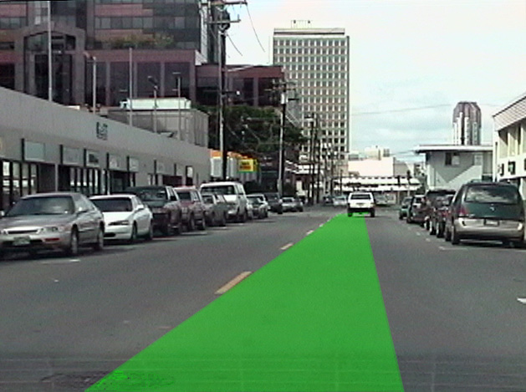
Notes:
Notice the additional space you can be away from the parked cars while taking lane position two as illustrated here.

Slide 34
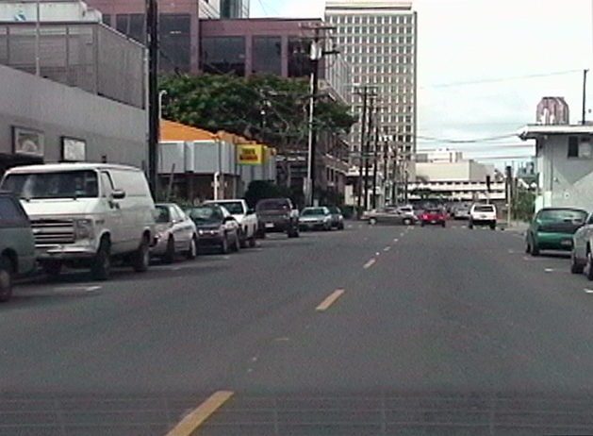
Notes:
Notice how easily you can see the stopped traffic as compared to seeing the red traffic light. It doesn’t matter whether you saw the red light or the stopped traffic, both are causing your front zone to be closed. Therefore, you should manage your speed by decreasing acceleration and begin to make a braking response.

Slide 35
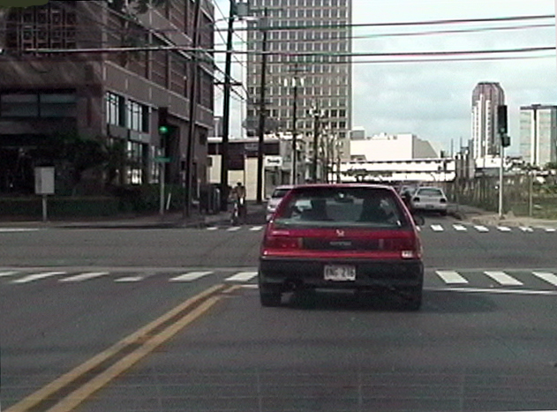
Notes:
By reducing speed after seeing the closed front zone you were able to time arrival into a green light and an open zone.
If you were the driver of the red car how should the intersection be searched before being the first car to move with the fresh green light?
*A. Check the left, front and right zones before moving.
B. Make certain the light is green before entering the intersection.
C. Check left, right and left before moving.
D. Delay two seconds before moving.
* correct response

Slide 36
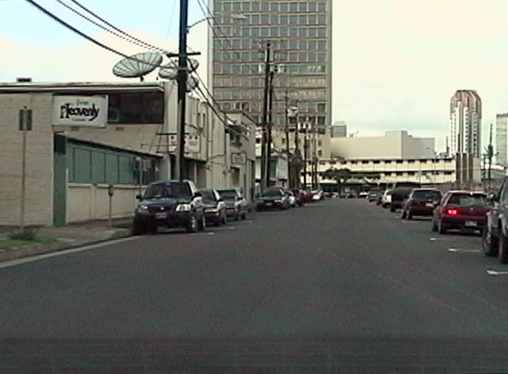
Notes:
What zone change that can affect your path of travel?

Slide 37
Notes:
The parked car with the brake lights on. The car can pull out into your path of travel, the door could be opened into your path, or someone can walk out from in front of the car. All of the problems coming from the right may cause you to take an alternate path of travel. Therefore, you should check your left front zone to see what your options are, before the trap is sprung.

Slide 38
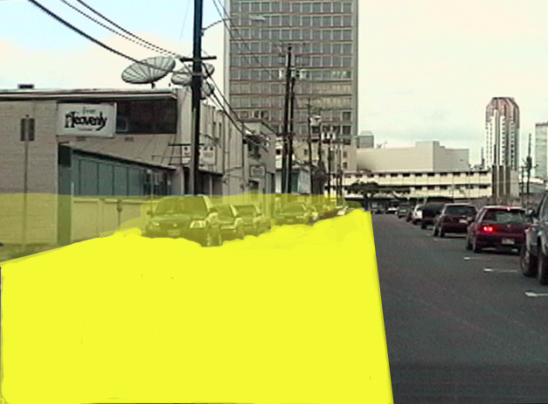
Check Left-front space
Notes:
Check your left front zone to see what your options are, before the trap is sprung.

Slide 39
Clutter
It is easier to find something when there is no clutter

Slide 40
Eliminate Clutter
Clutter is eliminated by drivers focusing on searching for restrictions to Sightline and the Path of Travel

Slide 41
Zone Control and ways to Reduce Clutter
See a
Sightline/Path of travel
Restriction
Search for Sightline/ Evaluate for Open Space
Path of Travel Change
Execute The
Best Control

Slide 42
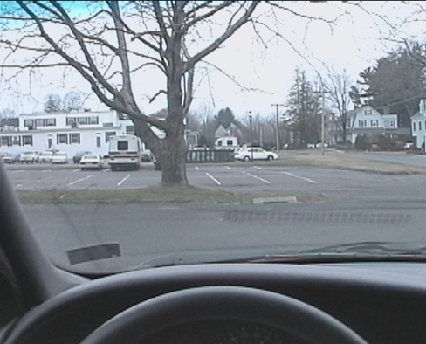
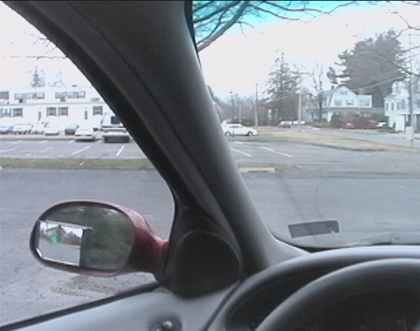
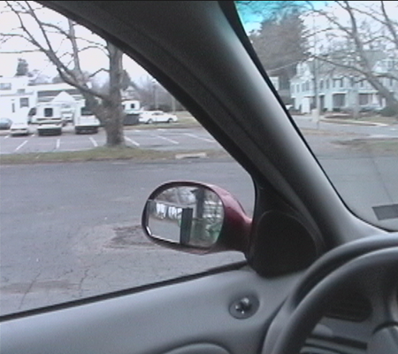
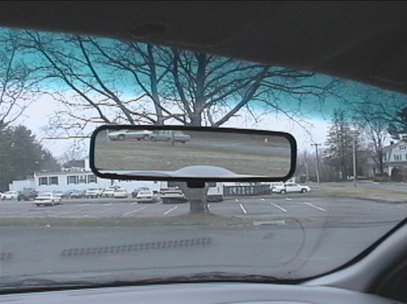
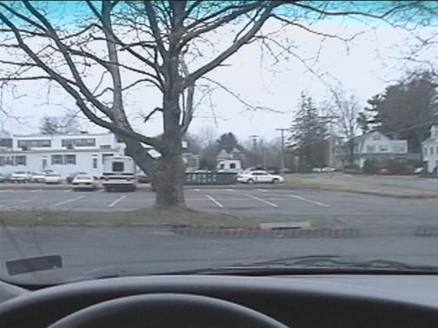
Choosing Targets
Q 1. Which photo shows the earliest stage of a turn being made? How can you tell?
Q 2. Which photo shows the car on-target? How can you tell?
Q 3. Which photo shows the transition peg for making a right turn? How can you tell?
Q 4. Which photo shows the transition peg for making a left turn? How can you tell?
Q 5. Which photo shows the beginning of a traction loss? Which way you turn the steering wheel to correct a traction loss?
Notes:
Use this slide to test student’s understanding of targets, transition pegs and knowing how to react to a situation.

Slide 43
Contact/Mission
For more information on the (the topic of the presentation) please visit PDE’s website at www.education.pa.gov
The mission of the Department of Education is to ensure that every learner has access to a world-class education system that academically prepares children and adults to succeed as productive citizens. Further, the Department seeks to establish a culture that is committed to improving opportunities throughout the commonwealth by ensuring that technical support, resources, and optimal learning environments are available for all students, whether children or adults.

