Slide 1
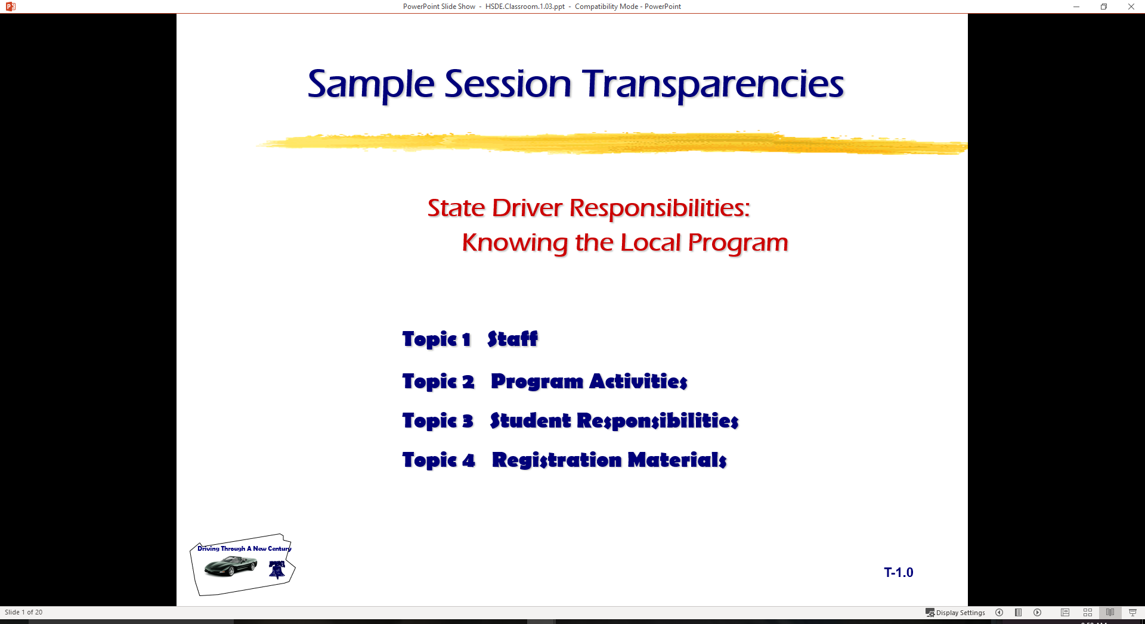
Driver Responsibilities:
Knowing State Traffic Laws
  Topic 1 Your License to Drive
  Topic 2 Right of Way Concepts
  Topic 3 Traffic Control Devices
  Topic 4 Controlling Traffic Flow

Slide 2
Last session
Signs Pretest
Guest Speaker
  Roadway Design
  Engineering Features
  Dealing with Crash Investigations
Driver Audit
Simulation
Traffic Safety Topic for Presentation

Slide 3
Obtaining a State License
Drivers are licensed to ensure basic skills
State residents need a driver license
Commercial License needed for certain vehicles
Commercial License not needed
  operators of pass. trucks, cars, motorcycles, mopeds
  operators of emergency vehicles
  operators of military vehicle
  operators of farm vehicles
  operators of recreational vehicles

Slide 4
Obtaining a State License
State license not required for:
  Armed Forces personnel operating military equipment
  Operators of road machinery, farm tractors, or farm implements
State license not issued to:
  Persons under 16 years of age
  Persons with suspensions or revocations
  Persons with physical or mental impairments unsafe for roadway
  Court rulings for incompetent
  Persons unable to understand signs and signals in English
  Permit holders under 18 that have not graduated, enrolled, or not being schooled at home

Slide 5
Types of State Licenses
Instructional Permit
Provisional License
Classified Driver License
Commercial Driver License
Identification Card

Slide 6
State Graduated Licensing
Must be 16 for permit
Under 18 must have parent signature
School enrollment verification
Must take vision and written test
Distinctive permit issued
Permit limitations
  Midnight-6:00 A
  Accompanied by driver over 21
  Alcohol use prohibited

Slide 7
State Graduated Licensing
Hold permit for 180 days
Pass skills test for license
Under 21 license
  Valid for 90 days past birthday
  Used for identification
Subject to point system
  6 points under 18 suspends license
Zero-Tolerance for alcohol and drugs
Completion of course within one year after licensing

Slide 8
Specialty Information
Allergic Reaction to Drugs
Anatomical Gifts
Health Care Directives
Social Security Information

Slide 9
Licensing Restrictions
Restriction Code
Endorsement Code
Removing Restrictions
Adding Endorsements

Slide 10
Licensing Renewal
Duplicate
  Application
  Costs
  Procedures
Renewal
  Application
  Costs
  Procedures

Slide 11
Suspensions/Revocations
Suspension
Revocation
Cancellation
Mandatory Suspensions
Discretionary Suspensions/Revocations
Individuals Under 21

Slide 12
Inspection/Registration
Vehicle Inspection
Required Equipment
Illegal Equipment
Optional Equipment
Vehicle Registration

Slide 13
Financial Responsibility
  The Liability Insurance Law
  The Safety Responsibility Act
  Evidence of Financial Responsibility

Slide 14
Right of Way Concepts

Slide 15
Right-of-Way Concepts
Drivers at times must wait for other users.
Principles based on giving the privilege of passage to others.
Right of way cannot be taken--not a right or privilege.
Determined by a set of rules and guidelines
  Intersections
  Merges
  Special conditions.

Slide 16
Intersections
Intersections controlled by signs and signals.
Single or two-lane road intersecting with multiple-lane road.
Unpaved road intersection with a paved road.

Slide 17
Intersections
Intersections not controlled by signs and signals, multi-lanes, or pavement.
Turning left.
T Intersections
Railroad grade crossings.

Slide 18
Merge (Lane Change) Areas
Entering or leaving controlled-access highway.
Driving on multiple-lane roadways

Slide 19
Special Situations
Give the Right-of-Way to Emergency Vehicles.
Give the Right-of-Way to School Buses.
Give the Right-of-Way to Pedestrians.

Slide 20
Railroad Crossings
Marked only with a crossbuck sign.
A train is approaching.
Red lights are flashing at a railroad crossing.
Railroad crossing arms have been lowered.
Never stop on tracks.
Be sure all tracks are clear before you proceed across.
Trains do not and cannot stop at crossings.

Slide 21
Signals, Signs, and Markings

Slide 22
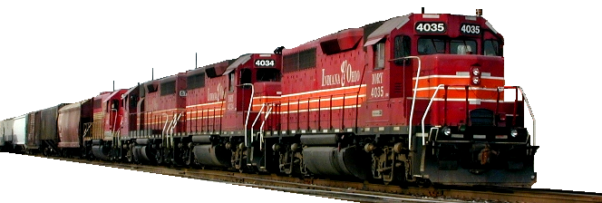
Railroad Crossings
Marked only with a crossbuck sign.
A train is approaching.
Red lights are flashing at a railroad crossing.
Railroad crossing arms have been lowered.
Never stop on tracks.
Be sure all tracks are clear before you proceed across.
Trains do not and cannot stop at crossings.

Slide 23
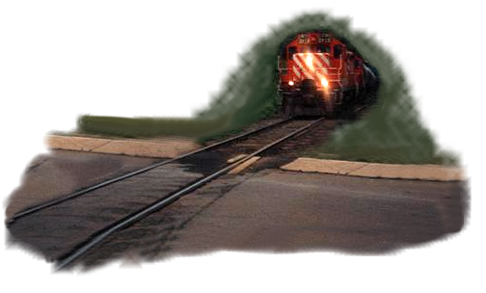
Specialized Intersections
Driver errors cause most of the crashes.
All were trying to beat the train: they lost.
Certain vehicles must stop at all railroad crossings.
If you follow one of these “Must Stop Vehicles,” prepare to stop, since you cannot pass or overtake them at an intersection.

Slide 24
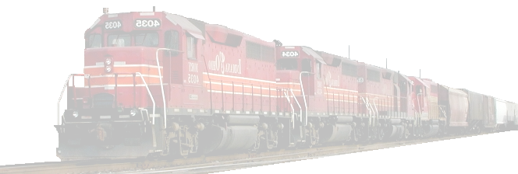
Facts About Trains
Trains cannot stop quickly.
A car moving at 55 mph takes 200 feet to stop.
A train moving at 50 mph takes 1.5 miles to stop.
Trains are not always on schedule.
Since many crossings have 2 or more tracks, a first train can hide a second one.
It is hard to say how fast a train is moving.
There are still crossings that have no warning lights or gates.
It is illegal and dangerous to drive around lowered gates.

Slide 25
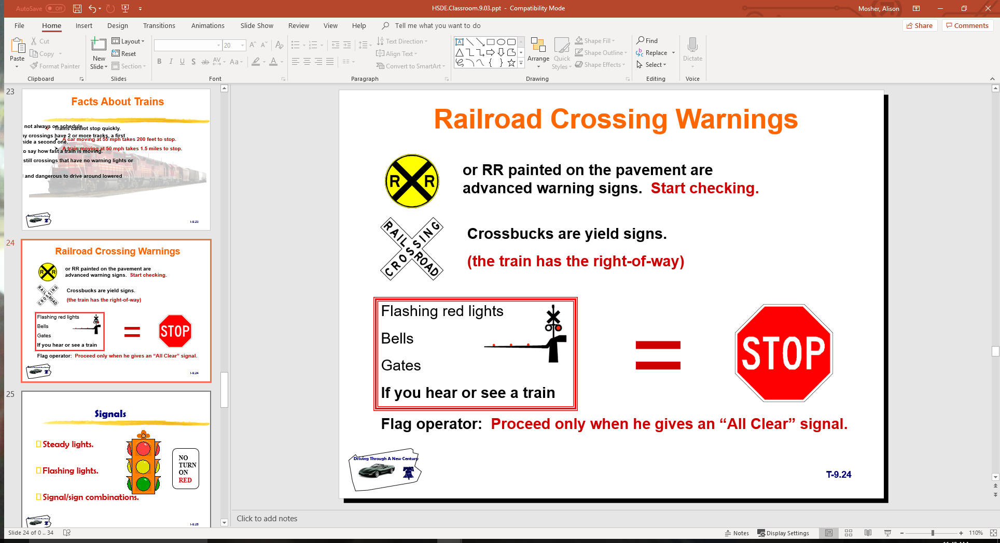
Railroad Crossing Warnings

Slide 26
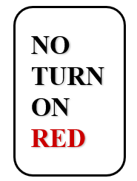
Signals
Steady lights.
Flashing lights.
Signal/sign combinations.

Slide 27
Signs
Warning
Guide
Inform
Regulate

Slide 28
Colors Have Meaning
Red Green
Blue Yellow
Black White
Orange Brown
Fluorescent Optic Yellow

Slide 29
Shapes Have Meaning
Octagon Rectangle (Horizontal)
Triangle Pennant
Diamond Rectangle (Vertical)
Pentagon Round
Crossbuck

Slide 30
Pavement Markings
Two lane rural Three lane, one way
Left turn only lane Multi-lane highways
Solid lines Broken lines
Crosswalks Stop lines
Lane markings

Slide 31
Basic Driving Rules

Slide 32
Signaling
When to signal
How to signal
Improper signal

Slide 33
Passing
Rules
Designated Lanes
Two-lane road
Pass to Right
Mirror Blind Spot /BGE Setting Method

Slide 34
Turning
Steps
Right Turn
Left Turn
Turning Procedures

Slide 35
Next Session
Continue with State Traffic laws…
Bring Laws Handout to class

