Slide 1
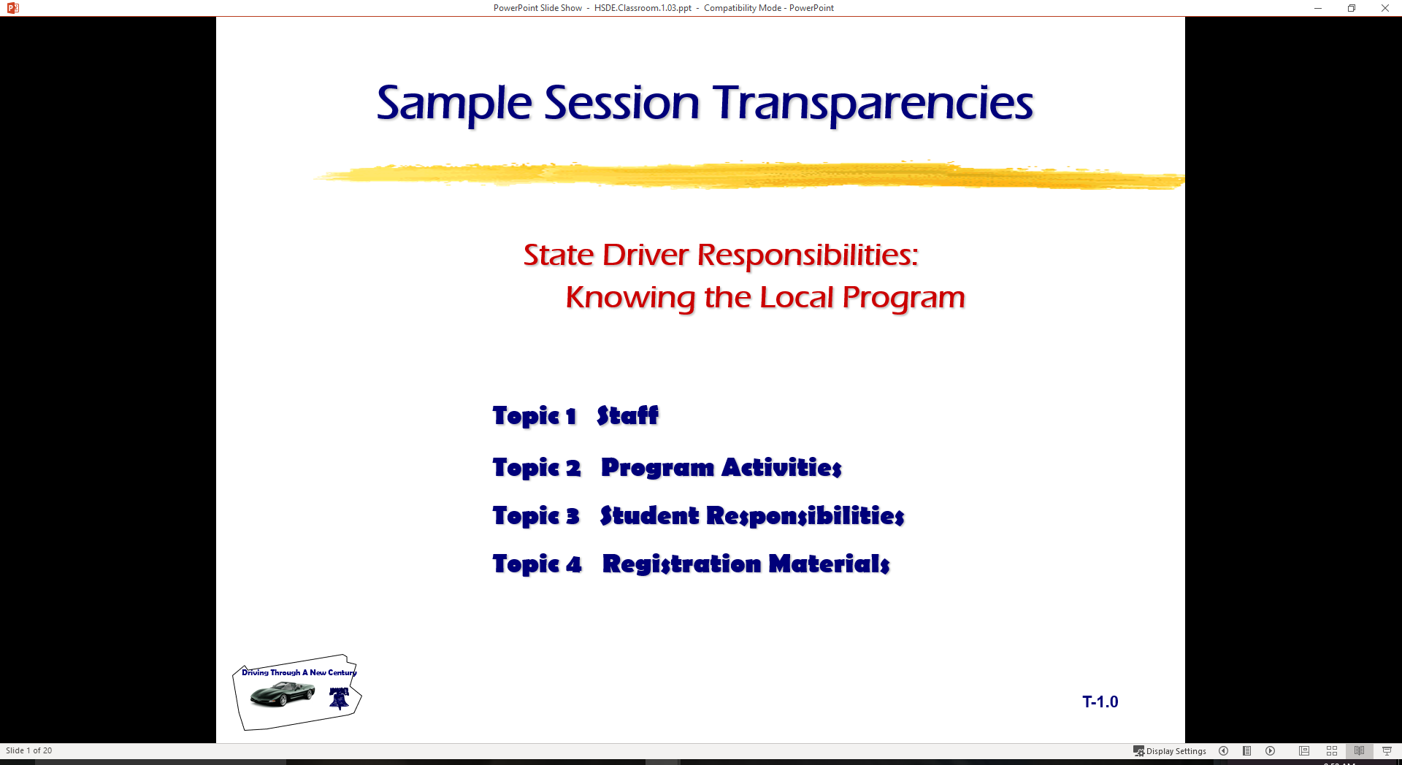
Basic Maneuvering Tasks: Understanding Risk Assessment
  Topic 1 Risk Assessment
  Topic 2 Driver Responsibilities
  Topic 3 Good Driving Practices
  Topic 4 Signs Pre-Test

Slide 2
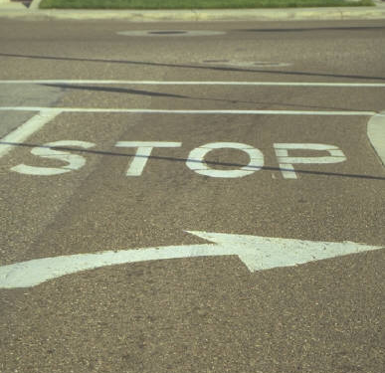
Introduction
Last Session
  Determining Risk and
  Responsibilities
    Legal Responsibilities
    Social Responsibilities
    Moral Responsibilities
This Session
  Risk Assessment
  Risk Reduction Decisions
  Signs, Signals, and Markings
  Pre-test

Slide 3
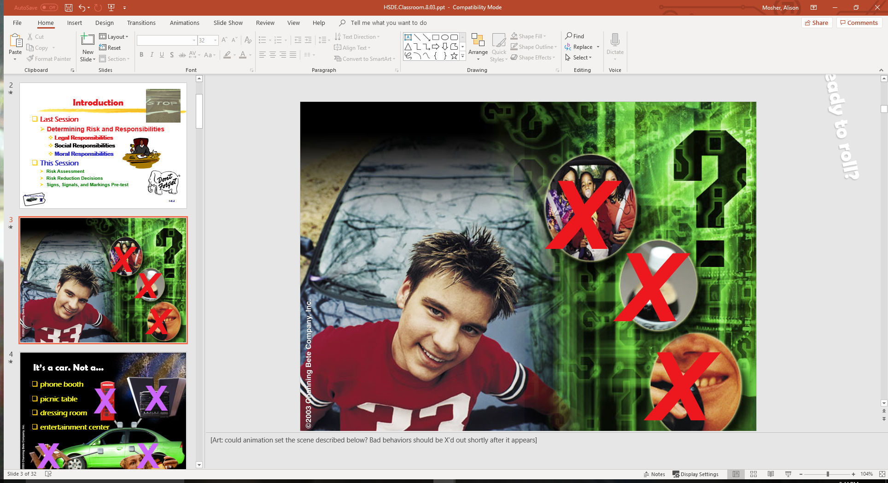
Ready to roll?

Slide 4
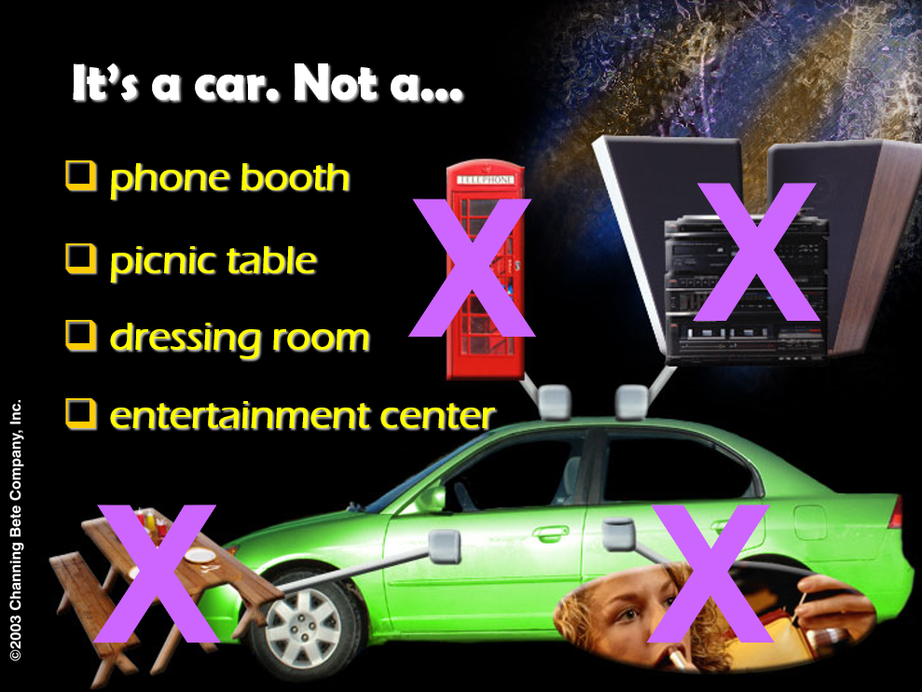

Slide 5
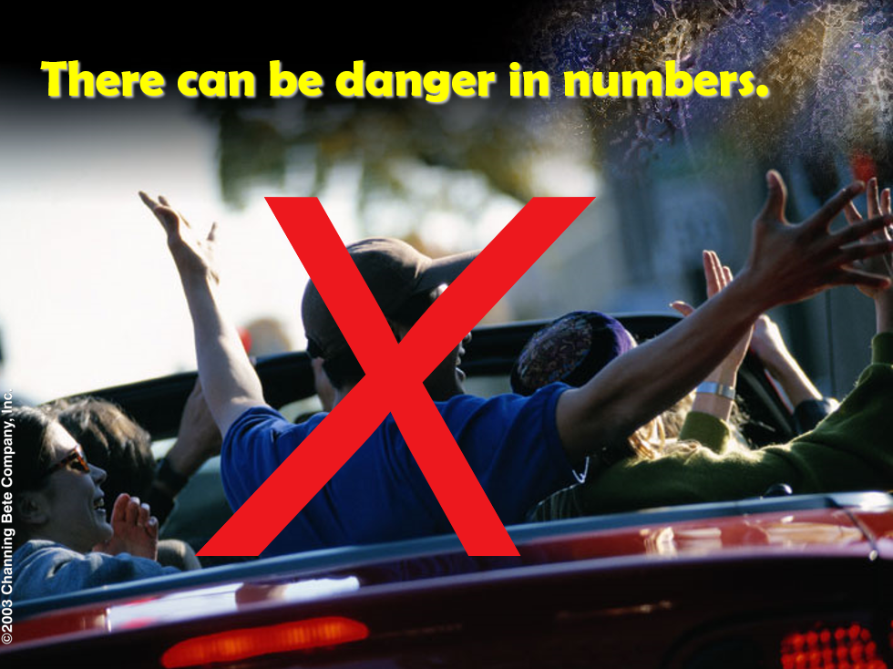

Slide 6
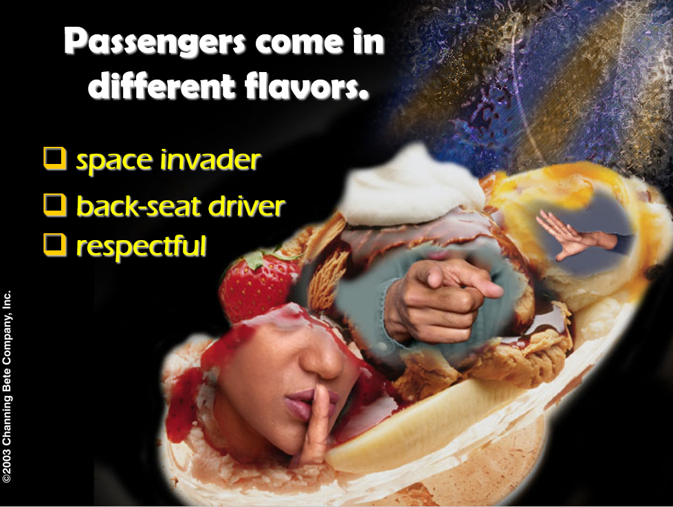

Slide 7
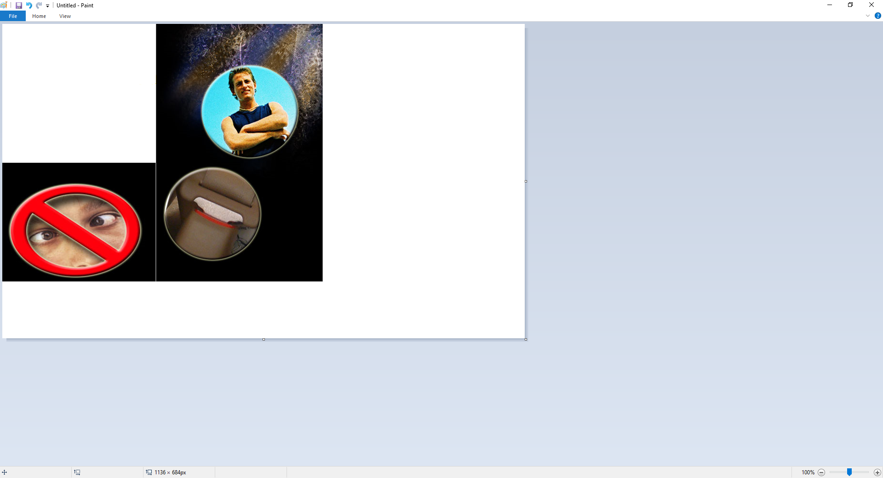
Control car chaos.
Set clear rules.
Require safety belts.
Keep troublemakers out.

Slide 8
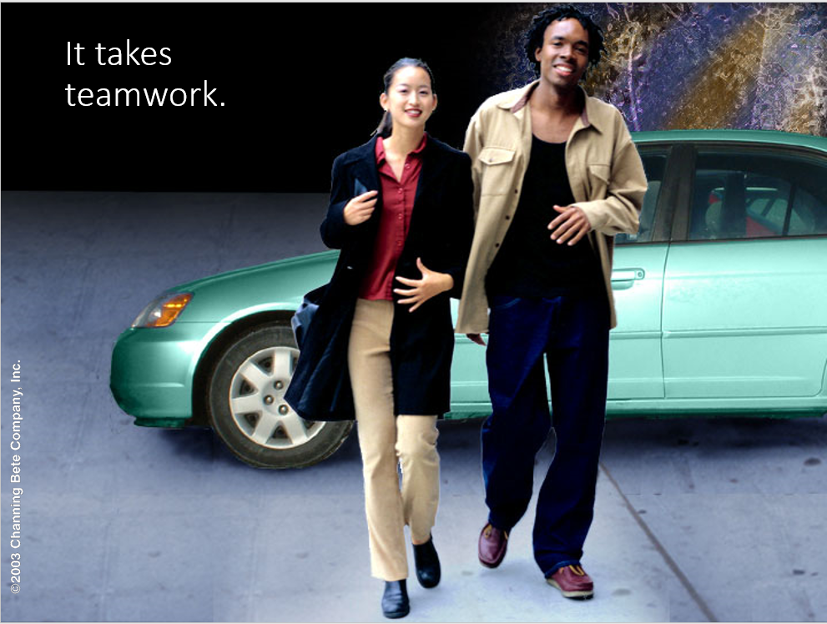

Slide 9
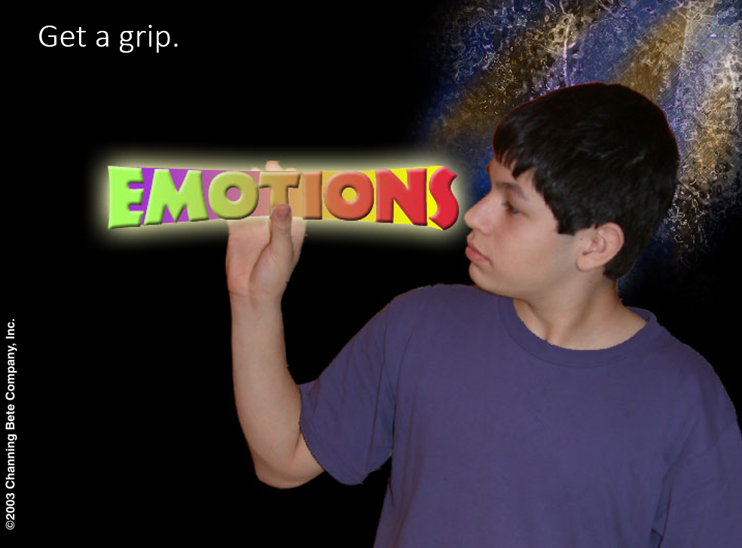

Slide 10
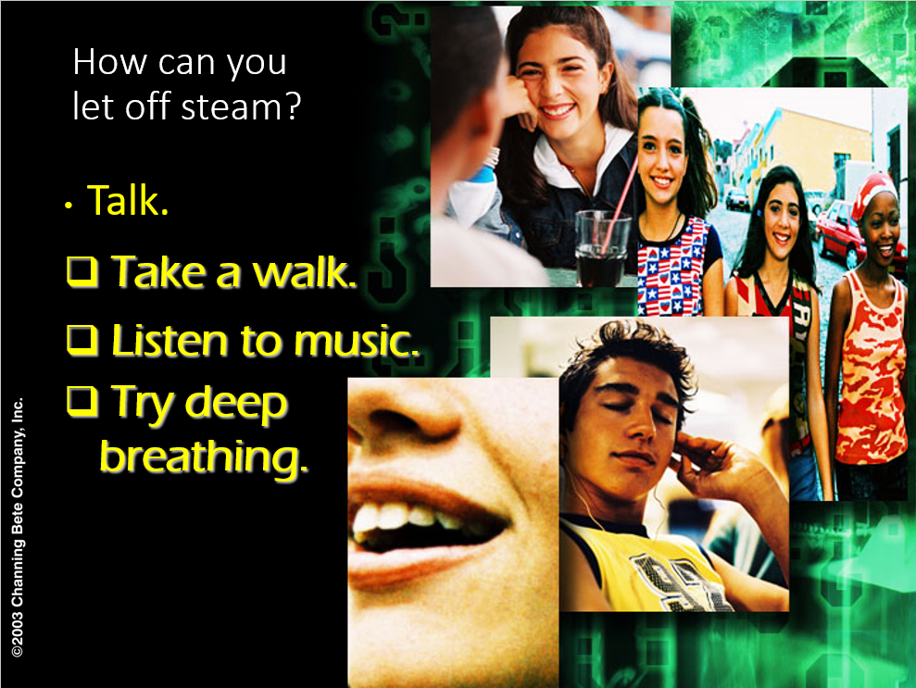

Slide 11
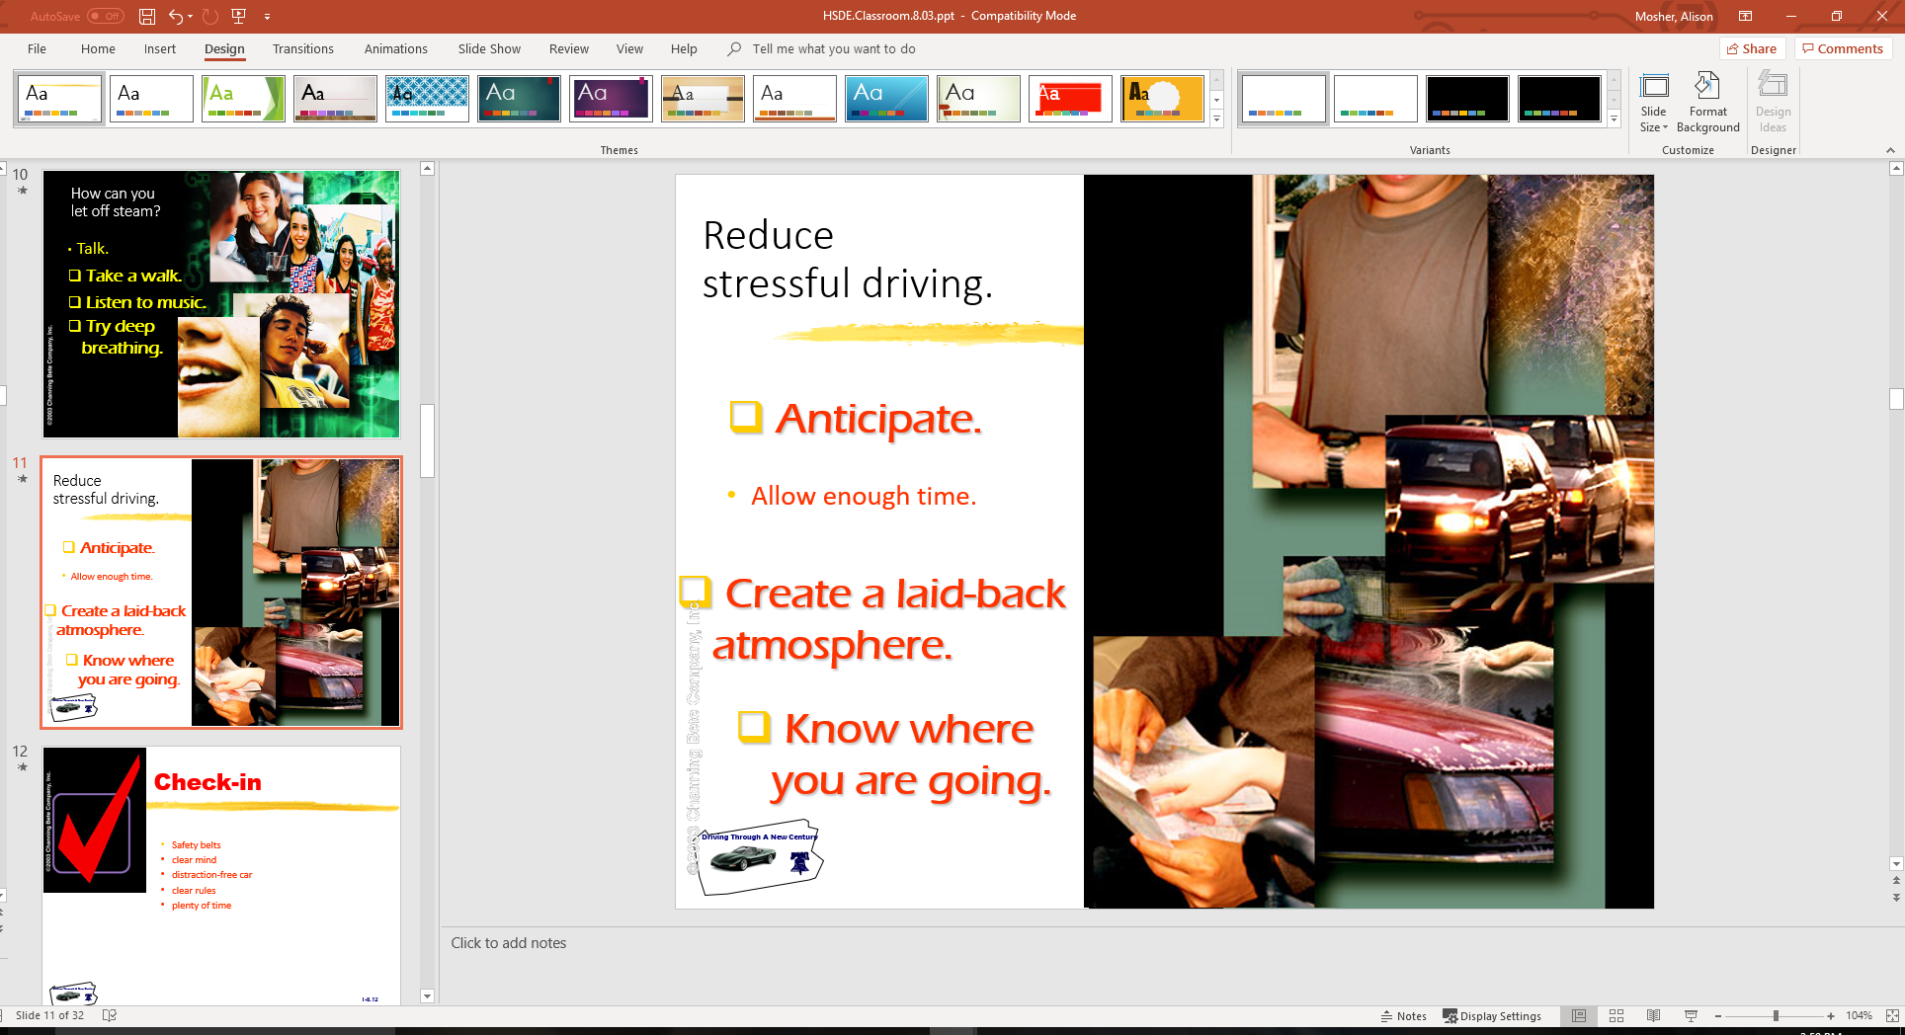
Reduce stressful driving.
Anticipate
  Allow enough time
Create a laid back atmosphere
Know where you are going

Slide 12

Check-in
Safety belts
Clear mind
Distraction-free car
Clear rules
Plenty of time

Slide 13
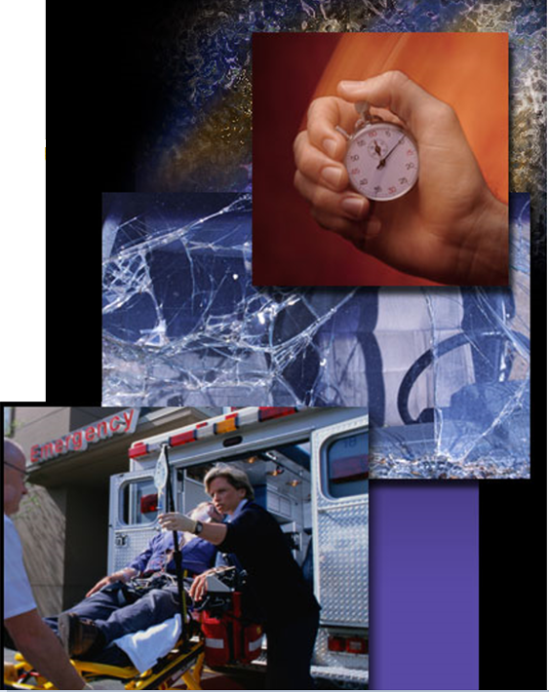
Don’t get caught in the speed trap.
Time flies.
Time is lost.
Time stops dead.

Slide 14
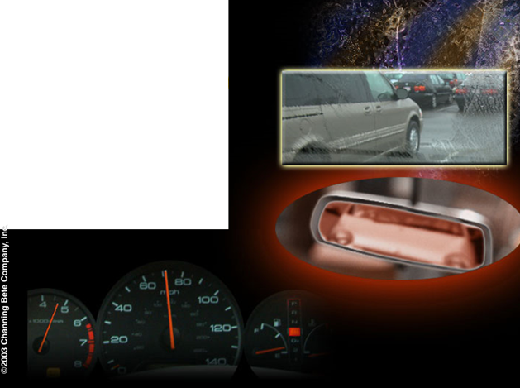
The question of speed
Pack effect
Emotions
Lack of concentration

Slide 15
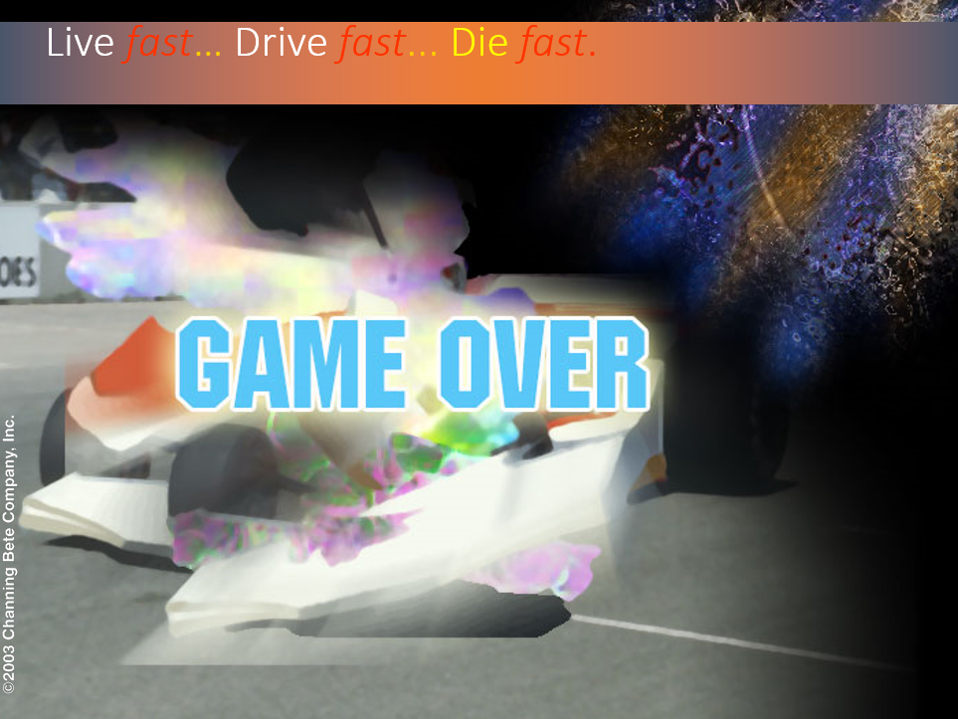

Slide 16
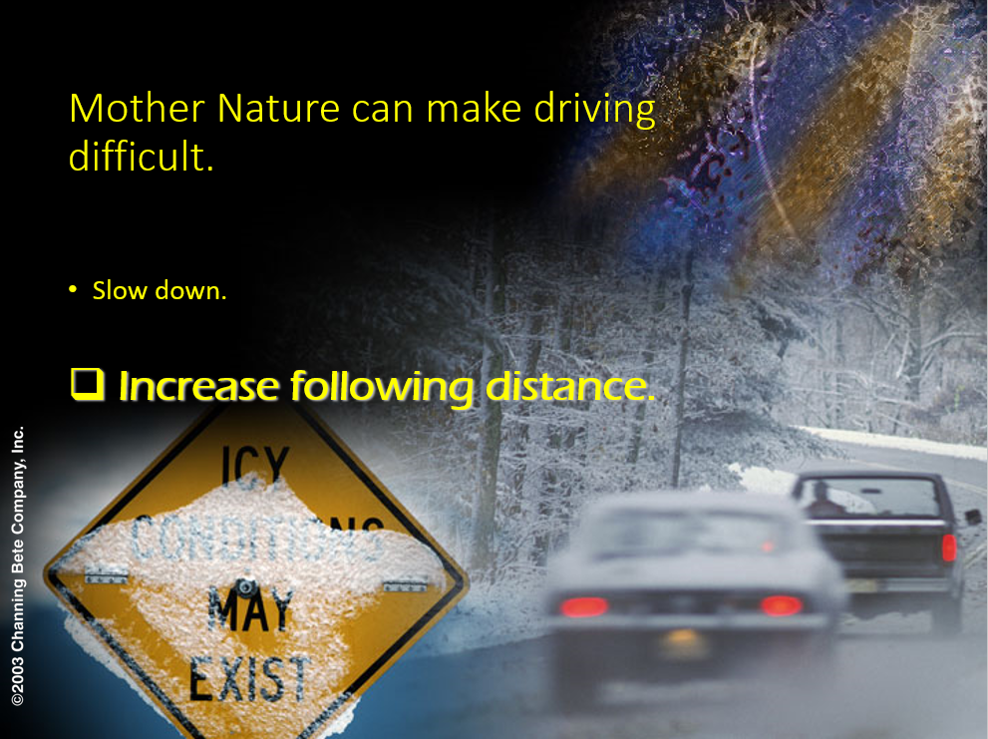

Slide 17
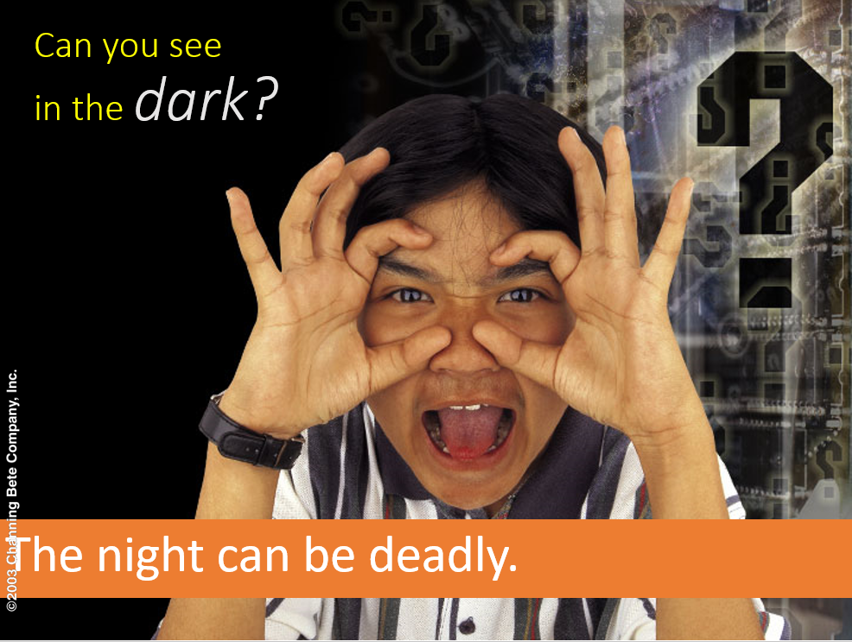

Slide 18
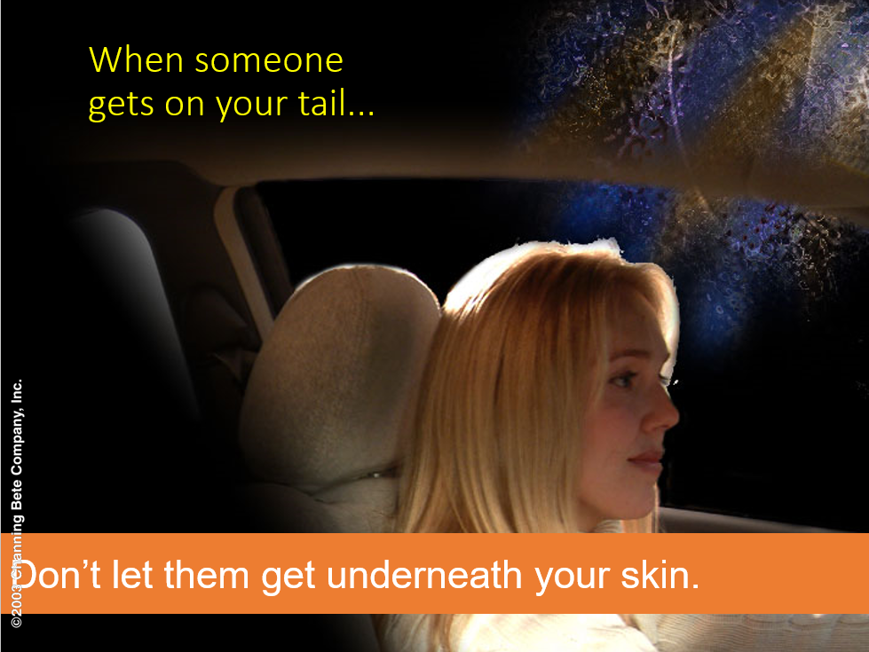

Slide 19
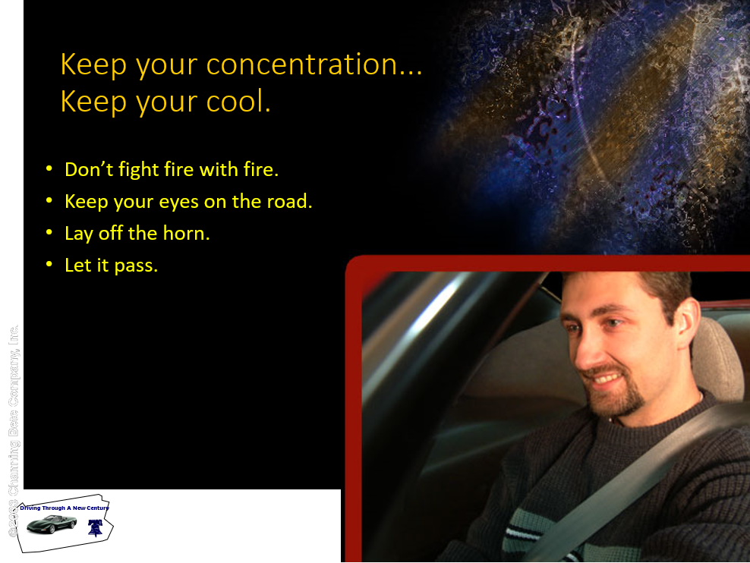

Slide 20
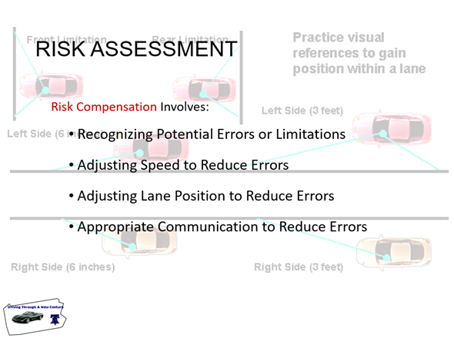

Slide 21

Doing Things Right
Decision-making is the most important driver skill
Procedural tasks vs. Processing tasks
Learning from good and bad experiences
Learning by observation

Slide 22
Doing Things Right
Procedures and experience equals habits
Work for developing best procedures and experience
Greater the resistance to change often means the greater the need for changing habits

Slide 23
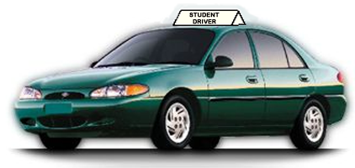
Guided Practice
Practice is key to sound habits and judgments
What to practice is important
Good habits and judgment deteriorate over time

Slide 24
Guided Practice
Majority of drivers rate themselves as good
Good versus poor procedures and processing
Poor driving experiences develop poor driving behaviors

Slide 25
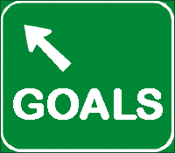
Traffic Safety Education Goals
Make every driving sequence a good driving sequence
Use processing techniques to make judgments
Develop sound procedures for maneuvers

Slide 26
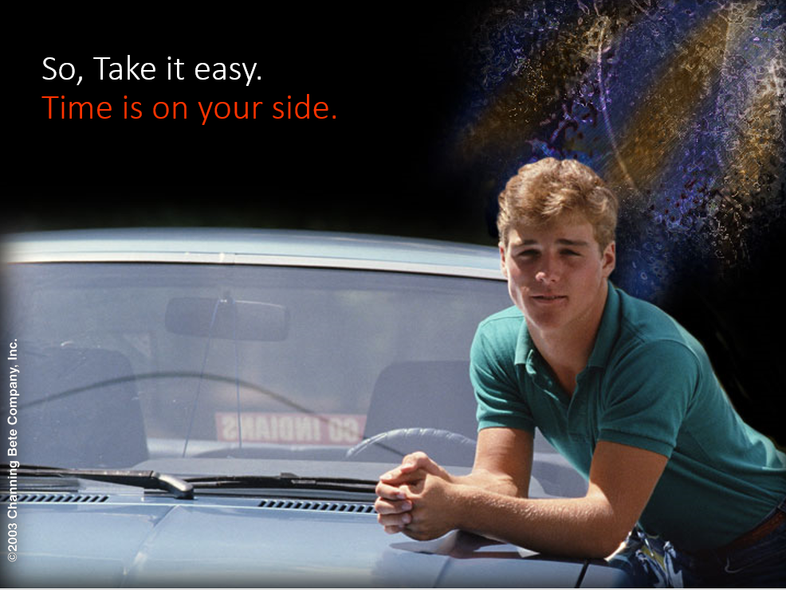

Slide 27
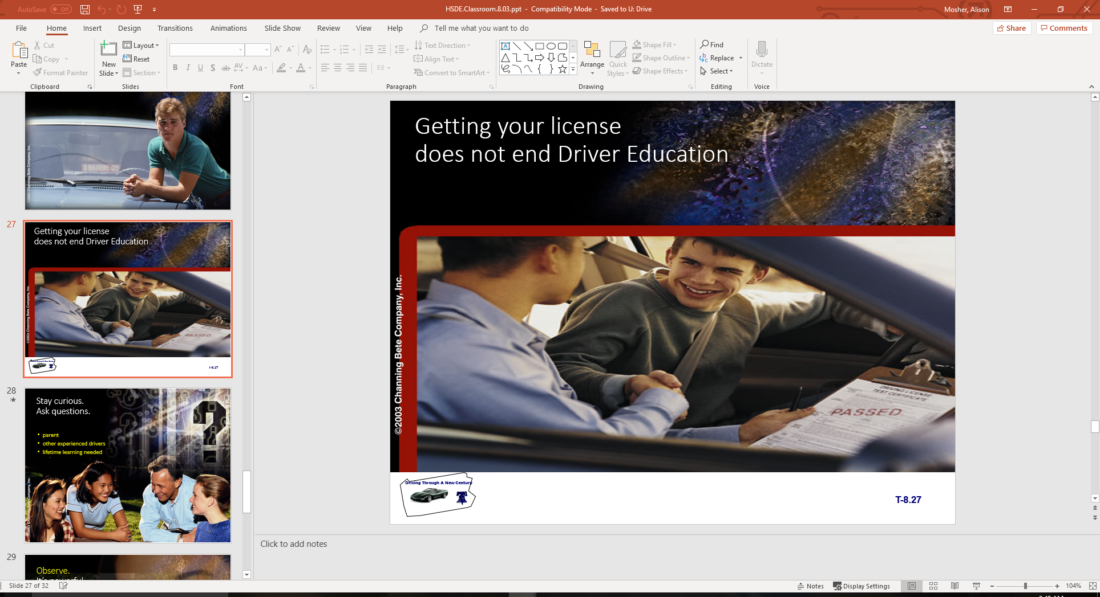

Slide 28
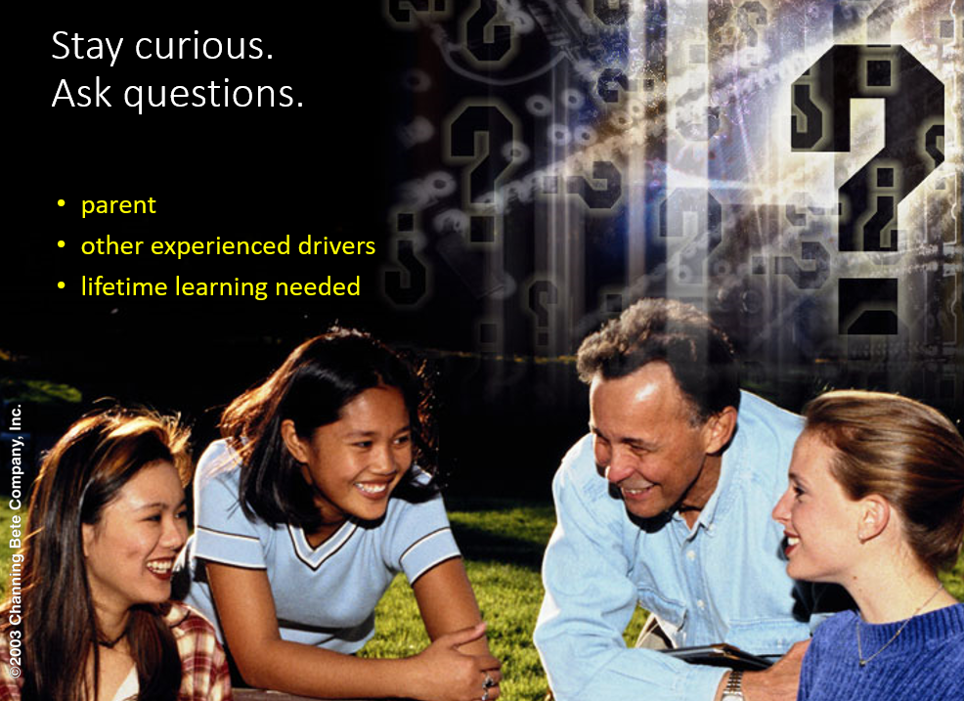

Slide 29
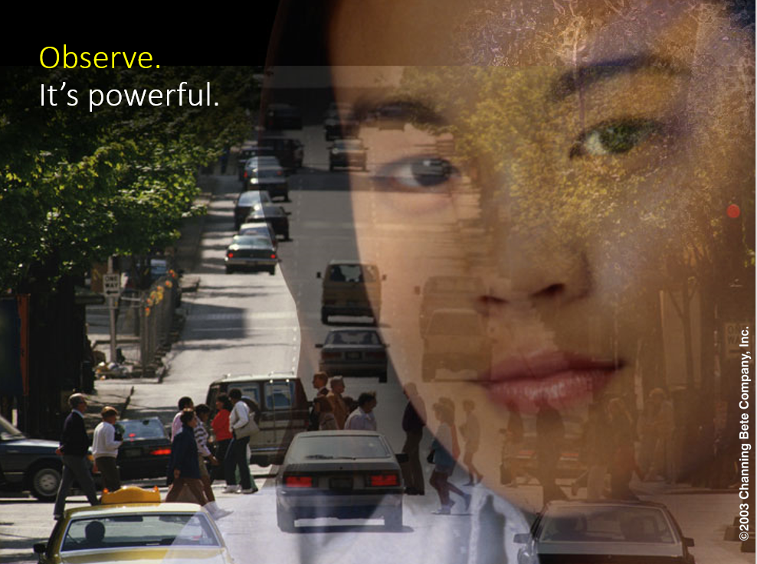

Slide 30
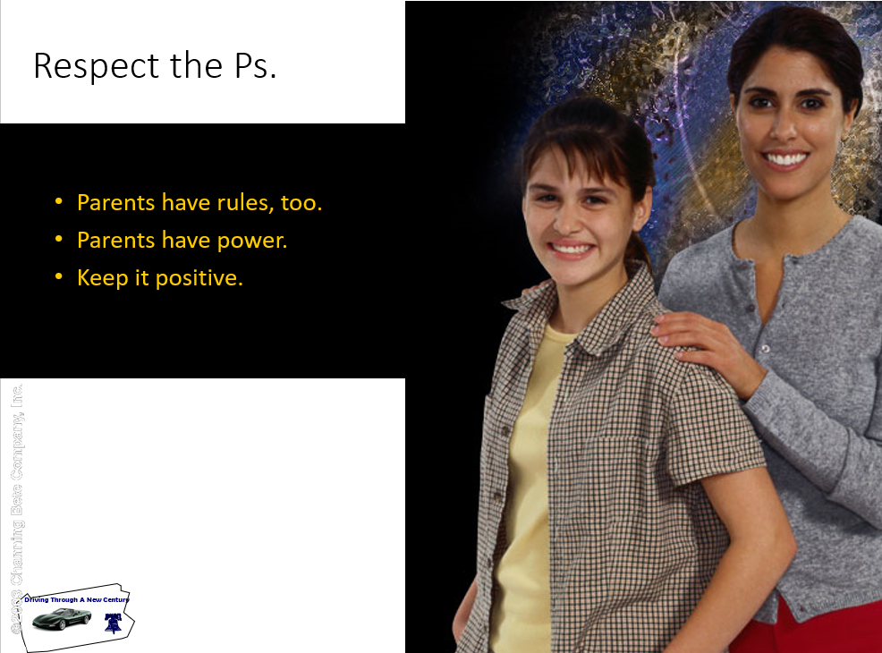

Slide 31
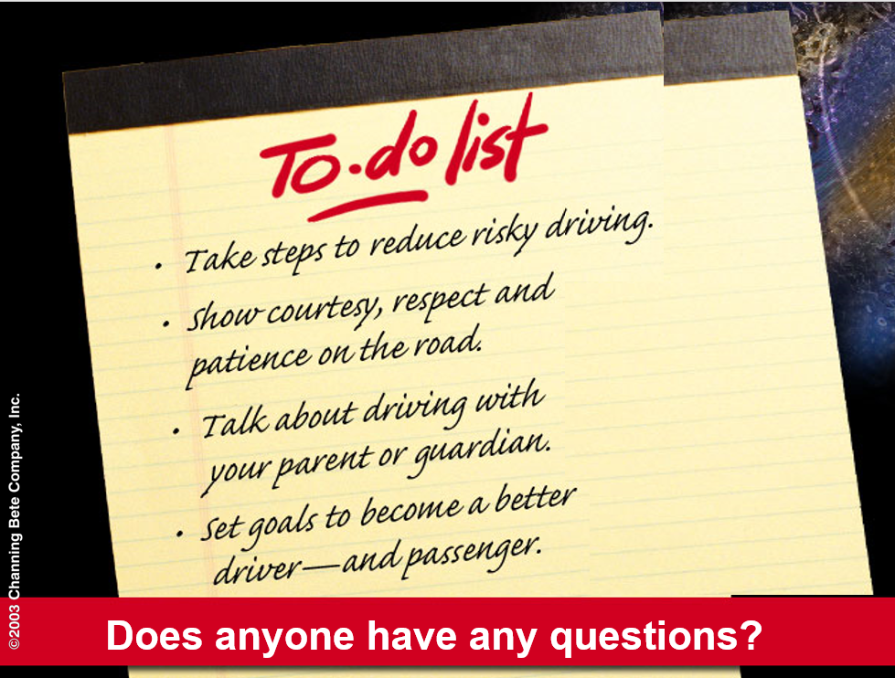

Slide 32
Assignment
Range Lesson Completion
  Vehicle Space
  Reference points
  Both groups on Range
State Rules and Regulations
  State Signs Pre-test
  Guest Speaker
  Signs, Signals, and Markings is next topic

