Slide 1
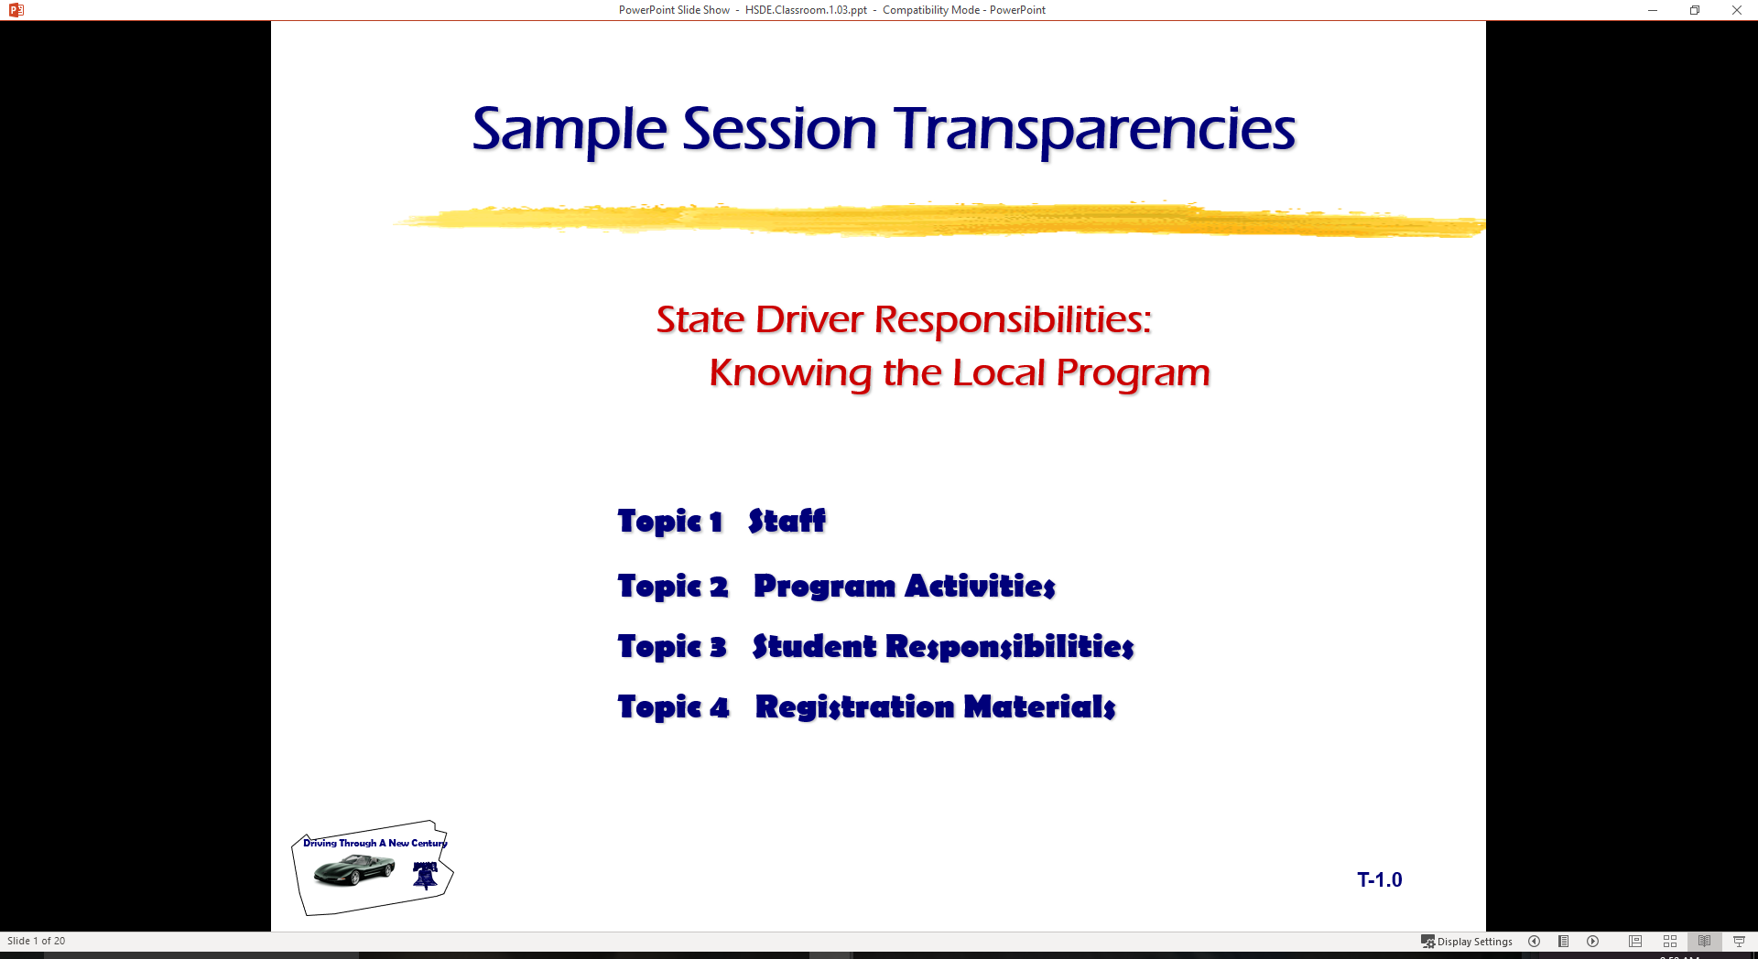
State Driver Responsibilities:
Knowing Your Capabilities
  Topic 1 Controlling Your Vision
  Topic 2 Perception and Training
  Topic 3 Central Space
  Topic 4 Dealing with Blind Zones

Slide 2

Introduction
Classroom
  visual skills
  blind zones
  central space area
Range Lab Activity
  knowing your limitations
  effect of 2 mph on vehicle control
  using your vision effectively
S E E

Slide 3
Vision and Perception
Seeing Techniques
Perceiving Techniques
In-Car Habits

Slide 4
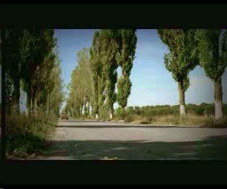
Effects of Misperceptions

Slide 5
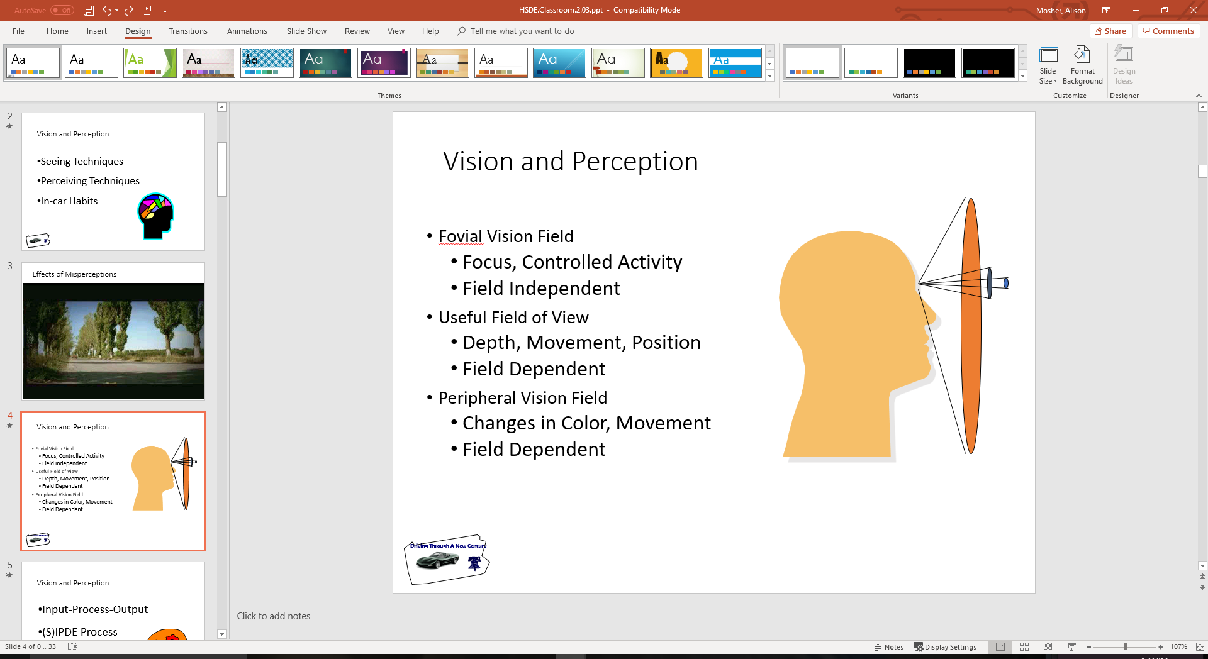
Vision and Perception
Fovial Vision Field
  focus, controlled activity
  field independent
Useful Field of View
  depth, movement, position
  field dependent
Peripheral Vision Field
  changes in color, movement
  field dependent

Slide 6
Vision and Perception
Input-Process-Output
(S)IPDE Process
Time Relevant

Slide 7
Vision and Perception Systems
Identify Process (Searching)
SEE System- search for open LOS/POT
Perceptual Driving System- scan, path of travel, space cushion
Zone Control System- look for LOS/POT restrictions
Smith System- aiming high, eyes moving, getting big picture

Slide 8
Vision and Perception
Predict Process (Evaluating)
SEE- evaluate space for speed or position adjustments
Perceptual- 2 sec/4 sec/12 sec, hazard criticality
Zone Control- changing or closed zones
Smith- big picture, a way out of situation

Slide 9
Vision and Perception
Decide Process (Evaluating)
SEE- evaluate space for speed or position adjustments
Perceptual- minimize, separate, compromise
Zone Control- check for open space
Smith- leave yourself an out

Slide 10
Vision and Perception
Execute Process (Responding)
SEE- execute communication, speed, or position change
Perceptual- communicate, speed, or position change
Zone Control- communicate, speed, or position change
Smith- make sure others see you

Slide 11
Vision and Perception
Following Interval
SEE- use a 4 second minimum and adjust for weather conditions
Perceptual- 2 sec minimum, 3 or more seconds based on conditions
Zone Control- gaining 4 seconds minimum or more based on conditions
Smith- 1 car for 10mph ( now 2-3 seconds)
National Safety Council- use 3 second minimum plus I sec for each mitigating factor

Slide 12
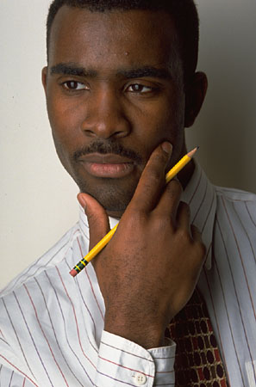
Perception
Being Perceptive is a Learned Process
Perceiving Problems Takes Time
Managing Visual Inputs Is Critical
Managing Time and Space is Primary Decision Tool

Slide 13
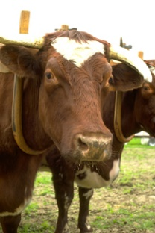
Language Example
Saville, Der Dago
Tousin busis inaro
Nocho, Demis troux
Summit cowsin
Summit doux

Slide 14
Language Example
Aoccdrnig to a rscheearch at an Elingsh Uinervtisy, it deosn't mttaer in waht oredr the ltteers in a wrod are, the olny iprmoetnt tihng is taht frist and lsat ltteer is at the rghit pclae. The rset can be a toatl mses and you can sitll raed it wouthit porbelm. Tihs is bcuseae we do not raed ervey lteter by it slef but the wrod as a wlohe.

Slide 15
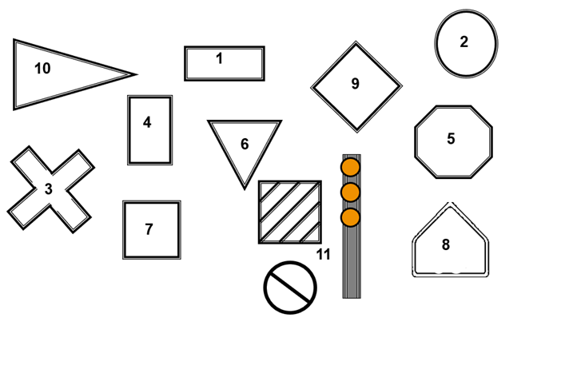
Language of Driving

Slide 16



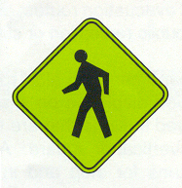




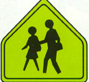

Language of Driving
ONE WAY
STOP
YIELD

Slide 17
Read This!
Buckle
Up For
For Safety

Slide 18
Read This!
What did it say?
Did you see...
  Buckle Up For For Safety
Why?

Slide 19
Imaging Effects
A
B
Which center image (A or B) looks larger?

Slide 20
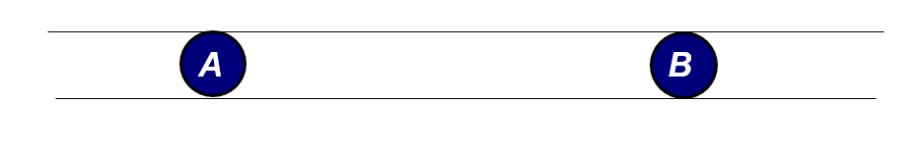
Imaging Effects
They are equal...

Slide 21
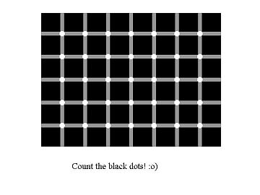
Imaging Effects
Visual Memory Imprint
Dots follow your focal vision.
Try staring at center box only to stop movement.

Slide 22
Your Brain Sees?
INTERSTATE
.
80

Slide 23
Your Brain Sees?
.

Slide 24
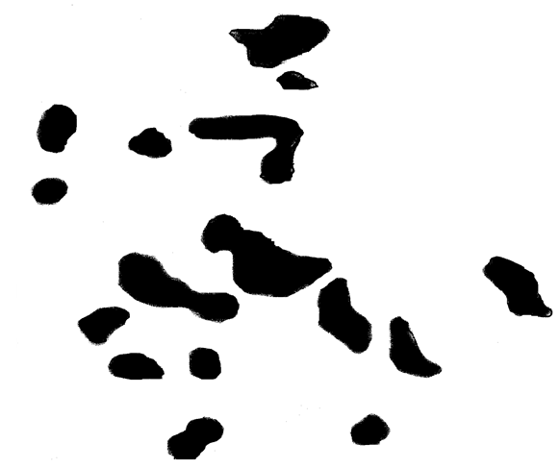
Your Brain Remembers

Slide 25
What Did You See?
A Horse and Rider?

Slide 26
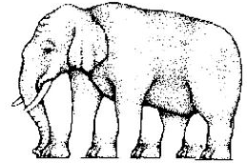
Visual Imagery Fools Brain Perception

Slide 27
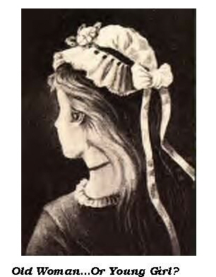
Visual Imagery Fools Brain Perception
What Do You See? …
The Old Woman or
The Young Girl

Slide 28
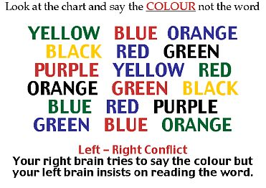
Visual Imagery Fools Brain Perception

Slide 29
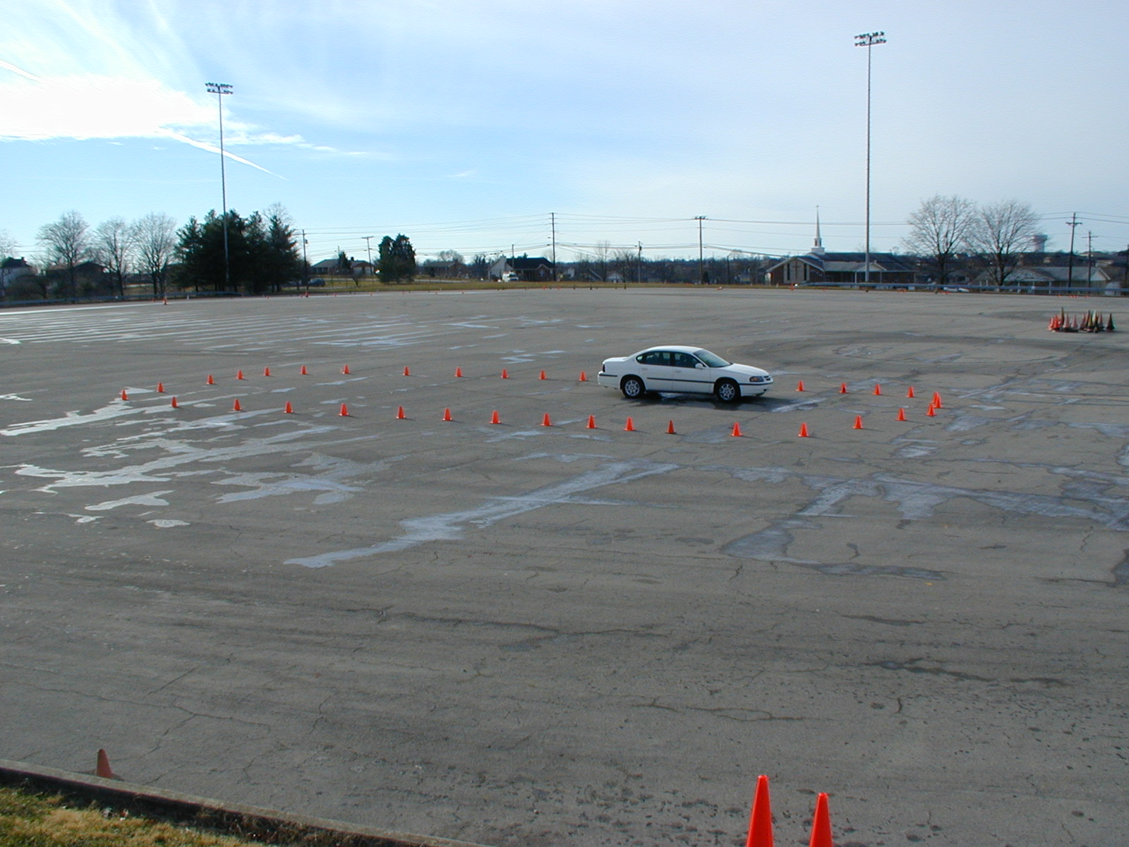
Vision and Perception
Central Space Area
True Blind Spot
Sightline Limitations

Slide 30
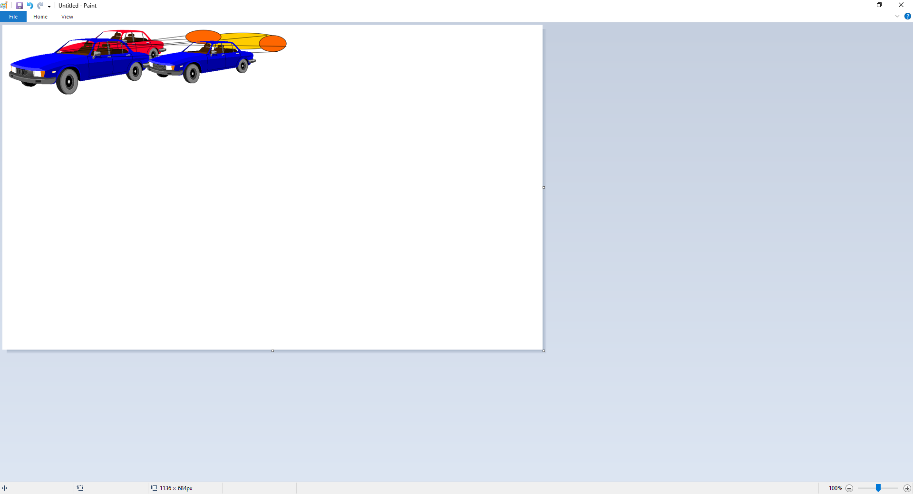
Vision and Perception
Rear and Side View Mirrors
Mirror Blind Spot
Sightline Limitations

Slide 31
Blindzone-Glare Elimination (BGE) Mirror Method
Move Side View Mirrors
Move Side Mirrors 15 degrees to outside
Head against left side window
Head in center of car

Slide 32
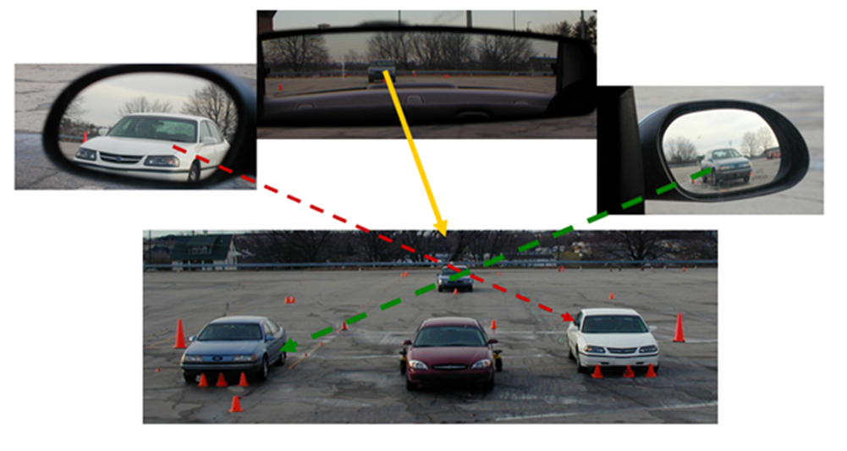
BGE Mirror Settings

Slide 33
Class Activity
Individually, on a sheet of paper
  Develop list of the five most important things that you will need to learn in driver education
Break into groups of 3-5
  Determine five most important items
  Place on Poster with names and images on wall
As a class
  Discuss the five most important class activities for Driver Education class…

Slide 34
High School Driver Education Program
Vision and Perceptual Training
Concepts and Practices

Slide 35
Contact/Mission
For more information on Driver’s Education and Safety please visit PDE’s website at www.education.pa.gov
The mission of the Department of Education is to ensure that every learner has access to a world-class education system that academically prepares children and adults to succeed as productive citizens. Further, the Department seeks to establish a culture that is committed to improving opportunities throughout the commonwealth by ensuring that technical support, resources, and optimal learning environments are available for all students, whether children or adults.

