Slide 1
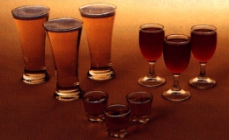
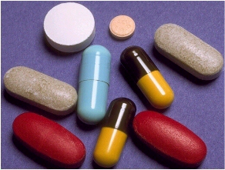
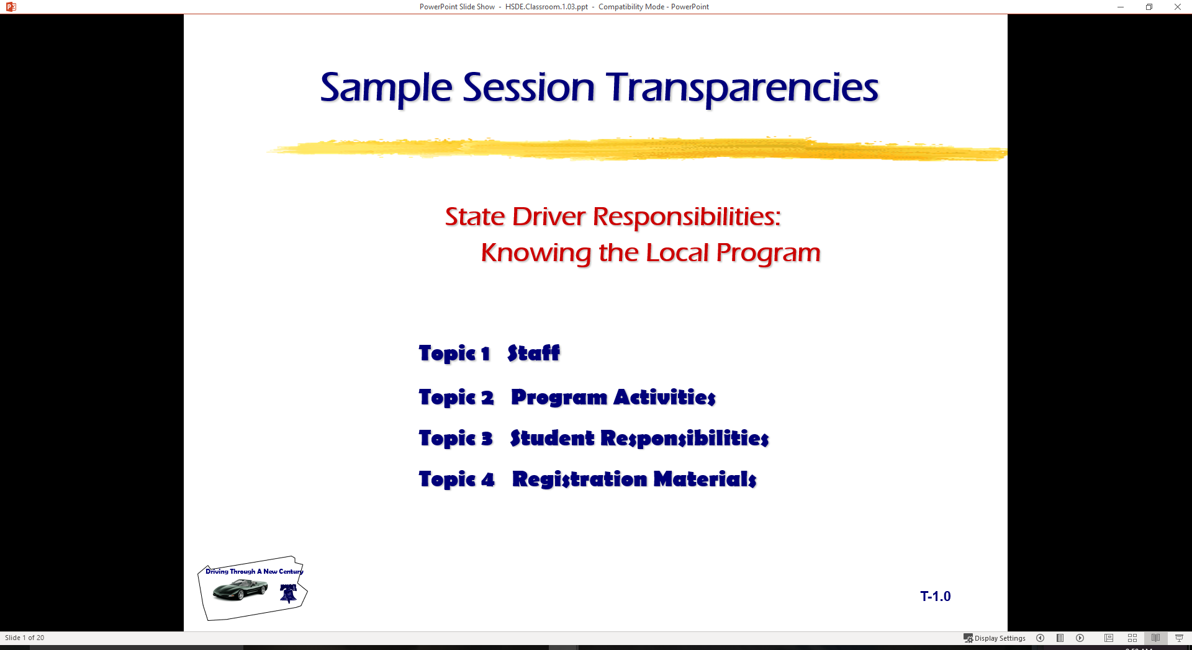
Taking Personal Responsibility: Alcohol and Other Drugs
Making Responsible Choices
Current Alcohol and Other Drugs Laws
BAC Factors
Alcohol Affects the Body
Alcohol and Driving Task

Slide 2
Introduction
What do we know about alcohol and other drugs and driving?
How do State laws impact teens.
How does BAC make a difference.
How does alcohol and other drugs impact driving ability.

Slide 3
Assessing the Facts
True or False Statements
A 12 oz regular beer has more alcohol than a 1 oz shot of 80 proof whiskey.
Regular beer and light beer have the same amount of alcohol but different amount of calories.
BAC means Blood Alcohol Content
All persons remove alcohol at the rate of 1 drink per hour.
Teenagers are at a lower risk of alcohol-related crashes than older drivers
There is a much greater risk of becoming an alcoholic if drinking begins as a teenager

Slide 4
State Alcohol/Drug Laws
Driving Under the Influence
  Title 75 Part III Chapter 38 Section 3802
21 and older BAC Level is .08%
  Title 75 Part III Chapter 38 Section 3802 (e)
20 and under BAC level is .02%
  Title 75 Part III Chapter 38 Section 3802 (a)
Implied Consent Law
  Drivers Manual Chapter 4 Page 80
Controlled Substance
  Title 75 Part III Chapter 38 Section 3802 (d)
Purchase and Age Misrepresentation
  Drivers Manual Chapter 4 Page 80

Slide 5
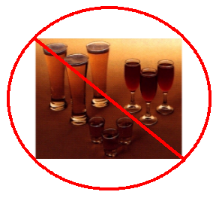
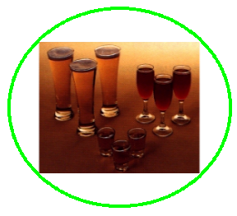
Using or Not Using?
Why do you think State has a Zero Tolerance Law for persons under age 21?
Why do some people choose not to use alcohol or other drugs?

Slide 6

Your Choices and Responsibilities
List some short-term and long-term rewards.
List some short-term and long-term consequences.
Is alcohol and other drug use short-term or long term reward?
Are consequences of alcohol use short-term or long-term?
Easiest way to avoid the consequences is?

Slide 7

BAC is:
Blood Alcohol Concentration
What is the difference between
  Blood Alcohol Content
  Blood Alcohol Concentration?

Slide 8
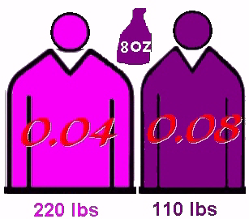
BAC Factors
Weight
Time Spent Drinking
Gender
Food
Alcohol Content
Size of Drink

Slide 9



Are They The Same ?
Beer
Whiskey
Wine
Cooler
Margarita

Slide 10
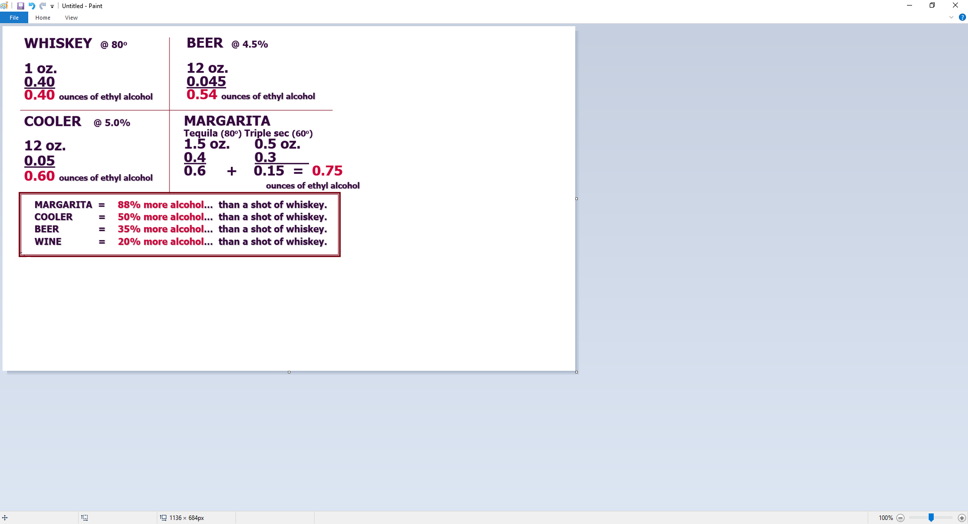
Crunching the Numbers

Slide 11

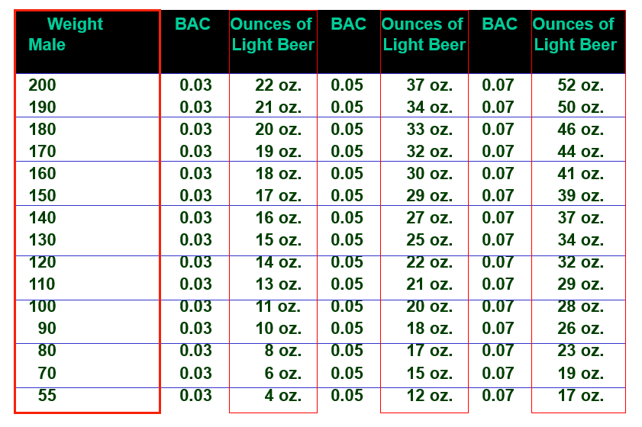
How Much Light Beer (Male)
Basic Assumption: 12 oz of Light Beer = 1 oz of 86 proof liquor

Slide 12
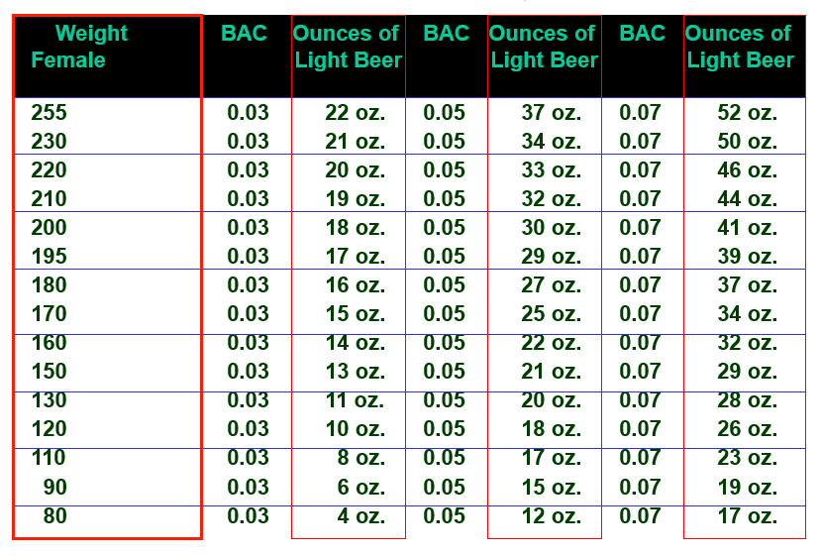
How Much Light Beer(Female)

Slide 13
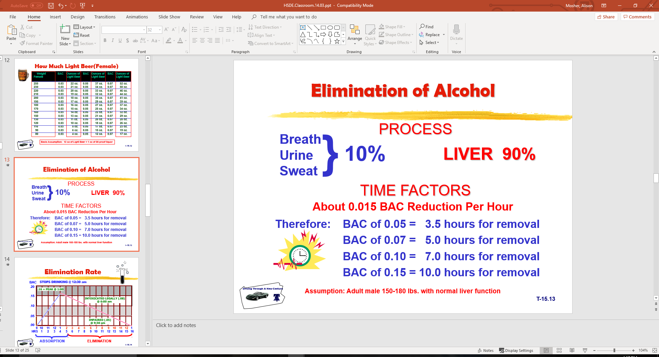
Elimination of Alcohol
Assumption: Adult male 150-180 lbs. with normal liver function

Slide 14
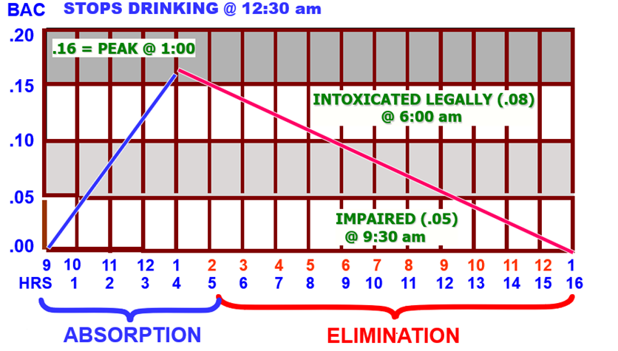
Elimination Rate

Slide 15
Does the body remove one drink per hour?
105 lb. Male
… Drinks 0ne 12 oz. Bud Light @ 7:00 PM
Sober (0) + .03 0.03 BAC
After One hour….. 0.03 - 0.015 0.015 BAC
… Drinks Another 12 oz. Bud Light @ 8:00 PM
0.03 + 0.015 0.045 BAC
After Second hour…. 0.045 - 0.015 0.03 BAC
… Drinks Another 12 oz. Bud Light @ 9:00 PM
0.03 + 0.03 0.06 BAC
After Third hour…. 0.06 - 0.015 0.045 BAC

Slide 16
Does the body remove one drink per hour?
105 lb. Female
…. Drinks another 12 oz. Bud Light @ 10:00 PM
0.045 + 0.03 0 .75 BAC
After Fourth hour…. 0.075 - 0.015 0.06 BAC
… Drinks Another 12 oz. Bud Light @ 11:00 PM
0.06 + 0.03 0.09 BAC
After Fifth hour…. 0.09 - 0.015 0.075 BAC
… Drinks Another 12 oz. Bud Light @ Midnight
0.075 + 0.03 0.105 BAC
After Sixth hour…. 0.105 - 0.015 0.09 BAC
… May be arrested for DUI/DWI on trip home...

Slide 17
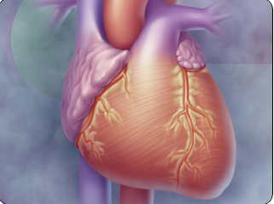
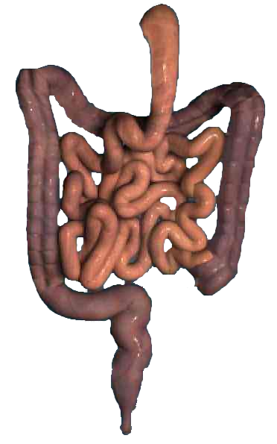

Alcohol Affects the Body
Liver
Heart
Sexuality
Sleep
Stomach
Brain

Slide 18

Affects Persons Differently
Tolerance
Personality
Mood
Experience
Fatigue
Medication
Weight
Age
Sensory Input to the Brain

Slide 19
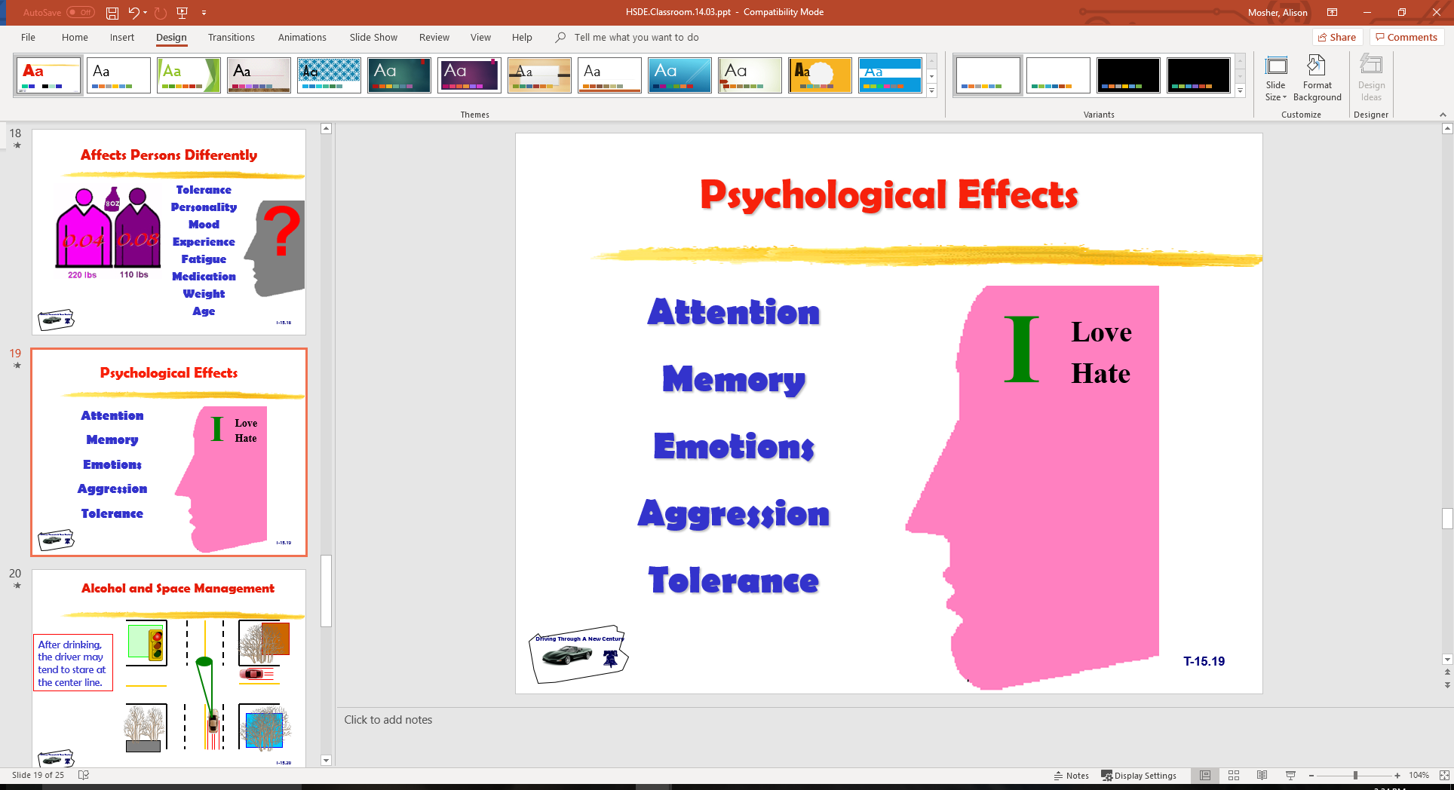
Psychological Effects
Attention
Memory
Emotions
Aggression
Tolerance
Sensory Input to the Brain

Slide 20
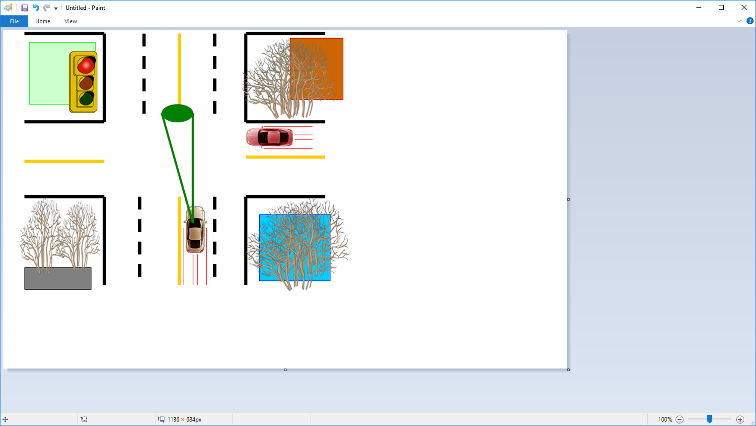
Alcohol and Space Management
After drinking,
the driver may tend to stare at the center line.
Sensory Input to the Brain

Slide 21

Impaired Vision
Sensory Input to the Brain
Side Vision
Visual Acuity
Color Distinction
Eye Focus
Double Vision
Distance Judgment

Slide 22




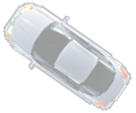
Risk-Taking Problems

Slide 23
Chance of Death for ages 16-19 by BAC levels
BAC Increased Risk of Death
.015 - .049 2.5
.05 - .079 9.0
.08 - .099 40.0
.10 - .149 90.0
.15 and greater 420.0
STUDY INCLUDES COMPARISON OF SINGLE VEHICLE COLLISIONS IN AGE GROUP

Slide 24
Other Drug Information
  Affects on Driving
  Making Choices

Slide 25
Contact/Mission
For more information on the (the topic of the presentation) please visit PDE’s website at www.education.pa.gov
The mission of the Department of Education is to ensure that every learner has access to a world-class education system that academically prepares children and adults to succeed as productive citizens. Further, the Department seeks to establish a culture that is committed to improving opportunities throughout the commonwealth by ensuring that technical support, resources, and optimal learning environments are available for all students, whether children or adults.

