Slide 1
Sample Lesson Session 13
Moderate Risk Involvement

Slide 2
Sample Lesson Session 13
Information Processing:
Moderate Risk Environment
  Topic 1 Processing Information
  Topic 2 Intersections, Curves and Hills
  Topic 3 passing

Slide 3
Session 13 Assessment
List two important things a driver must do to compensate for risk-taking.
What are the three steps for the SEE driving system?
The two space management basics for executing performances are:
The three space management basics for searching performances are:
List four typical lane changing sites.
What is the safest turning around procedure?
List two ways that a license may be improperly used in Pennsylvania.
List two bicyclist responsibilities when riding in Pennsylvania.
List three areas where you may have different speed limits.
What does the National Safety Council recommend for following interval?

Slide 4
Session 13 Assessment Answers
List two important things a driver must do to compensate for risk-taking. Recognizing potential errors or limitations, Adjusting speed to reduce errors, Adjusting lane position to reduce errors, and Appropriate communication to reduce errors.
What are the three steps for the SEE driving system? Search for travel path or sightline restrictions, Evaluate for open space, and Execute appropriate communication, speed, and lane position adjustments.
The two space management basics for executing performances are: Execute appropriate communication, speed or lane position adjustments
The three space management basics for searching performances are: What to look for, How to look, Where to look
List four typical lane changing sites. To and from a curb when starting and stopping, Moving into turn storage lanes, Pulling from roadway onto the improved shoulder of a highway to temporarily stop, Moving from improved shoulder to roadway, One-way street lane adjustments, Multi-lane rural roadways (Bypass), Limited access roadways (Interstate), Merge and exits on limited access roadways

Slide 5
Session 13 Assessment Answers
What is the safest turning around procedure? Turn around the block to the left or turn around the block to the right.
List two ways that a license may be improperly used in Pennsylvania. Use of false name/address to get a license, Possess more than one license, Use a cancelled or revoked license, Use another person’s license, Lend your license to others, Display or possess a false license
List two bicyclist responsibilities when riding in Pennsylvania. Full lane use by bicyclist, Cyclist not restricted to lane, Merging to traffic flow, Obey traffic rules
List three areas where you may have different speed limits. Urban areas, Parks, Rural interstate, Urban interstate, School buses, School zones
What does the National Safety Council recommend for following interval? The NSC recommends three seconds plus one for each mitigating circumstance.

Slide 6
Basic Requirements for Driving
DRIVER REQUIREMENTS
  VISIBILITY...SPACE...TIME...SPACE...TRACTION
        VEHICLE REQUIREMENTS

Slide 7
Space Management System Components
Search for objects or conditions
Evaluate the path ahead for alternate paths of travel
Prepare to make adjustments in speed and/or position

Slide 8

Space Management System Components
Searching Includes
  Where to search
  When to search
  How to search
  What to search for

Slide 9

Visual Fields
Peripheral Vision Field
Focus Vision Field
Central Vision Field

Slide 10
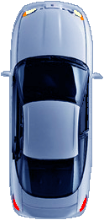

Search Practices

Slide 11
Search Practices
Your Focus Vision Field should be 15 to 20 seconds ahead of your vehicle
Your Central Vision Field should be 4 to 8 seconds ahead of your vehicle

Slide 12
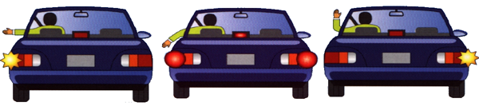
Communicating
Actions of Driver Signals Position of Vehicle
Hand Signal Turning Speed of Vehicle
Using Cell Phone Backing Brake Lights
Distracted Hazard Horn
Headlights

Slide 13
Managing Visual Searches
Search far ahead to identify potential conflicts
Objects in Path and Area of Limited Visibility
Limitations to Path of Travel and Line of Sight

Slide 14
Managing Visual Searches
20 to 30 Seconds 12 to 15 Seconds
Search Area Control Area
Find Conditions Requiring your Continuing Attention
Lok for Closed or Changing Paths of Travel

Slide 15


Managing Visual Search
Identify an Alternate Path of Travel and safe stopping Zone 8-12 Second
Evaluate open Zones to the Side and Rear Response Area
4-8 Seconds Directed The eyes will focus on what the brain tells them to concentrate
Response Area This is the only information that will be processed

Slide 16
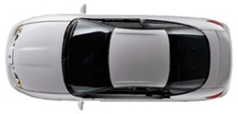

Determining Following Intervals
A two to four second following interval is intended to provide time to steer and is acceptable only in heavy traffic flows.
It provides time to brake to a stop only if you are monitoring the actions of drivers 8 to 12 seconds ahead in your path of travel. In most instances, it necessitates steering to alternate escape path.
8-12 second intervals 2-4 second intervals

Slide 17

Visual Search Categories
Traffic Controls
Motor Vehicles
Non-Motorized Users
Highway

Slide 18

Highway Conditions
Width Roadway Intersection
Curbing Structure
Curves
Slopes
Roughness Highway
Slick
Wet Leaves Roadway
Mud Surface Atmosphere
Sand
Shoulders Roadway Illumination
Affixed Objects Features Glare
Adjacent Buildings Precipitation
Wind/Noise
Sensory Input to the Brain

Slide 19


Traffic Controls
Regulatory
Warning Signs
Guide Unmarked Intersections
Signals Traffic
Stop/Go Controls
Lane
Turning
Flashers Roadway
Passing Markings Interchanges
Crosswalk
Stop Line
Sensory Input to the Brain

Slide 20
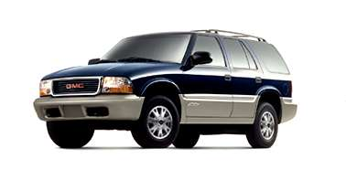
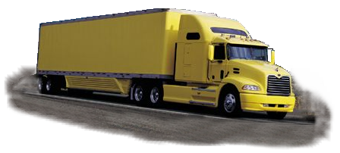
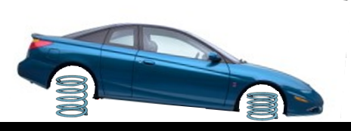
Motor Vehicles
Camper, Pick-Up,
Motor Homes, Off-Road,
Motorcycles,
Farm Machines,
Snowmobiles
Type Motor
Vehicles
Road Handling
Characteristics
Sensory Input to the Brain

Slide 21


Non-Motorized Users
NON-MOTORIZED
USERS
Bicycles
In-Line Skaters, Pedestrians
Kind & Size Skateboards
Numbers
Age of Riders Animals
Activity
Rider Ability
Sensory Input to the Brain

Slide 22
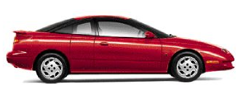
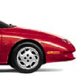
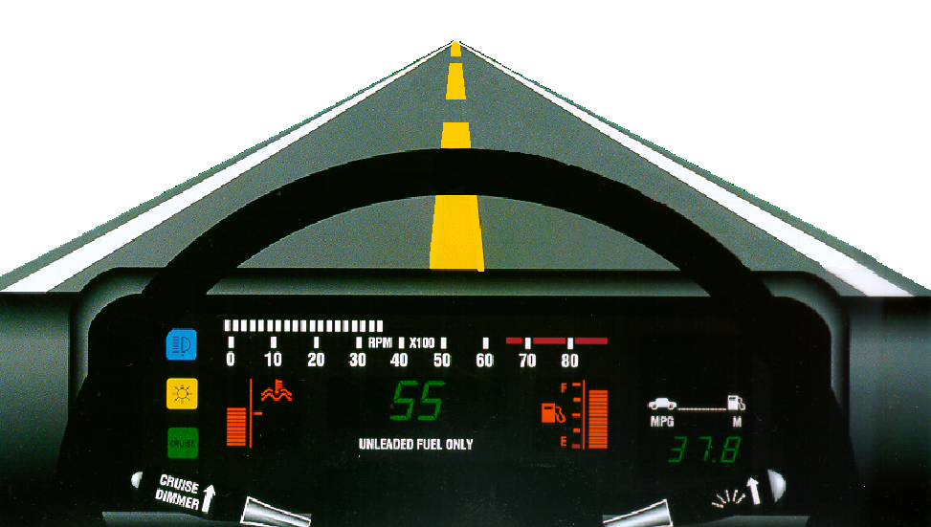
Controlling Space to the Front
Timing your Arrival
Forward Placement
Following Interval

Slide 23
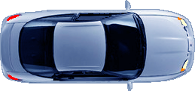
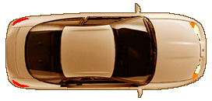
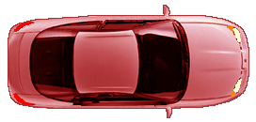
Make Space With Lane Position
Within Lane Positions
Straddle Lane Positions
5
3
1
2
6

Slide 24

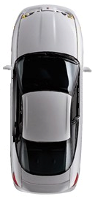

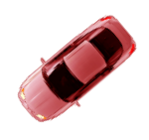
Staggered Stops
Stop Behind The:
Stop Bar
Crosswalk
Road Edge
Position Vehicle Toward
Right Side of Lane

Slide 25

Intersection Search Patterns
Intersection Approach
Check open areas, then Open
closed areas to the front
Check to the rear
Closed Closed
Communicate as necessary
Check areas adjacent to path of travel Open Open
Check sightlines left and right
Adjust speed and/or
position as appropriate Open

Slide 26



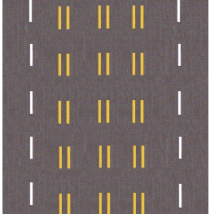

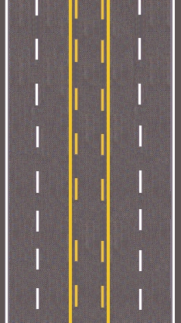
Lane Markings
Shared Left Turn Lane Reversible Lanes

Slide 27
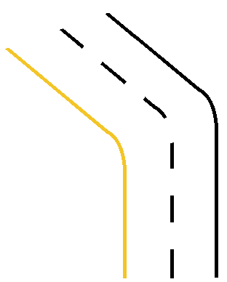

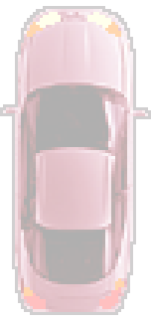
Line of Sight Through Curve
Establish Line of Sight and
Projected Path of Travel
Check to the Rear
Adjust Position for Maximum
View of Oncoming Traffic
Establish Target Area for Path of
Travel
Adjust speed and Position to
Conditions

Slide 28
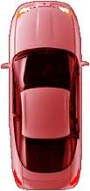

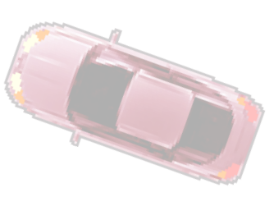
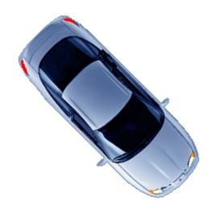

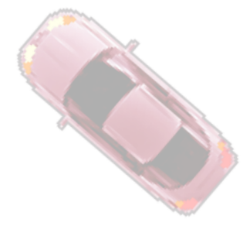
Line of sight Through Curves

Slide 29
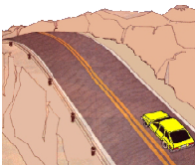
Line of Sight Over Hills
Sightline Limitations Similar to Curves
Adjustments are Speed Reduction and Position to the Right or Outside of Lane
Restrictions to Sightline is up and Down

Slide 30


Determining Passing Tine/Space Needs
1-2 second return to lane
40 mph = 60 feet
74 feet/second @ 50 mph
3 lengths of car per second may
take 8 to 10 seconds to pass
another car
3-4 seconds start pass
40 mph = 120 feet
Total Time: 12 -16 seconds

Slide 31
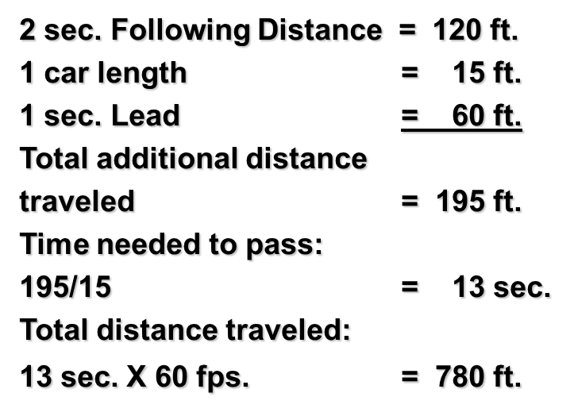



Passing Needs
Constant: 1mph = 1.4667 or
1.5 feet per second (fps)
Time to pass = distance
Traveled to complete pass, divided
by difference in distance traveled
per second by each vehicle,
30 mph = 45 fps
40 mph = 60 fps
60 ft - 45 ft = 15 ft

Slide 32

Passing Considerations
Larger Vehicles
  24 seconds to pass tractor trailer rig (90 feet) traveling @ 50 mph, when passing @ 60 mph
  2160 feet needed to complete a 24-second pass
Oncoming Vehicles
  Approaching vehicle travels 2160 feet @ 60 mph
  Total clear distance needed to pass becomes 4320 feet when approaching vehicles exist
Daylight Headlight Use Critical

Slide 33
Passing Procedures
Prepare to Pass
  Position your self two to three seconds behind the vehicle you intend to pass
  Check mirrors and oncoming traffic
  Check ahead for safe passing distance
  Signal your intention
  2-3 Seconds Behind

Slide 34


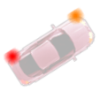


Passing Procedures
Overtake the ongoing car
- Signal and accelerate into passing lane
- Accelerate quickly to an appropriate speed
- Concentrate on the path ahead
- Check your mirror for following cars
Return to lane
- Check for the front of the car you are passing
- Signal intention
- Change lanes and maintain speed
- Cancel turn signal

Slide 35
Contact/Mission
For more information on the (the topic of the presentation) please visit PDE’s website at www.education.pa.gov
The mission of the Department of Education is to ensure that every learner has access to a world-class education system that academically prepares children and adults to succeed as productive citizens. Further, the Department seeks to establish a culture that is committed to improving opportunities throughout the commonwealth by ensuring that technical support, resources, and optimal learning environments are available for all students, whether children or adults.

