Slide 1
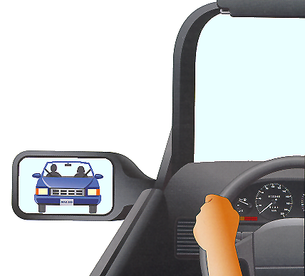
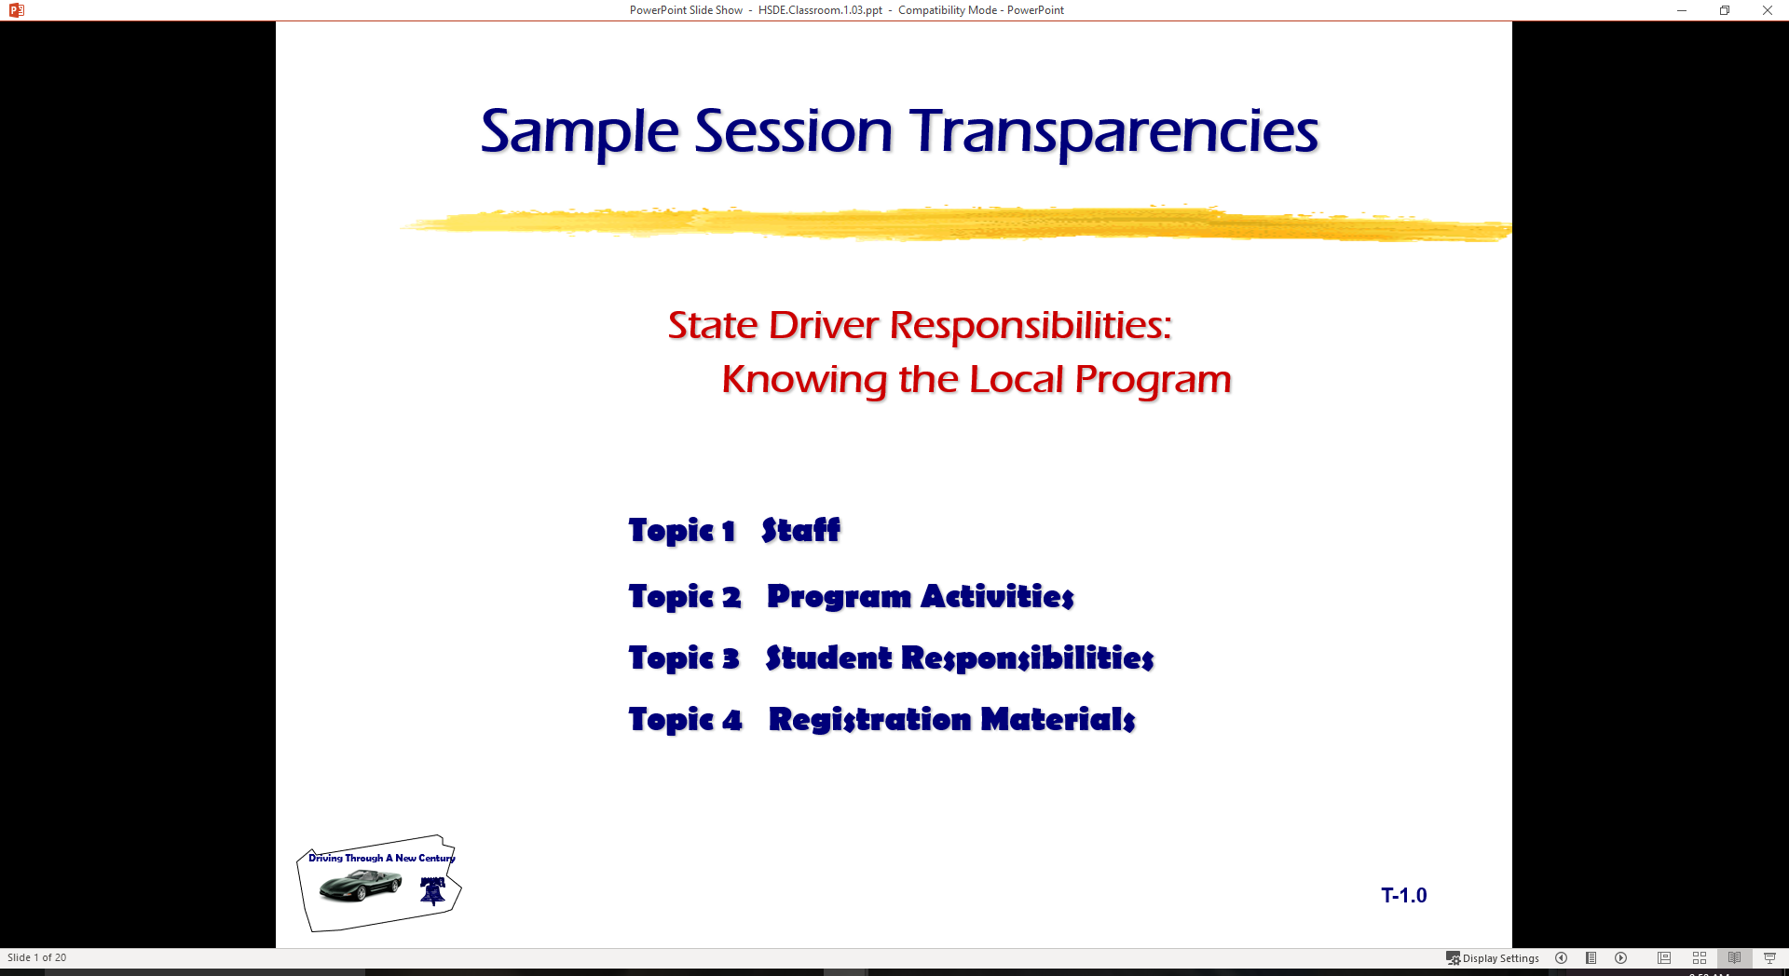
Basic Maneuvering Tasks:
Moderate Risk Environment
  Topic 1 Risk Assessment
  Topic 2 Space Management
  Topic 3 Lane Changes
  Topic 4 Turnabouts
  Topic 5 Parking

Slide 2
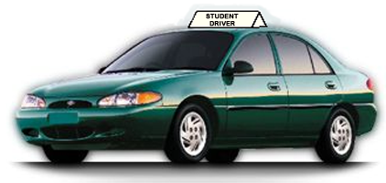

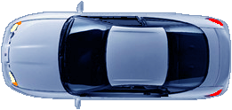

Introduction
In-car Lesson Review
Simulation Review
  - Communication Skills
  - Stopping in Time
Reviewing Risk-reduction Concepts
Developing Space Management Principles
Basic Lane Changes
Turning Around
Parking Maneuvers

Slide 3
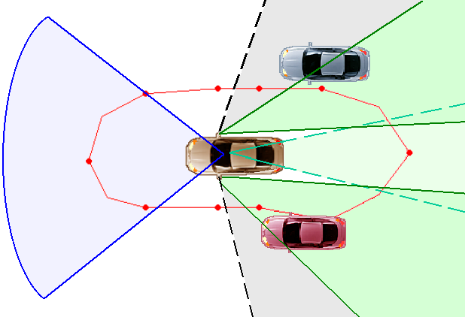
REDUCING DRIVING RISK
Decision-making is most crucial driver skill
Procedural tasks vs. Processing tasks
Learning from good and bad experiences
Learning by observation

Slide 4
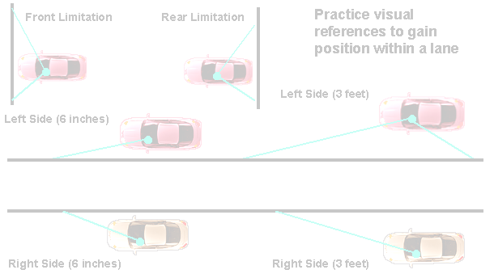
RISK ASSESSMENT
Risk Compensation Involves:
  Recognizing Potential Errors or Limitations
  Adjusting Speed to Reduce Errors
  Adjusting Lane Position to Reduce Errors
  Appropriate Communication to Reduce Errors

Slide 5
Reducing Driving Risk
Practice is key to sound habits and judgments
What to practice is important
Good habits and judgment deteriorate over time

Slide 6
Reducing Driving Risk
Procedures and experience equals habits
Work for developing best procedures and experience
Greater the resistance to change often means the greater the need for changing habits

Slide 7
Guided Practice
Practice is key to sound habits and judgments
What to practice is important
Good habits and judgment deteriorate over time

Slide 8
Guided Practice
Majority of drivers rate themselves as good
Good versus poor procedures and processing
Poor driving experiences develop poor driving behaviors

Slide 9
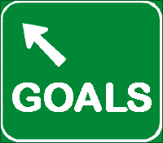
Traffic Safety Education Goals
Make every driving sequence a good driving sequence
Use processing techniques to make judgments
Develop sound procedures for maneuvers

Slide 10

Developing the SEE Driving System
Three steps for Space Management are:
  Search
  Evaluate
  Execute
Line of Sight, Path of Travel, or Area Changes
Clear Opposite Area or Areas for Speed or Position Adjustments

Slide 11
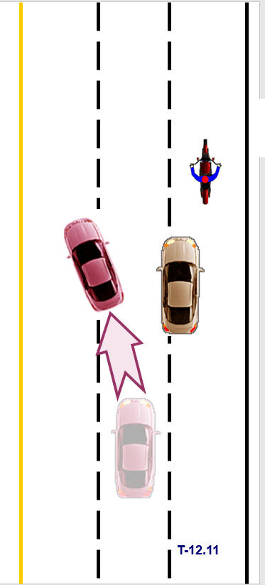
System Components
Speed Adjustment
Lane Position Adjustment
Risk Reduction is Goal
Guidelines for Decision-Making

Slide 12
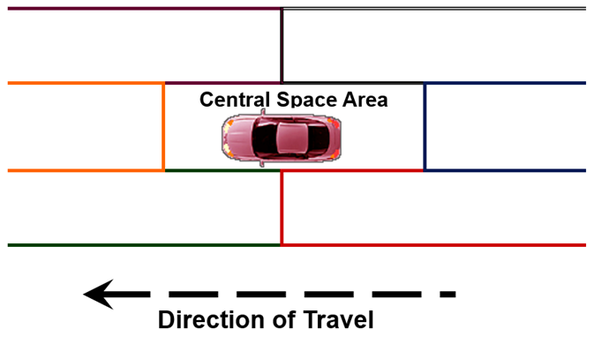
Space Management Areas
SEE Space Management Scheme

Slide 13
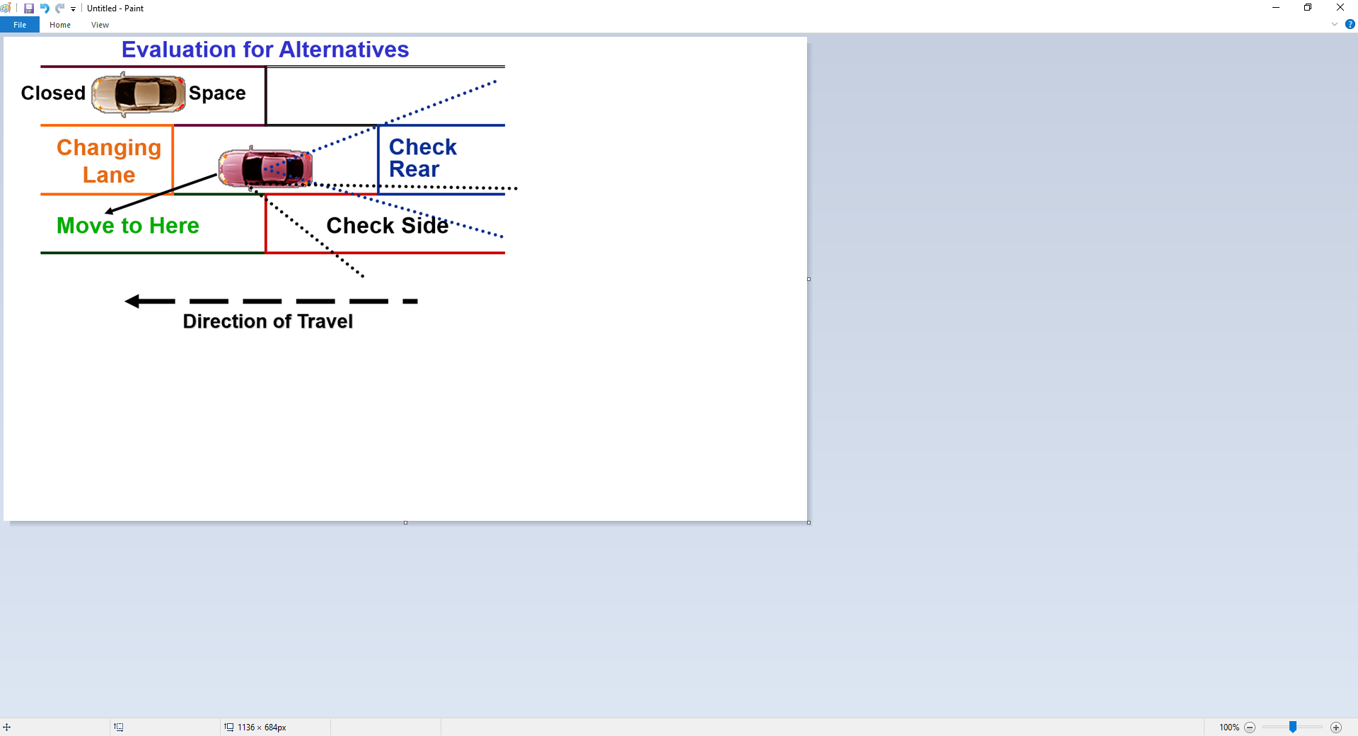
Managing Space Areas

Slide 14

Space Management Basics
Searching Performances:
  What to look for
  How to look
  Where to look
Evaluating Performances:
  Risk Potential of a Closed or Changing Area... Versus…
  Risk Potential of Alternative Area

Slide 15
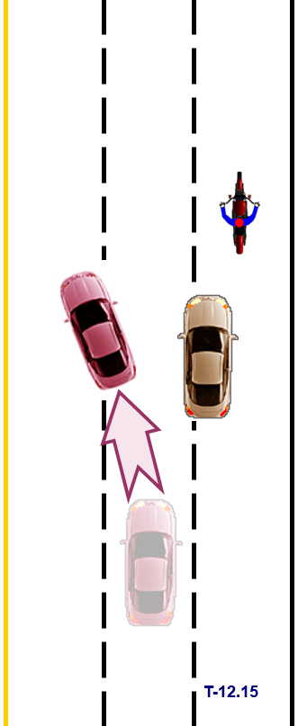
Space Management Basics
Executing Performances:
  Speed change without losing vehicle balance
  Lane position change without losing balance
Crash Prevention Performances:
  Controlling the Target Area, Sightline, and
  Travel path followed by … Speed Changes, Position Changes, and Effective Communication

Slide 16
Space Management Basics
Seeing Changing Space Conditions:
  A red traffic signal is…
  A parked car to your right is…
  A bicyclist to your right is…
  A vehicle in your left mirror blind area is…
  A cycle in your right mirror blind area is…
  A large truck following closely behind is…

Slide 17
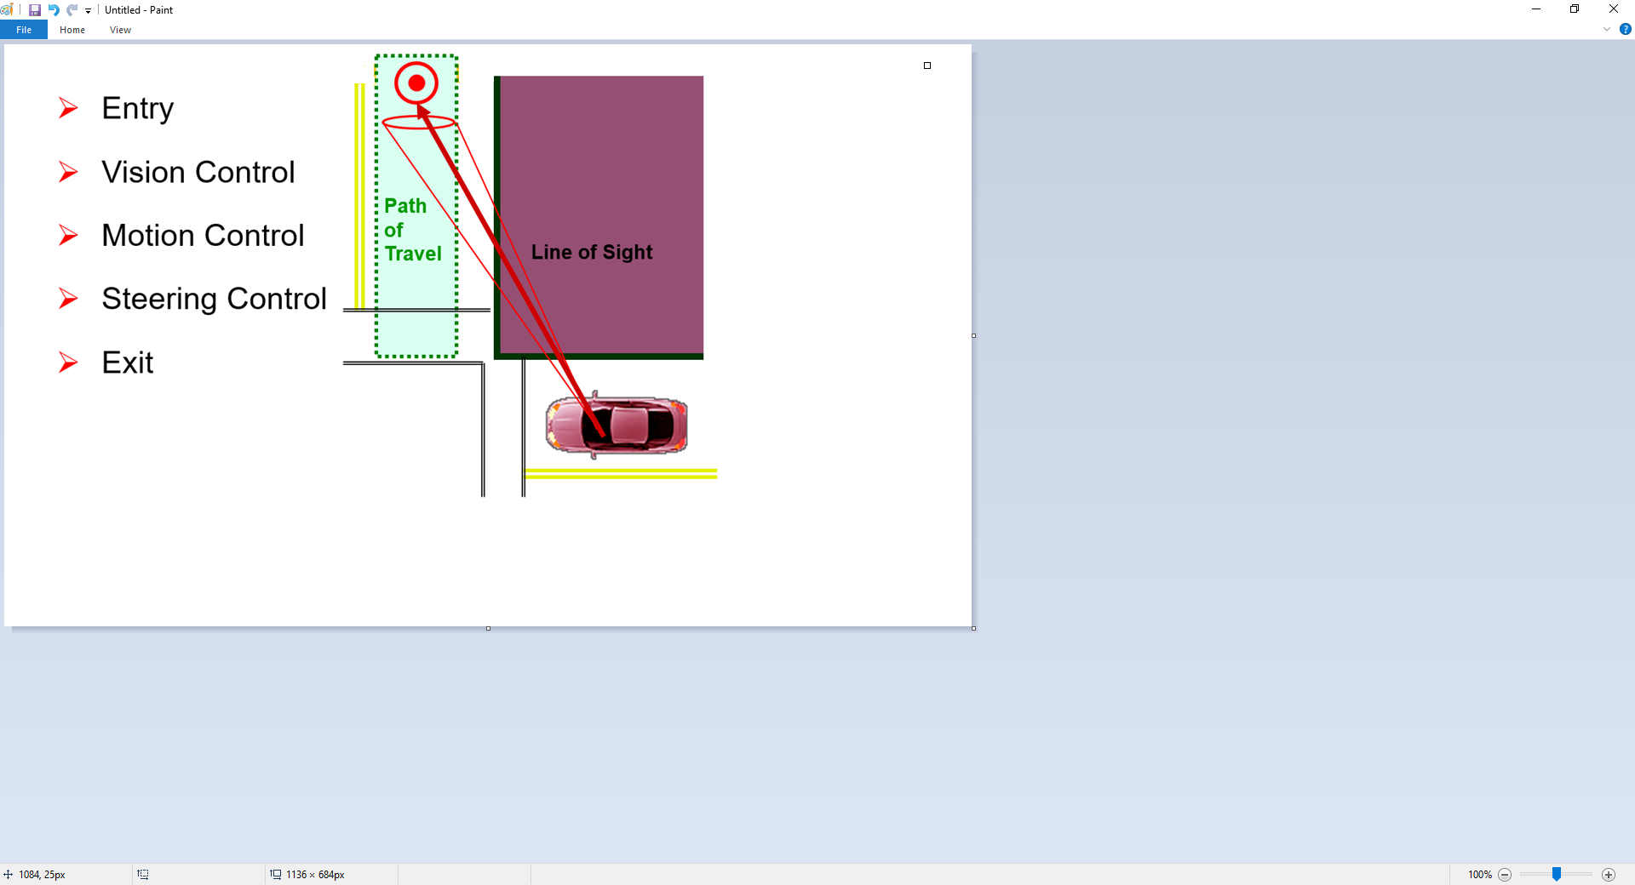
Turning At Intersections
Target Area

Slide 18
Performances In Turning
Target Area
Approach to Intersection
Communication
Target Areas
Travel Path
Sightline
Speed Adjustment
Lane Position
Reference Turning Point
Courtesy Considerations

Slide 19
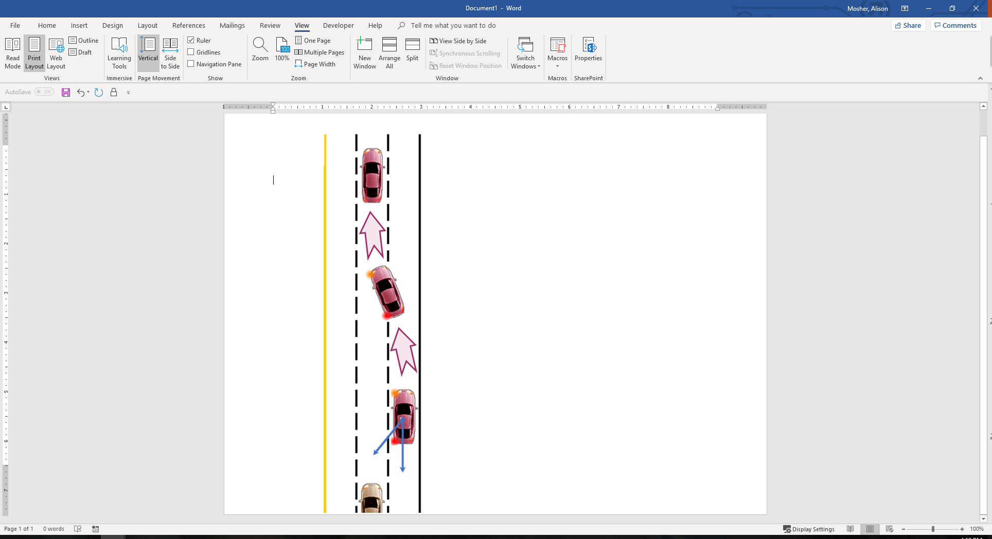
Performances In Lane Change
Traffic Flow to Rear
Appropriate Gap
Reduced-risk Decision
Effective Communication
Courtesy Considerations
Gradual Movements
Lane Position
Recheck to Rear
Regain Space

Slide 20
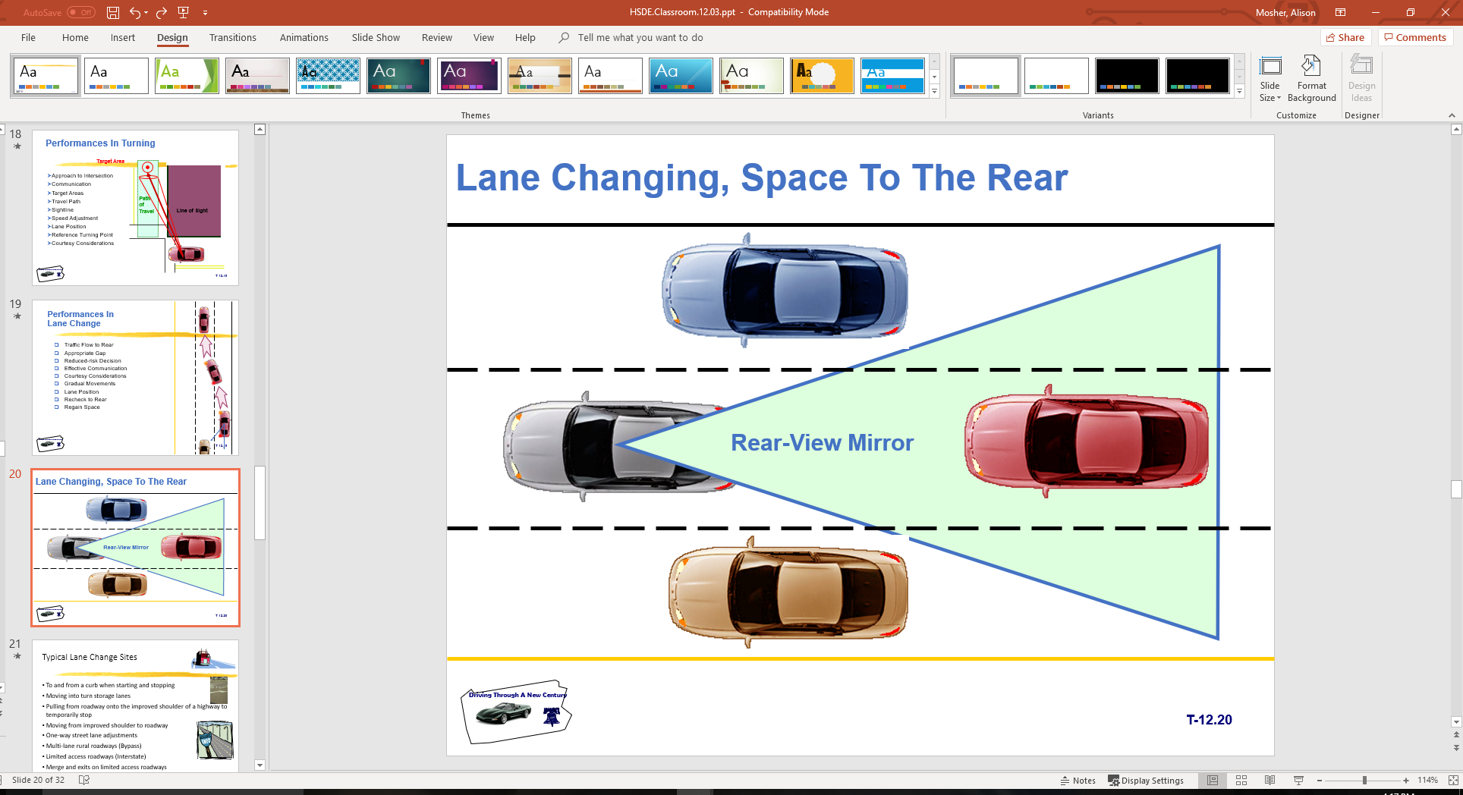
Lane Changing, Space To The Rear

Slide 21
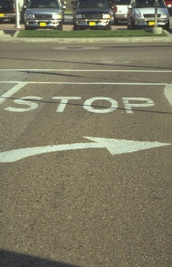
Typical Lane Change Sites
To and from a curb when starting and stopping
Moving into turn storage lanes
Pulling from roadway onto the improved shoulder of a highway to temporarily stop
Moving from improved shoulder to roadway
One-way street lane adjustments
Multi-lane rural roadways (Bypass)
Limited access roadways (Interstate)
Merge and exits on limited access roadways

Slide 22
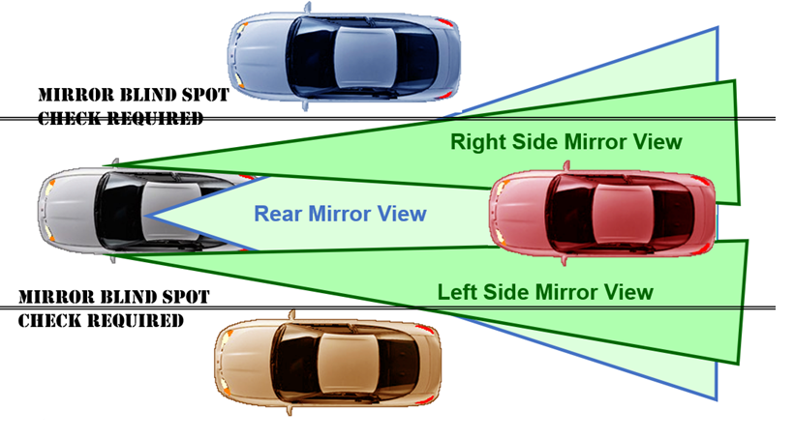
Traditional Mirror Settings

Slide 23
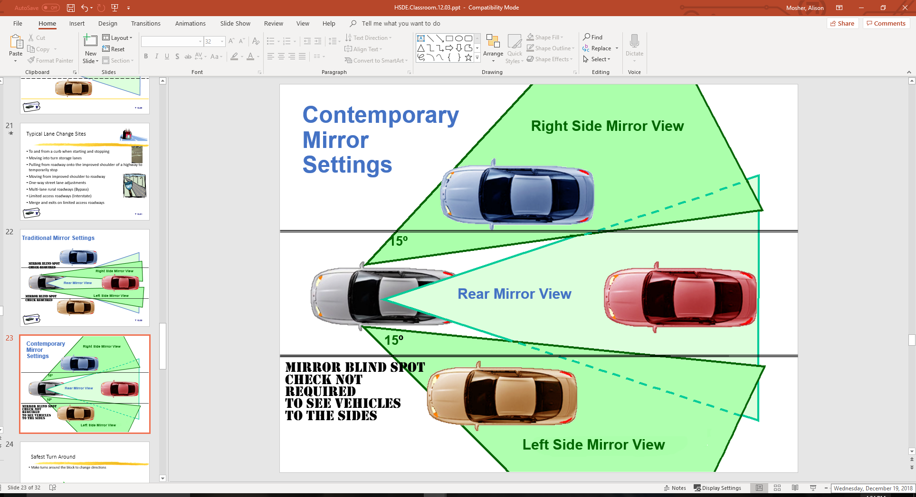
Contemporary Mirror Settings

Slide 24
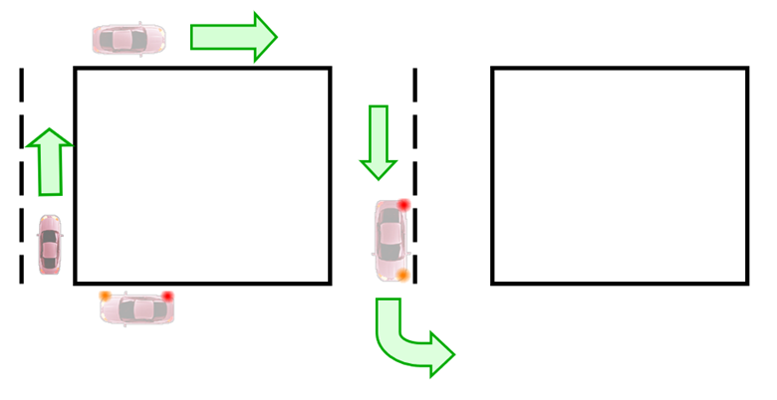
Safest Turn Around
Make turns around the block to change directions

Slide 25
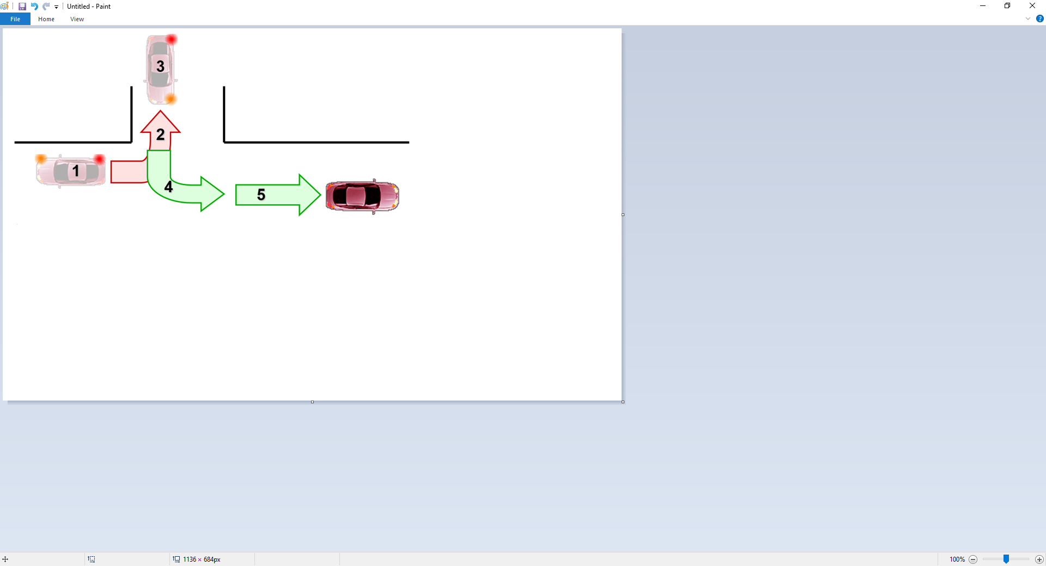
Turning Around
Approach
Communication
Target Areas
Line of Sight
References
Speed Control
Lane Position
Courtesy Considerations

Slide 26
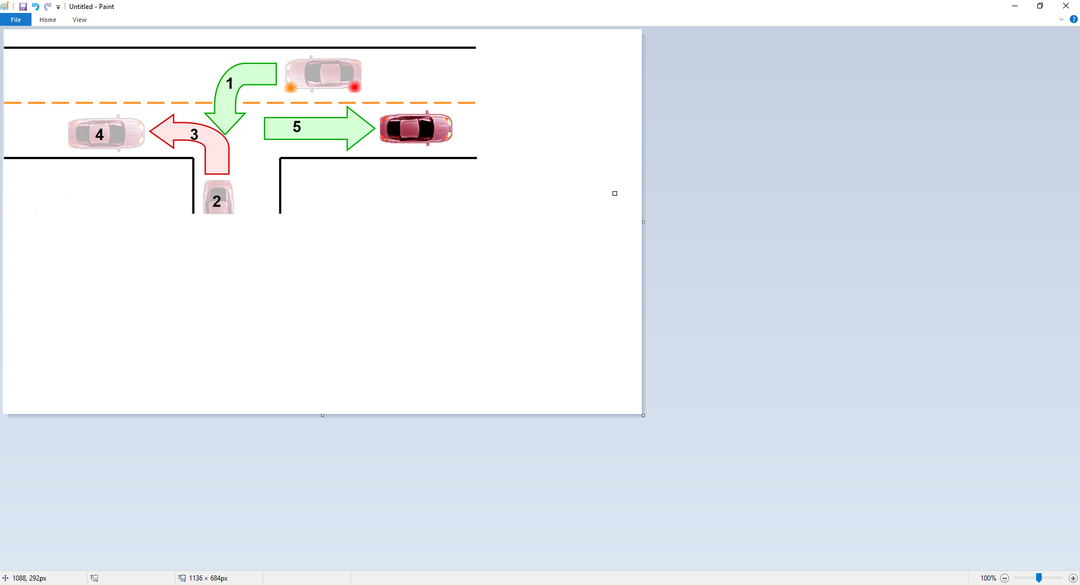
Turning Around
Approach
Communication
Target Areas
Line of Sight
References
Speed Control
Lane Position
Courtesy Considerations

Slide 27
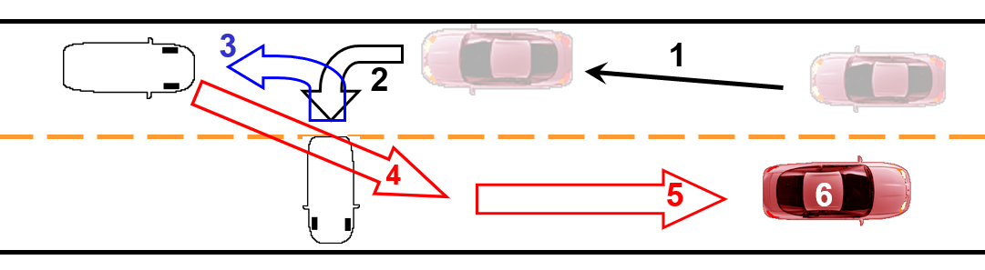
Turning Around
Approach
Communication
Target Areas
Line of Sight
References
Speed Control
Lane Position
Courtesy Considerations

Slide 28
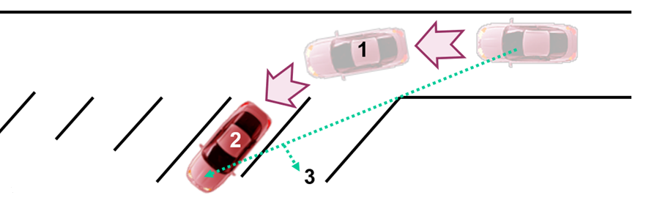
Angle Parking
Approach
Communication
Target Areas
Line of Sight
References
Speed Control
Lane Position
Courtesy Considerations

Slide 29
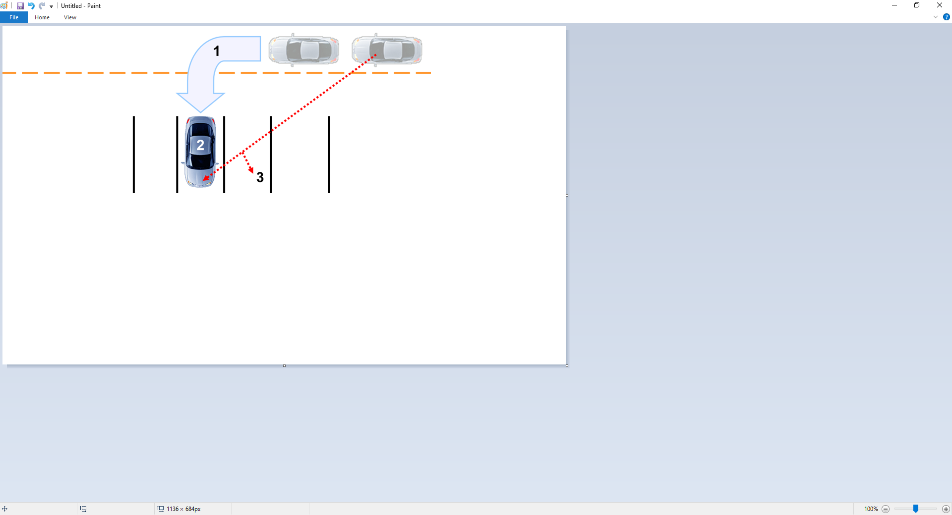
Perpendicular Parking
Approach
Communication
Target Areas
Line of Sight
References
Speed Control
Lane Position
Courtesy Considerations

Slide 30
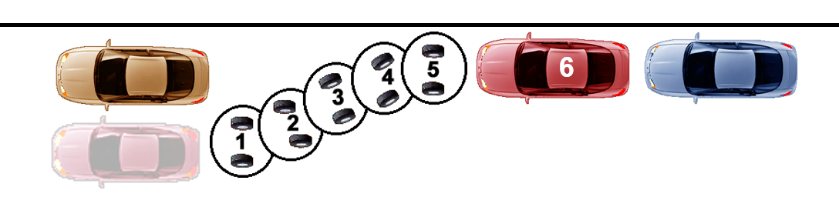
Parallel Parking
Approach
Communication
Target Areas
Line of Sight
References
Speed Control
Lane Position
Courtesy Considerations

Slide 31
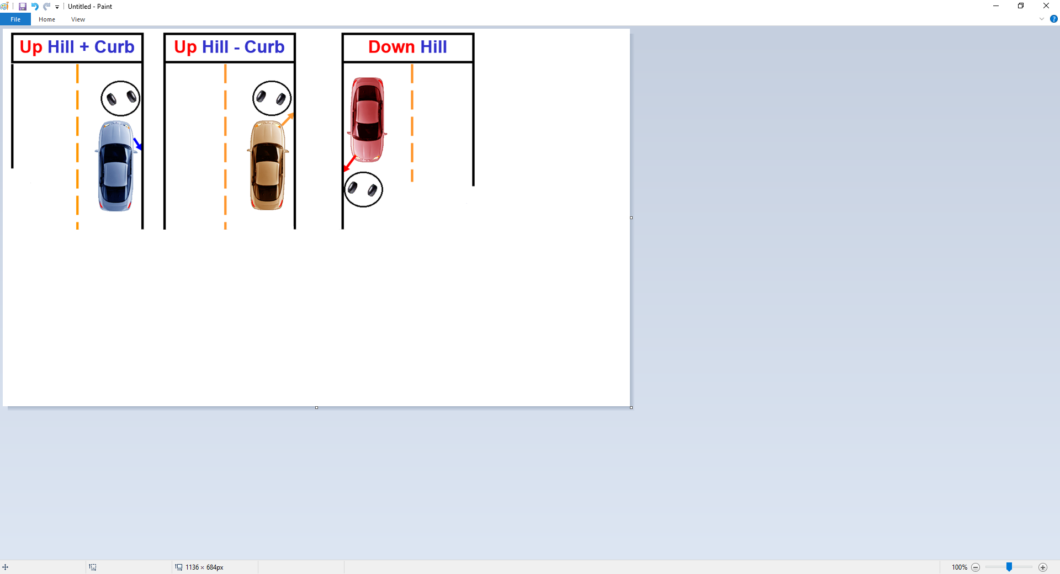
Hill Parking
Approach
Communication
Target Areas
Line of Sight
References
Speed Control
Lane Position
Courtesy Considerations

Slide 32
Next Sessions
In-car sessions
  check schedules carefully
Simulation Sessions
  B- group and A-group as scheduled
Classroom Information Assessment
  Next classroom session
  Bring class materials on laws and this packet for review

