Slide 1
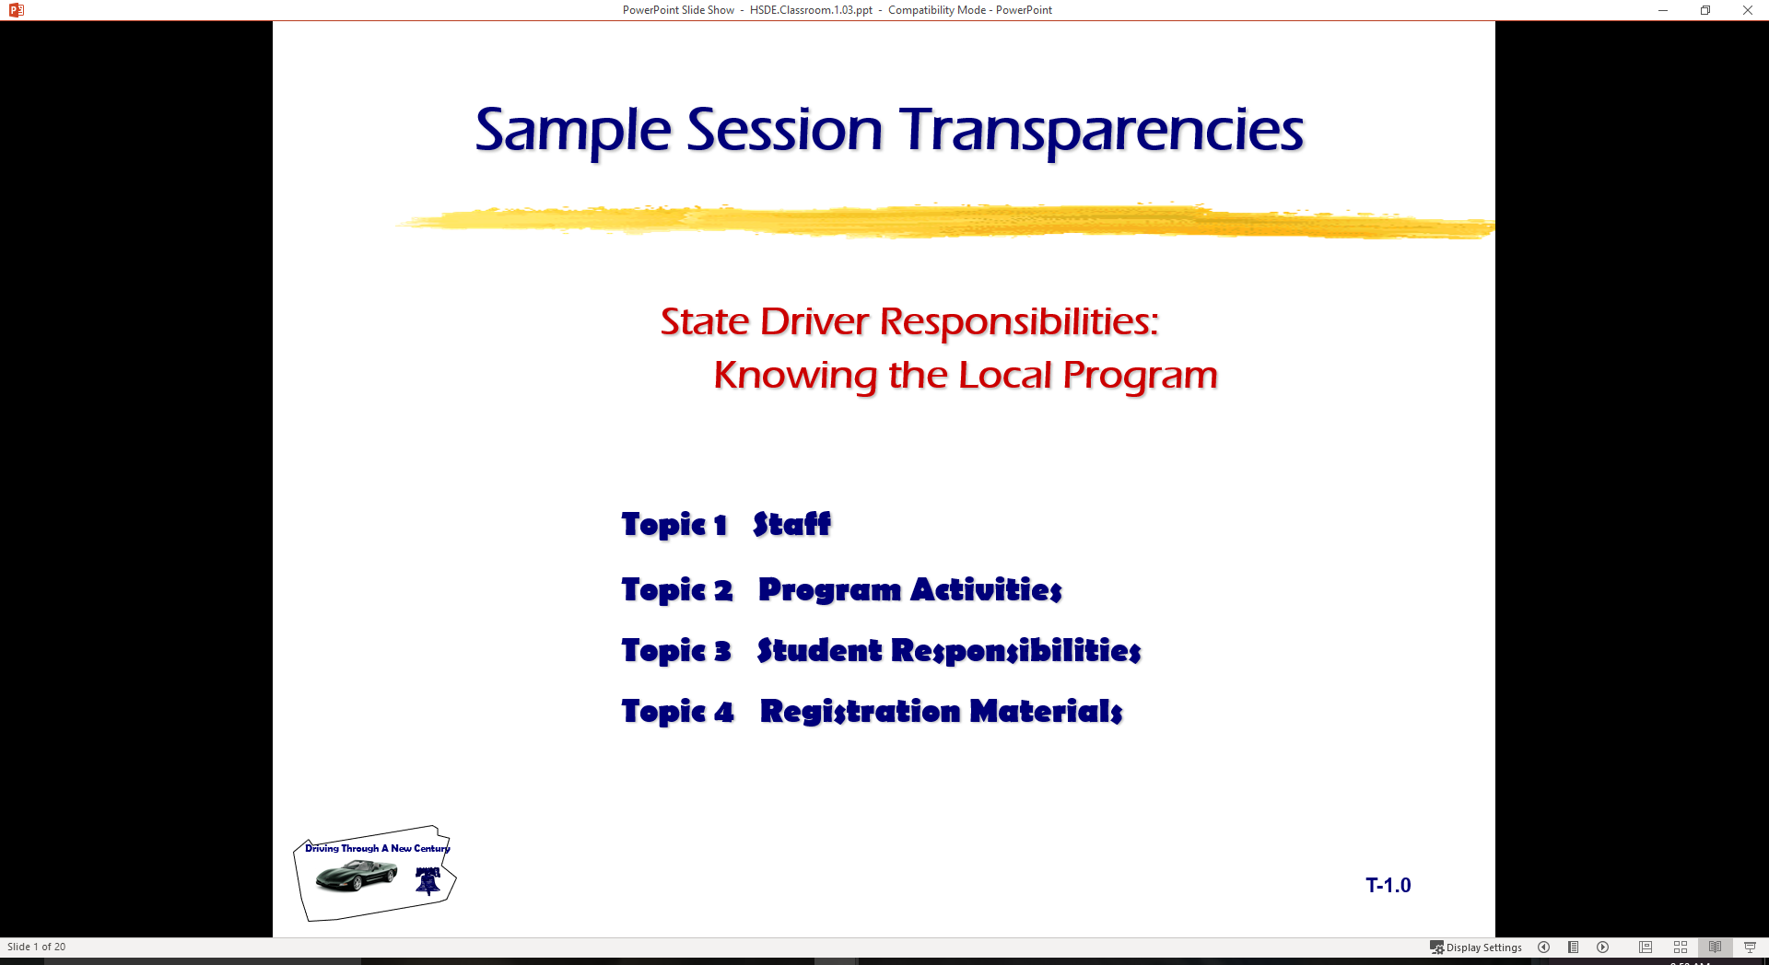
Driver Responsibilities:
Knowing State Traffic Laws
  Topic 1 Stopping, Standing, Parking
  Topic 2 Speed Limitations
  Topic 3 Alcohol Specific
  Topic 4 Sharing the Roadway

Slide 2
Last session
Rules for getting License
GDL requirements
Driver Audits completed
Simulation
Don’t Forget Traffic Safety Topic for Class Presentation
This session will look at State laws and rules for driving…

Slide 3
Stopping, Standing, Parking
Legal Prohibitions
Disabilities
Unattended Vehicle
Parallel to Curb
Hills
Leaving
Coasting

Slide 4
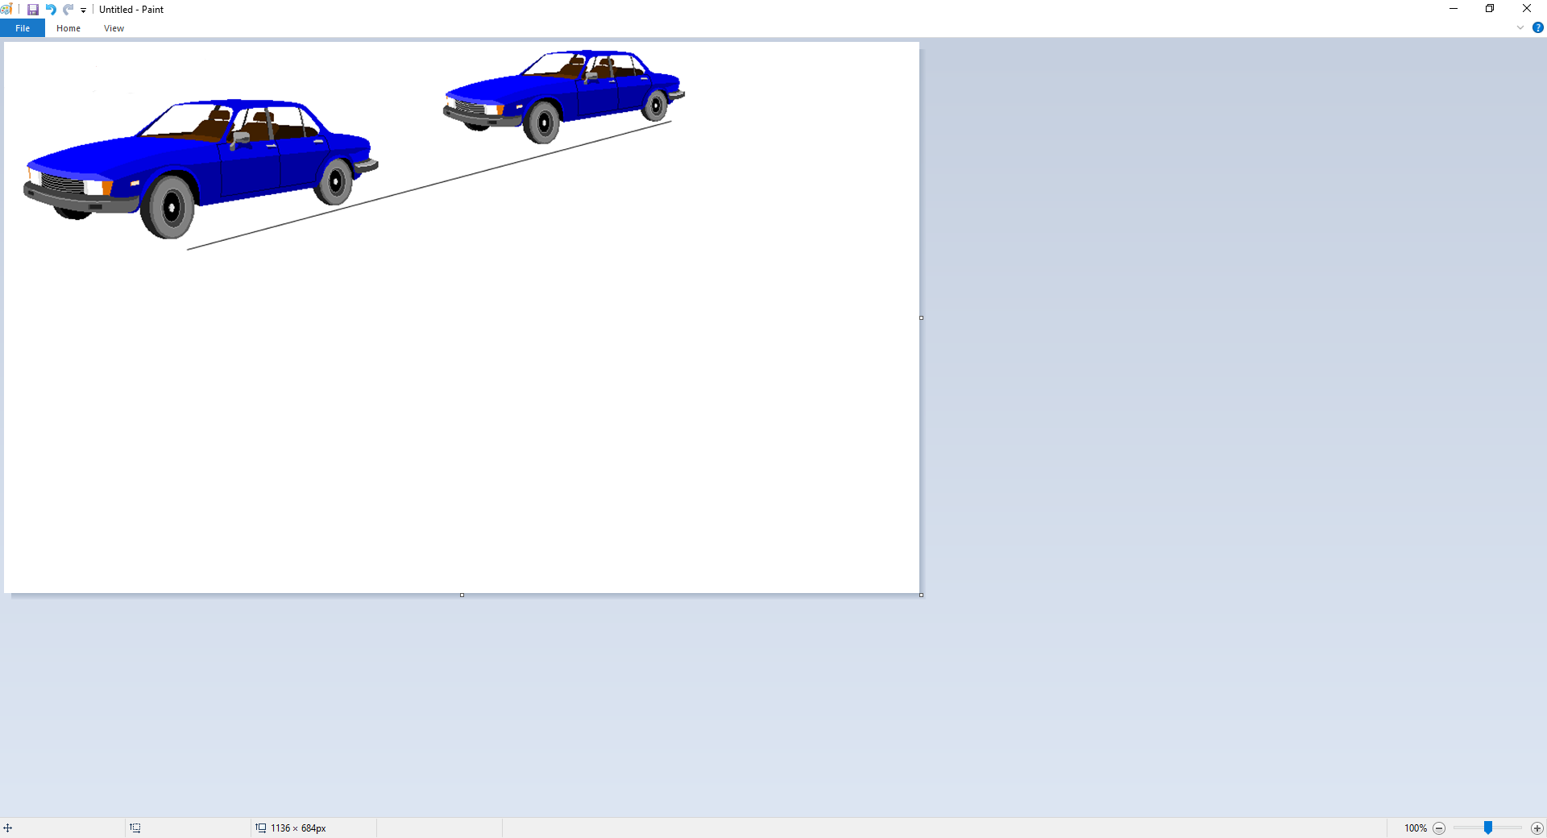
Speed
Speed & Distance
3 seconds minimum following interval
  NSC recommends adding 1 sec for each mitigating factor
4 or more seconds
  Novice = 3+1 sec for minimum following interval
Adjusting Speed

Slide 5
Speed Limits
Urban Areas
Parks
Rural Interstate
Urban Interstate
School Buses

Slide 6
Headlights
Daytime Running Lights
Use of Headlights
High Beam Use
Parking Light Use
Emergency Lights

Slide 7
Freeway Driving Concerns
Planning
Entry
Using Roadway
Exit
Freeway Tips
Vehicle Breakdown

Slide 8
Problem Situations
Skid Control Fundamentals
Brake Failure
Running Off Roadway
Tire Blowout
Steep Hill

Slide 9
Winter Driving Concerns
Equipment
Following Interval
Speed
Visibility

Slide 10
State Alcohol Laws
What items would constitute a minor in possession violation?
Give six ways a license may be illegally used.
Give two definitions of intoxication.
What is P.I.?
Does State have an open container law?
Are the penalties for DWI the same for all age persons?
What is DUI?
What is ALR and implied consent?

Slide 11
Minor In Possession (MIP)
Attempting to purchase alcoholic beverage
Purchase of alcoholic beverage
Possession of an alcoholic beverage
Consumption of alcoholic beverage
Misrepresentation of age to purchase an alcoholic beverage

Slide 12
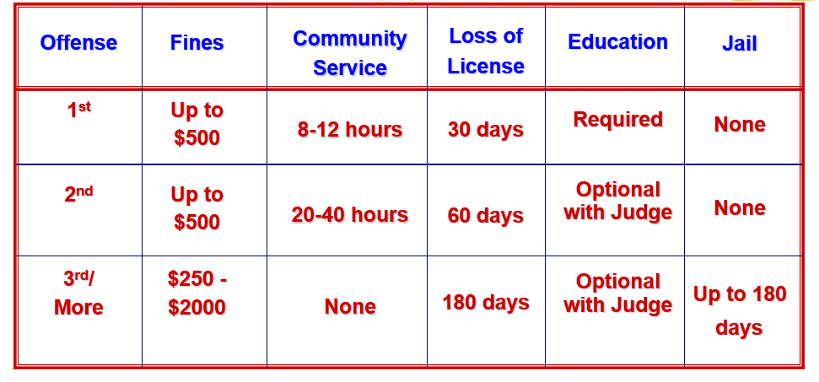
MIP Penalties
Deferred Disposition is conviction for enhancement

Slide 13
Improper Use of a License
Use of false name/address to get a license
Possess more than one license
Use a cancelled or revoked license
Use another person’s license
Lend your license to others
Display or possess a false license
Name
Address
Address
Driver License
PENALTIES: Up to $2,000 fine
and/or Jail Time (up to 180 days)

Slide 14
Driving While Intoxicated
A person commits an offense if the person is intoxicated while operating a motor vehicle in a public place.
Intoxication
Not having the normal use of mental or physical faculties because of alcohol, a legal or illegal drug, a combination of those substances, or any other substance into the body
OR
Having an alcohol concentration of .08 or more.
Note: A DWI violation is not age specific

Slide 15
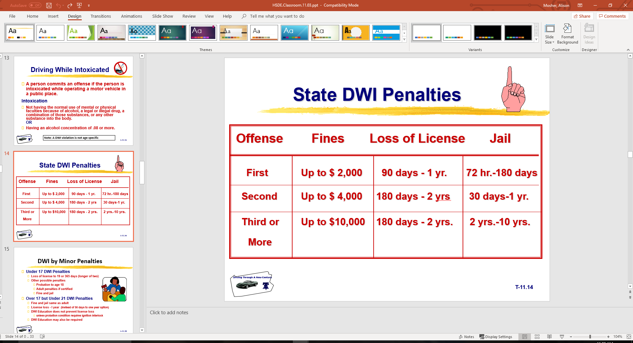
State DWI Penalties

Slide 16
DWI by Minor Penalties
Under 17 DWI Penalties
  Loss of license to 19 or 365 days (longer of two)
  Other possible penalties
    Probation to age 18
    Adult penalties if certified
    Fine and jail
Over 17 but Under 21 DWI Penalties
  Fine and jail same as adult
  License loss - I year (instead of 90 days to one year option)
  DWI Education does not prevent license loss
    unless probation condition requires ignition interlock
  DWI Education may also be required

Slide 17
Public Intoxication
Danger to self or others.
In a public place.
Intoxicated
Penalty to $500
Under 21: same as MIP

Slide 18
Open Container Law
Alcohol in driver’s immediate possession
Driver must be convicted of DWI
Penalty - 3 additional days in jail

Slide 19
Consumption Law
Driver must be seen drinking alcohol while driving
Penalty - up to $500 fine

Slide 20
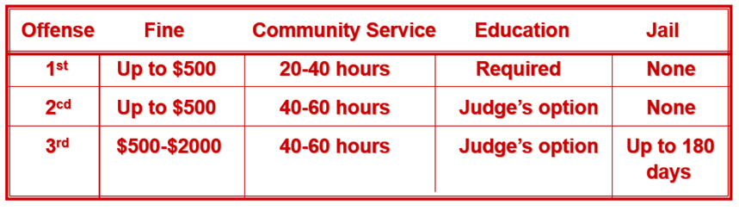
Driving Under the Influence (DUI) By Minor
Unlawful to operate a vehicle in a public place with ANY detectable amount of alcohol
DUI by Minor Penalties

Slide 21
Administrative License Revocation (ALR) Implied Consent
Definitions: ALR is failure (.08 or greater) of breath or blood test while implied consent is refusal of breath or blood test
Penalties: Loss of driver license from 60 days to 1 yr. (depending on offense) Apply even if DWI case not prosecuted
Fee: $100 License Reinstatement

Slide 22
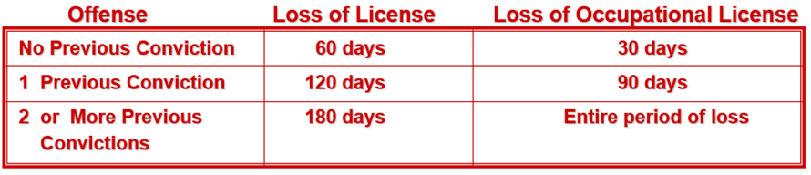
ALR for Minors
Minor qualifies for Administrative License Revocation when
  Breath/Blood test indicates ANY detectable amount of alcohol
  Police officer detects alcohol use
  Possible arrest and conviction for:
    DUI by minor, DWI, or Intoxication Assault/Manslaughter
Penalties for ALR Failure (may be in addition to those listed above)

Slide 23
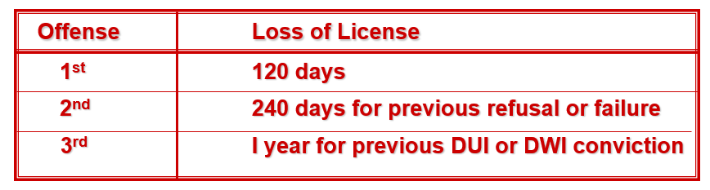
Implied Consent for Minors
DUI by Minor or DWI arrest may be the reason for a breath/blood test request by a law officer
Test Refusal Penalties (may be in addition to those listed above)

Slide 24
Intoxication Assault
Commits an offense if the person
operates a motor vehicle, aircraft, watercraft, or amusement ride
assembles a mobile amusement ride
is intoxicated
by reason of intoxication causes the injury of another person by accident or mistake
Penalty is felony of 3rd Degree
Fine is $0-$10,0000
Penitentiary sentence is 2-10 years
License suspension is 180 days to 2 years

Slide 25
Intoxication Manslaughter
Commits an offense if the person
operates a motor vehicle, aircraft, watercraft, or amusement ride
assembles a mobile amusement ride
is intoxicated
by reason of intoxication causes the death of another person by accident or mistake
Penalty is felony of 2nd Degree
Fine is $0-$10,0000
Penitentiary sentence is 2-20 years
License suspension is 180 days to 2 years

Slide 26
Bicyclist Responsibilities
Cyclist Responsibilities
Full Lane Use by Bicyclist
Cyclist not Restricted to Lane
Merging to Traffic Flow

Slide 27
Sharing Roadway with Bicyclists
Beware of Oncoming Cyclist Turning Left
Merge with Bicycle Traffic Flow Turning Right
Beware of Oncoming Cyclist at Intersection
Right-of-Way Rules Apply

Slide 28
Bicycle Safety Issues
Traffic Laws
Safety Guidelines
Wet Weather Riding
Common Motorist Errors

Slide 29
Sharing Roadway with Trucks
Passing
Following
Wide Turns
Backing
Maneuverability

Slide 30
Sharing Roadway with Motorcyclists
Motorcycle Awareness
Typical Situations
Motorist Responsibilities

Slide 31
Crash Involvement
Stop at Scene
Prevent Other Crashes
Notify Police
Provide Name and Address
When to Report
Unattended Vehicle
Blocking Traffic
Hit and Run Collisions

Slide 32
Aiding Injured
Calling For Help
Make No Injury Assumptions
Avoid Moving Victim
Control Serious Bleeding
Keep Victims Warm

Slide 33
Safety Concerns
Defensive Driving
Using Occupant Protection
Vehicles With Open Beds
When Stopped By Police
Speed Reduces Usable Vision

Slide 34
Safety Concerns
Keys to Safe Driving
Transporting Cargo
Safety Chains
Towing
Carbon Monoxide

