Slide 1
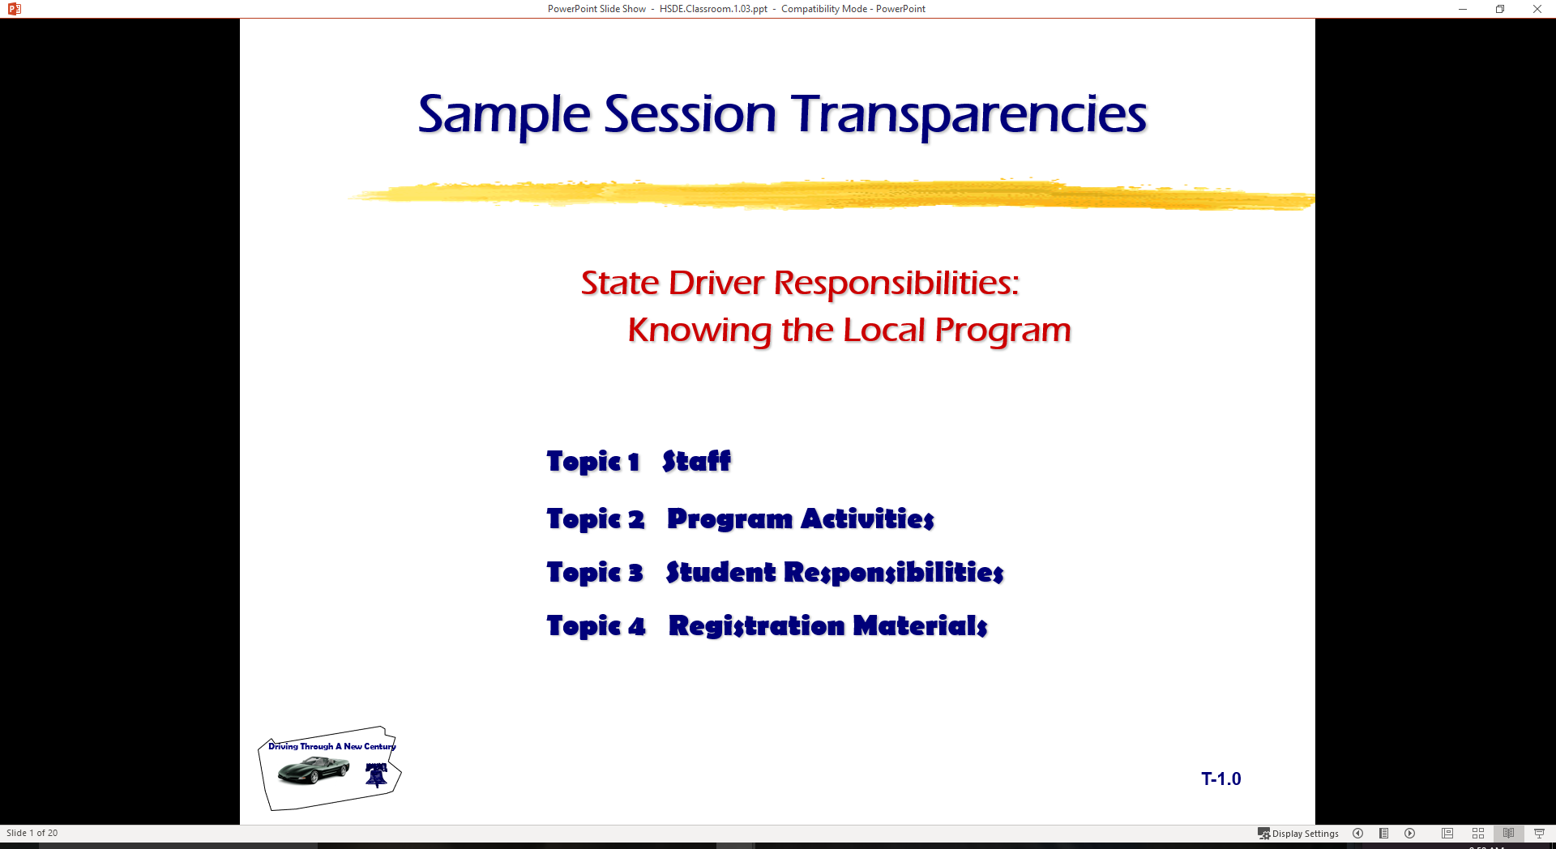
Driver Responsibilities:
Knowing State Traffic Laws
  Topic 1 Controlling Traffic Flow
  Topic 2 Alcohol Laws
  Topic 3 Other Users and Special Situations

Slide 2
Last session
State Licensing Laws
Basic Rules
Simulation
Driver Audit Practice

Slide 3
Session Assessment…Four
What does a round sign shape tell you about traffic flow?
What does a diamond sign tell you about traffic flow
How old must the front seat passenger be when the driver has a permit?
Name the items needed when going to get a driver permit in State.
What is the basic rule for right of way in State?
How does a driver determine an appropriate following interval in State?
Who must yield the right of way at an intersection controlled by a stop sign?
Where must a driver stop when required at an intersection controlled by a yield sign?
Explain the difference between a yellow line and a white line on the roadway.
Explain the difference between the solid line and a broken line on the roadway?

Slide 4
Session Assessment…Four
What does a round sign shape tell you about traffic flow?
  You are approaching a railroad crossing…
What does a diamond sign tell you about traffic flow?
  It is warning the driver of an unusual condition ahead
How old must the front seat passenger be when the driver has a permit?
  Over 21 years of age in State
Name the items needed when going to get a driver permit in State.
  Proof of age, proof of school attendance, and parent for signature.
What is the basic rule for right of way in State?
  When two vehicles approach an uncontrolled intersection at the same time, always yield to the person on the right.

Slide 5
Session Assessment…Four
How does a driver determine an appropriate following interval in State?
  Rule says to follow at a safe and prudent distance, court ruling says to keep enough distance to stop within following interval.
Who must yield the right of way at an intersection controlled by a stop sign?
  The driver that is facing the controlled intersection with the stop sign.
Where must a driver stop when required at an intersection controlled by a yield sign?
  Behind the stop line, the crosswalk line, crosswalk, or before entering the intersection.
Explain the difference between a yellow line and a white line on the roadway.
  Yellow line indicate two way traffic flow and white lines indicate one way traffic flow.
Explain the difference between the solid line and a broken line on the roadway?
  May indicate locations where you are allowed to cross over the lane divisions or limit the vehicle to the lane. Some indicate passing zones.

Slide 6
Stopping, Standing, Parking
Legal Prohibitions
Disabilities
Unattended Vehicle
Parallel to Curb
Hills
Leaving
Coasting

Slide 7
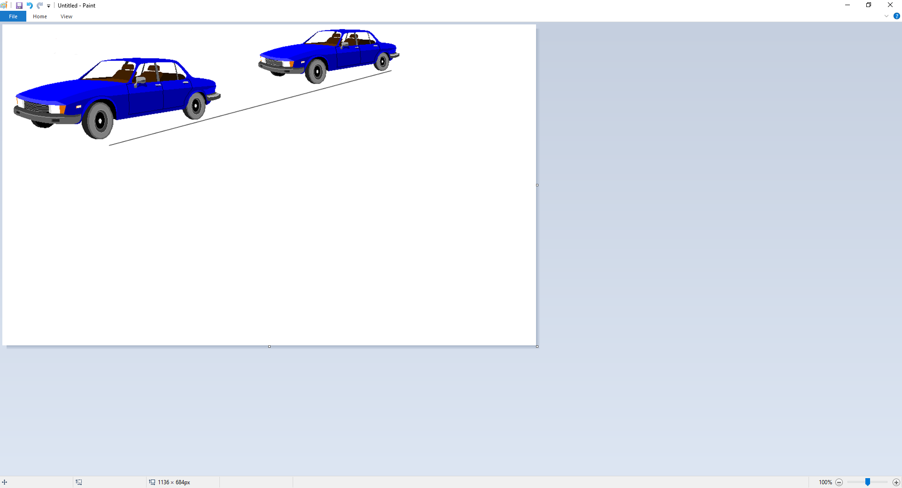
Speed
Speed & Distance
3 seconds minimum following interval
  NSC recommends adding 1 sec for each mitigating factor
4 or more seconds
  Novice = 3+1 sec for minimum following interval
Adjusting Speed

Slide 8
Speed Limits
Urban Areas
Parks
Rural Interstate
Urban Interstate
School Buses

Slide 9
Headlights
Daytime Running Lights
Use of Headlights
High Beam Use
Parking Light Use
Emergency Lights

Slide 10
Freeway Driving Concerns
Planning
Entry
Using Roadway
Exit
Freeway Tips
Vehicle Breakdown

Slide 11
Problem Situations
Skid Control Fundamentals
Brake Failure
Running Off Roadway
Tire Blowout
Steep Hill

Slide 12
Winter Driving Concerns
Equipment
Following Interval
Speed
Visibility

Slide 13
Other Roadway Users

Slide 14
Bicyclist Responsibilities
Cyclist Responsibilities
Full Lane Use by Bicyclist
Cyclist not Restricted to Lane
Merging to Traffic Flow

Slide 15
Sharing Roadway with Bicyclists
Beware of Oncoming Cyclist Turning Left
Merge with Bicycle Traffic Flow Turning Right
Beware of Oncoming Cyclist at Intersection
Right-of-Way Rules Apply

Slide 16
Bicycle Safety Issues
Traffic Laws
Safety Guidelines
Wet Weather Riding
Common Motorist Errors

Slide 17
Sharing Roadway with Trucks
Passing
Following
Wide Turns
Backing
Maneuverability

Slide 18
Sharing Roadway with Motorcyclists
Motorcycle Awareness
Typical Situations
Motorist Responsibilities

Slide 19
Crash Involvement
Stop at Scene
Prevent Other Crashes
Notify Police
Provide Name and Address
When to Report
Unattended Vehicle
Blocking Traffic
Hit and Run Collisions

Slide 20
Aiding Injured
Calling For Help
Make No Injury Assumptions
Avoid Moving Victim
Control Serious Bleeding
Keep Victims Warm

Slide 21
Safety Concerns
Defensive Driving
Using Occupant Protection
Vehicles With Open Beds
When Stopped By Police
Speed Reduces Usable Vision

Slide 22
Safety Concerns
Keys to Safe Driving
Transporting Cargo
Safety Chains
Towing
Carbon Monoxide

Slide 23
State Alcohol Laws
What items would constitute a minor in possession violation?
Give two definitions of intoxication.
What is P.I.?
Does State have an open container law?
Are the penalties for DUI the same for all age persons?
What is DUI?
What is implied consent?
What does ‘Zero’ Tolerance mean in State?

Slide 24
Minor In Possession (MIP)
Attempting to purchase alcoholic beverage
Purchase of alcoholic beverage
Possession of an alcoholic beverage
Consumption of alcoholic beverage
Misrepresentation of age to purchase an alcoholic beverage

Slide 25
Improper Use of a License
Use of false name/address to get a license
Possess more than one license
Use a cancelled or revoked license
Use another person’s license
Lend your license to others
Display or possess a false license
Name
Address
Address
Driver License

Slide 26
Driving While Intoxicated
A person commits an offense if the person is intoxicated
while operating a motor vehicle in a public place.
Intoxication
Not having the normal use of mental or physical faculties because of alcohol,
a legal or illegal drug, a combination of those substances, or any other
substance into the body.
OR
Having an alcohol concentration of .08 or more.
Note: A DUI violation is not age specific

Slide 27
Public Intoxication
Danger to self or others.
In a public place.
Intoxicated
Penalties
Under 21 penalties

Slide 28
Open Container Law
Alcohol in driver’s immediate possession
Container is open and laying on the floor of an auto..

Slide 29
Administrative License Revocation (ALR) Implied Consent
ALR is failure (.08 or greater) of breath or blood test while implied consent is refusal of breath or blood test

Slide 30
Intoxication Assault
Commits an offense if the person
operates a motor vehicle, aircraft, watercraft, or amusement ride
assembles a mobile amusement ride
is intoxicated
by reason of intoxication causes the injury of another person by accident or mistake

Slide 31
Intoxication Manslaughter
Commits an offense if the person
operates a motor vehicle, aircraft, watercraft, or amusement ride
assembles a mobile amusement ride
is intoxicated
by reason of intoxication causes the death of another person by accident or mistake

