Slide 1
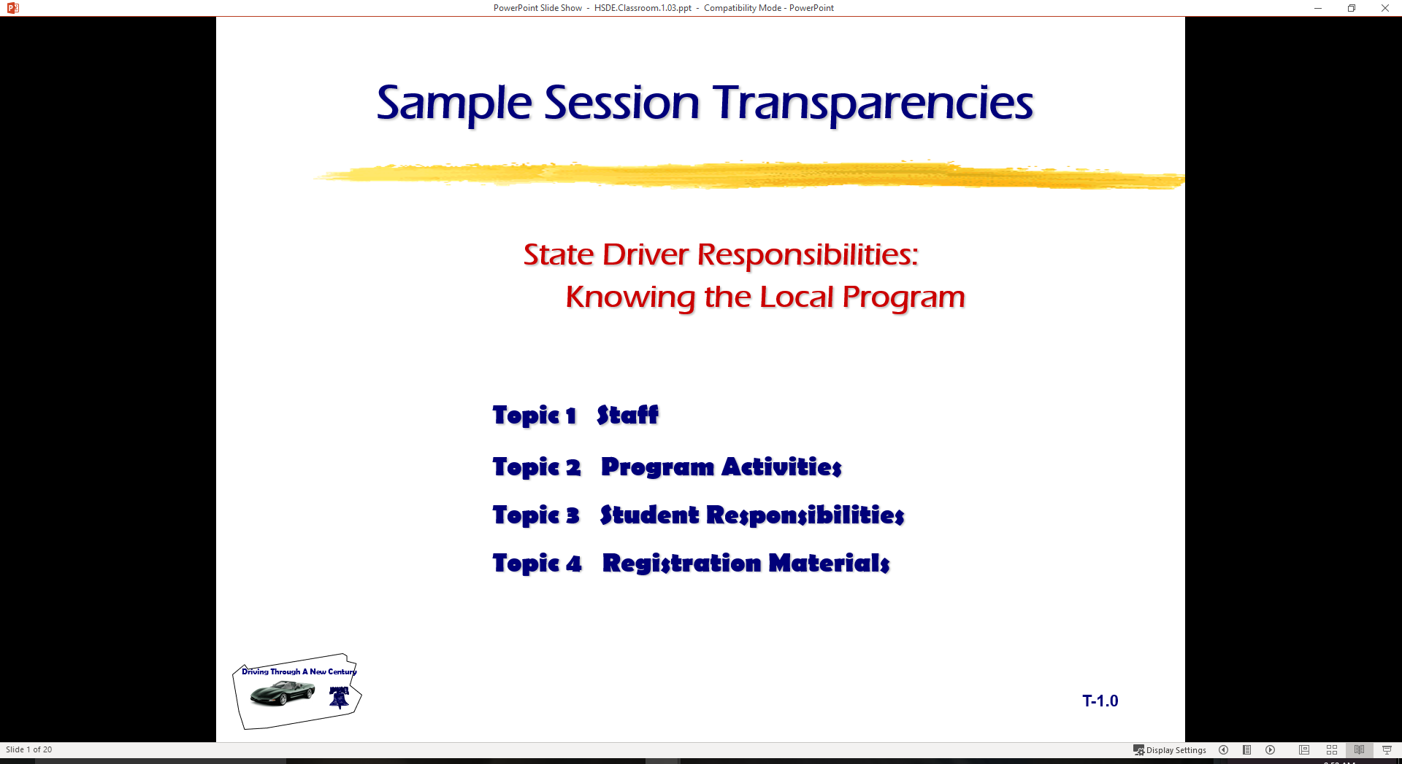
State Driver Responsibilities:
Knowing the Local Program
  Topic 1 Staff
  Topic 2 Program Activities
  Topic 3 Student Responsibilities
  Topic 4 Registration Materials

Slide 2

Introduction
Traffic Safety Institute Staff
  …………. is administrative support
  ……….. is coordinator of HSDE Program
  ……….. is coordinator of laboratory, in-car work, and student observers
Instructional Staff
  …………. is instructor and coordinator of ……….. HSDE program
  …………. is instructor for range and in-car activities
  students will observe and work with the lab phases
S E E

Slide 3
Class Activities
Classroom Lectures (large group activity)
Individualized Classroom Activities (small groups or individually)
Assessments (graded activities)
Simulation (small group activities)
  visit simulation units
  need to limit class size to twenty is based on simulation and range activities

Slide 4
In-Car Activities
Range activities are grouped activities
  space and reference point lab
  Vehicle Balance and Control (AutoControl Monster)
  basic skills audit (you may practice with your car)
  traction loss control (wet surface training)
In-car activities are grouped activities
  driver skills audit
  remedial training
  basic skill training
  perceptual skill training
  final audit of skills and performances

Slide 5
Attendance Policy
Hour requirement for completion and certification
When student misses fourth class or simulation
  dropped from class activities
  may make up work during next term class
  “I” grade will be issued
    must retake class if activities are not made up in next term
When a student misses third in-car activity
  suspended from in-car activities
  may make up work during next term class
  “I” grade will be issued
  must retake class if activities are not made up in next term
“I” grades turn to “F” grade if not made up during next term class

Slide 6
Passing Classroom to Participate
A student must be passing classroom and simulation activities to participate in the in-car activities
Example: if student fails test or is below passing... s/he is suspended from in-car activities
Attendance rules will apply

Slide 7
Rules of Conduct
We expect you to cooperate with our staff in any activity area
Food and drinks are not allowed in vehicle or simulator
  electrical components
  dangers to passengers
Abusive language will not be tolerated
Treat instructors and fellow class members with respect
Ask questions that are relative to the program and subject matter
Keep a notebook or portfolio of all classroom/laboratory activities
Be ready for class activities in a timely manner

Slide 8
Penalties for Breaking Rules of Conduct
Student will be removed from activity and treated as missing the class, simulation, or in-car activity
Attendance rules will be enforced as listed above
Tests, scores, or audits for the time missed will be recorded as a “0”

Slide 9
Registration and Waiver Information
Must be completed and returned by next classroom session for scheduling groups
Waiver signature needed by parent if under age 18

Slide 10
Class Schedule of Activities
Grouping arrangements
Tentative schedule depends on:
  model school programs
  our facilities availability
Overall groupings will be based on your forms returned
We will have the first example of groupings starting on next Tuesday
Homework will be kept to a minimum
Lab will be made available for make-up work

Slide 11
Complete a Class Project
Pick a Traffic Safety topical area by ……..
Prepare a written topic paper, PowerPoint with notations, or video
Prepare a fifteen minute class presentation
Be prepared for oral presentation by ………….
A schedule will be developed based on the topical areas
May be used as the basis for a Senior Project

Slide 12
In a Traffic Safety Program…
Evaluate your needs as a driver
Provide some basic skill development
Provide perceptual training skills
Develop a recognition of the problem concerning new drivers
View the video “Young Drivers: The High Risk Years” and discuss the issues presented
Our goal is to provide good experiences that will help novice drivers make good decisions in the future

Slide 13
State Graduated License Program
Affects you as a new driver
The basis for provisional and graduated licensing comes from high insurance claims and risk assumption by new drivers
View video entitled, “Phasing in the Driving Privilege”
Look at copies of the “Graduated Driver’s License” State pamphlet provided with textbook
  review licensing process
  answer PA GDL questions

Slide 14
Class Assignments
Begin with next session
Groupings and first laboratory sessions will be made available
A notebook or portfolio will be needed
Class activity information will be made available
Capability to operate more than one video presentation for individual work

Slide 15
Driver Education Program Goals
Demonstrate a working knowledge of
  laws for operating and owning an automobile
  rules for operating and owning an automobile
  procedures for operating and owning an automobile
  occupant restraints and new vehicle technology
Use a space management system to
  obtain correct information about driving maneuvers
  make reduced-risk decisions about driving maneuvers
  adjusting position and/or speed to avoid conflicts and reduce risk

Slide 16
Driver Education Program Goals
A student completing this driver education program will:
Manage factors that affect driver performance by
  developing refusal skills with alcohol and other drugs
  controlling displays of anger in traffic situations
  eliminating aggressive actions in traffic flow
  maintaining fitness and attitudes needed for reduced-risk driving performance
Protect natural resources by
  safe disposal of trash and toxic products
  conserving fuel and energy resources
  utilizing manufacturer’s vehicle maintenance specifications

Slide 17
Driver Education Program Goals
In this State, driver education students acquire the essential knowledge, skills, and experiences to perform reduced-risk driving practices in the total traffic environment.
Mastery of classroom and in-car instruction include:
Modeling behaviors
Knowledge and skills assessment
Observation
Parental/Mentor involvement
Continuous life-long learning of reduced-risk driving

Slide 18
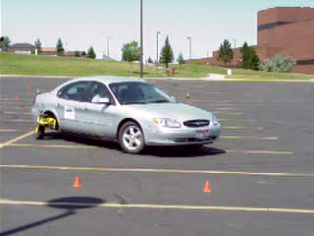
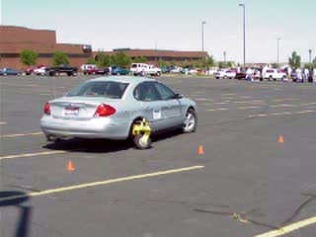
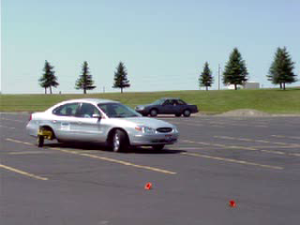
Next Session
Classroom
  vision skills
  perceptual skills
Range Lab Session
  vision control
  effect of 2 mph on
  vehicle control
  AutoControl Monster

Slide 19
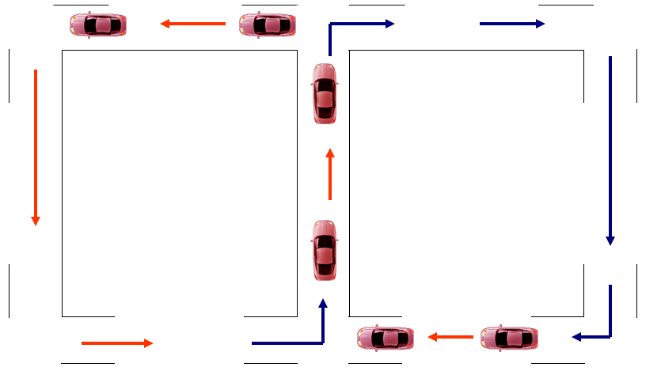
Adding 2 MPH to Speed

Slide 20
High School Driver Education Program
Program Development
Concepts and Practices

Slide 21
Contact/Mission
For more information on Driver’s Education and Safety please visit PDE’s website at www.education.pa.gov
The mission of the Department of Education is to ensure that every learner has access to a world-class education system that academically prepares children and adults to succeed as productive citizens. Further, the Department seeks to establish a culture that is committed to improving opportunities throughout the commonwealth by ensuring that technical support, resources, and optimal learning environments are available for all students, whether children or adults.

