Slide 1
Road Signs Recognition Quiz

Slide 2
Each sign will appear for 0.3 seconds…

Slide 3
You will then have ten (10) seconds to write down its meaning on your paper.

Slide 4
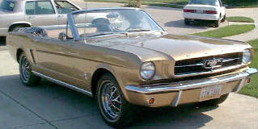
Ready to Roll?

Slide 5
Here Comes Sign # 1. . .

Slide 6


Slide 7
Here Comes Sign # 2. . .

Slide 8


Slide 9
Here Comes Sign # 3. . .

Slide 10


Slide 11
Here Comes Sign # 4. . .

Slide 12


Slide 13
Here Comes Sign # 5. . .

Slide 14
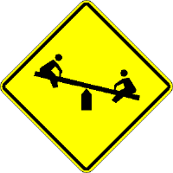

Slide 15
Here Comes Sign # 6. . .

Slide 16


Slide 17
Here Comes Sign # 7. . .

Slide 18


Slide 19
Here Comes Sign # 8. . .

Slide 20


Slide 21
Here Comes Sign # 9. . .

Slide 22


Slide 23
Here Comes Sign # 10. . .

Slide 24


Slide 25
Here Comes Sign # 11. . .

Slide 26


Slide 27
Here Comes Sign # 12. . .

Slide 28


Slide 29
Here Comes Sign # 13. . .

Slide 30


Slide 31
Here Comes Sign # 14. . .

Slide 32


Slide 33
Here Comes Sign # 15. . .

Slide 34


Slide 35
Here Comes Sign # 16

Slide 36
What do the DIAMOND SHAPED ROAD MARKINGS in this next slide signify?

Slide 37
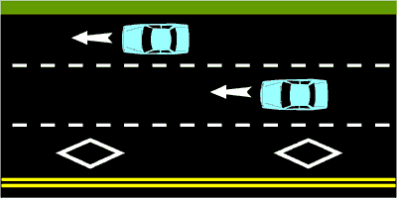

Slide 38
Here Comes Sign # 17. . .

Slide 39


Slide 40
Here Comes Sign # 18. . .

Slide 41


Slide 42
Here Comes Sign # 19. . .

Slide 43


Slide 44
Here Comes Sign # 20. . .

Slide 45


Slide 46
Here Comes Sign # 21. . .

Slide 47


Slide 48
Here Comes Sign # 22. . .

Slide 49


Slide 50
Here Comes Sign # 23. . .

Slide 51


Slide 52
Here Comes Sign # 24. . .

Slide 53


Slide 54
Here Comes Sign # 25. . .

Slide 55


Slide 56
Here Comes Sign # 26. . .

Slide 57


Slide 58
Here Comes Sign # 27. . .

Slide 59


Slide 60
Here Comes Sign # 28. . .

Slide 61


Slide 62
Here Comes Sign # 29. . .

Slide 64
Here Comes Sign # 30. . .

Slide 65


Slide 66
Here Comes Sign # 31. . .

Slide 67


Slide 68
Here Comes Sign # 32. . .

Slide 69


Slide 70
Here Comes Sign # 33. . .

Slide 71


Slide 72
Here Comes Sign # 34. . .

Slide 73
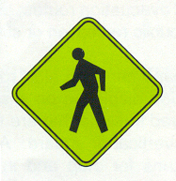

Slide 74
Here Comes Sign # 35. . .

Slide 75


Slide 76
Here Comes Sign # 36. . .

Slide 77


Slide 78
Here Comes Sign # 37. . .

Slide 79


Slide 80
Here Comes Sign # 38. . .

Slide 81


Slide 82
Here Comes Sign # 39. . .

Slide 83


Slide 84
Here Comes Sign # 40. . .

Slide 85


Slide 86
Here Comes Sign # 41. . .

Slide 87


Slide 88
Here Comes Sign # 42. . .

Slide 89


Slide 90
Here Comes Sign # 43. . .

Slide 91


Slide 92
Here Comes Sign # 44. . .

Slide 93


Slide 94
Here Comes Sign # 45. . .

Slide 95


Slide 96
Here Comes Sign # 46. . .

Slide 97


Slide 98
Here Comes Sign # 47. . .

Slide 99


Slide 100
Here Comes Sign # 48. . .

Slide 101


Slide 102
Here Comes Sign # 49. . .

Slide 103


Slide 104
Here Comes Sign # 50. . .

Slide 105


Slide 106
That is all of the Signs…

Slide 107

ANSWERS….

Slide 108
ANSWERS….
No Right Turn at the Intersection
Warning of Multiple Curves Ahead
Warning of Stop Sign at Intersection
Warning of Two-Way Traffic Ahead
Warning of Playground Ahead
Do Not Enter This Roadway

Slide 109
ANSWERS….
Warning of Intersection Ahead
Warning of Steep Downgrade..Downshift Needed
Warning of Wildlife Crossing..Elk Crossing
Warning of Divided Highway Starting Ahead
Regulation.. No Parking Area
Warning of Divided Highway Ending Ahead

Slide 110
ANSWERS….
Warning of Flagman Ahead
Regulation… Yield to Traffic at Next Intersection
Information… Hospital Zone or Location
16. Diamond Indicates High Occupancy Vehicle Lane
Warning of Restricted Height Space Ahead
Information… Information Center Location

Slide 111
ANSWERS….
Warning of Right Lane Ending Ahead
Regulation… Move to the Right into the Lane
Warning of Merging Traffic from the Right
Regulation… No Bicyclists on this Roadway
Warning… Uneven or Low Shoulder Ahead
Warning of Left Lane Ending Ahead

Slide 112
ANSWERS….
Warning of Traffic Signal at Next Intersection
Warning of T-intersection to the Right
No Pedestrians In This Area
Warning of School Zone Ahead
Warning of School Crosswalk
Regulation… One Way Street This Direction

Slide 113
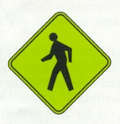
ANSWERS….
Warning of Railroad Crossing Near Intersection Ahead
No Delivery Trucks in This Roadway or Area
Junction of Roadways As Listed
Warning of Pedestrian Crossings Ahead
Warning of Construction Zone Ahead
Regulation… No U-turn Permitted

Slide 114
ANSWERS….
Warning of Slow Moving Ahead
Warning of Lane Added to Left Side of Roadway
Regulation… Dual Right Turns Allowed Within Lanes
Warning of Sharp Curves Ahead to Left and Right
All Traffic Flow Moves to the Left Here
Warning of Sharp Curve Ahead With Less than Normal Roadway Banking

Slide 115

ANSWERS….
Information… Airport Ahead
Recreational… Hiking Trail Ahead
Warning of Narrow Roadway with Bridge Abutments
Regulation… Towing Zone, Do Not Park In This Area
Regulation… No Hitchhiking in This Area

Slide 116

ANSWERS….
Information… Boat Loading/Unloading Docks Ahead
Warning of Roadway Pavement Ending, Changes from Paved Roadway to Gravel Roadway
Warning of Children Playing Ahead…Slow Down

Slide 117
Contact/Mission
For more information on the (the topic of the presentation) please visit PDE’s website at www.education.pa.gov
The mission of the Department of Education is to ensure that every learner has access to a world-class education system that academically prepares children and adults to succeed as productive citizens. Further, the Department seeks to establish a culture that is committed to improving opportunities throughout the commonwealth by ensuring that technical support, resources, and optimal learning environments are available for all students, whether children or adults.

