Slide 1
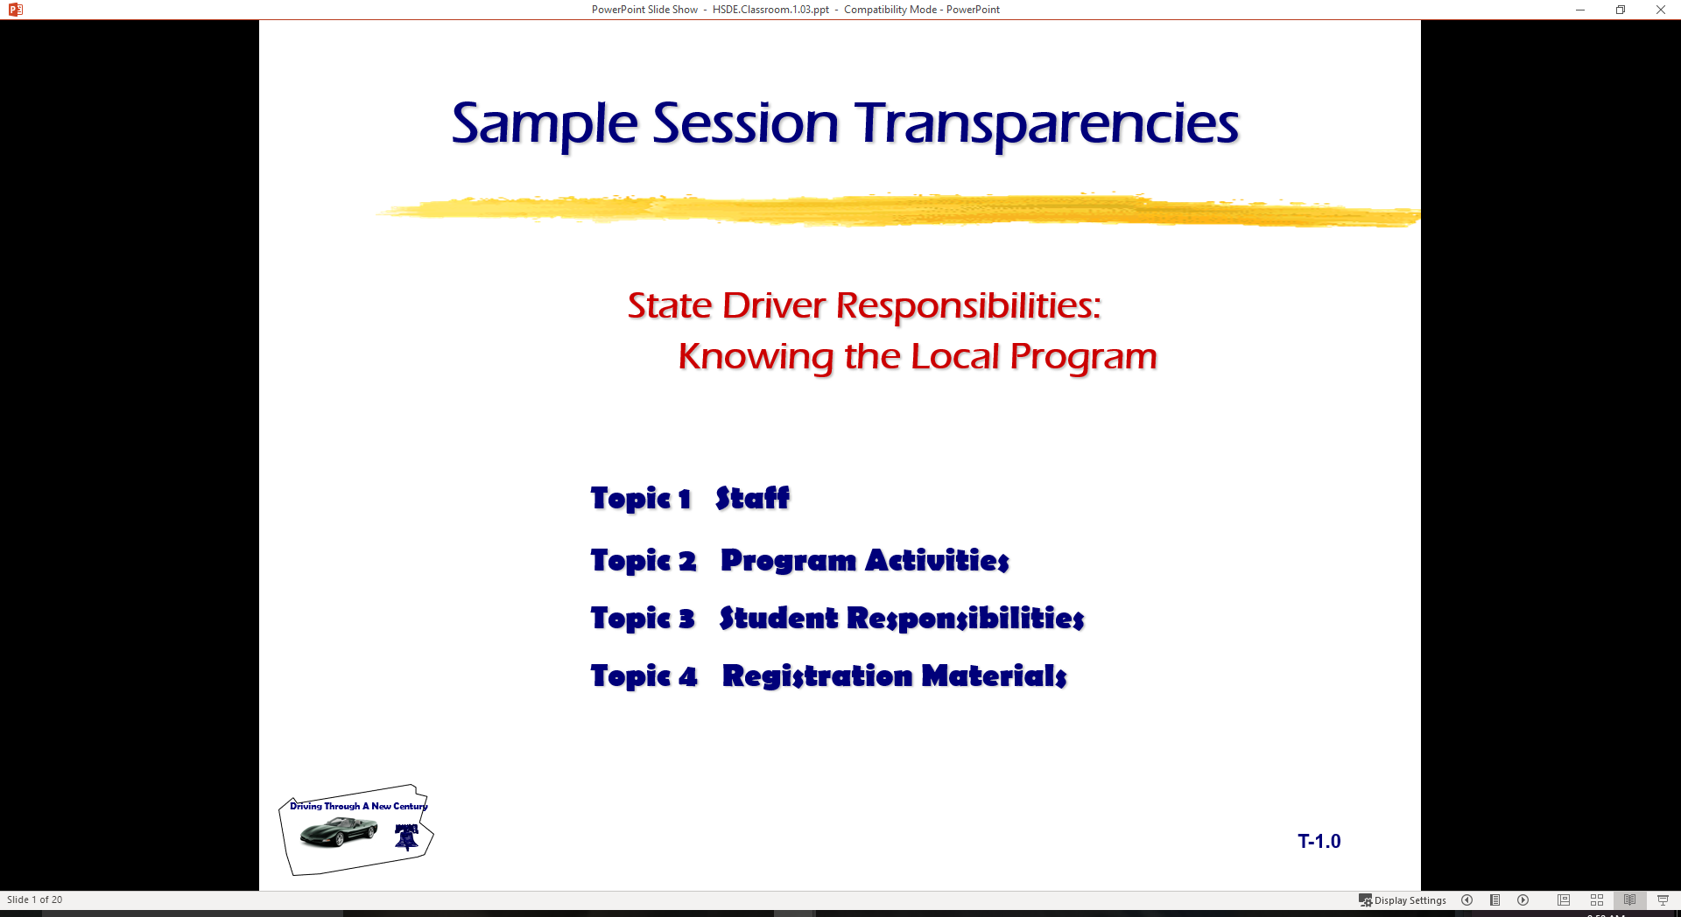
  Driving under limited visibility

Slide 2
Changing Visibility at Night
Limitations placed on gathering information
Limitations placed on processing information
Night driving factors:
reduced illumination
ability of the eyes to adjust to glare

Slide 3

Changing Visibility at Night
Distance you can see ahead is limited
Headlights provide limited illumination of off-road areas
Loss of contrast and impaired distance judgment
Glare from lights of oncoming and following vehicles
Glare recovery time

Slide 4
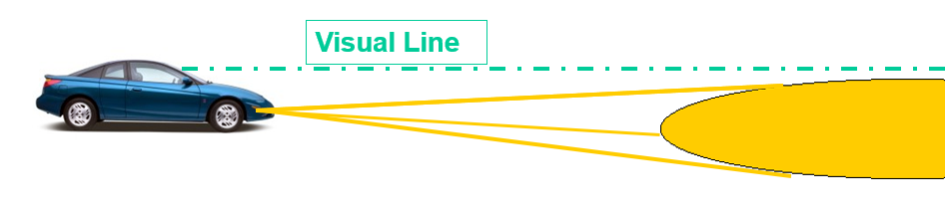
Headlight Alignment and Speed
  Beam hits roadway 100 to 150 feet ahead
  Illuminates area 300 to 500 feet ahead
  Load, load distribution, and vehicle height affect
  light beam distance
  Maximum safe speed 40 to 45 mph based on ability
  to stop within lighted area
Properly aligned low beams

Slide 5
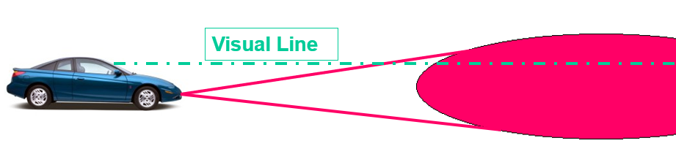
Headlight Alignment and Speed
Properly aligned high beams
  Beams hit roadway 350 to 500 feet ahead
  Illuminate area road 500 to 1800 feet ahead
  Load, load distribution, and vehicle height affect
  light beam distance
  Maximum safe speed 65 to 70 mph, based on ability
  to stop within lighted area

Slide 6

Nighttime Precautionary Measures
Clean windshield inside and out
  Special problem of windblown sand/dirt particles
  Diffused light gives appearance of halo around headlights
  of oncoming vehicle. Clean all lights.
  50 to 90 percent loss of headlight
  efficiency due to road grime
Reduce daytime speed
Increase following interval
Look to right of oncoming vehicles

Slide 7
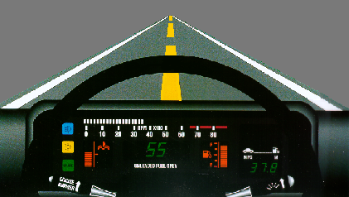
Nighttime Precautionary Measures
Turn off interior convenience
lights
Proper use of high/low head-
light beams
Use parking lights only when parked
If stopped beside road, take appropriate safety measures
Use day/night switch on rear-view mirror

Slide 8

Visibility Limitations in Fog
Driving in Drifting Fog
Reduce speed
Make sure headlights are on low beam to reduce
reflected glare
Turn on windshield wipers
Turn on defroster or air conditioner

Slide 9
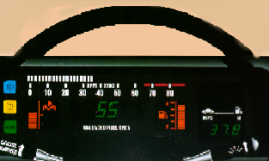
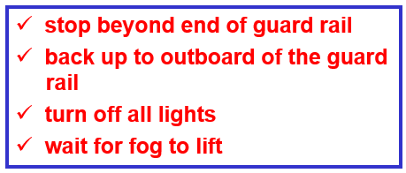
Visibility Limitations in Fog
Driving in Heavy Fog
Reduce speed, but do not stop in
a travel lane
Turn on emergency flashers
Look for an exit from the highway
If impossible to leave highway

Slide 10
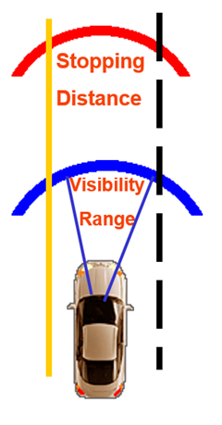
Visibility Limitations in Bad Weather
Reduce speed imposed by ability to stop
Do not stop in travel lane or shoulder
Turn headlights to low beams
Turn on emergency flashers when below speed limit
Maintain appropriate lane position
If your stopping distance is longer than your range of visibility, you are at risk

Slide 11

Precautions in Bad Weather
Turn on windshield wipers
Be alert for vehicles stopped in roadway
Be prepared for effects of gusting or
strong steady crosswinds
Make steering, acceleration and braking
actions gently and smoothly

Slide 12
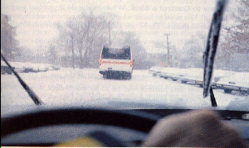
Precautions in Bad Weather
In severe snow conditions, look for exit from highway and turn on radio for weather report
If impossible to leave highway, stop beyond the outboard end of guard rail
Use cell phone or radio to check
conditions
Smoke, ice, and snow require
use of windshield washer

Slide 13
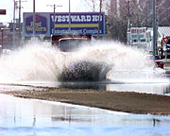
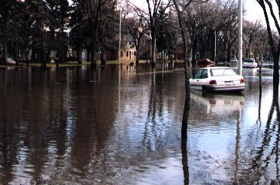
Low Water Crossings
Flash Flooding Conditions
Not Specific to Time of Year
Dangerous Condition

Slide 14
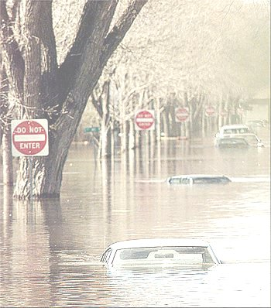
Low Water Crossings
Nearly 50% of flash flood fatalities are vehicle
related
Search for flood prone areas:
  highway dips
  bridges
  low areas
Largest and heaviest of vehicles will float
Six inches of water may cause loss of control

Slide 15
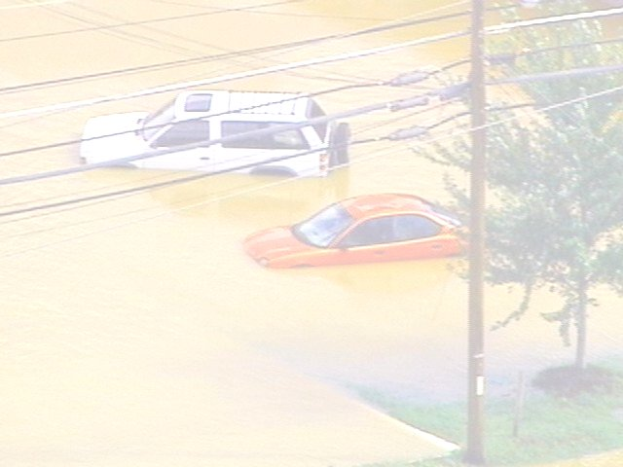
Low Water Crossing
Two feet of water carries most cars
Hidden danger awaits most motorists
Visibility is limited at night
Heed all flood warnings
Heed all flash flood watches and warnings
Keep aware of road conditions through news media

Slide 16
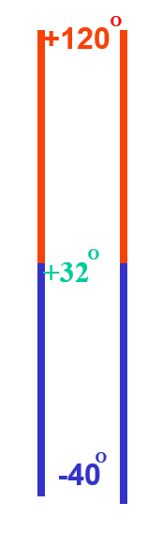
Hot Cold Temperatures
Additional Demands on Vehicle Systems
  High temperatures of summer
  Low temperatures of winter
If not addressed…
  Impairs your ability to assess conditions
  Impairs your ability to respond in a timely manner
  Creates conditions of increased risk

Slide 17
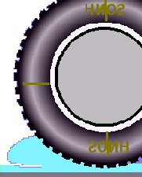
Cold Weather Precautions
Tires for balance, alignment, appropriate type
and depth of tread
- Minimum legal 2/32 of an inch tread depth inadequate on all
wet surfaces
Tire inflation
- Keep track of cold tire pressure (noted inside driver door)
- Maximum tire pressure indicated on tire sidewalls
Radiator coolant, hoses, and connections

Slide 18
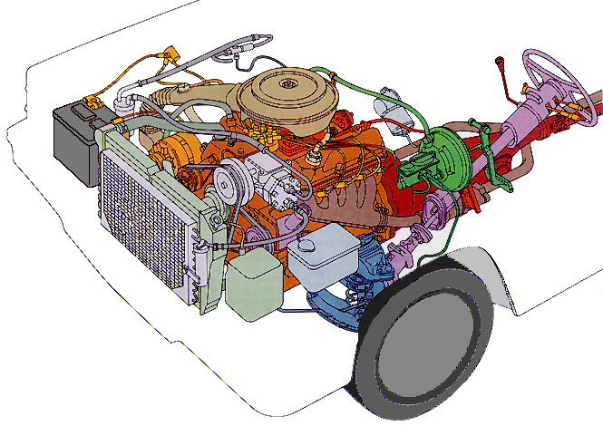
Cold Weather Checks
Heater, defroster and air
conditioner system
Drive belts for tension and wear
Winterized windshield wiper fluid
Windshield wiper blades
Lights and glass areas are clear and clean

Slide 19
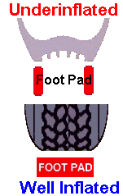
Hot Weather Checks
Tire inflation needs special attention
  Underinflated tires are subject to heat and pressure buildup
  Especially when driving for extended distances at higher speeds
The air conditioner, radiator coolant,
hoses, connections, and drive belts need
special attention
  Due to the extra load placed on the engine
  Due to the extra load placed on the cooling system

Slide 20
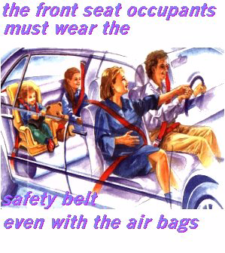
Safety Restraints for Adults
Snug lap belt after fastening
across hips or thighs
Adjust center post mounting for height
if vehicle is equipped with device
Belt over top of shoulder and across chest
distributes force in event of crash
Check frequently for snug fit

Slide 21
Safety Restraints for Adults
Keep seat back in upright position avoids submarine effect in frontal crash
Movement of belted occupant in a crash
Types of locking devices

Slide 22
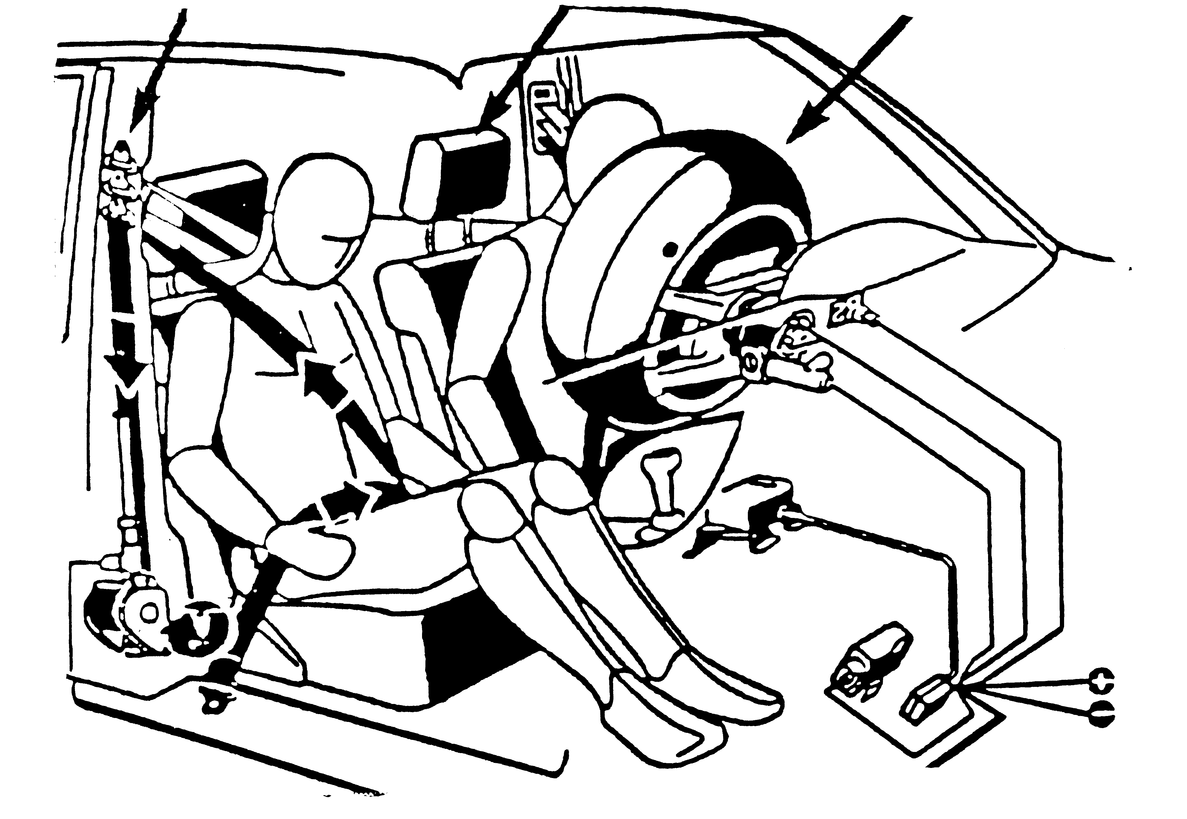
Safety Restraints for Adults
Air Bags in Dash
or Steering Wheel
No passenger under 12 years of
age in front seat
Protects against head and chest
injuries
Speed of inflation is critical
Driver should adjust seat for
minimum 10 inch clearance
between chest and steering wheel

Slide 23
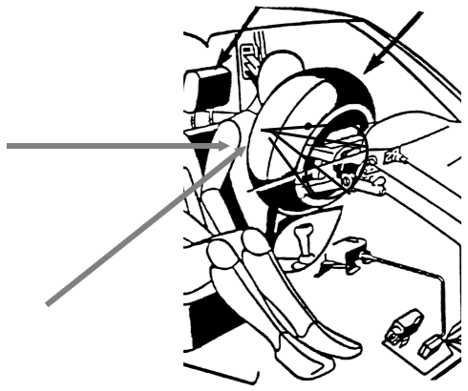
Safety Restraints for Adults
Air Bags in Dash
or Steering Wheel
Raise seat or adjust steering wheel to direct air bag toward chest and facial area
Hand position should be at 9 and 3 or lower
Avoid 10 and 2 for blow hole burn prevention

Slide 24

Safety Restraints for Adults
Air Bags for side impact protection
  - Upper door frame
  - Seat edge/door panel
Head Restraints
Proper adjustment to avoid neck injury
  - Seat position to aid in vehicle control

Slide 25
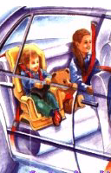
Safety Restraints for Youth
Belt and Seat Restraint Use
  Safest if seated in back seat
  Infant seats/rear facing/birth to 20 lbs.
  Child seats up to 40 lbs.
  Booster seats up to 60 lbs.
Head Restraints
  Proper adjustment to avoid neck injury
  Seat position

Slide 26
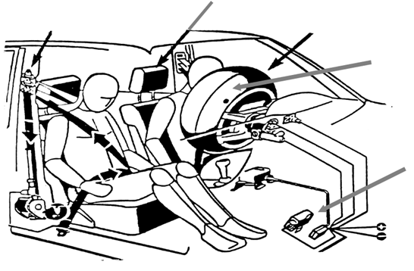
Occupant Protection
Adjustable
Shoulder-Belt Mount
Head Restraint
Air Bag
Gases Vent Opening
Crash Sensors

Slide 27
Restraints Protect
Against Ejection from Vehicle
Against Fire and Water Immersion
Protects Child from
Impact instead of
holding child on your lap
Protects Occupants at
Point of Impact

Slide 28
Movement of Belted Occupant
In 31 MPH Crash
Head = 1.9 ft.
Chest = 1.3 ft.
Pelvis = 1.2 ft.

Slide 29
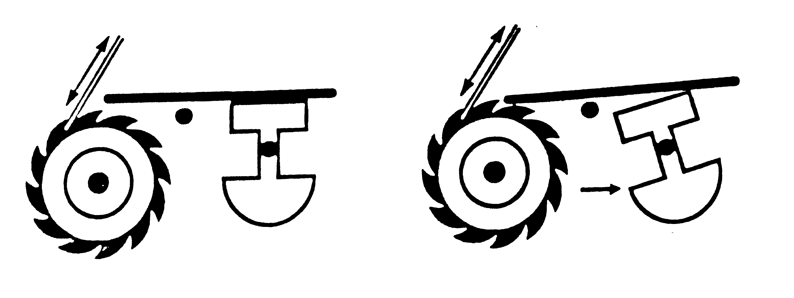
Types of Belt-Locking Systems
Sudden Car Movement
Normal Conditions Emergency Conditions

Slide 30
Adjusting Belts for Proper Fit
Lap belt
  low across hips
  snug across hips
  avoids internal injuries
Shoulder belt
  over collar bone and chest
  avoids shoulder dislocation
  avoids rib cage damage

Slide 31
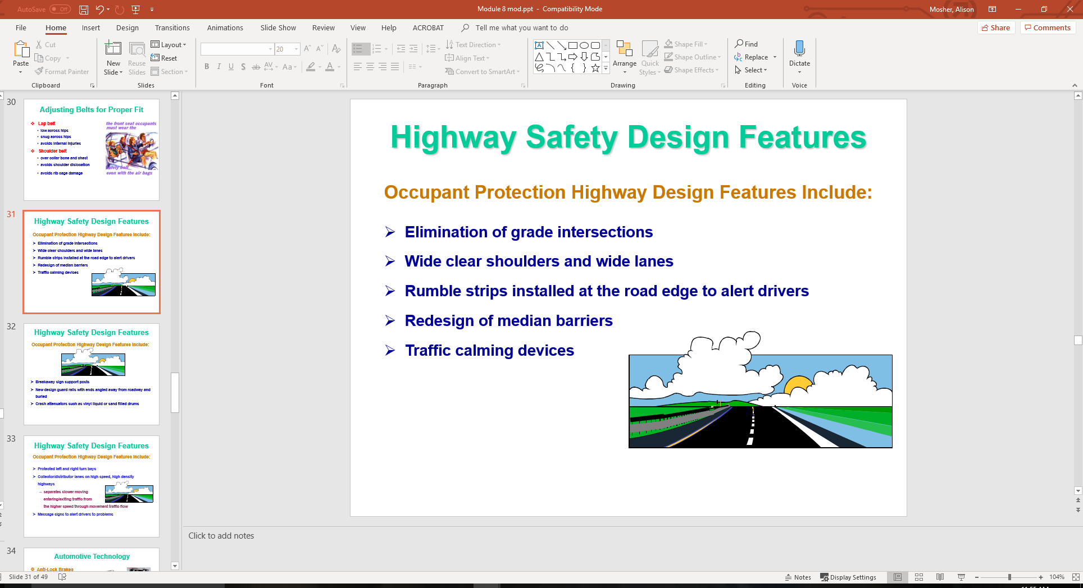
Highway Safety Design Features
Occupant Protection Highway Design Features Include:
Elimination of grade intersections
Wide clear shoulders and wide lanes
Rumble strips installed at the road edge to alert drivers
Redesign of median barriers
Traffic calming devices

Slide 32
Highway Safety Design Features
Occupant Protection Highway Design Features Include:
Breakaway sign support posts
New design guard rails with ends angled away from roadway and buried
Crash attenuators such as vinyl liquid or sand filled drums

Slide 33
Highway Safety Design Features
Occupant Protection Highway Design Features Include:
Protected left and right turn bays
Collector/distributor lanes on high speed, high density highways
  separates slower moving
  entering/exiting traffic from
  the higher speed through movement traffic flow
Message signs to alert drivers to problems

Slide 34
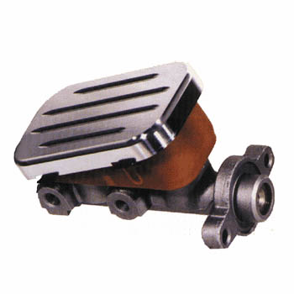
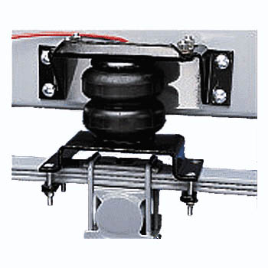
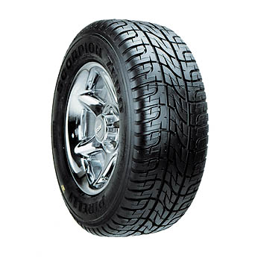
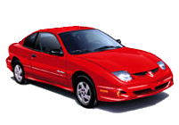
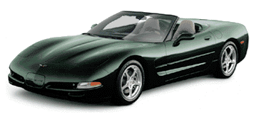
Automotive Technology
Anti-Lock Brakes
Traction Control Devices
Suspension Control Devices
Electronic Stability Program (ESP)
Crumple Zones
Door Latches
Glass
Headlights

Slide 35
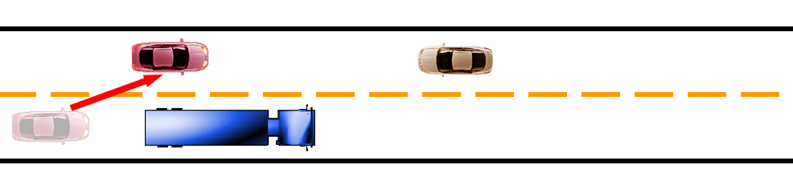
Controlling Consequences
Avoid Head-On Collisions
Drive off road rather than skid off road
Hit something soft rather than something hard
Hit something going your way rather than something stationary
Hit stationary object with glancing blow
Hit stationary object rather than an approaching object
Steer to avoid oncoming traffic

Slide 36
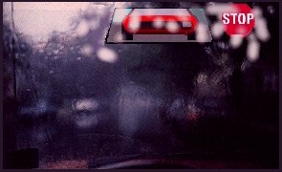
Other Adverse Conditions
Ice, snow, or frost
Wet, particularly first 15 minutes of rain after long dry period
when drops of oil and rubber particles have collected on surface
Hard rain or water standing
on road
Mud near farm entrances,
construction sites and truck
crossings

Slide 37
Condition of the Road Surface
Ice, snow or frost
Wet, particularly first 15 minutes of rain after a long dry period when drops of oil and rubber particles have collected on surface
Hard rain or water standing on road
Mud near farm entrances, construction sites and truck crossings

Slide 38
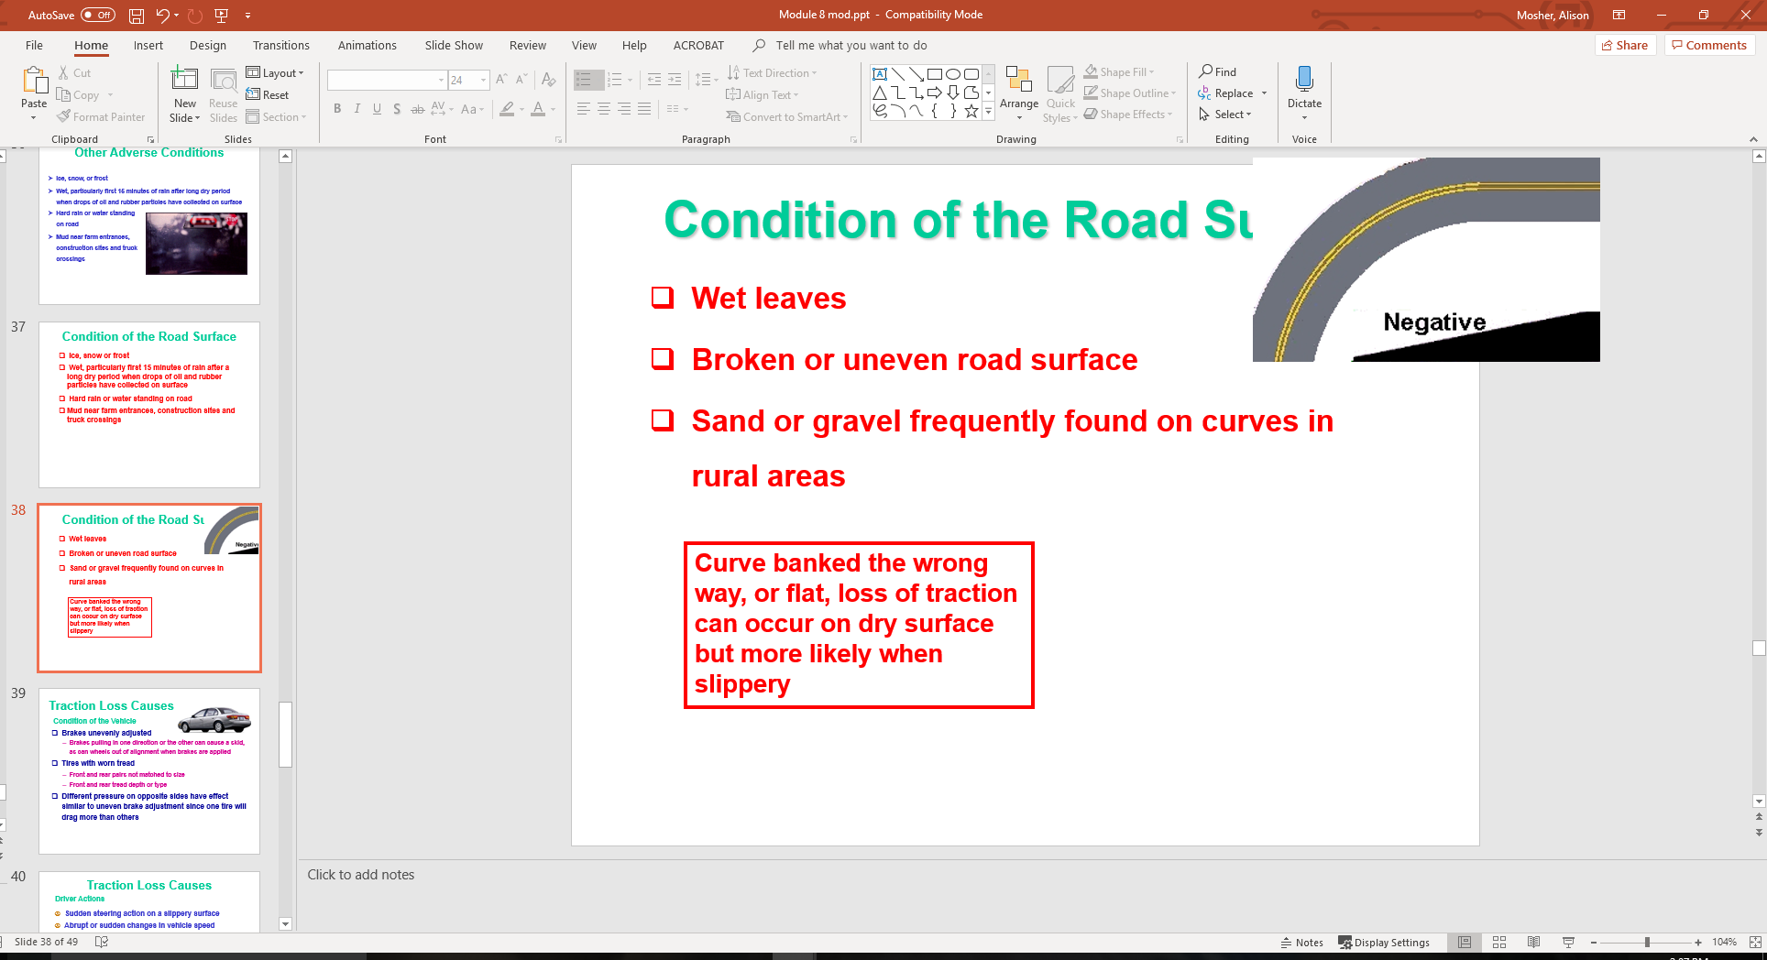
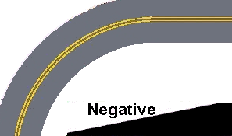
Condition of the Road Surface
Wet leaves
Broken or uneven road surface
Sand or gravel frequently found on curves in rural areas

Slide 39
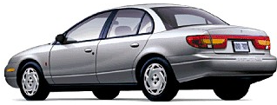
Traction Loss Causes
Condition of the Vehicle
Brakes unevenly adjusted
  Brakes pulling in one direction or the other can cause a skid, as can wheels out of alignment when brakes are applied
Tires with worn tread
  Front and rear pairs not matched to size
  Front and rear tread depth or type
Different pressure on opposite sides have effect
similar to uneven brake adjustment since one tire will
drag more than others

Slide 40
Traction Loss Causes
Sudden steering action on a slippery surface
Abrupt or sudden changes in vehicle speed
Panic stop or applying brakes too hard on hill,
curves or slippery surfaces
Sudden engagement of clutch on slippery surface
Most driver-induced skids
are caused by:
Driver Actions
  excessive speed
  coupled with excessive steering input
  or improper braking when turning
  same actions at normal speed on ice/snow
  or on roadways covered by sand, gravel, or water

Slide 41
Traction Loss Causes
Sudden shifts of vehicle causes traction loss
  - Left, Right, Forward, or Backward
Simultaneous steering, braking and/or
acceleration creates sudden shifts in vehicle
balance
Traction loss compounds crash consequences

Slide 42
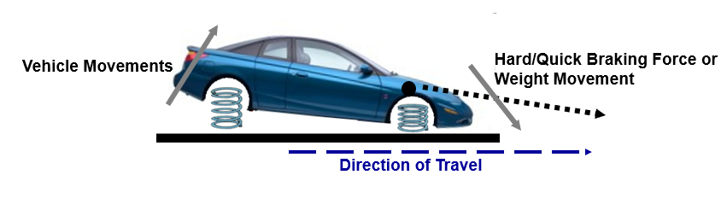
Traction Loss Considerations
When Brakes are Applied Too Hard or Quickly
Weight Moves to Front of the Car
Weight Movement or Brake Force Causes
  noticeable drop of the hood
  noticeable rise of the rear deck
  forward movement of driver and passengers

Slide 43
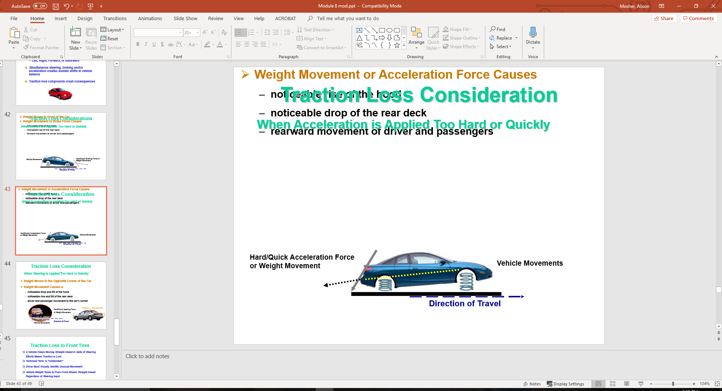
Traction Loss Consideration
When Acceleration is Applied Too Hard or Quickly
Weight Moves to the Rear of the Car
Weight Movement or Acceleration Force Causes
  noticeable rise of the hood
  noticeable drop of the rear deck
  rearward movement of driver and passengers

Slide 44
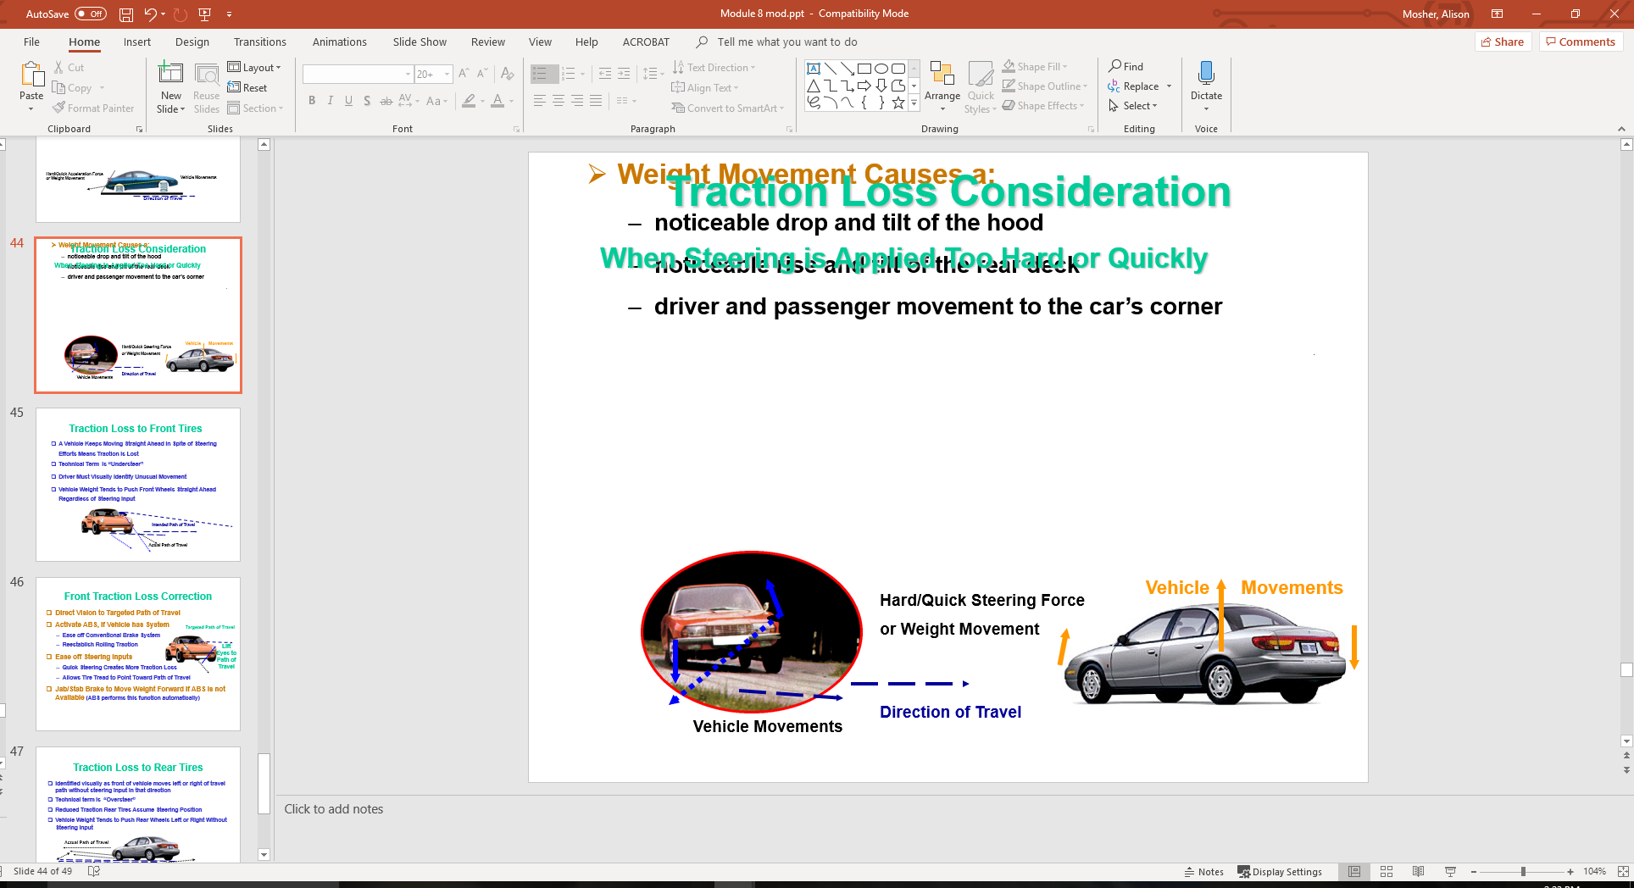
Traction Loss Consideration
When Steering is Applied Too Hard or Quickly
Weight Moves to the Opposite Corner of the Car
Weight Movement Causes a:
  noticeable drop and tilt of the hood
  noticeable rise and tilt of the rear deck
  driver and passenger movement to the car’s corner

Slide 45
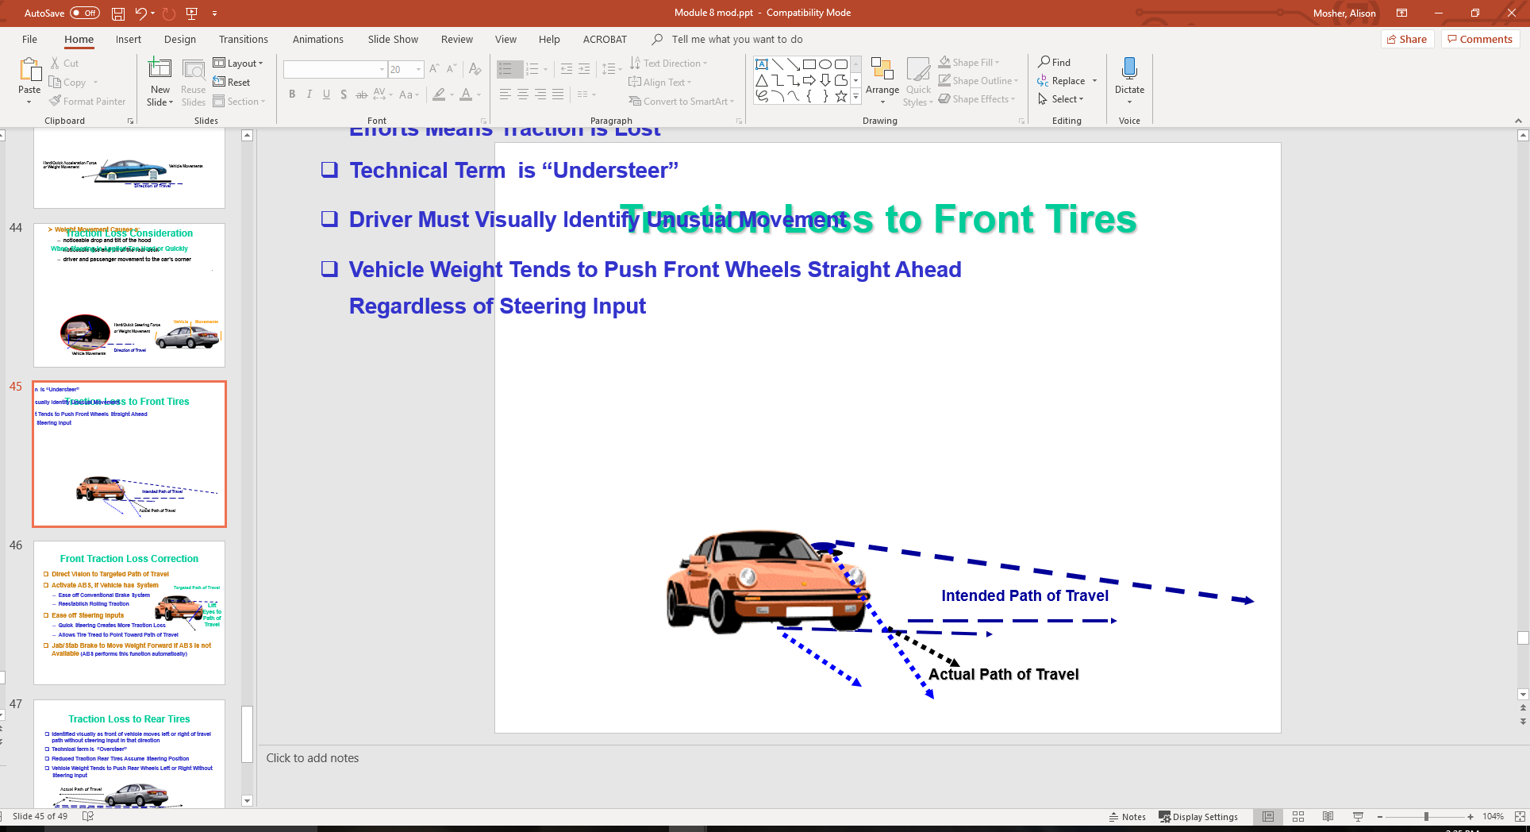
Traction Loss to Front Tires
A Vehicle Keeps Moving Straight Ahead in Spite of Steering Efforts Means Traction is Lost
Technical Term is “Understeer”
Driver Must Visually Identify Unusual Movement
Vehicle Weight Tends to Push Front Wheels Straight Ahead Regardless of Steering Input

Slide 46
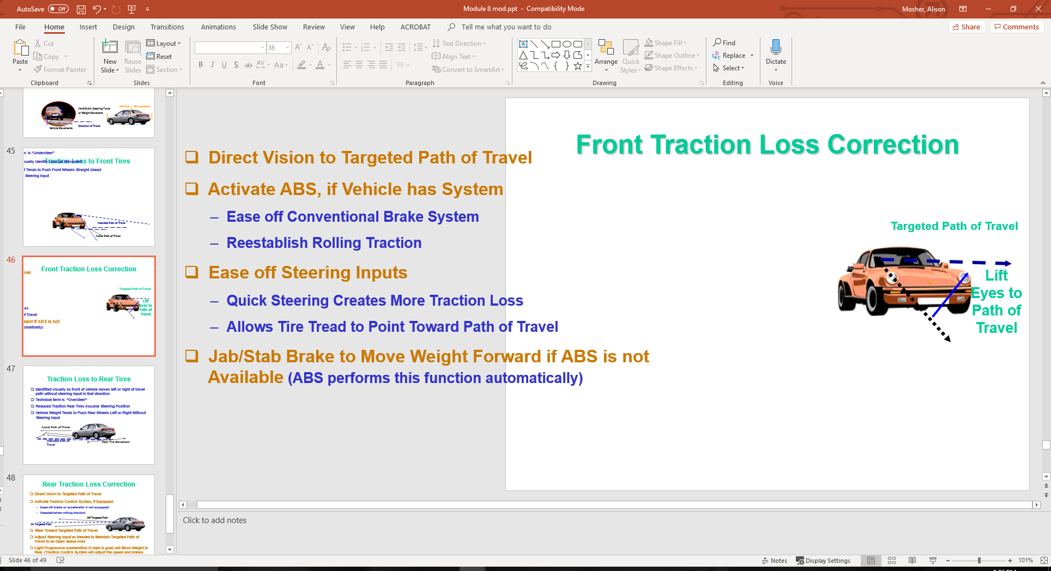
Front Traction Loss Correction
Direct Vision to Targeted Path of Travel
Activate ABS, if Vehicle has System
  Ease off Conventional Brake System
  Reestablish Rolling Traction
Ease off Steering Inputs
  Quick Steering Creates More Traction Loss
  Allows Tire Tread to Point Toward Path of Travel
Jab/Stab Brake to Move Weight Forward if ABS is not
Available (ABS performs this function automatically)

Slide 47
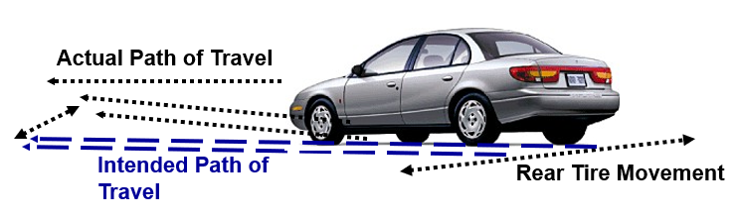
Traction Loss to Rear Tires
Identified visually as front of vehicle moves left or right of travel path without steering input in that direction
Technical term is “Oversteer”
Reduced Traction Rear Tires Assume Steering Position
Vehicle Weight Tends to Push Rear Wheels Left or Right Without Steering Input

Slide 48
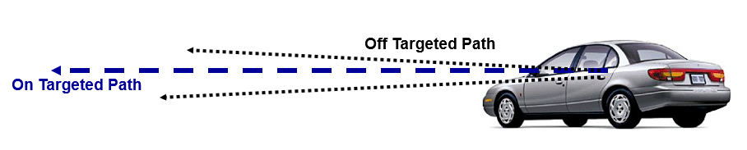
Rear Traction Loss Correction
Direct Vision to Targeted Path of Travel
Activate Traction Control System, if Equipped:
  Ease off brake or accelerator if not equipped
  Reestablishes rolling traction
Steer Toward Targeted Path of Travel
Adjust Steering Input as Needed to Maintain Targeted Path of Travel to an Open Space Area
Light Progressive Acceleration (2 mph is goal) will Move Weight to Rear. (Traction Control System will adjust the speed and brakes automatically while activated)

Slide 49
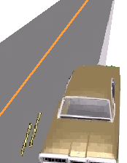
Off-Road Recovery
Do not panic and steer too much
Ease off accelerator and activate ABS
Align edge line of roadway to middle
of car
Check traffic to front and rear
If traffic is clear, return to roadway
with one wheel at a time to prevent crossing roadway
Limit steering inputs to less than 1/2 turn of wheel
Use less input when the edge of road is high
Target center of lane to avoid crossing over to other lane

Slide 50
Contact/Mission
For more information on Driver’s Education and Safety please visit PDE’s website at www.education.pa.gov
The mission of the Department of Education is to ensure that every learner has access to a world-class education system that academically prepares children and adults to succeed as productive citizens. Further, the Department seeks to establish a culture that is committed to improving opportunities throughout the commonwealth by ensuring that technical support, resources, and optimal learning environments are available for all students, whether children or adults.

