Slide 1
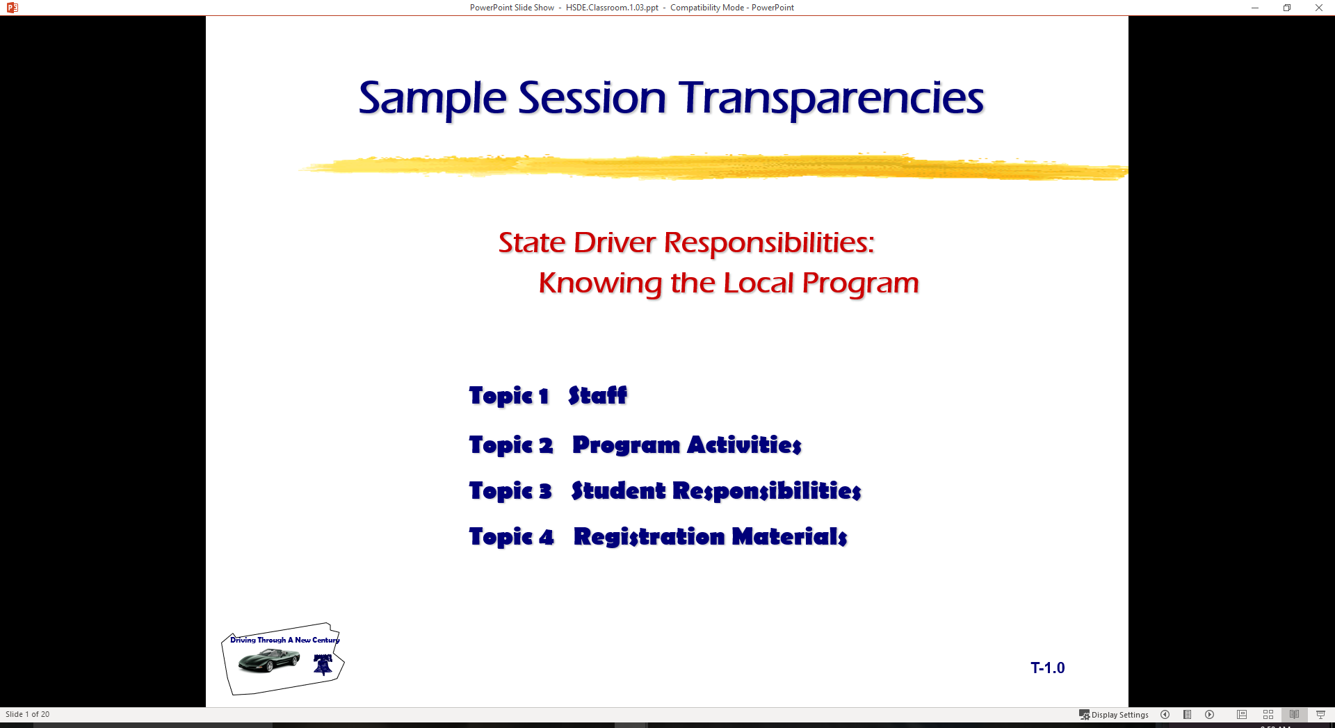
  Driving Responsibly – Free from all influences

Slide 2
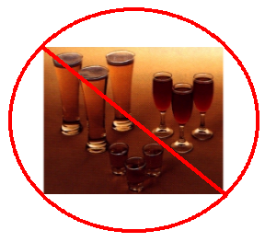
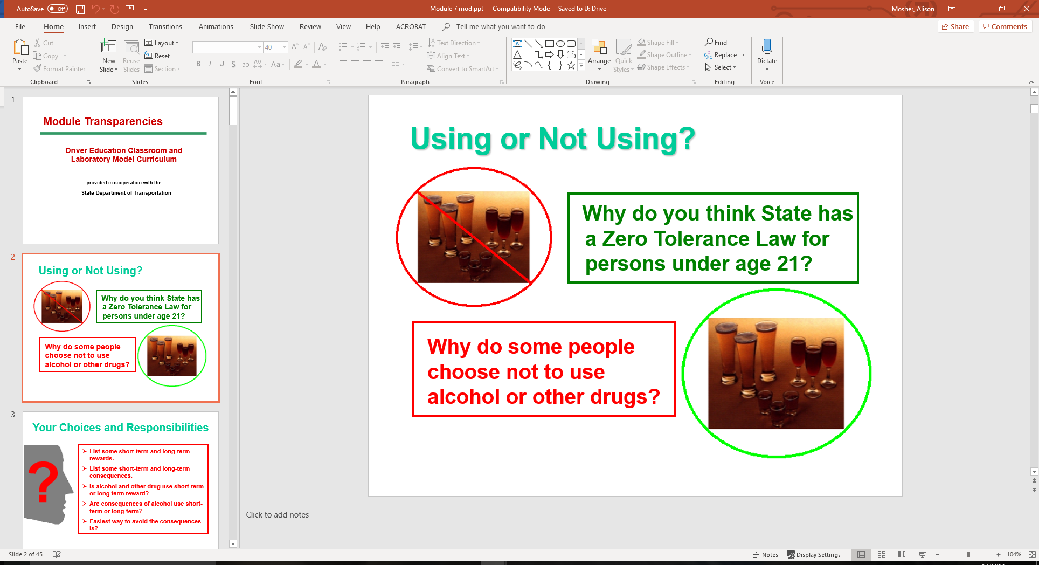
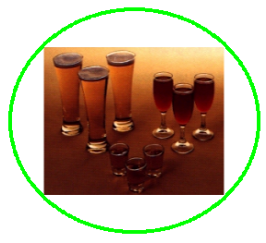
Using or Not Using?

Slide 3
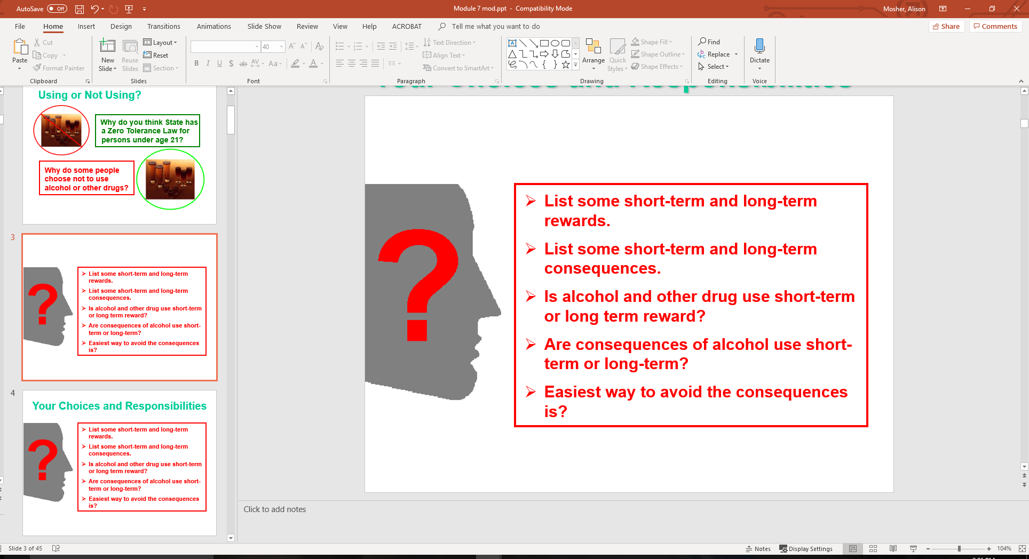
Your Choices and Responsibilities

Slide 4
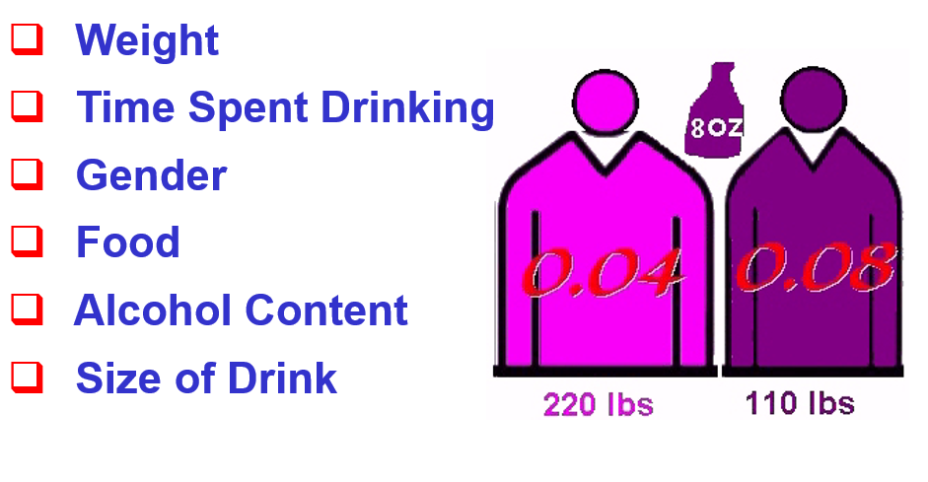
BAC Factors

Slide 5
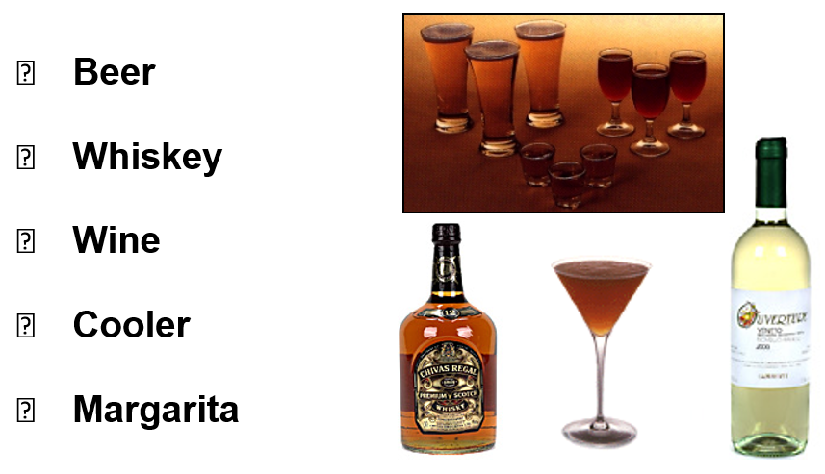
Are They The Same?

Slide 6
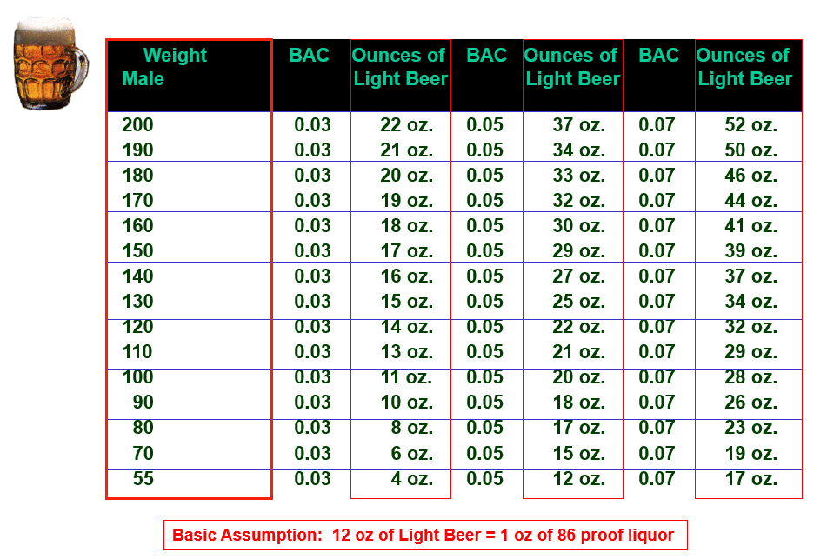
How Much Light Beer (Male)

Slide 7
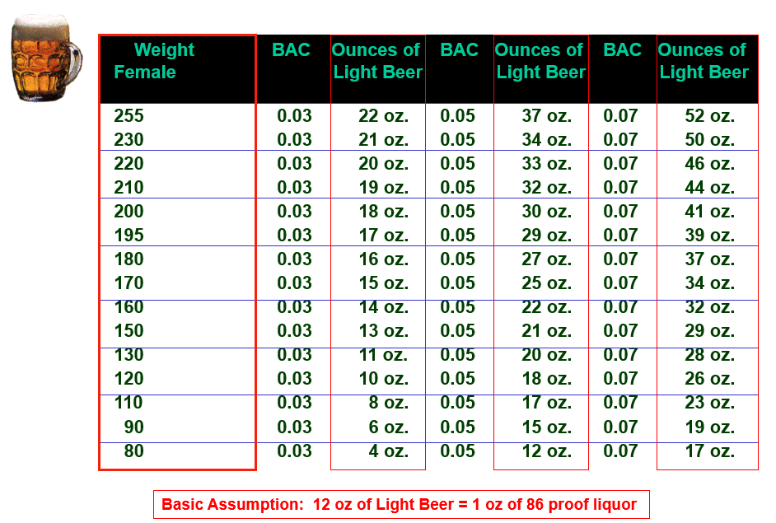
How Much Light Beer (Female)

Slide 8
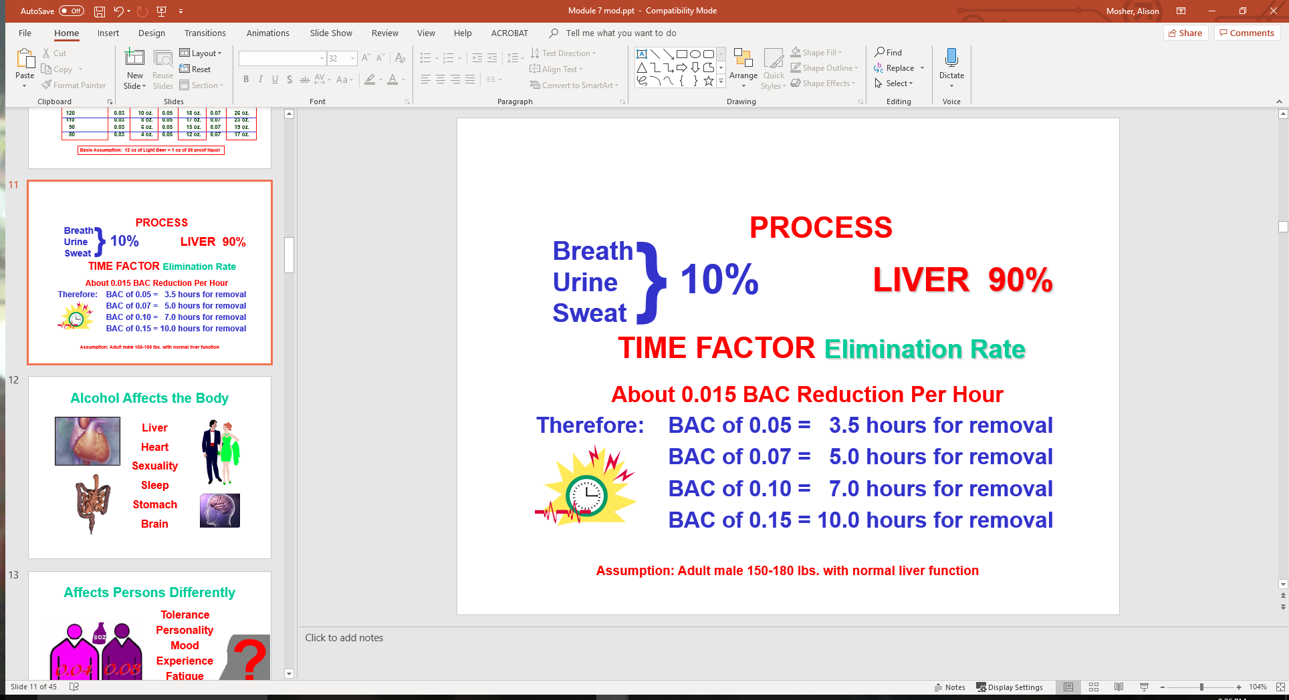
Elimination of Alcohol

Slide 9
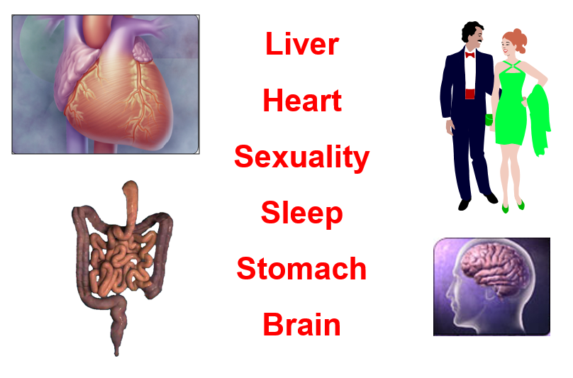
Alcohol Affects the Body

Slide 10
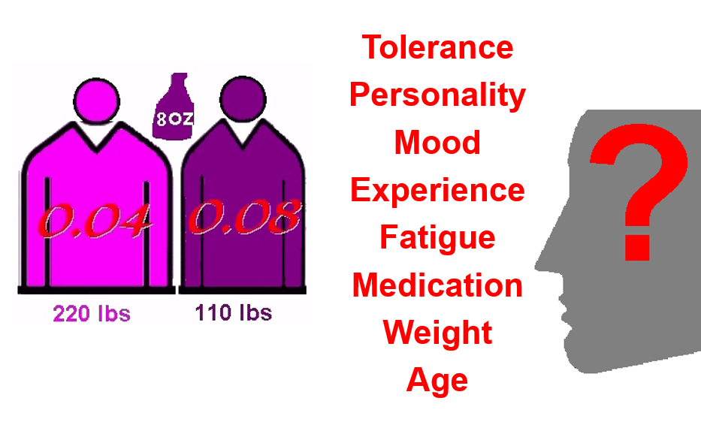
Affects Persons Differently

Slide 11
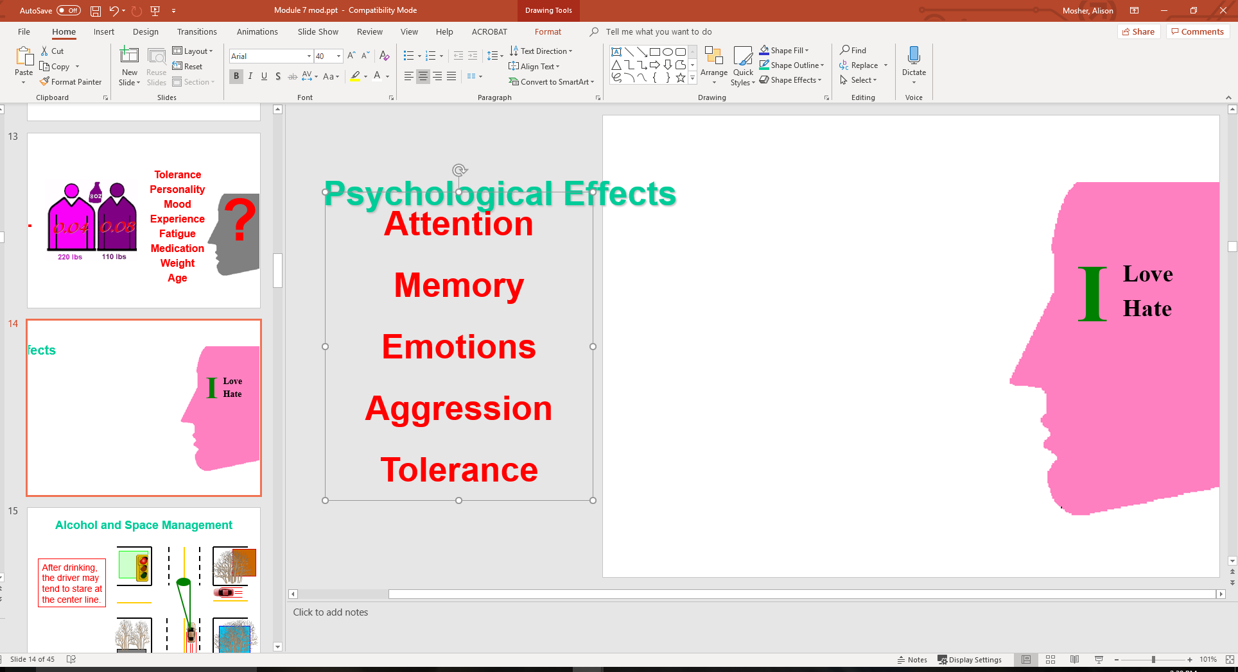
Psychological Effects
Attention
Memory
Emotions
Aggression
Tolerance

Slide 12
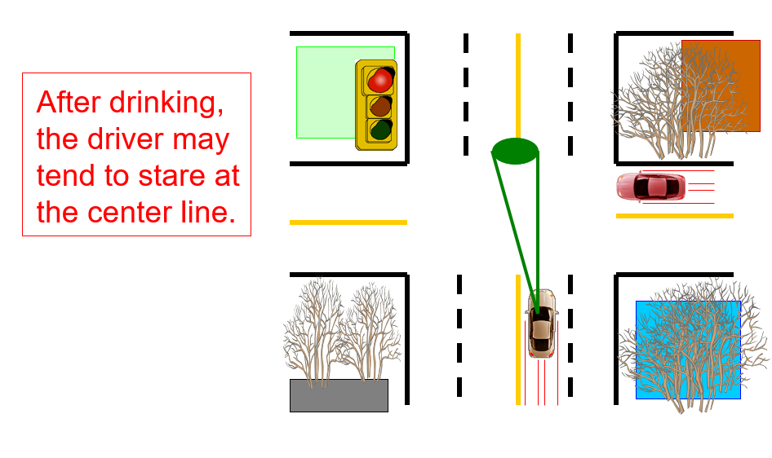
Alcohol and Space Management

Slide 13

Impaired Vision
Side Vision
Visual Acuity
Color Distinction
Eye Focus
Double Vision
Distance Judgment

Slide 14
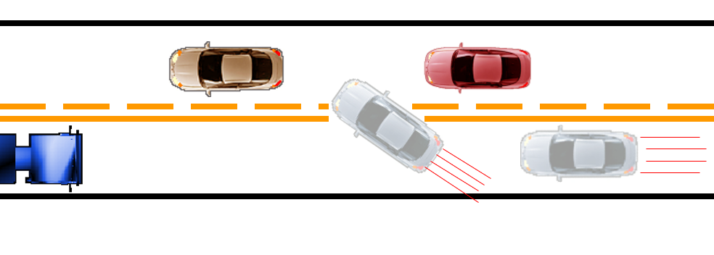
Risk-Taking Problem

Slide 15
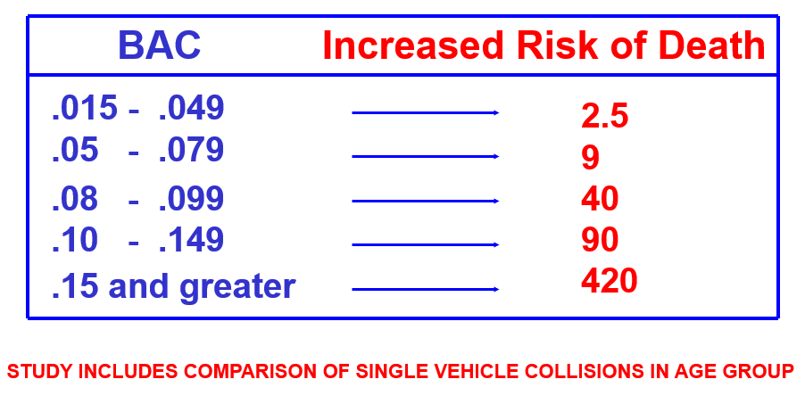
Chance of Death for ages 16-19 by BAC levels

Slide 16
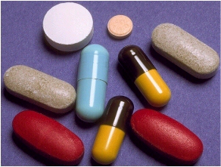
Drugs and Driving
Perception
Judgment
Coordination
Vision
Mood

Slide 17

Marijuana and Driving
About 300 µg/kg to achieve a high
Effects at 300 µg/kg:
  Tracking
  Following Distance
  Vigilance
  Divided Attention
Research should be conducted to
determine marijuana effects 8, 16, and 24 hours after smoking.

Slide 18
Other Types of Drugs and Driving
Over the Counter Medications
Prescription Medications
  Tranquilizers
  Stimulants
  Narcotics

Slide 19

Definition of Fatigue
Fatigue is:
  A Body Response
  Follows a Period of:
    Extended mental activity
    Extended bodily activity
  Characterized by:
    Reduced capacity for work
    Reduced efficiency of accomplishment

Slide 20

Causes of Fatigue
Extended Physical Activity
Emotional Stress
Sleep Disorders
  Disruption of Circadian Rhythm
  Sleep period danger: 12 a.m to 6 a.m
  Sleep period danger: 1 p.m to 3 p.m

Slide 21
Physical Symptoms of Fatigue
Tired Muscles
General Body Sensation
of Tiredness
Sleepiness
A Tired Feeling in the Head

Slide 22
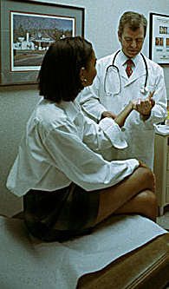
Physical Symptoms of Fatigue
Localized Pain in Back of Head
Pain and Soreness in Muscles
Stiffness in Joints
Swelling of Hands and Feet

Slide 23

Mental Symptoms of Fatigue
Inability to Keep Fixed Attention
Impaired Memory
Failure to Grasp New Ideas
Difficulty/Slowness in Reasoning

Slide 24
Delaying Fatigue Onset
Avoid Long Drives Unless Fit
Avoid Leaning Forward
Avoid Driving Long Stretches
Keep Your Eyes Moving
Let in Fresh Air

Slide 25
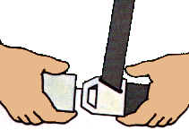
Delaying Fatigue Symptoms
Change Drivers at Regular Intervals
Wear Your Safety Belt
Avoid Getting Angry
Proper Adjustment of HVAC

Slide 26
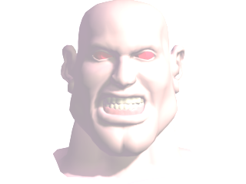
Formula for Road Rage
Cultural Norms of Disrespect
Condoning Hostility
+
More Cars
Less Space
More Driver Interactions
=
Aggressive Driving and Road Rage Battles

Slide 27
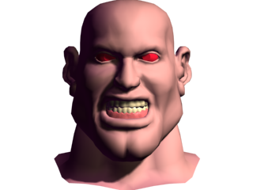
Three Types of Aggressive Drivers
Aggressive Driving and Road Rage Battles
Quiet Road Rage:
Verbal Road Rage:
Epic Road Rage:
complaining, rushing,
competing, resisting
yelling,
cussing, staring,
honking, insulting
cutting off, blocking,
chasing,
fighting, shooting

Slide 28
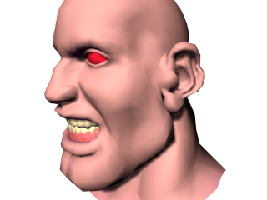
Driving Errors May Include...
Braking suddenly to scare a tailgater
Exceeding speed limits by more than 10 mph
Changing lanes without signaling
Cruising in the passing lane
Criticizing other drivers

Slide 29
Other Driving Errors May Include...

Slide 30
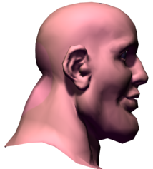
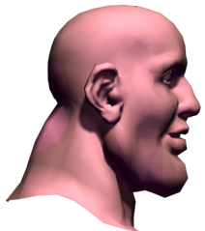
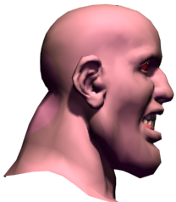
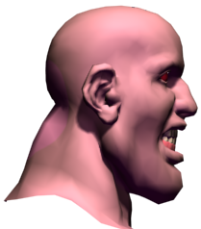
Do You Drive Aggressively?
Learning how to evaluate your driving space area is crucial.

Slide 31
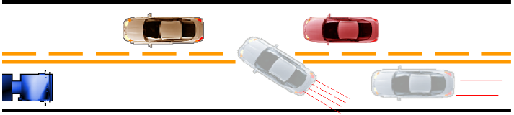
Do You Drive Aggressively?
The “Rush In” Area
Constant rushing and lane jumping is your style.
Others are just in your way. Get ahead.
Ignore road signs and regulations.
They’re for other drivers.
Driving with distraction, low alertness,
inattention.

Slide 32
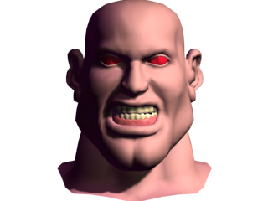
Do You Drive Aggressively?
The “Total Aggression” Area
Constantly ridiculing and criticizing other
drivers to self or passengers
Closing gap to deny entry into your lane
Give the “look” to show your disapproval
Speeding past another car, revving engine

Slide 33
Do You Drive Aggressively?
The “Total Aggression” Area
Prevent others from passing you
Tailgating to pressure a driver to go faster
or get out of your way
Fantasizing physical violence
Honking, yelling through the window
Making visible insulting gestures

Slide 34
Do You Drive Aggressively?
The “Violence” Area
Carrying a weapon just in case…
Deliberately bumping or ramming
Trying to run a car off the road to punish
Getting out of the car, beating or battering
someone
Trying to run someone down
Shooting at another car
Thoughts of killing someone

Slide 35
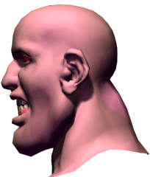
Irrational Actions
While Driving
Create Anger

Slide 36
Self-Imposed Anxieties
“I’m going to be late if I don’t hurry up.”
“Why are these cars going so slow?”
“We’ll never make it.”
“If only I had gone a little faster, I could’ve made it.”
“Oh no! Red light!”

Slide 37
Dangerous Maneuvering
“All of these cars are trying to squeeze in!”
“I have a lead foot.”
“Ha! I’ll speed up and show him a lesson!”
“Everyone else is speeding!”
“Let’s tailgate this car in front of me.”
“He’s driving too slow!”

Slide 38
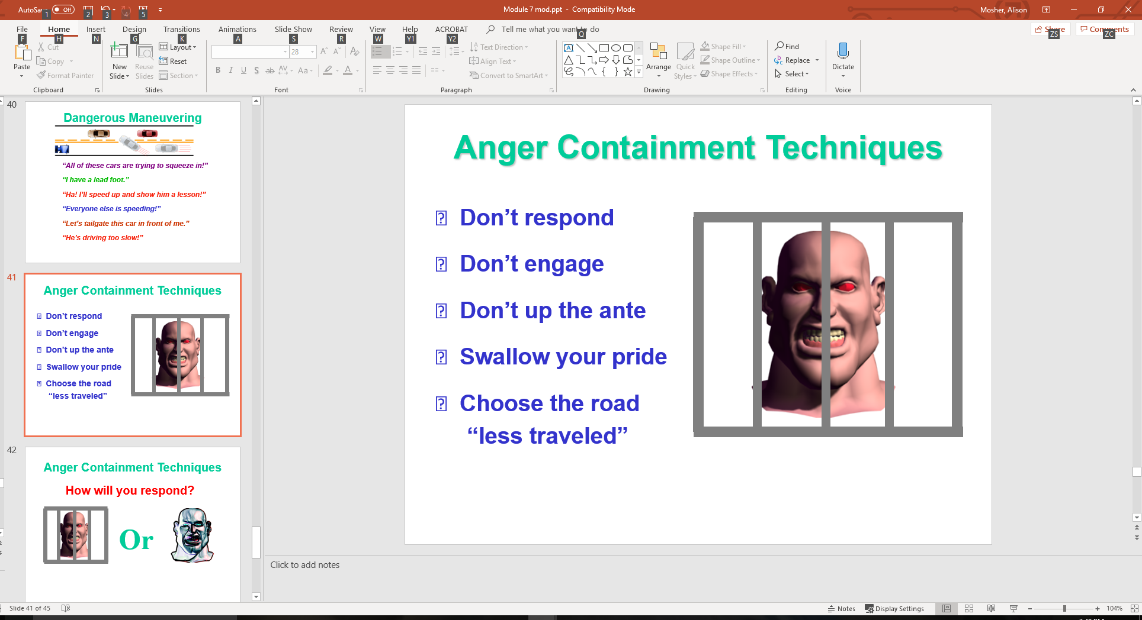
Anger Containment Techniques
Swallow your pride
Choose the road
“less traveled”
Don’t respond
Don’t engage
Don’t up the ante

Slide 39
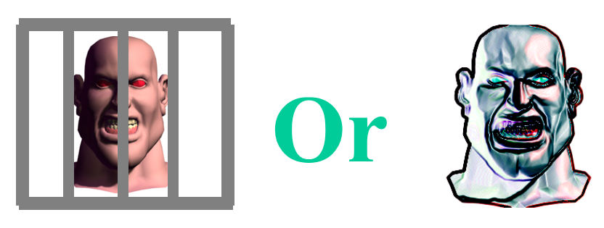
Anger Containment Techniques
How will you respond?

Slide 40
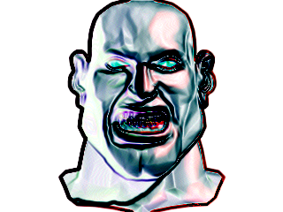

Anger Management
Making errors
Responding to errors
Controlling emotions
Response to problems

Slide 41
Managing Anger
How would you like others to react if you
did something dangerous like this?
React the same way you would like
them to react to your mistakes.

Slide 42
Contact/Mission
For more information on Driver’s Education and Safety please visit PDE’s website at www.education.pa.gov
The mission of the Department of Education is to ensure that every learner has access to a world-class education system that academically prepares children and adults to succeed as productive citizens. Further, the Department seeks to establish a culture that is committed to improving opportunities throughout the commonwealth by ensuring that technical support, resources, and optimal learning environments are available for all students, whether children or adults.

