Slide 1
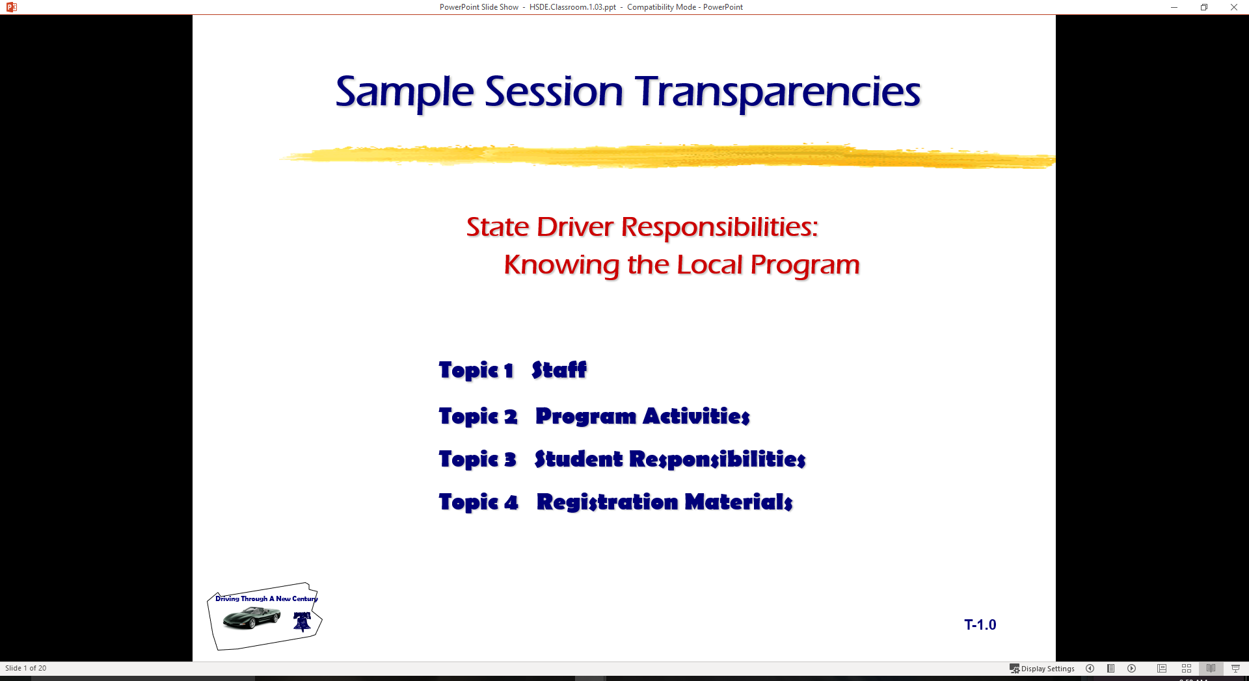
  Information Processing: Complex Risk Environment
Topic 1 Characteristics of Expressways
  Topic 2 Enter, Changing Lanes, and Exiting
  Topic 3 High Speed Considerations

Slide 2
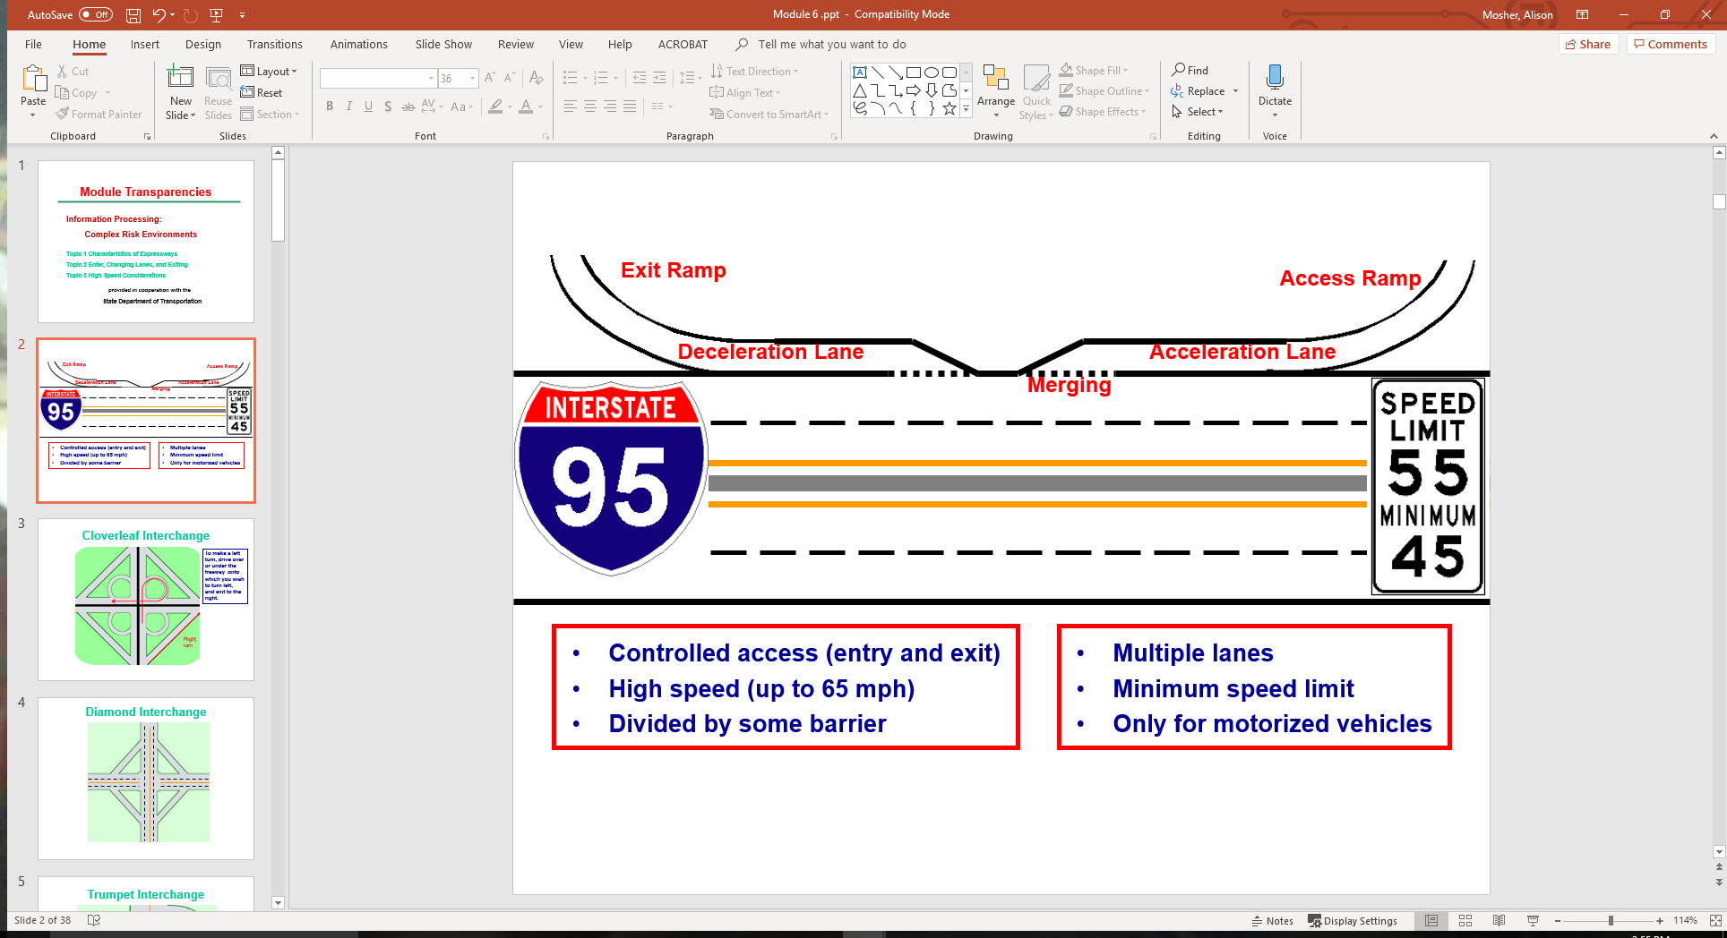
Characteristics of an Expressway

Slide 3
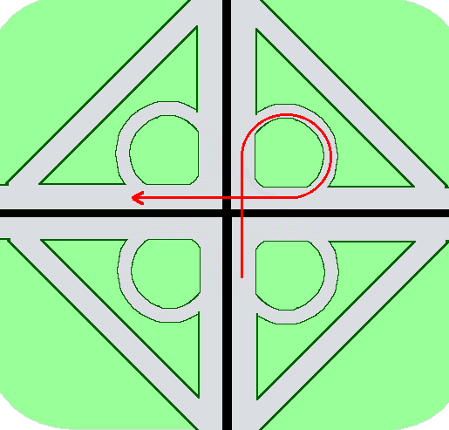
Cloverleaf Interchange
To make a left turn, drive over or under the freeway onto which you wish to turn left, and exit to the right.

Slide 4
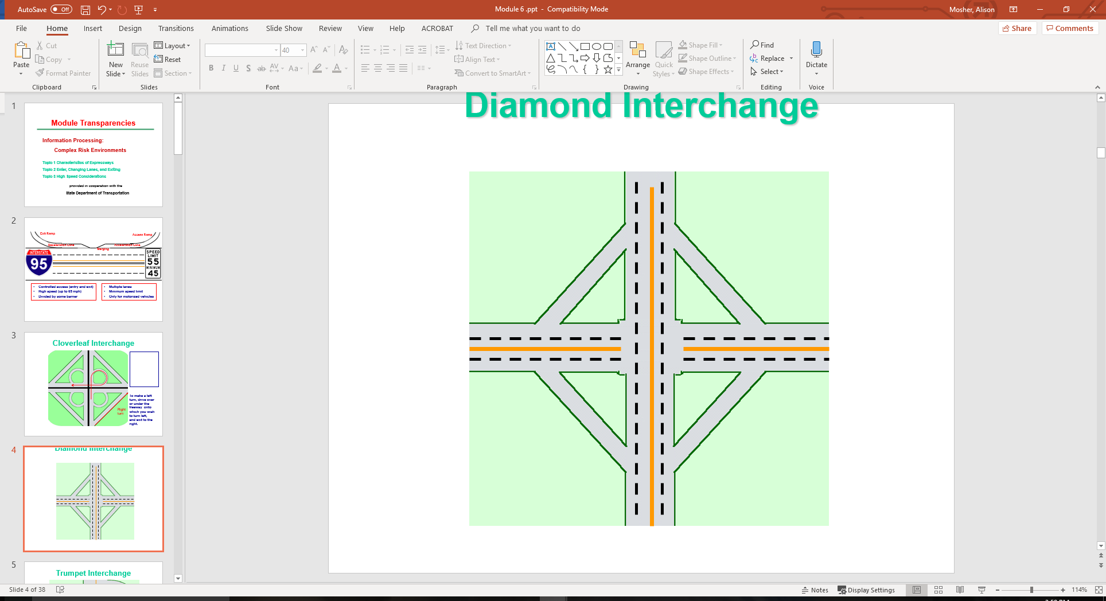
Diamond Interchange

Slide 5
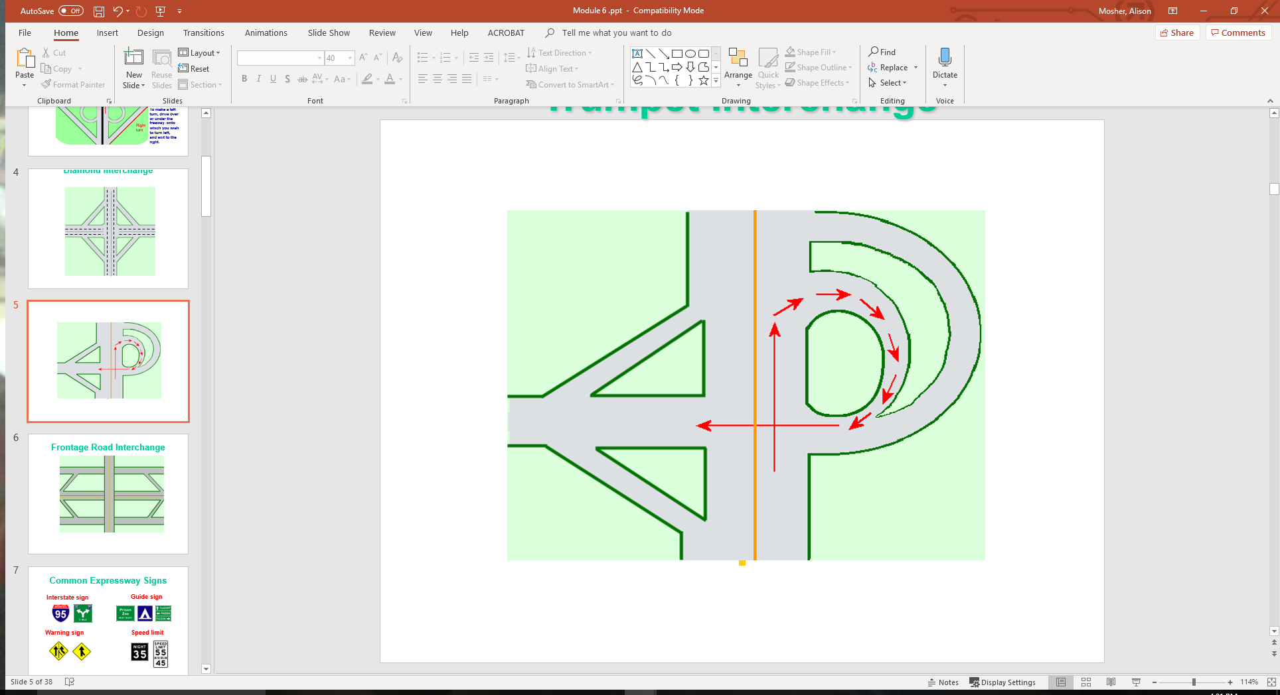
Trumpet Interchange

Slide 6
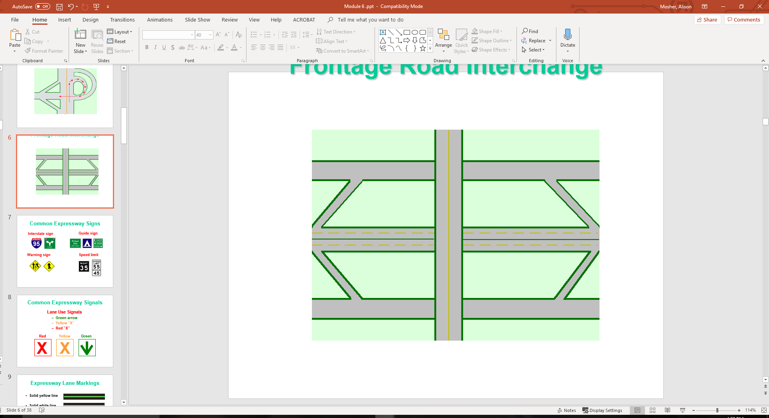
Frontage Road Interchange

Slide 7

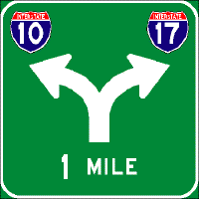



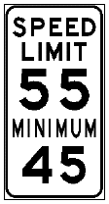



Common Expressway Signs
Guide sign
Interstate sign
Warning sign
Speed limit

Slide 8
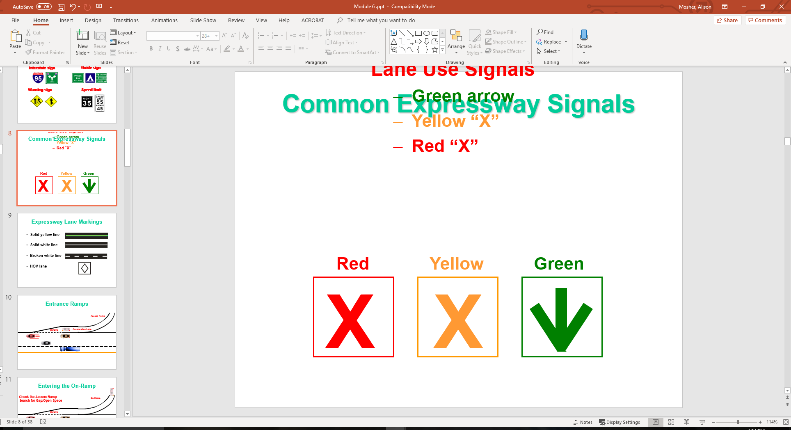
Common Expressway Signals
Lane Use Signals
  Green arrow
  Yellow “X”
  Red “X”

Slide 9
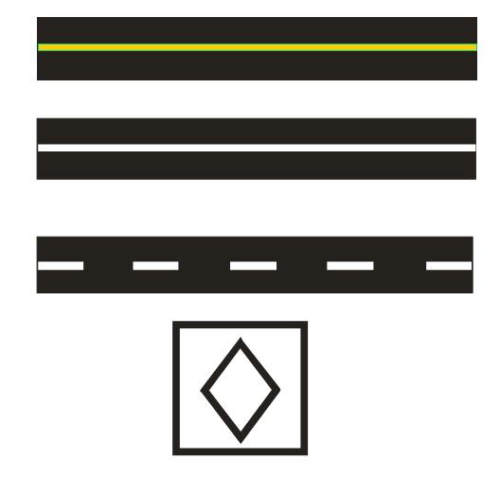
Expressway Lane Markings
Solid yellow line
Solid white line
Broken white line
HOV lane

Slide 10
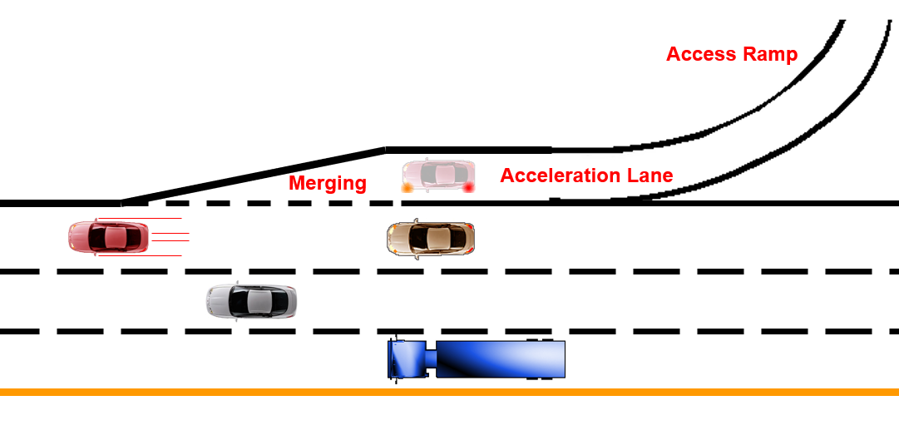
Entrance Ramps

Slide 11
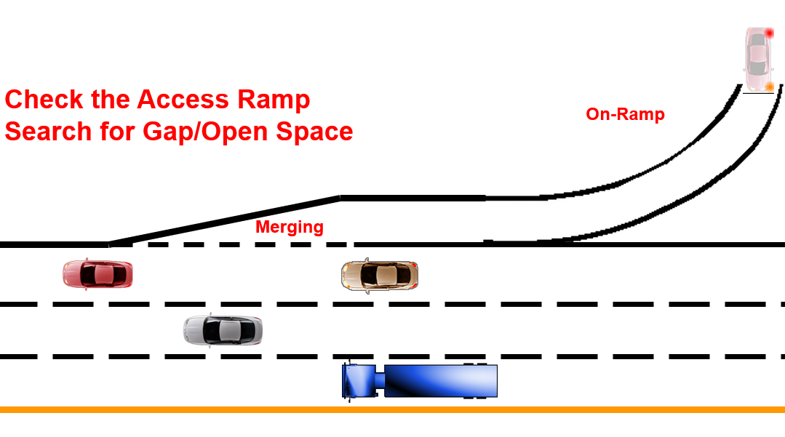
Entering the On-Ramp

Slide 12
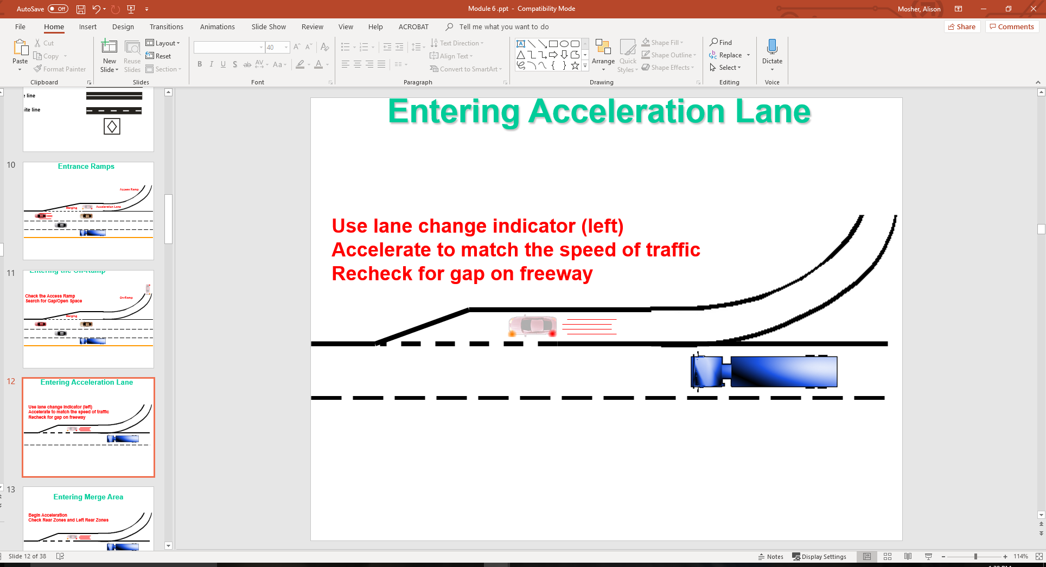
Entering Acceleration Lane

Slide 13
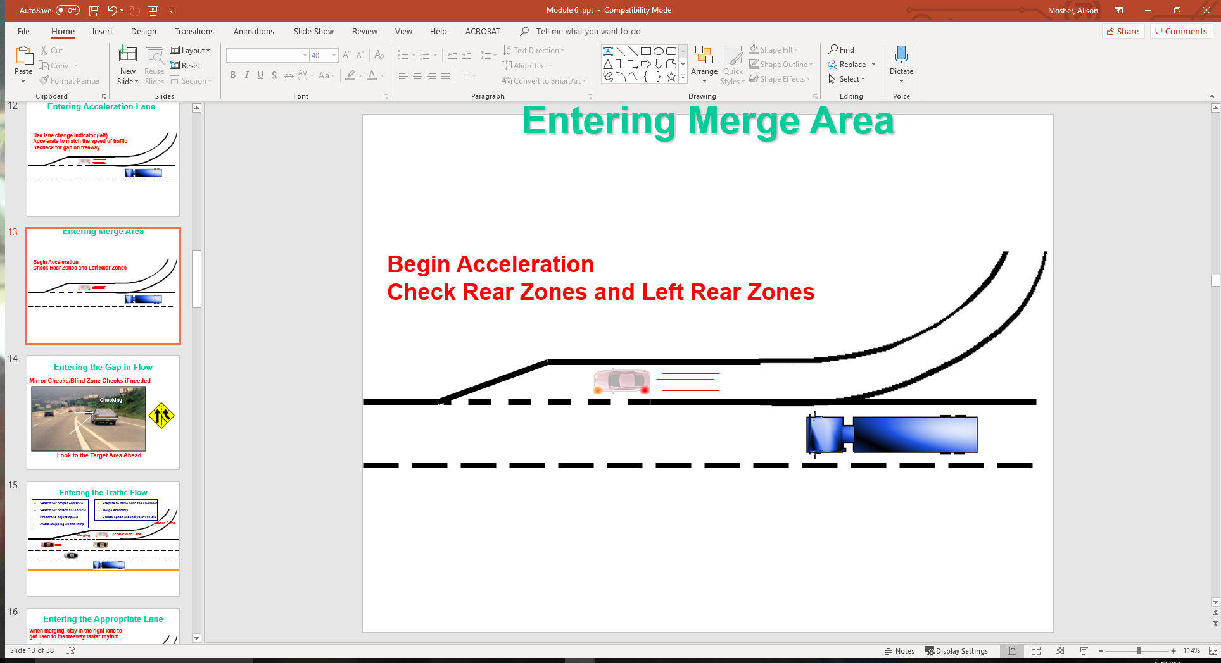
Entering Merge Area

Slide 14
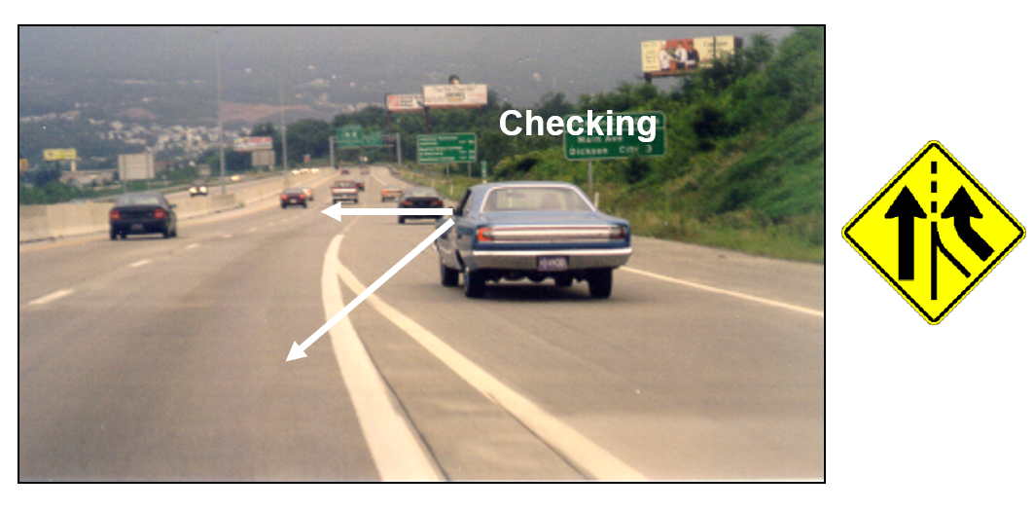
Entering the Gap in Flow
Mirror Checks/Blind Zone Checks if needed
Look to the Target Area Ahead

Slide 15
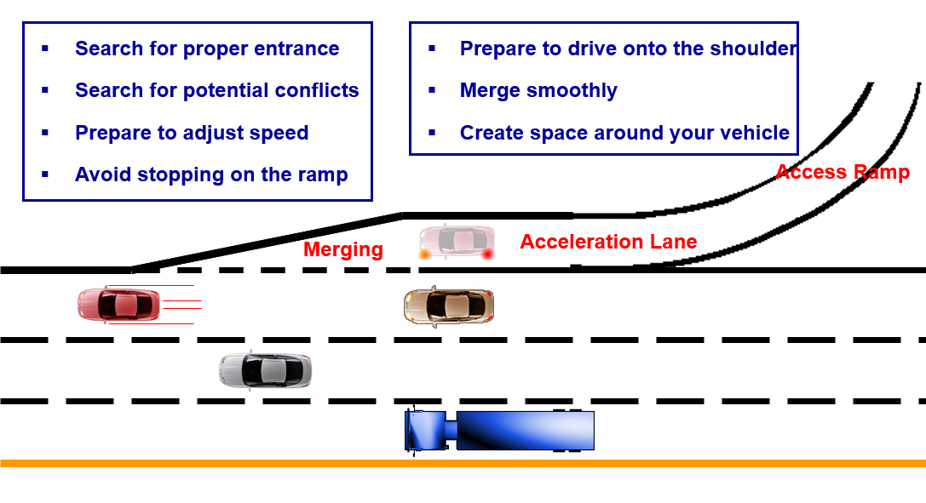
Entering the Traffic Flow

Slide 16
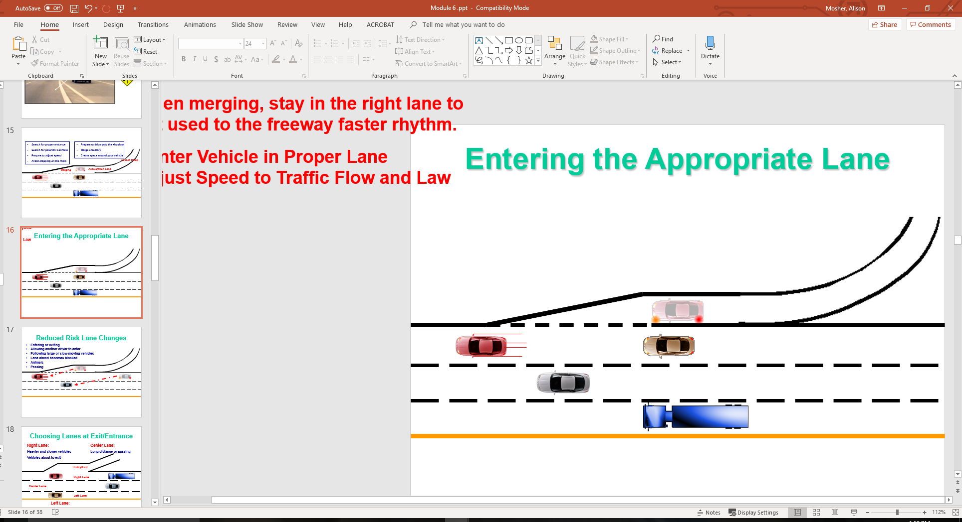
Entering the Appropriate Lane
When merging, stay in the right lane to get used to the freeway faster rhythm.
Center Vehicle in Proper Lane Adjust Speed to Traffic Flow and Law

Slide 17
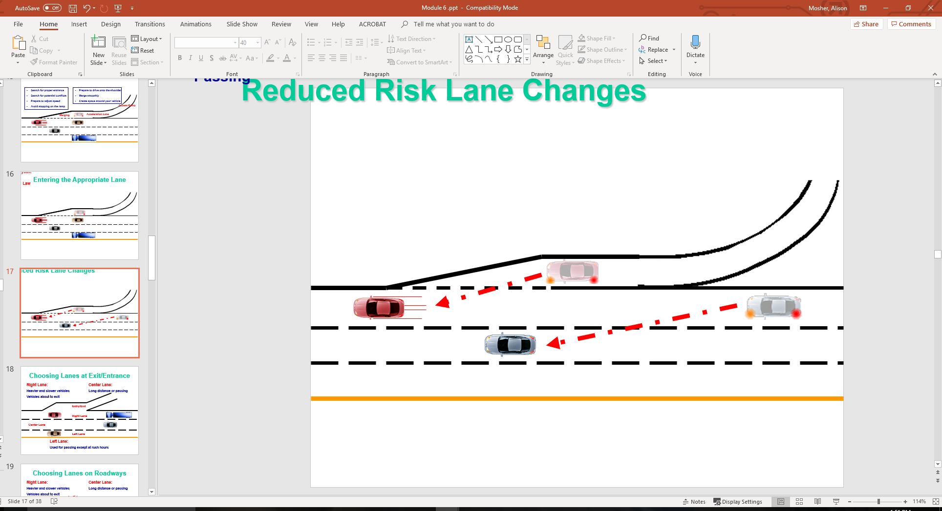
Reduced Risk Lane Changes
Entering or exiting
Allowing another driver to enter
Following large or slow-moving vehicles
Lane ahead becomes blocked
Animals
Passing

Slide 18
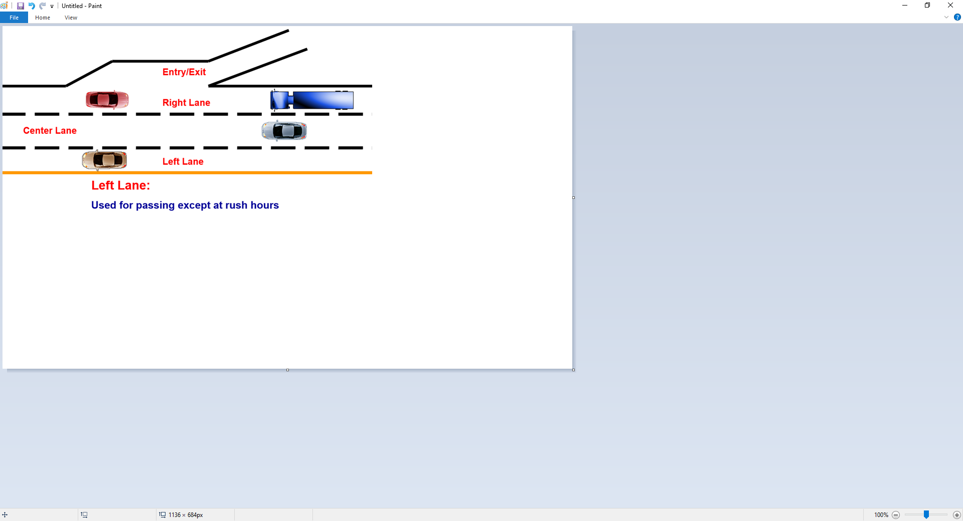
Choosing Lanes at Exit/Entrance
Right Lane:
Heavier and slower vehicles
Vehicles about to exit
Center Lane:
Long distance or passing

Slide 19
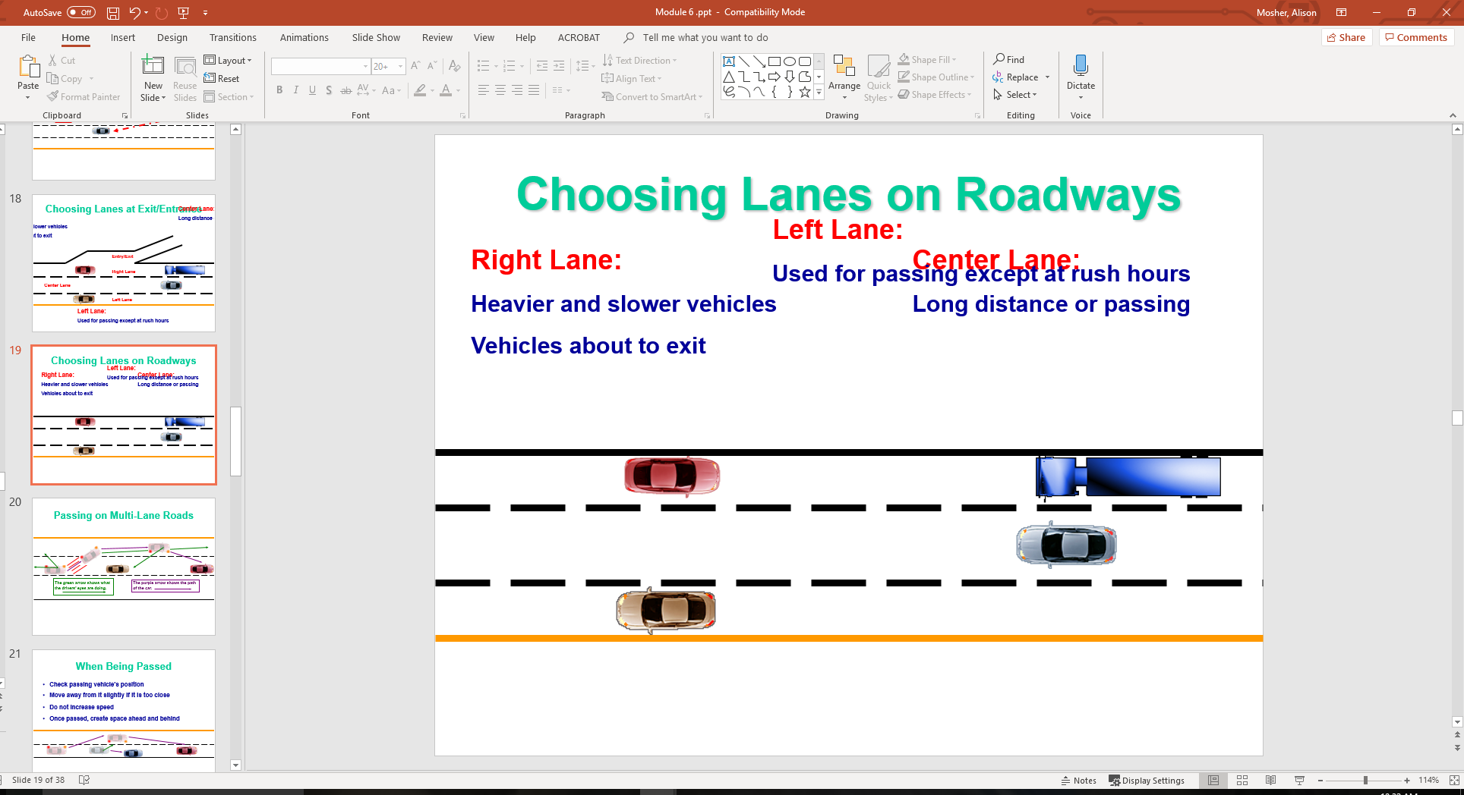
Choosing Lanes on Roadways
Right Lane:
Heavier and slower vehicles
Vehicles about to exit
Center Lane:
Long distance or passing
Left Lane:
Used for passing except at rush hours

Slide 20
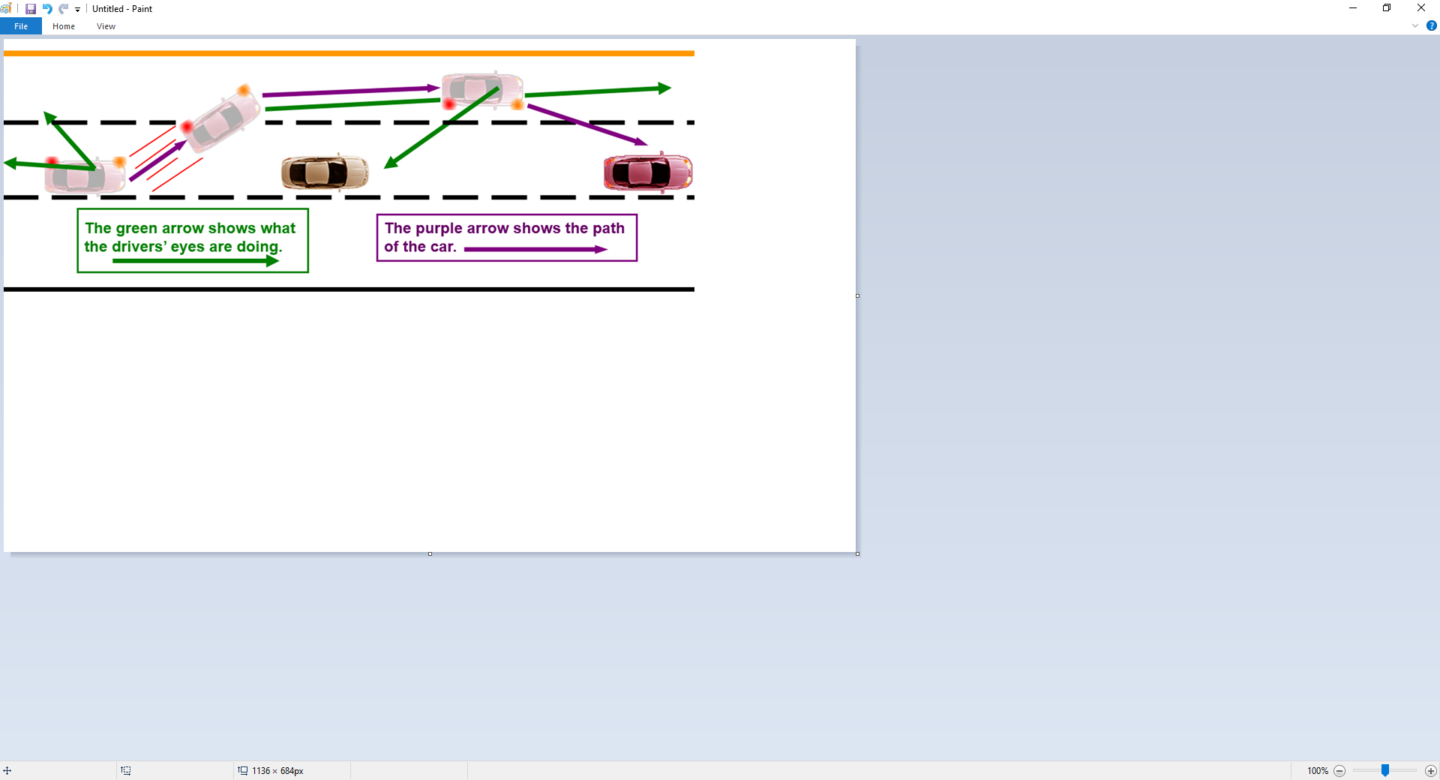
Passing on Multi-Lane Roads

Slide 21
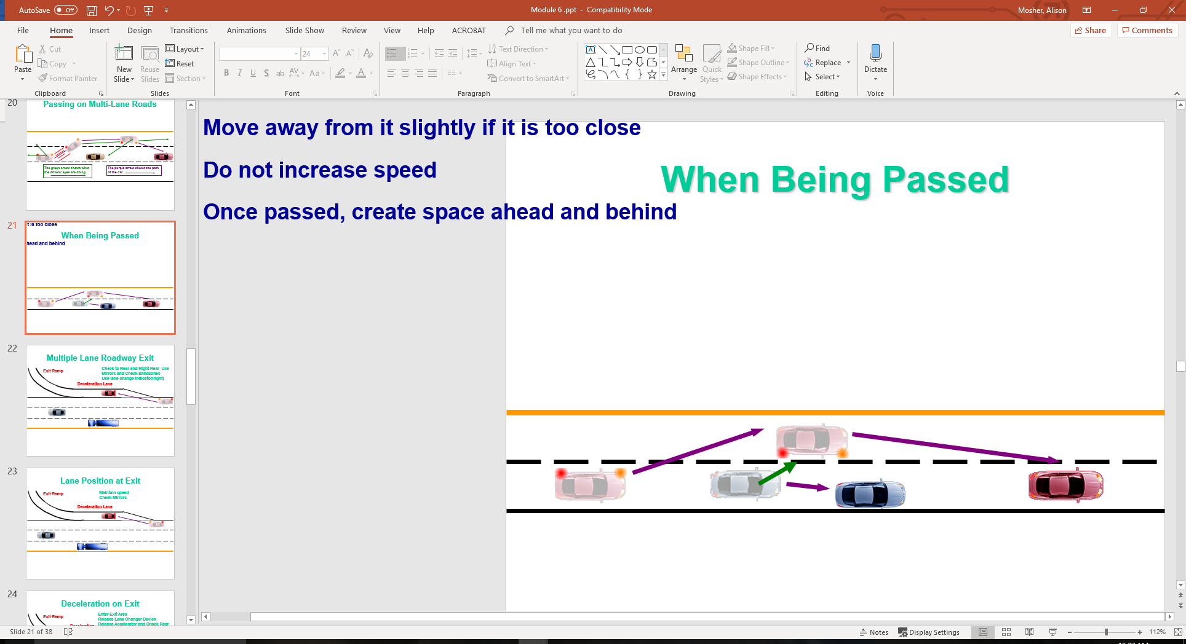
When Being Passed
Check passing vehicle’s position
Move away from it slightly if it is too close
Do not increase speed
Once passed, create space ahead and behind

Slide 22
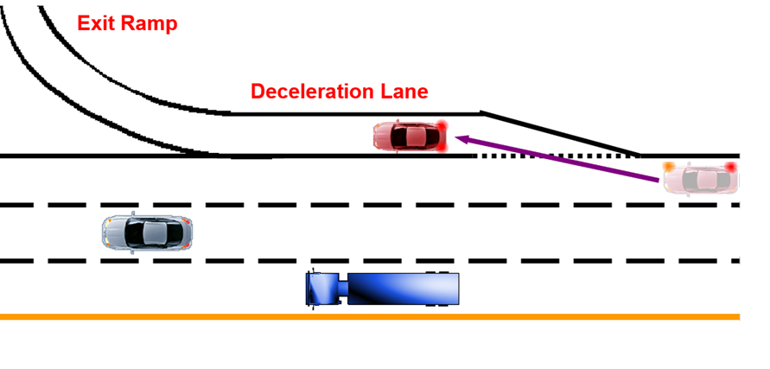
Multiple Lane Roadway Exit
Check to Rear and Right Rear Use Mirrors and Check Blindzones Use lane change indicator (right)

Slide 23
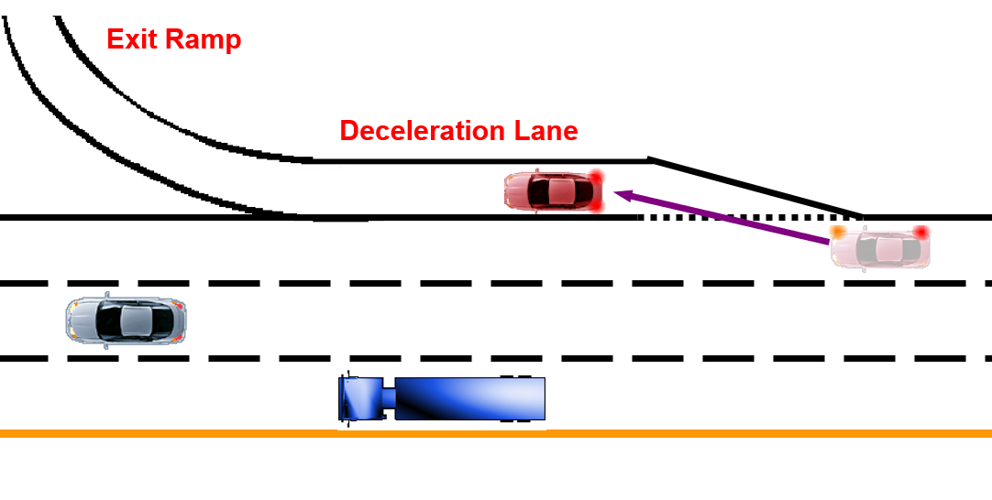
Lane Position at Exit
Maintain speed Check Mirrors

Slide 24
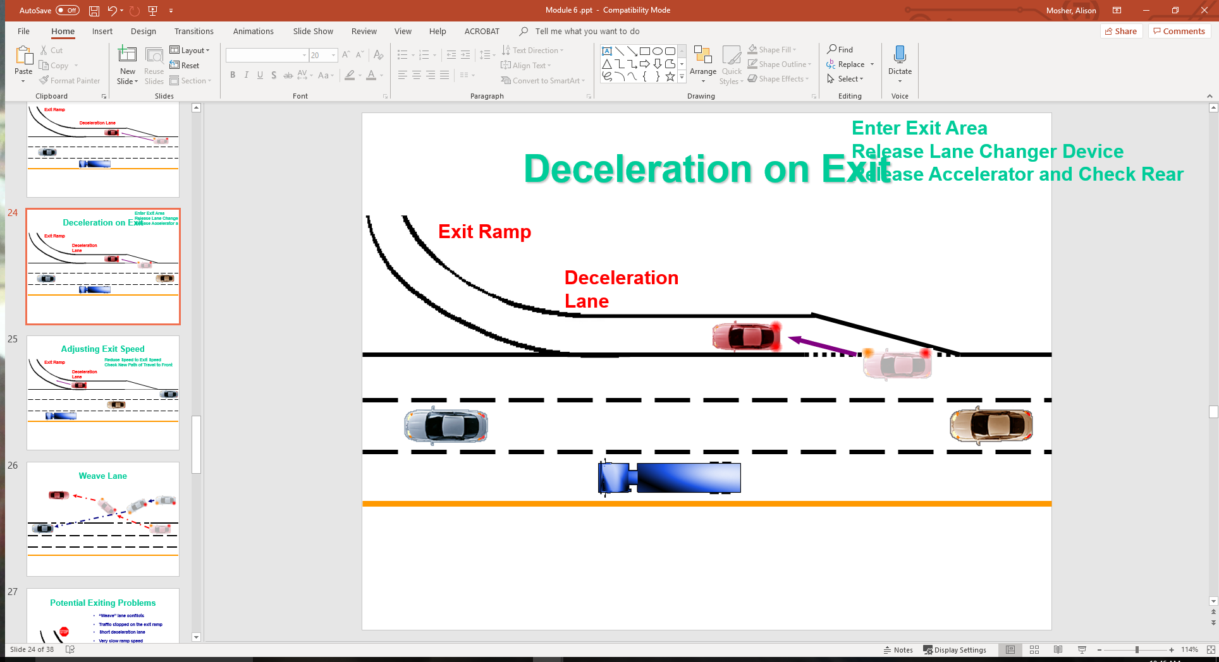
Deceleration on Exit
Enter Exit Area Release Lane Changer Device Release Accelerator and Check Rear

Slide 25
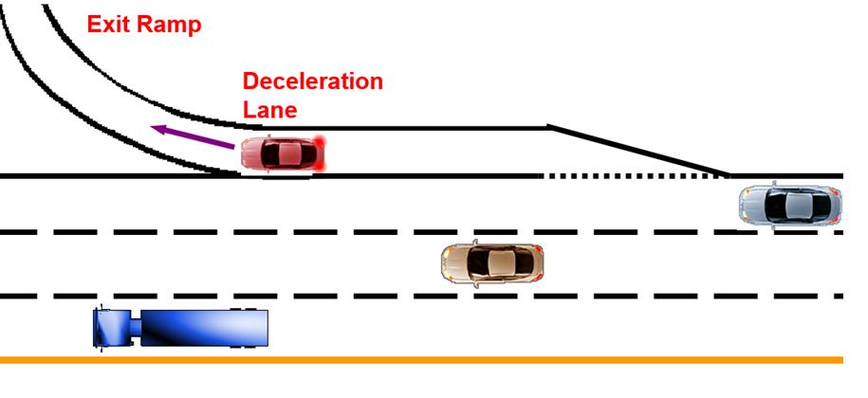
Adjusting Exit Speed
Reduce Speed to Exit Speed Check New Path of Travel to Front

Slide 26
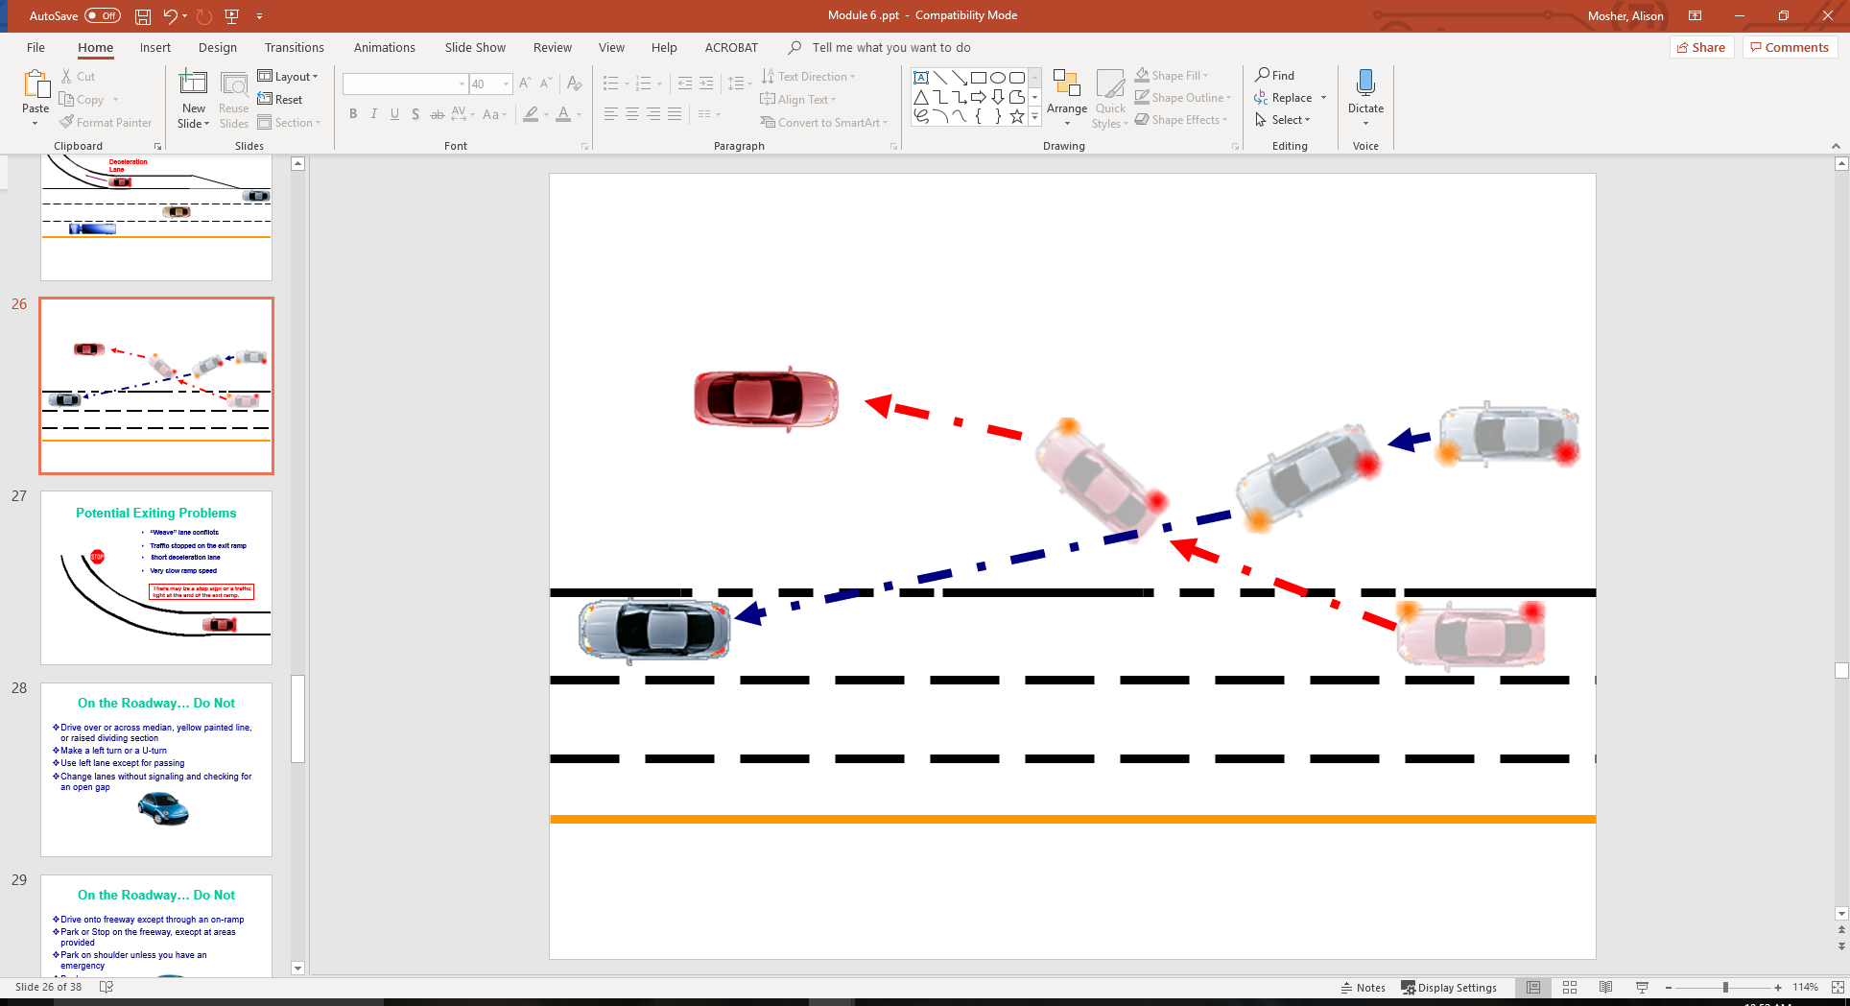
Weave Lane

Slide 27
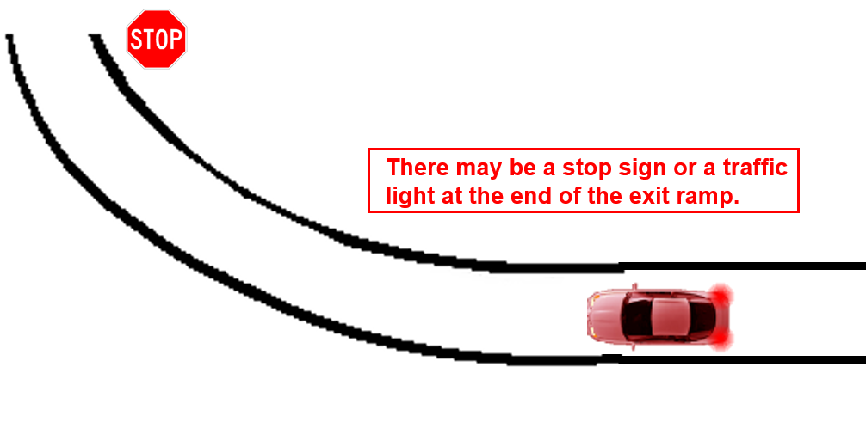
Potential Exiting Problems
“Weave” lane conflicts
Traffic stopped on the exit ramp
Short deceleration lane
Very slow ramp speed

Slide 28
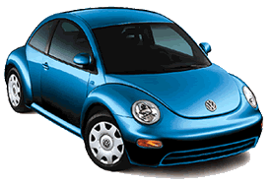
On the Roadway… Do Not
Drive over or across median, yellow painted line, or raised dividing section
Make a left turn or a U-turn
Use left lane except for passing
Change lanes without signaling and checking for an open gap

Slide 29
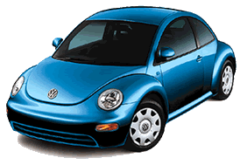
On the Roadway… Do Not
Drive onto freeway except through an on-ramp
Park or Stop on the freeway, except at areas provided
Park on shoulder unless you have an emergency
Backup

Slide 30

Multiple Lane Roadway Dangers
Higher speeds-greater breaking distances needed. (takes longer to stop!)
Field of vision is narrowed
Highway hypnosis
Velocitation effect
Entering and exiting sometimes on the left

Slide 31
Multiple Lane Roadway Dangers
Vehicles on shoulder re-entering
Windy sections of the roadway
Two vehicles changing lanes into same lane
Slow moving vehicles ahead
“Pack Driving”
Tire Hydroplaning during wet weather conditions

Slide 32
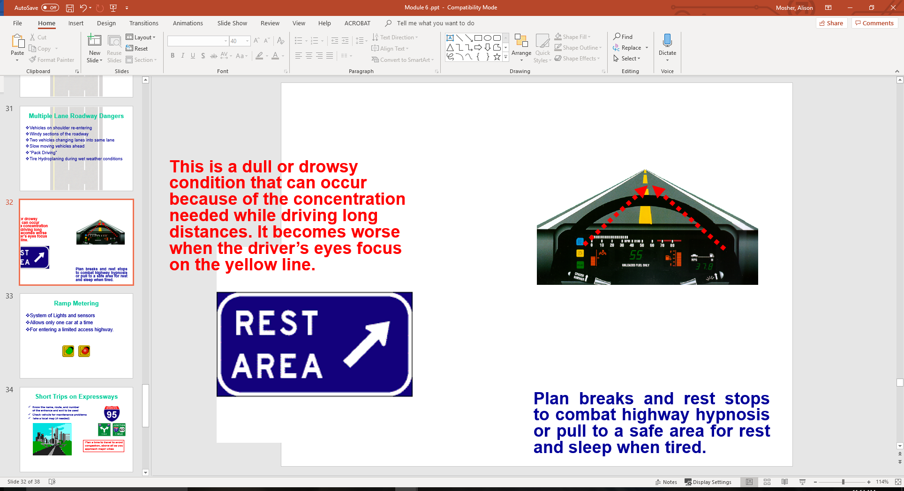

Highway Hypnosis
This is a dull or drowsy condition that can occur because of the concentration needed while driving long distances. It becomes worse when the driver’s eyes focus on the yellow line.
Plan breaks and rest stops to combat highway hypnosis or pull to a safe area for rest and sleep when tired.

Slide 33


Ramp Metering
System of Lights and sensors
Allows only one car at a time
For entering a limited access highway.

Slide 34

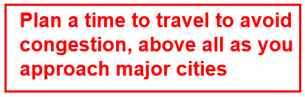
Short Trips on Expressways
Know the name, route, and number of the entrance and exit to be used
Check vehicle for maintenance problems
Take a local map (if needed)

Slide 35
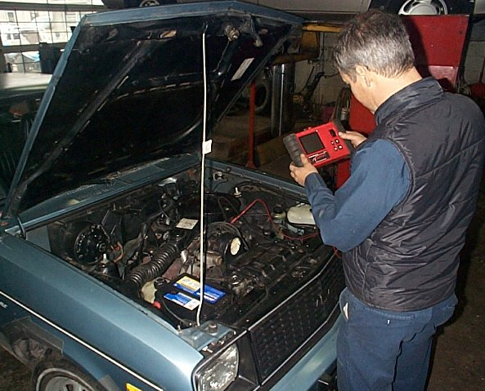




Long Trips on Expressways
Maintenance check of vehicle
Vehicle loading considerations
Plan stops for:
  Food
  Rest
  Fuel
Know the route numbers needed
Check with police for construction delays
Carry money or credit cards
Take a map of planned route

Slide 36
Reducing Risk Entering the Roadway
Search for proper entrance
Search for potential conflicts
Prepare to adjust speed
Avoid stopping on the ramp
Prepare to drive onto the shoulder
Merge smoothly
Create space around your vehicle

Slide 37
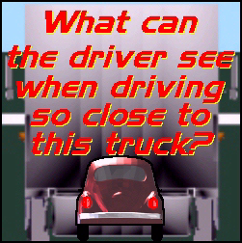
Increase Following Distance
Following large trucks or buses
Following motorcycles
Driving in bad weather
When being tailgated
When driving a heavy load or
pulling a trailer
Entering/exiting the expressway

Slide 38
Special Roadway Conditions
Expressways through cities
Disabled vehicles
  Others along the roadway
  Your vehicle becomes disabled
Construction areas
Toll booths

Slide 39
Contact/Mission
For more information on Driver’s Education and Safety please visit PDE’s website at www.education.pa.gov
The mission of the Department of Education is to ensure that every learner has access to a world-class education system that academically prepares children and adults to succeed as productive citizens. Further, the Department seeks to establish a culture that is committed to improving opportunities throughout the commonwealth by ensuring that technical support, resources, and optimal learning environments are available for all students, whether children or adults.

