Slide 1
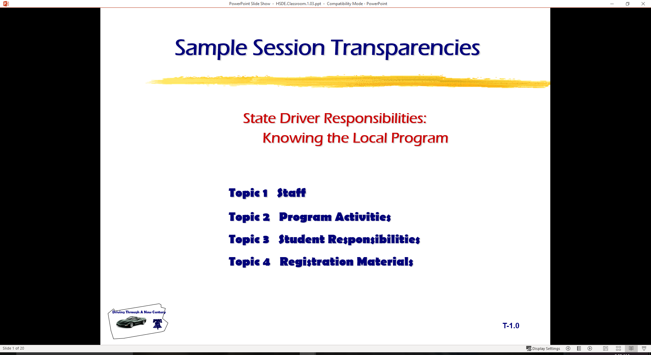
  Basic Maneuvering Tasks: Moderate Risk Environment
  Topic 1 Risk Assessment
  Topic 2 Space Management
  Topic 3 Lane Changes
  Topic 4 Turnabouts
  Topic 5 Parking

Slide 2
Risk Assessment
Risk is the Chance of Injury, Damage, or Loss
Chance is the Likelihood of a Crash
Injury, Damage, or Loss Are the Consequences of a Crash
Risk Involves Chance of Reward or Consequence

Slide 3
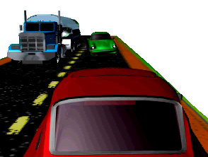
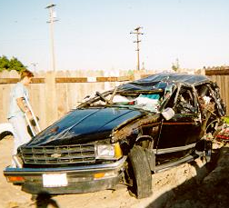
Risk Assessment
Elements of Risk are:
  Risk Assessment
  Risk Acceptance
  Risk Compensation

Slide 4
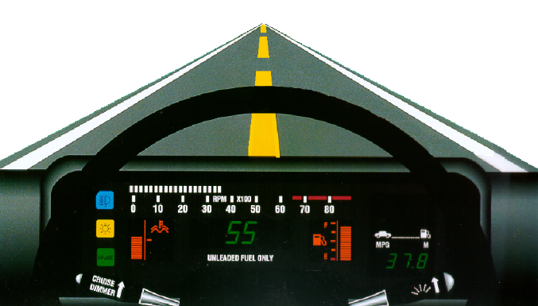
Risk Assessment
Risk Assessment Involves Knowing:
  The Number or Frequency of Risks
  The Chance that an Error Can Occur
  The Consequences of Errors Committed

Slide 5
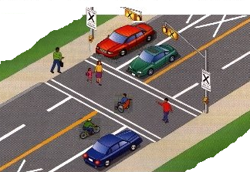
Risk Assessment
Risk Acceptance Involves Knowing:
  The Potential for Errors
  The Result of the Consequences
    Reward or False Positives
    Penalty, Damage, or Injury

Slide 6
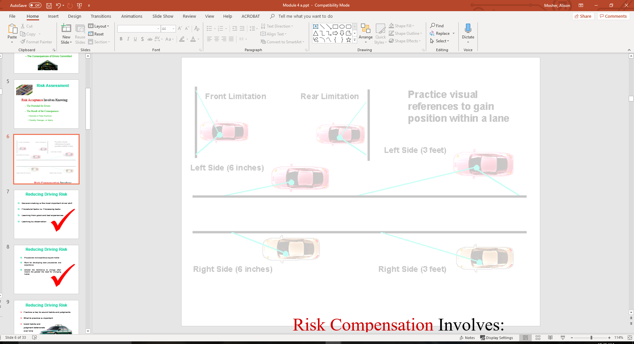
Risk Assessment
Risk Compensation Involves:
  Recognizing Potential Errors or Limitations
  Adjusting Speed to Reduce Errors
  Adjusting Lane Position to Reduce Errors
  Appropriate Communication to Reduce Errors

Slide 7

Reducing Driving Risk
Decision-making is the most important driver skill
Procedural tasks vs. Processing tasks
Learning from good and bad experiences
Learning by observation

Slide 8
Reducing Driving Risk
Procedures and experience equals habits
Work for developing best procedures and experience
Greater the resistance to change often means the greater the need for changing habits

Slide 9
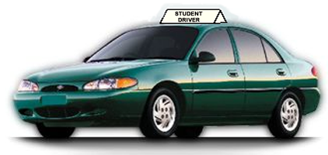
Reducing Driving Risk
Practice is key to sound habits and judgments
What to practice is important
Good habits and judgment deteriorate over time

Slide 10
Reducing Driving Risk
Majority of drivers rate themselves as good
Good versus poor procedures and processing
Poor driving experiences develop poor driving behaviors

Slide 11
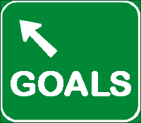
Risk Reduction Goals
Make every driving sequence a good driving sequence
Use processing techniques to make judgments
Develop sound procedures for maneuvers

Slide 12

System Components
Three steps for Space Management are:
  Search
  Evaluate
  Execute
Line of Sight, Path of Travel, or Area Changes
Clear Opposite Area or Areas for Speed or Position Adjustments

Slide 13
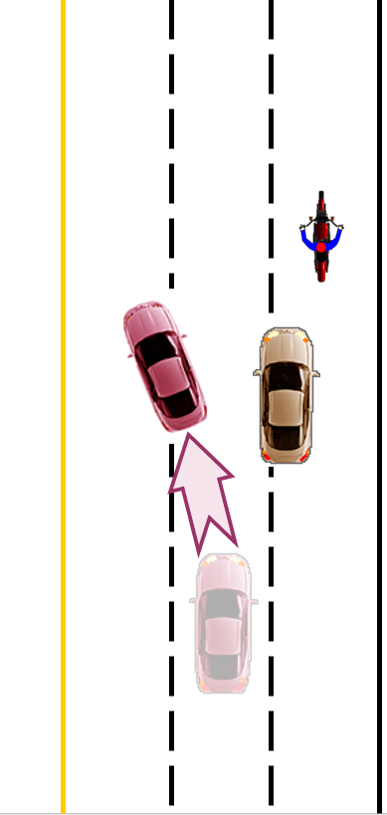
System Components
Speed Adjustment
Lane Position Adjustment
Risk Reduction is Goal
Guidelines for Decision-Making

Slide 14
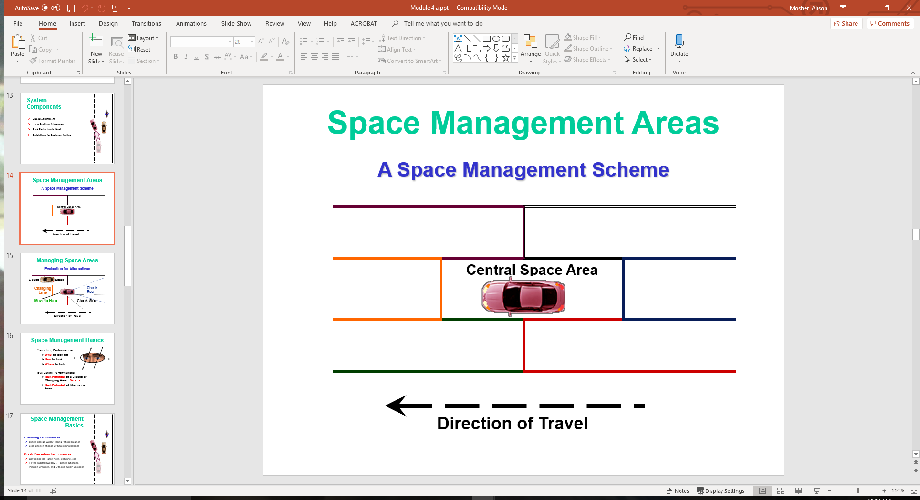
Space Management Areas
A Space Management Scheme

Slide 15
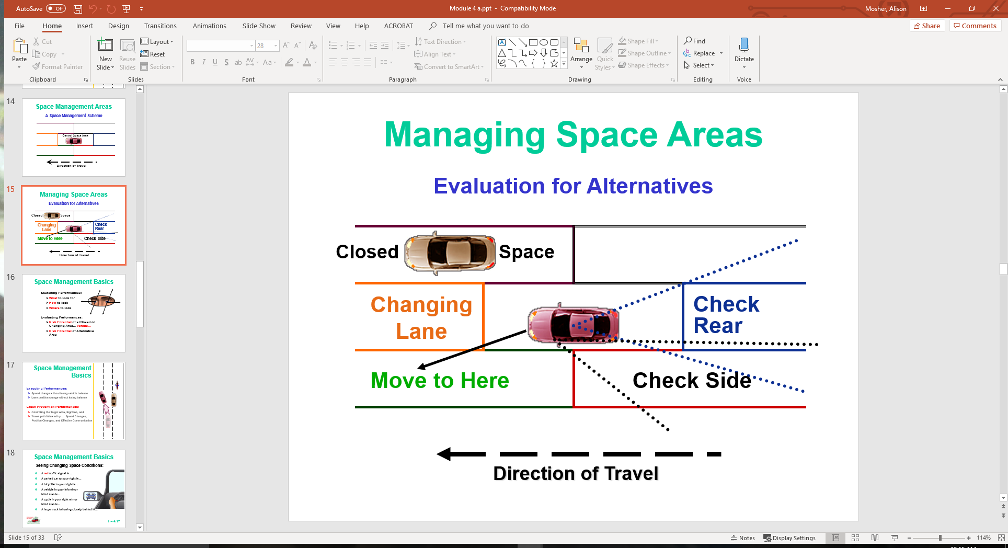
Managing Space Areas
Evaluation for Alternatives

Slide 16
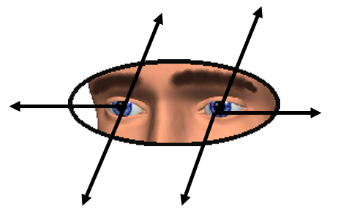
Space Management Basics
Searching Performances:
  What to look for
  How to look
  Where to look
Evaluating Performances:
  Risk Potential of a Closed or Changing Area... Versus…
  Risk Potential of Alternative Area

Slide 17
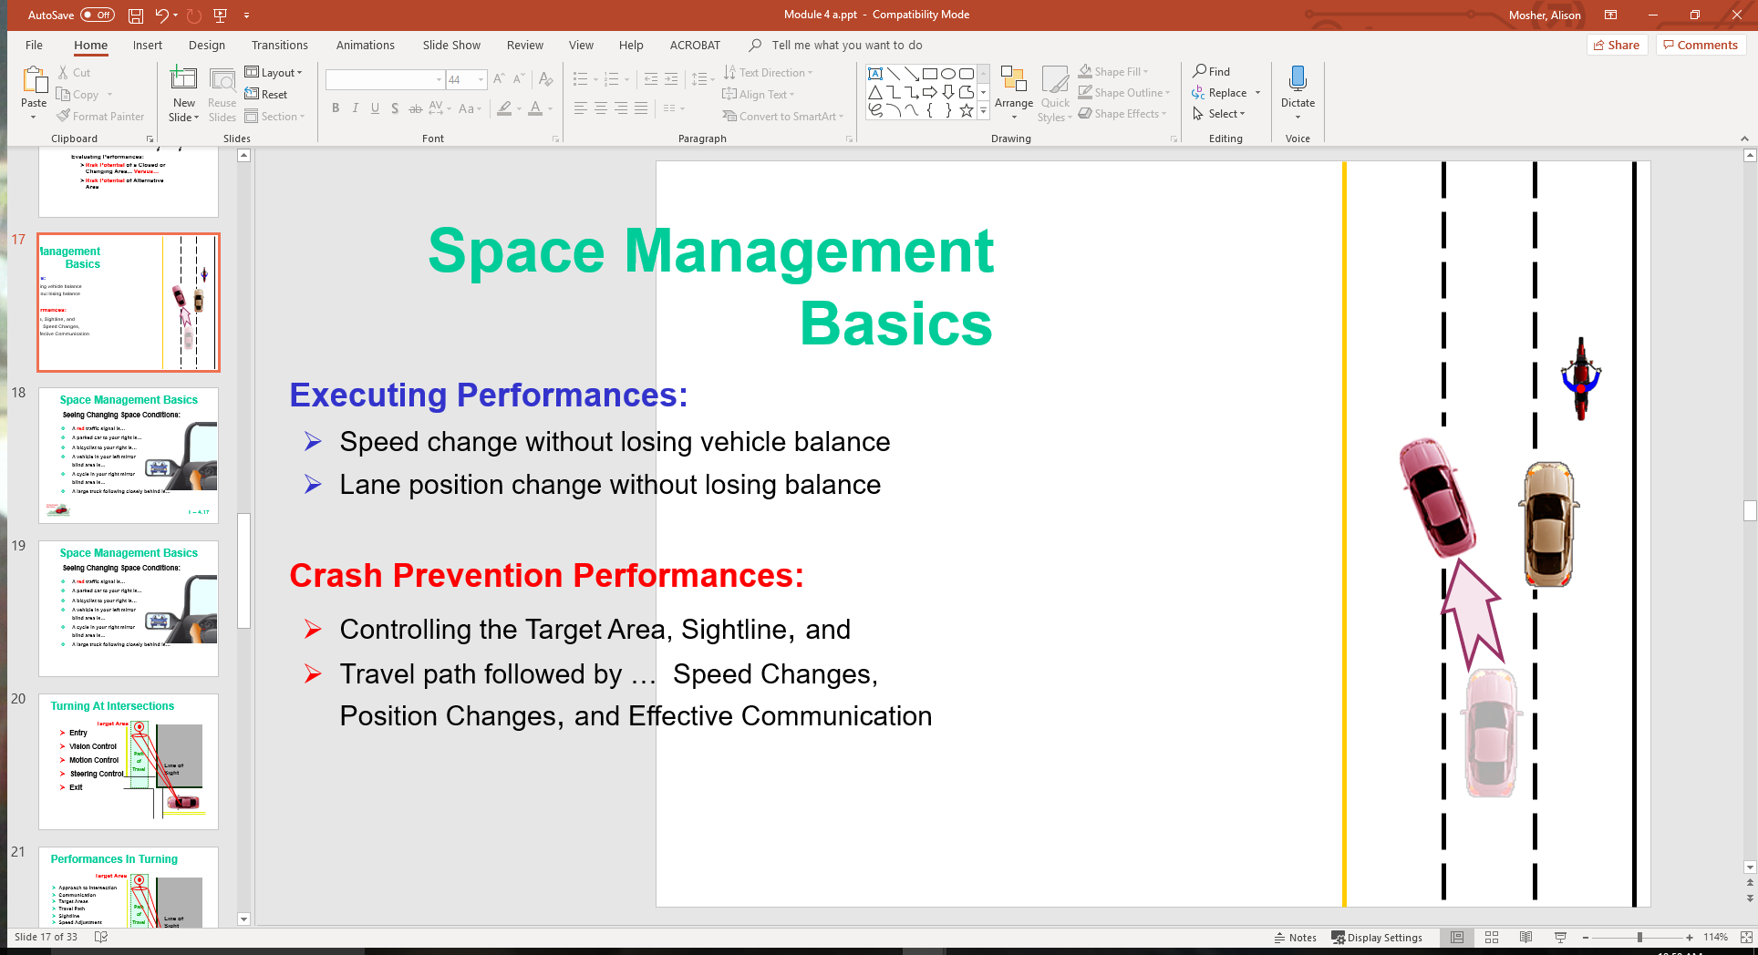
Space Management Basics
Executing Performances:
  Speed change without losing vehicle balance
  Lane position change without losing balance
Crash Prevention Performances:
  Controlling the Target Area, Sightline, and
  Travel path followed by … Speed Changes, Position Changes, and Effective Communication

Slide 18
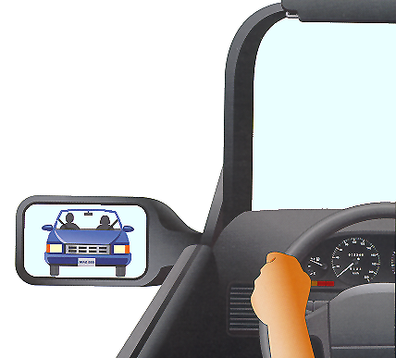
Space Management Basics
Seeing Changing Space Conditions:
  A red traffic signal is…
  A parked car to your right is…
  A bicyclist to your right is…
  A vehicle in your left mirror blind area is…
  A cycle in your right mirror blind area is…
  A large truck following closely behind is…

Slide 19
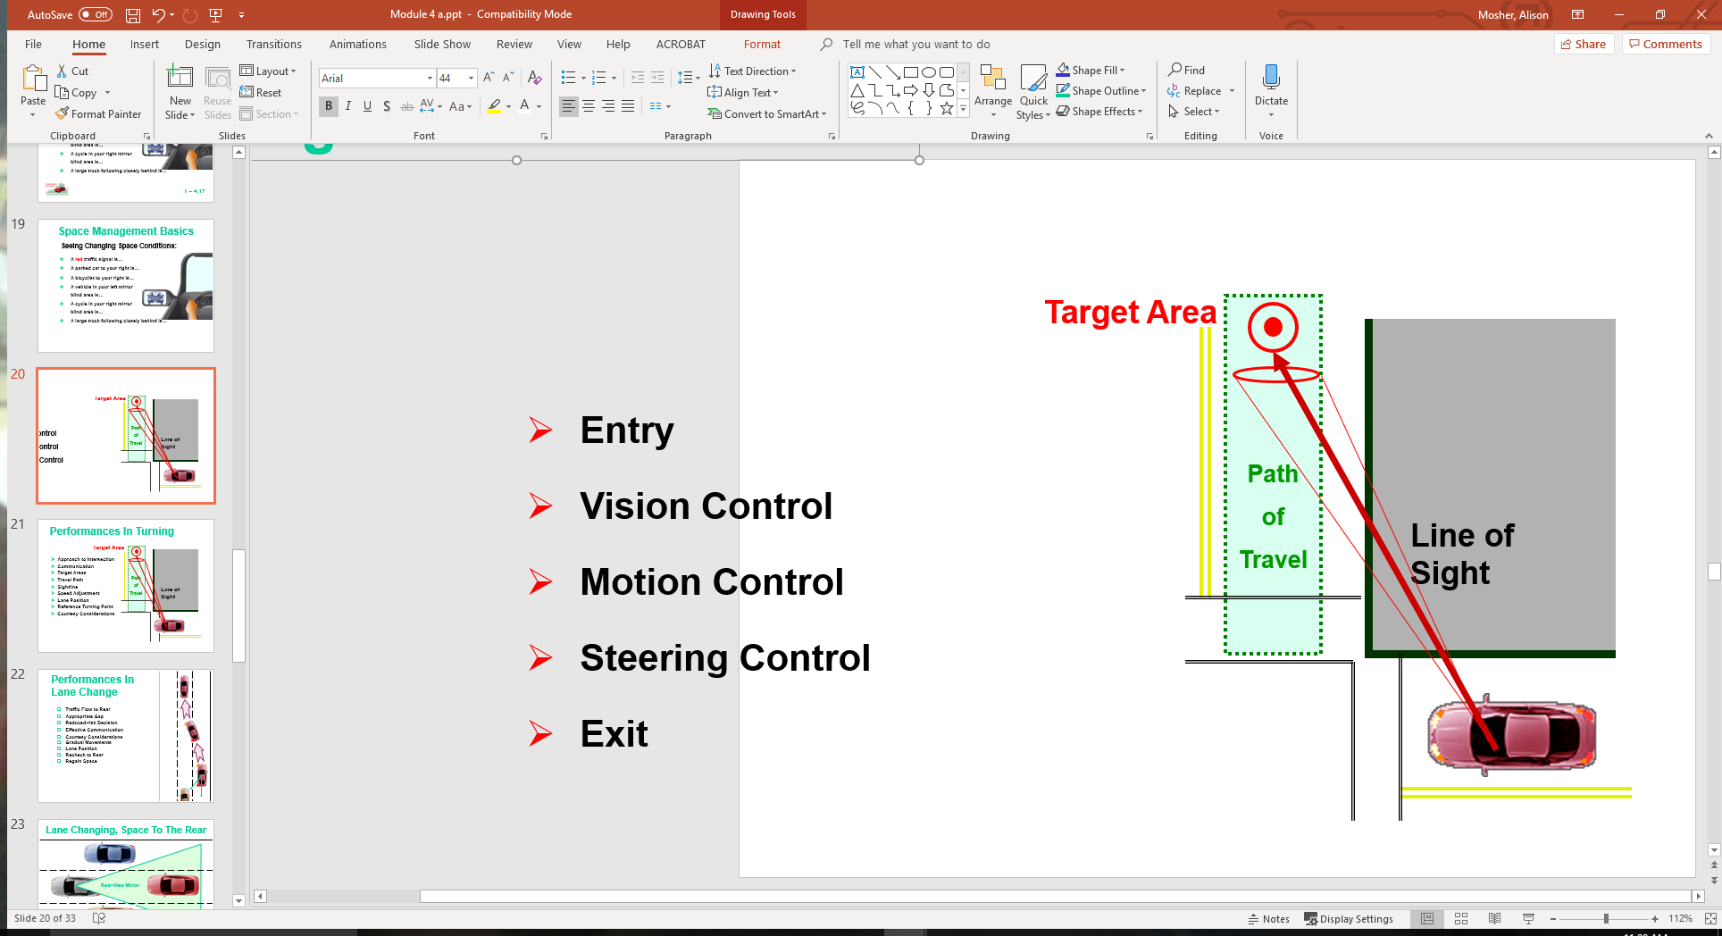
Turning At Intersections
Entry
Vision Control
Motion Control
Steering Control
Exit

Slide 20
Performances In Turning
Approach to Intersection
Communication
Target Areas
Travel Path
Sightline
Speed Adjustment
Lane Position
Reference Turning Point
Courtesy Considerations

Slide 21
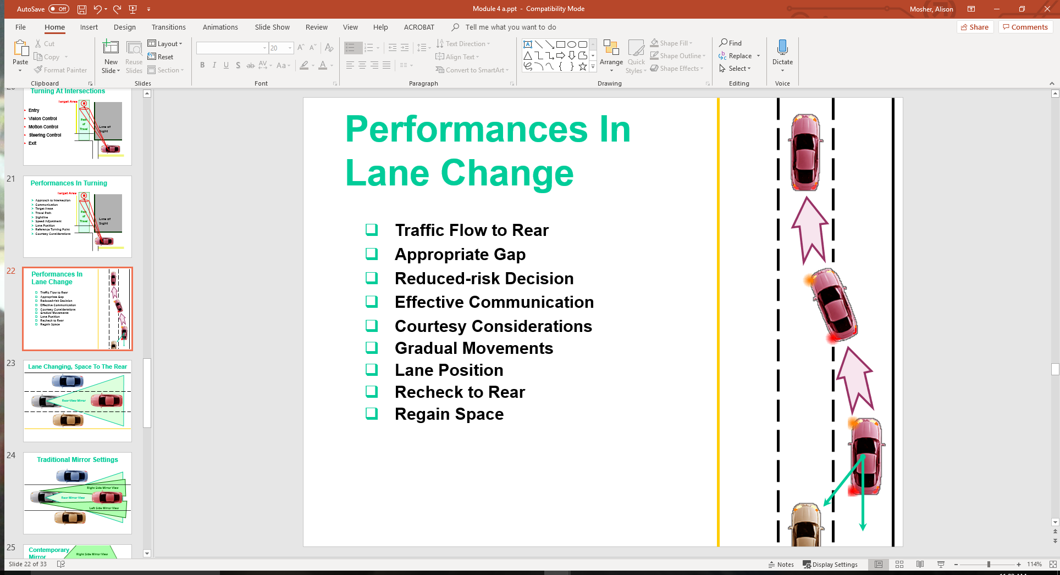
Performances In Lane Change
Traffic Flow to Rear
Appropriate Gap
Reduced-risk Decision
Effective Communication
Courtesy Considerations
Gradual Movements
Lane Position
Recheck to Rear
Regain Space

Slide 22
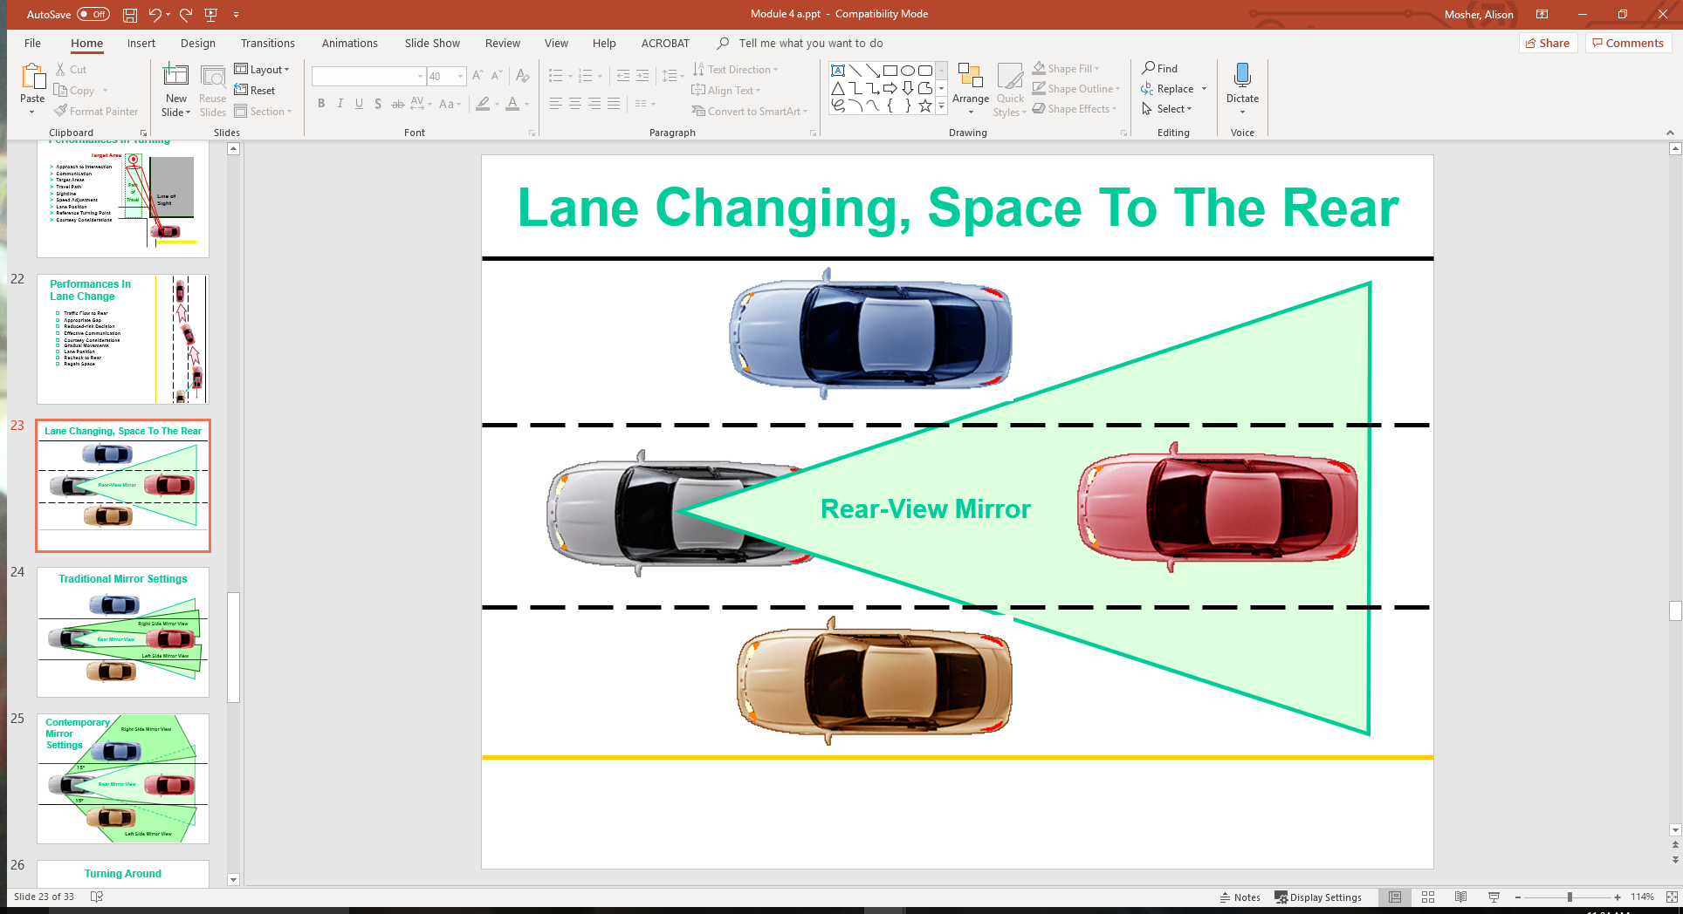
Lane Changing, Space To The Rear

Slide 23
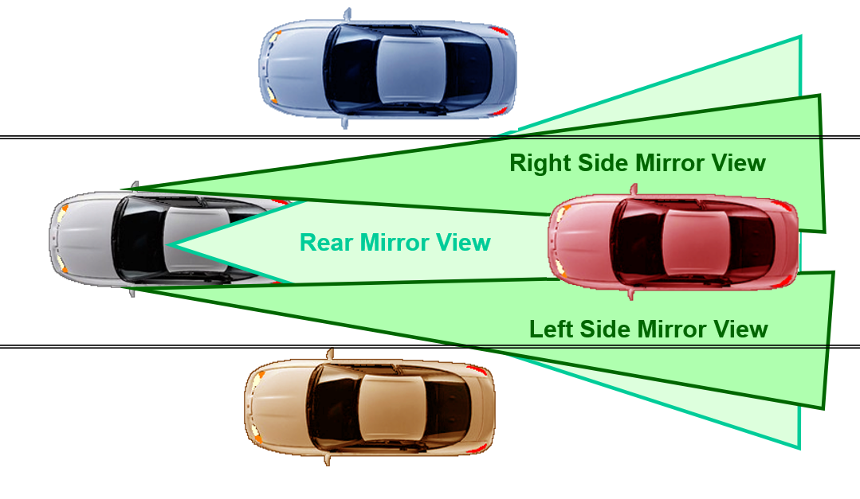
Traditional Mirror Settings

Slide 24
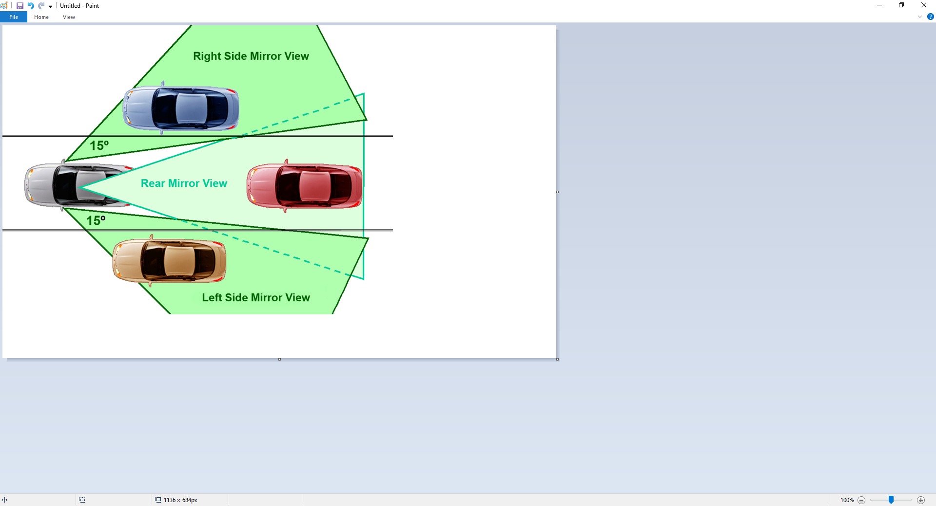
Contemporary Mirror Settings

Slide 25
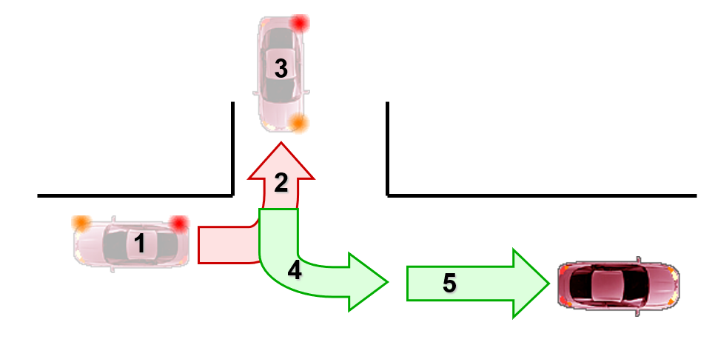
Turning Around
Approach
Communication
Target Areas
Line of Sight
References
Speed Control
Lane Position
Courtesy Considerations

Slide 26
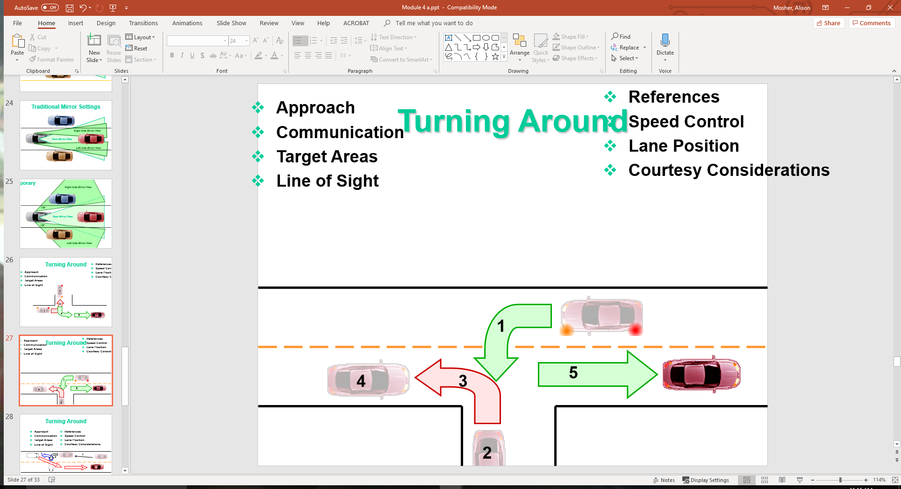
Turning Around
Approach
Communication
Target Areas
Line of Sight
References
Speed Control
Lane Position
Courtesy Considerations

Slide 27
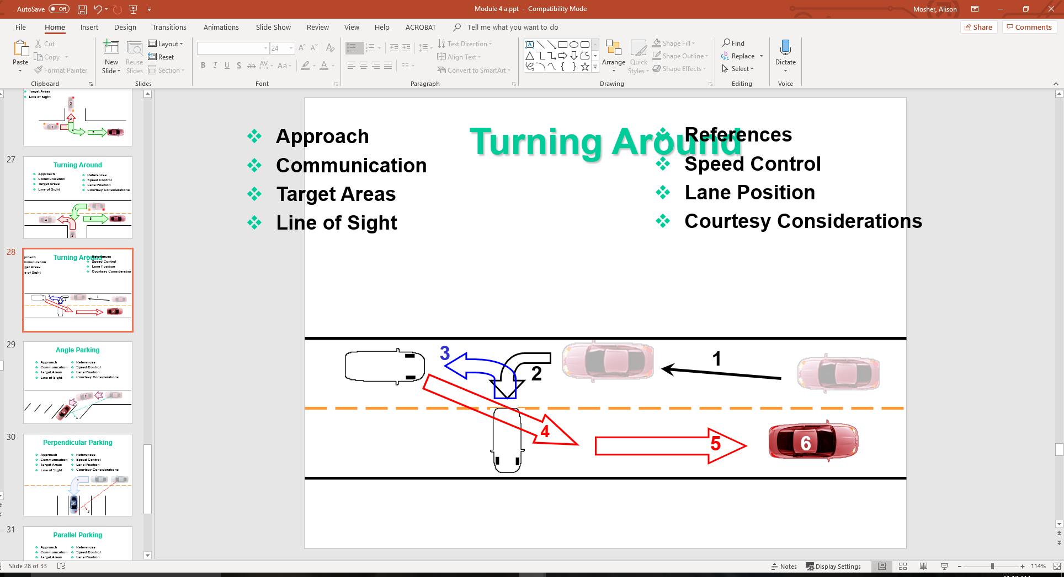
Turning Around
Approach
Communication
Target Areas
Line of Sight
References
Speed Control
Lane Position
Courtesy Considerations

Slide 28
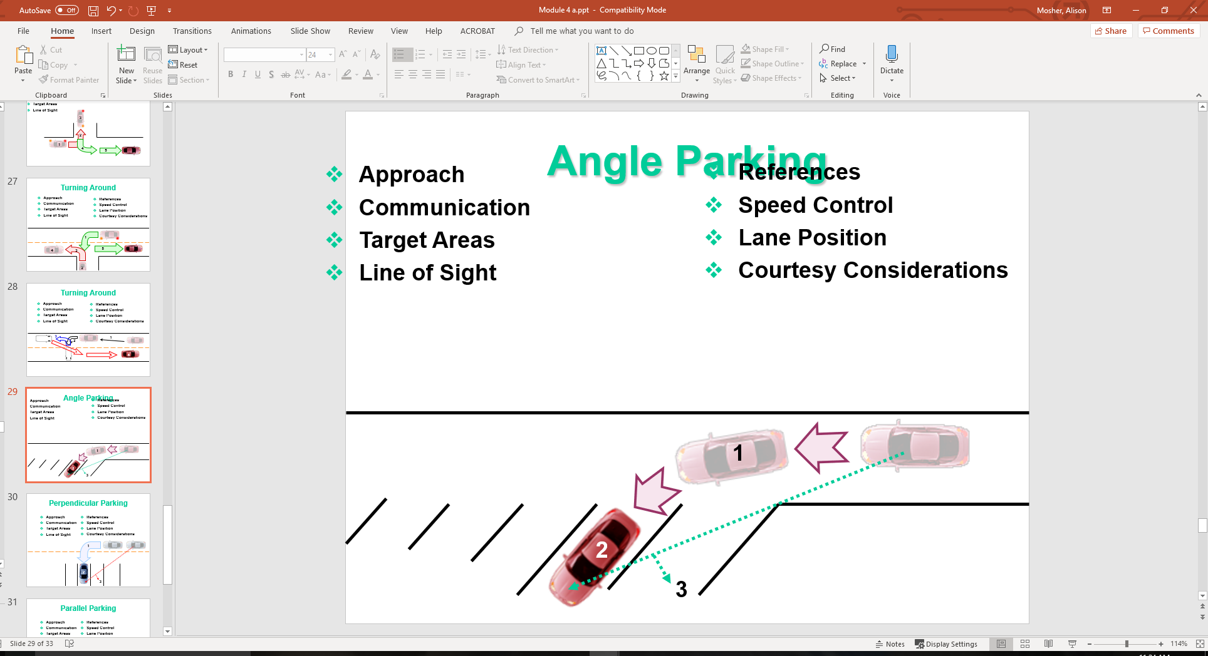
Angle Parking
Approach
Communication
Target Areas
Line of Sight
References
Speed Control
Lane Position
Courtesy Considerations

Slide 29
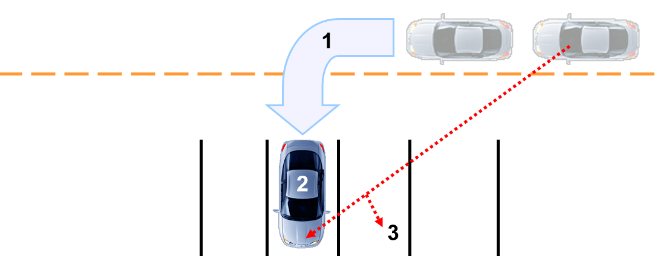
Perpendicular Parking
Approach
Communication
Target Areas
Line of Sight
References
Speed Control
Lane Position
Courtesy Considerations

Slide 30
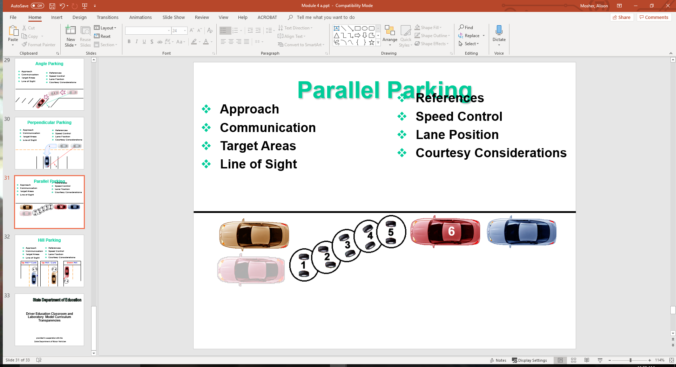
Parallel Parking
Approach
Communication
Target Areas
Line of Sight
References
Speed Control
Lane Position
Courtesy Considerations

Slide 31
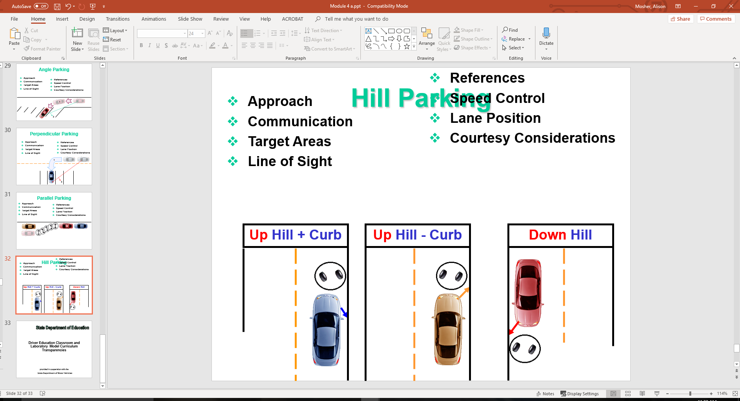
Hill Parking
Approach
Communication
Target Areas
Line of Sight
References
Speed Control
Lane Position
Courtesy Considerations

Slide 32
Contact/Mission
For more information on Driver’s Education and Safety please visit PDE’s website at www.education.pa.gov
The mission of the Department of Education is to ensure that every learner has access to a world-class education system that academically prepares children and adults to succeed as productive citizens. Further, the Department seeks to establish a culture that is committed to improving opportunities throughout the commonwealth by ensuring that technical support, resources, and optimal learning environments are available for all students, whether children or adults.

