Slide 1
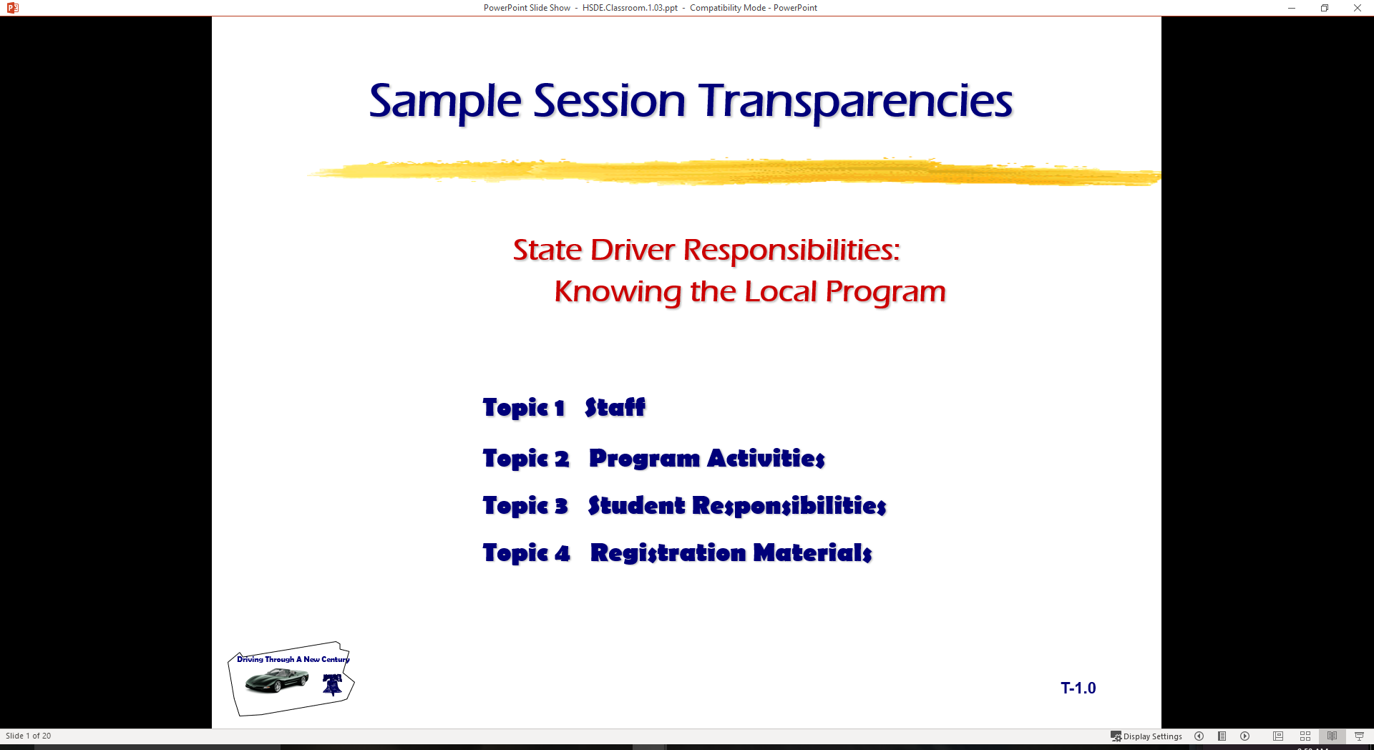
  Basic Maneuvering Tasks: Low Risk Environment
  Topic 1 Procedural Tasks
  Topic 2 Vision Requirements
  Topic 3 Introducing “SEE IT” System
  Topic 4 Developing Good Driving Habits

Slide 2
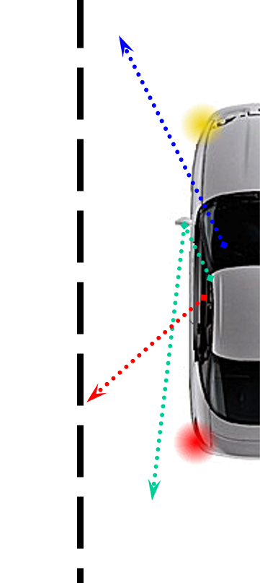
Entering Roadway Tasks
Place Foot Firmly on Service Brake
Select Proper Gear
  Overdrive, Drive, or Reverse
Perform Traffic Check
  Forward, Rear, and Sides
Apply Proper Signal
  Signal/Communicate Intentions

Slide 3
Entering Roadway Tasks
Release Parking Brake
Select Gap in Traffic Flow
Move to Lane
  Target Lane Position #1
  Release Service Brake
  Gradual Acceleration
  Steer to Center of Lane

Slide 4
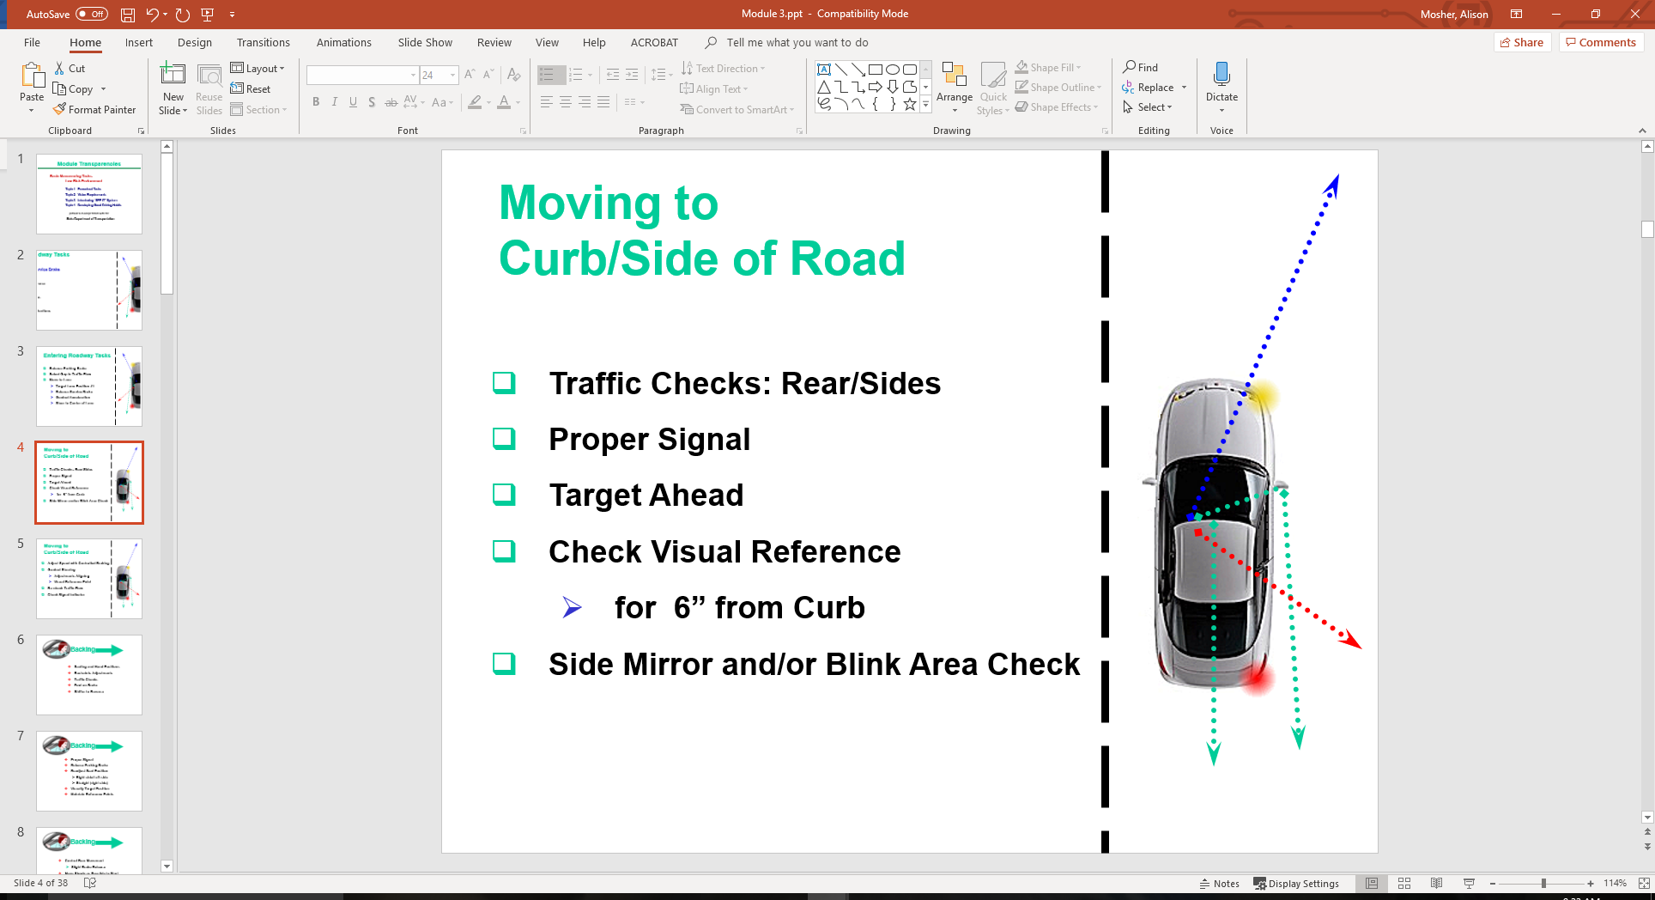
Moving to Curb/Side of Road
Traffic Checks: Rear/Sides
Proper Signal
Target Ahead
Check Visual Reference
  for 6” from Curb
Side Mirror and/or Blink Area Check

Slide 5
Moving to Curb/Side of Road
Adjust Speed with Controlled Braking
Gradual Steering
  Adjustments Aligning
  Visual Reference Point
Re-check Traffic Flow
Check Signal Indicator

Slide 6
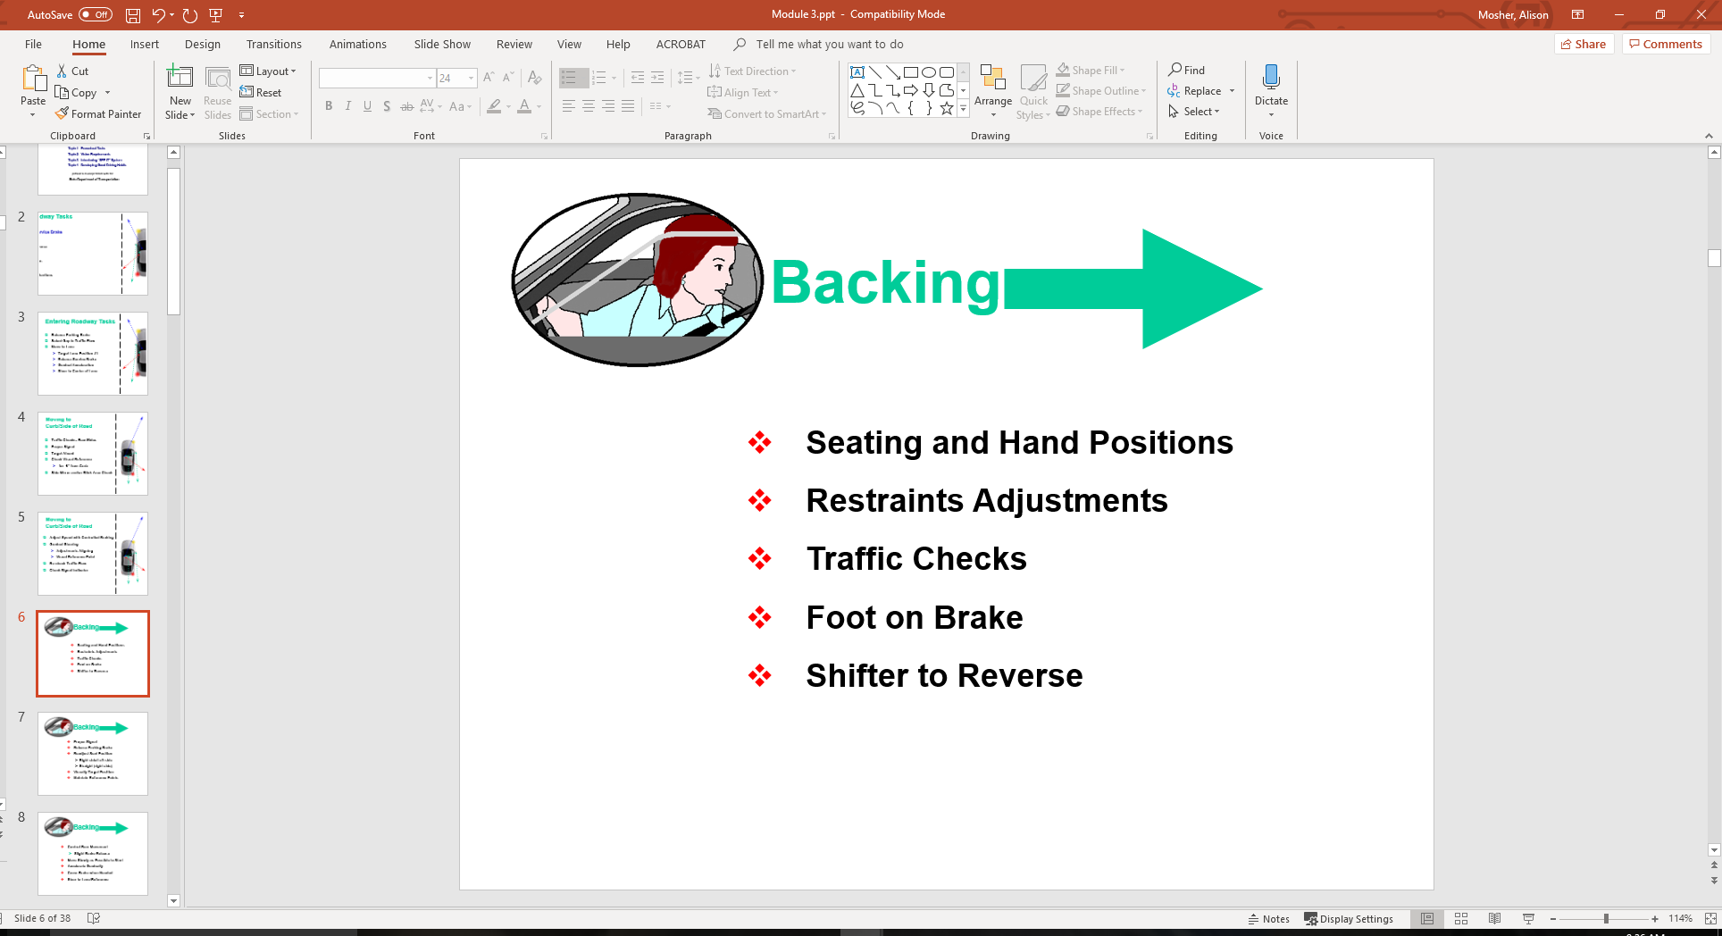

Slide 7
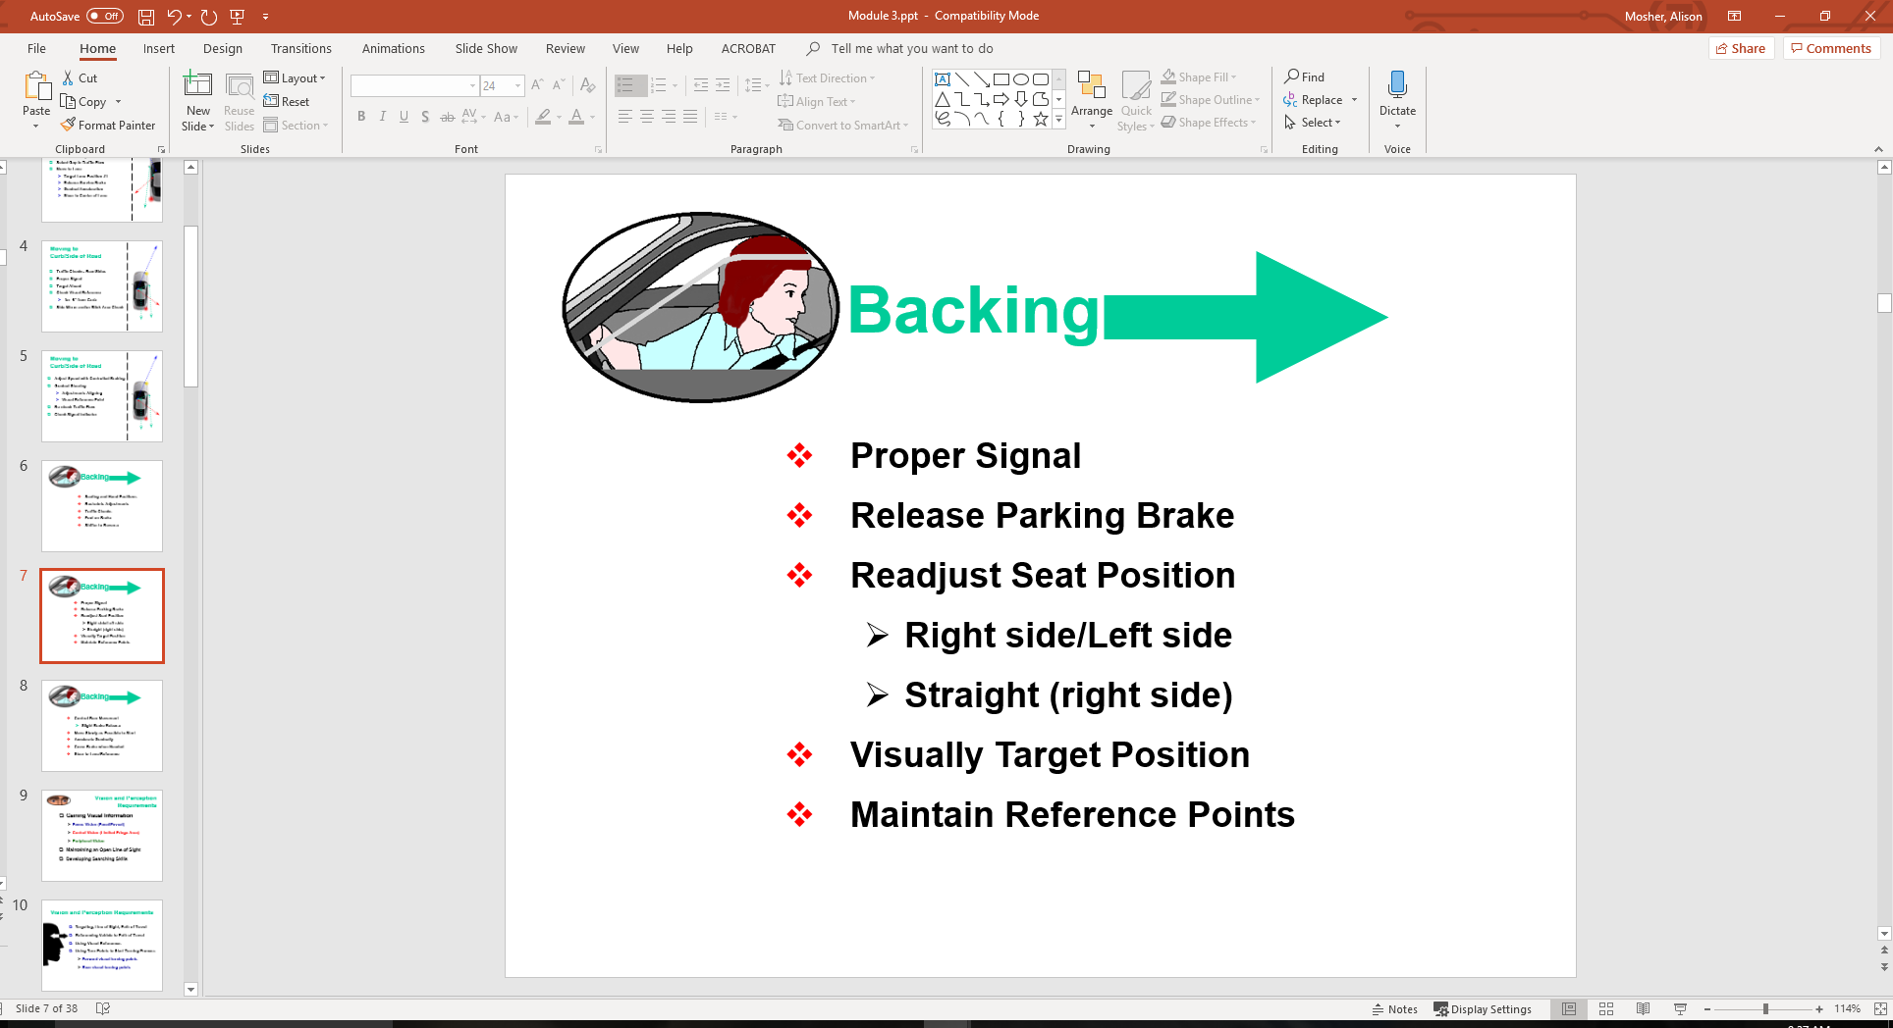

Slide 8
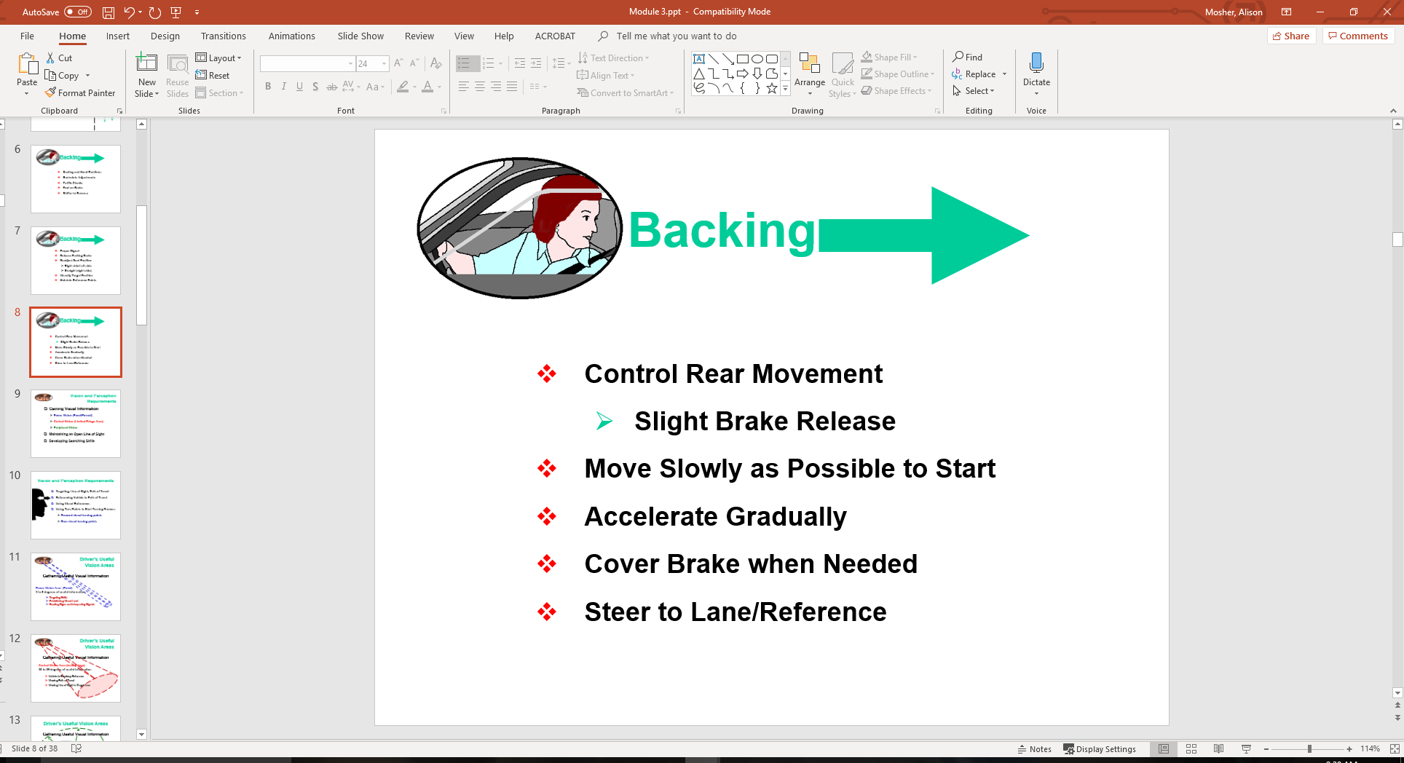

Slide 9

Vision and Perception Requirements
Gaining Visual Information
  Focus Vision (Focal/Foveal)
  Central Vision (Limited Fringe Area)
  Peripheral Vision
Maintaining an Open Line of Sight
Developing Searching Skills

Slide 10

Vision and Perception Requirements
Targeting, Line of Sight, Path of Travel
Referencing Vehicle to Path of Travel
Using Visual References
Using Turn Points to Start Turning Process
  Forward visual turning points
  Rear visual turning points

Slide 11
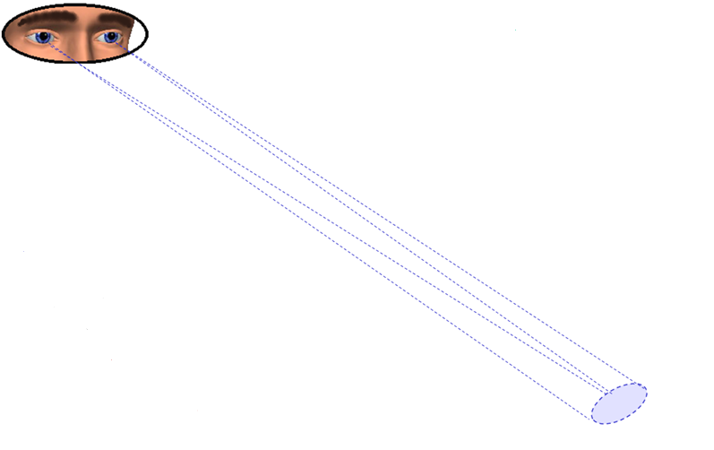
Driver’s Useful Vision Areas
Gathering Useful Visual Information
Focus Vision Area (Focal)
3 to 5 degrees of useful information
Targeting Skills
Establishing Visual Lead
Reading Signs and Interpreting Signals

Slide 12
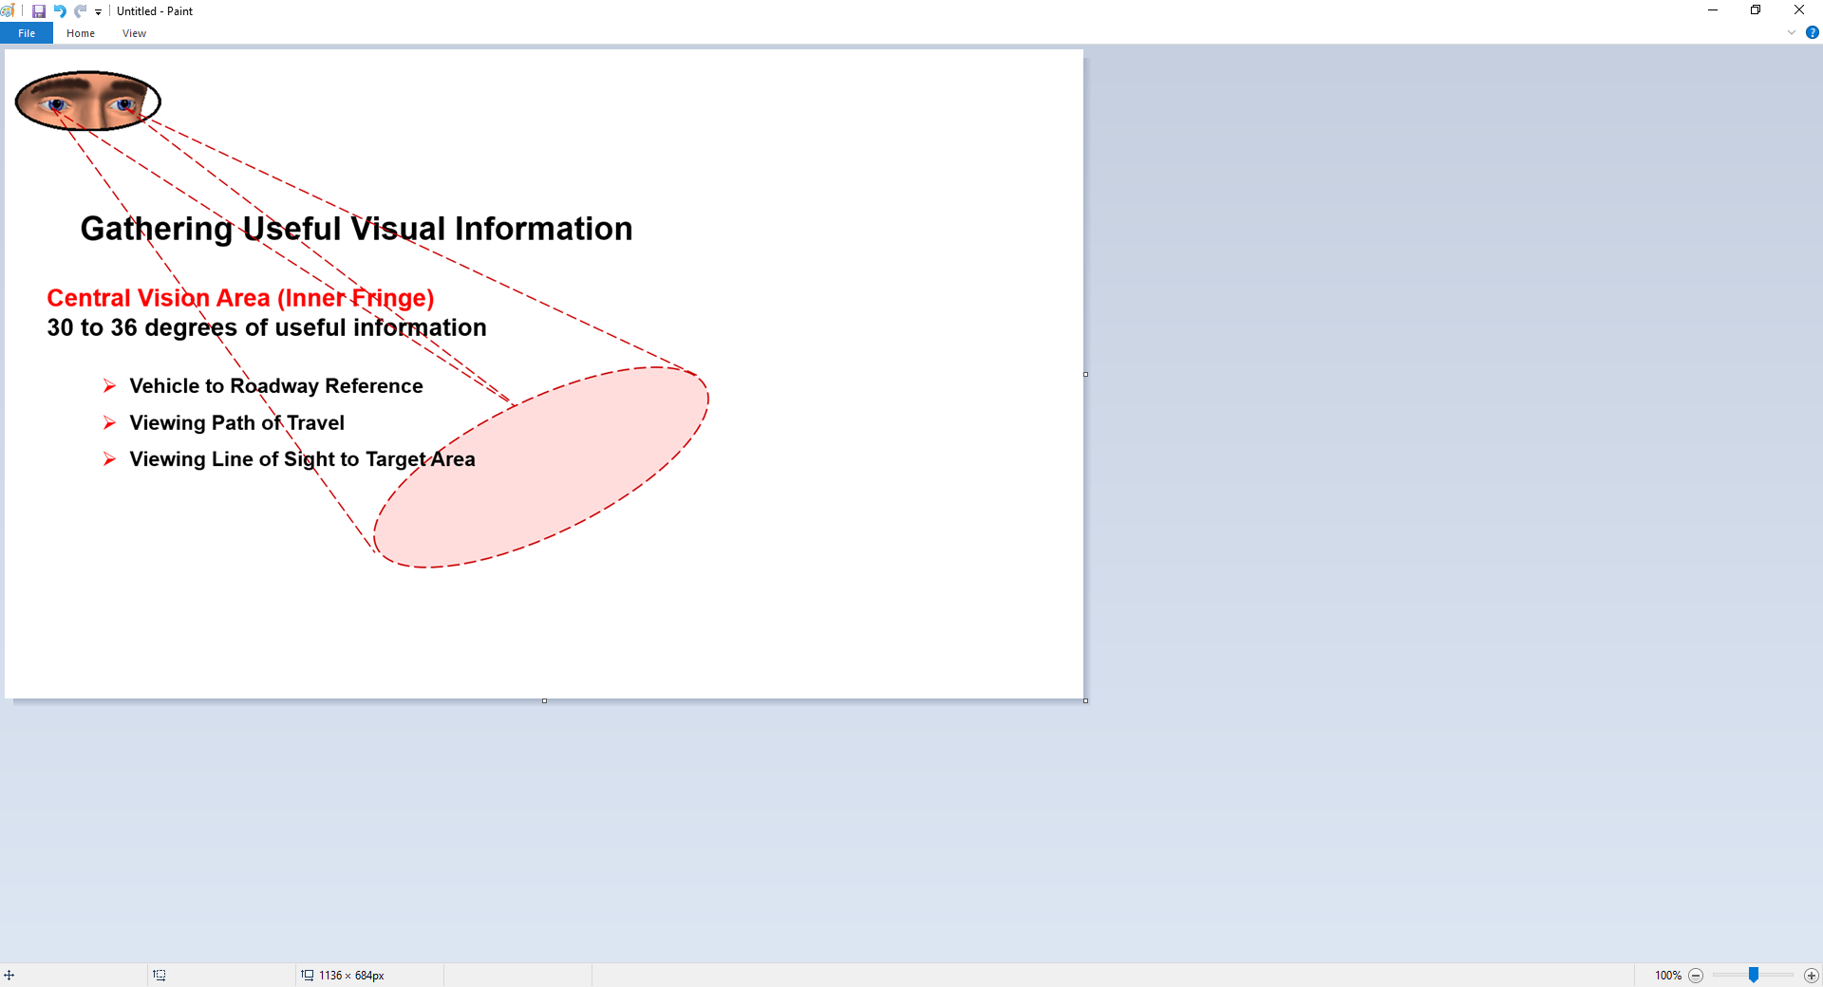
Driver’s Useful Vision Areas

Slide 13
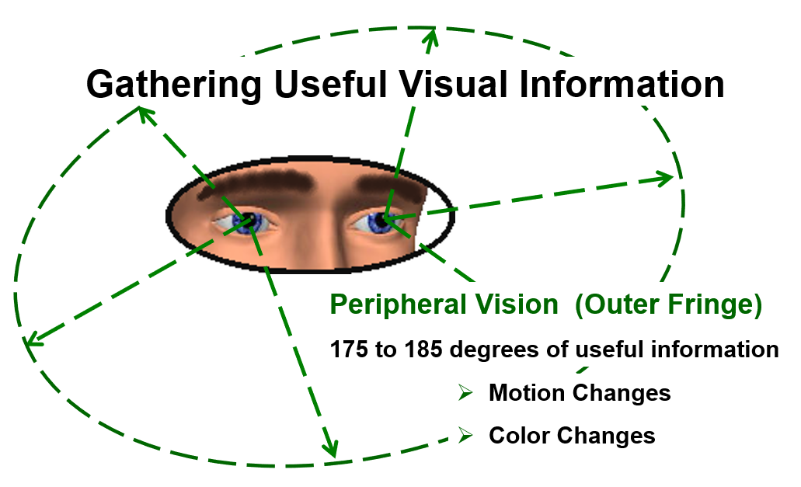
Driver’s Useful Vision Areas

Slide 14
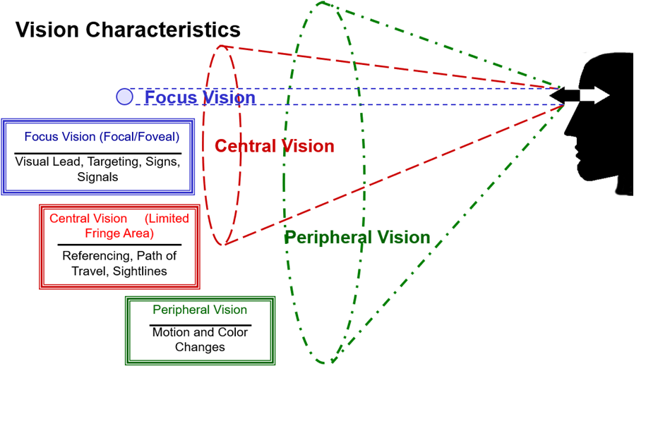
Visual Fields in Operation

Slide 15
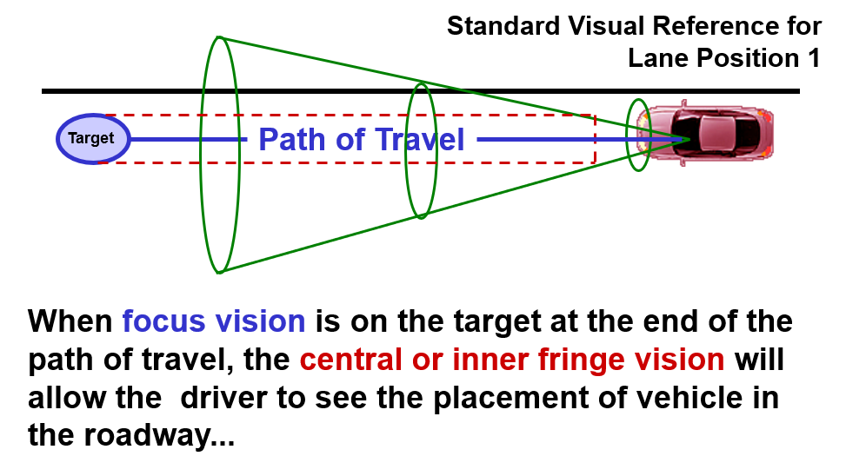
Visual Fields in Operation

Slide 16
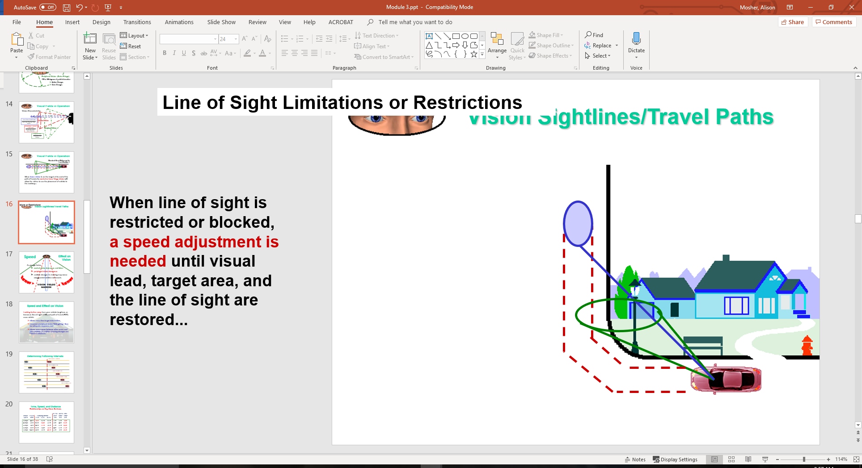
Vision Sightlines/Travel Paths
Line of Sight Limitations or Restrictions
When line of sight is restricted or blocked, a speed adjustment is needed until visual lead, target area, and the line of sight are restored...

Slide 17
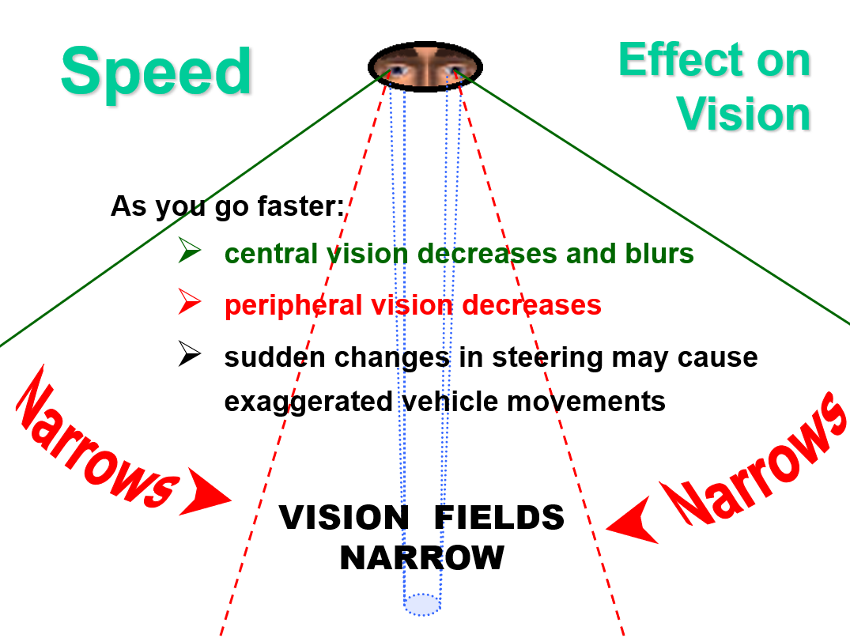

Slide 18
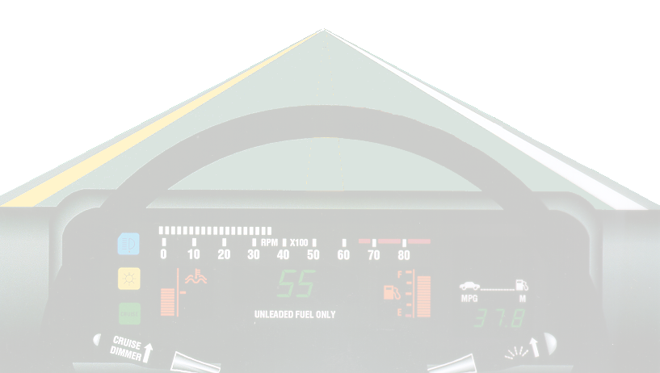
Speed and Effect on Vision
Looking farther away from your vehicle lengthens or increases line of sight (LOS) and path of travel (POT) areas which:
  allows more time to get information;
  increases peripheral vision field, giving time for adequate response; and
  places more space between other users and your vehicle, so sudden steering changes are held to a minimum.

Slide 19
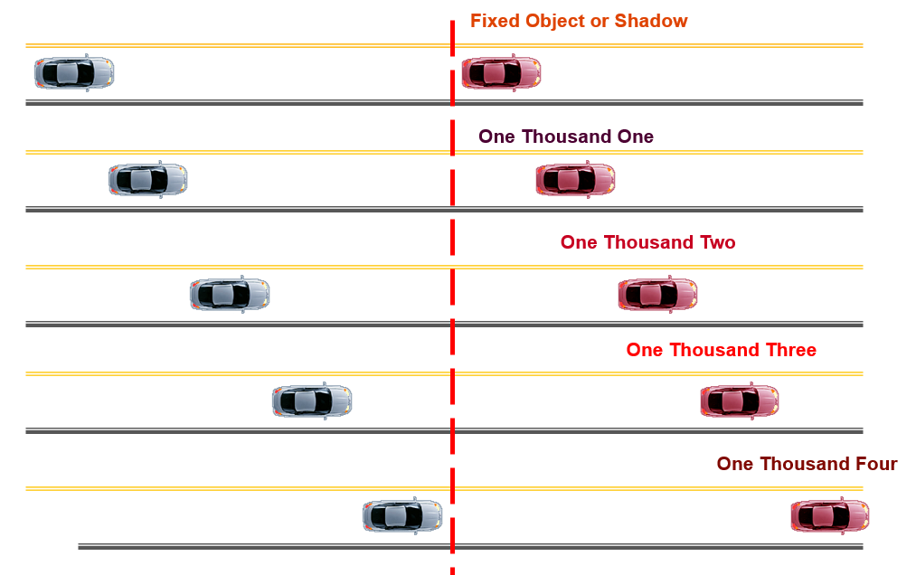
Determining Following Intervals

Slide 20
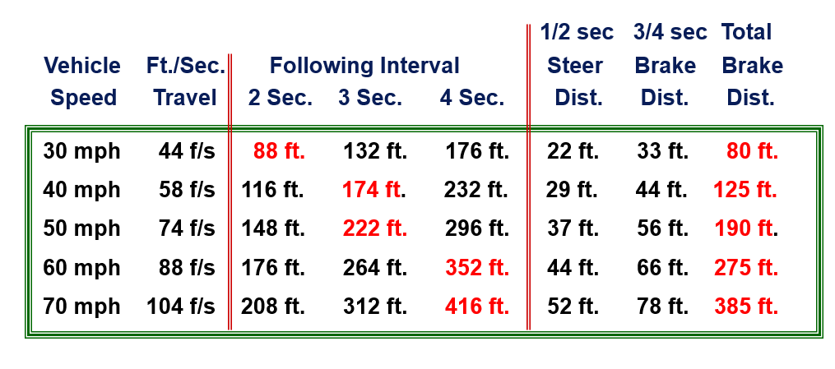
Time, Speed, and Distance Relationships on Dry, Clean Surfaces

Slide 21
Following Intervals
2 Seconds… Permits driver time to steer out of problem areas at all listed speeds on a dry surface and braking out of problems at speeds under 35 mph.
3 Seconds… Permits driver time to steer out of problem areas at all listed speeds on dry surface and braking out of problems at speeds to 45 mph.
4 Seconds… Permits driver to steer out of problems at all listed speeds on dry surface and braking out of problems at speeds to legal limit of 65 mph.
  * Factory equipped passenger car tires may not be designed to steer out of problem areas at speeds beyond 75 mph. Speed rated tires are required due to sidewall flexion problems at higher speeds and turning movements.

Slide 22
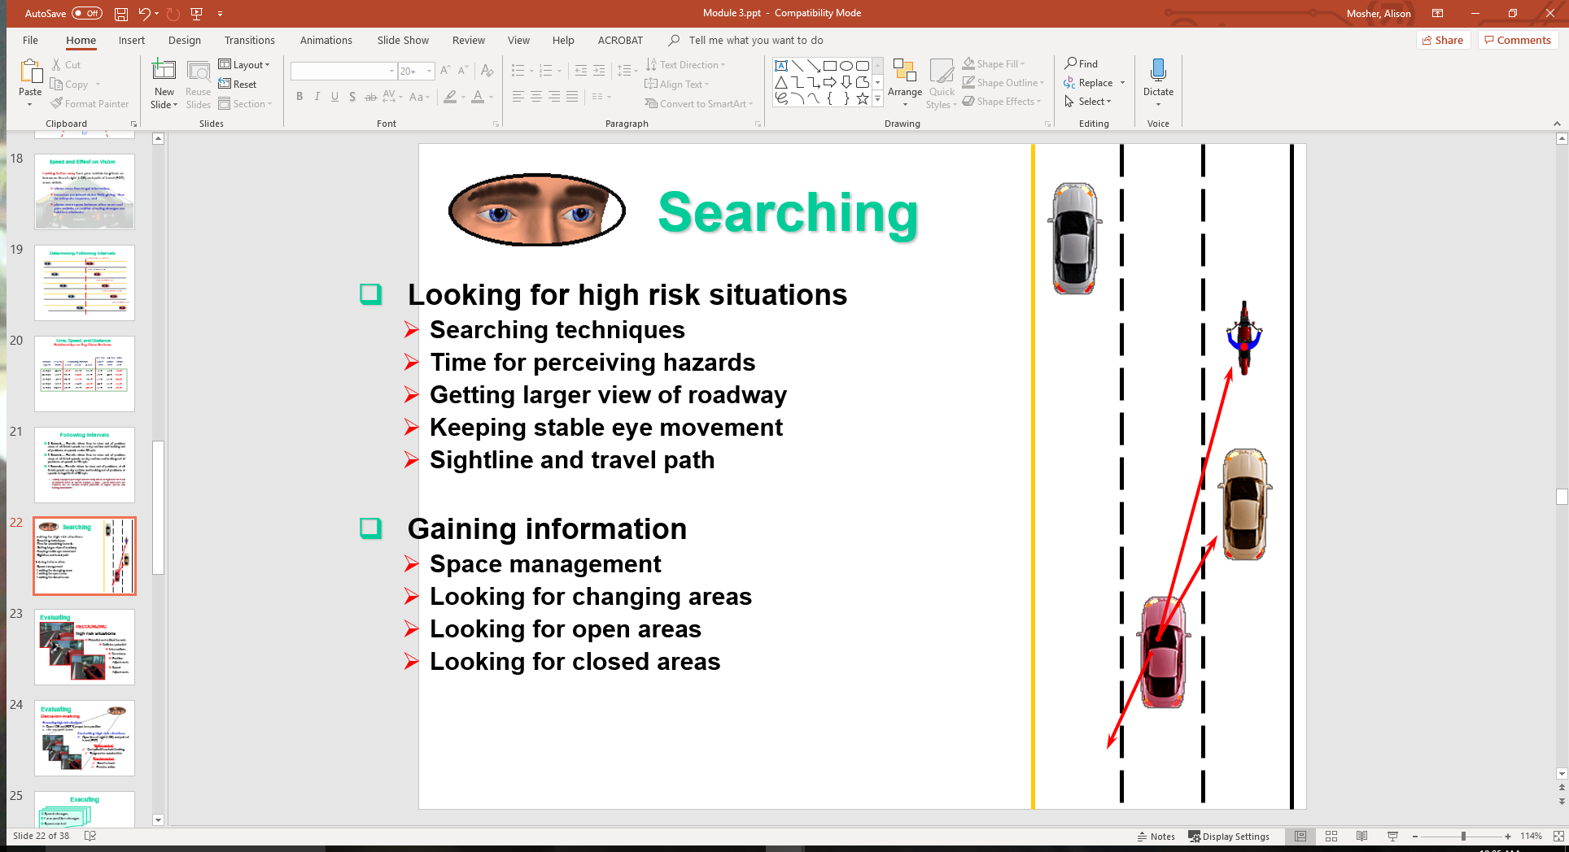
Searching
Looking for high risk situations
  Searching techniques
  Time for perceiving hazards
  Getting larger view of roadway
  Keeping stable eye movement
  Sightline and travel path
Gaining information
  Space management
  Looking for changing areas
  Looking for open areas
  Looking for closed areas

Slide 23
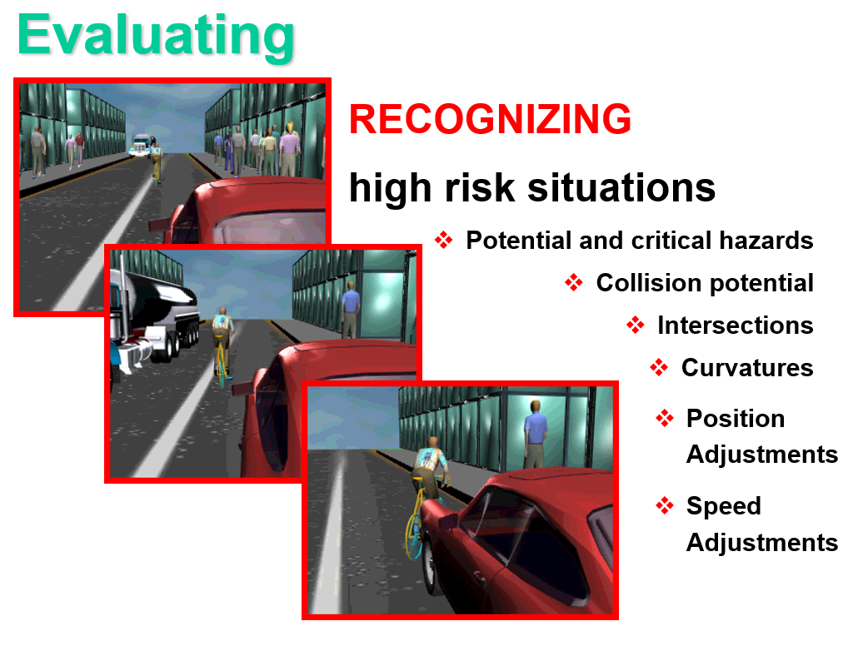

Slide 24
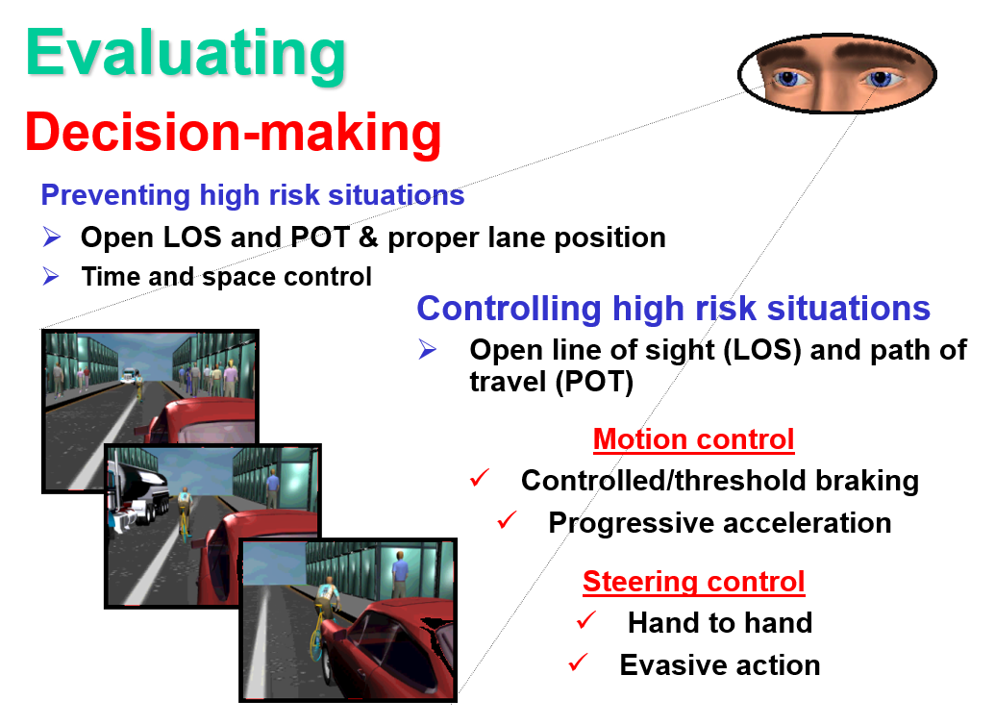

Slide 25
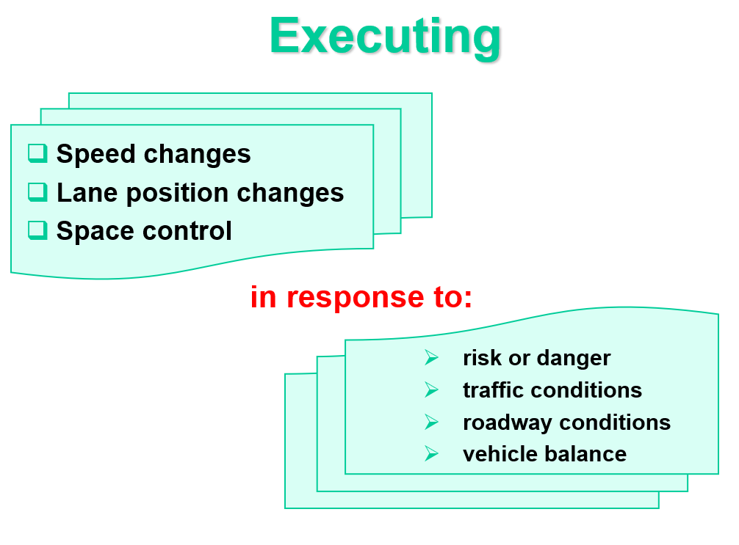

Slide 26
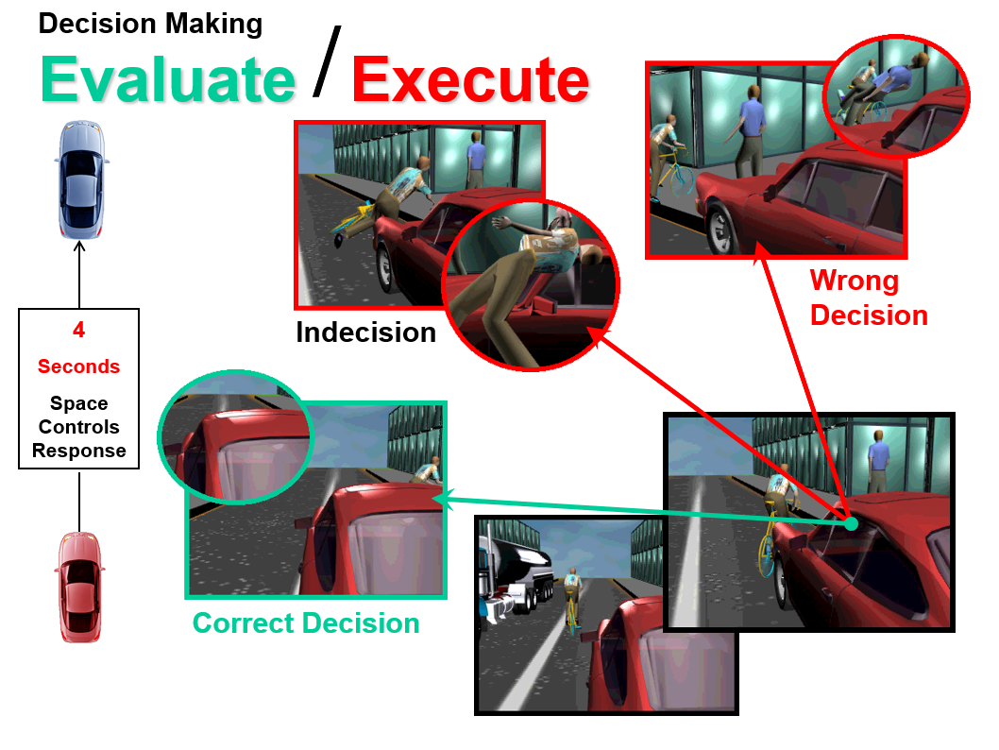

Slide 27
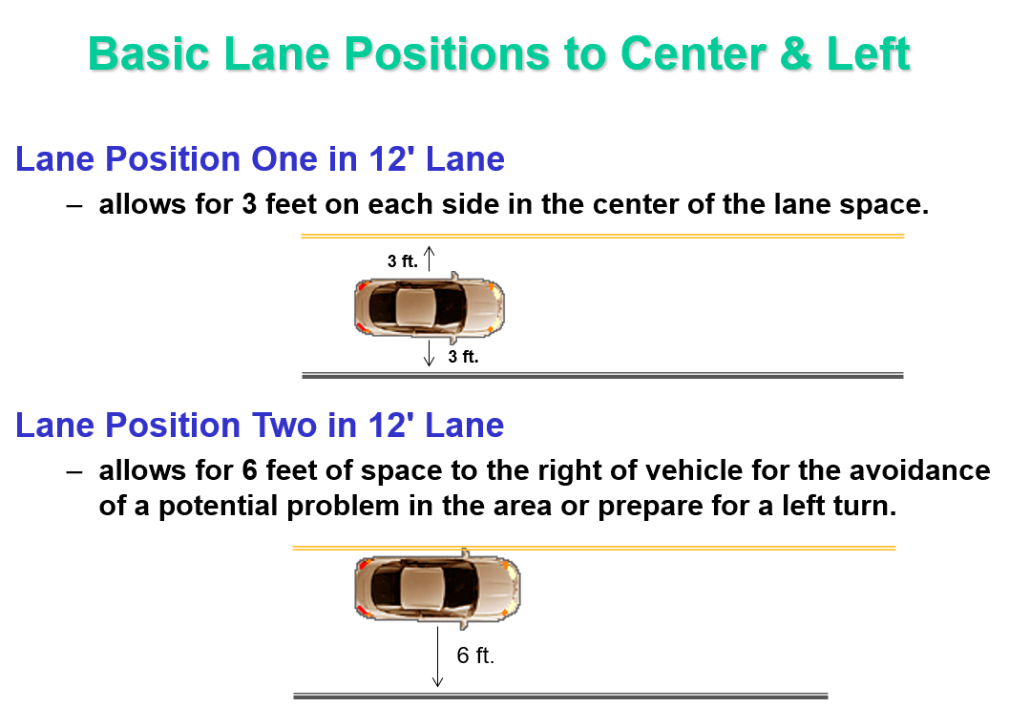

Slide 28
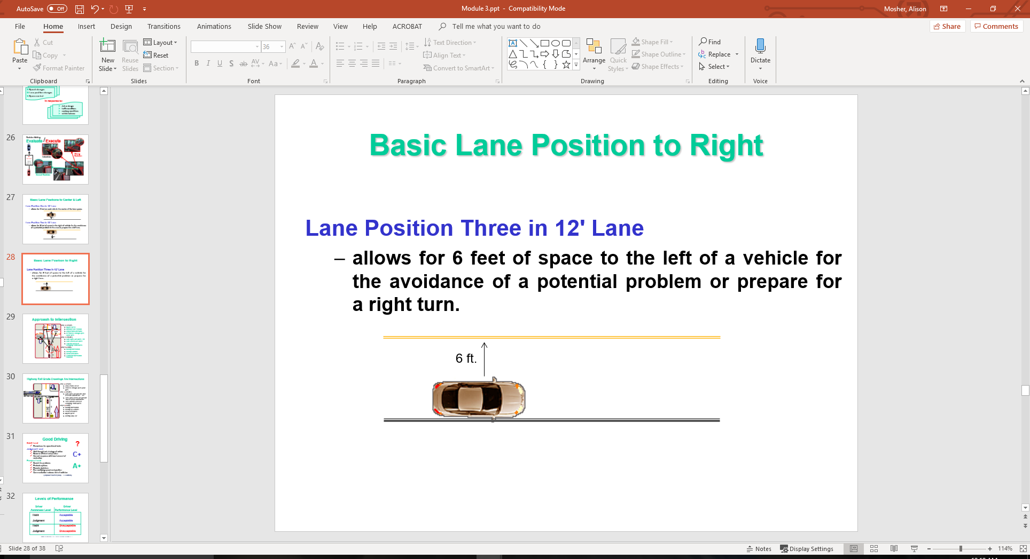

Slide 29
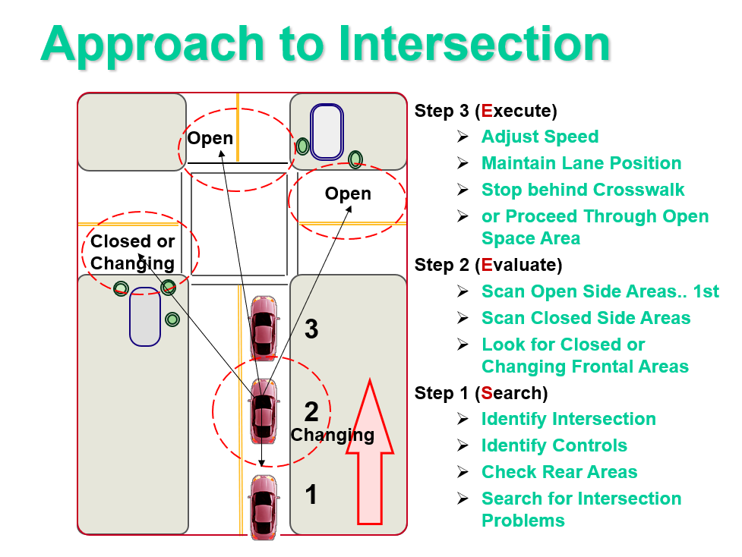

Slide 30
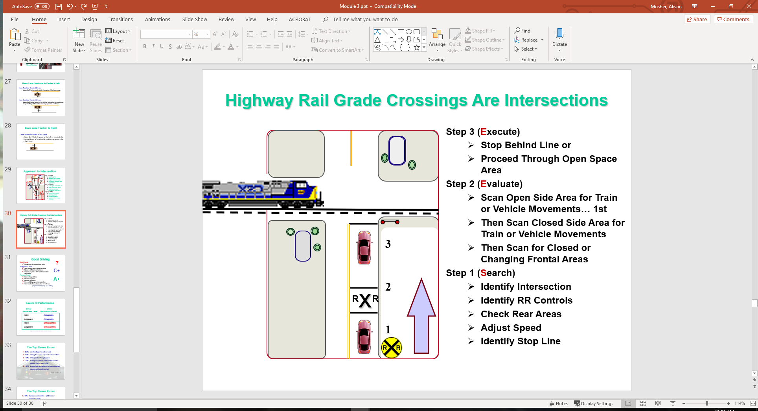

Slide 31
Good Driving
?
Habit Level
  Procedures for operational tasks
Judgment Level
  Well thought out strategy of action
  Become efficient and precise
  Correct response with least amount of evaluation
Process Level
  Search for problems
  Evaluate options
  Execute decisions
  For modifying speed and position
  Communication reduces risk of collision
C+
A+
    (Empower Yourself (1999) ... F.R. Mottola)

Slide 32
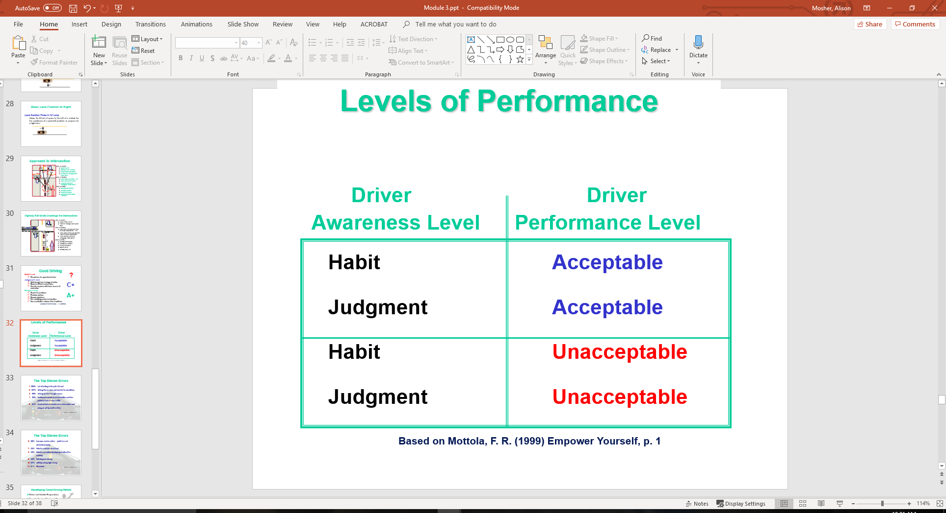
Levels of Performance

Slide 33
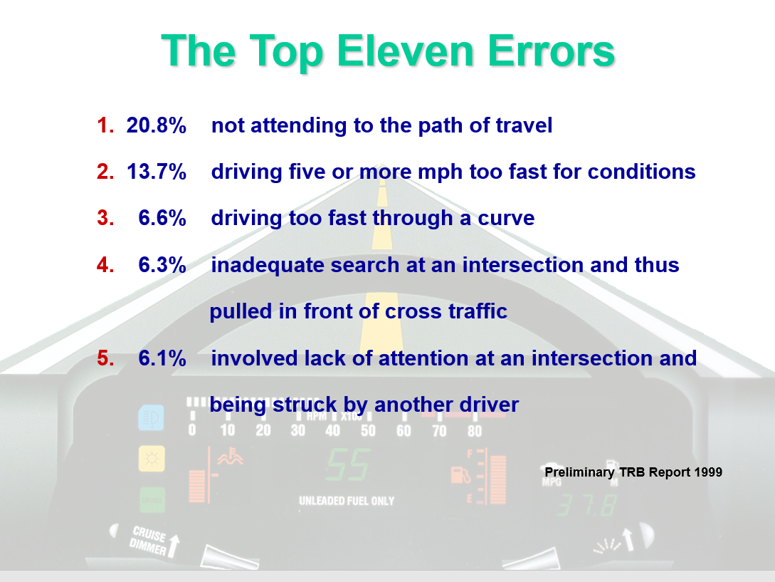

Slide 34
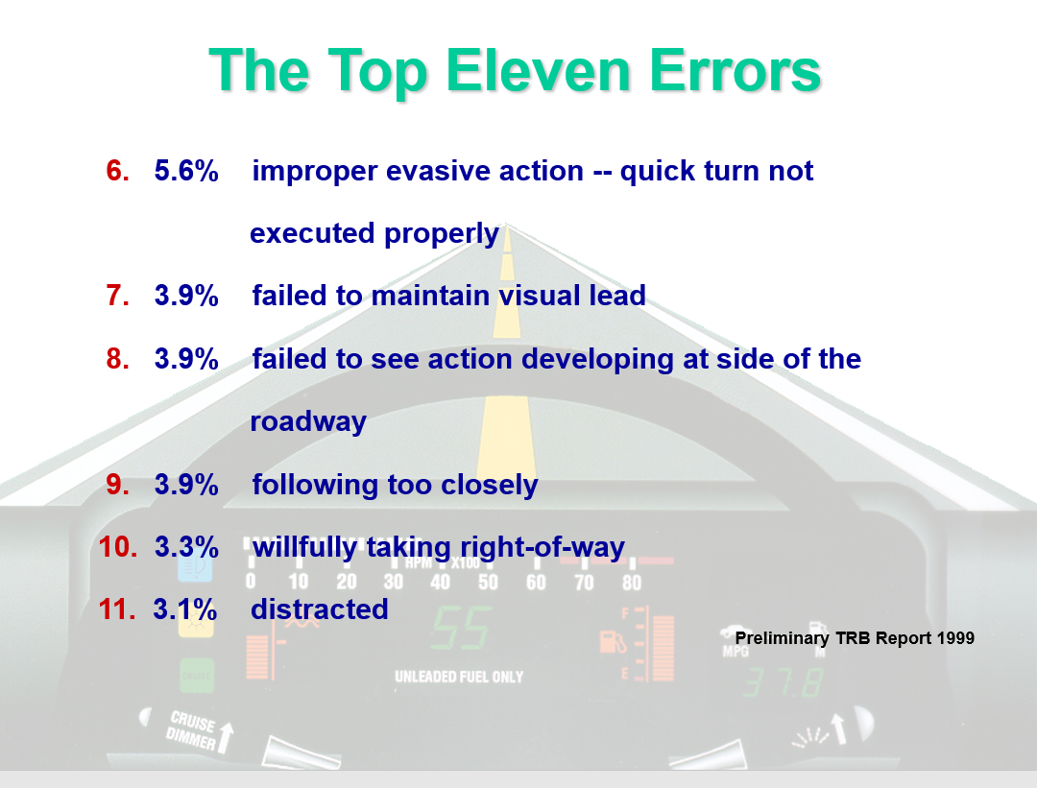

Slide 35
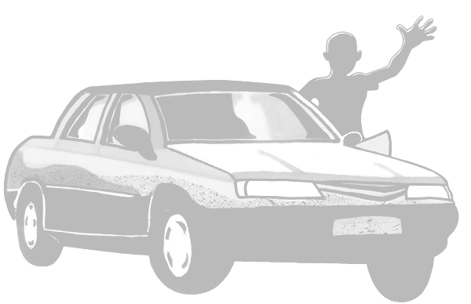
Developing Good Driving Habits
Driver and Vehicle Preparations
Smooth, Gradual Starts and Stops
Reference Points for Vehicle Placement
Getting Visual Targets before Movement
  Use a Vision Control, Motion Control, Steering Control Sequence
Visual Target to End of Path of Travel
May be 15, 20, or 30 seconds from vehicle
    Based on concepts from Mottola, F. R. (1999). Empower Yourself. p. 5

Slide 36
Developing Good Driving Habits
Be Alert to Changes to the Line of Sight (LOS) or the Path of Travel (POT)
Restrictions or Blocked LOS-POT causes a Speed Reduction
Adjust Speed and Lane Position to Increase Space to Front, Side, or Rear
Approaching Red Light, Adjust Speed to Time Your Arrival to Green Light
    Based on concepts from Mottola, F. R. (1999). Empower Yourself. p. 5

Slide 37
Developing Good Driving Habits
Prior to Intersection Entry, Clear the Left, Front, and Right Zones or Areas
  Try to check the area that can be viewed best first so that more time can be used to see the obstructed area
When Foot Goes to Brake or Accelerator, Check the Rear View Mirror
Prior to Moving to the Left or Right,
Check Side View Mirror or Mirror Blind Space
    Based on concepts from Mottola, F. R. (1999). Empower Yourself. p. 5

Slide 38
Developing Good Driving Habits
Make Goal to Maintain Four Seconds of Following Interval from the Vehicle in Front or to the Rear
  Protect yourself from the unexpected actions of other drivers to the front and rear
When stopped behind vehicle, leave space to move around in case of an emergency
Reduce stress by being courteous rather than competitive while driving
    Based on concepts from Mottola, F. R. (1999). Empower Yourself. p. 5

Slide 39
Contact/Mission
For more information on Driver’s Education and Safety please visit PDE’s website at www.education.pa.gov
The mission of the Department of Education is to ensure that every learner has access to a world-class education system that academically prepares children and adults to succeed as productive citizens. Further, the Department seeks to establish a culture that is committed to improving opportunities throughout the commonwealth by ensuring that technical support, resources, and optimal learning environments are available for all students, whether children or adults.

