Slide 1
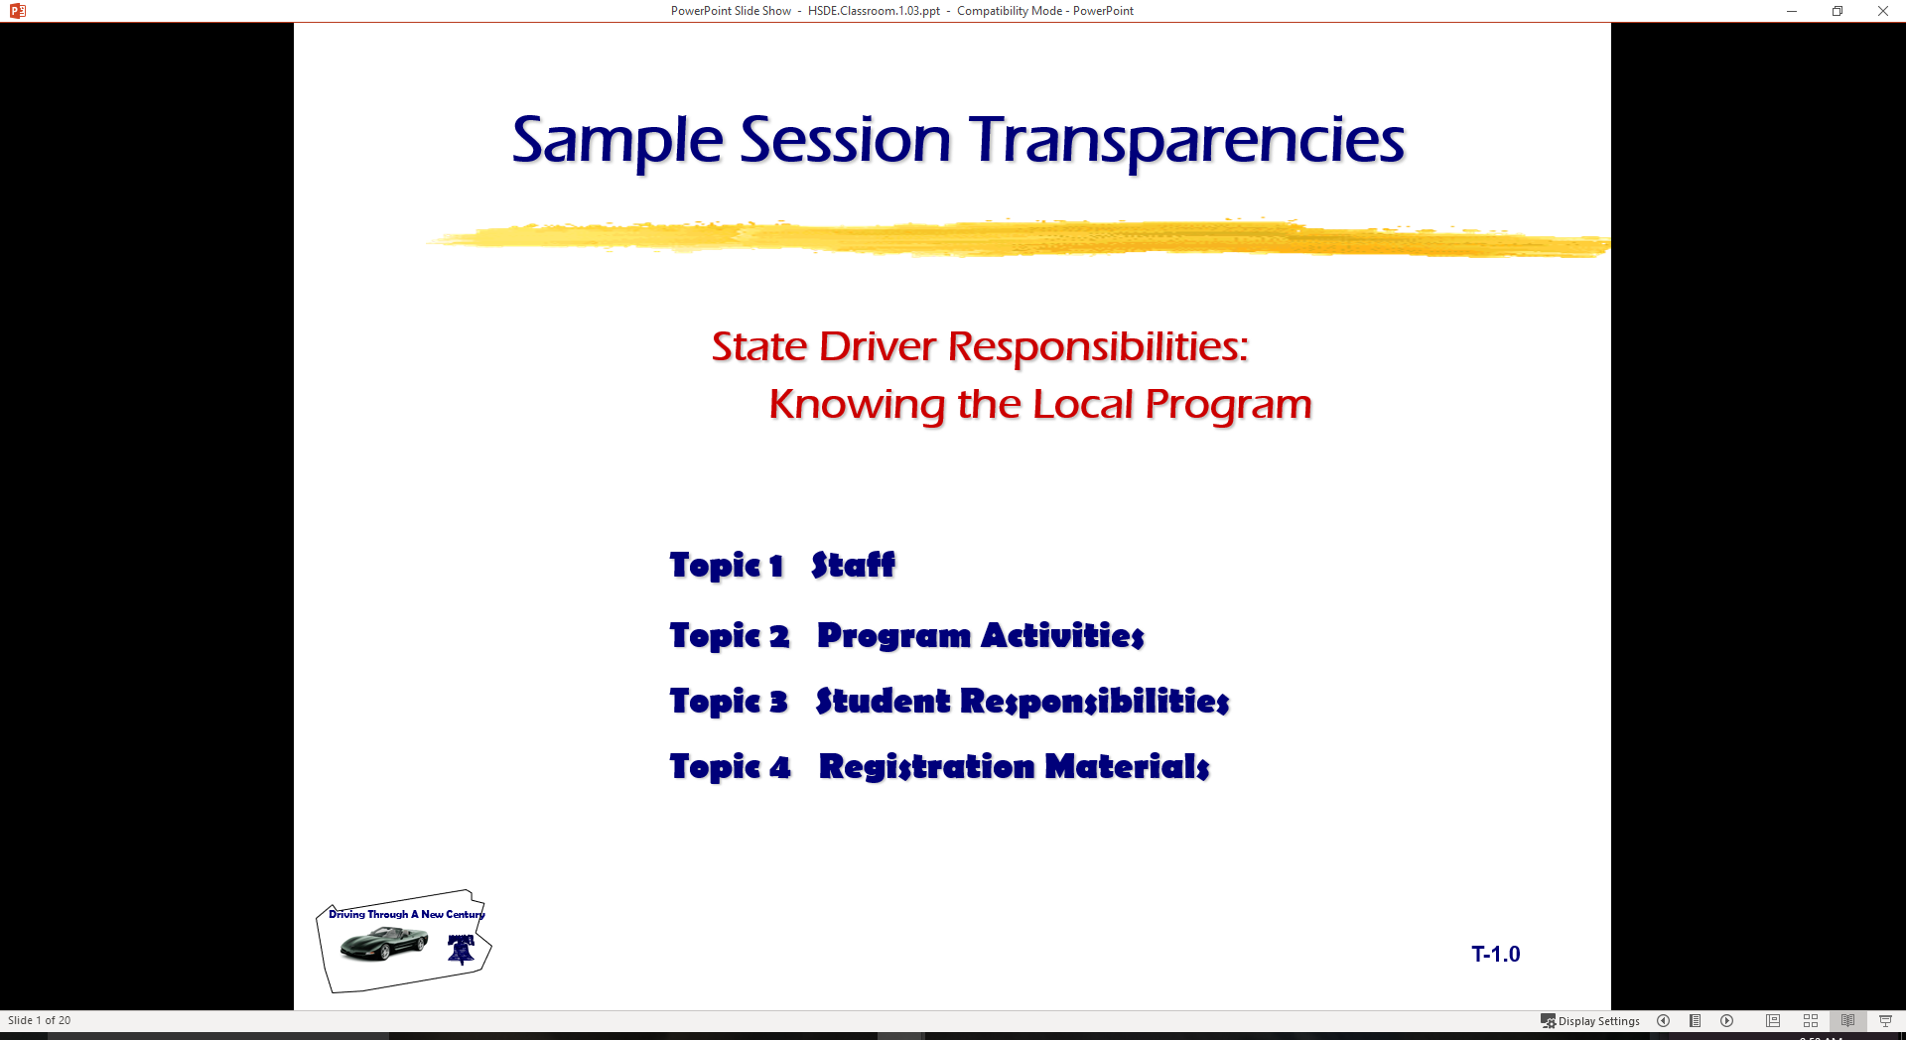
Driver Education Classroom and Laboratory Model Curriculum
Sample Transparencies

Slide 2

Pre-Drive Tasks
Check around the outside of the vehicle for broken glass (windows, lights), body damage, condition of tires, fluid leaks, direction front tires are turned (which way will vehicle move when placed in gear?), or debris on the ground that could interfere with movement.
Check for small children or pets near vehicle.

Slide 3
Pre-Drive Tasks
Store valuables in trunk of vehicle
- Books and book bags have less chance of slipping off seats
- The vehicle is a classroom with no room for
- food, candy and sodas
- homework and inattention in the rear
When parked at the curb
  - Approach from front of car
  - Increase awareness of oncoming traffic
  - Approach driver’s door with key in hand

Slide 4
Pre-Drive Tasks
When parked in parking lot
- Approach from rear of car
- Increase awareness of person and objects in area
- Driver’s door with key in hand
Unlock Doors
Check traffic flow
Enter the vehicle

Slide 5
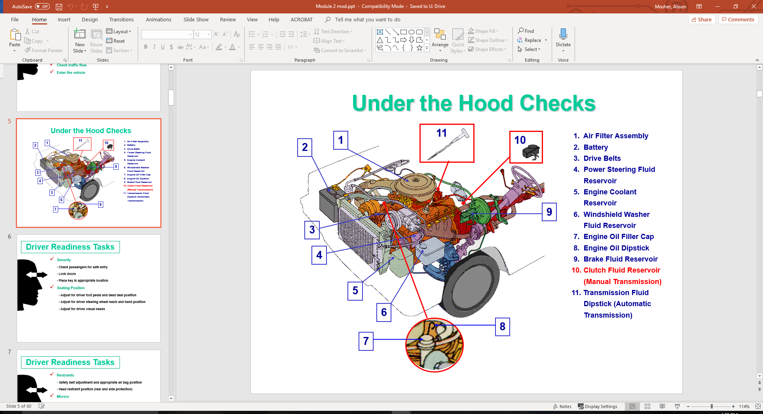
Under the Hood Checks

Slide 6
Driver Readiness Tasks
Security
- Check passengers for safe entry
- Lock doors
- Place key in appropriate location
Seating Position
  - Adjust for driver foot pedal and dead deal position
  - Adjust for driver steering wheel reach and hand position
  - Adjust for driver visual needs

Slide 7
Driver Readiness Tasks
Restraints
- Safety belt adjustment and appropriate air bag position
- Head restraint position (rear and side protection)
Mirrors
  - Rear view mirror settings (200 feet to rear)
  - Side view mirror settings (15 degrees out will gain side views)
  May be adjusted to view sides rather then rear view
  Rear view needed when inside mirror view is blocked to rear

Slide 8

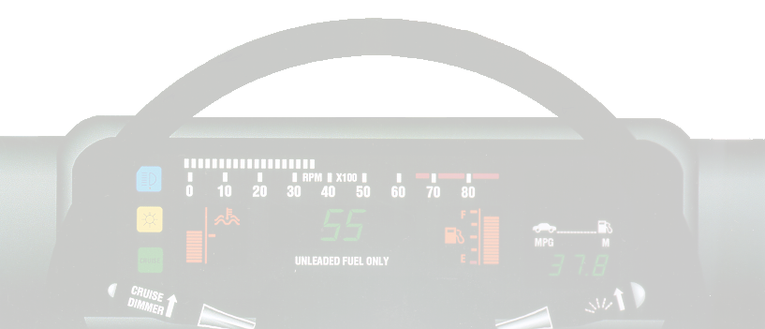
Starting Tasks
Check/set parking brake
Foot on service brake
Key in ignition and unlock
Shifter to park/neutral

Slide 9
Starting Tasks
Choke/fuel injection
Turn ignition/on position
Check gauges/operation
Adjust ventilation (HVAC)
Set needed accessories (heating, AC, wipers, etc.)

Slide 10
Securing Tasks
Stop within a legal, secure parking spot
- parked within appropriate distances of fire hydrant, intersection, RR crossing, legal parking zone, etc
- keep foot on service brake
Set Parking Brake
  - recommended in most new vehicle owner’s manuals
  - protects transaxle and constant velocity joints
Place gear selector in (P)ark.
  - place in recommended gear for standard shift transaxle or transmission
Turn off any vehicle accessories
  - are all systems functioning and ready to use for next time?

Slide 11
Securing Tasks
Turn ignition switch to “off”
- the engine should shut off a this time with all accessories off
Lock ignition switch and remove key
  - required to remove the key in most vehicles
Remove occupant restraints
  - some shoulder restraints operate when the door is opened
Check traffic and exit the vehicle
  - check traffic flow to rear prior to opening the door
  - rear child safety door locks may need to be opened from the driver’s door
Secure doors and windows
  - protects valuables and unauthorized entry by others

Slide 12
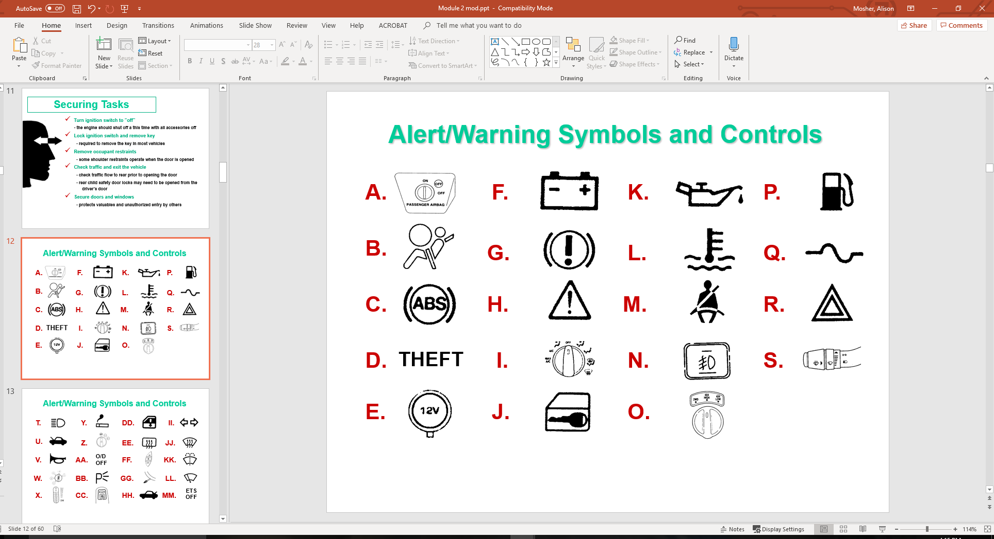
Alert/Warning Symbols and Controls

Slide 13
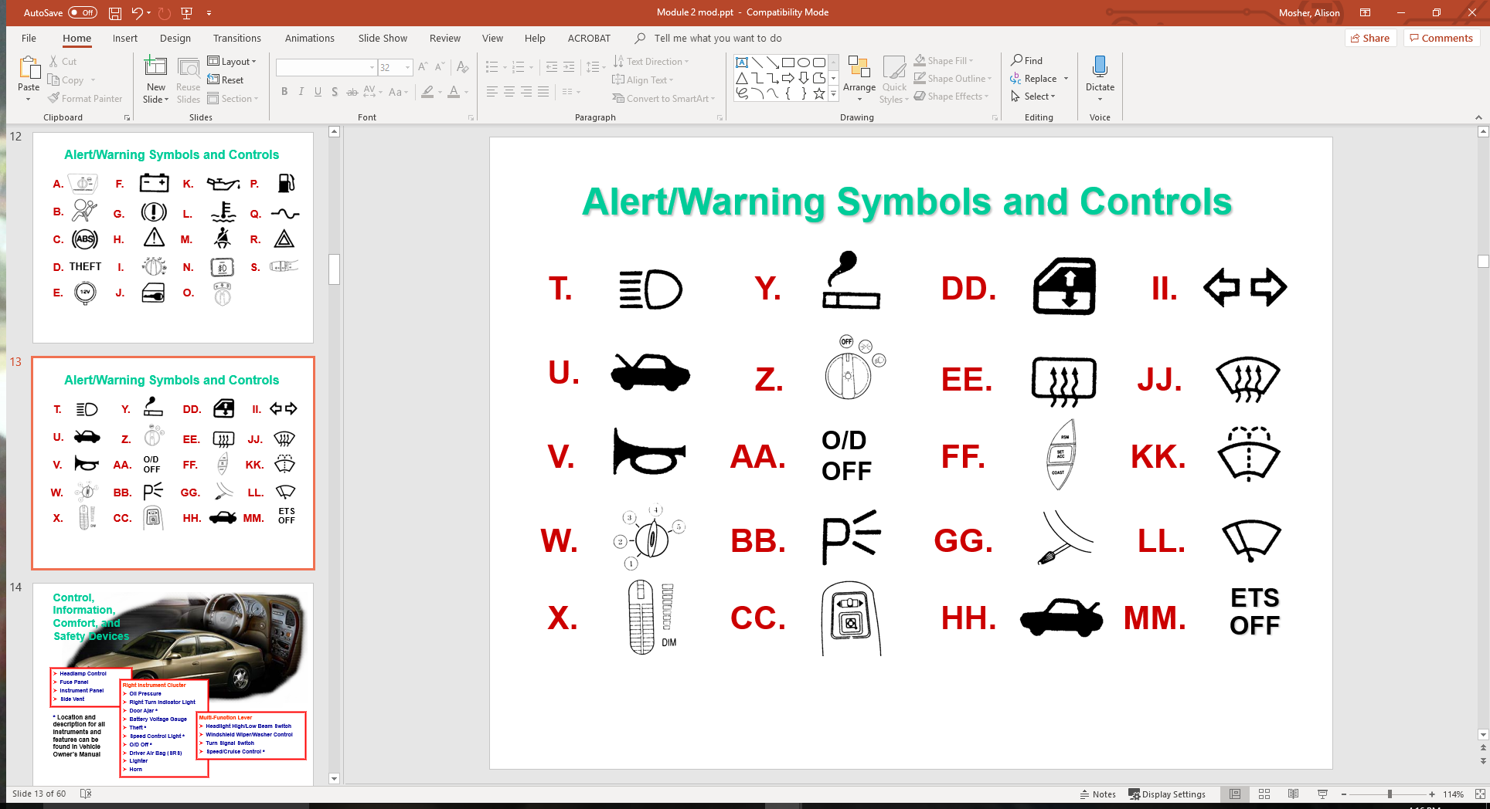
Alert/Warning Symbols and Controls

Slide 14
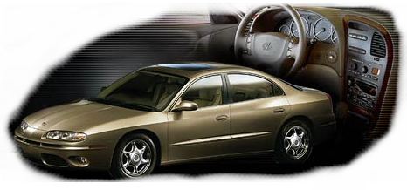
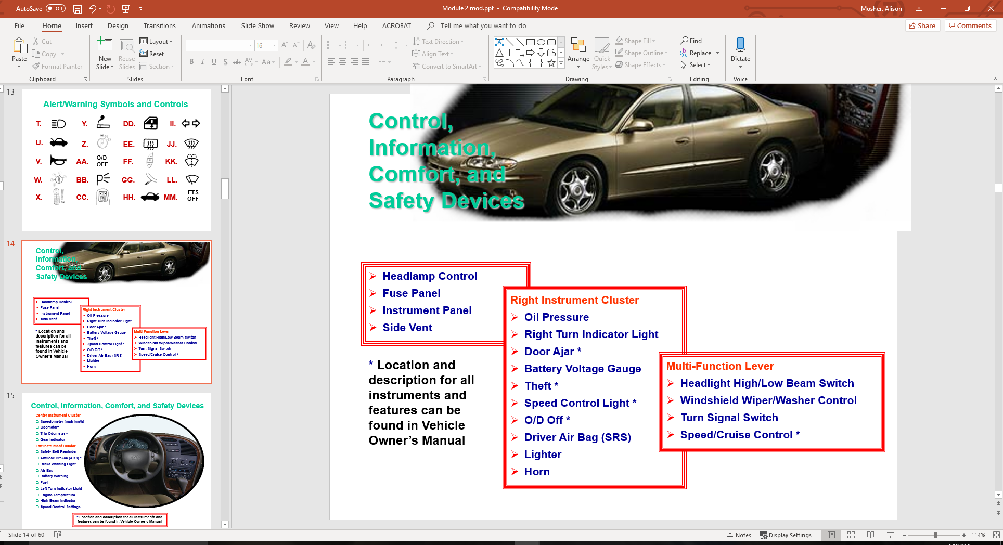
Control, Information, Comfort, and Safety Devices

Slide 15
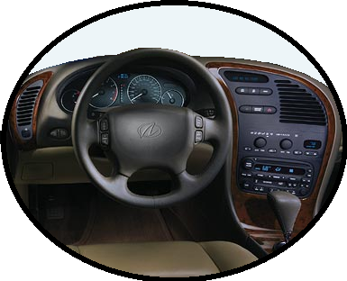
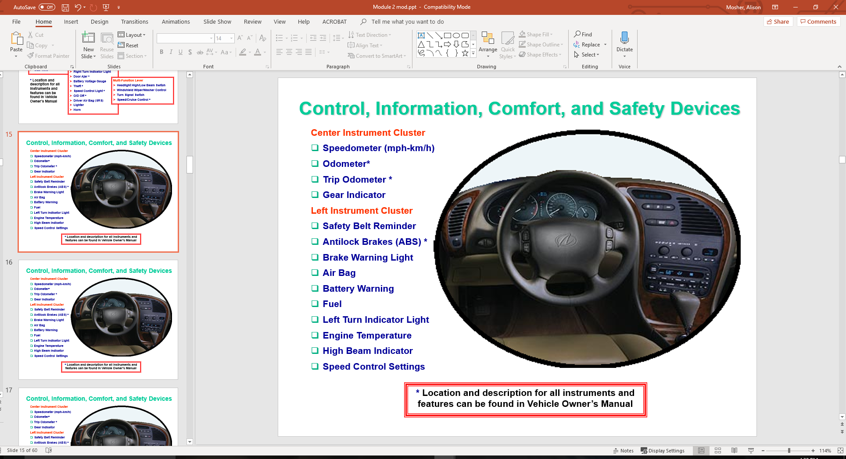
Control, Information, Comfort, and Safety Devices
Center Instrument Cluster
Speedometer (mph-km/h)
Odometer*
Trip Odometer *
Gear Indicator
Left Instrument Cluster
Safety Belt Reminder
Antilock Brakes (ABS) *
Brake Warning Light
Air Bag
Battery Warning
Fuel
Left Turn Indicator Light
Engine Temperature
High Beam Indicator
Speed Control Settings

Slide 16
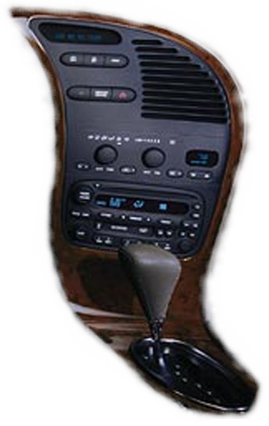
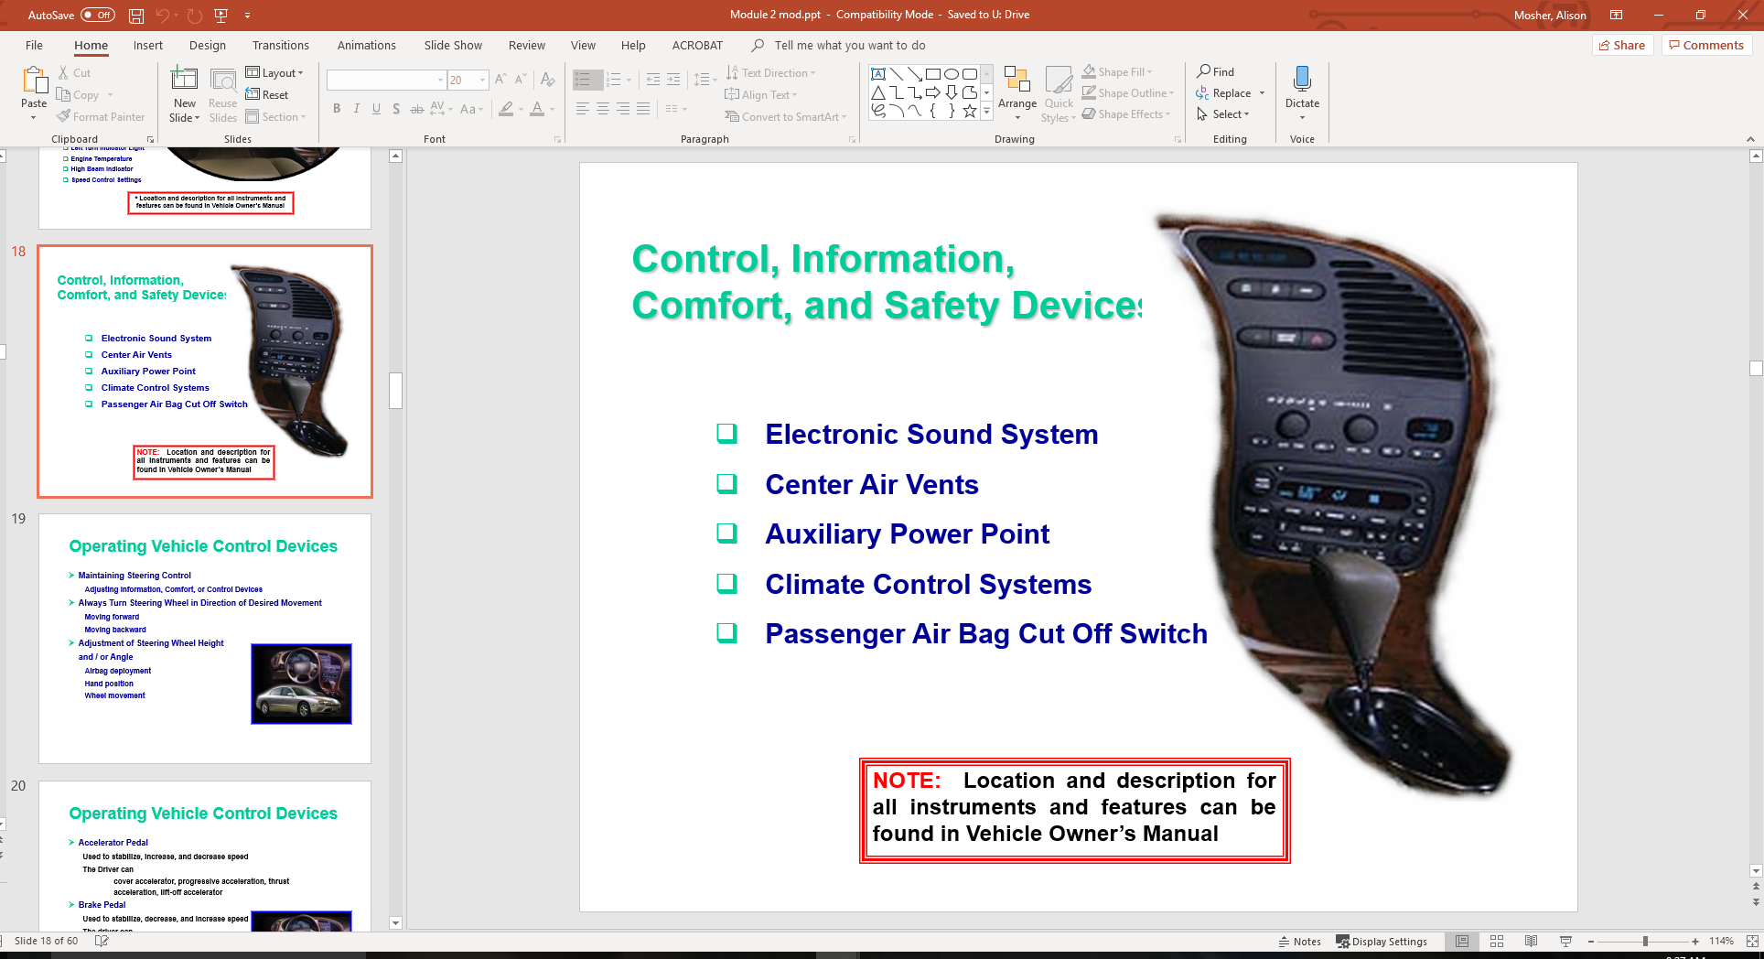
Control, Information, Comfort, and Safety Devices
Electronic Sound System
Center Air Vents
Auxiliary Power Point
Climate Control Systems
Passenger Air Bag Cut Off Switch

Slide 17
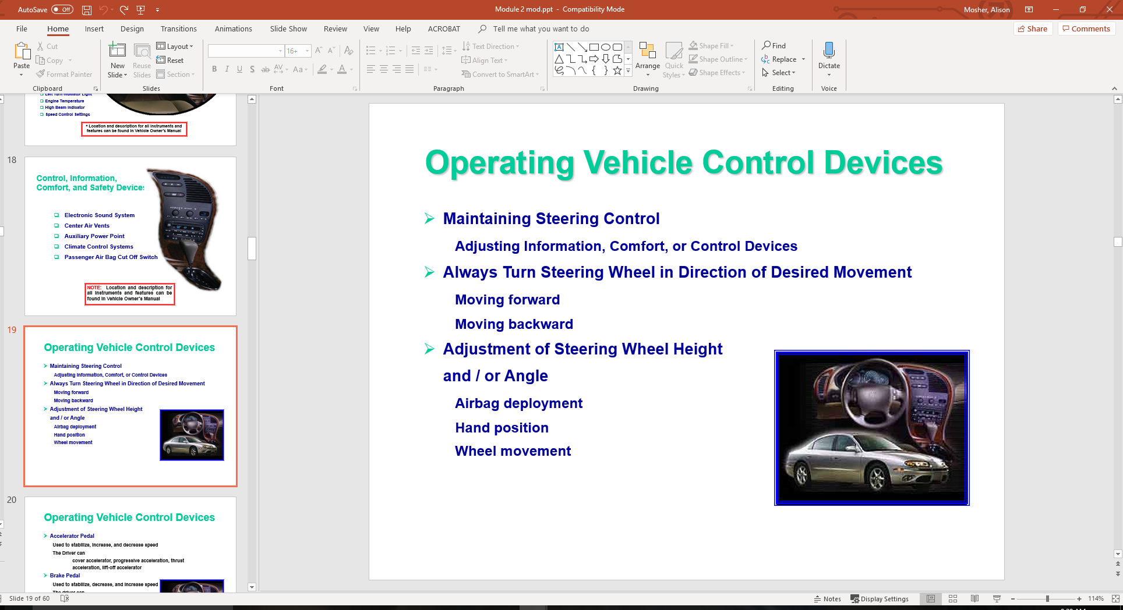
Operating Vehicle Control Devices
  Maintaining Steering Control
  Adjusting Information, Comfort, or Control Devices
  Always Turn Steering Wheel in Direction of Desired Movement
  Moving forward
  Moving backward
  Adjustment of Steering Wheel Height
  and / or Angle
  Airbag deployment
  Hand position
  Wheel movement

Slide 18
Operating Vehicle Control Devices
  Accelerator Pedal
  Used to stabilize, increase, and decrease speed
  The Driver can
  cover accelerator, progressive acceleration, thrust acceleration, lift-off accelerator
  Brake Pedal
  Used to stabilize, decrease, and increase speed
  The driver can
  cover brake, trail brake, controlled
  squeeze braking threshold brake,
  lock brake, ABS, jab (slab) brake,
  lift-off brake

Slide 19
Operating Vehicle Control Devices
  Gear Selector Lever –
  Transmission Type and Location
  (O)verdrive and (D)rive gear use
  Parking Brake – Emphasis on Parking
  Owners Manual requests use before placing into (P)ark
  Cruise / Speed Control – Why and How
  Purpose of cruise control
  Danger of cruise control
  Ignition Switch - Location and Functions

Slide 20

Safety, Communication, Comfort, & Convenience Devices
Mirrors
  – Adjustment Inside and Out
Safety Belts
  – Adjusting for Maximum Effectiveness
Head Restraints
  – Protecting Against Whiplash
Horn
  – Location and Use

Slide 21
Safety, Communication, Comfort, & Convenience Devices
Mirrors
  – Adjustment Inside and Out
Safety Belts
  – Adjusting for Maximum Effectiveness
Head Restraints
  – Protecting Against Whiplash
Horn
  – Location and Use

Slide 22
Safety, Communication, Comfort, & Convenience Devices
Hood Release
  – Where Located
Trunk Release
  – Where Located
Heat / Defroster / Air Conditioner Controls
Seat Adjustment
  – Power / Manual Controls

Slide 23

Controlling Vehicle Balance
Vehicle Balance (Roll, Pitch, and Yaw)
  Roll: vehicle moves side to side
  Pitch: vehicle moves forward or backward
  Yaw: vehicle moves left or right
  Specific amount of weight or down force on each tire patch
  Best balance is at rest with no movement
  Based on weight/suspension/tire pressure
Vehicle Movement
  Creates Changes to vehicle balance
  Due to suspension and pressure changes

Slide 24
Controlling Vehicle Balance
Maintaining Vehicle Balance
  Steering Wheel Balance
    Smaller steering wheel
    Rack and pinion steering
  Precise Steering, Braking, and Accelerator Input
    Less steering movement
    Squeeze brakes
    Smooth acceleration/deceleration
  Changes in Steering Ratios, 1980's to Date

Slide 25
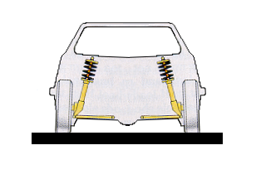
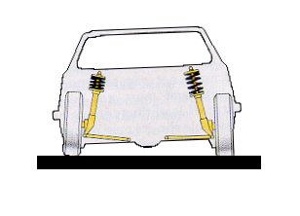
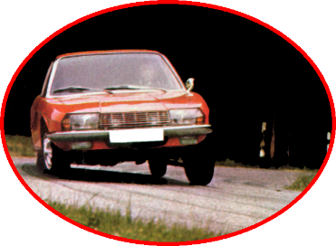
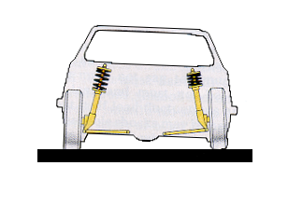
Controlling Vehicle Balance
Seating
  Driver position/balance and safety belt/pedal use
Changing Vehicle Load from Side to Side (Roll)
  Steering Wheel Movements
  Brake Application and Steering Combinations

Slide 26
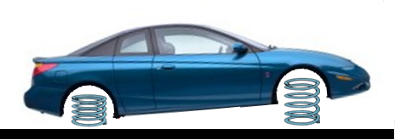
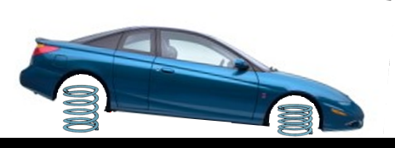
Vehicle Control
Vehicle Direction / Speed Requirements
Changing Vehicle Load from Front to Rear (Pitch)
Covering accelerator
Light accelerator pressure
Releasing brake
Progressive accelerator pressure
Thrust accelerator pressure
Changing Vehicle Load from Rear to Front (Pitch)
Similarities and differences between vehicles with which drivers must be familiar
Driver positioning for optimum brake pedal control
Releasing the accelerator
Covering the brake
Controlled braking (Squeeze on)
Threshold braking
Trail braking (Squeeze off)

Slide 27
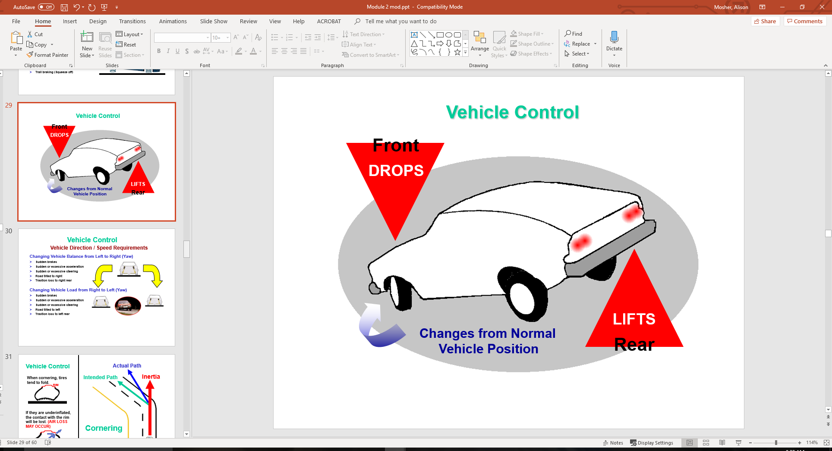
Vehicle Control

Slide 28
Vehicle Control
Vehicle Direction / Speed Requirements
Changing Vehicle Balance from Left to Right (Yaw)
Sudden brakes
Sudden or excessive acceleration
Sudden or excessive steering
Road tilted to right
Traction loss to right rear
Changing Vehicle Load from Right to Left (Yaw)
Sudden brakes
Sudden or excessive acceleration
Sudden or excessive steering
Road tilted to left
Traction loss to left rear

Slide 29
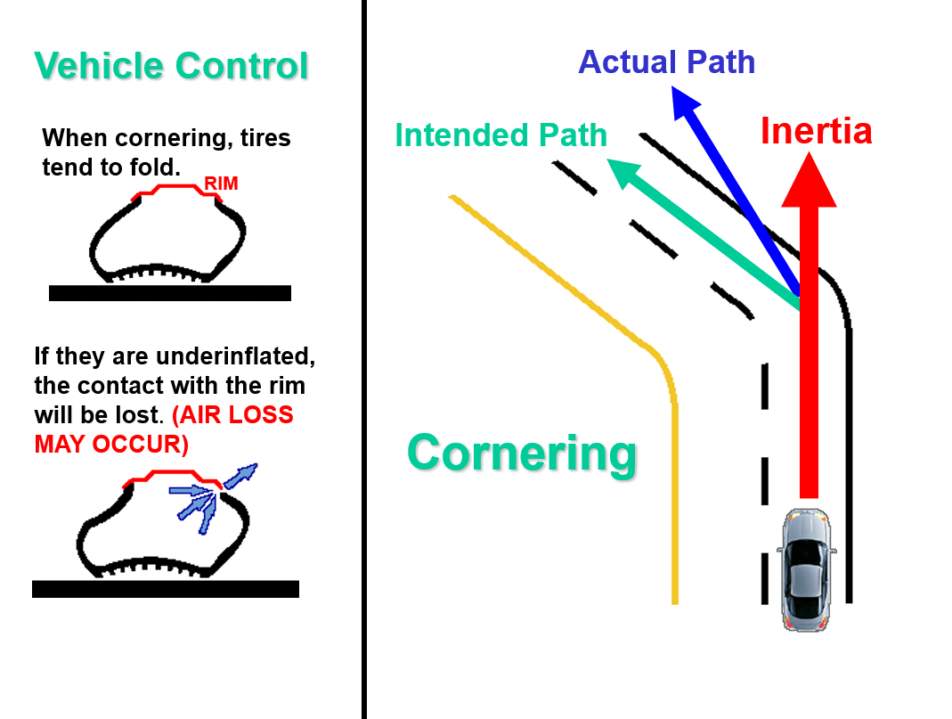

Slide 30

Targeting and Visual Requirements
Visual Functions
  Focus Vision (Focal/Fovial)
  Central Vision (Limited Fringe Area)
  Peripheral Vision
Maintaining an open line of sight
Searching skills
Targeted line of sight, paths of travel
Referencing vehicle to paths of travel
Using visual references and turn points to make turns
  Forward visual turning points
  Rear visual turning points

Slide 31
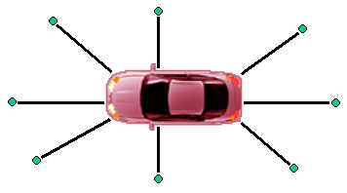


Determining Vehicle Operating Space
Placing markers at edge of sightlines
Drawing the central space area-true blind spot
Mark the tire patches prior to moving vehicle

Slide 32
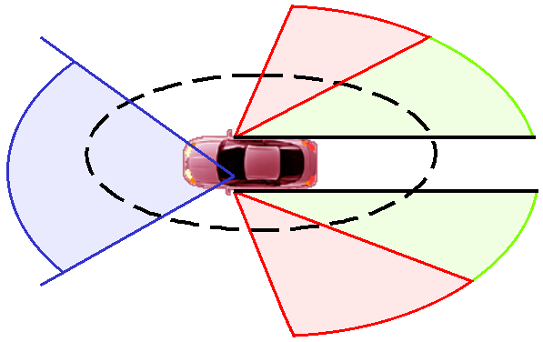
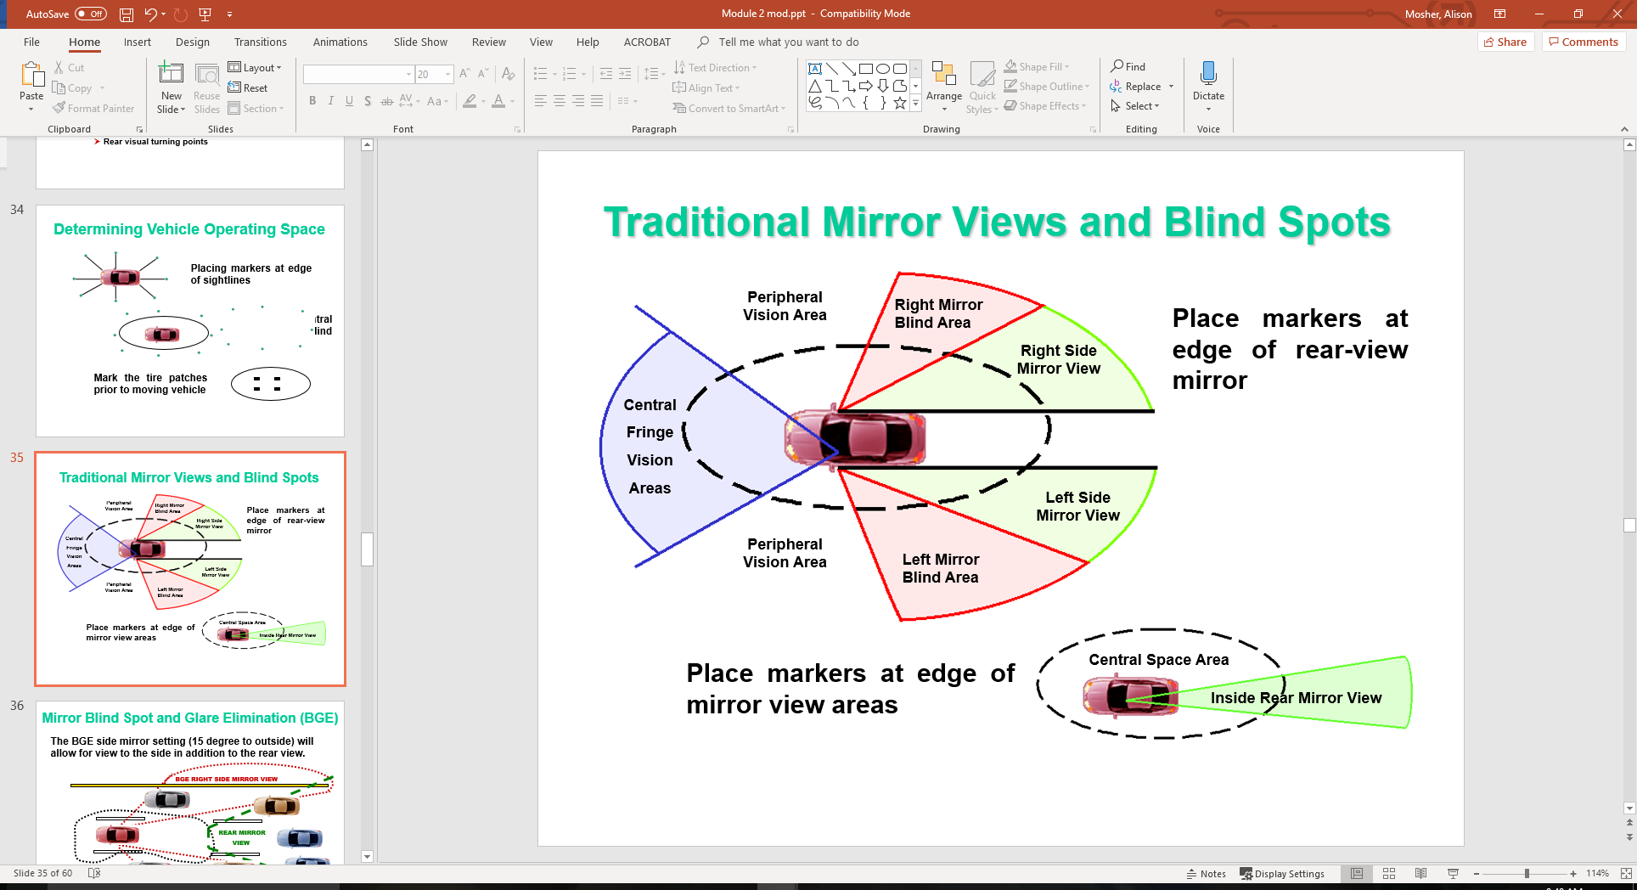
Traditional Mirror Views and Blind Spots
Place markers at edge of rear-view mirror
Place markers at edge of mirror view areas

Slide 33
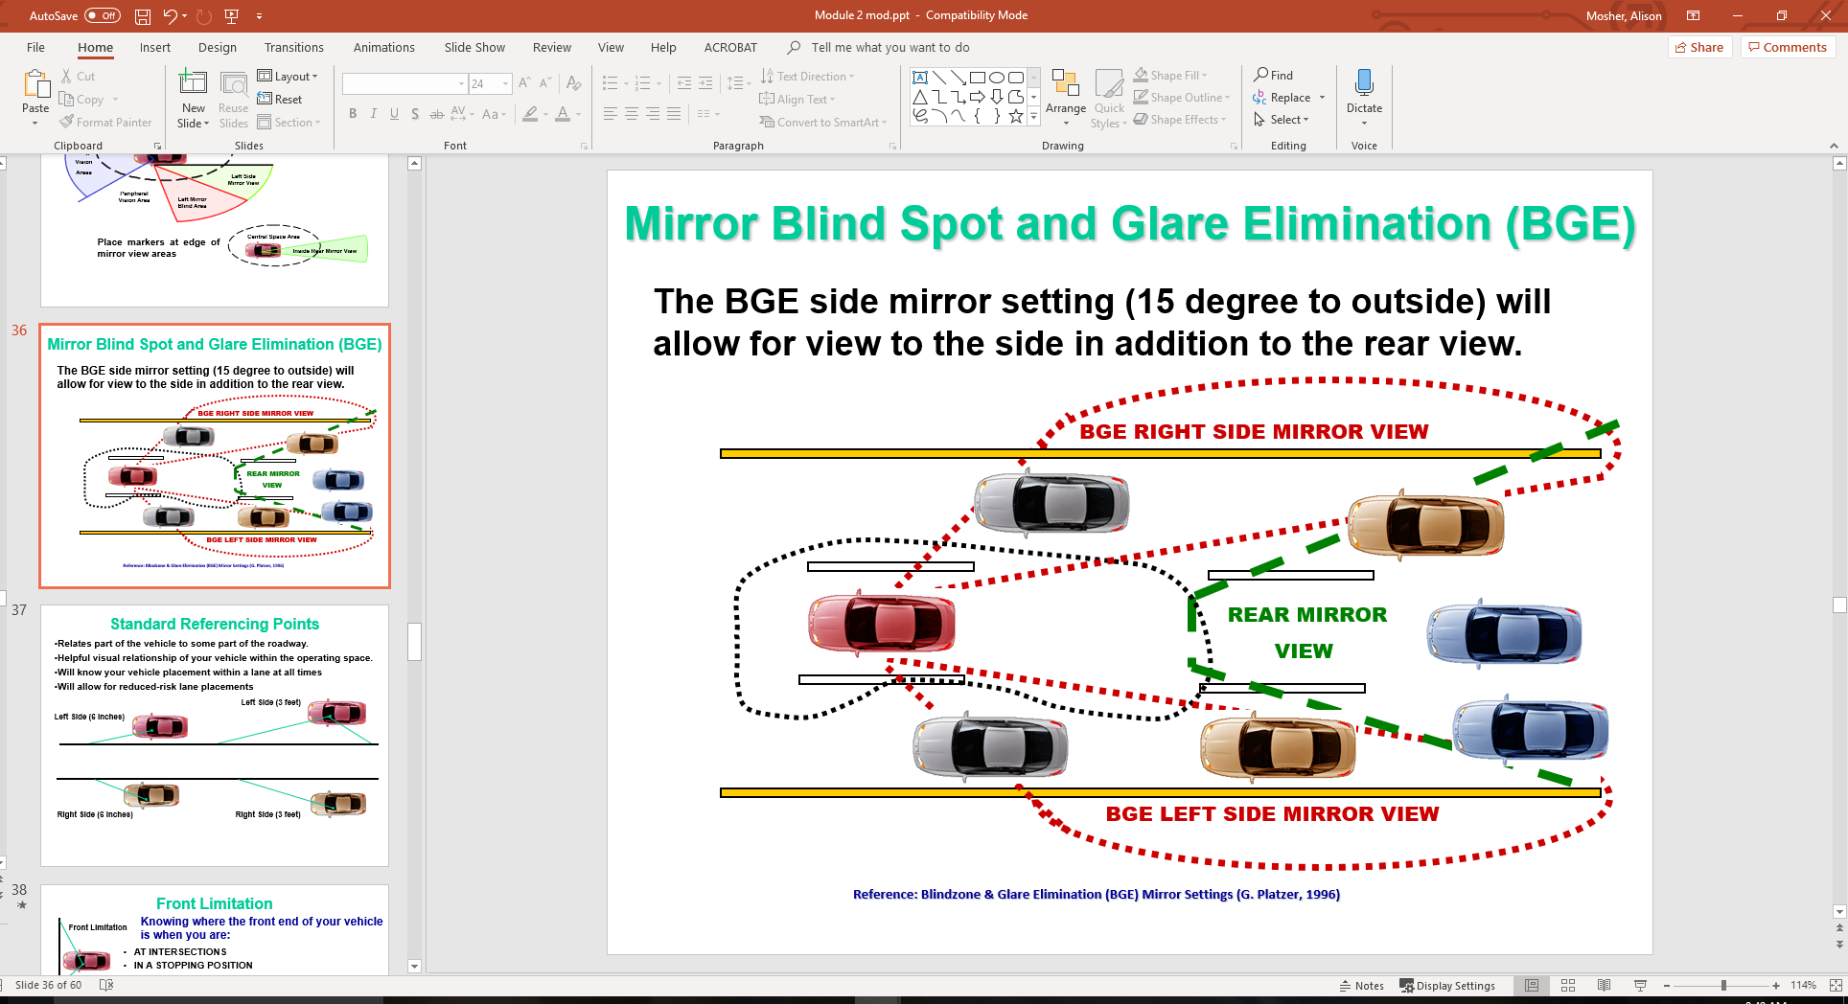
Mirror Blind Spot and Glare Elimination (BGE)
The BGE side mirror setting (15 degree to outside) will allow for view to the side in addition to the rear view.

Slide 34
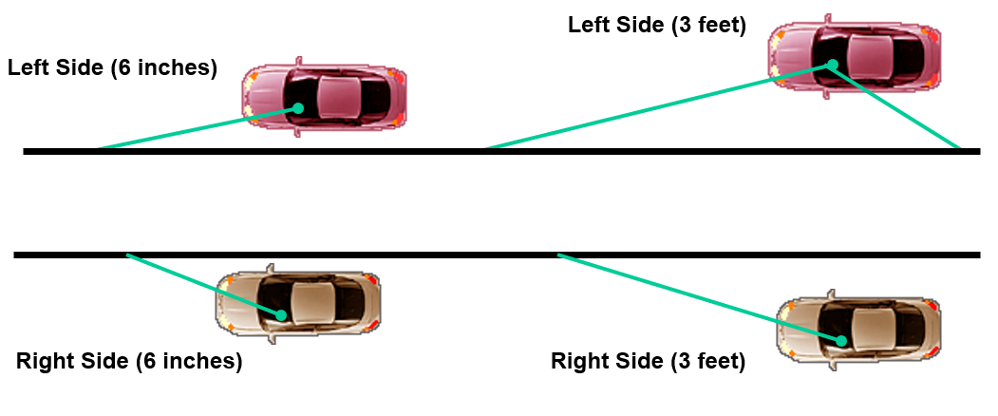
Standard Referencing Points
Relates part of the vehicle to some part of the roadway.
Helpful visual relationship of your vehicle within the operating space.
Will know your vehicle placement within a lane at all times
Will allow for reduced-risk lane placements

Slide 35
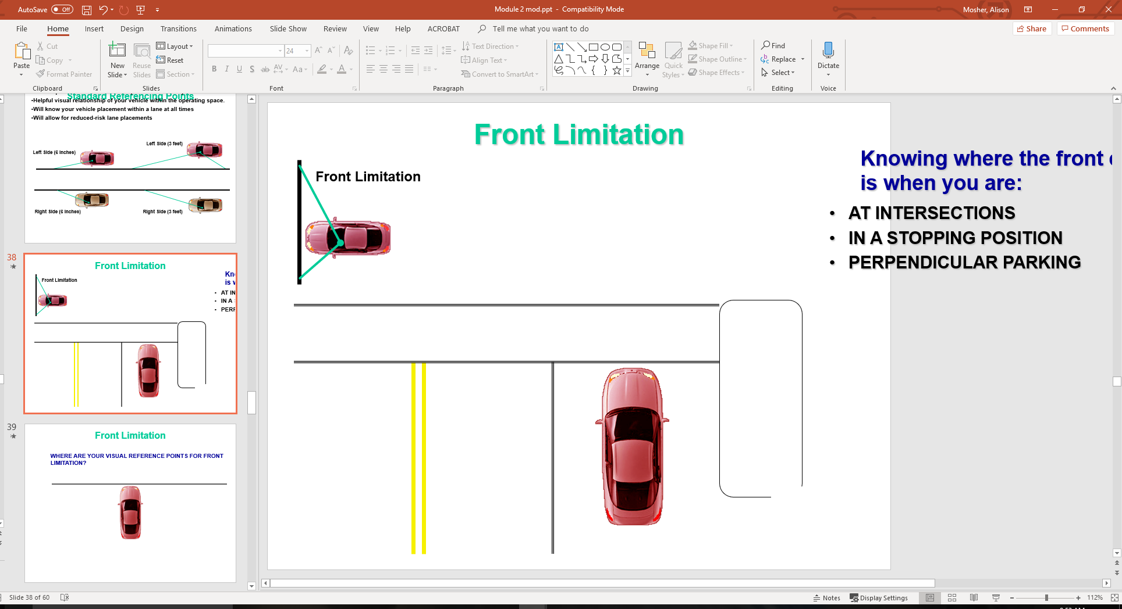
Front Limitation
Knowing where the front end of your vehicle is when you are:
AT INTERSECTIONS
IN A STOPPING POSITION
PERPENDICULAR PARKING

Slide 36
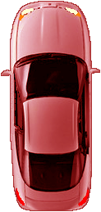
Front Limitation
WHERE ARE YOUR VISUAL REFERENCE POINTS FOR FRONT LIMITATION?

Slide 37
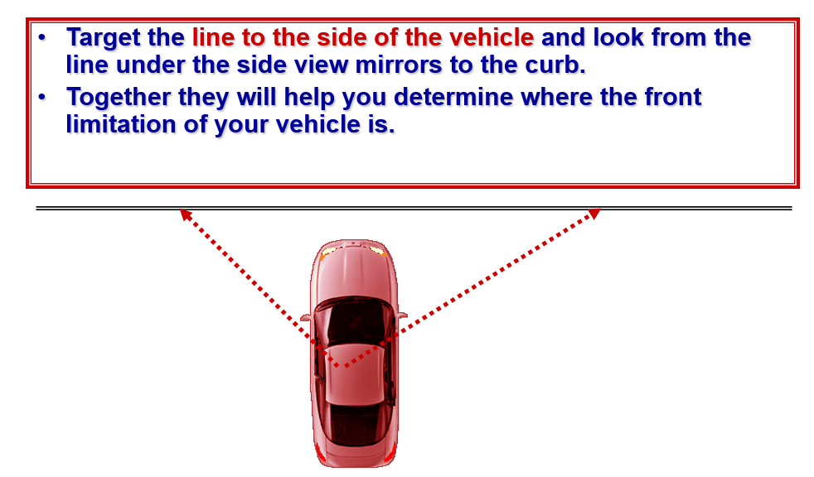
Front Limitation

Slide 38
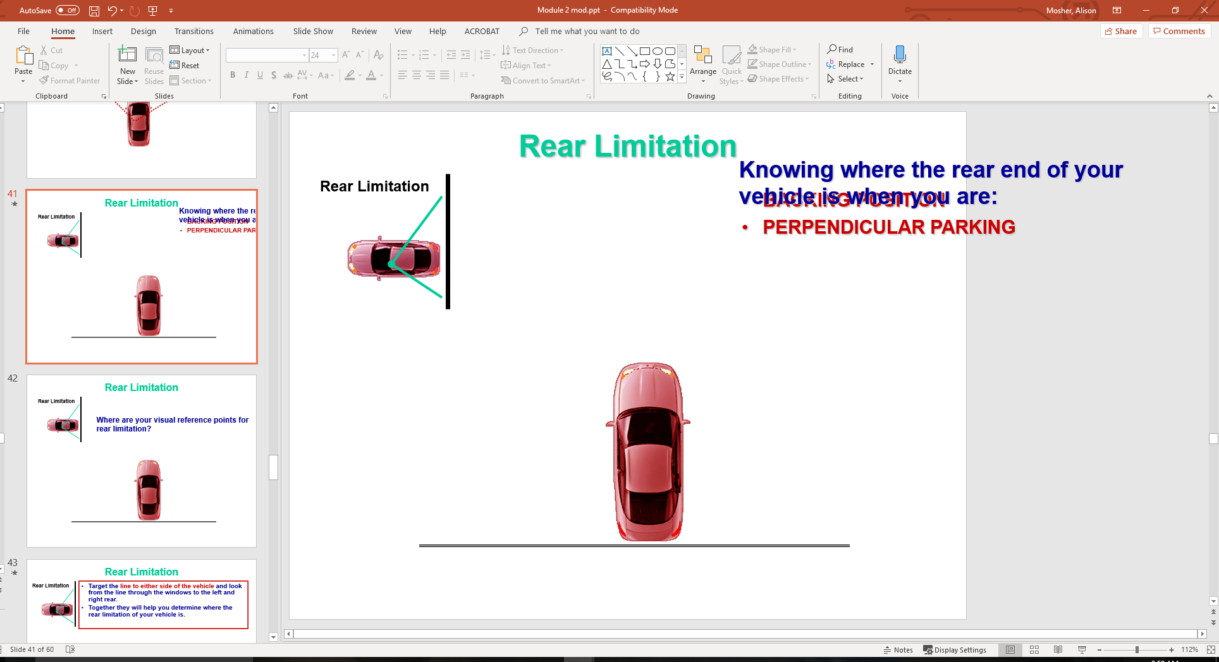
Rear Limitation
Knowing where the rear end of your vehicle is when you are:
BACKING POSITION
PERPENDICULAR PARKING

Slide 39
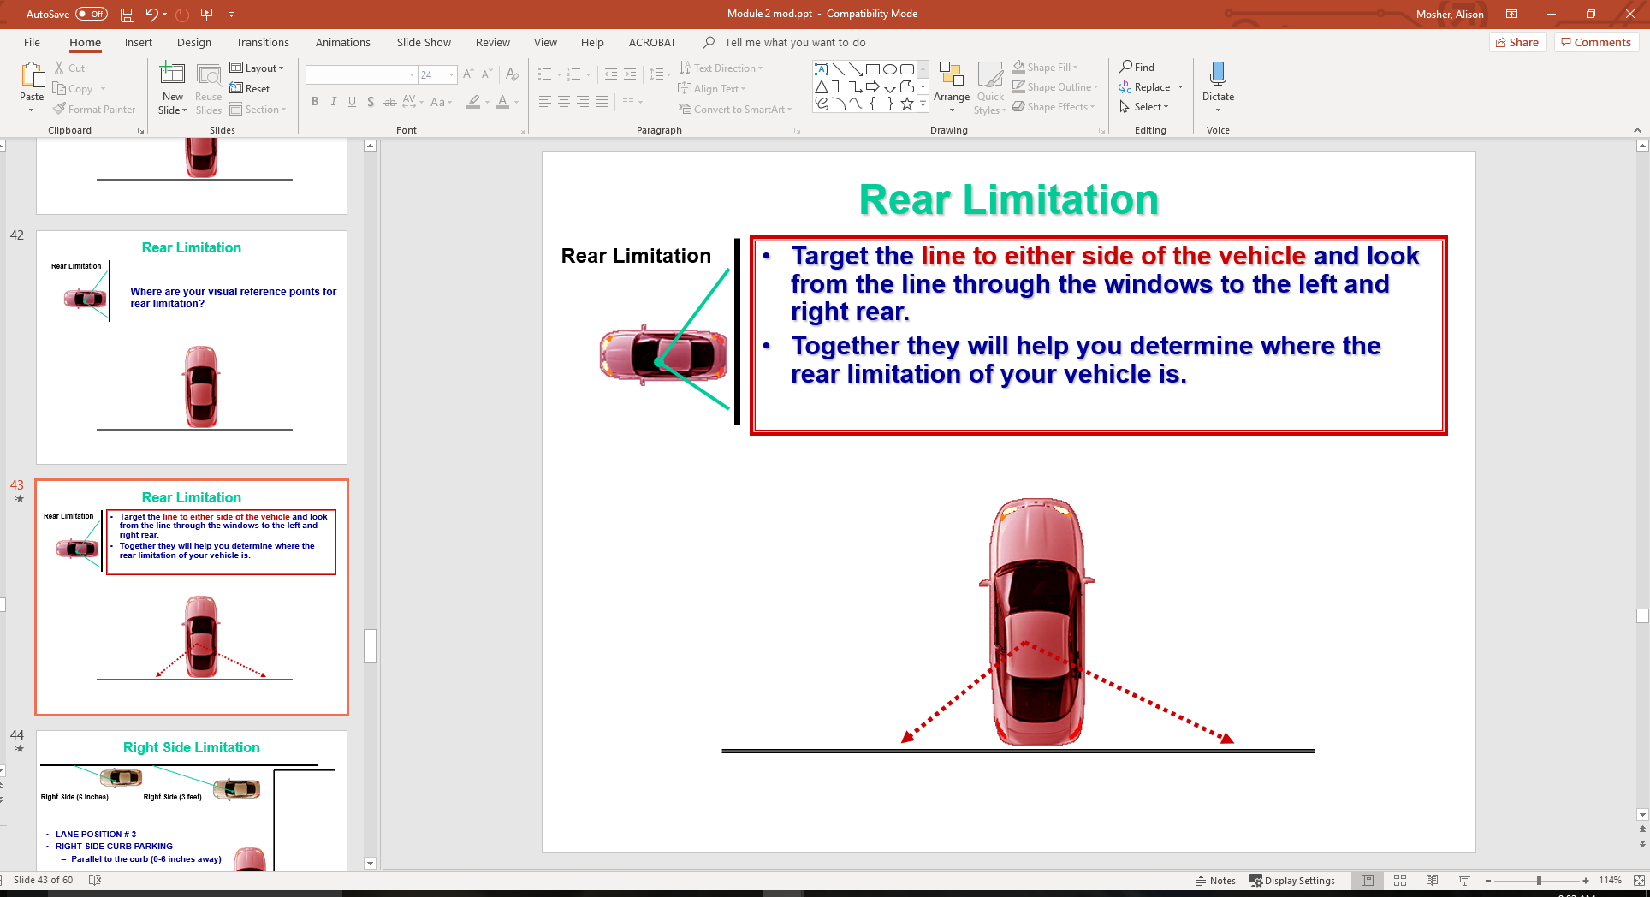
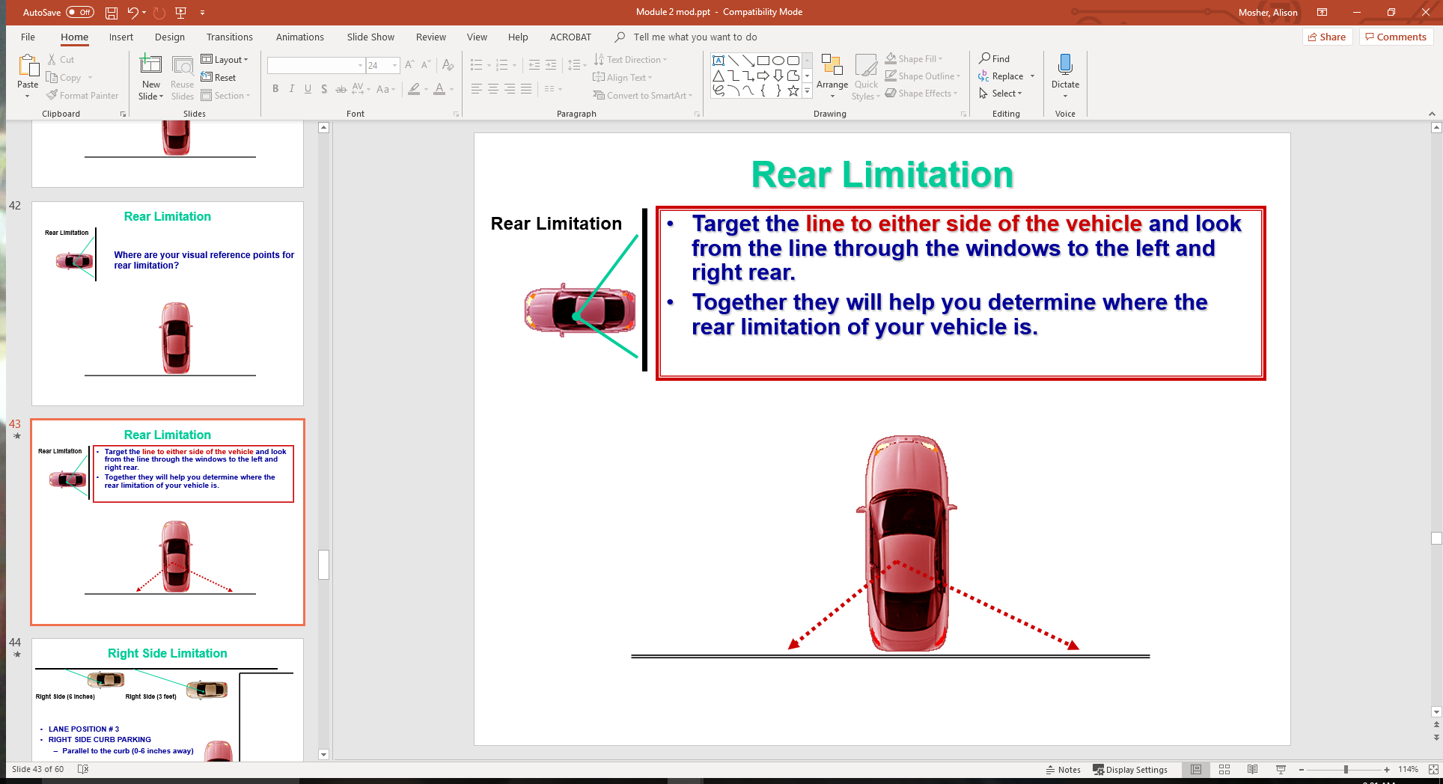
Rear Limitation

Slide 40
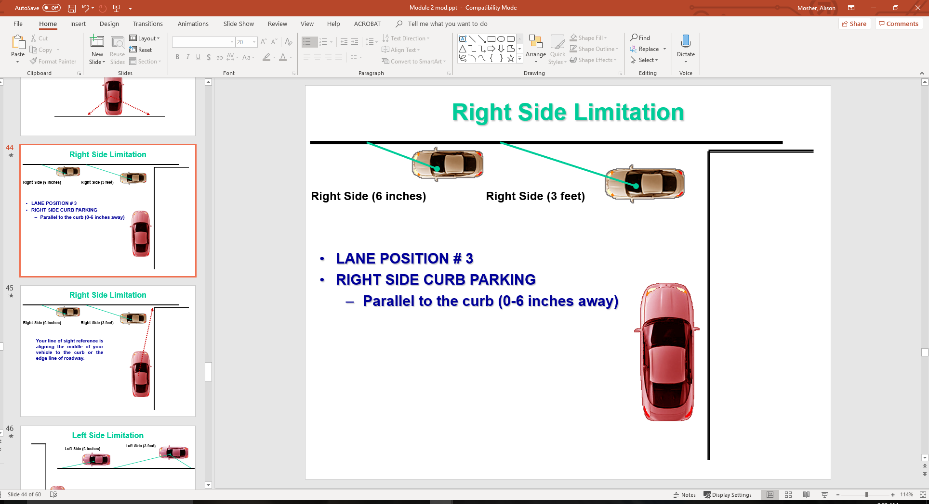
Right Side Limitation

Slide 41
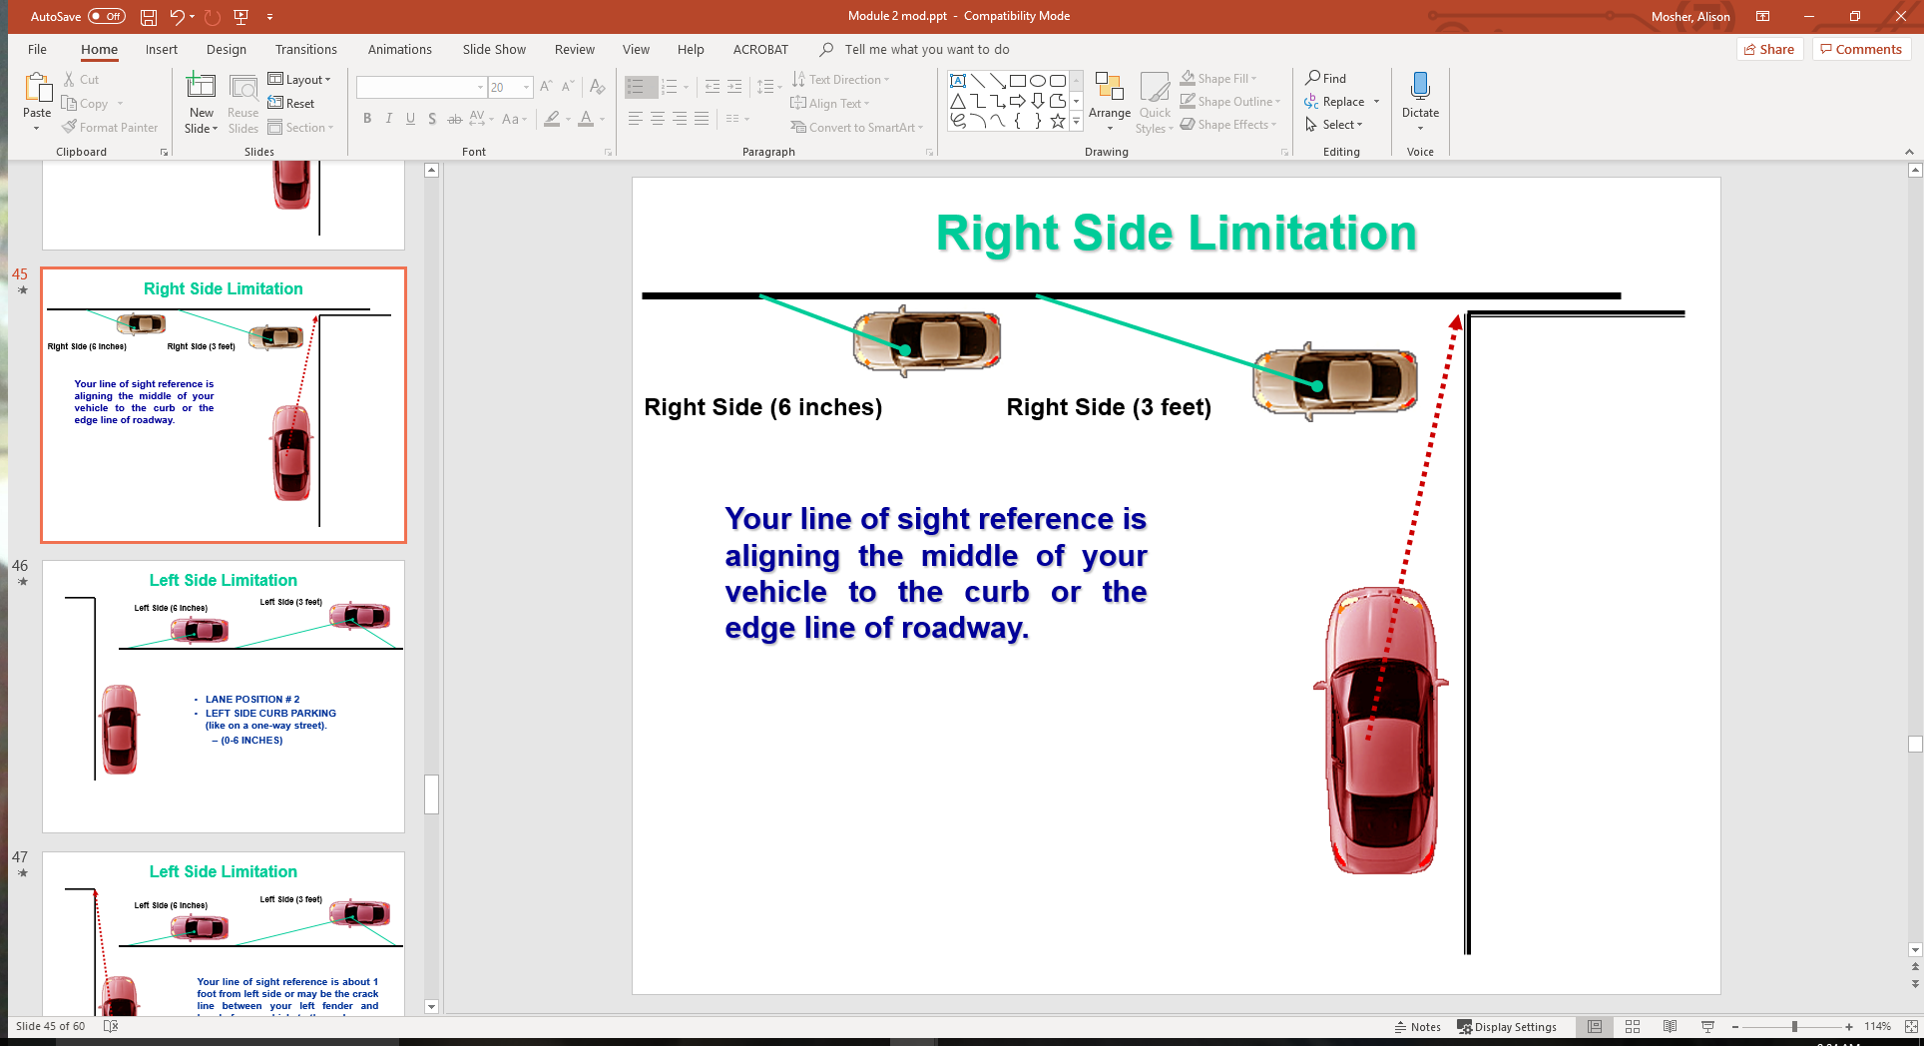
Right Side Limitation

Slide 42
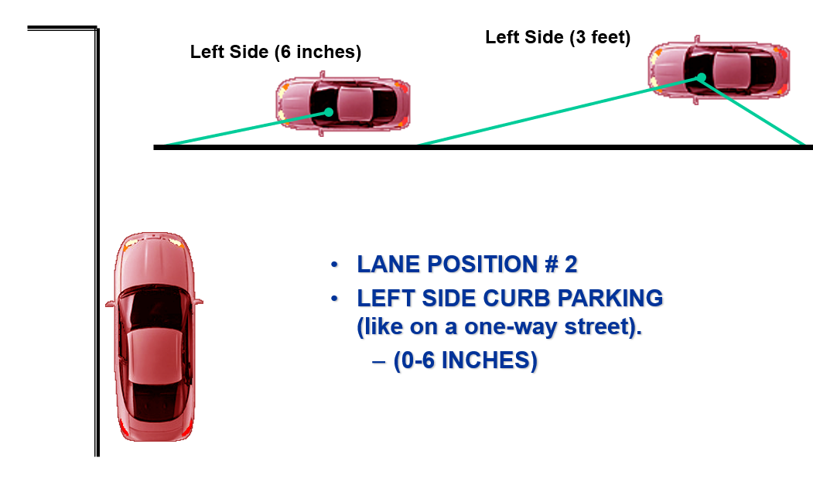
Left Side Limitation

Slide 43
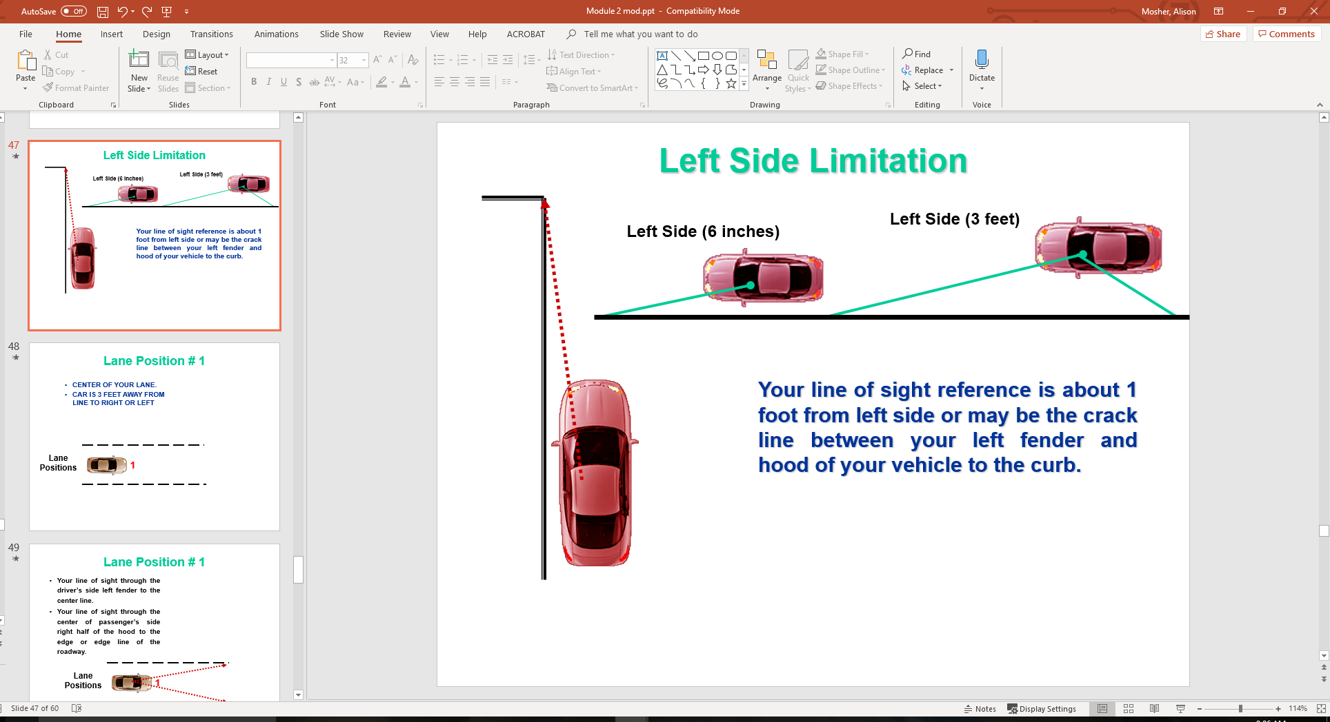
Left Side Limitation

Slide 44
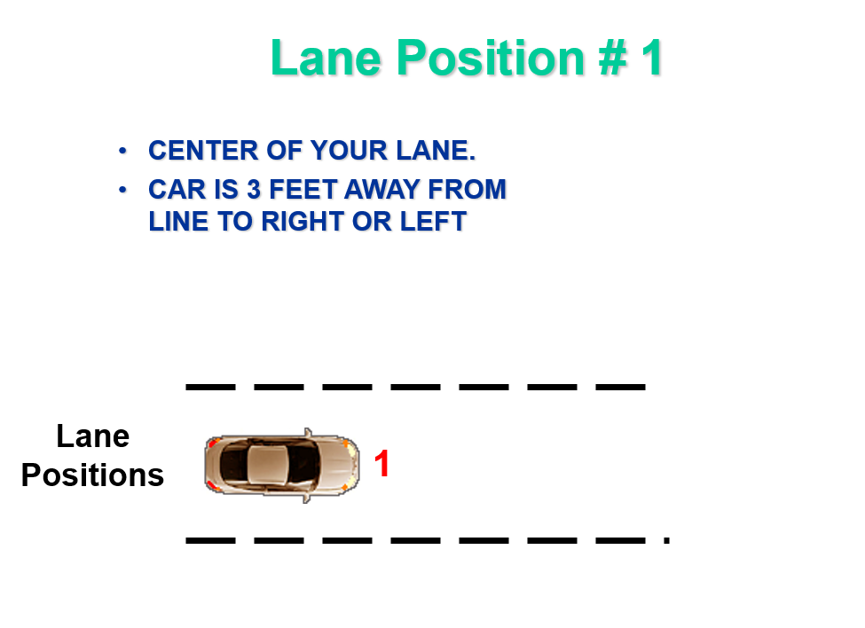

Slide 45
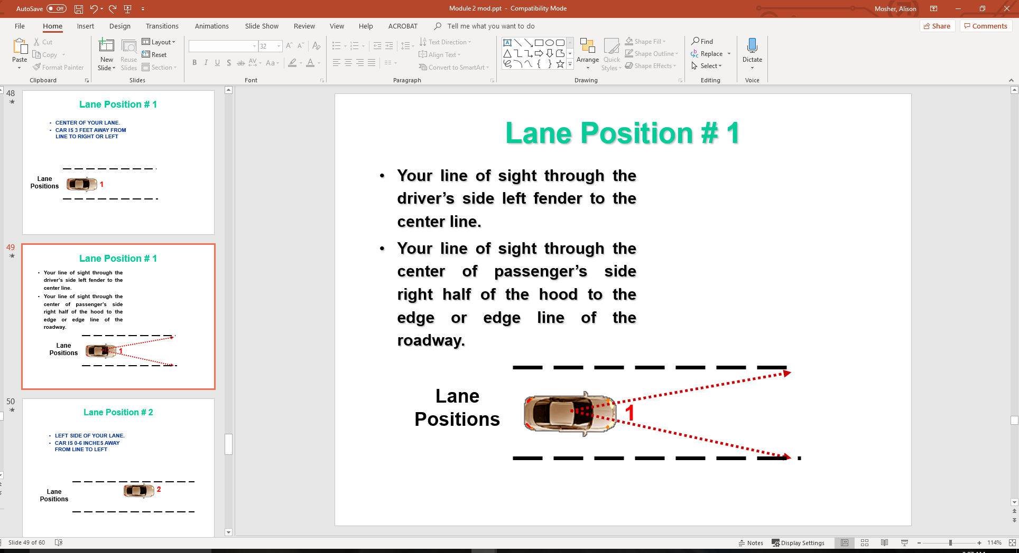

Slide 46
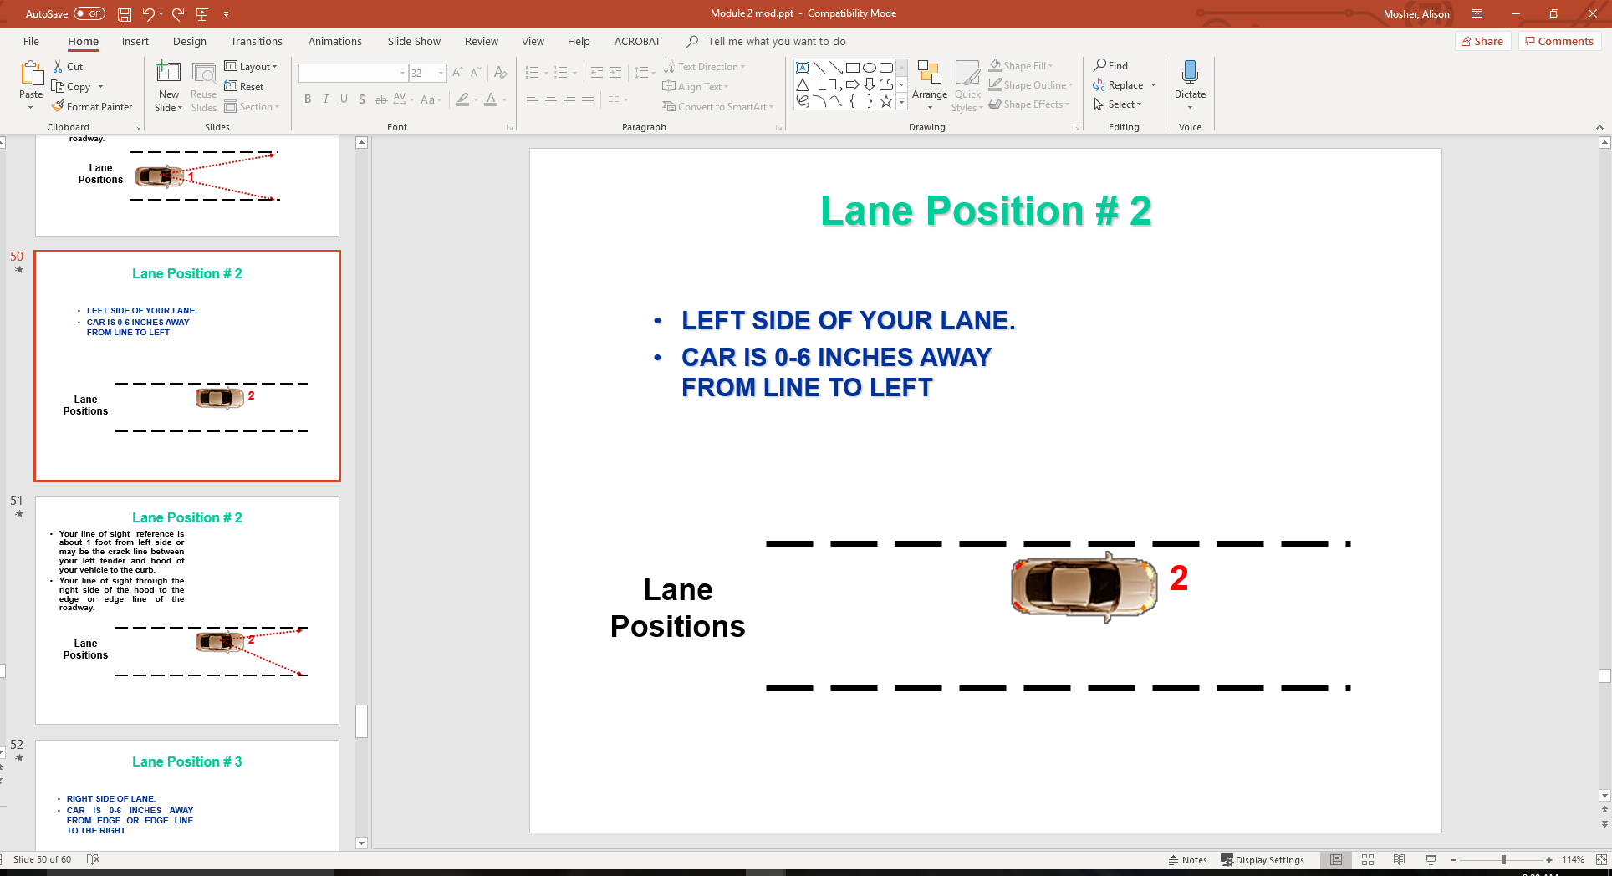

Slide 47
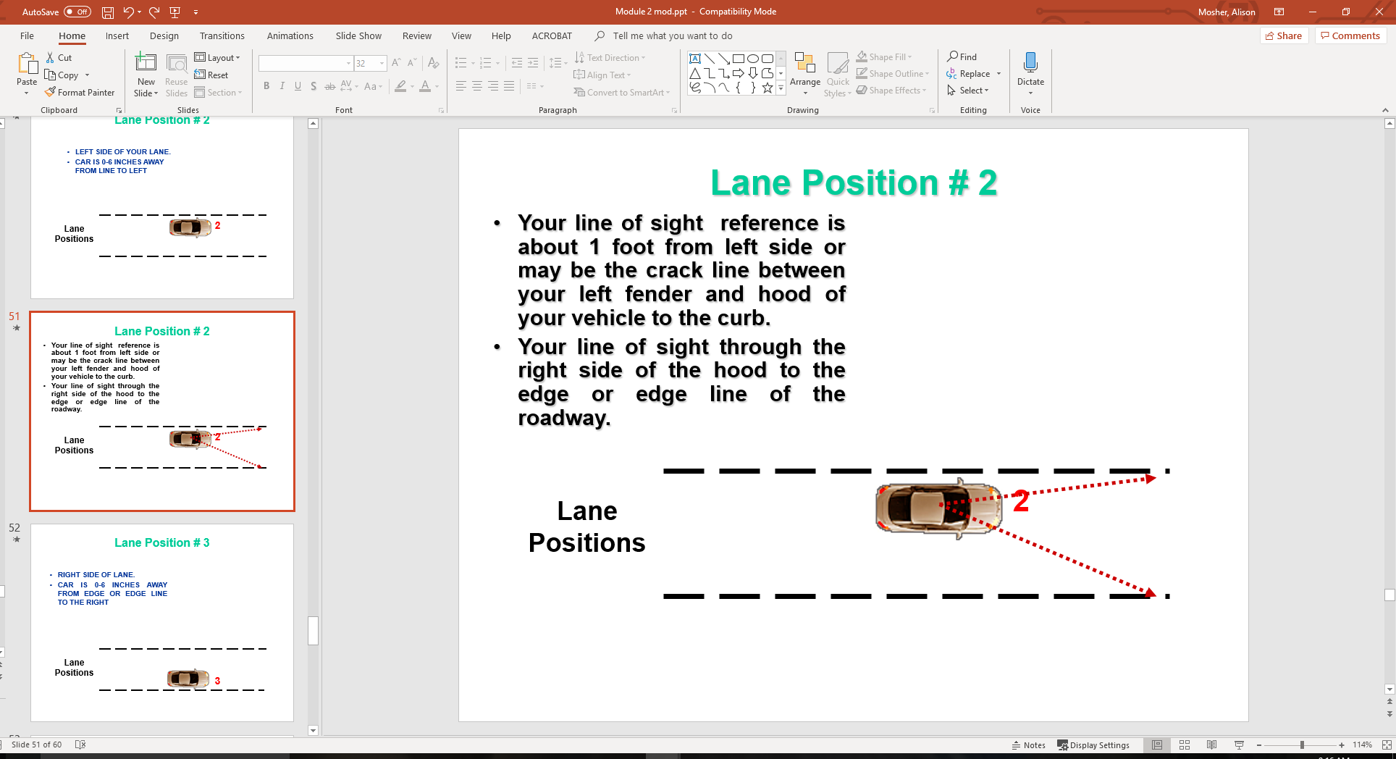

Slide 48
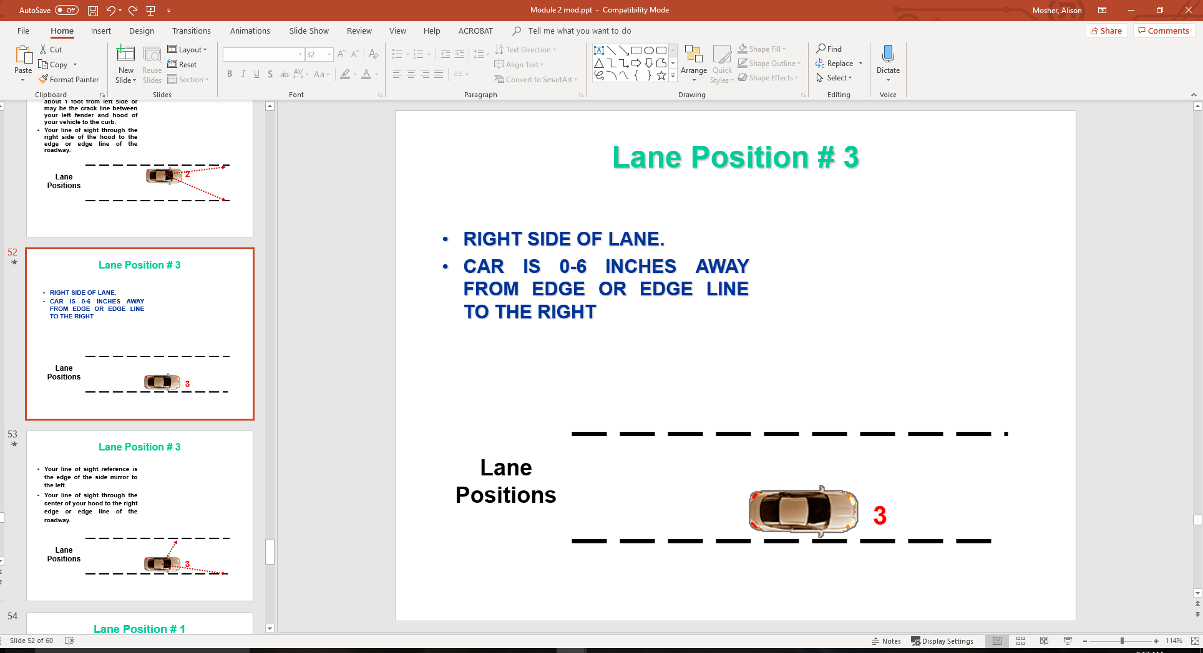

Slide 49
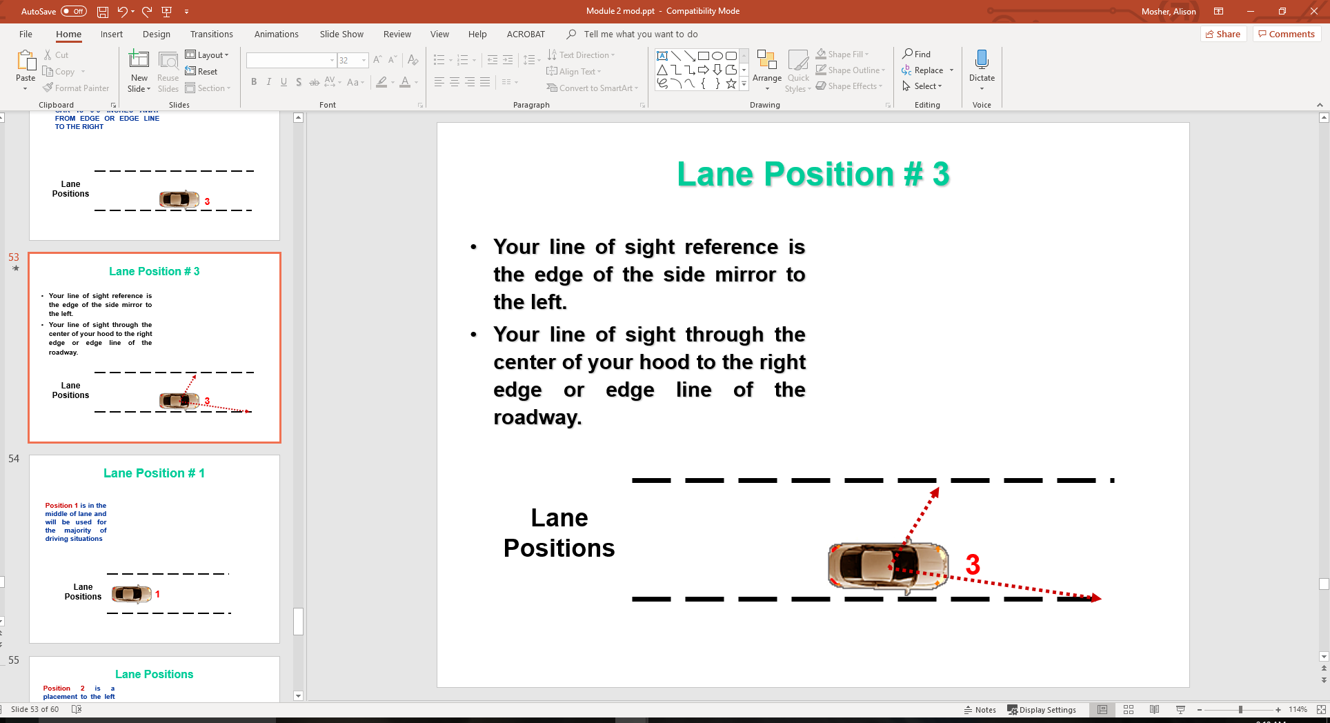

Slide 50
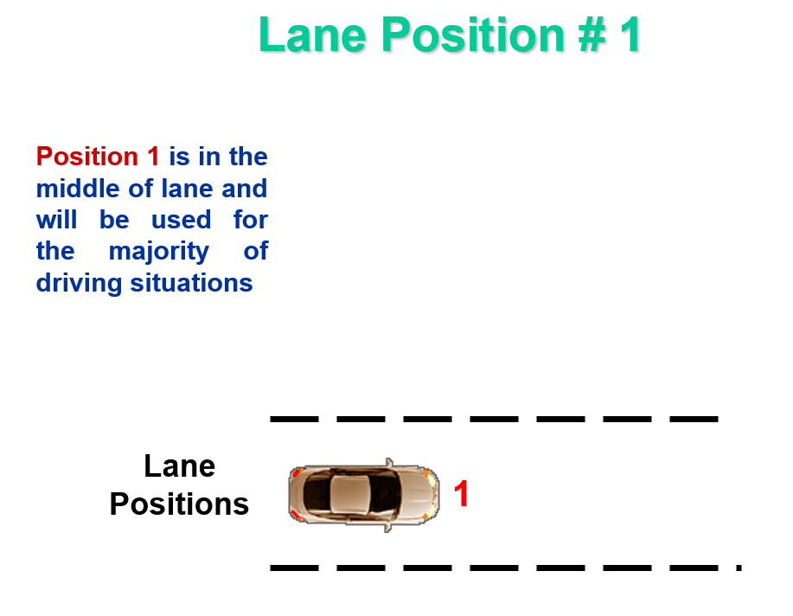

Slide 51
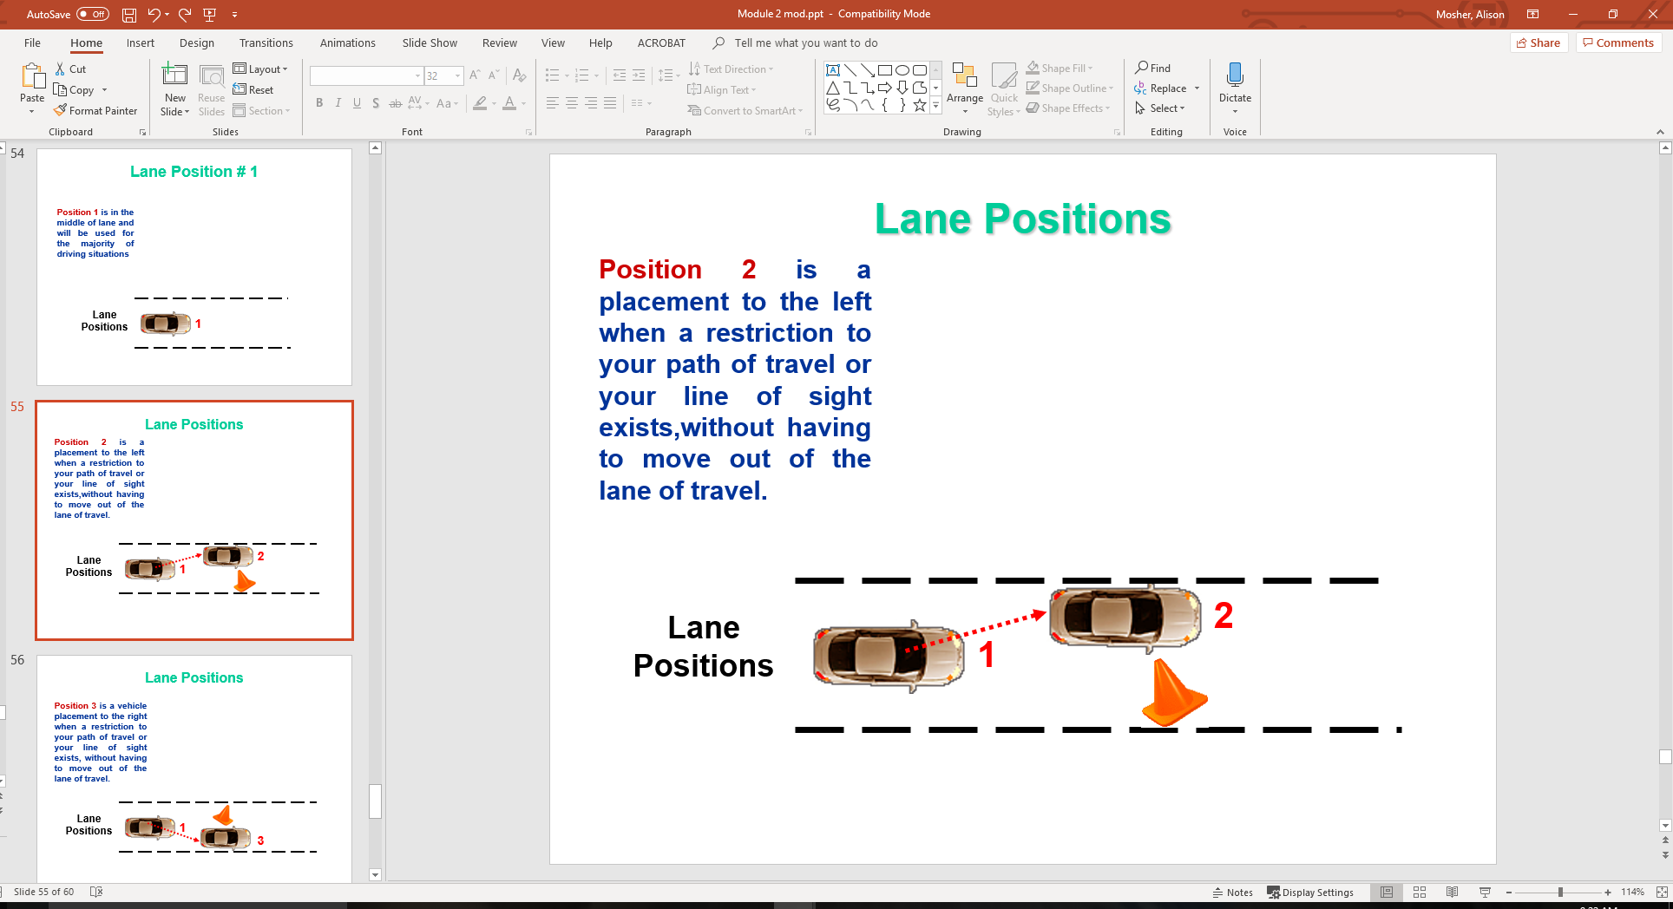

Slide 52
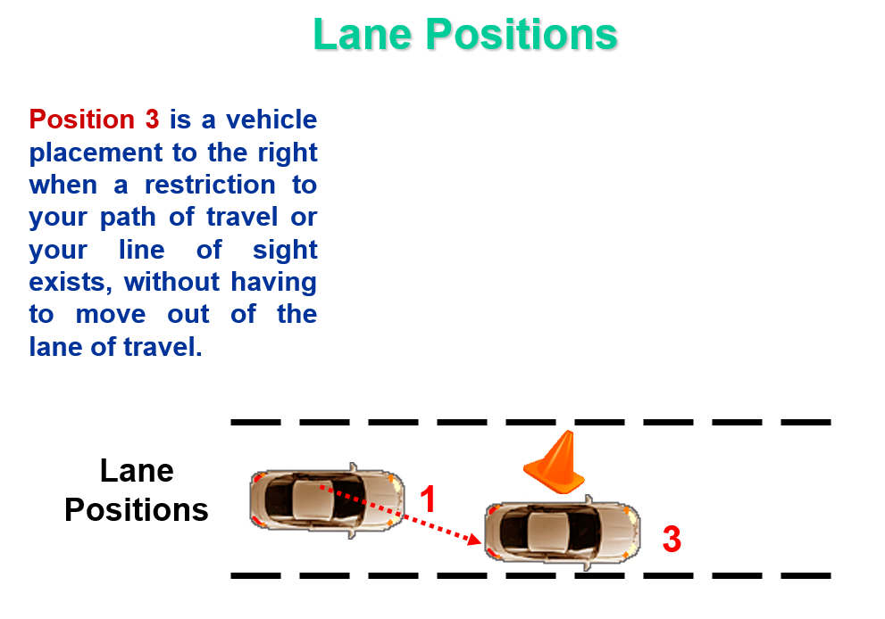

Slide 53
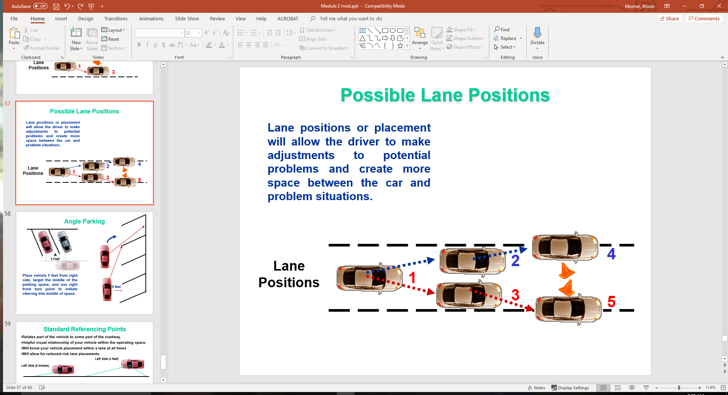

Slide 54
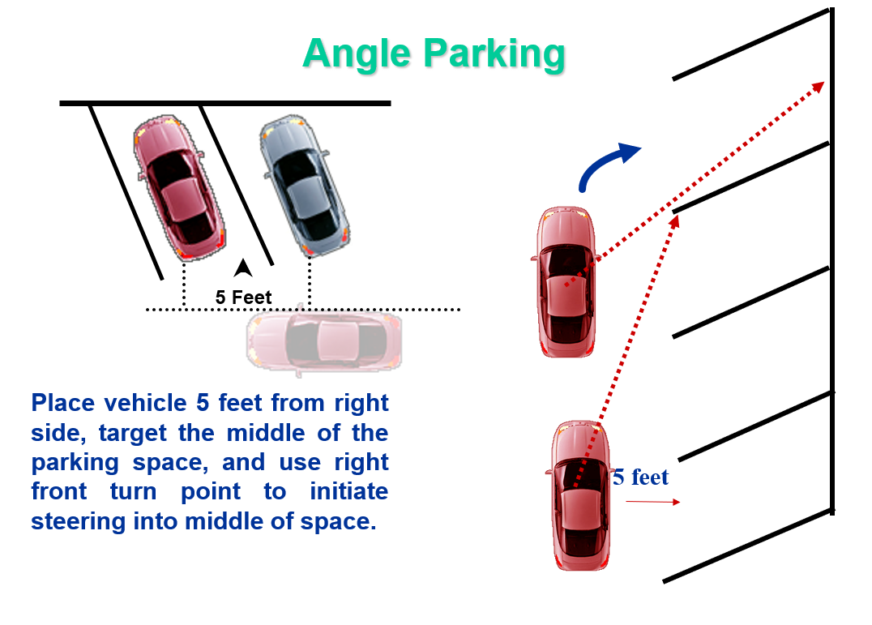

Slide 55
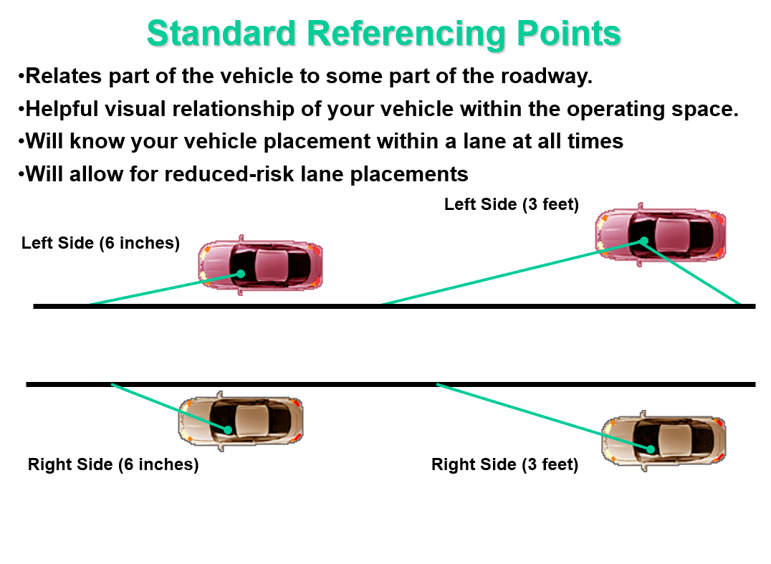

Slide 56
Contact/Mission
For more information on Driver’s Education and Safety please visit PDE’s website at www.education.pa.gov
The mission of the Department of Education is to ensure that every learner has access to a world-class education system that academically prepares children and adults to succeed as productive citizens. Further, the Department seeks to establish a culture that is committed to improving opportunities throughout the commonwealth by ensuring that technical support, resources, and optimal learning environments are available for all students, whether children or adults.

