Slide 1
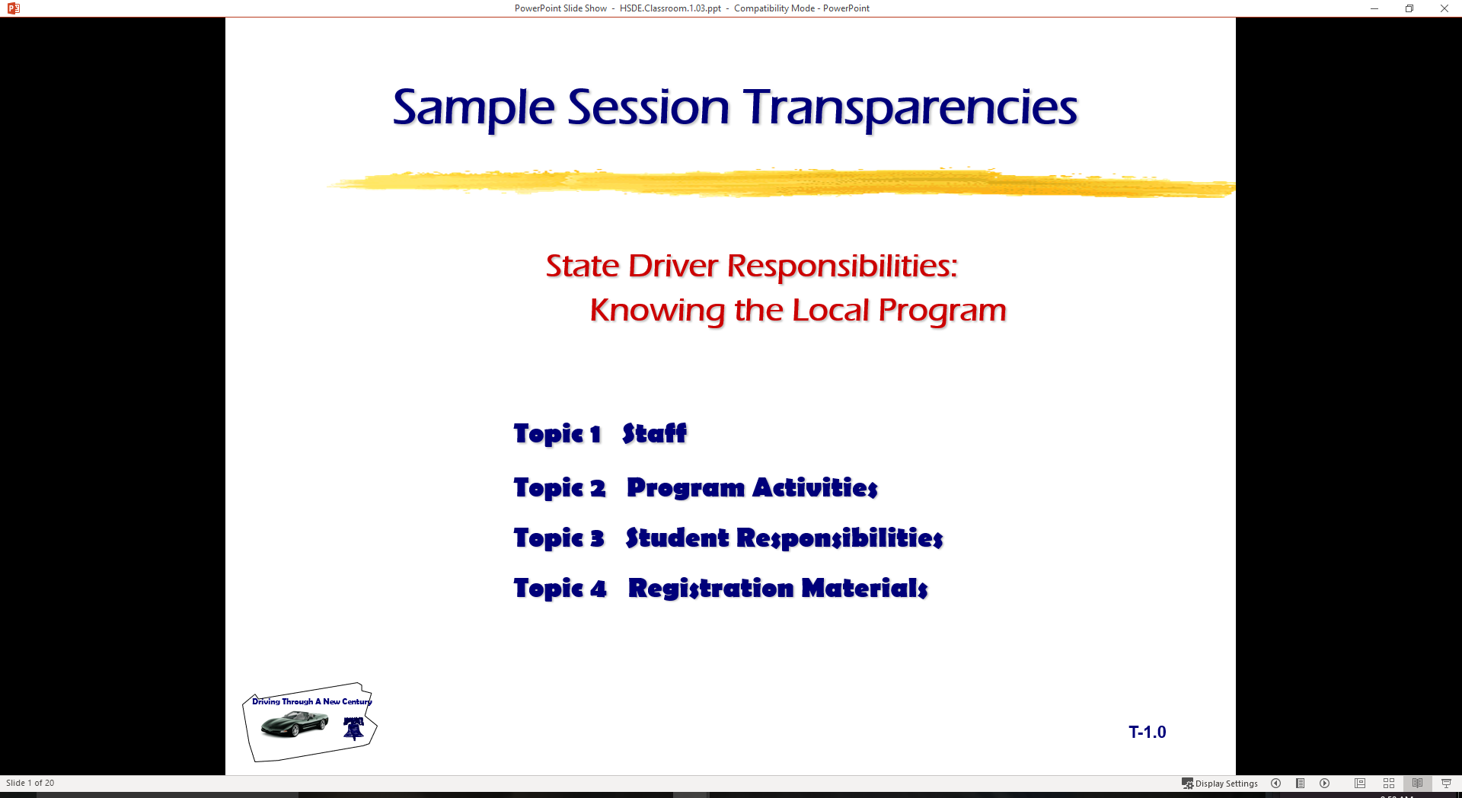
  Making Informed Choices
Topic 1 Insuring Your Vehicle
Topic 2 Purchasing Vehicle
Topic 3 Trip Planning
Topic 4 Littering Concerns
Topic 5 Driver Licensing

Slide 2
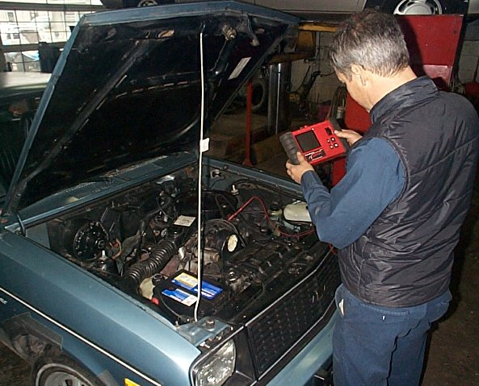
Ownership Responsibilities
$
$
Insurance Costs
Purchase and Financing Costs
Maintenance and Operating Costs
Registration and Inspection Costs

Slide 3

Insuring a Car
State law requires you to have car insurance
Your parents’ policy covers you while you have a learner’s permit
If you still owe money on your car, your lender can require insurance

Slide 4
Safety Responsibility Law
  Minimum liability coverage
  Alternatives to insurance
  Types of proof of financial responsibility
  When you must show proof of financial
  responsibility
  Penalties for driving without insurance

Slide 5

State Auto Insurance
Required Minimum Liability Coverage
  $25,000 per injured person
  Up to $50,000 for everyone hurt in an accident
  $20,000 for property damage

Slide 6

State Auto Insurance
You must show Proof of Financial Responsibility when you:
  Are asked for it by a police officer
  Have a collision
  Register your car or renew its plates
  Obtain or renew a driver license

Slide 7

State Auto Insurance
Penalties for Driving
without Proof of Insurance
  First Conviction:
    $175 to $350 fine
  Subsequent Convictions:
    $350 to $1,000 fine
    Driver’s license suspension
    Impoundment of your car

Slide 8
State Auto Insurance
Facts on the Declaration Page of Your Policy
  The exact name of your insurance company
  The policy number
  Your coverage and how much it costs
  Your deductibles, if any
  The vehicles insured on the policy, their vehicle
  identification numbers and their classifications for
  rating purposes

Slide 9
State Personal Auto Policy
Seven Types of Coverage
  Liability
  Medical Payments
  Uninsured/Underinsured Motorist
  Collision
  Comprehensive
  Towing and Labor
  Rental Reimbursement

Slide 10
Liability Coverage
Pays:
  Other people’s medical expenses
  Auto repairs
Covers:
  You
  Your family
  Others driving with your
  permission
Required?
  Yes, by State law

Slide 11

Medical Payments Coverage
Pays:
  Medical
  Funeral expenses
Covers:
  You
  Your family
  Your passengers
Required?
  Not required by State law

Slide 12
Uninsured/Underinsured Coverage
Pays:
  Medical expenses
  Funeral expenses
  Lost wages
  Homemaker/Caregiver services
Covers:
  You
  Your family
  Your passengers
Required?
  Not by State law, but company must offer

Slide 13

Collision Coverage
Pays:
  Your car repair
  Your car replacement
  After a crash
Covers:
  Your car
  Regardless of driver
Required?
  Not by state law, but by car loan lenders

Slide 14
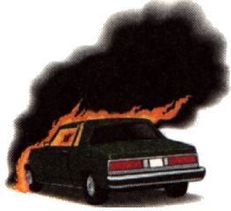
Comprehensive Coverage
Pays:
  Car repair or replacement after:
    Fire
    Hailstorm
    Theft or other non-collision event
    Rental car after theft
Covers:
  Your car
Required?
  Not by State law, but by car loan lenders

Slide 15

Towing and Labor Coverage
Pays:
  Towing
  Labor charges
  When your car is disabled
Covers:
  Your car
Required?
  Not required by State law

Slide 16

Rental Reimbursement COverage
Pays:
  A rental car
  Your car is undergoing repair
  For covered damage
Covers:
  You
  Your family members
Required?
  Not required by State law

Slide 17
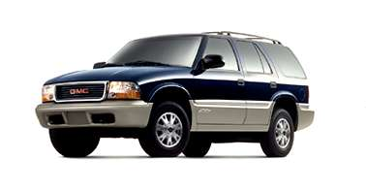
Insurance Costs
How car insurance rates are determined
Factors used in establishing rates
Discounts
  Mandatory
  Non-mandatory

Slide 18
Insurance Costs
Factors Used to Determine your Premium
Your age and marital status
    Highest Rates
      Male drivers under 25
      Unmarried women under 21
    Over 50 may get discounts
  County where you keep your car
  Urban counties have more accidents and auto thefts; tending to be higher than those of rural areas
  Your car
    Collision and comprehensive rates
      Highest for luxury, high-performance, and sports cars
      Higher for cars that damage easily
      Higher for cars that cost more to repair
  How you use your car
    Higher for cars driven to work or used for business

Slide 19
Insurance Costs
Factors used to determine your individual premium
  Your deductibles
    Your share of the cost of a collision or comprehensive claim
    Reduce your premium by raising your deductibles
  Surcharges
    Added for collisions resulting in property damage of $1,000 or more
  Discounts
    Some required by the state, while others are optional with companies
    Mutual Companies are not required to give any discounts

Slide 20
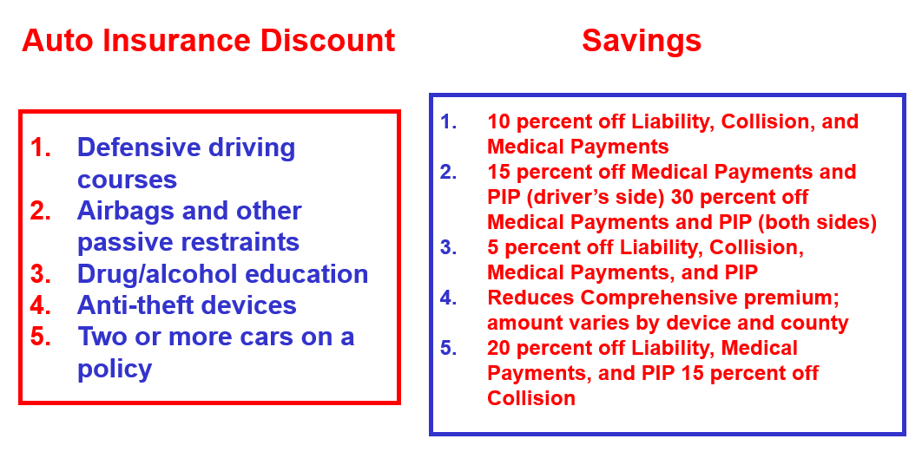
Premium Discounts Education and Car Equipment Saves

Slide 21
Premium Discounts
Companies may give optional discounts for:
  Your age and annual mileage driven
  Policy renewal, with a good claims and driving record
  and anti-lock brakes
  A parent or family whose young driver is away at school
  without a car
  Full-time college and high school students with a "B" or
  3.0 average
  Cars with automatic daytime running lights
  Membership or adult leadership in certain youth
  organizations

Slide 22
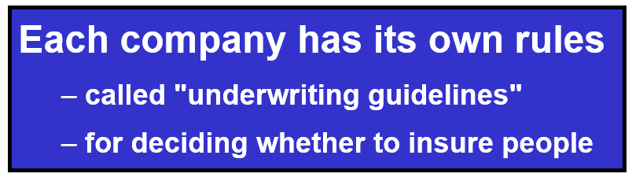
High Risk Drivers
Makes it harder to get car insurance
Must pay higher premiums
Insurance for high risk drivers
Surcharges

Slide 23
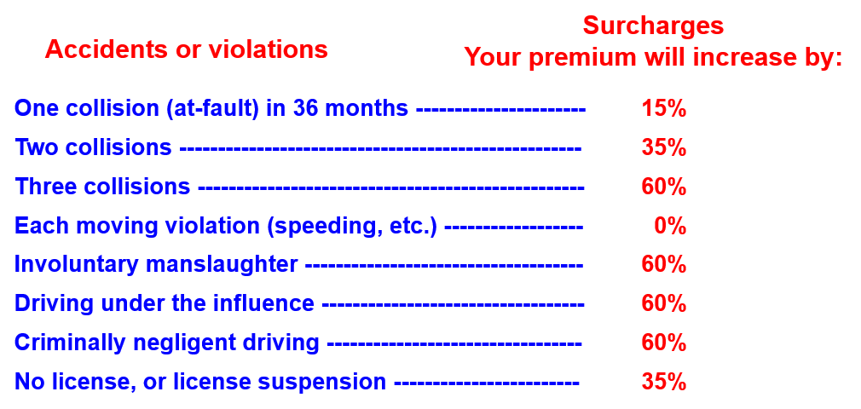
High Risk Drivers Your Driving Record Will Cost You

Slide 24
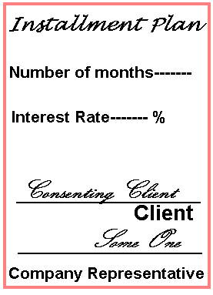
Paying for Insurance
Many people can’t pay their car insurance
premium in one installment
Insurance companies must offer installment plans
Agents and insurers use finance companies
  Lend money at high interest rates to pay insurance premiums
Look for insurance companies that offer their own installment plans

Slide 25
Paying for Insurance
Ask the agent:
  Who will provide my installment plan?
    the insurance company or a premium finance company
  If it is a premium finance company, what is the
  interest rate?
  How much is the down payment?
  How much is my monthly payment?
  How many payments do I make?
  How much is my total payment?
    annual or six-month premium plus interest

Slide 26
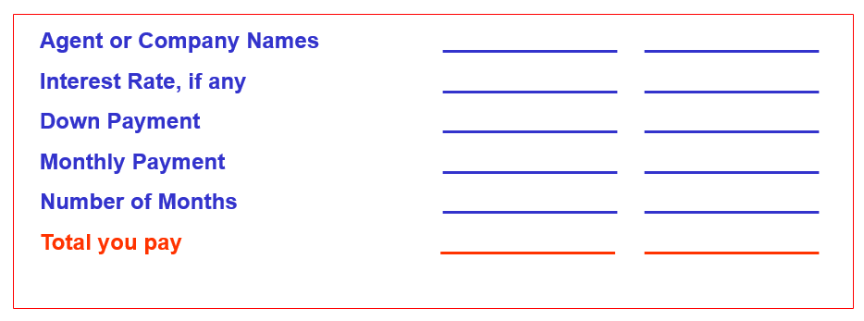
Paying for Insurance
Use worksheet to compare the installment packages offered by agents and companies
INSTALLMENT PLAN WORKSHEET

Slide 27
Losing Your Insurance
Cancellation
  First 60 days, company can cancel for any reason,
  including a ticket or a collision
  After policy is in effect more than 60 days, for the
  following reasons:
    Company must give 10 days' notice before canceling
    Refund of unearned premium
Non-renewal
  Company will not develop a new contract
Request Reasons in Writing
  Why company canceled policy
  Why company will not renew the policy

Slide 28

After the Collision…
What Now?
  Discuss what your policy requires you to do after a
  collision
  Your uninsured motorist coverage pays for hit-and-run
  collisions only if reported to the police

Slide 29


Buying a Car
New or Used?
Why Do I Need It?
What Safety Features are Needed?
How Much Will it Cost?
How Economical is It?
What Options Do I Need?

Slide 30
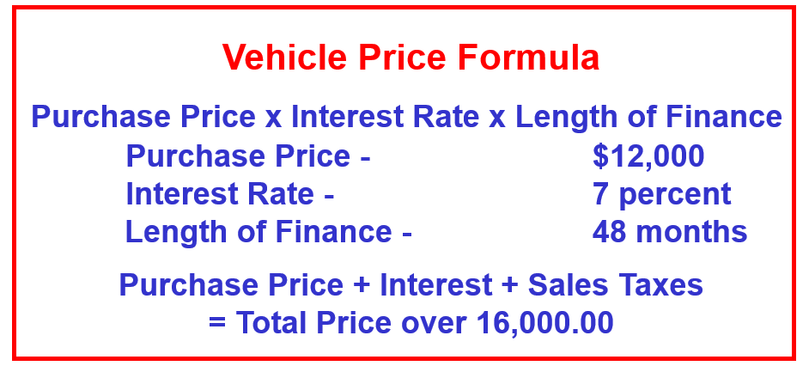
Your Monthly Payment
What is your monthly payment?

Slide 31
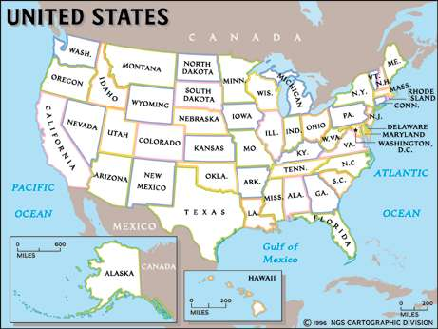
Planning an Extended Trip
Preparing the vehicle
Loading considerations
Basic and emergency equipment needs
Personal preparation

Slide 32

Trip Costs
Lodging (hotel/motel)
Meals
Tolls
Possible Repairs
Fuel
Calculating Fuel Costs
1500 mile trip
Car gets 22 mpg
Fuel costs $1.20 per gallon
Formula: 1500 x $1.20 = $81.60
22

Slide 33
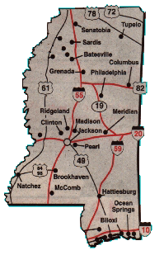
Map Reading
City Maps
  North orientation
  Legend (explains the markings
  and symbols on the map)
  Street Index
    Letters/numbers reference location
  Determining Distances
    Map scale

Slide 34
Map Reading
State Maps
  North orientation
  Legend (explains the markings
  and symbols on the map)
  Town/City index
  Coordinates
    Letters/numbers reference location
  Maps of major cities
  Determining distances
    Map scale
    Mileage chart
    Colored symbols

Slide 35
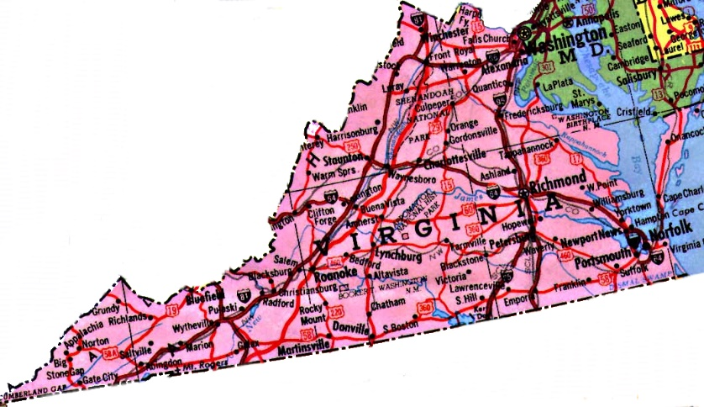
Destination Driving
Using the State map, plan a trip from your home to a point in State more than five hours away from home.
The route numbers you could use with the direction
of travel (Example: I-95 North)
How long it will take
The number of miles
Location of rest stops
Cost of fuel
(Your car gets 20 mph - cost of fuel is $1.25/gallon)

Slide 36
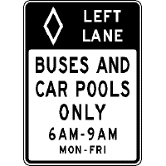

Conserving State’s Natural Resources
Accelerate Smoothly
Brake Gently
Keep Your Vehicle Maintained
Recycle Old Oil and Fluids
Carpool
Others?

Slide 37
Driver Licensing
State Permit Requirements
16 years minimum age
Parent/Guardian Cosign
Vision and Knowledge Test
Accompanied by a licensed driver at least 21 years old seated beside the driver

Slide 38
Driver Licensing
State License Requirements
Must possess permit for a minimum of 6 months
Must complete 65 hours of practice driving
You may not drive between the hours of 11 p.m. and 5 a.m., unless your parent, guardian, person in loco parentis, or spouse who is 18 years of age or older is with you.
You may not carry more passengers than seat belts available in the vehicle you are driving.
You may not carry more than one (1) passenger under the age of 18 who is not an immediate family member

Slide 39
You may get a regular driver’s license after you have held a junior driver’s license for one (1) year, if you meet the following conditions:
Have passed a driver training course approved by the PA Department of Education.
Have not been involved in a crash for which you are partially or fully responsible for one (1) year.
Have not been convicted of any violation of the Pennsylvania Vehicle Code for one (1) year.
Have the consent of your parent, guardian, person in loco parentis, or spouse who is at least 18 years of age.

Slide 40
Contact/Mission
For more information on Driver’s Education and Safety please visit PDE’s website at www.education.pa.gov
The mission of the Department of Education is to ensure that every learner has access to a world-class education system that academically prepares children and adults to succeed as productive citizens. Further, the Department seeks to establish a culture that is committed to improving opportunities throughout the commonwealth by ensuring that technical support, resources, and optimal learning environments are available for all students, whether children or adults.

