Slide 1
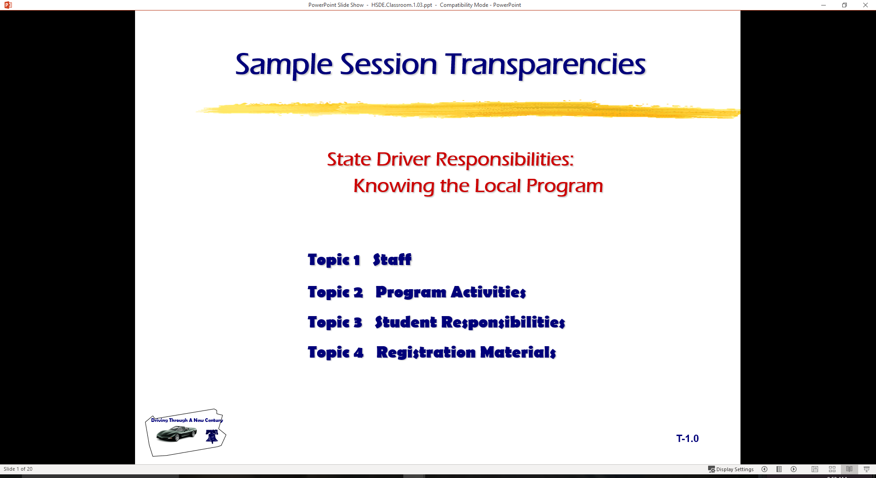
Driver Education Classroom and Laboratory Model Curriculum
Sample Transparencies

Slide 2
A novice driver is a person capable of:
Demonstrating a working knowledge of
  rules of operating an automobile
  procedures of operating an automobile
Using visual search skills to
  obtain correct information about driving maneuvers
  make reduced-risk decisions about driving maneuvers
Demonstrating abilities to manage space by
  adjusting position and/or
  speed to avoid conflicts and reduce risk

Slide 3
A novice driver is a person capable of:
Interacting with other roadway users in a positive manner
Demonstrating balanced vehicle movement
  through steering in a precise and timely manner
  braking in a precise and timely manner
  accelerating in a precise and timely manner
Protecting oneself and others by using occupant protection systems

Slide 4
A novice driver is a person capable of:
Displaying knowledge of responsible actions
In regard to
  physical conditions affecting driver performance
  psychological conditions affecting driver performance
Extending supervised practice with licensed parent, guardian, or mentor to develop precision in the use of skills, processes, and responsibilities.

Slide 5
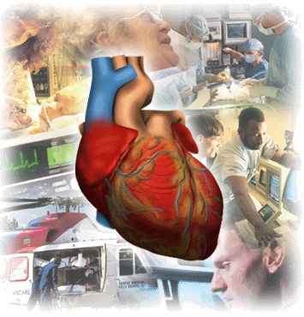
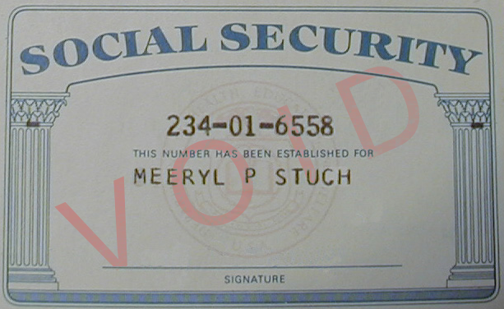
Specialty Information
Organ Tissue Donation
Social Security Number

Slide 6
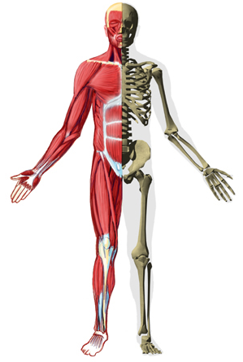
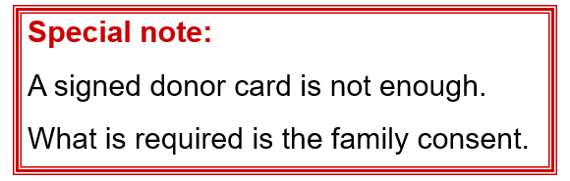
Obstacles to open discussion about donations:
There are still a lot of misconceptions about organ donation.
People prefer not to talk about their mortality.

Slide 7
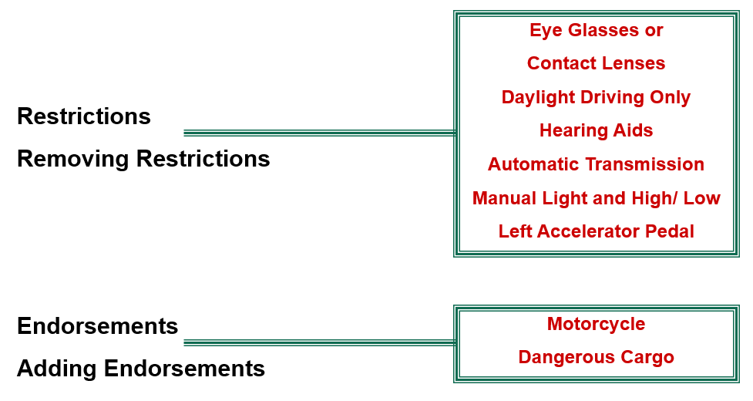
Licensing Restrictions

Slide 8
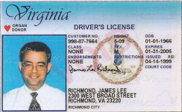
Licensing Renewal
Duplicate
Duplicate
Application
Costs
Procedures
Renewal
Application
Costs
Procedures

Slide 9
Suspensions/Revocations
X
Suspension
Revocation
Cancellation
Mandatory Suspension
Individuals Under 21

Slide 10

Suspensions/Revocations
Administrative License Suspension (ALS)
Cancellations
Court Ordered Suspensions/Revocations
Driving While License Suspended
Sanctions for Non-Driving Alcohol-Related Offenses by Minors

Slide 11
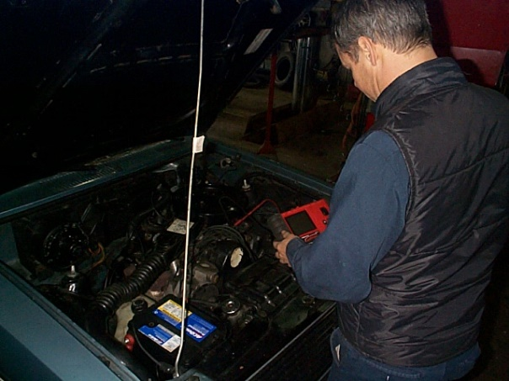
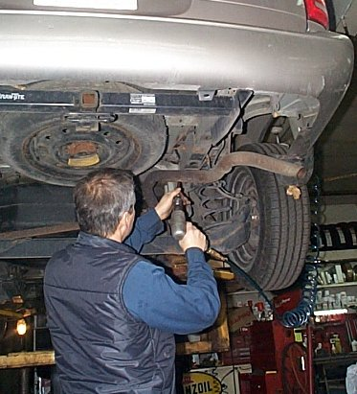
Inspection/Registration
Vehicle Inspection
Required Equipment
Illegal Equipment
Optional Equipment
Vehicle Registration

Slide 12
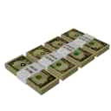
Financial Responsibility ?
?
Liability Insurance
Proof of Financial Responsibility
Assigned Risks

Slide 13
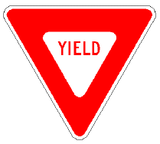
Right–of–Way Concepts
Drivers at times must wait for other users
Principles based on giving the privilege of passage to others
Right-of-Way cannot be taken—not a right or privilege
Determined by a set of rules and guidelines
Intersections
Merges
Special conditions

Slide 14

Intersections
Controlled by signs and signals
NOT Controlled by signs and signals, multi-lanes, or pavement
Single or two-lane road intersecting with multiple-lane road
Turning left
T Intersections
Railroad grade crossings

Slide 15
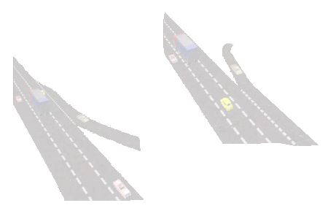
Merging Areas
Leaving a controlled - access highway
Entering a controlled - access highway
Driving on multiple-lane roadways

Slide 16
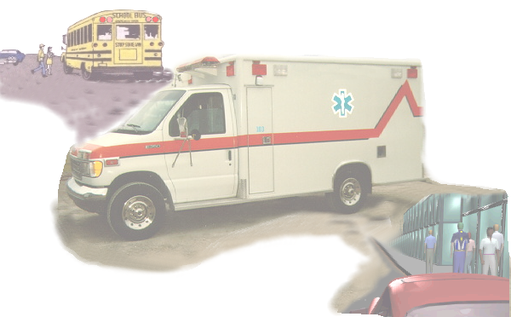
Special Situations
Give the Right-of-Way to School Buses
Give the Right-of-Way to Emergency Vehicles
Yield the Right-of-Way to Pedestrians

Slide 17
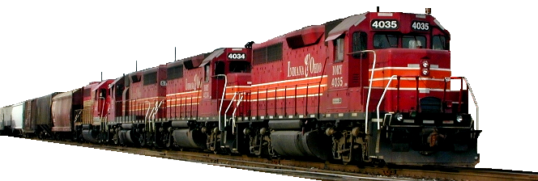
Railroad Crossings
Marked only with a crossbuck sign.
A train is approaching.
Red lights are flashing at a railroad crossing.
Railroad crossing arms have been lowered.
Never stop on tracks.
Be sure all tracks are clear before you proceed across.
Trains do not and cannot stop at crossings.

Slide 18
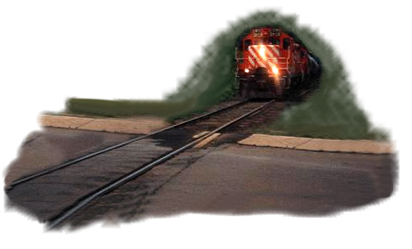
Specialized Intersections
Driver errors cause most of the crashes.
All were trying to beat the train: they lost.
Certain vehicles must stop at all railroad crossings.
If you follow one of these “Must Stop Vehicles,” prepare to stop, since you cannot pass or overtake them at an intersection.

Slide 19
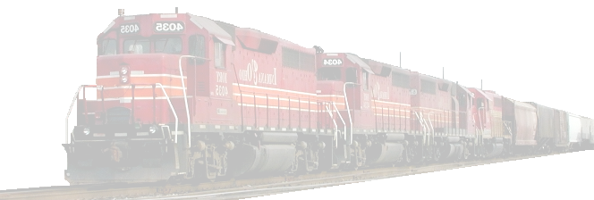
Facts About Trains
Trains cannot stop quickly.
A car moving at 55 mph takes 200 feet to stop.
A train moving at 50 mph takes 1.5 miles to stop.
Trains are not always on schedule.
Since many crossings have 2 or more tracks, a first train can hide a second one.
It is hard to say how fast a train is moving.
There are still crossings that have no warning lights or gates.
It is illegal and dangerous to drive around lowered gates.

Slide 20


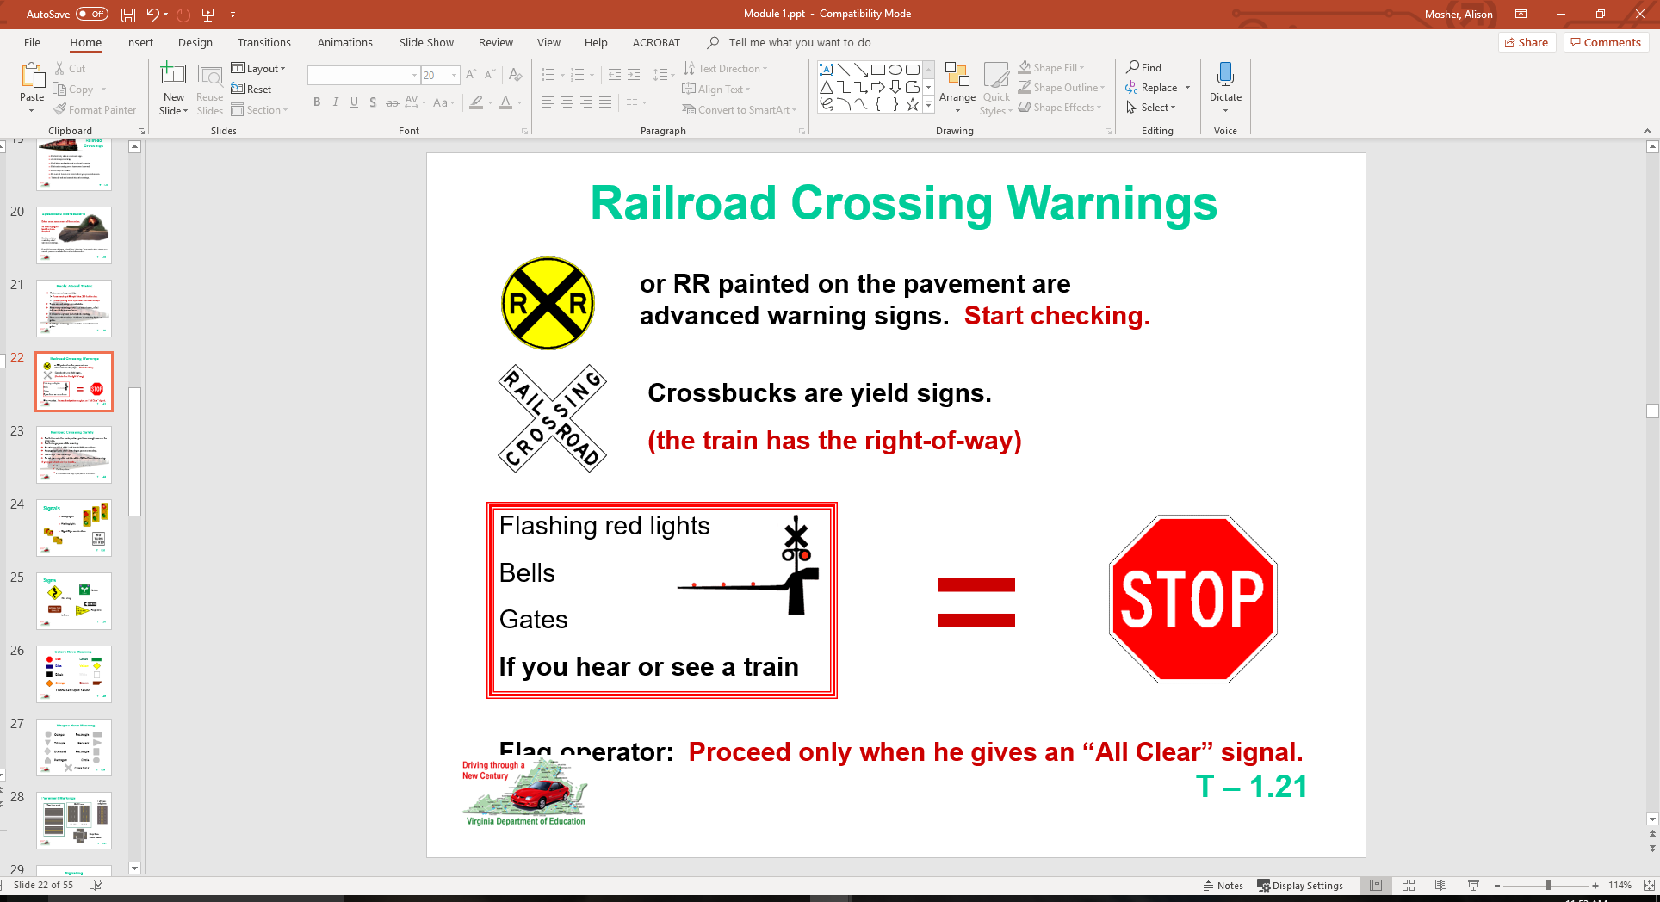
Railroad Crossing Warnings
or RR painted on the pavement are advanced warning signs. Start checking.
Crossbucks are yield signs.
(the train has the right-of-way)
Flag operator: Proceed only when he gives an “All Clear” signal.

Slide 21
Railroad Crossing Safety
Don’t drive onto the tracks, unless you have enough room on the other side.
Don’t change gears while crossing.
Be extra careful at night (and low visibility conditions).
Keep going if gate starts lowering as you are crossing.
Don’t stop—Don’t back up.
Do not pass any other vehicle within 100 feet from the crossing.
If you get stuck on the tracks:
Get everyone out—Run from the tracks.
Call the police.
If no train is coming, try to push the vehicle.

Slide 22
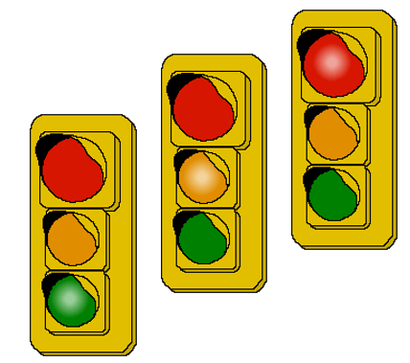

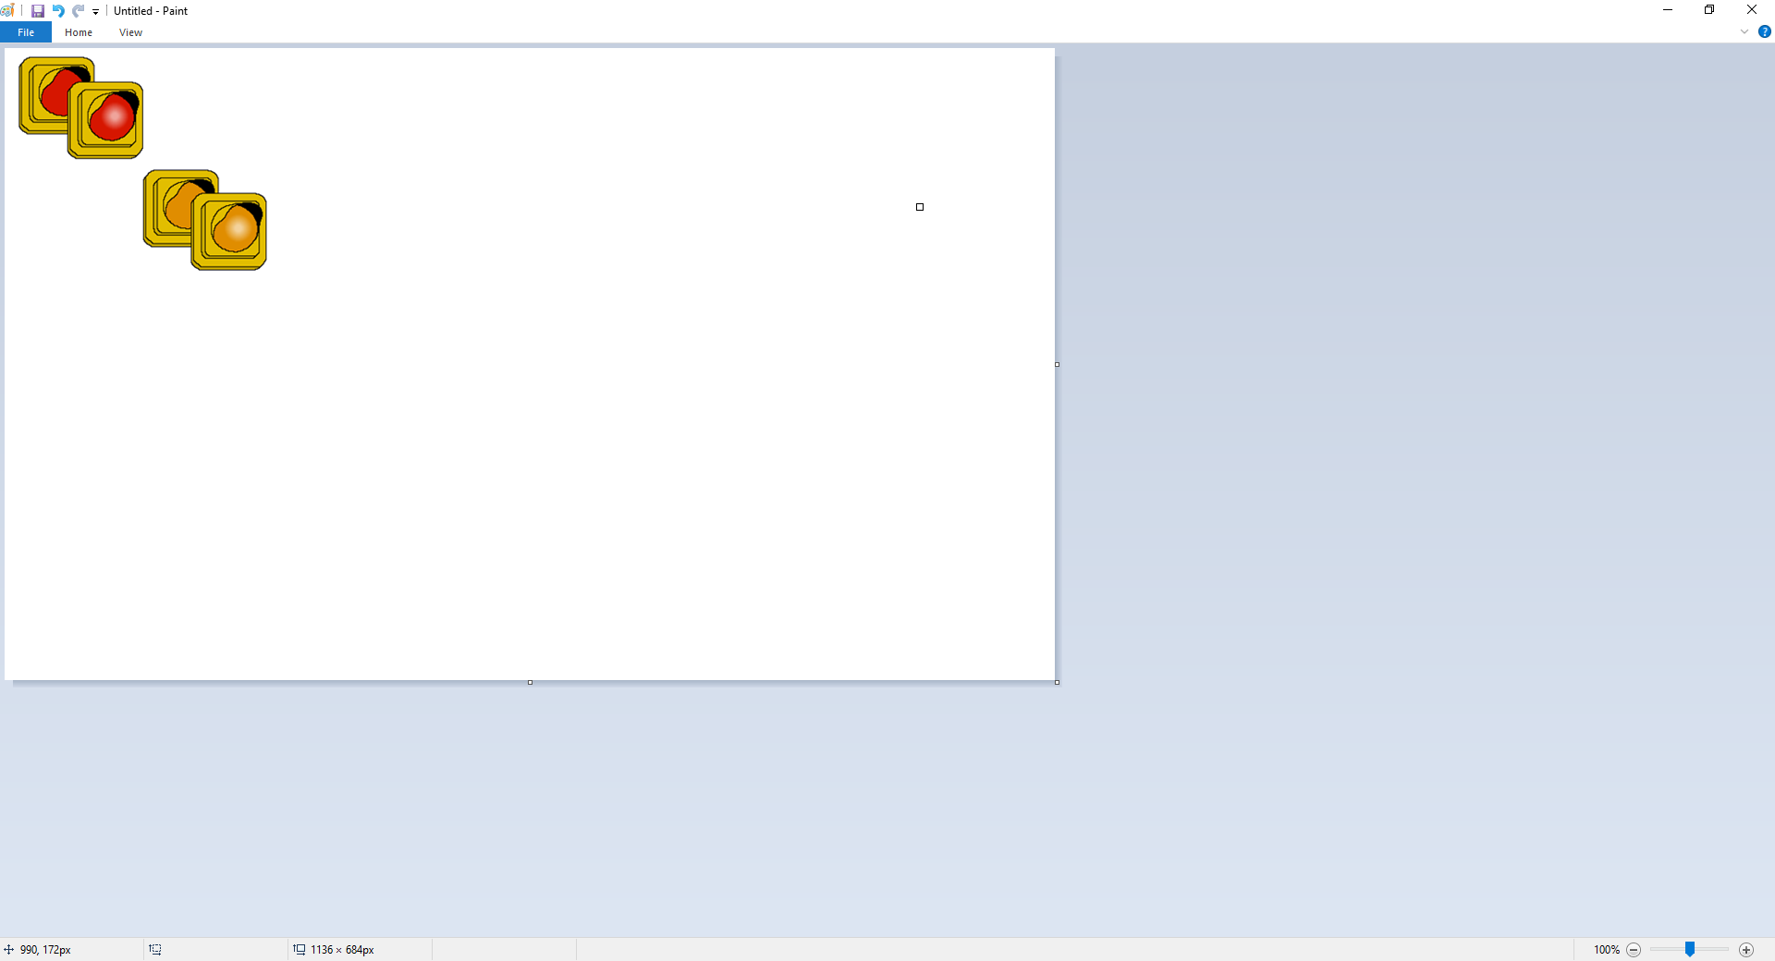
Signals
Steady lights
Flashing lights
Signal/Sign combinations

Slide 23
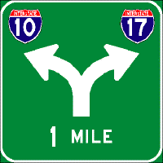




Signs
Guide
Warning
Regulate
Inform

Slide 24
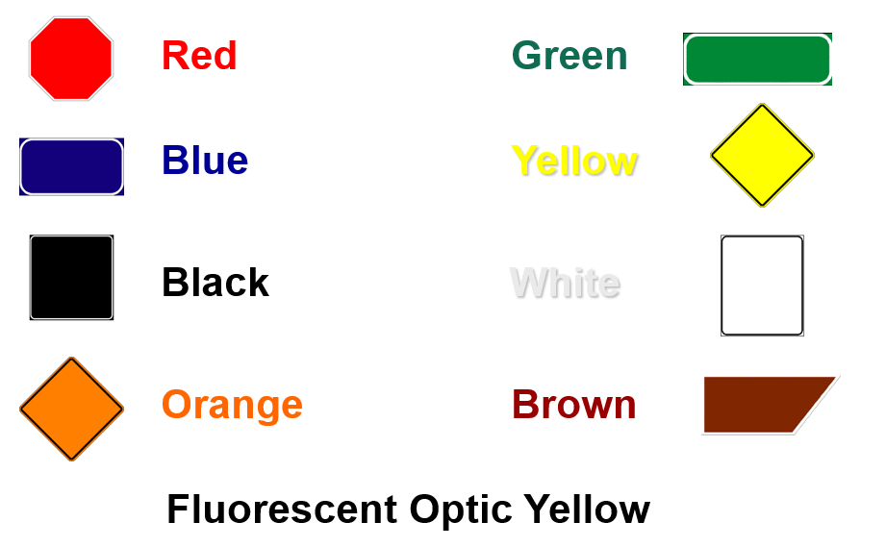
Colors Have Meaning

Slide 25
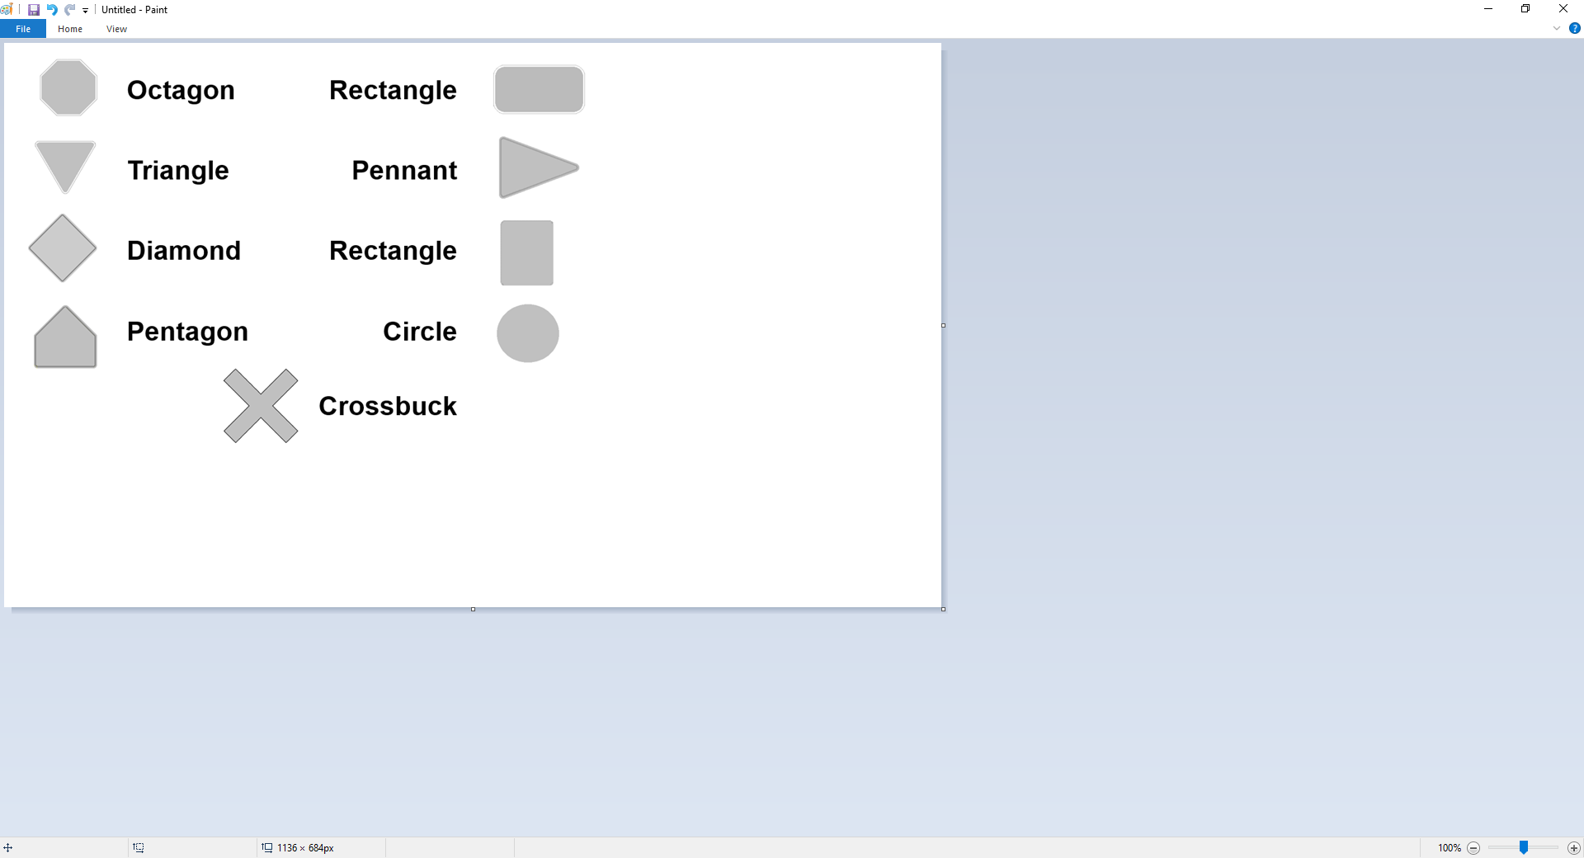
Shapes Have Meaning

Slide 26
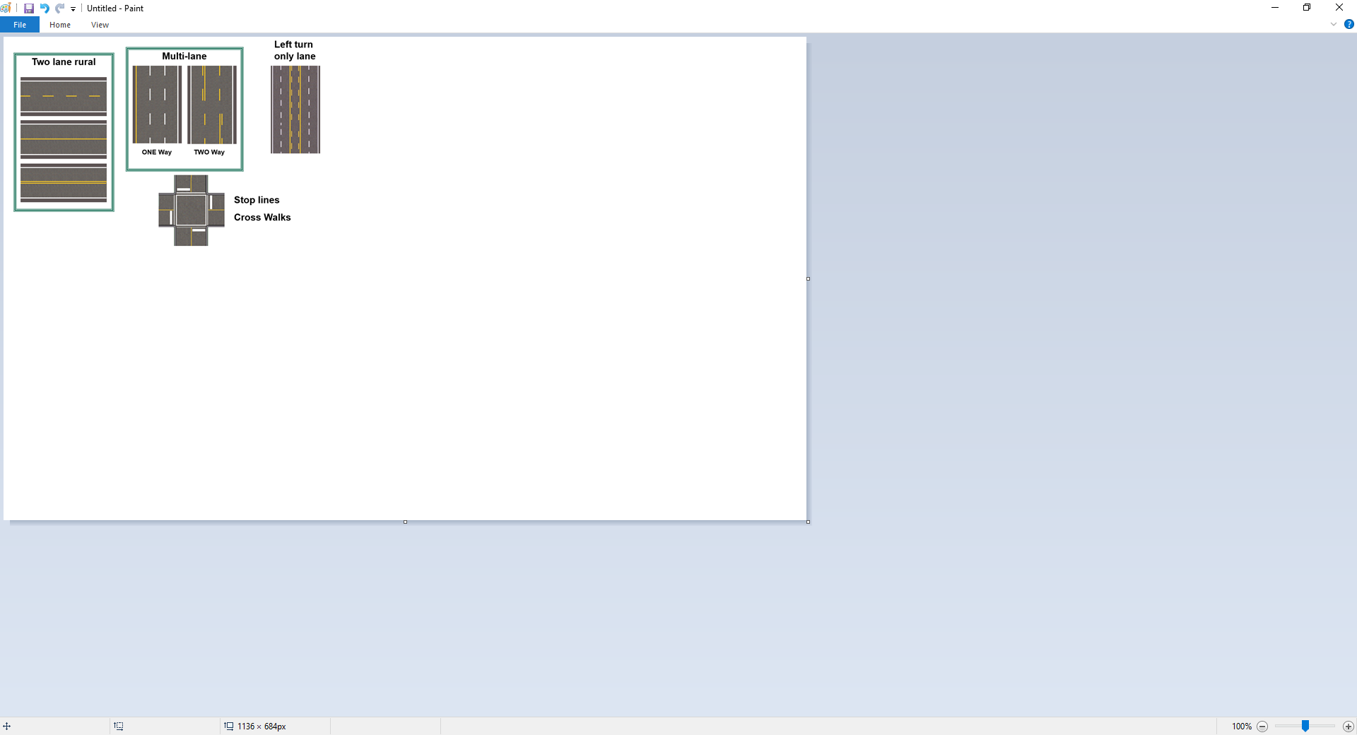
Pavement Markings

Slide 27
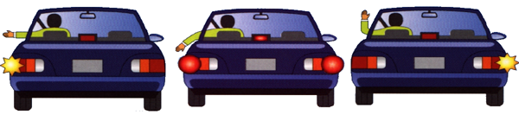
Signaling
How to signal
When to signal
X Improper signal

Slide 28

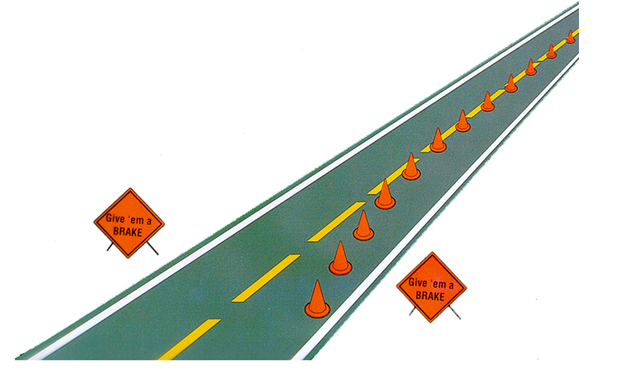
You are Entering a Work Zone

Slide 29

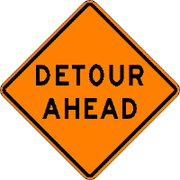
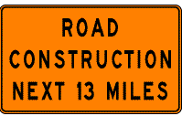
ORANGE Signals a Change
REMEMBER
Common Sense
Caution
Concentration

Slide 30
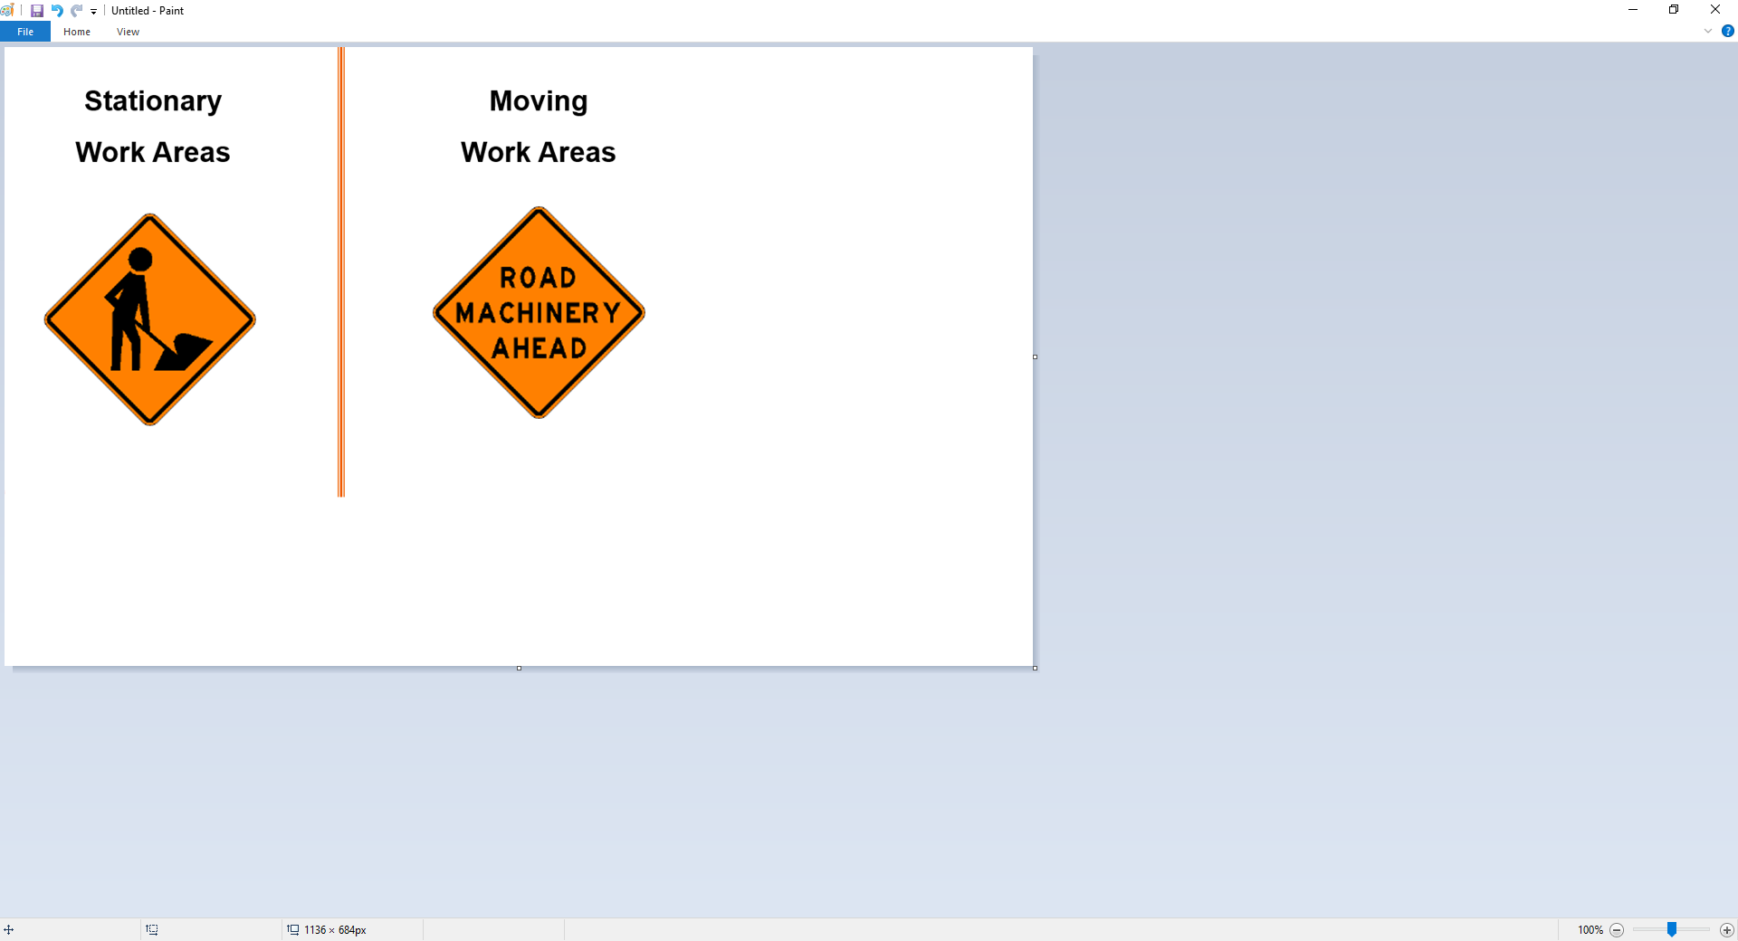
Types of Work Zones

Slide 31
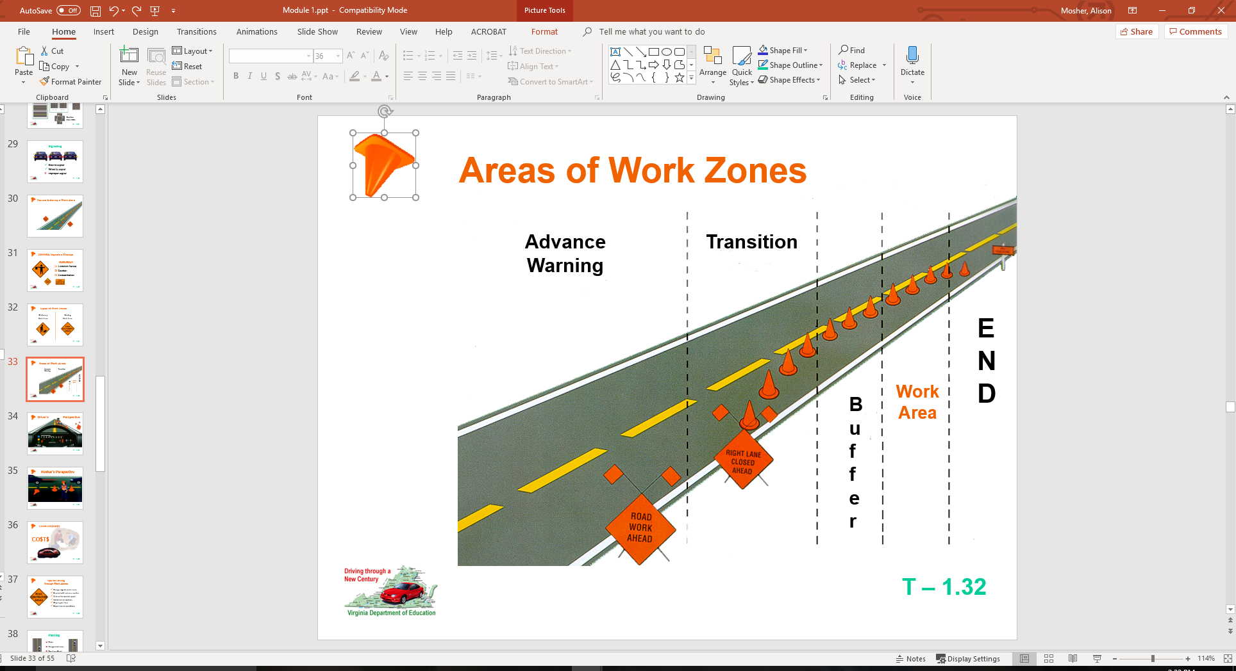
Areas of Work Zones

Slide 32
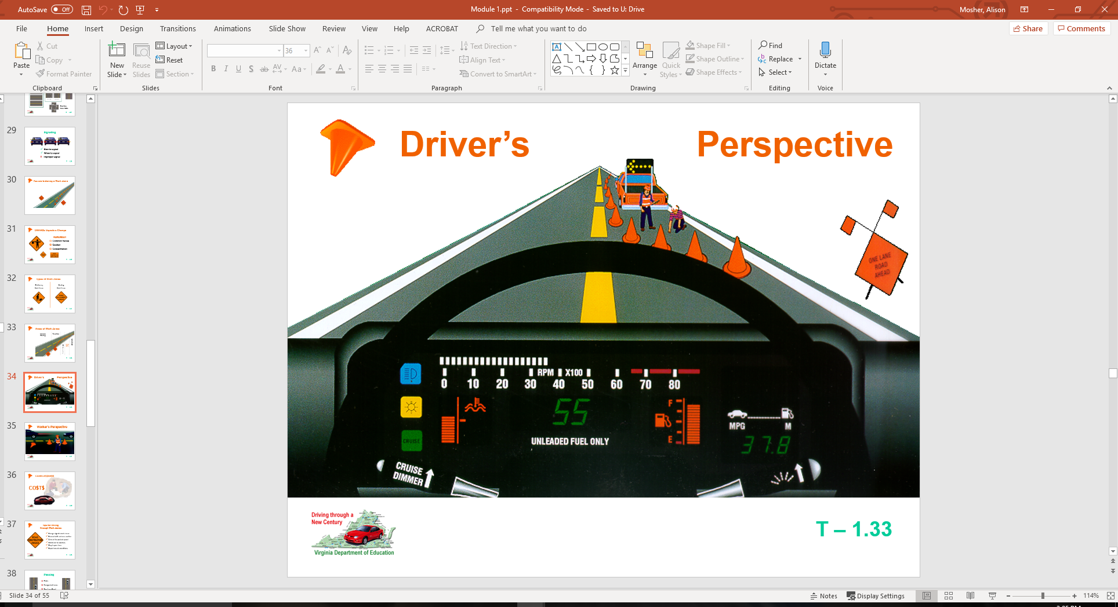

Slide 33
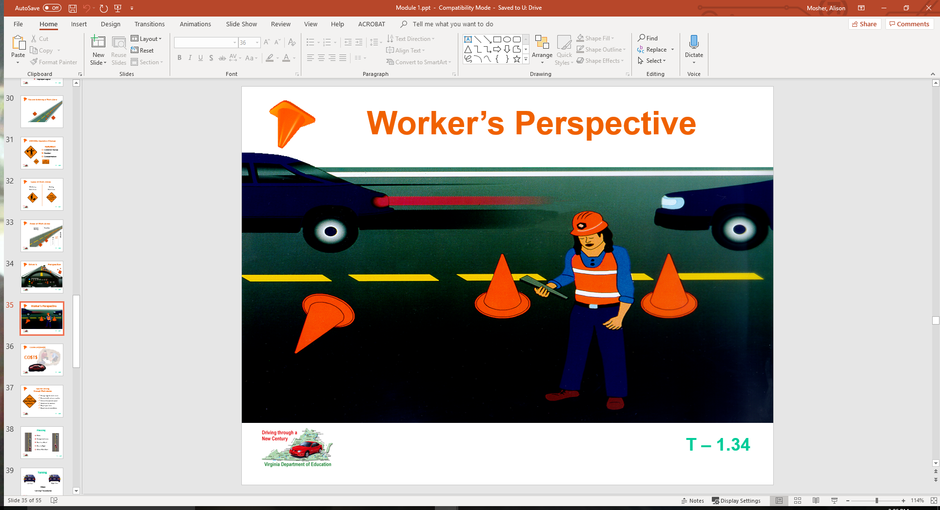

Slide 34
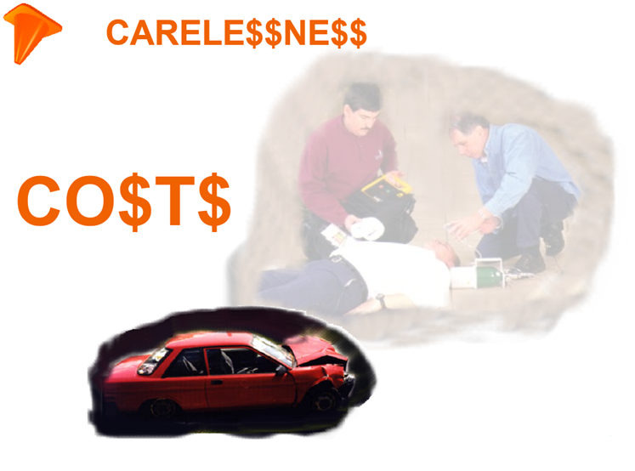

Slide 35

Tips for Driving Through Work Zones:
Orange signals work zones
Proceed with extreme caution
Drive at the posted speed
Watch out for workers
Stay in your lane
Report unsafe conditions

Slide 36
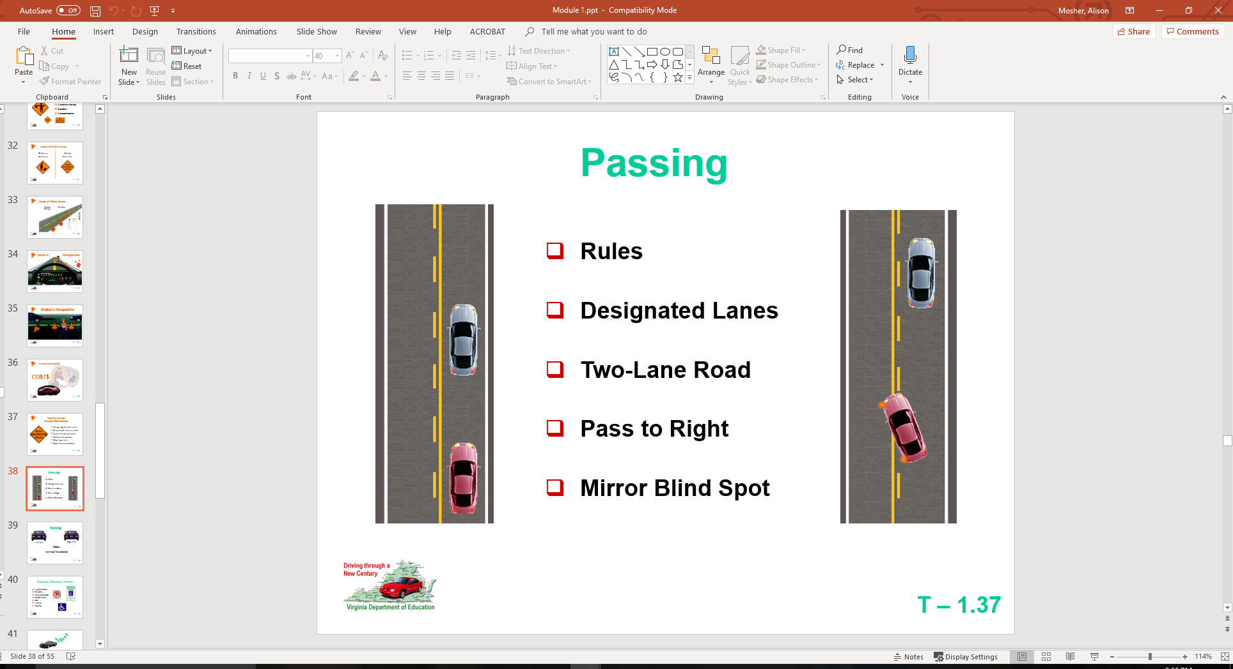
Passing

Slide 37
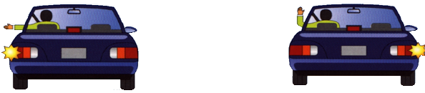
Turning
Left Turn
Right Turn
Steps
Turning Procedures

Slide 38
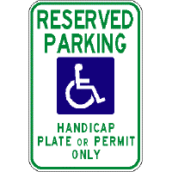

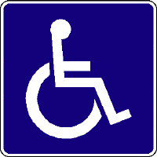
Stopping, Standing, Parking
Legal Prohibitions
Disabilities
Unattended Vehicle
Parallel to Curb
Hills
Leaving
Coasting

Slide 39
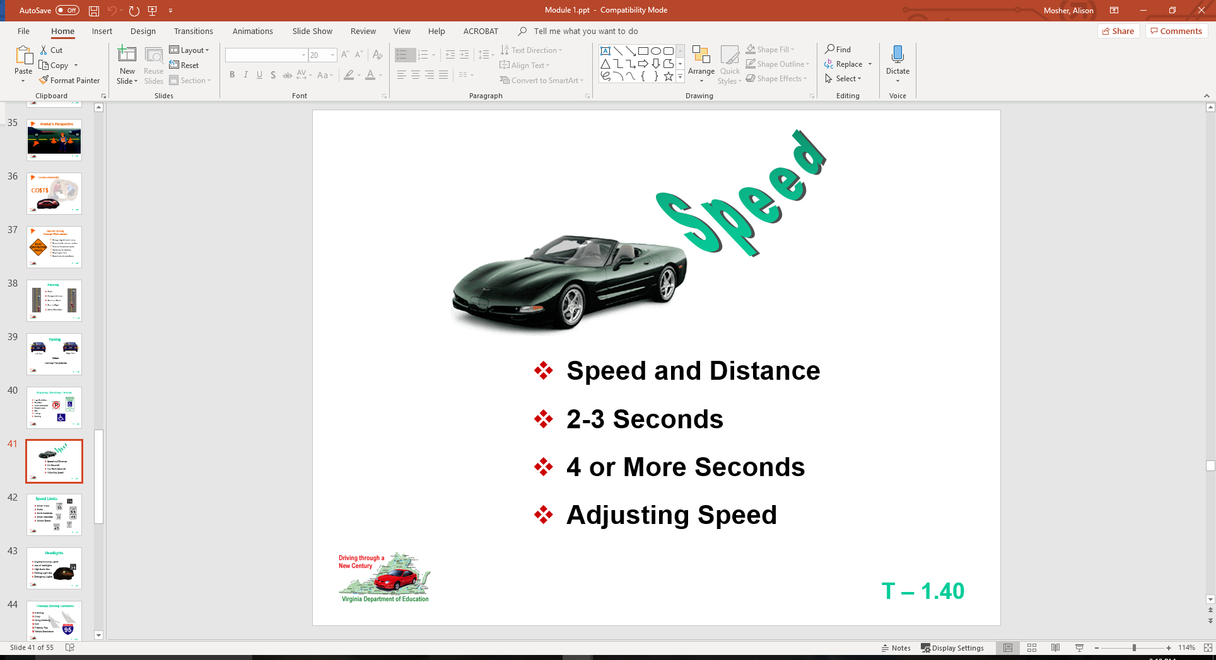

Slide 40
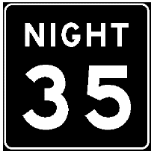
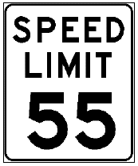
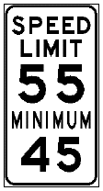
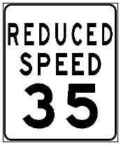
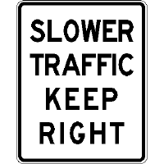
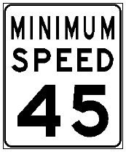
Speed Limits
Urban Areas
Parks
Rural Interstate
Urban Interstate
School Buses

Slide 41
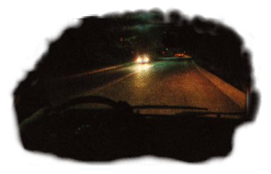
Headlights
Daytime Running Lights
Use of Headlights
High Beam Use
Parking Light Use
Emergency Lights

Slide 42
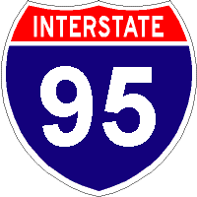
Freeway Driving Concerns
Planning
Entry
Using Roadway
Exit
Freeway Tips
Vehicle Breakdown

Slide 43
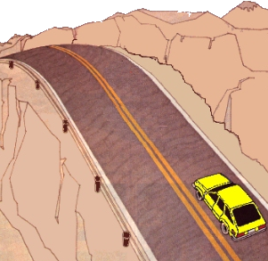
Problem Situations
Skid Control Fundamentals
Brake Failure
Running off Roadway
Tire Blowout
Steep Hill

Slide 44
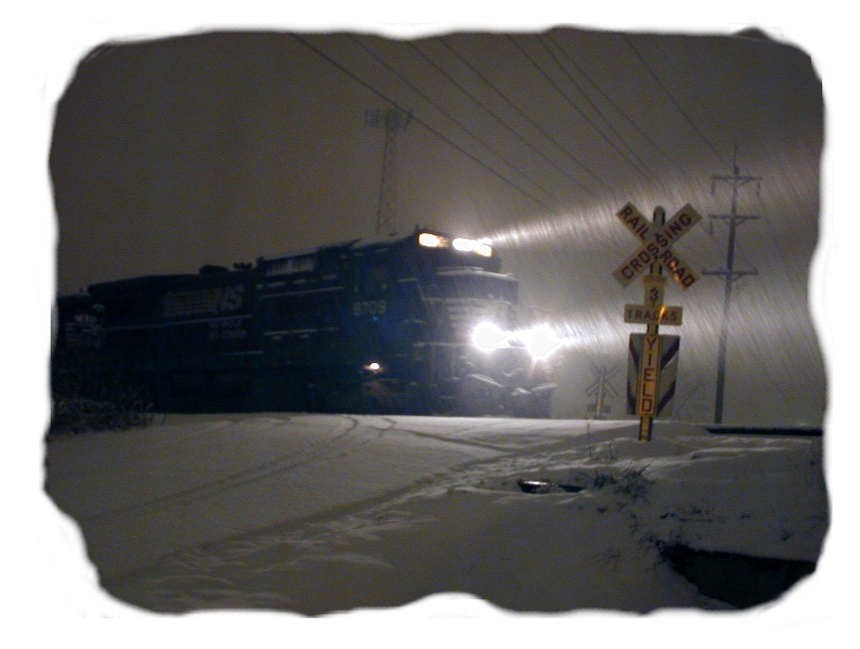
Winter Driving Concerns
Equipment
Following Interval
Speed
Visibility

Slide 45

Bicyclist Responsibilities
Cyclist Responsibilities
Full Lane Used by Bicyclist
Cyclist Not Restricted to Lane
Merging to Traffic Flow

Slide 46

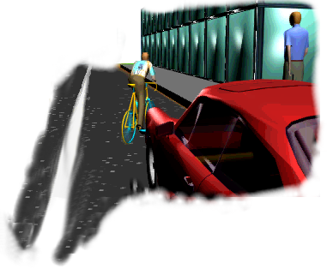
Sharing Roadway with Bicyclists
Right-of-Way Rules Apply
Beware of Oncoming Cyclist Turning
Merge with Bicycle Traffic Flow Turning Right
Beware of Oncoming Cyclist at Intersection

Slide 47



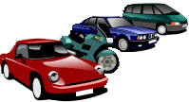
Bicycle Safety Issues
Traffic Laws
Safety Guidelines
Wet Weather Riding
Common Motorist Errors

Slide 48
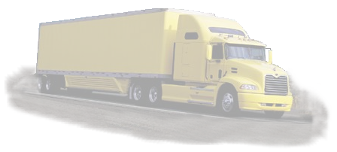
Sharing Roadway with Trucks
Passing
Following
Wide Turns
Backing
Maneuverability

Slide 49

Sharing Roadway with Motorcyclists
Typical Situations Motorist
Motorcycle Awareness
Responsibilities

Slide 50


Crash Involvement
STOP at Scene. See if anyone needs help.
Prevent Other Crashes
Notify Police
Provide Name and Address
When to Report
Unattended Vehicle
Blocking Traffic
Hit and Run Collisions

Slide 51

Aiding Injured
Calling for Help
Make No Injury Assumptions
Avoid Moving Victim
Control Serious Bleeding
Keep Victims Warm

Slide 52


Safety Concerns
Defensive Driving
Using Occupant Protection
Vehicles With Open Beds
When Stopped By Police
Speed Reduces Usable Vision
Carbon Monoxide

Slide 53

Safety Concerns
Keys to Safe Driving
Transporting Cargo
Safety Chains
Towing

Slide 54
Contact/Mission
For more information on Driver’s Education and Safety please visit PDE’s website at www.education.pa.gov
The mission of the Department of Education is to ensure that every learner has access to a world-class education system that academically prepares children and adults to succeed as productive citizens. Further, the Department seeks to establish a culture that is committed to improving opportunities throughout the commonwealth by ensuring that technical support, resources, and optimal learning environments are available for all students, whether children or adults.

