Slide 1
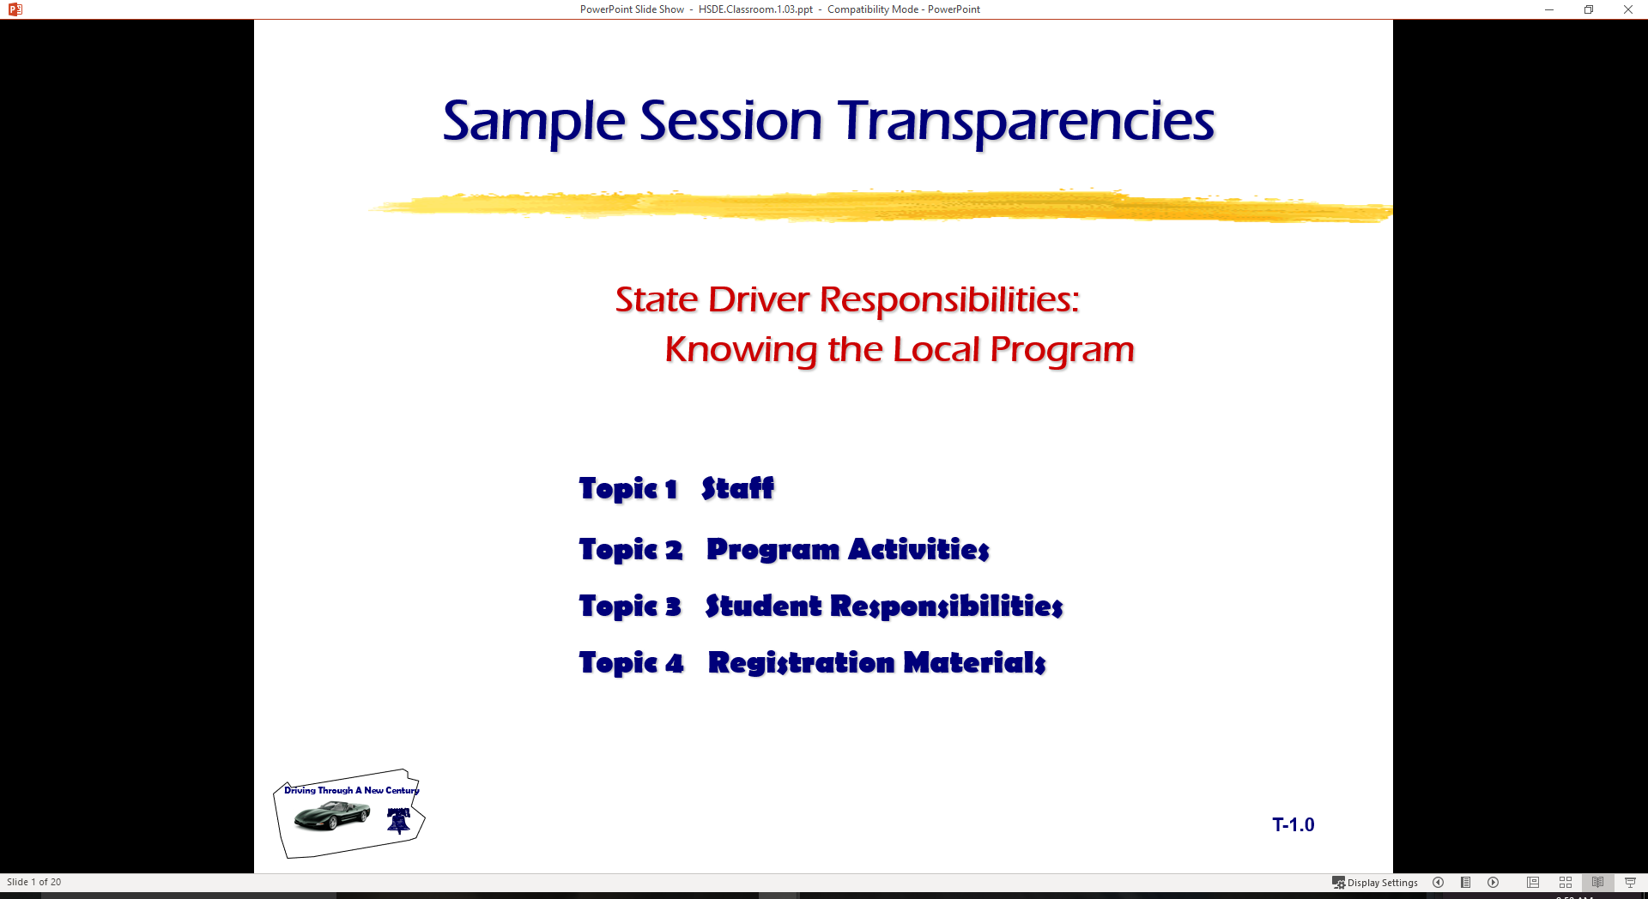
Driver Responsibilities: Knowing Your Vehicle and Developing a Driving System
  Topic 1 Vehicle Balance Considerations
  Topic 2 Targeting Skills
  Topic 3 Vision Requirements
  Topic 4 Introducing “SEE” Driving System

Slide 2
Introduction
Review of Range Lesson Two
  Standard Visual References
  Overcome Line of Sight (LOS) Limitations
  Need for Developing Targeting Skills
  Important to View from Line to Car
  … rather than from Car to Line or Curb
Vehicle Balance Concerns
  Next topical area with classroom and range
  How can you tell where your front bumper is?
Vehicle Control and Targeting Skills
  Next Simulation/Range activities will use Groups

Slide 3
Controlling Vehicle Balance
Vehicle Balance
  Specific amount of weight or down force on each tire patch
  Best balance is at rest with no movement
  Based on weight, suspension, and tire pressure
Vehicle movement
  Creates changes to the vehicle balance
  Due to suspension and pressure changes
Vehicle Balance Technical Terms
  Roll: vehicle moves from side to side
  Pitch: vehicle moves forward or backward
  Yaw: vehicle moves left or right

Slide 4
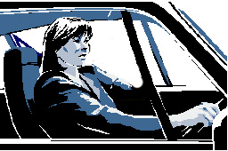
Controlling Vehicle Balance
Maintaining Vehicle Balance
  Steering Wheel Balance
    Smaller steering wheel
    Rack and pinion steering
  Changes In Steering Ratios and Mechanism
    Less steering needed for wheel response
    Amount of steering from left lock to right lock
    Prior to 1980 (4-5 turns), after 1980 (2-3 turns)
  Precise Steering, Braking and Accelerator Input Needed
    Less steering movements
    Squeeze brake
    Smooth acceleration and deceleration

Slide 5
Controlling Vehicle Balance
Seating
  Driver position behind the wheel
  Safety belt and dead pedal use
  Driver must be balanced to recognize vehicle balance
Changing Vehicle Balance Side to Side (Roll)
  Sudden Steering Wheel Movements
    Affect the amount of side to side movements
    Driver feels vehicle tilt to right or left
  Sudden Brake Application And Steering Combinations
    Affects the amount of side to side movements
    Driver feels movement tilt to the right or left corner of vehicle

Slide 6
Vehicle Control
Changing Vehicle Balance Front to Rear (Pitch)
  Releasing brake
  Covering accelerator
  Light accelerator pressure
  Progressive accelerator pressure
  Thrust accelerator pressure
Changing Vehicle Balance Rear to Front (Pitch)
  Differences between vehicles
  Driver position for best brake pedal control
  Releasing the accelerator
  Covering the brake
  Controlled brake (Squeeze on)
  Threshold brake
  Trail braking (Squeeze off)

Slide 7
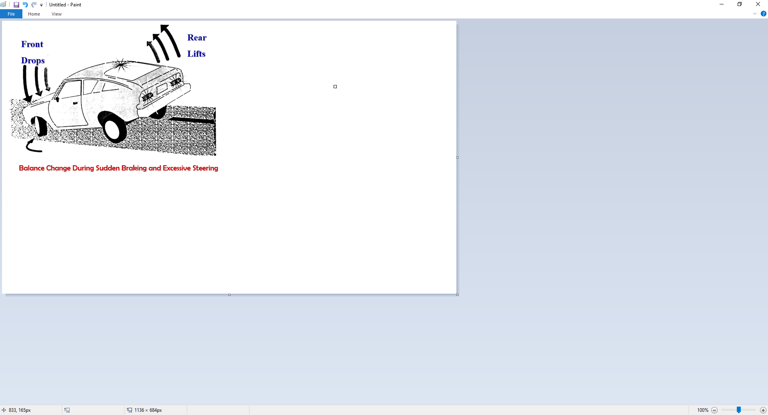
Vehicle Control

Slide 8
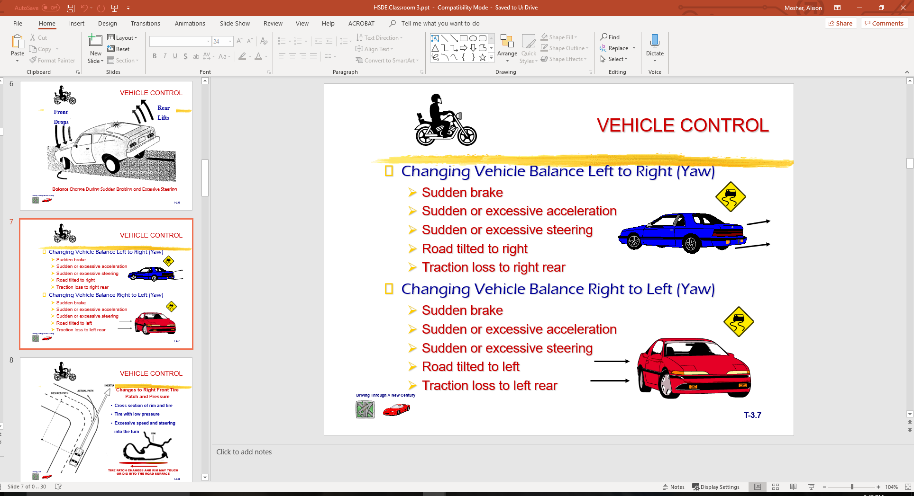
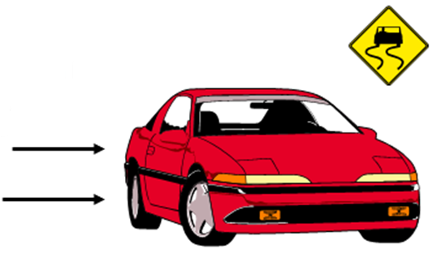
Vehicle Control
Changing Vehicle Balance Left to Right (Yaw)
  Sudden brake
  Sudden or excessive acceleration
  Sudden or excessive steering
  Road tilted to right
  Traction loss to right rear
Changing Vehicle Balance Right to Left (Yaw)
  Sudden brake
  Sudden or excessive acceleration
  Sudden or excessive steering
  Road tilted to left
  Traction loss to left rear

Slide 9
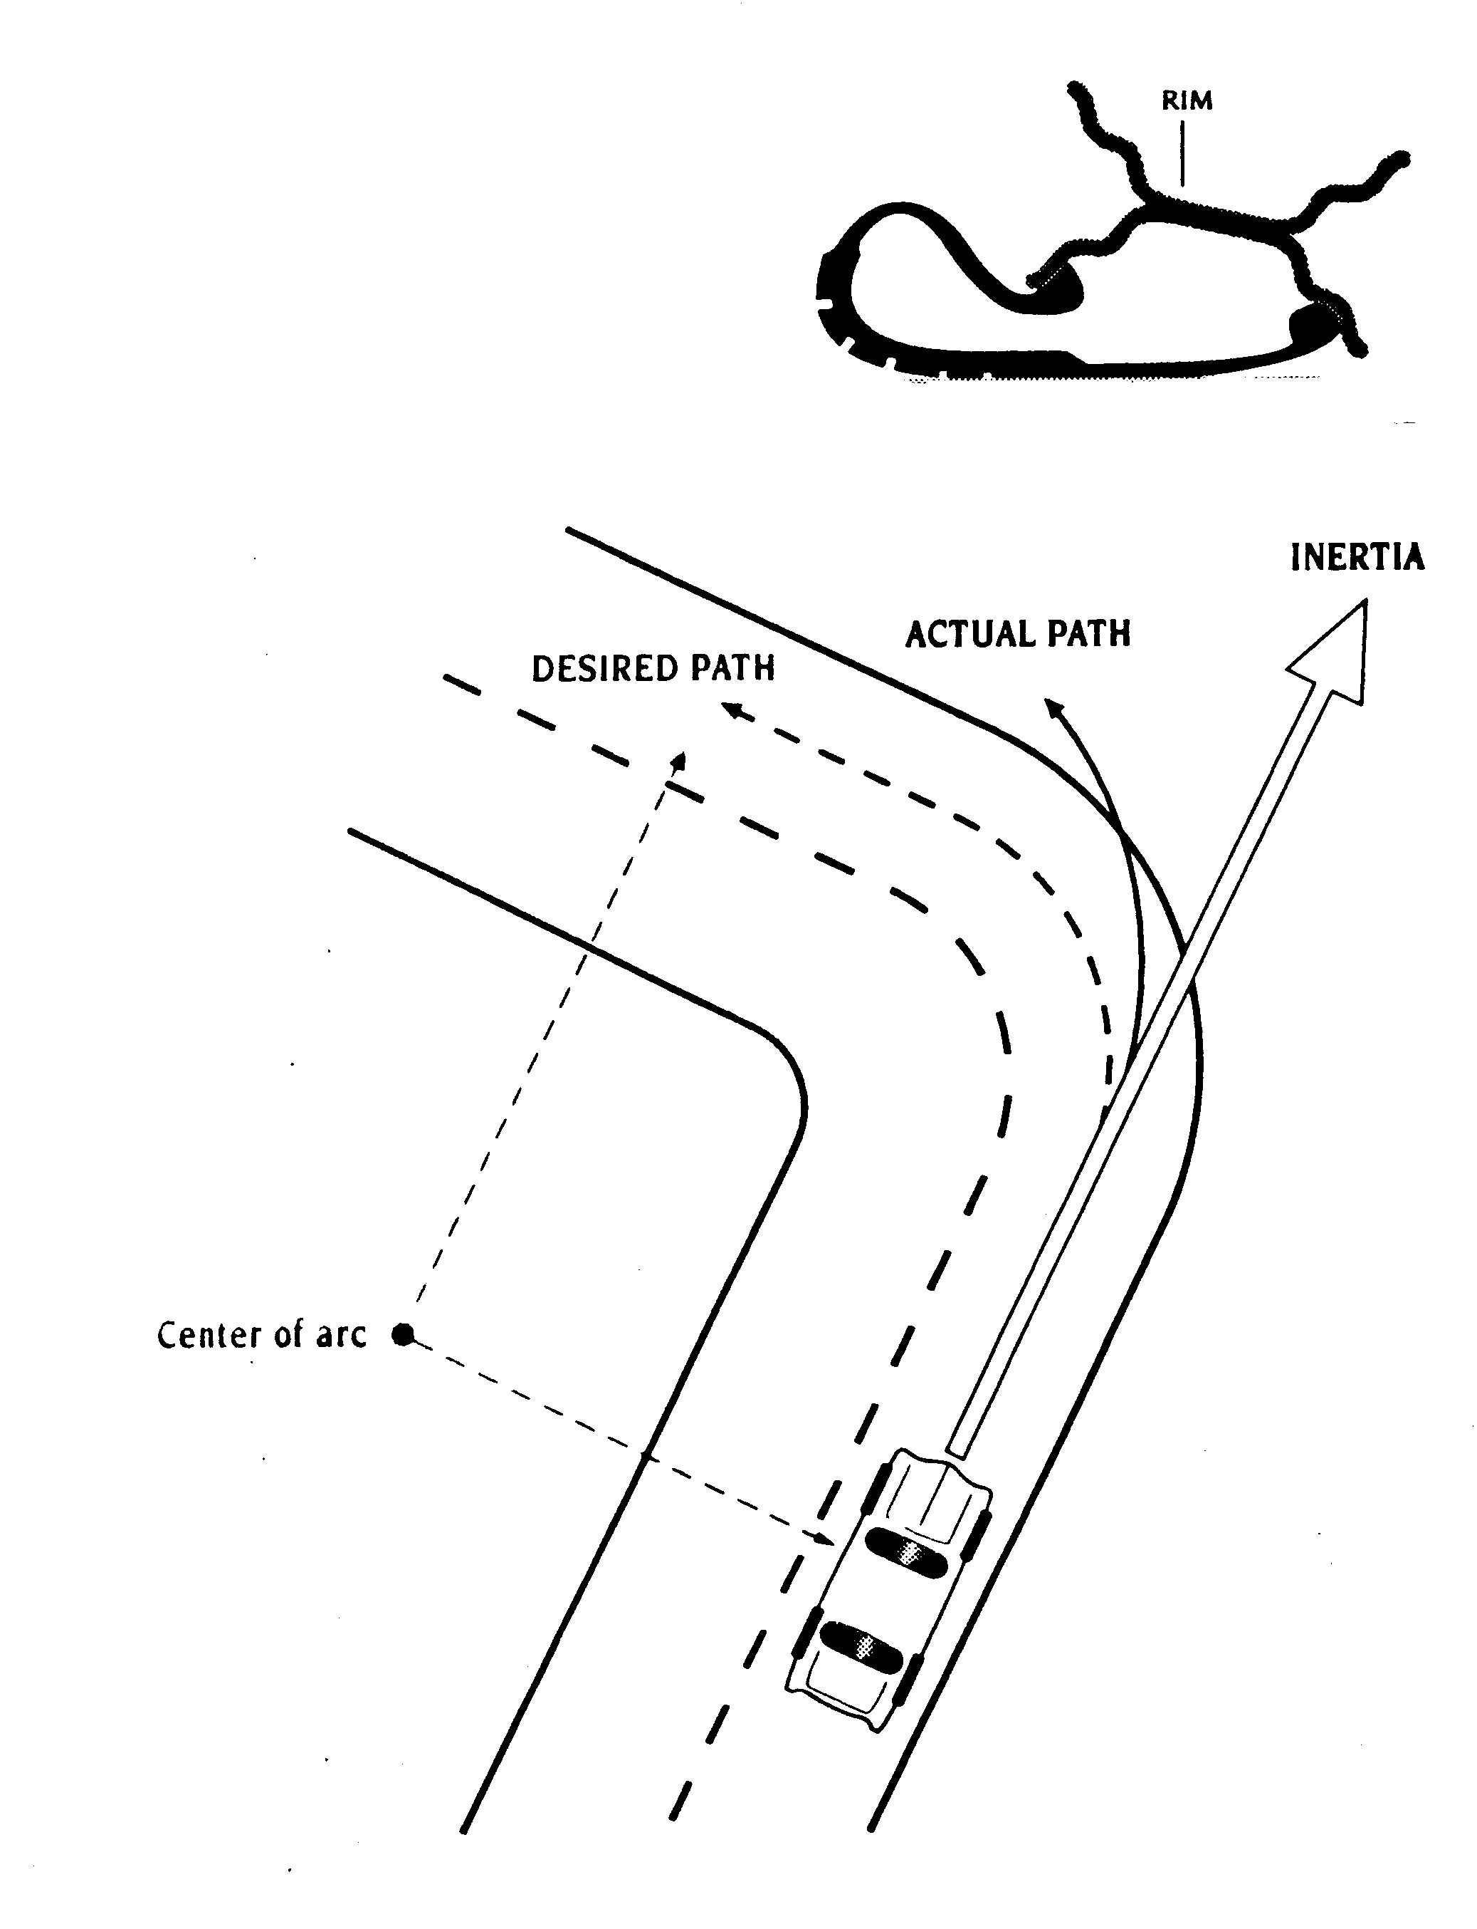
Vehicle Control
Changes to Right Front Tire Patch and Pressure
Cross section of rim and tire
Tire with low pressure
Excessive speed and steering
into the turn
TIRE PATCH CHANGES AND RIM MAY TOUCH OR DIG INTO THE ROAD SURFACE

Slide 10
Vehicle Control
Steering Wheel Control
  Hand position on steering wheel
    Holding top of Wheel (Poor balance & Air bag threat !!!)
    On upper half of wheel (Less balance & Air bag threat !!!)
    On lower half of wheel (Better balance with smaller wheel)
  Steering techniques
    Hand to Hand steering (recommended for air bag equipped))
    Hand over Hand steering (very low speed maneuvers)
    Limited evasive steering (ABS limitation to steering input)
    One hand steering (8 or 9 wheel position recommended)
      Side (8,9) or (3,4) to reach controls
      Top (12) when backing straight (limited air bag threat)
      Bottom (5,6,7) when backing trailer device

Slide 11
Targeting and Visual Requirements
Targeting is visual function
  Directed use of focus vision
Maintaining an open line of sight
  From target to front of vehicle
  Use of fringe vision (central vision)
Targeted path of travel
  Determines projected path of vehicle travel
Referencing vehicle to roadway position
Using standard references
  Vehicle placement within lane
  Vehicle placement to front and rear
  Vehicle placement to the side

Slide 12
Vision and Perception Requirements
Gaining Visual Information
  Focus Vision (Focal/Foveal)
  Useful Field of View (Limited Fringe Area)
  Peripheral Vision
Maintaining an Open Line of Sight (LOS)
Developing Searching Skills

Slide 13
Vision and Perception Requirements
Targeting, Line of Sight, Path of Travel
Referencing Vehicle to Path of Travel
Using Visual References
Using Turn Points to Start Turning Process
  Forward visual turning points
  Rear visual turning points

Slide 14
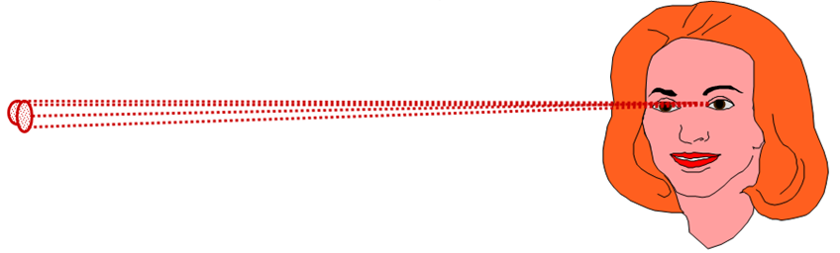
Driver’s Useful Vision Areas
Gathering Useful Visual Information
Focus Vision Area (Focal)
— 3 to 5 degrees of useful information—
  Targeting Skills
  Establishing Visual Lead
  Reading Signs and Interpreting Signals

Slide 15
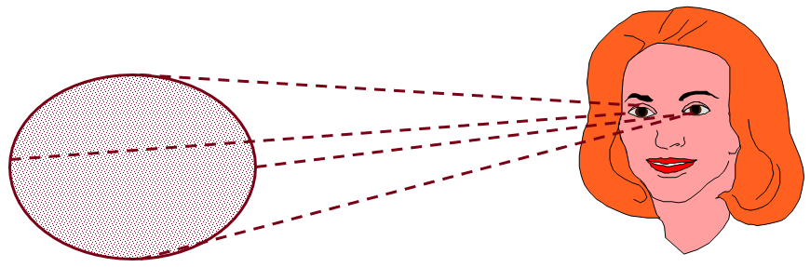
Driver’s Useful Vision Areas
Gathering Useful Visual Information
Useful Field of View (Inner Fringe)
— 30 to 36 degrees of useful information —
  Vehicle to Roadway Reference
  Viewing Path of Travel
  Viewing Line of Sight to Target Area

Slide 16
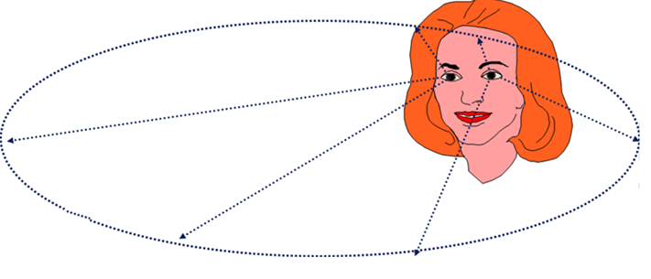
Driver’s Useful Vision Areas
Gathering Useful Visual Information
Peripheral Vision (Outer Fringe)
— 175 to 185 degrees of useful information —
  Motion Changes
  Color Changes

Slide 17
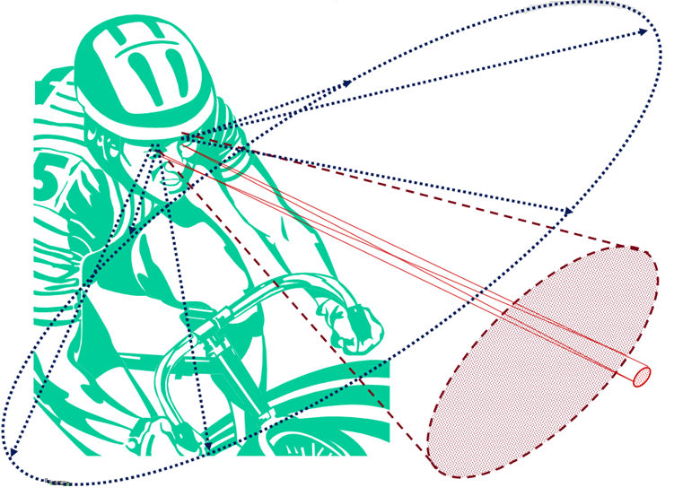
Visual Fields in Operation

Slide 18
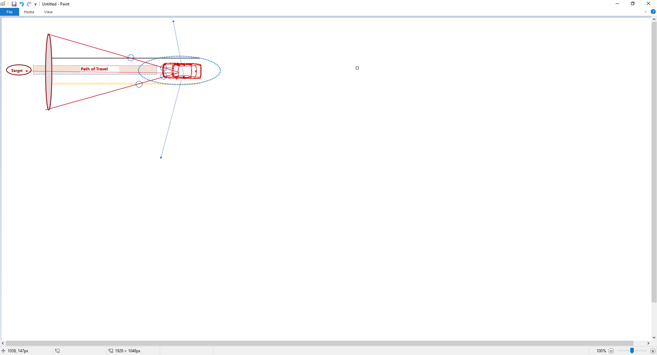
Visual Fields in Operation
Standard Visual Reference for Lane Position 1
When focus vision is on the target at the end of the path of travel, the central or inner fringe vision will allow the driver to see the placement of vehicle in the roadway...

Slide 19
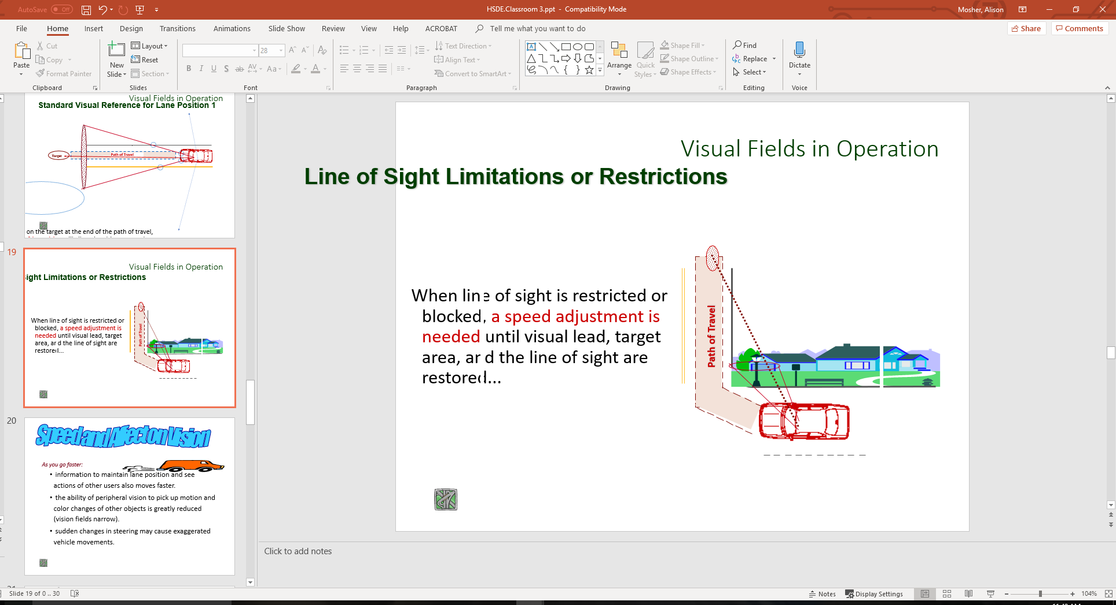
Visual Fields in Operation
Line of Sight Limitations or Restrictions
When line of sight is restricted or blocked, a speed adjustment is needed until visual lead, target area, and the line of sight are restored...

Slide 20
Speed and Affect on Vision
As you go faster:
  information to maintain lane position and see actions of other users also moves faster.
  the ability of peripheral vision to pick up motion and color changes of other objects is greatly reduced (vision fields narrow).
  sudden changes in steering may cause exaggerated vehicle movements.

Slide 21
Speed and Affect on Vision
Looking farther away from your vehicle lengthens or increases line of sight (LOS) and path of travel (POT) areas which:
  allows more time to get information;
  increases peripheral vision field, giving time for adequate response; and,
  places more space between other users and your vehicle, so sudden steering changes are held to a minimum.

Slide 22
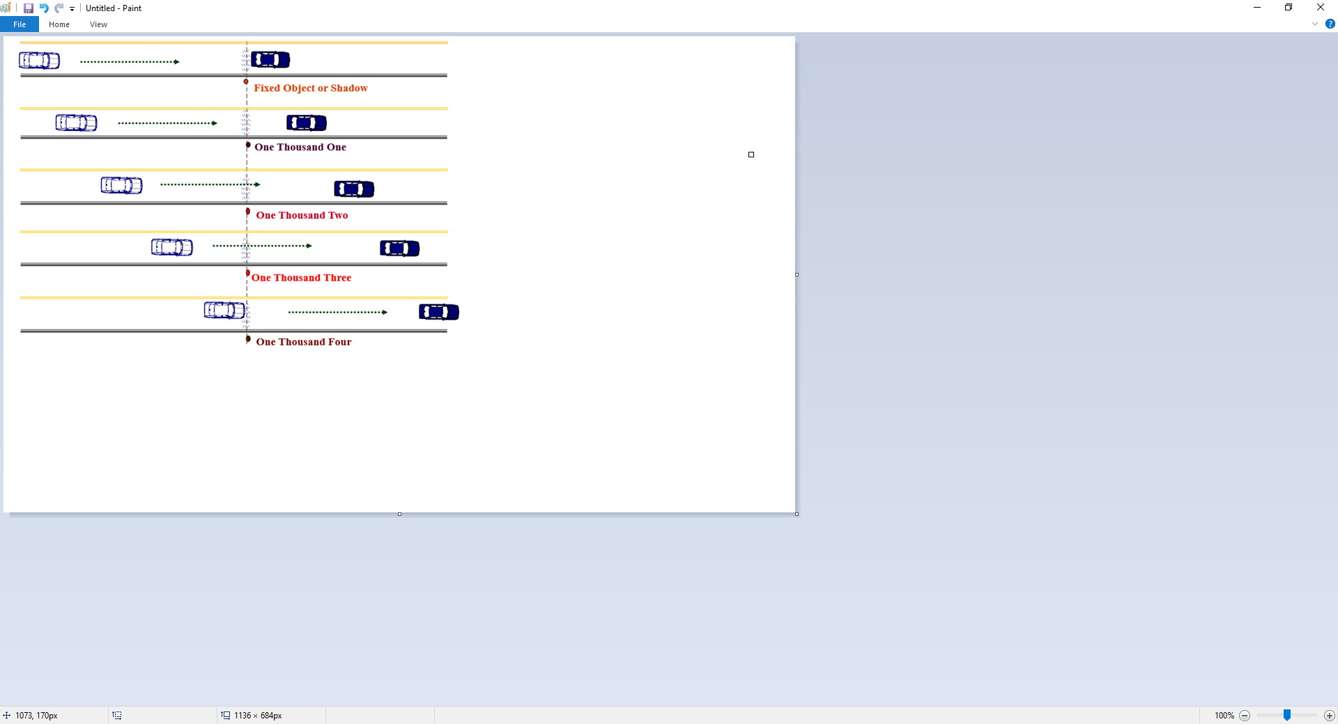
Determining Following Intervals

Slide 23
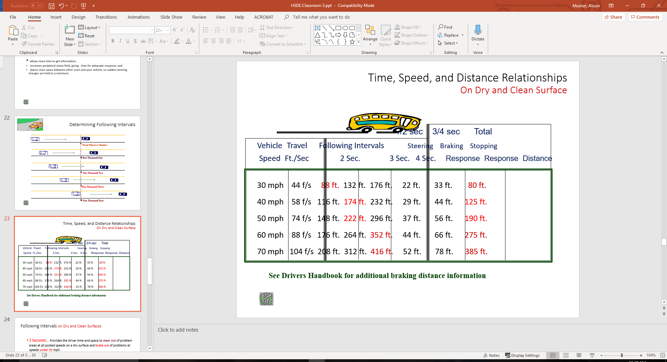
Time, Speed, and Distance Relationships
On Dry and Clean Surface

Slide 24
Following Intervals
On Dry and Clean Surfaces
2 Seconds… Provides the driver time and space to steer out of problem areas at all posted speeds on a dry surface and brake out of problems at speeds under 35 mph.
3 Seconds… Provides the driver time and space to steer out of problem areas at all posted speeds on dry surface and brake out of problems at speeds to 45 mph.
4 Seconds… Provides the driver time and space to steer out of problems at all posted speeds on dry surface and brake out of problems at speeds up to 70 mph.
  Note: Factory equipped passenger car tires may not be designed to steer out of problem areas at speeds beyond 75 mph. Speed rated tires may be required due to tire side wall flexion problems at higher speeds combined with turning movements.

Slide 25
(S)EARCHING
SEE Driving System
Looking for high risk situations
  Searching techniques important
  Time for perceiving hazards
  Getting larger view of roadway
  Keeping stable eye movements
  Line of sight and path of travel
Gaining information
  Space management
  Looking for changing areas
  Looking for open areas
  Looking for closed areas

Slide 26
(E)VALUATING
SEE Driving System
Recognizing high risk situations
  Potential and critical hazards
  Collision potential
  Intersections
  Curvatures
  Speed Adjustments
  Position Adjustments

Slide 27
(E)VALUATING
SEE Driving System
Decision-making
  Preventing high risk situations
    Open LOS and POT & proper lane position
    Time & space control
  Controlling high risk situations
    Open line of sight (LOS) and path of travel (POT)
    Motion control
      Controlled/threshold braking
      Progressive acceleration
    Steering control
      Hand to hand
      Evasive action

Slide 28
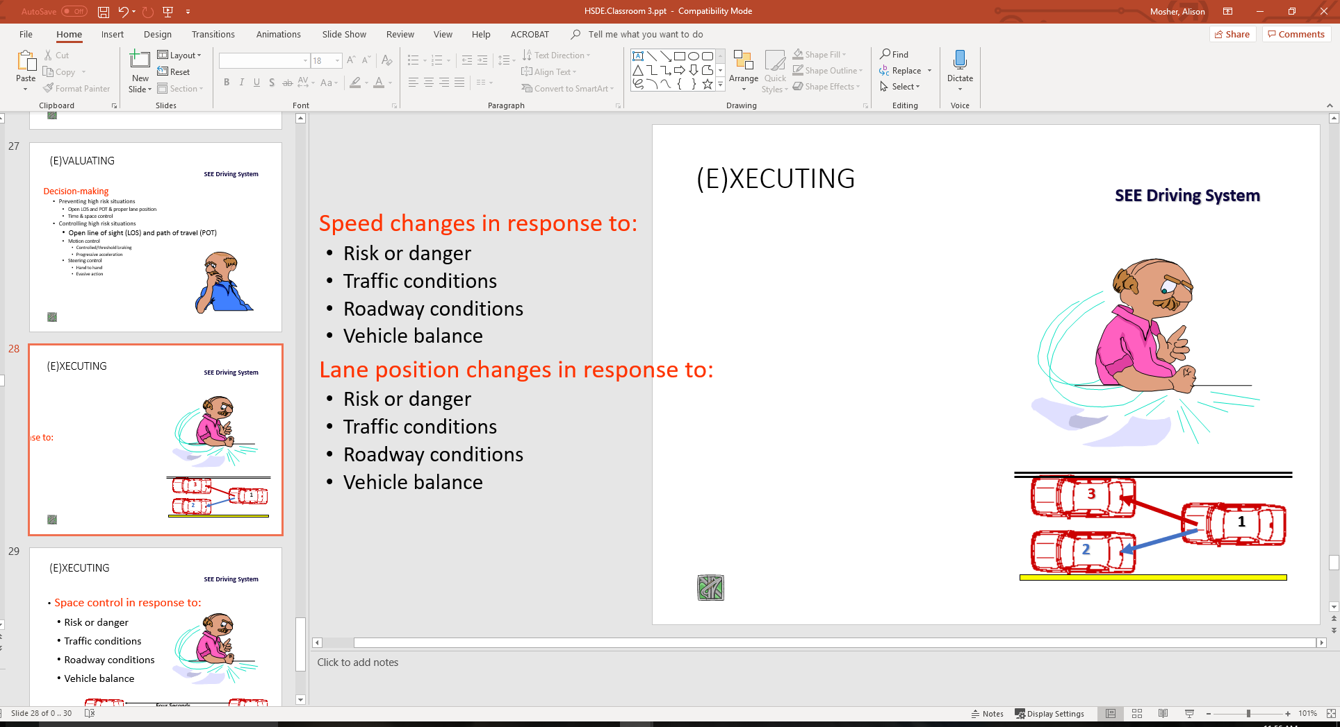
(E)XECUTING
SEE Driving System
Speed changes in response to:
  Risk or danger
  Traffic conditions
  Roadway conditions
  Vehicle balance
Lane position changes in response to:
  Risk or danger
  Traffic conditions
  Roadway conditions
  Vehicle balance

Slide 29
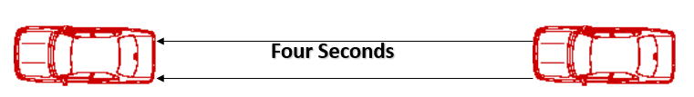
(E)XECUTING
SEE Driving System
Space control in response to:
  Risk or danger
  Traffic conditions
  Roadway conditions
  Vehicle balance

Slide 30
Assignment
Range Activity Group
  Auto Control Monster
  Take activity sheets to vehicle
Simulation Activity Group
  Sign in on attendance sheet
  Place grade on your sheet
  Note your simulator number

Slide 31
Contact/Mission
For more information on Driver’s Education and Safety please visit PDE’s website at www.education.pa.gov
The mission of the Department of Education is to ensure that every learner has access to a world-class education system that academically prepares children and adults to succeed as productive citizens. Further, the Department seeks to establish a culture that is committed to improving opportunities throughout the commonwealth by ensuring that technical support, resources, and optimal learning environments are available for all students, whether children or adults.

