Slide 1
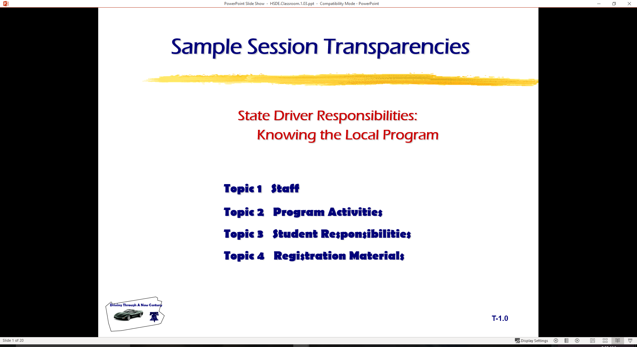
Driver Responsibilities: Knowing Traffic Laws
  Topic 1 Your License to Drive
  Topic 2 Right of Way Concepts
  Topic 3 Traffic Control Devices
  Topic 4 Controlling Traffic Flow
  Topic 5 Alcohol and Other Drugs
  Topic 6 Cooperating with Other Users

Slide 2
Driver Education Program Goals
A student completing a State driver education program will:
Demonstrate a working knowledge of
  laws for operating and owning an automobile
  rules for operating and owning an automobile
  procedures for operating and owning an automobile
  occupant restraints and new vehicle technology
Use a space management system to
  obtain correct information about driving maneuvers
  make reduced-risk decisions about driving maneuvers
  adjusting position and/or speed to avoid conflicts and reduce risk

Slide 3
Driver Education Program Goals
A student completing a State driver education program will:
Manage factors that affect driver performance by
  developing refusal skills with alcohol and other drugs
  controlling displays of anger in traffic situations
  eliminating aggressive actions in traffic flow
  maintaining fitness and attitudes needed for reduced-risk driving performance
Protect natural resources by
  safe disposal of trash and toxic products
  conserving fuel and energy resources
  utilizing manufacturer’s vehicle maintenance specifications

Slide 4
Driver Education Program Goals
In this State, driver education students acquire the essential knowledge, skills, and experiences to perform reduced-risk driving practices in the total traffic environment.
Mastery of classroom and in-car instruction include:
Modeling behaviors
Knowledge and skills assessment
Observation
Parental/Mentor involvement
Continuous life-long learning of reduced-risk driving

Slide 5
Who May Operate
Residents with Valid License
Driver of U.S. or State Military Vehicle
Driver of Farming Equipment
A Non-resident at least 16 or 18 with Valid License
Member of U.S. Armed Forces Outside State
Nonresident on Active Military Duty
New Residents for 30 days

Slide 6
Types of State Licenses
Instructional Permit
Provisional License
Classified Driver License
Commercial Driver License
Essential Need License
Identification Card

Slide 7
Specialty Information
Allergic Reaction to Drugs
Anatomical Gifts
Health Care Directives
Social Security Information

Slide 8
Licensing Restrictions
Restriction Code
Endorsement Code
Removing Restrictions
Adding Endorsements

Slide 9
Licensing Renewal
Duplicate
  Application
  Costs
  Procedures
Renewal
  Application
  Costs
  Procedures

Slide 10
Suspensions/Revocations
Suspension
Revocation
Cancellation
Mandatory Suspensions
Discretionary Suspensions/Revocations
Individuals Under 21

Slide 11
Suspensions/Revocations
Administrative License Revocation
Cancellations
Court Ordered Suspensions/Revocations
Driving While License Suspended
Sanctions for Non-driving Alcohol Offenses by Minors

Slide 12
Inspection/Registration
Vehicle Inspection
Required Equipment
Illegal Equipment
Optional Equipment
Vehicle Registration

Slide 13
Financial Responsibility
  The Liability Insurance Law
  The Safety Responsibility Act
  Evidence of Financial Responsibility

Slide 14
Right-of-Way Concepts
Drivers at times must wait for other users.
Principles based on giving the privilege of passage to others.
Right of way cannot be taken — not a right or privilege.
Determined by a set of rules and guidelines
  Intersections
  Merges
  Special conditions.

Slide 15
Intersections
Intersections controlled by signs and signals.
Single or two-lane road intersecting with multiple-lane road.
Unpaved road intersection with a paved road.

Slide 16
Intersections
Intersections not controlled by signs and signals, multi-lanes, or pavement.
Turning left.
T Intersections
Railroad grade crossings.

Slide 17
Merge (Lane Change) Areas
Entering or leaving controlled-access highway.
Driving on multiple-lane roadways

Slide 18
Special Situations
Give the Right-of-Way to Emergency Vehicles.
Give the Right-of-Way to School Buses.
Give the Right-of-Way to Pedestrians.

Slide 19
Railroad Crossings
Marked only with a crossbuck sign.
A train is approaching.
Red lights are flashing at a railroad crossing.
Railroad crossing arms have been lowered.
Never stop on tracks.
Be sure all tracks are clear before you proceed across.
Trains do not and cannot stop at crossings.

Slide 20
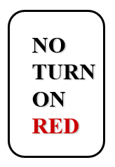
Signals
Steady lights.
Flashing lights.
Signal/sign combinations.

Slide 21
Signs
Warning
Guide
Inform
Regulate

Slide 22
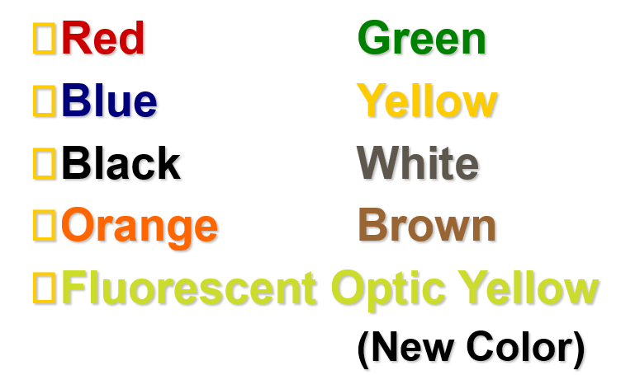
Colors Have Meaning

Slide 23
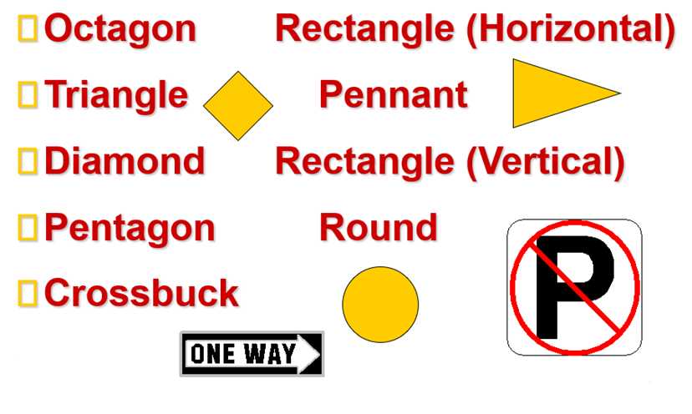
Shapes Have Meaning

Slide 24
Pavement Markings
Two lane rural Three lane, one way
Left turn only lane Multi-lane highways
Solid lines Broken lines
Crosswalks Stop lines
Lane markings

Slide 25
Signaling
When to signal
How to signal
Improper signal

Slide 26
Passing
Rules
Designated Lanes
Two-lane road
Pass to Right
Mirror Blind Spot /BGE Setting Method

Slide 27
Turning
Steps
Right Turn
Left Turn
Turning Procedures

Slide 28
Stopping, Standing, Parking
Legal Prohibitions
Disabilities
Unattended Vehicle
Parallel to Curb
Hills
Leaving
Coasting

Slide 29
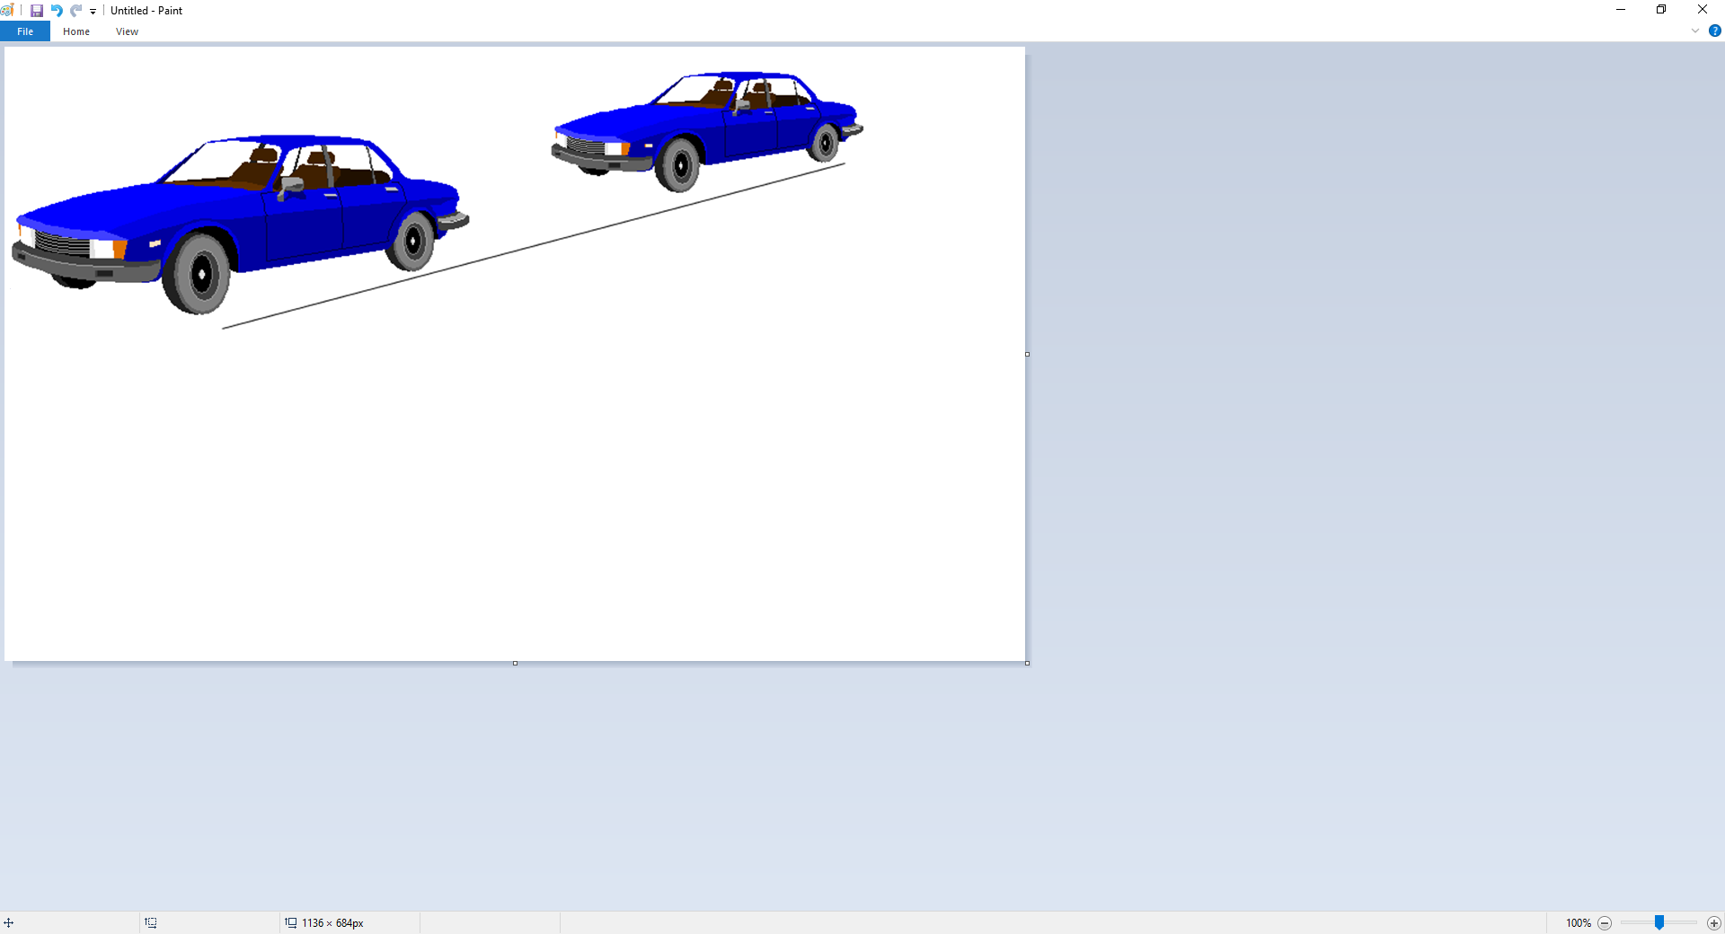
Speed
Speed & Distance
3 seconds minimum following interval
  NSC recommends adding 1 sec for each mitigating factor
4 or more seconds
  Novice = 3+1 sec for minimum following interval
Adjusting Speed

Slide 30
Speed Limits
Urban Areas
Parks
Rural Interstate
Urban Interstate
School Buses

Slide 31
Headlights
Daytime Running Lights
Use of Headlights
High Beam Use
Parking Light Use
Emergency Lights

Slide 32
Freeway Driving Concerns
Planning
Entry
Using Roadway
Exit
Freeway Tips
Vehicle Breakdown

Slide 33
Problem Situations
Skid Control Fundamentals
Brake Failure
Running Off Roadway
Tire Blowout
Steep Hill

Slide 34
Winter Driving Concerns
Equipment
Following Interval
Speed
Visibility

Slide 35
State Alcohol Laws
What items would constitute a minor in possession violation?
Give six ways a license may be illegally used.
Give two definitions of intoxication.
What is P.I.?
Does State have an open container law?
Are the penalties for DWI the same for all age persons?
What is DUI?
What is ALR and implied consent?

Slide 36
Minor In Possession (MIP)
Attempting to purchase alcoholic beverage
Purchase of alcoholic beverage
Possession of an alcoholic beverage
Consumption of alcoholic beverage
Misrepresentation of age to purchase an alcoholic beverage

Slide 37
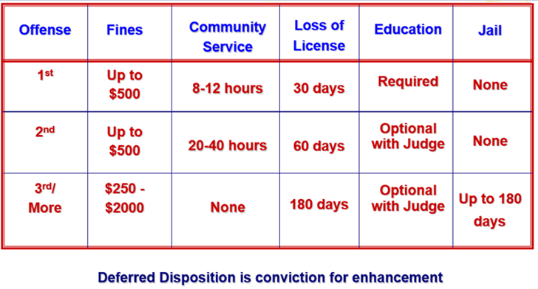
MIP Penalties

Slide 38
Improper Use of a License
Use of false name/address to get a license
Possess more than one license
Use a cancelled or revoked license
Use another person’s license
Lend your license to others
Display or possess a false license
Name
Address
Address
Driver License
PENALTIES: Up to $2000 fine
and/or Jail Time (up to 180 days)

Slide 39
Driving While Intoxicated
A person commits an offense if the person is intoxicated while operating a motor vehicle in a public place.
Intoxication
Not having the normal use of mental or physical faculties because of alcohol, a legal or illegal drug, a combination of those substances, or any other substance into the body.
OR
Having an alcohol concentration of .08 or more.
Note: A DWI violation is not age specific

Slide 40
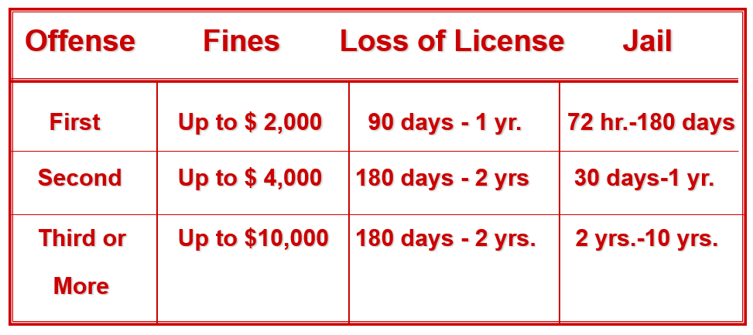
State DWI Penalties

Slide 41
DWI by Minor Penalties
Under 17 DWI Penalties
  Loss of license to 19 or 365 days (longer of two)
  Other possible penalties
    Probation to age 18
    Adult penalties if certified
    Fine and jail
Over 17 but Under 21 DWI Penalties
  Fine and jail same as adult
  License loss - I year (instead of 90 days to one year option)
  DWI Education does not prevent license loss
    unless probation condition requires ignition interlock
  DWI Education may also be required

Slide 42
Public Intoxication
Danger to self or others.
In a public place.
Intoxicated
Penalty to $500
Under 21: same as MIP

Slide 43
Open Container Law
Alcohol in driver’s immediate possession
Driver must be convicted of DWI
Penalty - 3 additional days in jail

Slide 44
Consumption Law
Driver must be seen drinking alcohol while driving
Penalty - up to $500 fine

Slide 45
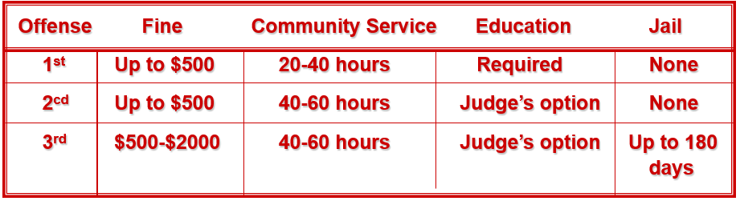
Driving Under the Influence (DUI) By Minor
Unlawful to operate a vehicle in a public place with ANY detectable amount of alcohol
DUI by Minor Penalties

Slide 46
Administrative License Revocation (ALR) Implied Consent
Definitions: ALR is failure (.08 or greater) of breath or blood test while implied consent is refusal of breath or blood test
Penalties: Loss of driver license from 60 days to 1 yr. (depending on offense) Apply even if DWI case not prosecuted
Fee: $100 License Reinstatement

Slide 47
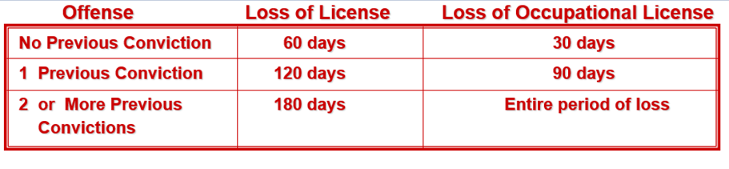
ALR for Minors
Minor qualifies for Administrative License Revocation when
  Breath/Blood test indicates ANY detectable amount of alcohol
  Police officer detects alcohol use
  Possible arrest and conviction for:
    DUI by minor, DWI, or Intoxication Assault/Manslaughter
Penalties for ALR Failure (may be in addition to those listed above)

Slide 48
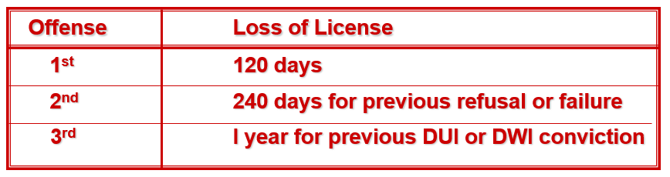
Implied Consent for Minors
DUI by Minor or DWI arrest may be the reason for a breath/blood test request by a law officer
Test Refusal Penalties (may be in addition to those listed above)

Slide 49
Intoxication Assault
Commits an offense if the person
operates a motor vehicle, aircraft, watercraft, or amusement ride
assembles a mobile amusement ride
is intoxicated
by reason of intoxication causes the injury of another person by accident or mistake
Penalty is felony of 3rd Degree
Fine is $0-$10,0000
Penitentiary sentence is 2-10 years
License suspension is 180 days to 2 years

Slide 50
Intoxication Manslaughter
Commits an offense if the person
operates a motor vehicle, aircraft, watercraft, or amusement ride
assembles a mobile amusement ride
is intoxicated
by reason of intoxication causes the death of another person by accident or mistake
Penalty is felony of 2nd Degree
Fine is $0-$10,0000
Penitentiary sentence is 2-20 years
License suspension is 180 days to 2 years

Slide 51
Bicyclist Responsibilities
Cyclist Responsibilities
Full Lane Use by Bicyclist
Cyclist not Restricted to Lane
Merging to Traffic Flow

Slide 52
Sharing Roadway with Bicyclists
Beware of Oncoming Cyclist Turning Left
Merge with Bicycle Traffic Flow Turning Right
Beware of Oncoming Cyclist at Intersection
Right-of-Way Rules Apply

Slide 53
Bicycle Safety Issues
Traffic Laws
Safety Guidelines
Wet Weather Riding
Common Motorist Errors

Slide 54
Sharing Roadway with Trucks
Passing
Following
Wide Turns
Backing
Maneuverability

Slide 55
Sharing Roadway with Motorcyclists
Motorcycle Awareness
Typical Situations
Motorist Responsibilities

Slide 56
Crash Involvement
Stop at Scene
Prevent Other Crashes
Notify Police
Provide Name and Address
When to Report
Unattended Vehicle
Blocking Traffic
Hit and Run Collisions

Slide 57
Aiding Injured
Calling For Help
Make No Injury Assumptions
Avoid Moving Victim
Control Serious Bleeding
Keep Victims Warm

Slide 58
Safety Concerns
Defensive Driving
Using Occupant Protection
Vehicles With Open Beds
When Stopped By Police
Speed Reduces Usable Vision

Slide 59
Safety Concerns
Keys to Safe Driving
Transporting Cargo
Safety Chains
Towing
Carbon Monoxide

Slide 60
Contact/Mission
For more information on Driver’s Education and Safety please visit PDE’s website at www.education.pa.gov
The mission of the Department of Education is to ensure that every learner has access to a world-class education system that academically prepares children and adults to succeed as productive citizens. Further, the Department seeks to establish a culture that is committed to improving opportunities throughout the commonwealth by ensuring that technical support, resources, and optimal learning environments are available for all students, whether children or adults.

