Slide 1
TRAFFIC CONTROLS
Driver Education

Slide 2
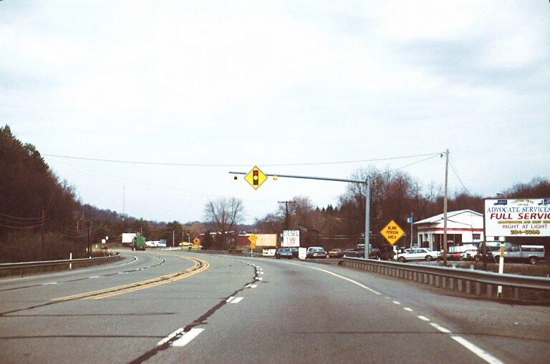
Practice Scenario
Topic of Current Slide
  Font must be Arial
  Details of slide should be confined to a few bullet points
  Leave plenty of white space to ensure that the slide is easy for your audience to read
  Do not use clip art or any unapproved graphics

Slide 3
Practice Scenario Questions
You are approaching a Blind Person Area.
You are approaching a traffic signal.
You are in a no-passing zone.

Slide 4
Answers
A. You are approaching a traffic signal. True
B. You are approaching a Blind Person Area. True
C. You are in a no-passing zone. False

Slide 5
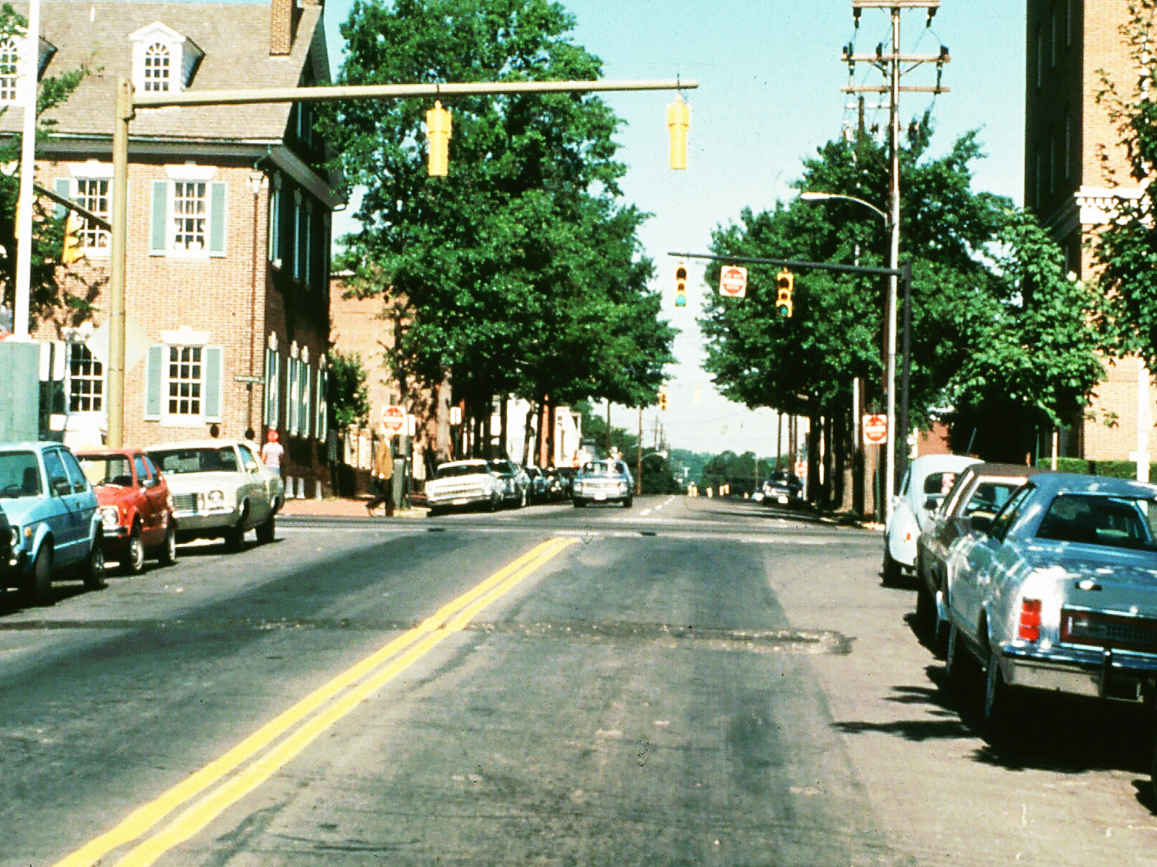
Scenario 1

Slide 6
Scenario 1 Questions
A. You may go straight ahead after yielding to traffic.
B. You may turn right on red.
C. You are in a no-passing zone.

Slide 7
Scenario 1 Answers
A. You may go straight ahead after yielding to traffic. False
B. You may turn right on red. True
C. You are in a no-passing zone. True

Slide 8
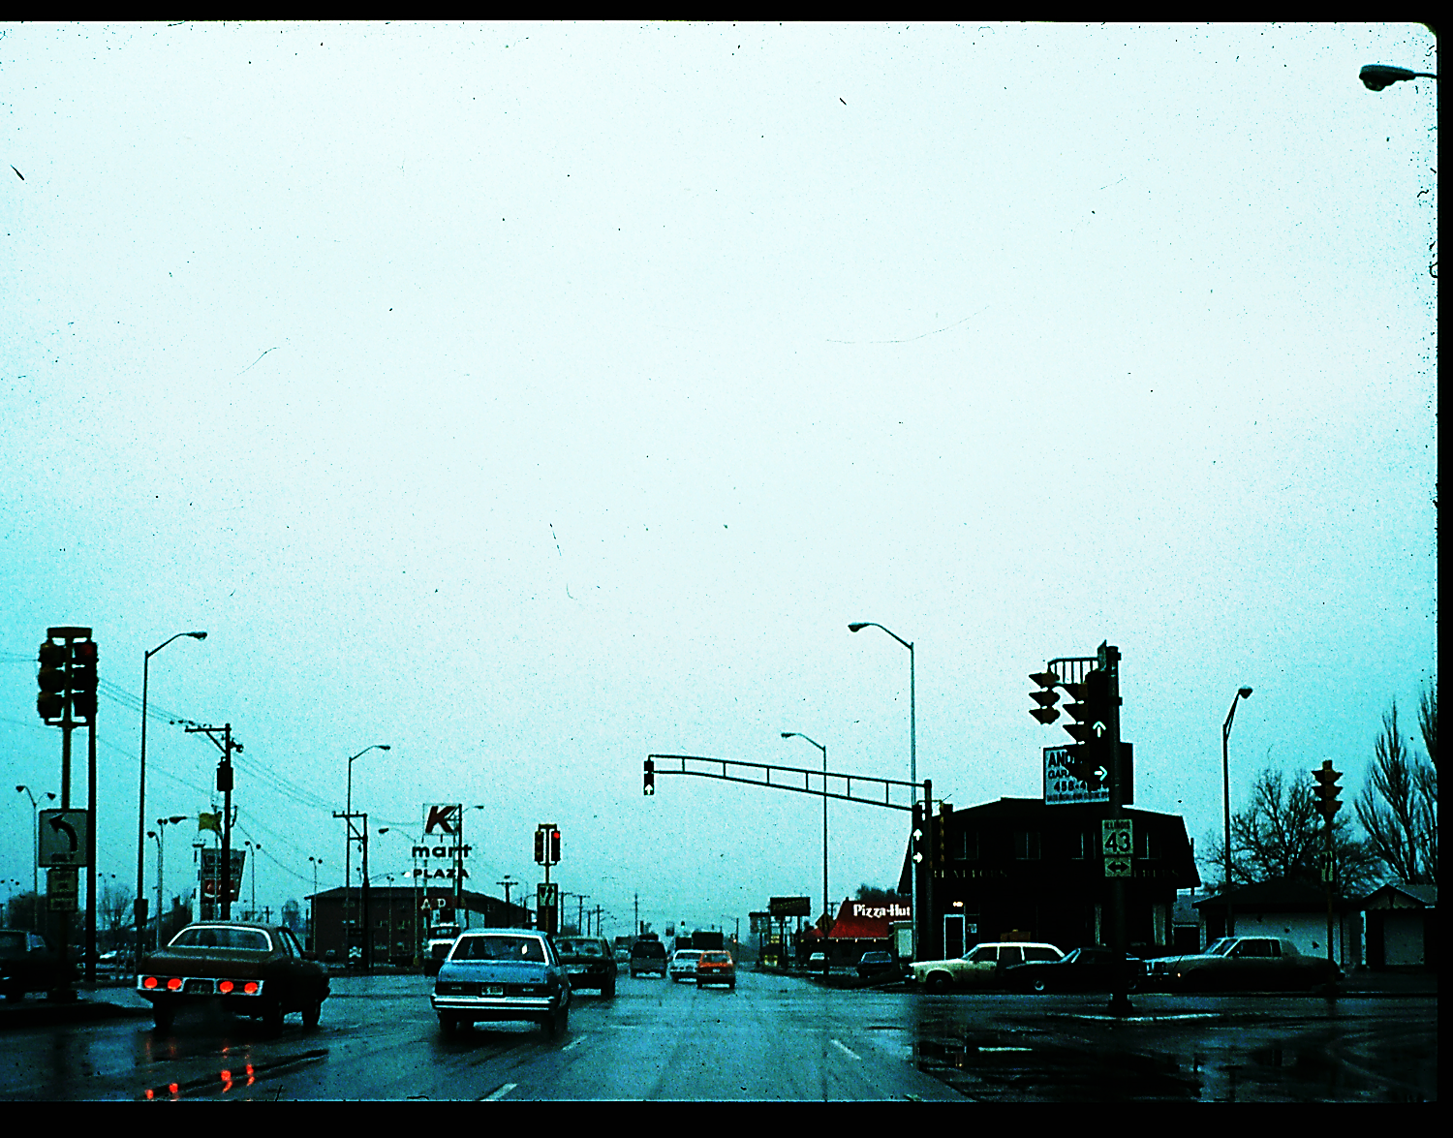
Scenario 2

Slide 9
Scenario 2 Questions
You are on Route 43.
Traffic may turn right without stopping.
No right turns are allowed on red.

Slide 10
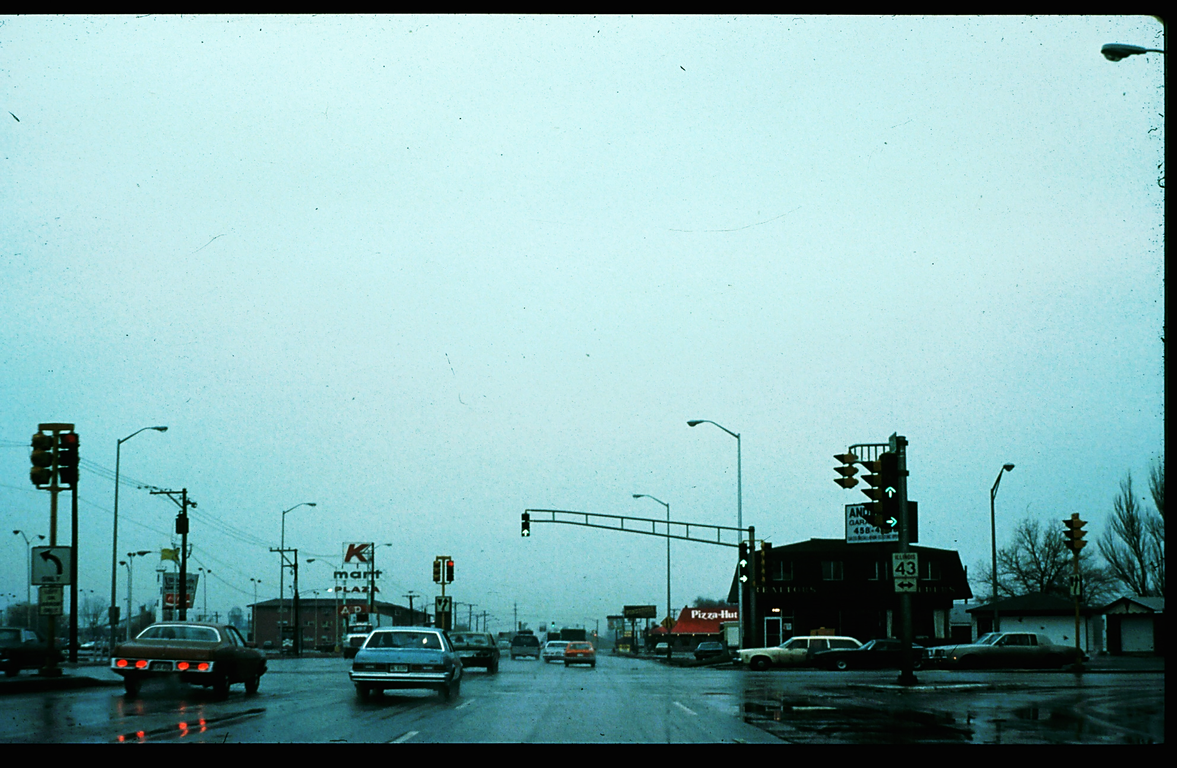
Scenario 2 Answers
You are on Route 43. False
B. Traffic may turn right without stopping. True
C. No right turns are allowed on red. False

Slide 11
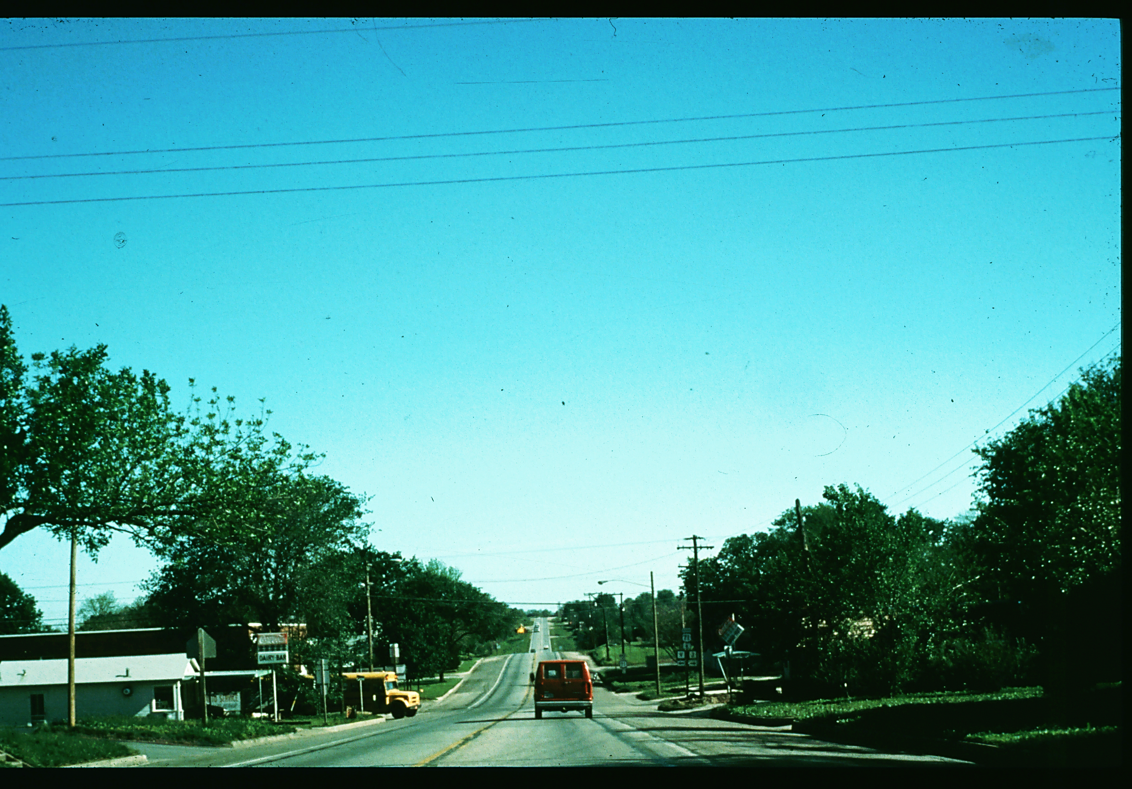
Scenario 3

Slide 12
Scenario 3 Questions
At the next intersection, you must stop.
The signal light is about to change to red.
You must yield right-of-way to the school bus.

Slide 13
Scenario 3 Answers
At the next intersection, you must stop. False
The signal light is about to change to red. False
You must yield right-of-way to the school bus. False

Slide 14
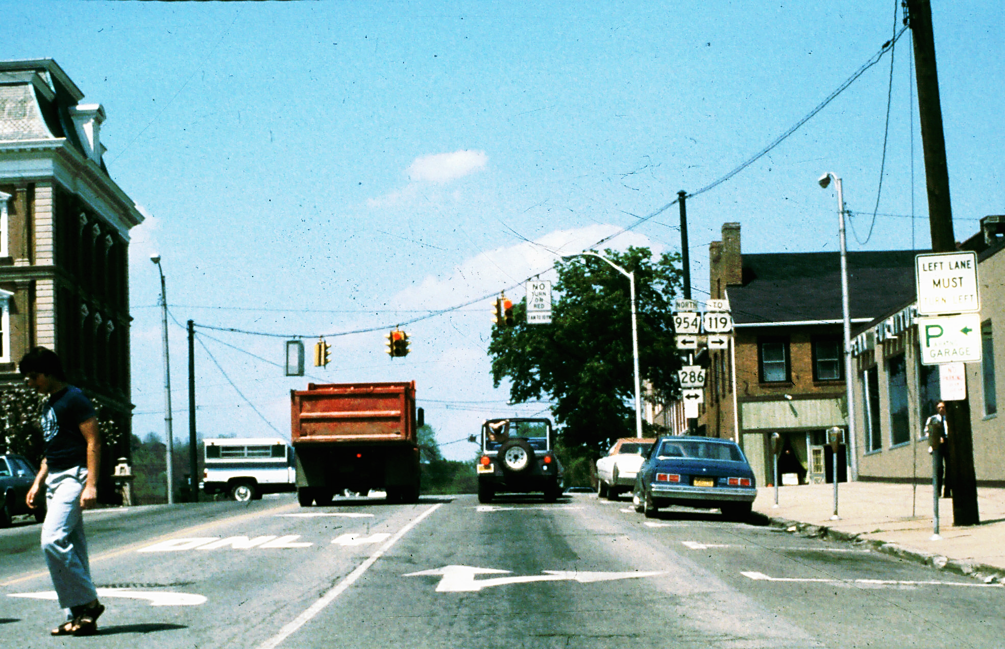
Scenario 4

Slide 15
Scenario 4 Questions
You may not change lanes.
B. The cross street is a state route.
C. You may turn right on red.

Slide 16
Scenario 4 Answers
You may not change lanes. False
B. The cross street is a state route. True
C. You may turn right on red. False

Slide 17
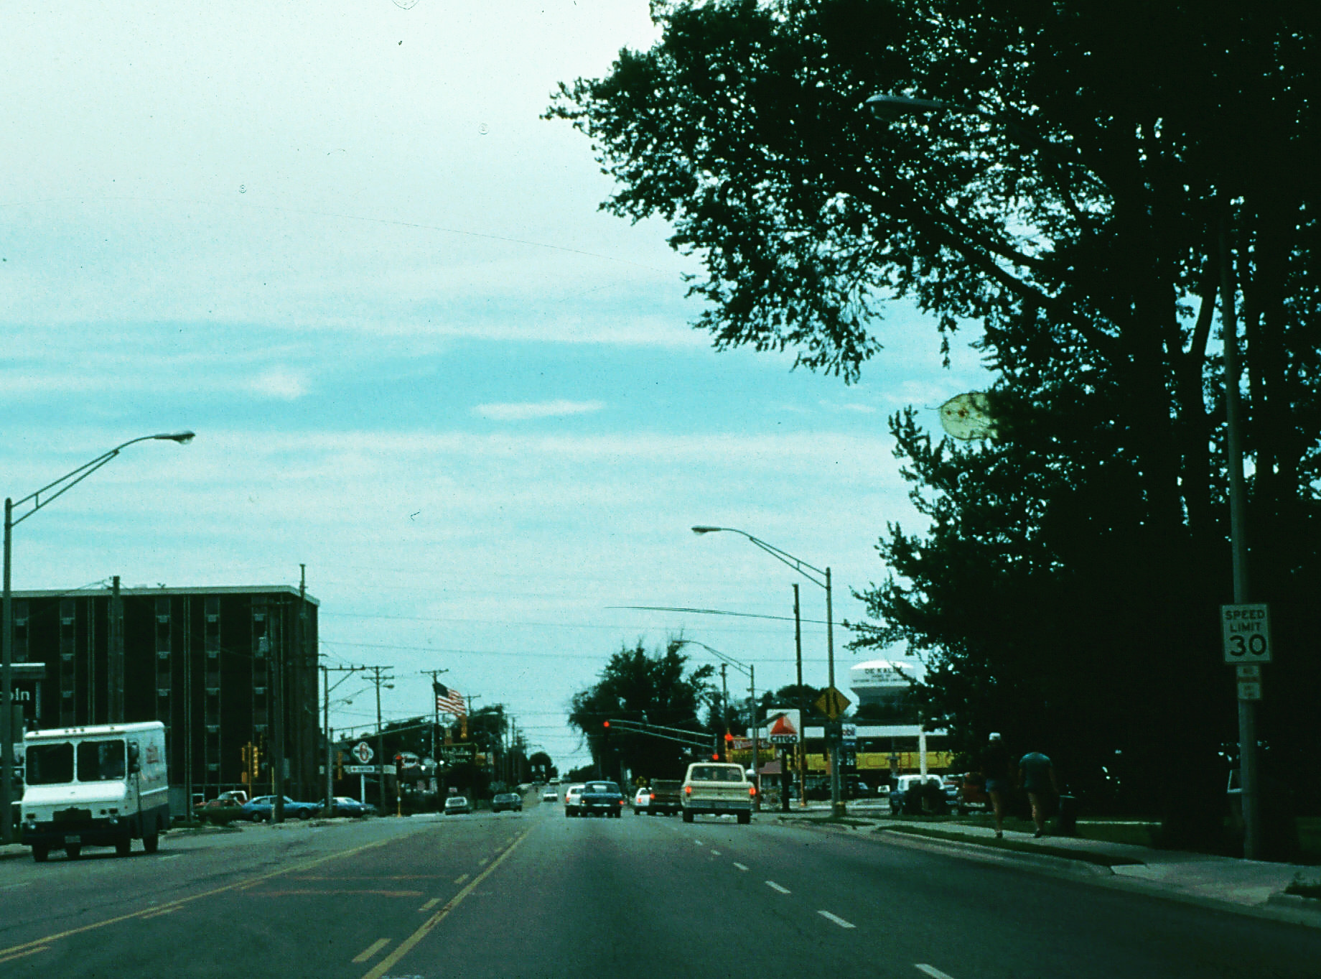
Scenario 5

Slide 18
Scenario 5 Questions
The right lane ends ahead.
The speed limit is 35 mph.
You must change lanes to turn left.

Slide 19
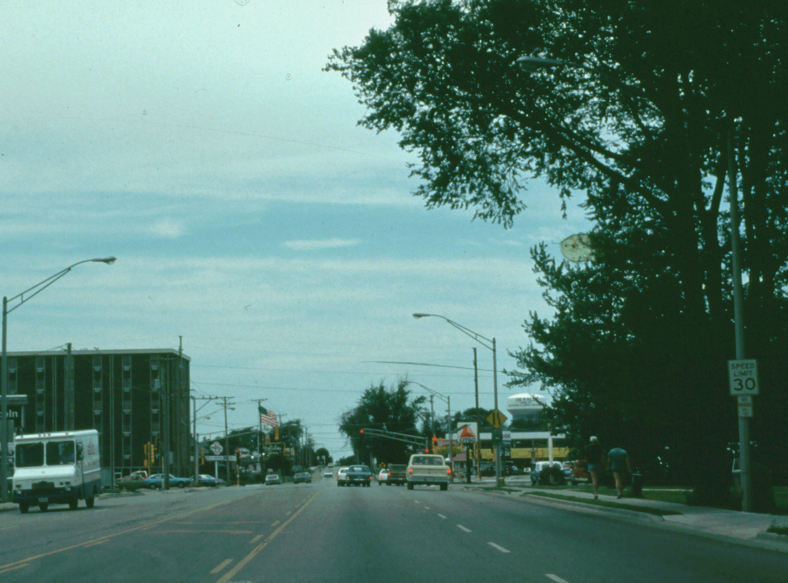
Scenario 5 Answers
The right lane ends ahead. True
The speed limit is 35 mph. False
You must change lanes to turn left. True

Slide 20
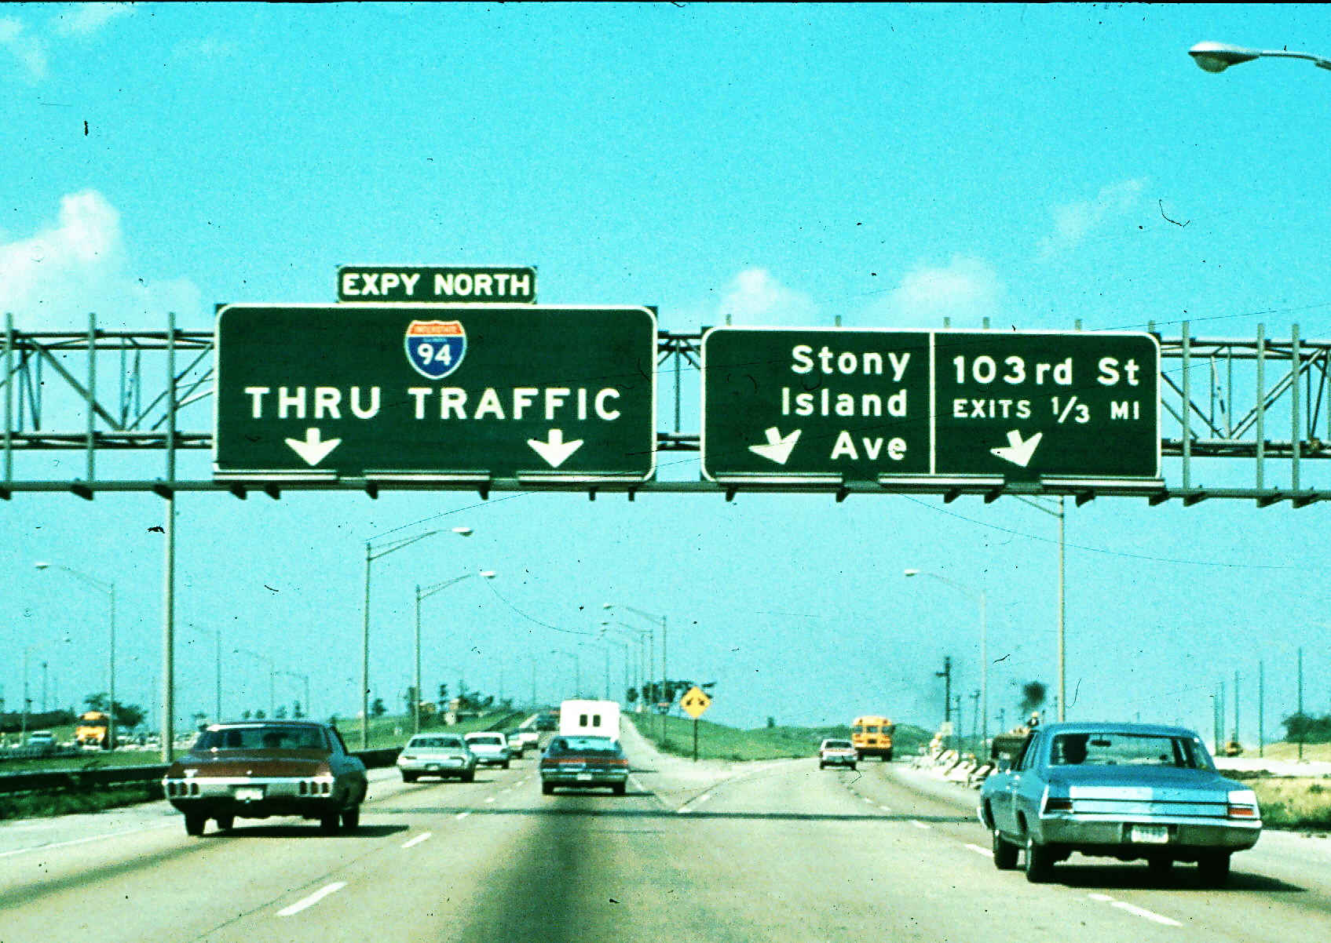
Scenario 6

Slide 21
Scenario 6 Questions
The expressway divides here.
You must change lanes to go north on Route 94. (T or F)
Route 94 is an interstate highway. (T or F)

Slide 22
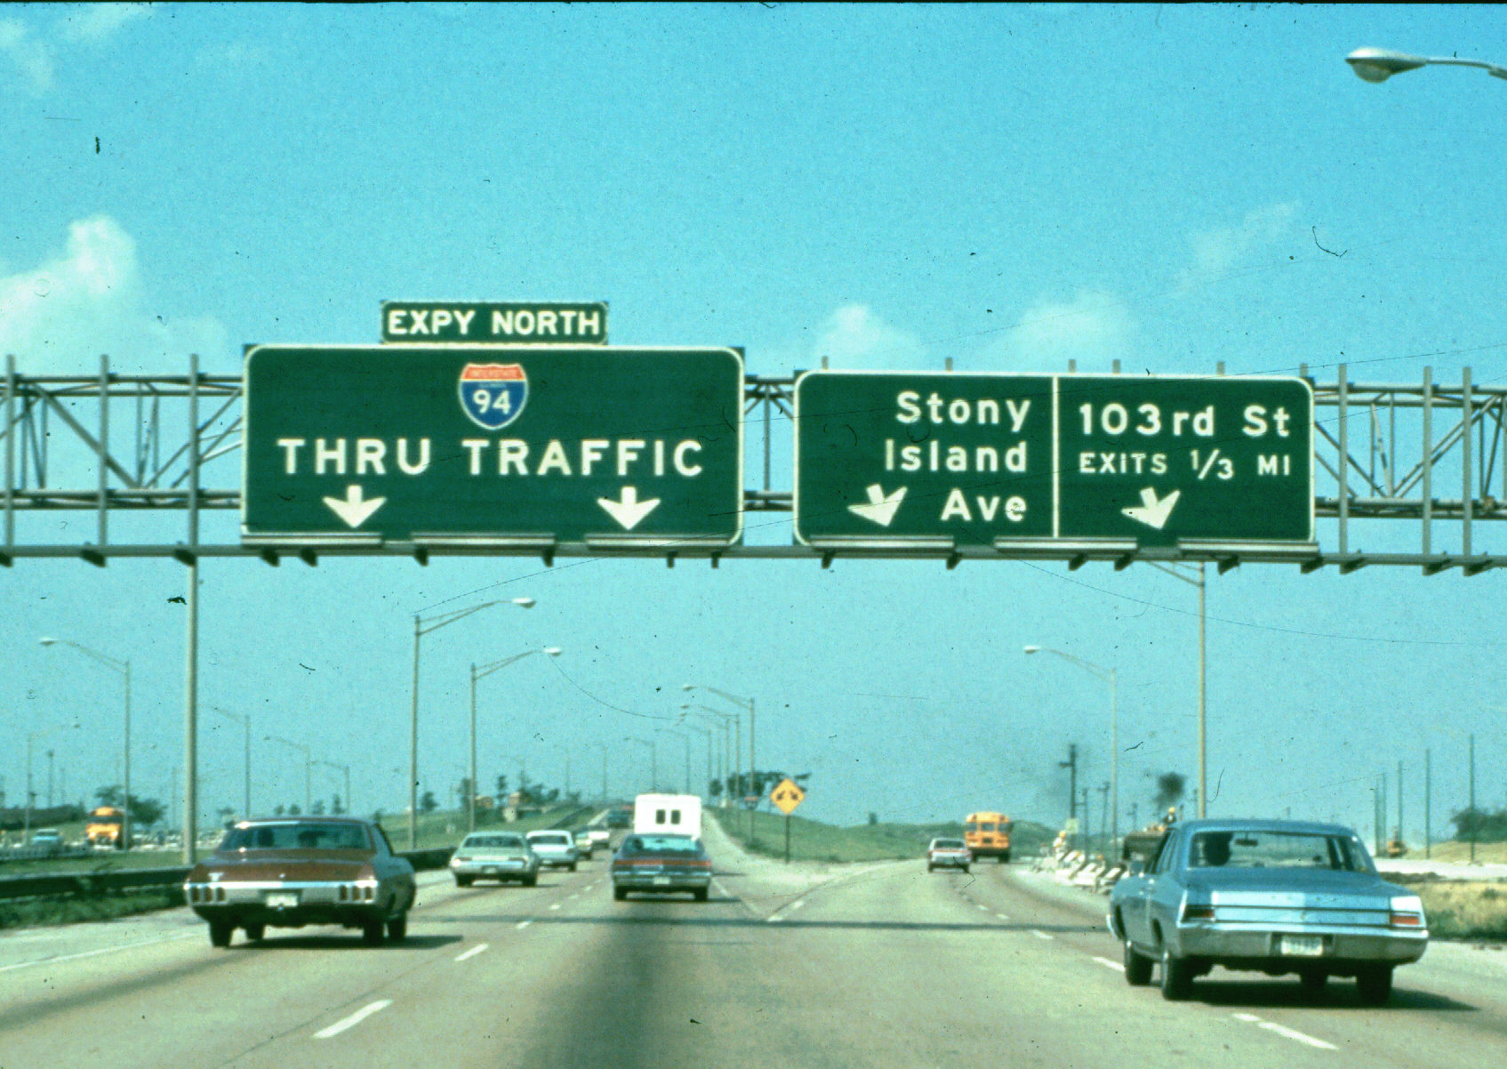
Scenario 6 Answers
The expressway divides here. (True)
You must change lanes to go north on Route 94. (False)
Route 94 is an interstate highway. (True)

Slide 23
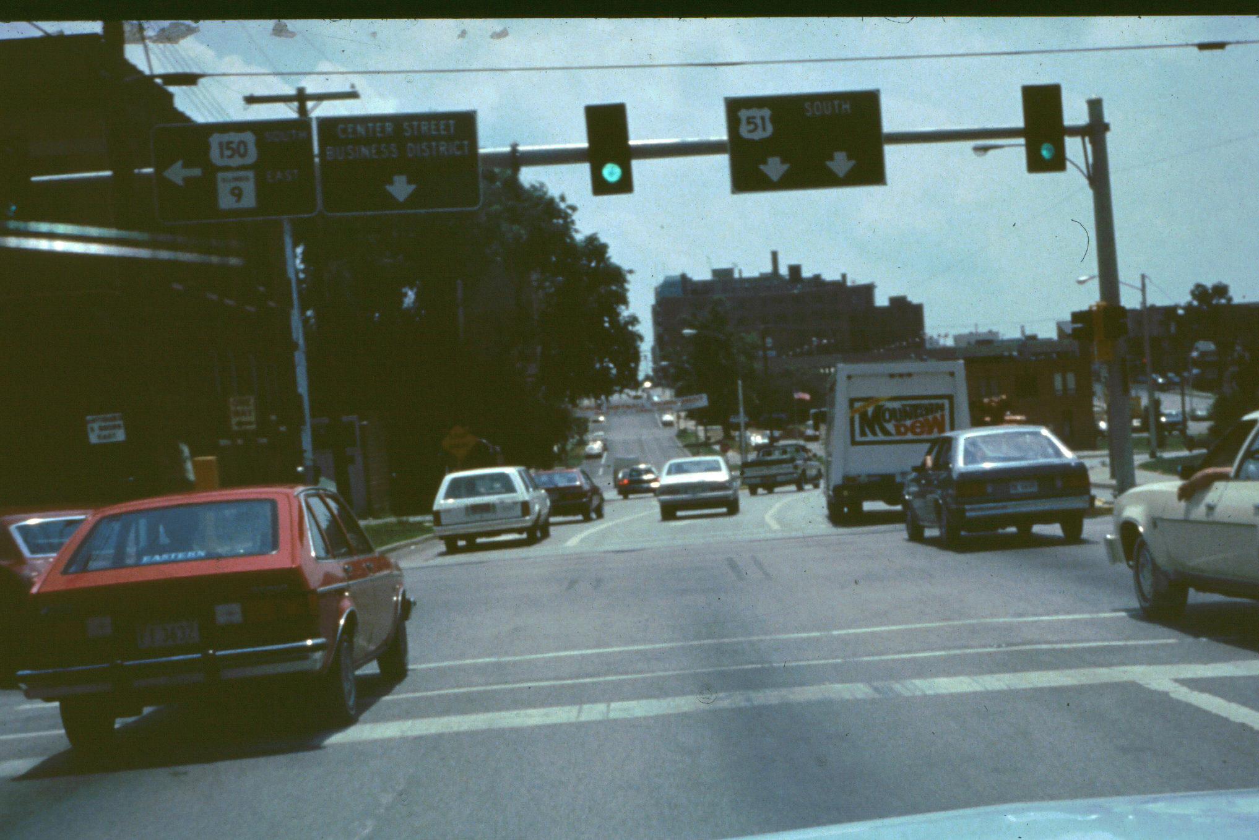
Scenario 7

Slide 24
Scenario 7 Questions
We are on a one-way street and will be crossing a one-way street.
Cars in the two right lanes may not change lanes.
No left turns are allowed.

Slide 25
Scenario 7 Answers
We are on a one-way street and will be crossing a one-way street. True
Cars in the two right lanes may not change lanes. False
No left turns are allowed. False

Slide 26
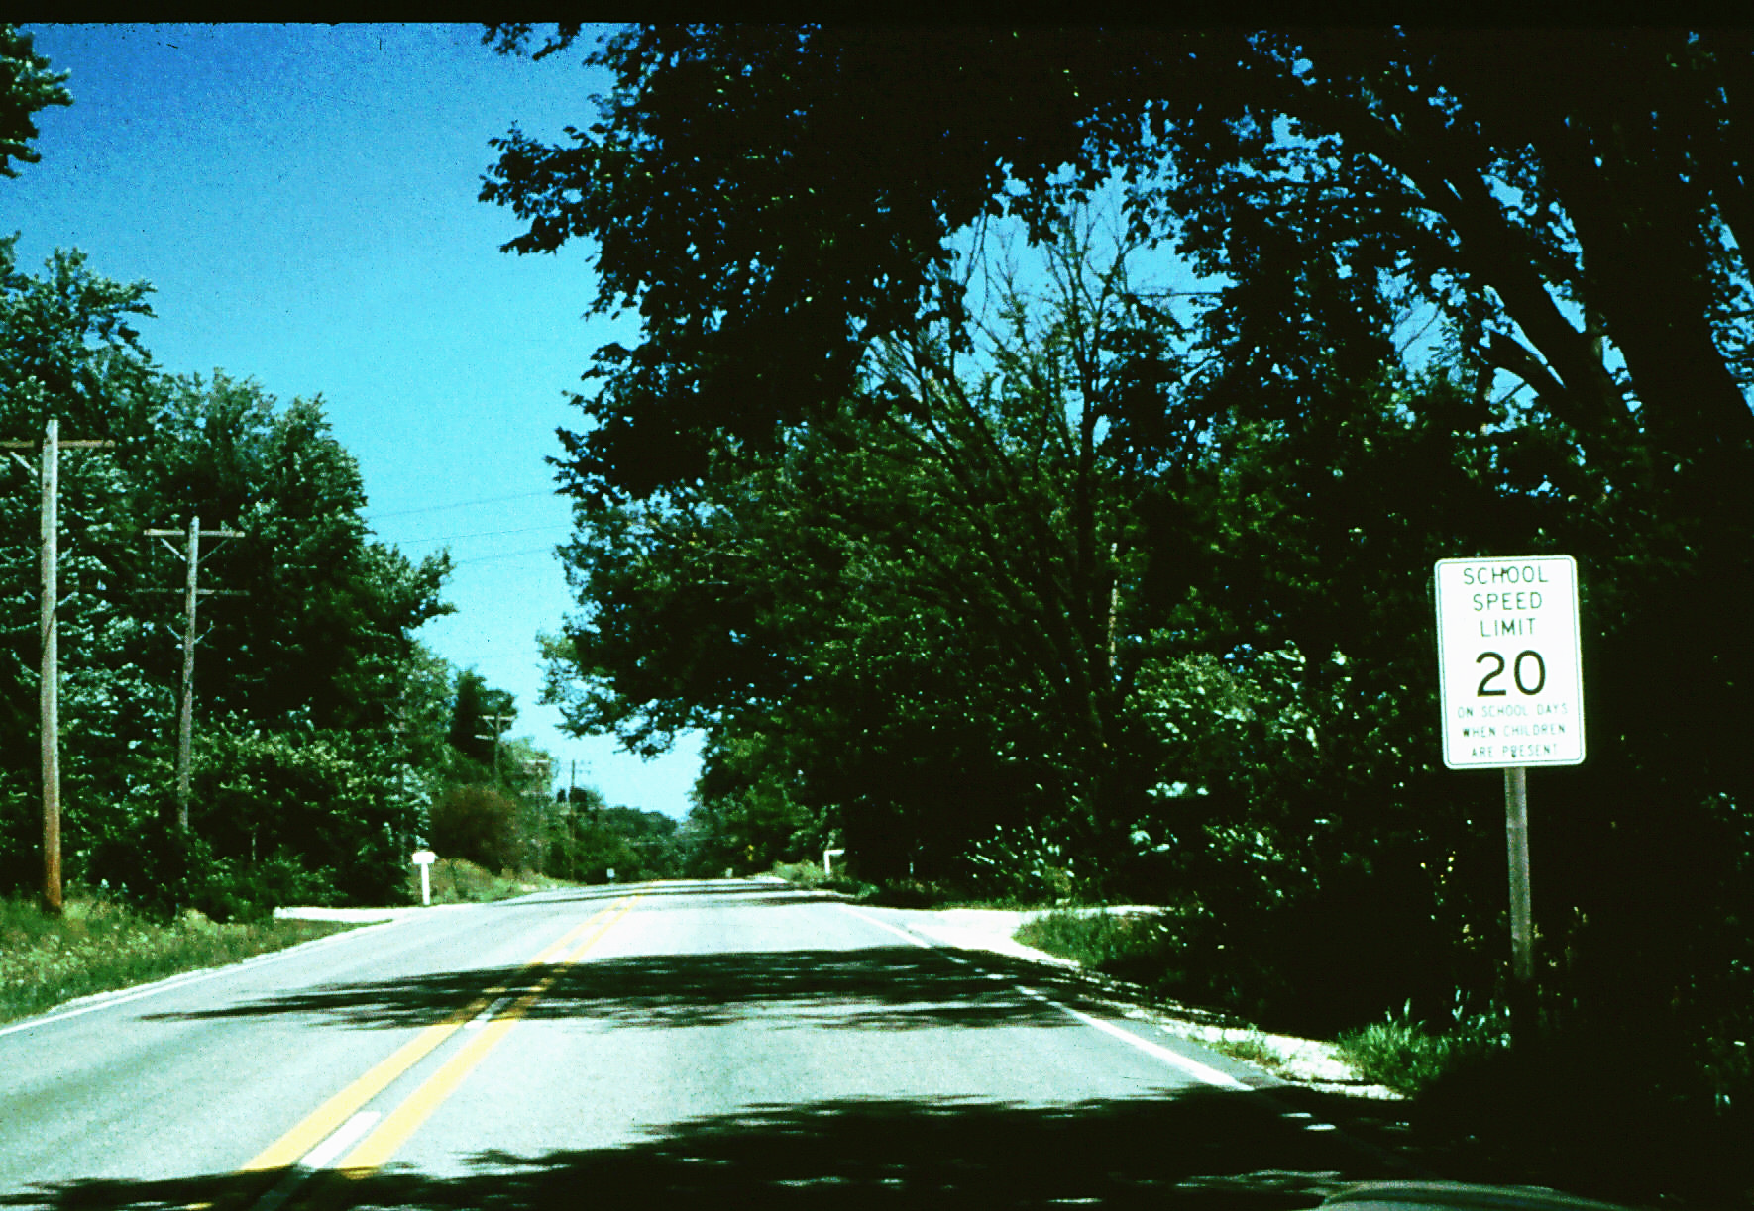
Scenario 8

Slide 27
Scenario 8 Questions
The speed limit here at all times is 20 mph.
You are in a no-passing zone.
Oncoming traffic can turn left.

Slide 28
Scenario 8 Answers
The speed limit here at all times is 20 mph. False
You are in a no-passing zone. True
Oncoming traffic can turn left. True

Slide 29
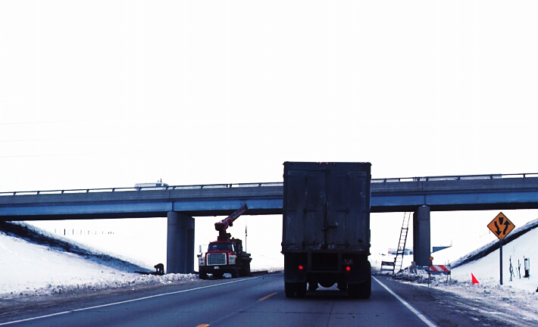
Scenario 9

Slide 30
Scenario 9 Questions
You are on an interstate highway.
You are coming to a divided highway.
You are in a no-passing zone.

Slide 31
Scenario 9 Answers
You are on an interstate highway. False
You are coming to a divided highway. True
You are in a no-passing zone. False

Slide 32
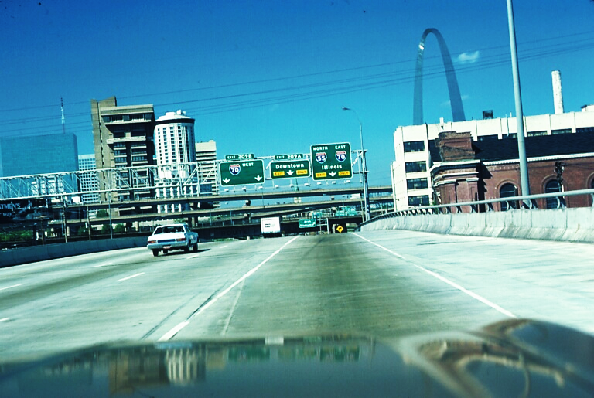
Scenario 10

Slide 33
Scenario 10 Questions
To go west on I-70, stay in the right lane.
Drivers in the two right lanes must exit.
Drivers in the two right lanes shall not change lanes to the left.

Slide 34
Scenario 10 Answers
A. To go west on I-70, stay in the right lane. False
B. Drivers in the two right lanes must exit. True
C. Drivers in the two right lanes shall not change lanes to the left. False

Slide 35
Traffic Controls
The End

Slide 36
Contact/Mission
For more information on the (the topic of the presentation) please visit PDE’s website at www.education.pa.gov
The mission of the Department of Education is to ensure that every learner has access to a world-class education system that academically prepares children and adults to succeed as productive citizens. Further, the Department seeks to establish a culture that is committed to improving opportunities throughout the commonwealth by ensuring that technical support, resources, and optimal learning environments are available for all students, whether children or adults.

