Slide 1
Other Users
Perceptual Awareness and Sharing the Road

Slide 2
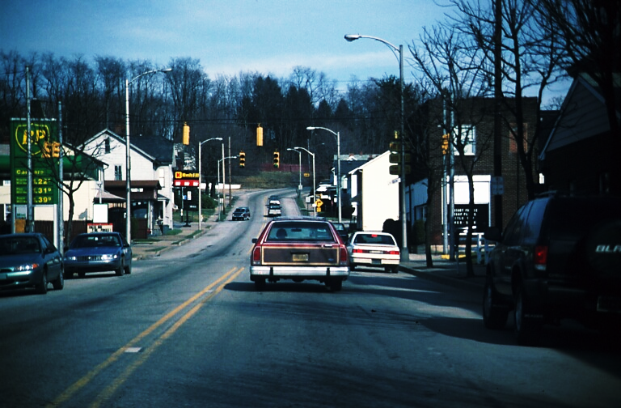
Practice Scene

Slide 3
Practice Scene Questions
The ongoing vehicle has brake lights on.
The parked vehicle on the right appears to be ready to enter our lane.
The oncoming vehicle is turning to its right.

Slide 4
Practice Scene Answers
The ongoing vehicle has brake lights on. False
The parked vehicle on the right appears to be ready to enter our lane. True
The oncoming vehicle is turning to its right. True

Slide 5
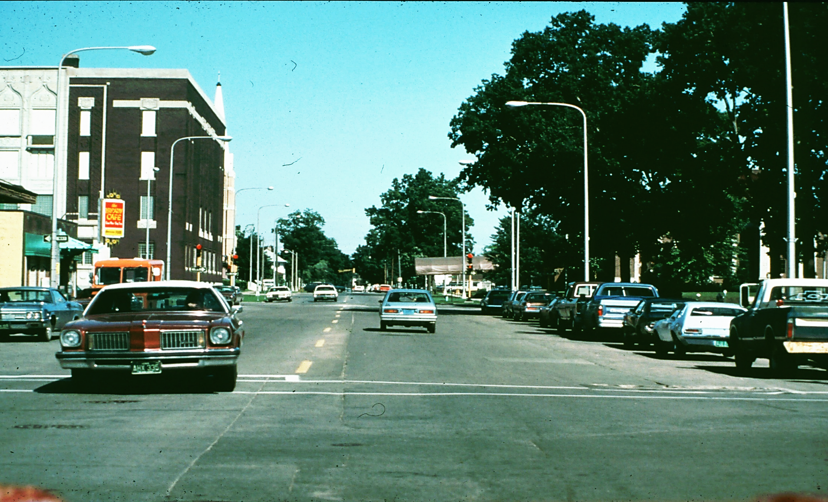
Scene 1

Slide 6
Scene 1 Questions
None of the parked cars has wheels turned out.
The ongoing car is getting ready to turn left.
The oncoming car is preparing to turn left.

Slide 7

Scene 1 Answers
None of the parked cars has wheels turned out. True
The ongoing car is getting ready to turn left. False
The oncoming car is preparing to turn left. False

Slide 8
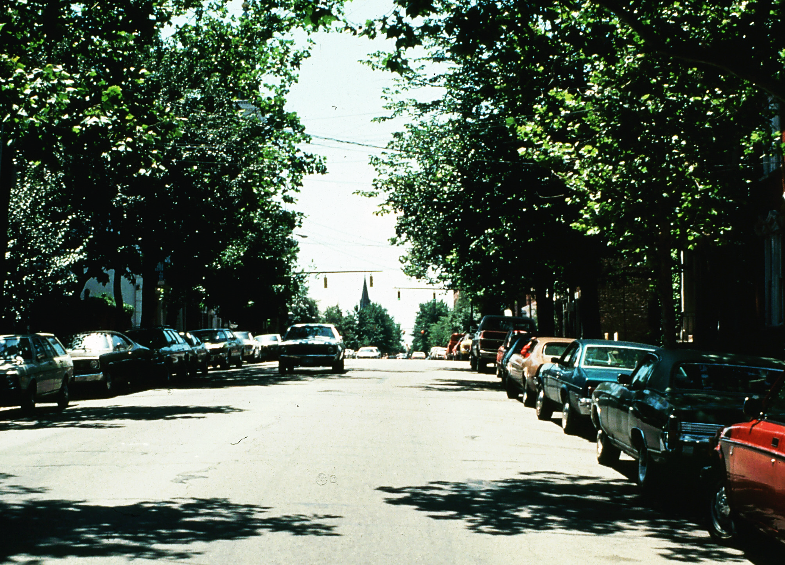
Scene 2

Slide 9
Scene 2 Questions
There is a driver in one of the parked cars on your right side.
The oncoming car is partially in your lane.
A car door is open on the left side.

Slide 10
Scene 2 Answers
There is a driver in one of the parked cars on your right side. True
The oncoming car is partially in your lane. False
A car door is open on the left side. False

Slide 11
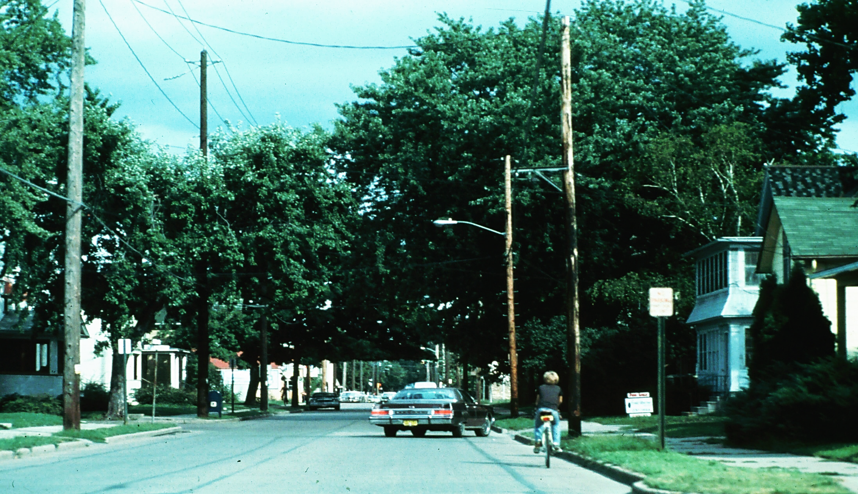
Scene 3

Slide 12
Scene 3 Questions
A car ahead is backing out of a driveway.
The bike rider is an adult.
There is a parked car on the left ahead.

Slide 13
Scene 3 Answers
A car ahead is backing out of a driveway. True
The bike rider is an adult. False
There is a parked car on the left ahead. True

Slide 14
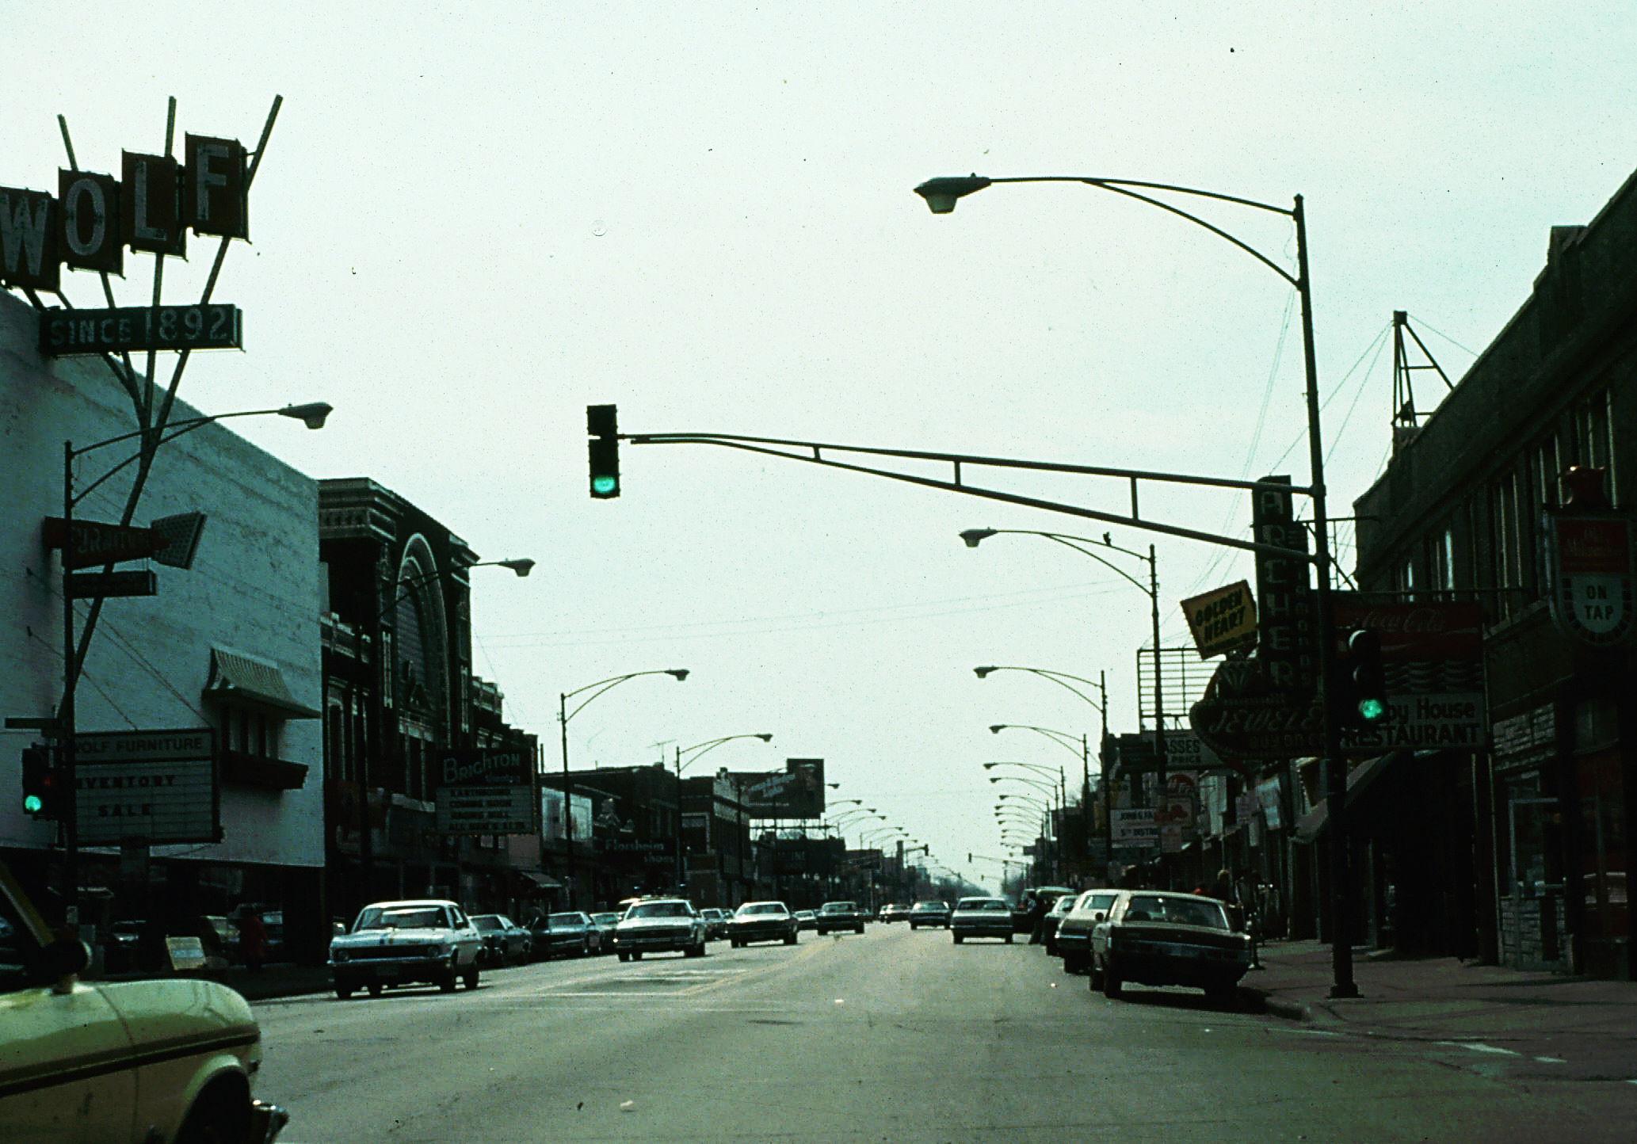
Scene 4

Slide 15
Scene 4 Questions
The first parked car on the right is backing up.
A car ahead in your lane is stopped.
The oncoming car has the left turn signal on.

Slide 16
Scene 4 Answers
The first parked car on the right is backing up. False
A car ahead in your lane is stopped. True
The oncoming car has the left turn signal on. False

Slide 17
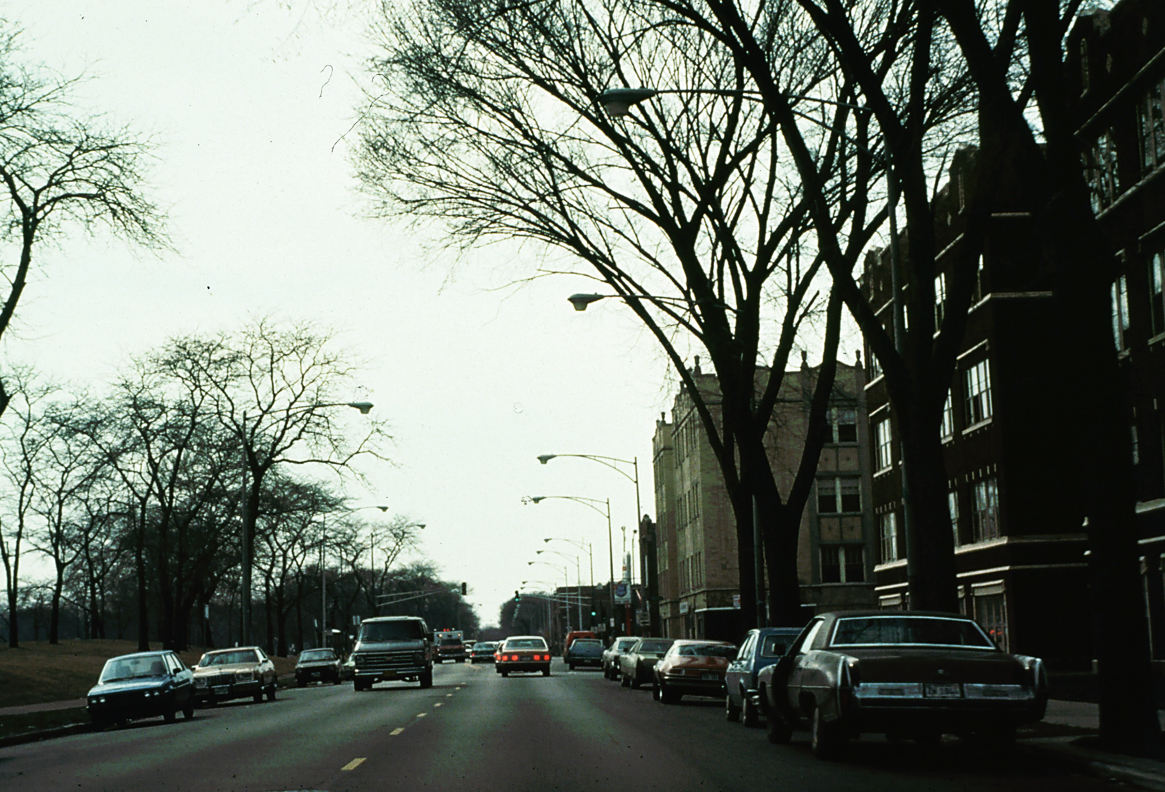
Scene 5

Slide 18
Scene 5 Questions
The first parked car on the right has its door partly open.
A parked car on the left is entering traffic.
There is an oncoming ambulance.

Slide 19
Scene 5 Answers
The first parked car on the right has its door partly open. True
A parked car on the left is entering traffic. False
There is an oncoming ambulance. True

Slide 20
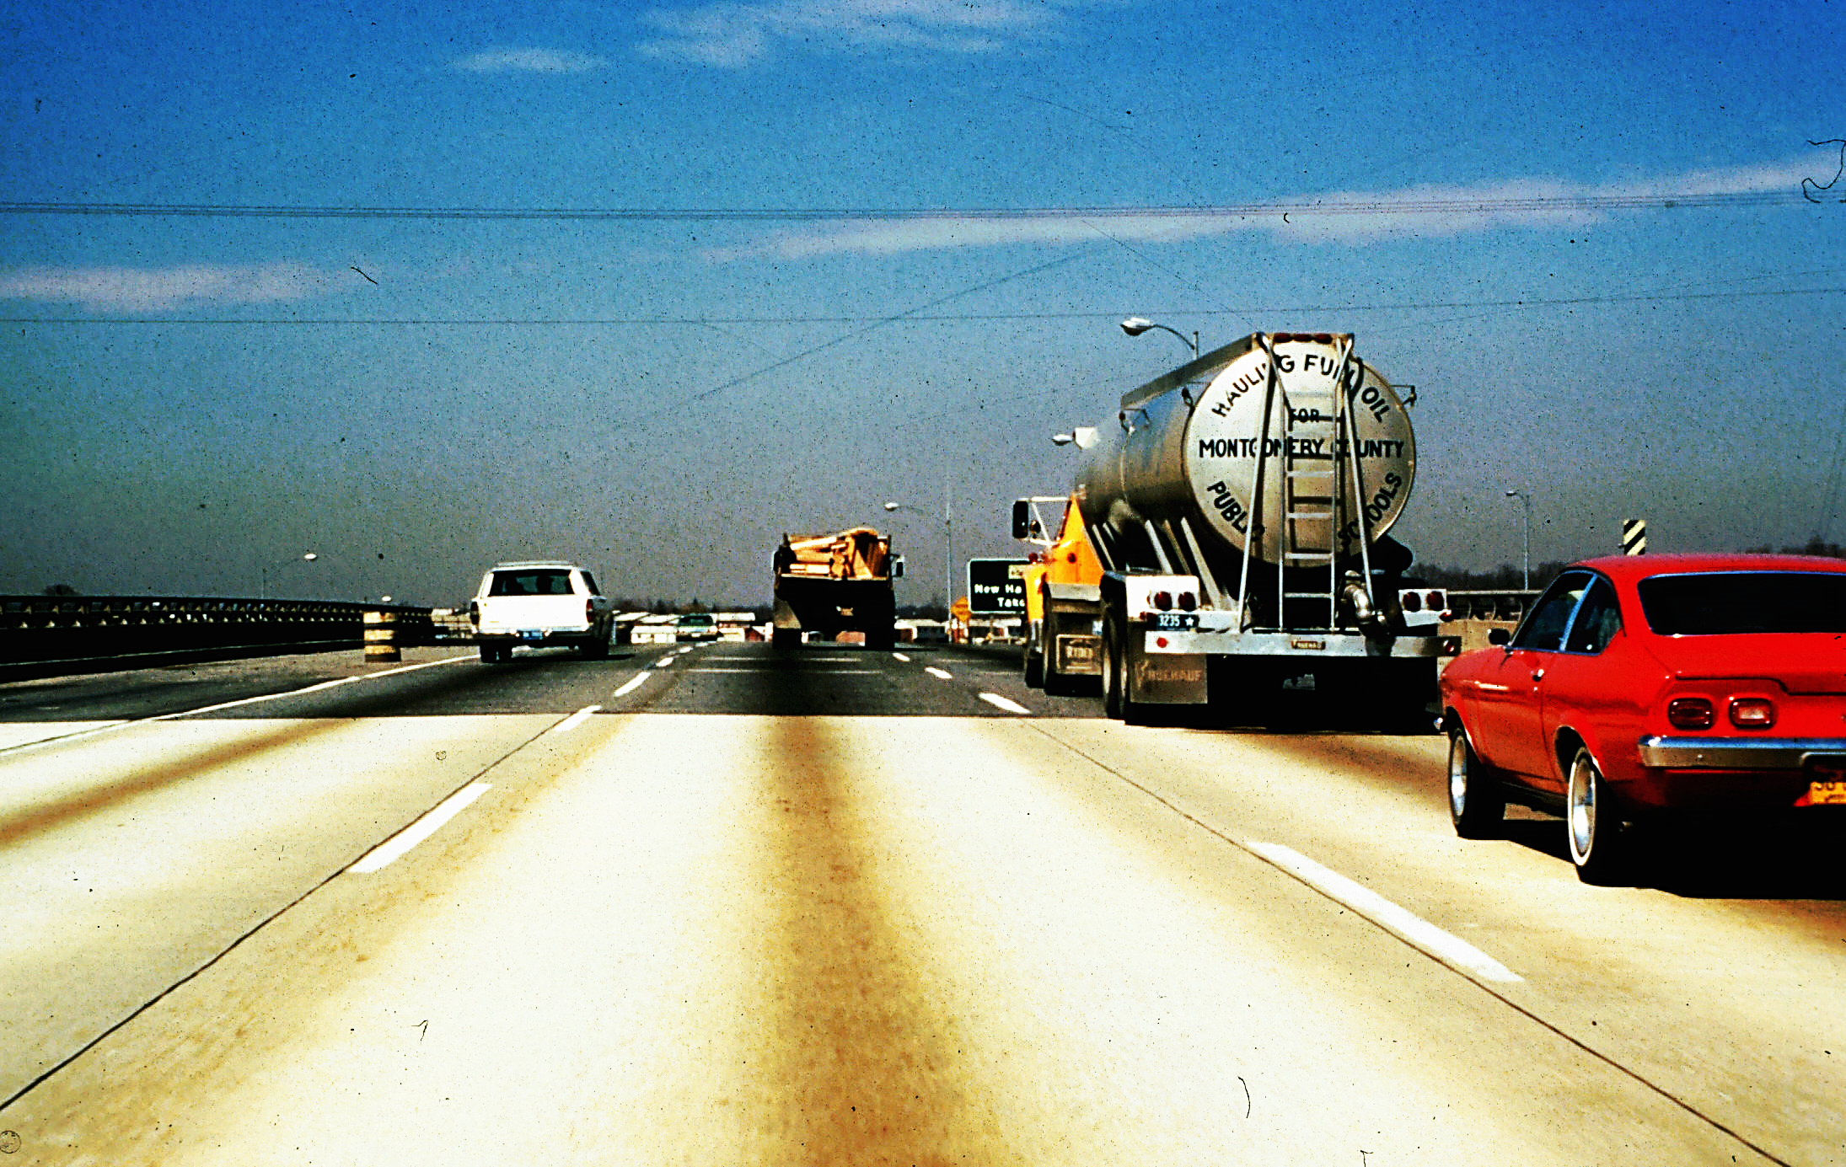
Scene 6

Slide 21
Scene 6 Questions
The dump truck ahead is on the lane line.
The tank truck on the right is centered in the lane.
The station wagon in the left lane has brake lights on.

Slide 22
Scene 6 Answers
The dump truck ahead is on the lane line. True
The tank truck on the right is centered in the lane. True
The station wagon in the left lane has brake lights on. False

Slide 23
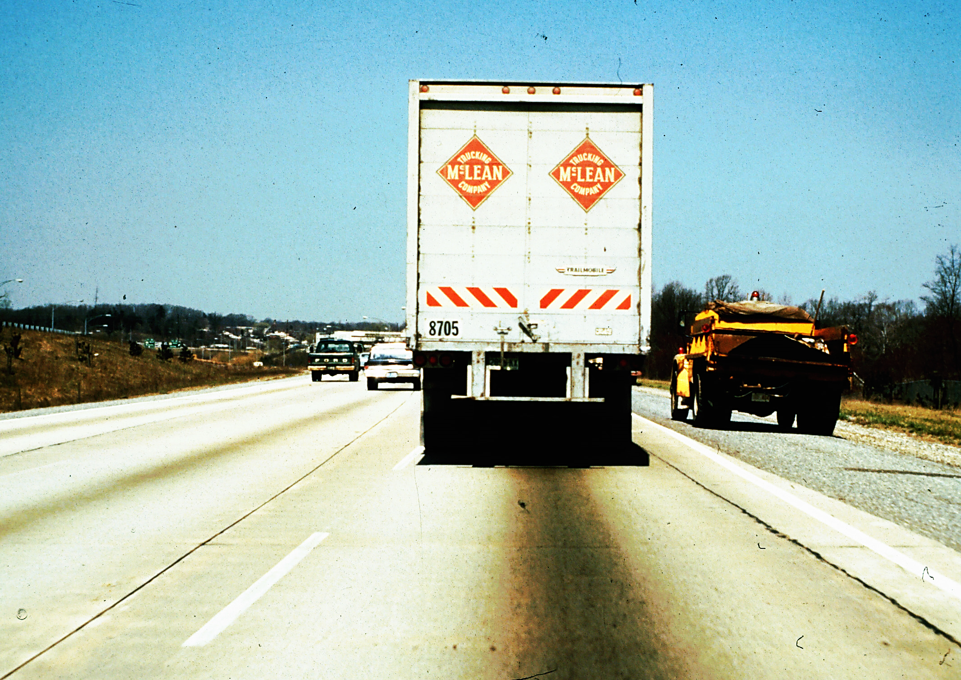
Scene 7

Slide 24
Scene 7 Questions
There is a maintenance truck on the shoulder.
The truck ahead is on the lane line.
The truck ahead has the left turn signal on.

Slide 25
Scene 7 Answers
There is a maintenance truck on the shoulder. True
The truck ahead is on the lane line. True
The truck ahead has the left turn signal on. False

Slide 26
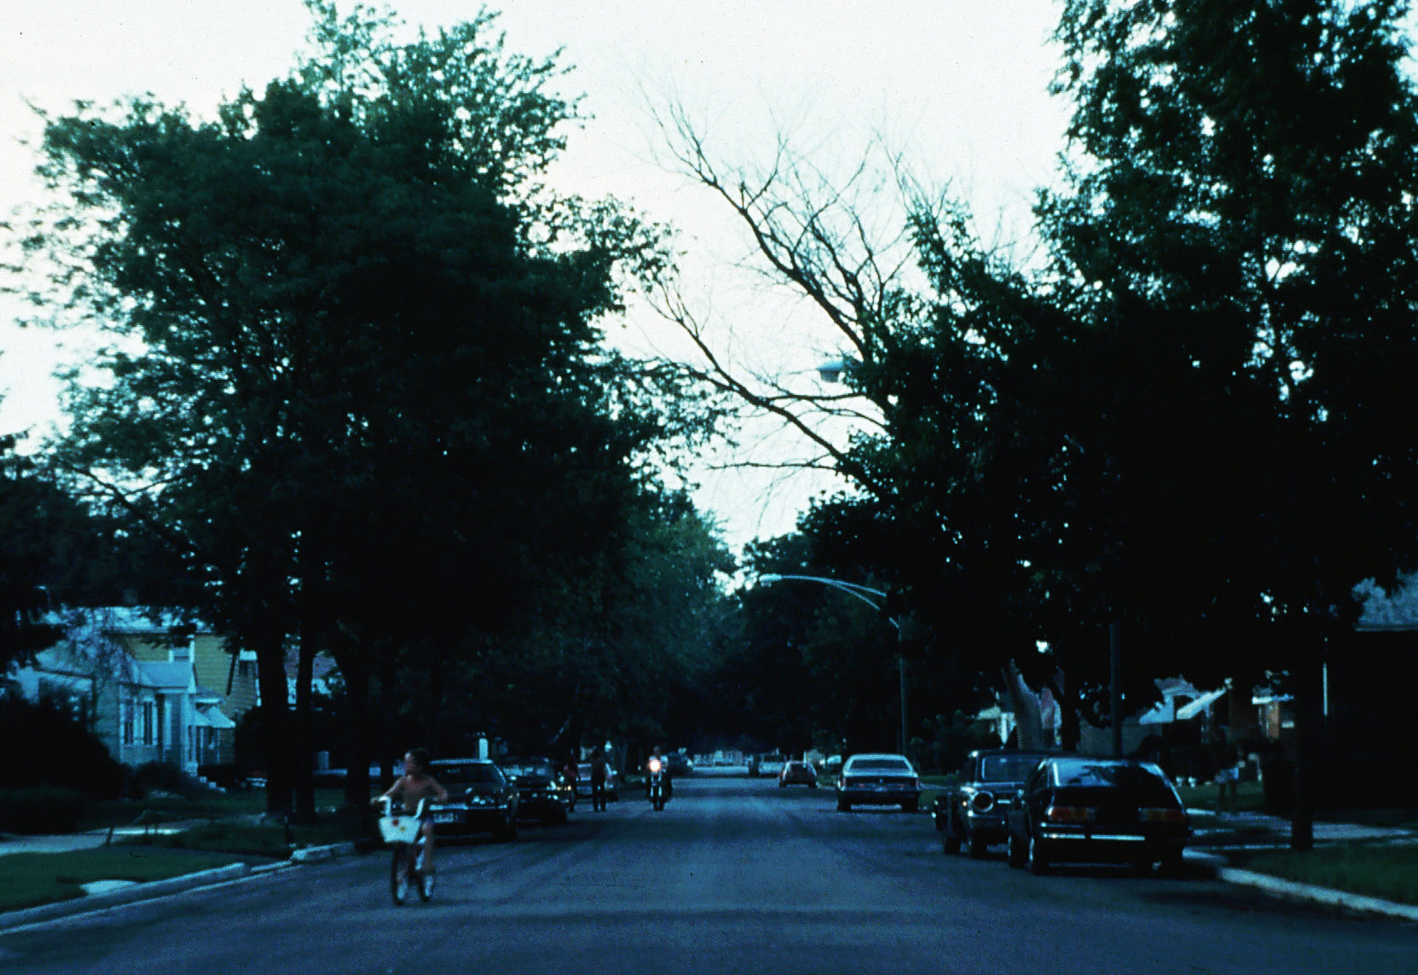
Scene 8

Slide 27
Scene 8 Questions
The bicyclist is looking at us.
There is a second oncoming bicyclist.
There are two pedestrians in the street on the left side.

Slide 28
Scene 8 Answers
The bicyclist is looking at us. False
There is a second oncoming bicyclist. False
There are two pedestrians in the street on the left side. True

Slide 29
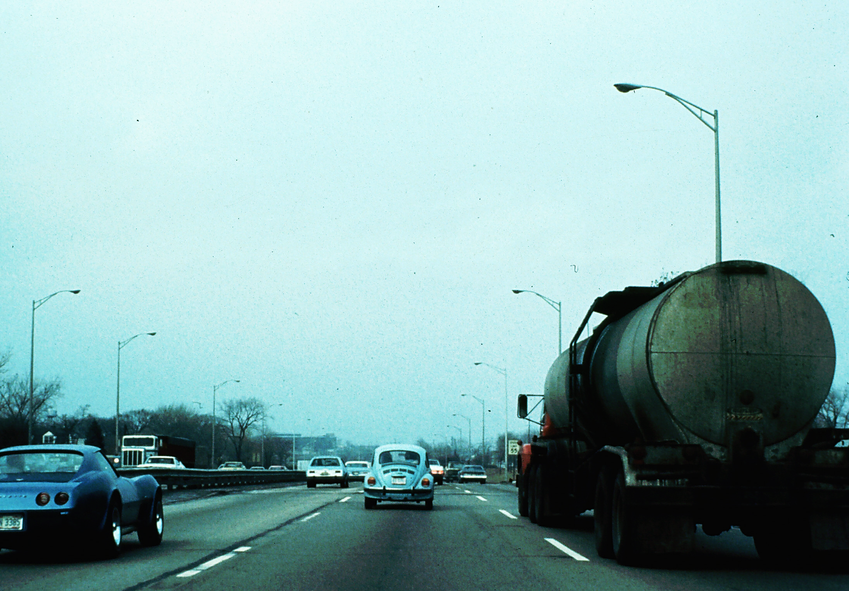
Scene 9

Slide 30
Scene 9 Questions
The first car ahead is over the lane line.
The second car ahead has the brake lights on.
The tank truck is changing lanes.

Slide 31
Scene 9 Answers
The first car ahead is over the lane line. False
The second car ahead has the brake lights on. True
The tank truck is changing lanes. False

Slide 32
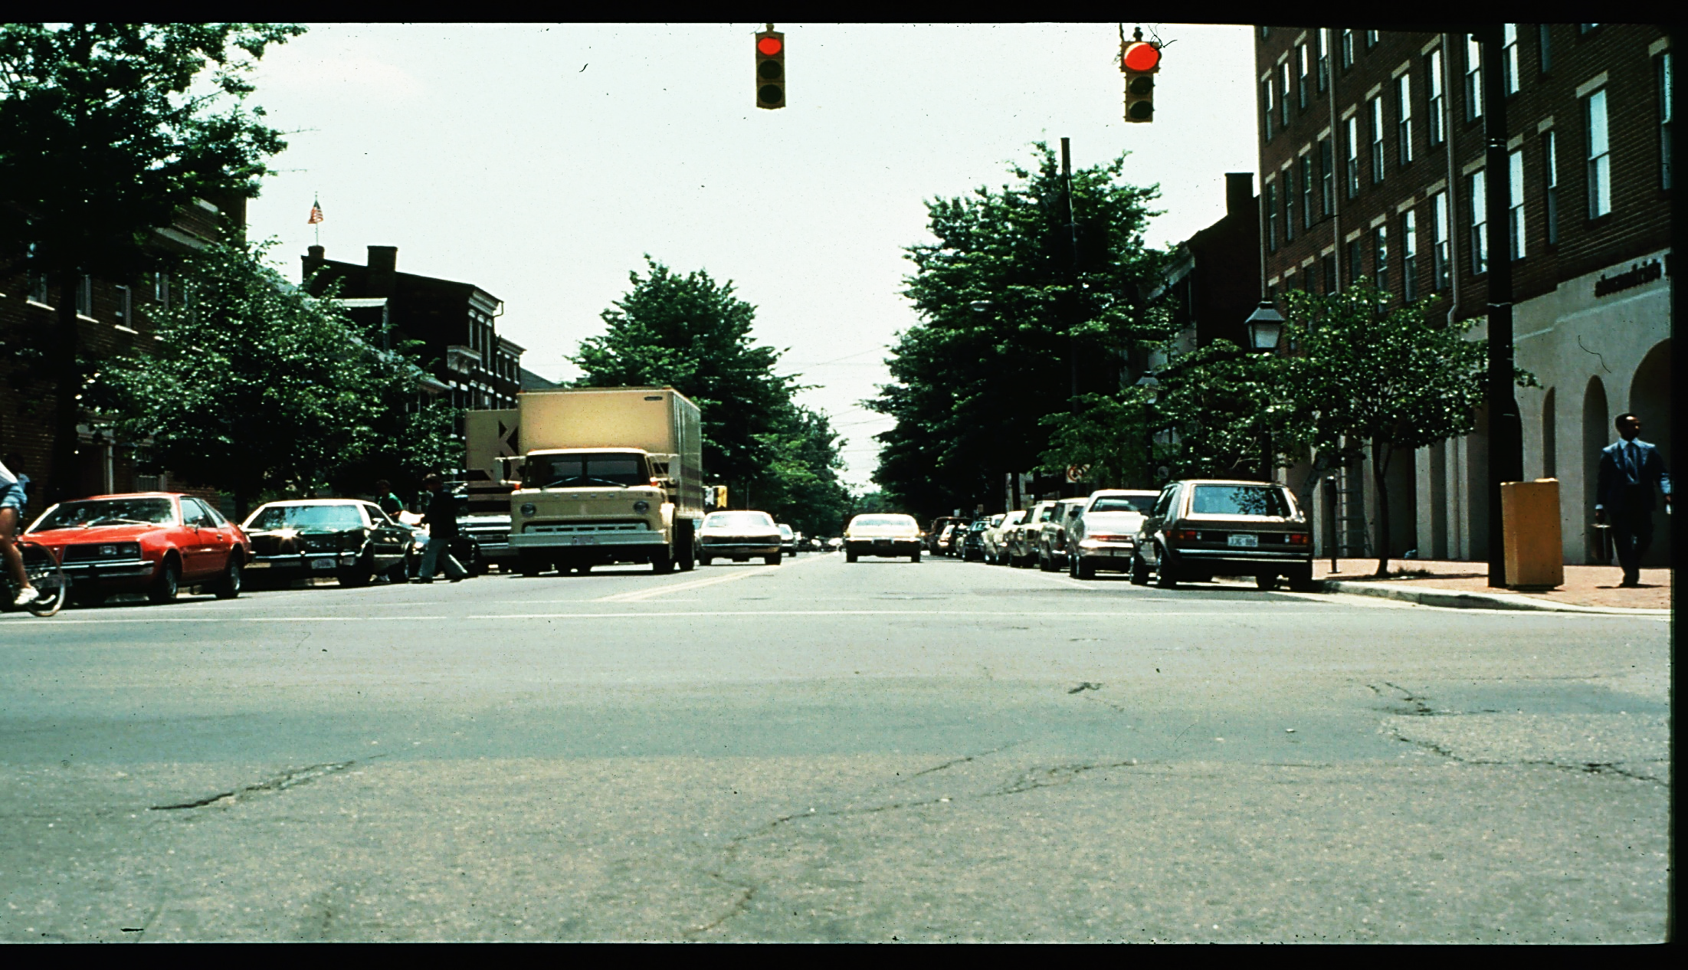
Scene 10

Slide 33
Scene 10 Questions
The double-parked truck has no driver.
The oncoming car is over the center line.
No parked cars on the right have wheels turned out.

Slide 34
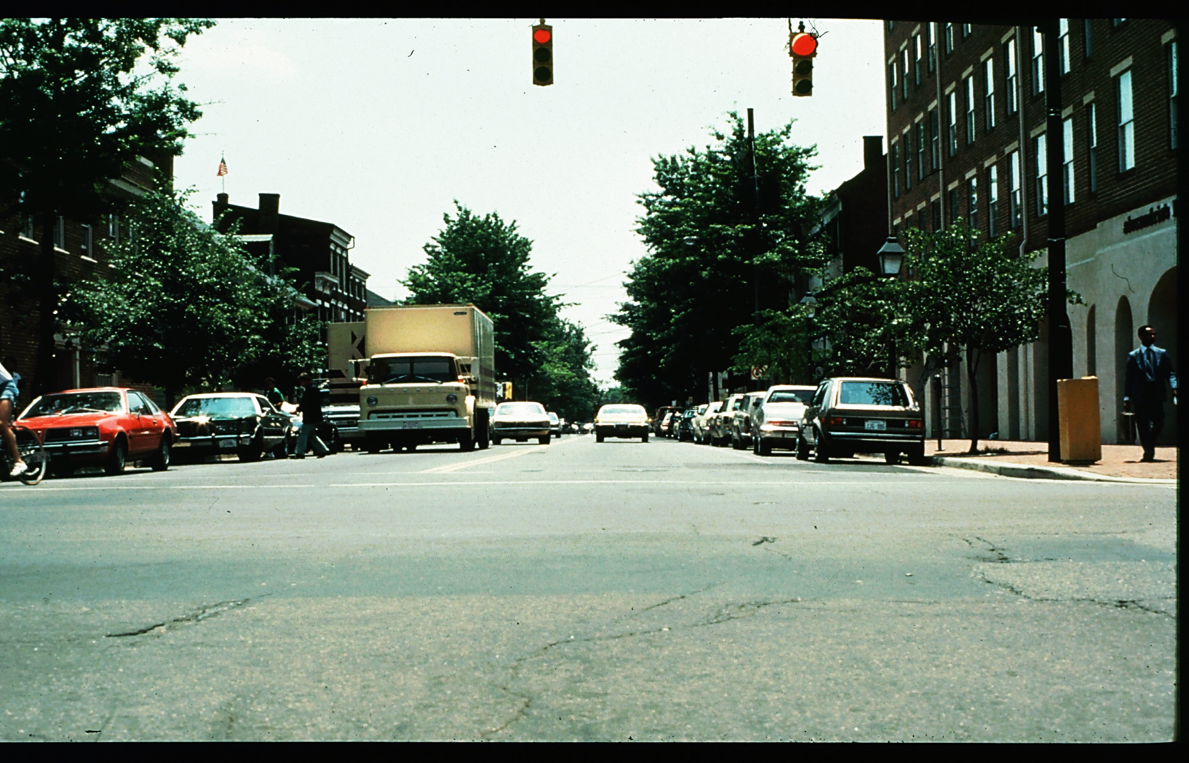
Scene 10 Answers
The double-parked truck has no driver. True
The oncoming car is over the center line. True
No parked cars on the right have wheels turned out. True

Slide 35
Contact/Mission
For more information on the (the topic of the presentation) please visit PDE’s website at www.education.pa.gov
The mission of the Department of Education is to ensure that every learner has access to a world-class education system that academically prepares children and adults to succeed as productive citizens. Further, the Department seeks to establish a culture that is committed to improving opportunities throughout the commonwealth by ensuring that technical support, resources, and optimal learning environments are available for all students, whether children or adults.

