Slide 1
Highway Transportation System Events
All Events

Slide 2
Practice
In the following search for all HTS events

Slide 3
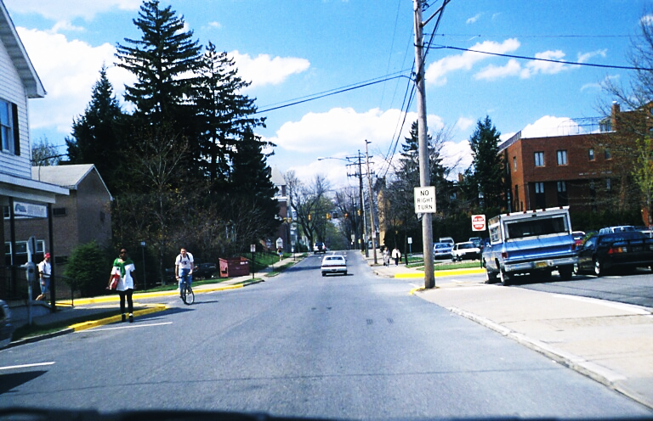

Slide 4
Practice Questions
You are on a one-way street.
You are approaching an area of less view to the sides.
The pedestrian and bicyclist are looking at us.

Slide 5
You are on a one-way street. True
You are approaching an area of less view to the sides. True
The pedestrian and bicyclist are looking at us. True

Slide 6
HTS Events
In slide A-1, search for Traffic Controls and Other Users

Slide 7
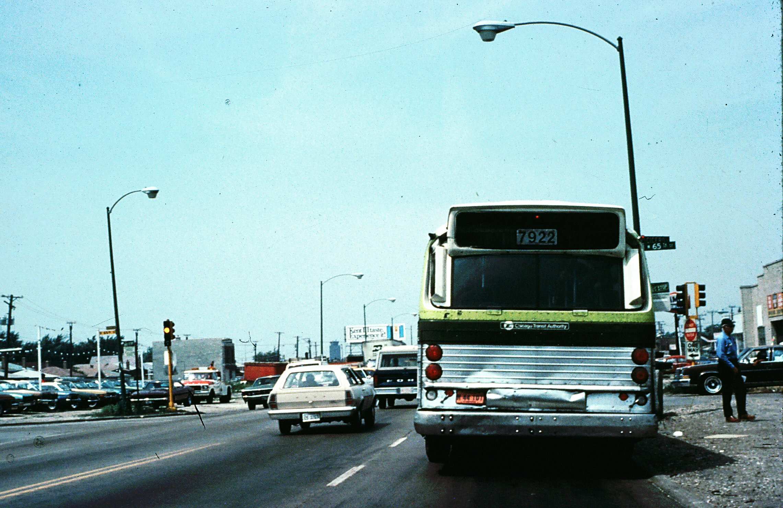

Slide 8
Slide A-1 Questions
The signal light is green.
You may turn right on red.
The bus will continue through the intersection.

Slide 9
The signal light is green. False
You may turn right on red. False
The bus will continue through the intersection. True

Slide 10
HTS Events
In slide A-2 Search for ALL Groups

Slide 11
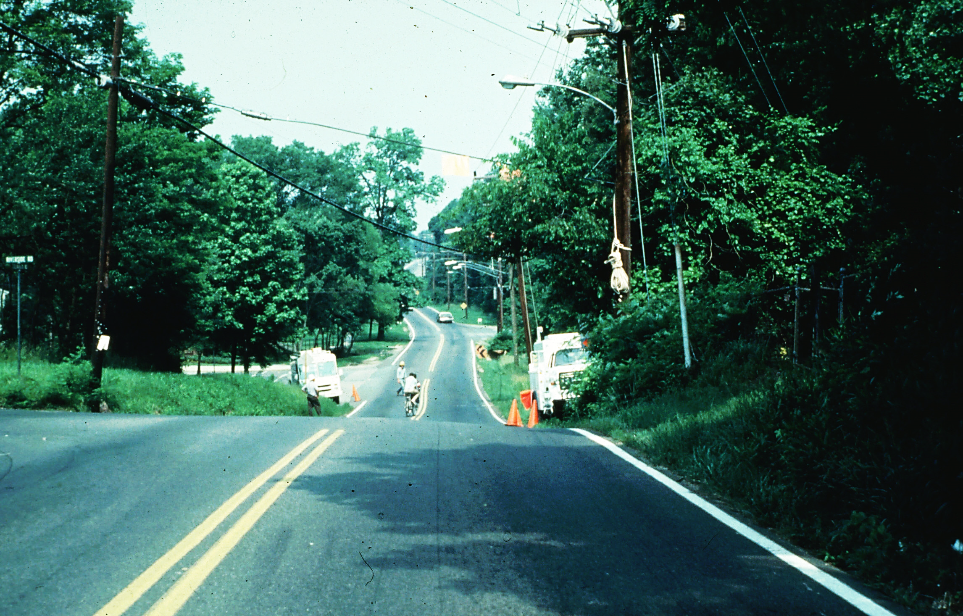

Slide 12
A-2 Questions
All Groups
The bike rider is coming toward us.
There is less space to the sides ahead.
This is a no-passing zone.

Slide 13
The bike rider is coming toward us. False
There is less space to the sides ahead. True
This is a no-passing zone. True

Slide 14
HTS Events
In A-3, search for Traffic Controls and Other Users.

Slide 15
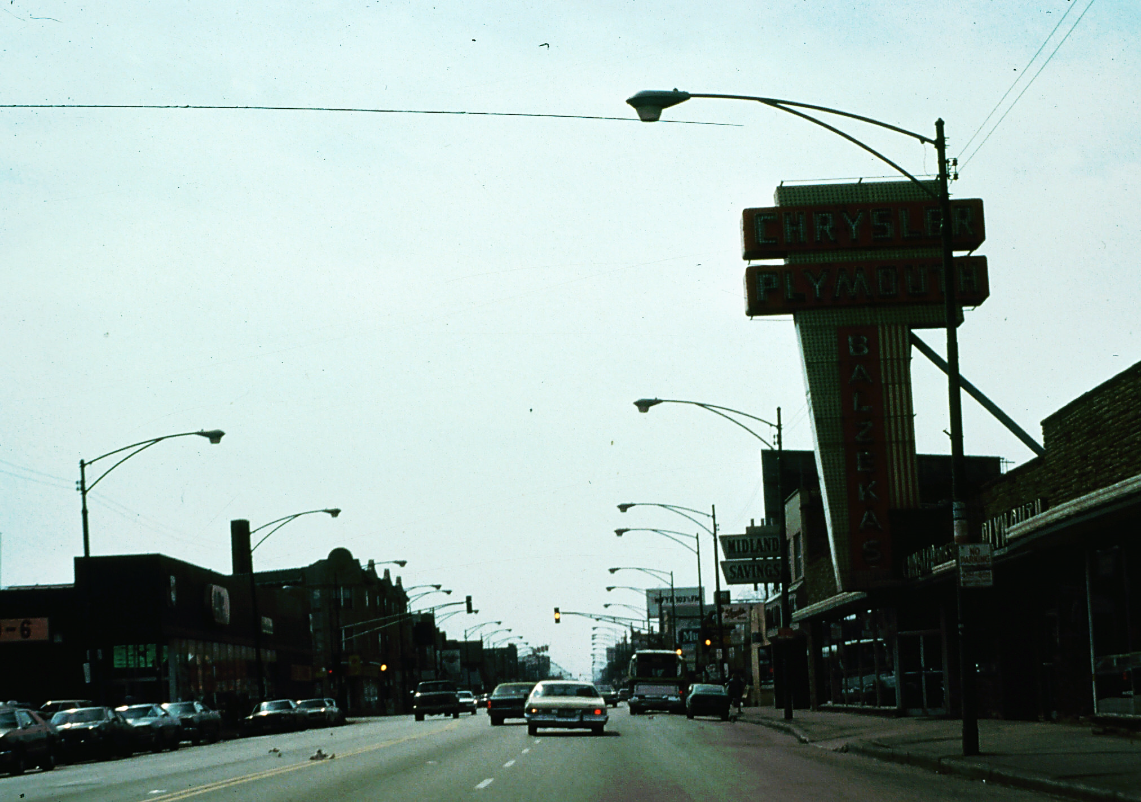

Slide 16
A-3 Questions
Traffic Controls and Other Users
The traffic light ahead is red.
The car ahead is straddling the lane line.
There is a city bus on the right.

Slide 17
The traffic light ahead is red. False
The car ahead is straddling the lane line. True
There is a city bus on the right. True

Slide 18
HTS Events
In A-4, search for Traffic Control and Highway Conditions

Slide 19
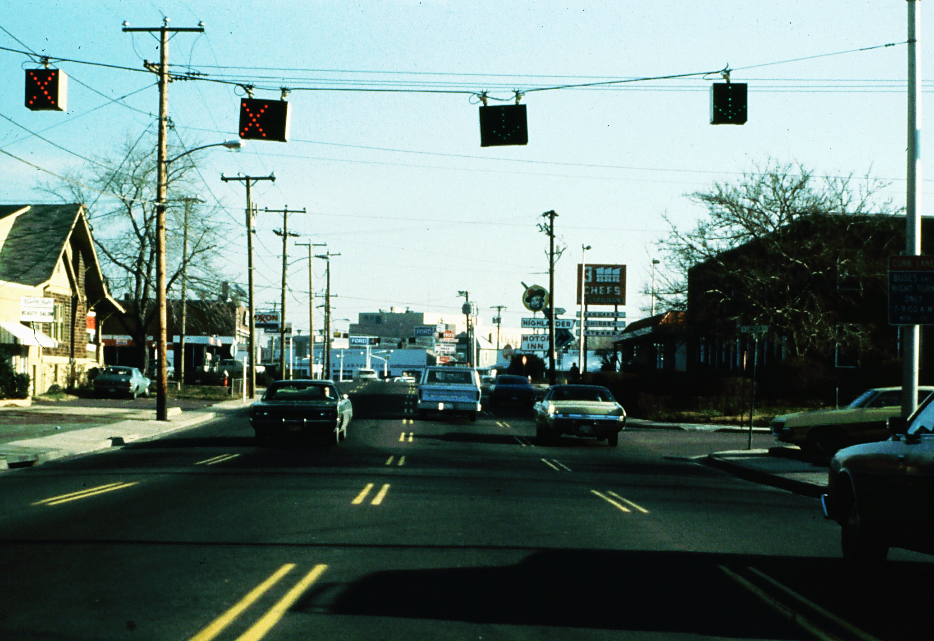

Slide 20
A-4 Questions
Traffic Controls and Highway Conditions
You cannot change lanes to the right.
You cannot change lanes to the left.
This street has reversible lanes.

Slide 21
You cannot change lanes to the right. False
You cannot change lanes to the left. True
This street has reversible lanes. True

Slide 22
HTS Events
In A-5, Search for Highway Conditions and Other Users

Slide 23
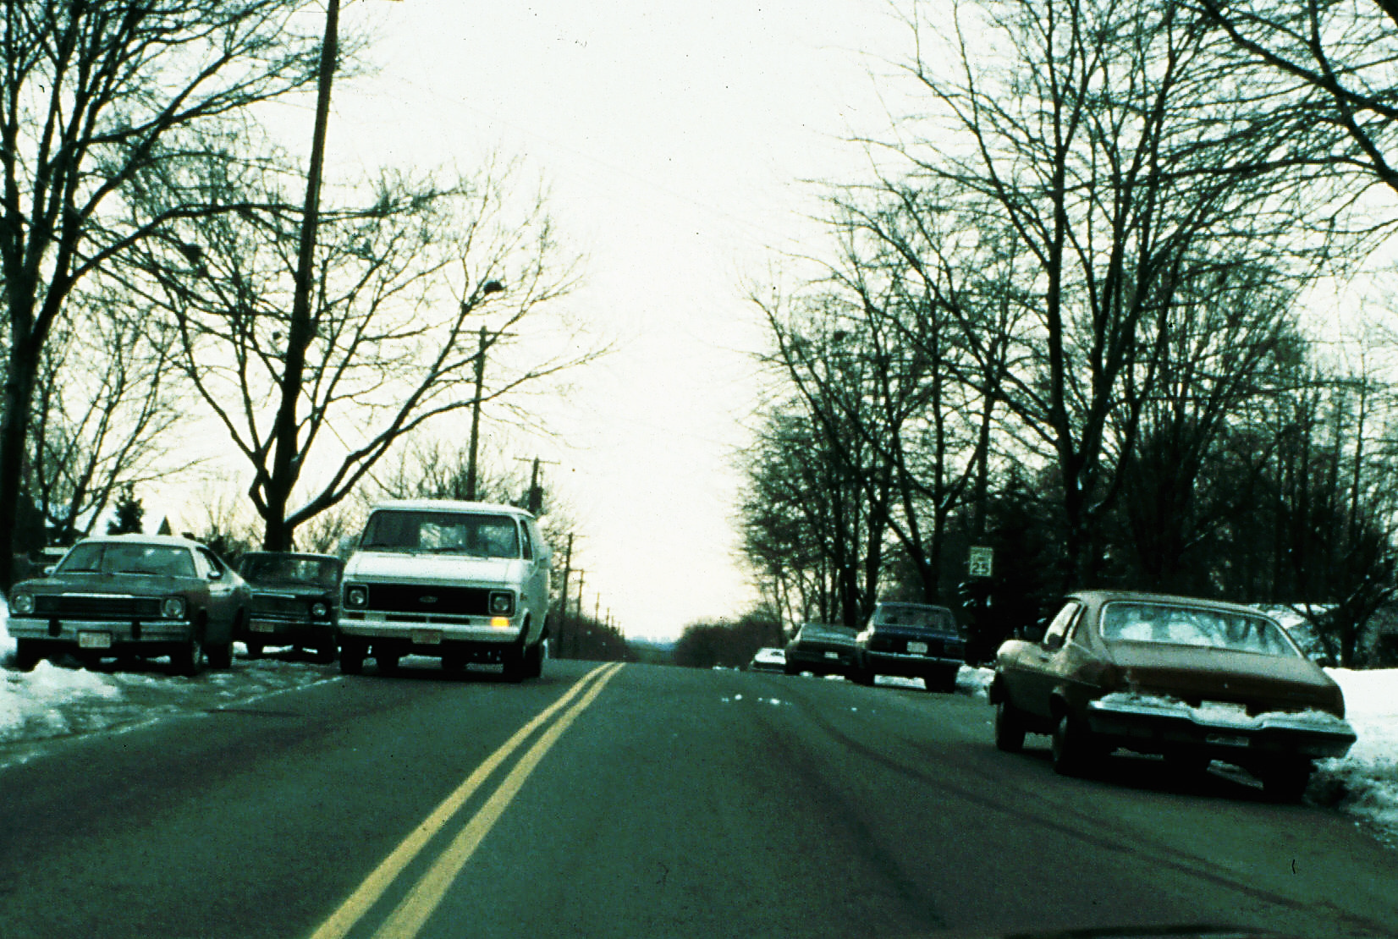

Slide 24
A-5 Questions
Highway Conditions and Other Users
The van is double parked.
This is an area of less view ahead and to the sides.
This is an area of less space to the sides.

Slide 25
The van is double parked. True
This is an area of less view ahead and to the sides. True
This is an area of less space to the sides. True

Slide 26
HTS Events
In A-6, search for Traffic Controls and Highway Conditions

Slide 27
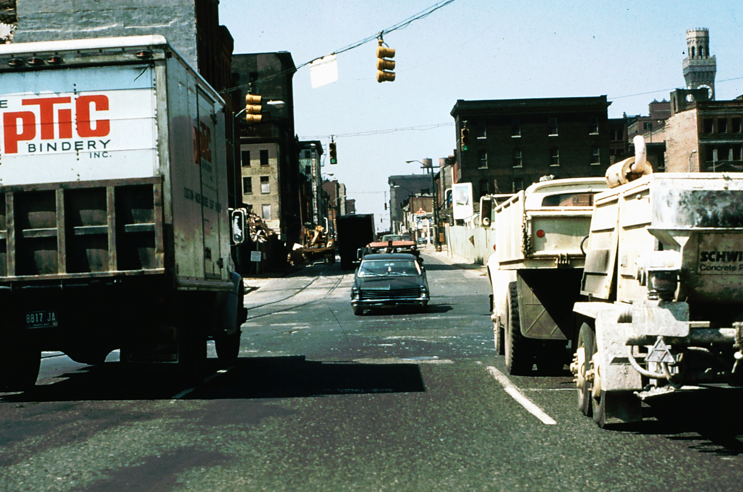

Slide 28
A-6 Questions
Traffic Controls and Highway Conditions
The street gets narrower ahead.
You are on a one-way street.
You have good visibility.

Slide 29
The street gets narrower ahead. True
You are on a one-way street. True
You have good visibility. False

Slide 30
HTS Events
In A-7, you will be searching for ALL HTS Groups and looking for Route 61

Slide 31
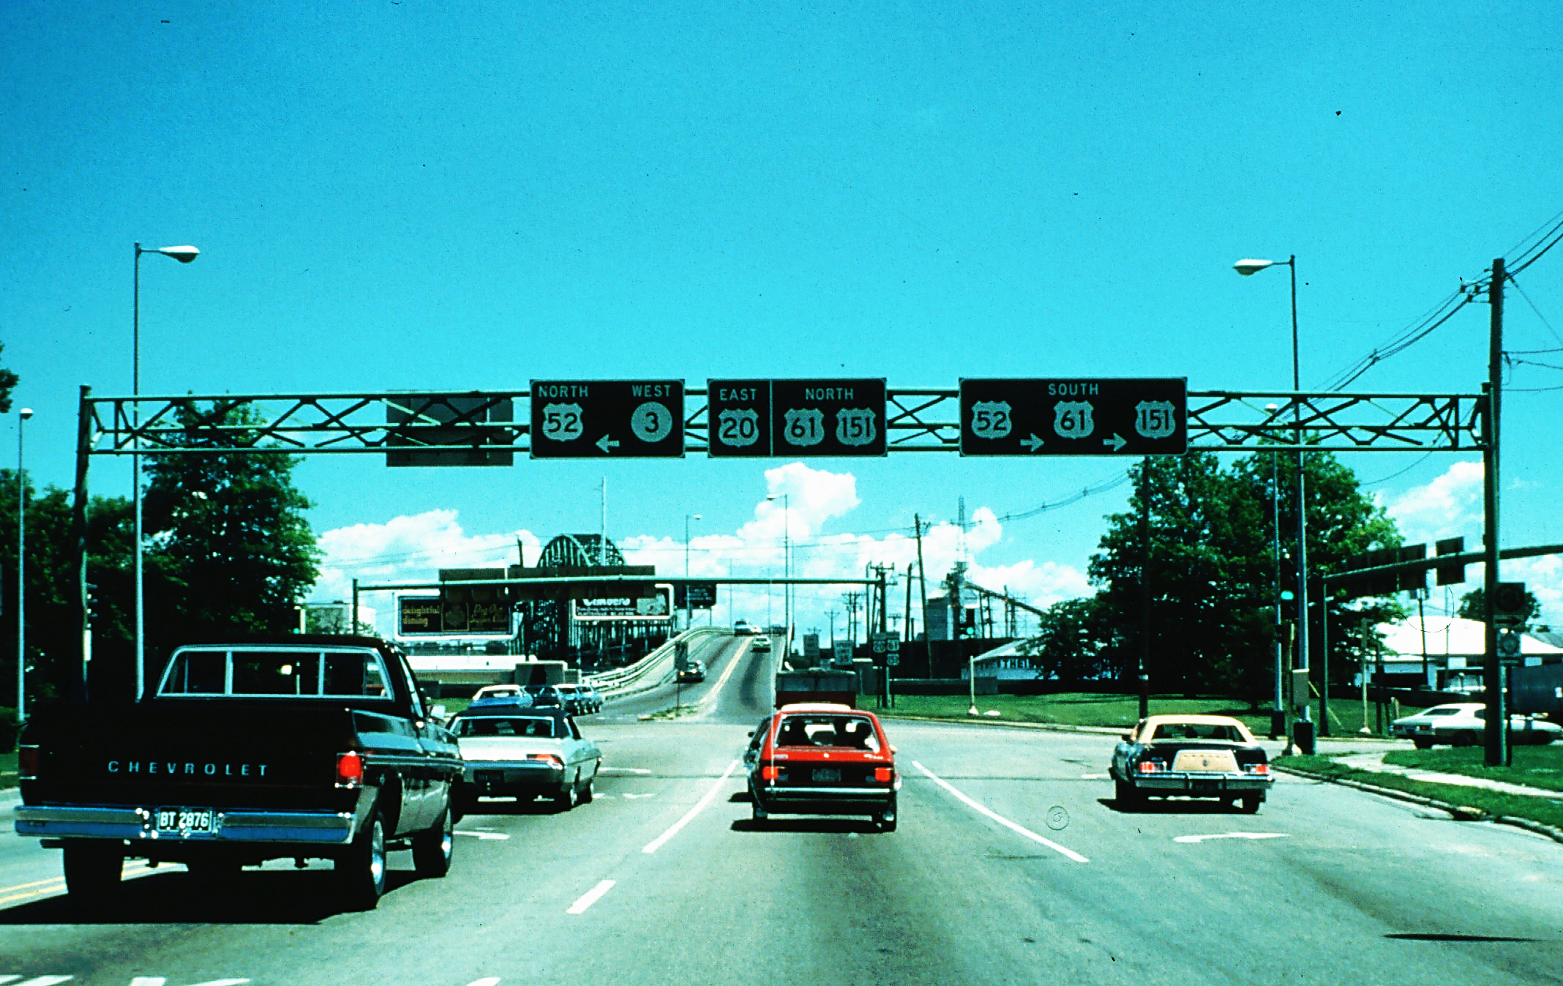

Slide 32
A-7 Questions
All Groups
The pick-up truck on the left appears to want to turn left.
There is an area of less space ahead.
To go south on Route 61, you should change lanes to the right.

Slide 33
The pick-up truck on the left appears to want to turn left. True
There is an area of less space ahead. True
To go south on Route 61, you should change lanes to the right. True

Slide 34
A-8
Search for ALL HTS Groups

Slide 35
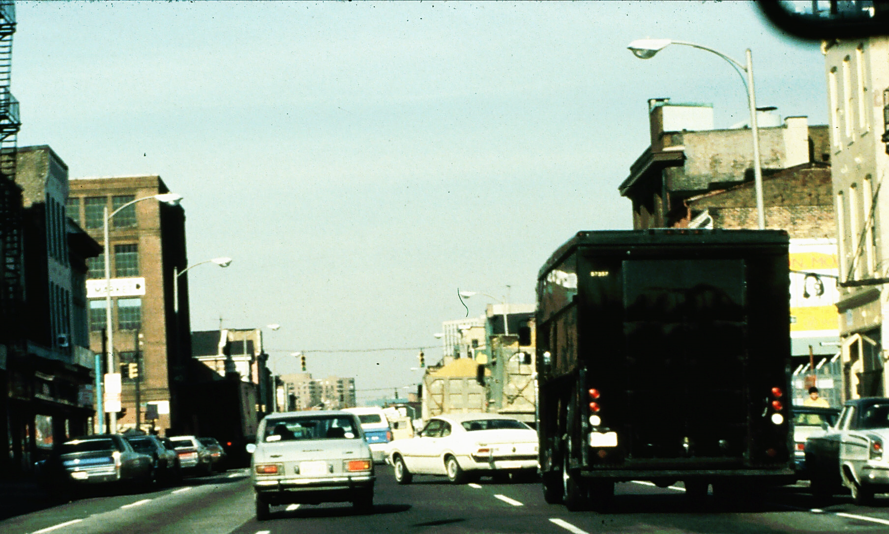

Slide 36
A-8 Questions
All HTS Groups
You are on a one-way street.
You are coming to an area of less space.
The car ahead is straddling the lane line.

Slide 37
You are on a one-way street. True
You are coming to an area of less space. True
The car ahead is straddling the lane line. True

Slide 38
A-9
In A-9, search for All HTS Groups

Slide 39
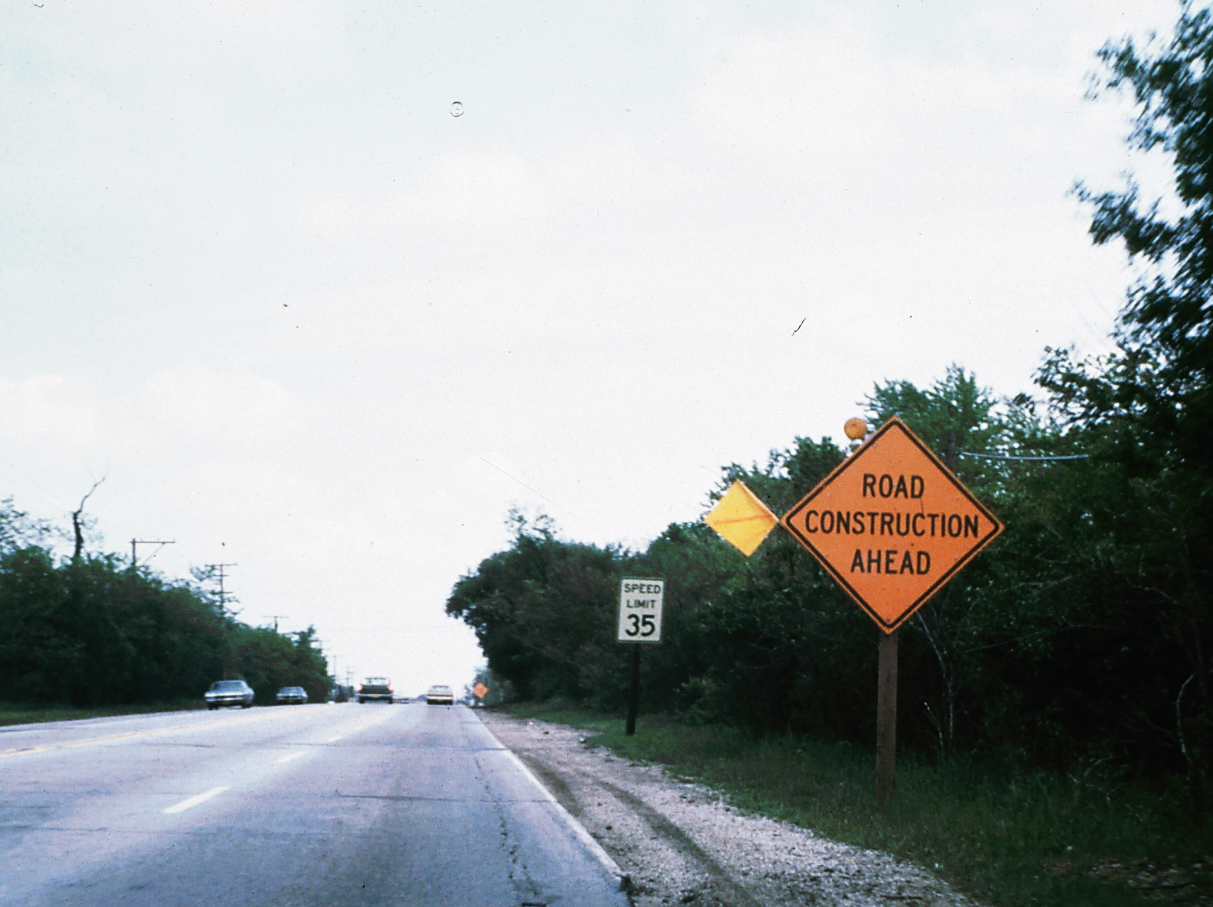

Slide 40
A-9 Questions
All HTS Groups
The shoulder is level with the pavement.
The speed limit is 55 mph.
The ongoing car in the left lane has its brake lights on.

Slide 41
The shoulder is level with the pavement. False
The speed limit is 55 mph. False
The ongoing car in the left lane has its brake lights on. True

Slide 42
A-10
In A-10, search for Traffic Controls and Other Users

Slide 43
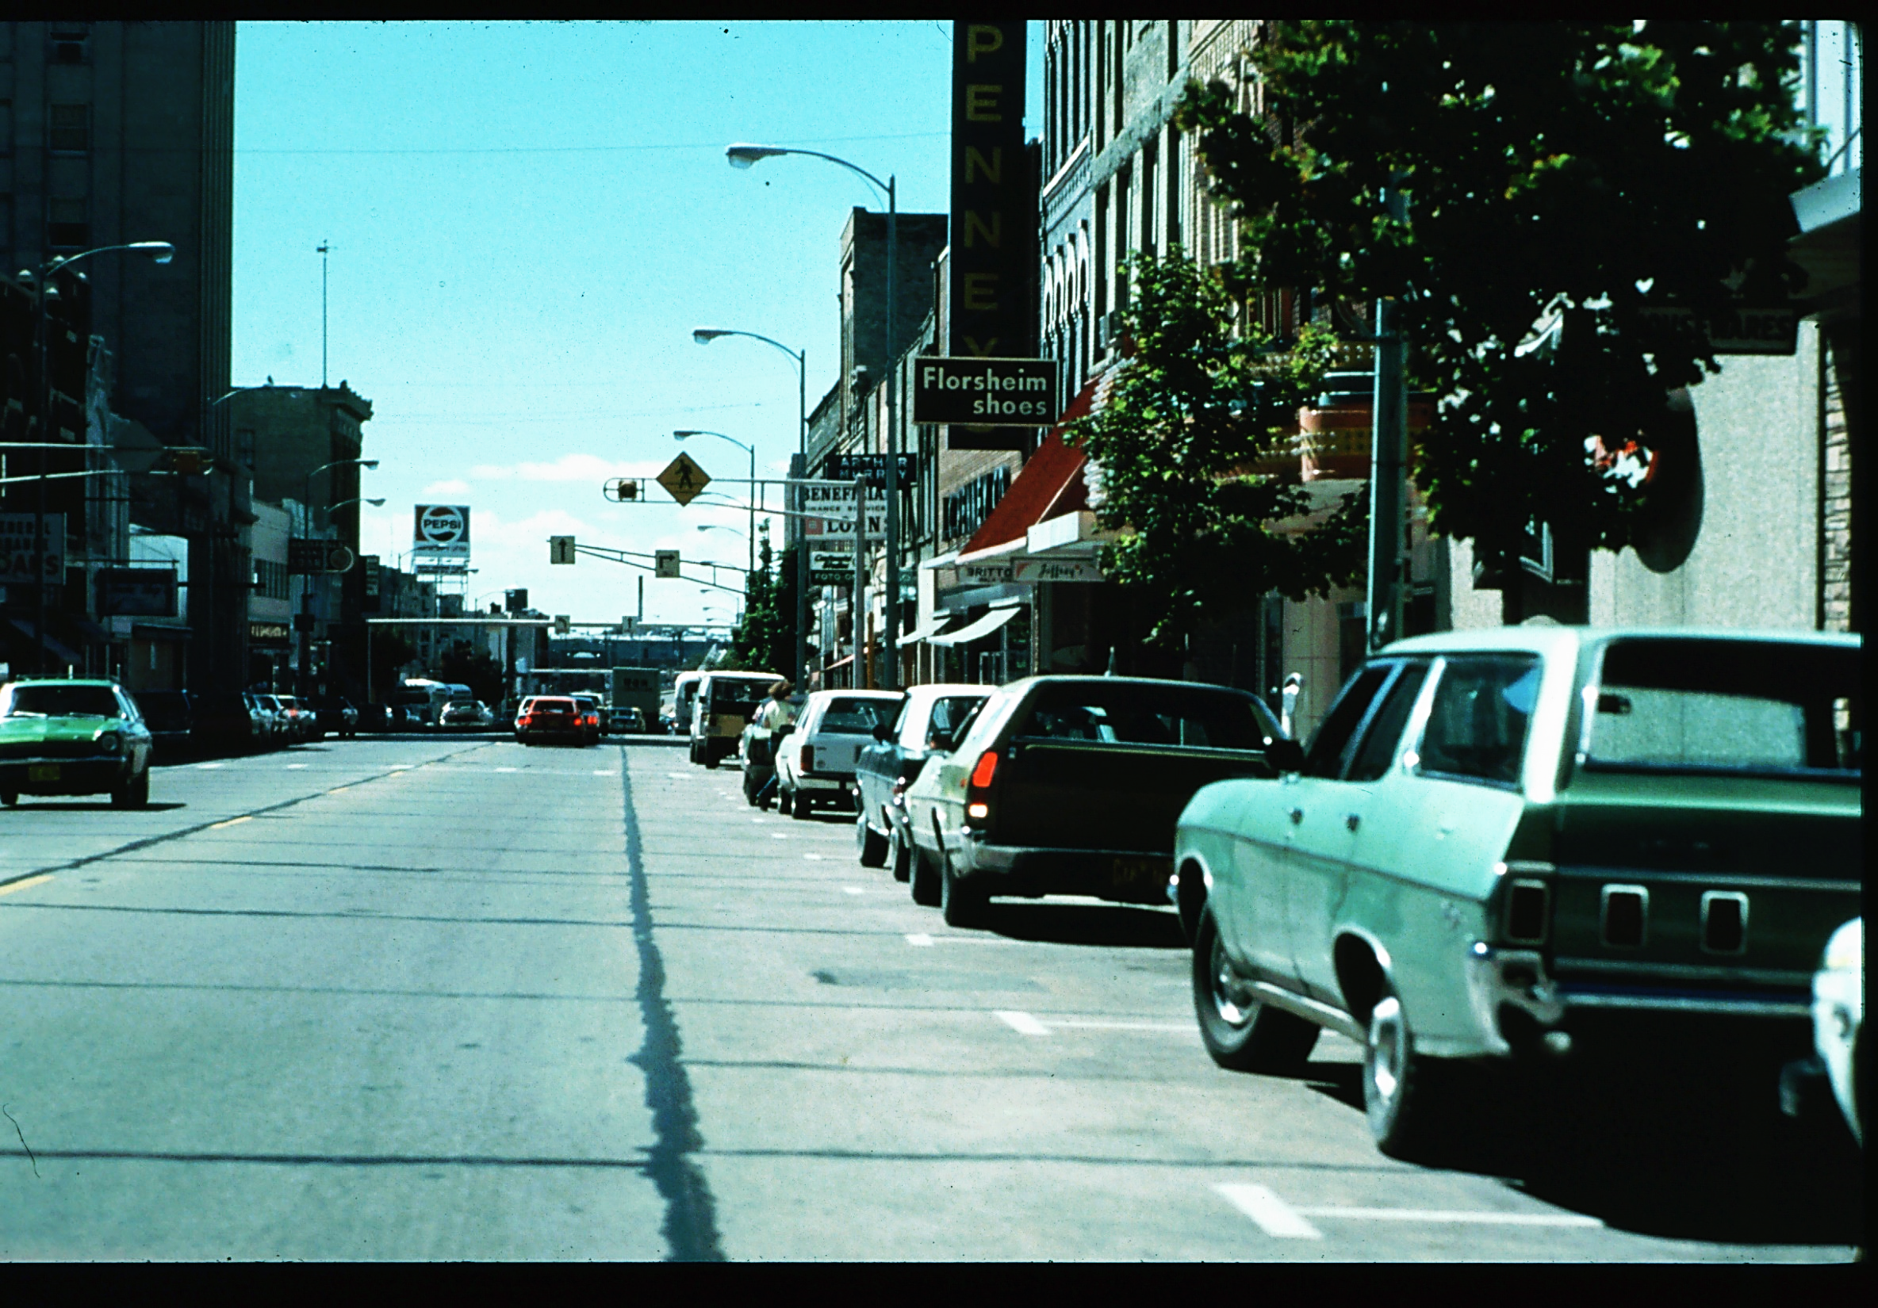

Slide 44
A-10 Questions
All Traffic Controls and Other Users
There is a pedestrian crosswalk just ahead.
One of the parked cars has the back-up lights on.
There is a pedestrian between two of the parked cars.

Slide 45
There is a pedestrian crosswalk just ahead. True
One of the parked cars has the back-up lights on. True
There is a pedestrian between two of the parked cars. True

Slide 46
END
End of
ALL HTS Events

Slide 47
Contact/Mission
For more information on the (the topic of the presentation) please visit PDE’s website at www.education.pa.gov
The mission of the Department of Education is to ensure that every learner has access to a world-class education system that academically prepares children and adults to succeed as productive citizens. Further, the Department seeks to establish a culture that is committed to improving opportunities throughout the commonwealth by ensuring that technical support, resources, and optimal learning environments are available for all students, whether children or adults.

