Slide 1
Highway Conditions
Space, Visibility, and Traction

Slide 2
Instructions
In this unit, we will concentrate our efforts on proper identification of space, visibility, and traction.

Slide 3
Space & Reduction in Space
An “area of less space” is where the driver does not have at least “one car width” next to your “path of travel.”
Remember, Leave yourself an “out.”

Slide 4
Visibility
Line of Sight – where you are looking at any given moment. This is where you have your best visual acuity. Central vision is only three degrees.
View to the Sides-the outer edge of your “field of vision.” In this area, you can see movement, color, and mass.

Slide 5
Traction
“Area of Less Traction” – Any part of the highway ahead in which the friction or the gripping of the tires to the highway surface is reduced.

Slide 6
Remember:
Any time you have a reduction in space, visibility or traction you must make an adjustment in your driving.

Slide 7
Practice Scenario
The next slide is a practice scene.
Just look at the slide.
Ready?

Slide 8
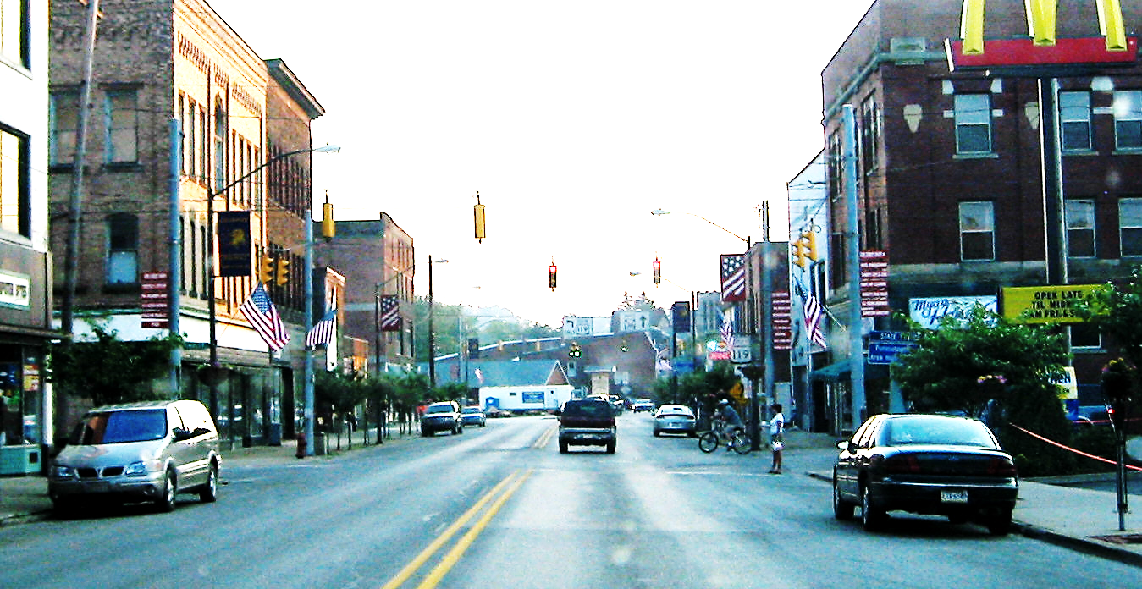
Practice Scenario

Slide 9
Highway Conditions-Practice Scenario
Our “line of sight” is good.
Our “view to the sides” is also good.
Space problems increase as we continue forward.

Slide 10

Practice Scenario Answers
Our “line of sight” is good. True
Our “view to the sides is also good. False
C. Problems with space increase as we move forward. True

Slide 11
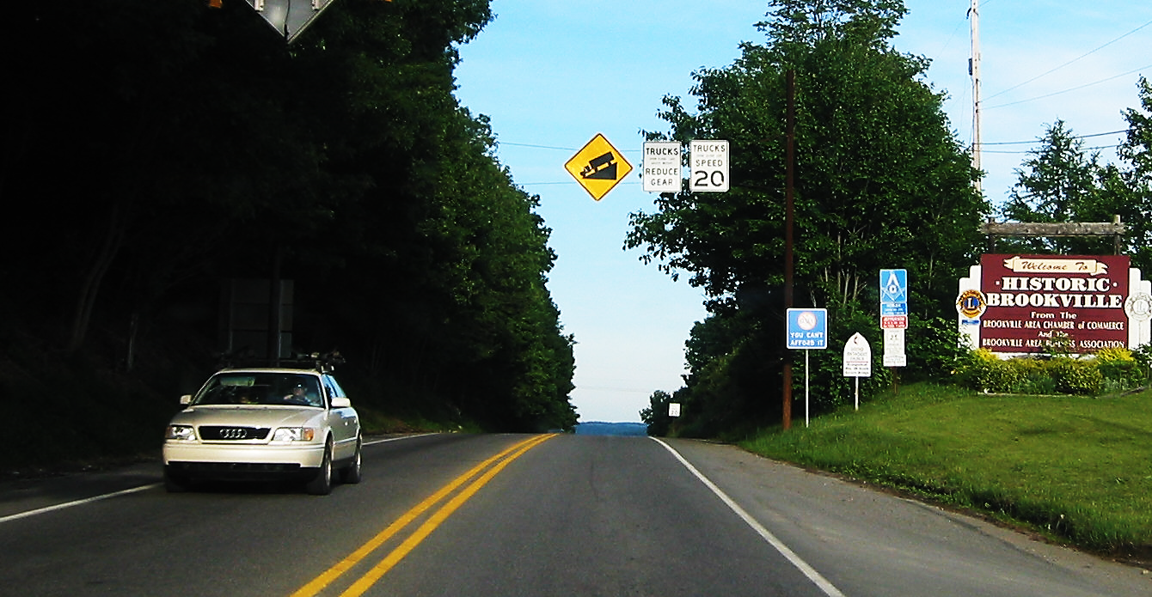
Scenario 1

Slide 12
Scenario 1 Questions
Our “line of sight” is good.
Our space is good.
The “shoulder” is level with the highway.

Slide 13
Scenario 1 Answers
Our “line of sight” is good. False
Our space is good. True
The shoulder is level with the highway. True

Slide 14
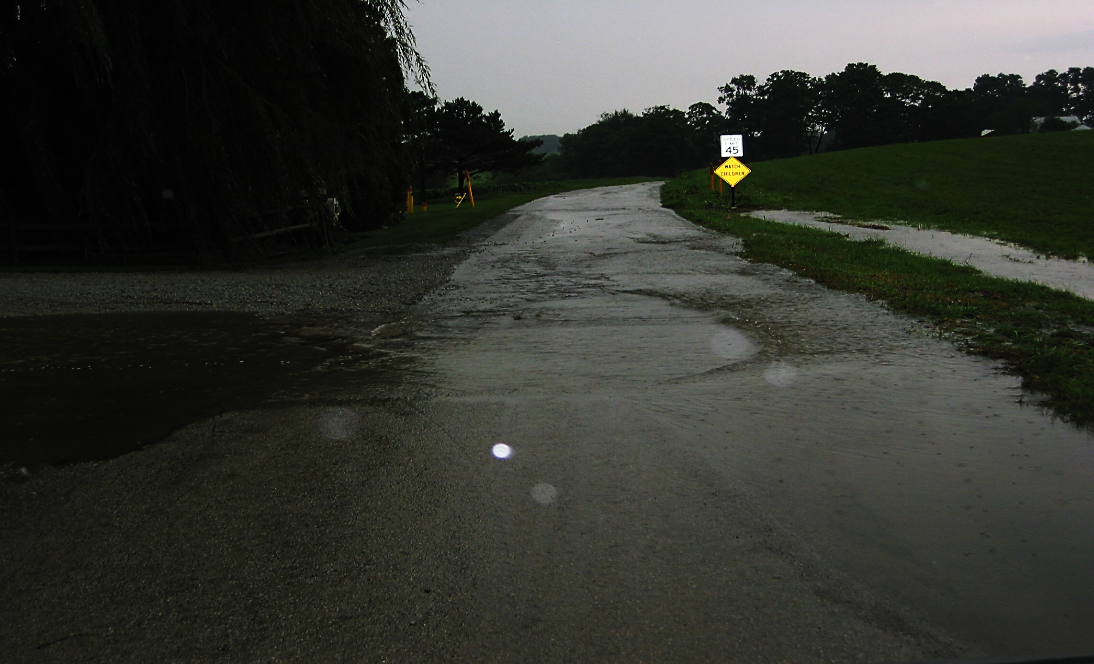
Scenario 2

Slide 15
Scenario 2 Questions
Our “line of sight” ahead is reduced.
Spacing is definitely a problem here.
C. If we drive through the water, we need to check our brakes on the other side of the water hazard.

Slide 16
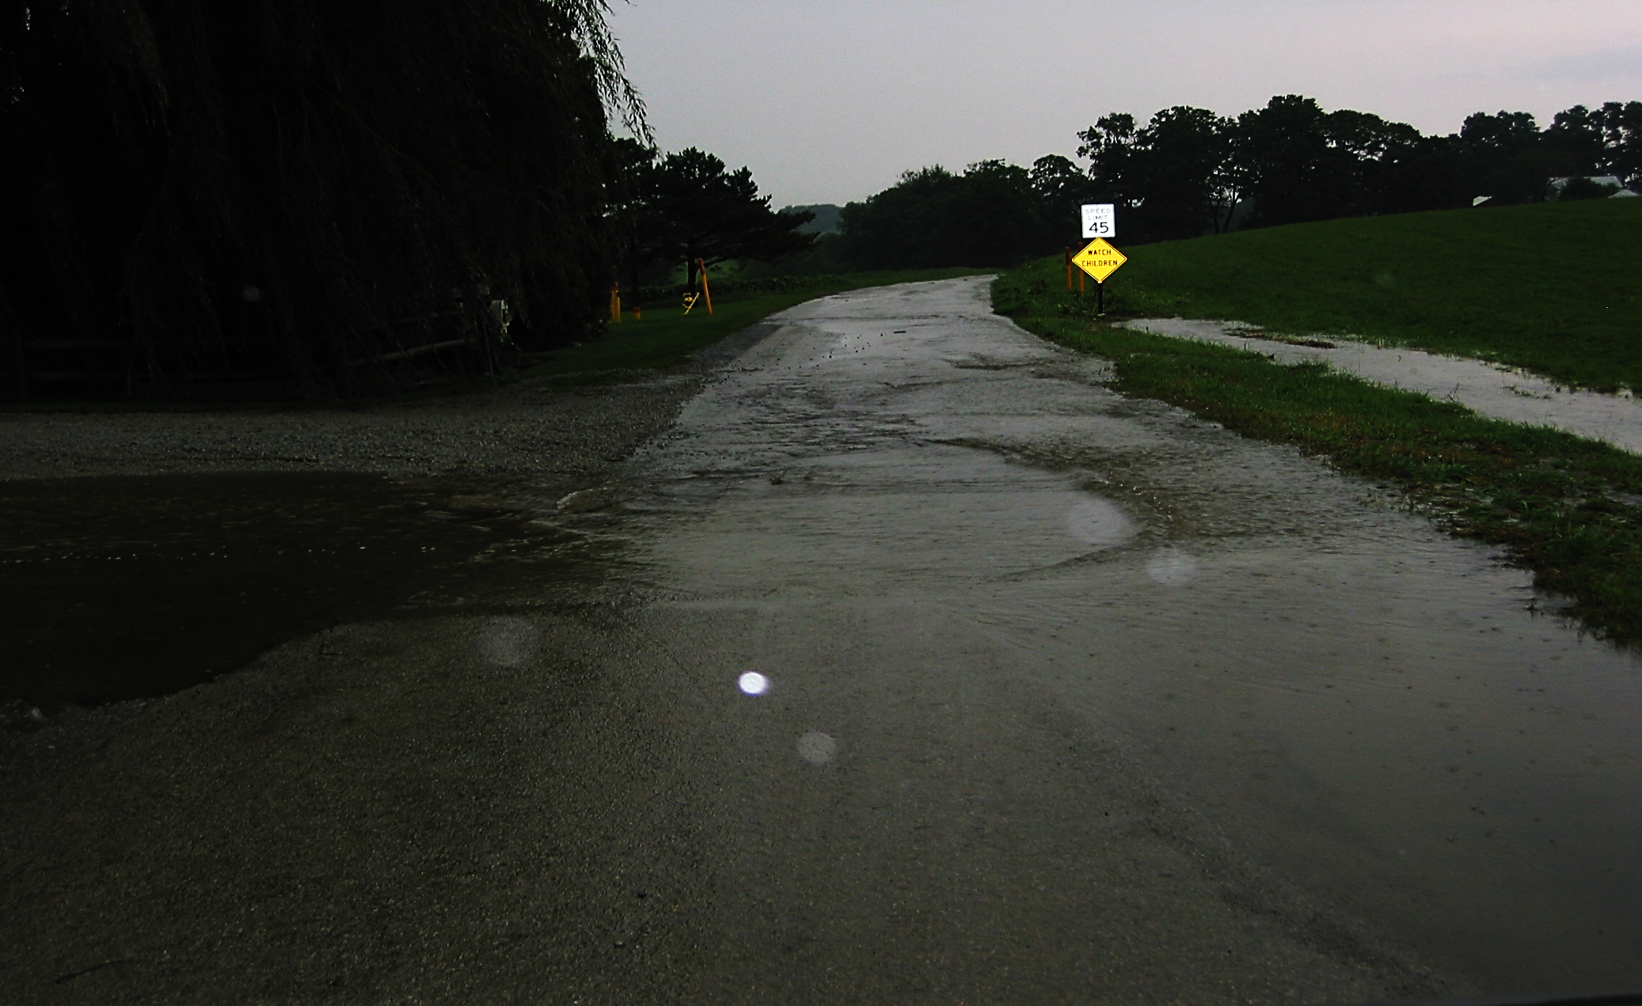
Scenario 2 Answers
Our “line of sight” ahead is reduced. True
Spacing is definitely a problem here. True
If we drive through the water, we need to check our brakes
on the other side of the water hazard True

Slide 17
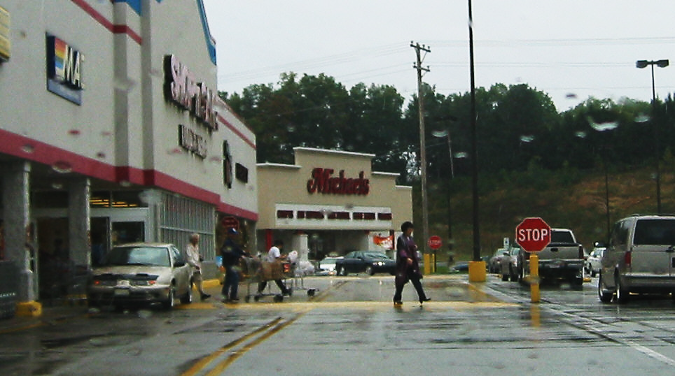
Scenario 3

Slide 18
Scenario 3 Questions
Our traction is reduced.
Our view to the sides is good.
There are three people in the crosswalk ahead.

Slide 19
Scenario 3 Answers
Our traction is reduced. True
Our “view to the sides” is good. False
There are three people in the crosswalk ahead. False

Slide 20
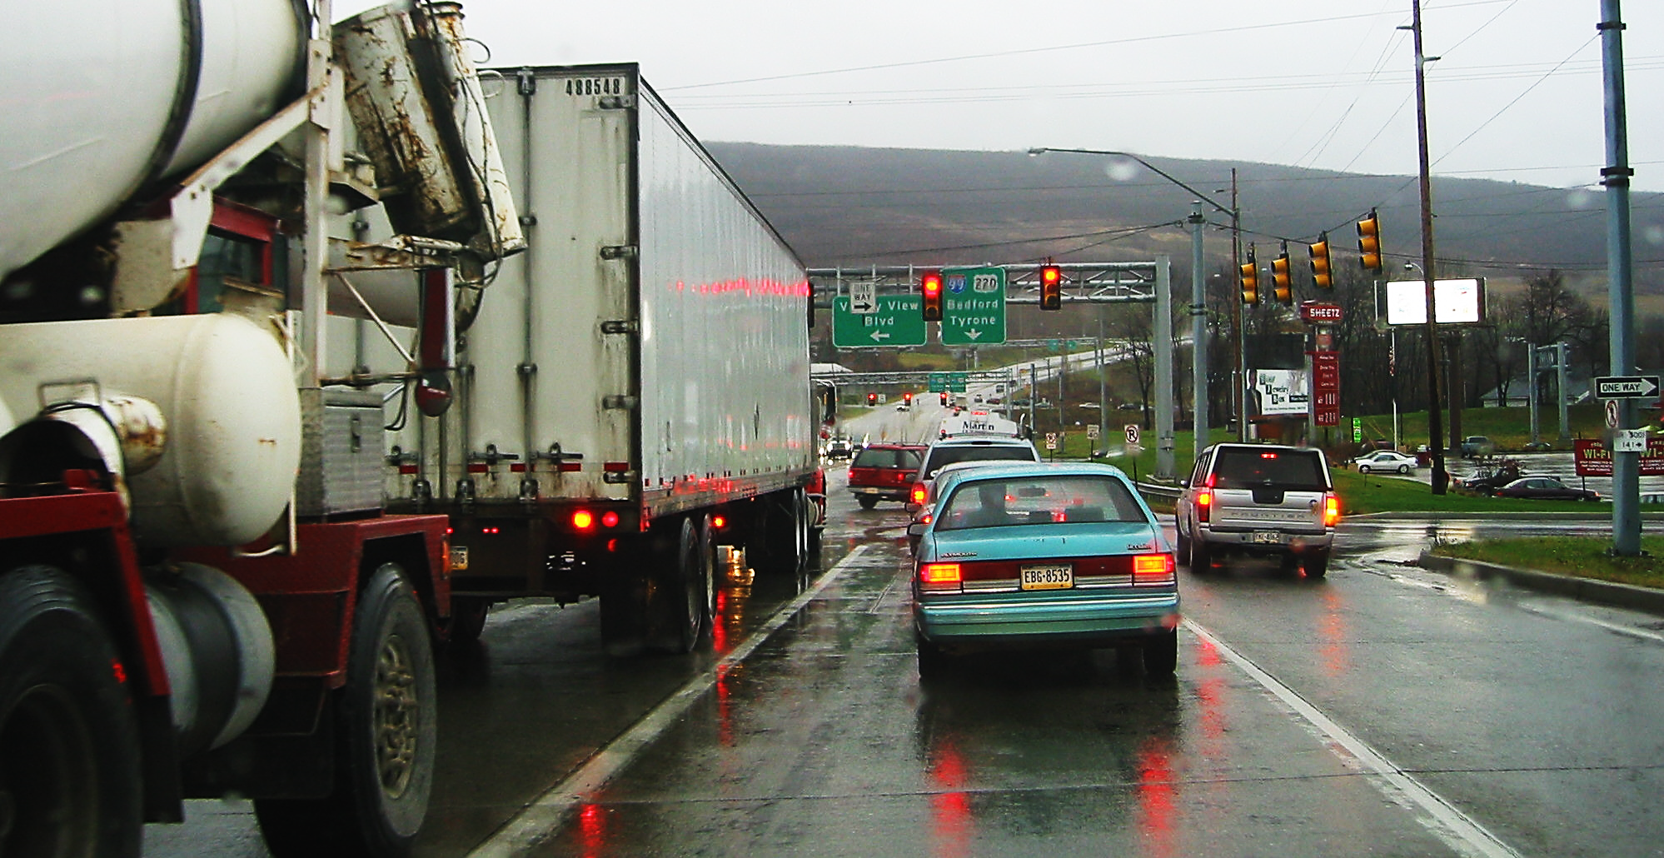
Scenario 4

Slide 21
Scenario 4 Questions
Our view to the left side is poor.
The roadway appears to be wet.
It appears that we have enough space to lane change to the right.

Slide 22
Scenario 4 Answers
Our view to the left side is poor. True
The highway appears to be wet. True
It appears that we have enough space
to lane change to the right. True

Slide 23
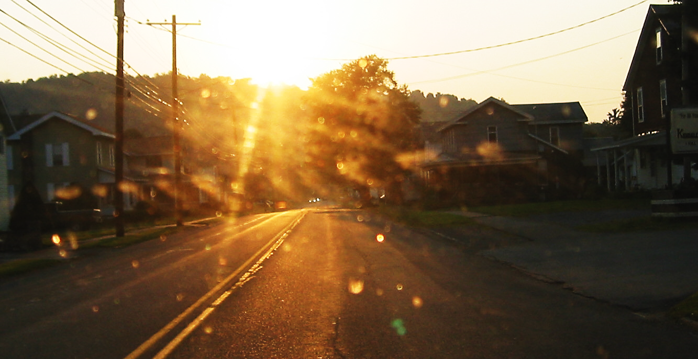
Scenario 5

Slide 24
Scenario 5 Questions
We need to reduce our speed.
Our traction is questionable.
There are cars approaching.

Slide 25
Scenario 5 Answers
We need to reduce our speed. True
Our traction is questionable. False
There are cars approaching. True

Slide 26
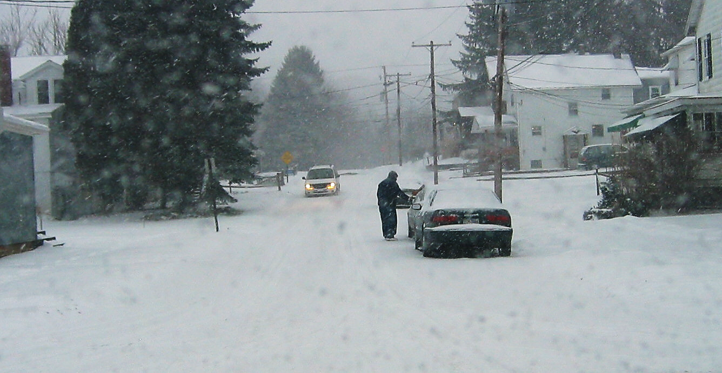
Scenario 6

Slide 27
Scenario 6 Questions
When we brake, we need to increase our stopping distance.
There is a second parked car on the far side of the first parked car.
We need to “time” when we steer around the parked car.

Slide 28
Scenario 6 Answers
When we brake, we need to increase our stopping distance. True
There is a second parked car on the far side of the first parked car. True
We need to “time” when we steer around the parked car. True

Slide 29
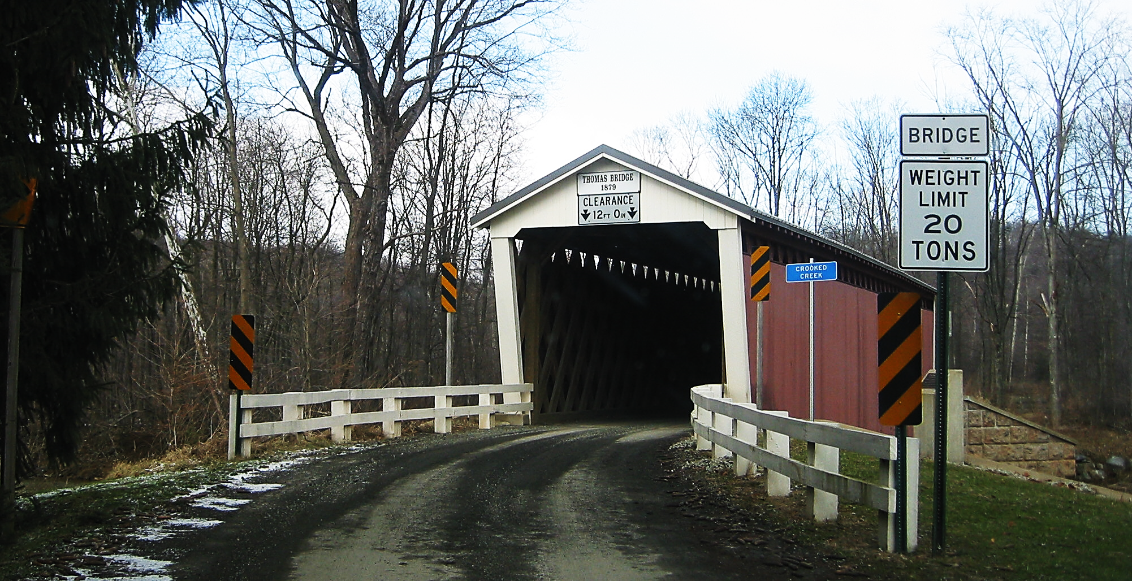
Scenario 7

Slide 30
Scenario 7 Questions
Our “line of sight” is good.
Our traction is good.
Our approaching space is good.

Slide 31
Scenario 7 Answers
        Our “line of sight” is good. False
        Our traction is good. False
        Our approaching space is good. False

Slide 32
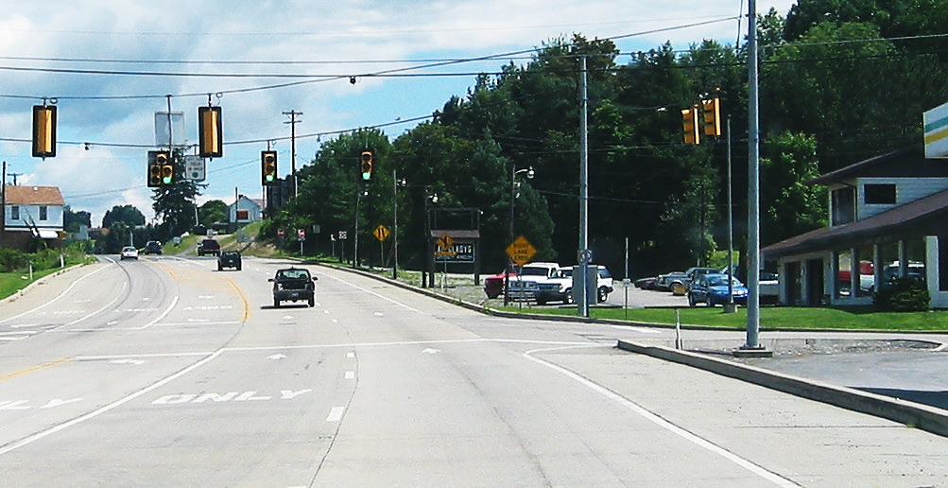
Scenario 8

Slide 33
Scenario 8 Questions
Our visibility is good.
Our lane ends after the traffic light.
To turn right, we must lane change to the right turn lane.

Slide 34
Scenario 8 Answers
Our visibility is good. True
Our lane ends after the traffic light. True
To turn right, we must lane change to the right turn lane. False

Slide 35
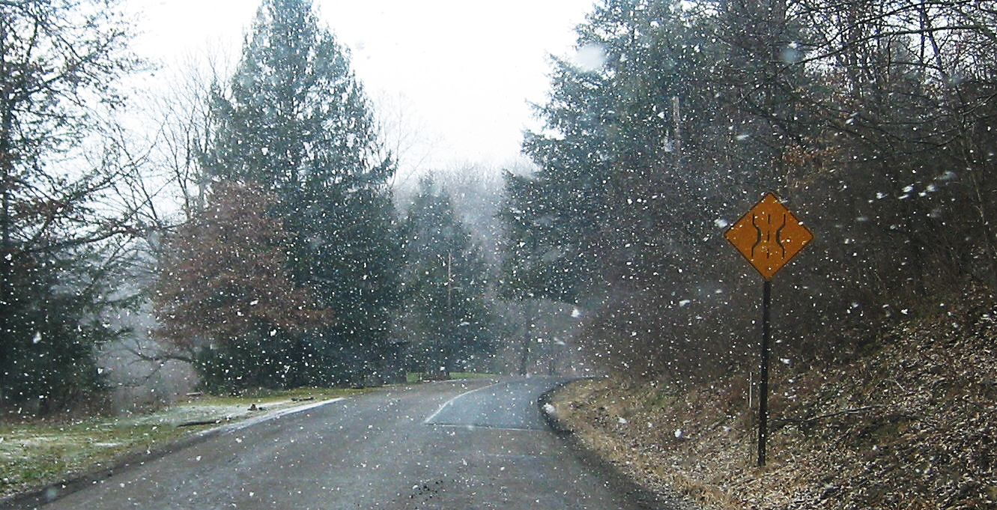
Scenario 9

Slide 36
Scenario 9 Questions
Our visibility is questionable.
Traction is extremely poor.
Our space ahead is reduced.

Slide 37
Scenario 9 Answers
Our visibility is questionable. True
Traction is extremely poor. False
Our space ahead is reduced. True

Slide 38
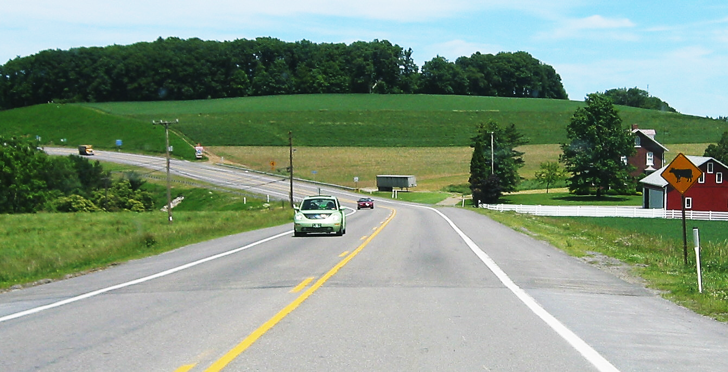
Scenario 10

Slide 39
Scenario 10 Questions
Our visibility is good.
Our traction is good.
Our space is good.

Slide 40
Scenario 10 Answers
Our visibility is good. True
Our traction is good. True
Our space is good. True

Slide 41
Scoring
Add up your correct answers
30-27 = Excellent
26-24 = Good
23-21 = Average
20 and below = Needs Improvement

Slide 42
Contact/Mission
For more information on the (the topic of the presentation) please visit PDE’s website at www.education.pa.gov
The mission of the Department of Education is to ensure that every learner has access to a world-class education system that academically prepares children and adults to succeed as productive citizens. Further, the Department seeks to establish a culture that is committed to improving opportunities throughout the commonwealth by ensuring that technical support, resources, and optimal learning environments are available for all students, whether children or adults.

