Slide 1
Responding to Problem Situations
Masters R-A through R-L

Slide 2
Objectives
1. Managing the space around one’s vehicle
2. Timing driver actions
3. Identifying factors that require a speed adjustment
4. Selecting a safe path of travel
5. Communicating one’s intentions to other highway users
6. Demonstrating the decision making process

Slide 3
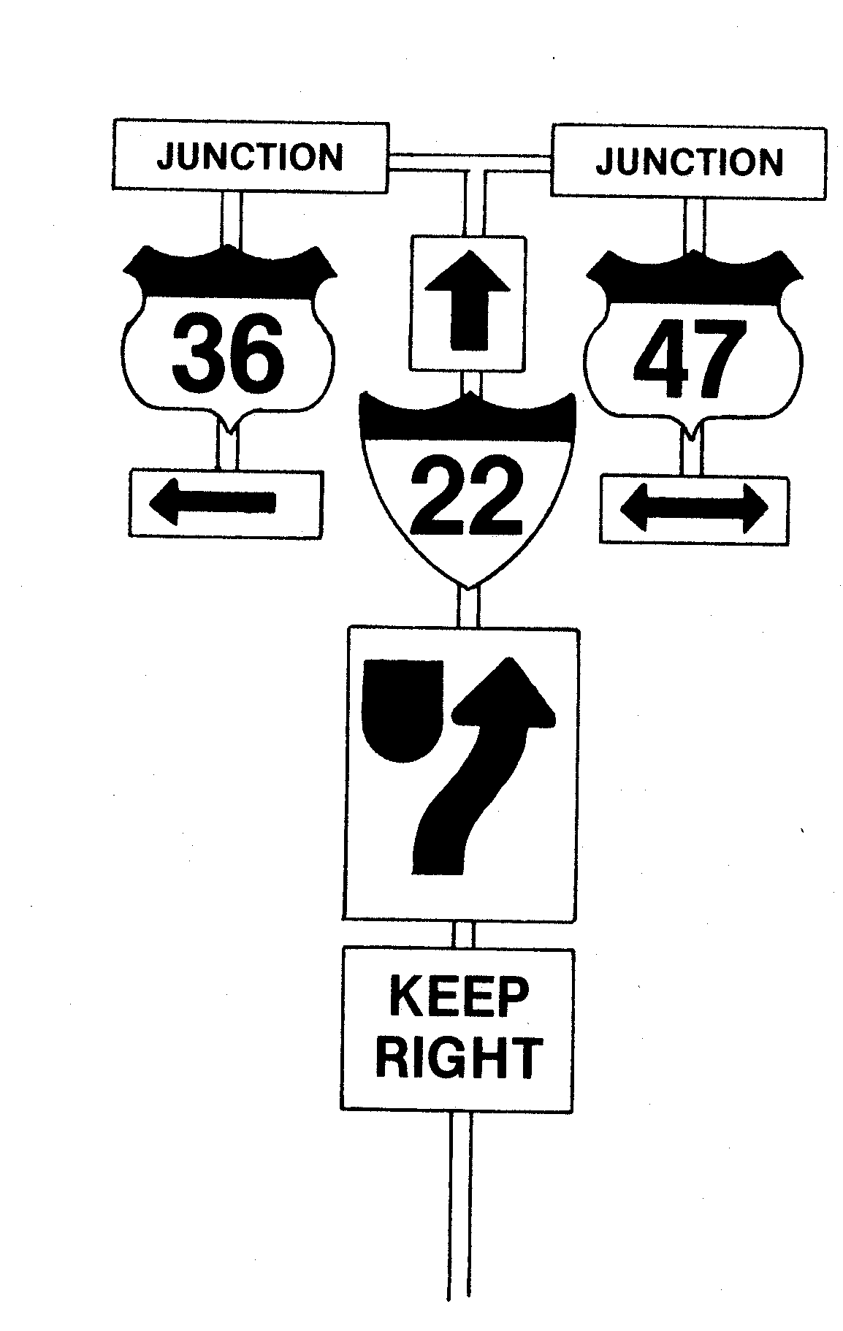
Kinds of Decisions
What
Route to follow
Path to Pick
Maneuver to make
Communication to use
Time to start
Speed to choose
Controls to use
When and Where to
Meet other traffic
Perform maneuvers
Change direction
Yield
Signal
Change speed
How Much To
Accelerate
Decelerate
Steer
Brake
Signal

Slide 4
Nature of Decision Making
Identify the Choices Available
Compare for Consequences
Choose the Best Response
Apply a Plan of Action

Slide 5
Plan of Action
1. Maintain Adequate Space Margins
2. Time Your Driving Actions
3. Choose Best Speed for Conditions
4. Choose the Best Path of Travel
5. Communicate All Changes

Slide 6
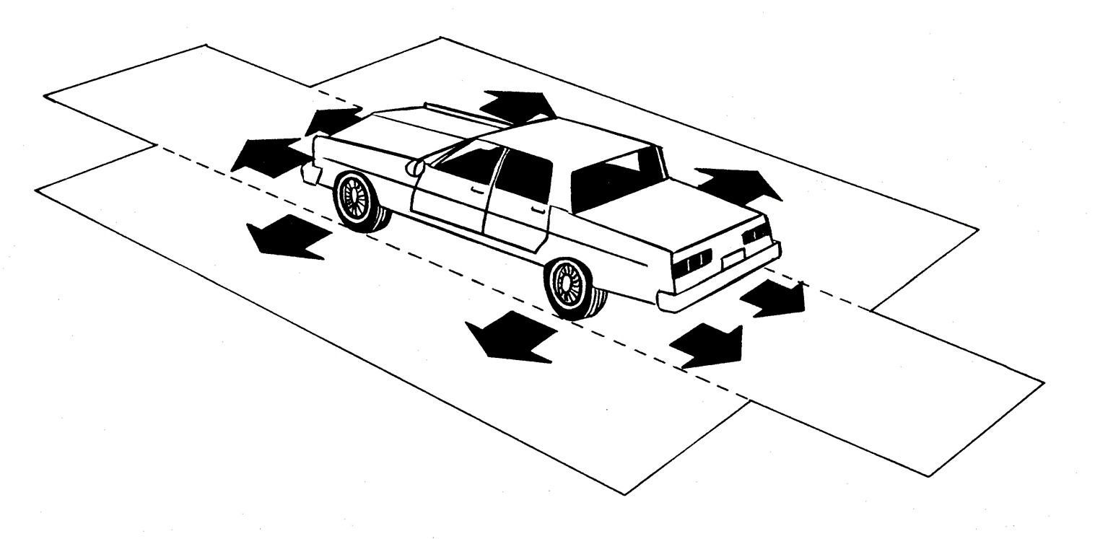
Maintain Adequate Space Margins

Slide 7
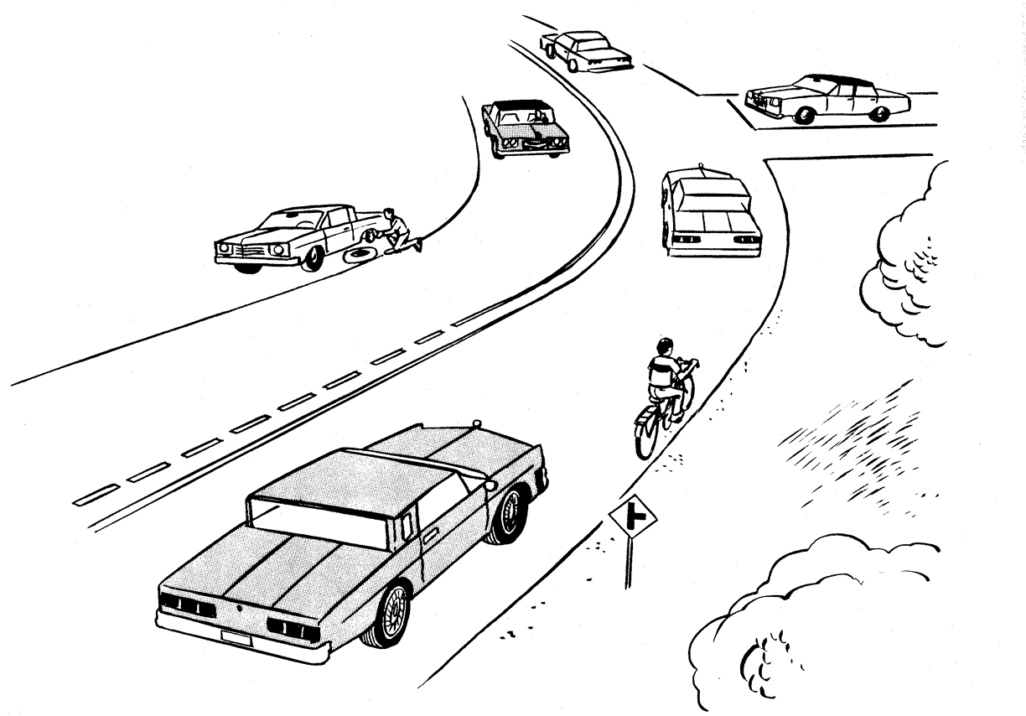
Time Your Driving Actions

Slide 8
Choose Best Speed for Conditions
What Type of Conditions?

Slide 9
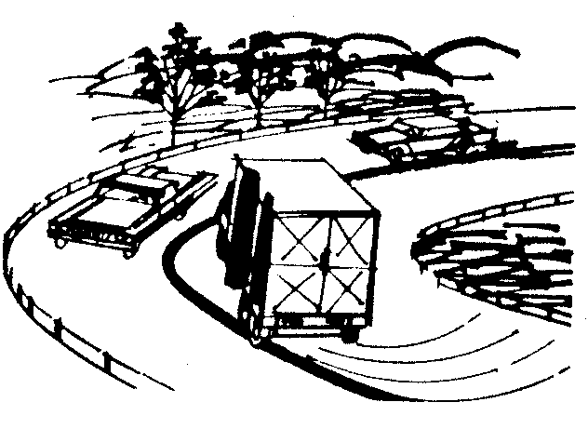
Adjust Speed for Highway Conditions
Changes in sight distance ahead
Changes in surface conditions
Change in space to sides
Changes in view to sides

Slide 10
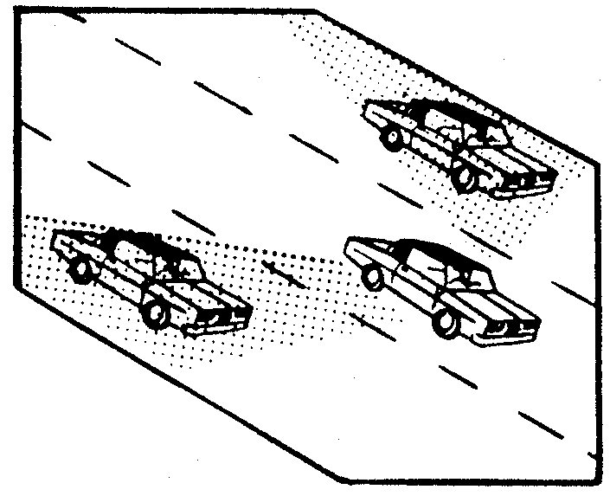
Adjust Speed for Traffic COnditions
Flow of traffic or common speed
Types and amount of traffic
Location of other traffic

Slide 11
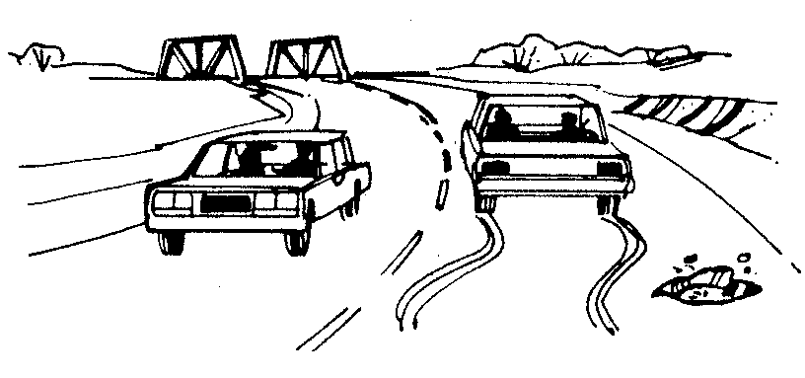
Adjust Speed for Time Needed
Time to observe and process information
Time to avoid traffic hazards
Time to make maneuvers

Slide 12
Choose Best Path of Travel
Space Margin to Side?
Flow of Traffic?
Road Surface?
Visibility?

Slide 13
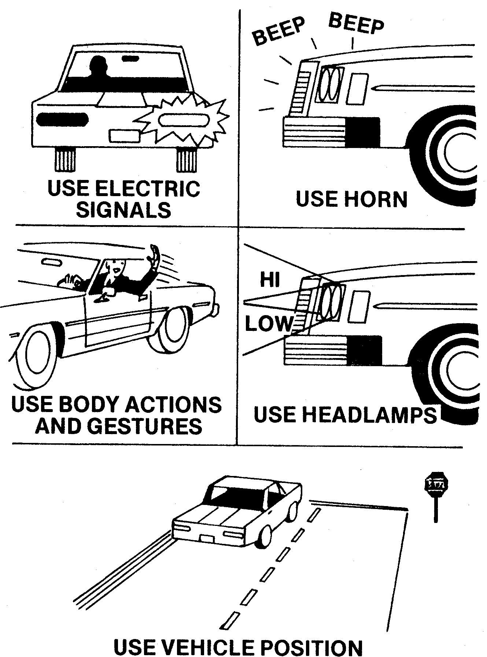
Communicate All Changes

Slide 14
Contact/Mission
For more information on the (the topic of the presentation) please visit PDE’s website at www.education.pa.gov
The mission of the Department of Education is to ensure that every learner has access to a world-class education system that academically prepares children and adults to succeed as productive citizens. Further, the Department seeks to establish a culture that is committed to improving opportunities throughout the commonwealth by ensuring that technical support, resources, and optimal learning environments are available for all students, whether children or adults.

